Slide 1
Current Threats – National and International Perspective
Henry Hughes – CTO Security

Slide 2
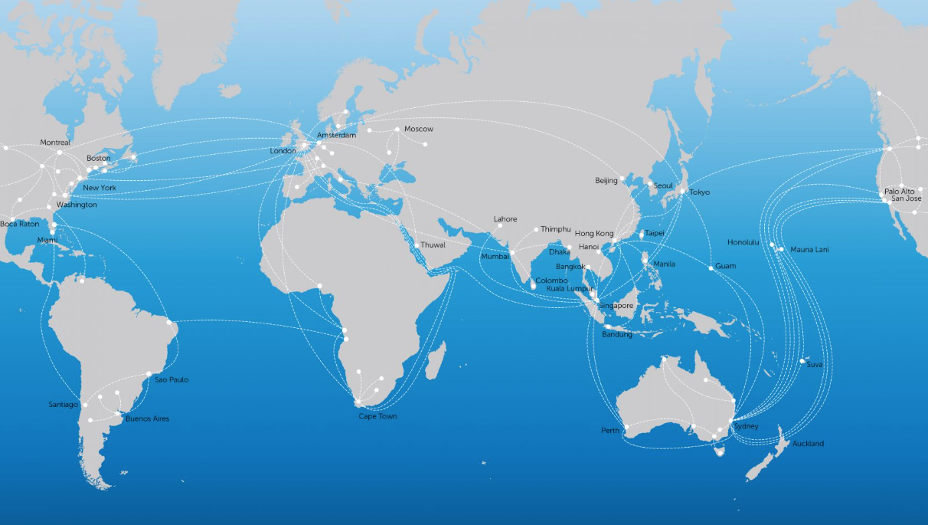
The role of an NREN

Slide 3
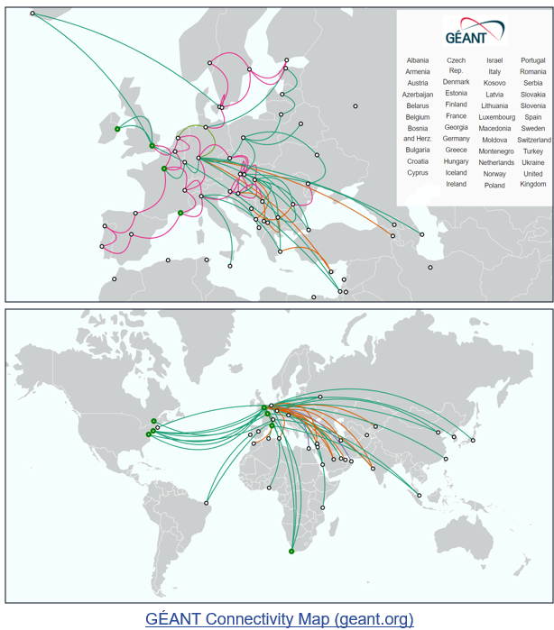
Janet the NREN
NREN = National Research and Education Network
NRENs are specialist service providers dedicated to supporting the digital needs of the research and education communities within their country.
The primary focus of an NREN is to provide its members with high-quality network, security, cloud and other related services, that can’t be provided by commodity and commercial providers.
Many services are developed by multiple NRENs and delivered in a federated manner across continents and often globally.​

Slide 4
UK cyber security landscape
“Ransomware remains one of the most acute cyber threats facing the UK, and all domestic organisations should take action to protect themselves from this pervasive threat.”
“297 reports of ransomware, triaged into 28 NCSC-managed incidents, 18 of which were categorised as C3 or above.”
The top five sectors reporting into NCSC were academia (50), manufacturing (28), IT(22), finance (19) and engineering (18)
https://www.ncsc.gov.uk/files/Annual_Review_2023.pdf
Notes:
- Ransomware biggest risk
- National co-ordination, NCSC have led these ransomware incidents (level 1 risk)
- Ransomware and other cyber attacks are under reported (happy to investigate)

Slide 5
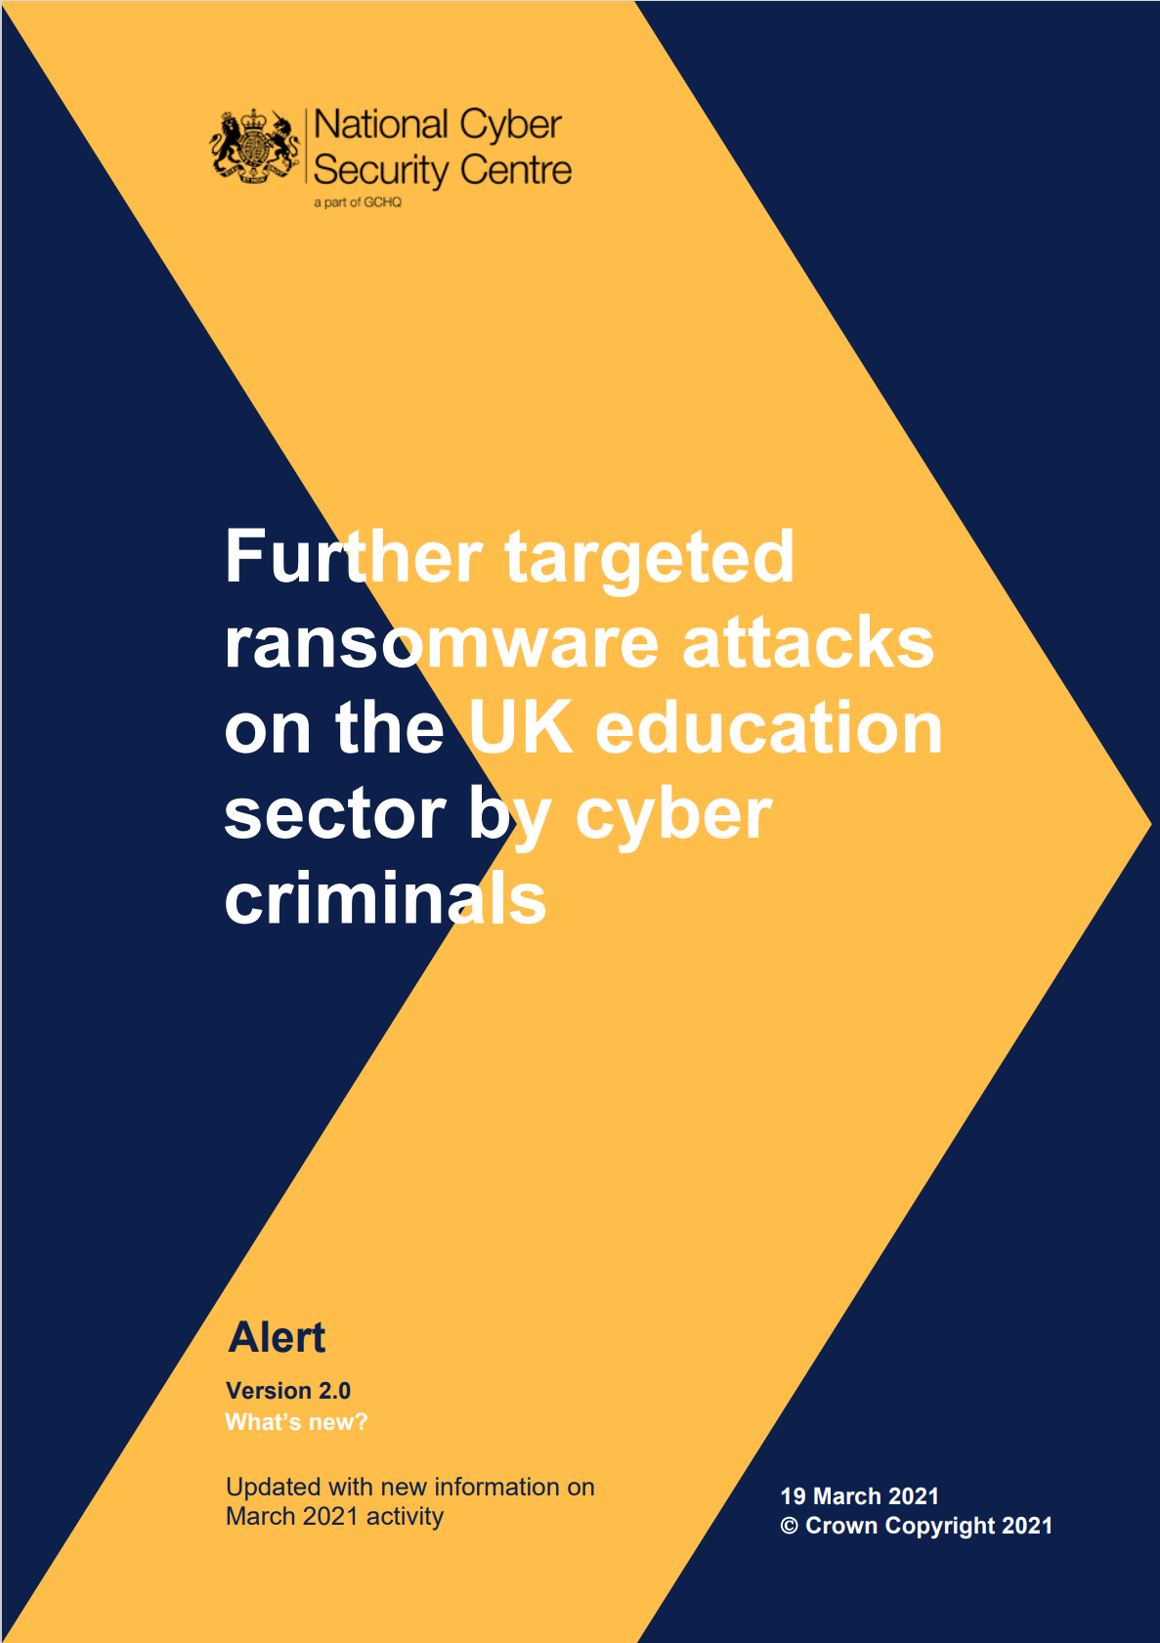
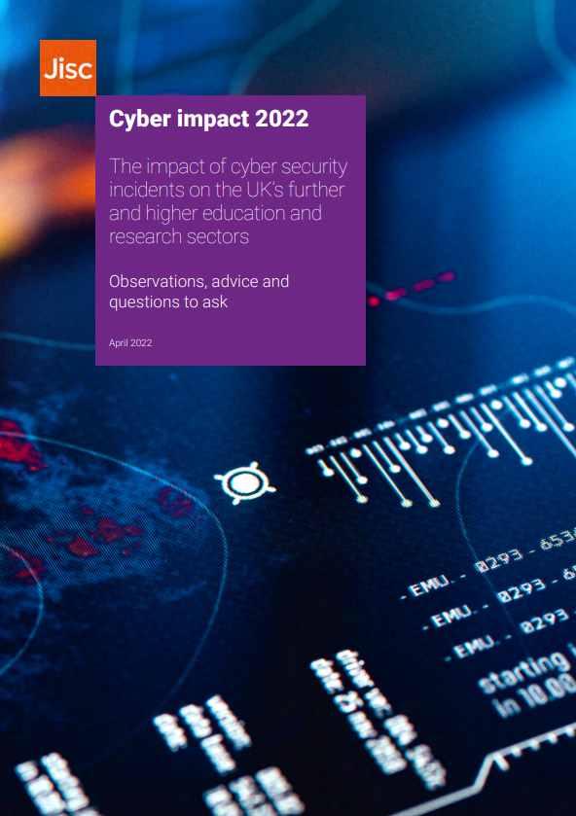
The threat landscape
“Ransomware is no longer just a financial crime; it is an urgent national security risk ” Ransomware Task Force*
2021 – 18 universities and colleges seriously impacted by ransomware
2022 – 19 universities and colleges seriously impacted by ransomware
2023 – 11 universities and colleges seriously impacted by ransomware
Direct impact costs - per institution - £2M
Service disruption between 10 and 20 days
* https://www.ncsc.gov.uk/blog-post/ransomware-taskforce-rtf-announce-framework-to-combat-ransomware
Notes:
We continue to see significant impact from ransomware attacks documented in our Cyber impact report.
The NCSC has published advisories warning that organized crime is targeting UK education and research.
We continue to work with members through the incident response lifecycle
Including proactive work undertaking Cyber Security Assessments to help members to improve their security posture.
Direct impacts cost of ransomware incidents have exceeded £2M in a number of cases
Service disruption averages between 10 and 20 days as we work to support and help members recover

Slide 6
Challenges & Threats
Fallout from geo-politics
Supply chain threats
Internet of Things / Operational Technology
Impact of the skills gap
Reputation of the academic sector
Intellectual property theft
Sector maturity & technical debt
Challenges & Threats

Slide 7
Janet network resolver service (JNRS) – June 2023-2024
Prevents access to known malicious domains and puts restrictions on malware communication on compromised networks
Est. 3 million
education sector internet users protected by JNRS (Does not include Local Authorities)
60+ million
Blocked domains
280 billion
Successfully resolved JNRS queries in the last 12 months.
366 subscriber organisations
Higher Education 85 Further Education 235
Research 3 Customers 43
Notes:
Large increase in numbers, including a half term.
Two half terms, Easter holidays and academia tend to stop teaching around May time for exams
We have plenty of capacity for growth.

Slide 8
JNRS Stats
60 million blocks comprising of:
7,000 DDoS Logged
20.1 million Malware Blocked
17.8 million Other Blocked
19.6 million Other Logged
1.8 million Phishing Blocked
Last 12 months

Slide 9
DDoS Attacks 23/24
"DDoS, or Distributed Denial of Service, is a cyberattack where multiple compromised devices, often infected with malware, flood a targeted system or network with excessive traffic, causing it to become overwhelmed and unavailable to legitimate users."

Slide 10
MISP Threat Sharing
Purpose
“The sharing of cyber threat information and intelligence, between Participating Organisations, in support of the protection of the education and research sectors from the wide ranging impacts of cyber attacks and other cyber enabled crime (such as fraud and Intellectual Property theft), as well as safeguarding people from harmful content and the protection of academic integrity.”

Slide 11
Benefits of Intelligence Sharing
Sharing of indicators
Enables proactiveness
Collaboration
Threat profiling

Slide 12
Summary
The dynamic security landscape necessitates a culture of continual improvement
State aligned groups as well as cyber criminals continue to develop capabilities
The complexity and difficulty of establishing and maintaining strong security posture should not be underestimated
Regular rehearsals and testing are an essential part of security preparedness
Notification of cyber security incidents is required as part of the Janet Security Policy
Make the most of our evolving services within subscription
We’re here to help

Slide 13
