Slide 1
National and
International context
Digital Research Infrastructure Cybersecurity
David Crooks

Slide 2
Who am I?
David Crooks, UK Research and Innovation, STFC (RAL)
Core role in cybersecurity for research infrastructures
  Computing infrastructure supporting CERN LHC (WLCG)
  Security Officer for UK component (GridPP)
  IRIS DRI
Head of Cybersecurity for STFC Scientific Computing
Chair of STFC Cybersecurity Group
UK DRI Cybersecurity Lead

Slide 3
UKRI Digital Research Infrastructures
Digital research and innovation infrastructure (DRI) underpins the research and innovation ecosystem.
It enables us to solve problems, and to analyse and understand complex topics on any subject.
This is possible because digital infrastructure allows us to work with data and computation efficiently and securely, at scale.
https://www.ukri.org/what-we-do/creating-world-class-research-and-innovation-infrastructure/digital-research-infrastructure/

Slide 4
What is DRI?
The building blocks of the DRI system include:
  large scale compute facilities, including high-throughput, high-performance, and cloud computing
  data storage facilities, repositories, stewardship and security
  software and shared code libraries
  mechanisms for access, such as networks and user authentication systems
  people: the users, and the experts who develop and maintain these powerful resources.
The vision of the UKRI DRI programme is
  “… a coherent state-of-the-art national digital research infrastructure that will seamlessly connect researchers, policymakers and innovators to the computers, data, tools, techniques and skills that underpin the most ambitious and creative research.”

Slide 5
Features of DRI
Digital Research Infrastructures are often nationally or globally federated across multiple organisations
Often involving a heterogeneous mix of technologies
  Driven by national and international science community needs
  This is what makes it so different to a corporate IT infrastructure
Typically not “owned” by a single organisation

Slide 6
DRI Cybersecurity
Persistent threat at (inter)national R&E level
  Manchester, British Library, HZB, DDoS, …
  Requirement for DRI to provide secure, assured environments across risk appetites
  Diverse range of activities
Opportunity to use our community to improve overall security
  Both within specific research infrastructure scope but actually more broadly for research computing cybersecurity
Similarly, we have the need, but opportunity, to act as a national scale endeavour
  Hard challenge, but benefits come from acting at this scale
  Funding/ setting baselines/ working with partners

Slide 7
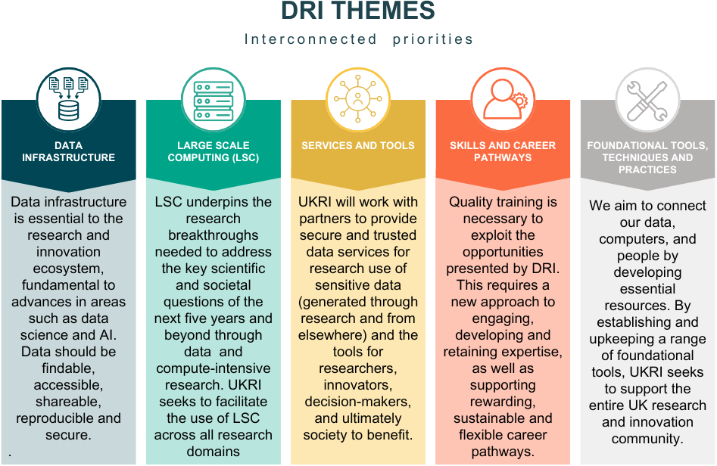
Digital Research Infrastructure Programme

Slide 8
Security and interoperability
Beyond islands: interoperability and federation of systems may lead to challenges in security (up/down/side-to-side)
Command-and-control will not work!
Requires coordinated cybersecurity strategies
Complex risk environments
  Compute – cloud compute – storage
  Trusted Research Environments
  Shared user communities

Slide 9
DRI Cybersecurity
Persistent threat at national R&E level
  Requirement for DRI to provide secure, assured environments across risk appetites
  Diverse range of activities
Opportunity to use our community to improve overall security
  Both within specific research infrastructure scope but actually more broadly for research computing cybersecurity
Similarly, we have the need, but opportunity, to act as a national scale endeavour
  Hard challenge, but benefits come from acting at this scale
  Funding/ setting baselines/ working with partners

Slide 10
DRI Risk Environments
Different types of research infrastructures
  “Open” research environments where integrity of data is primary concern
  “Trusted” research environments where confidentiality may be primary concern
  Maturing environments where uses cases may be evolving rapidly
  Although: more than this bimodal distribution
Different technology stacks
  High Throughput; High Performance; Cloud
Different federation models
  Mature/transitioning/new
  Yet to federate/won’t federate
  Understanding (shared) user communities is critical

Slide 11
DRI Risk Environments
Across our work, we have a range of environments
  BUT we all have a risk environment
Understanding these and where the boundaries lie will be essential
  How is a different question
Helps with understanding how we can interoperate between infrastructures
  And how we can work effectively with organisational, corporate risk

Slide 12
NCSC Cyber Assessment Framework
An outcomes-based risk management framework
Meeting a need identified several years ago to improve the security of network and information systems across the UK
Originally focused on organisations that
  play a vital role in the day-to-day life of the UK
  are designated as forming part of the Critical National Infrastructure (CNI)
  are subject to certain types of cyber regulation
    Networks & Information Systems (NIS)
    cyber aspects of safety regulation such as Control Of Major Accident Hazards (COMAH)
https://www.ncsc.gov.uk/collection/caf

Slide 13
Government Cyber Security Strategy
In early 2022, Government Cyber Security Strategy 2022-2030 published
  https://www.gov.uk/government/publications/government-cyber-security-strategy-2022-to-2030
“to ensure that core government functions - from the delivery of public services to the operation of National Security apparatus - are resilient to cyber attack”
“Government will adopt the Cyber Assessment Framework (CAF) as the assurance framework for government.”

Slide 14
GovAssure
Earlier this year the GovAssure approach was launched
  https://www.security.gov.uk/guidance/govassure/
  https://www.gov.uk/government/news/government-launches-new-cyber-security-measures-to-tackle-ever-growing-threats--2
Using the NCSC’s Cyber Assessment Framework (CAF) to review the cyber security of government departments’ and selected arm’s length bodies’ essential functions and services
  Including UK Research and Innovation
  UK WLCG Tier-1 now undergoing assessment against CAF

Slide 15
DRI and CAF
Mappings exist between the CAF and other standards
  Including ISO27k/NIST Cybersecurity Framework/CIS
  https://www.security.gov.uk/guidance/govassure/templates-and-downloads
The CAF could provide a useful, government backed tool in building a baseline for organisations participating in DRI activities

Slide 16
Compliance (as compliance)
Compliance will play an increasing role in all of our lives
  Cyber Assessment Framework
  UKRI currently going through assessment process
  GridPP Tier1 (SCD) being assessed
  Extensive piece of work but very fruitful
Clearly more complex than one framework
  The compliance needs we have will depend on our particular environment
  We will have more than one
  ISO27k/CAF/CE(+)/…

Slide 17
Compliance (as development tool)
We can use cyber frameworks as a development tool
  CAF has existing mappings between it and other frameworks
  A “Research CAF profile” which we develop together could help in the bootstrapping of new infrastructures
  Providing assurance at a governance level is essential, BUT is also a powerful tool for the same reasons
  Underpins the work to be done

Slide 18
People and process
Across our diverse landscape, we will have a range of operating environments
  The processes and approaches we put in place can be used more broadly
This work is never done, but we can establish a sustained activity
People and processes -> technology
People are our most important resource

Slide 19
Strong links with partners
Work as closely as possible with Jisc and NCSC
  Collectively as DRI community can act more effectively than individually
Reinforce existing links to our international security partners and infrastructures
NCSC
“We support the most critical organisations in the UK, the wider public sector, industry, SMEs as well as the general public.”
DRI Cybersecurity
“Represents the perspective of digital research infrastructures including innovative workflows and large-scale data management.”
Jisc
“Jisc is the UK digital, data and technology agency focused on tertiary education, research and innovation..”
International community
Essential that we continue ongoing engagement internationall

Slide 20
International context
Much of the work of STFC is intrinsically international
  For example working with CERN, SKA, …
All of our cybersecurity work immediately requires working with colleagues and partners internationally
  WLCG security – CERN, The Netherlands, Slovenia, France, Germany, Portugal, USA
Last week: NSF Cybersecurity Summit in Pittsburgh: Trusted-CI, NSF Cybersecurity Centre of Excellence
  Very similar challenges to the UK, close partnership

Slide 21
Core Cybersecurity Skills
Already heard about theme in DRI programme of the development of the skills needed to support our research infrastructures
In a cybersecurity context, these include
  General outreach (users)
  Infrastructure (shared and agreed best practice for operations)
  Specialist skills (cybersecurity professionals)

Slide 22
Cyber Threat Intelligence
The use of shared cyber threat intelligence is vital to this work
  Both strategically (threat landscape)
  And operationally (incident response, detection and prevention)
Effective use of threat intelligence has to be part of our strategy

Slide 23
DRI Cybersecurity Workshops
First Strategy workshop took place in April 2024
  Broad representation, focusing on high level strategy, scope, goals…
First “Technical” workshop in November
  Focused on developing concrete artefacts
  Documentation, strategy, guidance, …
Intention to hold Strategy workshops in the spring and Technical workshops in the fall
  Would really like to have representation from Trusted-CI community

