Slide 1
Potential Inverse Compton Scattering Experiments at CLARA
Christopher Arran, University of York / Lancaster University

Slide 2
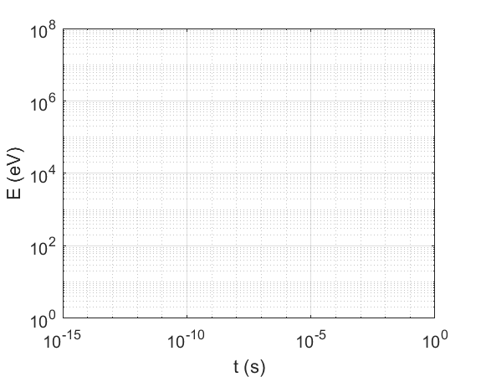
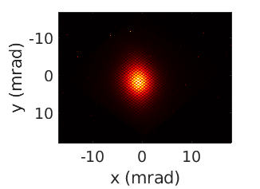
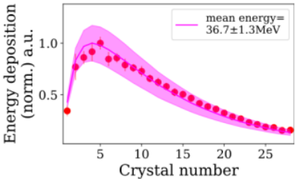
Inverse Compton Scattering
Fundamental QED process possible in vacuum
Source of bright polarised x-ray and gamma-ray beams
Ultrafast and highly penetrative diagnostic
E. Los et al. Gemini 2021
ICS
XFEL
DLS
μCT

Slide 3
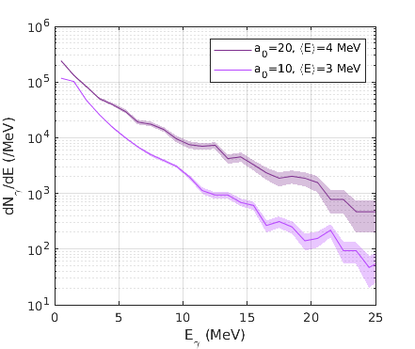
Simulated interaction at CLARA
120 TW laser hitting a 250 MeV CLARA beam at ≤10²¹ Wcm⁻²
High charge conditions, assuming 250 pC in 100 μm, 100 fs and a laser focus of 2 μm
7x10⁵ photons produced above 1 MeV
Peak brightness of ~2x10¹⁸ photons/s/mm²/mrad²/0.1% BW
Only a tiny fraction of the electrons hit peak intensity
Photon beam has 30 fs rms duration and 1 μm rms radius
MeV-scale γ-ray beam
250 MeV e⁻ beam
120 TW laser
focussed at f/2

Slide 4
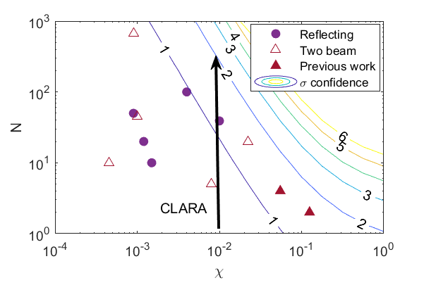
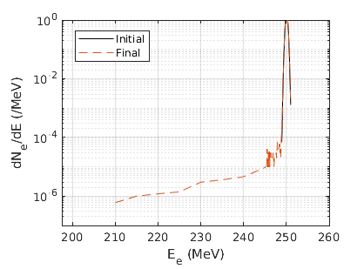
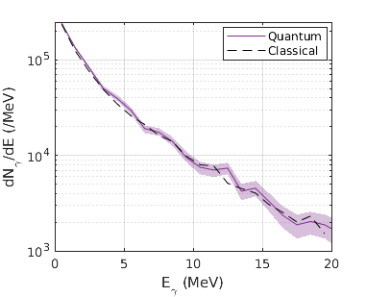
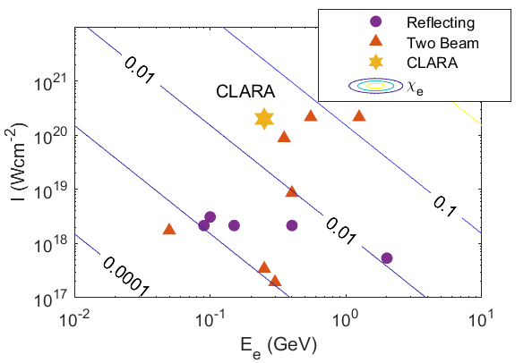
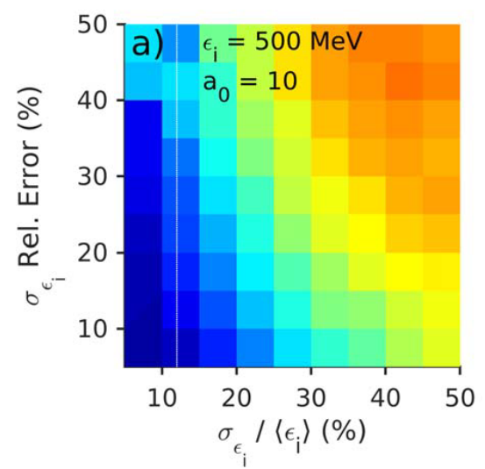
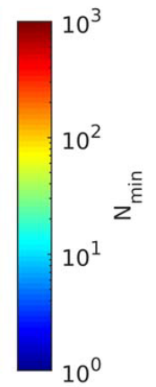
Exploring Strong Field QED
Strong fields change Compton scattering and cause electron recoil
But only small divergences are possible under CLARA conditions
Repeatable consistent shots are crucial

Slide 5
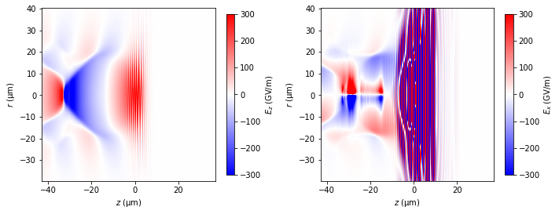
Potential plasma optics
Creating a few μm, 10s fs electron beam would improve ICS signatures
Plasma boosters could increase electron beam energy
Beam compression and focussing could increase bunch density at interaction
Ultra-fast kicker could remove non-interacting electrons
FBPIC simulation
200 TW laser
focussed at f/40
into 2x10¹⁸ cm⁻³ plasma

