Slide 1


Millimetre-wave Technology
Peter Huggard

Slide 2
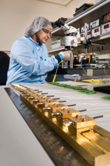
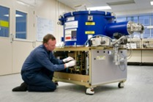

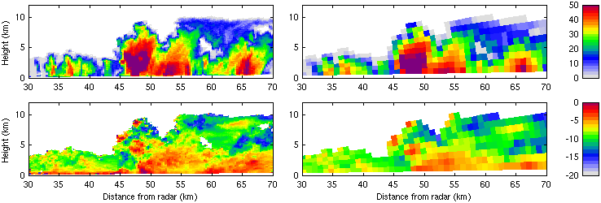
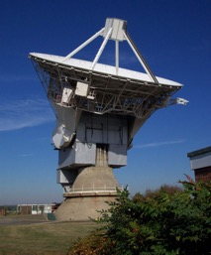
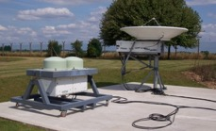
MMT Background
Circa 20 staff supporting instrumentation R&D GHz to 5 THz.
Component/system technologies for ground, air & space.
Support passive and active sounding.
Testing capability (phase & mag.) to < 1 GHz to > 1 THz.
Project based: universities, space industry, ESA, UKSA and ESO are our customers
500 GHz Airborne SIS
Receiver
MM-wave Photomixer
Production
Passive MM-wave Rx AIV
Chilbolton Cloud Radars
Chilbolton 25m antenna

Slide 3
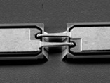
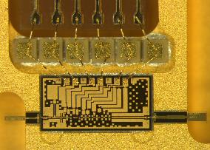
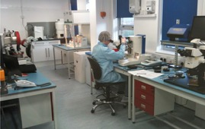
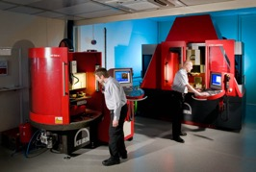
MMT Group at RAL
We provide everything from single semiconductor and photonic devices to complete autonomous systems for atmospheric remote sensing, radio astronomy and security applications
Schottky diode fab, shared with
Teratech Components Ltd: Quartz and silicon dicing
Precision workshop “PDF”: CNC machining of metal THz components with few µm tolerances
Assembly cleanrooms
Photomixer THz sources
30 µm
RAL GaAs Schottky Diode
Packaged mm-wave integrated circuit (MMIC)
Cleanroom Assembly
Precision Development Facility

Slide 4
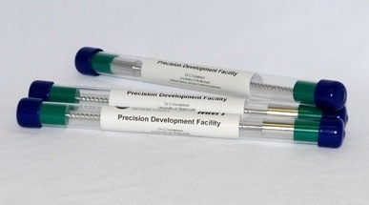
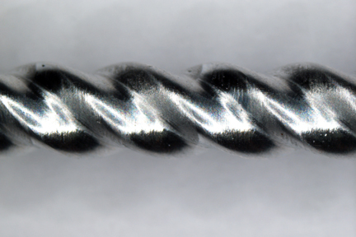
Precision Machining: examples
Helical sacrificial mandrels for Gyro-TWA.
EPSRC grant with University of Strathclyde
Have machined these to 0.7 mm diameter
Completed Mandrels, 3 mm diameter
Detail of Helical Structure

Slide 5
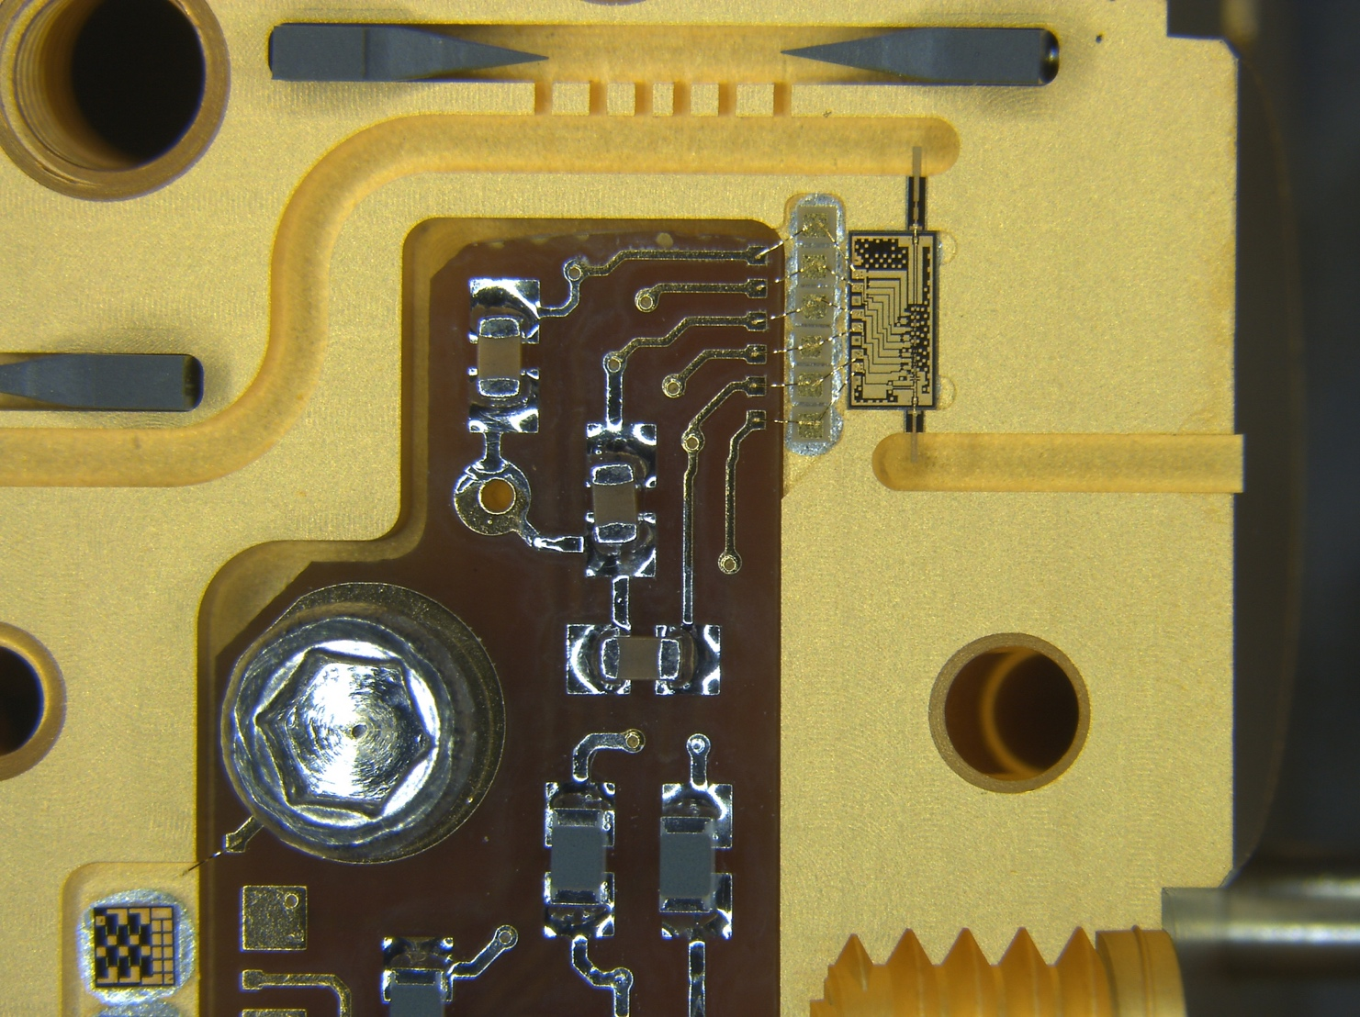
Precision Machining: examples
Split block waveguide packaging
0.2 THz waveguide
Dielectric lined waveguides, not shown, for various DL experiments

Slide 6
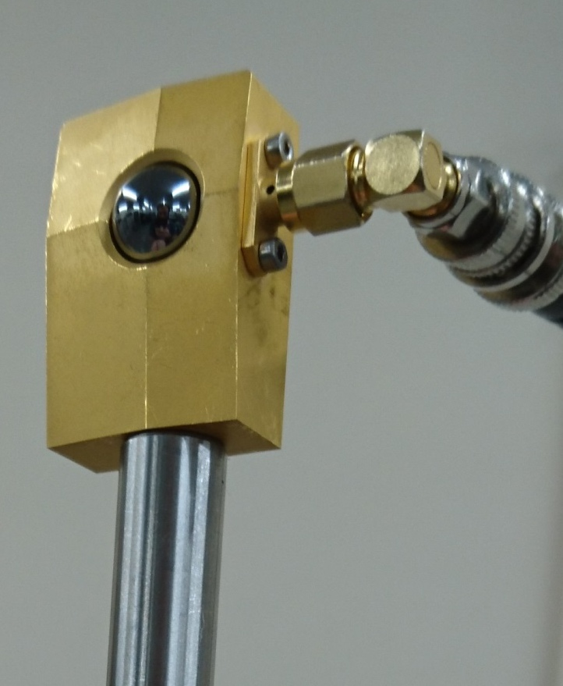
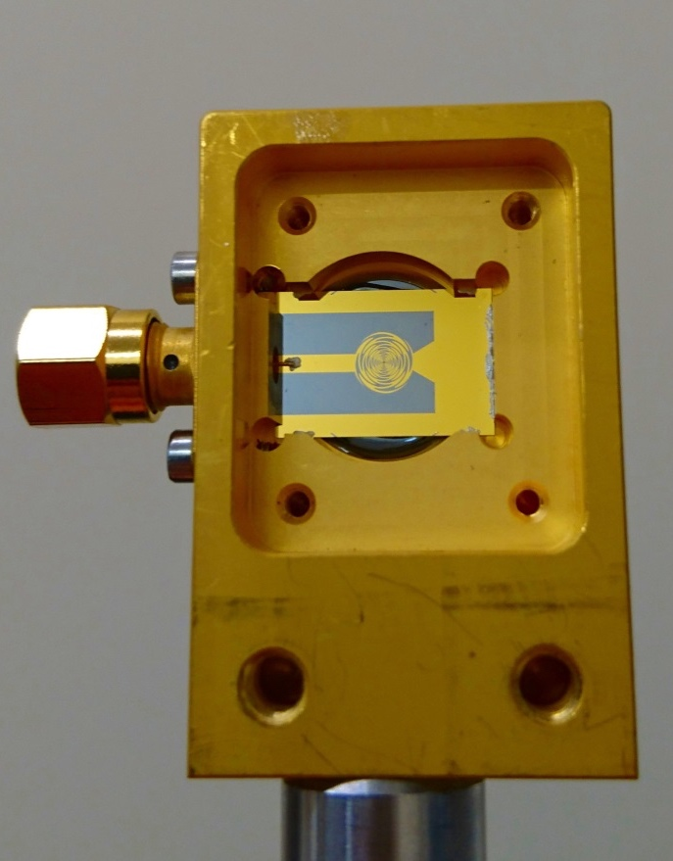
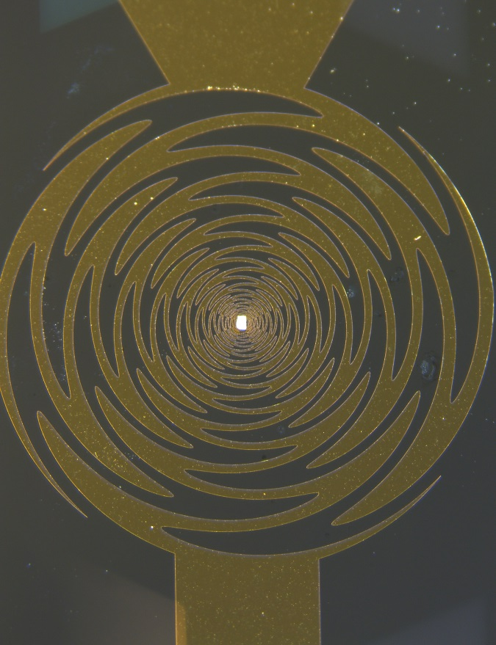
Ultrafast direct THz detectors
Planar antennas with InGaAs diode detectors
Picosecond response times
Room temperature operation
THz Pulse at Daresbury Lab (S. Jamison)

Slide 7
Contact details etc
Mat.Beardsley@stfc.ac.uk for manufacturing
Peter.Huggard@stfc.ac.uk for THz stuff
Can be named on RC grants, charge time to a DL project code, or provide a commercial quotation

