Slide 1
Overview of the CLARA Beamtime Application Process
Tim Noakes

Slide 2
Outline
Overview
Eligibility Criteria
Modes of Access
Application Form (online)
Technical Assessment
Peer Review of Proposals
Beamtime Allocation Panel
Evaluation Criteria
Outcomes and Feedback
Scheduling
User and Facility expectations
User Support Scientist
User Office
Risk Assessments
User Data
Reporting, Evaluation and Feedback
Summary
Changes from previous procedures highlighted in red!

Slide 3
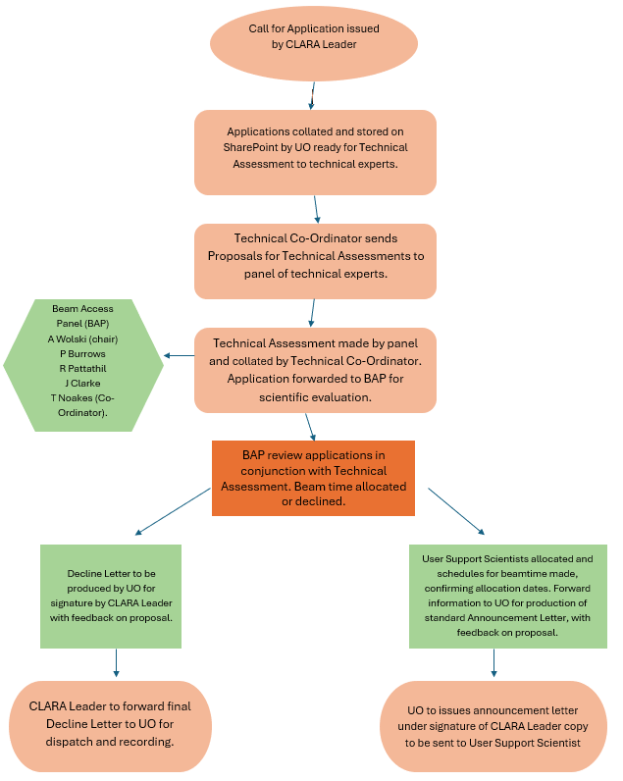
Overview
Basic procedure similar to 2018 but with some changes/modernisation
Documentation has been modified to reflect this
Existing documentation will be transitioned to a web-based version
As before
Users discuss experiment with facility staff
Users submit application form
Technically assessment
Scientific evaluation by Beamtime Allocation Panel (BAP)
Ranking list formed and proposals awarded time starting from the top until it is all allocated
Letters sent out to all applicants

Slide 4
Eligibility
UK academics – UK universities and Research Council institutes (including STFC staff) and those with Research Council senior or advanced research fellowships (or their equivalent) and Royal Society and Royal Academy of Engineering fellowships.
Joint proposals with UK and international industrial/commercial users possible, but results must be made available in the open literature.
International Users – applications from non-UK academics (without prior contractual access arrangement) may be accepted at the discretion of the CLARA Leader.
International Agreements – Recognised overseas research organisations will be eligible for access through contractual access agreements, for example transnational access agreements (current Euro-Labs scheme).
Commercial and Contractual Users – through an agreed contract with STFC.
Commercial access will be run in time not allocated to facility access

Slide 5
Modes of Access
Six months of access to be provided per year for the following access categories in priority order
Trans-national Access
Programmatic Access
Direct Access
Trans-national access will have a limited number of days available as defined by the scheme
Trans-national access proposals will be assessed by the scheme panel as well as the CLARA beamtime access panel

Slide 6
Programmatic Access
Applicable where there is a need for a connected series of experiments or individual experiments requiring significant access (several weeks) and this is to be included on a grant or other funding request
Where programmatic access is to be included in an external grant a letter of support from the CLARA Leader is required.
Programmatic access should be discussed with the CLARA Leader and facility staff before asking for the letter of support
A written description of work and anticipated beam time requirements needed – 1 to 2 pages
A technical evaluation of the request will be made
The Beamtime Allocation Panel (BAP) will assess the scientific and technical merit of the Programmatic Access proposal and provide a recommendation.
The final decision to accept a programmatic access proposal is with the CLARA Leader
Costs of providing CLARA beam time are to be included in any research council grant proposal (number to be determined)
Note that programmatic access users will still need to fill in an application form for each allocation period to provide technical details
To allow facility staff to plan effectively for the experiment
Whilst these proposals will not be reassessed for scientific merit they will be assessed for technical feasibility and potential health and safety issues
Applicants still need to discuss the proposals with facility staff before submission

Slide 7
Direct Access
Calls for applications requesting ‘Direct Access’ to the accelerators will be issued periodically
Requests for beamtime under the direct access scheme will normally be for shorter periods
Longer requests are expected to apply under the Programmatic Access process
Direct access requests for longer periods may be considered, for example where the proposed work will be in support of a later Programmatic Access bid, or where the complexity and scientific impact of the proposed experiments justify a longer experimental run
All proposals are subjected to peer review by the BAP
Successful proposals are scheduled in accordance with accelerator availability as determined by the CLARA Leader
Direct Access will be free of operating costs to eligible users. All other costs (for example, travel and/or provision of additional equipment) are the responsibility of the user

Slide 8
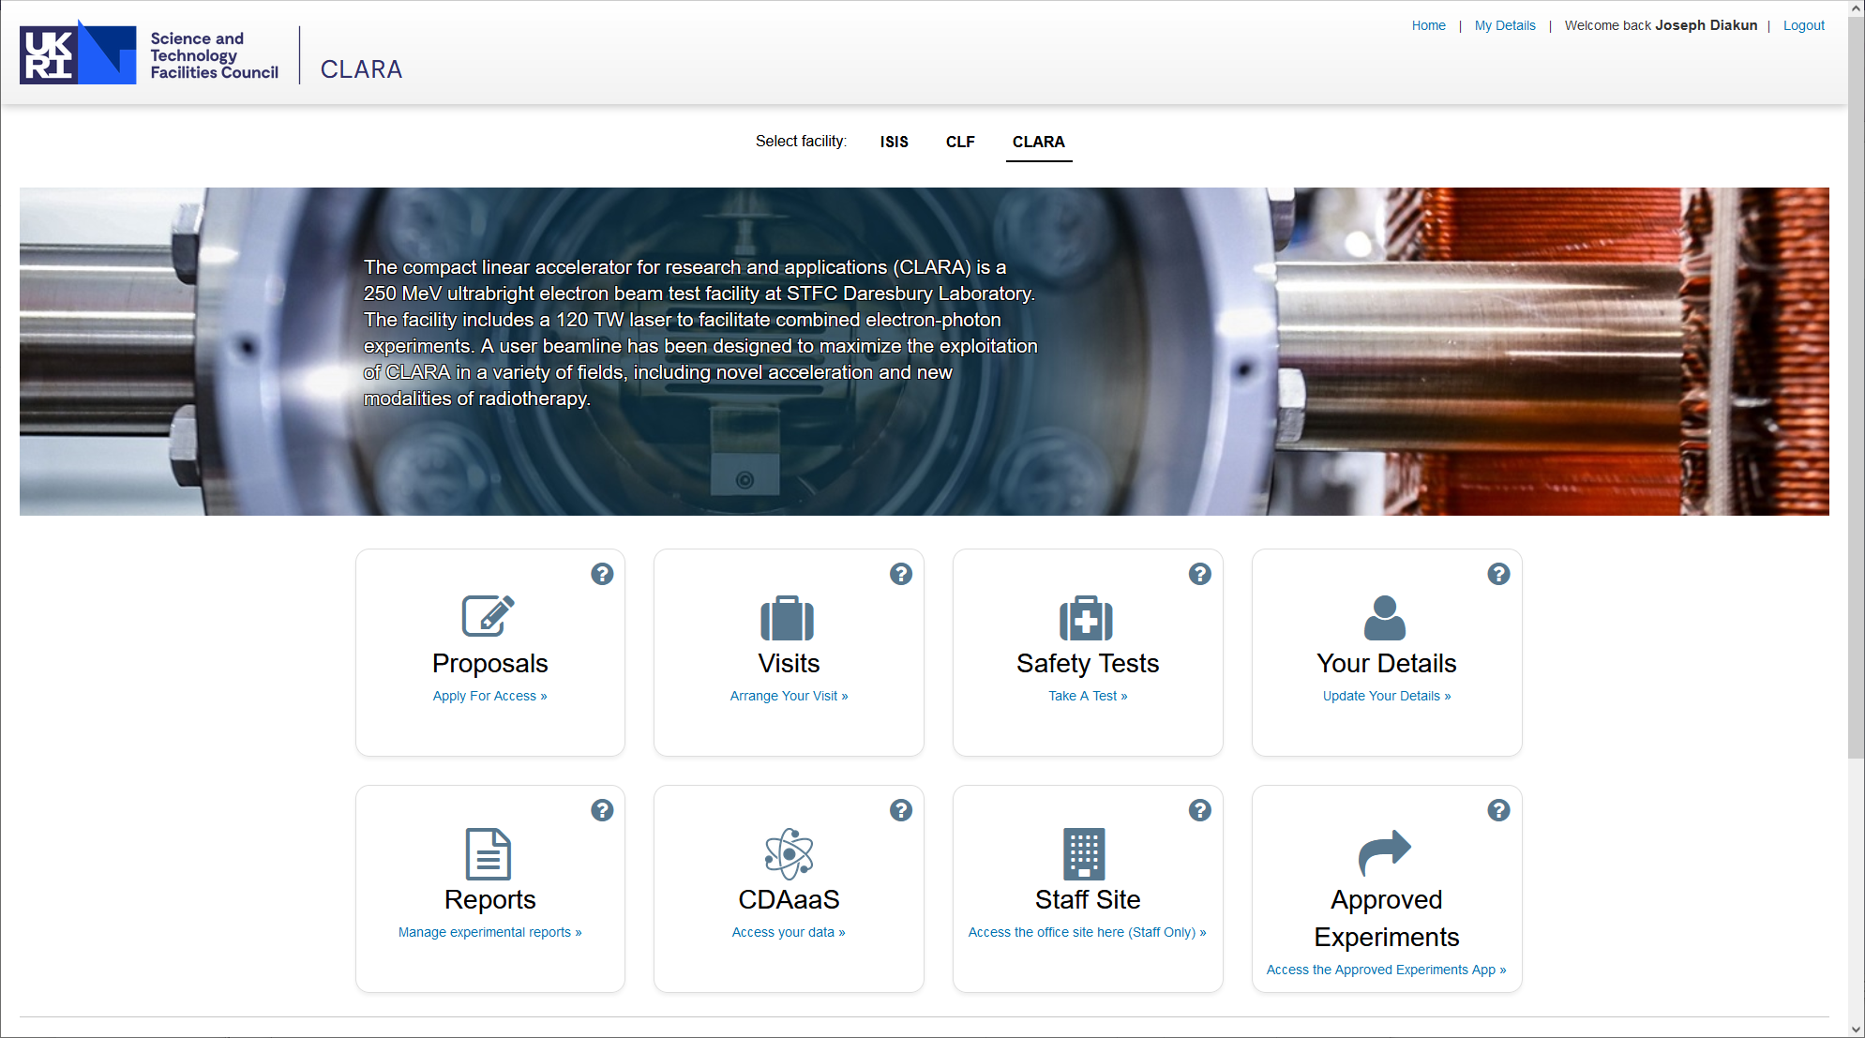
Application Form
New web-based version of the form being developed
Information required includes
Details of the Principal Investigator and Co-investigators
Experiment title and science and technology area it addresses
Duration of beamtime and set-up time required
Experimental requirements
Accelerator operating conditions
Sample and environment conditions
Additional equipment required
Safety information
Experiment description
Goals
Impacts
Potential applications
Light touch for Programmatic Access!

Slide 9
Technical Assessment
Before scientific evaluation a technical assessment will be carried out
Carried out by a panel of ASTeC experts across many technical areas (beam dynamics, lasers, diagnostics, vacuum, etc)
Feasibility of experiment
Additional capabilities that might be required
Technical support and other resource that might be required and how this would be funded
Potential health and safety issues
Number of days requested/needed for experiment and set-up
Where issues are identified further discussions between facility staff and the Principal Investigator may be held and some modifications to the application may be permissible at this stage
A report will be provided to the Beamtime Allocation Panel
Technical difficulty could be a factor influencing the panel awarding beam time

Slide 10
Peer Review of Proposals
Reviewed by the Beamtime Access Panel
Andy Wolski (CI) – Chair
Phil Burrows (JAI)
Jim Clarke (ASTeC)
Rajeev Pattathil (CLF, alternative acceleration expert)
Tim Noakes (Technical Coordinator) – advisory capacity only
Each panel member ranks the proposals independently
Scores averaged and an initial ranking list formed
Pairwise comparison of proposals running down the list – where two proposals are close in score should the order be changed?
Diversity and Inclusion check before final ranking list agreed

Slide 11
Evaluation Criteria
New criteria going forward
Scientific Excellence
Scientific and technical merit
International competitiveness
Strategic value and timeliness
Leadership and Planning
Level of leadership in the area
Track record of the investigators
Planning of the proposed experiment
Impact
Scientific or technical impact
Training and the development of next generation researchers
Industrial relevance
Before the meeting each panel member rates each proposal out of 6 in these three criteria
1 - This proposal is fundamentally flawed
2 - This proposal does not meet all of the evaluation criteria
3 - This proposal meets all evaluation criteria but with clear weaknesses
4 - This is a good proposal that meets all evaluation criteria but with minor weaknesses
5 - This is a strong proposal that broadly meets all evaluation criteria
6 - This is a very strong proposal that fully meets all evaluation criteria
Individual members average their scores using a weighting which they personally specify to produce a single mark for each proposal
Scientific Excellence must have the highest weighting!
Members individual scores are collated and averaged to form the initial ranking list
A cut off will be determined by the panel below which a proposal cannot be awarded beamtime (likely to be around 4)

Slide 12
Outcomes and Feedback
Proposals will be awarded time going down the ranking list until the allocation period is full
In the event that the next proposal in the list needs more time than available then a less highly ranked proposal (but still above the cut off) may be scheduled if this can be completed in the available time
Letters (emailed) will be sent to all applicant letting them know the outcome of their proposal
Where unsuccessful some feedback will be included in the letter

Slide 13
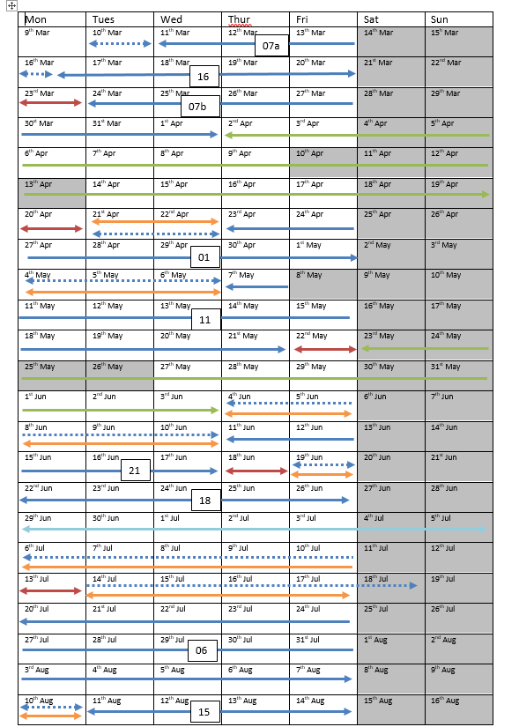
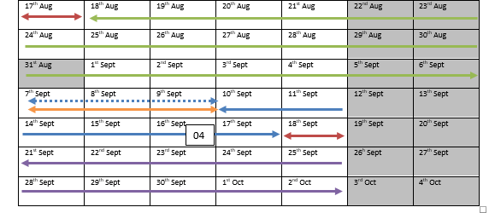
Scheduling
Successful applicants will be asked for availability before scheduling
Attempt will be made to comply with users wishes
Scheduling flexibility may be limited by various factors such as the order experiments need to run in, the availability of equipment, new capability coming online, etc
One 8 hour shift/day
Some flexibility to run on into the evening at the discretion of the user support scientist/beam delivery team
Interruptions for re-optimisation and longer periods for changing parameters/set up should be expected

Slide 14
Facility and User Expectations
Preparedness - Users should be well prepared both before putting in an application and specifically before the beamtime commences
Allocations - Where users cannot use their allocated beamtime they should notify the User Office at the earliest possible opportunity. This could increase the likelihood of contingency time being available
Experimental Team Leader – Each application will have an Experimental Team Leader (which could be the PI) who will be the main point of contact, be available during the whole run and should have an excellent understanding of the experiment
Team Members - Normally at least 2 per shift
Be sufficiently knowledgeable to contribute to the experiment
Have received suitable Health and Safety training at their host institutions
Will also be required to carry out Induction Training and more specific ‘Tool-Box Training’ to use particular sub-systems or equipment (for example search training for the FEBE hutch)
Health and Safety – Users must abide by STFC Health and Safety rules and should be aware of ’Local Rules’ and ‘Standing Orders’ that may apply
A suitable ‘Risk Assessment’ and in many cases ‘Method Statement’ must be provided at least two weeks before the run (more later)
Equipment Loan – Where users need to borrow specific equipment from the laboratory, they should enquire well in advance (potentially before applying). Enquiries should be made on each run where such equipment is required

Slide 15
Facility and User Expectations
Allocations – Minimum 1 month’s will be given and ideally longer for more complex experiments
Notification of any delay or cancellation will be sent as soon as practicably possible. An alternative time slot within contingency will be sort and discussed this with the users at the earliest possible opportunity
Users should expect to receive the number of shifts allocated or as near as is reasonably practicable.
Beam Parameters and Performance – Probable performance outlined in previous talks
Users should consult with accelerator staff (in the first instance the Principal User Support Scientist) to confirm that the parameters they need can be provided
The successful shift delivery gauged by ability to provide the agreed parameters for a substantial part of that shift
Experimental Areas - Description of FEBE given in previous talks
User Office- A User Office (UO) will be established to assist users with administrative tasks (more later)
User Support Scientist - Each user group will be provided with a User Support Scientist to act as the principal interface with the accelerator staff (more on next slide).
Other Support - Daresbury has access to extensive specialist expertise (i.e. mechanical, electrical, controls, riggers etc.) and every effort will be made to make these services available to Users
Limited resource, and prior planning is essential
Extended use may require costs to be met from the users host institution

Slide 16
User Support Scientist
User Support Scientists replace Local Contacts used in previous runs
Scientific support only (administrative support via UO)
Dedicated staff plus some of the previous local contacts (accelerator physicists, laser scientists, etc)
Provide advice, expertise and support prior to and during the experimental beamtime
User groups should also feel free to discuss aspects of their experiment with any other member of the accelerator team as appropriate during their run
User Support Scientists can be contacted before writing a beamtime application for advice
Should help establish/more clearly define user requirements before the run
Ensure everything is ready at start of run
Available for consultation during the whole experiment (or provide a suitable deputy)

Slide 17
User Office
A new user office will be established to handle various administrative tasks and will be the contact point for all non-scientific enquiries. Examples include
Providing details of required training for site access and experimental area access and how this can be completed
Information on accommodation in the local area and travel to and from it
Expenses claims where these are covered (likely to be trans-national access only in the first instance)
Responsible for correspondence, for example informing users of any potential delays

Slide 18
Risk Assessments
Users must submit an agreed Risk Assessment and in many cases Method Statement (RAMS) at least two weeks in advance of their run
The preparation of the RAMS is likely to be an iterative procedure between users and facility staff to ensure the final document is suitable
The assigned User Support Scientist will provide assistance with the preparation of the RAMS
The facility operations team will also be more involved in RAMS preparation
Recognition that a more collaborative approach to RAMS preparation is required!

Slide 19
User Data
Implementing standardized data structures for storing metadata as part of any machine data stored – part of CLARA software tools​
In talks with Ada Lovelace Centre (part of STFC Scientific Computing Department) regarding existing tools to handle data storage and user access to data repositories​
Transition towards similar solutions to CLF and ISIS, such as the Instrument Catalogue and centralized storage with access via User Office credentials​
Plans for a more formal data policy to be established, including commitments to long term storage of data​
Ambition is to make data access easier for users pre- intra- and post-experiment and leverage existing STFC digital solutions

Slide 20
Reporting, Evaluation and Feedback
Immediately after a run users should submit a 1-2 page report summarising of the work carried out and likely outputs (papers, etc)
Submission of this report will be a required precursor to any further beamtime allocation
A user feedback questionnaire will be circulated for completion after each run following the format used for the previous two allocation periods
The results from the feedback questionnaires will be reported in subsequent user meetings and an action plan formed to address issues arising
Separate questionnaire will be issued to staff and a wash-up meeting held to capture any additional learning points

Slide 21
Previous Feedback 2018 Run
Lack of well-defined beam set-ups – Ensured more ‘standard’ set-ups were developed before the following run commenced and also improved beam reproducibility and reliability
Unknown longitudinal beam properties – Bunch compression diagnostic (CTR) installed for optimisation, EO measurements after the run to measure actual bunch lengths
Scheduling (need for gaps between runs) – Schedule for VCAP03 spread 3 months of facility time over 6 months and included more contingency
Changes implemented for the 2022 run!

Slide 22
Previous Feedback from 2022 Run
Planning and support – Dedicated User Support Scientists (and Operators) hired. Should provide more effort to plan effectively and work more closely with users
Risk assessments – Need for more assistance for users has been identified, facility staff to play a larger role
Data acquisition and diagnostics (requirement to save multiple image streams simultaneously and shot numbering) – Multiple images at 5 Hz, shot numbering being implemented (not yet tested on the machine). FEBE line and hutch will have more diagnostics plus capacity to upgrade

Slide 23
Summary
Beamtime application procedure similar to previous runs but with some subtle changes
More details provided on the mechanism for programmatic access
More online processes being developed
To develop a technically feasible proposal talk to facility staff before hand
User support being split between new User Office (administrative) and dedicated Support Scientists
Improved support for users and specifically the preparation of RAMS
New policies and procedures for data handling – easier for users to access
Brief reports on each experiment now required
Please complete feedback forms as we do act on the findings!

