Slide 1
Preparing for
Experiments at FEBE
Thomas Pacey
On behalf of the CLARA Team
ASTeC & TD, STFC Daresbury Laboratory
4th CLARA User Meeting,
December 3rd 2024
Notes:
Welcome

Slide 2
Outline
CLARA & FEBE Beamlines
FEBE Chambers
Electron Beam Parameters & Delivery
Summary

Slide 3
CLARA &
FEBE Beamline

Slide 4
CLARA
High brightness beam
Flexible & optimised parameters
Thoroughly instrumented beamline
Delivered to a shielded hutch

Slide 5
FEBE Beamline & Energy Sectors
ICT &
CTR
BAM
ICT
Up to 250 MeV
250 – 600 MeV
All accelerated beam experiments subject to:
Experimental Risk Assessment
Shielding power limits
Radiation survey under experimental conditions
250 MeV – 2 GeV
Further detail on FEBE beamline design can be found in
Snedden, E. W., et al. "Specification and design for full energy beam exploitation of the compact linear accelerator for research and applications." PRAB 27.4 (2024): 041602.
https://doi.org/10.1103/PhysRevAccelBeams.27.041602

Slide 6
FEBE Hutch and
Experiment Chambers

Slide 7
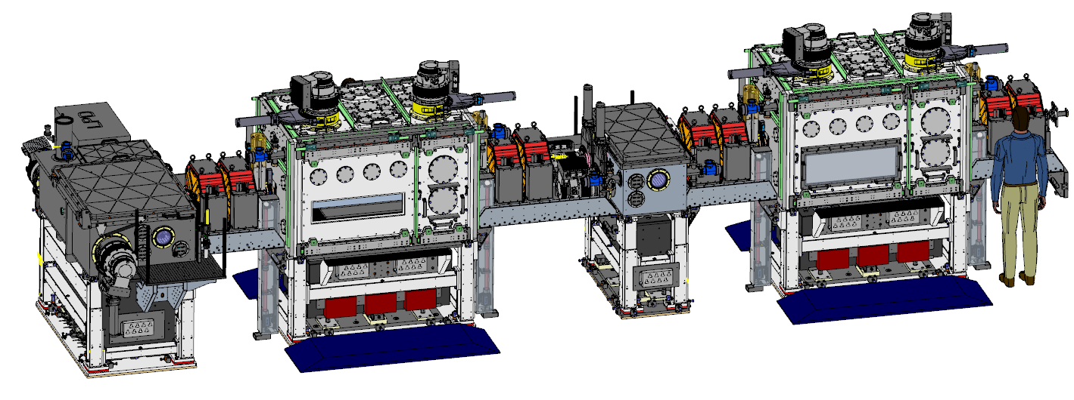
FEBE Hutch Beamline: viewed on orientation similar to previous schematic
FEC = FEBE Experiment Chamber
IP = Interaction Point (e- foci)
More images at end of presentation
FEC2
Laser from roof
FEC1
IP2
IP1
CLARA
250 MeV e-

Slide 8
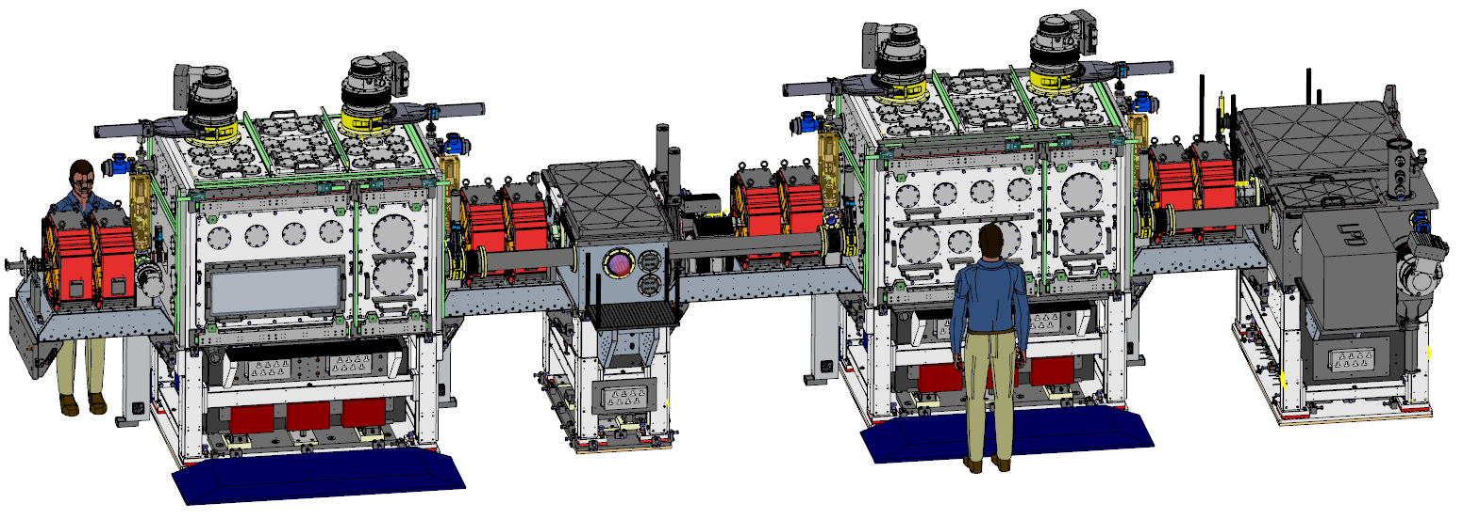
FEBE Hutch – Viewed as one enters
FEC = FEBE Experiment Chamber
IP = Interaction Point (e- foci)
More images at end of presentation
FEC1
Laser from roof
FEC2
IP1
CLARA
250 MeV e-
IP2

Slide 9
FEBE Hutch Plan
Shield wall
FEC = FEBE Experiment Chamber
IP = Interaction Point (e- foci)
6.5m
4.9m
Distance last IP to dipole straight on port
Distance between nominal IPs
FEC1
FEC2
IP1
IP2
e-
Dipole
Straight on port
Internal ~0.9m
Internal ~0.9m
Internal ~0.9m
Internal ~0.9m

Slide 10
FEC1&2 Plan view – sectioned on beam axis
Slide door
Slide door
Base breadboard
1 m
e-
1.5 m
Slide door
Slide door

Slide 11
FEC1&2 Side, sectioned on beam axis
Feeds
Feeds
Feeds
e-
Internal 1.1M
Beam height off base board 0.2515M
Base breadboard
Internal 1.8M

Slide 12
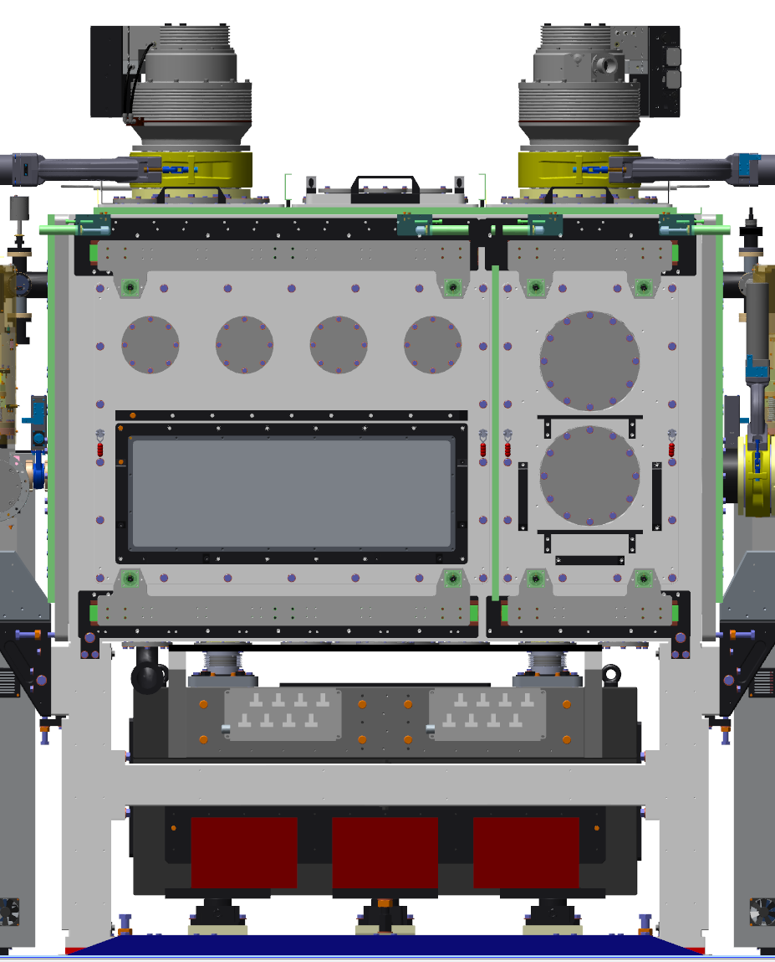
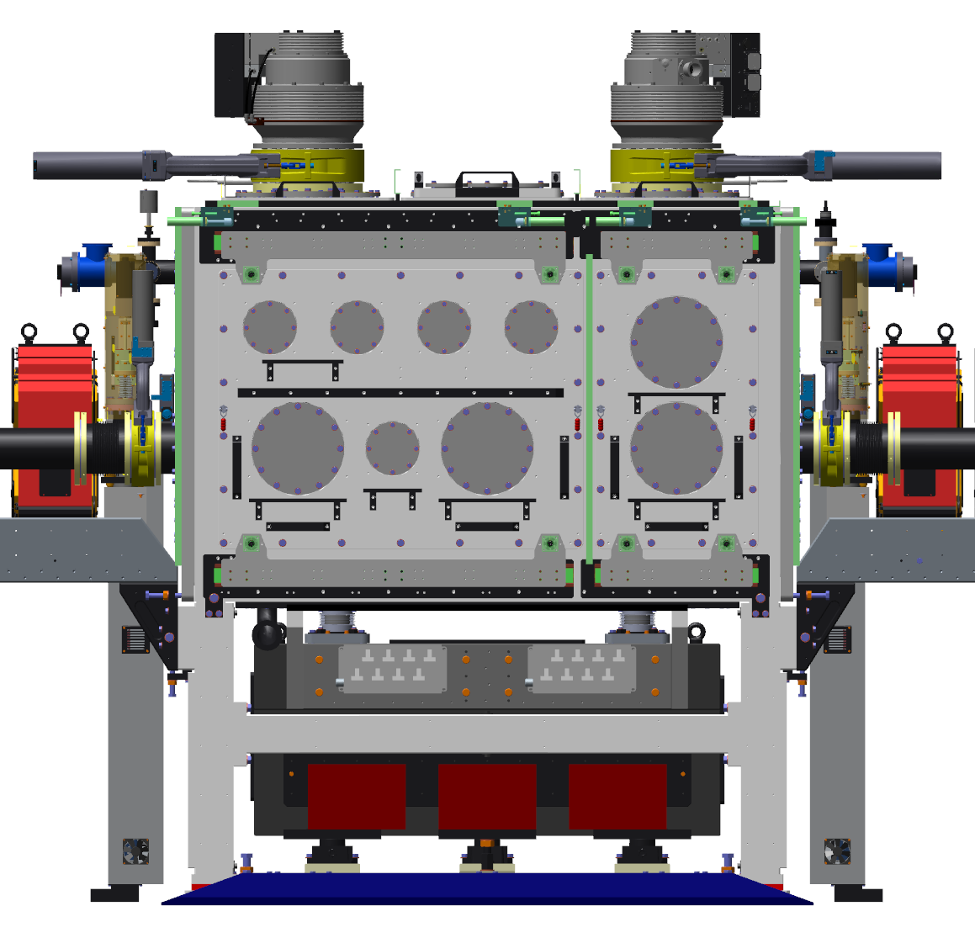
FEC Chamber Doors
Design for FEC2 large doors to be confirmed. Circular ports all ISO flanges – see end of slides for sizes
FEC2
FEC1
CLARA
250 MeV e-
CLARA
250 MeV e-

Slide 13
FEC Chamber Doors Annotated
Design for FEC2 large doors to be confirmed. Circular ports all ISO flanges – see end of slides for sizes
FEC2
FEC1
Large transparent viewport
Can be used for feedthroughs
Can be used for feedthroughs
CLARA
250 MeV e-
CLARA
250 MeV e-
Centred over IP1
Can be used as viewport or feedthrough
Centred on beam axis
Can be used as viewport or feedthrough;
Centred on beam axis

Slide 14
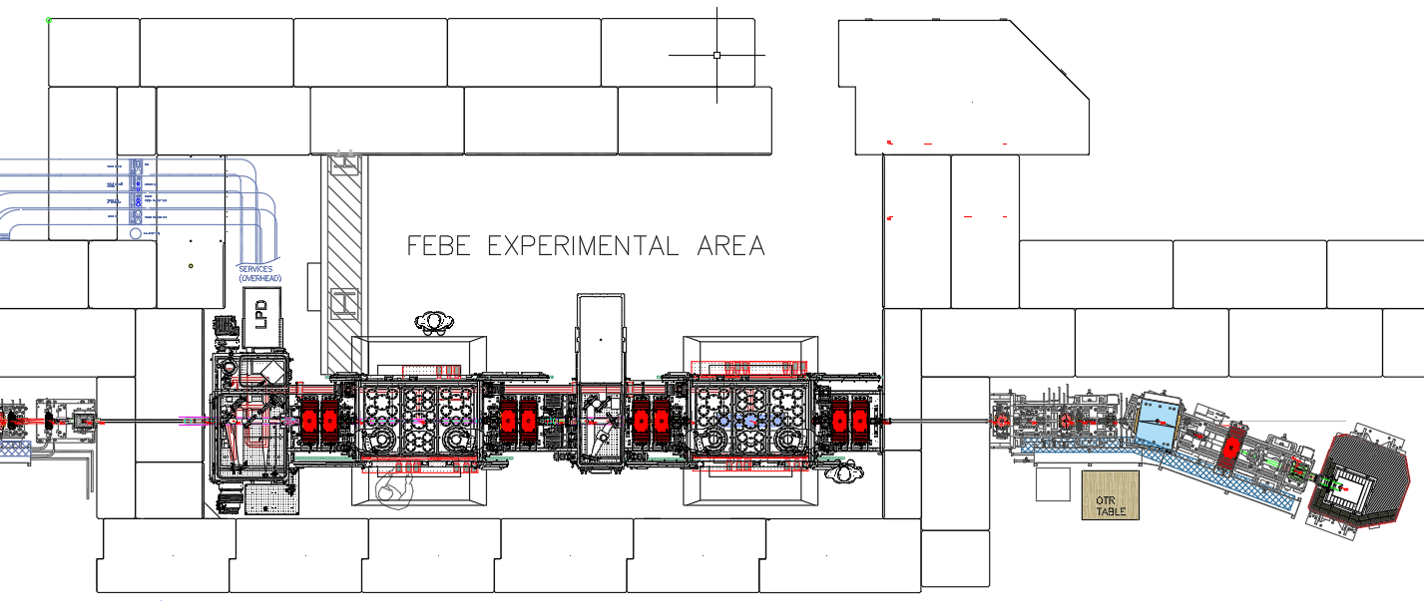
Notes on chambers - Doors
Doors will be on ½ - 2/3 split as shown, and slide open.
A clear access path to the centre of the chamber (IP1/2) is possible from either side.
Additional space is availible on the ‘north side’ of the chambers for tables and other breadboards
Discuss us your requirements with us.
The final of design of the doors with large rectangular viewports is TBC early 2025
North
South

Slide 15
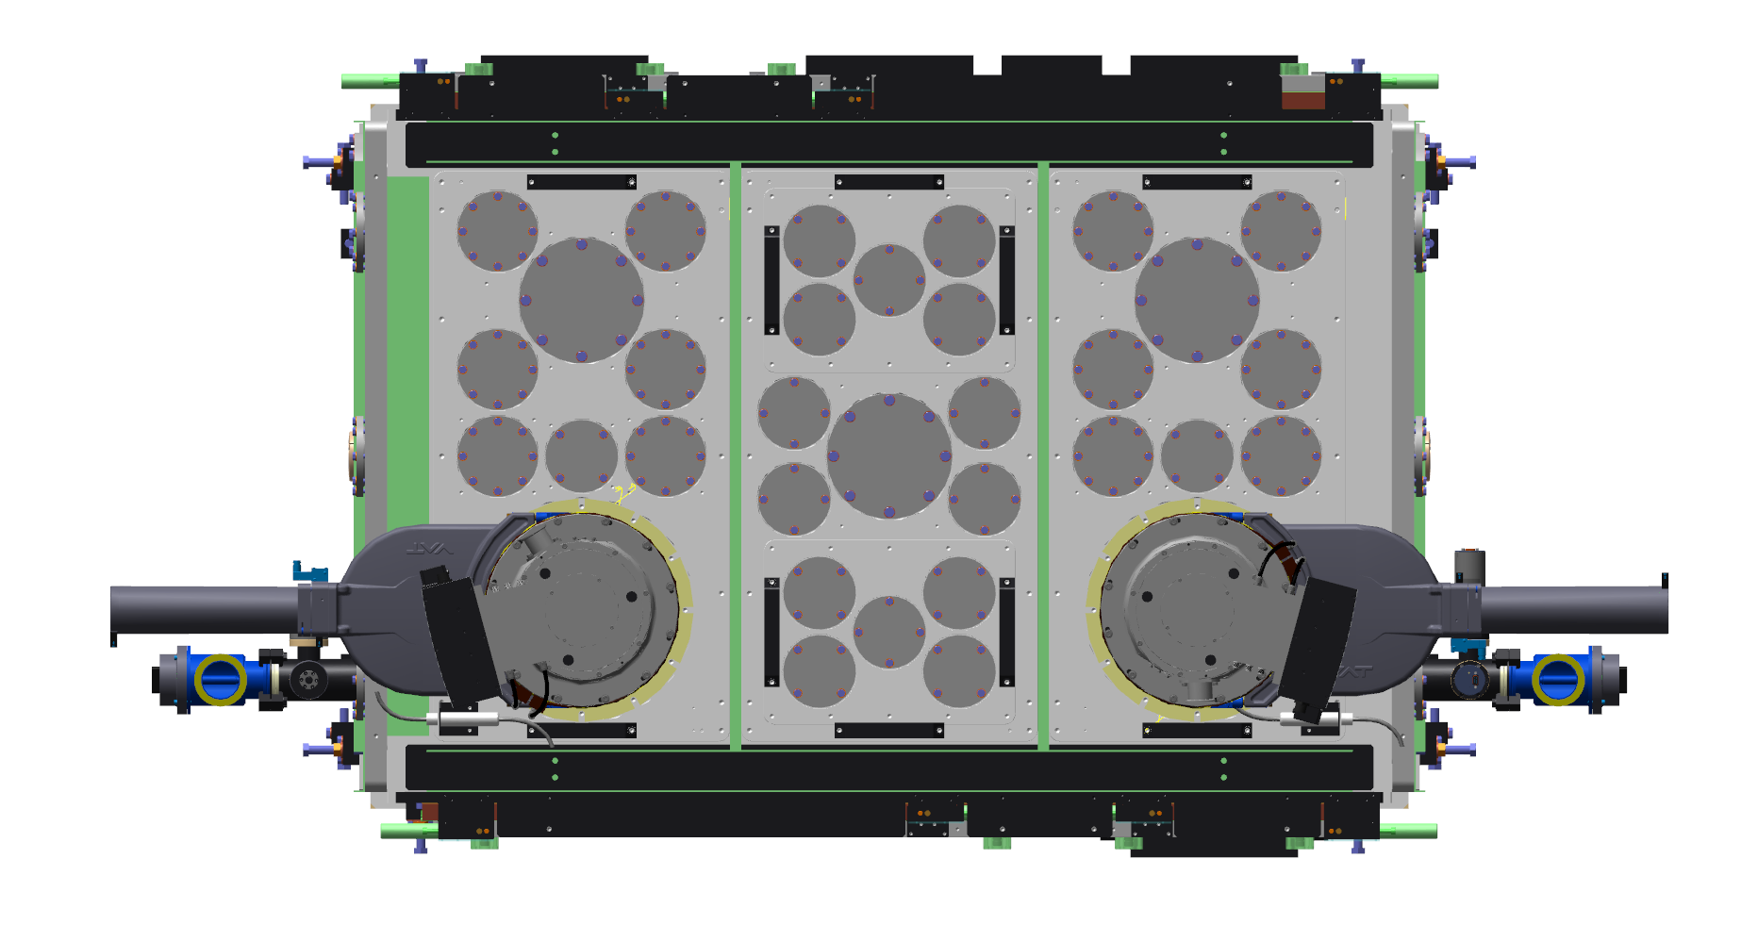
FEC1 Top
Viewport over IP1 or 2 (both) is possible from the top
Turbo pump locations cannot be changed
CLARA
250 MeV e-

Slide 16
FEC1&2 Plan view
These port clusters are on interchangeable panels if required. Alternate panels to be provided by users.
Port Cluster
Slide door
Slide door
Port Cluster
Port Cluster
Port Cluster
Port Cluster
e-
Port Line
Port Line
Internal ~ 1.1m
Turbo
Turbo
Port Cluster
Can be used as viewport or feedthrough
Centred on beam axis
Slide door
Slide door
Technical drawing on slide 27
Internal ~ 1.8m

Slide 17
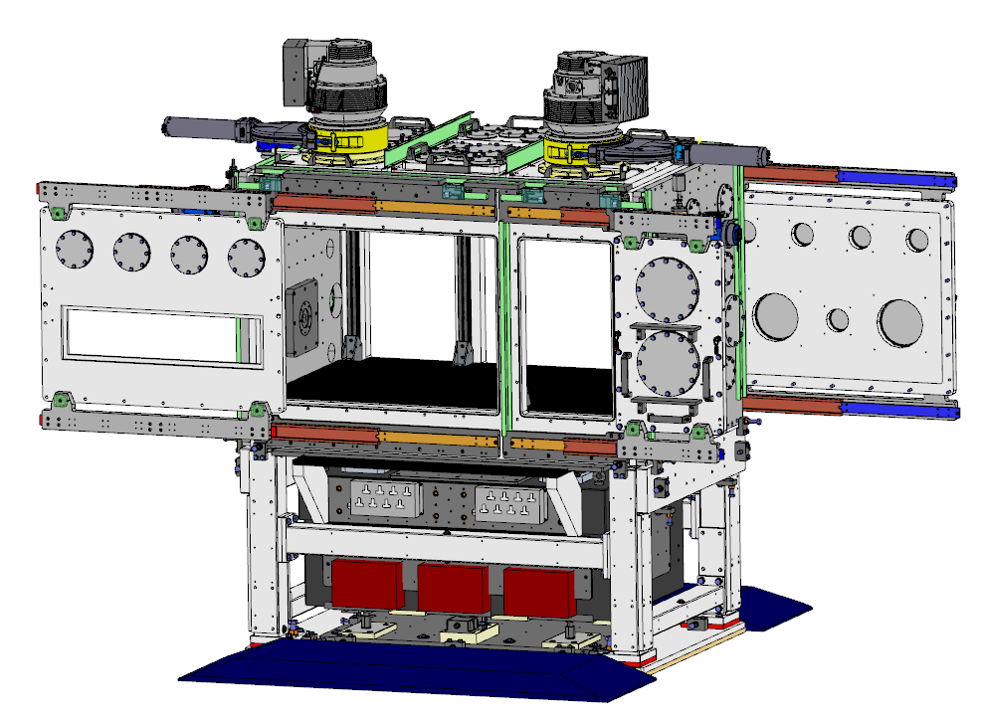
In Air Experiments
Experiments can be performed in air in either FEC1 or 2
There is an operational preference for FEC2 so that beam scatter and excess radiation is delivered to FEH back wall and not to other components
If required by beam parameters, FEC1 can be used
There is an ICT before FEC2, providing on-shot absolute charge measurement for irradiation experiments
Internal flange mount for vacuum isolation window

Slide 18
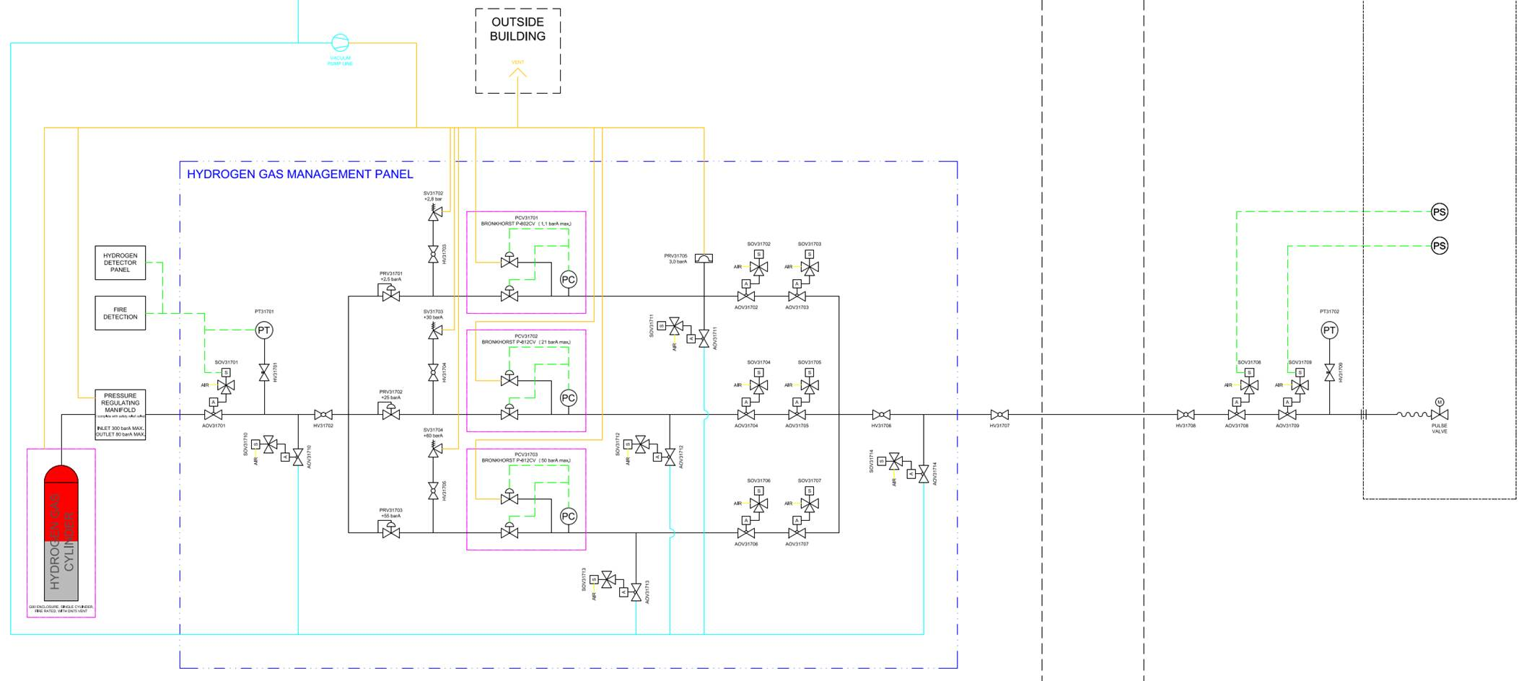
Gas delivery
Gas delivery will be possible to FEC1 , from a manifold outside of the hutch
Upgraded version of BA1 system
We will be able to deliver: hydrogen, inerts, and premixed cylinders
Gas delivery in absolute pressures.
Remote control of backing line pressure regulators possible.
All gas delivery parameters subject to vacuum limitations and in-situ experimental verification of pumping performance.
Specific limits will vary based on the geometry of gas target used.
For experiments with high gas load differential pumping may be required.
Different requirements for the FEBE laser & for CLARA beam
A conceptual design has been prepared for diff. pumping.
Schematic for H2 delivery system

Slide 19
Photos of chambers
As Installed Dec 24

Slide 20
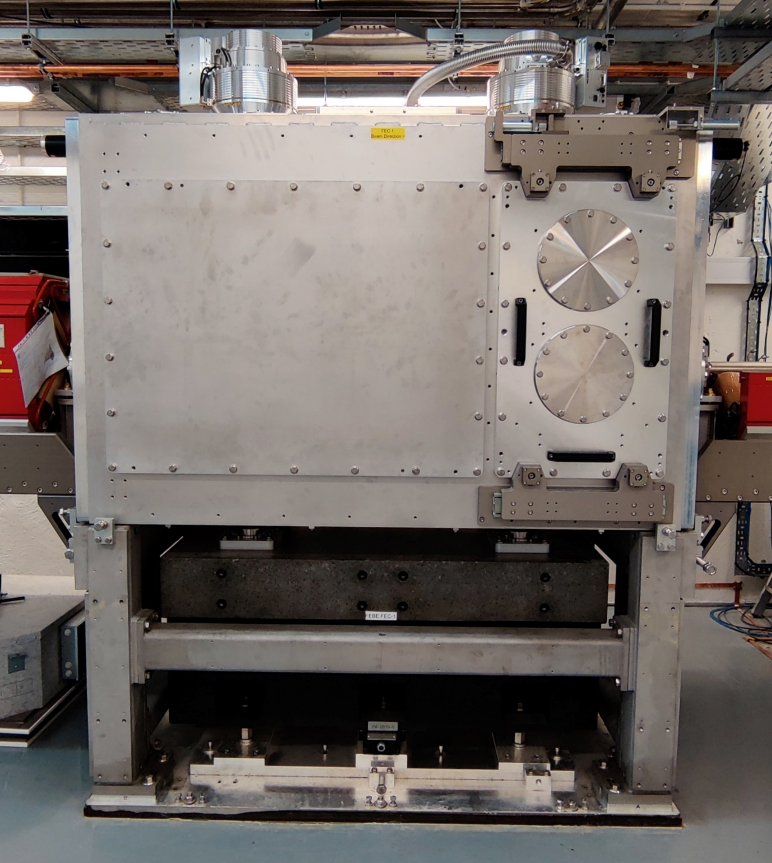
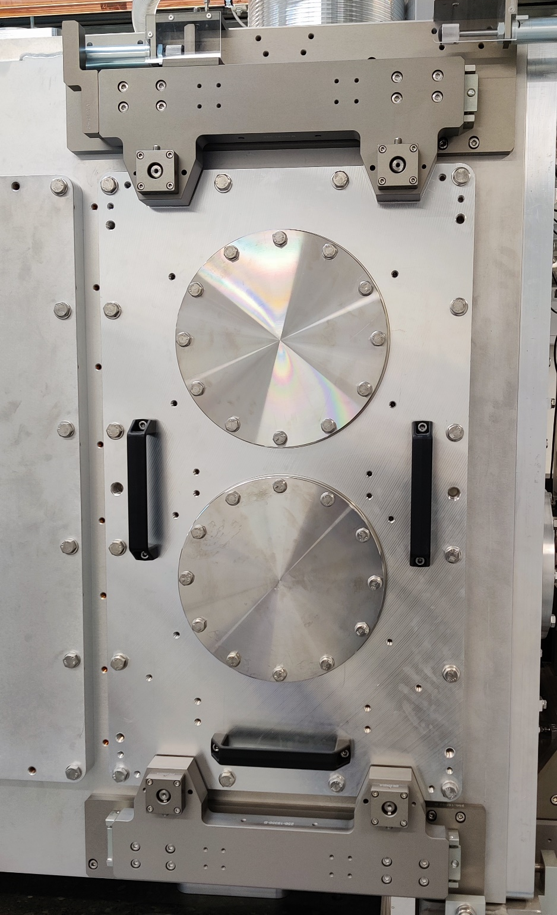
FEC Chambers
Slide door motion & safety system
FEC 1 from North, e- right to left
FEC1 narrow door w/ x2 ISO200 flanges
Bottom is on axis with e-

Slide 21
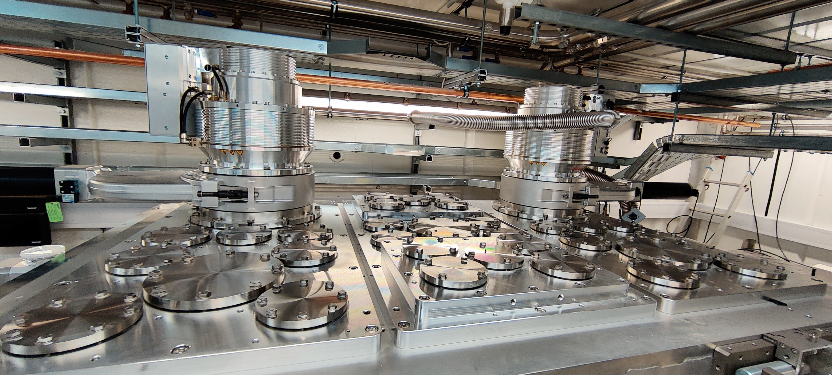
FEC Chamber Top
Some feedthroughs will be reserved for diagnostics

Slide 22
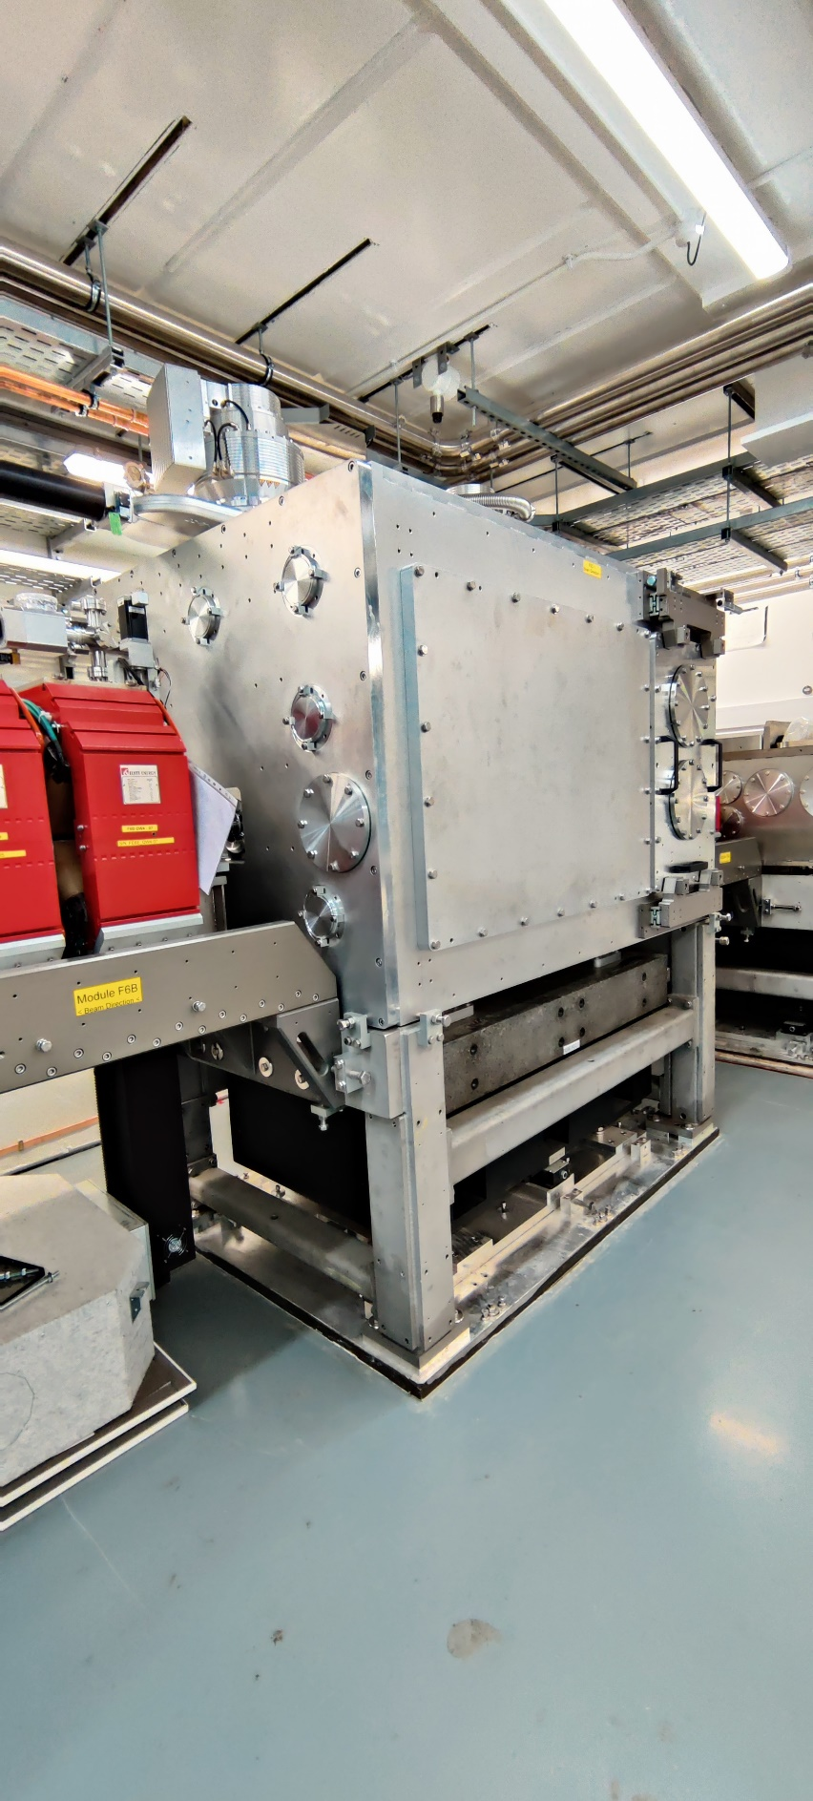
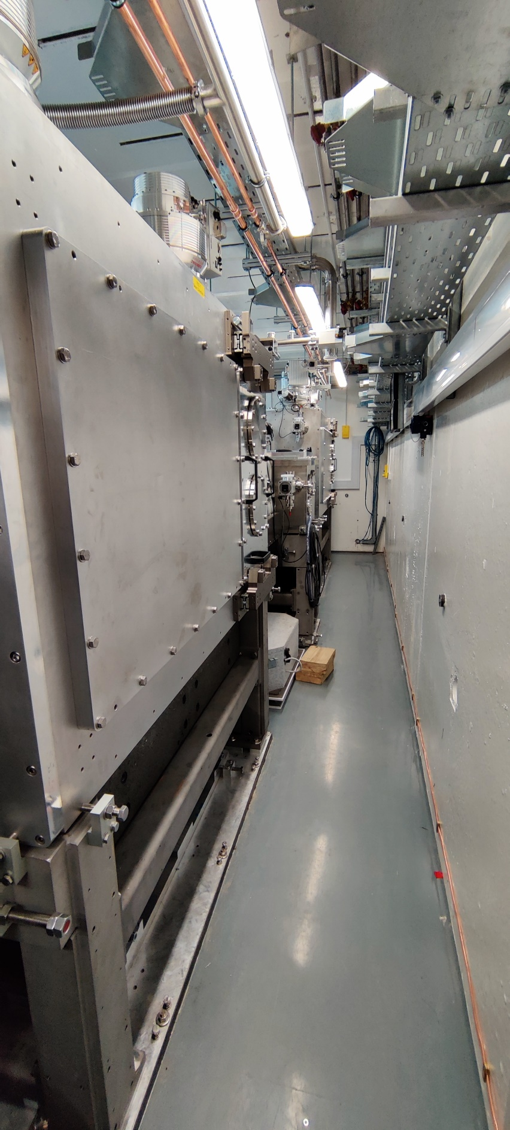
Hutch
FEC1 from North Side
Narrow south side
Space will be used for commissioning diagnostics & search route

Slide 23
Electron Beam Delivery

Slide 24
Day 1 Electron Beam Parameters
To be delivered at either FEC1 or FEC2 IP
Parameter | High charge | Low charge
Energy [MeV] | 250 | 250
Charge [pC] | 250 | 5
RMS t [fs] | 100 | 50
σ_{E}/E [%] | <5 | <1
RMS x [µm] | 100 | 20
RMS y [µm] | 100 | 20
ε_{N} x [µm] | 5 | 2
ε_{N} y [µm] | 5 | 2
These parameters are for short beams.
If longitudinally compressed beam is not required, emittance will be reduced and transverse focus also reduced in size.
Further detail on FEBE beam parameters can be found in
Snedden, E. W., et al. "Specification and design for full energy beam exploitation of the compact linear accelerator for research and applications." PRAB 27.4 (2024): 041602.
https://doi.org/10.1103/PhysRevAccelBeams.27.041602

Slide 25
Technical Systems Commissioning
All RF / diagnostics / magnets / controls ready for beam
>x5 increase in all sub-components from CLARA front-end to CLARA Phase 2 + FEBE
0
Injector & Emittance
Characterise and optimise injector emittance and transverse properties
1
CLARA LPS measurements
Measure (TDC) CLARA long. phase space (LPS) and optimise to meet goals
FEBE Technical Systems Commissioning
2
CLARA Longitudinal Setup
Achieve required compression in CLARA and characterise beam
FEBE Advanced Technical Systems Commissioning
3
CLARA Longitudinal Dynamics Optimisation
Optimise CLARA LPS for multiple beam modes (Q, E, σ_{t}, σ_{E} etc.)
4
FEBE Standard Setups + Characterization
Optimise CLARA+FEBE for multiple beam modes (Q, E, σ_{t}, σ_{E} etc.)
5
COMMISSIONING COMPLETE

Slide 26
How Day 1 parameters will be verified
Parameter | High charge | Diagnostic | Low charge | Diagnostic
Energy [MeV] | 250 | FED Spec | 250 | FED Spec
Charge [pC] | 250 | FED FCUP & FEH ICT | 5 | FED FCUP & FEH ICT
RMS t [fs] | 100 | Wakefield Streaker + TDC & Modelling of FEBE Arc | 50 | TDC & Modelling FEBE Arc
σ_{E}/E [%] | <5 | FED Spec | <1 | FED Spec
RMS x [µm] | 100 | FEC Imaging | 20 | FEC Imaging
RMS y [µm] | 100 | FEC Imaging | 20 | FEC Imaging
ε_{N} x [µm] | 5 | FEBE Quad Scan | 2 | FEBE Quad Scan
ε_{N} y [µm] | 5 | FEBE Quad Scan | 2 | FEBE Quad Scan

Slide 27
How you should use ‘Day 1’ Parameters
Please do use in simulations of experiments
Where possible support proposals with simulations using day 1 parameters
Please do not submit proposals which are strongly contingent on R&D parameters for the first run
Consider how your requested beam parameters will be validated and make allowances for this in your plans
We will support integration of our existing diagnostics systems into your experiments
There will be constraints & resolution will be limited; performanceTBC in commissioning
If significant beam changes are needed, please discuss with us
Short discussions will be offered in first instance
We will have limited performance knowledge until we complete beam commissioning

Slide 28
Flexibility of Delivery: Electron Parameters
Users must allow for beam time to tune to a beam setup when requesting time in a proposal
Especially for first run(s)
Please discuss any requests for setups with CLARA team in advance of proposal submission. We can advise an estimate of time required to tune, based on commissioning experience.
Over time our number of quickly repeatable setups will evolve and increase.
We will strive to provide the beam most suited to experimental requirements; performance restrictions and time permitting.

Slide 29
Tuning beam setups
In order of easiest to tune away from a ‘working point’ machine setup:
Electron focal position and size :
Focus can be moved up- or downstream in either FEC
This will compromise quality, best optics match is for IP1/2
Laser focus is always centre of FEC1 at IP1 for first run.
Charge:
Can be varied between 5 and 250 pC
Tighter requirements on bunch length or size will require more tuning and optimisation time for a given charge
If no requirements on length, and with relaxed focusing requirements, charge is more readily tunable.
Bunch Length and energy spread/chirp
These are both tunable, but initial setups will be at fixed working points
Delivering specific combinations of length or chirp will require dedicated modelling and setup time.

Slide 30
The R&D Parameters
Parameter | High charge | Low charge
Energy [MeV] | 250 | 250
Charge [pC] | 250 | 5 → <5
RMS t [fs] | 100 → 50 | 50 → <50
σ_{E}/E [%] | <5 → 1 | <1
RMS x [µm] | 100 → 50 | 20 → ~1
RMS y [µm] | 100 → 50 | 20 → ~1
ε_{N} x [µm] | 5 → <5 | 2 → 1
ε_{N} y [µm] | 5 → <1 | 2 → <1
Also presented in PRAB:
Snedden, E. W., et al. "Specification and design for full energy beam exploitation of the compact linear accelerator for research and applications." PRAB 27.4 (2024):
These are looking to the future
Later runs we will publicize the 'actual' modes
R&D: Verifying these parameters will require upgraded and/or new diagnostics

Slide 31
Summary
There is a huge potential to exploit the full flexibility and performance of the CLARA Beam & the FEBE Hutch.
Our Vision: Maximising the potential of CLARA for its users
It will take us time to get there.
We will take input from you, our community, on what directions to explore and prioritise.
We will build up the complexity of experiments we can support.
Please work with us and discuss with us throughout the proposal call and experiment process.

Slide 32
Backup slide
Appendix
& technical
Drawings

Slide 33
2D Plan View
Dims
Laser from roof
North
CLARA
250 MeV e-
South

Slide 34
View from South
Laser from roof
CLARA
250 MeV e-

Slide 35
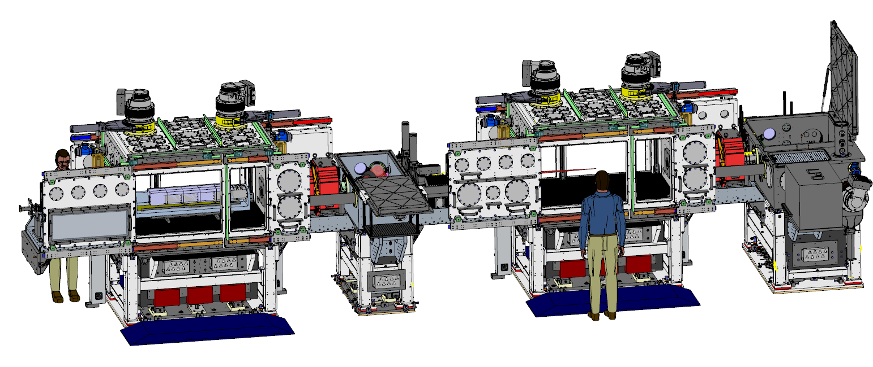
View from North
Laser from roof
CLARA
250 MeV e-

Slide 36
FEC1- Some additional Details; view from south
Usable internal dimensions will be slightly less than indicated in slides above because of internal cage, end plates and differential pumping baffles.
Internal Cage for Experiment support mounting

Slide 37
FEC1 Top
CLARA
250 MeV e-

Slide 38
FEC1 Plan: Section on Beam Axis
CLARA
250 MeV e-
Internal breadboard holes span across whole chamber

Slide 39
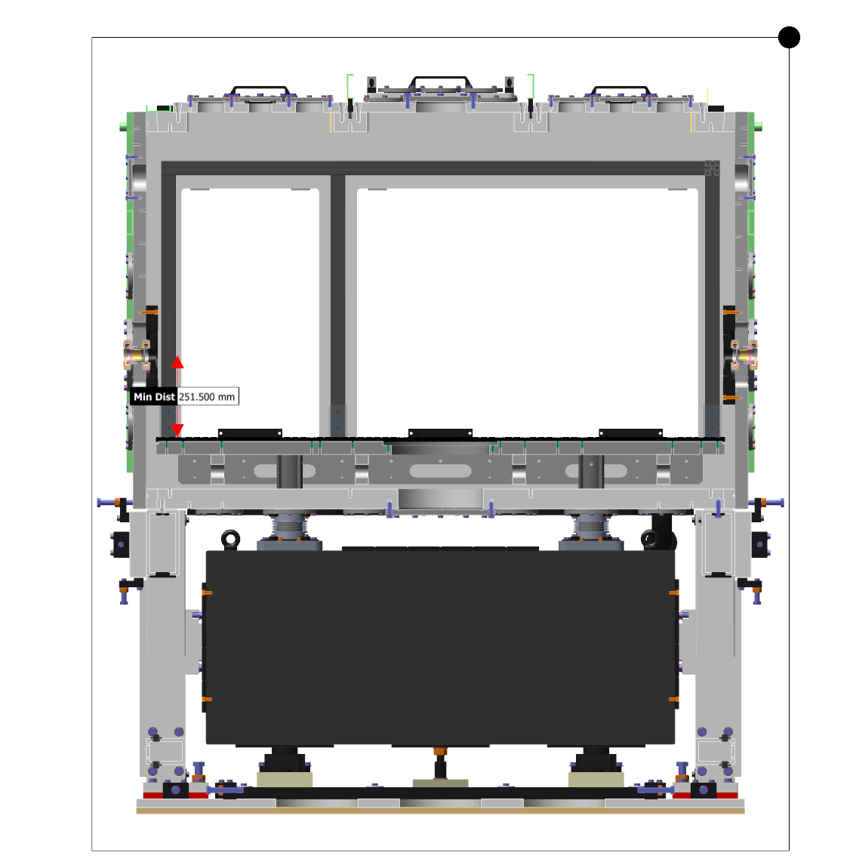
FEC1&2 Side – Section on Beam axis
CLARA
250 MeV e-

Slide 40
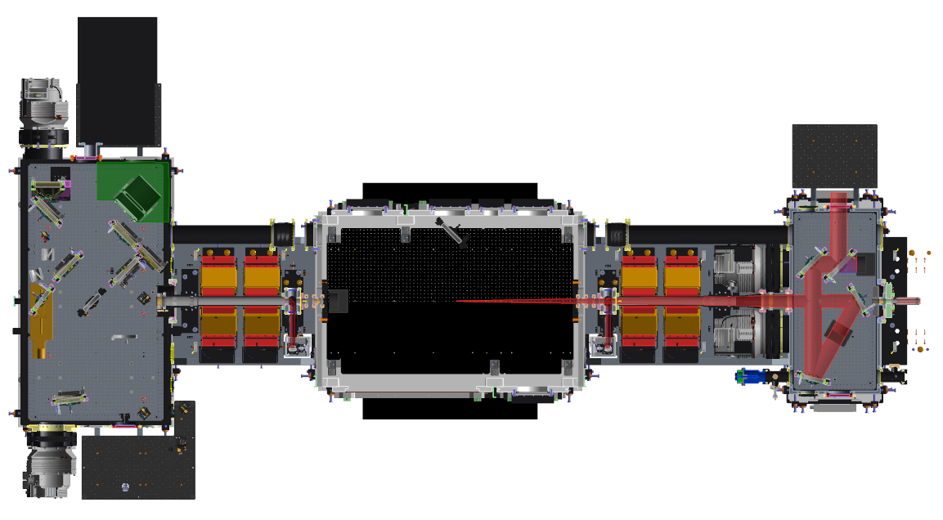
FMBOX1 – FMBOX2 Section on Beam Axis
Laser from roof
CLARA
250 MeV e-

Slide 41
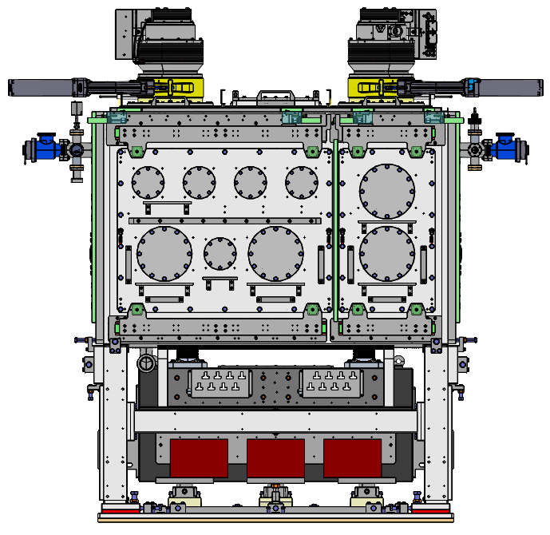
North Side
FLANGE | QTY | Colour | Designation | System Flange | Notes
ISO100 | 5 | Green | Free | N
ISO200 | 4 | Bright Yellow | Free | N

Slide 42
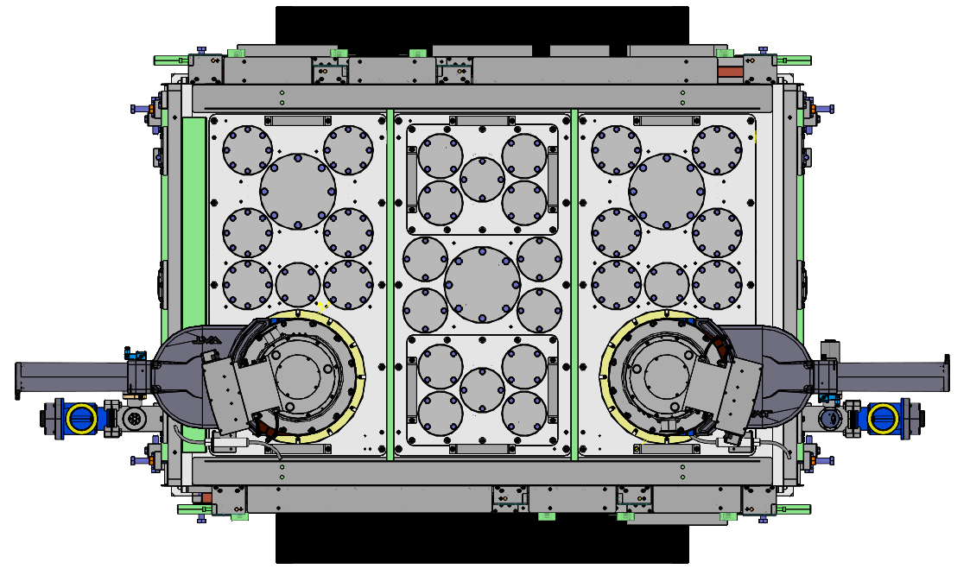
Top
FLANGE | QTY | Colour | Designation | System Flange | Notes
ISO63 | 16 | Light Blue | Free | N
ISO80 | 12 | Turquoise | Free | N
ISO160 | 3 | Red | Free | N
ISO250 | 2 | Purple | TMP | Y | Bespoke adaptor designed – non-standard bolt pattern

