Slide 1



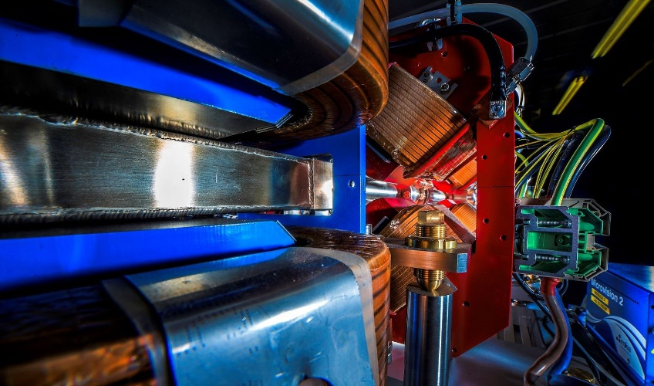
Making a brighter future through advanced accelerators
Status of CLARA
Deepa Angal-Kalinin
ASTeC, STFC Daresbury Laboratory
and The Cockcroft Institute
On behalf of the CLARA Team
Fourth CLARA User Meeting, Daresbury, 3rd December 2024

Slide 2
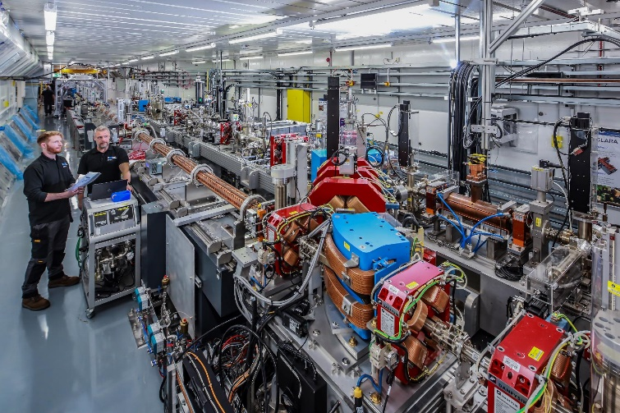
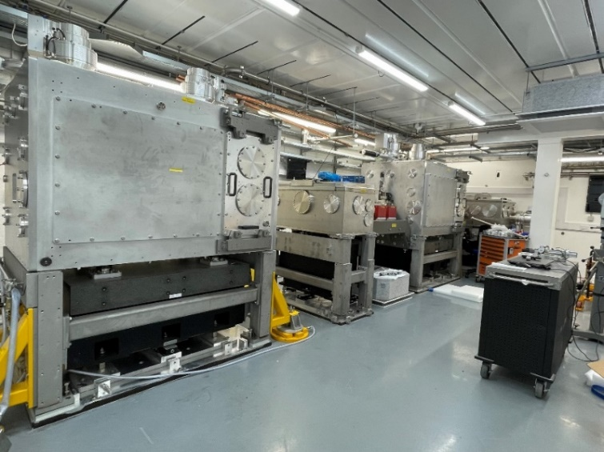
Outline
Updates since last user meeting
Status of CLARA
Beam commissioning plans
CLARA as an operational facility
  Preparations & Timeline

Slide 3
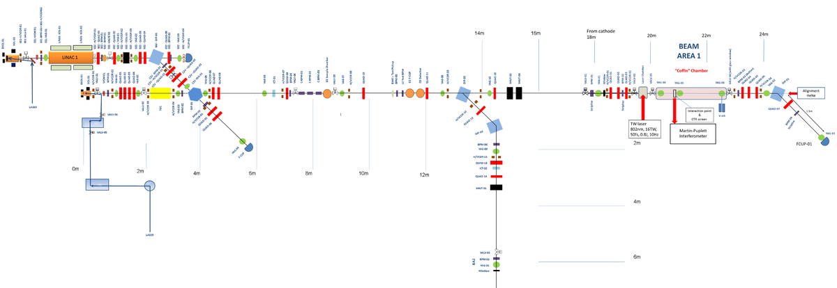
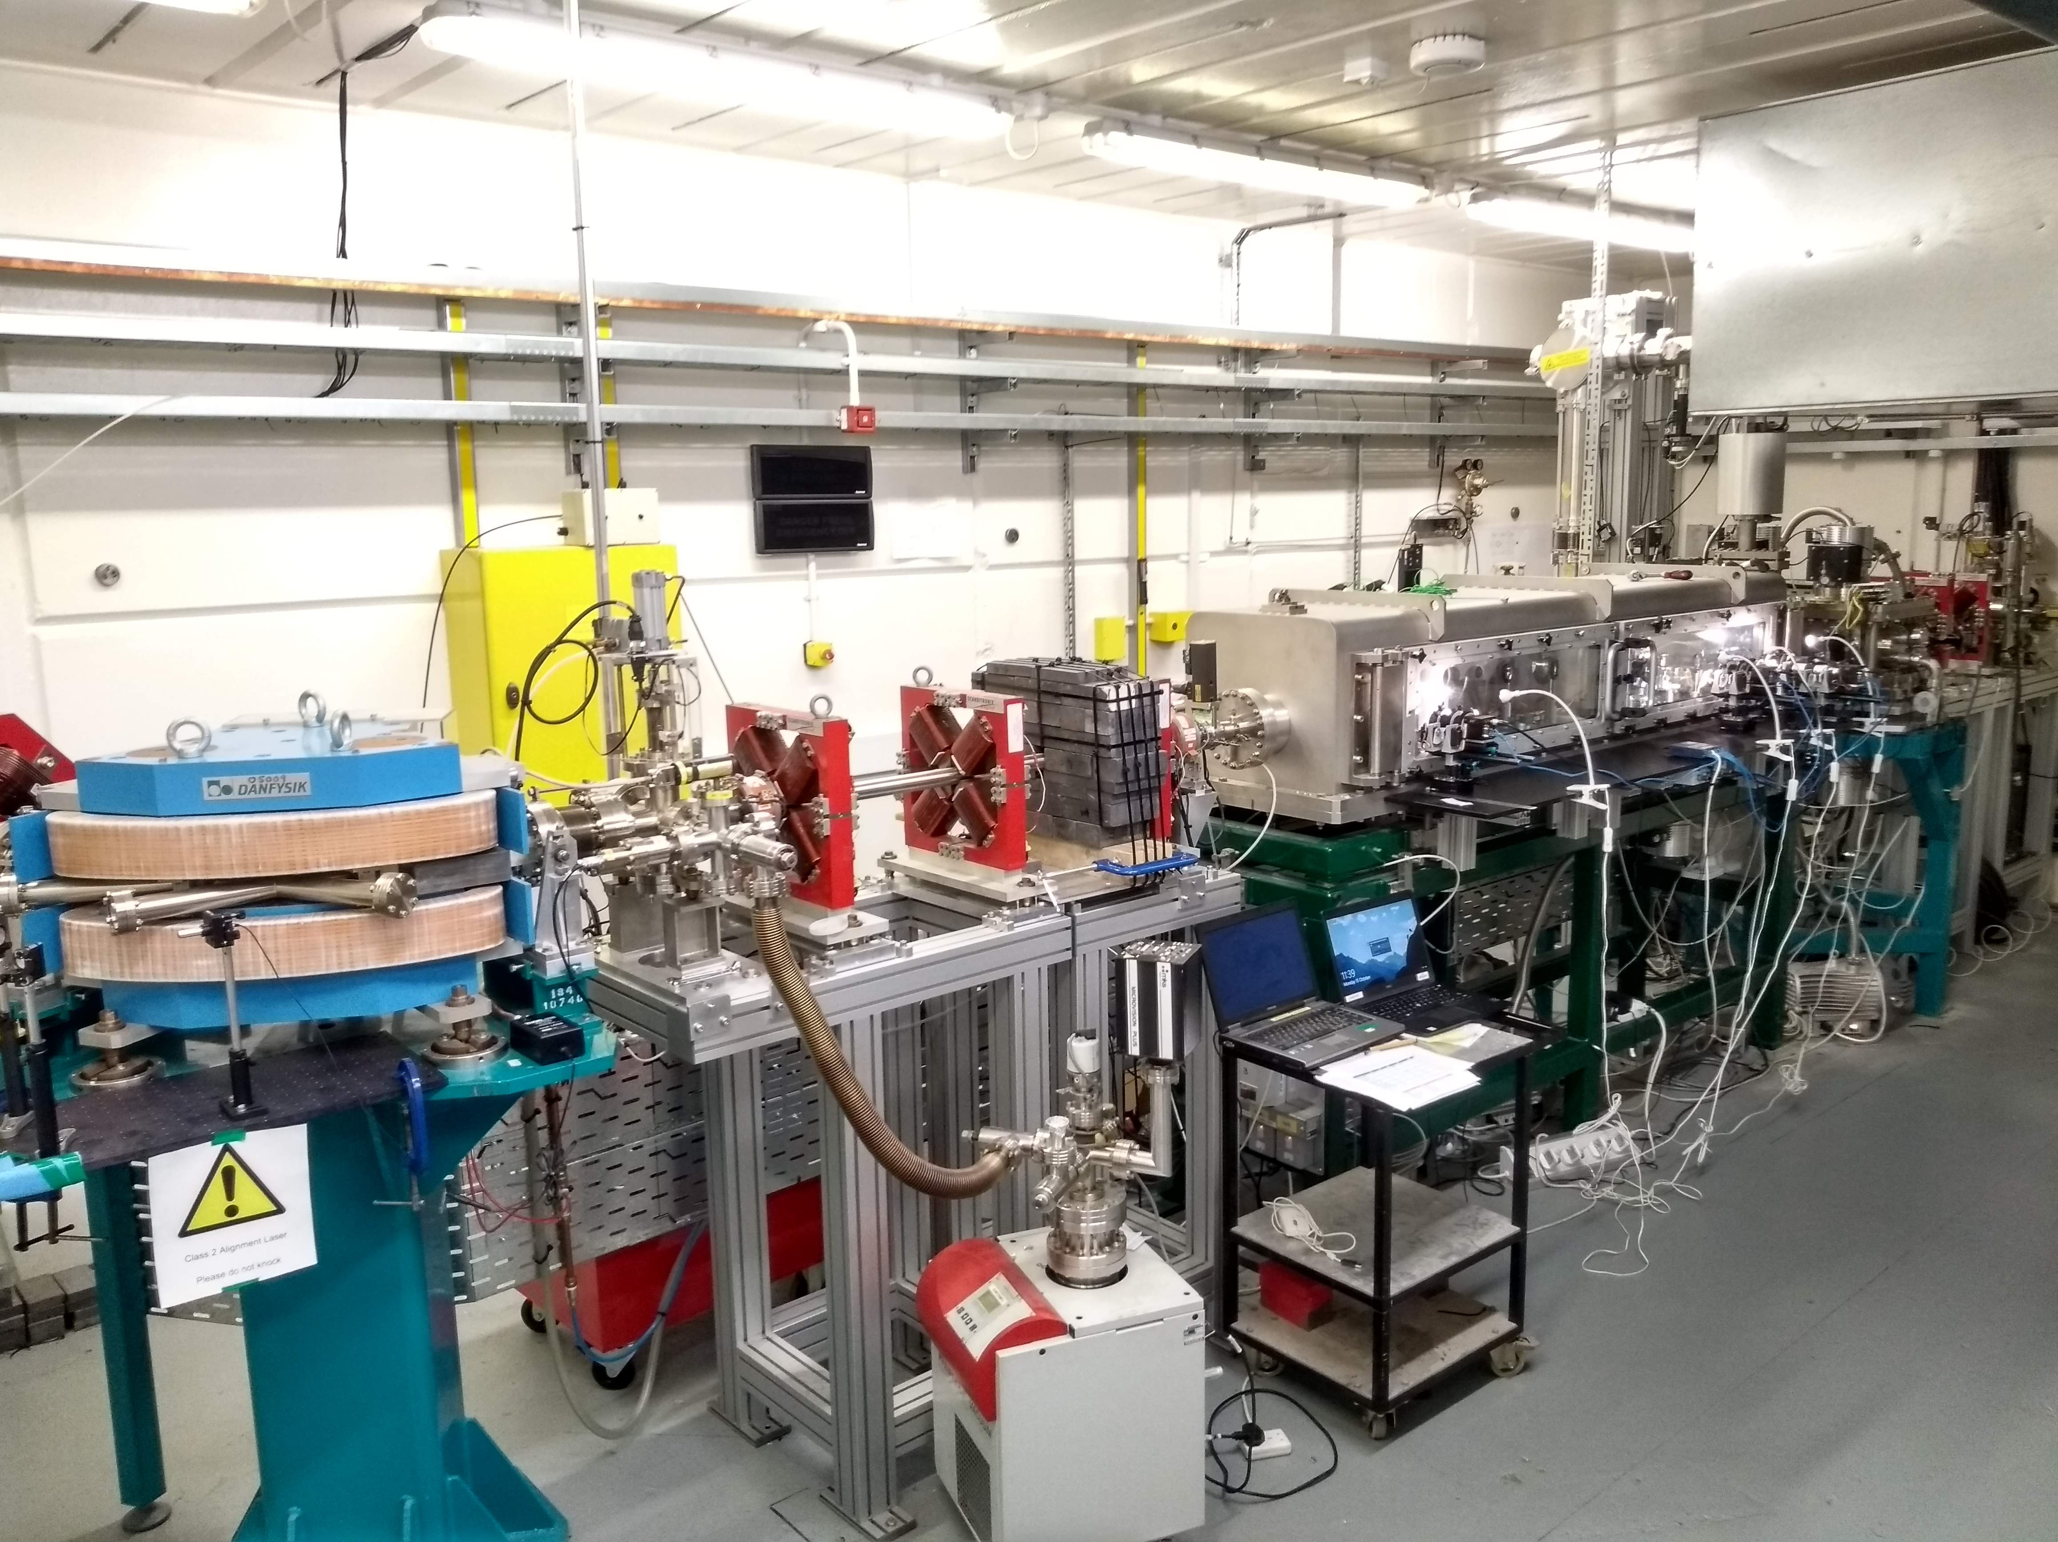
CLARA (Previous Two User Runs)
CLARA FE
Beam Area 1
10Hz gun
400Hz gun
VELA beam line
Beam energy 35 MeV
Bunch charge 100 pC
Repetition rate 10 Hz
LATTE Lab laser < 10 TW
Experimental beamline on VELA
Angal-Kalinin et al, Phys. Rev. Accel. Beams 23, 044801, 2020

Slide 4
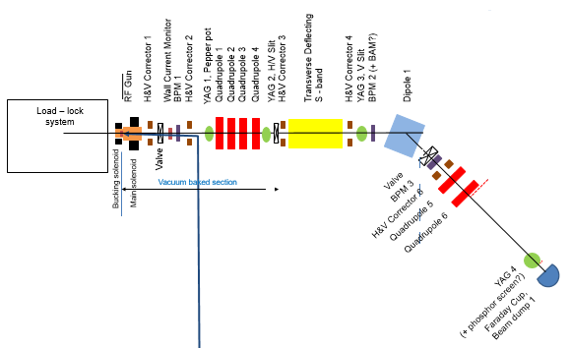
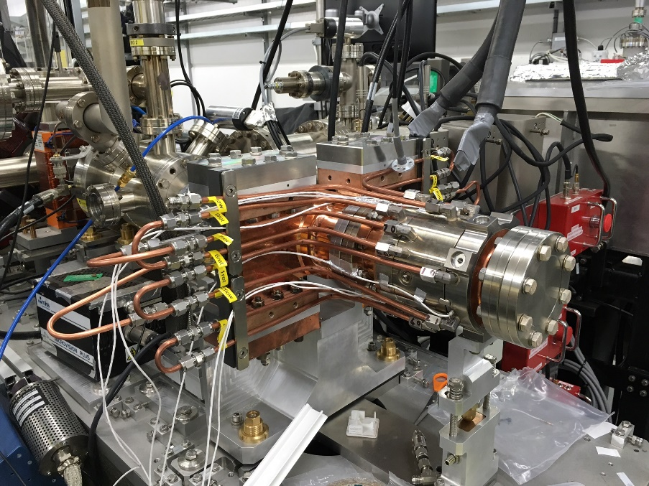
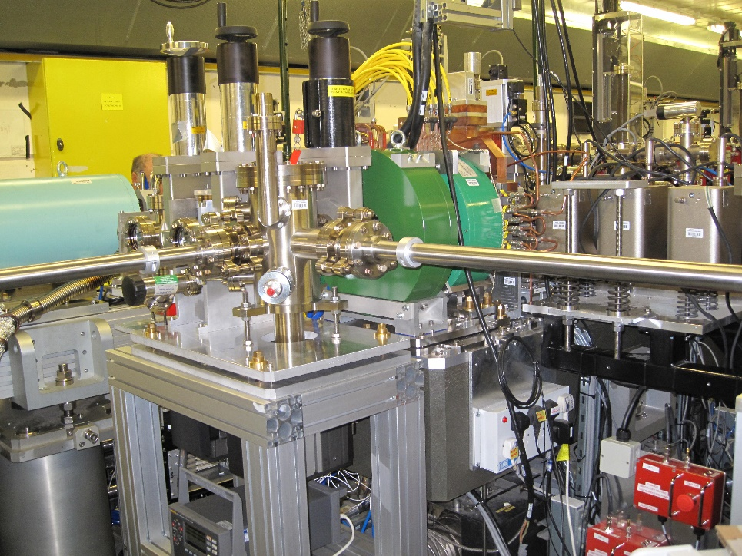
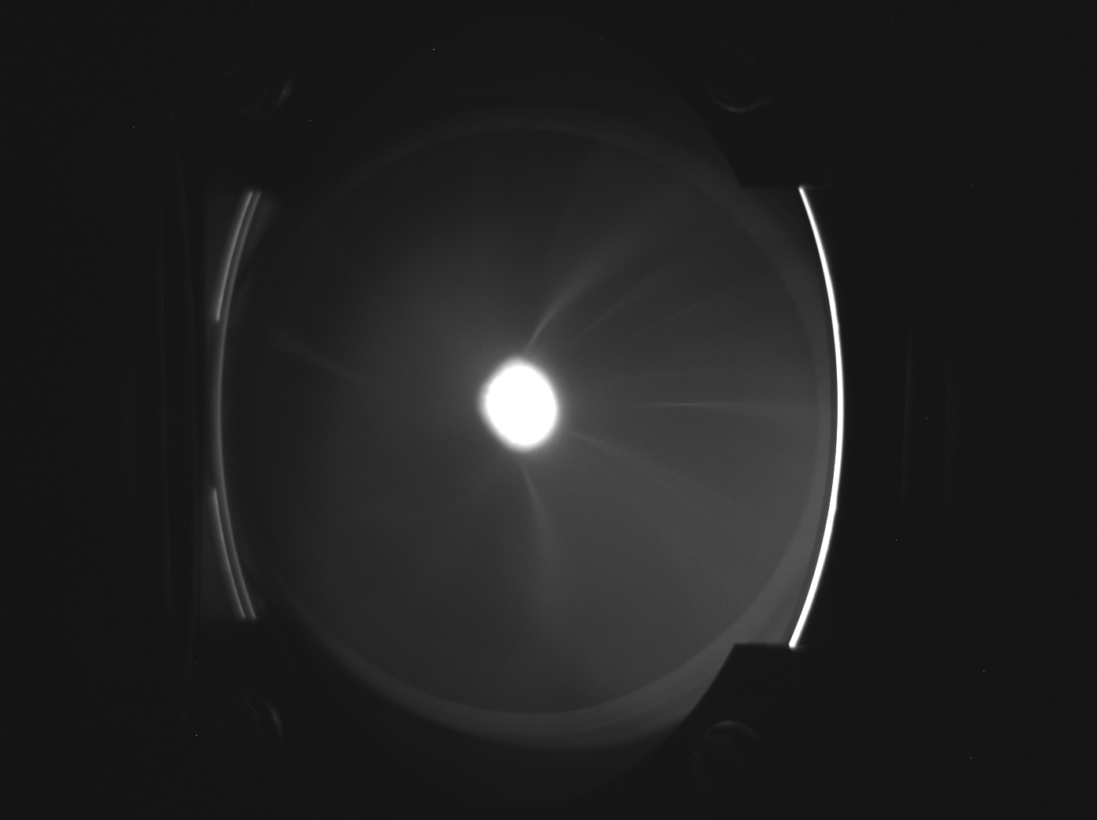
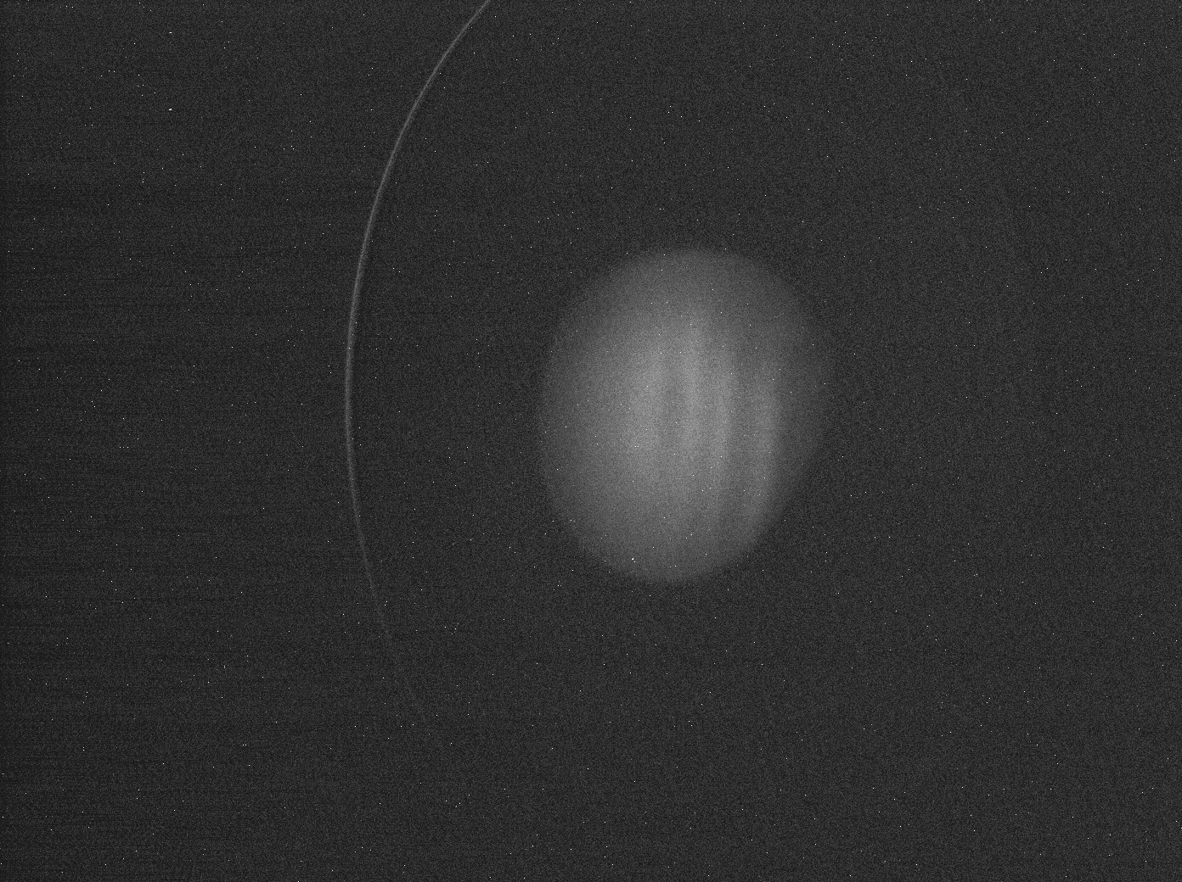
HRRG Commissioning VELA line (2023)
First beam from the high repetition rate gun (HRRG) was achieved in March 2023.
  CLARA specification of 100 Hz rep rate demonstrated
  Decision to swap the Gun from VELA to CLARA line
YAG1
YAG1
YAG4

Slide 5
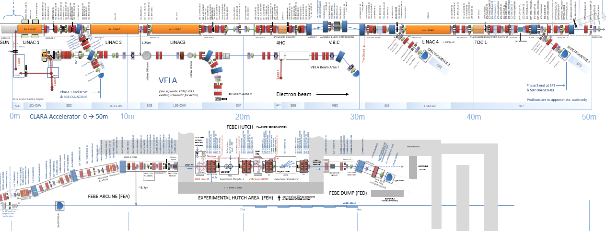
CLARA (2024)
CLARA FE
400Hz gun
Number of technical systems:
RF cavities, magnets, diagnostics, vacuum systems etc..
All at least five times more compared to CLARA FE.

Slide 6
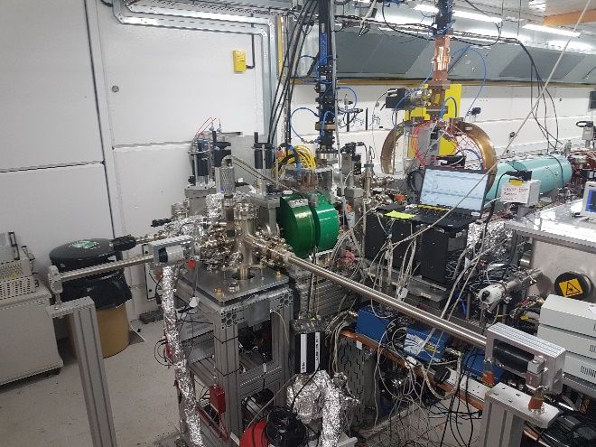
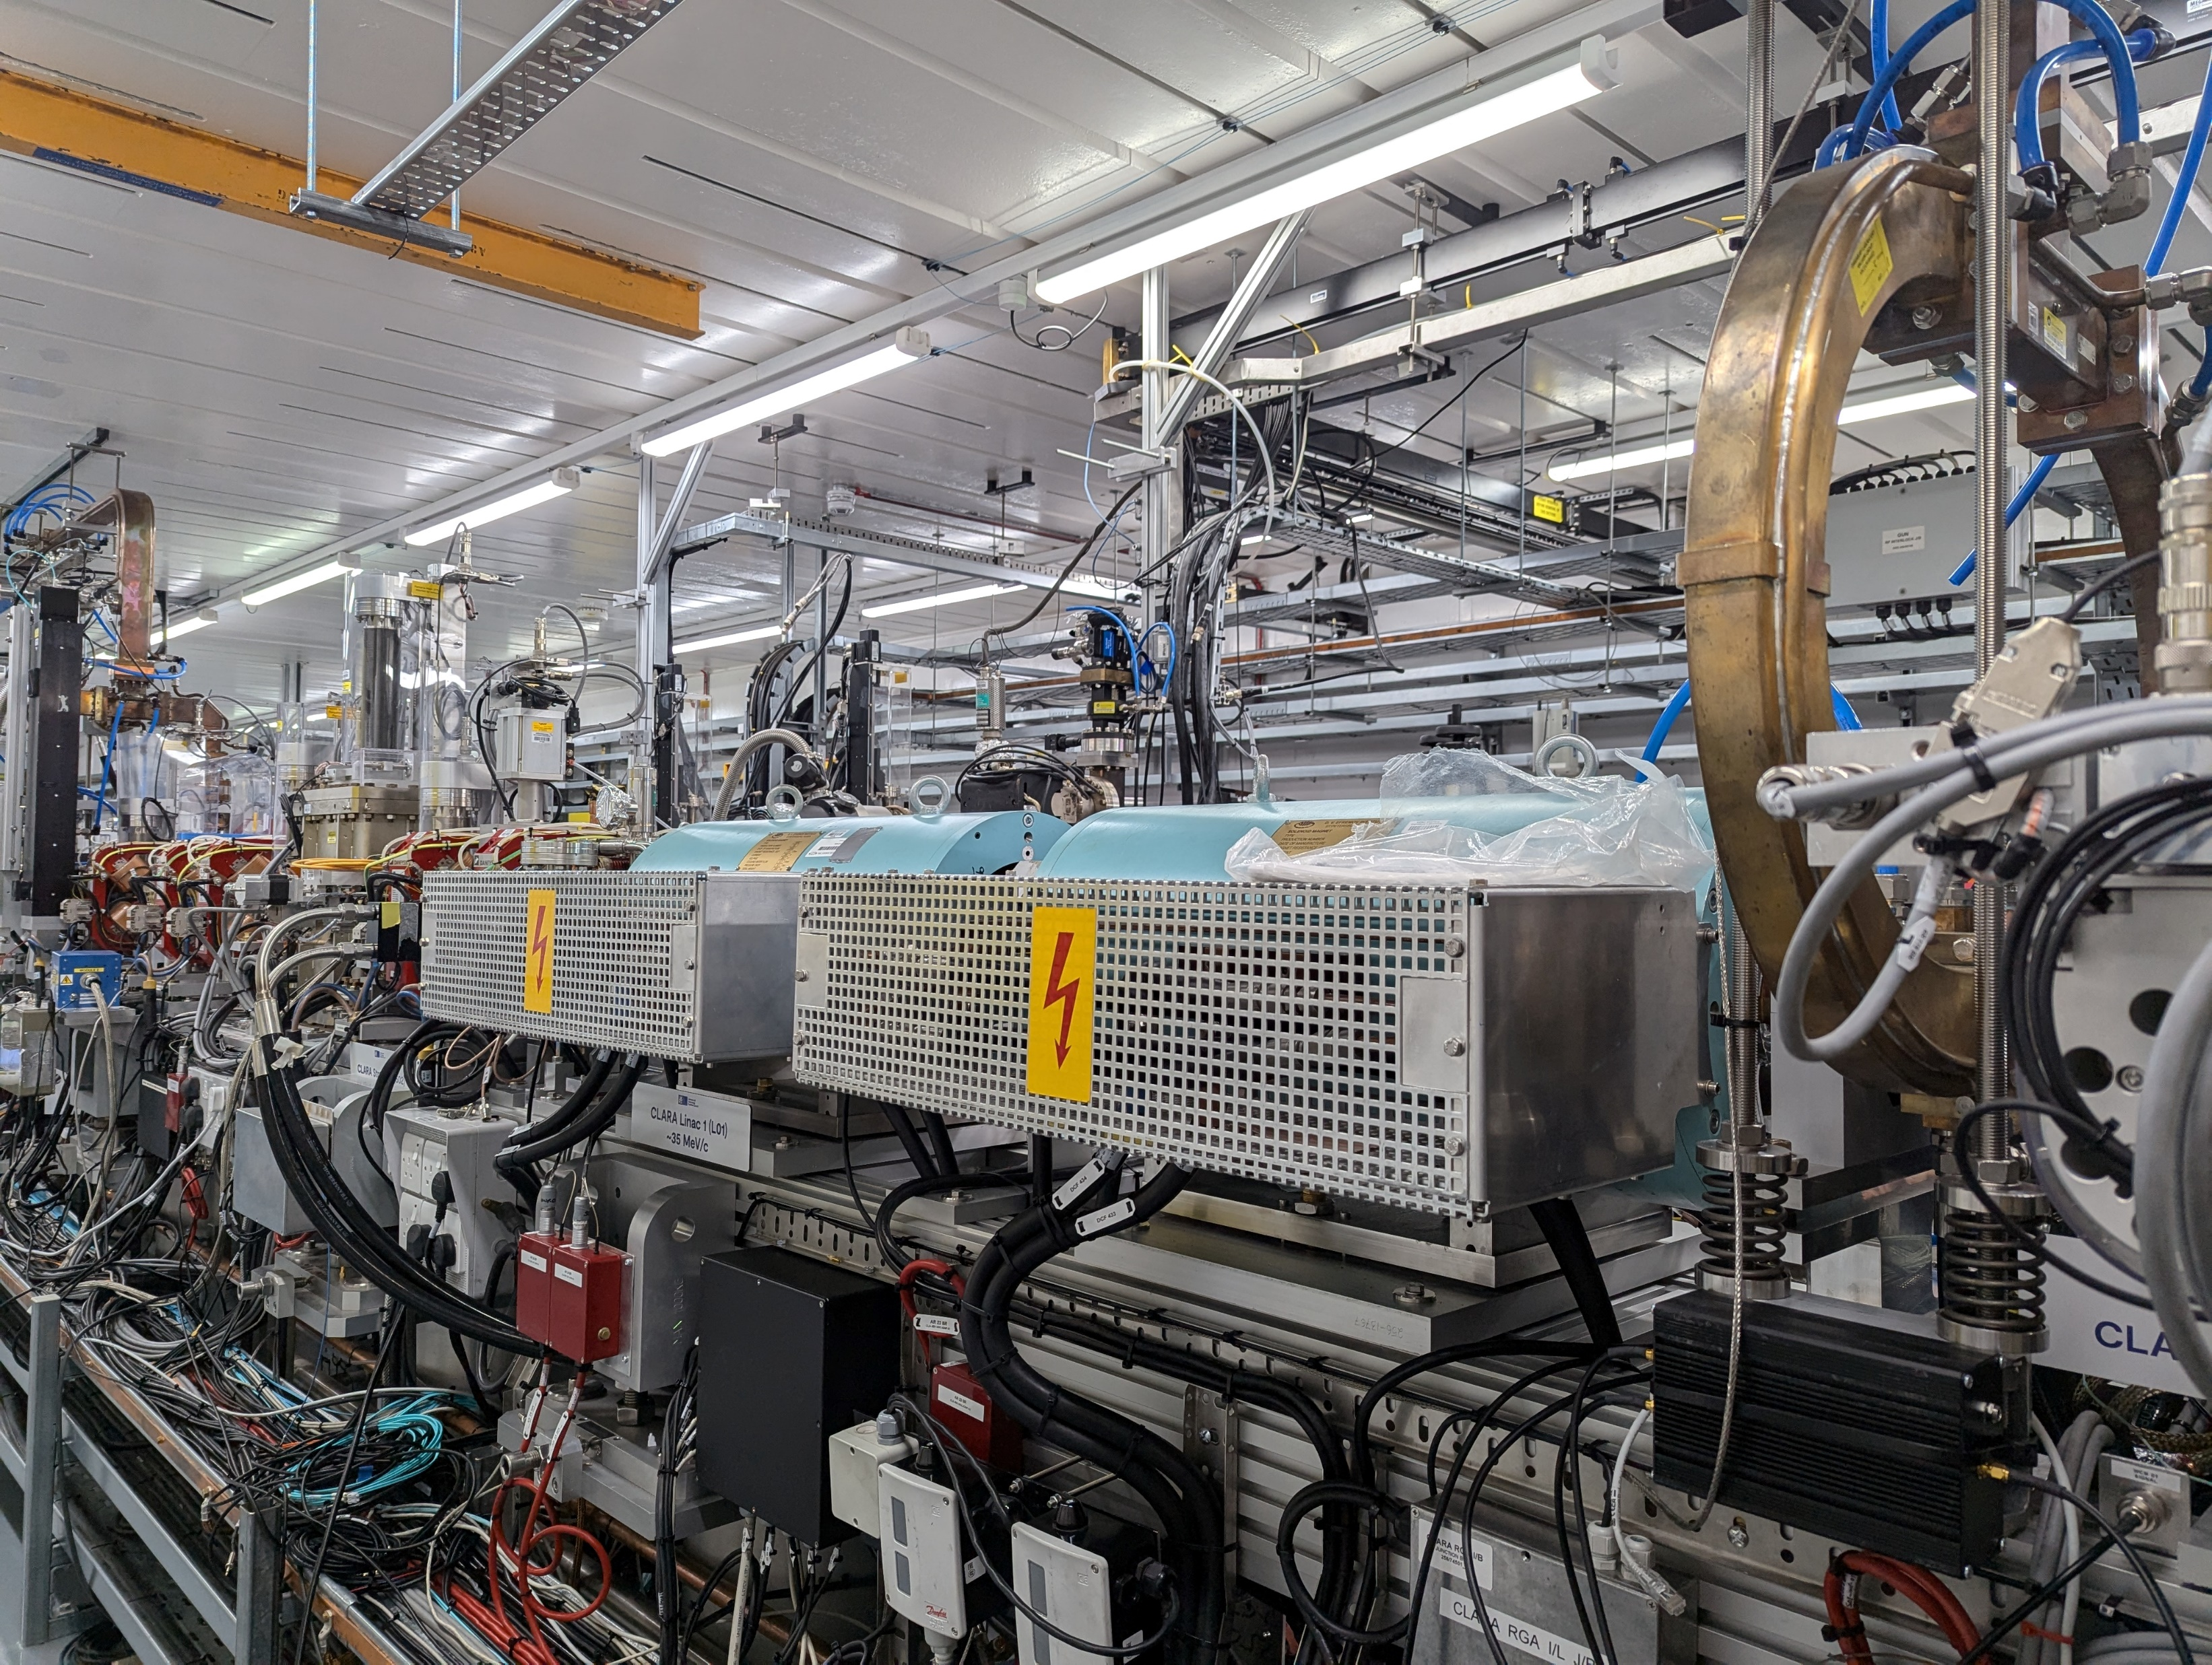
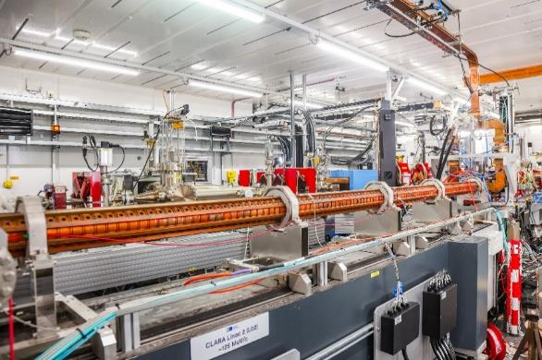
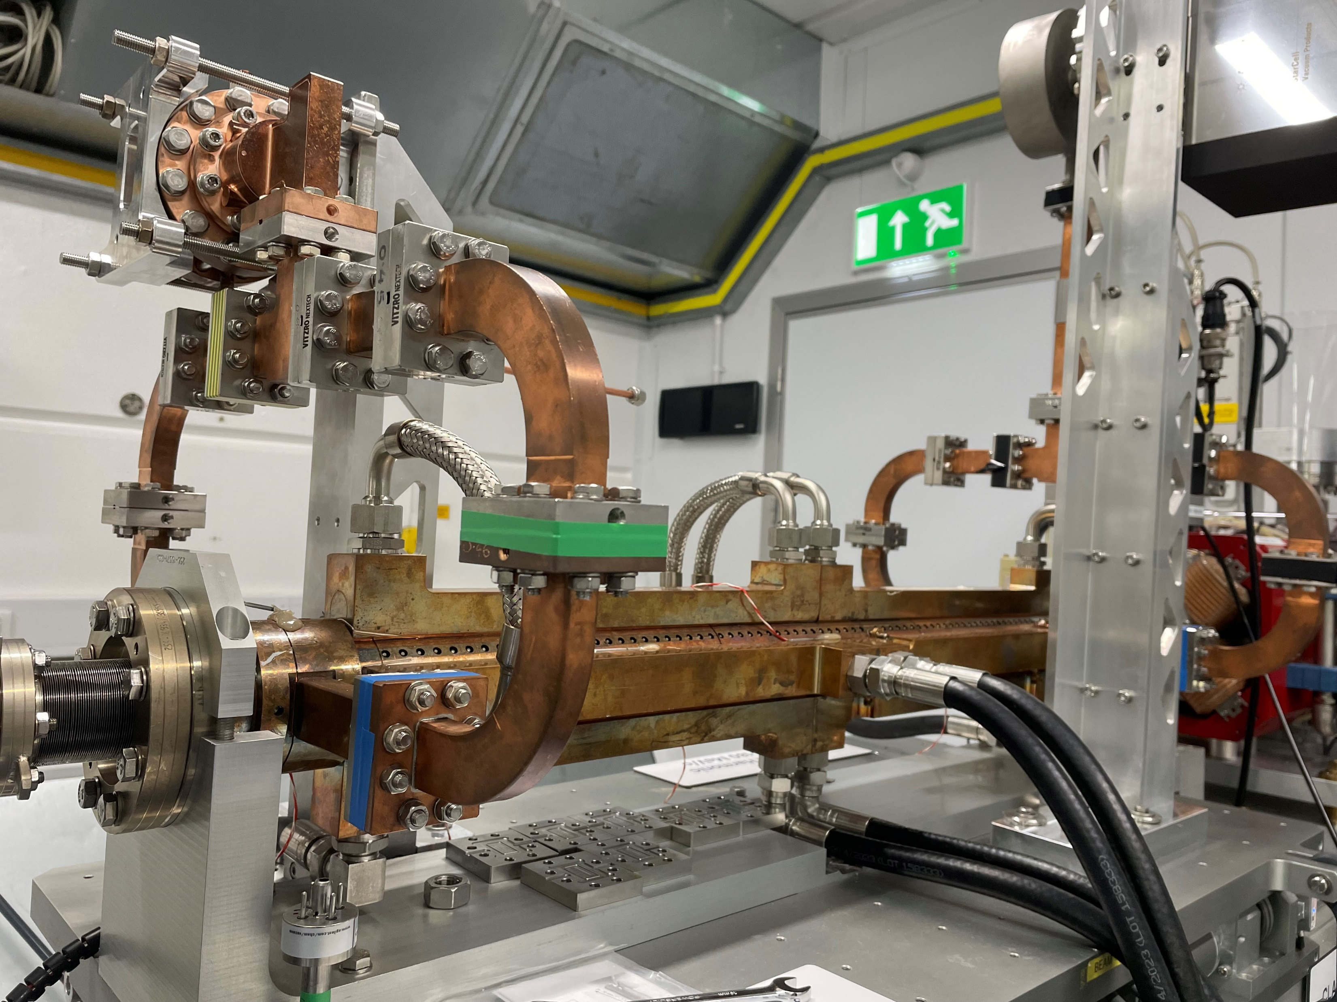
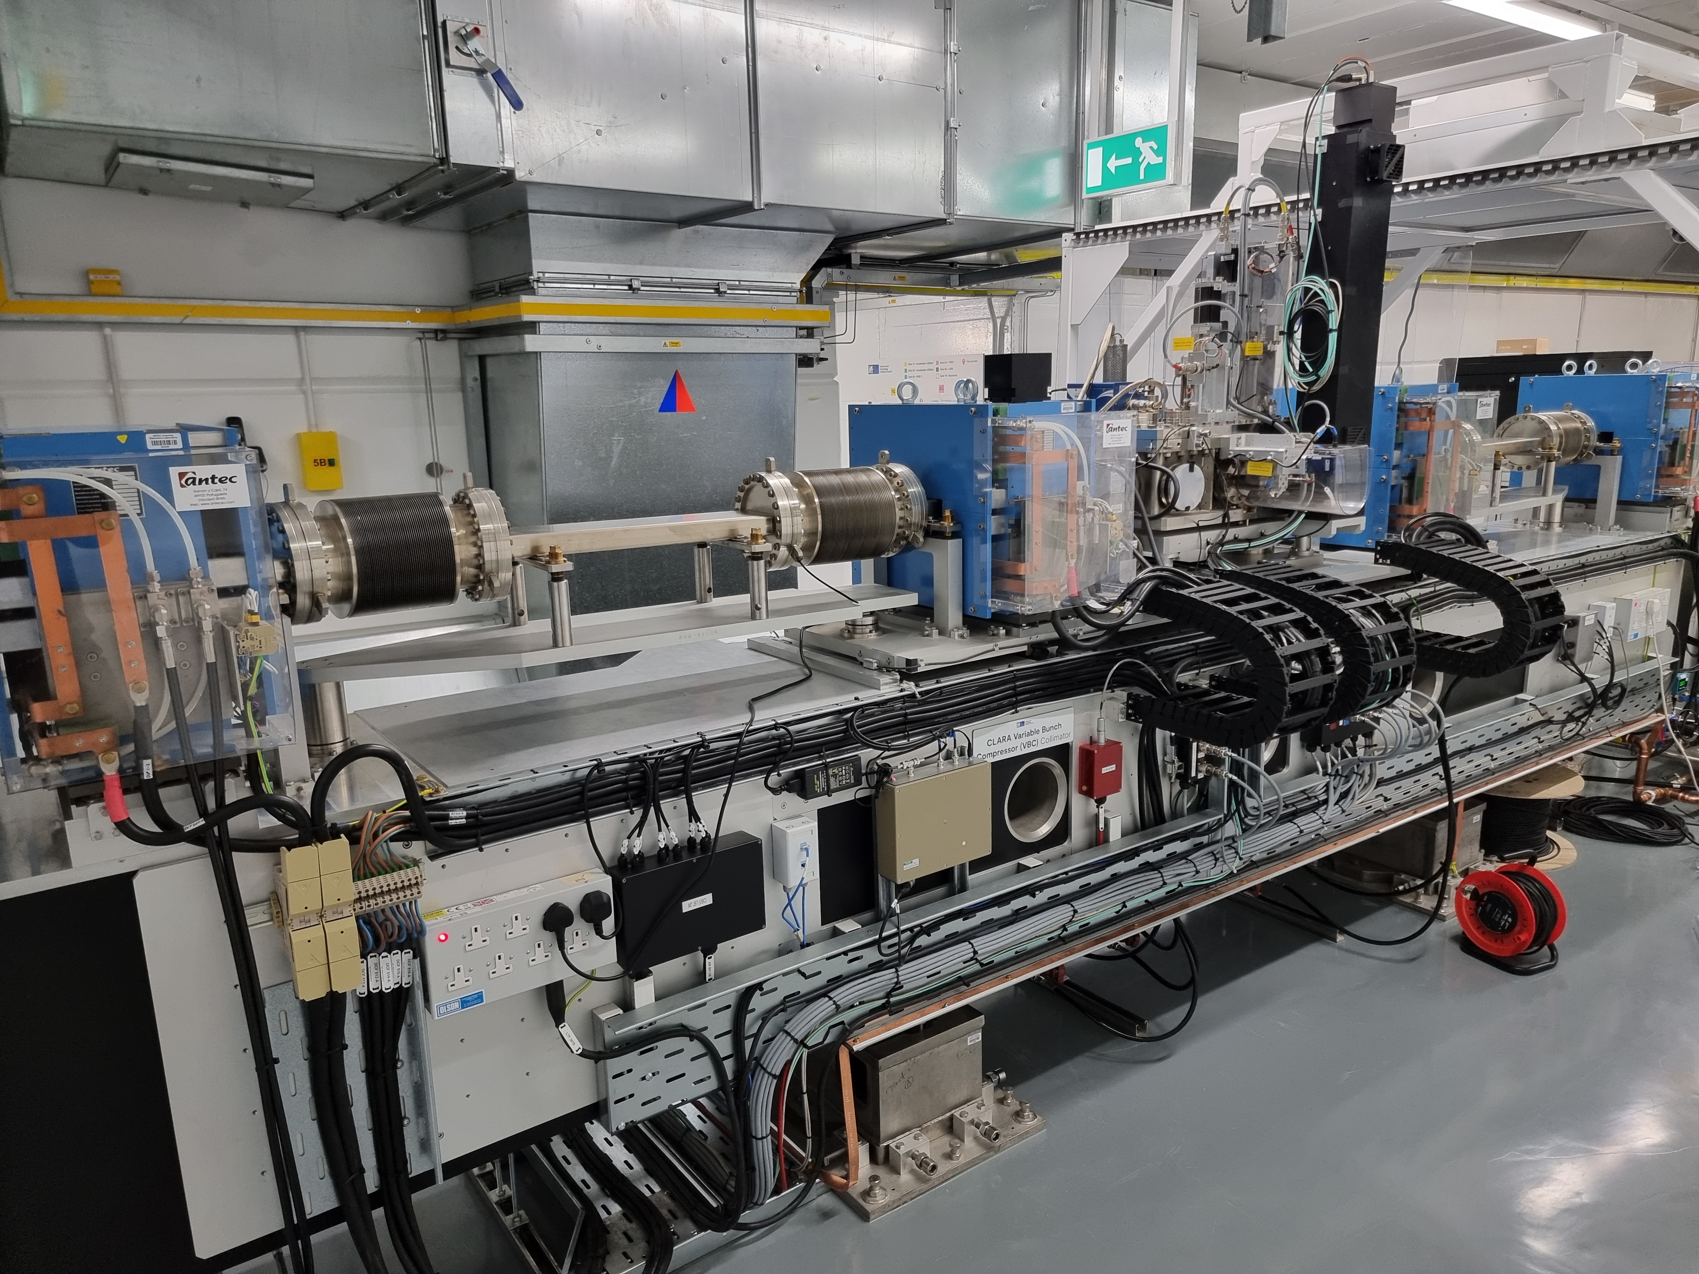
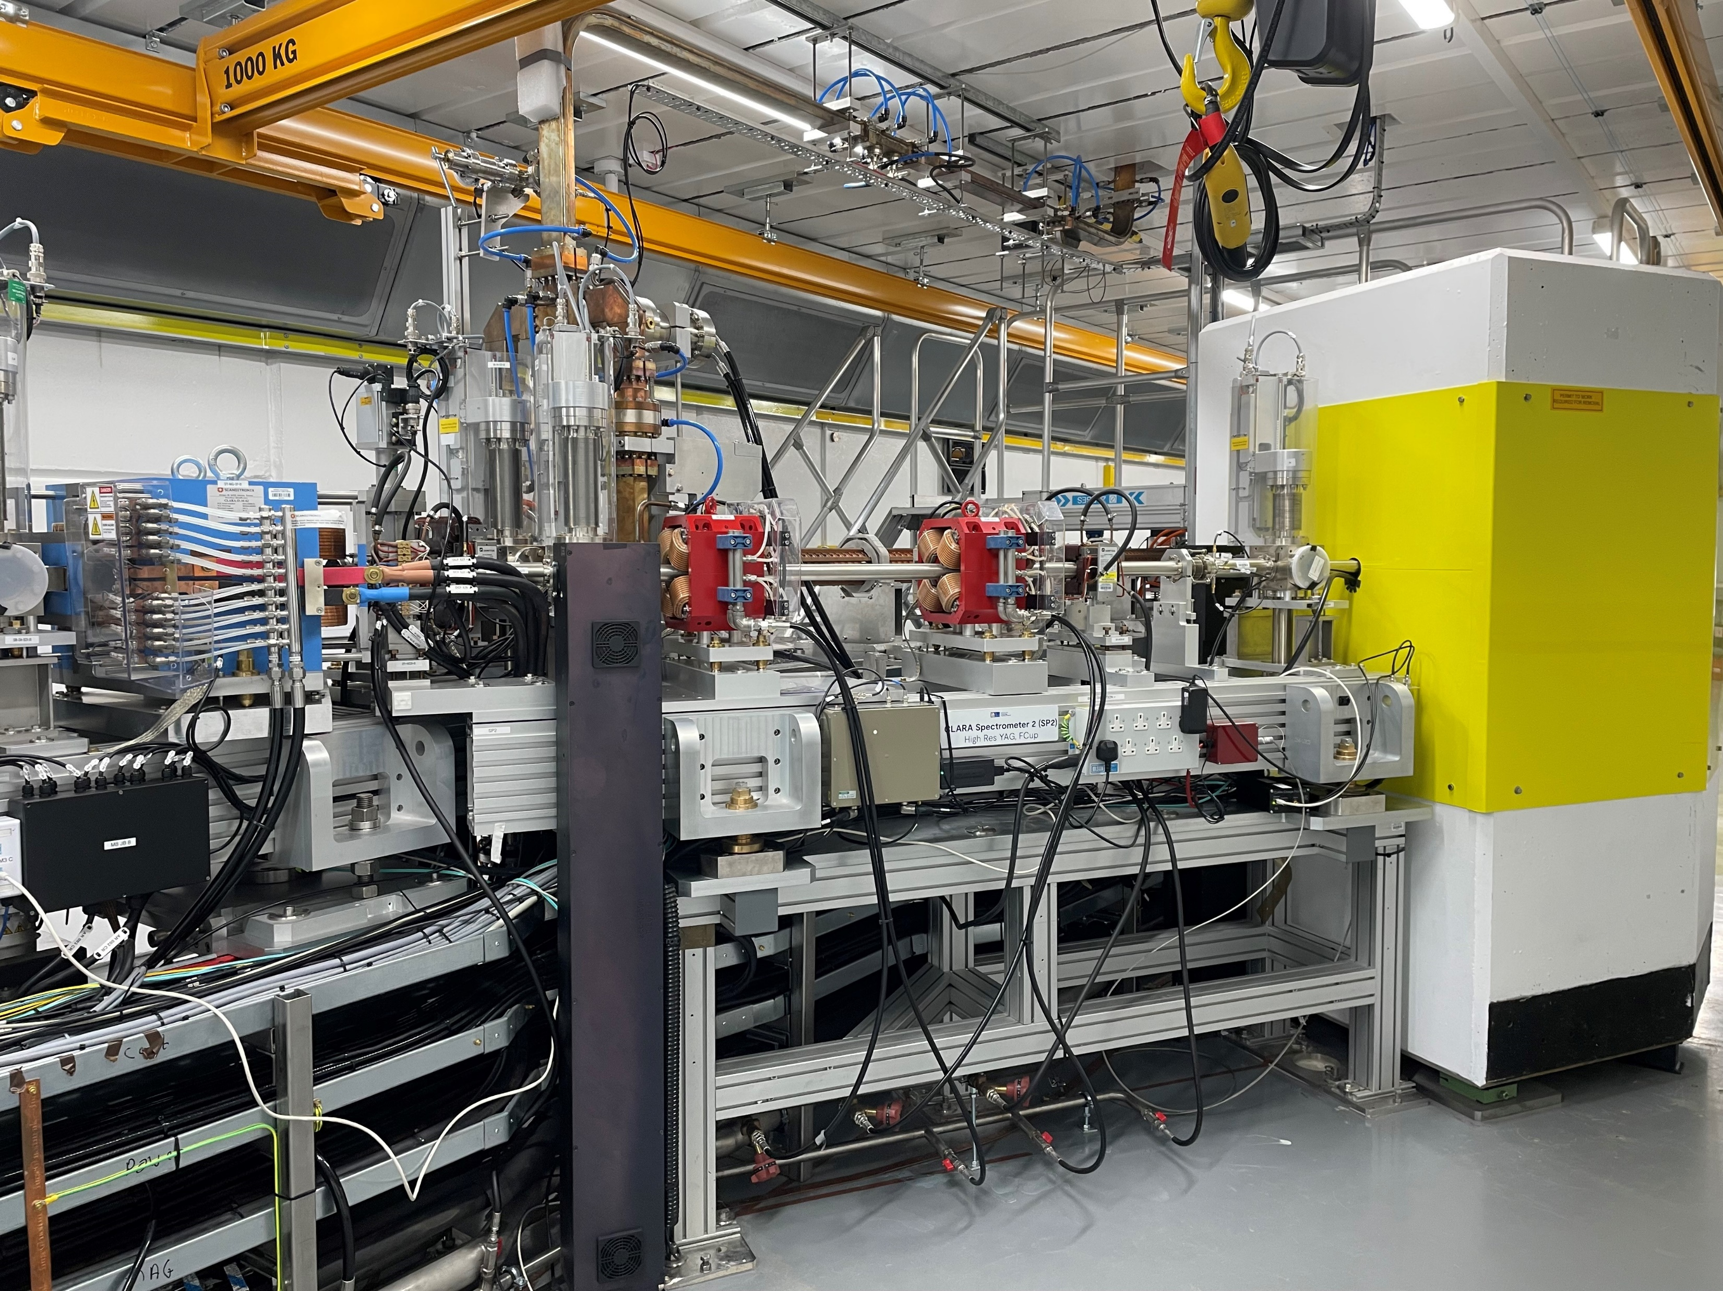
CLARA Accelerator Hall (2024)
Installation of beamline in the accelerator hall is complete – will be able to see it on the tour.
High Rep Rate Gun
Linac1
Linac2
Fourth Harmonic Cavity
Variable Bunch Compressor
Spectrometer Beam line 2

Slide 7
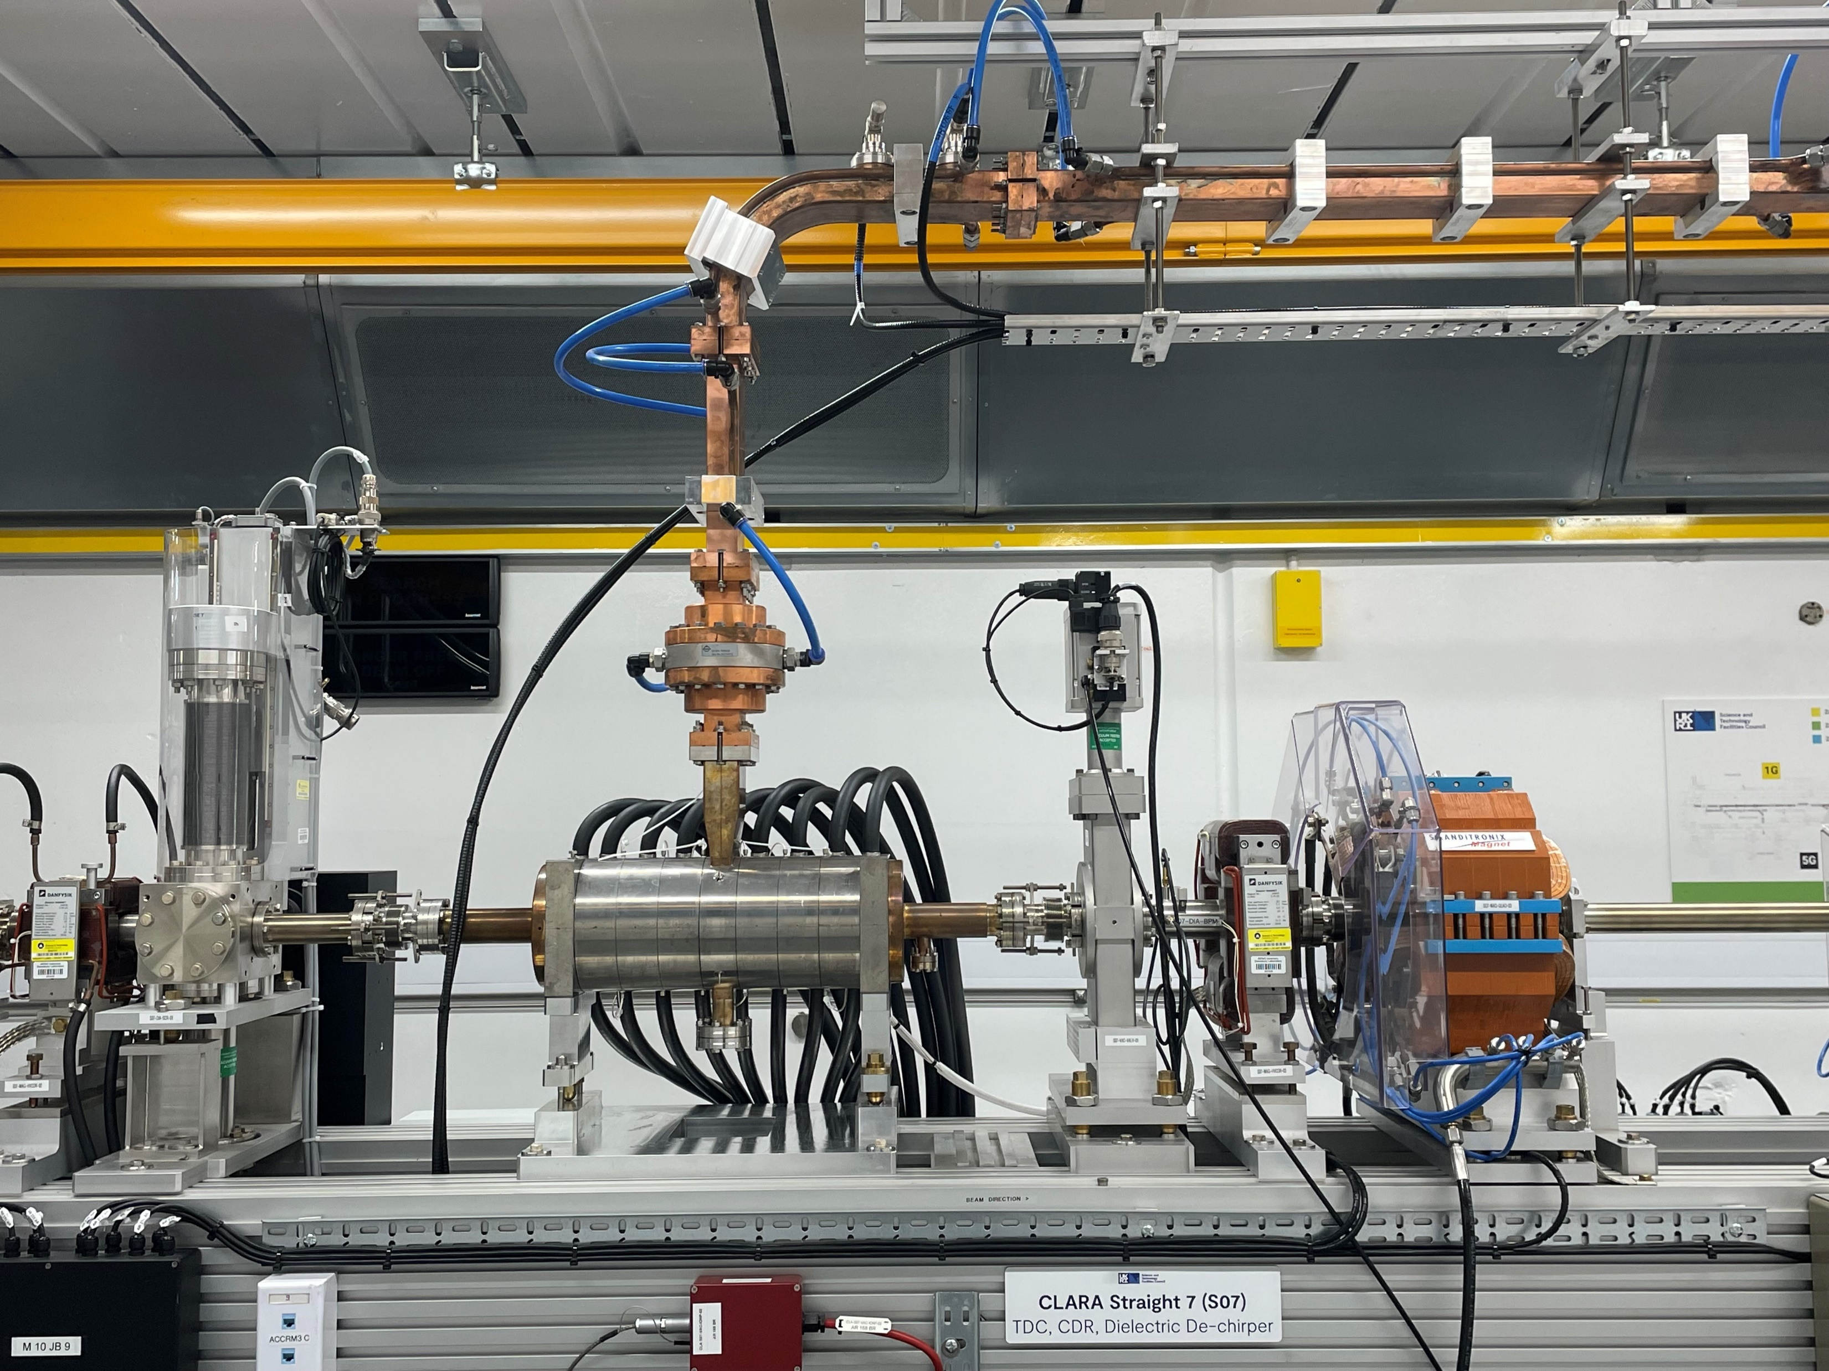
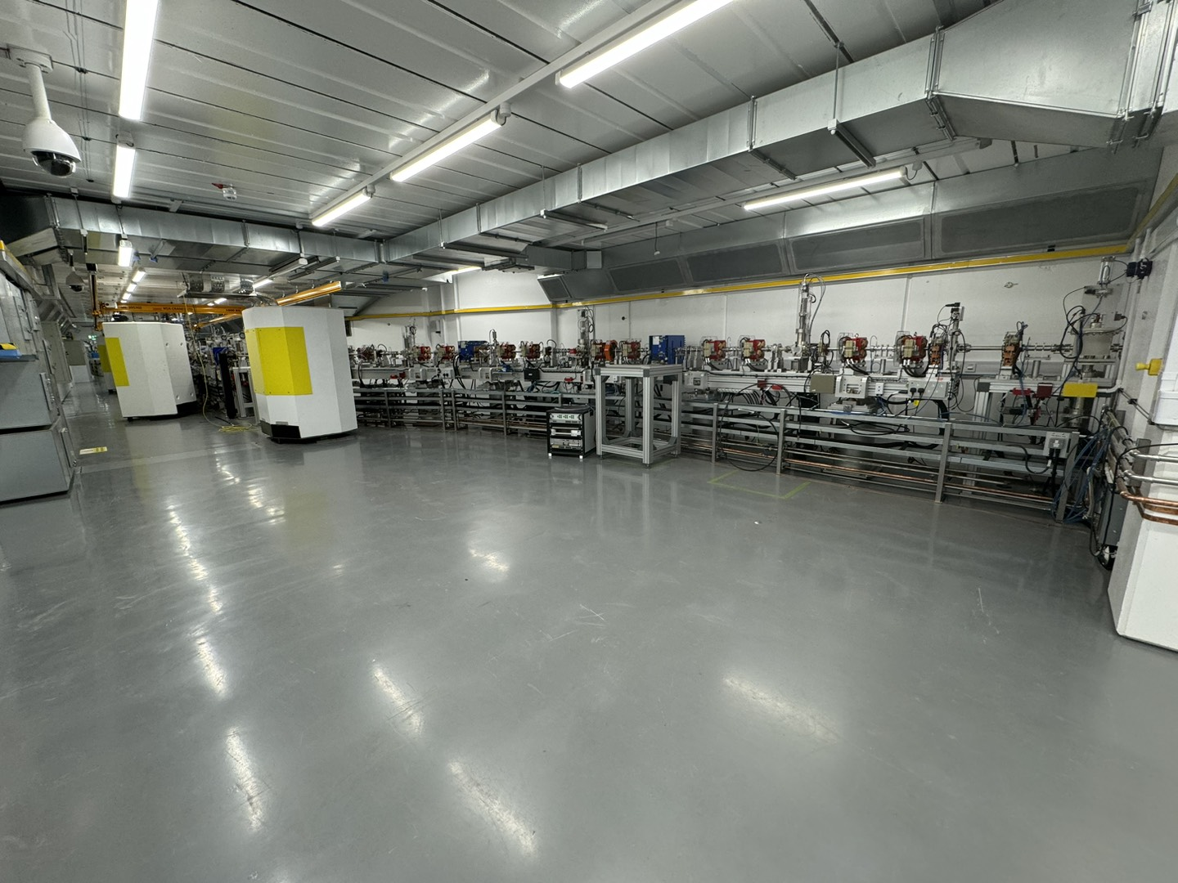
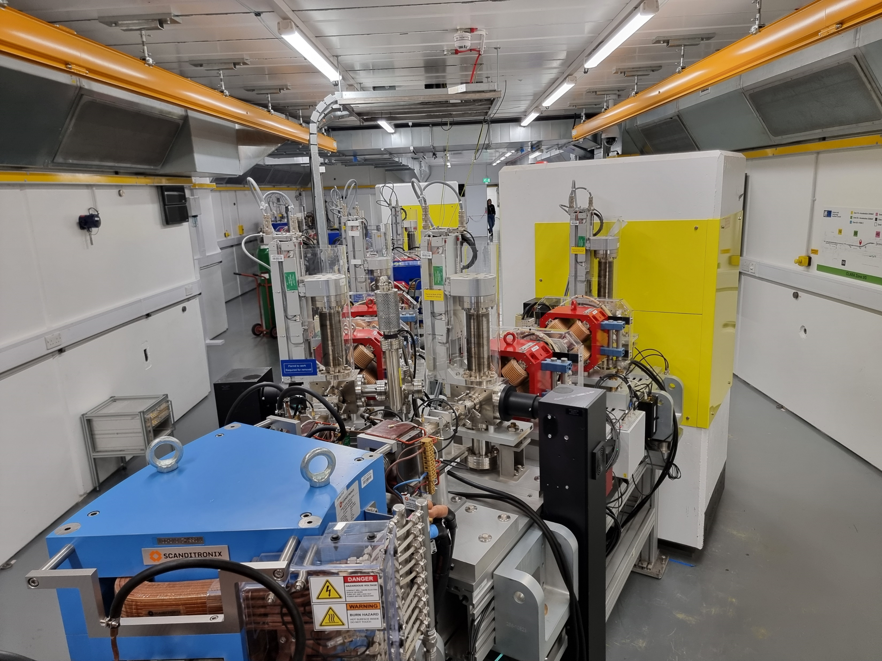
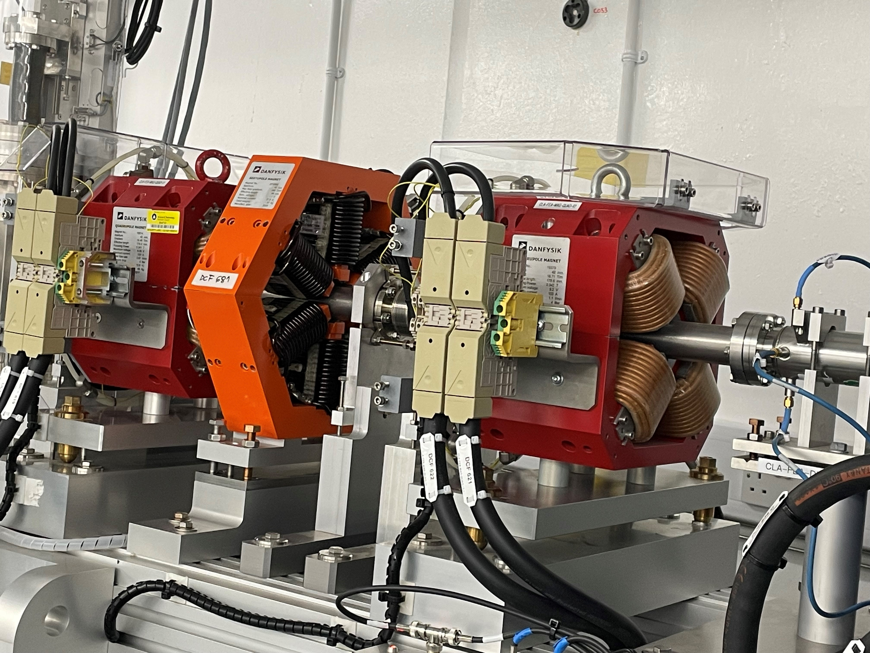
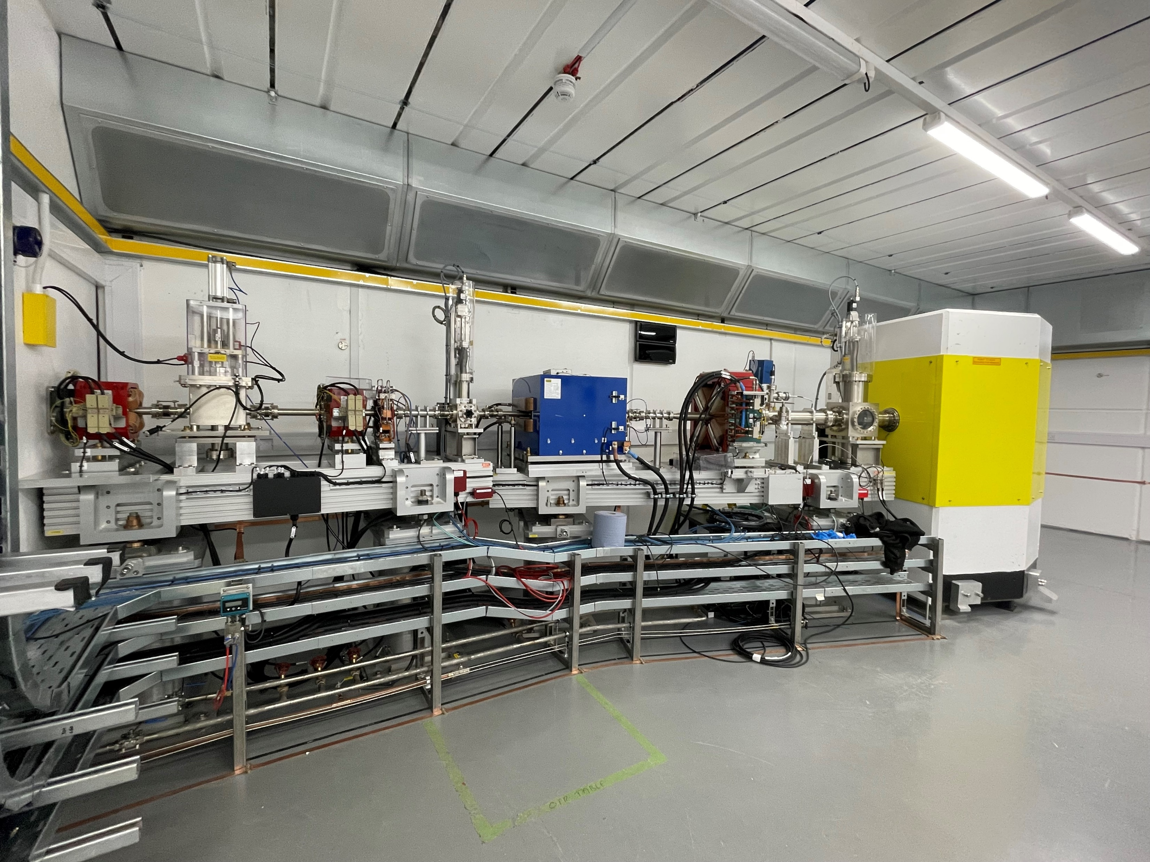
CLARA Accelerator Hall (2024)
Installation of beamline in the accelerator hall is complete – will be able to see it on the tour.
Transverse Deflecting Cavity
FEBE Arc
Spectrometer Beam line 3 & FEBE Arc Take-off
FEBE Beam line - Sextupole
FEBE Beam Dump line

Slide 8
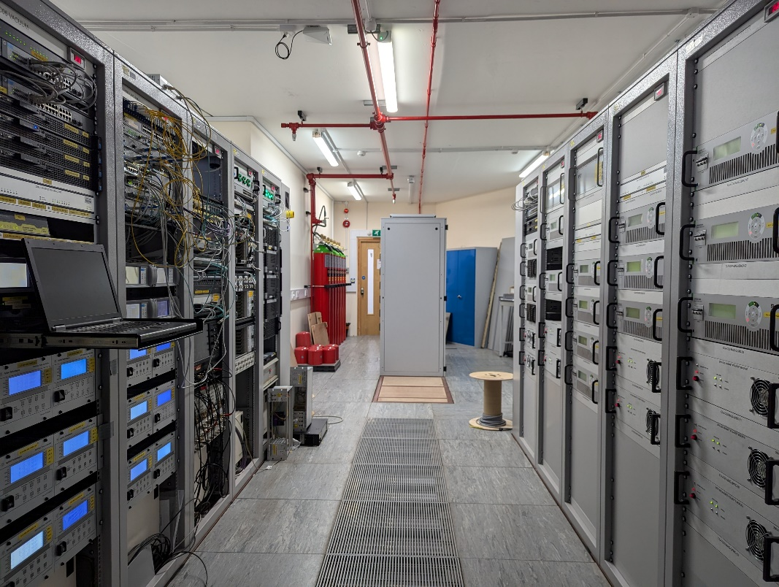
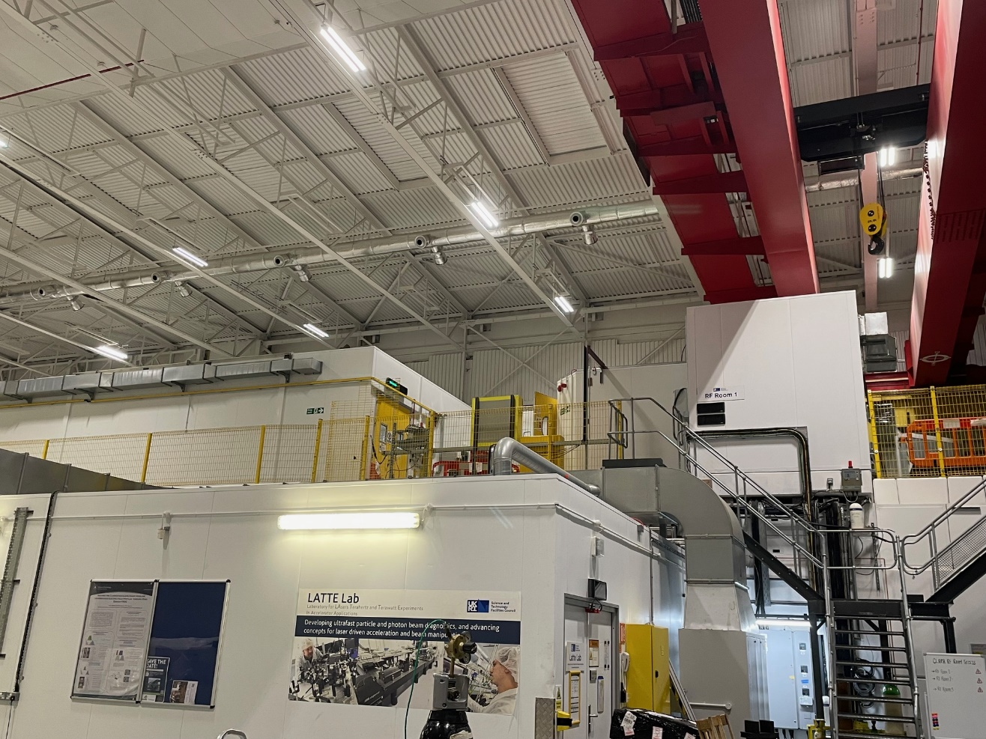
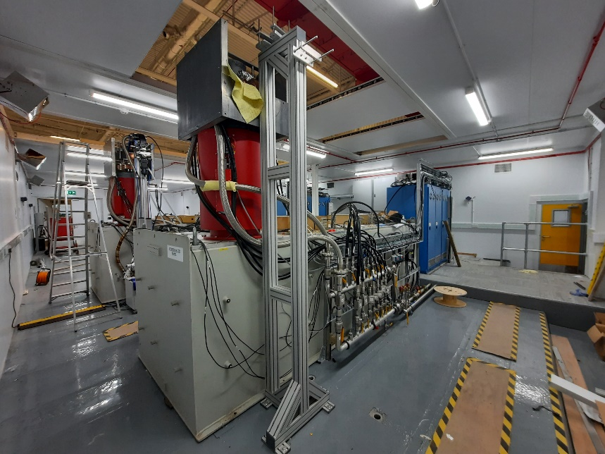
RF and Rack Rooms
CLARA RF Rooms on the roof of the accelerator hall
Rack Room 2
3 RF rooms on the roof of CLARA.
3 rack rooms outside accelerator hall at different locations for power supplies.
1 rack room on the roof next to FEBE Laser room
CLARA Linac 2 Modulator & Klystron

Slide 9
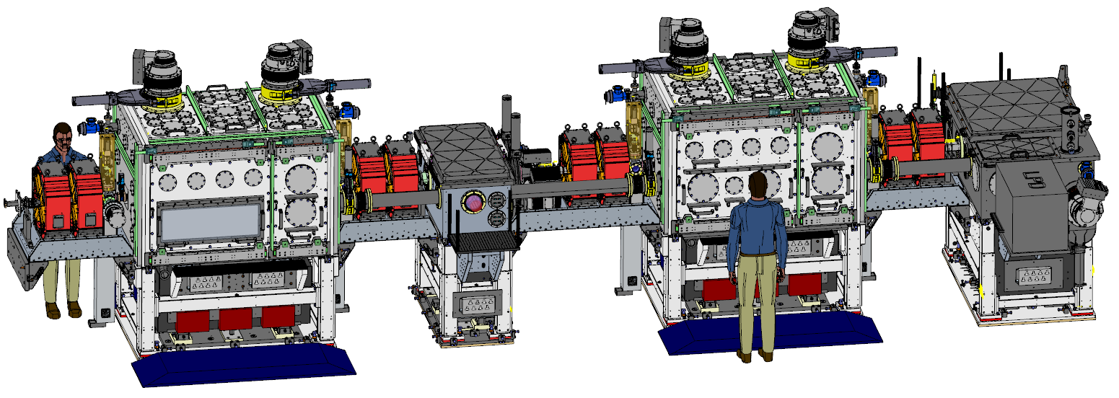
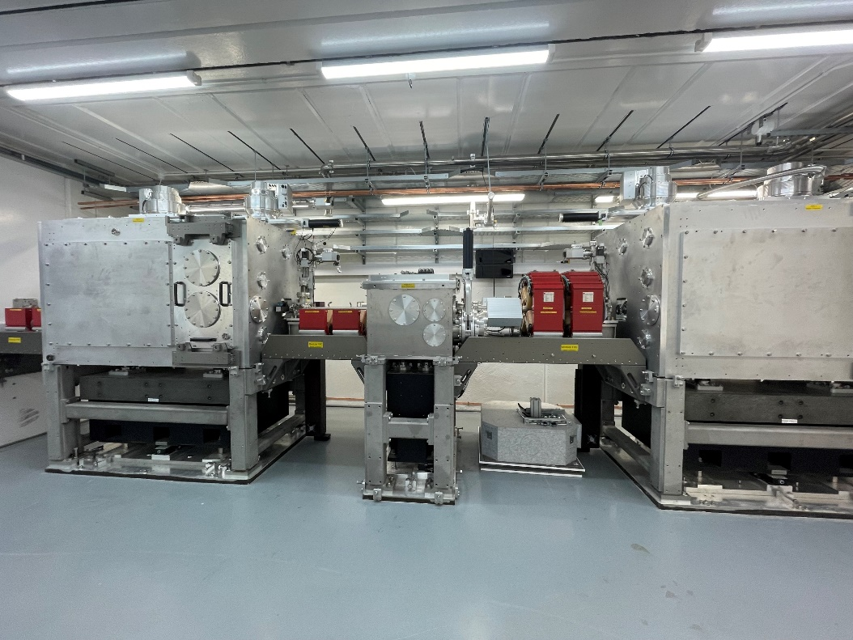
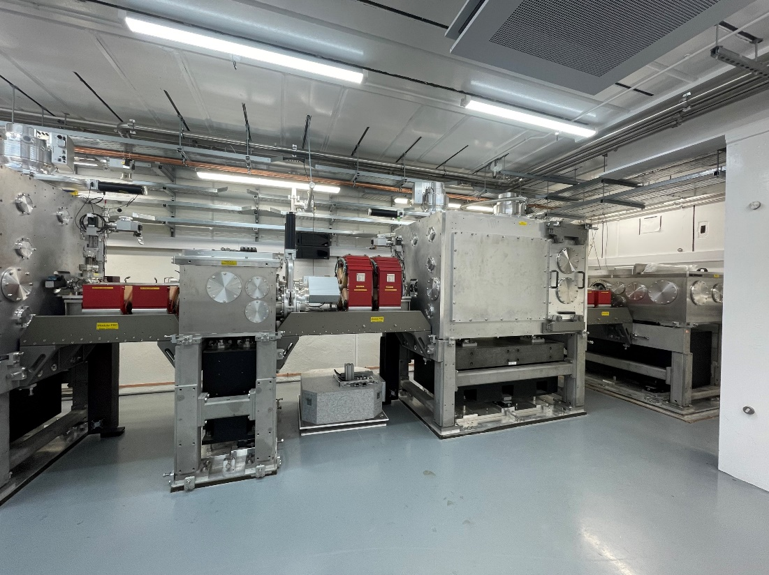
FEBE Beamline & Chambers
Hutch beamline being completed – will be able to see it on the tour.
Laser from roof
FEC2
FEC1
e- beam
Laser from roof
FMBOX1
FMBOX2
FEC1
Details in Tom Pacey’s talk
FMBOX1
FEC2
FEC1
FMBOX2
FEBE hutch beamline
FEBE hutch beamline
9

Slide 10
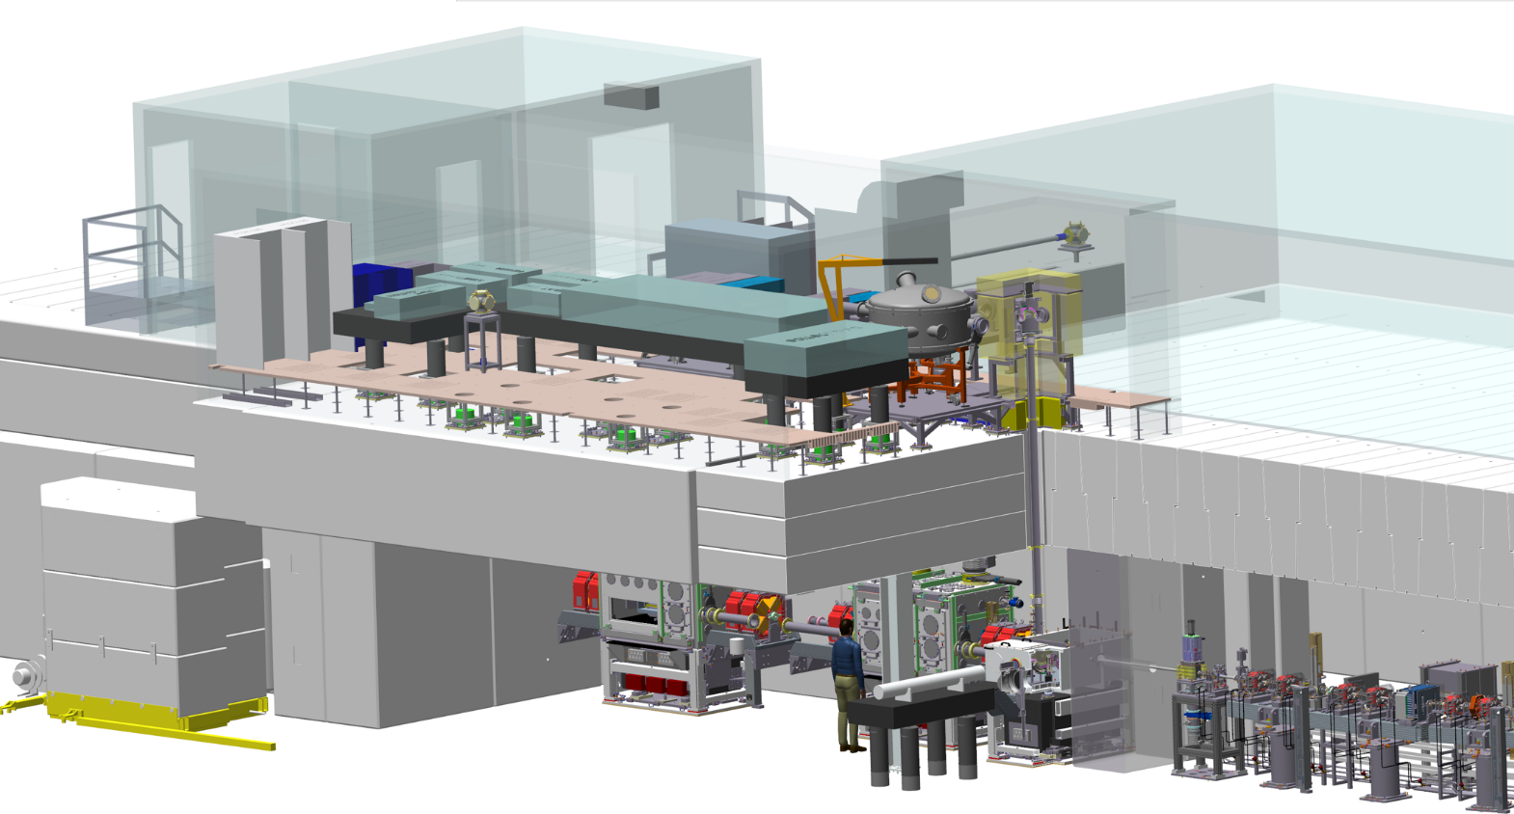
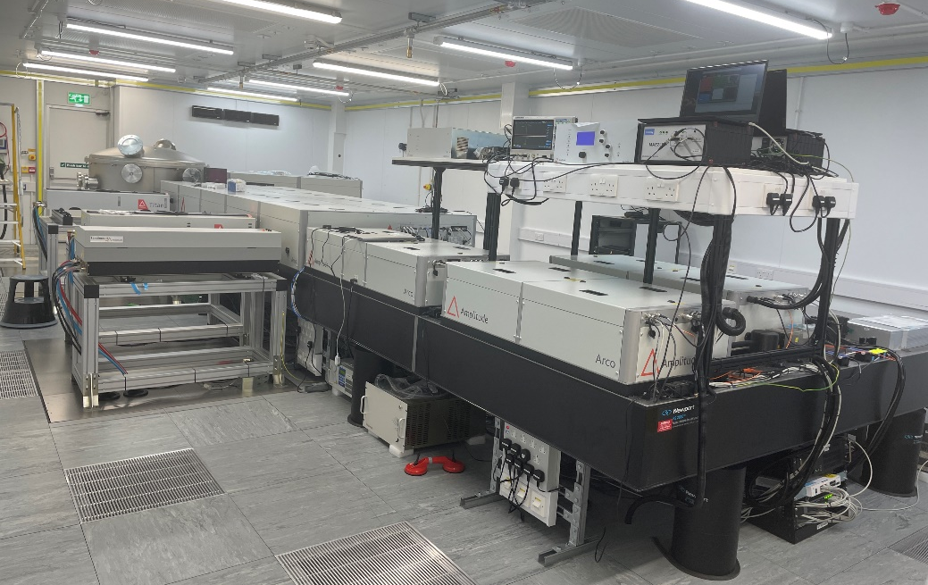
FEBE Laser
STFC funded FEBE laser over FY23/24, FY24/25. Laser contract placed on 1st April 2023.
Brand new 120TW, 5Hz, 2.6J, commercial system
Currently undergoing commissioning on site, Site Acceptance Test to be completed before Christmas.
Details in Lewis Reid’s talk
CAD drawing of FEBE laser room & hutch
FEBE laser room

Slide 11
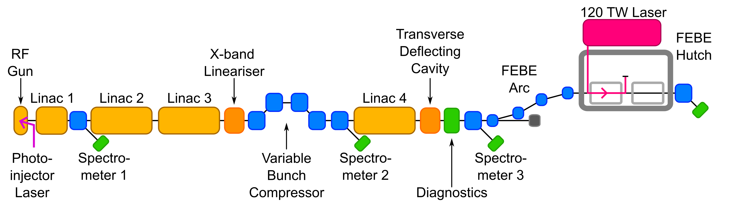
CLARA (2025)
Generate
Accelerate + Manipulate + Accelerate
Experiment
Characterise in 6D
  CLARA full energy accelerator will increase:
      Beam energy x 5
      Beam brightness x 100
      Repetition rate x 10
      Laser power > x 10

Slide 12
CLARA Commissioning Plans
Vision
  Maximising the potential of CLARA for its users
Mission​
  To deliver a characterised, flexible, and repeatable accelerator, which is supported by an integrated model, and ready for impactful science​
  To develop a diverse team capable of taking CLARA into the user programme and beyond​
  (Strive) to achieve the above as efficiently as possible without undue delay​
CLARA Commissioning plans
Estimated Time = 4-6 Months
CLARA-FEBE / CLARA-BA1 = >5x
New Major Systems to Commission = 9+
ASTeC Staff Required = 10+
ASTeC Staff to Train = 6+

Slide 13
Technical Systems Commissioning
All RF / diagnostics / magnets / controls ready for beam
0
CLARA Commissioning Plans

Slide 14
Technical Systems Commissioning
All RF / diagnostics / magnets / controls ready for beam
0
Injector & Emittance
Characterise and optimise injector emittance and transverse properties
1
CLARA Commissioning Plans

Slide 15
Technical Systems Commissioning
All RF / diagnostics / magnets / controls ready for beam
0
Injector & Emittance
Characterise and optimise injector emittance and transverse properties
1
CLARA LPS measurements
Measure (TDC) CLARA long. phase space (LPS) and optimise to meet goals
FEBE Technical Systems Commissioning
2
CLARA Commissioning Plans

Slide 16
Technical Systems Commissioning
All RF / diagnostics / magnets / controls ready for beam
0
Injector & Emittance
Characterise and optimise injector emittance and transverse properties
1
CLARA LPS measurements
Measure (TDC) CLARA long. phase space (LPS) and optimise to meet goals
FEBE Technical Systems Commissioning
2
CLARA Commissioning Plans
CLARA Longitudinal Setup
Achieve required compression in CLARA and characterise beam
FEBE Advanced Technical Systems Commissioning
3

Slide 17
Technical Systems Commissioning
All RF / diagnostics / magnets / controls ready for beam
0
Injector & Emittance
Characterise and optimise injector emittance and transverse properties
1
CLARA LPS measurements
Measure (TDC) CLARA long. phase space (LPS) and optimise to meet goals
FEBE Technical Systems Commissioning
2
CLARA Commissioning Plans
CLARA Longitudinal Setup
Achieve required compression in CLARA and characterise beam
FEBE Advanced Technical Systems Commissioning
3
CLARA Longitudinal Dynamics Optimisation
Optimise CLARA LPS for multiple beam modes (Q, E, σ_{t}, σ_{E} etc.)
4

Slide 18
Technical Systems Commissioning
All RF / diagnostics / magnets / controls ready for beam
0
Injector & Emittance
Characterise and optimise injector emittance and transverse properties
1
CLARA LPS measurements
Measure (TDC) CLARA long. phase space (LPS) and optimise to meet goals
FEBE Technical Systems Commissioning
2
CLARA Commissioning Plans
CLARA Longitudinal Setup
Achieve required compression in CLARA and characterise beam
FEBE Advanced Technical Systems Commissioning
3
CLARA Longitudinal Dynamics Optimisation
Optimise CLARA LPS for multiple beam modes (Q, E, σ_{t}, σ_{E} etc.)
4
FEBE Standard Setups + Characterization
Optimise CLARA+FEBE for multiple beam modes (Q, E, σ_{t}, σ_{E} etc.)
5

Slide 19
Technical Systems Commissioning
All RF / diagnostics / magnets / controls ready for beam
0
Injector & Emittance
Characterise and optimise injector emittance and transverse properties
1
CLARA LPS measurements
Measure (TDC) CLARA long. phase space (LPS) and optimise to meet goals
FEBE Technical Systems Commissioning
2
CLARA Commissioning Plans
CLARA Longitudinal Setup
Achieve required compression in CLARA and characterise beam
FEBE Advanced Technical Systems Commissioning
3
CLARA Longitudinal Dynamics Optimisation
Optimise CLARA LPS for multiple beam modes (Q, E, σ_{t}, σ_{E} etc.)
4
FEBE Standard Setups + Characterization
Optimise CLARA+FEBE for multiple beam modes (Q, E, σ_{t}, σ_{E} etc.)
5
COMMISSIONING COMPLETE

Slide 20
CLARA Software
Development of integrated framework for high-level applications (HLA):
  Robust, repeatable, portable
  Utilises industry standard packages
  Rapid prototyping
Integrated data structures for
storing machine + experimental data
  Standards based, self-contained,
  portable
Enabling repeatable and reliable,
machine setup and exploitation!
HLA
CLARA Software Tools
pyCATAP
Integrated Physics + Controls Model
Virtual EPICS

Slide 21
Challenges
Linac1 klystron failure – currently using a spare klystron from PSI on loan.
  Spare modulator for Linac1 on order.
    will allow a pool of common klystron spares with other Linacs for future proofing.
Oil leak in the accelerator hall during klystron change process (February 24)
  needed to remove the Gun and Linac1 girders out of accelerator hall for thorough cleaning.
Technical issues with Linacs 2,3 and 4 Modulators – issues resolved.
Number of technical issues with the Dechirper – now almost resolved.
All waveguides (excluding Gun and TDC) now in vacuum – first time experience.
5 x more technical systems to commission. It is practically entire new machine.

Slide 22
Current Status of CLARA
The CLARA Phase 2 installation in the accelerator hall is almost complete; work to complete FEBE hutch will continue in 2025.
RF conditioning of the Gun and Linac cavities is progressing.
RF conditioning is taking a lot longer than anticipated.
We expect to start beam threading early 2025 for technical system commissioning with beam.
Core commissioning team has made very detailed plans for step-by-step commissioning.
Excellent progress has been made on High level Apps using virtual machine.
FEBE laser installation is expected to complete in December 2024.
FEBE laser transport in the hutch will be installed in 2025.

Slide 23
CLARA as an Operational Facility
Our goal now is to transition CLARA into an operating user facility.
Our aim is to operate CLARA for users for a period of 6 months (not in a single block & including user experiment set-up time ) per year, 26 x 5 = 130 days.
Users will get beamtime for 8 hours a day Monday to Friday. There are no plans for weekend operation.
We have prepared a full list of spares, that we are procuring as funds allow, to operate CLARA as a user facility to increase up time of the facility.
We have recruited additional staff to operate CLARA and FEBE laser.
STFC Executive Board have endorsed our ambition to fully realise the potential of CLARA as a user facility.

Slide 24
CLARA as an Operational Facility
To achieve this goal:
  We have updated CLARA access policy which includes details for programmatic access.
  A Web based beam time call process similar to ISIS & CLF is currently being worked out.
  A user liaison office is being set up.
  The process of technical assessment will now be carried out by a technical panel and roles of people supporting the experiments are defined for better clarity. We recognise that this will evolve over time for smooth operation and support to users.
Tim Noakes will present the details in his talk.

Slide 25
Current Situation
STFC is under financial pressure, which is delaying the completion of FEBE and procurement of spares.
We will not get clarity of our FY25/26 budget for some time yet.
The allocated budget will determine how much time we will be able to operate CLARA (this includes commissioning and then possible user run) during FY25/26.
We are planning to complete FEBE hutch beamline & laser beam transport into the hutch in the first few months of FY25/26.
We will carry out beam commissioning in the accelerator hall in parallel to FEBE completion.
Beam and laser commissioning into the hutch will be carried out in separate blocks when the hutch build is complete.
We will reach out to users by email around April-May 2025 to provide an update on the situation.
We will send out a user beam time call with six months notice, at the earliest opportunity.

Slide 26

Thank you for listening
Any Questions?
Notes:
The abstract pattern can be removed or repositioned if required. Be careful to ‘Send to Back’ so that it does not obscure any important information.

