Slide 1
Cloud and Net0
Engagement with multiple groups
ISIS – Sam Tigier
IRIS[CAST|CMP|Net0Next]
Technology – Catherine Jones
Working towards
Power/Carbon Accounting for VMs – Anish/Ramzi
Baseline power/carbon usage of hardware – Chris Green/Martin Summers
Representative benchmarks of cloud workloads – IRISBench/Meerkat
Estimated power/carbon use per hour for flavors – depending on the above

Slide 2
Cloud and Net0 – past , present and future
So far:
Cloud did a power footprint report back in November 2022 – to help with rack placement of new kit for Operations staff.
Report was a rack by rack “snapshot” based on what the systems in the rack said they were using.
A significant % Racks of kit were not in production yet, and some were decommissioning: many new racks over in R26.(racks have a 7KW power footprint)
Conclusion then: Cloud power usage is “patchy” – much more so than Grid compute.
Today:
Users want to know how much power each “flavor” in the cloud consumes – maximum, average etc.
Chris Green has been working on benchmarks for the compute cloud systems to give some figures and is working on a report.
Chris is currently working on tests to put in power optimization changes in the BIOS of hypervisors, then running the same benchmarks – expecting a report on how the power optimization affects the time and compute figures as well as the power footprint.

Slide 3
Monitoring the Cloud’s Physical and Virtual Machines
We've been monitoring long-term cloud hardware power usage for around 1.5 years now – using the same pipeline we developed as part of the IRISCAST (IRIS Carbon Auditing SnapshoT) work.
We've recently started using prometheus as the primary source of metric collection within the cloud, with a wide variety of exporters available, it makes it possible to collect and monitor thousands of metrics including power usage.
With the collection of this volume of metrics the cloud has also needed to implement a robust and efficient storage solution, that being victoria-metrics which will be used to store a set of 'hot' data.
Prometheus Exporters: libvirtexporter – for vm utilisation node-exporter – for physical machine power metrics (currently some generations of machines only)
Victoria-Metrics TSDB – Storing live data

Slide 4
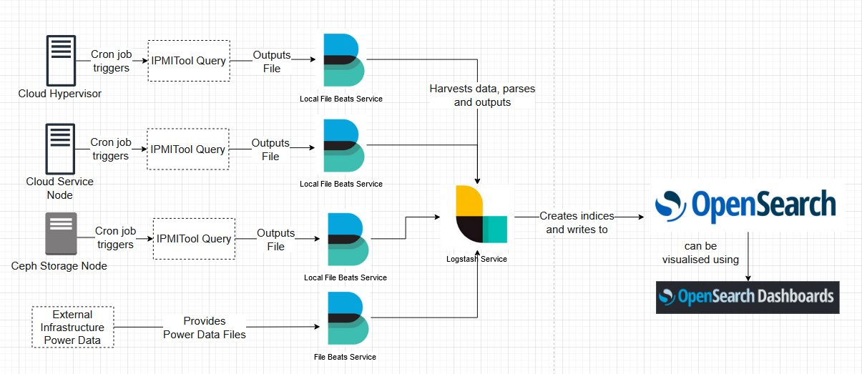
Continuing IRISCAST Work...
Diagram shows how our current power collection data pipeline works – on over 700 hypervisors and control plane nodes

Slide 5
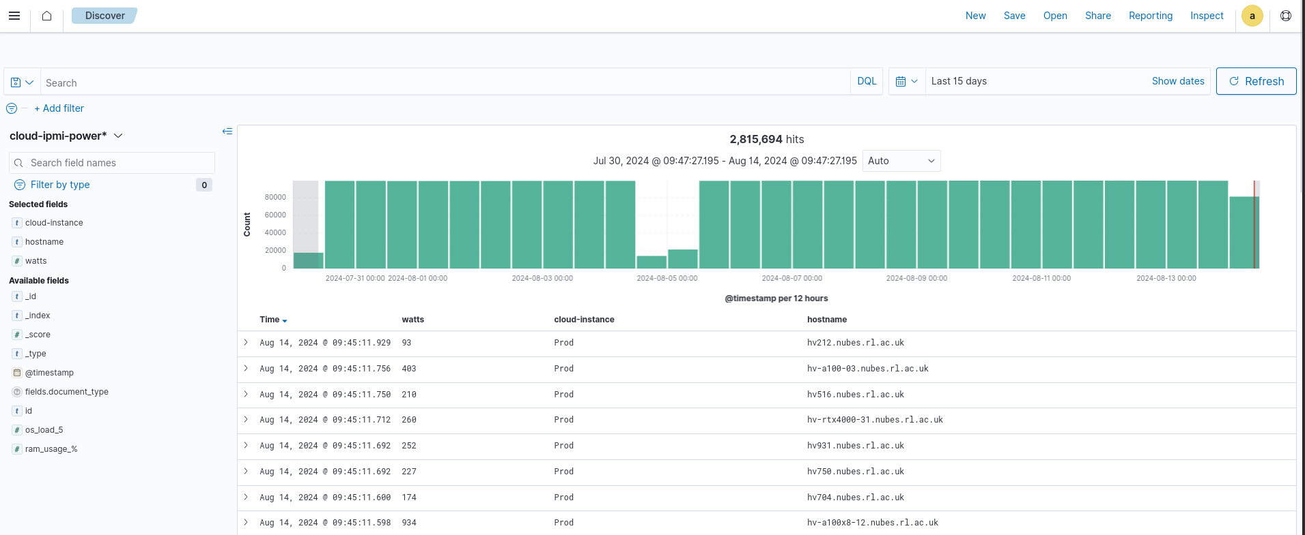
Continuing IRISCAST Work...
Data for all STFC Cloud hypervisors is being actively collected and stored in the Opensearch cluster – Stephano at 15 minute intervals

Slide 6
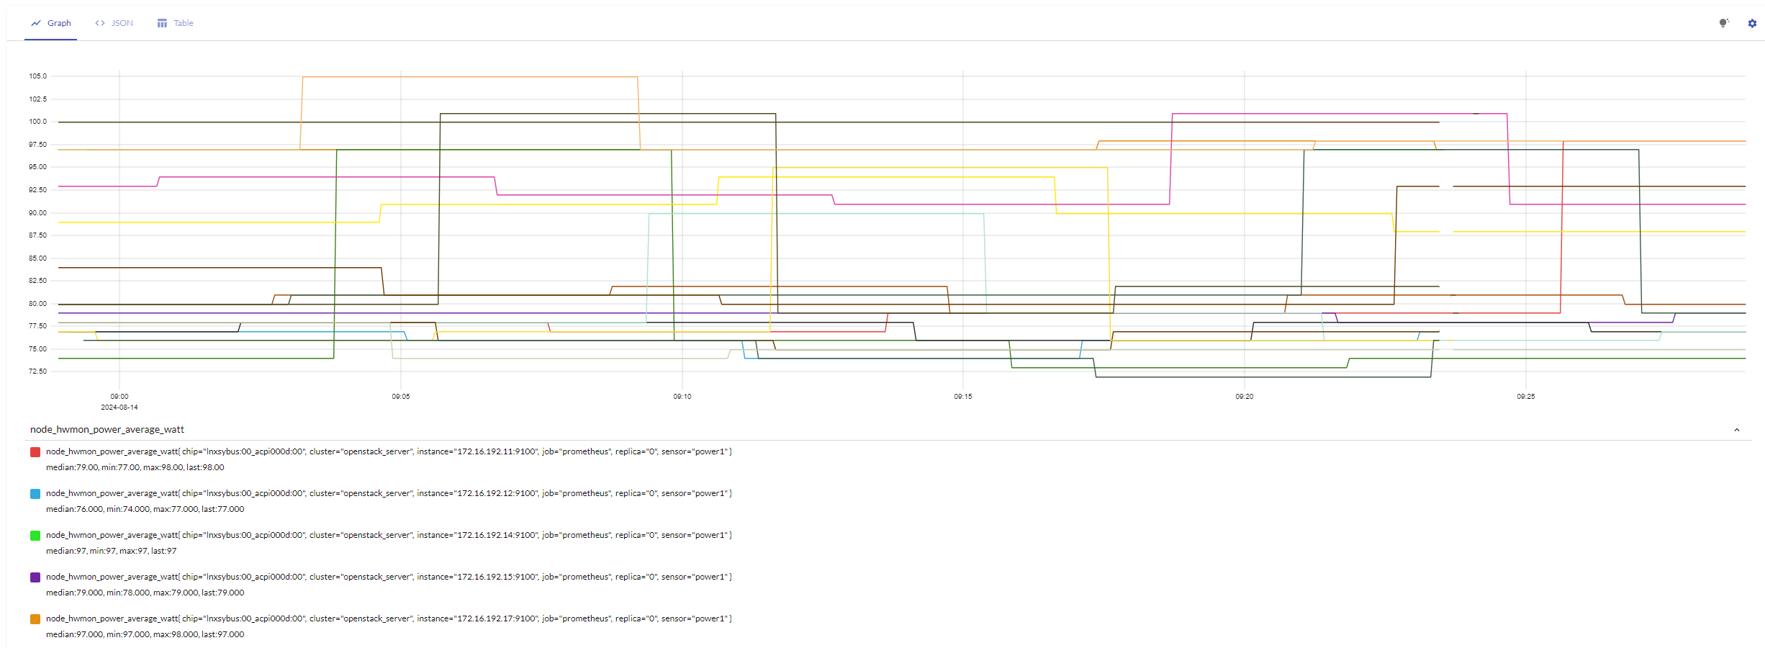
Collecting Hardware Power Usage using Prometheus
Query = node_hwmon_power_average_watt
Table shows the power for some of the Hypervisors, data being stored for 30 days on the live VM (Example data)

Slide 7
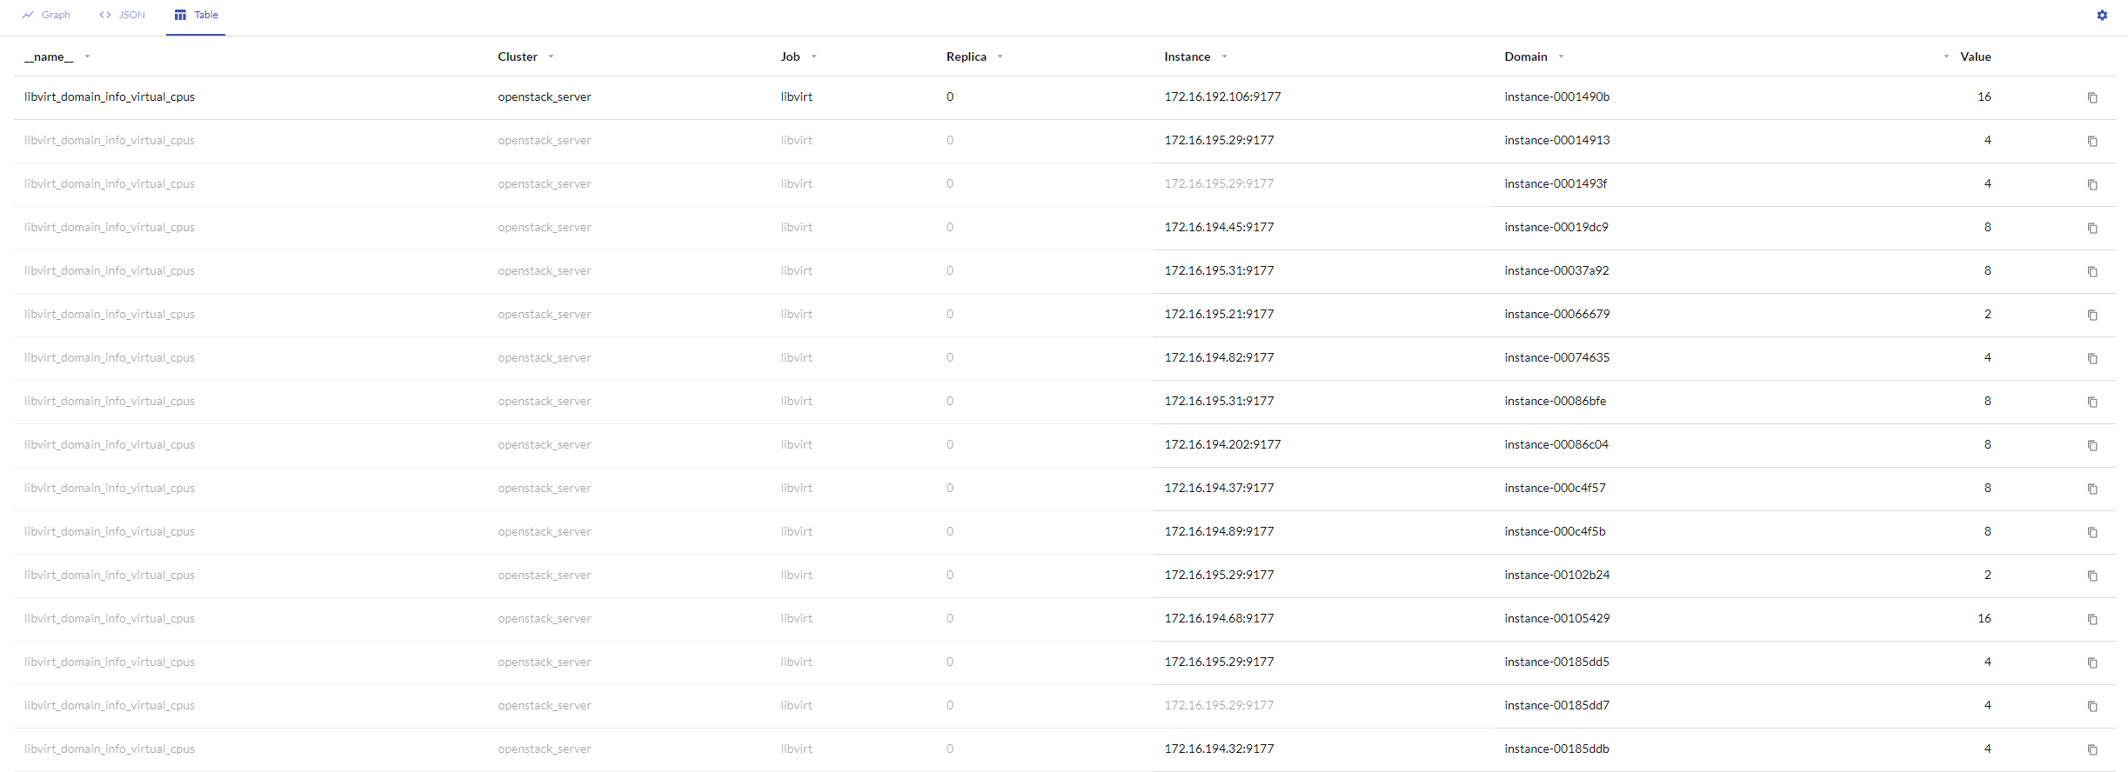
Collecting Hardware Power Usage using Prometheus
Query = libvirt_domain_info_virtual_cpus
Table shows the latest virtual core count for some of the cloud hypervisors (Arbitrary data)

Slide 8
Cloud and Net0 – past , present and future…2
Future:-
We need to get much better about how we manage bringing new equipment online and making it available to cloud community, as well as how we take old equipment offline.
We should profile hardware and our flavor offerings and image/ VM lifecycle around use cases where we know we can save power on: I.e Virtual desktop / user interactive systems, rather than “compute”
Better “preening” tools to check where high value / high power footprint equipment has non-productive or non-working systems that have failed on equipment: and to fix / move the workload to a “better fit” equipment resource.
Better policies to clean up “orphaned” VM resource.
Better reporting and accounting: Be able to give end user organisation a picture of their power resource usage based on what they have consumed in the cloud.

