Slide 1
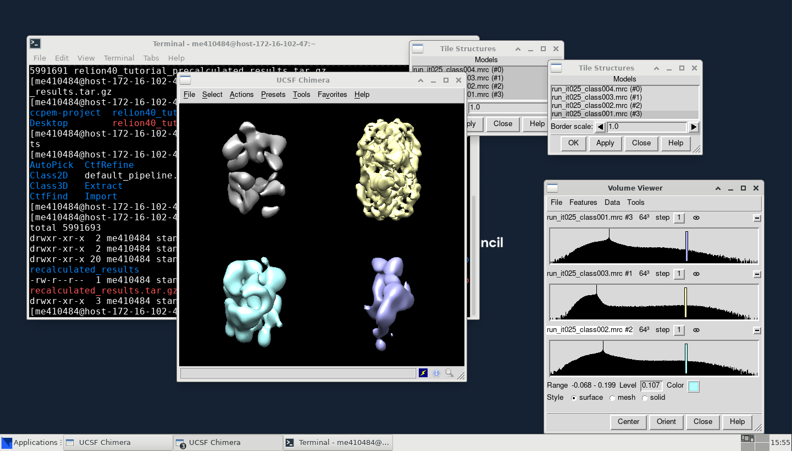
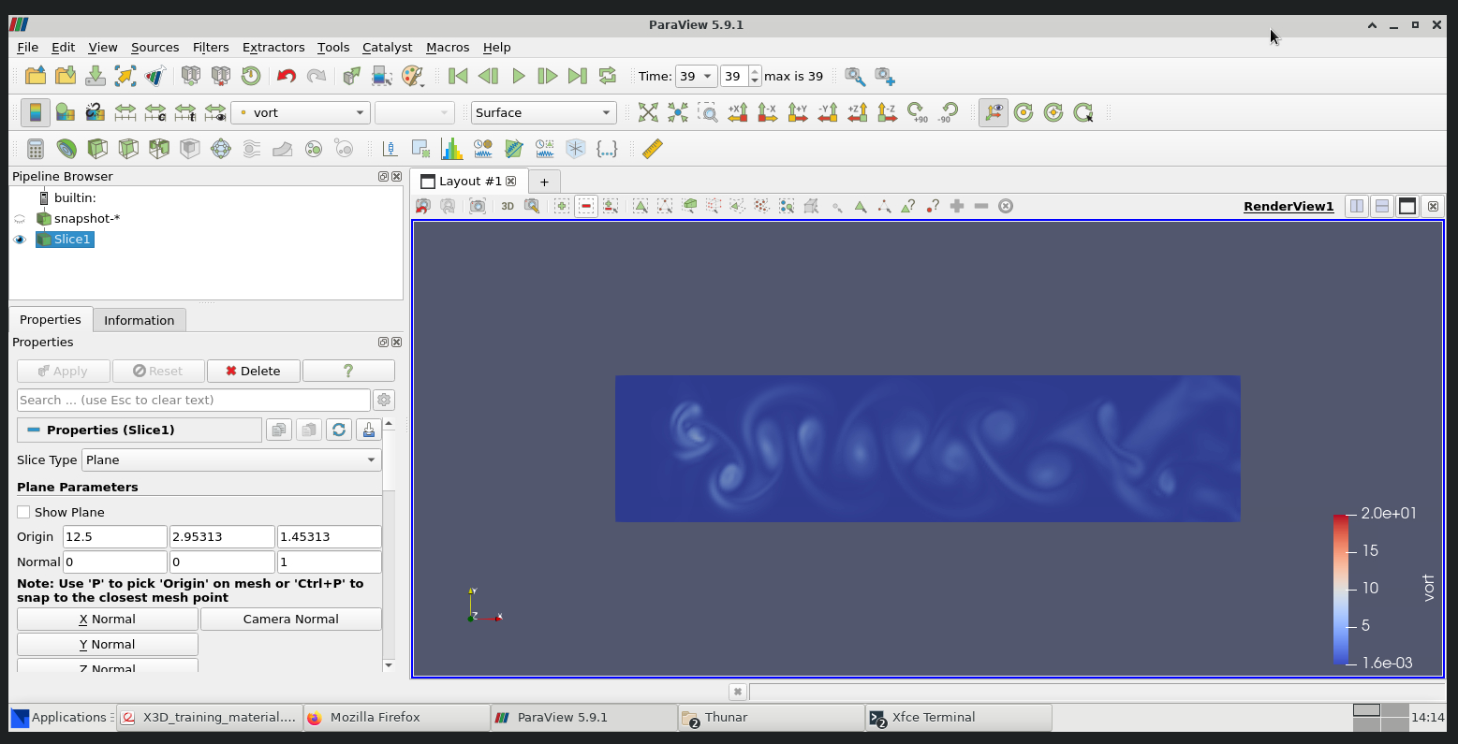
DAaaS - Introduction
What is DAaaS?
Remote data analysis service
Brings together the data, software and compute resources for a variety of scientific workflows
In-browser remote desktop to a cloud virtual machine
Interactive GUI based workflows
Primarily used by facilities at RAL (ISIS/CLF)
~8,000 VMs created by users per year
Use of resources
Virtual Machines on the STFC Cloud
It takes time to set up VMs and install scientific software
We do this in advance so the scientists do not have to wait
Configured VMs idle in a pool until they are required
There is a workspace pool for each science group.
VMs are disposable, upon deletion applications exit, but data persists in network storage
Notes:
To edit the graph data. Click on the chart, Chart design, and choose select data or edit chart data in excel.

Slide 2
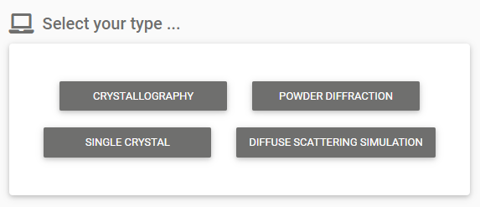
DAaaS – Resource Optimisation
Pool Management
We can choose the size of each pool and have been optimising them based on usage
Reduced average pool size by 40% in the past year
We are reworking the pool system to reduce this further, and ensure resource usage does not grow linearly with new use cases
Deletion of unused VMs
Users tend not to delete their own VMs once they are finished
We have a process which deletes VMs which have not been used for a period of time
This deletes ~100 unused VMs per month
User Decision Making
To help our users choose the resources they need, we work with scientists in STFC to define appropriate sizes of VMs and name them according to the workflow they will be using
We learned that if you name a set of resources as “Small” vs “Large”, people will choose “Large” to try and speed up their workflow
Instead, we try to name them after the type of analysis they are performing
Notes:
To edit the pie chart data. Click on the chart, Chart design, and choose select data or edit chart data in excel.

