Slide 1
Next 20 years: CLARA/FEBE
An informal, fun, and speculative view
Tom Pacey
ASTeC, Daresbury Laboratory
Cockcroft Institute 20th Anniversary 20/09/24
Notes:
The abstract pattern can be removed or repositioned if required. Be careful to ‘Send to Back’ so that it does not obscure any important information.

Slide 2
Outline
CLARA and FEBE
5 years of Awesome Experiments at FEBE
Legal Obligation: Diagnostics
10-20 years into future of CLARA

Slide 3
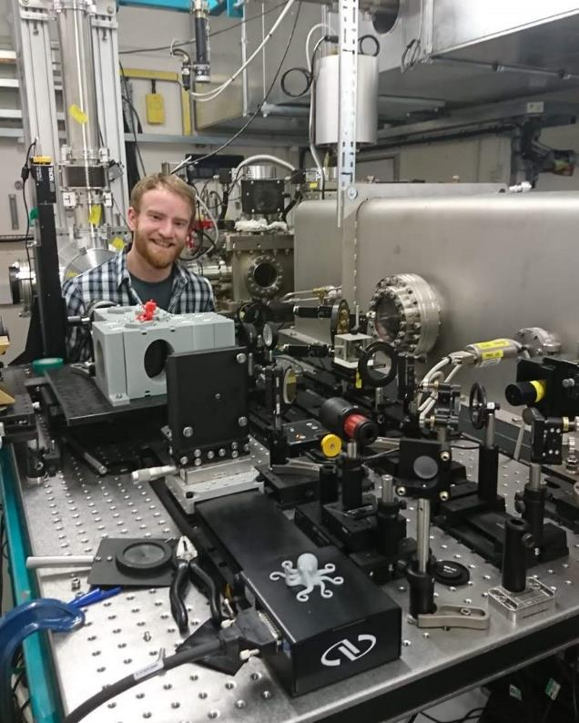
My background
Undergrad at Manchester, project with Hywel Owen and James Jones, Storage Ring beam dynamics
First came to Daresbury 10 years ago for a tour with Hywel…a lot has changed!
PhD with Yuri Saveliev, Dielectric Wakefield Accelerators
Bunch length measurements, tunable THz sources, Wakefield Dechirpers
Since 2019: CLARA Operation, User Exploitation (BA1), Diagnostics Development, FEBE Design…
BA1 Martin-Puplett interferometer, 2018

Slide 4
Health warning
This is our (Daresbury Lab) flagship facility
CLARA vision changed from 10 years ago…
But we do have a strategy…
CLARA/FEBE over next 5 years is relatively clear
Truth is talking about facility/area in 15 years post 2029…
Everything presented is my own personal view and does not reflect the views of:
Diagnostics Group, ASTeC Senior Management, STFC, UKRI, or DSIT
All comments to be addressed to: rob.smith@stfc.ac.uk
Notes:
Feeling pressure
Bring out the CDR
Bring out strategy

Slide 5
CLARA layout

Slide 6
FEBE Beamline & Hutch
PARS Design: G. Xia, O. Mete et. al. NIMA 2014
FEBE Design: E. Snedden et. al., PRAB 2024
Up to 250 MeV
250 – 600 MeV
Highly instrumented beamline supports
- Setup & characterisation
- Feedback systems
250 MeV – 2 GeV

Slide 7
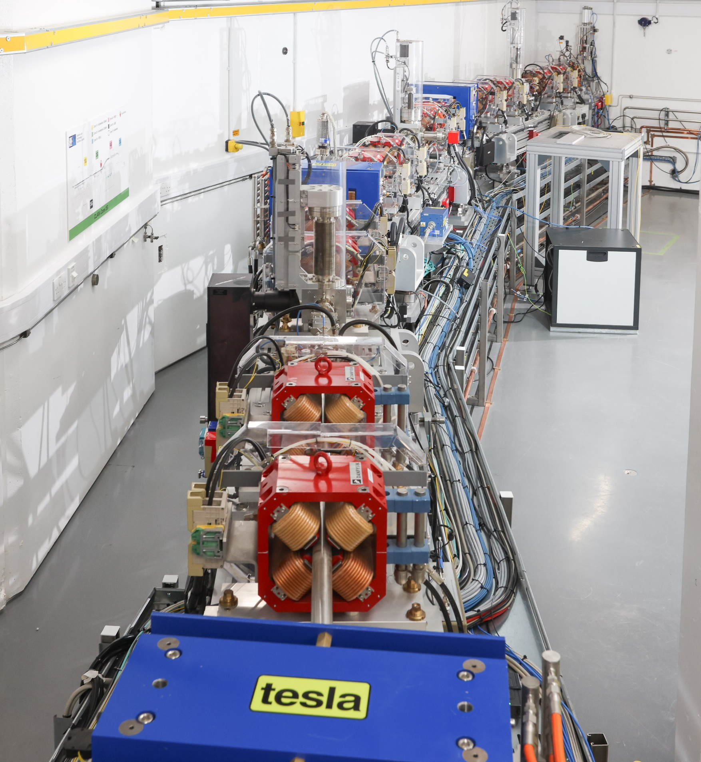
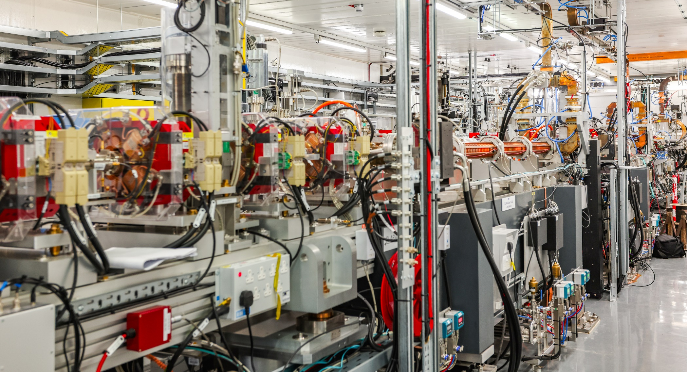
Tom Pacey, CI 20th Celebration, Sept 24

Slide 8
Things we will do in the next 5 years
Finish CLARA
Finish FEBE
What does ‘Finish’ mean to me?
Spatio-temporal alignment & synchronisation of 120 TW laser with 250 MeV electrons:
Compressed pulses, <50um, <10fs in FEC1
…
Complete several competitive access exploitation periods
What would those periods look like?
Notes:
Rather than list all of the many commissioning milestones along the way, boil it down to one specific technical achievement

Slide 9
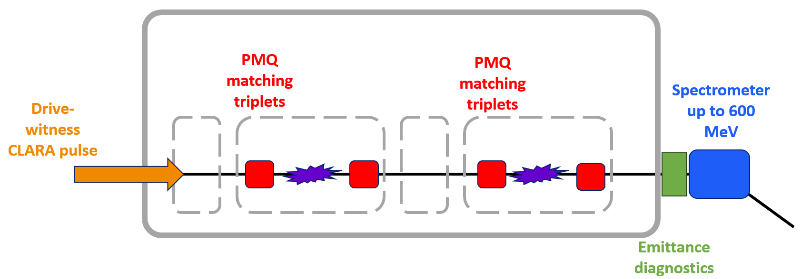
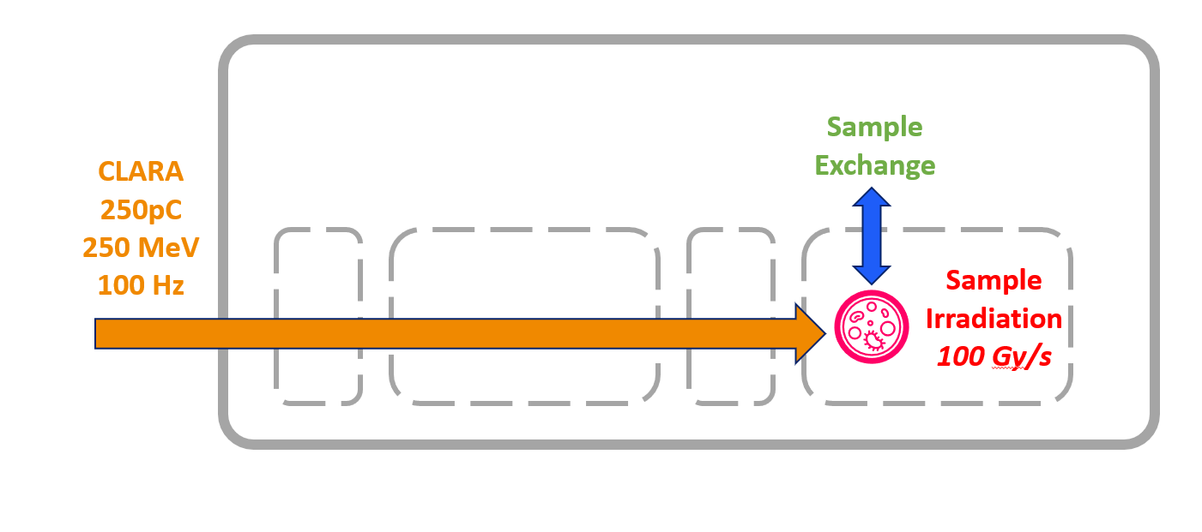
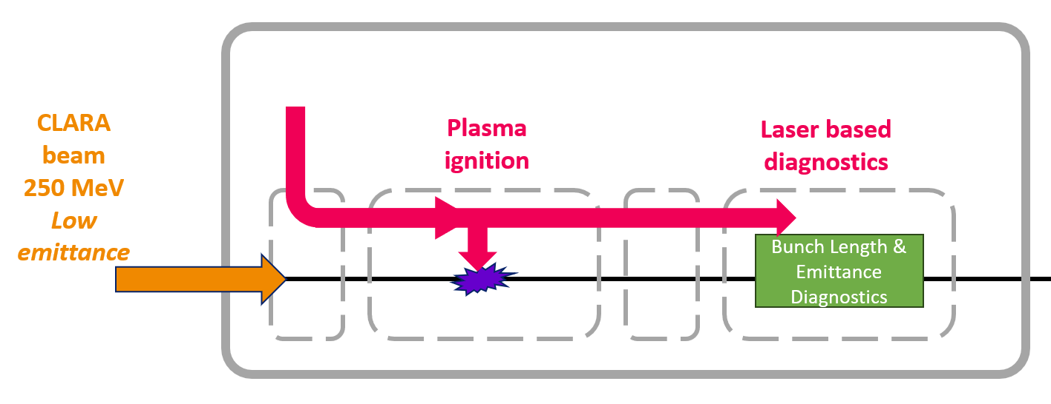
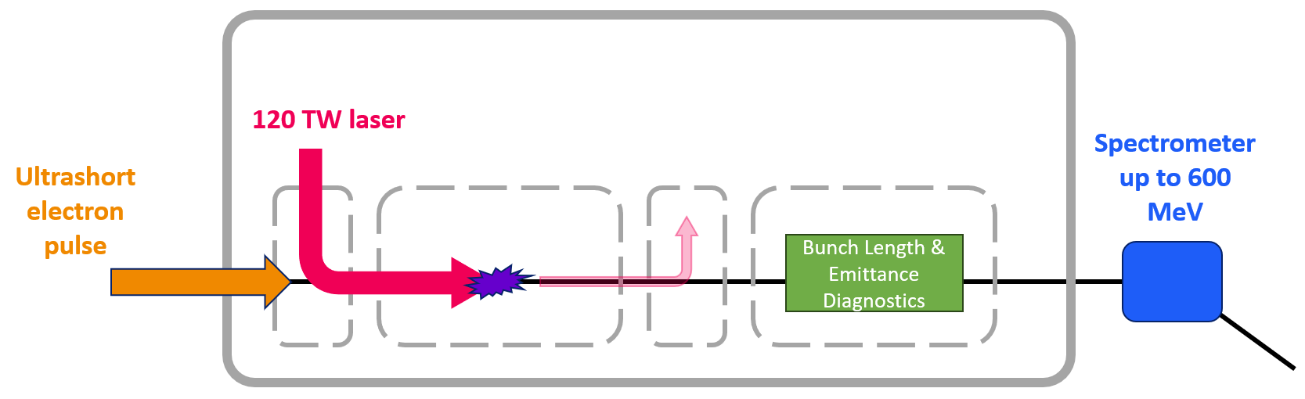
Some ways of doing FEBE experiments
Beam Driven wakefields: Staging
Flash Irradiation
External Injection Laser Wakefield Acceleration
Plasma wakefield: Advanced Diagnostics

Slide 10
Aspirations for Awesome Experiments at FEBE
These are because I have:
been involved in design of FEBE since 2019
been in discussions with previous and prospective users over plans
some ideas of what facility is design capable of
“Awesome” = what would be challenging/impactful/exciting
Presented in no particular order
Suggesting some extra challenges, impactful areas
Some experiments/goals will take multi-run iteration & development

Slide 11
Awesome Experiments I would love to see at FEBE
Dielectric Wakefield: Beam Break Up suppression
Structures across 2 FEBE chambers
1.5m of wakefield structure, 100 MeV drive beam energy extraction
Beam driven PWFA experiments
Support R&D EUPRAXIA @ SPARC
Or R&D for HALHF
Plasma optics, staging, plasma dynamics
Energy doubling of CLARA beam to 500 MeV using ex-injection LWFA
Beam stabilised and held for 8 hours in the FEBE dump
Combined THz manipulation – plasma acceleration experiment
Otherwise unreachable beam-laser optimisation
(diagnostics, compression, shaping, sync.)
FLASH VHEE therapy on biological samples (cells)
FLASH VHEE diagnostics (dosimetry, beam shaping)
Reliability Robustness, deployable in clinical setting
Single shot diagnostics for emittance & bunch length
‘RF Free’ & ‘EM Quad Free’
ML driven, ‘high dimension’ virtual diagnostics
Optimise/provide high-order correction for CLARA beam,
Measure the otherwise unobservable
Photon production from electrons
Compton backscatter, undulator

Slide 12
Awesome Experiments I would love to see at FEBE
If fully completed would be a very impressive science programme; broad, impactful
All of these experiment would be in led by, or in collaboration with Cockcroft Institute partners
To keep up with this programme need to average:
~2 “Awesomes” per year over 5 years…

Slide 13
Legal Obligation:
Diagnostics are very important
Notes:
The abstract pattern can be removed or repositioned if required. Be careful to ‘Send to Back’ so that it does not obscure any important information.

Slide 14
Novel Accelerators as ‘THE FUTURE’
“We can make a GeV beam in only a few centimetres”
“We can simulate that quality is preserved under ABC scheme to X TeV”
Need to validate the models to scale to a FEL/Collider
Challenging experiments, not many places in world to do them
Precision diagnostics needed for models to be validated

Slide 15
Challenge: Diagnostics for ‘Novel Accelerators’
Space = limited
Beam = rigid
Stability = variable
‘RF Free’
CLF/EPAC don’t want to buy RF modulators etc. etc.!
Need: high precision, single shot diagnostics
Bunch profiles, emittances, longitudinal phase spaces…etc.
ML is a tool, not a catch all solution. We need to validate models
Need creativity, ‘new diagnostics’, and a test bed for experiments
FEBE can deliver these types of experiments

Slide 16
CLARA/FEBE
in 10-20 years…
Speculating…
Notes:
The abstract pattern can be removed or repositioned if required. Be careful to ‘Send to Back’ so that it does not obscure any important information.

Slide 17
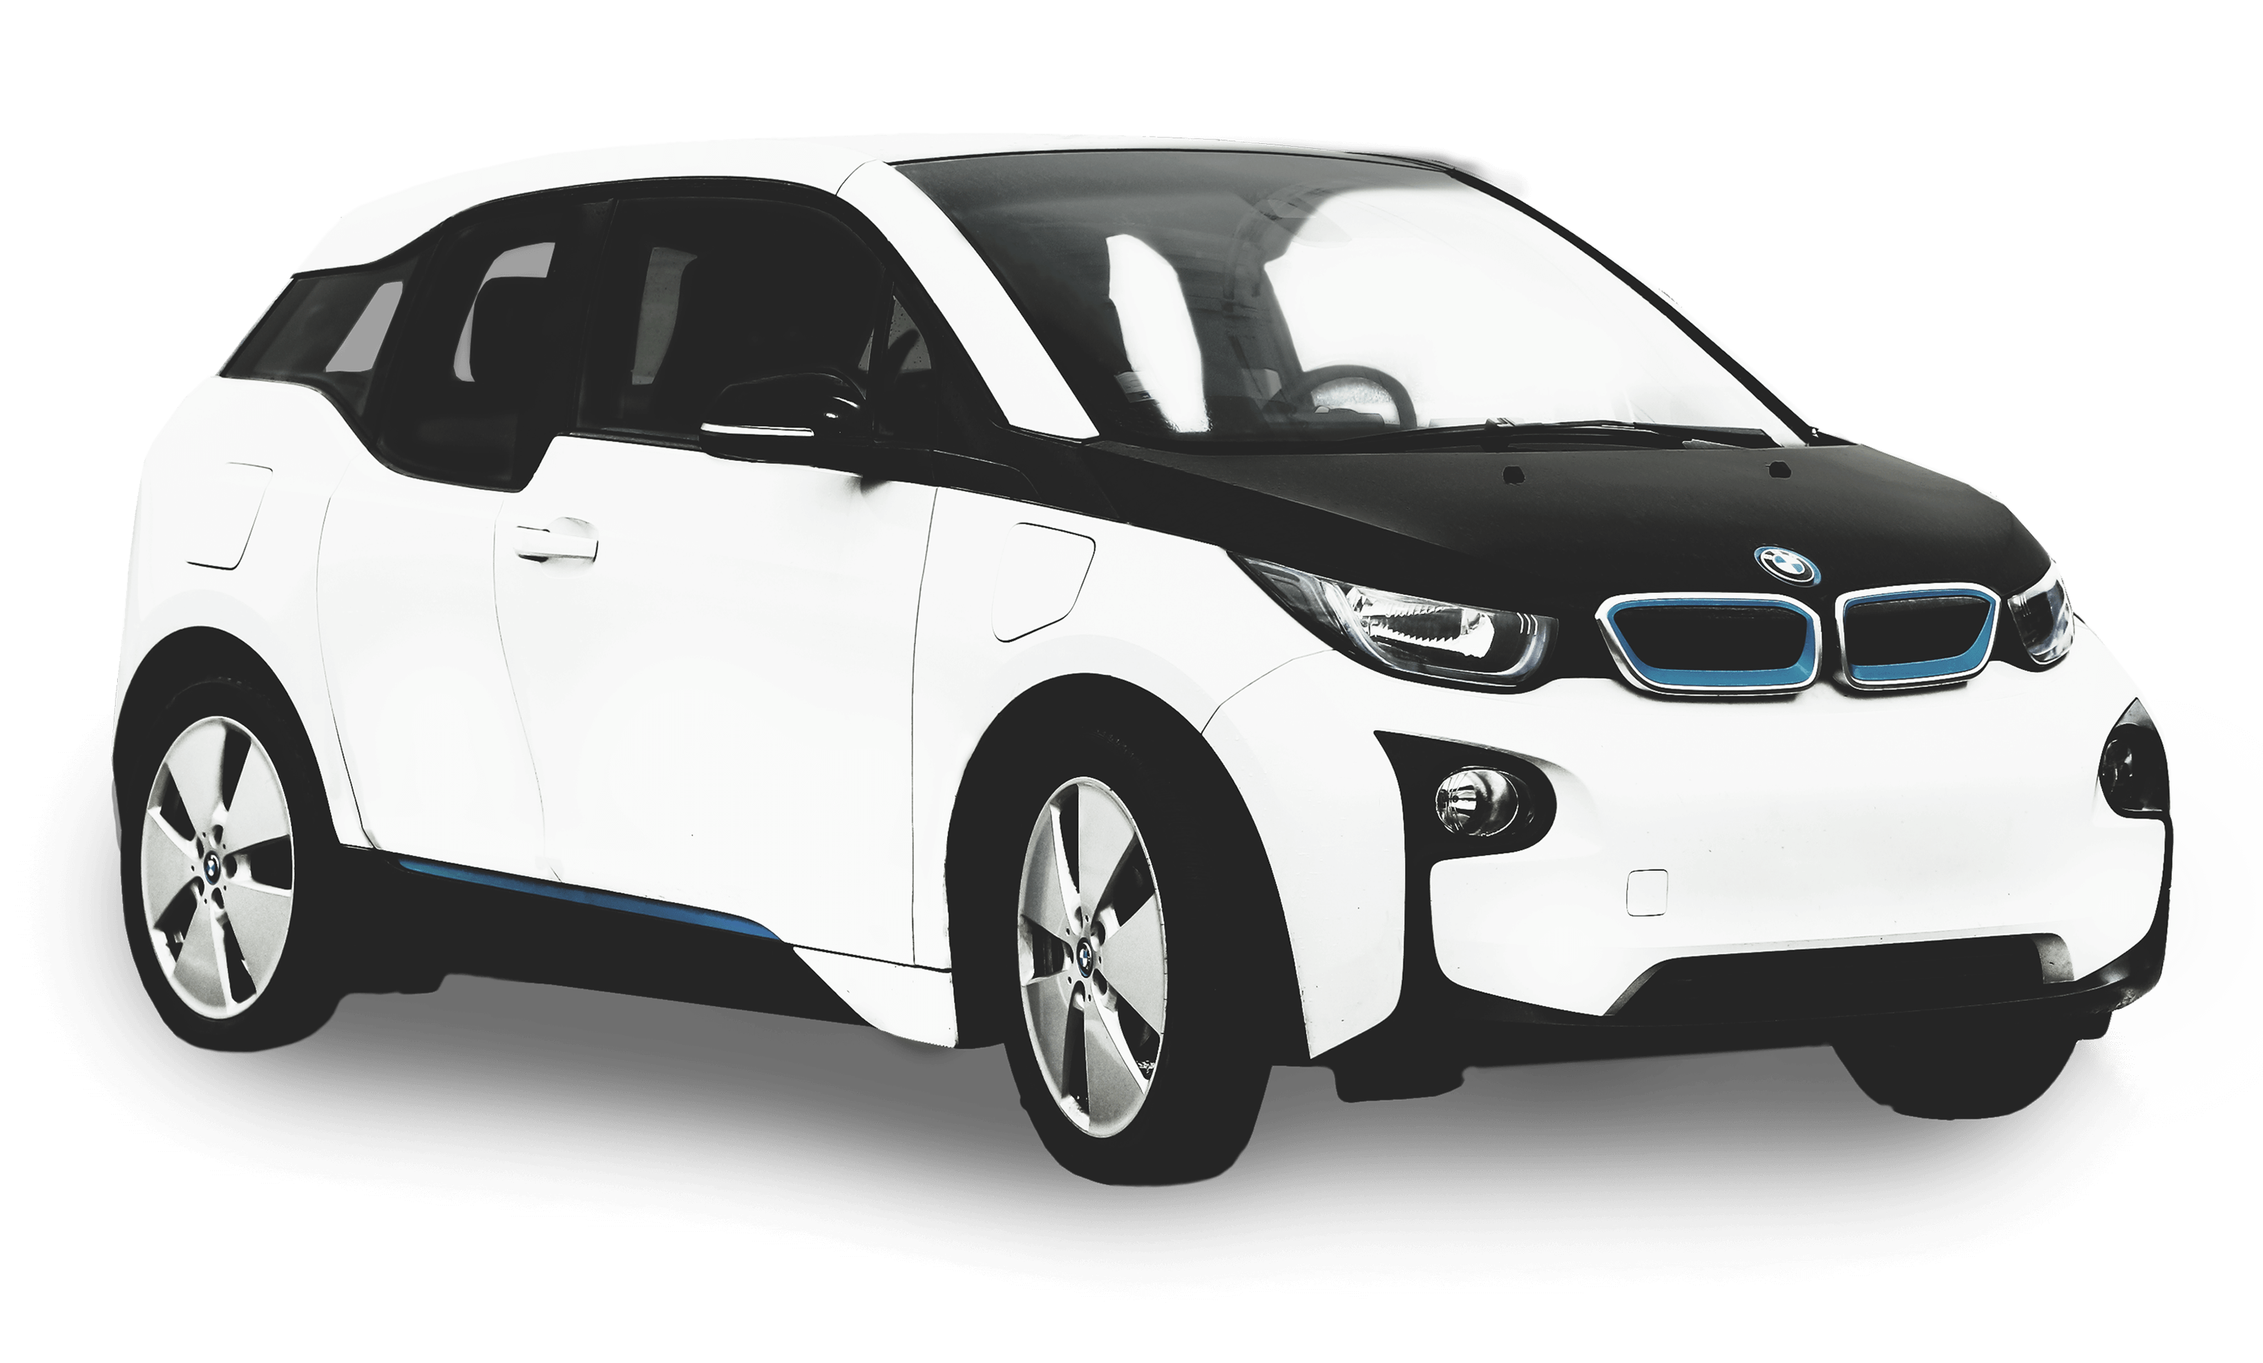
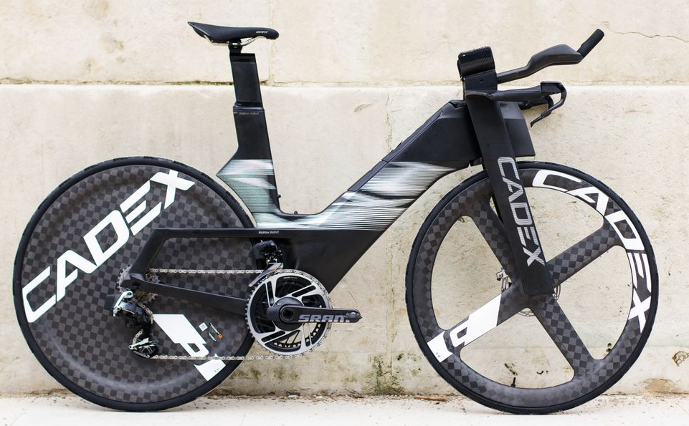
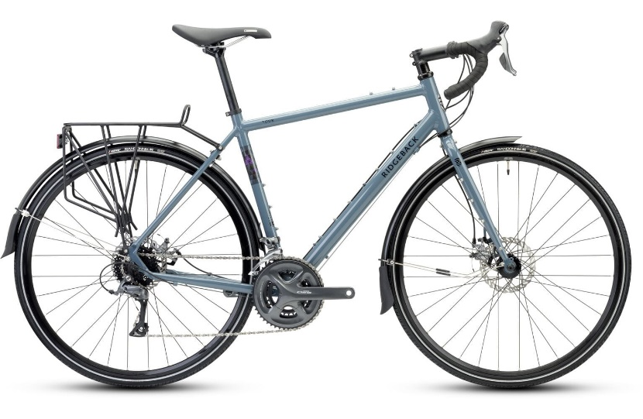
Bring back GeV Beams to Daresbury Lab
NINA 4.5 GeV, SRS 2 GeV
ALICE 30 MeV,
CLARA Ph.1 50 MeV, Phase 2 250 MeV
GeV technologies for CLARA:
Lasers – FEBE laser 5 Hz…10 years R&D
Beam driven, 40% transfer efficiency Drive - witness
X band RF
Need to consider…Beam brightness, characterisation, stability, etc. etc. etc.
laser
High-tech. Flexible Compact Interesting
Powerful Fast Optimised Exciting

Slide 18
CLARA – ‘Original Phase 3’
Modulator
≈20m Undulators
≈ 10m Afterburner
≈ 10m e- Diagnostics
≈ 40m space budget

Slide 19
CLARA 1 GeV Booster Concept: Deliver within ~10 years
~5 keV Photons
~1 GW peak power
0.25 → 1 GeV booster module
10 m (i.e. FEBE hutch)
~kA current bunch
Novel short period undulator section
10m sat. length
≈ 10m e- Diagnostics
FEBE prototyping?
FEL provides ‘proof of quality’
Phased Build?
e.g. SC Helical,
RF,
Halbach ‘comb’
Thanks Neil T for discussion on photons & scaling
What could the booster look like?
Notes:
I will present 4 boosters, in order of increasing Awesome and technical difficulty/risk

Slide 20
CLARA 1 GeV Booster Concept: XARA (2019)
Add 3
X-band cavities
@ 70 MV/m
~0.5 keV Photons
100 uJ, ~4 GW
1 GeV
Modulator
Undulator section
15m
≈ 10m e- Diagnostics
D. J. Dunning , L. S. Cowie1 , J. K. Jones ,
XARA: X-BAND ACCELERATOR FOR RESEARCH AND APPLICATIONS ,
THP066, FEL2019

Slide 21
CLARA 1 GeV Booster Concept: Collinear DWA Booster
CLARA creates and shapes
Drive + witness beams
500pC Drive (shaped)
50 pC Witness
Both at 250 MeV
~5 keV Photons
~1 GW peak power
5m long DWA structure
Modular construction
<1mm gap, BBU suppression
50 MV/m decelerating field
TR ≈ 3 Produces ~1 GeV witness
40-50% energy transfer, Fully passive.
Novel short period undulator section
10m
≈ 10m e- Diagnostics

Slide 22
CLARA 1 GeV Booster Concept: Laser Wakefield Booster
CLARA creates high quality witness
Accelerated by FEBE laser
≈ 20 pC Bunch
Highly Compressed >3kA
Low Emittance
~5 keV Photons
>1 GW peak power
≈ 10cm plasma cell
Transverse Matching Section
Post acceleration beam conditioning
Novel short period undulator section
10m
≈ 10m e- Diagnostics
Notes:
I will present 4 boosters, in order of increasing Awesome and technical difficulty/risk

Slide 23
A 1 GeV Beam Driven Plasma Booster stage for CLARA…
(Not a copy of EuPRAXIA@SPARC)
…which could also be a test module for HALHF
Notes:
EUPRAXIA@ SPARC – 1 GeV x band linac, configure for 500 MeV with a 500 MeV plasma booster stage
Shouldn’t copy that…but could as a 250 MeV – 500 MeV booster.
But they will beat us ont ime scales and energy, so why bother

Slide 24
What is HALHF?
Hybrid Asymmetric Linear Higgs Factory: 250 GeV e+ e- c.o.m.
B Foster, R D'Arcy, and C A Lindstrøm, New J Phys, 2023
Beam driven plasma linac, 5 GeV → 500 GeV, 32 Stages, 500m
“Serious plasma collider”

Slide 25
CLARA 1 GeV Booster Concept: PWFA Module Booster
Recipe:
HALHF: 32 GeV Drive, 5 GeV Witness → 37 GeV Witness
CLARA: 250 MeV Drive, 50 MeV Witness → 1 GeV Witness
≈40% Drive – Witness energy transfer
Drive Beam:
250 pC (shaped)
250 MeV
~5 keV Photons
~1 GW peak power
0.5 m plasma cell
0.5 GV/m gradient on drive
TR of > 4, (shown at PITZ)
≈2GV/m witness
≈ 10m e- Diagnostics
Novel short period undulator section
10m
Compression and
matching line
5-10m
Build accelerator next to CLARA!
(VELA will get jealous)
25 pC, 50 MeV in <5m
See CLARA Phase 1

Slide 26
Incredibly preliminary simulation
Wake-T (as in HALHF paper)
Adopt shaping as in Loisch, PRL 2018
Drive bunch length 0.7ps
Plasma density 2 x 10¹⁶ cm⁻³
Non-optimised loading of witness
(Produced yesterday…)
Credit: Toby Overton
0.5 GV/m gradient on drive
≈2GV/m witness

Slide 27
CLARA & FEBE next 20 years
We (CI) have the potential to carry out a very exciting and impactful experiments at CLARA on FEBE
We should develop high precision diagnostics for novel accelerators
We should bring GeV beams back to Daresbury
We could build a (really) novel energy booster to get to 1 GeV
Such a booster could be relevant to HEP Colliders

Slide 28
Happy Birthday CI!
20 Years Old!
Thank you for listening
Notes:
The abstract pattern can be removed or repositioned if required. Be careful to ‘Send to Back’ so that it does not obscure any important information.

