Slide 1
VHEE-FLASH Radiotherapy: Particle Physics, Medicine and Everything Inbetween
Dr Kristina Small

Slide 2
How I got here…
Growing up…
Didn’t know if I wanted to study physics or medicine
Cancer in the family while I was growing up
2012-2016: MPhys in Theoretical Physics at the University of York
MPhys project – “Stochastic quantum electrodynamic effects on ion motion in extreme electromagnetic fields”
Application to radiotherapy – designing smaller treatment accelerators for use in hospitals
2016-2021: PhD at the University of Manchester
“Nanodosimetric Properties of Very High Energy Electrons through pBR322 Plasmid Irradiation Studies”
2023 – present: Post-doctoral research associate at the University of Manchester

Slide 3
Cancer in the North West
~400,000 cancer cases and 170,000 cancer deaths in the UK – increasing year on year
Cancer incidence and mortality rates are consistently higher in the North West compared to the national average
Majority of cancers are treated with a combination of surgery, chemotherapy and radiotherapy
Radiotherapy – using ionising radiation to kill cancer cells

Slide 4
Radiotherapy at the Molecular Scale
Direct damage
H₂O
OH⁻
O₂⁻
DNA Lesion | Number per cell per Gray
Base damage | > 2000
Single-strand break (SSB) | 1000
Double-strand break (DSB) | 40
Indirect damage
H₂O₂

Slide 5
Radiotherapy at the Cellular Scale
Cell Irradiation
DNA damage occurs within the nucleus after irradiation
Cells activate DNA repair mechanisms
Several options available for cell outcome
Successful DNA Repair
Cell continues with full functionality
Unsuccessful DNA Repair
Mutation and unregulated cell division - cancer
Irreversible cell dormancy – senescence
Programmed cell death - apoptosis

Slide 6
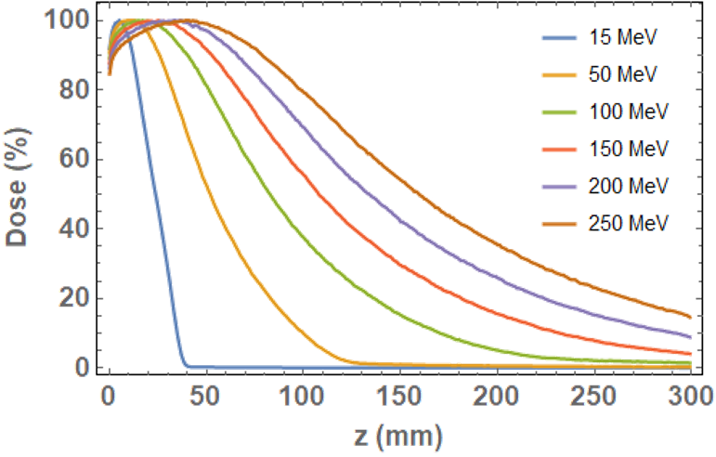
Novel Radiotherapy - VHEE
a
Very High Energy Electron radiotherapy will use 100-250 MeV electrons to treat cancer. Key advantages:
Increased range in tissue – can treat deep-seated tumours
Reduced lateral beam spread – lower dose delivered to healthy tissue surrounding a tumour
Insensitivity to inhomogeneities – changes in tissue density do not affect dose delivery as for protons
Similar DNA damage rates compared with established radiotherapy modalities – measured relative biological effect of 1.1-1.2

Slide 7
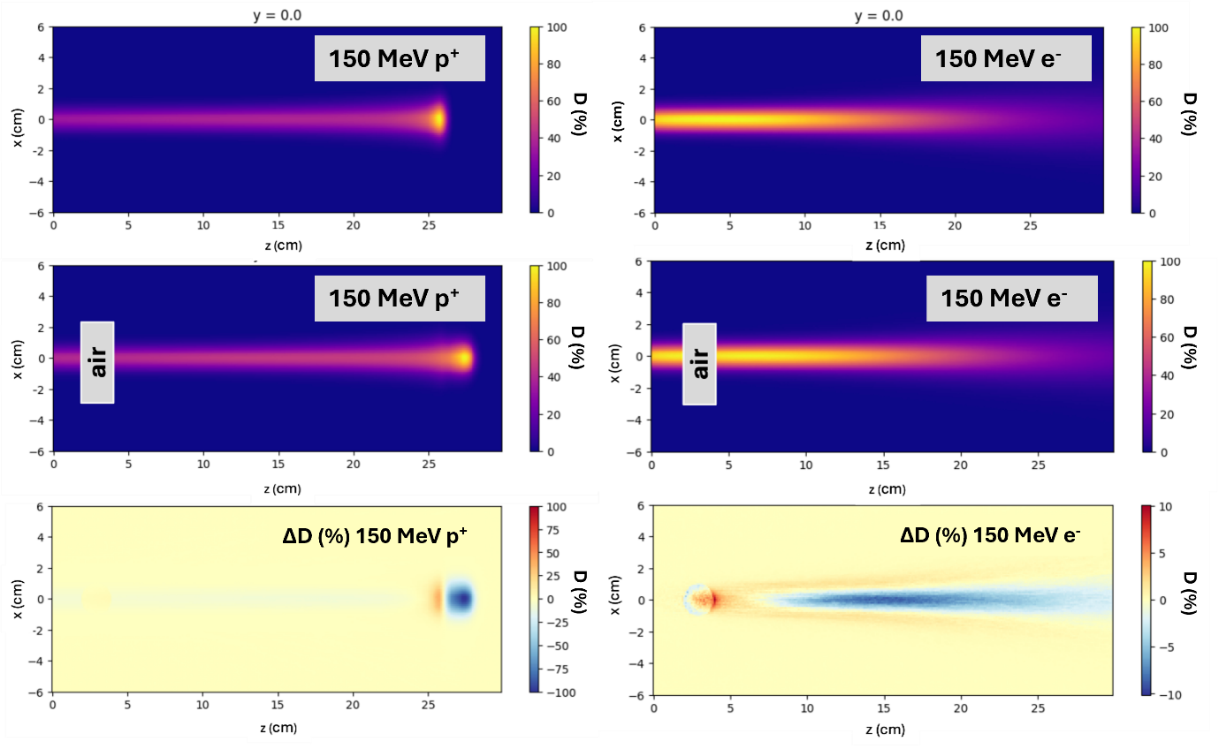
Novel Radiotherapy - VHEE
Very High Energy Electron radiotherapy will use 100-250 MeV electrons to treat cancer. Key advantages:
Increased range in tissue – can treat deep-seated tumours
Reduced lateral beam spread – lower dose delivered to healthy tissue surrounding a tumour
Insensitivity to inhomogeneities – changes in tissue density do not affect dose delivery as for protons
Similar DNA damage rates compared with established radiotherapy modalities – measured relative biological effect of 1.1-1.2
Lagzda, A. et al. Influence of heterogeneous media on Very High Energy Electron (VHEE) dose penetration and a Monte Carlo-based comparison with existing radiotherapy modalities. Nucl. Instruments Methods Phys. Res. Sect. B. 482 70-81 (2020)

Slide 8
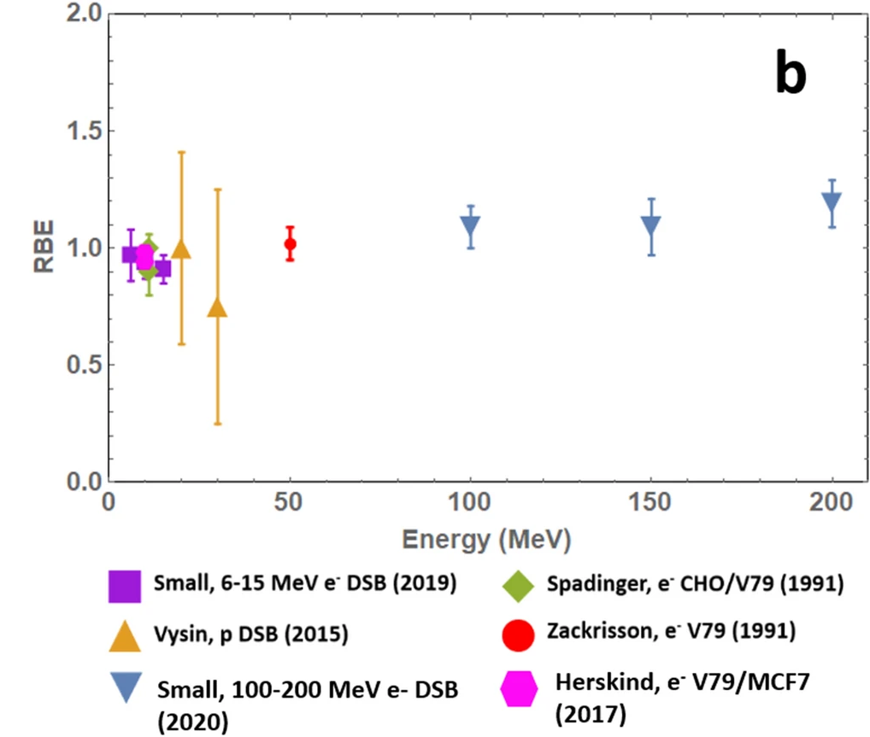
Novel Radiotherapy - VHEE
Very High Energy Electron radiotherapy will use 100-250 MeV electrons to treat cancer. Key advantages:
Increased range in tissue – can treat deep-seated tumours
Reduced lateral beam spread – lower dose delivered to healthy tissue surrounding a tumour
Insensitivity to inhomogeneities – changes in tissue density do not affect dose delivery as for protons
Similar DNA damage rates compared with established radiotherapy modalities – measured relative biological effect of 1.1-1.2
Small, K. et al. Evaluating very high energy electron RBE from nanodosimetric pBR322 plasmid DNA damage. Sci. Rep. 11, 3341 (2021)

Slide 9
Novel Radiotherapy - FLASH
FLASH-RT – Radiotherapy dose delivered in ms/us/ns timescales, rather than minute timescales for conventional radiotherapy
Consistently shown to significantly reduce radiation-induced side effects in healthy tissue
Electrons are light and charged – ideal for FLASH delivery
Combining VHEE and FLASH could mean an effective, patient-friendly cancer treatment
Conventional
FLASH
Vozenin, M. C. et al. The advantage of FLASH radiotherapy confirmed in mini-pig and cat-cancer patients. Clin. Cancer Res. 25, 35–42 (2018).

Slide 10
Radiotherapy at CLARA
Establish CLARA as a European/global centre for VHEE and FLASH radiotherapy research
Multidisciplinary approach:
Expertise in accelerator physics will inform research into machine design
Collaboration with Christie and Cancer Sciences (UoM) will inform patient-focused research – dosimetry, treatment planning, radiobiology
Short-term aim – set up a biological lab workspace for cell work
CO₂ incubator
Tissue culture hood
Hypoxia cabinet

Slide 11
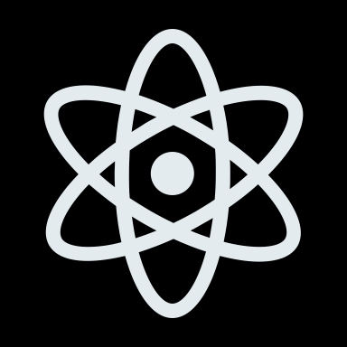
Radiotherapy at CLARA
Covers full clinical VHEE energy range
Beam Parameter | CLARA
Energy Range | 100-250 MeV
Bunch Charge | 5-250 pC
Repetition Rate | 100 Hz
Relative Energy Spread | 0.01% (low charge) 0.1% (high charge)
Beam Exit Window | 250 μm Be
Can irradiate at both conventional and FLASH dose rates (> 40 Gy/s)
Low energy spread = reliable and repeatable beam – key for clinical VHEE machine design
Easy access to FEBE experimental chambers – rapid sample setup and throughput

Slide 12
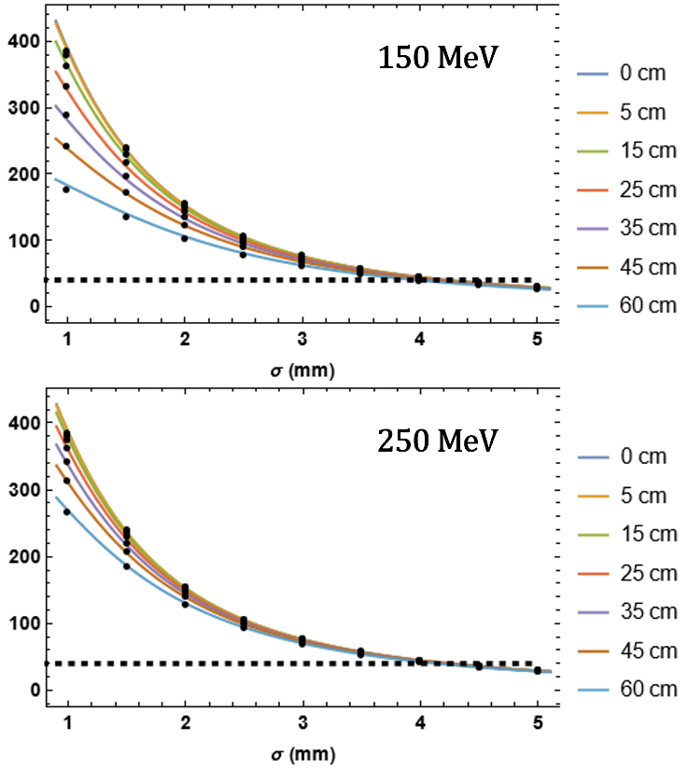
Moving Forward – Beam Characterisation and Focusing
What makes a FLASH beam FLASH?
Aim – establish beamline parameters required for reliable, repeatable FLASH irradiation (bunch charge/length, repetition rate, beam width) with dose rate >40 Gy/s
Preliminary simulation work carried out in TOPAS/BDSIM
CLARA comfortably reaches FLASH dose rate threshold
Can assess CLARA dose rate through simulation data fit to analytical functions
Early work on CLARA will validate theoretical dose rates through radiochromic film irradiation studies

Slide 13
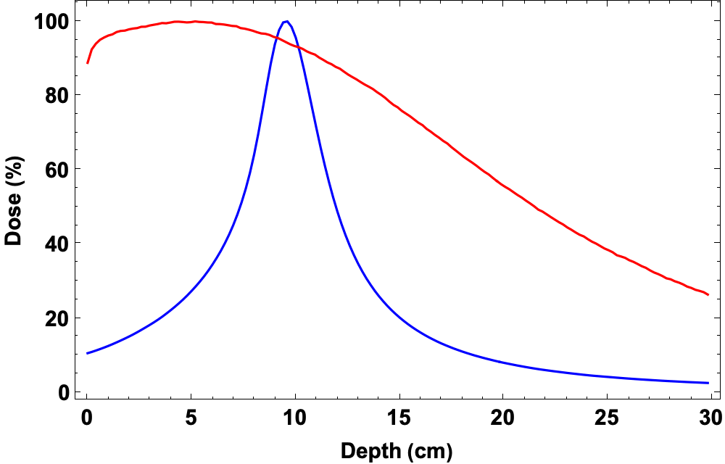
Moving Forward – Beam Characterisation and Focusing
How do we treat the correct region in a patient?
Aim – beam focusing using quadrupole magnets at patient-relevant depths (10-20 cm). Added benefit – reduced entrance/exit doses
Successful focusing has been achieved at depths up to 5 cm (Whitmore et al.) – not far enough for most patients!
Initial simulation work underway in collaboration with James Jones – translating quadrupole strength optimisation in vacuum to dose profile in patient-equivalent water phantoms
250 MeV
Unfocused
250 MeV
Focused
Whitmore, L. et al. CERN-based experiments and Monte Carlo studies on focused dose delivery with very high energy electron (VHEE) beams for radiotherapy applications. Sci. Rep. 14 (2024)

Slide 14
Moving Forward – Cell Irradiation
What does VHEE and VHEE-FLASH radiation do to cells?
Aim – observe how cancer cells and normal cells respond to VHEE irradiation at conventional and FLASH dose rates. Comparison with clinically established radiotherapy modalities – are VHEEs as good?
Key focus – lung and pancreatic cancer cell lines
Method – calculate survival rate through clonogenic assay:
Survival Fraction
Incubate cells to allow for growth
Dose (Gy)
Irradiate cells
Count surviving colonies
Calculate cell survival fraction

Slide 15
Moving Forward – Tumour Environment
What does VHEE and VHEE-FLASH radiation do to tumours?
Tumours are much more complex than simple cells in a flask – we need to replicate this complexity
Spheroids are multi-dimensional cell clusters which approximate the tumour environment – including cell signalling, tumour growth
Aim – irradiate lung and pancreatic spheroids with VHEEs at conventional and FLASH dose rates. Measure size before and after to determine effects on cell survival and growth rates
Possibility of altering oxygen levels using a hypoxia cabinet to further model the tumour environment?

Slide 16
Conclusions
Physics is vitally important to the success of radiotherapy treatment – from fundamental research into mechanisms to delivering in the clinic
VHEE and FLASH radiotherapy have the potential to revolutionise cancer treatment, particularly lung and pancreatic cancers – cancers of unmet need and with high rates in the North West
The CLARA beamline is ideal for research into VHEE-FLASH radiotherapy due to wide energy range, high bunch charge/dose rate and efficient experimental area design
My next five years – reliably delivering VHEE-FLASH beamlines and establishing biological viability of VHEE-FLASH as a lung/pancreatic cancer treatment

Slide 17
Acknowledgements
Roger Jones
Deepa Angal-Kalinin
James Jones
Stewart Boogert
Nicholas Henthorn
Michael Merchant
Karen Kirkby
Amy Chadwick
Elham Santina
Adam Aitkenhead
Wilfrid Farabolini
Roberto Corsini
Davide Gamba
Antonio Gilardi

Slide 18
Conclusions
Physics is vitally important to the success of radiotherapy treatment – from fundamental research into mechanisms to delivering in the clinic
VHEE and FLASH radiotherapy have the potential to revolutionise cancer treatment, particularly lung and pancreatic cancers – cancers of unmet need and with high rates in the North West
The CLARA beamline is ideal for research into VHEE-FLASH radiotherapy due to wide energy range, high bunch charge/dose rate and efficient experimental area design
My next five years – reliably delivering VHEE-FLASH beamlines and establishing biological viability of VHEE-FLASH as a lung/pancreatic cancer treatment

