Slide 1
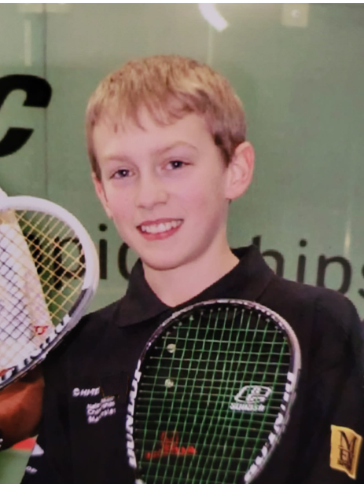
Cockcroft Institute 20th Anniversary | 20th September 2024
The next 20 years: “Advanced” acceleration
20 years ago…
Please scan…
Dr Morgan Hibberd
morgan.hibberd@manchester.ac.uk

Slide 2
Ask the audience
Morgan Hibberd | The next 20 years: Advanced acceleration | CI 20th Anniversary 20th Sep 2024

Slide 3
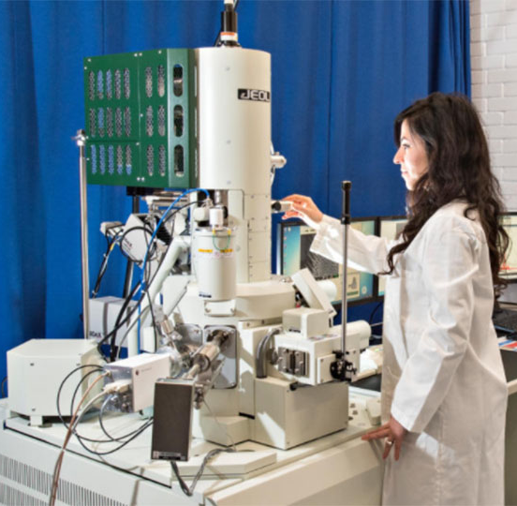
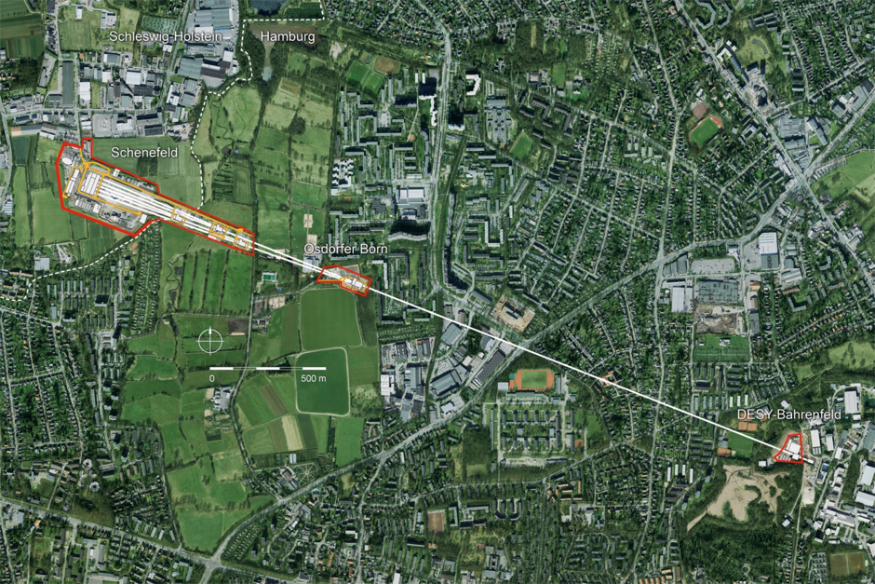
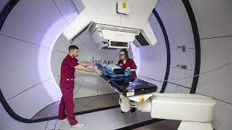
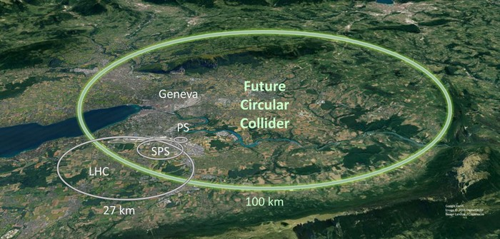
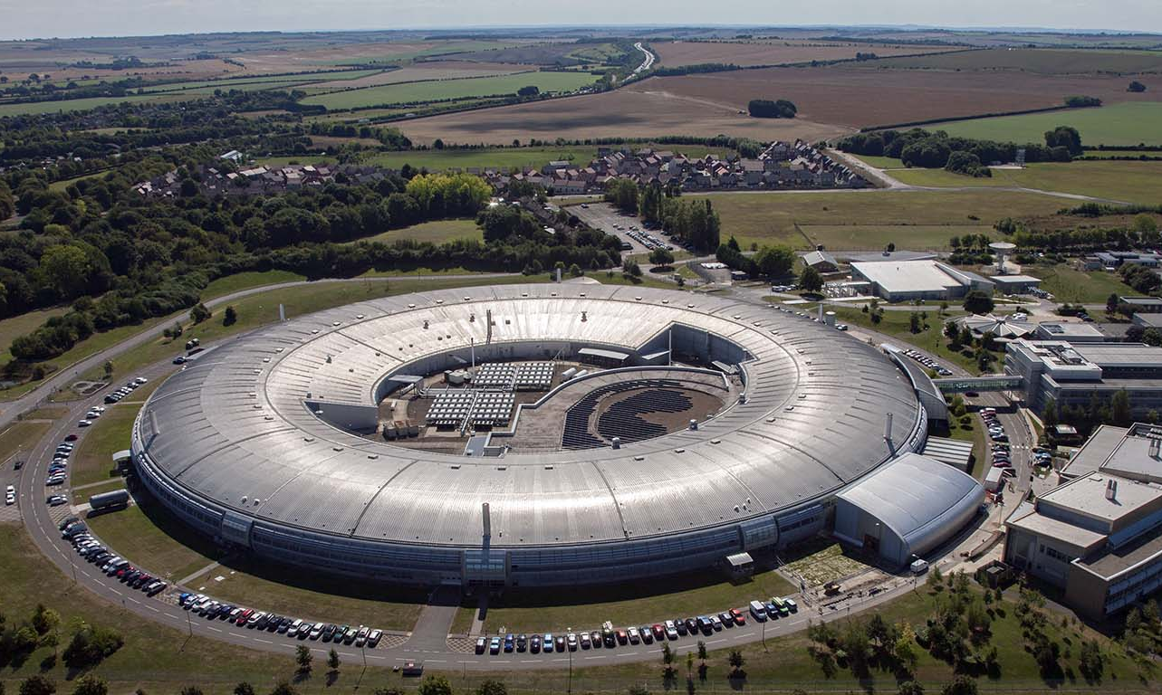
“Standard” accelerators
Electron microscopy
Energy ≡ Size
100 keV
1 m
Proton therapy
Free electron lasers
17.5 GeV
3.4 km
7 TeV → 100 TeV
27 km → 100 km!
230 MeV
20 m
Colliders
Synchrotrons
3 GeV
700 m
Morgan Hibberd | The next 20 years: Advanced acceleration | CI 20th Anniversary 20th Sep 2024

Slide 4
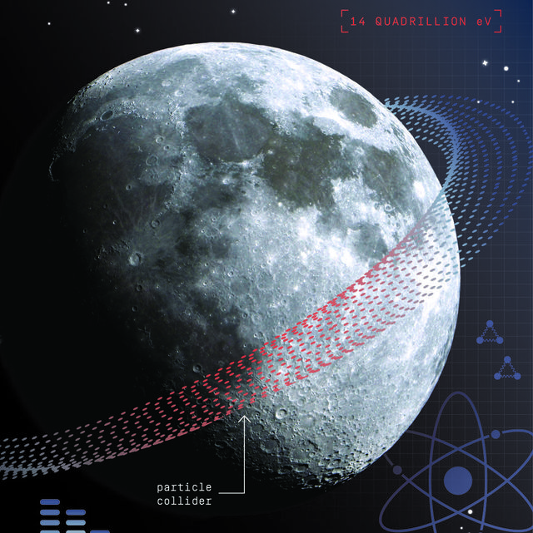
“Standard” accelerators
https://www.popularmechanics.com/space/moon-mars/a36686887/moon-particle-collider-plans/
Morgan Hibberd | The next 20 years: Advanced acceleration | CI 20th Anniversary 20th Sep 2024

Slide 5
Ask the audience
Morgan Hibberd | The next 20 years: Advanced acceleration | CI 20th Anniversary 20th Sep 2024

Slide 6
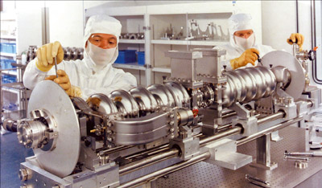
“Standard” acceleration
Conventional accelerators are powered by radio-frequency (RF) radiation
Frequency ≈ 3 GHz
Time period ≈ 300 ps
Wavelength ≈ 10 cm
Cavity aperture ≈ 2 cm
Pulse length ≈ 100 µs
Accelerating gradient is typically 10 – 30 MV/m
Limited to <100 MV/m by material breakdown
https://www2.kek.jp/accl/legacy/eng/topics/topics190122.html
RF cavities at the Jefferson lab CEBAF operate with gradients of 7-10 MV/m
Oscillating electric field in the RF cavity switches between acceleration and deceleration
Morgan Hibberd | The next 20 years: Advanced acceleration | CI 20th Anniversary 20th Sep 2024

Slide 7
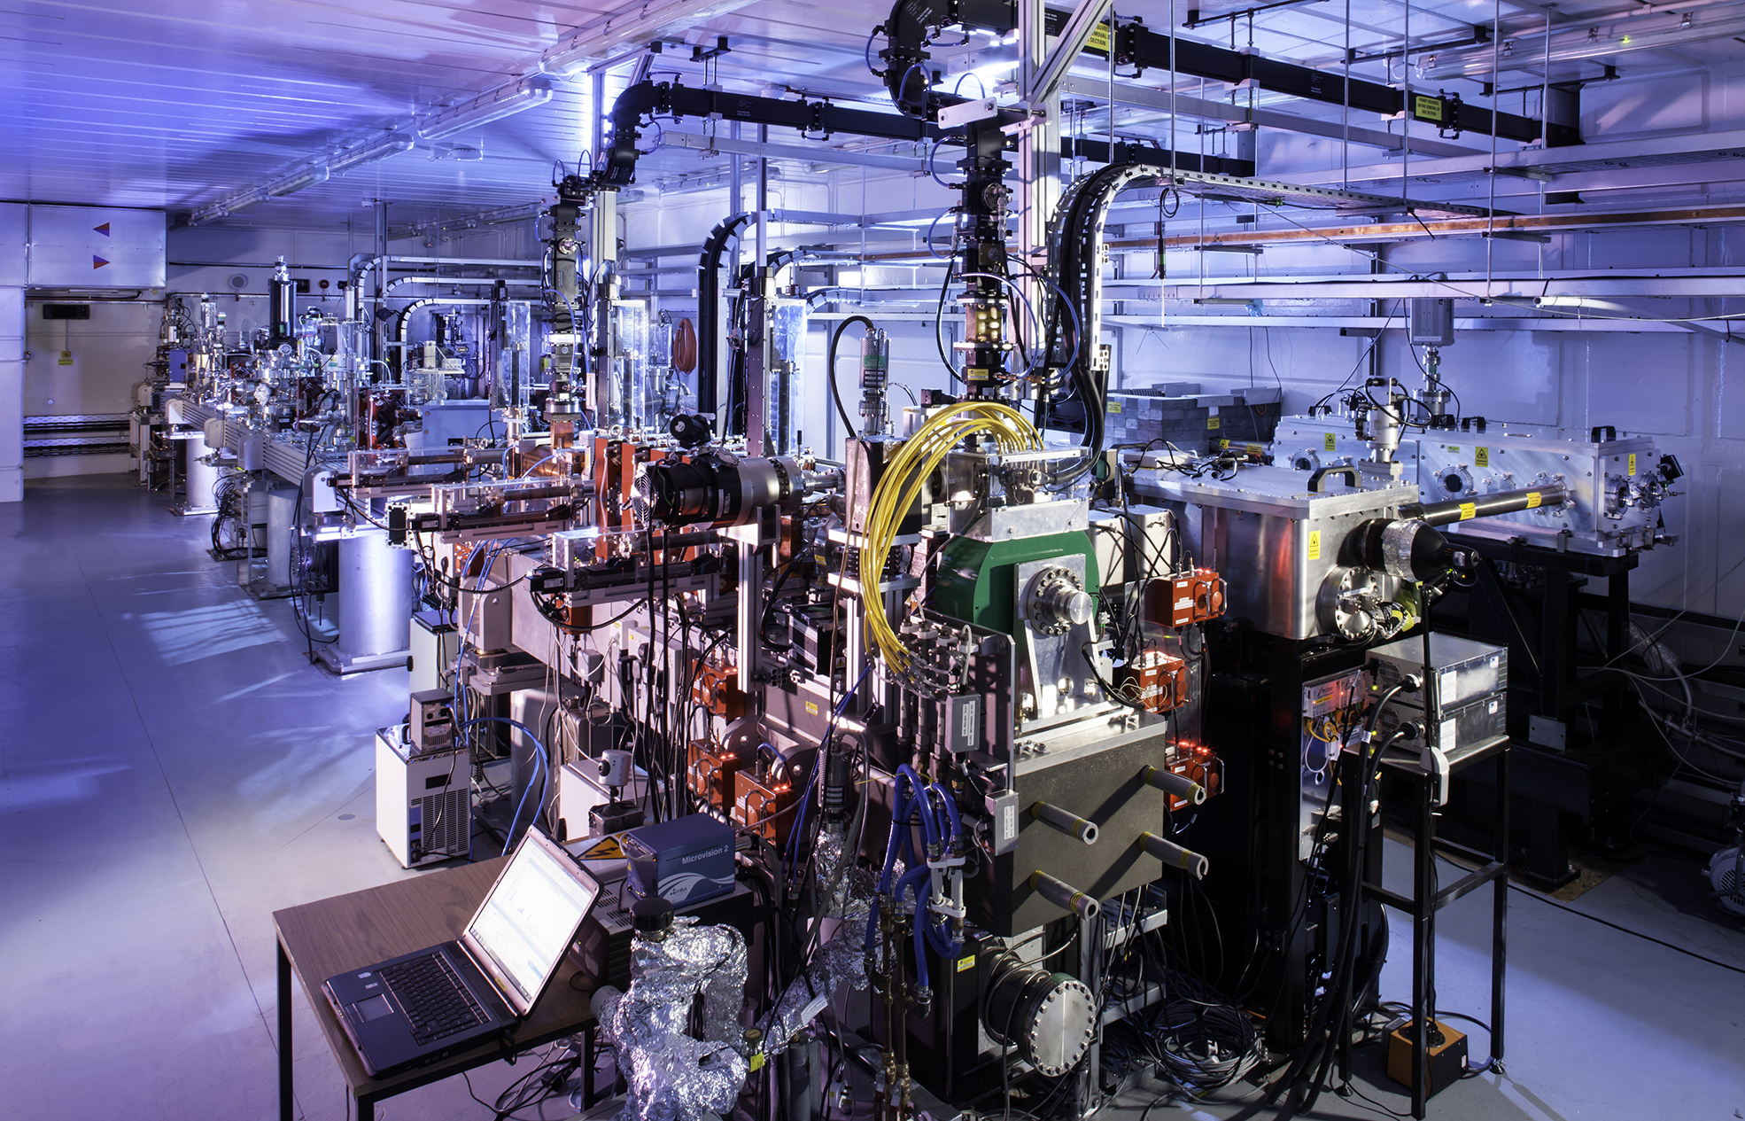
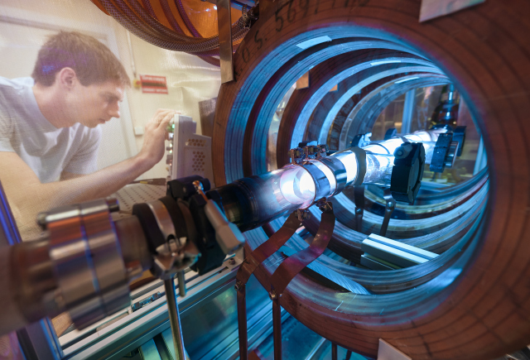
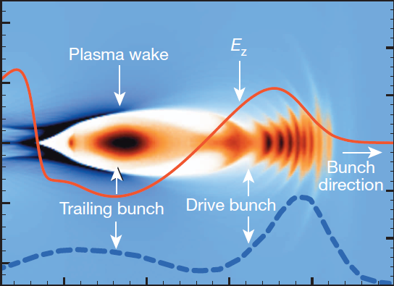
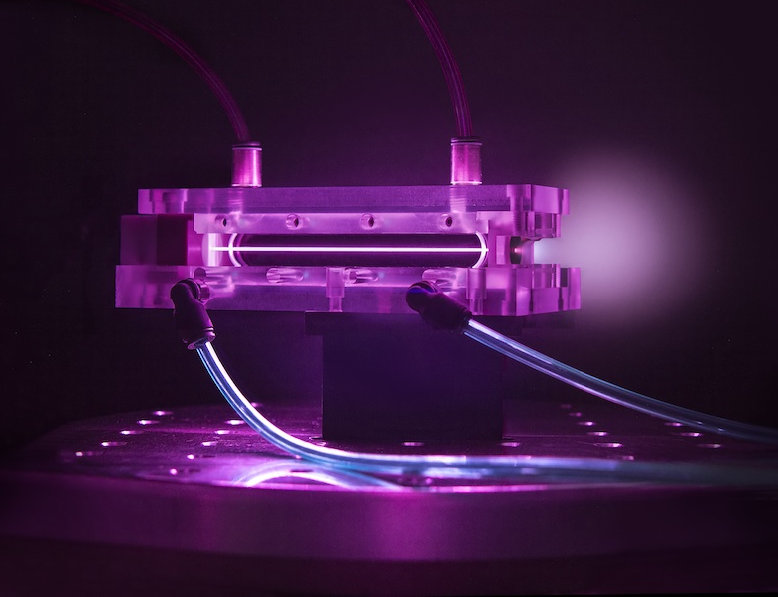
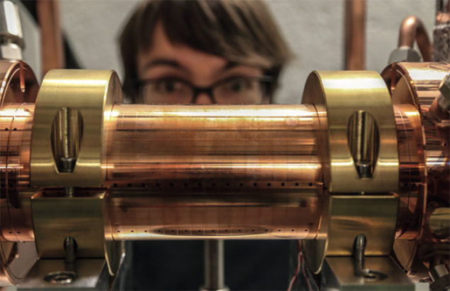
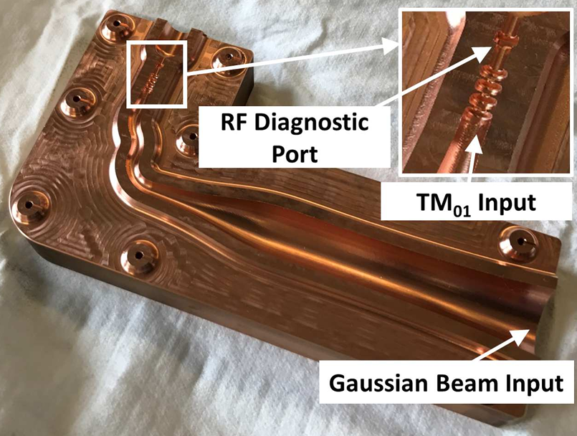
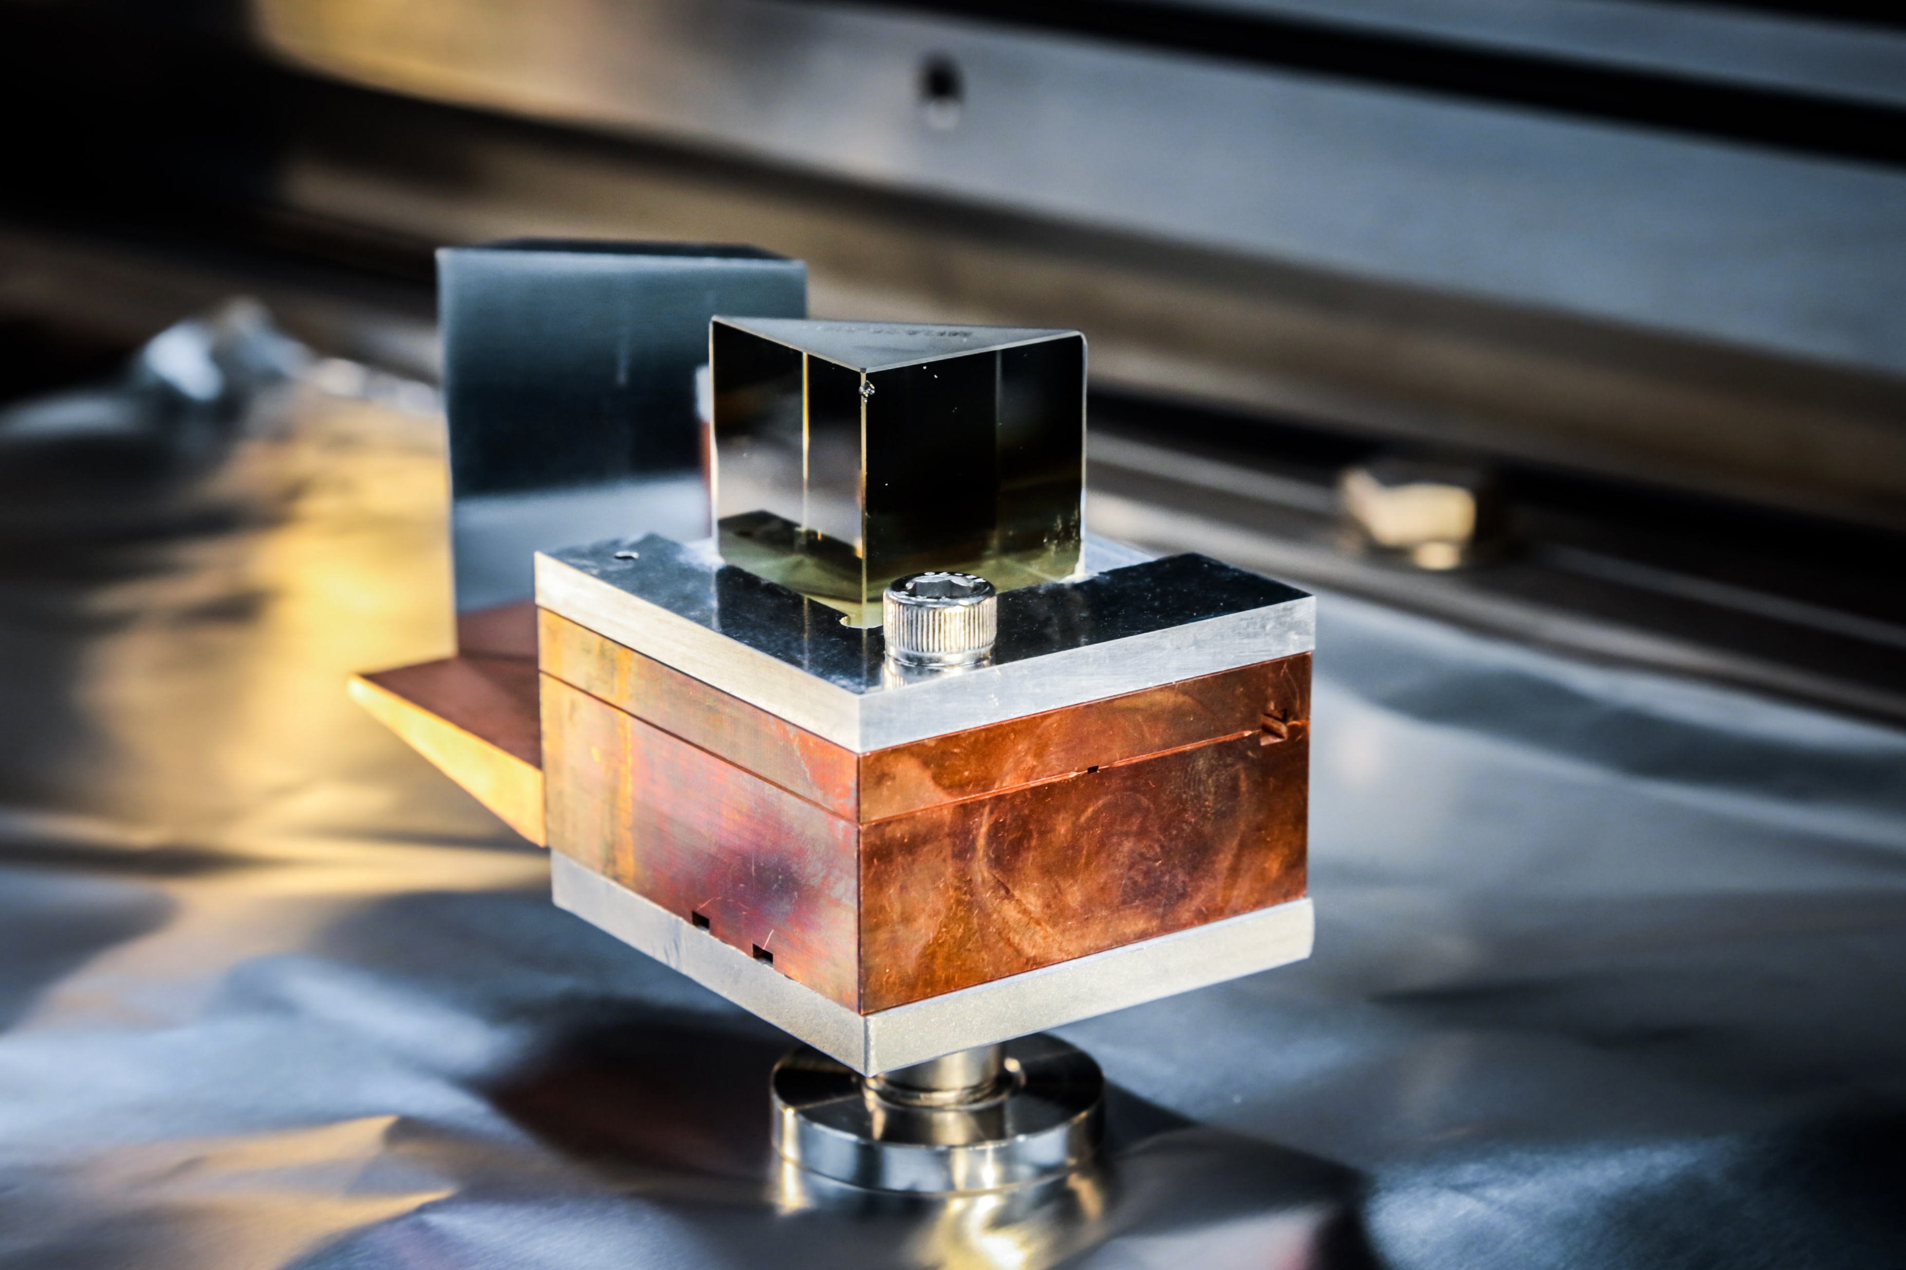
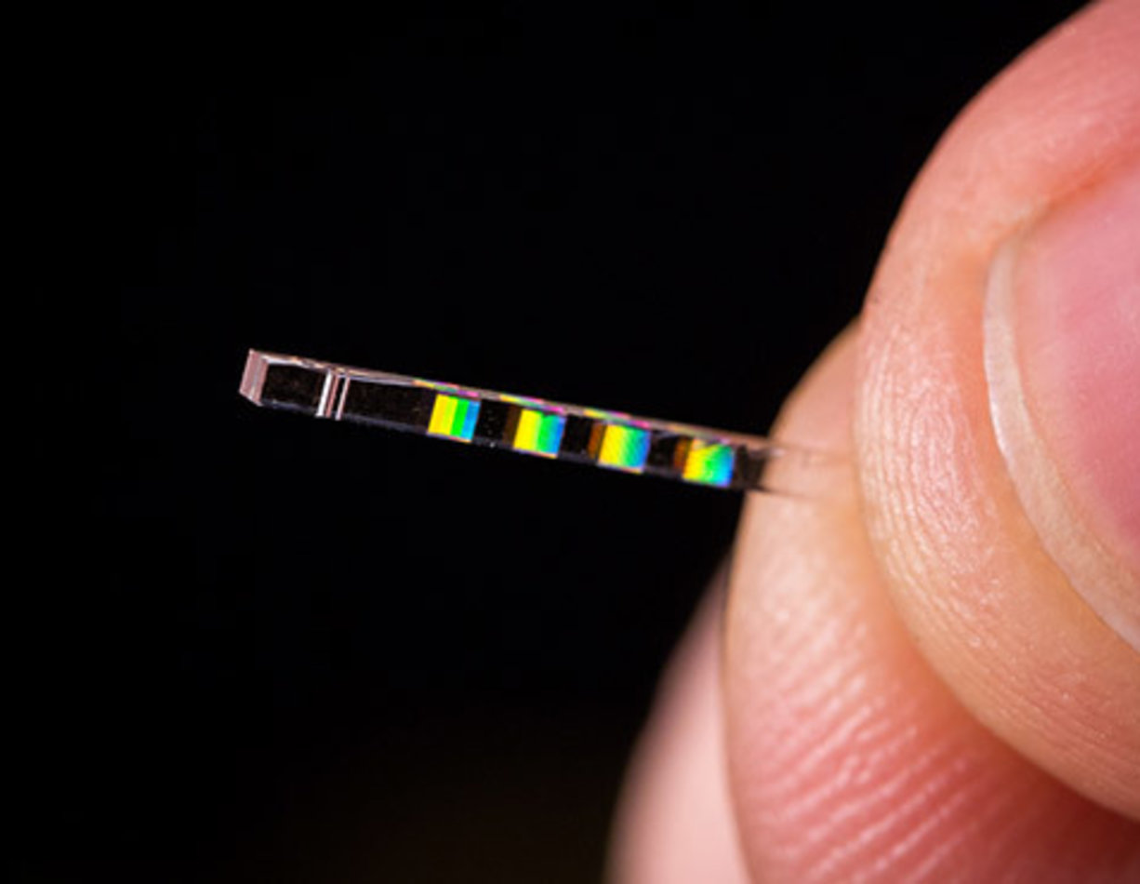
Advanced acceleration
RF
AWAKE
PWFA
LWFA
Radio
Microwave
Terahertz
Infrared
Visible
Ultraviolet
X-Ray
Gamma
2 THz
150 µm
8 THz
40 µm
3 GHz
10 cm
0.2 THz
1.5 mm
12 GHz
25 mm
0.1 THz
3 mm
0.4 THz
750 µm
375 THz
800 nm
X-band
Terahertz-driven
Dielectric laser accelerators
mm-wave
Morgan Hibberd | The next 20 years: Advanced acceleration | CI 20th Anniversary 20th Sep 2024

Slide 8
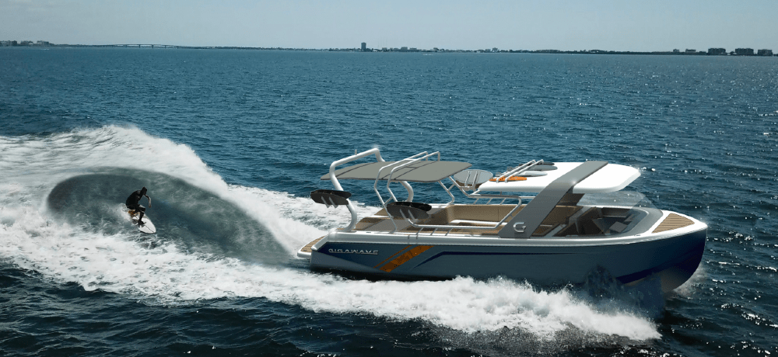
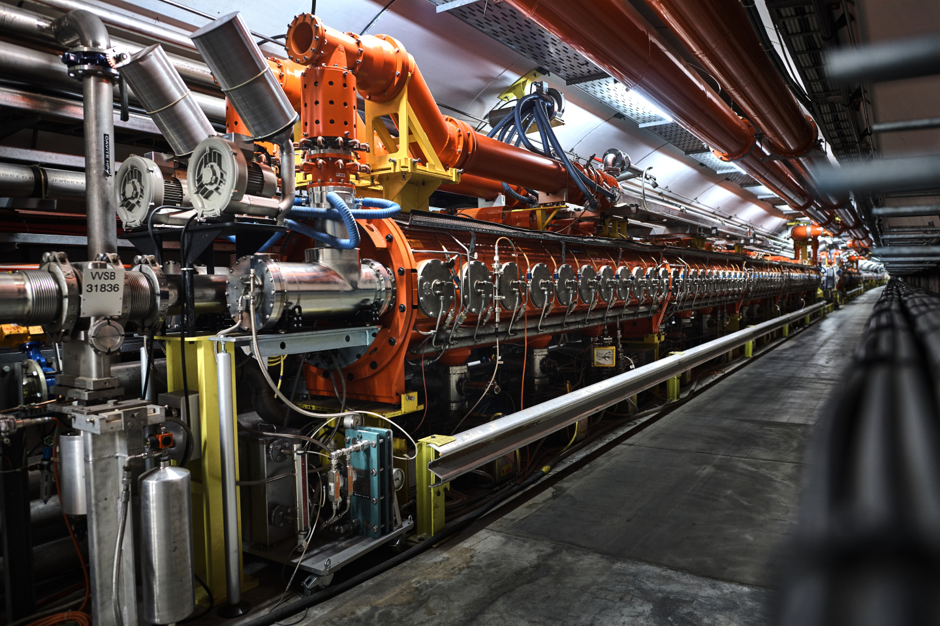
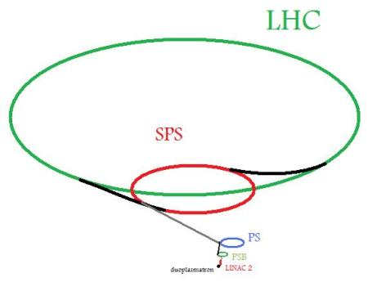
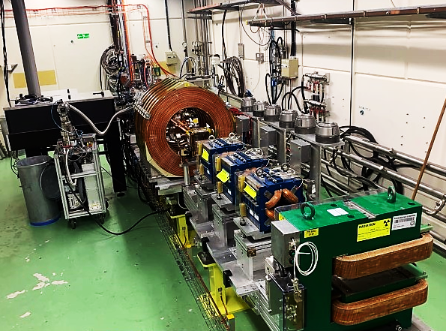
Beam-driven plasma wakefield acceleration
Particle beam (protons or electrons) drives wakefields in a plasma
Create accelerating fields up to a 1000x higher than conventional accelerators
Combines both conventional and advanced accelerator technology
“Gigawave” wake boat
Injected beam
Plasma
Drive beam
A unique example is the Advanced Wakefield Experiment (AWAKE) at CERN
RF-based accelerators
Proton-driven plasma wakefield
Electron-driven plasma wakefield
Super Proton Synchrotron
(400 GeV protons)
Large Hadron Collider
(7 TeV protons)
Next 5 years
High quality beams
Scalable to >100 m
Next 20 years
Particle physics
20-200 GeV electrons
TeV-scale electrons
The issues…
Low repetition rate → Low luminosity
Needs a high energy proton machine!
AWAKE RF injector
(150 MeV electrons)
Morgan Hibberd | The next 20 years: Advanced acceleration | CI 20th Anniversary 20th Sep 2024
Notes:
AWAKE max rep rate = 10 Hz (gun)
SPS proton extraction = 0.14 Hz
LHC fill time = 4 mins

Slide 9
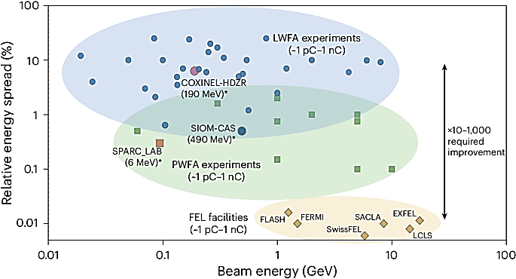
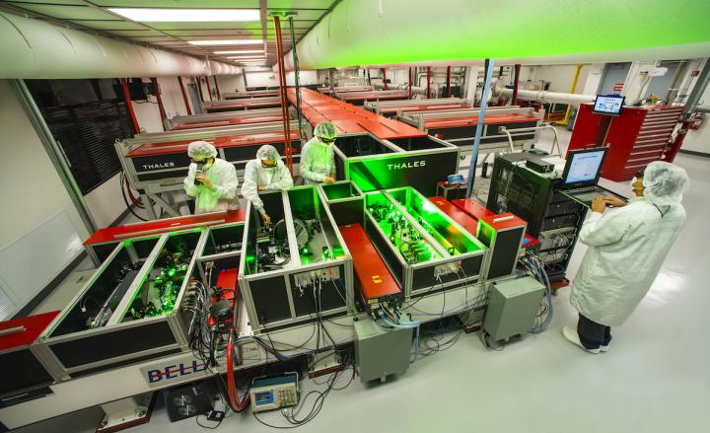
Laser-driven plasma wakefield acceleration
Extremely intense laser pulse drives wakefields in a plasma
Create accelerating fields up to a 1000x higher than conventional accelerators
Self-injection - generates its own electron beam!
Achievements
Record energy gain of 7.8 GeV in 20 cm (BELLA @ LBNL)
Stable operation for 30 hours (LUX @ DESY)
Free-electron lasing has been achieved (SIOM-CAS + COXINEL-HZDR)
The challenges…
Poor beam quality
Staging to high energy
Repetition rate
Energy efficiency
Galletti et al. Nat. Photonics 18, 780 (2024)
LWFA
PWFA
Can explore with new 120 TW laser here at CLARA/FEBE
RF
Berkeley Lab Laser Accelerator (BELLA)
Morgan Hibberd | The next 20 years: Advanced acceleration | CI 20th Anniversary 20th Sep 2024

Slide 10
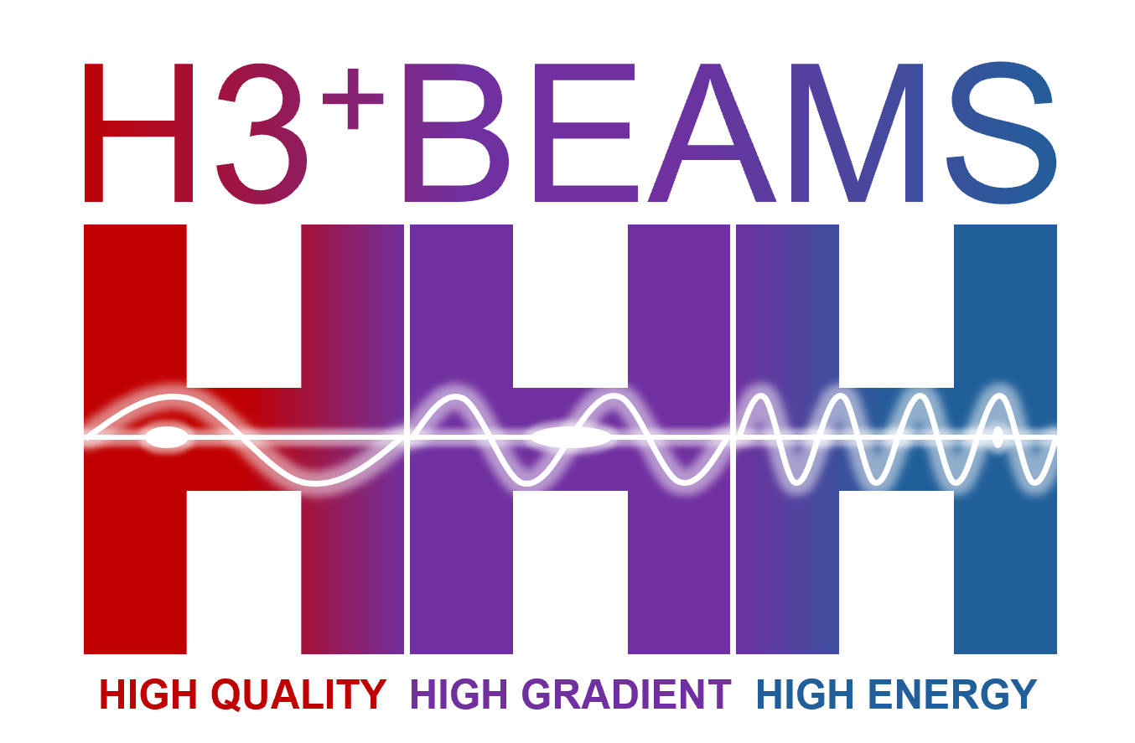
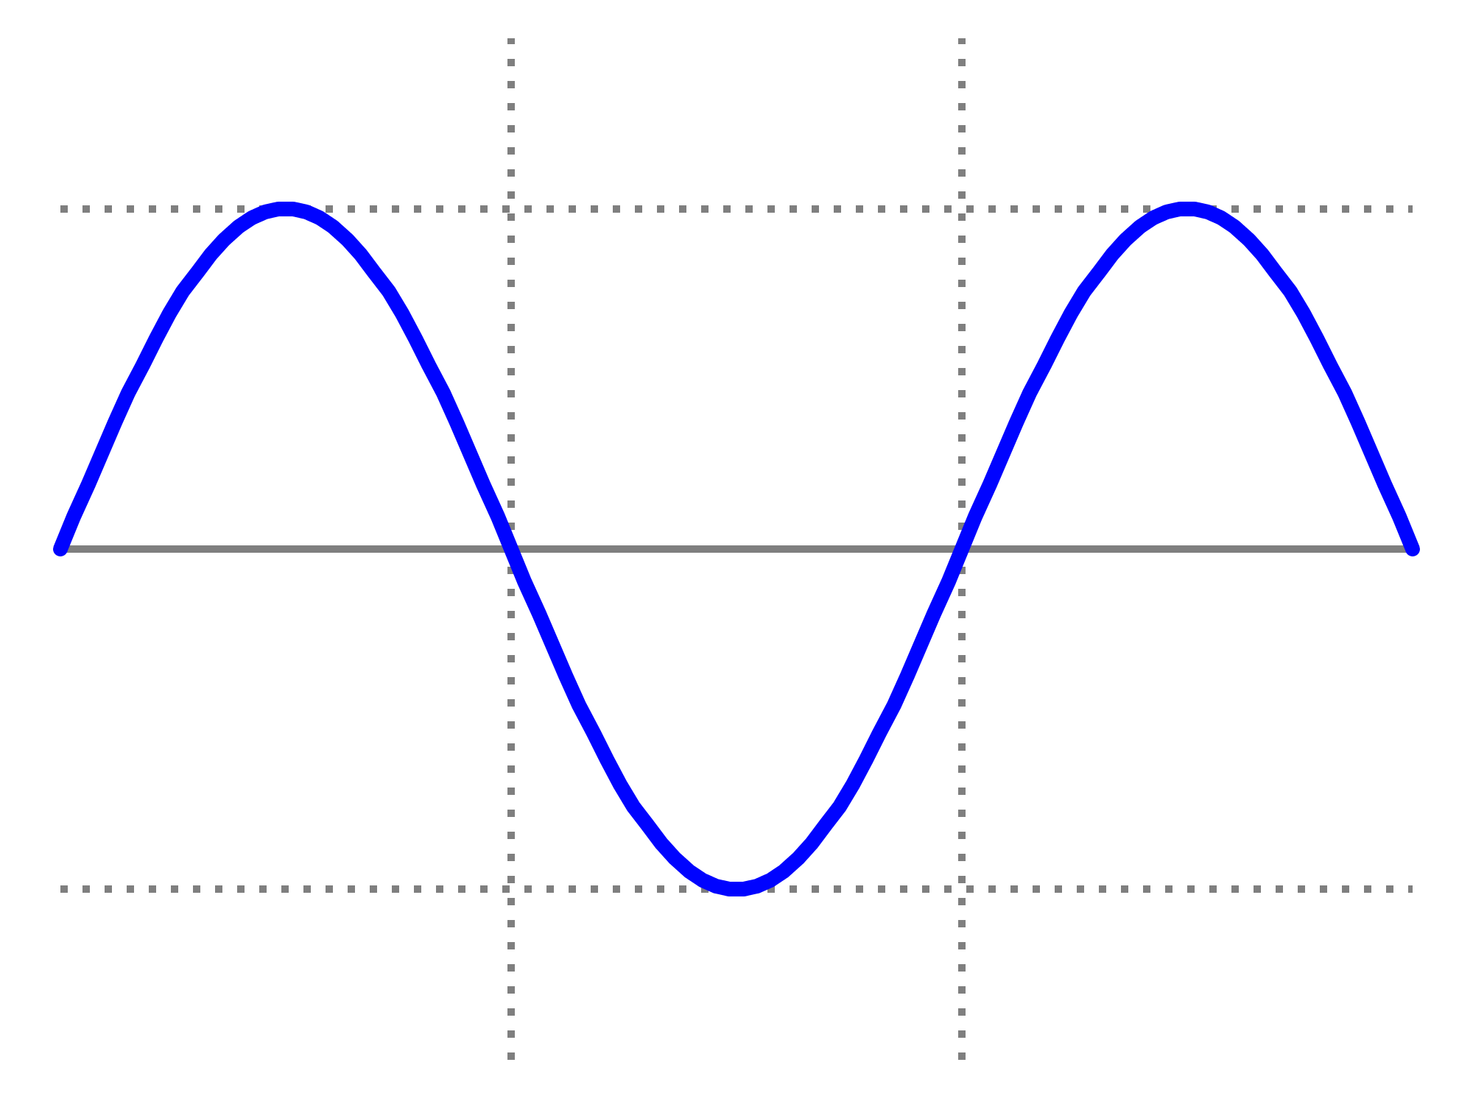
Combining conventional and advanced technologies
External injection of electrons into a laser-driven plasma wakefield
CLARA/FEBE one of only a few facilities in the world with this capability
AWAKE
0.2 THz
1.5 mm
LWFA
8 THz
40 µm
RF-based accelerator
Terahertz-driven “acceleration”
Laser-driven plasma wakefield
0.4 THz
750 µm
CLARA (250 MeV electrons)
Laser
Electron bunch
Accelerating field
≈ 60 fs
≈ 60 fs
Combines 3 accelerator technologies
THz “bridge” between RF and LWFA
Poor beam quality
High beam quality
Morgan Hibberd | The next 20 years: Advanced acceleration | CI 20th Anniversary 20th Sep 2024

Slide 11
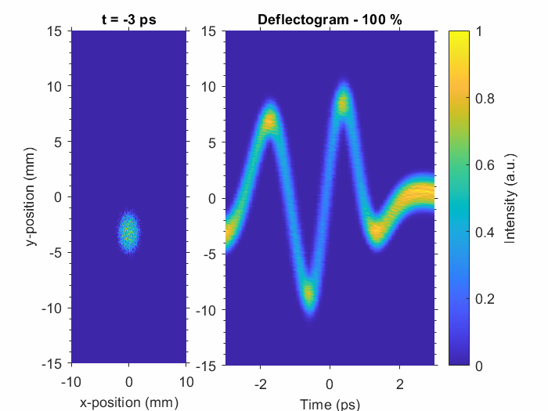
Terahertz-driven acceleration
Use ultrashort lasers to generate high-field terahertz pulses
Compact, high-charge, laser synchronisation, ideal for beam manipulation, no messy plasmas!
Sources developed with >10 GV/m fields – need to harness this potential for acceleration
THz streaking
Hibberd et al. Nat. Photon. 14, 755 (2020)
First demonstrations with relativistic electrons in 2020
From keV to MeV acceleration in <5 years
Laser-based THz-driven waveguide
Enhanced accelerator capabilities
Bunch compression & synchronisation
Streaking for bunch diagnostics
Bunch trains at THz repetition rates
THz pulse
Plasma wakefield
GeV and beyond?
Major source and structure developments
Efficiency a key challenge
THz bunch trains
Morgan Hibberd | The next 20 years: Advanced acceleration | CI 20th Anniversary 20th Sep 2024

Slide 12
Ask the audience
Morgan Hibberd | The next 20 years: Advanced acceleration | CI 20th Anniversary 20th Sep 2024

Slide 13
Thoughts on the next 20 years
The Future Circular Collider (FCC)
Monumental feat of engineering/science + new flagship for HEP – operation in 2040s
Whatever happens…we have to look to new advanced technologies!
Compact accelerators more accessible to wider communities
University labs, hospitals, industry etc.
Combination of advanced and conventional technologies to solve challenges
Transition from “advanced” concepts to real machines
e.g. EuPRAXIA – European Plasma Research Accelerator with eXcellence In Applications
Lasers integrated across all accelerator components – towards femtosecond regime and below
Photocathode
Gun
Linear accelerator
Free electron “laser”
User experiments
Diagnostics
Timescale for a future advanced collider?
Big challenges ahead – repetition rate/luminosity, stability, beam quality, staging, energy efficiency, sustainability
Morgan Hibberd | The next 20 years: Advanced acceleration | CI 20th Anniversary 20th Sep 2024

Slide 14
Ask the audience
Morgan Hibberd | The next 20 years: Advanced acceleration | CI 20th Anniversary 20th Sep 2024

Slide 15
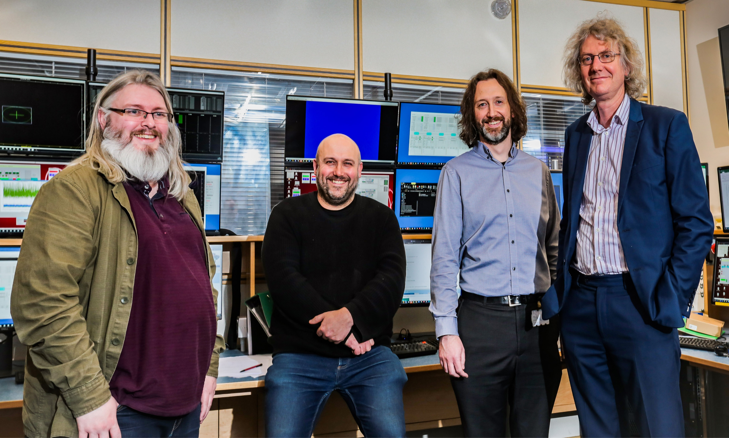
My future prospects
20 years ago
in 20 years*
X-Ray
Gamma
*no one in this picture is actually 20 years older than me
Thanks for listening!
Morgan Hibberd | The next 20 years: Advanced acceleration | CI 20th Anniversary 20th Sep 2024

Slide 16
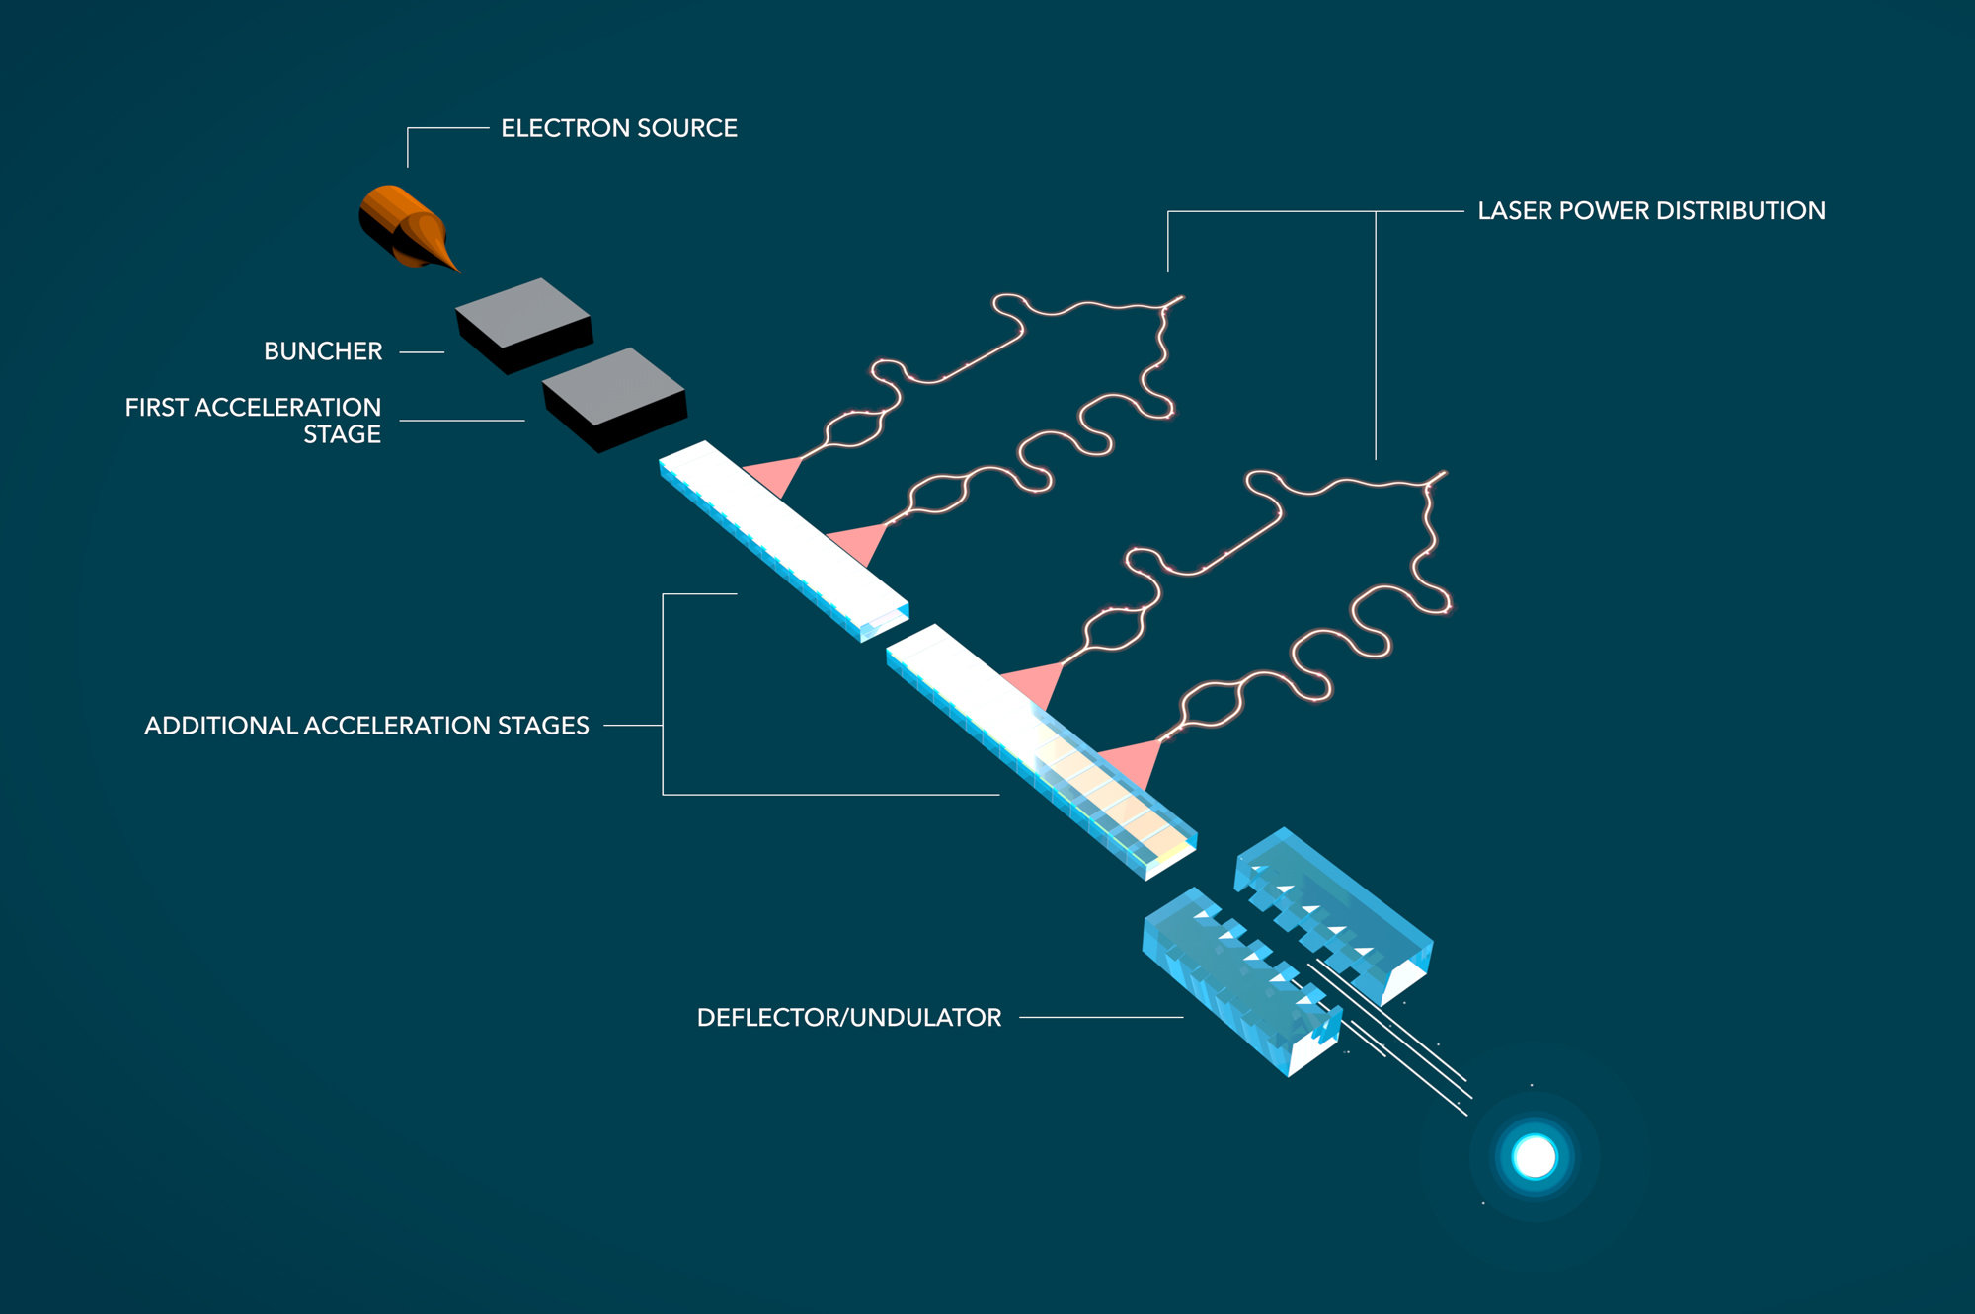
Exciting alternatives
Accelerator on a chip (ACHIP) programme
@ SLAC/DESY/PSI
The mm-wave accelerator programme @ SLAC
Dielectric laser accelerator
Gyrotron-driven mm-wave cavity
Powered by 110 GHz megawatt gyrotron oscillator
Laser switch chops 10 ns pulses from 3 µs pulses
Accelerating gradient of 230 MV/m achieved so far
0.3% of total pulse used → Drive 100’s of stages!
Othman et al. Appl. Phys. Lett. 117, 073502 (2020)
Morgan Hibberd | The next 20 years: Advanced acceleration | CI 20th Anniversary 20th Sep 2024

