Slide 1
A (personal) vision for the next 20 years of the Cockcroft
Professor Stewart Boogert
Director of Cockcroft Institute

Slide 2
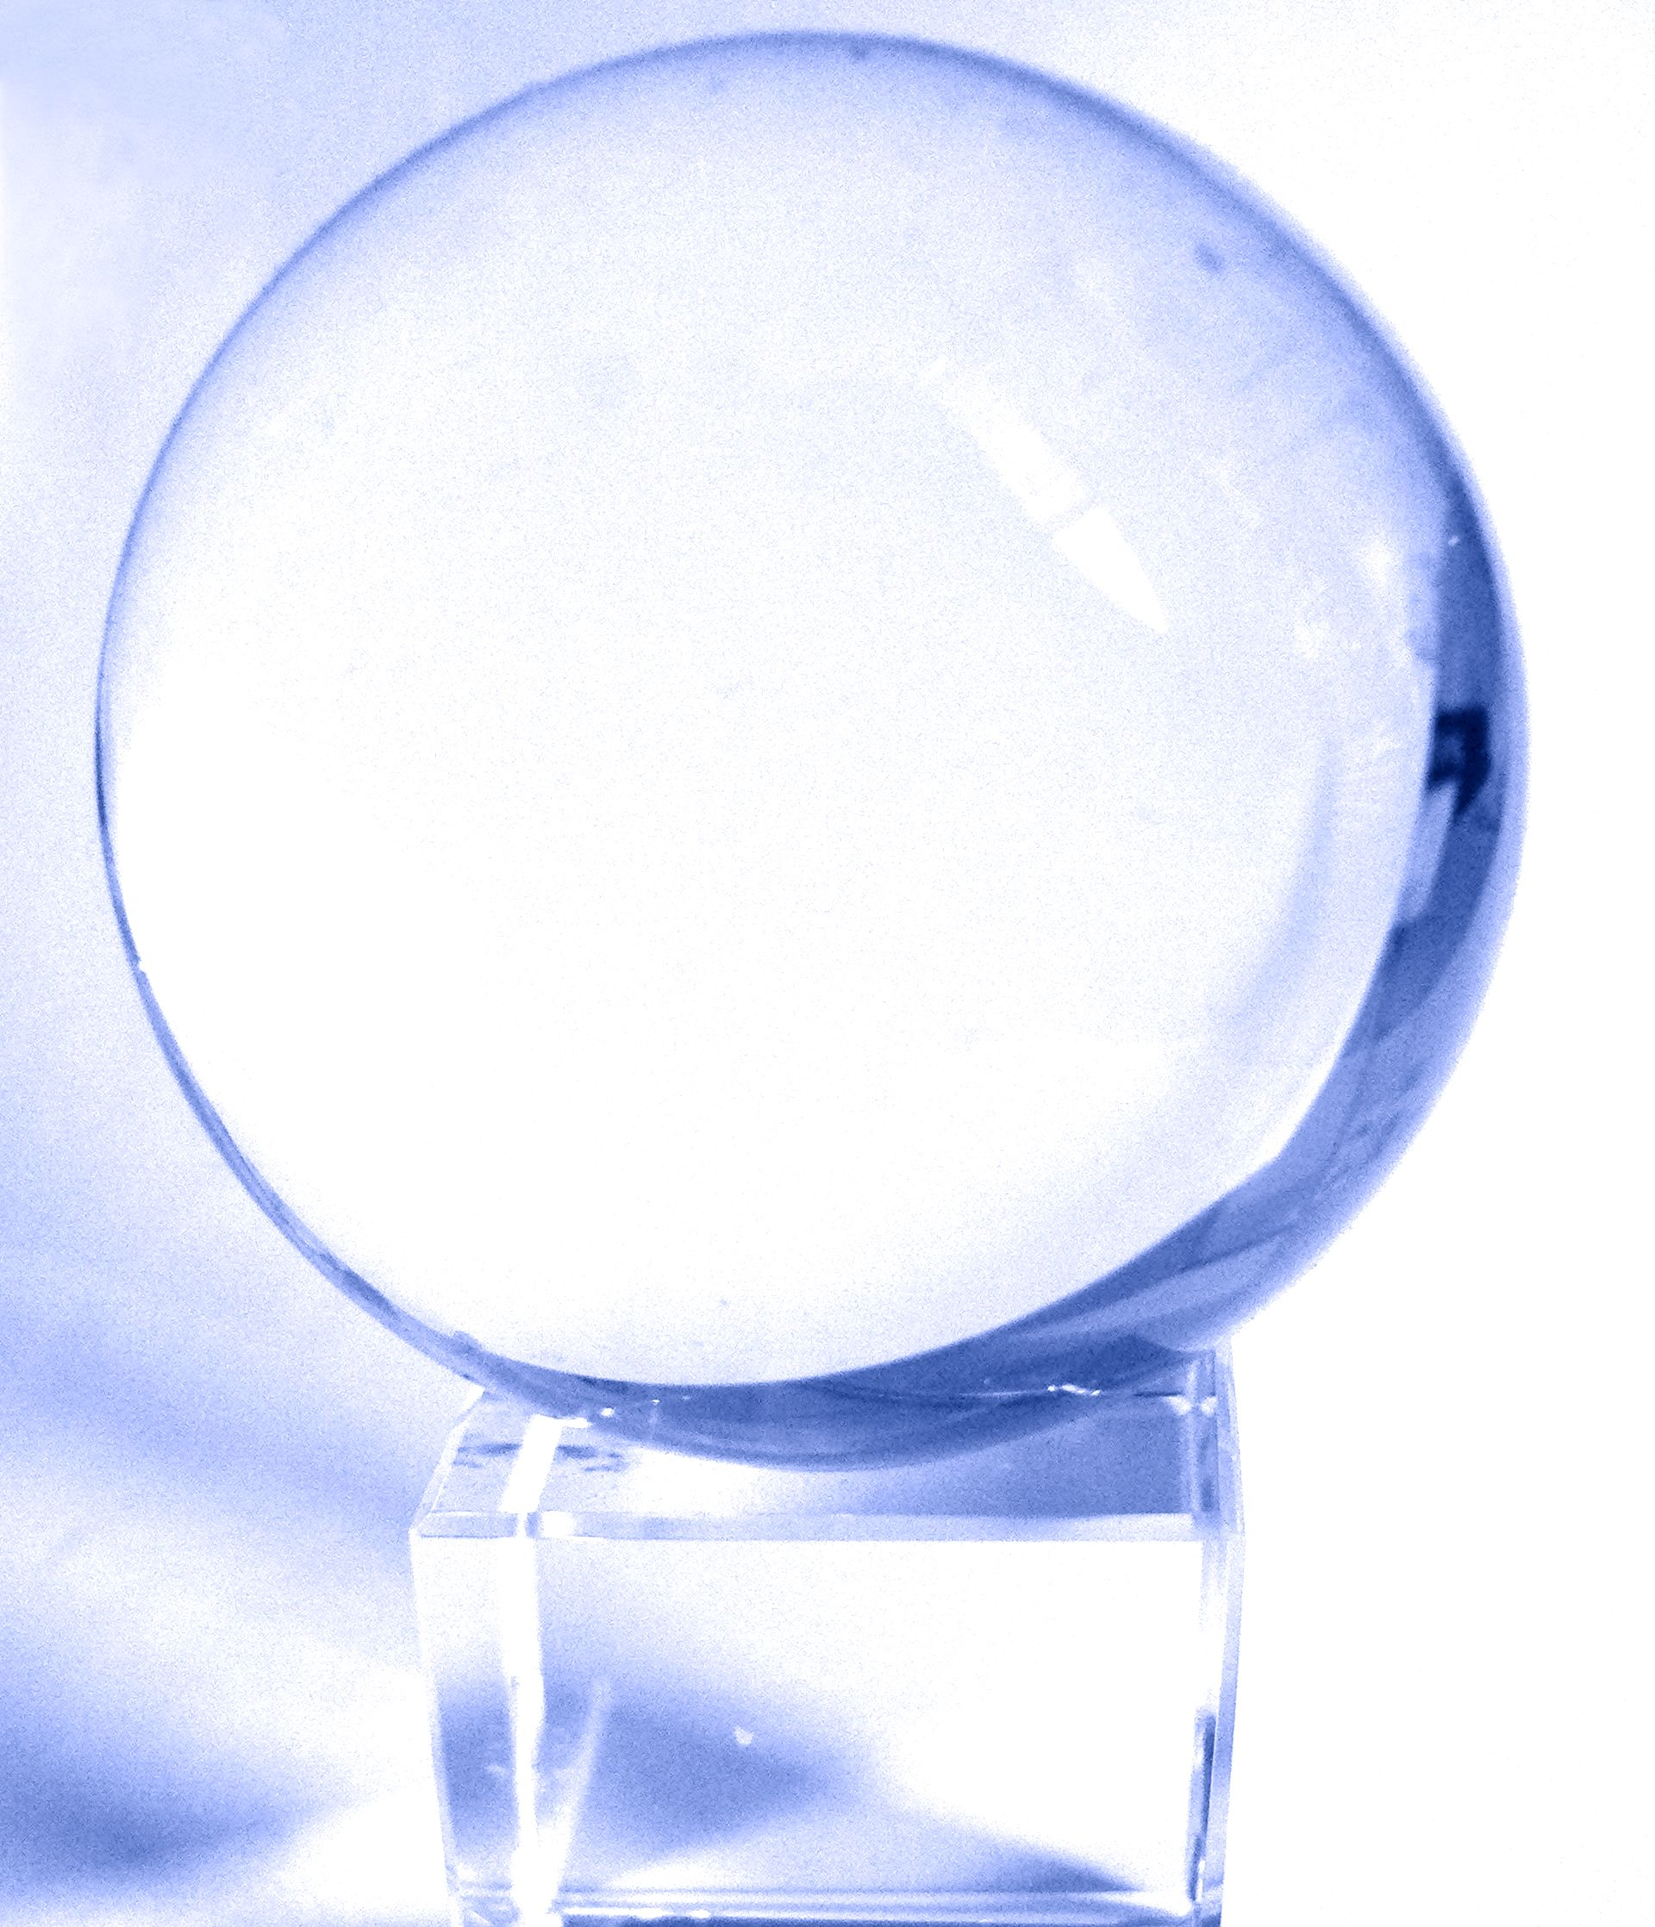
What will the next 20 years hold in store...
Notes:
Crystal ball but actually what the most important ball to look at?

Slide 3
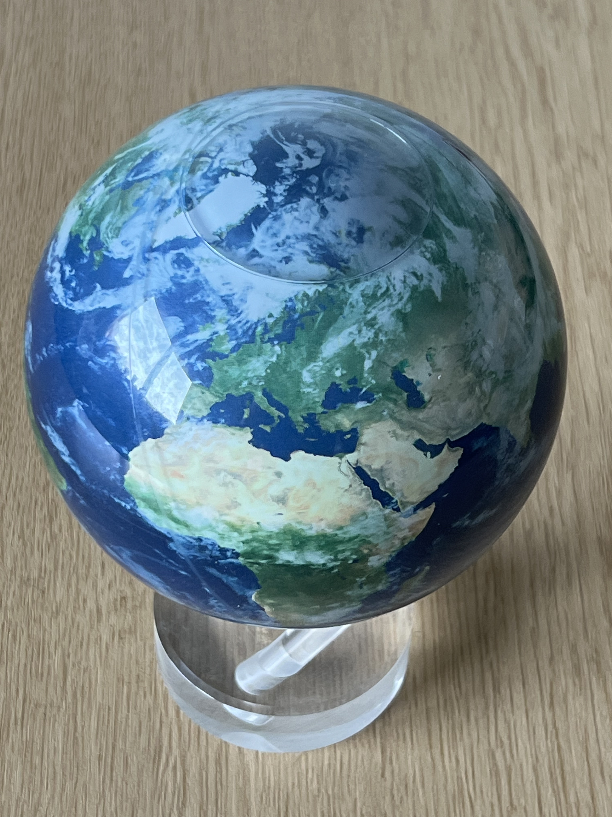
What will the next 20 years hold in store…
Notes:
Crystal ball but actually what the most important ball to look at?

Slide 4
Research areas which must feature
Sustainability
  Reducing the power consumption of accelerators
  Limiting the other material usage (e.g. concrete)
Novel acceleration
  Compact accelerators based on plasma wake-fields
  Other novel ”structures”
Applications of particle beams for societal good
  Treating cancer with particle beams (electrons, protons and ions)
  Industrial processing (textiles, water, etc.)
Industry 4.0
  Artificial intelligence
  New manufacturing techniques
  Digital twins and simulation
Future of high energy physics

Slide 5
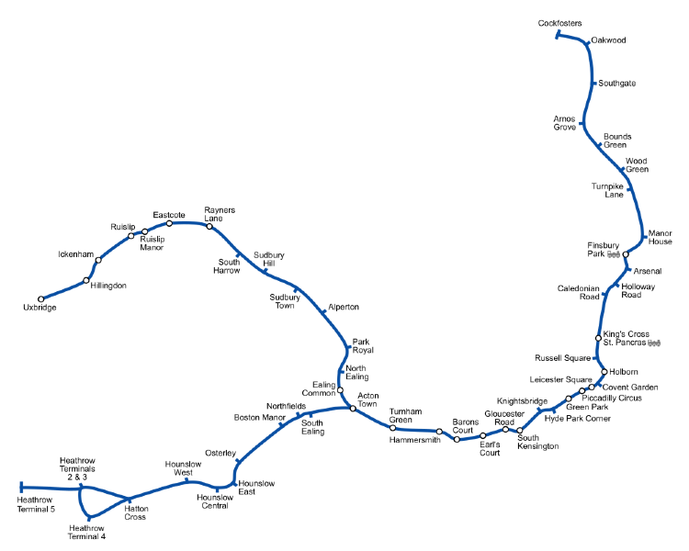
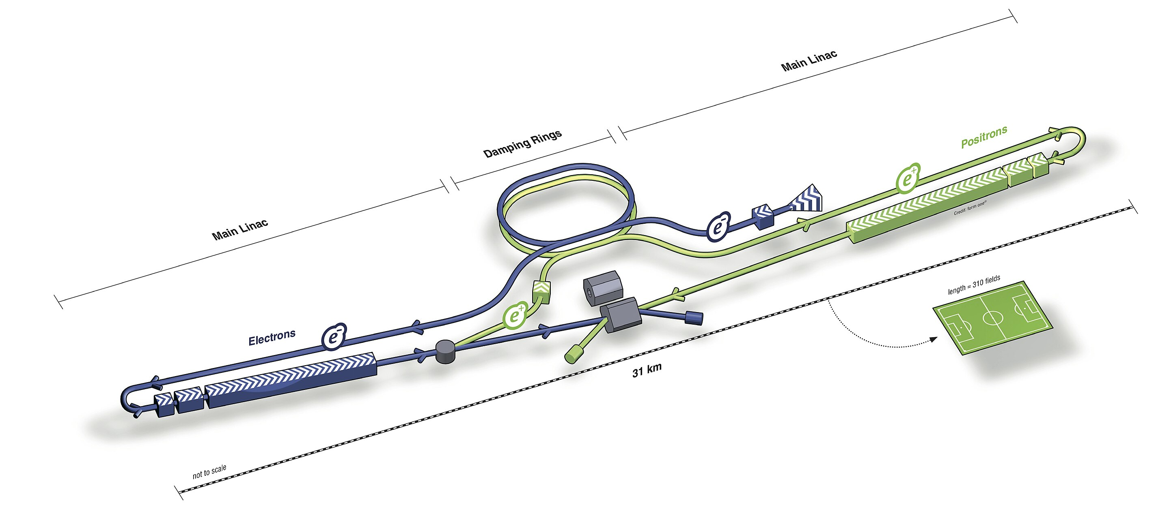
Sustainability: Context
Piccadilly line
Line length :73.97 km
International linear collider
Length : 31 km

Slide 6
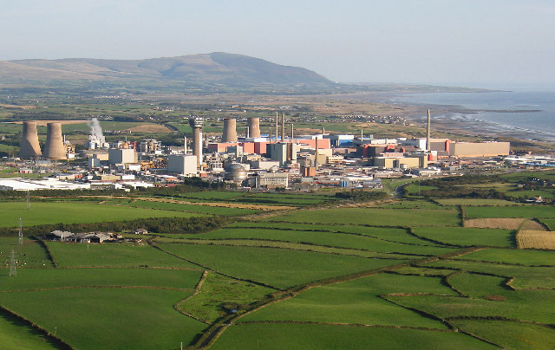
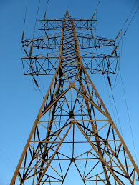
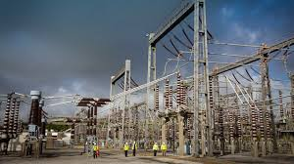
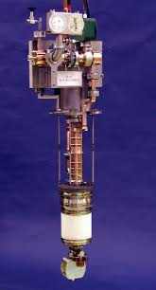
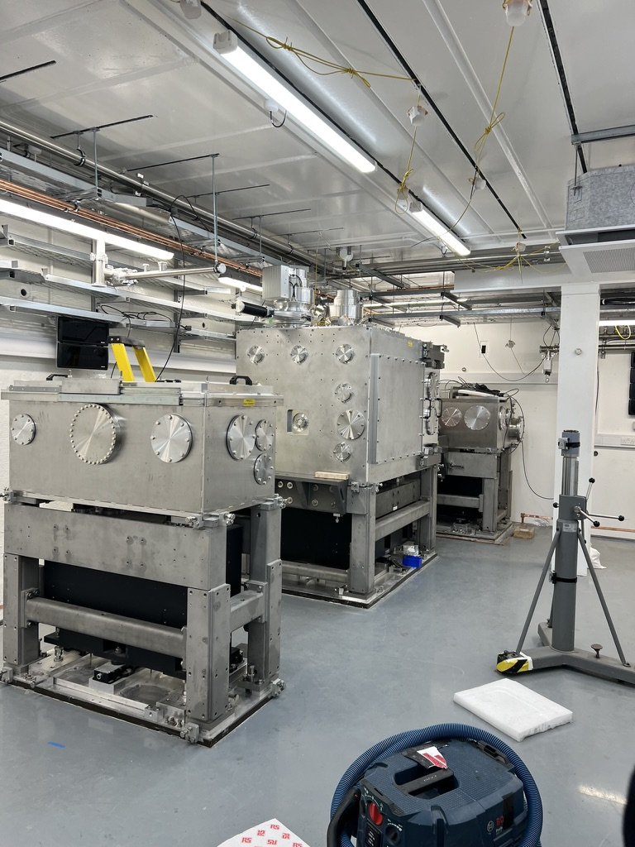
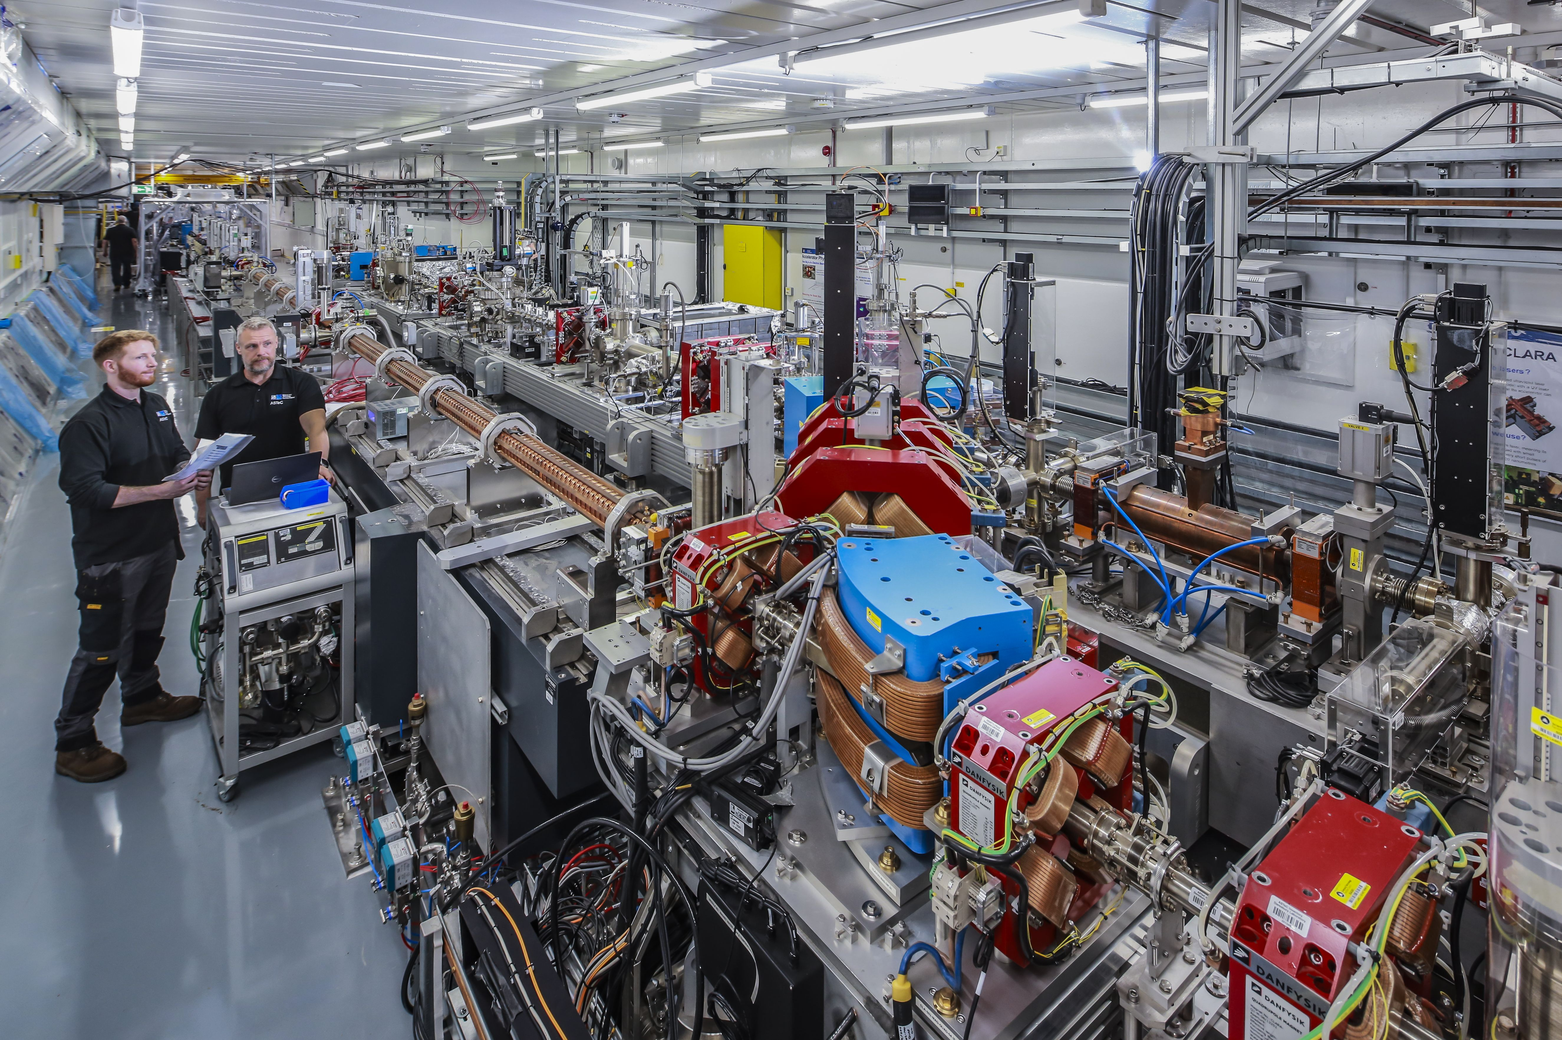
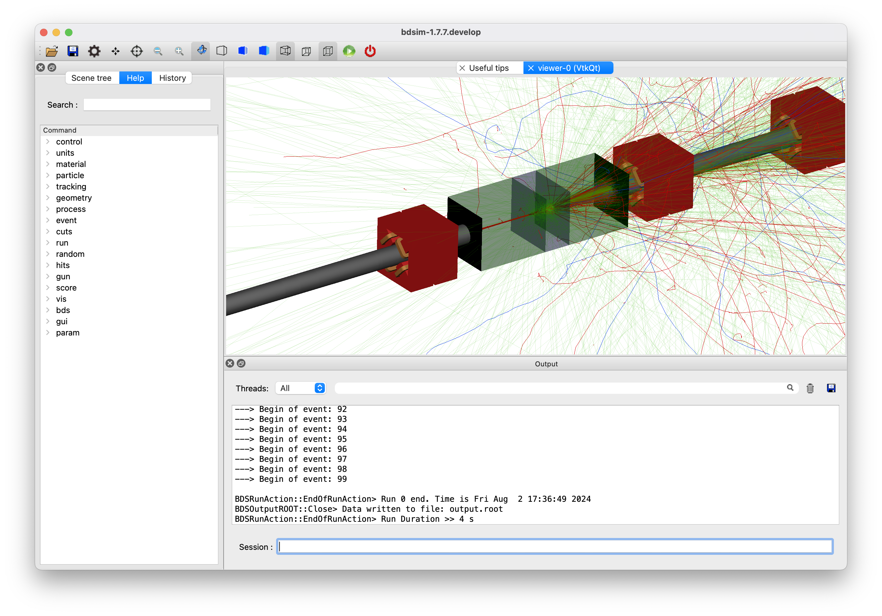
Sustainability: accelerators are just transformers

Slide 7
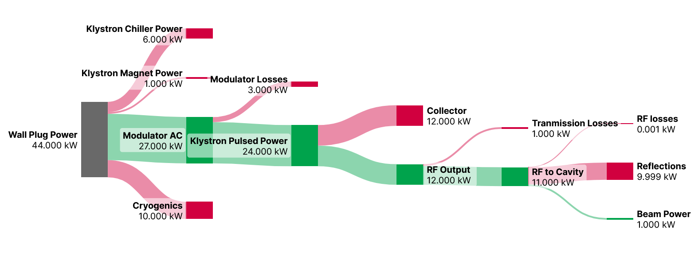
Sustainability: just looking at the RF
High efficiency Klystrons can halve this
Fast reactive tuners can reduce this by 10
Thin film SRF can halve this

Slide 8
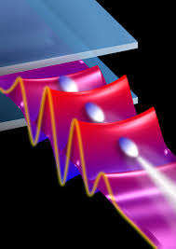
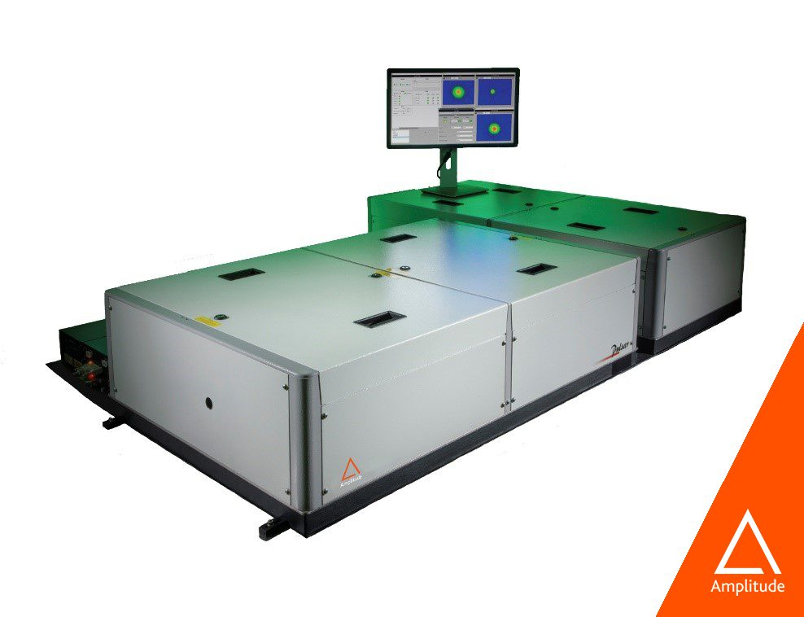
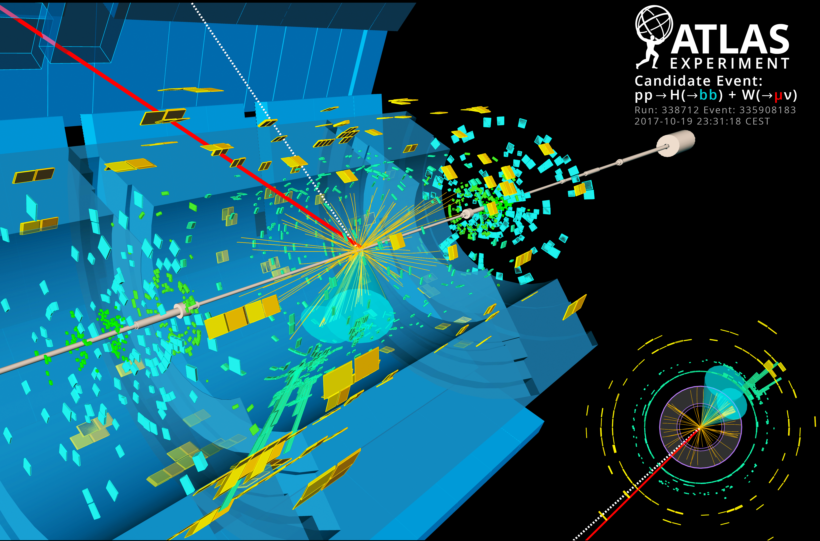
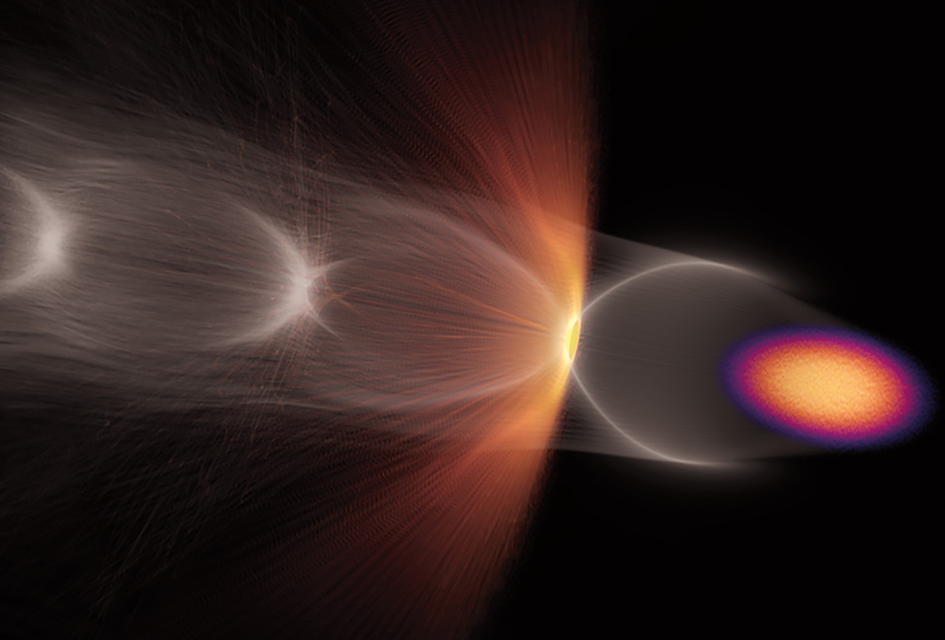
Novel acceleration: Reimagine the accelerating structure

Slide 9
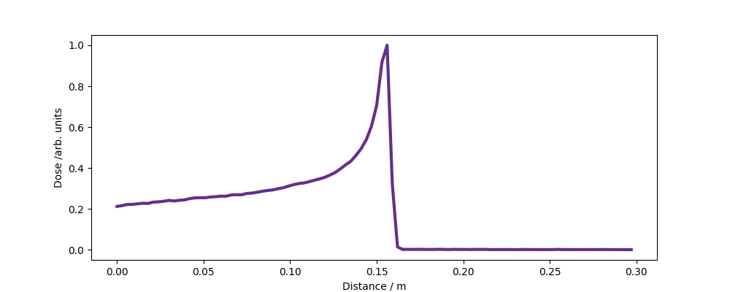
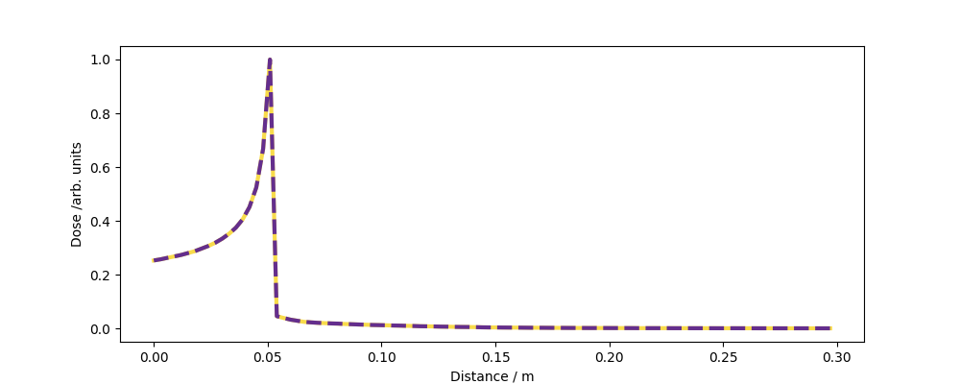
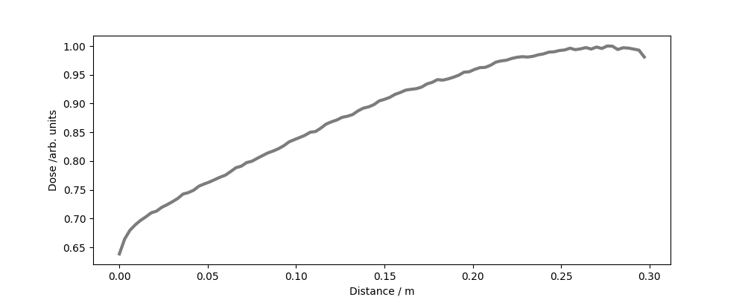
Particles to treat cancer
✅ 250 MeV VHEE
  CLARA/FEBE
✅ 150 MeV protons
  Christie
🛑 320 MeV C-12
✅ 35 MeV
  Dalton
✅ 6 MeV photons
  Almost every large hospital
Dose
Proton
0/cm
Depth/cm
30/cm
Nucleus (He)
Atom
Electron

Slide 10
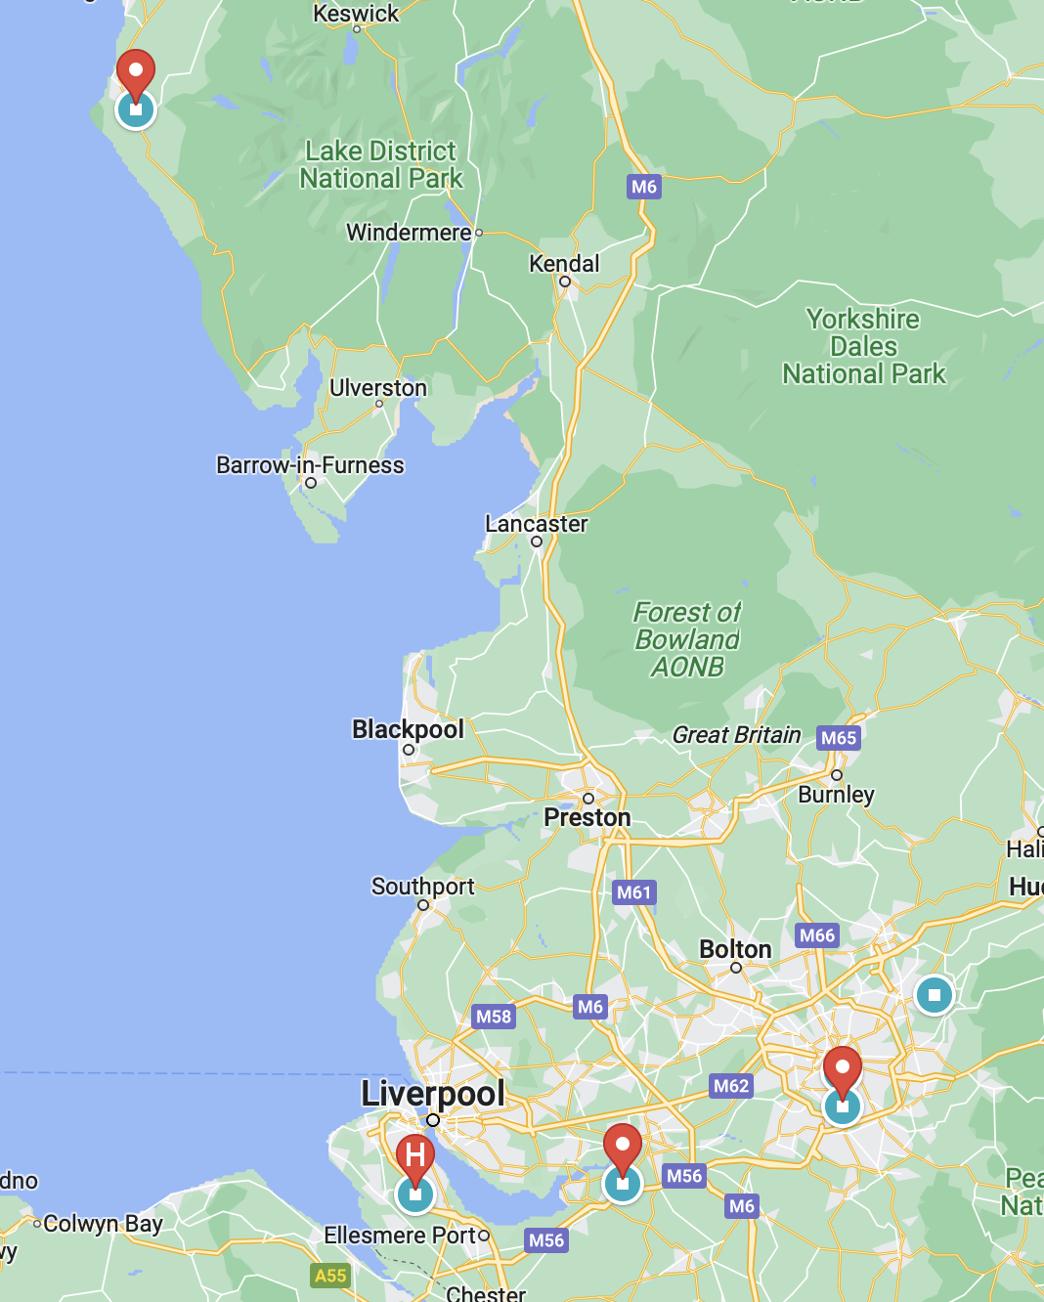
Medical applications: Therapeutic beams in the northwest of England
Lots of regional activity
  Dalton Cumbria Facility
  Christie Research room
  CLARA/FEBE VHEE facility
  Clatterbridge Hospital
Covering protons, electrons and ions with potential backing of leading international cancer research centre(s)
What is the appetite for a regional organisation?
Dalton Cumbria Facility
Christie
Clatterbridge
Daresbury

Slide 11
Medical applications: Promise of FLASH

Slide 12
Future for high energy physics
Facility
International linear collider
Compact linear collider
Future Circular collider (ee)
Future Circular collider (hh)
Muon collider
HALHF
Energy
500 GeV
500 - 3 TeV
350 GeV
100 TeV
10 TeV
350 GeV
Particles
Electrons - positrons
Electrons - positrons
Electrons – positrons
Proton – proton
Muons
Electrons – positrons

Slide 13
International Linear Collider

Slide 14
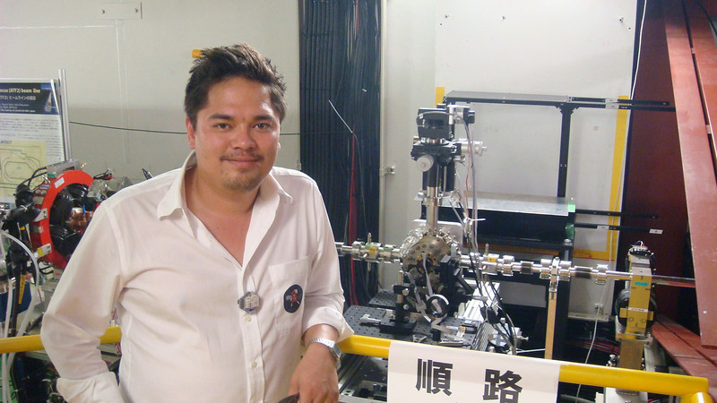
Personal aside: working on the ILC
Similar vintage to Graeme
Worked for over a decade on the International Linear Collider
  Beam position monitors
  High resolution cavities
  Final focus diagnostics
  Laser wire emittance diagnostics
  Diffraction radiation beam size
Almost everything you would need to measure an ILC beam

Slide 15
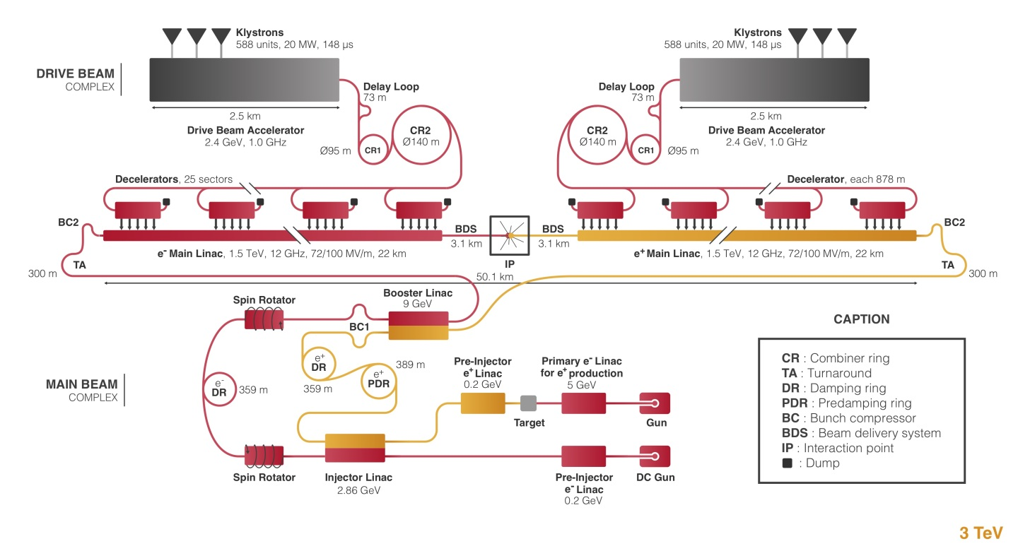
Compact Linear Collider

Slide 16
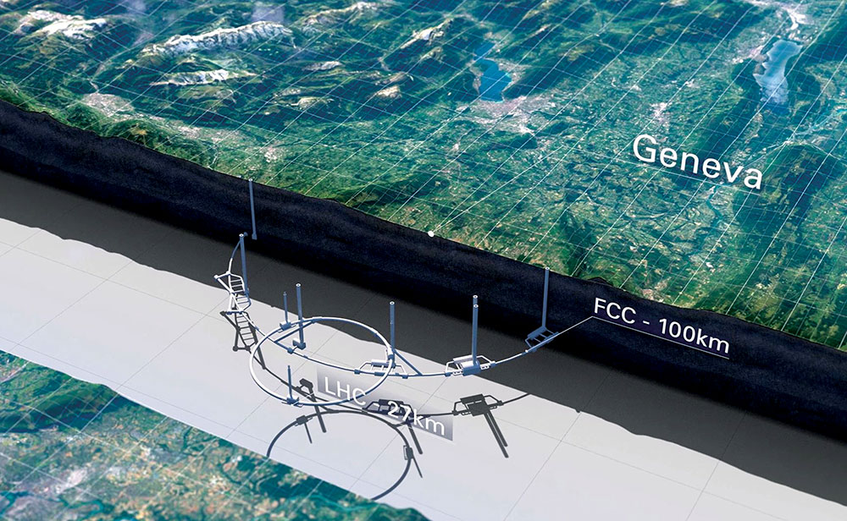
Future circular collider (FCC-ee)

Slide 17
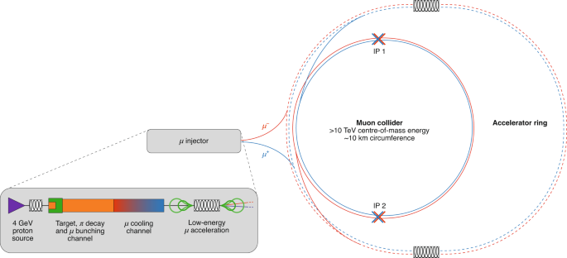
Muon collider

Slide 18
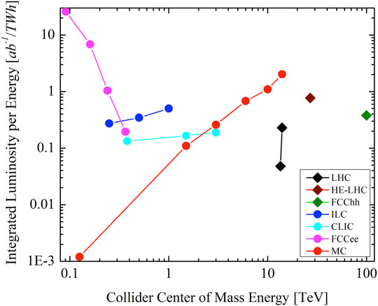
Physics is proportional to electrical power
Does not matter which particles protons on target (neutrinos), X-ray pulse energy, neutron flux
High energy particle physics facilities are at the limit
Sustainability important for all facilities
Sustainability will define which future HEP machines can be build

Slide 19
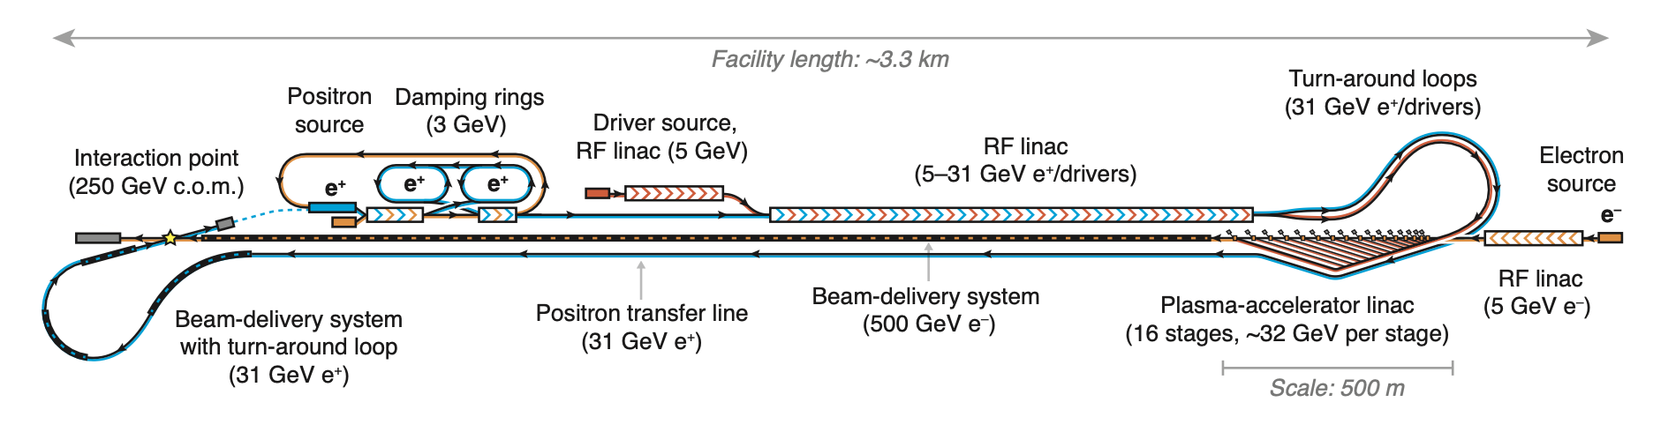
HALHF

Slide 20
HALHF: Great let's build one now
Still a long long way to go
Luminosity needs beam power
3 orders of magnitude in bunches/second
5 orders of magnitude in beam power
R&D required over next 10 years to see if these goals are achievable
R. D’Arcy ALEGRO workshop 2023 link

Slide 21
Tests occurring in Daresbury laboratory
Around the corner in STFC Daresbury
  CLARA/FEBE accelerator
  Built as a free electron laser test facility
    Bunch energy 250 MeV,
    Charge 250 pC,
    Frequency 10/100 Hz
  120 TW Ti:Sap CPA laser system
  2 large experimental chambers
Perform measurements of injection and acceleration

Slide 22
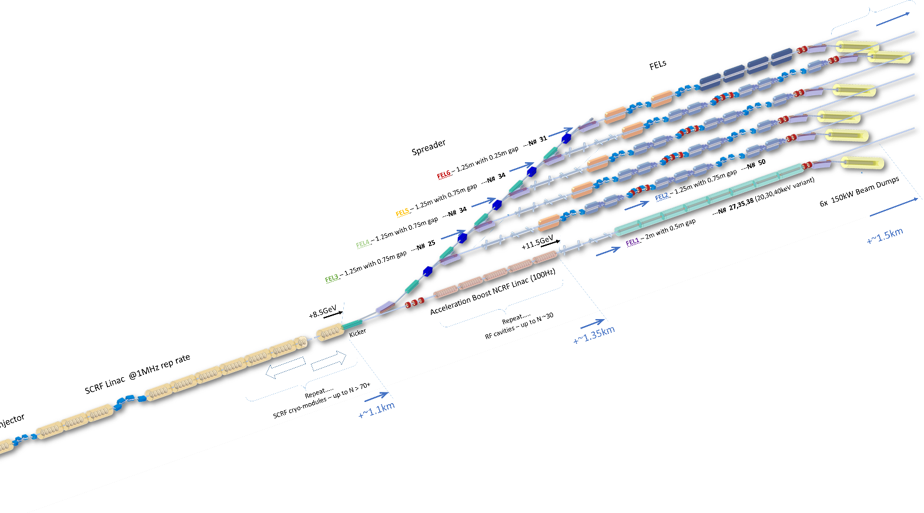
Is it all high energy physics? : UK XFEL

Slide 23
The next 20 years
Are accelerators all about high energy physics: No!
Is high energy physics a driver for innovation and development: Yes!
Sustainability is a moral imperative, but also key for approval (societal, government, financial) for future facilities
The Cockcroft Institute should chart a course towards sustainable accelerators
  Allows a high energy physics future
  Innovations are essential for lower energy machines (free electron lasers, neutron sources)
  Explore the impact of new methodologies and techniques e.g. AI/ML/AM
Cockcroft should continue to develop new ways of accelerating beams and useful applications of beams
Is the future of the Cockcroft a project or the people?

