Slide 1
From the CI to Industry
Mike Jenkins
Cockcroft Institute 20th Anniversary

Slide 2
“Life is about timing”
Attributed to Carl Lewis

Slide 3
The Journey
September 2009
2015
2017
2019
Today

Slide 4
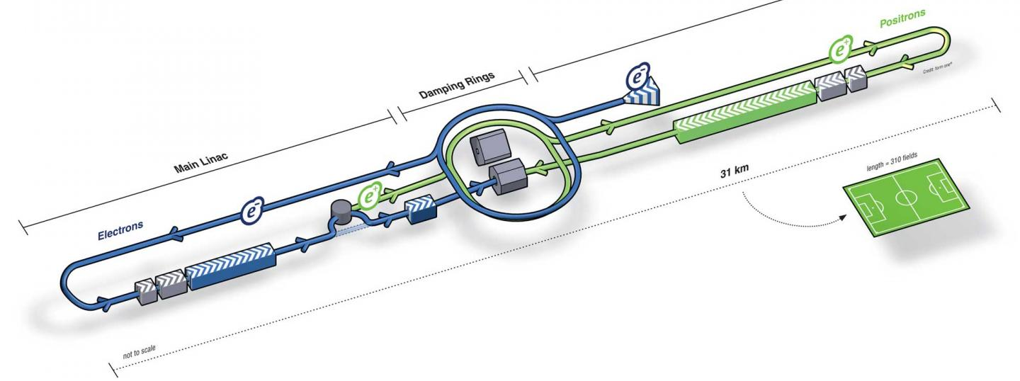
Lancaster University – Part 1
Joined Lancaster University Physics Department in September 2009
PhD Student working on:
“Undulator-based positron sources for future linear colliders”
Work initially focused on ILC before expanding to CLiC and LHeC

Slide 5
Impeccable Timing?
2010 UK funding for ILC stopped
ASTeC staff who were working on ILC transitioned to other programs
University academics moved to other projects driven by funding streams
I was funded until 2013 – but what would be the next step?

Slide 6
RF engineering, how hard could it be?

Slide 7
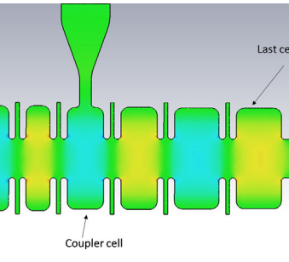
Lancaster University - Part 2
September 2013 – PhD funding had expired, and I need a job
Applied for PDRA position in High Power RF Engineering at Lancaster University
I got the job, but how I had no RF experience
Skills

Slide 8
First Exposure to Industry
The PDRA position I got at Lancaster was funded by CLASP
What is CLASP?
“Challenge Led Applied Systems Program supports the application and commercialisation of core STFC research in four key global research challenge areas, Energy, Environment, Healthcare and Security”
There were two CLASP programs I was involved in:
1MeV X-band linac for aviation cargo inspection (Security)
3MeV S-band linac for radiotherapy (Healthcare)
CLASP programs have an industrial partner which is where I got my first exposure to industry

Slide 9
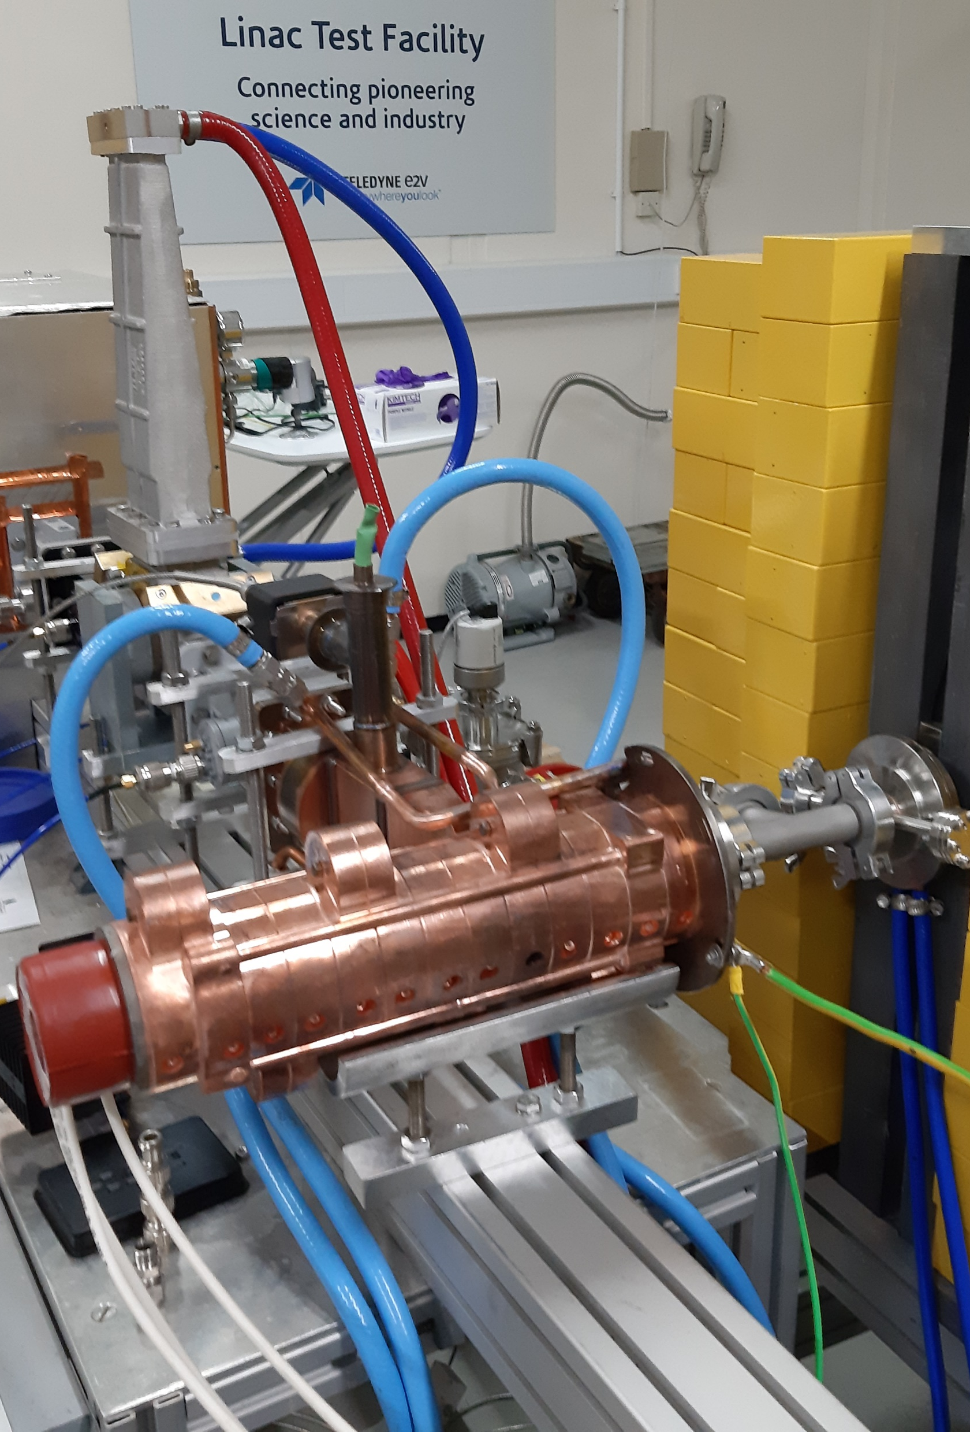
Lancaster to ASTeC
Turns out RF Engineering is fun, but 2-hour commutes are not
Relocated with my fiancé to be nearer to Daresbury
Simulations had turned into an experiment and working hands on with an accelerator was amazing
2015: the funding for my PDRA position was finishing and I needed a new job
Pete Corlett who I had been working closely with was moving to Australia so ASTeC was recruiting for a High Power RF Engineer
I applied and was accepted

Slide 10
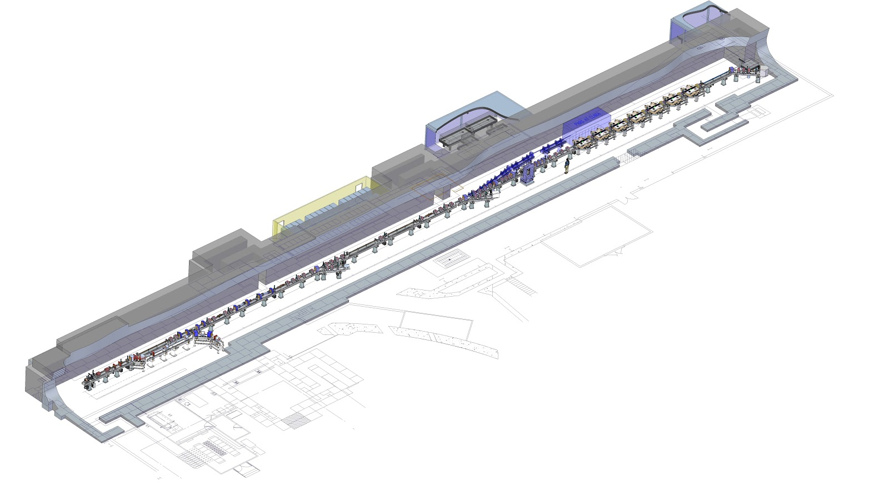
ASTeC
I joined ASTeC in 2015 to work on CLARA and the LTF
The LTF work was a continuation of the CLASP program I had been working on at Lancaster
CLARA was the new exciting program
The focus of my work was continuing to shift from simulations to hardware implementation

Slide 11
Bumps in the road
Mental health, Family, and Money

Slide 12
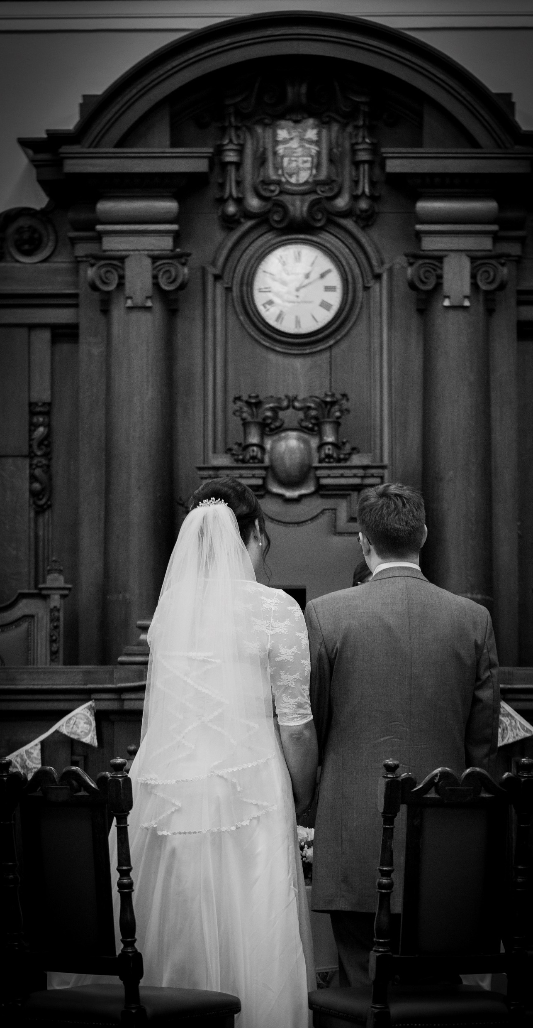
Family Comes First
2016 was a year of highs and lows
My fiancé was working as a Child Protection Social Worker in Cheshire and was struggling
The stress of her job combined with a lack of support from her employer was making her ill
We made the decision that she should stop working to allow her to get better
Money was tight but we thought we would be able to manage
Then we decided to get married, but that is ok as weddings aren’t expensive…
Then our rent went up… I had been having to sell possessions to pay bills, which was not sustainable something needed to change
It was time to reassess

Slide 13
To Industry
I had learnt a lot during my time at Cockcroft
What I thought I wanted to do when I joined turned out to be completely wrong
What I enjoyed and was good at was practical science and engineering using accelerators
Could I find a career where I can do what I enjoy whilst earning enough to support my family?

Slide 14
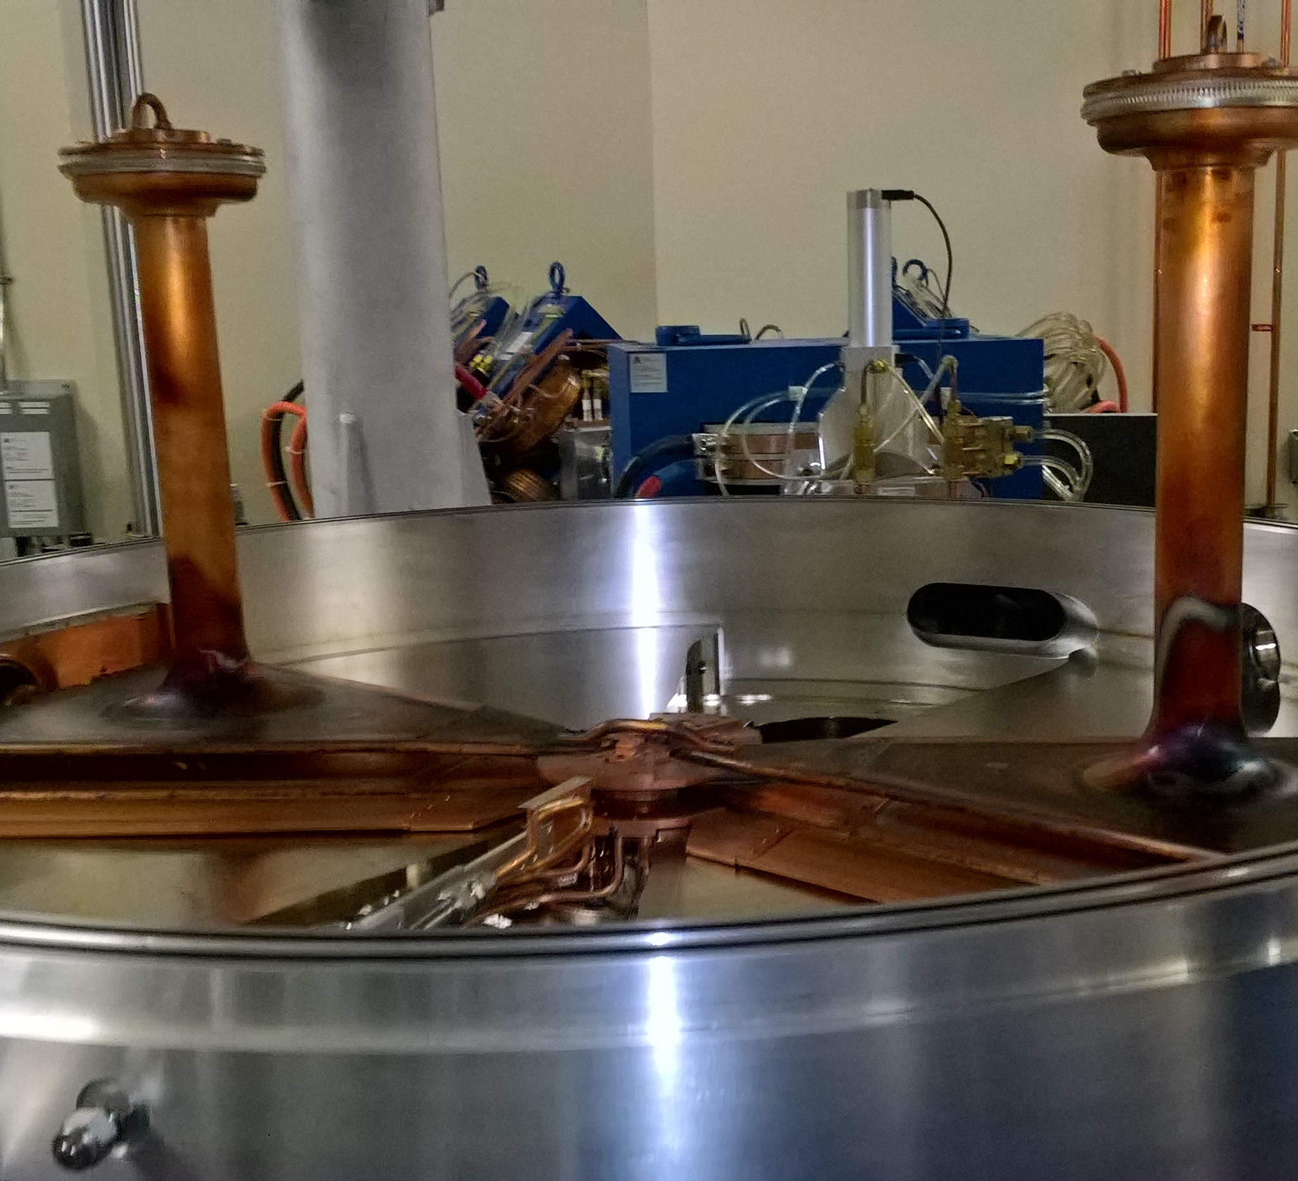
Alliance Medical
Alliance Medical were looking for a Cyclotron Engineer for a new facility
I had no experience with cyclotrons, but a lack of experience never stopped me before
What I did have was the skills and knowledge they needed
I thought this role came at a perfect time as it would provide the change we needed
Unfortunately my sense of timing hadn’t got any better

Slide 15
Timing Revisited
March 2017: Construction Starts
September 2017: Cyclotron Installation
October 2017: Construction Complete
November 2017: Commissioning Starts
January 2018: Radioisotope Production
What I was told
March 2017: Construction Firm Appointed
July 2017: Demolition Starts
October 2017: Construction Starts
May 2018: Cyclotron Installation 1
January 2019: Cyclotron Installation 2
April 2017: Project Lead Retired
March 2019: Building Contract Finishes
April 2019: I leave for a new role
What happened

Slide 16
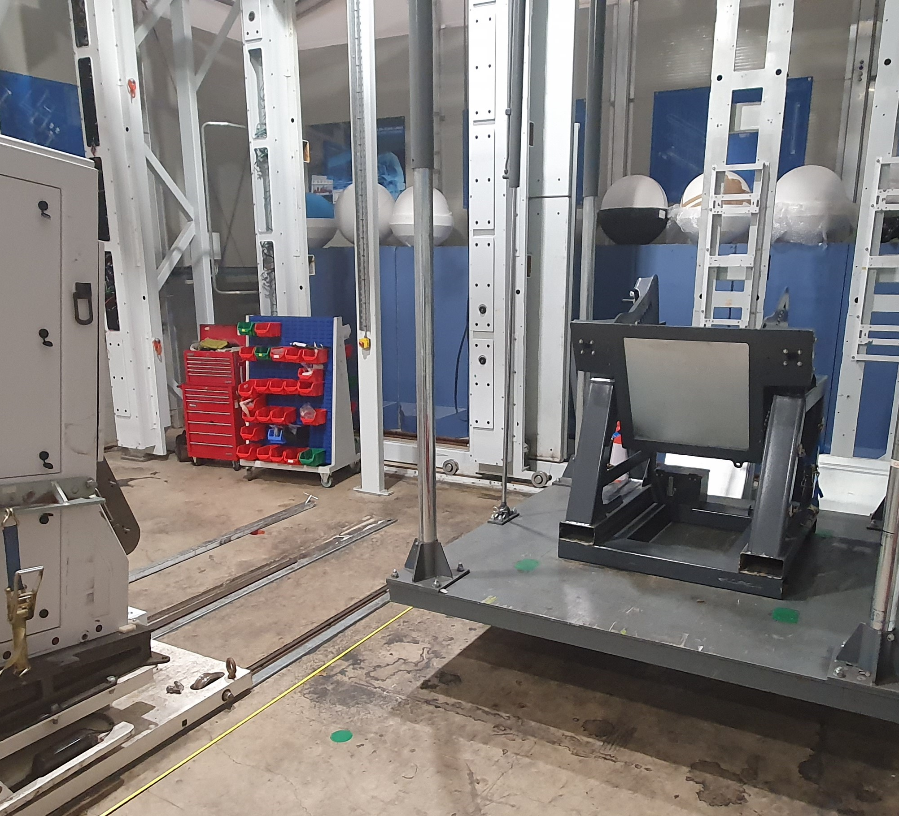
The First Job I have Experience For
My time at Alliance Medical was challenging
I never actually got to commission the cyclotron I was hired to work on
18 months into the role I started to really struggle
It was time for another change, but I still wanted to make a difference
Rapiscan were hiring for a Radiation Physicist, and I actually had experience for the position
Joined Rapiscan in April 2019

Slide 17
From the CI to Industry
My time at Cockcroft is what gave me the tools to succeed in industry
The tool kit needed for industry:
Soft Skills
Technical Skills
Networking
Knowledge and experience are helpful but not necessary
Why I moved to industry was for personal reasons:
Money
Family
Health
Sense of fulfilment

