Slide 1
20 years of graduate training and education
at the Cockcroft Institute
Dr Laura Corner & Dr. Rob Apsimon
Universities of Liverpool & Lancaster
Co-leads, Education & Training

Slide 2
Overview
Heads of Education & Training:
Neil Marks
Roger Jones
Graeme Burt
Louise Willingale
Graeme Burt
Hywel Owen
Laura Corner/Andy Wolski
Laura Corner/Rob Apsimon
Aim of training programme:
Provide graduate level training to accelerator students on the assumption that accelerator science is not taught in UG physics/engineering courses.
Provide broad overview of accelerator science not just specialised area of PhD research.
More useful overall skills.
Training part of STFC accreditation.
Peer support.

Slide 3
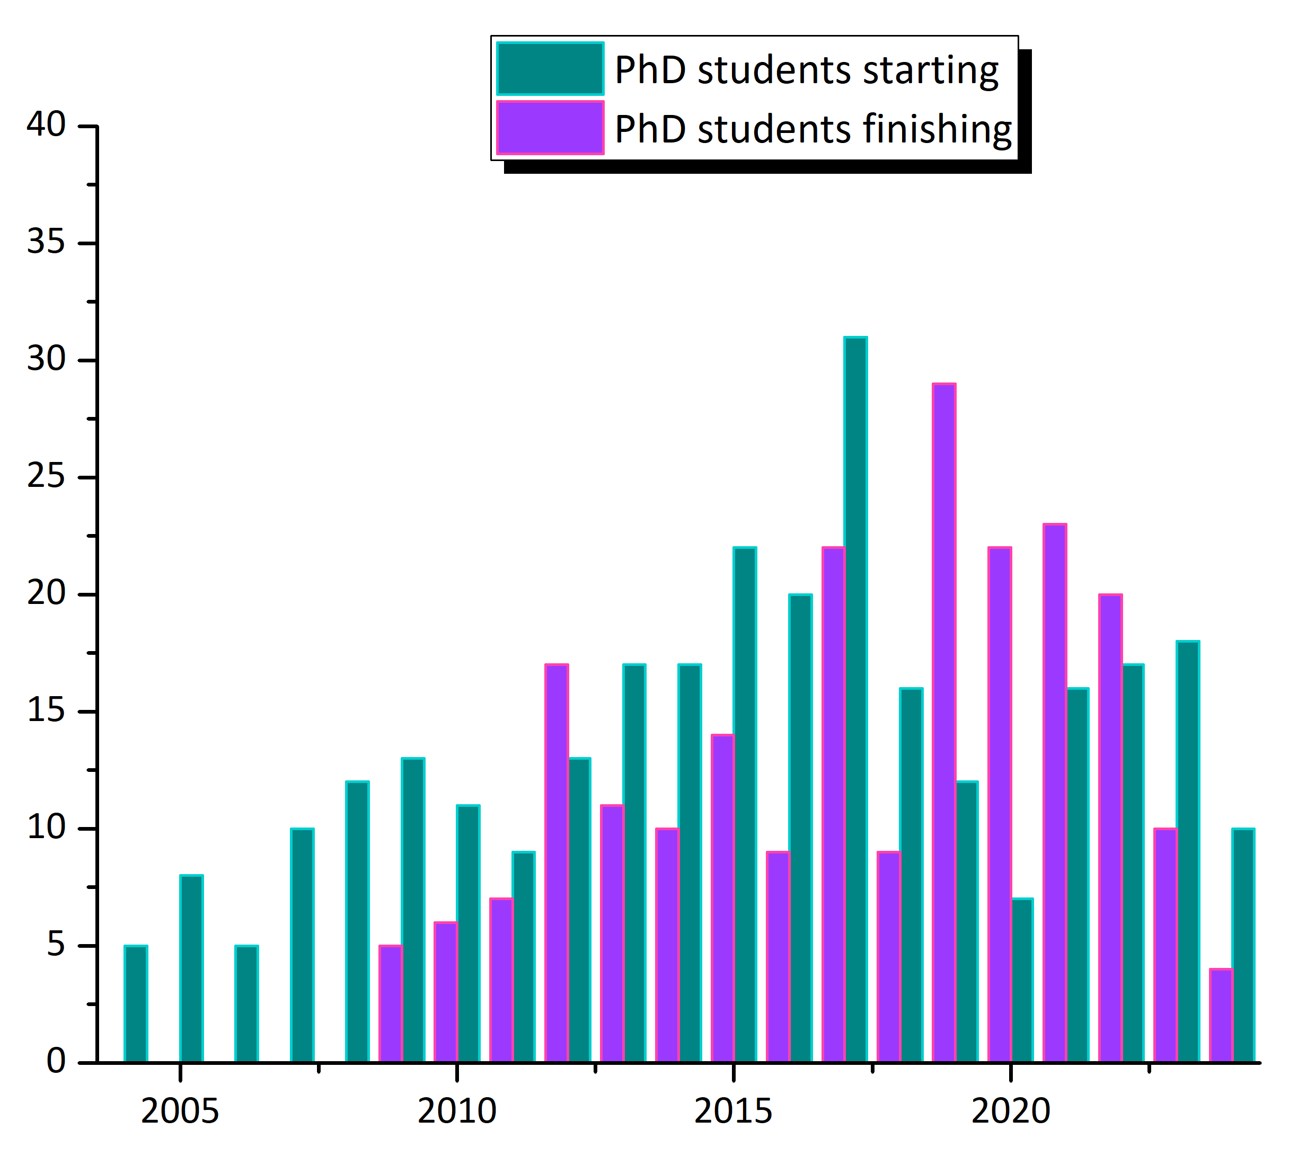
CI PhDs
Core funding (STFC quota) for 5 – 6 students/yr.
Individual years influenced by MCSN/CDT recruitment.
Other funding sources – university, self-funded, gov. scholarships, other funding councils, charities.
Average ~ 12 starters/yr.
192 students graduated.
One of, if not the, largest accelerator training programmes in the world.

Slide 4
Current lecture programme
Semester 1
CI-ACC-101 Introduction to accelerators (Hywel Owen)
CI-ACC-102 Relativity and elements of electromagnetism (Jonathan Gratus)
CI-RF-103 Introduction to radio frequency systems (Graeme Burt)
CI-BEAM-104 Introduction to beam dynamics (Ian Bailey)
CI-BEAM-105 Lattice design and computational dynamics (Rob & Oznur Apsimon)
CI-MAG-106 Conventional magnets for accelerators (Alex Bainbridge)
CI-SWA-107 Introduction to short-wavelength accelerators (Guoxing Xia)
Introductory courses provided every year
SUPA courses for Strathclyde students
Videos available online
Advanced courses every other year
Semester 2 (24-25)
CI-ACC-211 Vacuum systems and surface science (Oleg Malyshev)
CI-ACC-212 Beam diagnostics (Stewart Boogert)
CI-MAG-213 Synchrotron radiation and undulators (Jim Clarke)
CI-SWA-214 Novel EM materials for high-frequency accelerators (Rosa Letizia)
Semester 2 (25-26)
CI-ACC-221 Particle sources and secondary beams (Dan Faircloth)
CI-RF-222 RF linear accelerators (Graeme Burt & Rob Apsimon)
CI-ACC-225 Electron sources (Boris Militsyn)
Graded assessments in magnets, rf
& beam dynamics
Students expected to attend JAI/CI seminar series

Slide 5
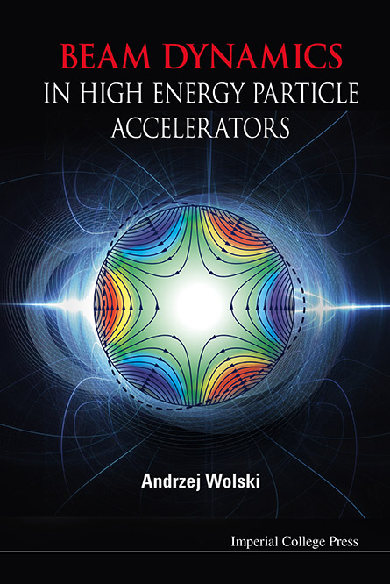
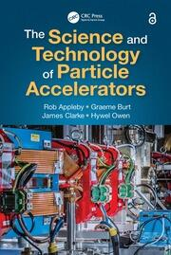
Textbooks
CI authors:
Andy Wolski, Rob Appleby, Graeme Burt, Jim Clarke, Hywel Owen
Books developed from CI lecture courses.
Filling a need for a textbook with practical examples.
But also available for a bargain £43 on Amazon…..

Slide 6
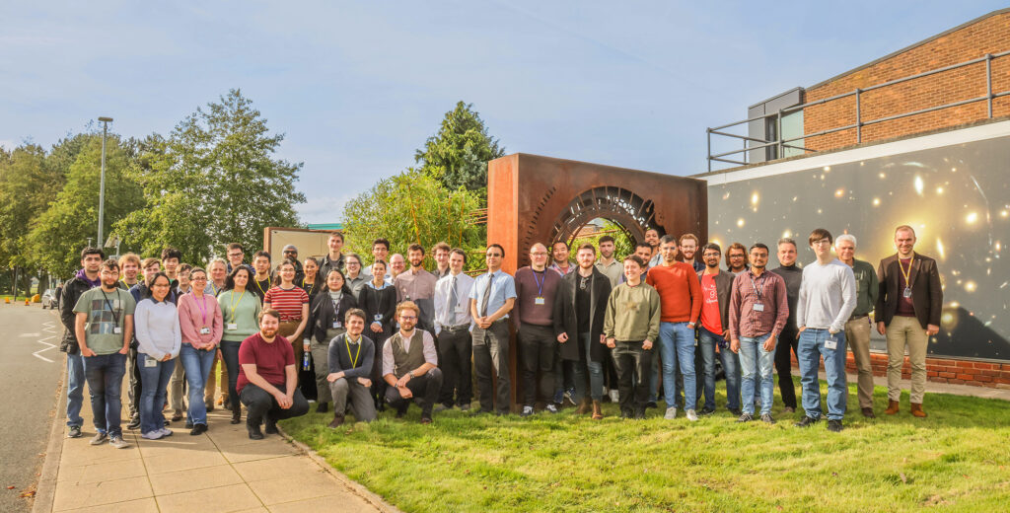
CI Postgraduate Conference
Conference running for > 10 yrs for CI PhD students presenting talks and posters.
Valuable professional experience in a friendly environment.
Ideal for new students to find out what the CI does and meet their fellow students.
Prizes awarded for best presentation.
IC PGR Conference 2023

Slide 7
Leading PGR Education
Beam Diagnostics 2008 – 2012
21 Fellows, 32 Partners www.liv.ac.uk/ditanet
Laser Applications 2011 - 2015
19 Fellows, 38 Partners www.la3net.nu
Accelerator Optimization 2011 - 2015
23 Fellows, 35 Partners www.opac-project.eu
Medical Applications 2016 – 2020
15 Fellows, 33 Partners www.oma-project.eu
Antimatter R&D 2017 – 2021
16 Fellows, 35 Partners www.ava-project.eu
U. Liverpool recognised as world leader in PG education and training going beyond technical knowledge to transferable skills.
Carsten Welsch (Liv) chaired STFC’s Education Training & Careers Committee 2021-2023, shaping postgraduate training across all UKRI science and technology.
CI is at the forefront of modern PhD training through these networks.
Accelerator Applications CDT 2017 – 2022
Lancaster + partners
Big Data Science CDT 2017 – 2021
UoL/LJMU https://www.liverpool.ac.uk/livdat/
Data Innovation CDT 2022 – 2028
UoL/LJMU https://www.liverpool.ac.uk/centre-for-doctoral-training-for-innovation-in-data-intensive-science/
EuPRAXIA Doctoral Network 2023 -
12 Fellows, 23 Partners https://www.eupraxia-dn.org/

Slide 8
Challenges & the Future
Pandemic caused severe disruption to student research experiments & mental wellbeing.
Work patterns changed significantly – more WFH.
CI supported students financially – university extensions unfunded.
How do we respond to changing research environment and student needs?
Revising curriculum e.g. new AL/MI module for next year.
Reintroduce group design project.
Student representation on education & training committee.
Streamline and improve student application process.
Encourage community and on-site attendance for students & postdocs.
Push for diversity in applications and acceptances and best practice in EDI.
Looking forward to the next 20 years and our 200th PhD graduate!

