Slide 1
First 20 Years (From post-doc to professor):
A life with crabs!
Prof Graeme Burt

Slide 2
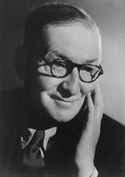
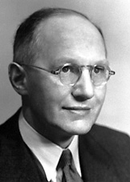
Physics and Engineering a symbiotic relationship
Sir John Cockcroft
Studied electrical engineering at the College of Technology in Manchester under Miles Walker. And a two years apprenticeship with Metropolitan Vickers Electrical Company (he went on to St. John's College, Cambridge, and took the Mathematical Tripos in 1924, but no one is perfect).
Ernest Walton
Read the honours courses in both mathematics and experimental science at Trinity College, Dublin, specializing in physics, and graduated in 1926 with first class honours in both subjects.

Slide 3
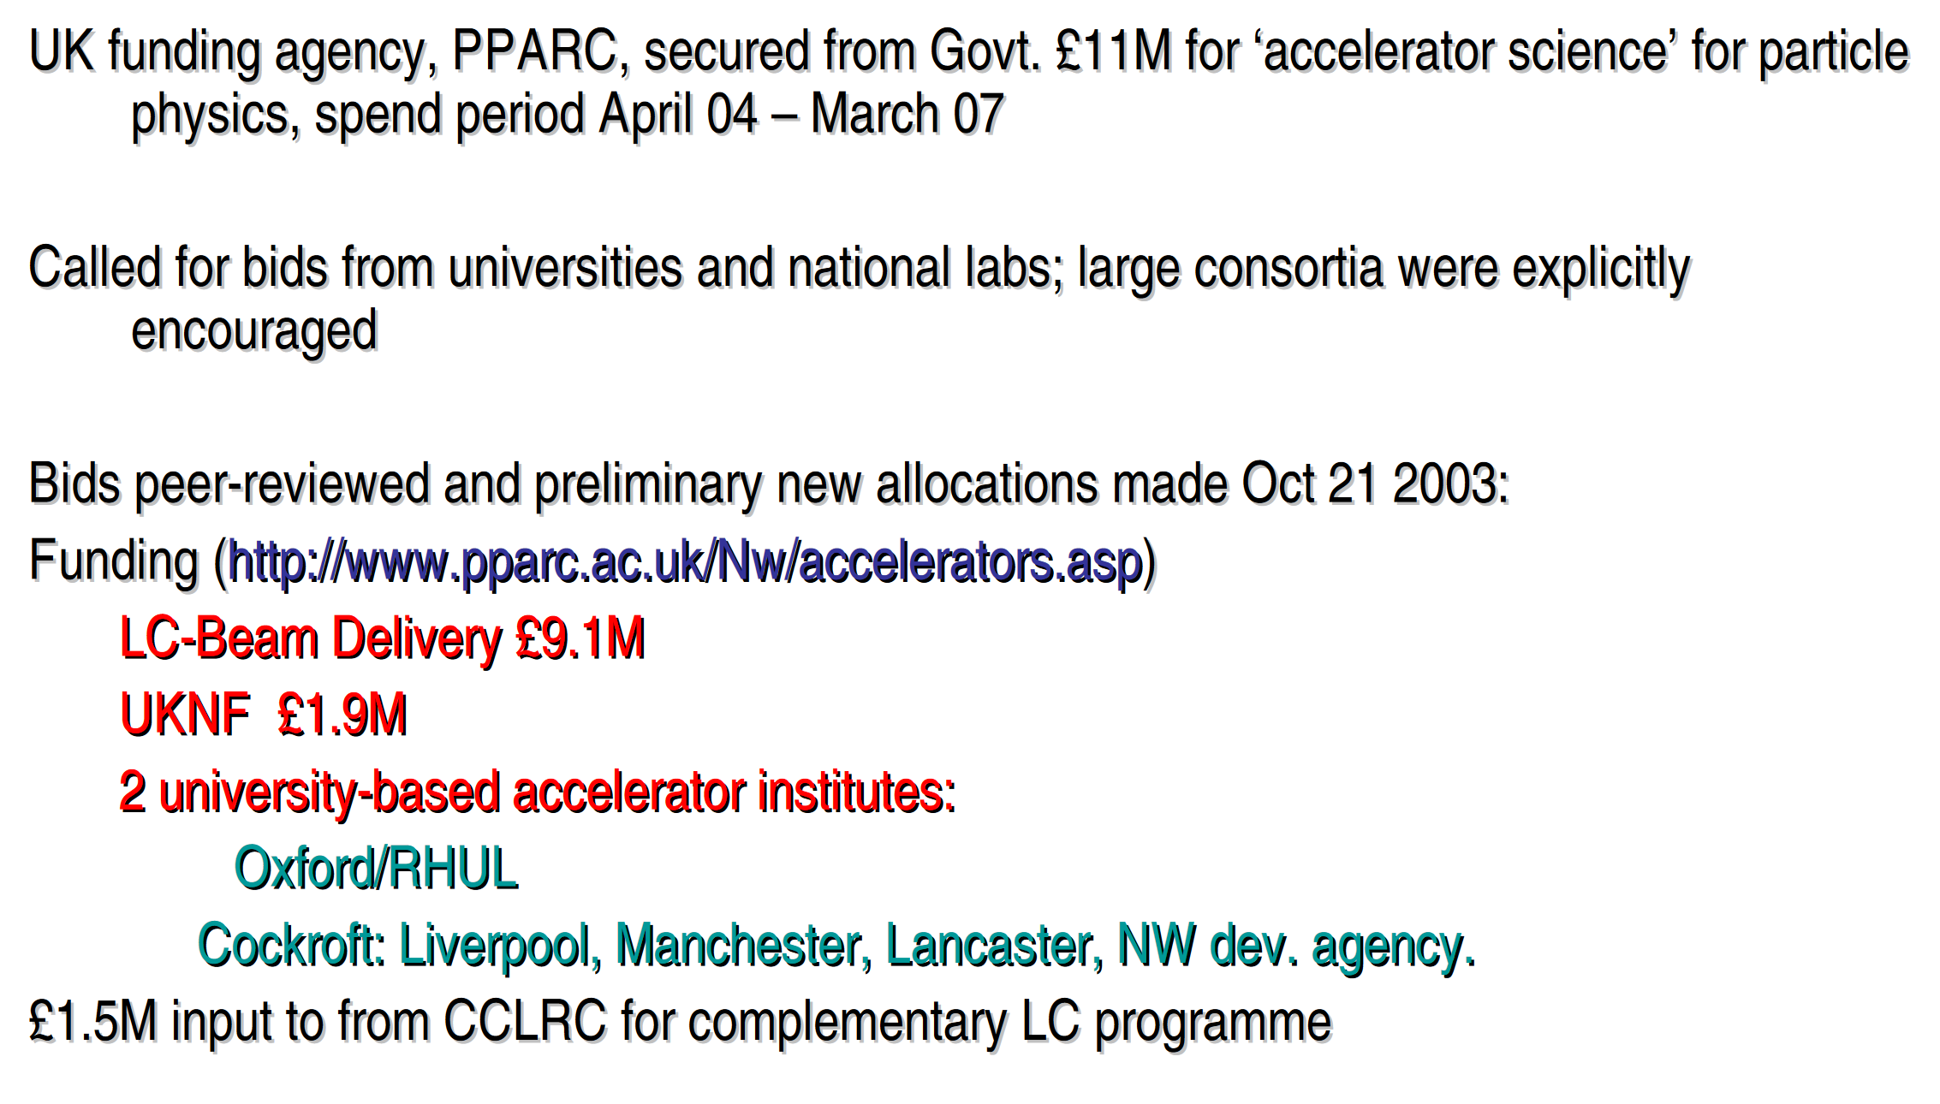
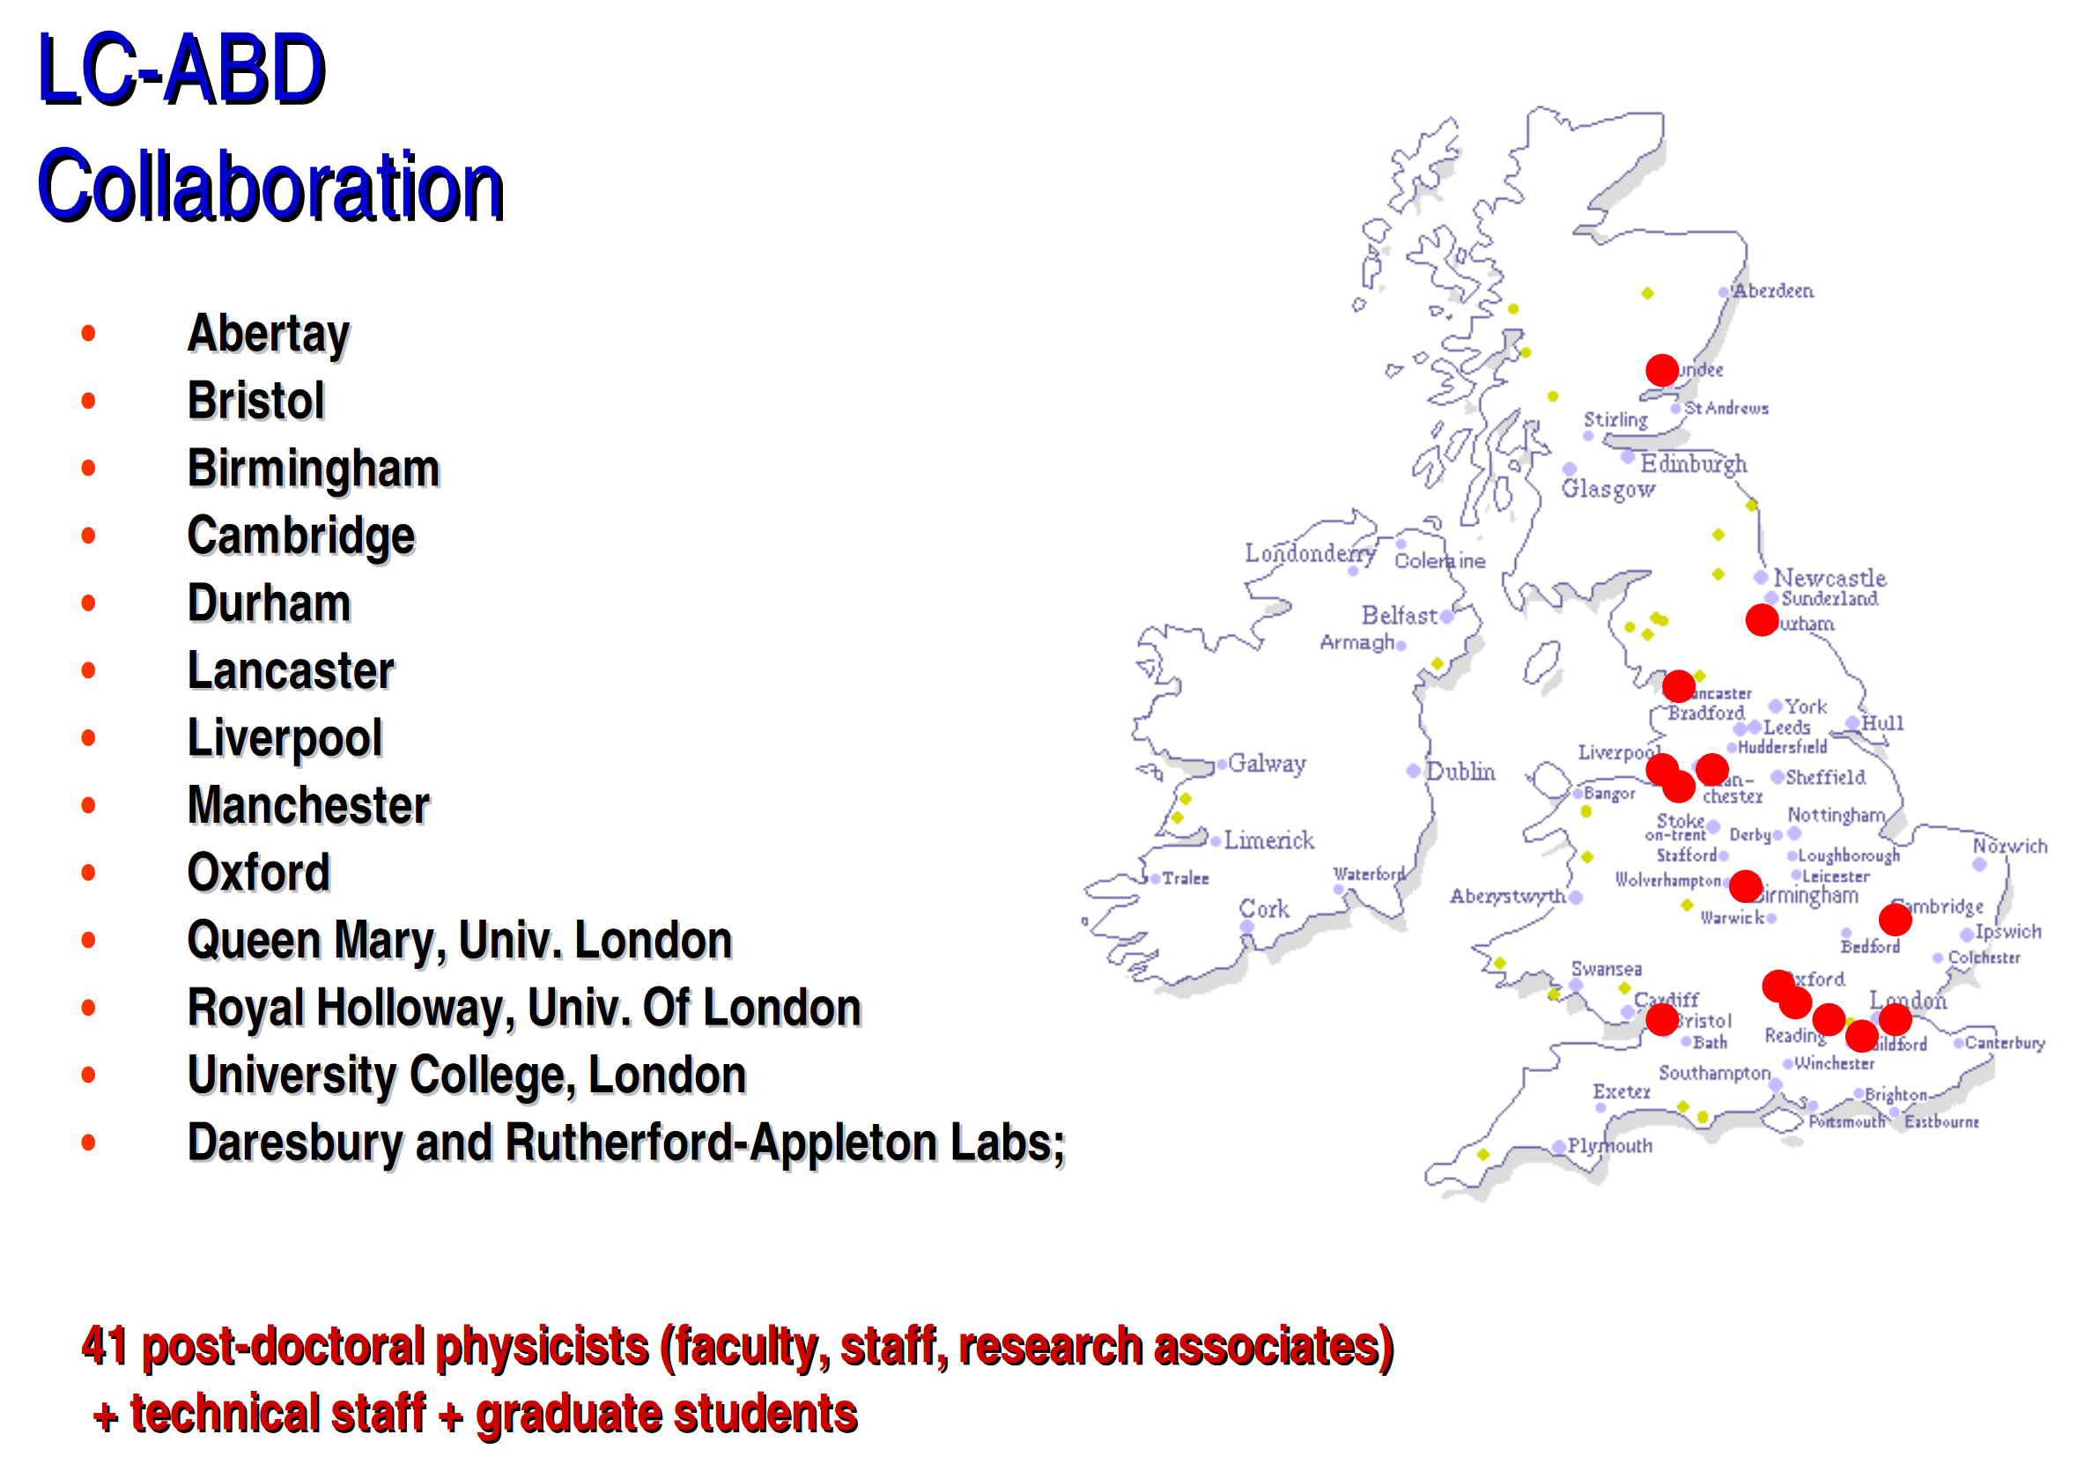
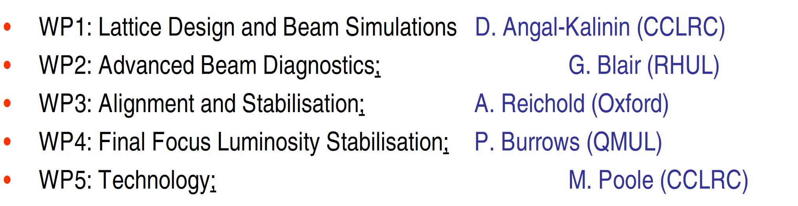

Slide 4
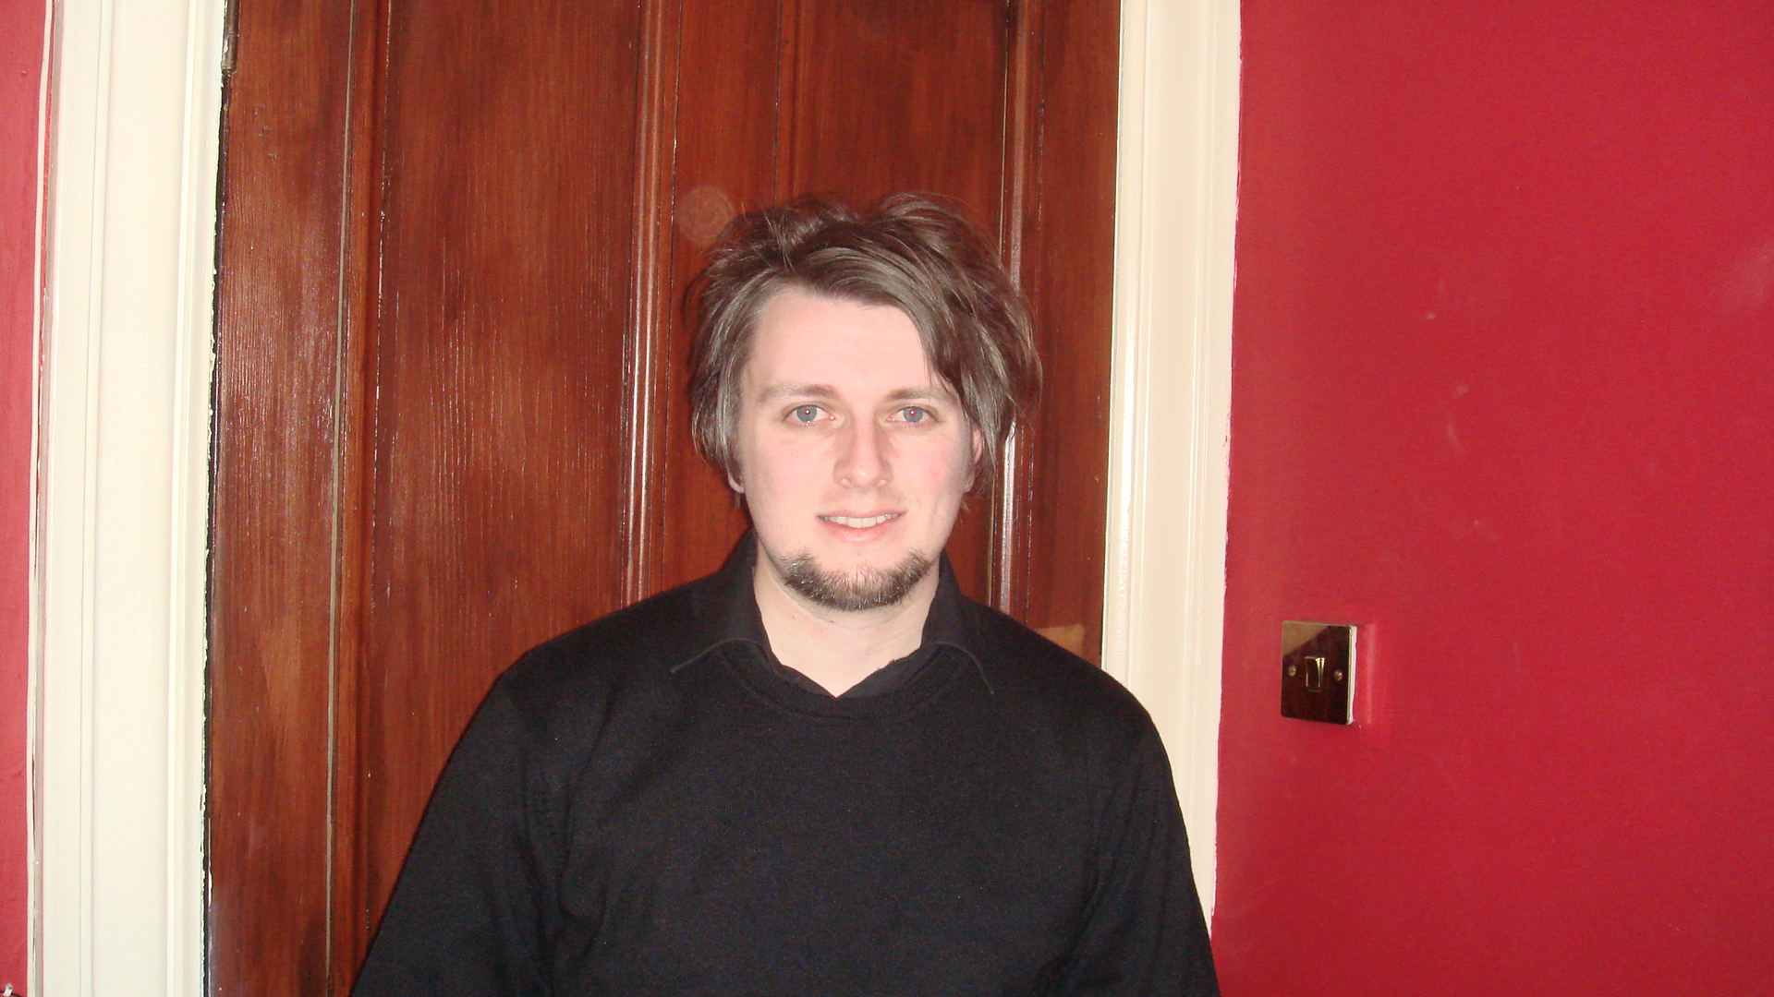
Every PDRA working in accelerators in the UK in Nov 2004

Slide 5
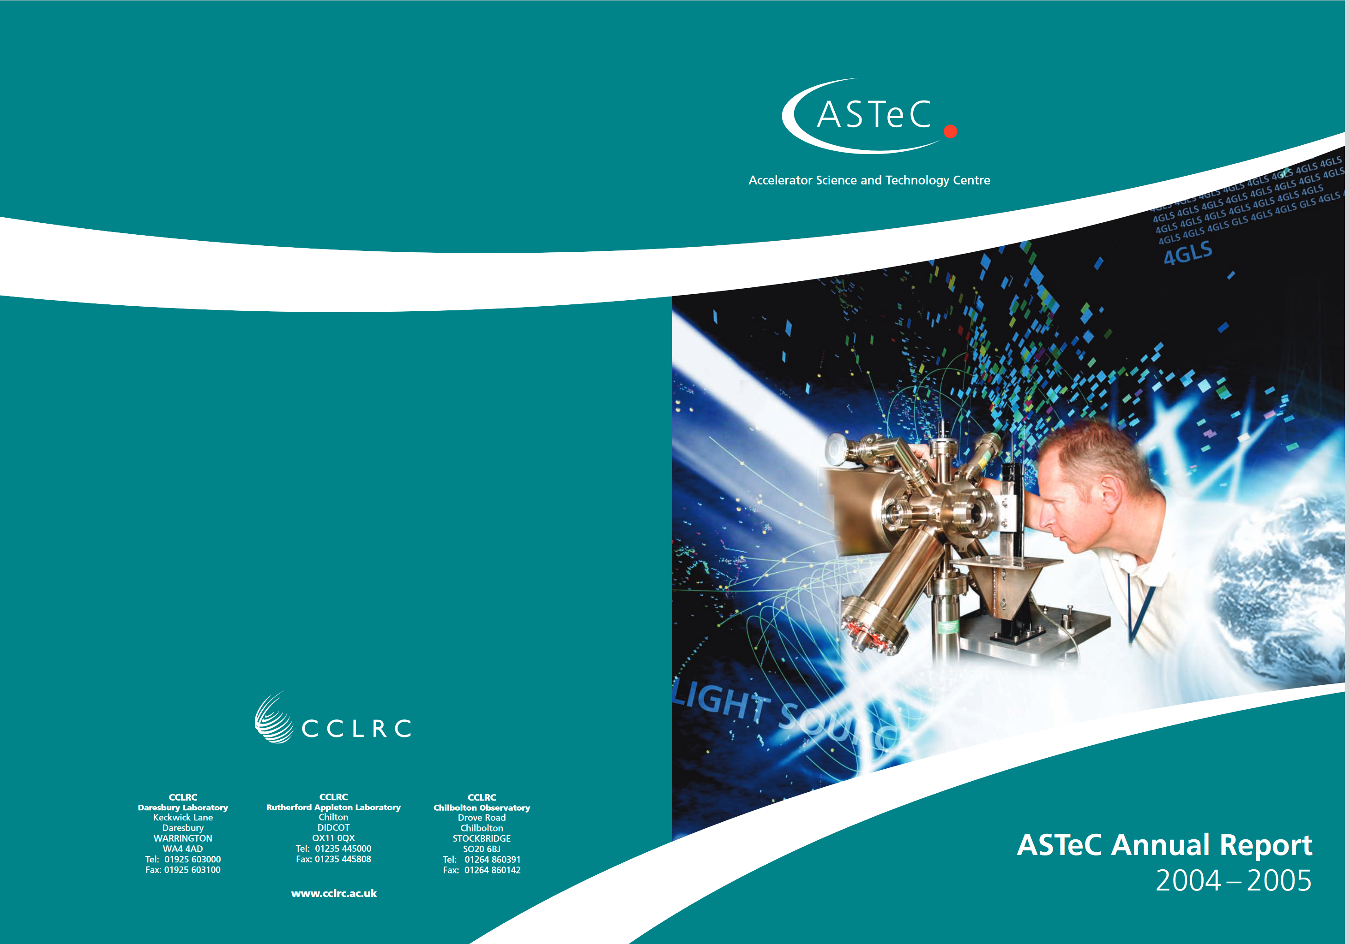
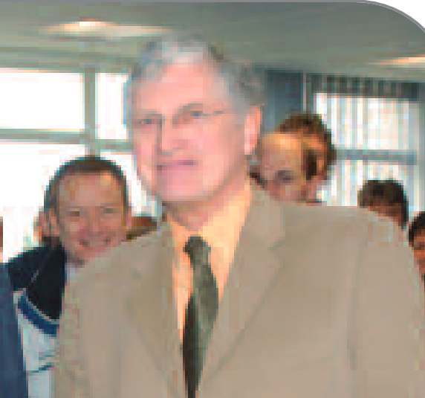
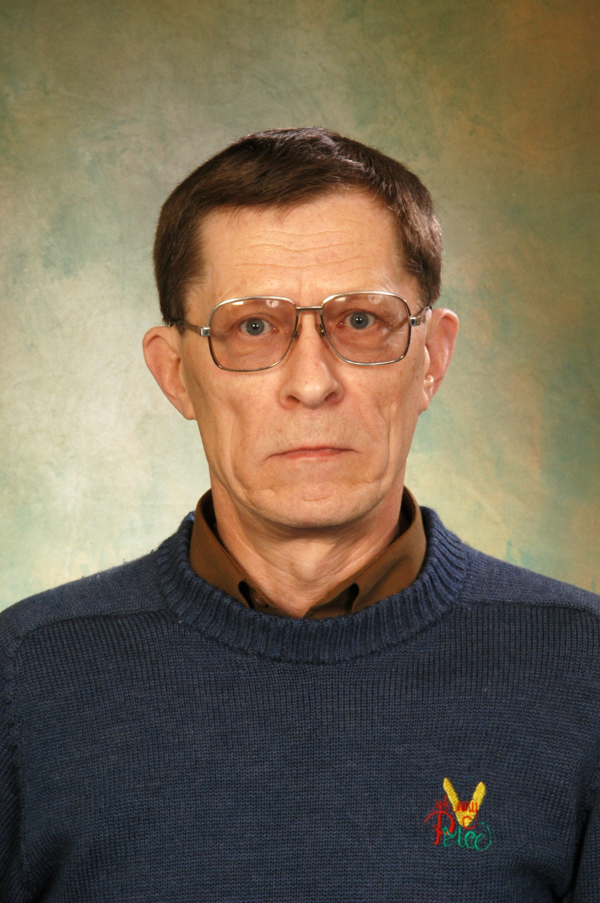
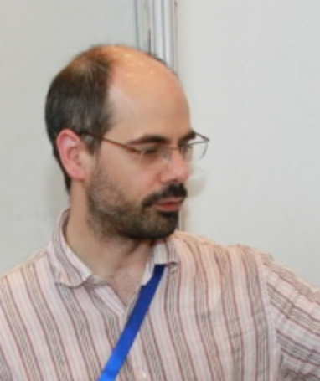
But the UK still had a thriving accelerator R&D programme in what was then CCLRC.
So I was placed in the ASTeC RF group for my first year.

Slide 6
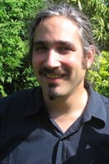
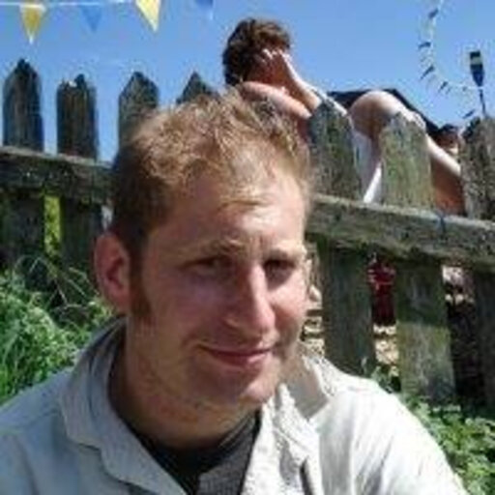
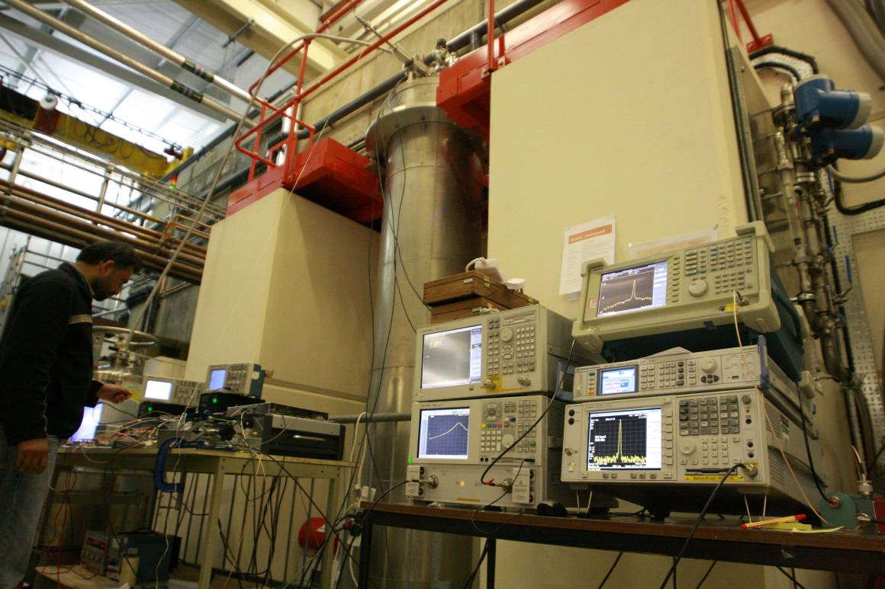
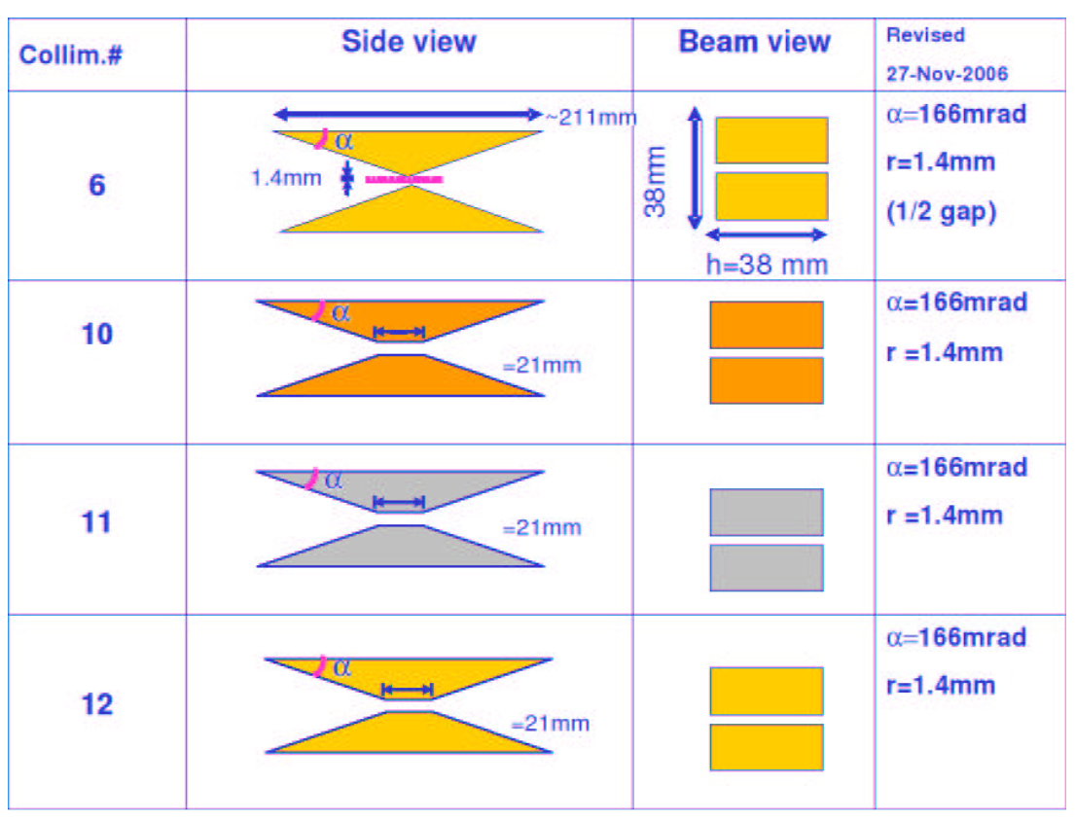
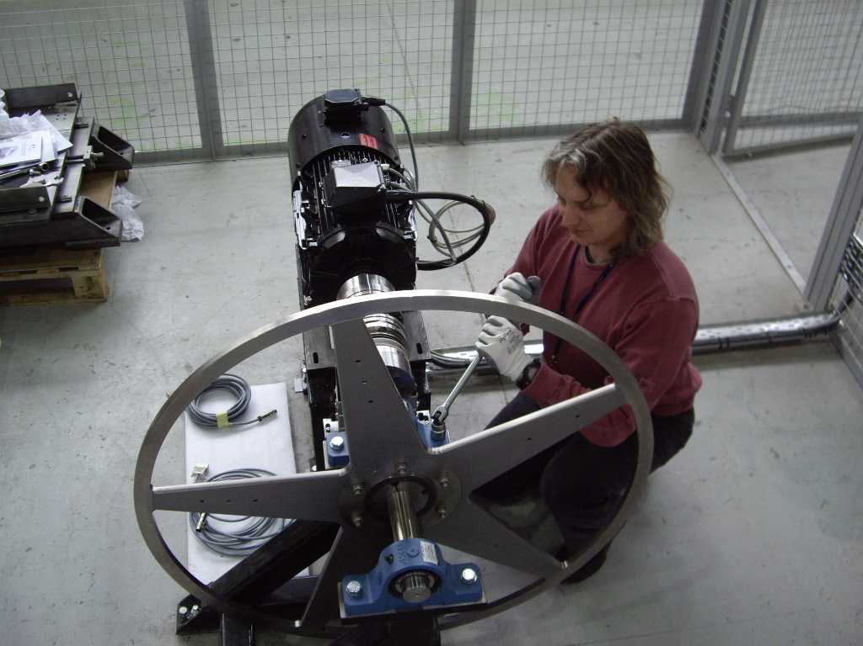
But I was soon joined by many others
ILC positron target ie “Big Spinny Wheel”
Low Level RF
ILC Collimator wakefields

Slide 7
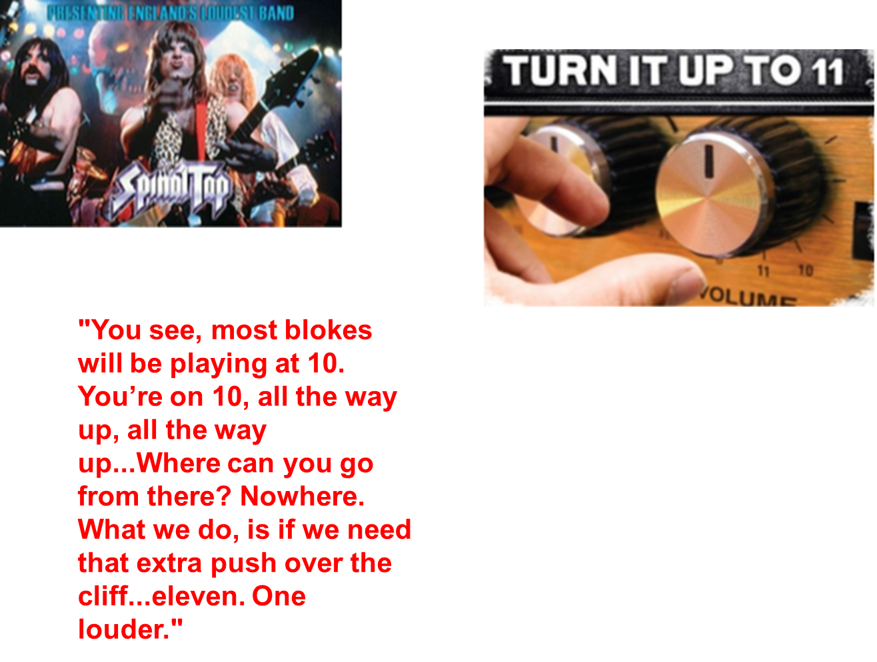
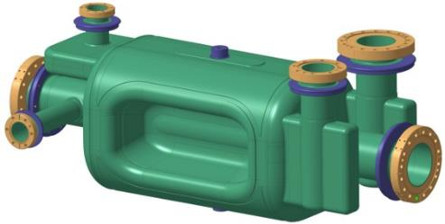
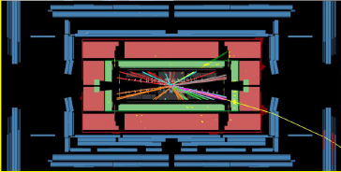
Crab crossing
RFD Crab cavities
fb⁻¹
IR

Slide 8
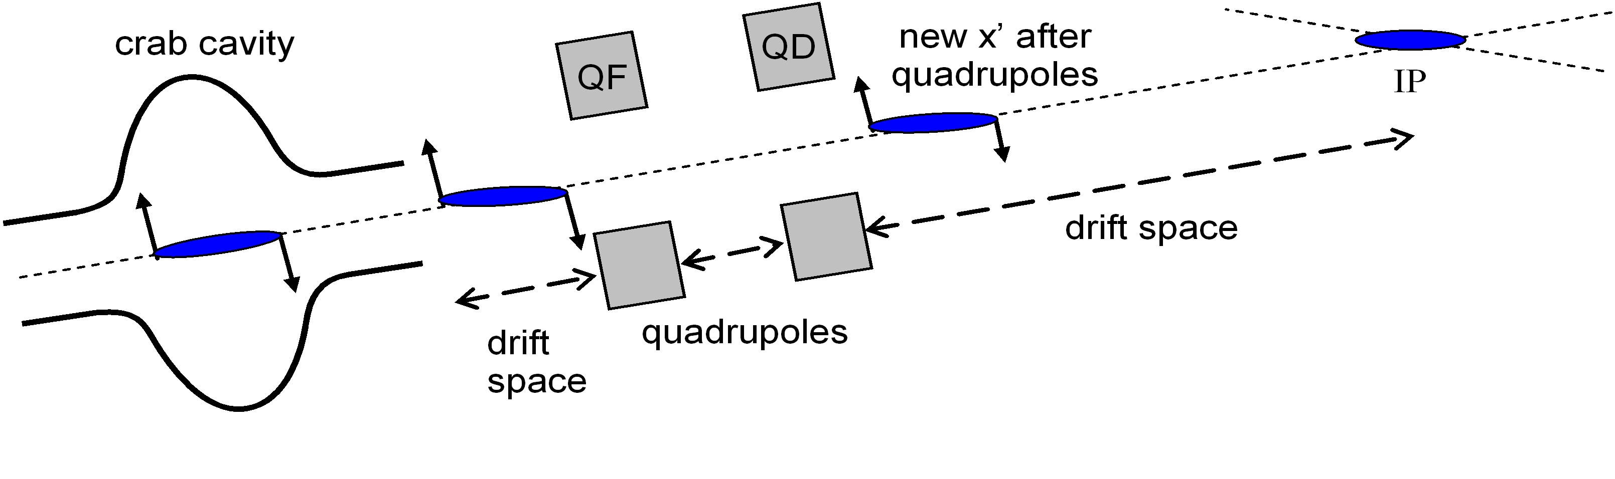
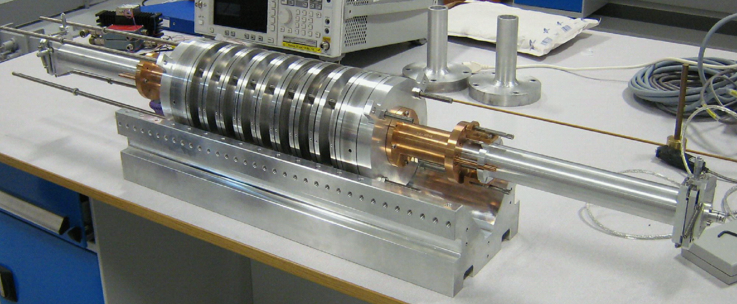
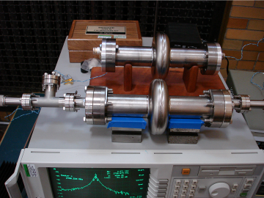
Crab Cavity Development
2005 14mR Crab System Specification Developed:
0.095º RMS relative phase stability
0.33 % RMS beam energy jitter
2.64 MV rotational field required for 1 TeV CM
2006 ILC Crab Cavity Design Developed:
3.9 GHz superconducting RF cavity
9-cell configuration
Independent LOM, SOM and HOM couplers
Jul 2007 ILC Crab Cavity Design Model Verified:
Modular multi-cell aluminium model designed & built
Bead-pull & stretched wire measurements completed
MAFIA & MWS simulation results confirmed
Sep 2007 Single-cell SRF Cavities Built and Verified:
3 x single-cell cavities fabricated at Niowave Inc. USA
Vertical tests showed > 7 MV/m achieved - no quench
Low Qo (3e8)

Slide 9
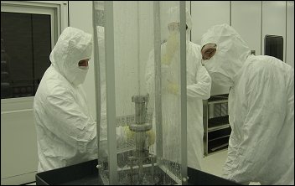
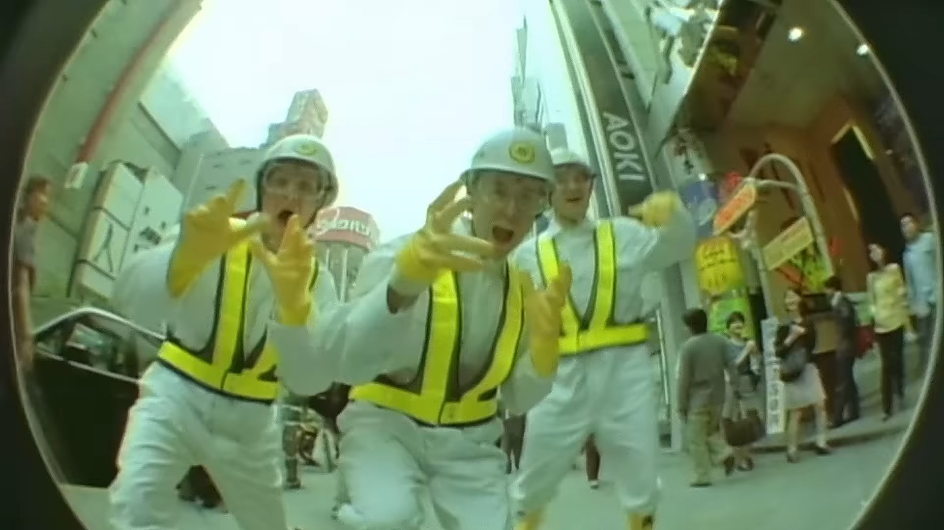
First SRF cavities developed in the UK
First Vertical Test Cryostat (in the Tower)
The max voltage in a single 3.9 GHz cavity was low enough to operate right next to the OVC.

Slide 10
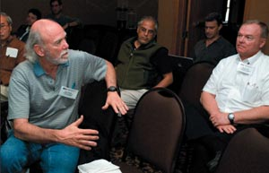
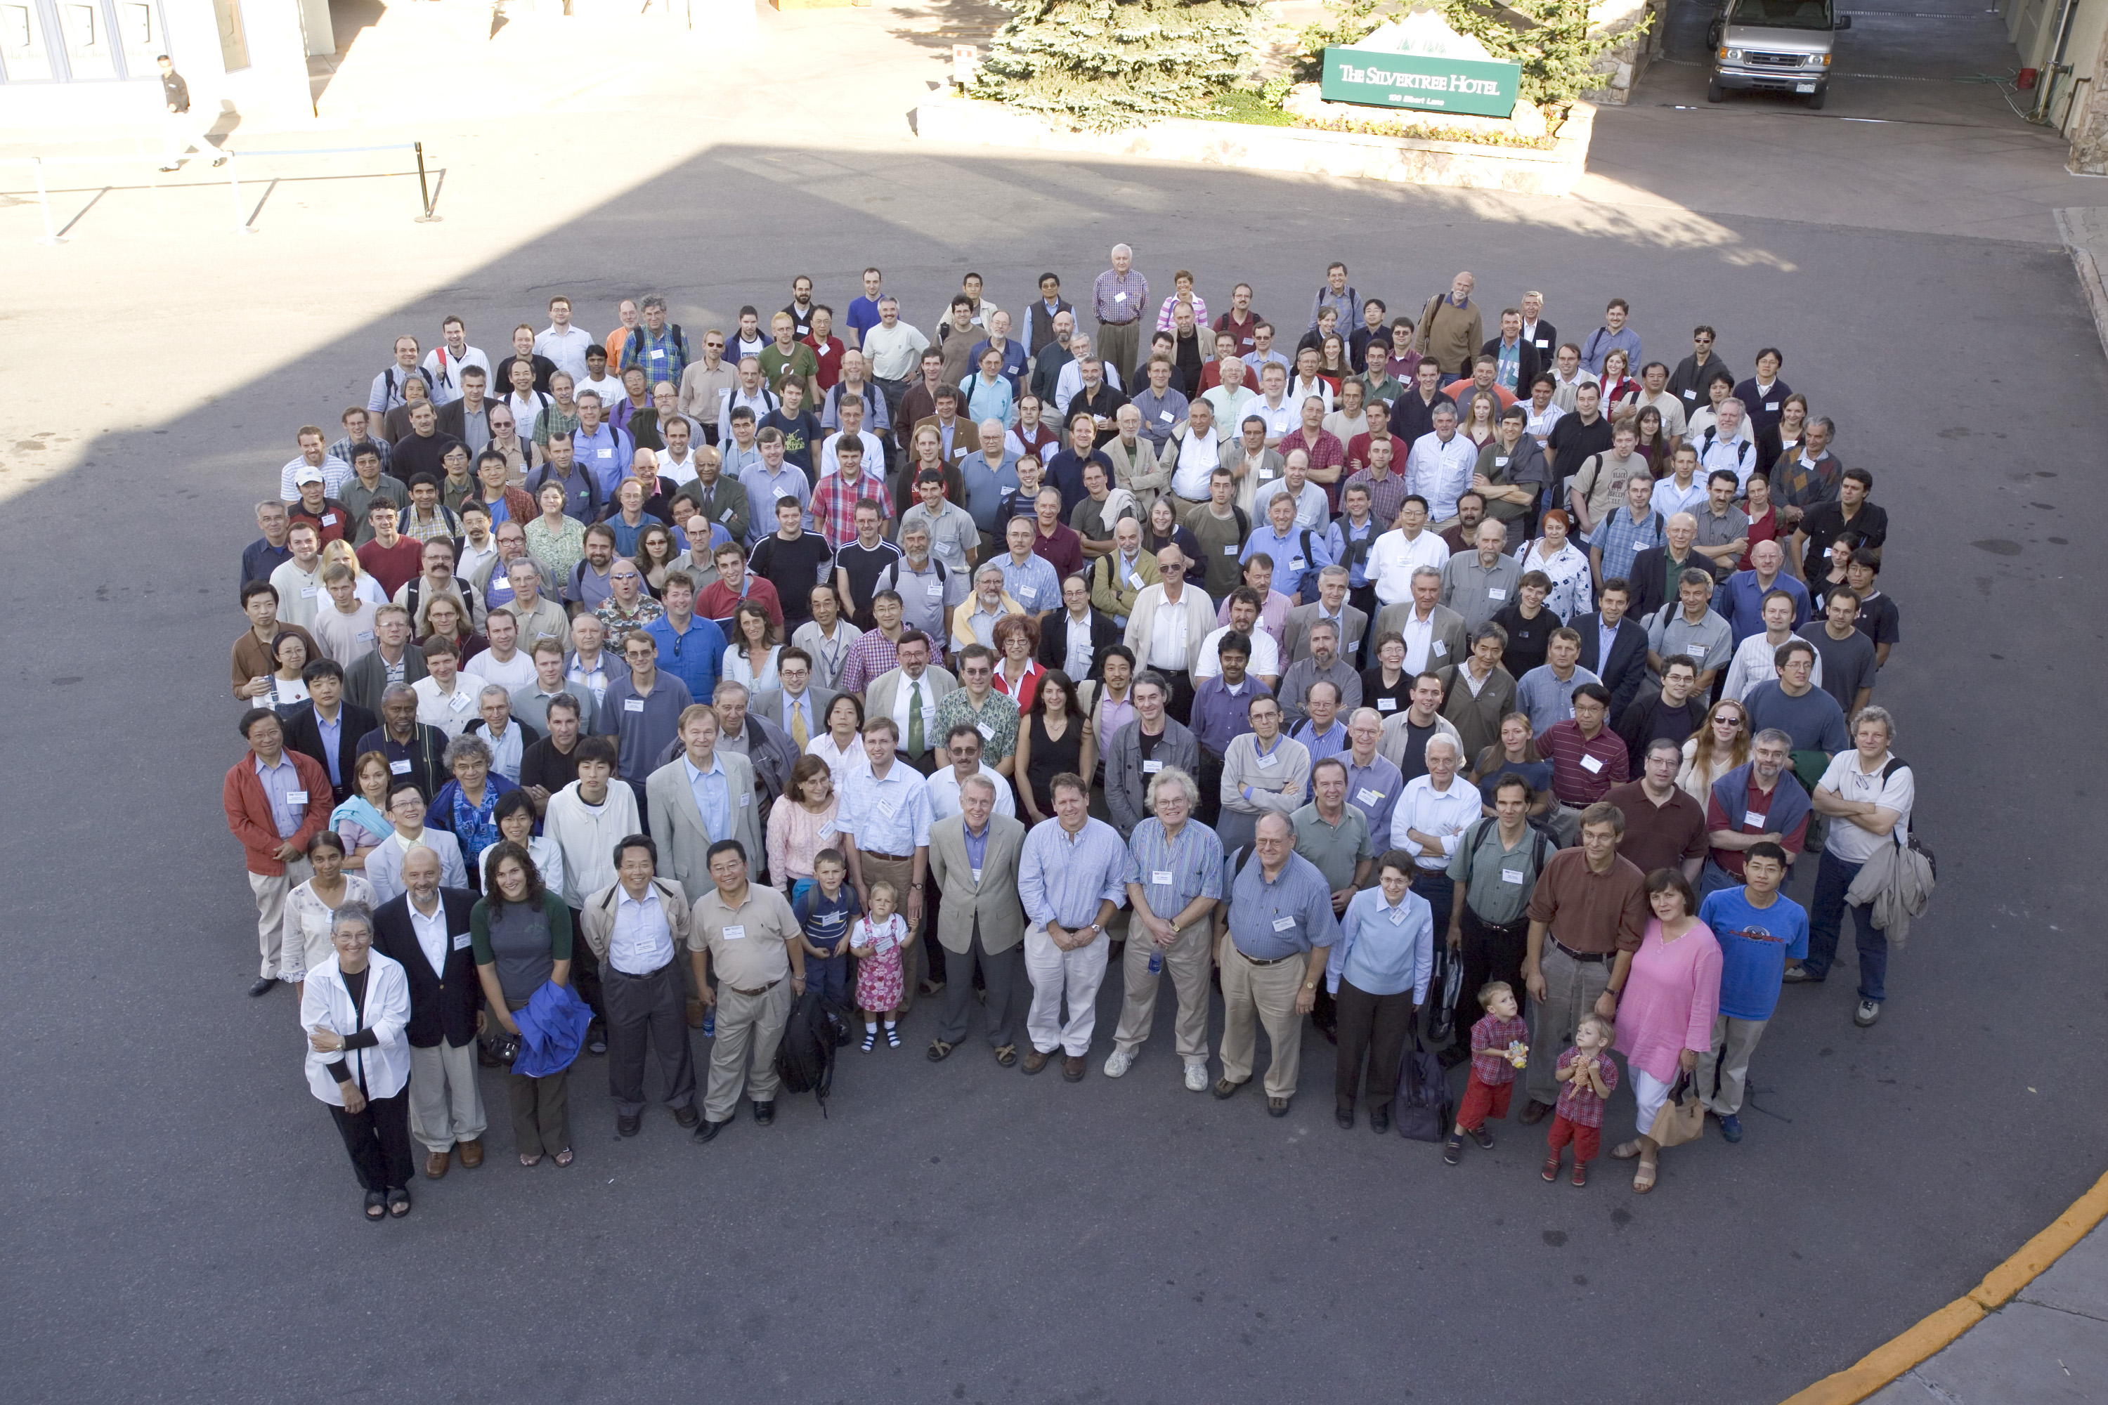
2005 Cockcroft goes to Snowmass on mass
But the 2nd week was closed to junior staff, but we had all booked for 2 weeks in Aspen.

Slide 11

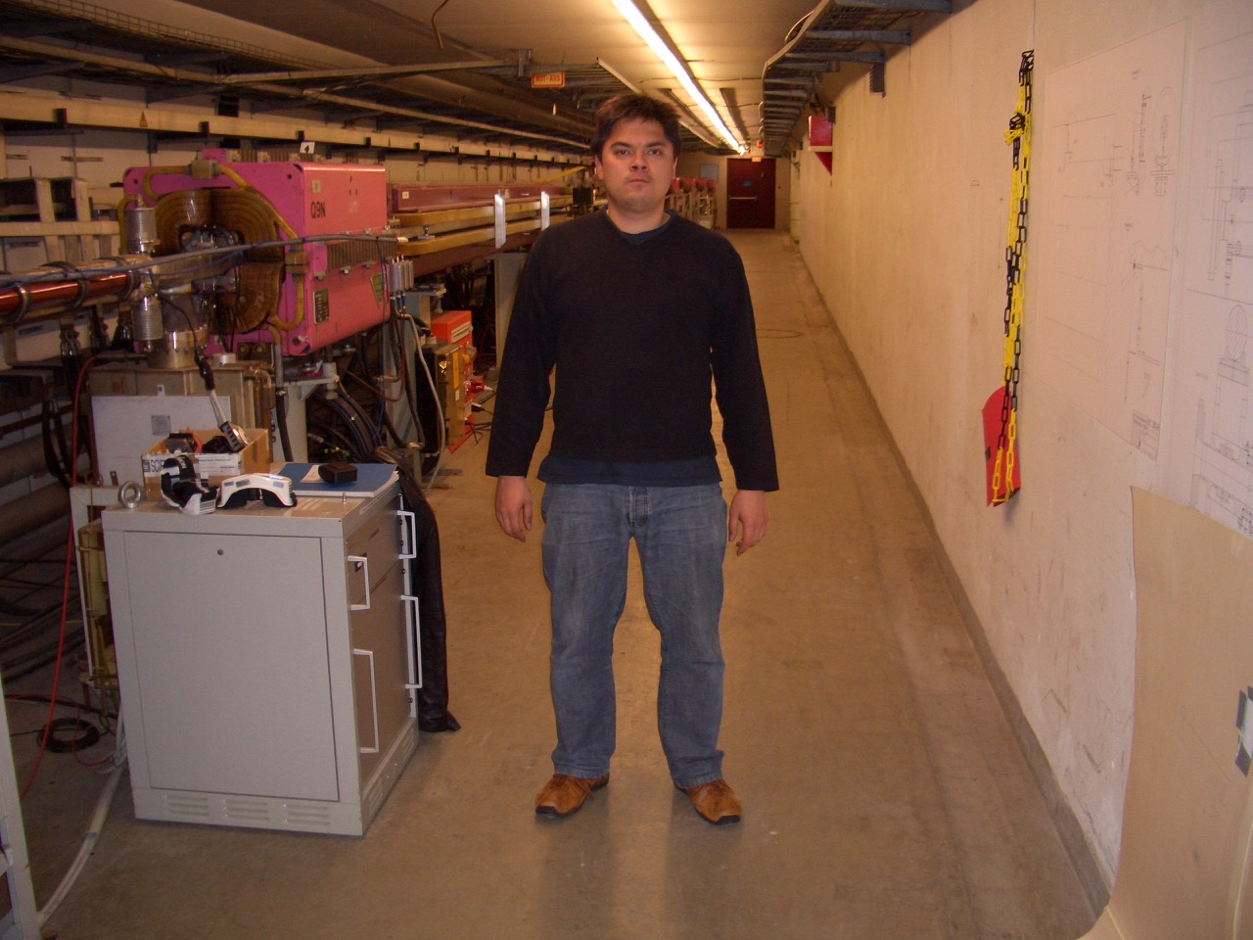

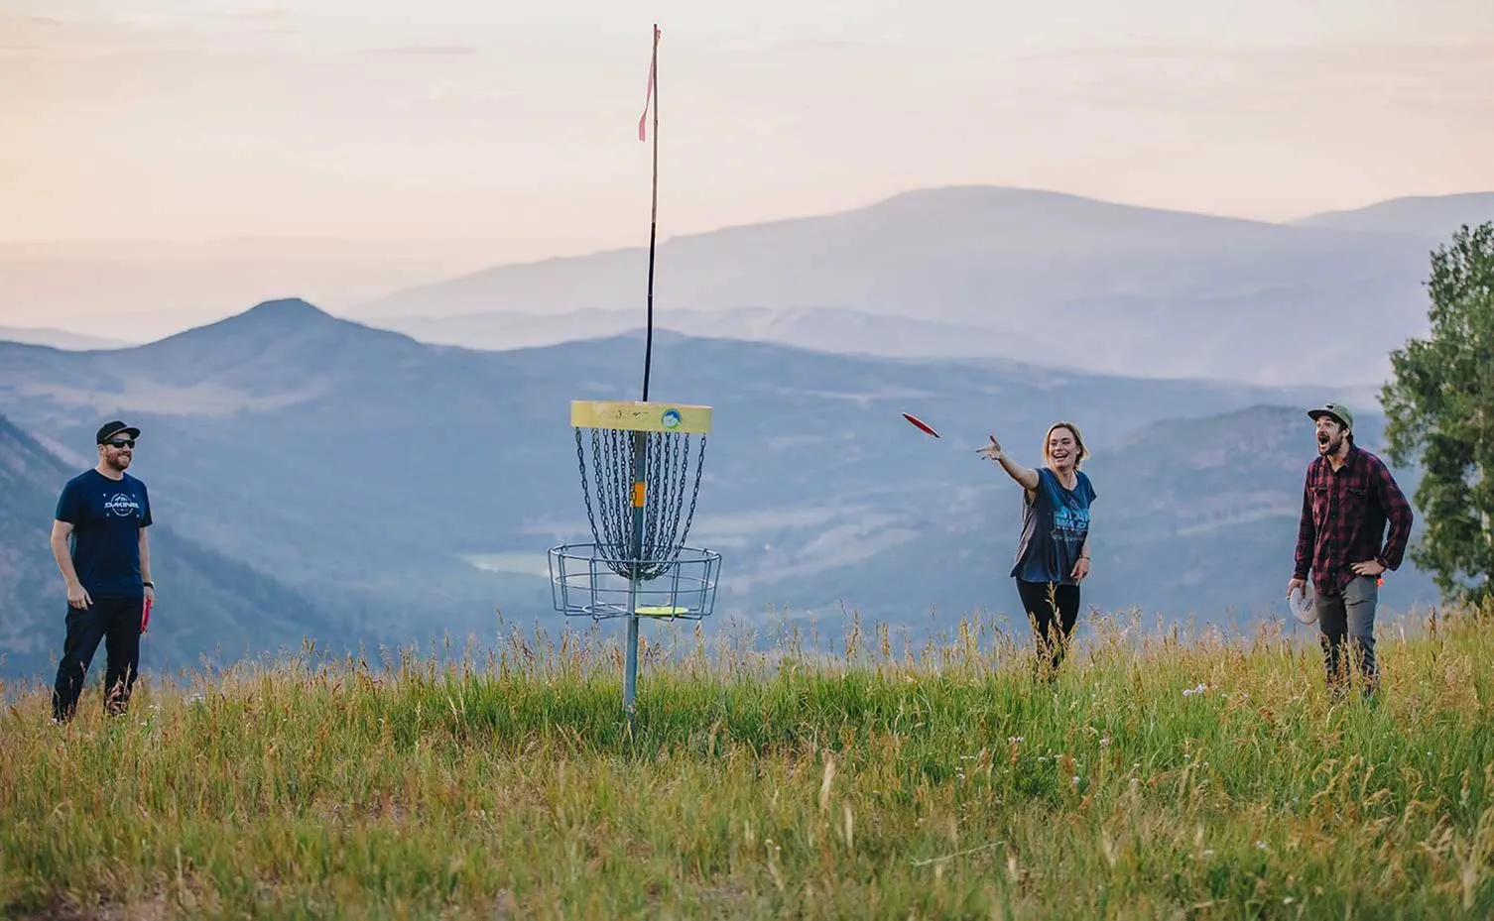
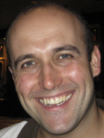
Frisbee golf, karaoke and drunken adventures

Slide 12
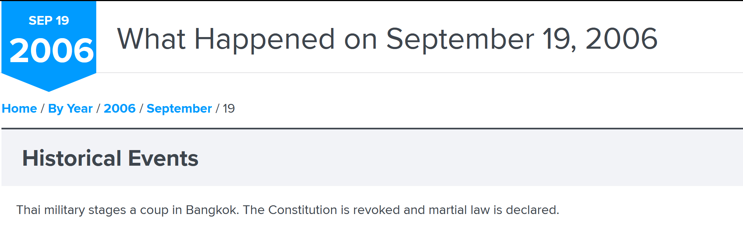
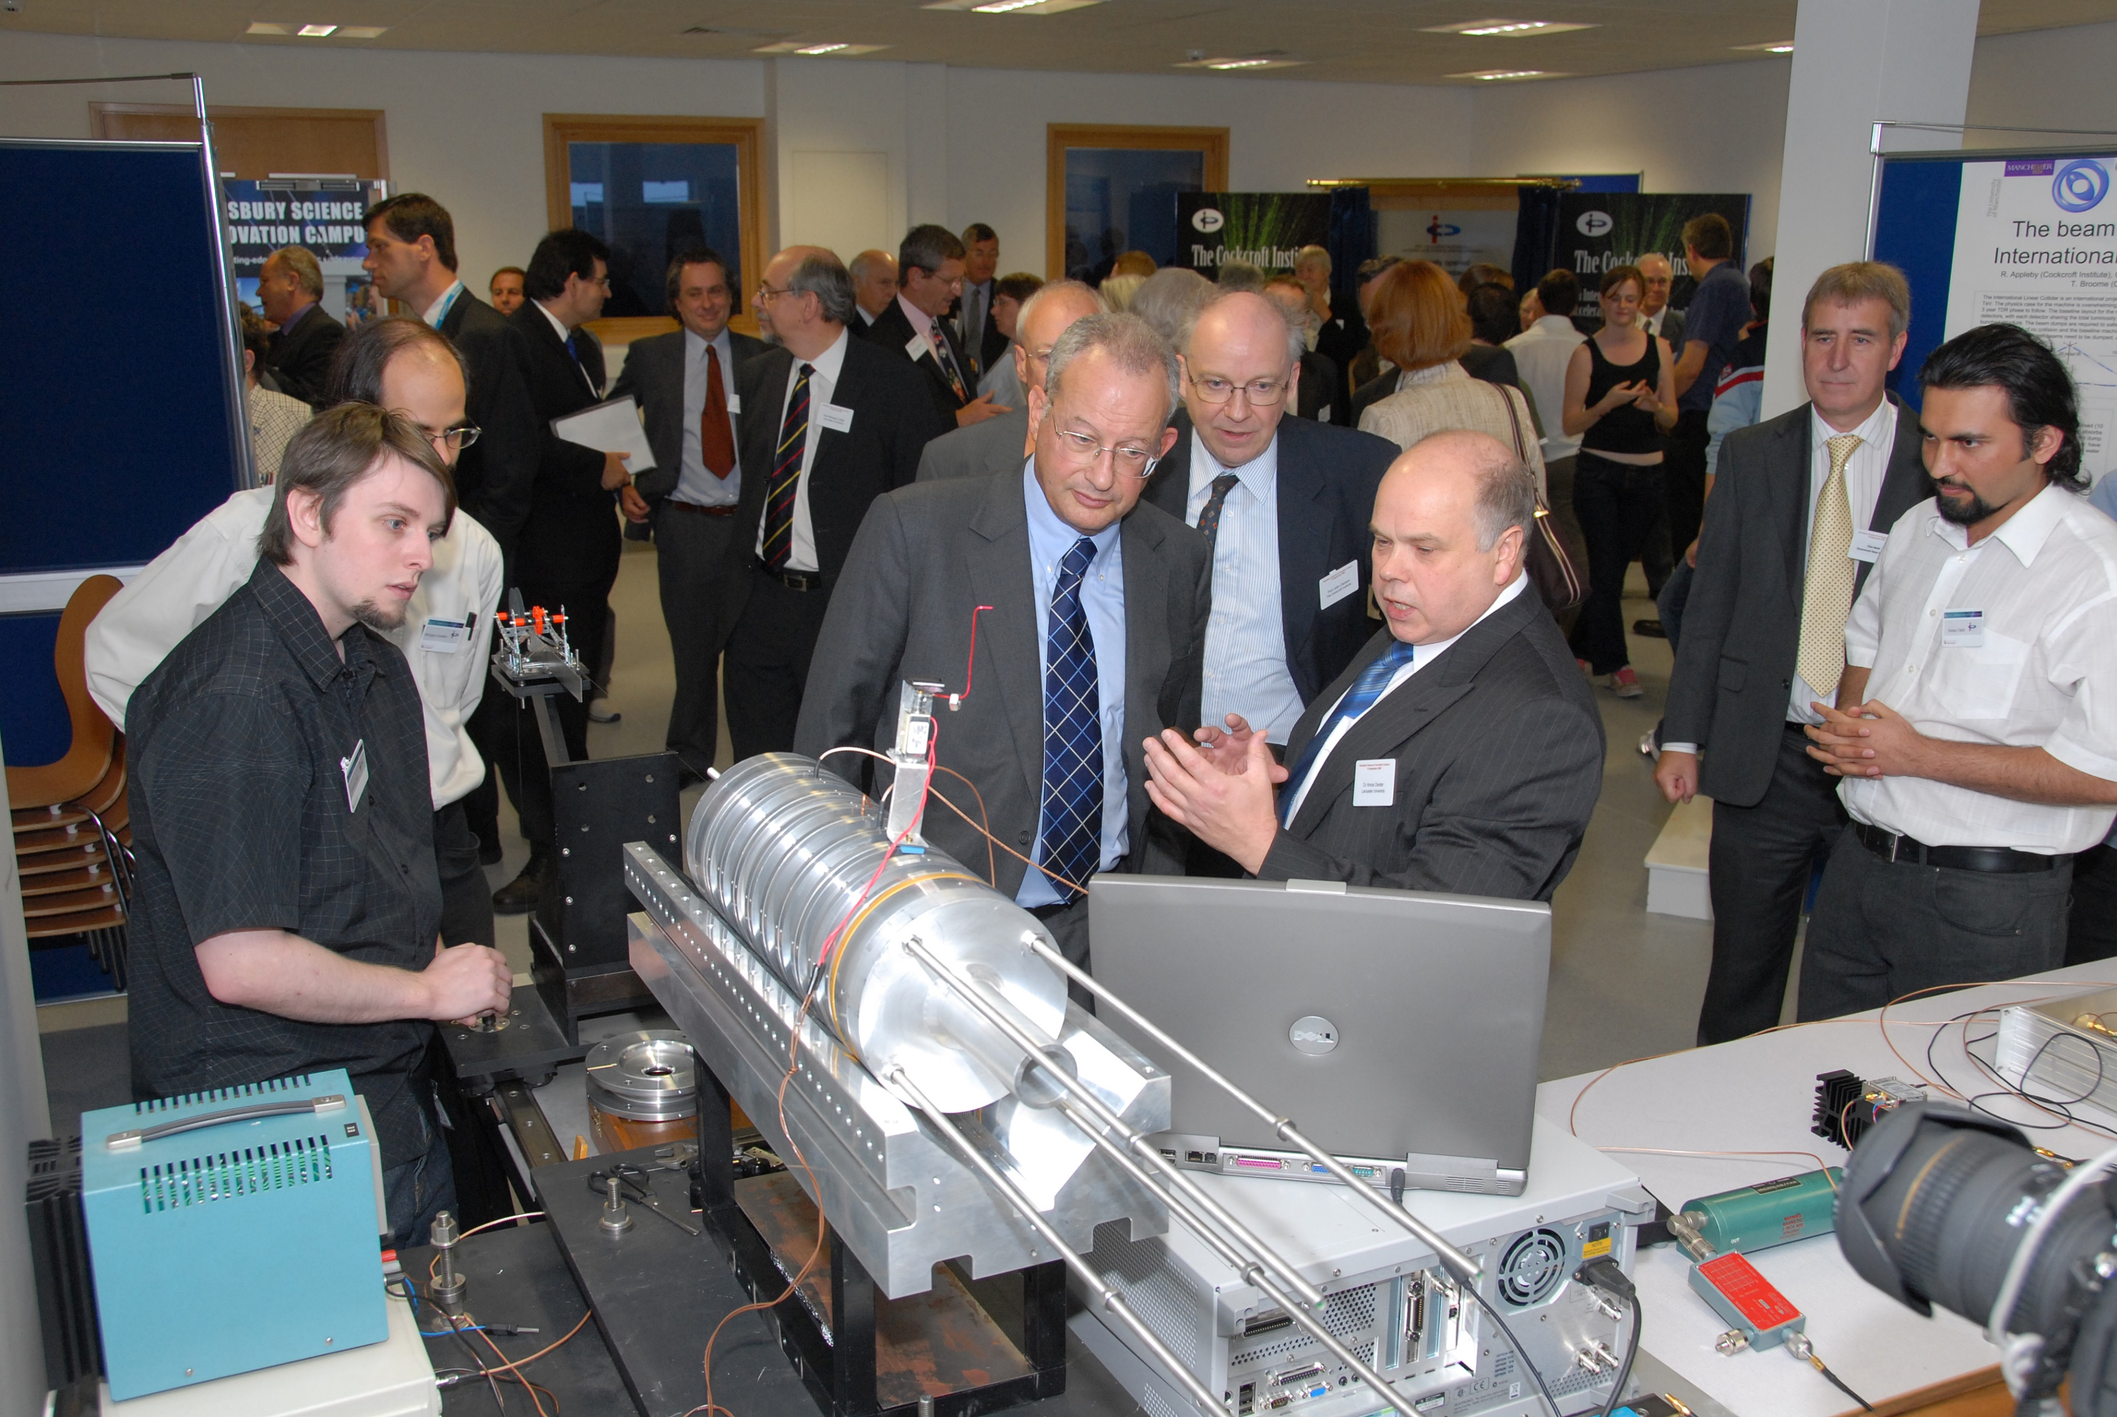
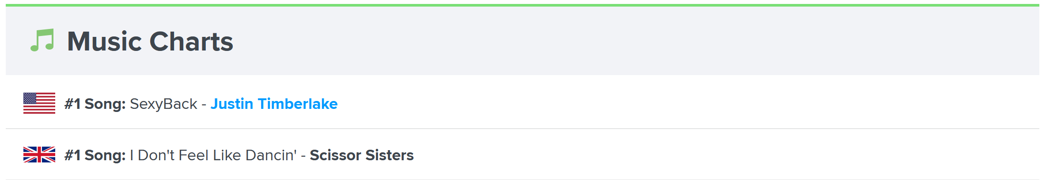
And Cockcroft was indeed bringing sexy back to UK accelerator R&D

Slide 13

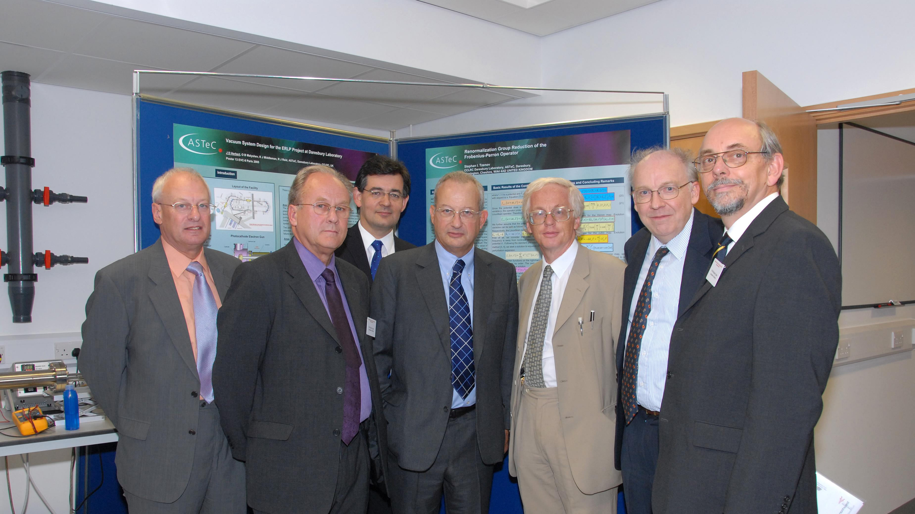

Slide 14
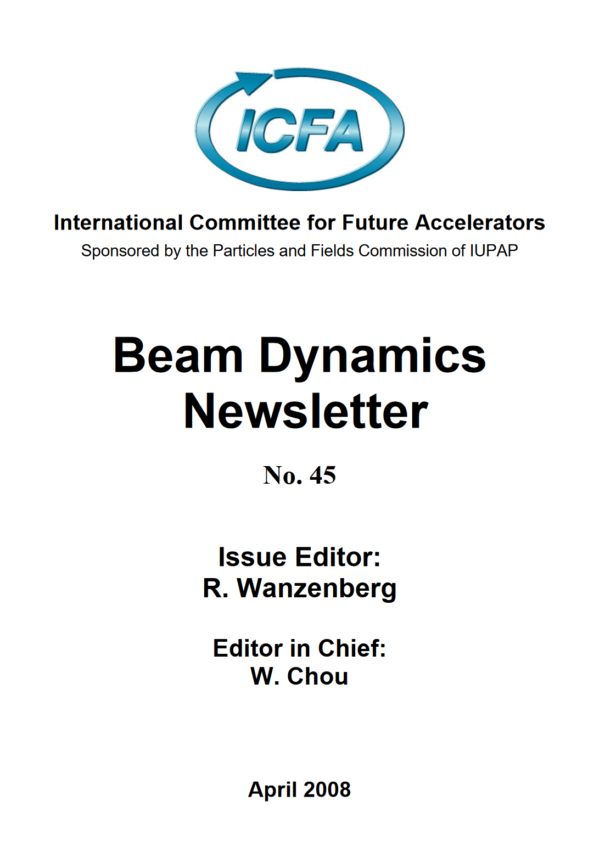
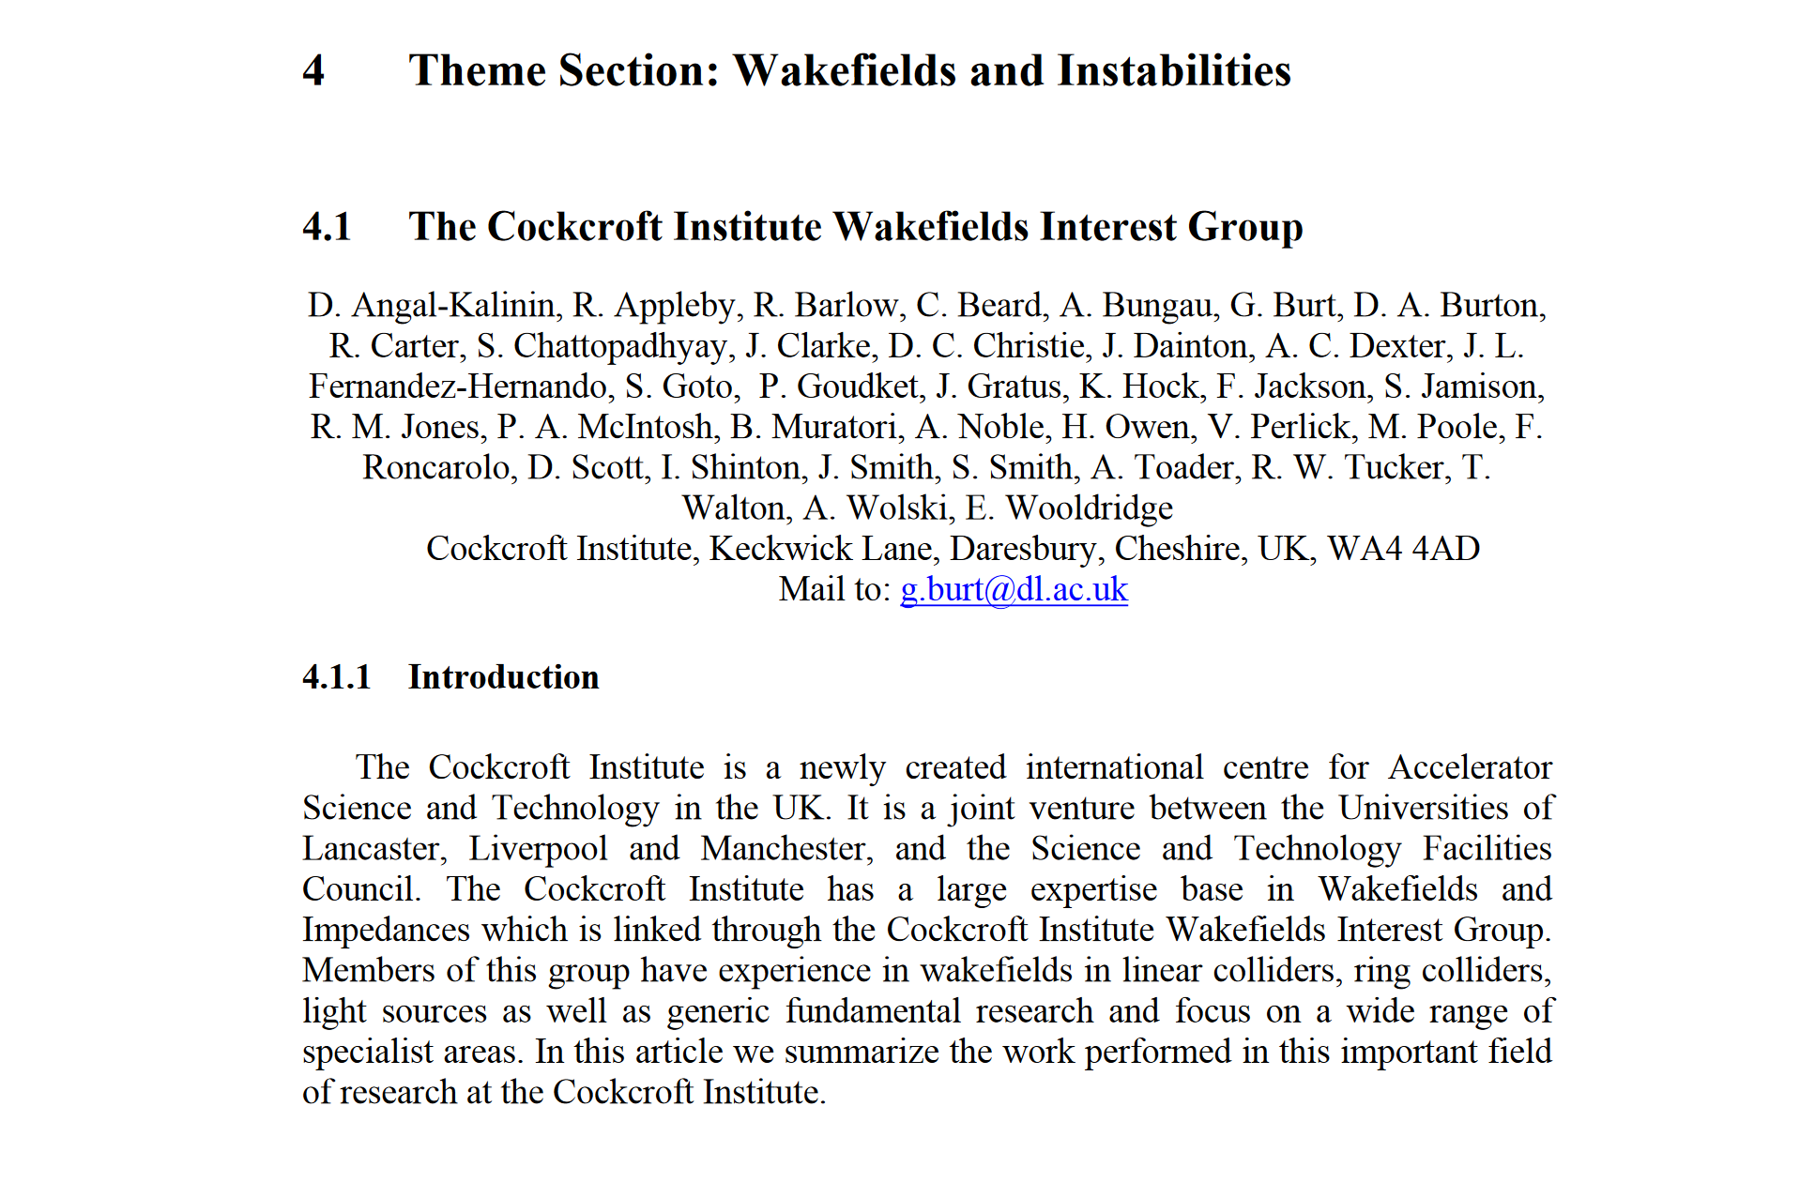
Wakefield interest group
In 2006 it was clear that Wakefields and impedance was a key issue for many projects at CI and that we had a lot of disconnected people working on the topic.
My self and Jonny Smith felt we needed a forum for sharing ideas so we established the CI wakefield interest group.
We have regular half-day meetings where people presented their work and discussed
This culminated in a 30 page report in ICFA Beam Dynamics newsletter

Slide 15
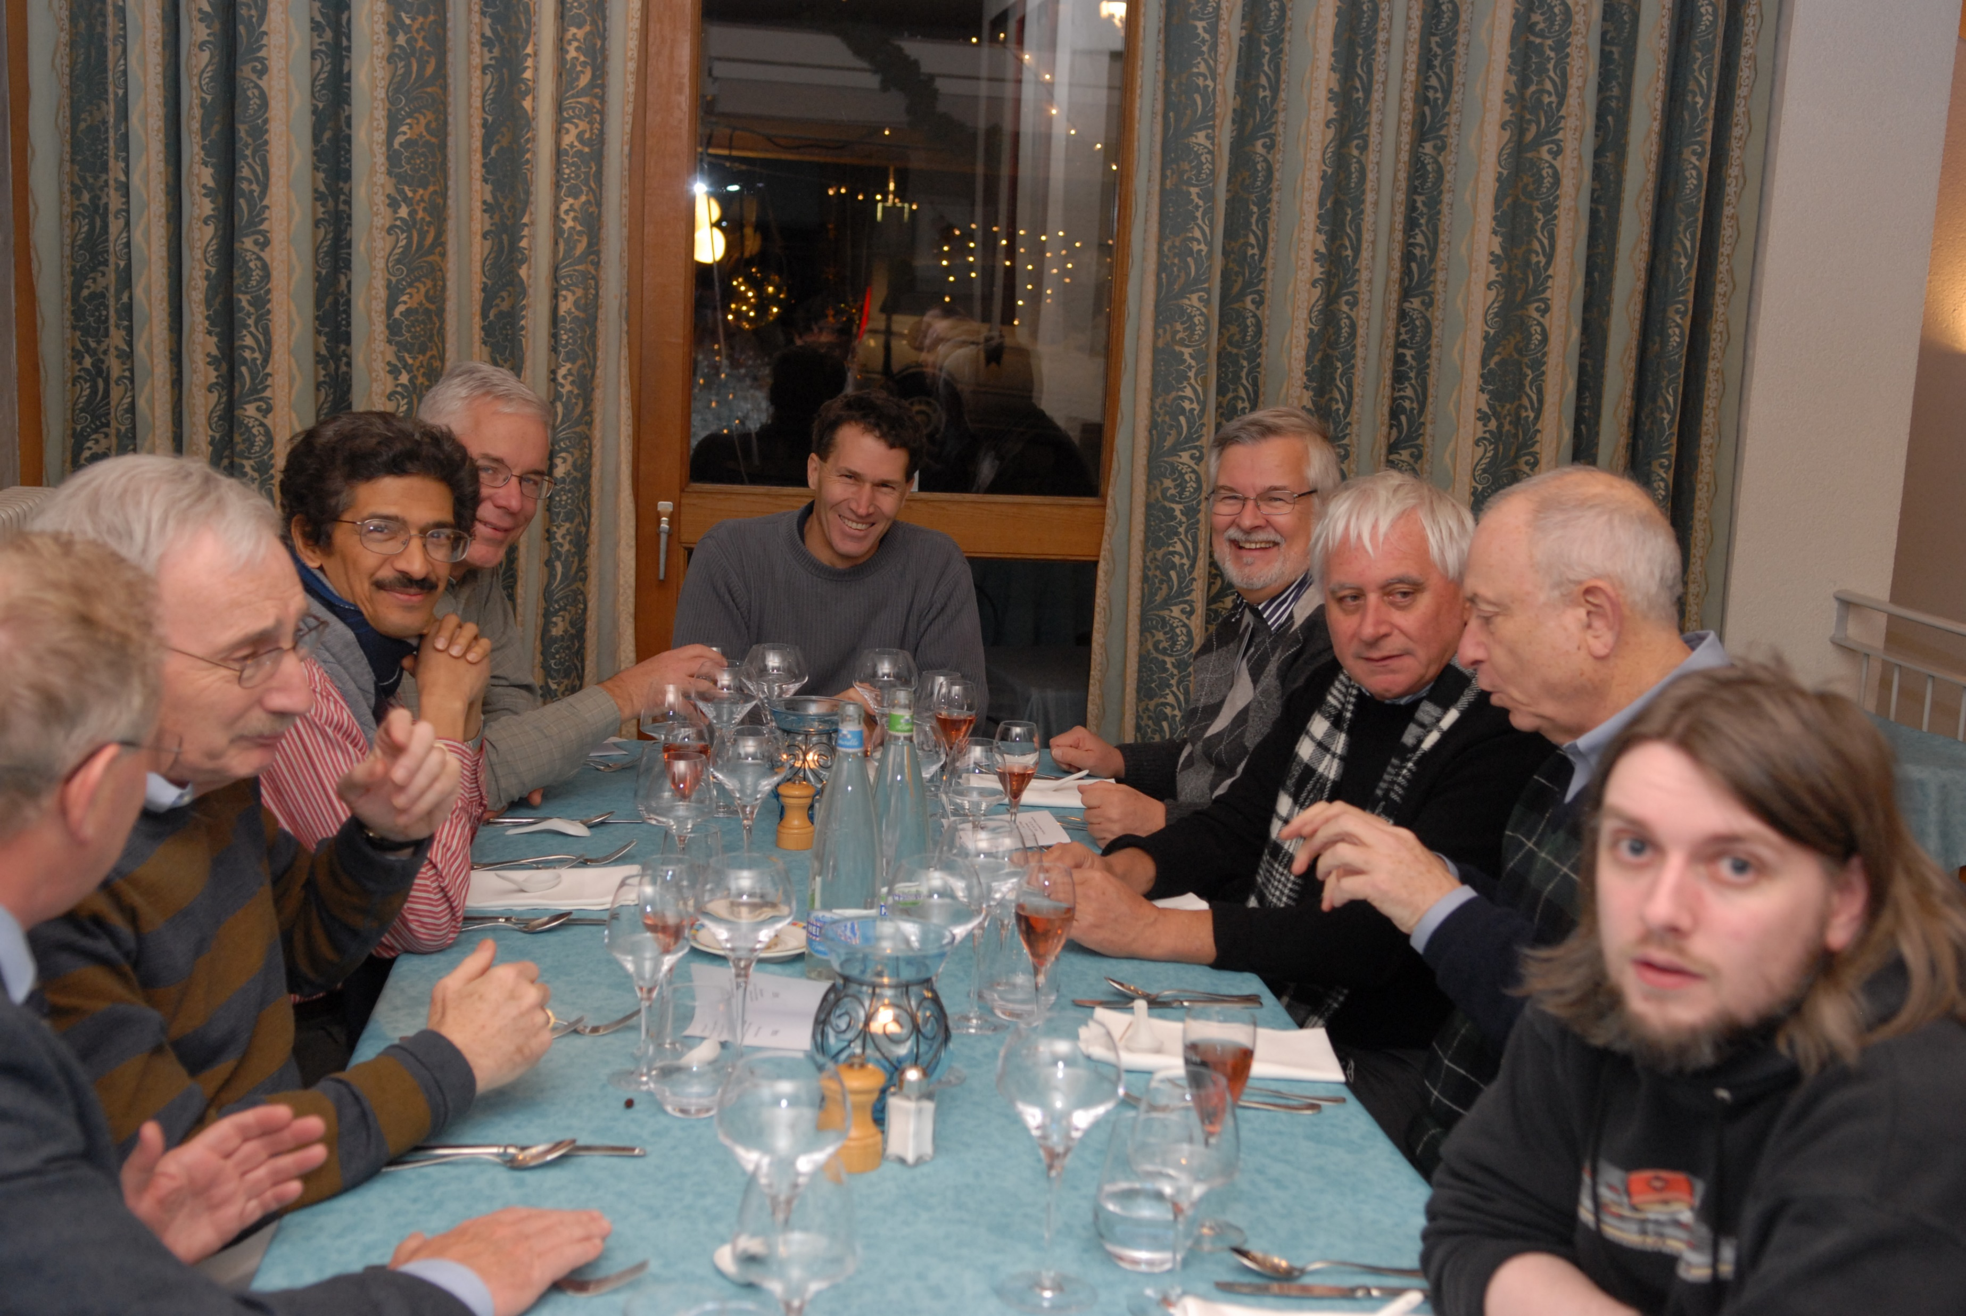
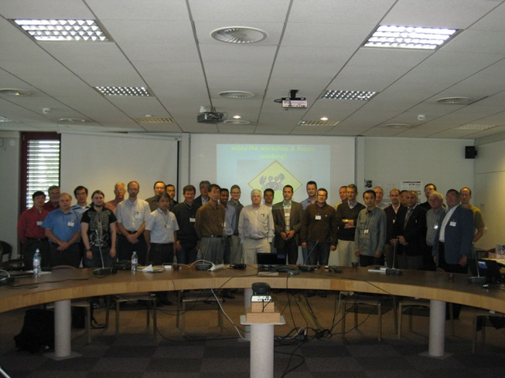
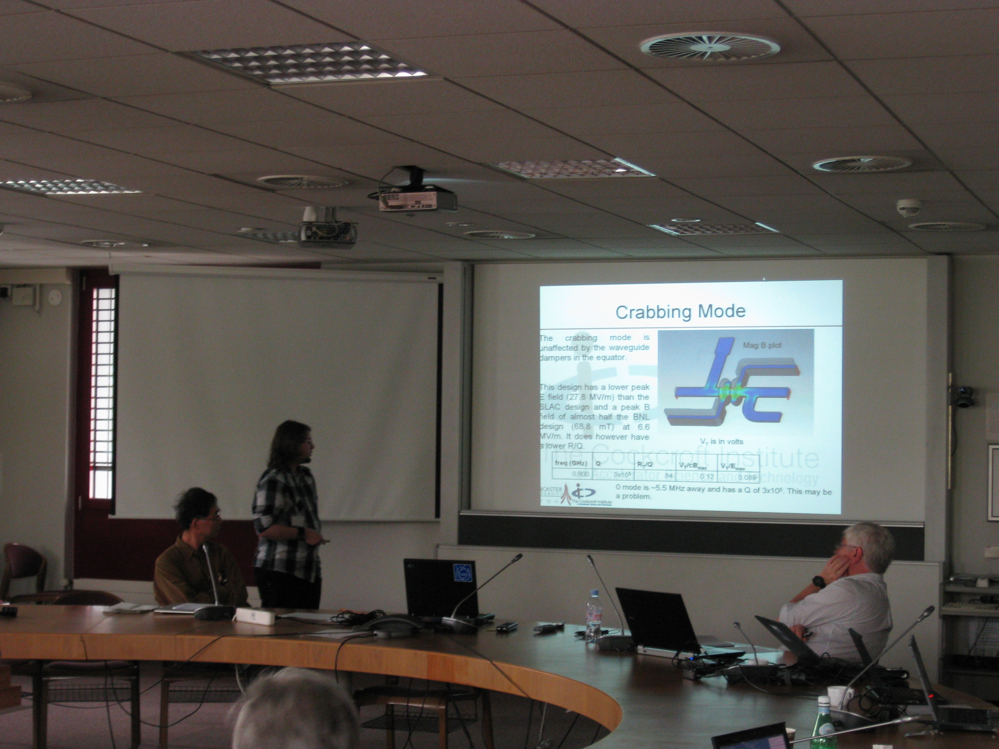
2008 Crabs for LHC

Slide 16
Lectureship -2008
My publications
S.V. Samsonov, A.D.R. Phelps, V.L. Bratman, G. Burt, G.G. Denisov, et al, Compression of frequency modulated pulses using helically corrugated waveguides and its potential for generating multi-gigawatt RF radiation, Phys. Rev. Letts. 92, 118301 (2004).
G. Burt, S.V. Samsonov, et al, Microwave pulse compression using helically corrugated waveguides, IEEE Trans Plasma Sci., 33 (2),pg 661 (2005)
G. Burt, S.V. Samsonov, et al, Dispersion of helically corrugated waveguides: Analytical, numerical and experimental study, Phys Rev E, 70 (2004)
G. Burt, R.M. Jones, A. Dexter, “Analysis of Damping Requirements for Dipole Wake-Fields in RF Crab Cavities.” IEEE Trans. Nuclear Science, 54, 5, Oct (2007)
G. Burt et al, Anti-Crab cavities for the removal of spurious vertical bunch rotations caused by crab cavities PRST-AB Oct (2008).
Pretty sure I would not have gotten an interview today, but I had been a main co-author of the crab section for the ILC design report, had multiple invited talks, and had established the CI wakefield interest group and was seen as a key person in the development of ILC crabs.
Moral, sometimes leadership and esteem trumps publications (and sometimes its good to be lucky)
From PhD

Slide 17
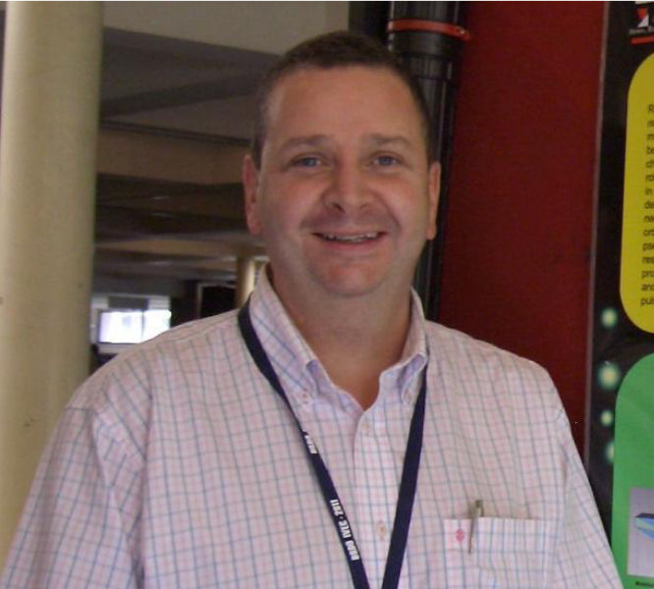
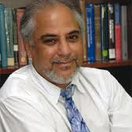
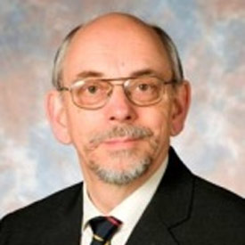
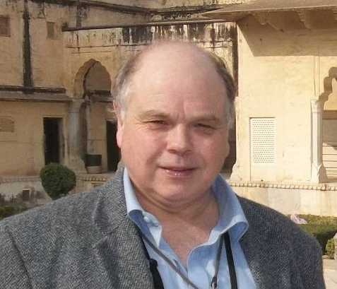
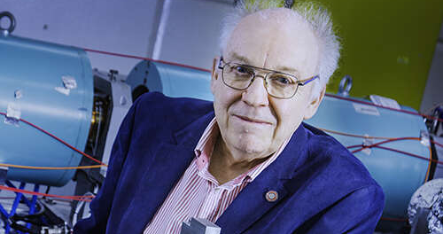
Mentors
A key part of any researcher’s journey is the academic mentors he picks up along the way.
At Cockcroft we have had some excellent mentors and an environment where founders/directors have been happy to have a postdoc knock on their door for advice
OK, maybe not happy, but they never said no.

Slide 18
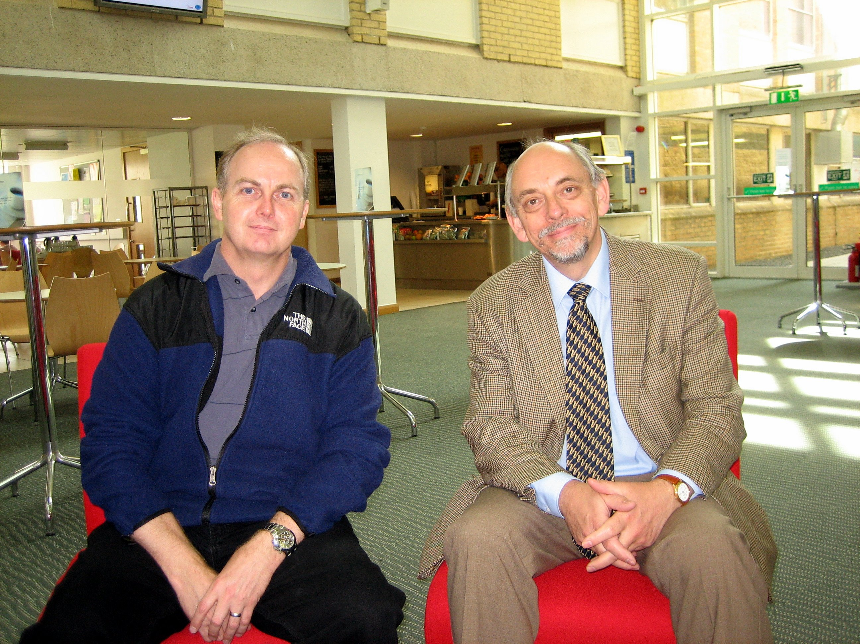
Carterfest
21 October 2010
Cockcroft Institute Hosts Fest Event for its First Emeritus Professor
Professor Richard Carter, who retired from Lancaster University in September 2009, was instrumental in the founding stages of the Cockcroft Institute and hence it was fitting that the Institute should host a colloquium to mark his career. The fest aimed to bring distinguished colleagues to deliver scientific papers on aspects of RF engineering which overlap Richard’s work or interests.

Slide 19
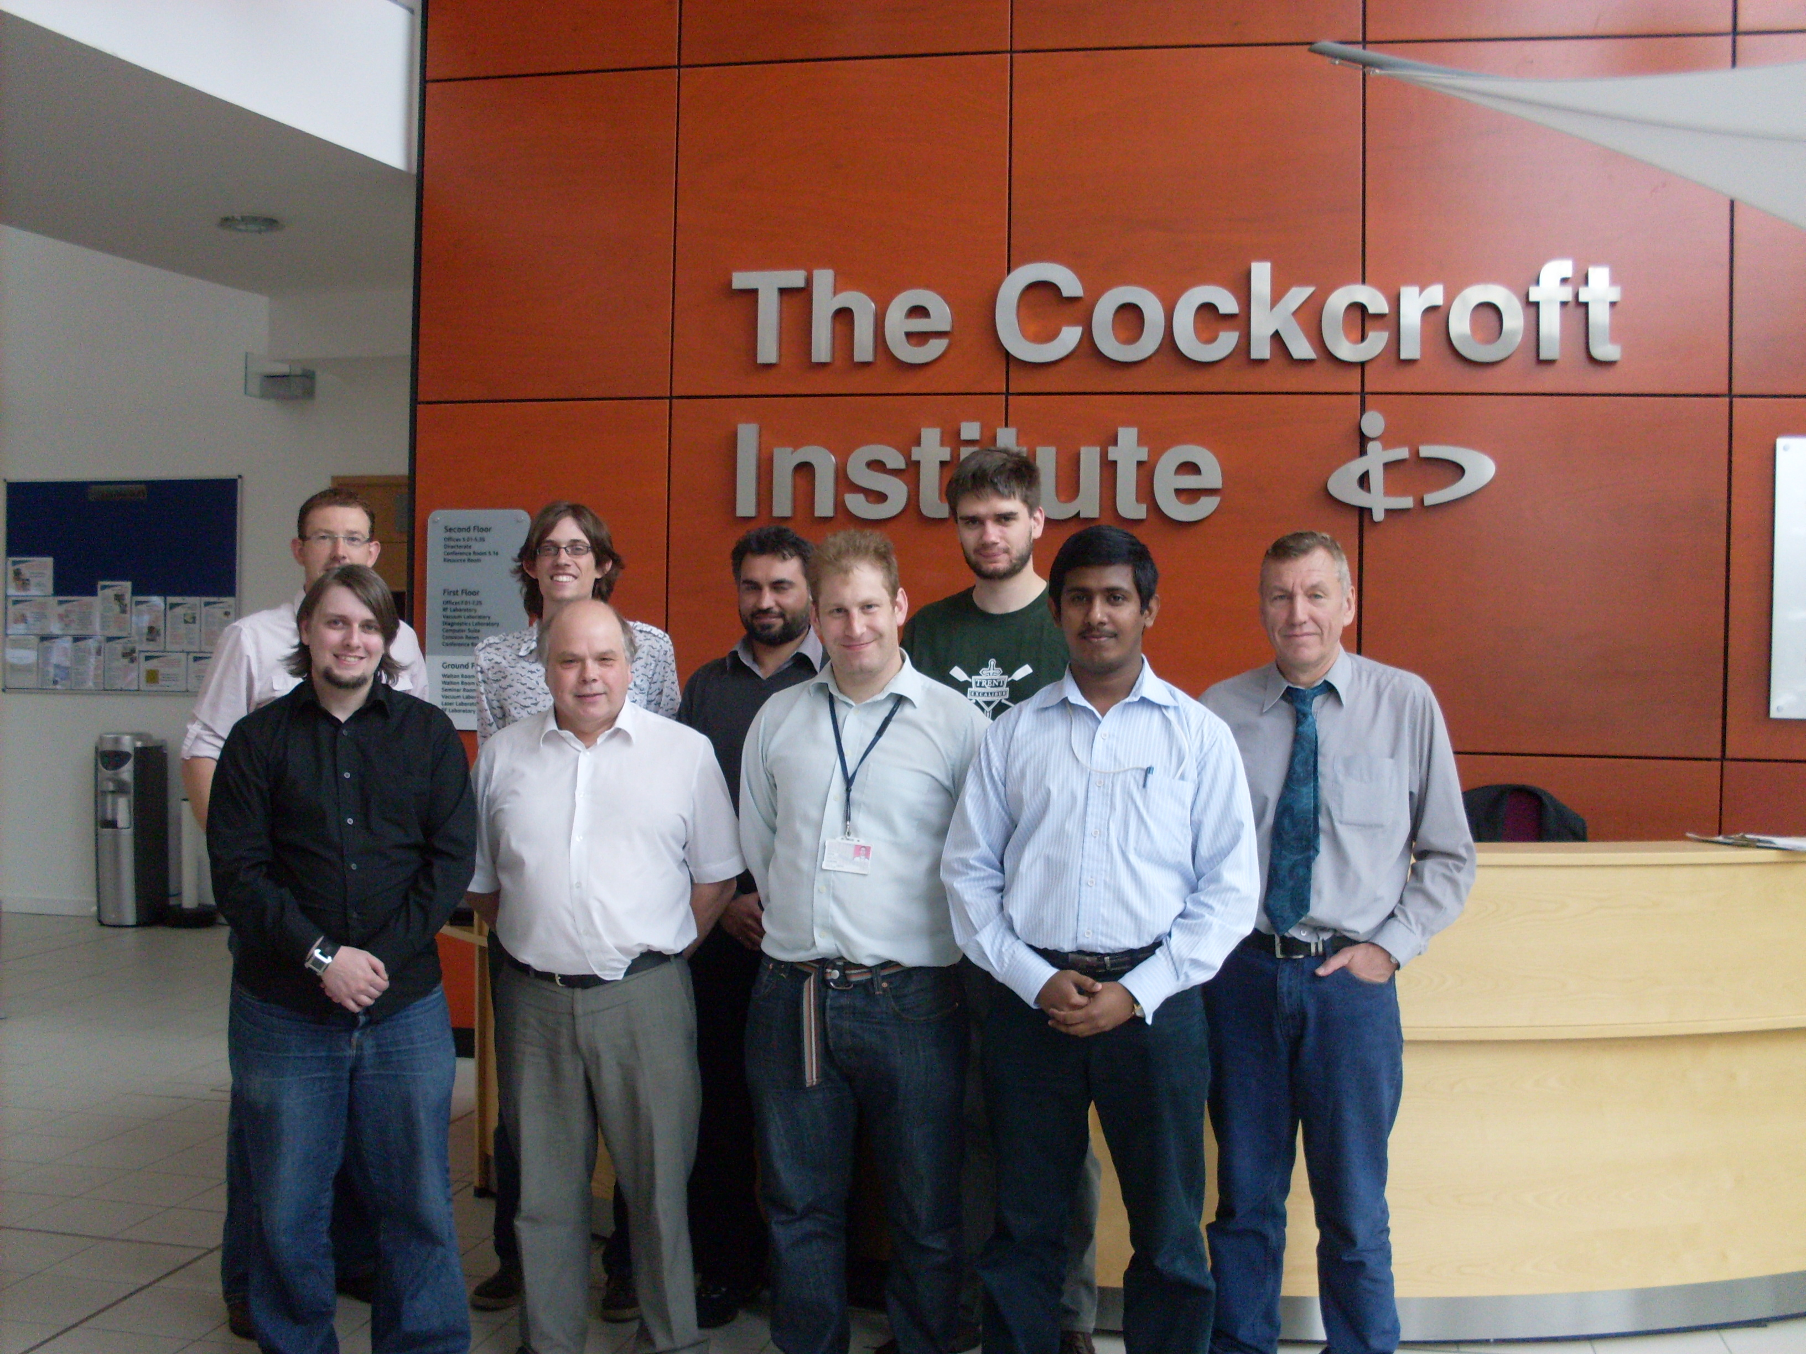
Lancaster Eng Cockcroft group in 2010

Slide 20
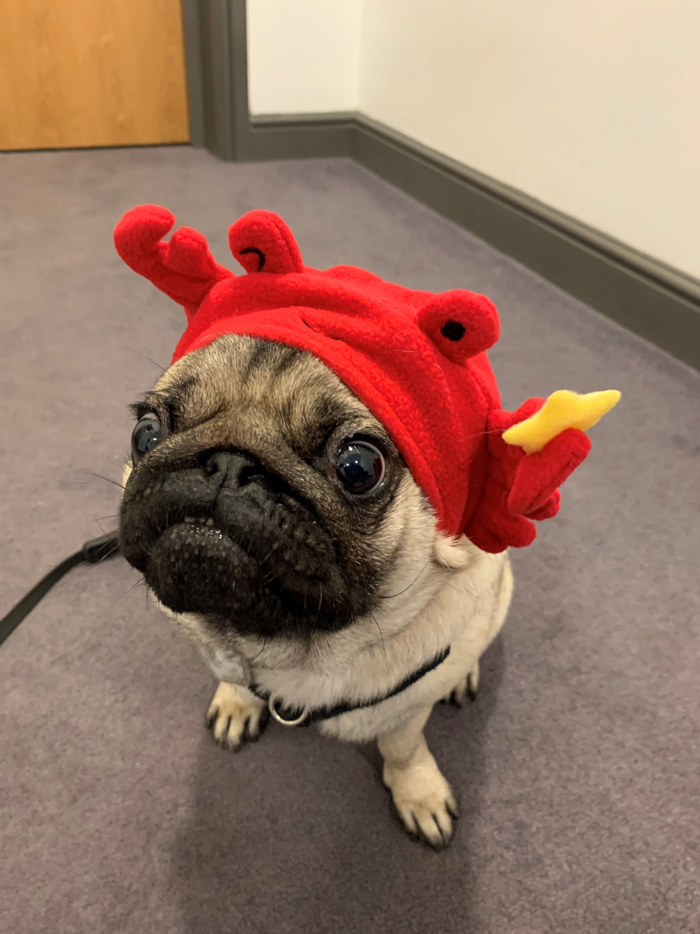
Back to Crabs

Slide 21
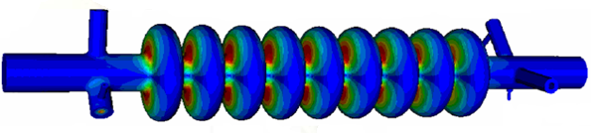
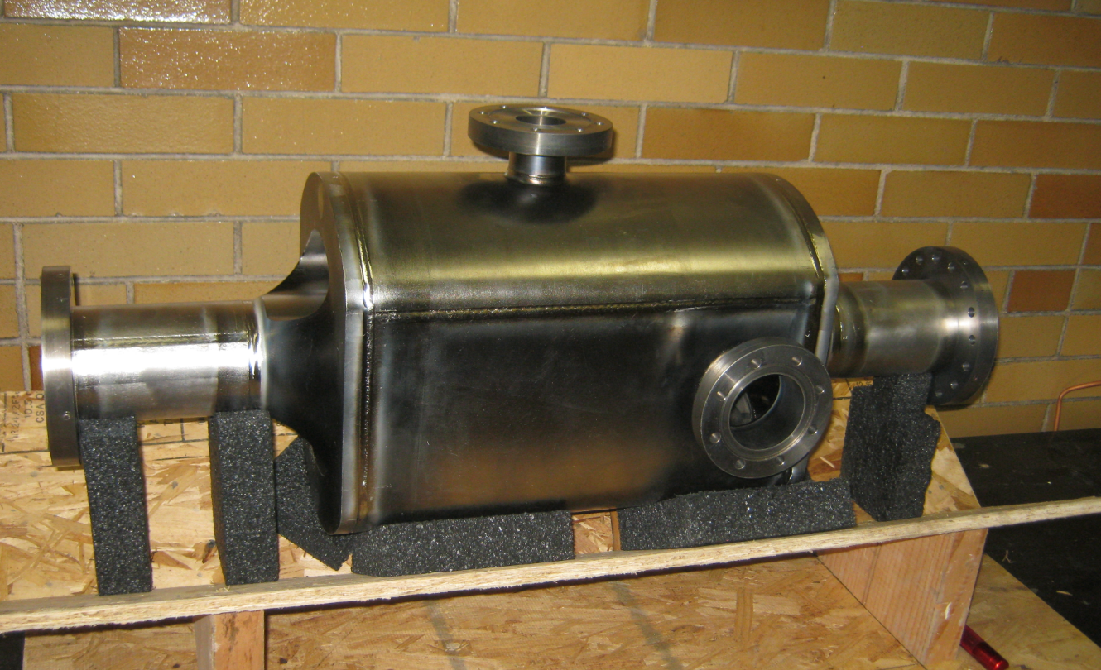
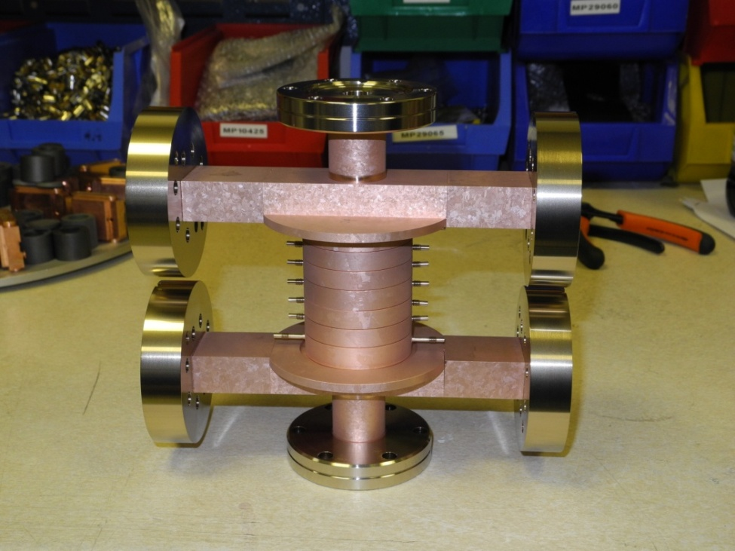
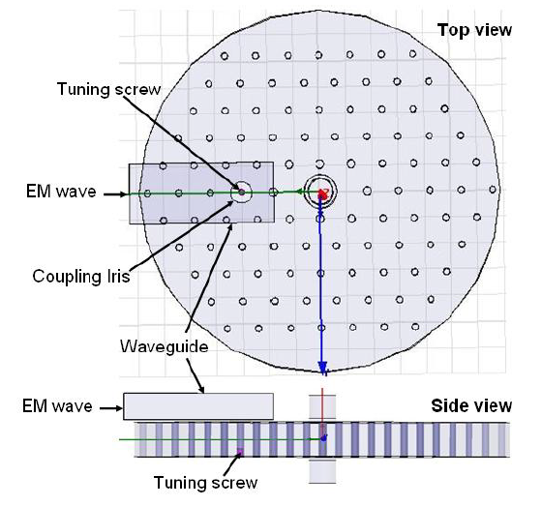
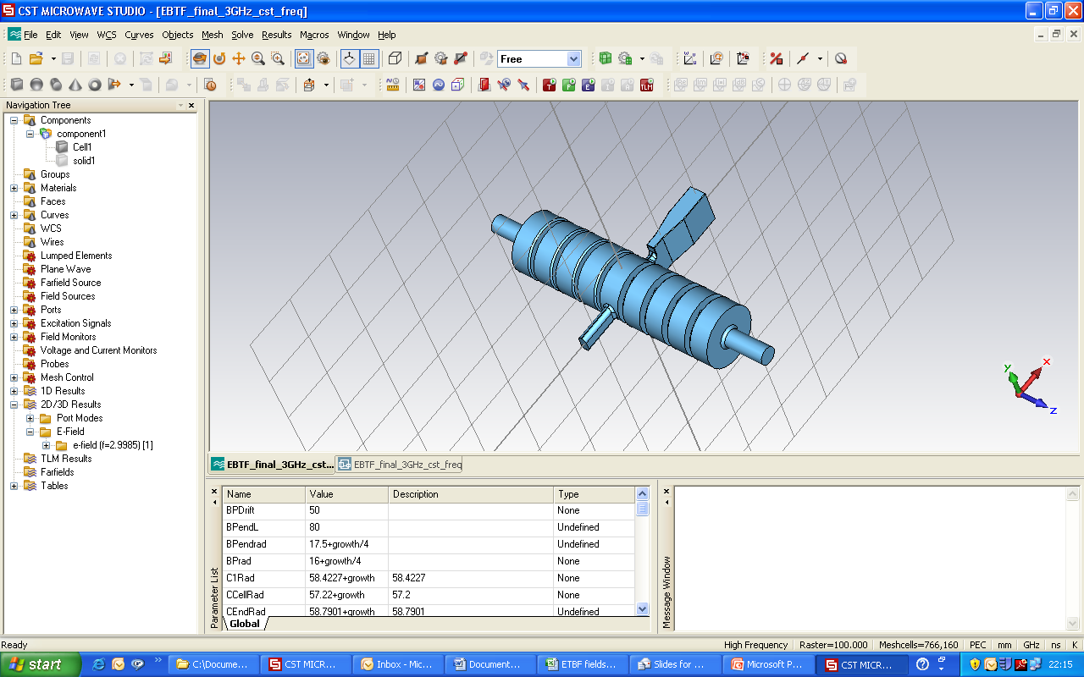
Deflecting mode cavities
International Linear Collider (ILC)
Large Hadron Collider (LHC)
CLIC
PBG crab
VELA

Slide 22



Tests at CERN SM18 in 2013
1st ever high gradient test of a compact crab cavity
The cavity was prepared for vertical testing mid-November at CERN in SM18.

Slide 23






Protons meet Crabs
2 DQW vertical crab cavities were installed in the SPS at the start of 2018.
A program of 7 10-hour shifts were carried out to make fundamental measurements of the proton-crab cavity interaction.
Worlds first crabbing of proton beam – 12:55 on May 23rd 2018. Shown right is crabbing reconstruction from the headtail monitor.

Slide 24


Slide 25




Medical & Security Linacs
Swapan was keen to have CI integrated with UK industry and Rapiscan were keen to develop their own linacs so in 2008 we started working on building aviation cargo screening linacs
Have used this experience to also work on medical linacs now being applied to Low-Middle Income countries

Slide 26


(back to 2015) THz Linacs
Steve was looking for someone in ~2015/16 to take traditional RF linac design approaches and scale them up in frequency to THz for future accelerators.
CI PhD quota supported a joint student (Alisa) to develop the first THz linacs with Steve/Darren delivering the THz sources

Slide 27
Conclusion
Cockcroft has come a long way in the past 20 years from no university accelerator expertise, but having ASTeC as a core member was a massive headstart.
The seamless integration of the three universities and ASTeC made Cockcroft a great place to work as a young PDRA with really collaborative potential.
A key success of Cockcroft was having engineers and physicists work together, and that not replicated in many places. Without it we probably wouldn’t have had as much success in the crabs or THz.
I certainly was lucky to start when I did, things are probably harder now for young accelerator reserachers

