Slide 1
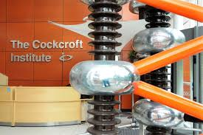
CI-Fest (2004-2024)
Twenty Years of the Cockcroft Institute
Swapan Chattopadhyay
Inaugural Director/Sir John Cockcroft Chair of Physics
(2007 – 2014)

Slide 2
It is indeed very rare in history that three leading internationally ranked universities, a major world-class national laboratory, local industry and a government-funded national research council ---- come together in a collaboration to create a one-of-kind institute of excellence in scientific research, education, training and entrepreneurship!
And it is rarer still to have the honour, privilege and opportunity to lead that institution for a period equivalent to almost the full double-term of a US president!
That is exactly what happened in the first decade and a half of this century, thanks to the insight and inspiration of the Founding members of the Cockcroft Institute, led by Prof. John Dainton, inspired by the legacy of the British Nobelist Sir John Cockcroft and his immediate family, supported by three enlightened Vice-Chancellors and Executives of the Research Councils PARC and CCLRC (later merged into STFC) and local industry!
The Cockcroft Institute
2004 – 2024
My eternal gratitude to the founding stalwarts of CI for helping me lead and serve the Cockcroft Institute
2007-2014
The CI now has arrived squarely on the world stage!
THANK YOU!!!

Slide 3
The soaring success of the Cockcroft Institute must be credited to a handful of outstanding individuals, visionaries, leaders and supporters…..
We will be remiss in not remembering and recounting them

Slide 4
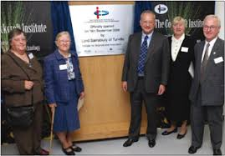
The family of Sir John Cockcroft and Lord Sainsbury laying the foundation of the Cockcroft Institute officially and ceremonially
(2006)
The Cockcroft sisters (daughters of Sir John Cockcroft), Peter Cockcroft (son of Sir John Cockcroft) and Lord Sainsbury, then Minister of Science and Technology, UK

Slide 5
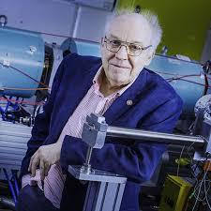
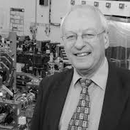
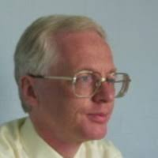
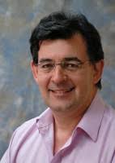
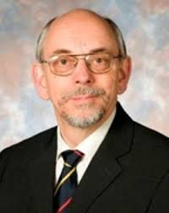
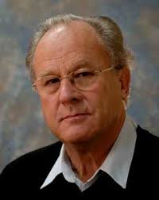
The original Cockcroft Institute Management Committee at Foundation
John Dainton (Liverpool Physics), Mike Poole (Daresbury Lab, STFC, ASTeC), Roger Barlow (Manchester Physics), Peter Ratoff (Lancaster Physics), Richard Carter (Lancaster Engineering), Robin Tucker (Lancaster Physics)

Slide 6
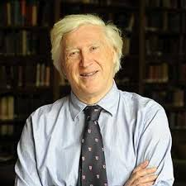
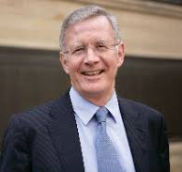
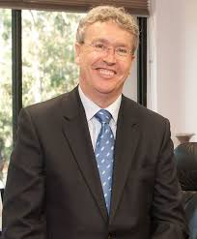
Vice-Chancellors of the Cockcroft Institute founding Universities
Sir Drummond Bone Alan Gilbert Paul Welling
Univ. of Liverpool Univ. of Manchester Lancaster Univ.

Slide 7
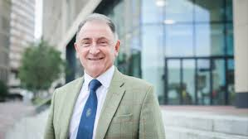
University of Strathclyde joins Cockcroft Institute
2011
Professor Sir Jim McDonald

Slide 8
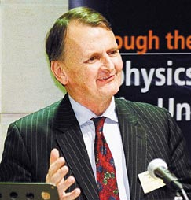
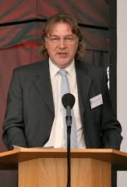
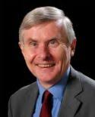
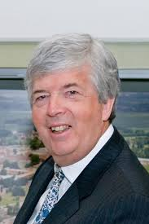
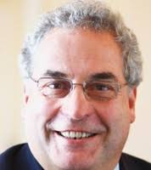
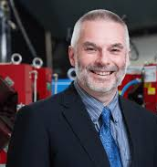
PPARC, CCLRC (eventually merged into STFC) Directors supporting the Cockcroft Institute
Ian Halliday Keith Mason John Wood Andrew Taylor Colin Whitehouse John Womerseley

Slide 9
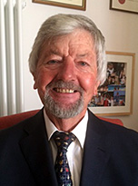
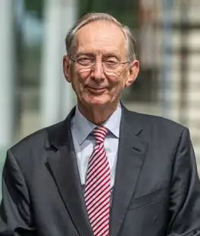
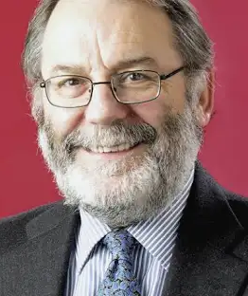
CHAIRs of the Cockcroft Institute Governing Board
2007 - 2014
Michael Dexter Sir John Pendry Sir Peter Knight
FRS FRS FRS
2007-2010 2010-2013 2013-2014

Slide 10
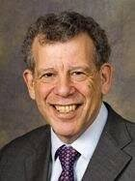
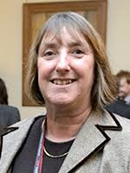
Chairs of the Cockcroft Institute Industrial Board
2007 - 2014
Sir Peter Saraga Dame Frances Saunders
OBE, CBE, FREng DBE, CB
2008 – 2013 2013-2014

Slide 11
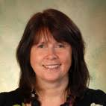
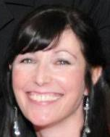
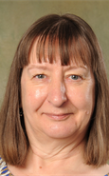
No Institution can survive without the care, dedication, attention to detail and administrative skills demanded by a complex
multi-stakeholder orgsnization
The Cockcroft Institute was fortunate to have Liz Mason (Business Manager), Liz Kennedy (Executive Administrator), Mary Highmore (Financial Manager) and Sue Waller (Executive Administrator) to guide its scientific leaders with firm hands

Slide 12
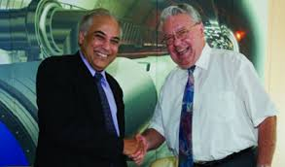
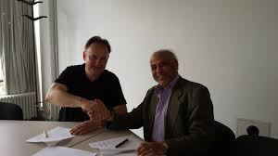
Cockcroft Institute-CERN Collaboration
LHC, Hi-Lumi LHC, FCC, CLIC, HI-ISOLDE, ELENA, AWAKE,….

Slide 13
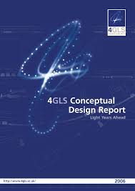
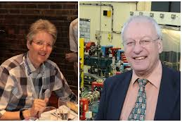
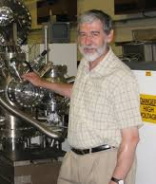
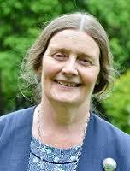
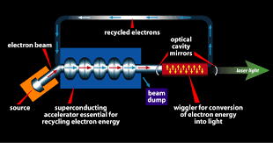
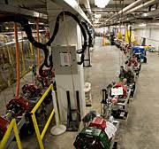
Cockcroft Institute-Jefferson Lab Collaboration on a vision of a potential 4GLS!
Elaine Seddon, Mike Poole, Susan Smith,
Peter Weightman, Wendy Flavell
Jefferson Lab FEL scientists

Slide 14
Cockcroft Institute-Fermilab Collaboration
PIP-II, SRF, IOTA, g-2, Mu-2-e, PASI

Slide 15
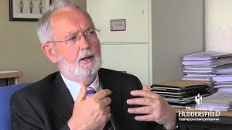
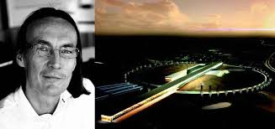
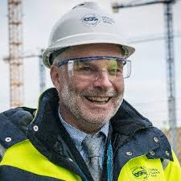
Cockcroft Institute-ESS Collaboration
Colin Carlile, Mats Lindroos, John Womerseley
SRF, low-medium beta cryomodules

Slide 16
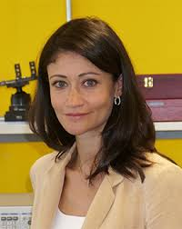
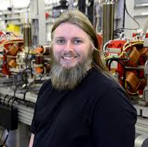
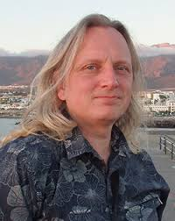
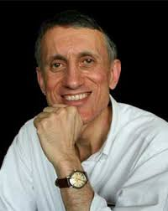
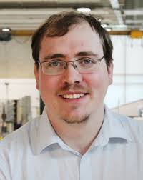
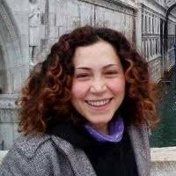
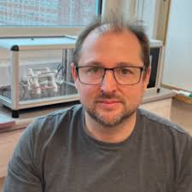
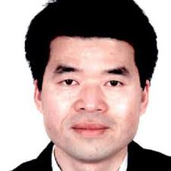
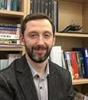
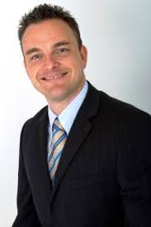
Faculty Appointments 2007 - 2014
Lancaster
Manchester
Liverpool

Slide 17
The Cockcroft Institute looks forward with 2020 Vision
11 October 2009
The Cockcroft Institute
Following a successful peer review and subsequent competitive national and global assessment in early 2009 by an international group of experts, the Science and Technology Facilities Council (STFC) UK has authorized the Cockcroft Institute Core Grant for renewal and extension till March 31, 2017. This will see the Cockcroft Institute awarded £20.0 M since its founding in 2004, £16.3 M of which over the next eight years till 2017.
Swapan Chattopadhyay, Director of the Cockcroft Institute said: "I am delighted at the exciting opportunities for growth now secured for the Cockcroft Institute by this award. At the same time I am also aware of the struggles faced by our colleagues in UK in the fundamental areas of particle physics, nuclear and photon sciences -the very fields that we accelerator scientists and technologists aspire to enable. At such a time, the awarding of the Cockcroft Institute core grant extension till 2017 is most welcome news. In my privileged position as the Director of the institute, it will be one of my priorities to share our efforts and add value to the above scientific fields in the most optimised fashion achievable."

Slide 18
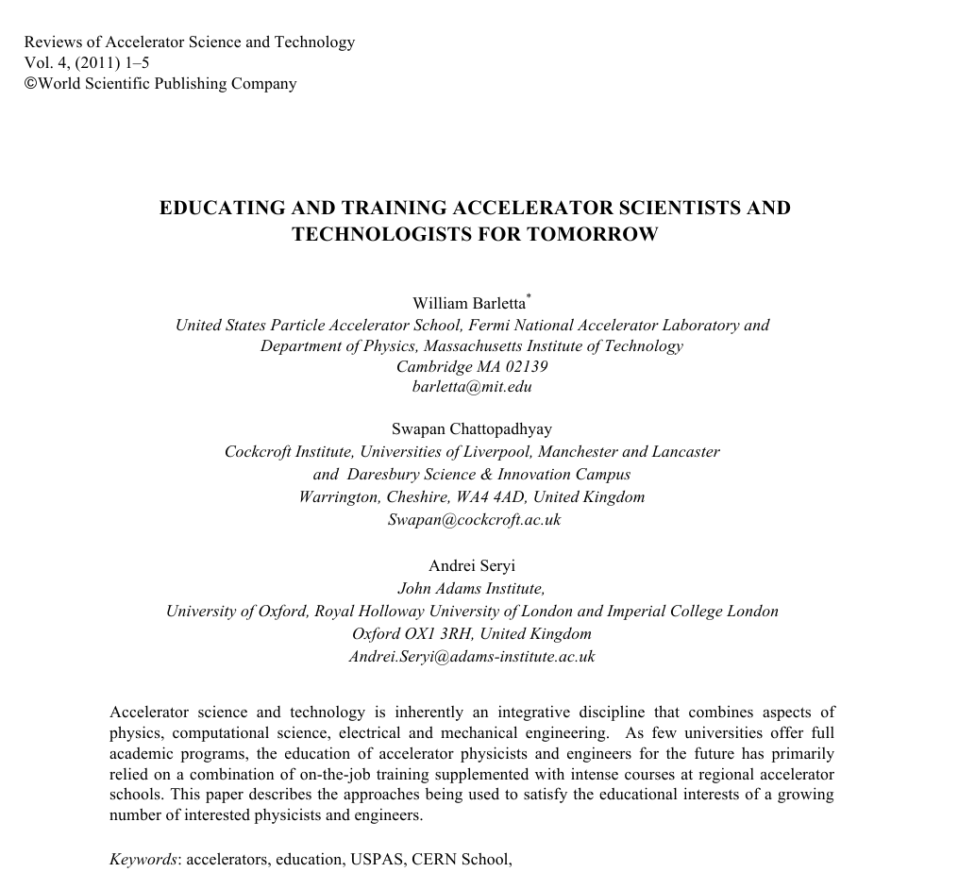
Cockcroft Institute Education and Training program was highlighted in a high-visibility World Scientific Publication

Slide 19
Highlights of Achievements (2007 – 2014)
1. CI STFC Grant Renewal 2007-2017 > 16.5 M Pounds
CI Faculty Recruitment: > 10 Faculty appointed to universities
University of Strathclyde joined as partner (true UK institute with Scotland ‘in’ by 2011!)
4. Collaborations with CERN, ESS, Fermilab, Jefferson Lab: Scientific output of the highest caliber
5. CI contributions to Manchester Christies Proton Therapy Accelerator Facility
6. Development of Research and Training on Accelerators on-site at Daresbury: ALICE/EMMA
8. CERN Tech hub established on CI-DL site……….+ many more…..

Slide 20
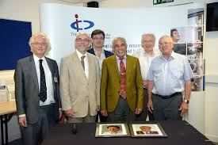
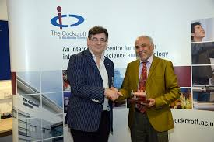
On my last day at the Cockcroft Institute……..
transferring the baton to Prof. Peter Ratoff

Slide 21
Thank You!

