Slide 1
The Beginning !
John Dainton
The Cockcroft Institute
Department of Physics
Lancaster University

Slide 2
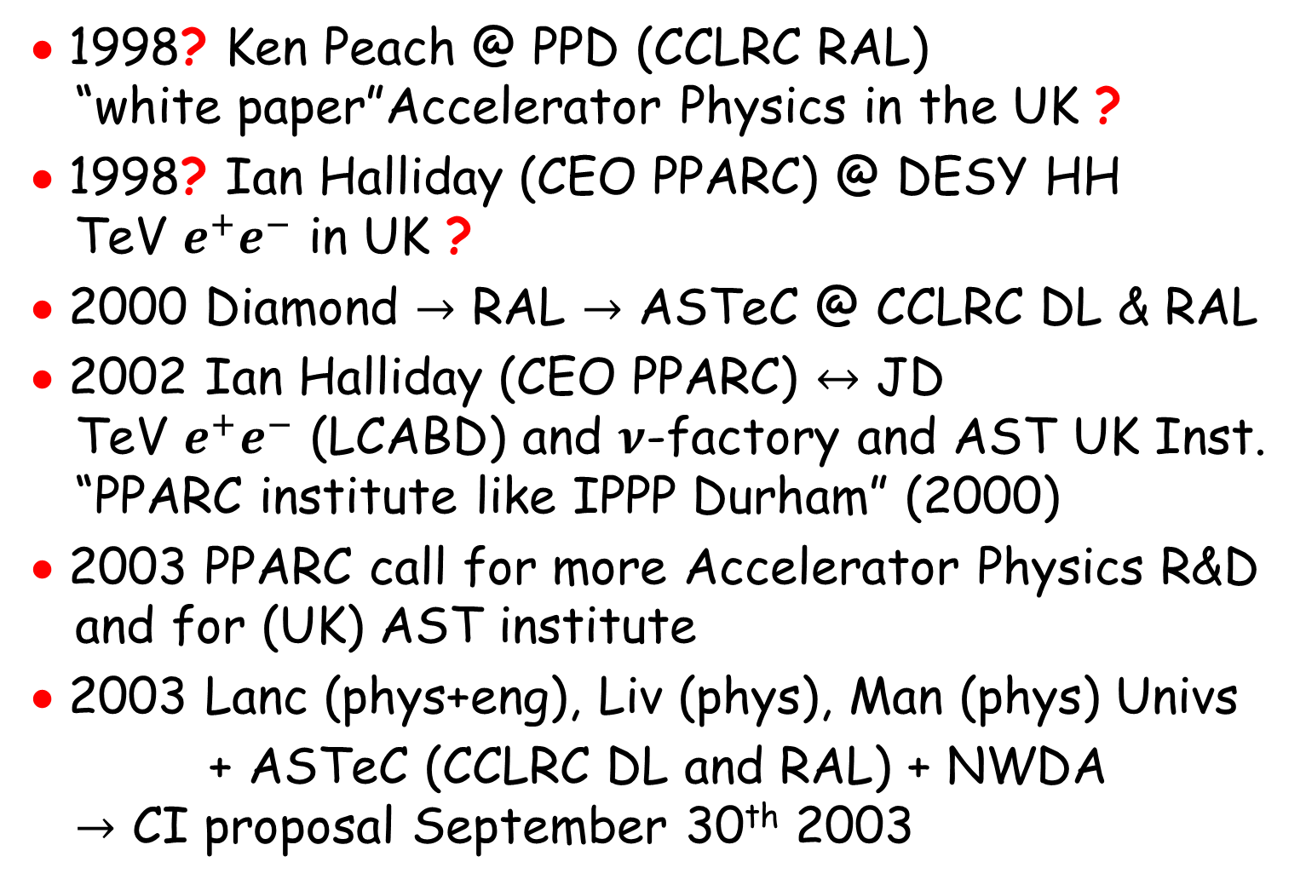
The Very Beginning !
• 1998? Ken Peach @ PPD (CCLRC RAL)
“white paper”Accelerator Physics in the UK ?
• 1998? Ian Halliday (CEO PPARC) @ DESY HH
TeV $e^{+}e^{−}$ in UK ?
• 2000 Diamond $→$ RAL $→$ ASTeC @ CCLRC DL & RAL
• 2002 Ian Halliday (CEO PPARC) $↔$ JD
TeV $e^{+}e^{−}$ (LCABD) and $ν$-factory and AST UK Inst.
“PPARC institute like IPPP Durham” (2000)
• 2003 PPARC call for more Accelerator Physics R&D
and for (UK) AST institute
• 2003 Lanc (phys+eng), Liv (phys), Man (phys) Univs
+ ASTeC (CCLRC DL and RAL) + NWDA
$→$ CI proposal September 30th 2003

Slide 3
Proposal
…

Slide 4
Mission

Slide 5
Commitments

Slide 6
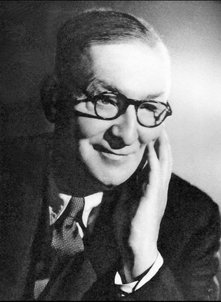







On the road through Maghull …
Sir John Cockcroft OM KCB CBE FRS
b. Todmorden (Lancashire and Yorkshire!)
ed. Manchester University: Maths
Manchester College of Technology (UMIST): Elec. Eng.
Metropolitan-Vickers, Manchester
PhD then post-doc, Cambridge Univ.
Nobel Laureate, Physics, 1951
http://www.lancs.ac.uk/cockcroft-institute/

Slide 7
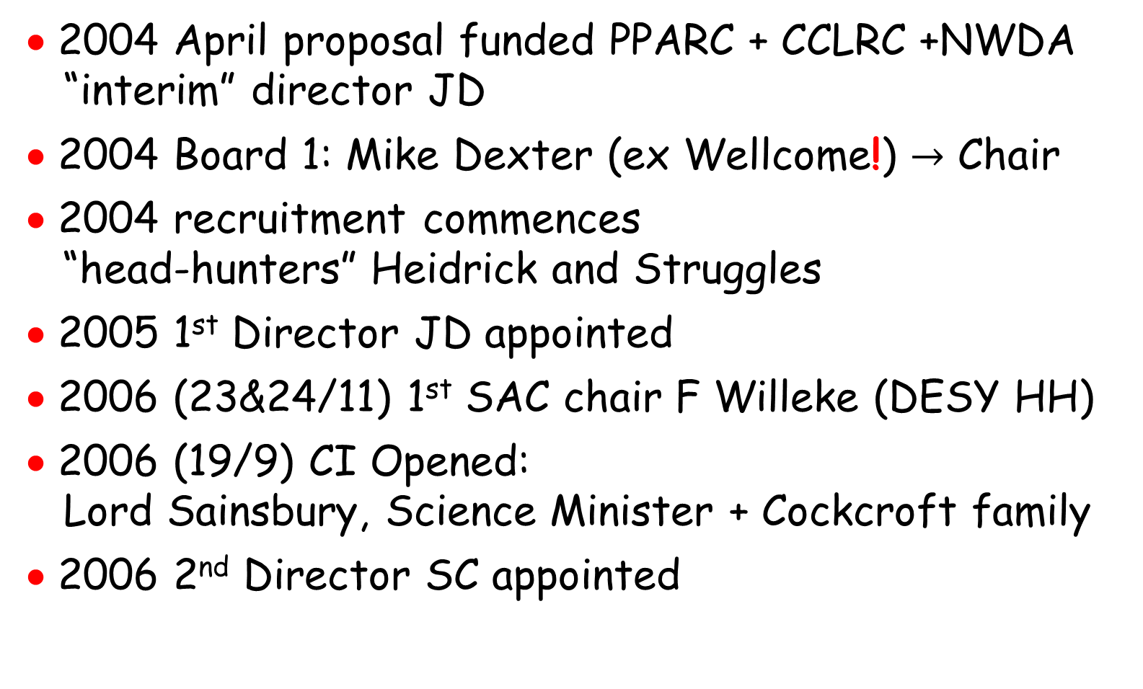
Outcome and Onwards
• 2004 April proposal funded PPARC + CCLRC +NWDA
“interim” director JD
• 2004 Board 1: Mike Dexter (ex Wellcome!) $→$ Chair
• 2004 recruitment commences
“head-hunters” Heidrick and Struggles
• 2005 1st Director JD appointed
• 2006 (23&24/11) 1st SAC chair F Willeke (DESY HH)
• 2006 (19/9) CI Opened:
Lord Sainsbury, Science Minister + Cockcroft family
• 2006 2nd Director SC appointed

Slide 8
CI Board 26/3/04

Slide 9
CI @ SAC 1: 23&24/11 2006
• senior staff committing to the CI at foundation
 | University | Department | Start | Main Research Interest
R Barlow | Manchester | Physics and Astronomy | September 2003 | Particle Physics → ILC BDS: wakefields and collimation
R Carter | Lancaster | Engineering | September 2003 | RF supply and delivery
A Dexter | Lancaster | Engineering | September 2003 | RF supply and delivery
J Dainton | Liverpool | Physics | September 2003 | Particle Physics → ILC positron source, founding Director
T Greenshaw | Liverpool | Physics | September 2003 | Particle Physics → ILC positron source
P Ratoff | Lancaster | Physics | September 2003 | Particle Physics T2K, ILC positron source
R Tucker | Lancaster | Physics | September 2003 | Mathematical Physics → radiation and beam dynamics (CI theory group)
 | Institution | Centre | Start | Main Research Interest
M Poole | CCLRC Daresbury Lab | ASTeC | September 2003 | ASTeC group leadership
~55 FTE | CCLRC Daresbury Lab | ASTeC | September 2004 | ASTeC staff^{[1]}
^{[1]} Most ASTeC staff collaborate seamlessly with university staff. There are ASTeC projects which do not involve (yet) university staff.

Slide 10
CI @ SAC 1: 23&24/11 2006
• university faculty staff appointed to the CI ^{[1]}
 | University | Start | Main Research Interest
D Burton | Lancaster | July 2005 | global field analysis of accelerator beams
R Jones | Manchester | December 2005 | Linac physics
R Appleby | Manchester | August 2005 | ILC Optics and Beam Dump, FP420 and LHC
R Seviour | Lancaster | August 2005 | RF cavity R&D
A Wolski | Liverpool | May 2006 | ILC: Damping Rings, ERLP
G Moortgat-Pick^{[2]} | Durham | September 2006 | ILC: positron, spin transport, and spin delivery
J Gratus | Lancaster | December 2006 | radiation and beam dynamics
S Chattopadhyay | Liverpool Lancaster Manchester | March 2007 | Inaugural Director

Slide 11
CI @ SAC 1: 23&24/11 2006
• university visiting staff at the CI ^{[1]}
 | Institution | Cockcroft Institute University | Position | Start | Main Research Interest
D Barber | DESY Hamburg | Liverpool | Visiting Professor | September 2005 | Spin dynamics
K Potter | CERN | Manchester | Visiting Professor | June 2006 | Beam-line engineering
J A Clarke | CCLRC ASTeC | Liverpool | Visiting Professor | June 2006 | Insertion Devices
N Marks | CCLRC ASTeC | Liverpool | Visiting Professor | August 2005 | Education and Training Magnet design and technology
M W Poole | CCLRC ASTeC | Liverpool | Visiting Professor | August 2005 | Beam dynamics
V Suller | CAMD Baton Rouge, USA | Liverpool | Visiting Professor | August 2005 | Beam dynamics

Slide 12
PDRA Staff: Project
RA | Supervisor (Faculty) | HEI | Start | End | Funding | Project
G Burt | A Dexter | Lancaster | October 2004 | September 2007 | PPARC LCABD | ILC crab cavity
G Kourevlev | R Barlow R Jones | Manchester | October 2004 | March 2006 | PPARC LCABD | ILC collimator wakefields
J Smith^{[1]} | R Carter | Lancaster | Feb 2005 | Feb 2008 | CCLRC LCABD | ILC collimation
I Bailey | A Wolski | Liverpool | March 2005 | February 2008 | PPARC LCABD | ILC robust spin transport and positron source
J Phillips | A Gillespie | Dundee | March 2005 | February 2008 | CCLRC LCABD | fast laser optics and laser photocathode
L Jenner | A Wolski | Liverpool | June 2005 | May 2008 | PPARC LCABD | ILC optics for BD and positron source
I Tahir⁷ | R Carter A Dexter | Lancaster | April 2006 | September 2007 | EUFr6 EuroTeV | ILC crab cavity
R Jenkins | R Carter A Dexter | Lancaster | May 2006 | December 2007 | EUFr6 EuroTeV | ILC crab cavity

Slide 13
PDRA Staff: Project
RA | Supervisor (Faculty) | HEI | Start | End | Funding | Project
F Roncarolo | R Appleby R Jones | Manchester | September 2006 | August 2007 | PPARC FP420 | LHC commissioning & beam-p ipe wake-fields
A Toader | R Barlow R Jones | Manchester | September 2006 | August 2007 | PPARC LCABD | ILC collimator wakefields
A Bungau | R Barlow | Manchester | October 2006 | September 2009 | EUFr6 EuroTeV | ILC beam delivery collimation and wakefields
R Tucker | R Tucker | Lancaster | October 2006 | September 2007 | EPSRC | Springboard Fellowship
A Noble | D Burton | Lancaster | January 2007 | December 2008 | EPSRC | Ultrarelativistic charge
tba^{[2]} | R Seviour | Lancaster | March 2007 | February 2010 | EPSRC | High Power RF and photonic band gap
tba⁸ | R Seviour | Lancaster | March 2007 | February 2010 | EPSRC | High Power RF and photonic band gap
tba⁸ | R Tucker | Lancaster | May 2007 | April 2009 | EPSRC | Plasma wake theory
tba⁸ > 1 | R Barlow | Cockcroft Institute universities and ASTeC | April 2007 | September 2010 | RCUK BT | EMMA (non scaling FFAG)

Slide 14
PG Students
Student | Supervisor | University | Start | End | Degree | Funding | Topic
D Scott | T Greenshaw | Liverpool | October 2002 | December 2006 | PhD | CCLRC | ILC Undulator positron source
C Hill | R Carter | Lancaster | October 2003 | September 2007 | PhD | PPARC/e2V CASE | Multipactor discharge
P Goudket | R Carter | Lancaster | October 2003 | March 2006 | PhD | CCLRC | Multipactor Discharge
S Malton | S Smith | UCL | October 2003 | September 2006 | PhD | PPARC/CCLRC CASEplus | Laser-beam interactions
S Crane¹⁰ | R Carter | Lancaster | October 2004 | September 2009 | PhD | PPARC/e2V CASE | Innovative RF sources
A Mercer | R Barlow | Manchester | October 2004 | December 2005 | MPhil | PPARC (AST^{[1]}) | ILC BD wake-fields
C Nam | J Clarke | Strathclyde | October 2004 | September 2007 | PhD | CCLRC | FEL simulations
J Smith^{[2]} | D Burton | Lancaster | Feb 2005 | Feb 2008 | PhD | CCLRC | ILC Collimation
C Glasman | R Barlow R Jones | Manchester | October 2005 | September 2006 | MSc | self | ILC BD wake-fields
A Hale | R Tucker | Lancaster | October 2005 | September 2008 | PhD | EPSRC | Fundamentals of Beam Dynamics
F Hannon | R Seviour | Lancaster | October 2005 | July 2008 | PhD | Jefferson Lab, US | High brightness gun for JLab FEL upgrade
^{[1]} AST = Accelerator Science and Technology
^{[2]} employed as RA, University of Lancaster
^{[3]} registered part-time

Slide 15
PG Students
Student | Supervisor | University | Start | End | Degree | Funding | Topic
C Lingwood | R Carter | Lancaster | October 2005 | September 2008 | PhD | PPARC (AST⁸) Thales ED | CLIC/CTF3: RF sources (multi-beam klystron)
L Malysheva | J Dainton A Wolski | Liverpool | October 2005 | September 2008 | PhD | PPARC (Particle Physics) | ILC robust spin transport and positron source
R Nag | R Tucker | Lancaster | October 2005 | September 2008 | PhD | PPARC (AST⁸) | CLIC/CTF3: coherent SR
N Shales | R Tucker | Lancaster | October 2005 | September 2008 | PhD | PPARC (project AST⁸) | ILC Collimation
E Wooldridge^{[3]} | R Carter | Lancaster | October 2005 | September 2009 | PhD | CCLRC | Beam break up in ERL
I Tahir⁹ | R Carter A Dexter | Lancaster | January 2004 | September 2007 | PhD | EUFr6 EuroTeV | ILC crab cavity
C Glasman | R Jones | Manchester | October 2006 | September 2009 | PhD | PPARC CI core | ILC BD wake-fields
K Panagiotidis | A Wolski | Liverpool | October 2006 | September 2009 | PhD | PPARC CI core | ILC Damping Rings
A Scarfe | R Appleby | Manchester | October 2006 | September 2009 | PhD | PPARC/CCLRC CASE | ILC beam dumps and BD optics
B Spencer | R Jones | Manchester | October 2006 | September 2009 | PhD | PPARC CI core | ILC linac RF

Slide 16
PG Students
Student | Supervisor | University | Start | End | Degree | Funding | Topic
L Zang | A Wolski | Liverpool | October 2006 | September 2009 | PhD | PPARC CI core and EuroTeV | ILC Undulator positron source
tba⁸ | R Seviour | Lancaster | October 2007 | September 2010 | PhD | EPSRC | High Power RF and photonic band gap
tba⁸ | R Seviour | Lancaster | October 2007 | September 2010 | PhD | EPSRC | High Power RF and photonic band gap
tba⁸ | tba⁸ | Lancaster | October 2007 | September 2010 | PhD | PPARC (Particle Physics) | High Power RF
UG Students
Student | Cockcroft Institute Supervisor | University | Start | End | Degree | Funding | Project
A Birch | J Clarke | Bath | September 2006 | August 2007 | MPhys | CCLRC | Positron source
L Hooper | J Clarke | Bath | September 2006 | August 2007 | MPhys | CCLRC | Magnet measurement
^{[1]} AST = Accelerator Science and Technology
^{[2]} employed as RA, University of Lancaster
^{[3]} registered part-time

Slide 17
Strategy for “Mission”
• strategic statement: Cockcroft 06-17-brd
the importance and impact of the work underway at the moment
the range of topics in the work underway at the moment
the degree to which certain activities should be further expanded, or contracted, or even stopped
omissions in the scope of work to date and planned (as presented by speakers and more generally in the strategy statement)
the degree to which present work positions the Institute to meet its “mission”, in particular items 1, 2 and 3, and in particular their relative weights
how the remaining recruitment should be handled in the light of any or all of 1 through 5 above, e g the degree to which appointments should be made with specific expertise.
- strategic statement ← “on-site” systems ?

Slide 18
Concerns
project funds from PPARC/CCLRC ?
2. sc+warm RF R&D and UK strategy
→ global collaboration ?
3. studentships ?
4. move to prototyping and “hands-on” ?
5. publication ?

Slide 19
CI @ SAC 1: 23&24/11 2006
• why here in NW England ?
- Daresbury ↔ accelerator-lead research univs
Liverpool Lancaster Manchester
Nuclear Physics (since Rutherford !)
High Energy Physics (since Chadwick !)
Synchrotron Radiation science (since SRF 1970s)
- all require new accelerator systems for progress
- all have been on Daresbury campus in their time
• Cockcroft/Walton experience … 70 years on
“… they were fortunate to have the support of Metropolitan Vickers: … the Manchester company.”
B Cathcart in “The Fly in the Cathedral”

Slide 20
CI @ SAC 1: 23&24/11 2006
• why here in NW England ?
- Daresbury ↔ accelerator-lead research univs
Liverpool Lancaster Manchester
Nuclear Physics (since Rutherford !)
High Energy Physics (since Chadwick !)
Synchrotron Radiation science (since SRF 1970s)
- all require new accelerator systems for progress
- all have been on Daresbury campus in their time
• Cockcroft/Walton experience … 70 years on
“… they were fortunate to have the support of Metropolitan Vickers: … the Manchester company.”
B Cathcart in “The Fly in the Cathedral”

Slide 21
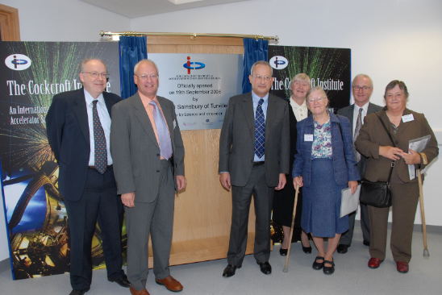
Cockcroft Institute Open

Slide 22
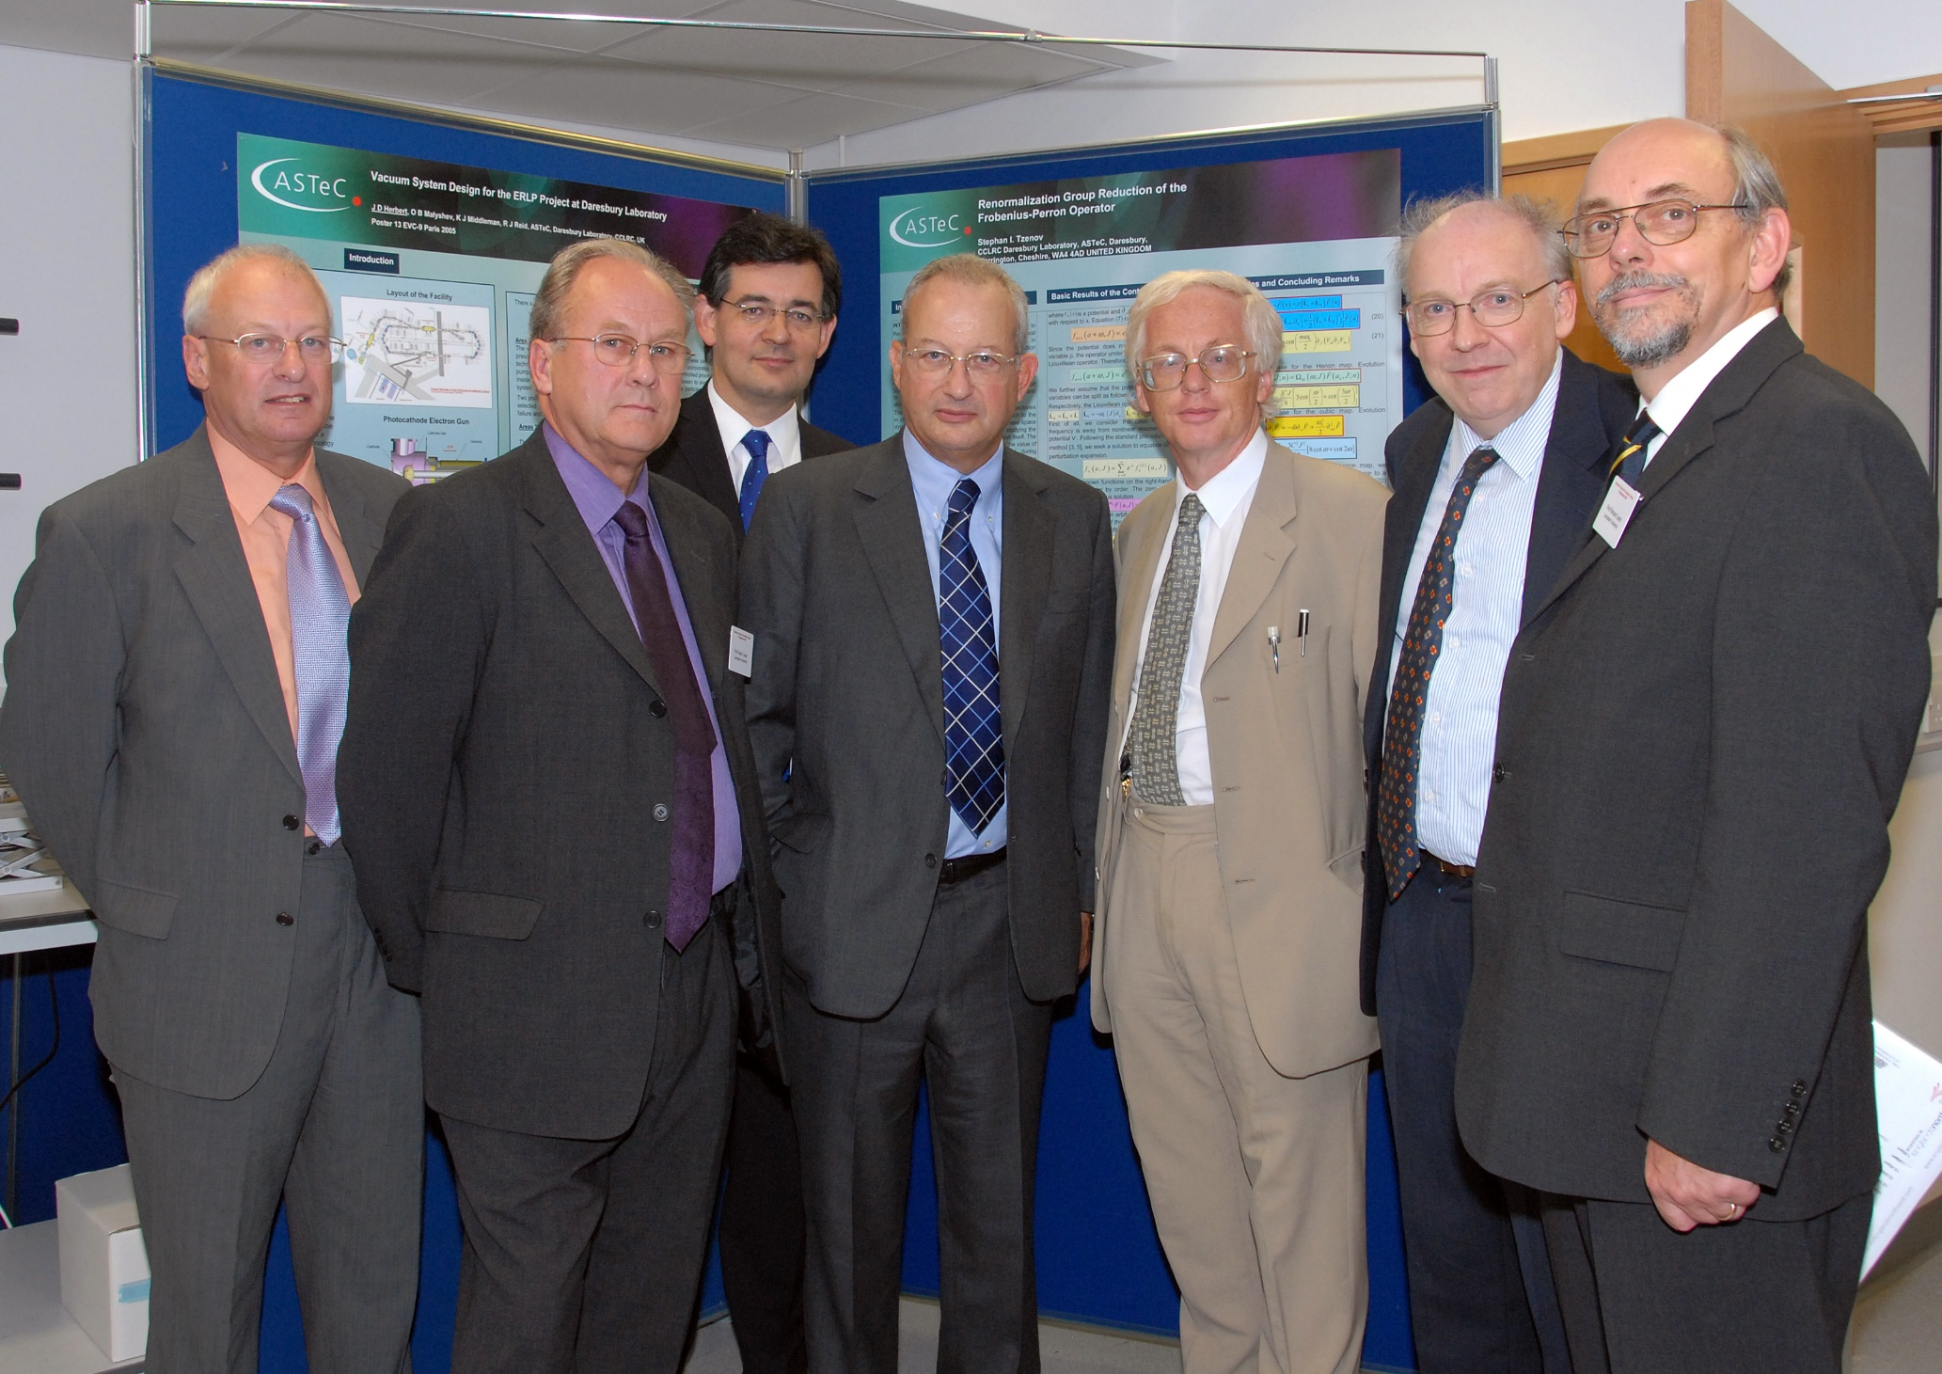
Cockcroft Institute Open
Lancaster
Physics
Lancaster
Math Physics
Manchester
Physics
Lancaster
Engineeeing
DL ASTeC
Liverpool
Physics

Slide 23
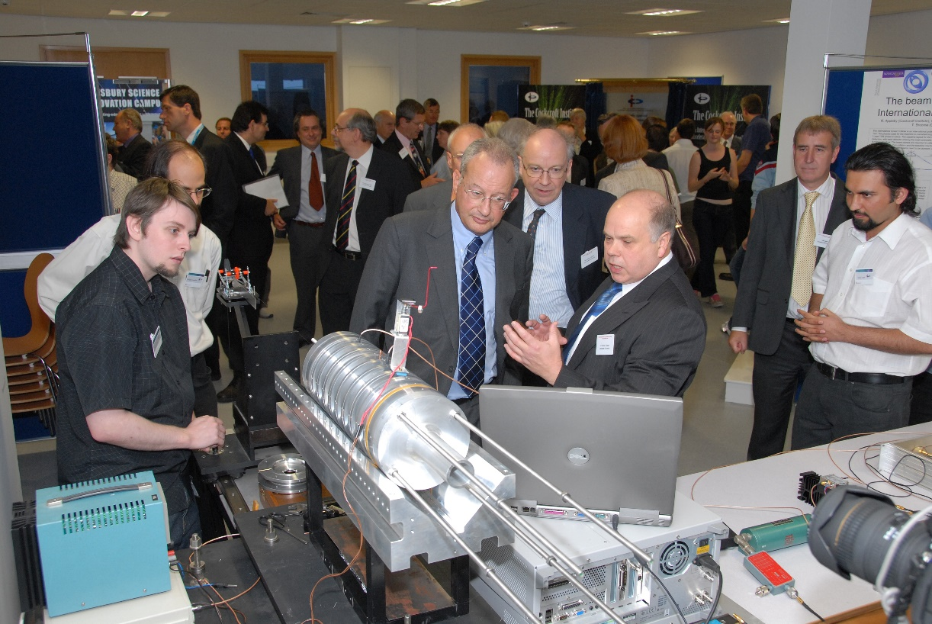
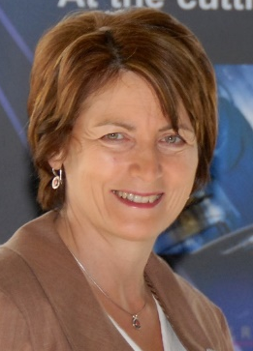
Cockcroft Institute Open
…

Slide 24
The Chattopadhyay Era
• there are three C’s in CoCkCroft !
… but two R’s ? !
CERN Courier

