Slide 1


Making a brighter future through advanced accelerators
The Scientific Career of Mike Poole
Jim Clarke
Director of ASTeC
The Cockcroft Institute 20th Anniversary
20th September 2024

Slide 2
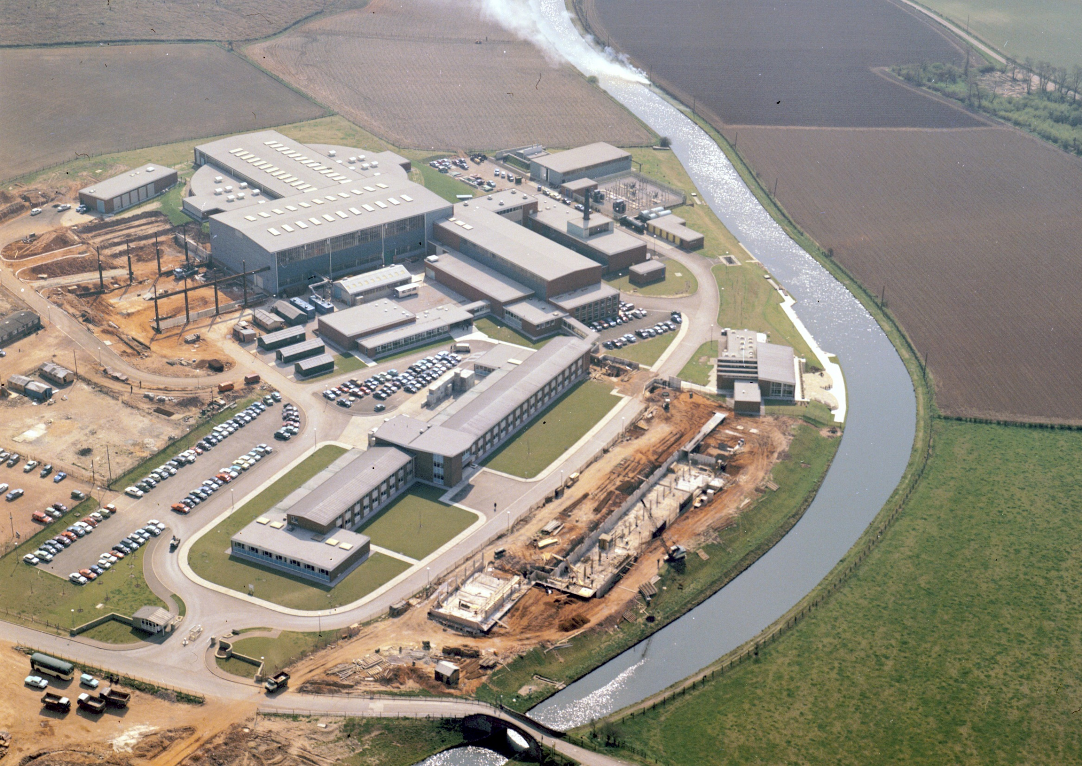
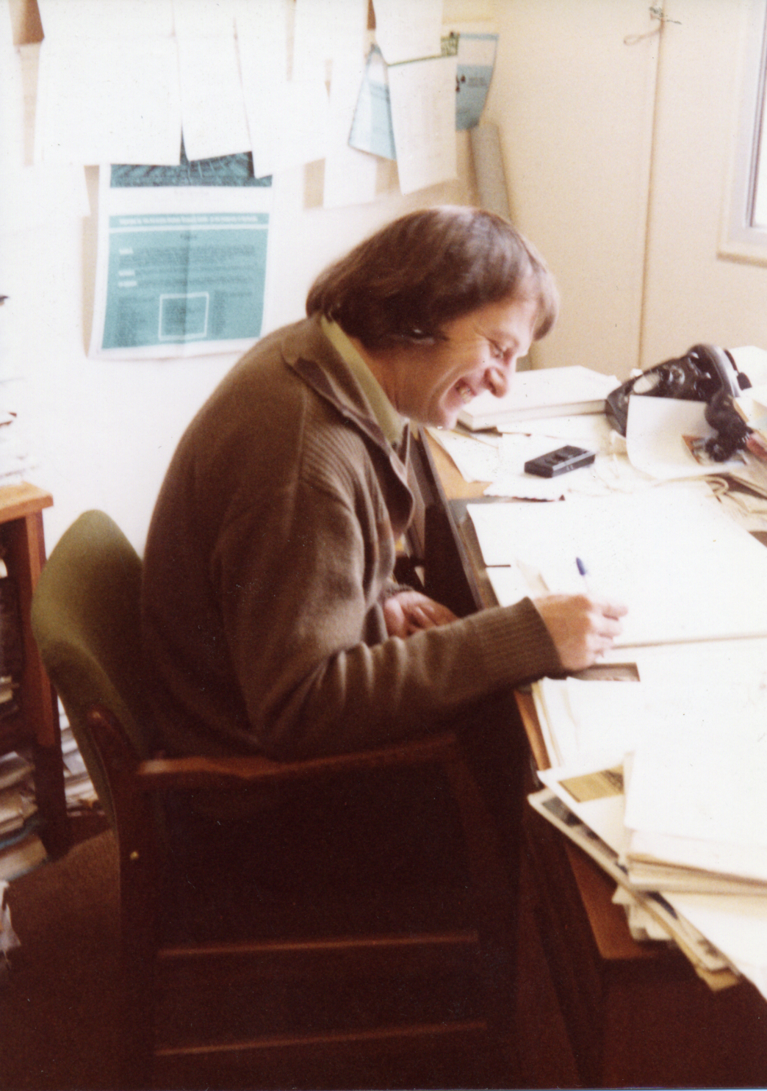
Early Career
Mike joined Daresbury Nuclear Physics Laboratory (as it was then known) in 1966 after graduating from the University of Liverpool with a degree in physics.
The Lab itself was created in 1962 with construction beginning in 1963 so Mike was a very early employee.

Slide 3
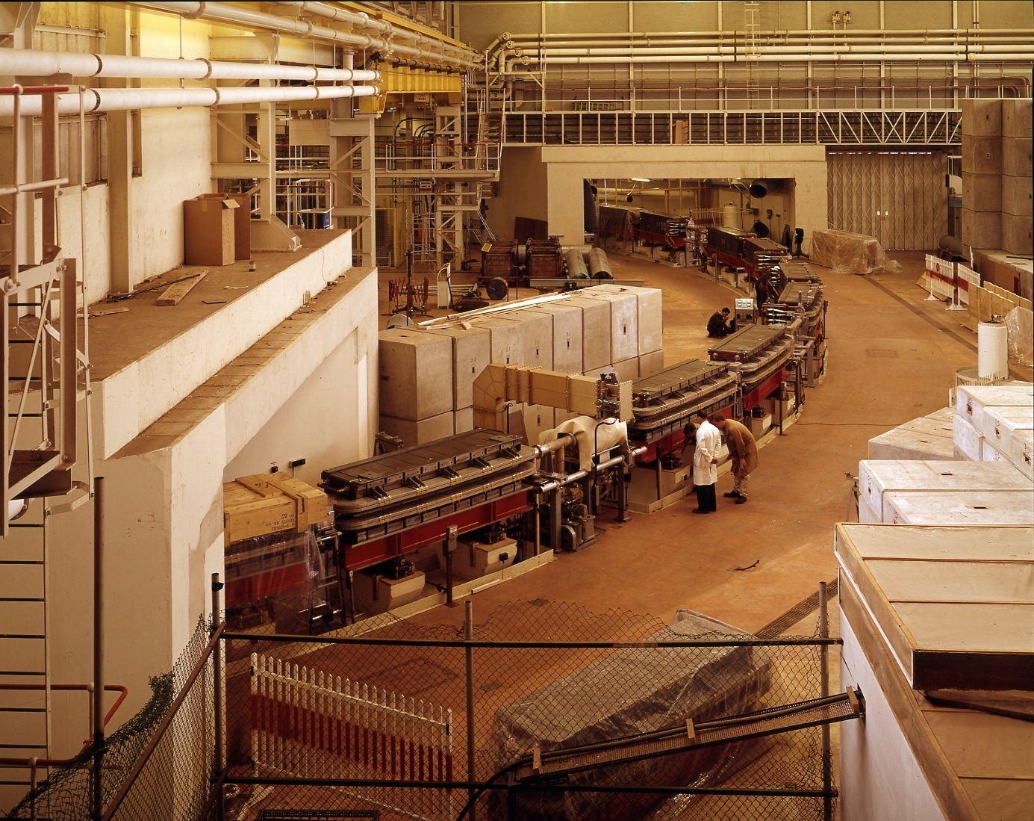
NINA
Mike joined the Beam Physics Section where he helped design and operate the beam transport systems of the 5 GeV NINA electron synchrotron.
He was to go on to spend the whole of his 44 year career working on various particle accelerator facilities and projects at Daresbury.

Slide 4
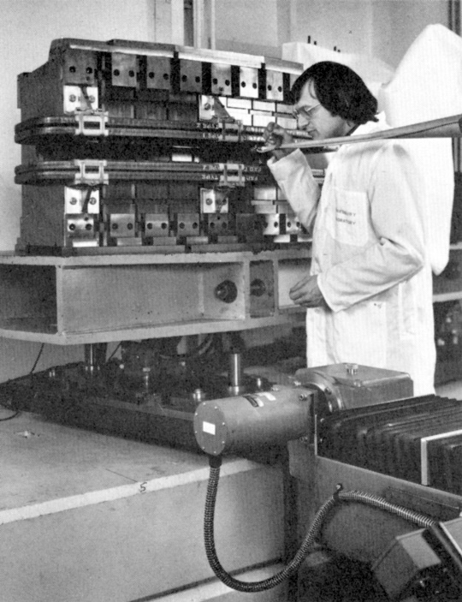
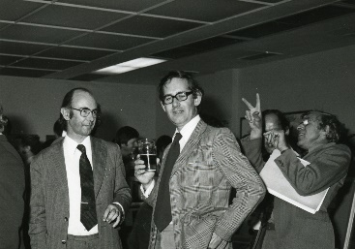
Light Sources
Following his early work on NINA, Mike spent the majority of his career on accelerator-based light sources, reflecting the change in focus of Daresbury Laboratory itself.
He successfully designed and measured all of the major magnet systems for the SRS with Neil Marks.
Jerry Thompson, Neil Marks and Godfrey Saxon (1980)

Slide 5
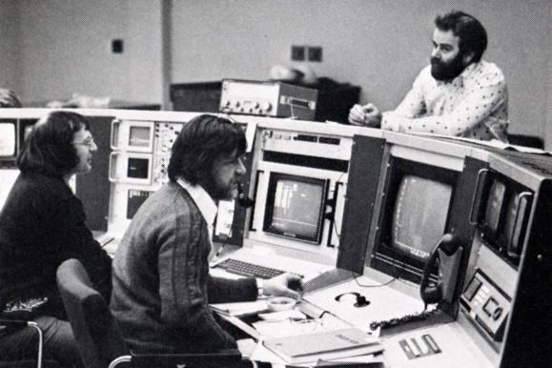
SRS
Commissioning the SRS in 1978
Mike was a member of the team that spent many shifts in the Control Room and successfully commissioned the SRS, which was the first X-ray light source of its kind.
This was previously used for NINA and is now the CLARA Control Room!
Mike, Ted Hughes, ???

Slide 6
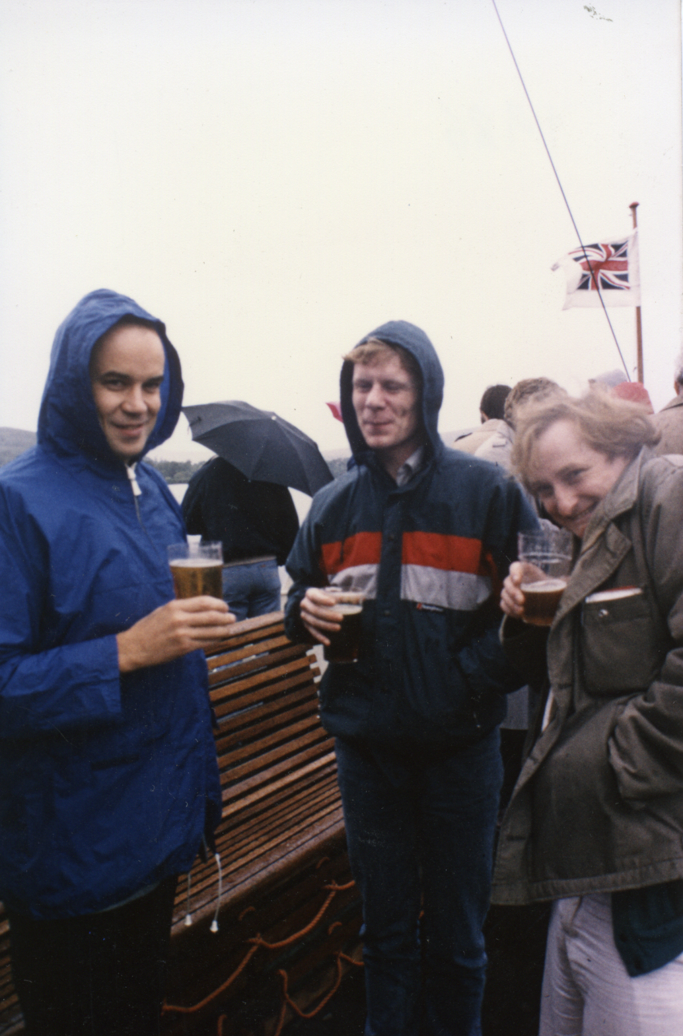
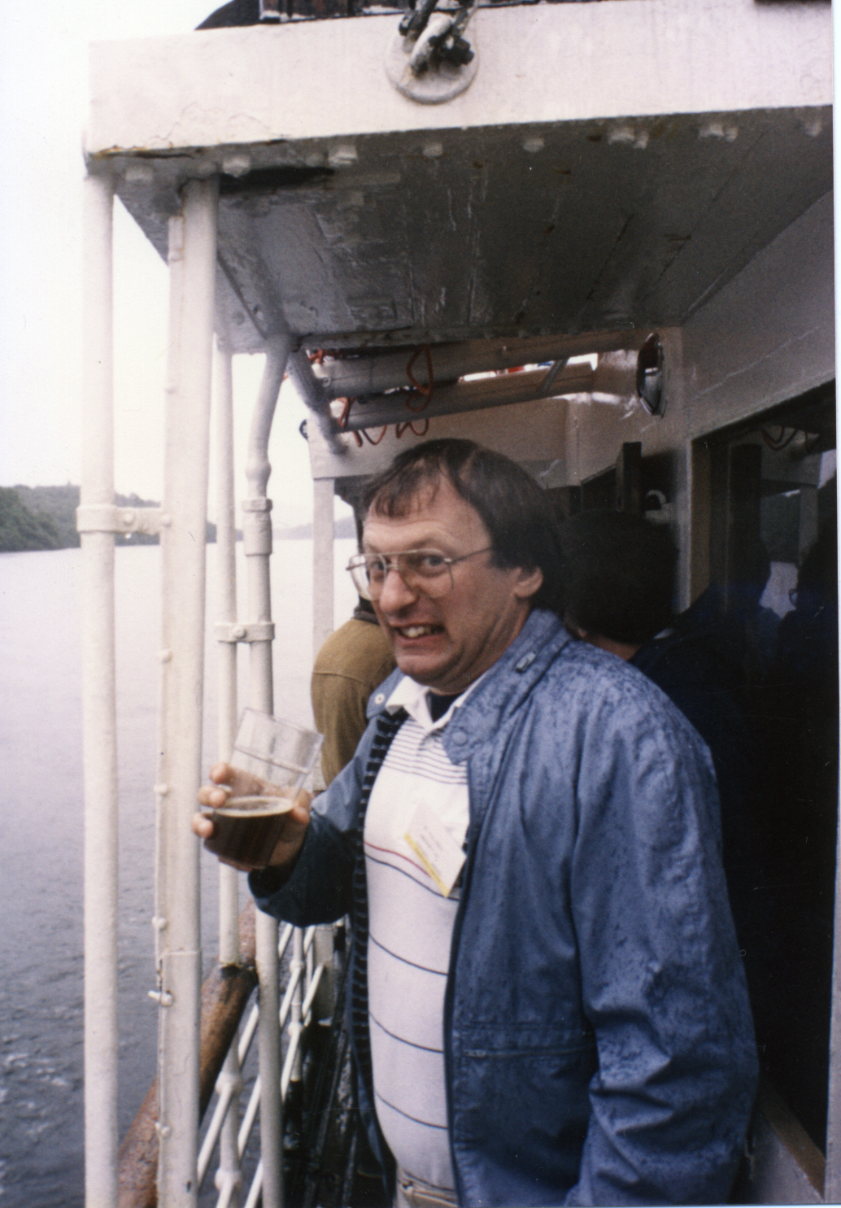
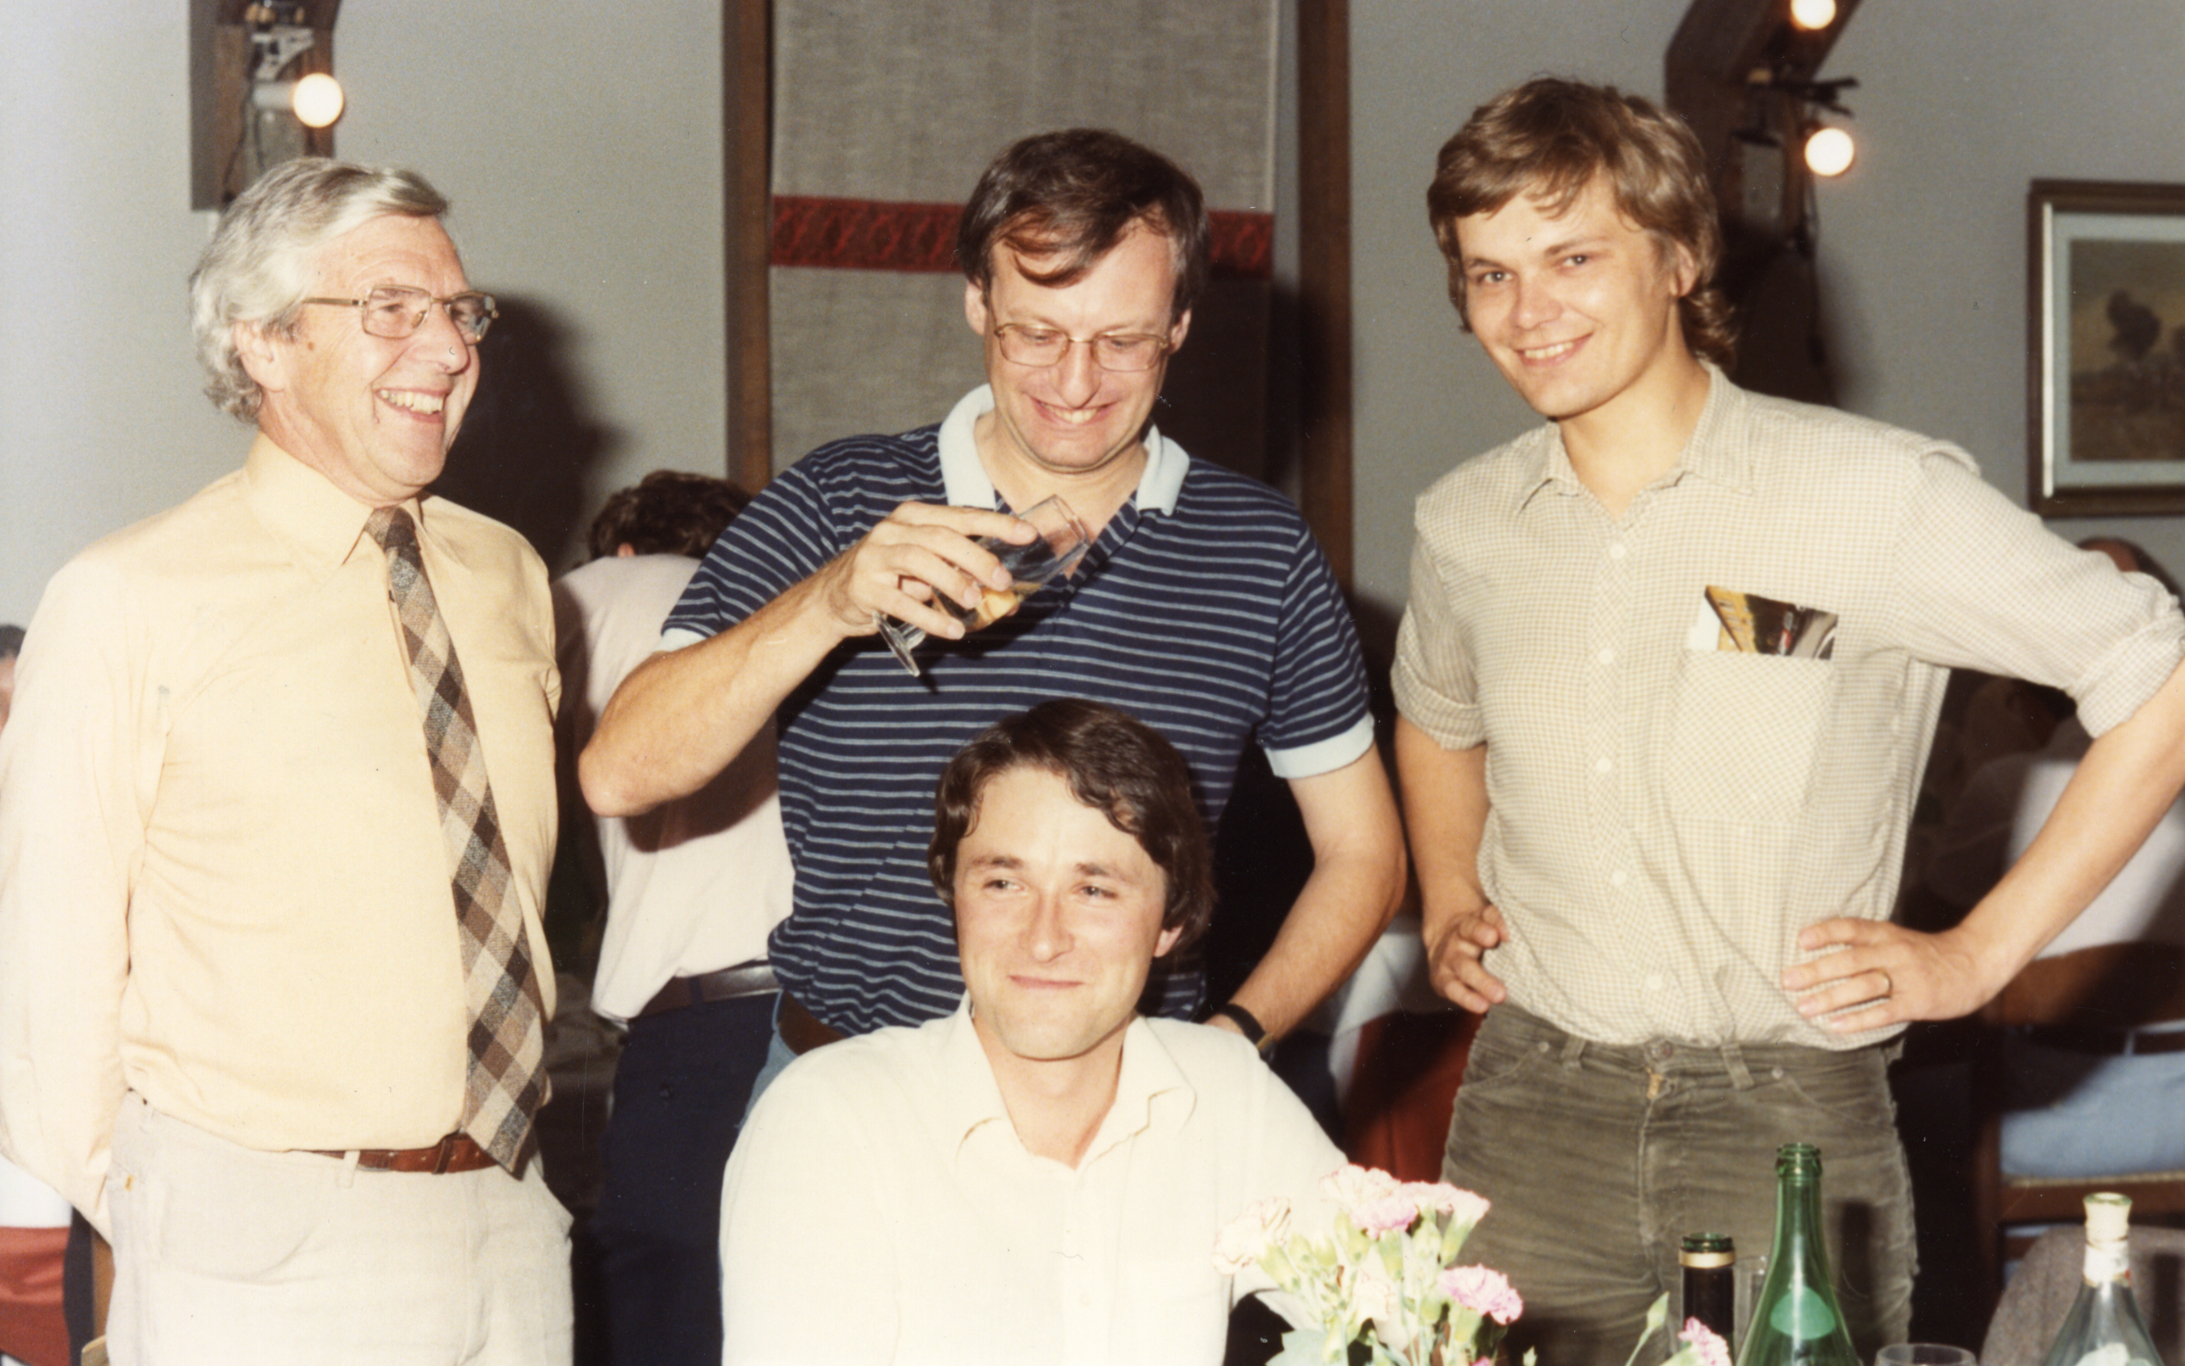
Free Electron Lasers and the first UK FEL
Mike always had an eye for what could be the next innovation and it was this interest that led to his lifelong passion for free electron lasers (FELs).
He quickly recognised the potential of this new type of light source when it was demonstrated in the USA for the first time in the mid-1970s.
He became an advocate for FELs of all types, personally initiating a project to build a similar demonstrator in the UK in 1978.
This collaborative project, based at East Kilbride in Scotland, achieved gain but not lasing much to Mike’s disappointment.
Allan Gillespie, ???, Brian McNeil
Some key members of the UK FEL team at FEL 1984 in Italy
(Godfrey Saxon, Mike, Richard Walker, Dino Jaroszynski)
The FEL conference was held in Glasgow in 1986 which included a lovely excursion on Loch Lomond

Slide 7
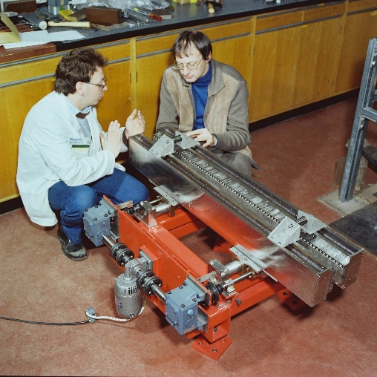
FELIX
Despite the disappointment the undulators for UK FEL, built by Mike, were subsequently given to the Netherlands where they operated successfully for many years as part of the FELIX user facility.
In return UK users were given free access to the facility

Slide 8
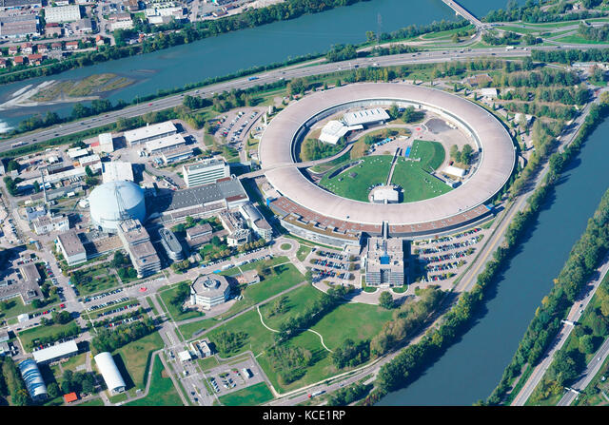
European Synchrotron Radiation Facility
When the potential of the SRS was appreciated internationally, a proposal to develop a shared European X-ray source was generated
Mike played a key part in the design of the ESRF, which is still the leading synchrotron light source within Europe today
Daresbury, under D.J. (Jerry) Thompson, was effectively responsible for the design of the ESRF accelerator – the famous Green Book published in 1984 and edited by Mike and Jerry
Construction started in 1989 and Mike was to travel to Grenoble many times each year to serve on various committees and eat in all the best restaurants

Slide 9
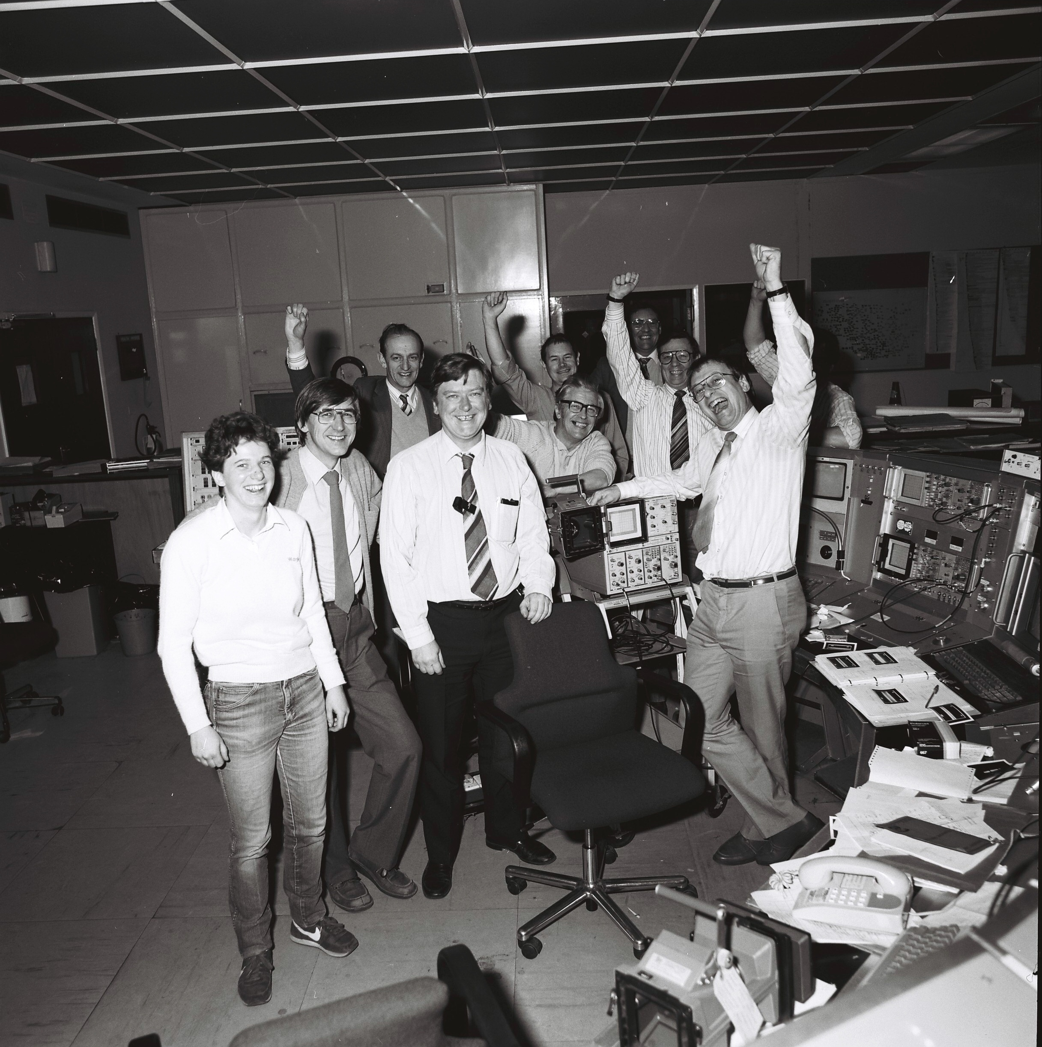
The SRS Upgrade
The SRS accelerator was upgraded in the mid 1980s to increase the X-ray brightness
This photo from 1987 is celebrating the successful beam commissioning
Front Row:
Susan Smith, Vic Suller, Ted Hughes, Mike

Slide 10
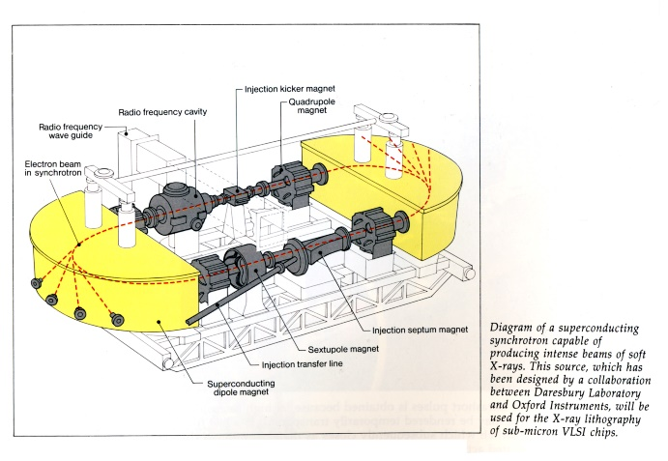
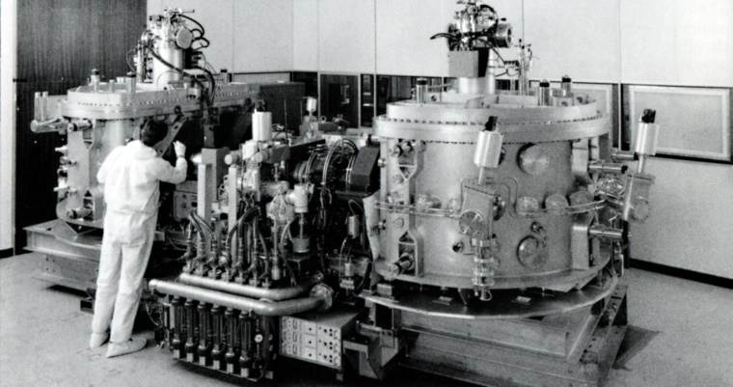
HELIOS
Around this time IBM decided to invest in an X-ray light source for chip lithography
They commissioned Oxford Instruments in partnership with Daresbury Laboratory to supply the synchrotron source which was called Helios
By this time, Mike was Accelerator Physics group leader (and I was a new graduate who joined the group in 1989)
Helios was commissioned in Oxford, before being shipped to an IBM lithography R&D facility in New York state in 1991 – the accelerator worked beautifully but X-ray lithography took a lot longer to sort out!
I have a very clear memory of watching England in the 1990 World Cup with Mike after a commissioning shift in a pub in Oxford!

Slide 11
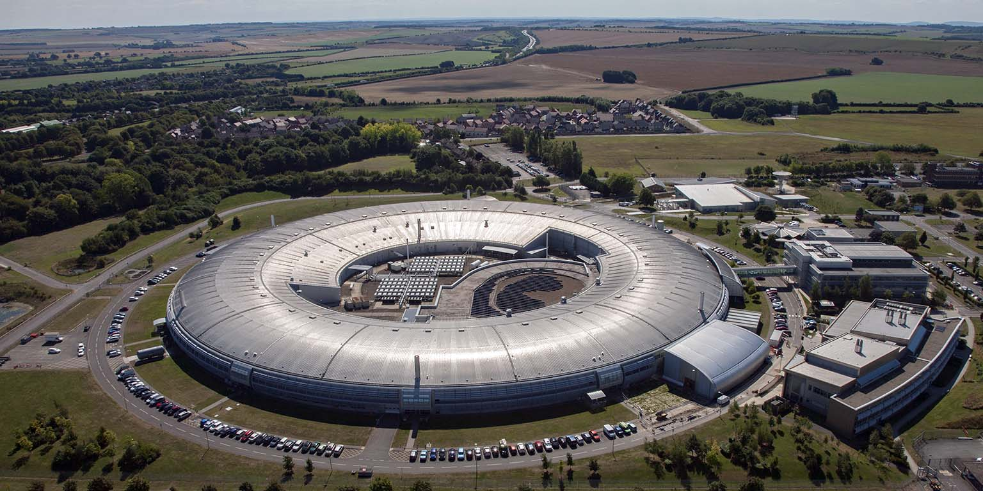
Diamond Light Source
As leader of the Accelerator Physics Group during the 1990s, Mike led the beam physics design of the replacement for the SRS which, was to become known as the Diamond Light Source and which continues to be an outstanding facility for the UK research community today.
On a personal note, a new promotion scheme was introduced around the early 1990s to recognise staff who were making an outstanding research contribution – Mike was one of the first to benefit in recognition of his international standing

Slide 12
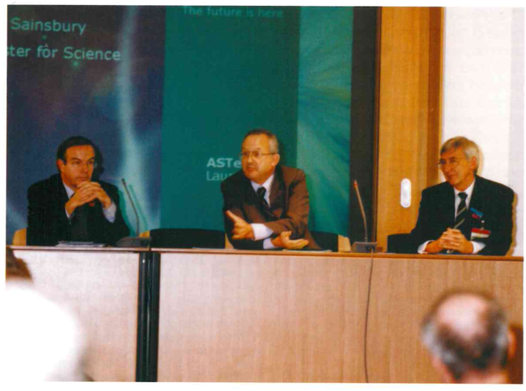
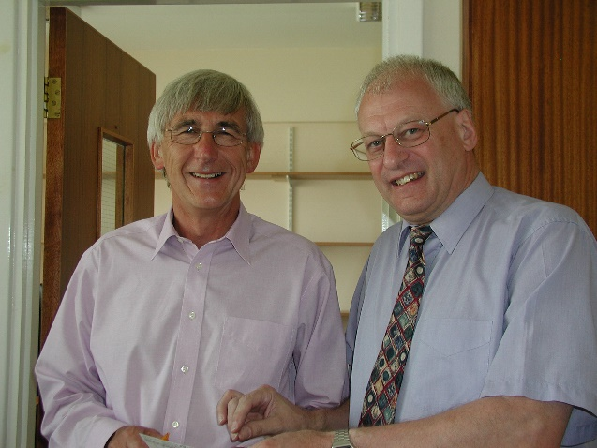
ASTeC
One of the consequences of siting Diamond at Harwell was the creation in 2001 of the Accelerator Science and Technology Centre – a new home for all of the in-house accelerator professionals
Vic Suller was appointed the Director with Mike as Deputy
In 2003, when Vic retired, Mike assumed the position of Director of ASTeC.
This was a crucial period in the department’s early history as it emerged from the shadow of the SRS and started to work on a much broader remit than just light sources. The delivery of Diamond Light Source was a major activity for ASTeC at that time but new work themes in linear colliders, neutrino factories, energy recovery linacs, FELs, and fixed field accelerators quickly developed and set the foundation for the successful department that we have today.
ASTeC was officially launched on 6th November 2002 at the DTI.
L to R
John Taylor, Director General of the Research Councils,
Lord Sainsbury, Science Minister
Vic Suller, Director of ASTeC

Slide 13
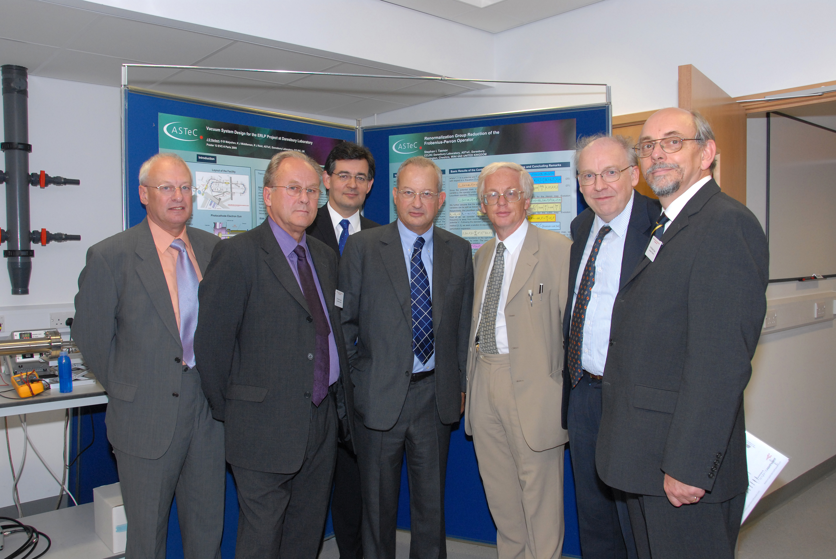
The Cockcroft Institute
Mike often lamented the lack of an accelerator research activity in the UK universities and compared the UK against other countries which had both national laboratories and university groups active in the field.
He was therefore very enthusiastic, when the opportunity arose, to help establish the Cockcroft Institute, with ASTeC as one of the partners.

Slide 14
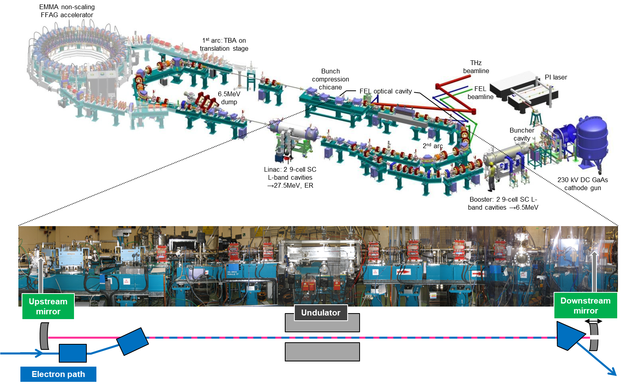
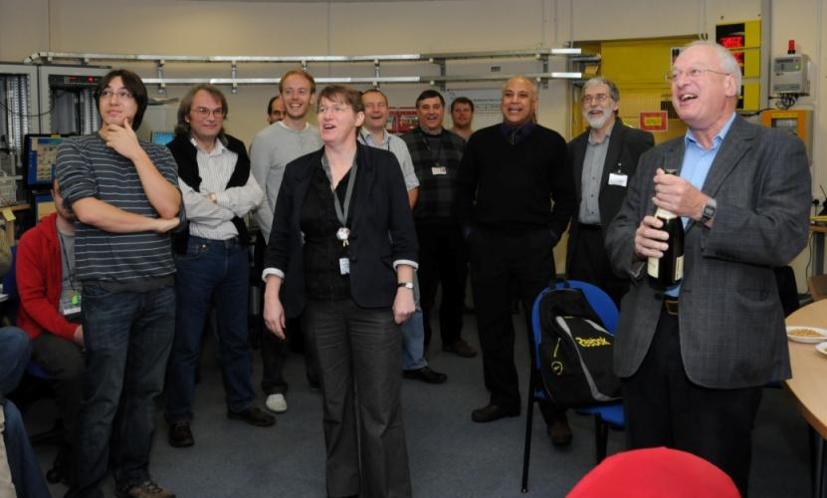
ALICE
In 2010, the year Mike retired, the UK finally achieved lasing in an FEL for the first time and fittingly it was at Daresbury on the ALICE energy recovery linac under Mike’s guidance!

Slide 15
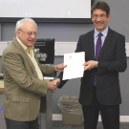
Institute of Physics Particle Accelerators and Beams Group
Mike continued to be passionate about raising the professional standing of accelerator science and technology in the UK.
He was already very active in the IoP and so he spearheaded the establishment of the Particle Accelerator and Beams Group
Fittingly, he was awarded the Group’s prize for outstanding professional contributions in 2016.

Slide 16
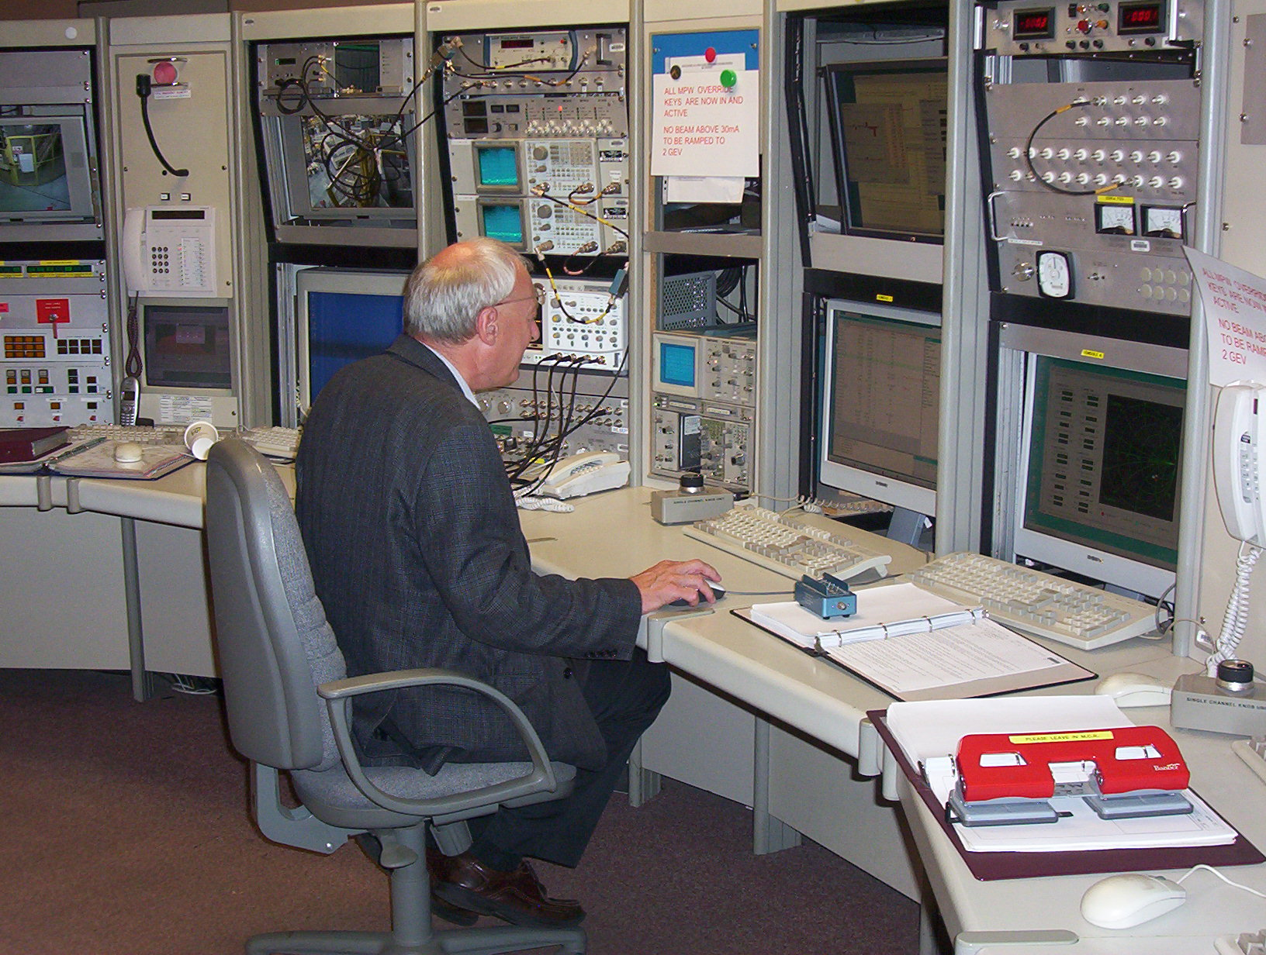
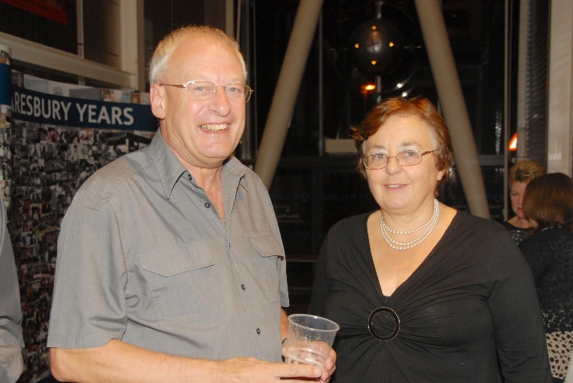
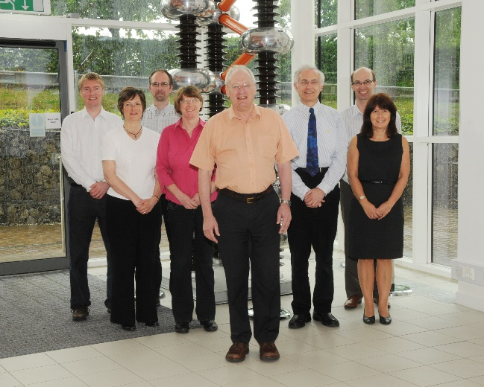
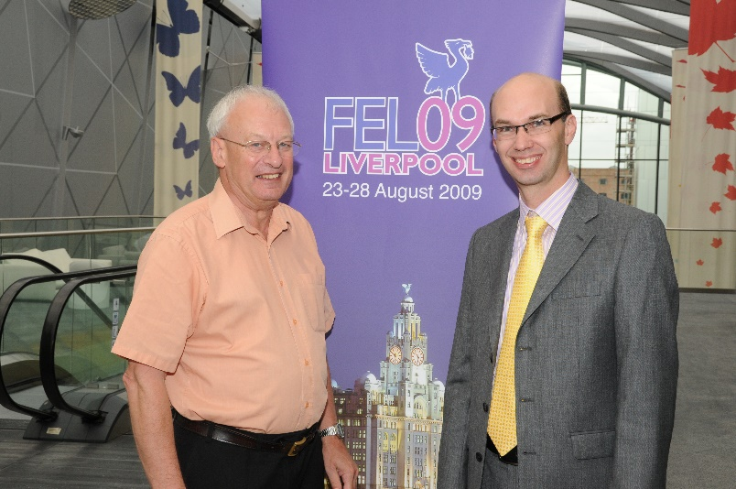
Mike Poole
Mike was a popular and inspiring leader and mentor to many.
He always found the time to discuss any issues or offer advice where requested and was especially encouraging to younger staff and students.
He continued to be active beyond his retirement and fittingly his last paper, which was published in 2023, co-authored with Elaine Seddon, was a historical overview of FEL activities in the UK.
Mike and Rosemary at the SRS closing party
Mike in the Control Room on one of his last shifts on the SRS
The ASTeC management team in 2009
Co-chairing the FEL conference in Liverpool in 2009

