Slide 1
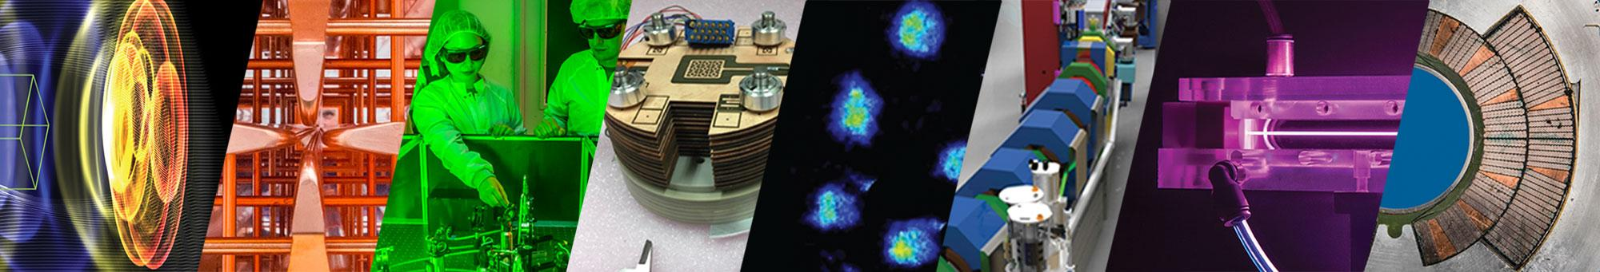


Exploring the use and delivery of laser-driven proton beams for ultra-high dose rate radiobiology at the BELLA Center
Jared De Chant*, J. L. Inman, L. Obst-Huebl, A. McIlvenny, K. Nakamura, S. Hakimi, J. H. Bin, C. G. R. Geddes,
L. Geulig, A. J. Gonsalves, S. Kidd, J.-H. Mao, C. Palmer, C. Y. Ralston, C. B. Schroeder, B. Simmons,
B. Stassel, S. Subramanian, J. van Tilborg, A. M. Snijders, E. Esarey
Lawrence Berkeley National Laboratory
ITRF/LhARA Collaboration Meeting #6
Belfast, UK, Sep 3, 2024
Work supported by the U.S. DOE Office of Science, Offices of FES and HEP, and LaserNetUS under Contract No. DE-AC02-05CH11231 and Laboratory Directed Research and Development Grant, PI A. M. Snijders
*Also at Michigan State University

Slide 2
Outline
Investigating FLASH Radiotherapy with laser-driven ion acceleration at the BELLA Center
The challenges of delivering laser-driven ions for radiobiological applications
  Beam transport
  Dosimetry
Initial in vitro radiobiological experiments at the long focal length (LFL) beamline with an active plasma lens (APL)
Design and implementation of permanent magnet-based beam transports for 10 & 30 MeV protons
Recent LaserNetUS radiobiological experiments:
  irradiation of in vivo samples with laser-driven ions (~7 MeV) and
  irradiation of peptides in solution with laser-driven ions (7-30 MeV)

Slide 3
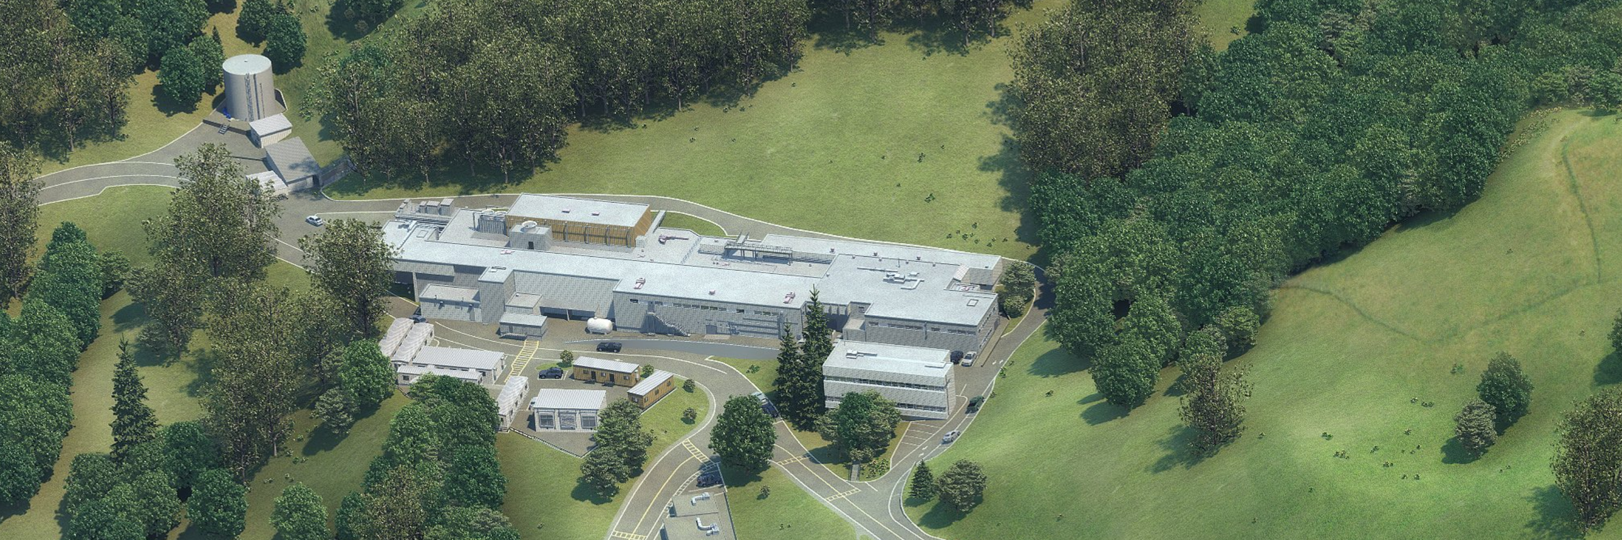
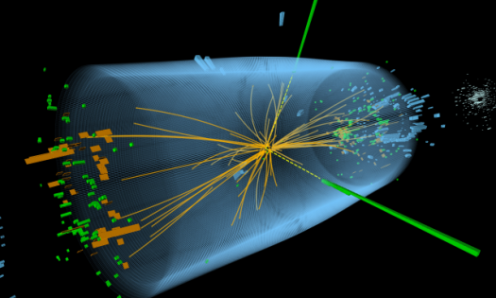

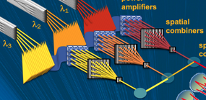
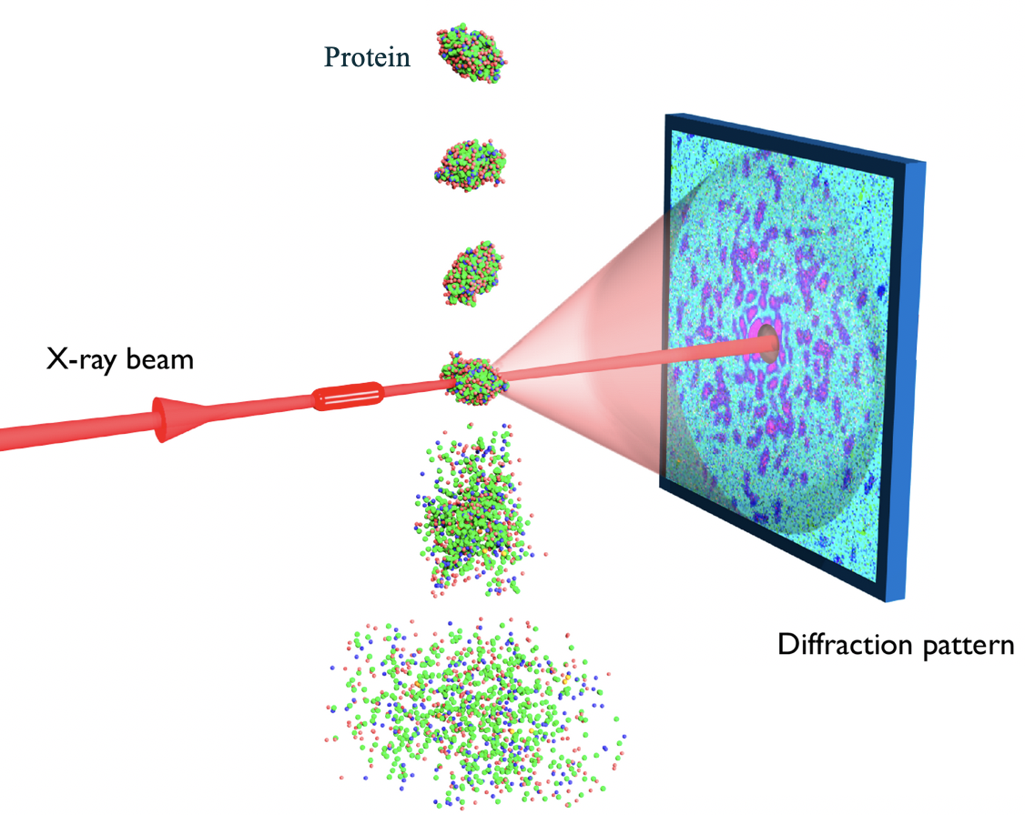
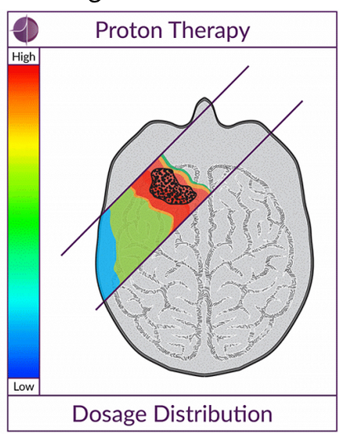
BELLA (Berkeley Lab Laser Accelerator) Center houses multiple laser systems enabling a wide range of applications^{[1]}
BELLA-PW (iP1)
40 Joule in 40fs (1 PW)
GeV acceleration, Staging
Proton & ion acceleration
BELLA-HTT
3 Joule in 30fs (100 TW)
Mono-chromatic gamma rays
BELLA FIBER
100s mJ in <100fs (>1kHz)
Laser R&D
Light sources at >1kHz
BELLA-HTU
3 Joule in 30fs (100 TW)
X-ray laser
BELLA-iP2 at BELLA-PW
40 Joule in 40fs (1 PW)
Proton & ion acceleration
BELLA-KHz
A few mJ in 5fs (TW)
MeV Acceleration
[1] K. Nakamura et al., Journal of the Particle Accelerator Society of Japan 19, 205 (2023)

Slide 4
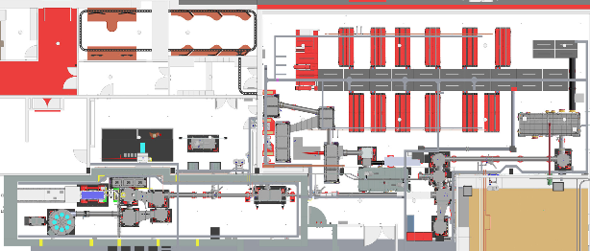

Recent upgrades of the BELLA PW Laser facility enable groundbreaking research on laser plasma-based particle acceleration (e⁻ & p⁺)
Laser room
On target | Value
Rep-rate | 1 [Hz]
Energy | 40 [J]
Peak Power | 1 [PW] (for 40 fs)
Peak Intensity (iP1) | 1.5 [10¹⁹ W/cm²] (for w₀ 53 μm)
Peak Intensity (iP2) | > 1 [10²¹ W/cm²] (for w₀ 2.7 μm)
Control room
GAIA pump lasers (x12)
Gowning room
Main Amplifier table
BS
DM 1&2
Diagnostic room
comp1
OAP2
2BL focus
comp2
iP1
1BL focus
Sf-OAP
5 m
OAP3
Shielded room
OAP1
iP2
- Two interaction regions iP1 (LFL, f/65) and iP2 (SFL, f/2.5)
- Second beamline (2BL) enables multiple LPA stages
- iP2 enables high-intensity laser plasma interactions

Slide 5
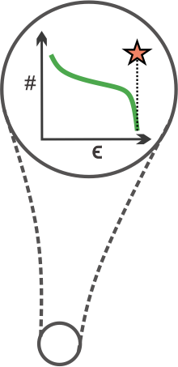
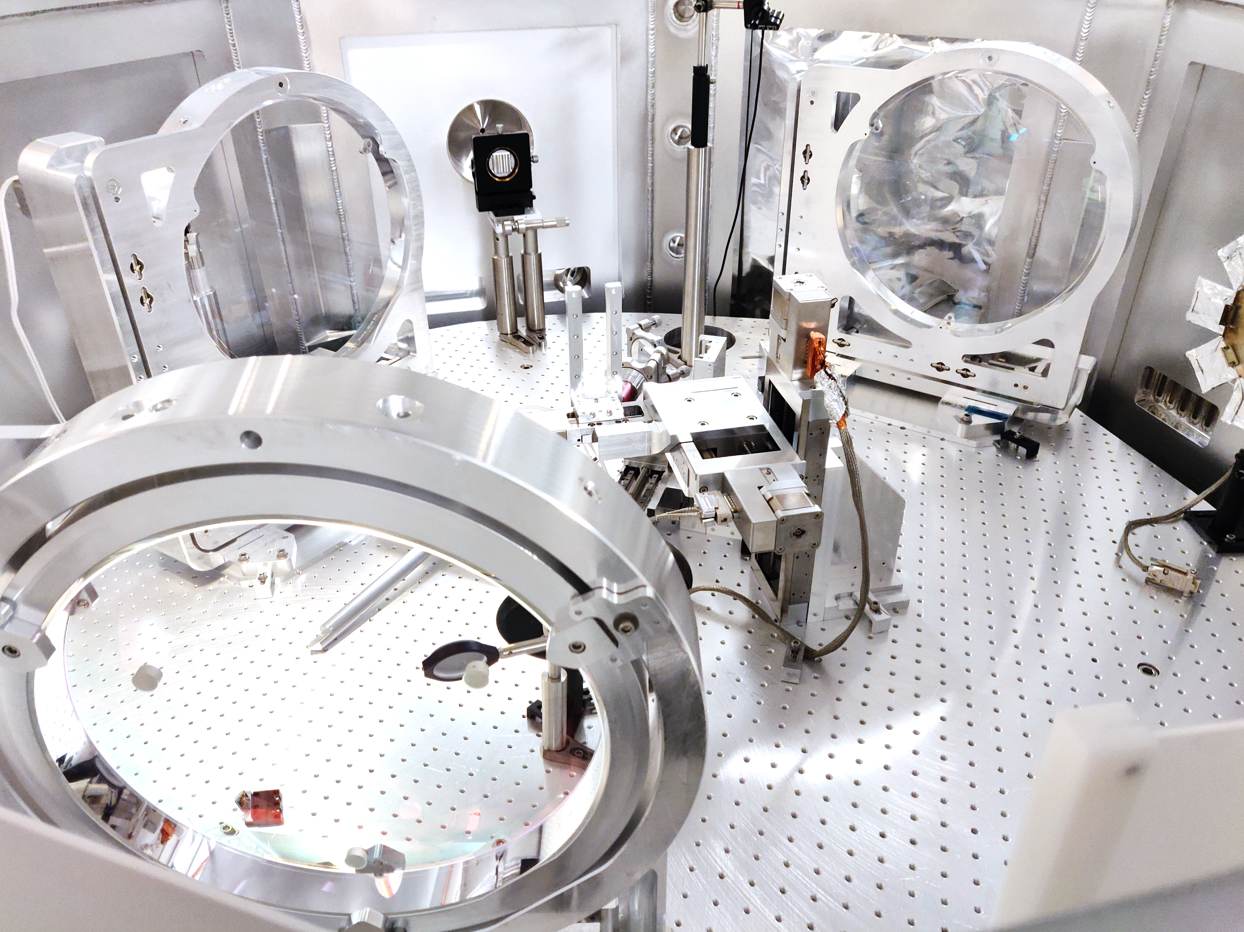
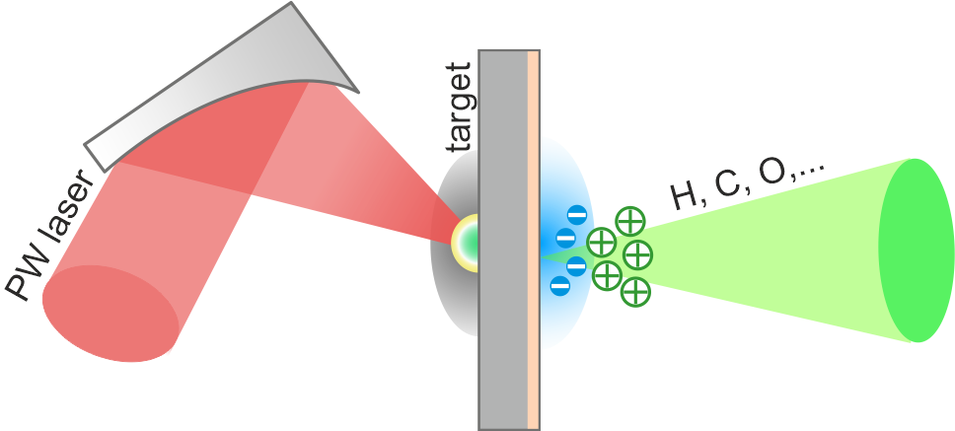
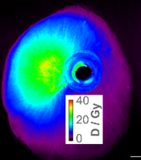
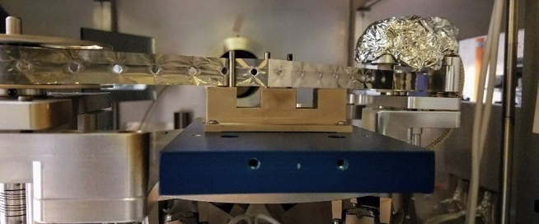
The laser-driven ion accelerator at BELLA is a good platform for studying ultra-high dose rate radiobiology due to its short pulse and high intensity
iP2 target chamber
Target Normal
Sheath Acceleration
TPS*
Target
40 J
High intensity laser
>10²¹ W/cm²
2.7 µm focal spot
10¹³ ions/shot
~ps pulse duration at source
Short focal length F/2.5 OAP
*Thompson parabola spectrometer
13 µm Kapton tape
Laser-driven protons:
instantaneous dose rate >10⁷ Gy/min
Laser-driven
protons
Hz
Log(amplitude)
Conventional
Protons
MHz
High rep rate (1 Hz) tape drive target
Time
Mean dose rate 1800 Gy/min

Slide 6
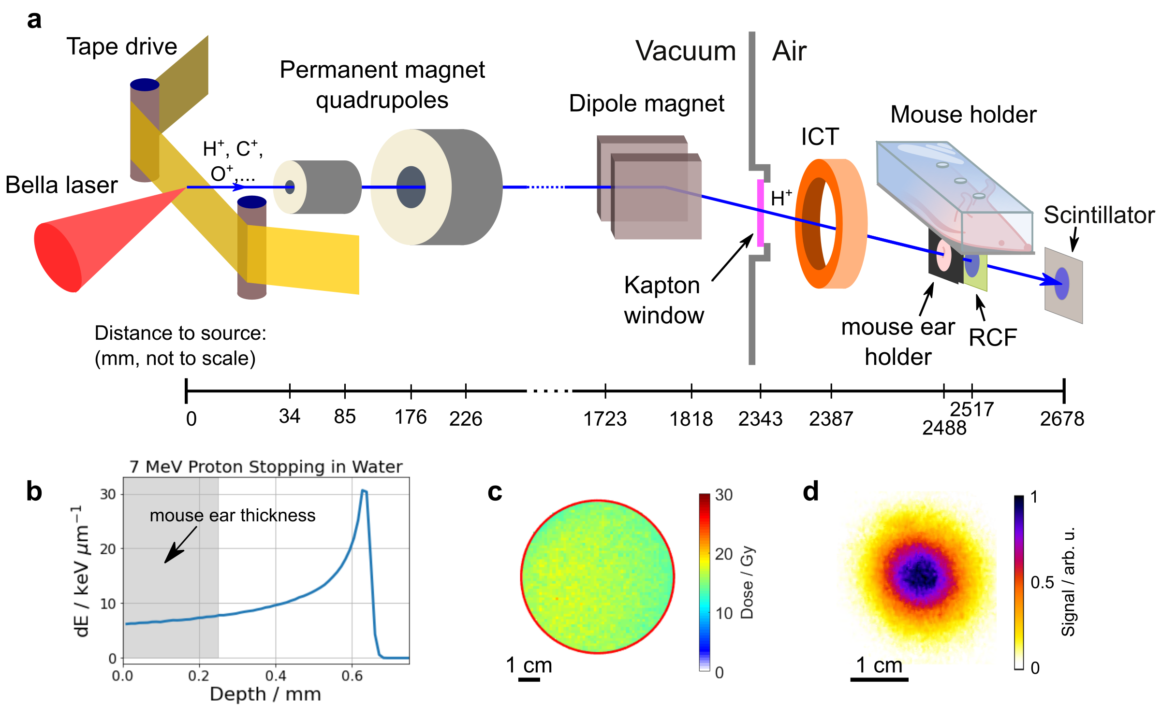
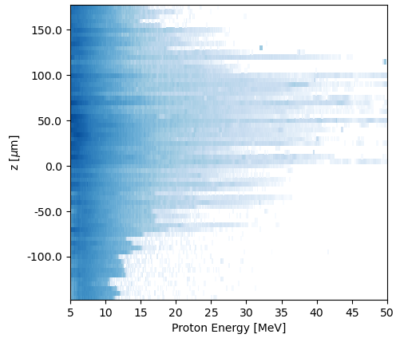
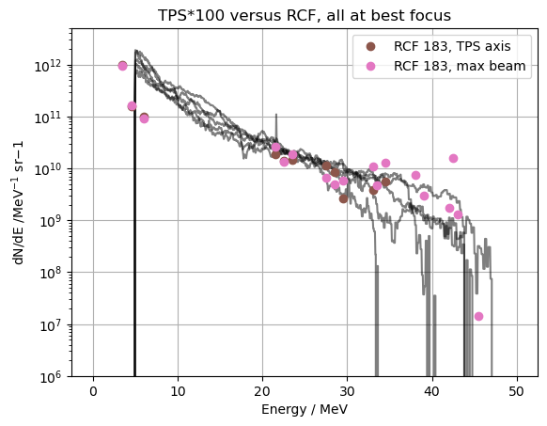
Recently achieved proton energies up to 45 MeV with ~22 J laser energy; enables the irradiation of thicker samples
TPS measured proton spectra
TPS/RCF measured proton spectra at source
Particles will deposit their energy at different depths according to their Bragg peak
Waterfall plot of proton spectra measured by TPS with varying target z positions relative to laser focus
Sample proton spectra measured by TPS scaled to match particle number measured with radiochromic film (RCF) placed 10 cm from the laser target

Slide 7
Outline
Investigating FLASH Radiotherapy with laser-driven ion acceleration at the BELLA Center
The challenges of delivering laser-driven ions for radiobiological applications
  Beam transport
  Dosimetry
Initial in vitro radiobiological experiments at the long focal length (LFL) beamline with an active plasma lens (APL)
Design and implementation of permanent magnet-based beam transports for 10 & 30 MeV protons
Recent LaserNetUS radiobiological experiments:
  irradiation of in vivo samples with laser-driven ions (~7 MeV) and
  irradiation of peptides in solution with laser-driven ions (7-30 MeV)

Slide 8
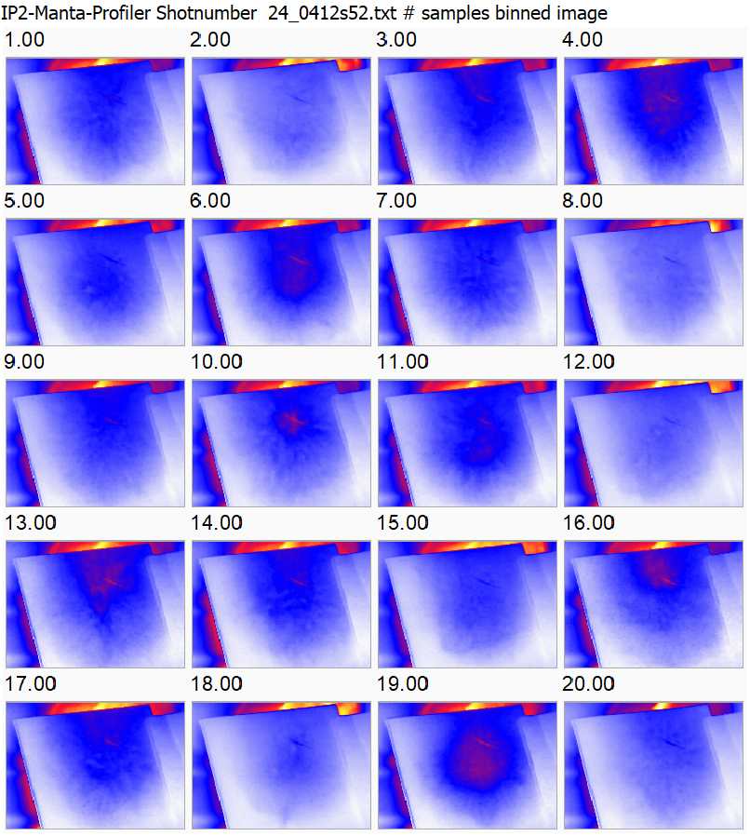
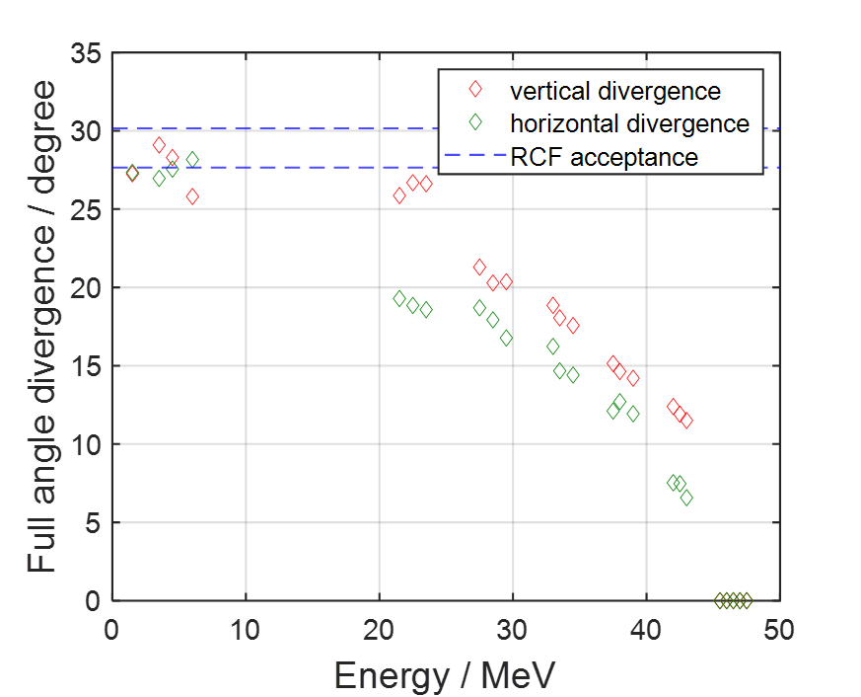
Delivering laser-driven ions to biological samples is challenging due to their high divergence, broad energy spread, and shot-to-shot variability
A beam transport system is required to:
            collimate the highly divergent beam,
            select the desired energy,
  and deliver a high dose rate with a uniform profile.
On-shot dosimetry is required to:
            account for shot-to-shot fluctuations
            and ensure uniform dose deposition.
Proton profile stability measurement
Beam divergence 10-30°
Measured proton spectrum (iP2)
Plastic scintillator (EJ-260) 10 cm from source with 300 μm Cu attenuator to block proton energies < 10 MeV

Slide 9
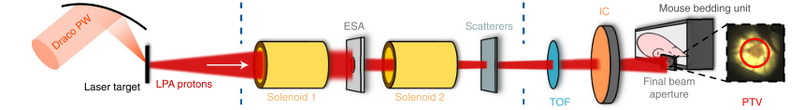
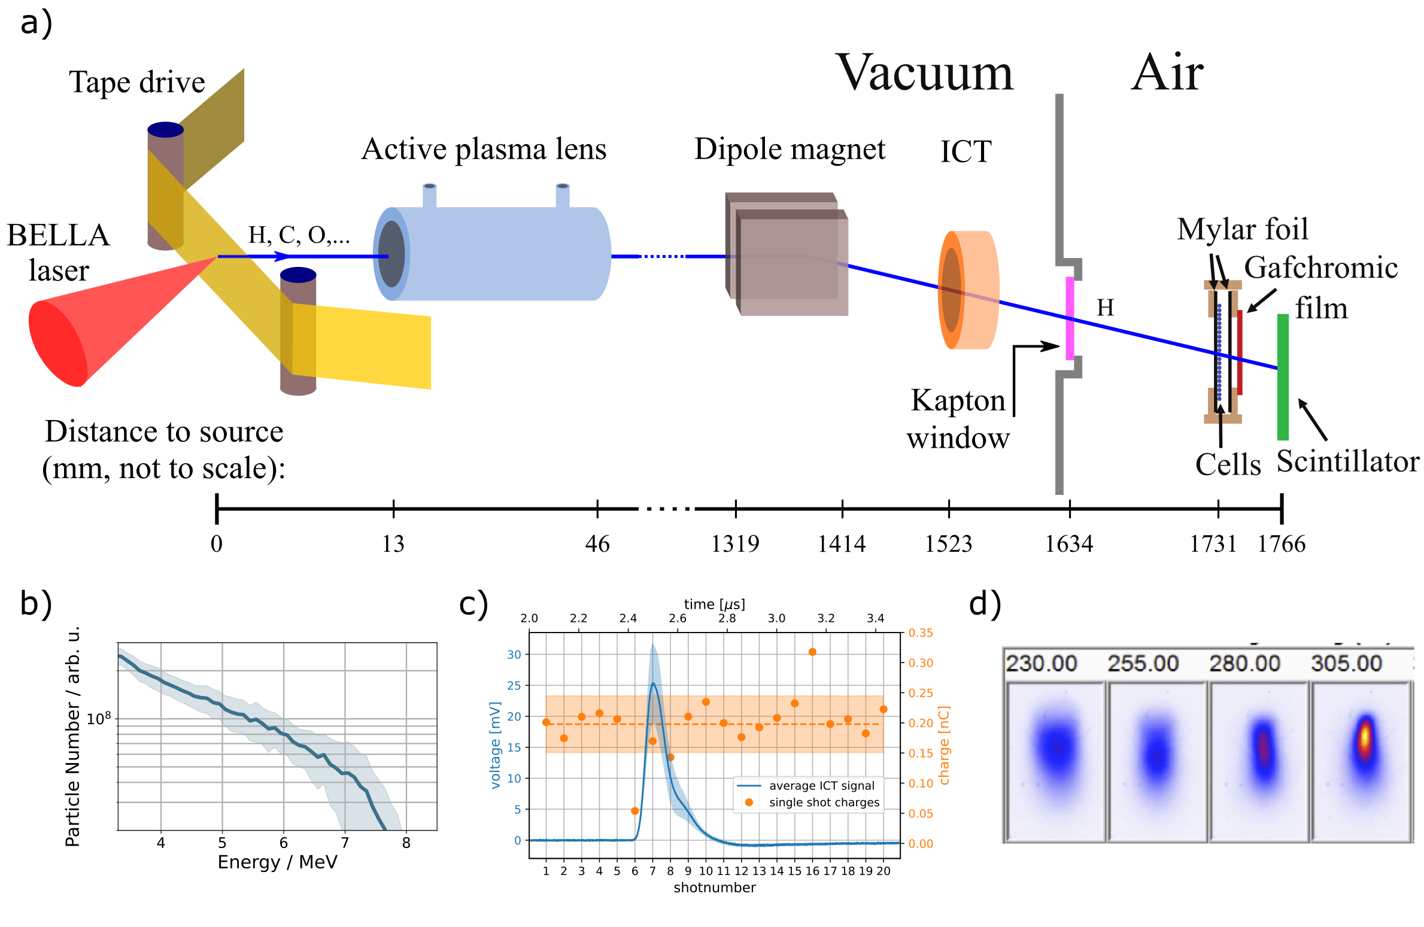
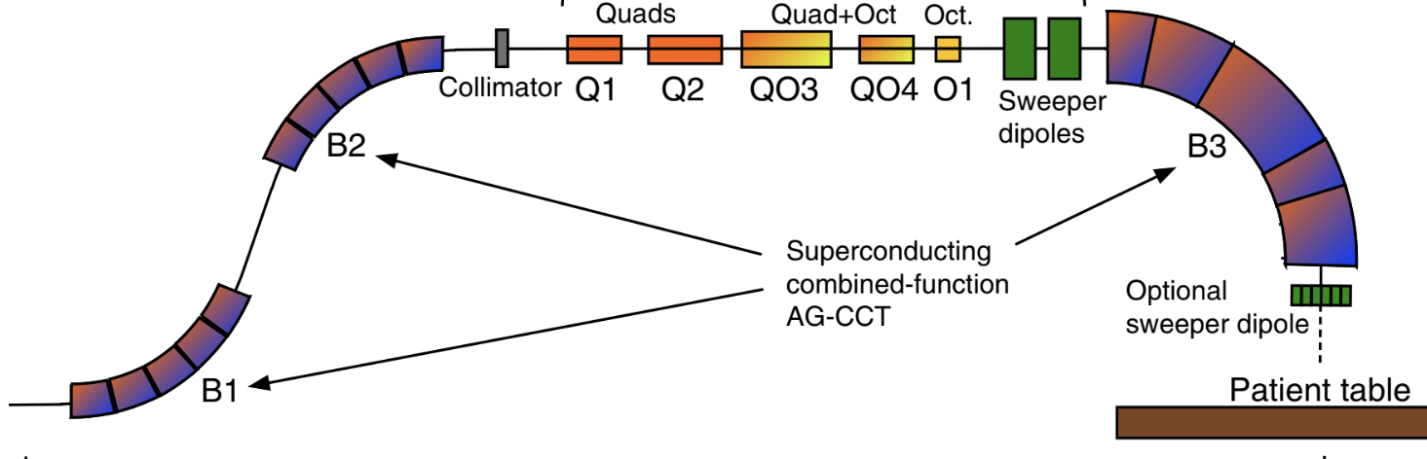
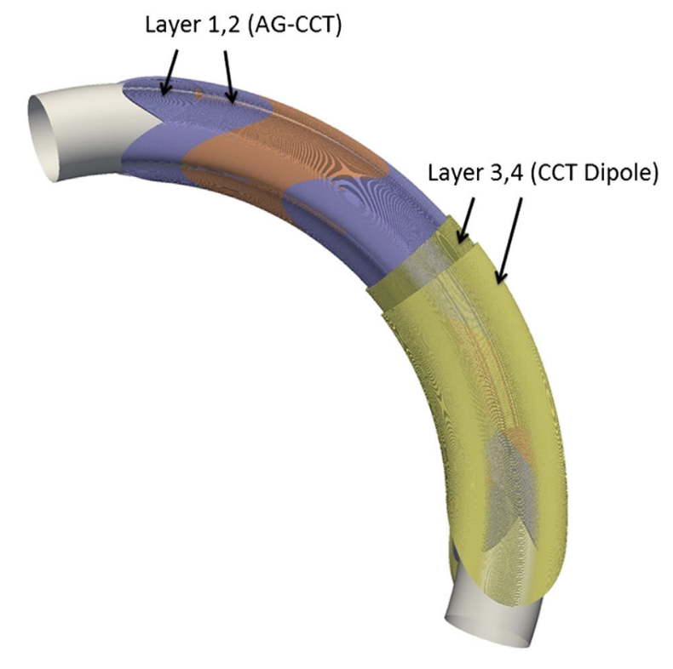
BELLA and other groups have attempted to address the challenges with transporting laser-driven ions by using advanced beam optics
Pulsed solenoid
Strong focusing field
Low rep rate
Large bore → high collection efficiency
HZDR DRACO
F. Kroll, et al.. Nat Phys. 2022 doi:10.1038/s41567-022-01520-3
BELLA PW iP1
Active plasma lens
Strong focusing field
Small bore → low capture efficiency
Axially symmetric focusing
J. H. Bin, L. Obst-Huebl, et al., Sci. Rep. 2022
Superconducting achromats*
  Large energy acceptance and collection efficiency
  Strong possibility of quenching (laser or ions)
*Not demonstrated in LDA experiments
W. Wan, L. Brouwer, et al.. Phys. Rev. ST Accel. Beams 2015 doi:10.1103/PhysRevSTAB.18.103501
Notes:
Add citations
Make table of pros and cons

Slide 10
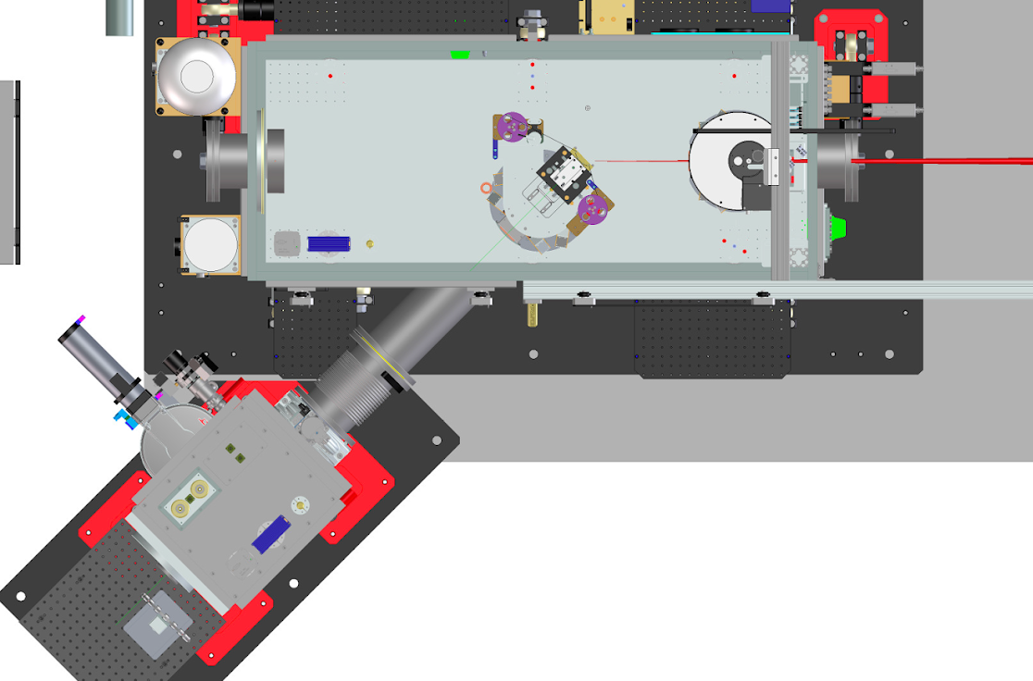
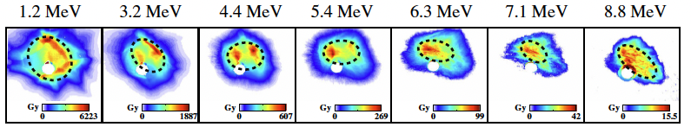
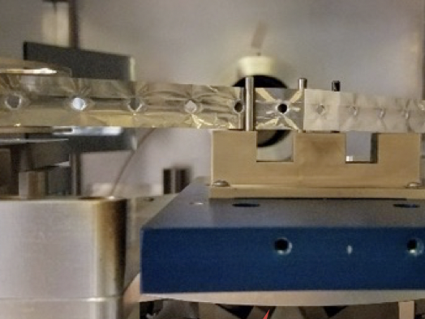
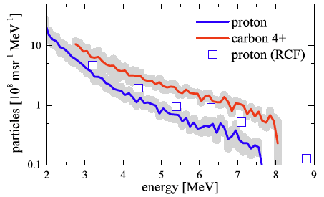
Long focal length (F/65) BELLA PW beamline (iP1) allows for acceleration of low divergence, high charge, < 10 MeV proton beams
BELLA laser beam
Ion beam
TPS
Tape drive target
Steinke et al., PRAB 23, 021302 (2020),
J.H. Bin et al., Rev. Sci. Instrum. 90, 053301 (2019)

Slide 11
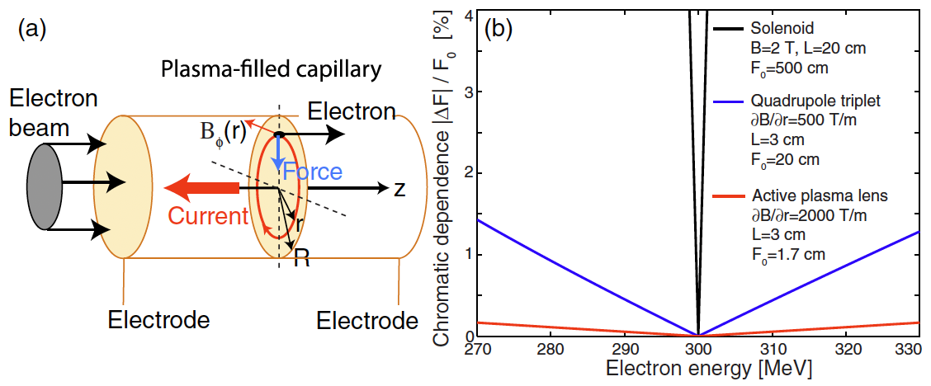

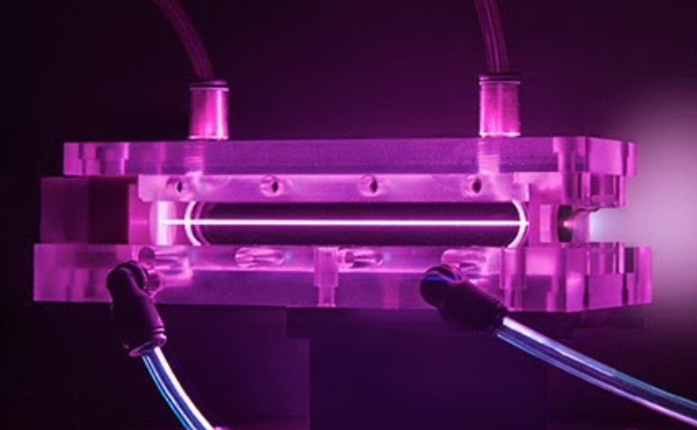
Capture and transport of fraction of proton beam with active plasma lens (APL)
APL provides strong, compact focusing
- Compact strong B-field (1mmD, 33 mm unit)
- Radially symmetric focus
- Tunable via current (timing)
- ~20 years of experience and infrastructure ready
For radbio experiment at iP1,
APL + Dipole was chosen to fulfill requirements.
Neutral particles, X-rays
Protons, ions
Limitation →
Small bore (1 mm D) limits ion capture and transport and is not easily scalable
J. van Tilborg et al., PRL 115 (2015) 184802.
11

Slide 12
Outline
Investigating FLASH Radiotherapy with laser-driven ion acceleration at the BELLA Center
The challenges of delivering laser-driven ions for radiobiological applications
  Beam transport
  Dosimetry
Initial in vitro radiobiological experiments at the long focal length (LFL) beamline with an active plasma lens (APL)
Design and implementation of permanent magnet-based beam transports for 10 & 30 MeV protons
Recent LaserNetUS radiobiological experiments:
  irradiation of in vivo samples with laser-driven ions (~7 MeV) and
  irradiation of peptides in solution with laser-driven ions (7-30 MeV)

Slide 13
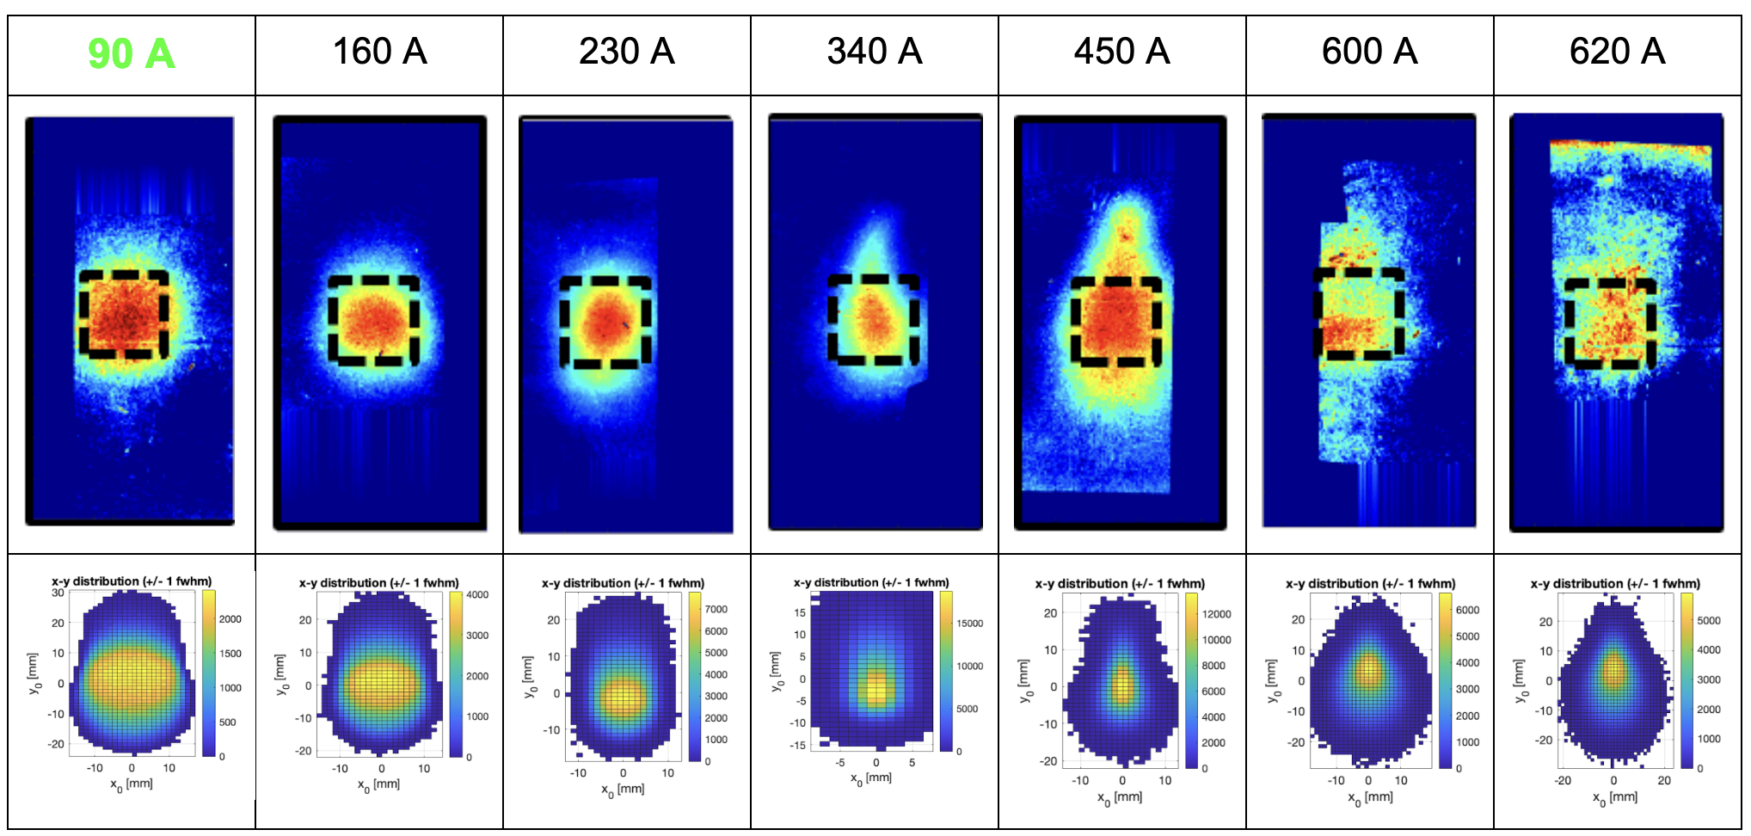
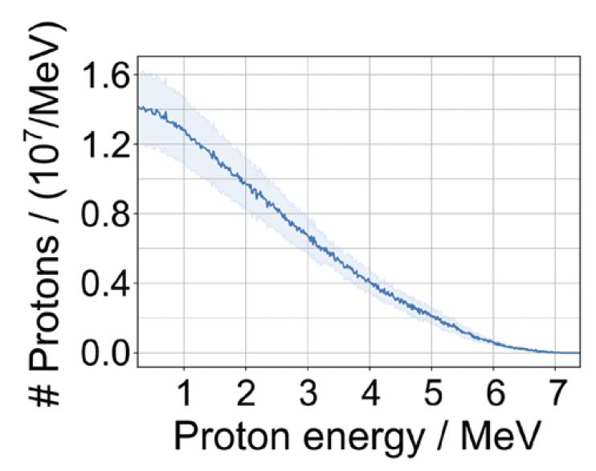
Active plasma lens transport: Experiment/Simulation showed good agreement, providing ~1 cm beam for in vitro cell studies
RCF Stack
On-sample spectrum
RCF
1cm²
Simulation
L. Geulig et al., Rev. Sci. Instrum., 93, 103301 (2022)
J.H. Bin et al., Rev. Sci. Instrum. 90, 053301 (2019)

Slide 14
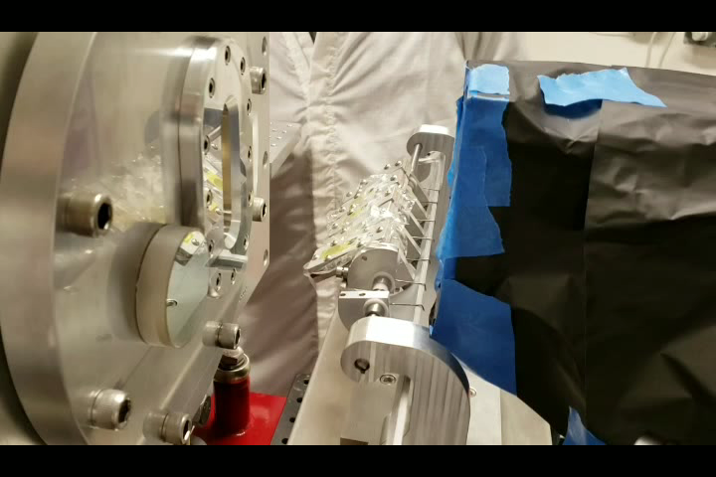
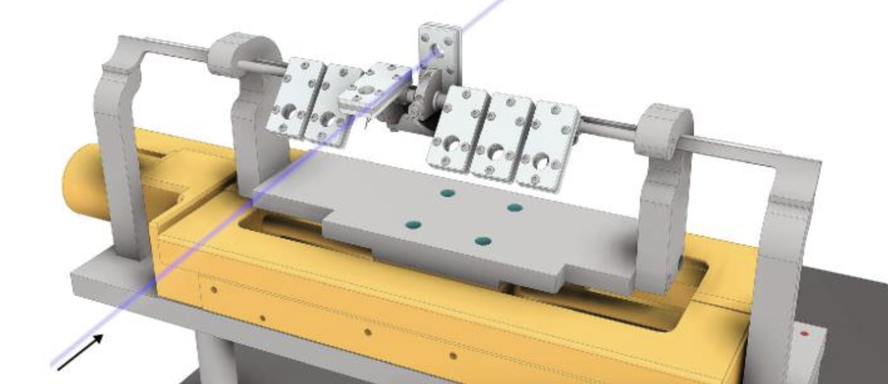
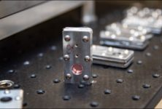
Cell holder design and automation drains sample solution during irradiation allowing for low energy protons to pass through
Design for cell culture holder with following characteristics:
1 cm irradiation field
Stretched 3.6 um thick mylar membrane windows
Rubber leak proof seals
Remove culture media during irradiation
After radiation move media back onto cells
Successfully proton-irradiated 56 cell samples in two days with a total of 1000 PW-laser shots
14

Slide 15
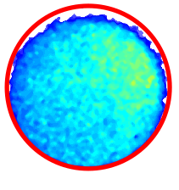
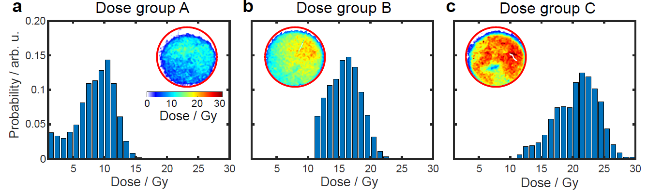
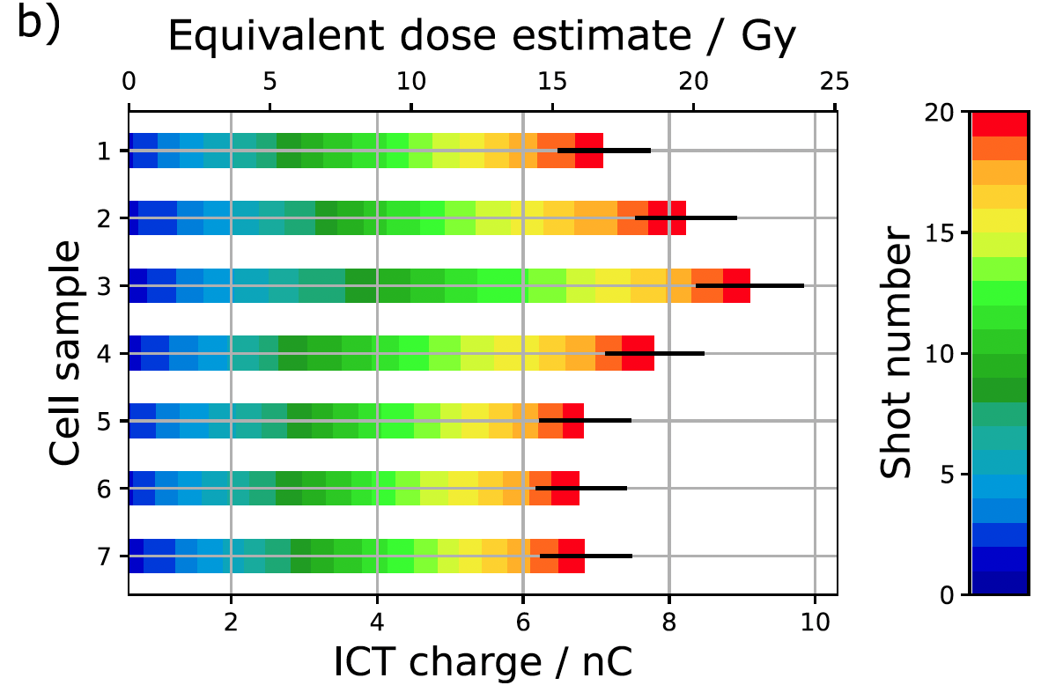
Offline/absolute (RCF) and online/relative (ICT) diagnostics are used to determine the dose applied to every irradiated cell sample
1 cm
Dose on cells:
1 Gy per shot
Variation across sample: 20 % due to beam profile non-uniformity
Integrating current transformer (ICT)
fielded for online dosimetry
10 shots
16 shots
20 shots
Proton pulse length ~30 ns → instantaneous dose rate of 4×10⁷ Gy/s
mean dose rate: 0.5 Gy/s (pulse separation 5 s)
L. Geulig et al., Rev. Sci. Instrum., 93, 103301 (2022)
J.H. Bin et al., Rev. Sci. Instrum. 90, 053301 (2019)

Slide 16
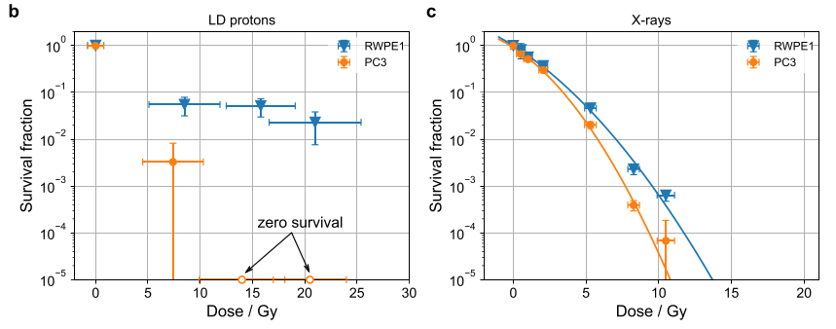
Laser accelerated ions delivered by active plasma lens to cell sample -differential sparing between normal and tumor cells observed
1 cm
Dose on cells:
1 Gy per shot
- PC3 prostate tumor cells
- RWPE1 normal prostate cells
Limitations:
Dose homogeneity and shot to shot fluctuations
Clinical proton dose rate reference is missing (X-ray radiobiological effectiveness is different) → influence of LET?
Oxygen tension is unknown
More cell types needed
In vivo study needed
LD protons: ultra-high instantaneous dose rate
X-rays: clinical dose rate
J. H. Bin et al., Sci. Rep. 12 1585 (2022)

Slide 17
Outline
Investigating FLASH Radiotherapy with laser-driven ion acceleration at the BELLA Center
The challenges of delivering laser-driven ions for radiobiological applications
  Beam transport
  Dosimetry
Initial in vitro radiobiological experiments at the long focal length (LFL) beamline with an active plasma lens (APL)
Design and implementation of permanent magnet-based beam transports for 10 & 30 MeV protons
Recent LaserNetUS radiobiological experiments:
  irradiation of in vivo samples with laser-driven ions (~7 MeV) and
  irradiation of peptides in solution with laser-driven ions (7-30 MeV)

Slide 18
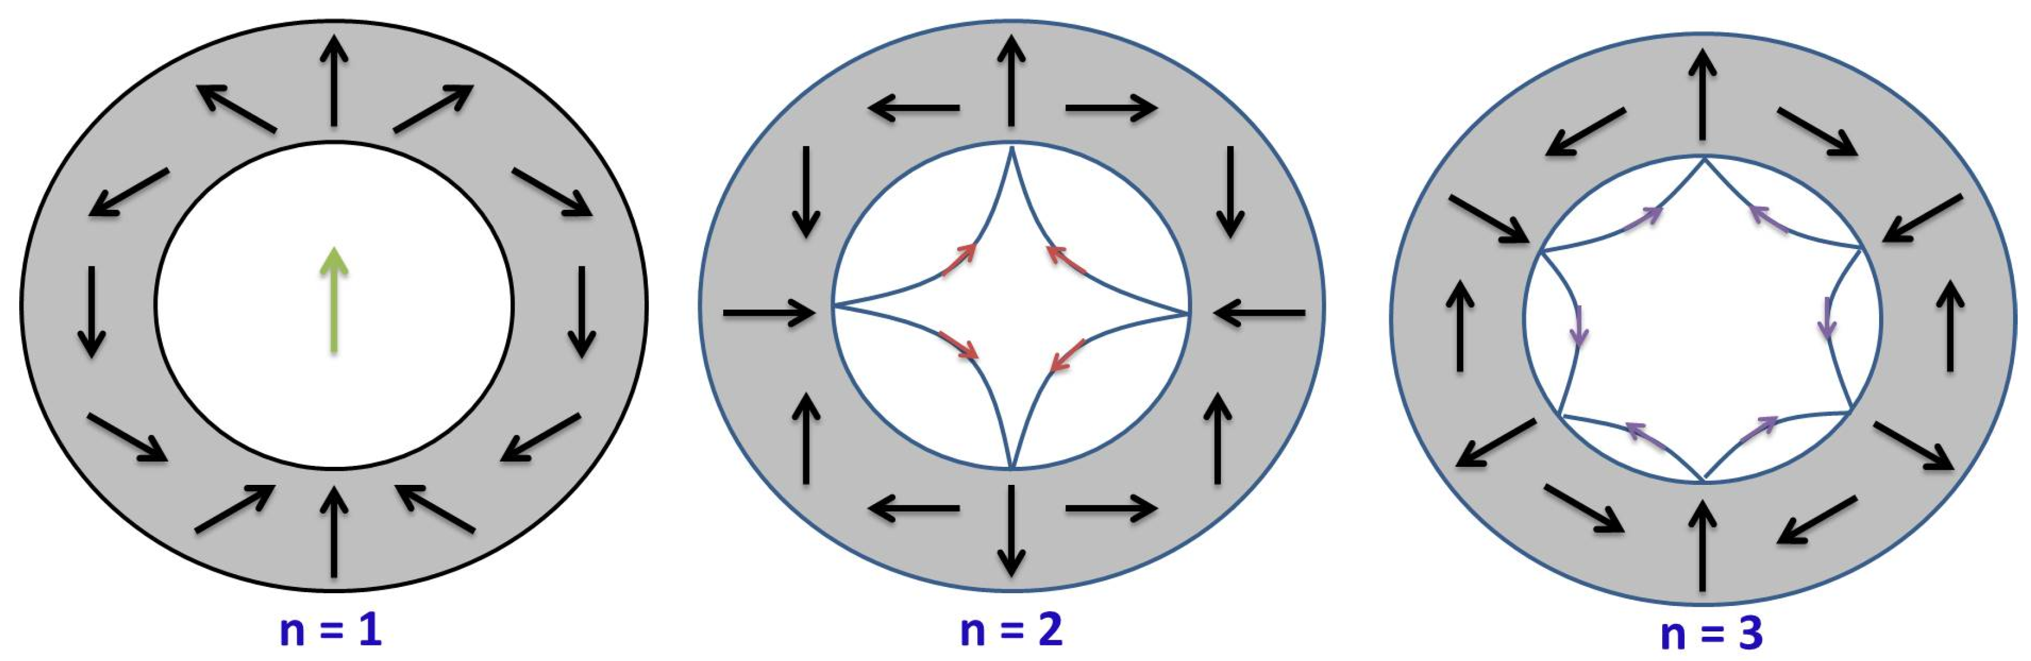
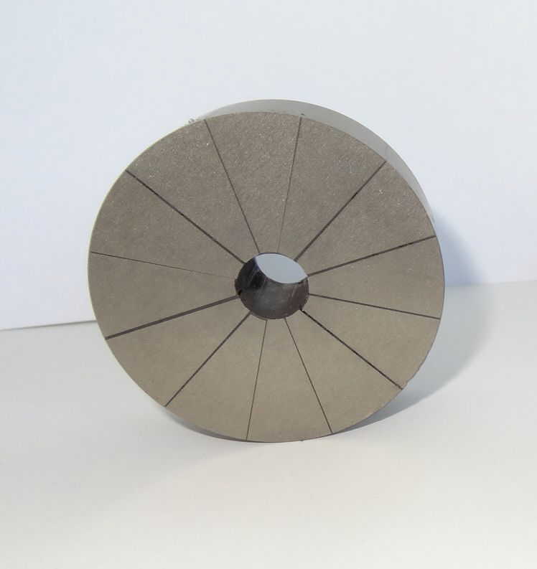
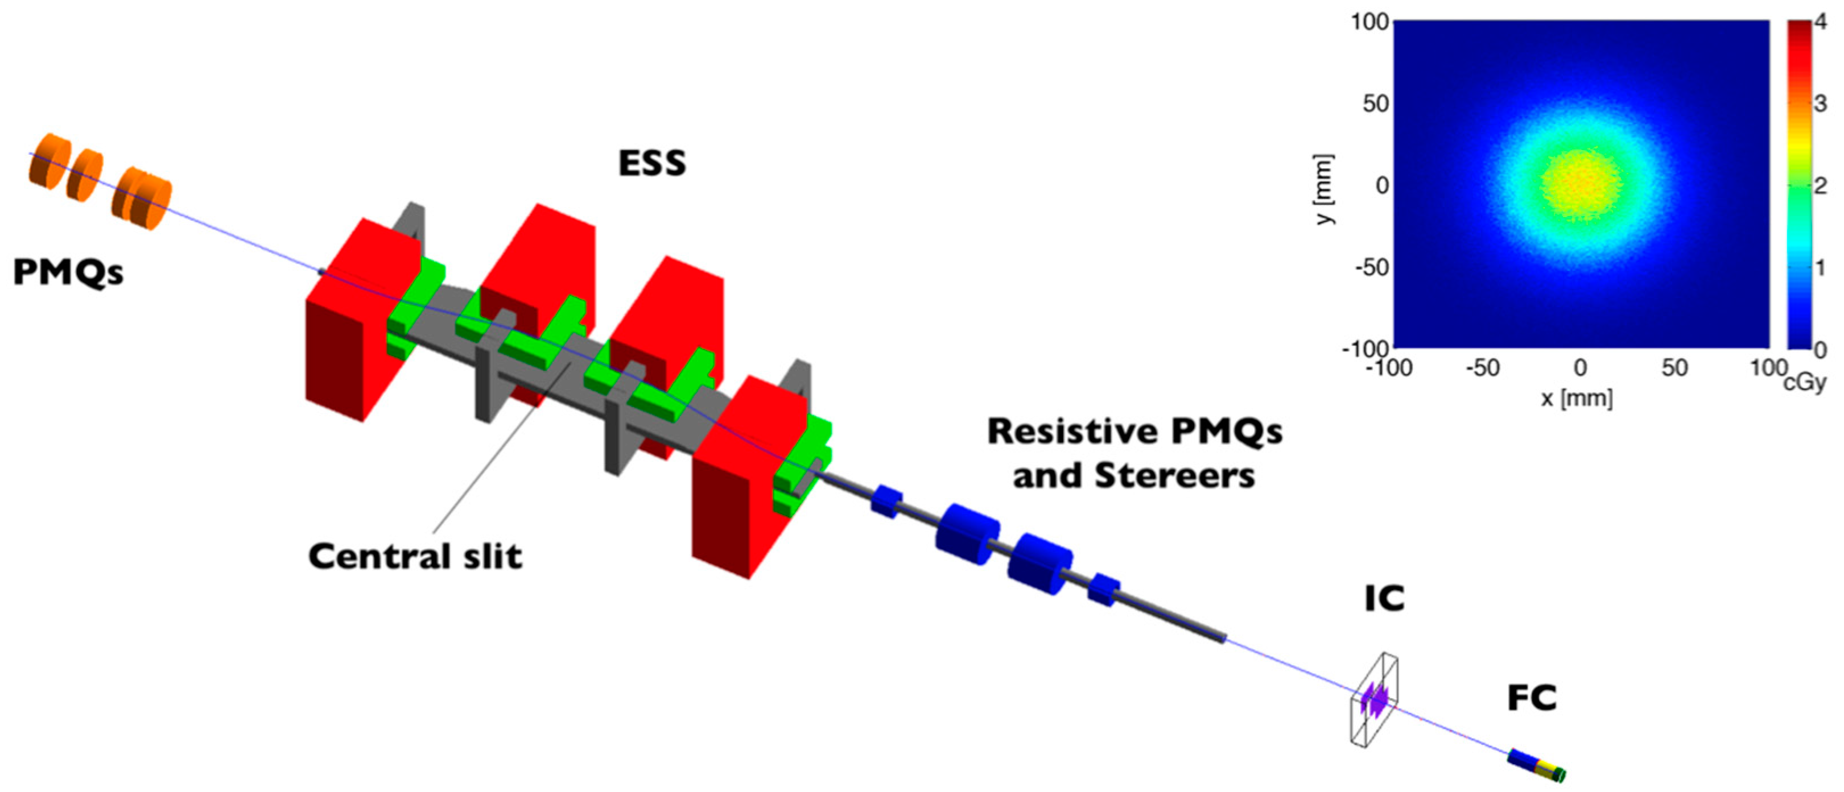
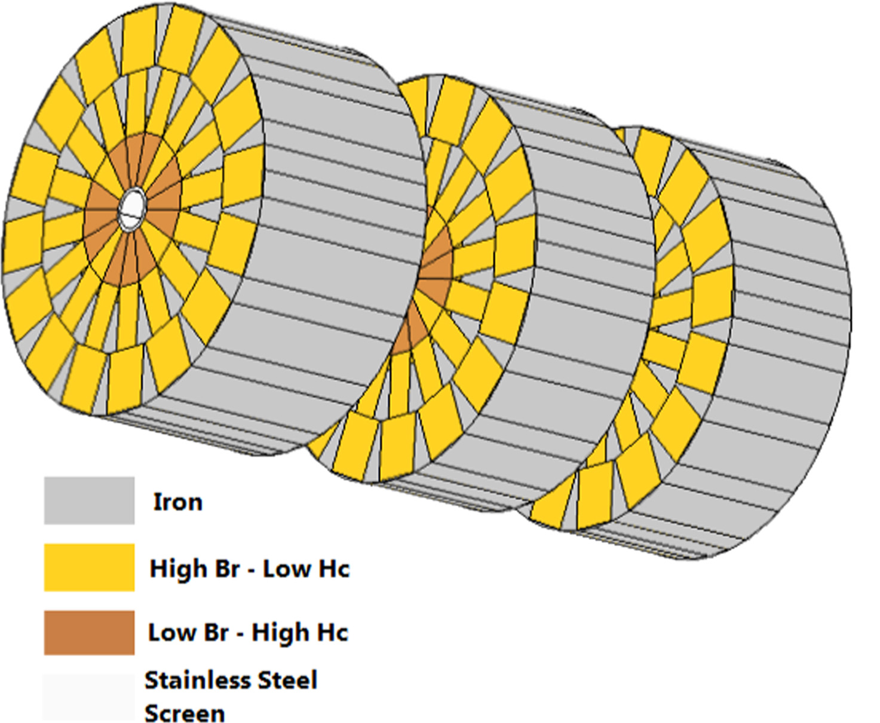
Permanent magnet quadrupoles (PMQs) are compact, high field gradient focusing elements with a large bore, necessary for maximum charge collection
Permanent magnets can be arranged in a Halbach configuration to produce a strong focusing gradient (100s T/m) with a large bore (10-50 mm)
LMU Munich PMQ
K. Halbach, Nucl. Instrum. Methods. 1980
A. Ghaith et al. Instruments 2019 https://doi.org/10.3390/instruments3020027
ELIMAIA: ELIMED beamline
T. Rösch, PhD dissertation, LMU Munich 2022
D. Margarone et al. ELIMAIA: A Laser-Driven Ion Accelerator for Multidisciplinary Applications. Quantum Beam Sci. 2018 https://doi.org/10.3390/qubs2020008
Notes:
Talk about other beamlines (lucas Brouwers
work)

Slide 19
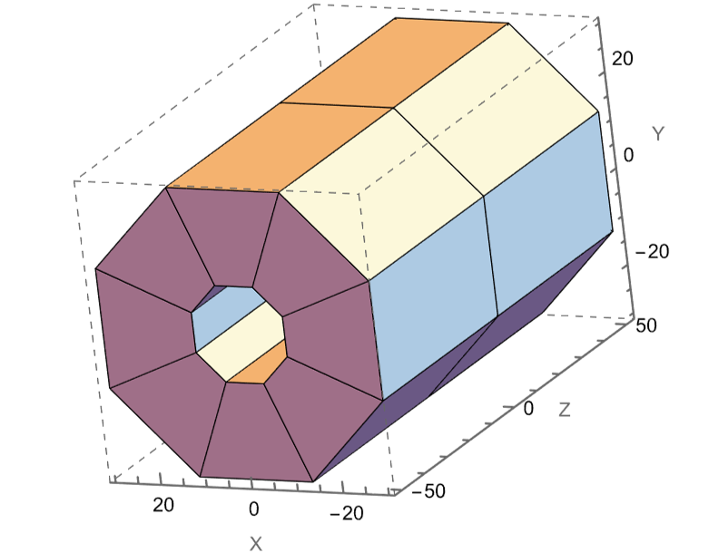
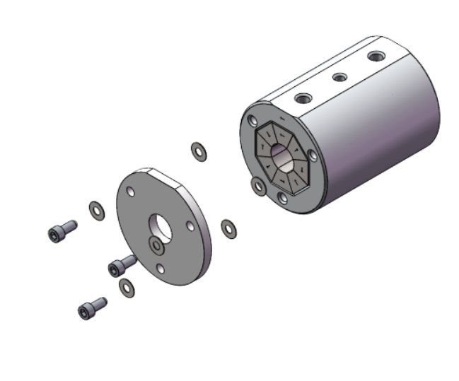
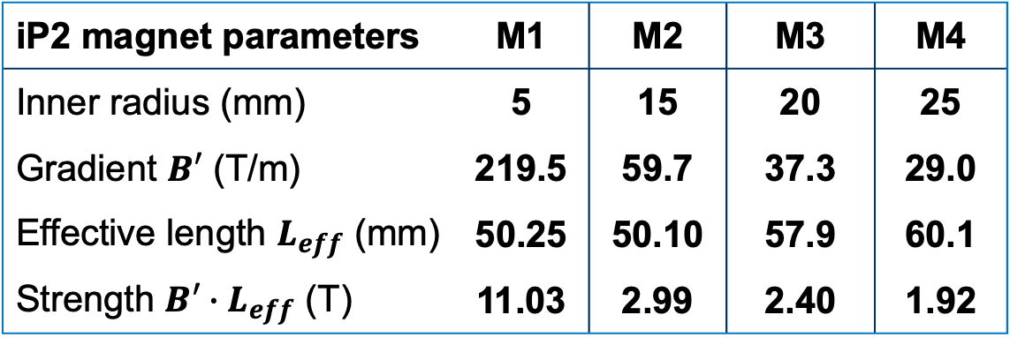
Permanent magnet quadrupoles (PMQs) are compact, high field gradient focusing elements with a large bore, necessary for maximum charge collection
Permanent magnets can be arranged in a Halbach configuration to produce a strong focusing gradient (100s T/m) with a large bore (10-50 mm)
Compact transversely and longitudinally and radiation resistant
Not easily tunable but simple to construct and commercially available
Designed in Radia
(mm)
iP2 magnet parameters | M1 | M2 | M3 | M4
Inner radius (mm) | 5 | 15 | 20 | 25
Gradient $B′$ (T/m) | 219.5 | 59.7 | 37.3 | 29.0
Effective length $L_{eff}$ (mm) | 50.25 | 50.10 | 57.9 | 60.1
Strength $B′∙L_{eff}$ (T) | 11.03 | 2.99 | 2.40 | 1.92
NdFeB
Purchased from Radiabeam and Radial Magnets
Notes:
Talk about other beamlines (lucas Brouwers
work)

Slide 20
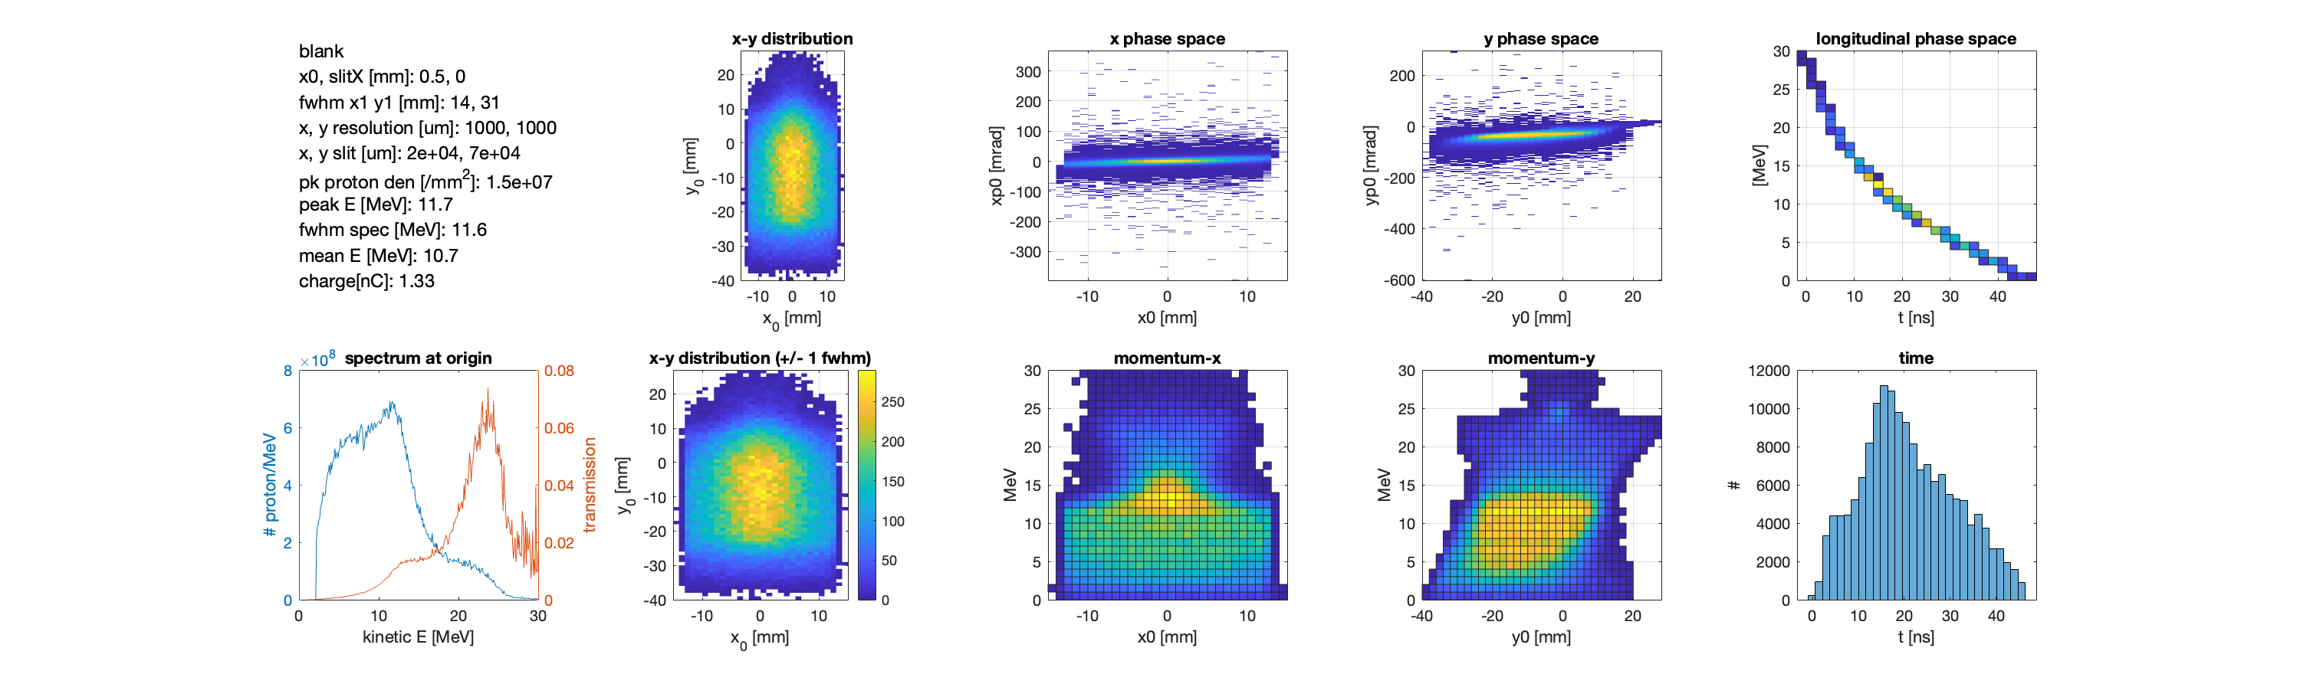
Transports were modeled and optimized using COSY Infinity while performance was estimated based on high order particle tracking
COSY Infinity
Software package for the simulation of particle optical systems
Uses differential algebra (DA) techniques to compute Taylor transfer maps to high order
3rd order maps and above are necessary due to the large energy spread of the beam
Monte Carlo Particle Tracking
Performed in MATLAB by passing a large number of particles (>10⁷) through the COSY-generated map
Models the effect of the beam passing through matter (Kapton window, air, RCF, etc.) and estimates the dose deposited in the sample

Slide 21
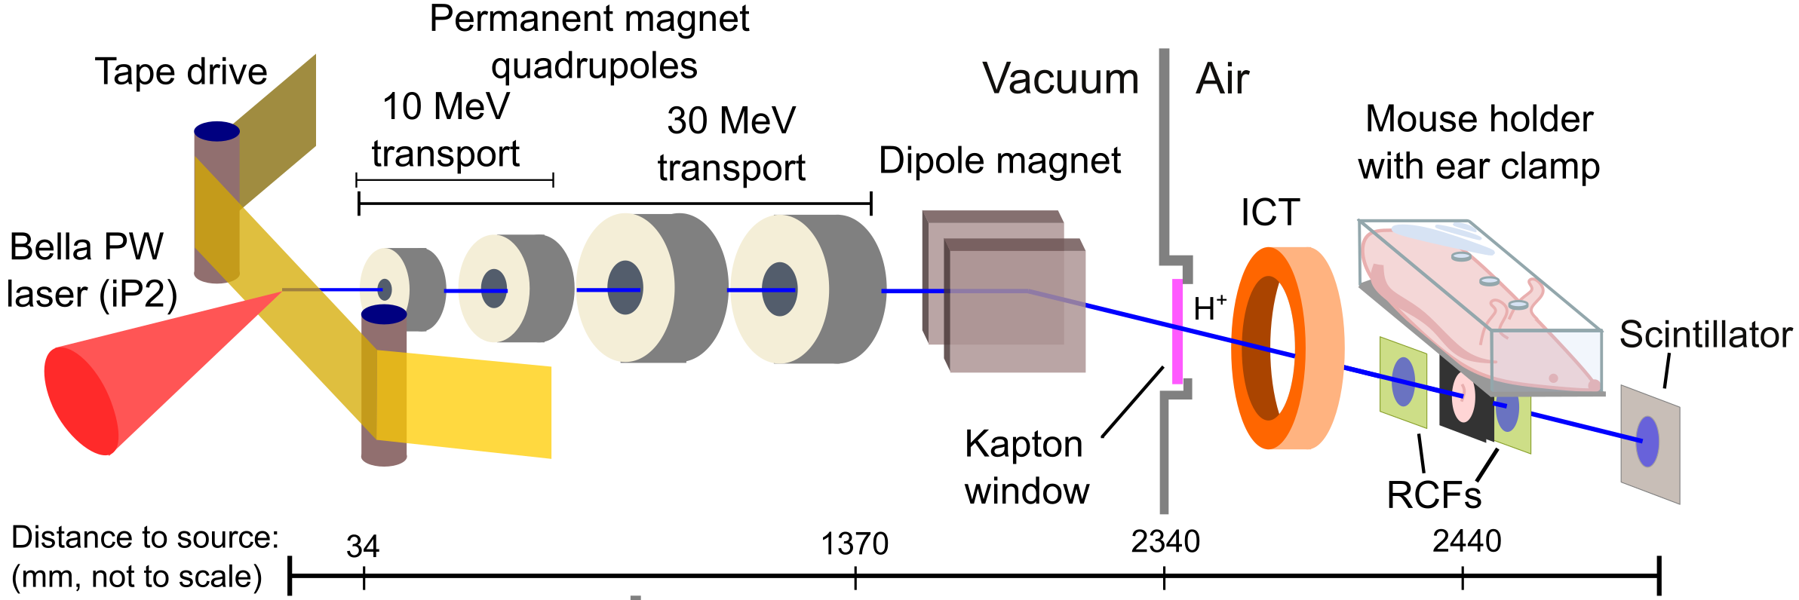

Permanent magnet-based beam transports for 10 & 30 MeV protons were installed in the BELLA iP2 beamline and used for RadBio experiments
Two configurations were implemented, designed to collimate protons with energies of 10 MeV and 30 MeV. The PMQs are mounted on motorized stages to easily switch between configurations.
After collimation, the beam is deflected with the dipole to separate the co-propagating neutrals and electrons and for spectrum manipulation.
On-shot dosimetry was performed with radio chromic films (RCFs) and an online integrating current transformer (ICT).

Slide 22
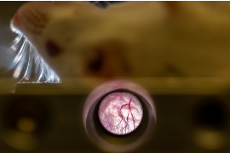
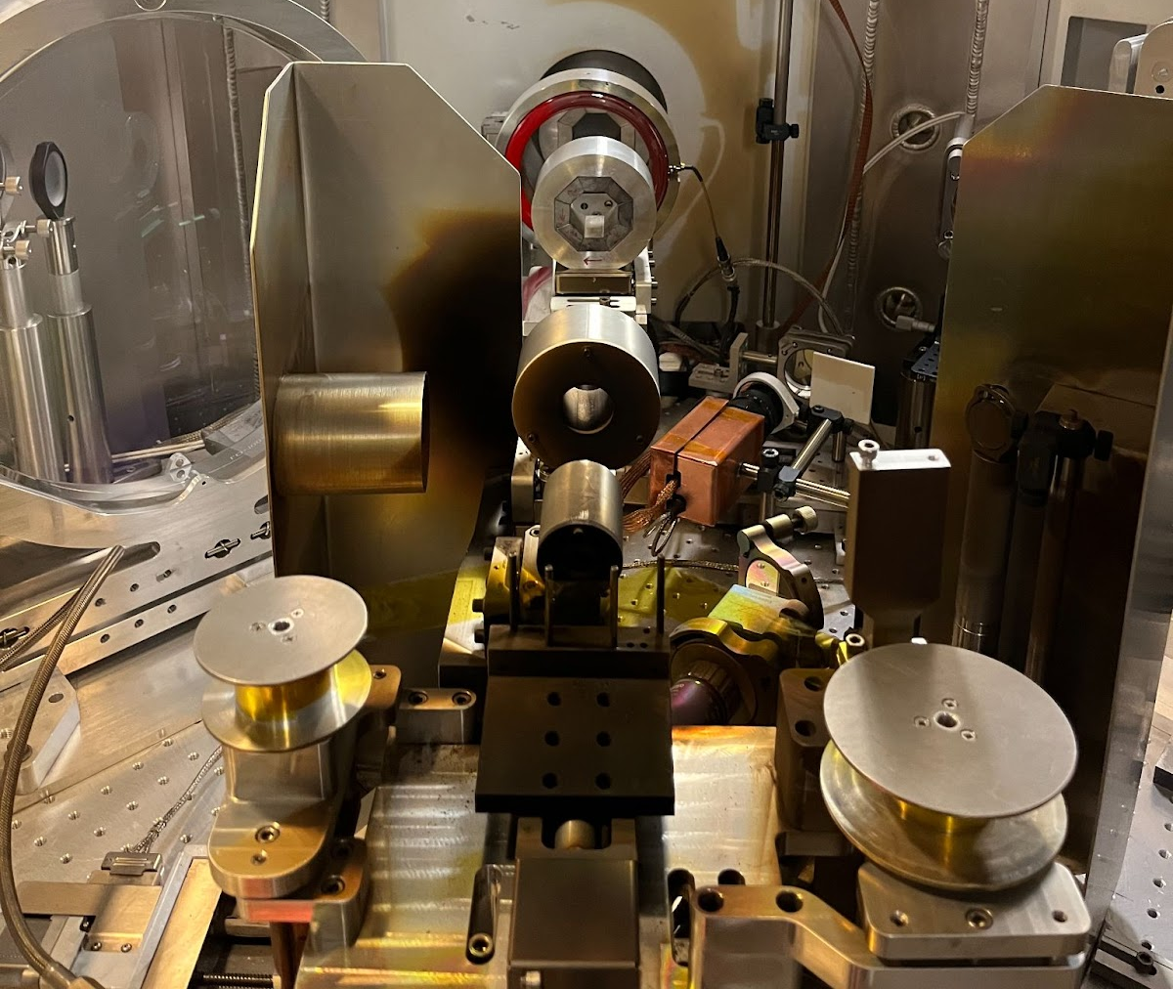
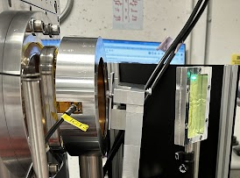
Permanent magnet-based beam transports for 10 & 30 MeV protons were installed in the BELLA iP2 beamline and used for RadBio experiments
Two configurations were implemented, designed to collimate protons with energies of 10 MeV and 30 MeV. The PMQs are mounted on motorized stages to easily switch between configurations.
After collimation, the beam is deflected separation from co-propagating neutrals and electrons and for spectrum manipulation.
On-shot dosimetry was performed with radio chromic films (RCFs) and an online integrating current transformer (ICT).

Slide 23
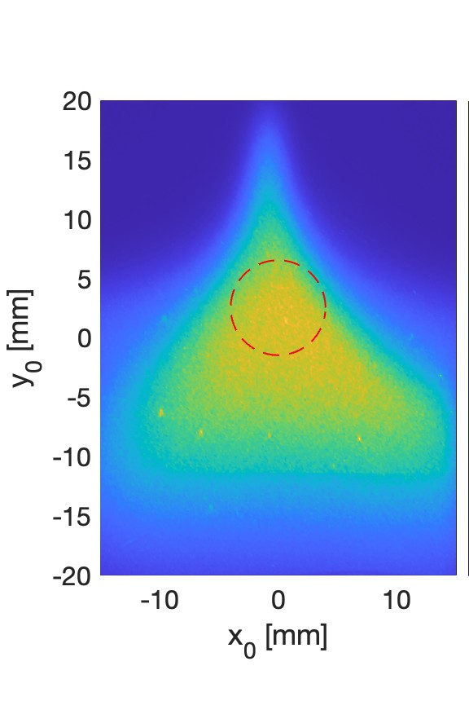
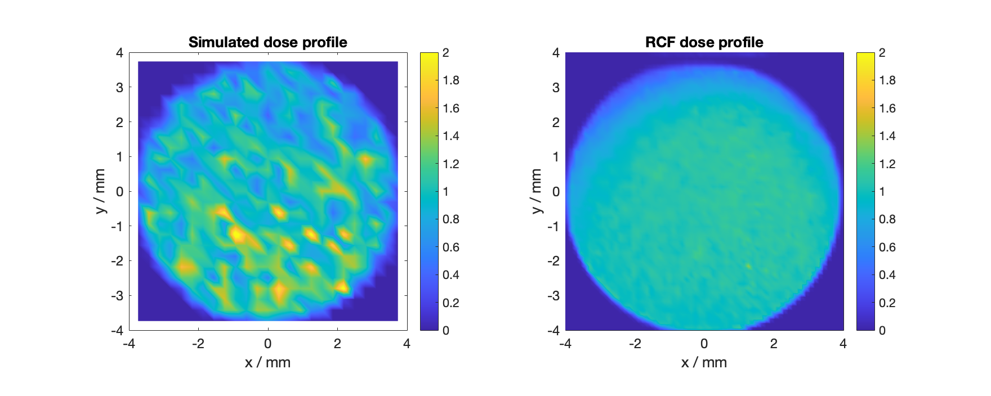
Beam transport system successfully delivered over 1 Gy/shot to the samples while maintaining a uniform dose profile
Simulated profile
Measured profile
Transport boosted the charge delivered to the sample by at least x5
After 8 mm D collimation
Notes:
Need to rotate, crop

Slide 24


Online dosimetry performed by correlating the charge measured by the ICT to the dose measured by in situ RCF
$$η=1−0.4 \text{exp}\left({−4e}^{−0.2 dE/ⅆx}\right)$$
Modeling the measured beam spectrum through the beamline, the dose values measured by the RCFs were scaled to account for their LET-dependent response.
Schollmeier et al. Rev. Sci. Instrum. 2014
Dose-charge correlation
Raw ICT Signal
145 pC
L. D. Geulig et al., Rev Sci Instrum 2022
*Accumulated over multiple shots

Slide 25
Outline
Investigating FLASH Radiotherapy with laser-driven ion acceleration at the BELLA Center
The challenges of delivering laser-driven ions for radiobiological applications
  Beam transport
  Dosimetry
Initial in vitro radiobiological experiments at the long focal length (LFL) beamline with an active plasma lens (APL)
Design and implementation of permanent magnet-based beam transports for 10 & 30 MeV protons
Recent LaserNetUS radiobiological experiments:
  irradiation of in vivo samples with laser-driven ions (~7 MeV) and
  irradiation of peptides in solution with laser-driven ions (7-30 MeV)

Slide 26






First animal irradiation at BELLA with ~7 MeV laser-driven protons to investigate radiation damage to mouse ear tissue in vivo shows sparing compared to x-rays
7 mm
7 J
Preliminary data
36 Gy +/- 1.1 Gy
4 shot days, total of 1220 shots & 60 irradiated animals with prescribed doses of 10 – 40 Gy
Bio endpoints: ear thickness and reddening
L. Geulig et al., Rev. Sci. Instruments 93 (2022) 103301.
J. De Chant et al., Journ. of Acc. Conferences, IPAC'24 MOPR72 (2024)

Slide 27

First animal irradiation at BELLA with ~7 MeV laser-driven protons to investigate radiation damage to mouse ear tissue in vivo shows sparing compared to x-rays
7 mm
7 J
Preliminary data
L. Obst-Huebl, J. Inman, et al., in preparation
Ongoing:
Biological tissue staining methods and transcript sequencing
Is RBE (proton/x-ray) = 1.1 valid? → Seeking proton reference irradiation opportunities
36 Gy X-rays
40 Gy X-rays
36 Gy BELLA prt

Slide 28
Outline
Investigating FLASH Radiotherapy with laser-driven ion acceleration at the BELLA Center
The challenges of delivering laser-driven ions for radiobiological applications
  Beam transport
  Dosimetry
Initial in vitro radiobiological experiments at the long focal length (LFL) beamline with an active plasma lens (APL)
Design and implementation of permanent magnet-based beam transports for 10 & 30 MeV protons
Recent LaserNetUS radiobiological experiments:
  irradiation of in vivo samples with laser-driven ions (~7 MeV) and
  irradiation of peptides in solution with laser-driven ions (7-30 MeV)

Slide 29




First peptide experiments at BELLA iP2 with ~7-30 MeV protons were conducted in April 2024
20 J
“Flat” spectrum → uniform dose deposition
Sample
Volume
29

Slide 30

The stability of the higher energy TNSA source needs further improvement for systematic radbio studies
Sample #
1
2
3
4
5
6
20 J
time
“Flat” spectrum → uniform dose deposition
Proton dose and spectrum declined over the course of sample irradiations due to a drift in the system when shooting the laser continuously
→ Finding the source of this drift + implementing online spectral measurements are work in progress
Sample
Volume
~1 Gy/shot
Cumulated ICT charge / nC
Cumulated dose / Gy
30

Slide 31



Outlook: explore physico-chemical step of FLASH effect with ultra-short electron bunches from laser plasma accelerator
“Very high energy electrons” (VHEE) ~150-250 MeV range, can penetrate large samples
Few 10 fs bunch length
  ultra-high instantaneous dose rate ~ 10¹² Gy/s
  ultrafast access to the very early (physico-chemical) step of FLASH
Synchronized measurements with pulsed optical (incl. higher harmonics) & betatron x-ray beams
LPA VHEE are increasingly recognized as a tool for radiobiology research/potential future radiotherapy: Laschinsky Radiat. Res. 53:395-403 (2012), Kokurewicz SPIE: Bellingham WA, USA (2017), Labate Sci. Rep. 10:17307 (2020), Cavallone Appl. Phys. B 127:57 (2021), Svendsen Sci. Rep. 11:5844 (2021),
+ startup company in Israel ebeam4therapy, …
Chappuis Physica Medica 110 (2023) 102601
BELLA HTT LPA spectrum

Slide 32

Outlook: explore physico-chemical step of FLASH effect with ultra-short electron bunches from laser plasma accelerator
“Very high energy electrons” (VHEE) ~150-250 MeV range, can penetrate large samples
Few 10 fs bunch length
  ultra-high instantaneous dose rate ~ 10¹² Gy/s
  ultrafast access to the very early (physico-chemical) step of FLASH
Synchronized measurements with pulsed optical (incl. higher harmonics) & betatron x-ray beams
1) Simulations with OpenTOPAS-nbio
Chappuis Physica Medica 110 (2023) 102601
BELLA HTT LPA spectrum
A. Lu, J. De Chant
2) Build setup at BELLA HTT for in vitro/in vivo sample irradiations

Slide 33
Summary
The laser-driven ion accelerator at BELLA iP2 is a good platform for investigating ultra-high dose rate radiobiology and was used in recent LaserNetUS experiments to explore the FLASH effect.
Permanent magnet-based beam transports for 10 & 30 MeV protons were installed in the BELLA iP2 beamline to improve the overall dose rate and uniformity of the dose delivered.
Experiments have explored:
  differential sparing of normal versus tumor tissue in both in vitro and in vivo (analysis ongoing) samples when irradiated with ultra-high instantaneous dose rate laser-driven protons and
  first peptide irradiation experiments at BELLA iP2 with ~7-30 MeV protons conducted in April 2024 (analysis ongoing).
Online dosimetry performed by correlating the charge measured by the ICT to the dose measured by in situ RCF.
Plan to explore physico-chemical step of FLASH effect with ultra-short electron bunches on the HTT beamline at BELLA.

Slide 34



Acknowledgements
Kei Nakamura
Lieselotte Obst-Huebl
Aodhán McIlvenny
Sahel Hakimi
Antoine Snijders
Jian-Hua Mao
Jamie Inman
Laura Geulig
Jianhui Bin
Stepan Bulanov
Savannah Kidd
Anthony J. Gonsalves
Qing Ji
Carl B. Schroeder
Cameron G.R. Geddes
Brendan Stassel
Corie Ralston
Sayan Gupta
Brandon Russell
Charlotte Palmer
Simruthi Subramanian
Sven Steinke
Jeroen van Tilborg
Thomas Schenkel
Blake Simmons
Eric Esarey
We gratefully acknowledge the contributions of:
Zac Eisentraut, Mark Kirkpatrick, Tyler Sipla, Teo Maldonado, Art Magana, Joe Riley, Mackinley Kath, Wim Leemans, Eleanor Blakely, Samuel Barber, Csaba Toth, Jonathan Bradford, Greg Mannino and Nathan Ybarrolaza
Supported by the U.S. Department of Energy Office of Science Offices of High Energy Physics and Fusion Energy Sciences, under Contract No. DE-AC02-05CH11231 and by LaserNetUS

Slide 35



The use of ultra-high dose rates in radiotherapy is recognized as a promising breakthrough in radiation oncology, but further research is needed
Radiotherapy is the current standard of care for > 50% of all cancer patients but its use is limited by access to facilities and healthy tissue toxicity.
FLASH effect: the differential sparing of healthy tissue under irradiation at ultra-high dose rates (historically >40 Gy/s)
Ion therapy center
Heidelberg
Electrons
Normal Tissue Damage (%)
(1 Gy of dose equals the absorption of 1J of radiation energy per kilogram of matter)
?
Weeks after irradiation
M. Vozenin et al., Nature Rev Clin Onc, 2022, 10.1038/s41571-022-00697-z
S. Boucher et al., Snowmass 2021 White Paper, arXiv:2203.11047
Durante et al., Br Radiol 2018 10.1259/bjr.20170628.,
Favaudon et al: Sci Transl Med. 2014 10.1126/scitranslmed.aba4525

Slide 36


A peptide irradiation platform was established at the Advanced Light Source (ALS) to study dose rate effects on oxidative damage to peptides
X-ray footprinting mass spectrometry used with a reductionist approach (peptides in vitro) to isolate individual components of the FLASH effect
E_{crit} = 3.1 keV
+16 Dalton
oxidative modification
Liquid Chromatography
Mass Spectrometry (LC-MS)
S. Gupta et al., Radiation Research 200(6), 523-530 (2023)
36

Slide 37



A peptide irradiation platform was established at the Advanced Light Source (ALS) to study dose rate effects on oxidative damage to peptides
Dosimetry was conducted with radiochromic film
(Exposure time is determined by sample speed)
S. Gupta et al., Radiation Research 200(6), 523-530 (2023)
37

Slide 38


The dose rate and oxygen dependent modification of peptides is confirmed in x-ray irradiations at the ALS versus at a conventional x-ray tube
Less damage after ultra-high dose rate than conventional dose rate irradiations
Less damage at low than atmospheric oxygen content
X-rays
S. Gupta et al., Radiation Research 200(6), 523-530 (2023)
38

Slide 39

The dose rate and oxygen dependent modification of peptides is confirmed in x-ray irradiations at the ALS versus at a conventional x-ray tube
Less damage after ultra-high dose rate than conventional dose rate irradiations
Less damage at low than atmospheric oxygen content
6 MeV pulsed electron beam (linac)
S. Gupta et al., Radiation Research 200(6), 523-530 (2023)
39

Slide 40
The dose rate and oxygen dependent modification of peptides is confirmed in x-ray irradiations at the ALS versus at a conventional x-ray tube
Less damage after ultra-high dose rate than conventional dose rate irradiations
Less damage at low than atmospheric oxygen content
6 MeV pulsed electron beam (linac)
Result: peptides can be used in a reductionist approach to study the damage by OH radicals under different radiation regimes and sample conditions
S. Gupta et al., Radiation Research 200(6), 523-530 (2023)
40

Slide 41






BELLA iP2: Short focal length setup to achieve >2 orders higher intensity on target for ion acceleration and HEDS studies
OAP
Option for double plasma mirror in PL1 →
Ultra high contrast and advanced ion acceleration mechanisms for iP2
iP2: New short focal length F/2.5
Focal spot measurements indicate >5x10²¹ W/cm² for 40 J pulse energy
Available for user experiments through LaserNetUS
L. Obst-Huebl et al., Proc. SPIE Optics and Optoelectronics (2023) submitted.
41

Slide 42


Back reflections limited iP2 operation at higher laser pulse energies
Faraday rotation isolator and saturable absorber on selected shots were not able to prevent damage in Booster amplifier (focused geometry) ---- downstream 1 Hz PC did not function to specs (1μs HV pulse instead of 10 ns) --- now fixed
Safe operation up to 12 J on plastic foil target
1-10 mJ back reflected energy measured in rejected beam
1 cm diameter Ti:Sa crystal
μs HV pulse
L. Obst-Huebl et al., Proc. SPIE Optics and Optoelectronics (2023) submitted.

Slide 43
Laser-driven proton pulses are uniquely short and intense and are therefore of interest to study radiobiological/radiotherapeutical effects induced by ultra-high dose rates
FLASH effect: the differential sparing of healthy tissue under irradiation at ultra-high dose rates
In-vivo study on mice irradiated with electrons
Constant total dose but different (mean) dose rates (blue vs. red)
Mean dose rate might be low but
instantaneous dose rate >10⁷ Gy/min
Laser-driven
protons
Hz
Log(amplitude)
Conventional
Protons
MHz
Time
(reminder: 1 Gy of dose equals the absorption of 1J of radiation energy per kilogram of matter)
Mean dose rate 1800 Gy/min
Pulmonary fibrosis (%)
Mechanism of FLASH effect is not well understood
Laser-driven radiation sources provide uniquely high intra-pulse (“instantaneous”) dose rates and are increasingly available in university-scale laser labs
They can contribute to FLASH research by complementing conventional accelerator facilities
Weeks after irradiation
Continuous growth of radiobiological research with laser-driven proton beams: A. Yogo et al., Appl. Phys. Lett. 94:181502 (2009), S. Kraft et al., New J. Phys. 12:085003 (2010), D. Doria et al., AIP Advances 2:011209, E. Bayart et al., Sci. Rep. 9:10132 (2019), F. Hanton et al., Sci Rep. 9:1-10 (2019), F. Kroll et al., Nat. Phys. 18:316-322 (2022), J. Metzkes, et al., Sci. Rep. 13:20611 (2023), Snowmass/Journal article: R. Schulte et al., Transformative Technology for FLASH Radiation Therapy, Appl. Sciences 13:5021 (2023)
Notes:
FLASH effect: several pre-clinical studies have shown that irradiation at dose rates far exceeding those currently used in clinical contexts reduce radiation-induced cell damage of healthy tissue
whilst maintaining an equivalent tumor response
Pulmonary fibrosis (radiation induced lung tissue damage) substantially reduced when going to ultra-high dose rates of 60 Gy/s as can be achieved with conventional accelerators
This differential effect could be even further enhanced when going for laser-driven protons with 10^7 Gy/s
unique time structure resulting in ultra-high instantaneous dose rates
Mice exposed to total 17 Gy with 4.5 MeV electrons

Slide 44



In general, the literature recognizes that oxygen concentration may play an important role in the FLASH effect
Wilson et al. Frontiers in Oncology 2020 10.3389/fonc.2019.01563
44
Notes:
Wilson: Some researchers have suggested that the differential response between FLASH-RT and CONVRT may be due to the radiochemical depletion of oxygen at ultra-high dose rates and subsequent radioresistance conferred to the irradiated tissue (32, 38, 39). It is widely accepted that hypoxic tissues are more radioresistant than well-oxygenated tissues. This is because in the presence of molecular oxygen there is fixation of indirect radiation-induced DNA damage. Indirect damage, the predominant mechanism by which low linear energy transfer (LET) radiation induces DNA damage, occurs when radiation results in the radiolysis of water molecules and the subsequent generation of free radicals. Free radicals are then incorporated into DNA, causing damage—yet this can be easily resolved. However, if a free radical reacts with molecular oxygen, this yields a peroxyl radical. Peroxyl radicals have the potential to induce permanent damage, and are therefore a more efficacious DNA damaging agent. Hence, a lack of oxygen in the immediate environment of a cell limits the extent of radiation-induced DNA damage (40).
The authors hypothesized at the time that this response was a consequence of oxygen depletion following a large dose of radiation in such a short timeframe; the time for which the bacteria were irradiated for was shorter than the time required for oxygen to diffuse and restore the oxygen that had been depleted. Given that molecular oxygen is depleted as it reacts with free radicals generated from the radiolysis of water, irradiation at ultra-high dose rates is able to significantly deplete oxygen before it can replenish. This gives rise to a small window of radiobiological hypoxia.
Adrian [2020]: Besides local and transient oxygen depletion, radical–radical interaction is another hypothesized reason for the FLASH effect. FLASH irradiation results in a high local radical concentration, leading to radical–radical interactions and less free radicals available to interact with DNA.17 Biological damage produced by X-ray/electron radiation is dominated by indirect action, i.e. free radicals interacting with DNA.18 Furthermore, radical-induced DNA damage can be permanently 'fixed' by molecular oxygen, rendering DNA damage irreparable. Consequently, lower oxygen concentration is recognized to cause radio-resistance.19

Slide 45

RNA sequencing of cell samples suggests a possible role of different responses of normal versus tumor cells to oxidative stress
1 cm
Dose on cells:
1 Gy per shot
- PC3 prostate tumor cells
- RWPE1 normal prostate cells
Cell samples were sealed off from air 24 hrs prior and 24 hrs after irradiation
Artificially reducing oxygen concentration to be more similar to in vivo conditions
RNA sequencing of cell samples showed differential expression of genes responsible for dealing with oxidative stress.
→ E.g., down/up regulated in RWPE1/PC3:
  ATF3: responsive to reactive oxygen species (ROS), which induce permanent damage in cells
J. H. Bin et al., Sci. Rep. 12 1585 (2022)
45
Notes:
Dose estimation error:
Sample to sample fluctuations including shot to shot variation dominates the accumulated dose error per data point.
We are currently working on online dose diagnostics to ensure that the prescribed dose is applied.
- In vivo response may be very different from in vitro (you would not expect 99% killing):
Immuno response
3D effects in vivo different → usually more resistant than in vitro,
only one cell type → different cell types interact to repair damage,
individual cell sensitivity in the presence of oxygen differs between cell types
wide range of oxygen concentrations in different cell types
In irradiation setting: damage to cells is measured e.g. via reddening and blistering of the skin
why lower tumor survival for ref. x-rays, should be inverse (tumors hypoxic so less radiation damage)
because this is in-vitro, no surrounding living organism that would result in hypoxic conditions
needs to be studied in vivo
Is this in agreement with previous FLASH studies?
This is the first study observing diff. sparing w/ ld protons, so no “prev data” to compare to
For comparison of FLASH vs. CONV, where proton FLASH achieved with conv. Acc., so ~ 1000Gy/s: FLASH/CONV (for relevant endpoint for healthy tissues) is ~ -50-90% (Friedl et al 2021) at 10 Gy total dose.
Why FLASH effect observed in vitro in the first place? Normally not observed in vitro
Adrian (2020): sparing effect depends on Oxygen concentration and we reduced oxygen by sealing cells off 24 hrs before irradiation.
But this was done to both healthy and cancer cells, so both should be equally spared
So the observed difference might be a result of different metabolic pathways involved in the response of normal and tumor cells. We observe indication of this in our RNA sequencing results

