Slide 1

FLASH Radiotherapy Research at QUB
LhARA collaboration meeting
Monday 2nd September, 2024
Prof Karl Butterworth
Advanced Radiotherapy Group
Notes:
Good morning, thank organisers
Rapid period of development in flash research over the past 18 months or sos
Received funding from MRC to implement a program of photon flash RT research using a novel preclinical platform - the FLASH SARRP -

Slide 2
Radiotherapy Research at PGJCCR
Johnston Cancer Centre
(PGJCCR)
Advanced Radiotherapy Group (ARG)
Prostate Cancer Centre (PCC)
Northern Ireland Cancer Centre (NICC)
LhARA Collaboration Meeting, 2024.
Notes:
Give you a brief overview of RT at the PGJCCR.
The Advanced Radiotherapy Group (ARG) is a multidisciplinary team of clinicians, physicists, radiation biologists, radiographers and physiologists whose remit is to research, initiate and develop new and advanced radiation treatments encompassing basic laboratory research, preclinical studies and clinical delivery.

Slide 3
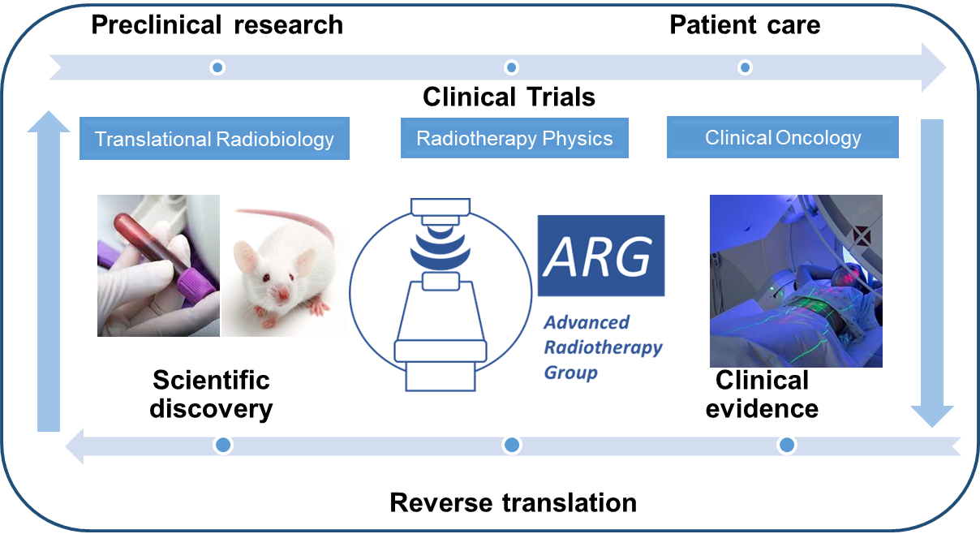
Radiotherapy Research at PGJCCR
Johnston Cancer Centre
(PGJCCR)
Advanced Radiotherapy Group (ARG)
Prostate Cancer Centre (PCC)
Northern Ireland Cancer Centre (NICC)
LhARA Collaboration Meeting, 2024.
Notes:
Workflow encompassing radiobiology, physics and clinical oncology
Example of both forward translation early phase studies in SABRT, radionuclide and drug RT combinations
Reverse translation, some excellent examples of this recently in the area of radiation induced cardiac toxicity and subvolume effects

Slide 4
ARG Research Themes
Advanced delivery modalities including radionuclides
Genomic signatures
Imaging biomarkers
Mechanistic modelling
RBE treatment planning
Radiotherapy Combinations
DDRI’s
HDAC’s
Radiation protectors
Nanoparticle radiosensitizers
Tumour metabolism
Precision Radiotherapy
Clinical Trials
PACE-NODES, SABRE, SPORT, ADDRAD
CONCORDE
PARABLE
CENTRE
LhARA Collaboration Meeting, 2024.
Notes:
Research crosses a number of central themes

Slide 5
Preclinical Infrastructure
Advanced delivery modalities including radionuclides
Genomic signatures
Imaging biomarkers
Mechanistic modelling
RBE treatment planning
Radiotherapy Combinations
DDRI’s
HDAC’s
Radiation protectors
Nanoparticle radiosensitizers
Tumour metabolism
Precision Radiotherapy
Preclinical radiotherapy technologies
Small animal radiotherapy research platform (SARRP)
Ultra-high dose rate (FLASH- SARRP)
LhARA Collaboration Meeting, 2024.
Notes:
Support by key enabling preclinical infrastructure.
Example of how we are using these platforms to drive innovation in precliinical RT studies
Describe infrastructure

Slide 6
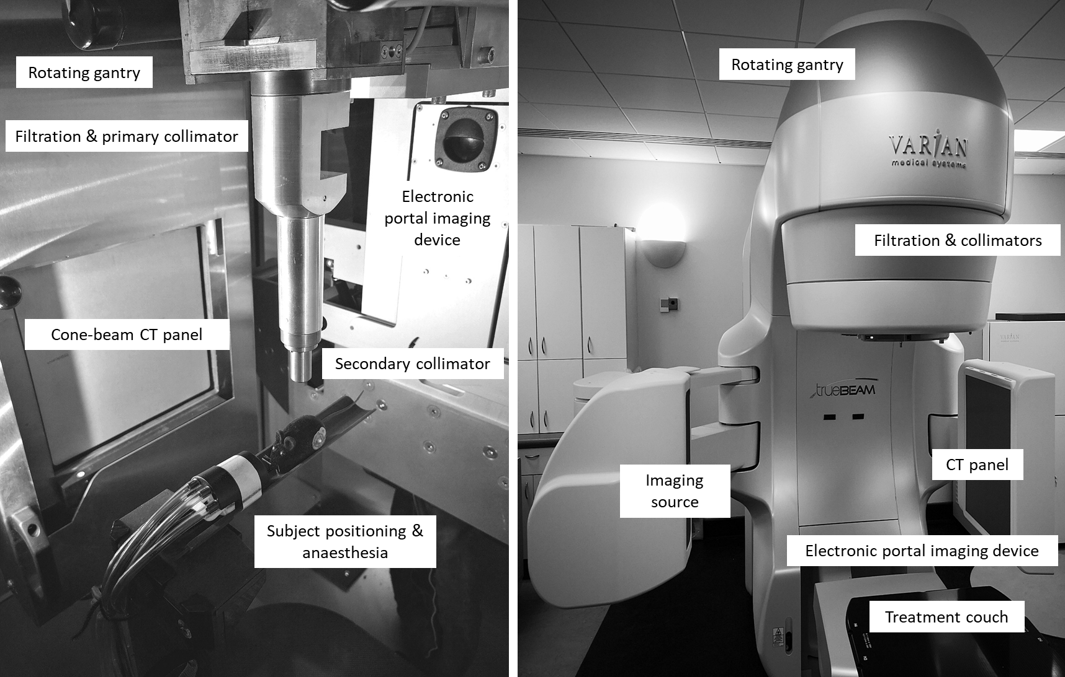

Preclinical infrastructure
Small animal radiotherapy research platform (SARRP)
CBCT image guidance, TPS, > 0.5 mm beam size.
Conventional dose rates (0.5 Gy/min).
Dedicated TPS, collimation etc.
LhARA Collaboration Meeting, 2024.
Notes:
SARRP
Onboard CBCT, enabling previously unimaginable capabilities for radiological experimentation
Enbale normal tissue radiobiology developments
2014, grant from friends, develop by john wong

Slide 7
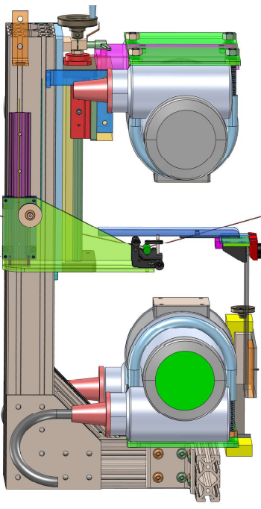
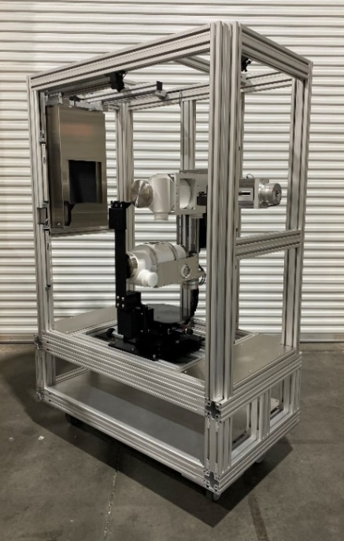
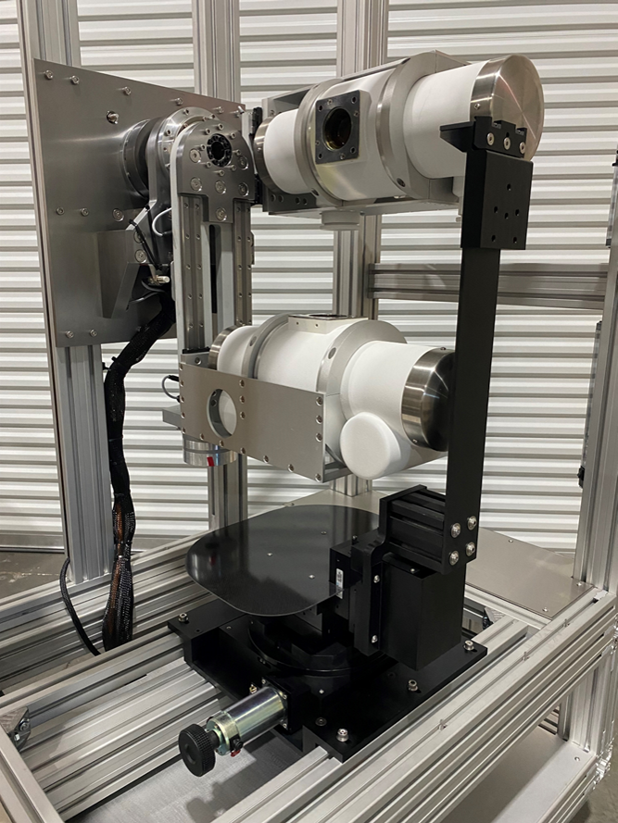

Preclinical infrastructure
Small animal radiotherapy research platform (SARRP)
CBCT image guidance, TPS, > 0.5 mm beam size.
Conventional dose rates (0.5 Gy/min).
Dedicated TPS, collimation etc.
FLASH-SARRP
Conventional dose rates: 0.05 – 0.5 Gy/s
FLASH dose rates (<200 Gy/sec), exposures 50 – 500 ms
On board μCT capability (40 μm voxel size).
LhARA Collaboration Meeting, 2024.
Notes:
More recently flash sarrp
Enabled rapid development of flash RT program within QUB – define specifically at does rates < 200 Gy/sec
Also developed by john wong and commercialised by xtrshal
Rotating anode fluoroscopic xray tubes

Slide 8
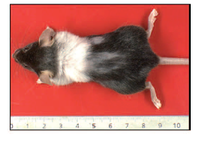
Modern Era of FLASH Research
Favaudon et al, 2014.
LhARA Collaboration Meeting, 2024.
Notes:
Followed by pioneering studies for example by Jolyen studies be Hendry and colleague reporting sparing of radionecrosis in a mouse tail studies.
Innovation trigger for the modern era FLASH research from Vincent Favuadon and MCat Vozenin., seminar study demonstrating

Slide 9
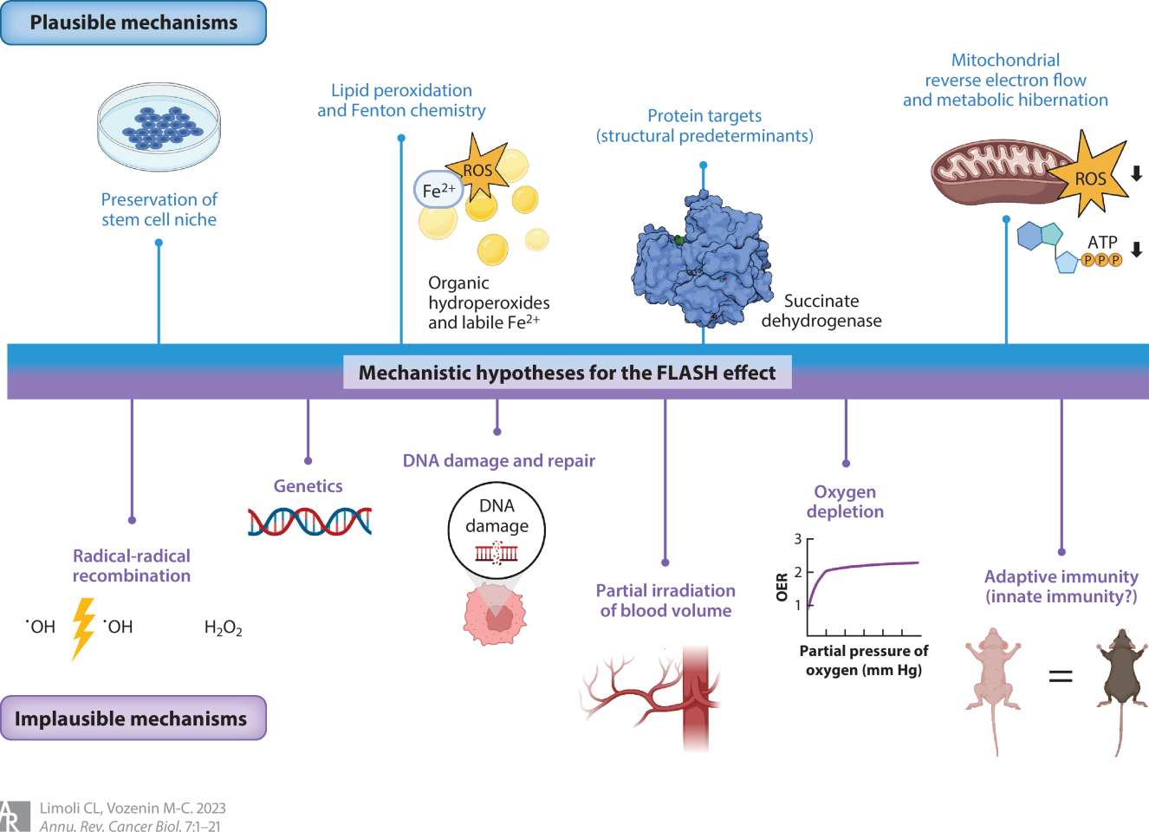
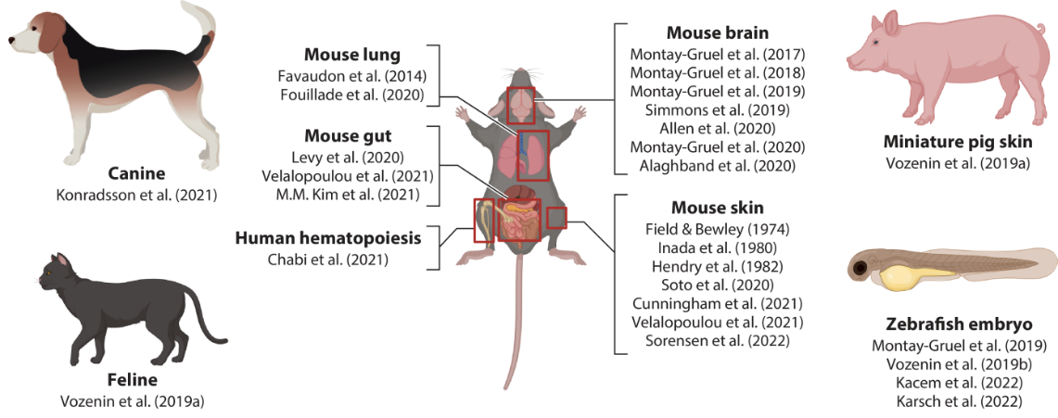
Preclinical models & mechanisms of FLASH sparing
Limoli & Vozenin, 2023.
LhARA Collaboration Meeting, 2024.
Notes:
No consensus on biological mechanism.

Slide 10
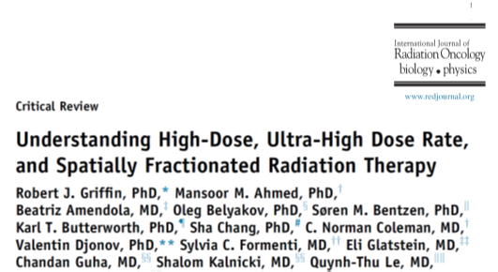
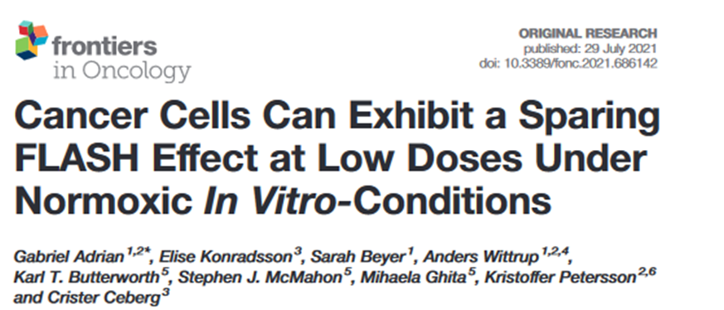

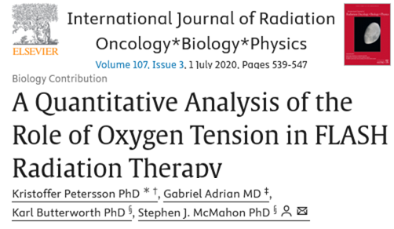

Development of FLASH-RT Research at QUB
2018
2019-2021
2022-
NCI Workshop
FLASH SARRP ERA
UK Preclinical Photon-FLASH Radiotherapy Facility
Collaborations with K Petersson & G Adrain, Lund University.
LhARA Collaboration Meeting, 2024.
Notes:
A FLASH effect appearing at low doses under normoxic conditions for several cell lines in vitro. The magnitude of the FLASH effect differed between the cell lines, suggesting inherited biological susceptibilities for FLASH irradiation.
Models of oxygen kinetics during irradiation were used to develop a time-dependent model of the oxygen enhancement ratio in mammalian cells that incorporates oxygen depletion.

Slide 11
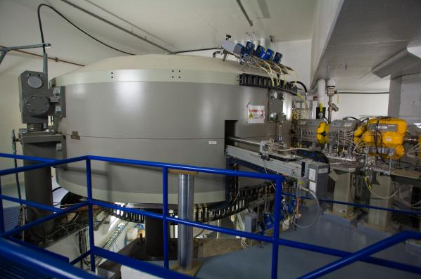
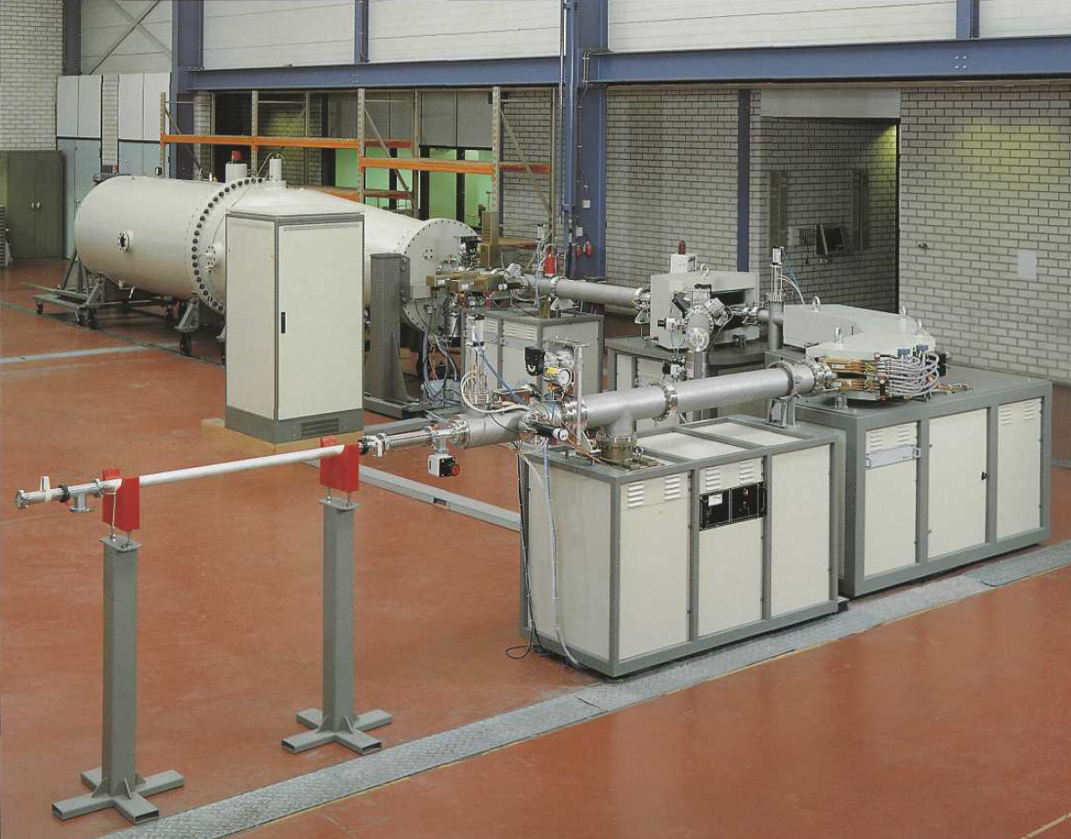
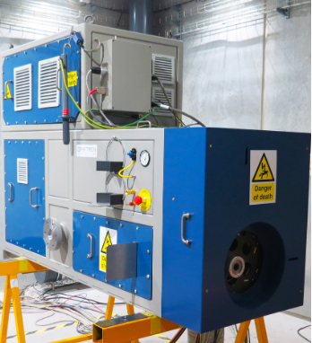
FLASH systems (<2022)
Modified Linac
6 MeV,<150Gy/s
Proton Cyclotron
230 MeV, 40-100 Gy/s
FLASH studies require complex beamlines not initially designed for purpose.
Majority of studies have used H⁺ or e⁻ sources.
  >85% of treatments & radiobiology studies use photons.
  Different macro- and micro-scale energy deposition patterns - Dosimetry & RBE challenges.
  Need for accessible photon sources to leverage pre-existing knowledge.
Singletron Accelerator
4.5 MeV, <1000 Gy/s
Electron Accelerator
5.6 MeV,< 300 Gy/s
6 MeV electrons
150 kV X-ray
LhARA Collaboration Meeting, 2024.
Notes:
Up to this point, very little evidence for the FLASH effect reported using photons, major of studies using e- and p+
Complicates the interpretation of much of the published data on FLASH-RT and its translation to clinical settings
Low penetration
Only a small fraction of the energy fluence of electrons is transferred to photons, with the majority of the energy fluence dissipated through various phenomena, including heat.
This means that a FLASH photon accelerator must have a source capable of producing many more electrons (by a factor of 1000) than is achievable with currently available devices
No compact, labor

Slide 12
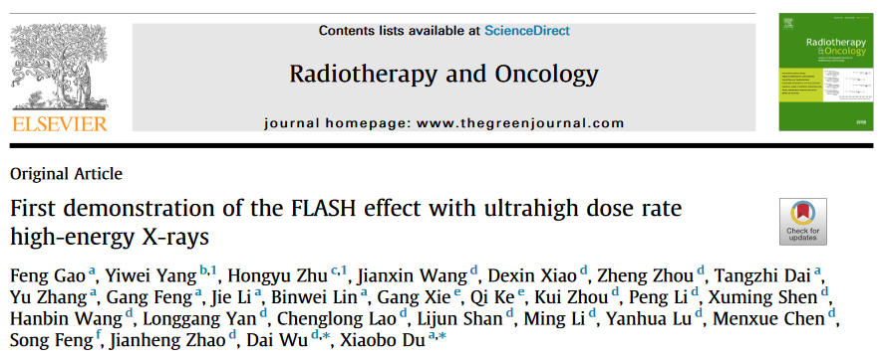
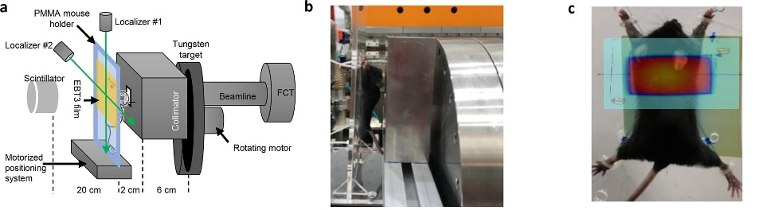
X-ray FLASH
High energy x-rays generated using PARTER (platform for advanced radiotherapy research) at the CTFEL (Chengdu THz Free Electron Laser facility, China).
Superconducting linac, 6–8 MeV electrons with an adjustable mean current of up to 10 mA.
Maximum dose rate of 1000 Gy/s.
CONV doses using a 6 MV beam Elekta Precise linac.
Gao et al, 2022.
LhARA Collaboration Meeting, 2024.

Slide 13
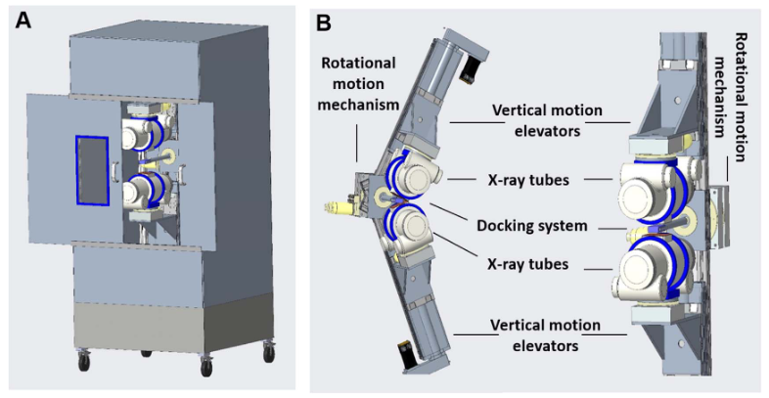
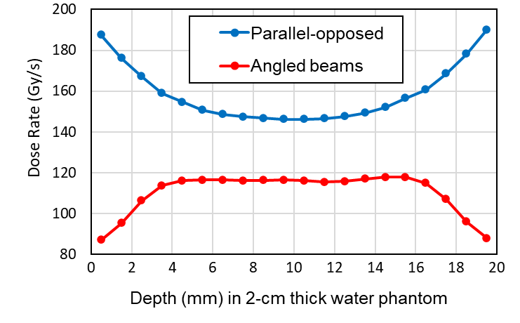

FLASH SARRP
First commercial photon FLASH system for preclinical studies.
Developed by JHU and commercialised by XStrahl.
Opposing-pair rotating anode x-ray tubes provide > 100 Gy/s over 2 cm thick medium.
Key enabling technology for FLASH-RT research.
  150 kVp x-ray sources at 100 kW.
  Vertical motion of tubes for SSD adjustment.
  Rotational motion to reduce high entrance/exit dose.
  Mirrored beams to compensate heel effects.
Rezaee et al 2021, Phys. Med. Biol. 66 095006 (2021)
LhARA Collaboration Meeting, 2024.
Notes:
The target rotates rapidly during X-ray generation, allowing for more efficient heat dissipation and increased X-ray output.

Slide 14
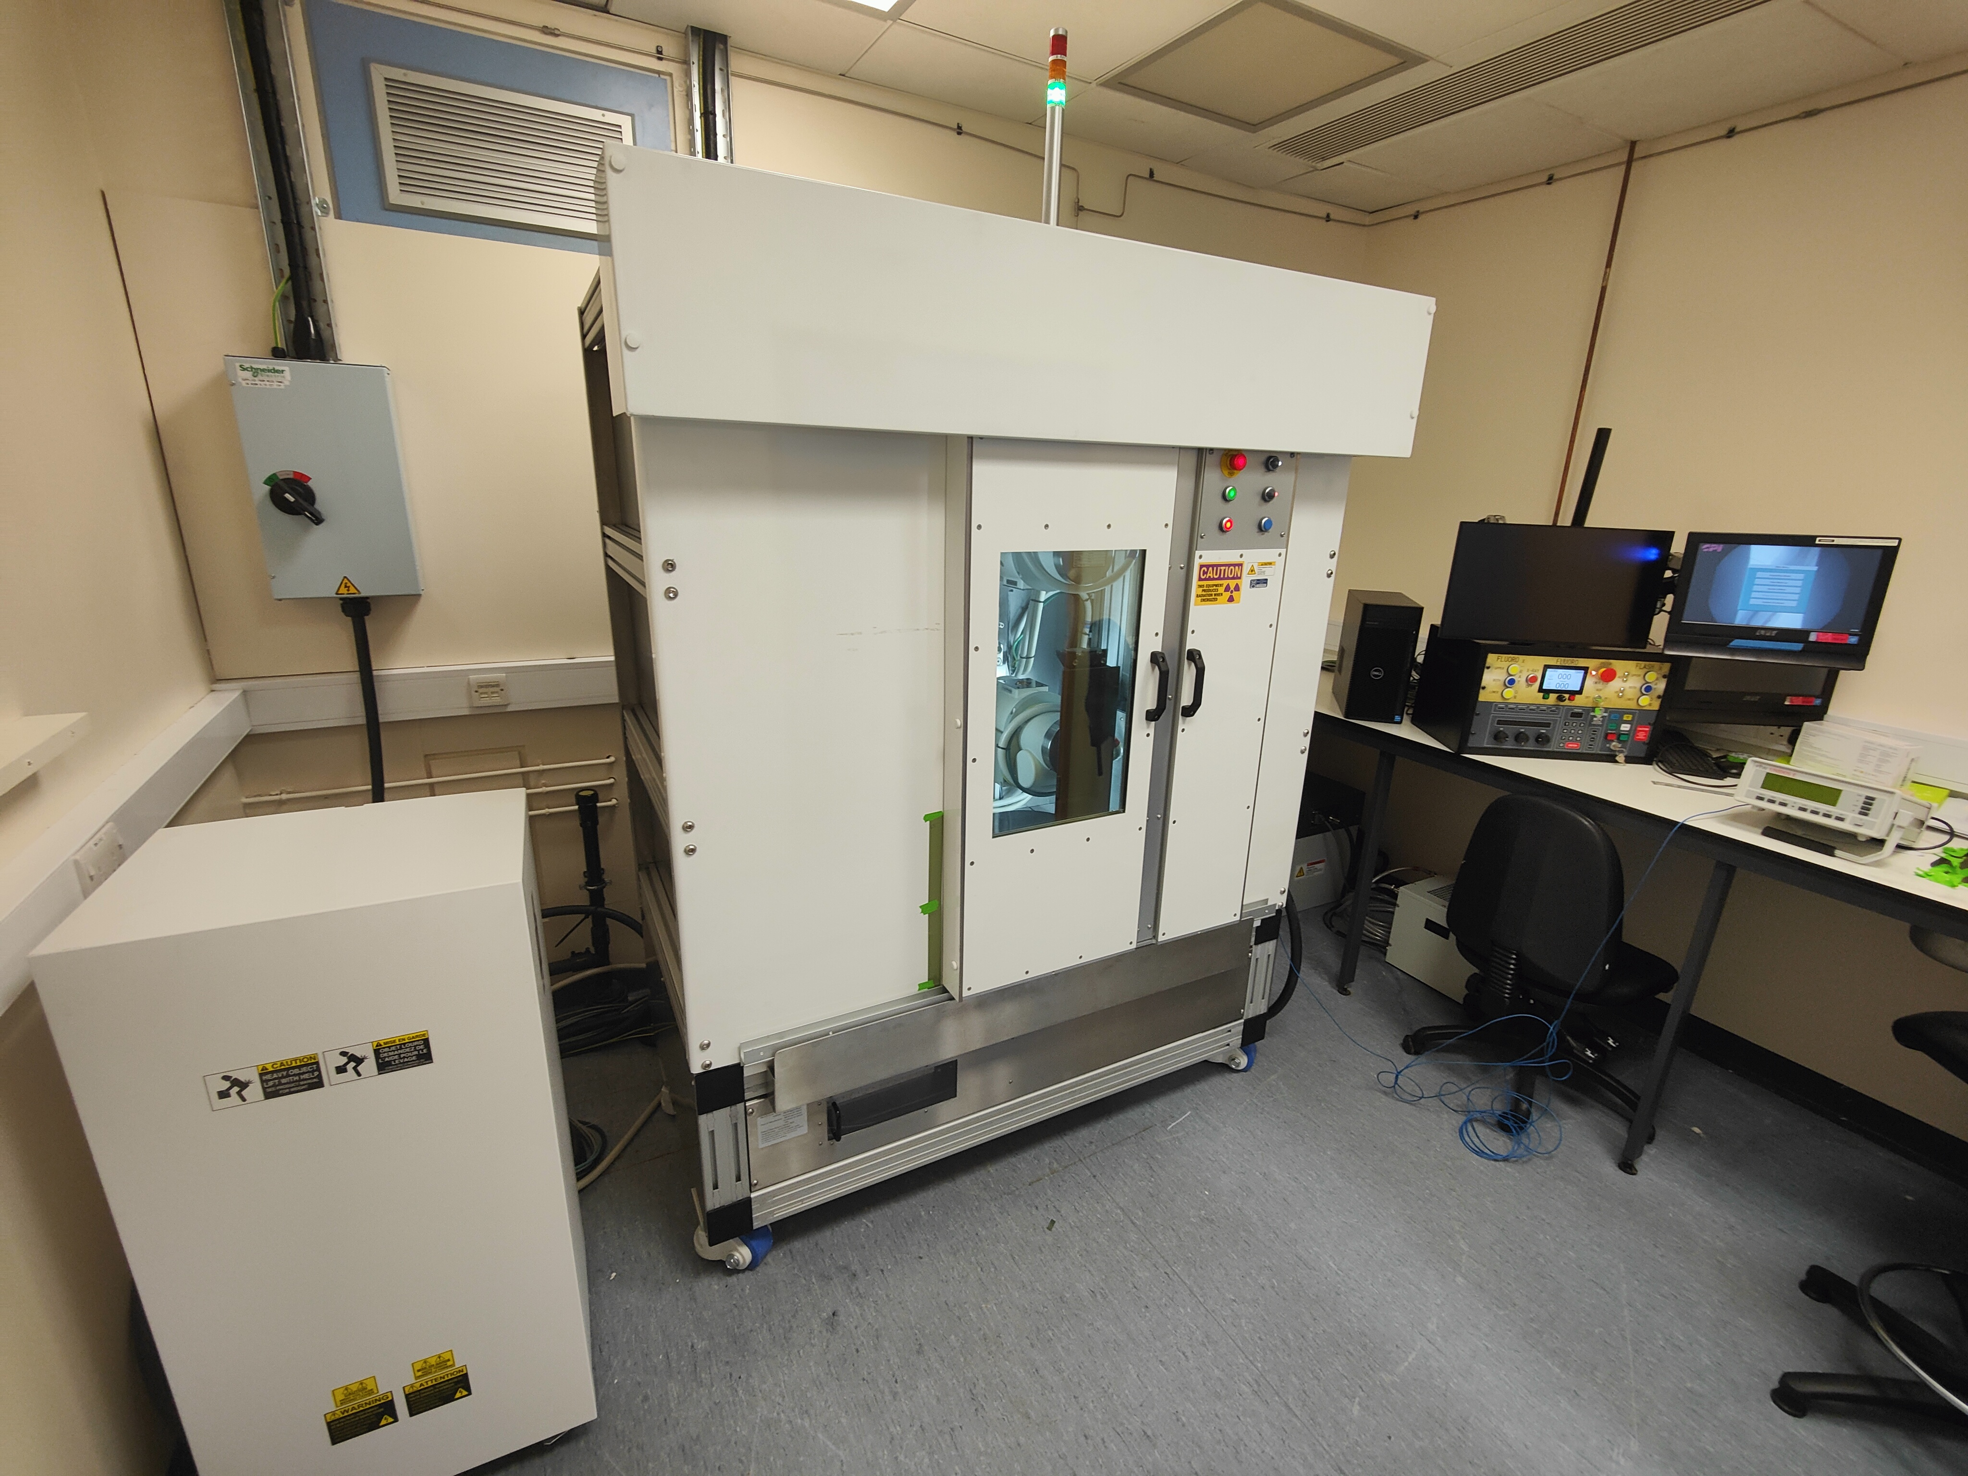
FLASH SARRP
LhARA Collaboration Meeting, 2024.

Slide 15
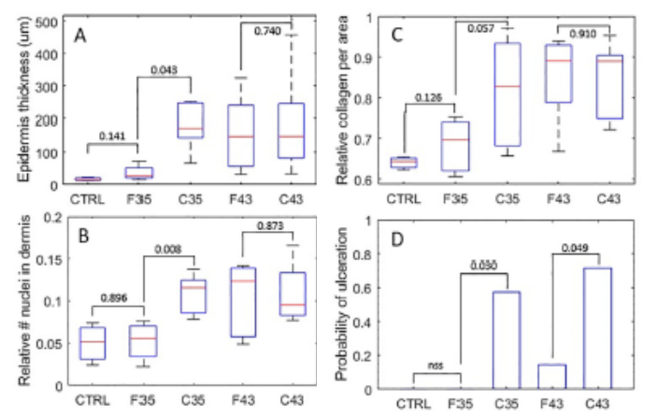
First implementation of the FLASH SARRP
Miles et al, Int J Radiat Oncol Biol Phys, (2023).
LhARA Collaboration Meeting, 2024.
Notes:
A custom 3-dimensionally printed immobilization and positioning tool was developed for reproducible irradiation of a mouse hind limb.

Slide 16
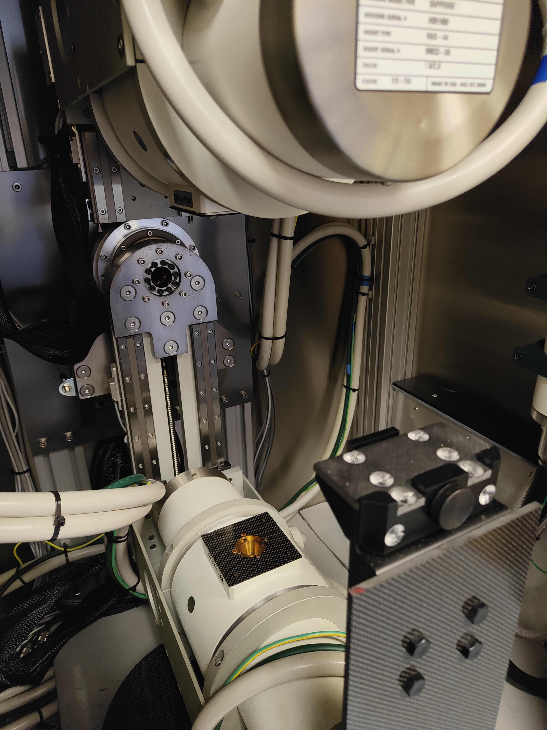
Commissioning & implementation challenges
Alignment and firing of 2 tubes.
Defining mechanical and radiation isocentres.
Filtration, dosimetry & QA
Tube conditioning & warmup.
Stage control & Mouse positioning.
Target localisation and CBCT integration.
Integration of TPS.
Define workflows for different targets.
LhARA Collaboration Meeting, 2024.

Slide 17
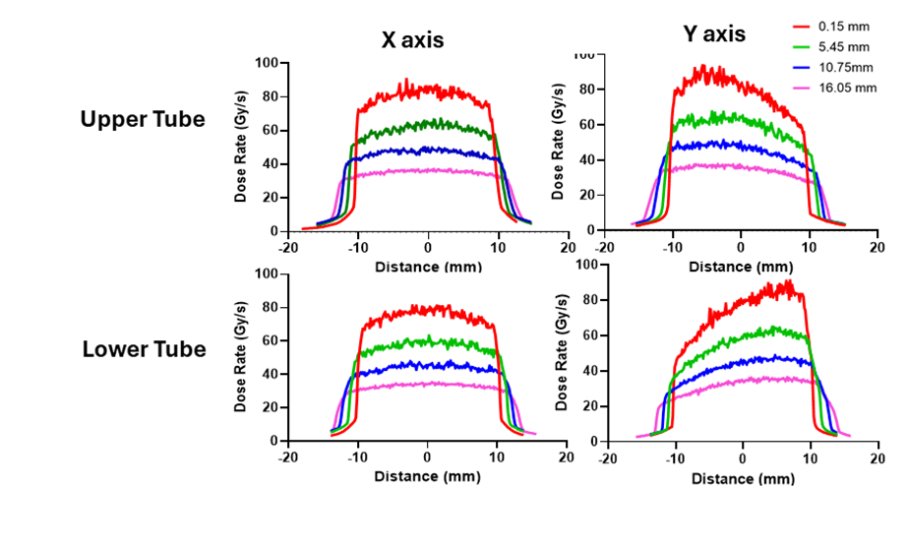
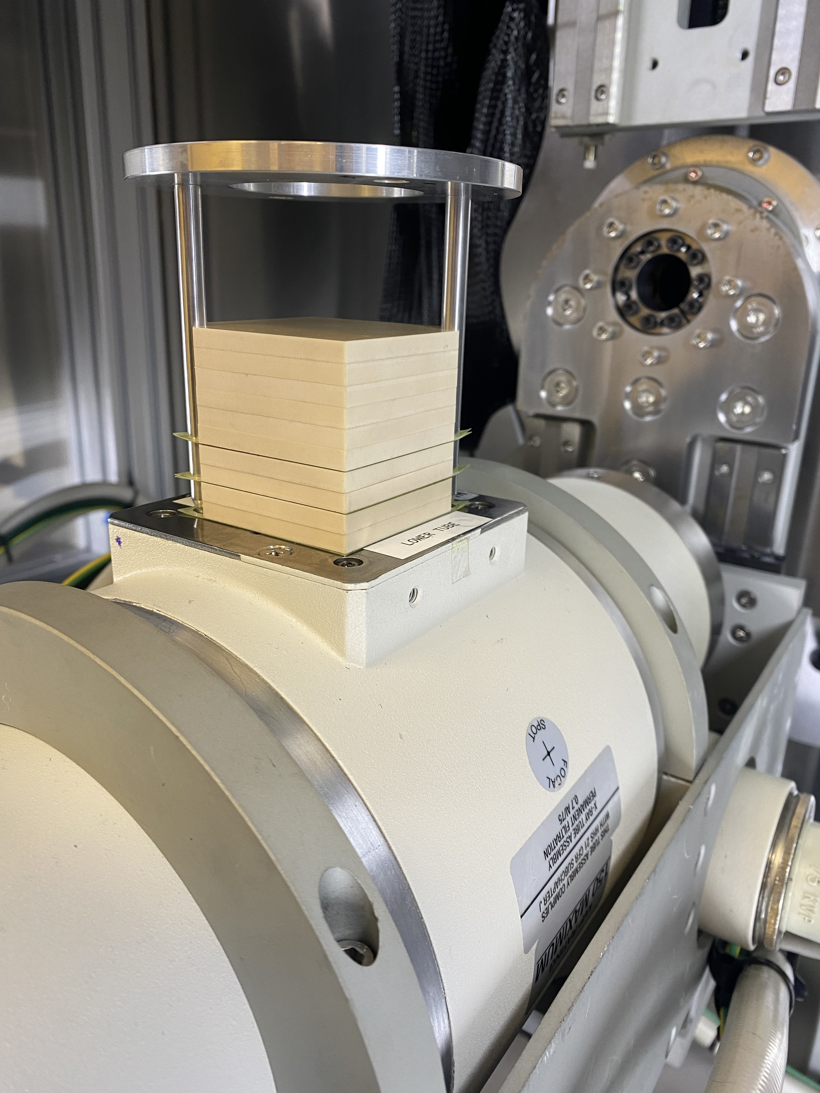
Beamline characterisation
Depth dose measurements & field uniformity using SARRP phantom & EBT3.
Distances measured from flange exit.
LhARA Collaboration Meeting, 2024.
Notes:
-dose rates > 60 Gy sec at 5 mm depth
-upper and lower tubes have similar outputs
-Heel effects are observed for single tube orientations (top, middle), but combining two tubes at equal distances gives a relatively uniform dose distribution (bottom).

Slide 18
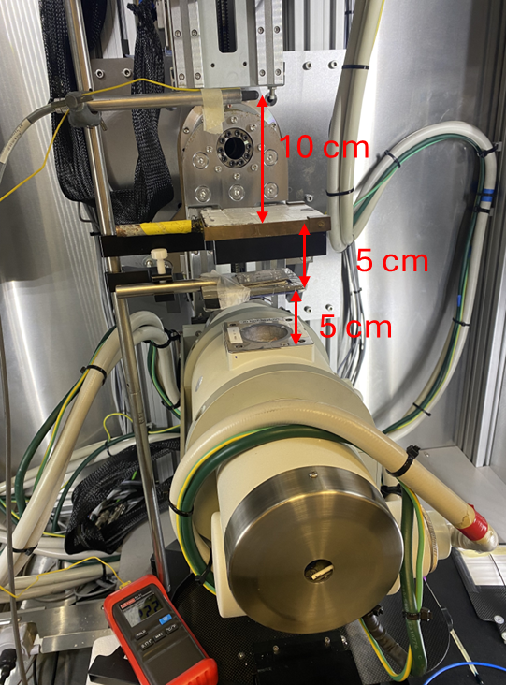
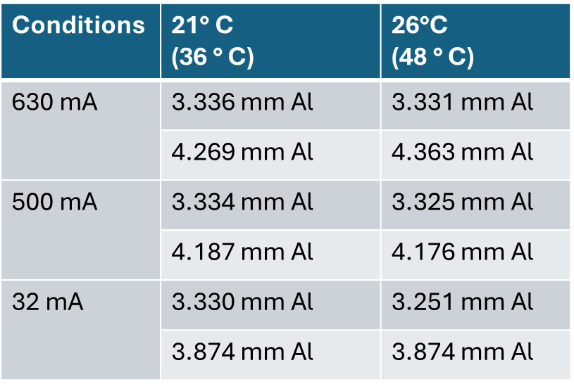
Beamline characterisation
Ionisation Chamber outputs.
HVL measurements -150 kV (Anna Subiel, NPL).
LhARA Collaboration Meeting, 2024.
Notes:
-correction factors for flash dose rates
-reliable HVL measurements at different currents and temperatures.
Technical characteristics, development of the program

Slide 19



QUB FLASH-RT Program
Aim: To support the safe & robust translation of photon FLASH-RT.
Establish the technical infrastructure of a UK photon FLASH-RT Facility (partnered with ICR).
Develop the evidence base for photon FLASH.
  Define key physical & radiobiological variables (Dose, dose-rate, beam structure, fx, hypoxia).
  Develop a mechanistic understanding of the photon FLASH effect (genetic, epigenetic, metabolic & immune effects).
Enable collaborative, cross-centre studies including other FLASH modalities.
Support clinical translation of FLASH towards UK led trials.
LhARA Collaboration Meeting, 2024.

Slide 20
Program Development
2024
2025
Spatio-temporal dependenc of radiotherapy induced cardiac toxicity MRC Project: 1/10/2021 - 30/9/24
Investigating the impact of photon FLASH in primary glioblastoma
Brainwaves NI Studentship: 1/10/23 - 30/9/26
QUB Agility fund
Investigating the basis of photon FLASH in tumours & normal tissues. MRC Project: 1/6/24 – 31/5/27
Beamline validation & biological characterisation of the FLASH-SARRP. MRC CAST Studentship 1/10/24 - 30/9/27
ProFLASH - photon FLASH in prostate cancer.
Prostate Cancer UK. 1/2/24 -31/7/26
LhARA Collaboration Meeting, 2024.

Slide 21
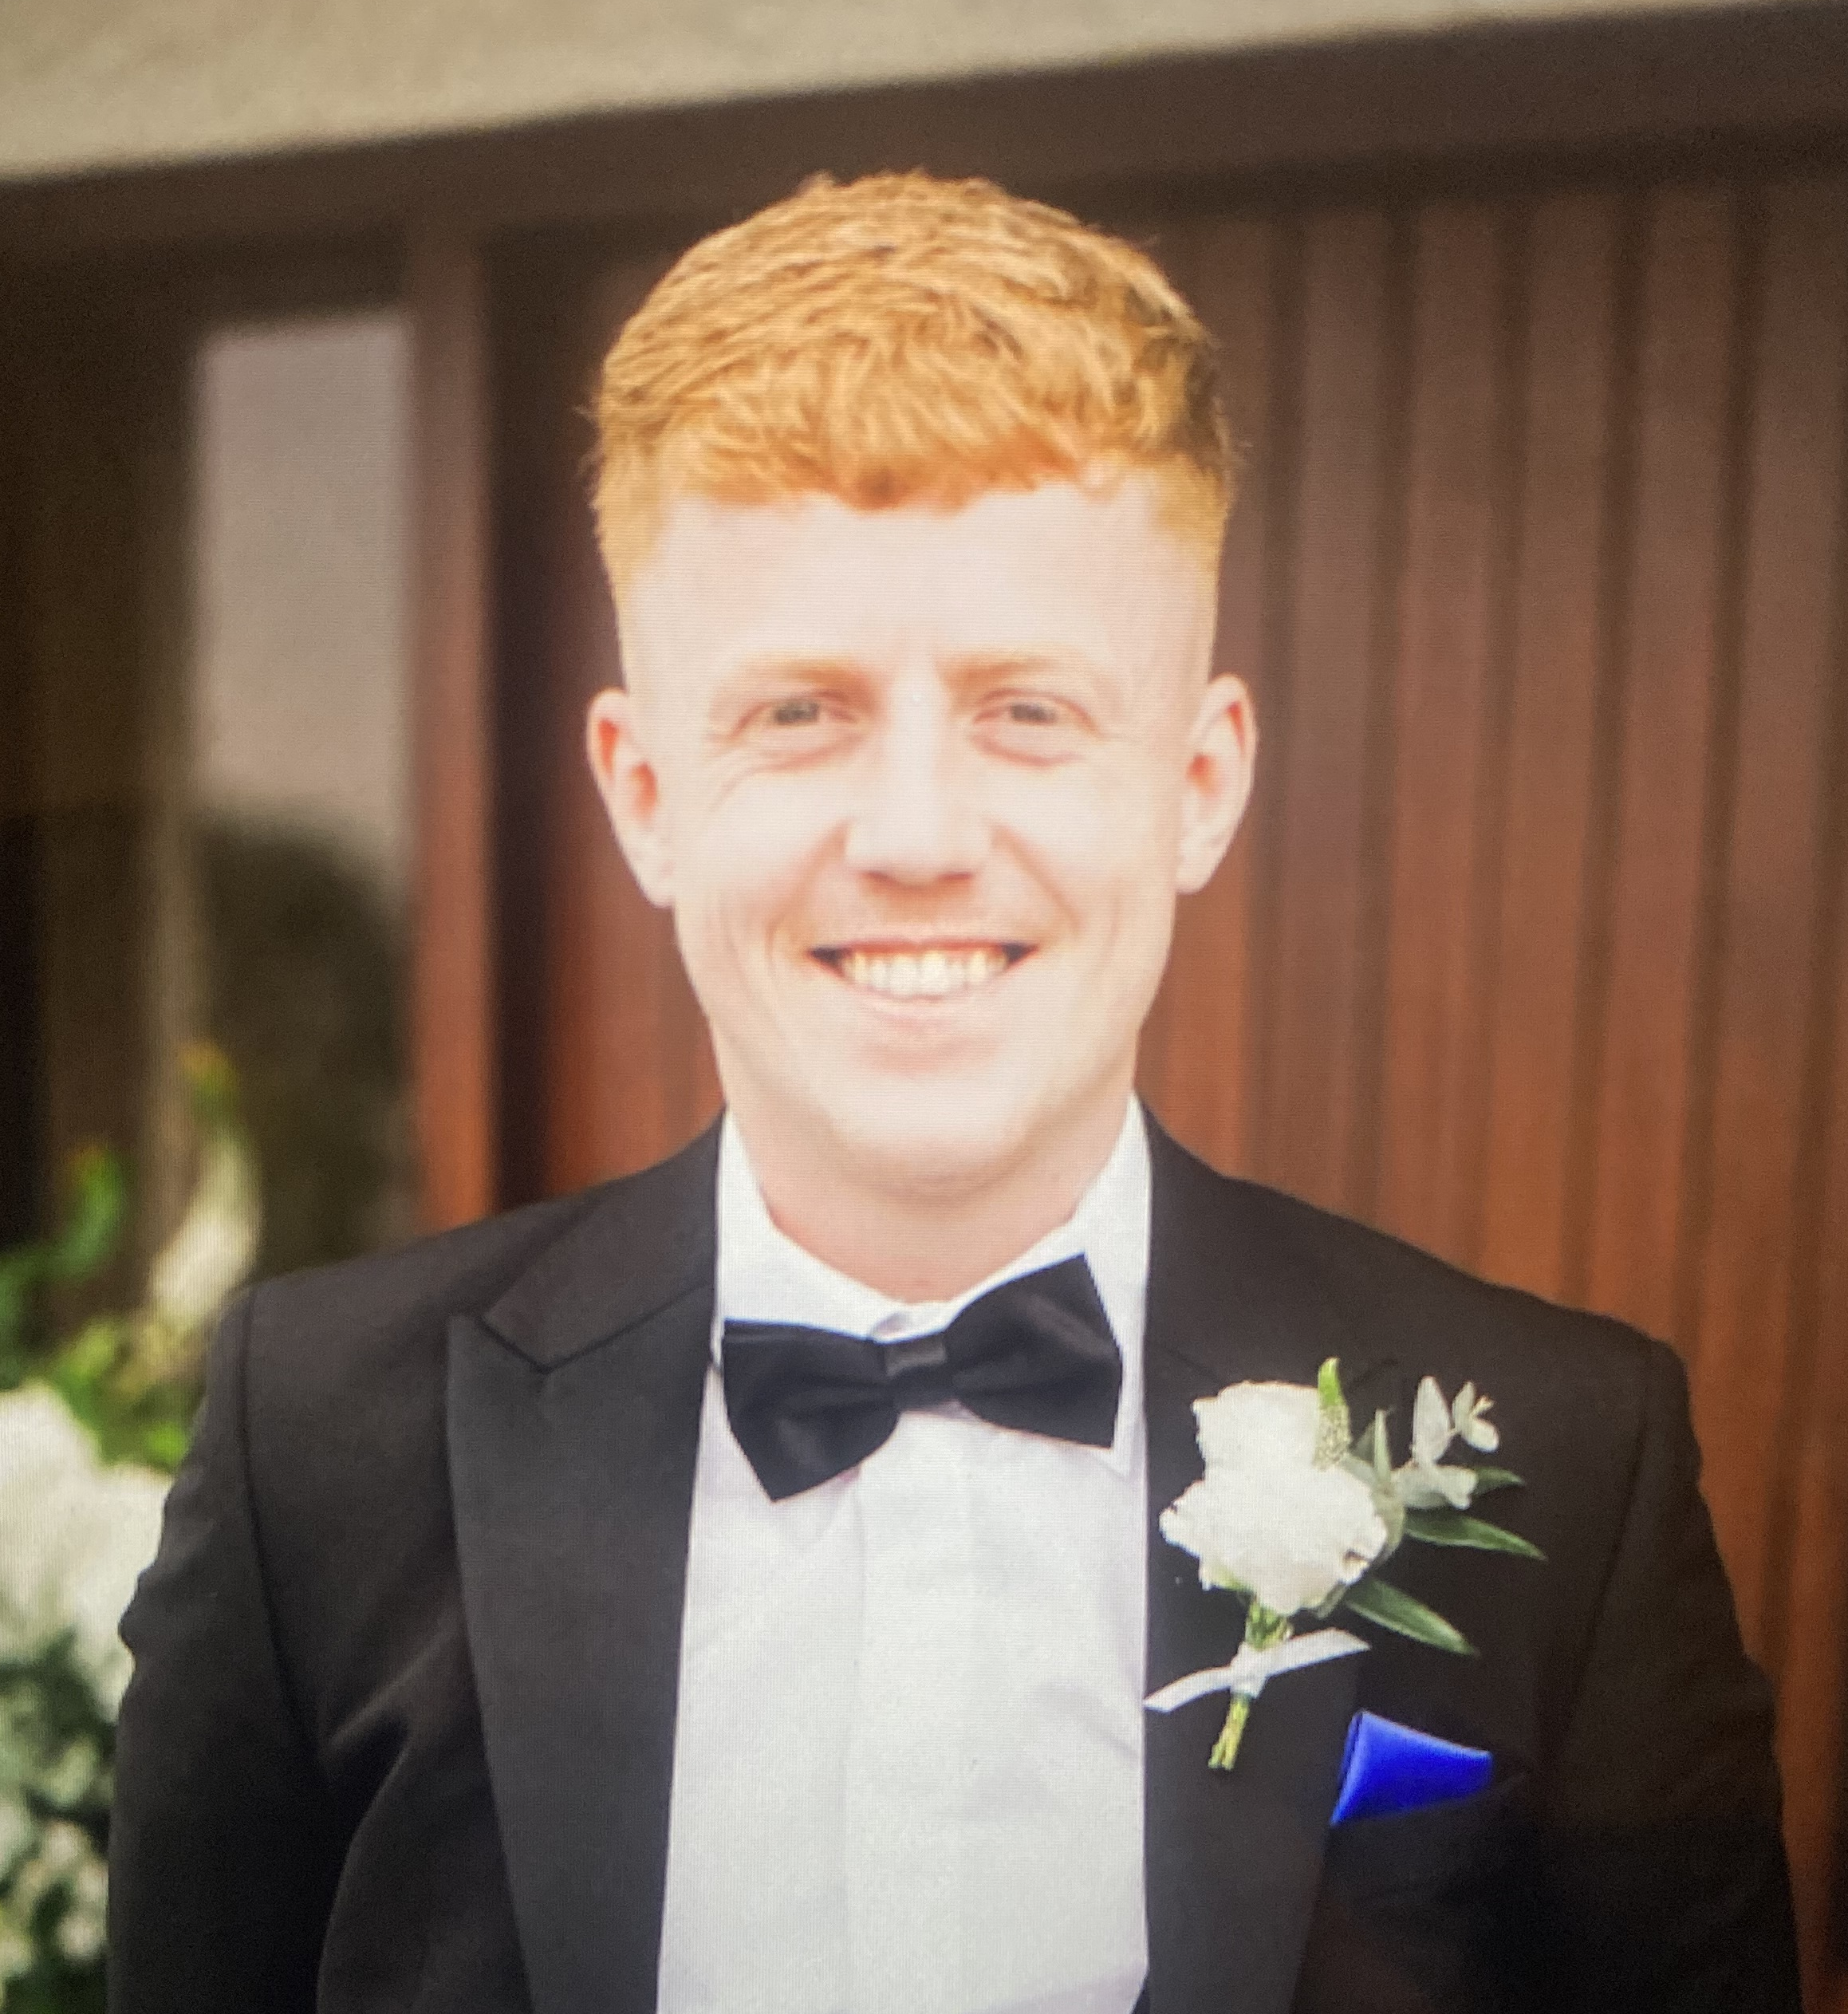

FLASH in primary GBM
Investigating the impact of photon FLASH radiotherapy on therapeutic index in primary glioblastoma (October 2023-26).
Aim 1: Development of in vitro system to investigate responses to photon FLASH-RT.
Aim 2: Assessment of GBM tumour responses to photon FLASH-RT.
Aim 3: Development of an in vivo model of radiation-induced normal tissue injury.
Malachy McIvor
LhARA Collaboration Meeting, 2024.

Slide 22
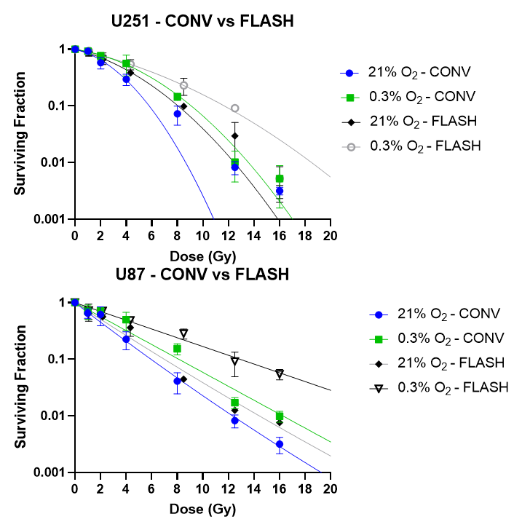
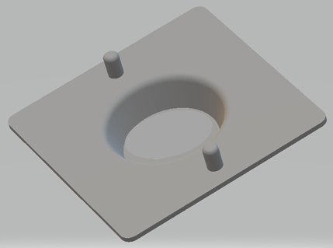
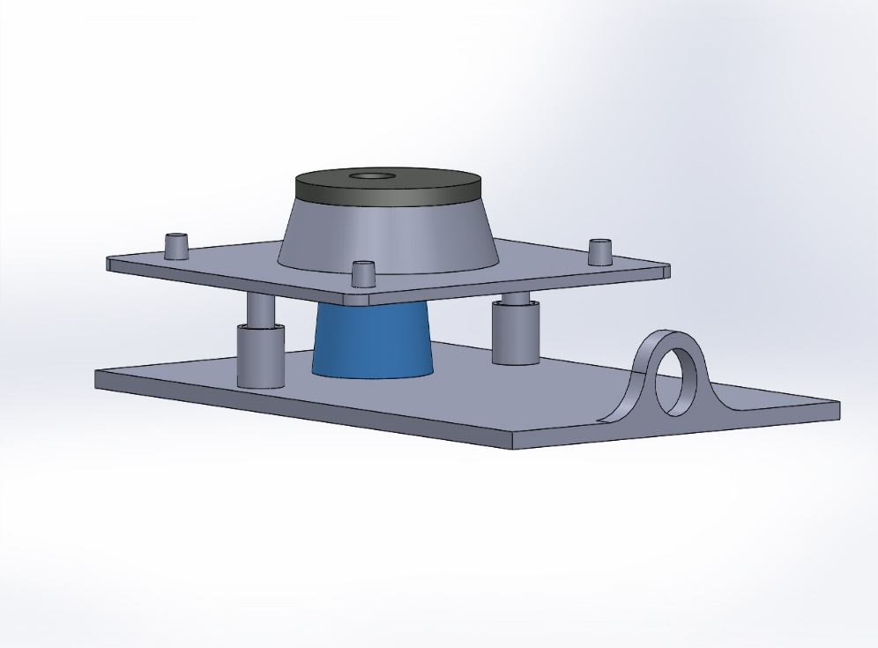
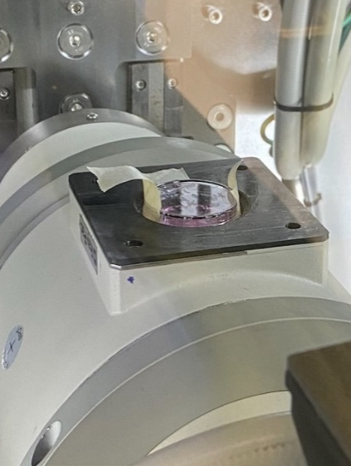
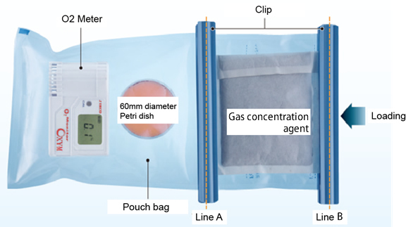
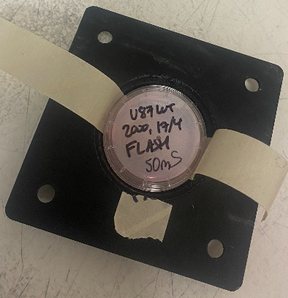
In vitro FLASH studies in GBM cell models
Assembly
Inverted JHU flange adaptor & collimator.
Surface 100% PLA, infill 40%/60% PLA/air.
Lower tube, dose rate = 86 Gy/s
Adaptable for hypoxic in vitro irradiations – nBIONIX Cell culture kit.
LhARA Collaboration Meeting, 2024.

Slide 23


Photon FLASH in tumours & NTs
WP1: Characterising the photon FLASH effect in normal tissues.
Lung, skin, gut & radiation-induced lymphopenia.
WP2: Characterising the photon FLASH effect in lung tumour models.
Subcutaneous lung tumour models (LL3 & KP).
Orthotopic lung tumour model.
KP inducible tumour model.
WP3: Defining the biological mechanisms of tumour and normal tissue responses to FLASH-RT
Integration of gene expression, metabolomics and immune-cell phenotypes
Preclinical radiomics.
Quantitative radiobiological modelling.
Mihaela Ghita
Kathryn Brown
LhARA Collaboration Meeting, 2024.
Notes:
Started June 2024.

Slide 24
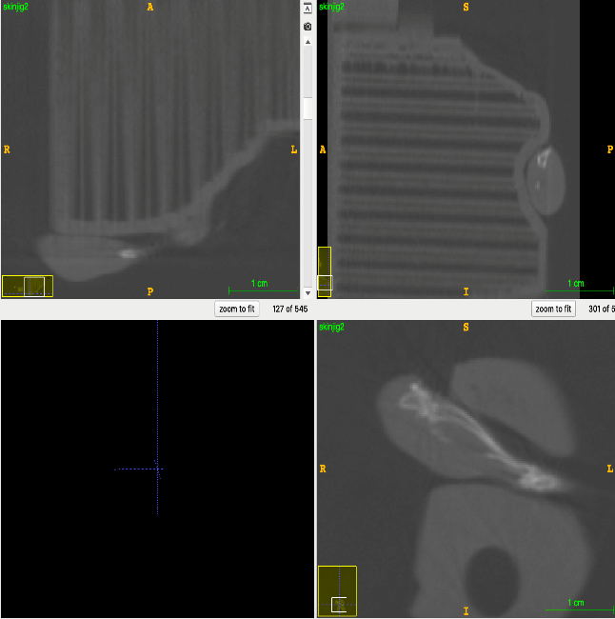
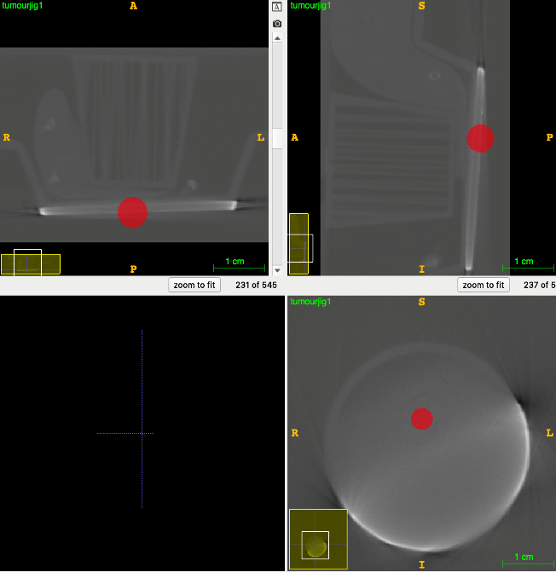
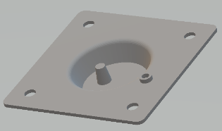
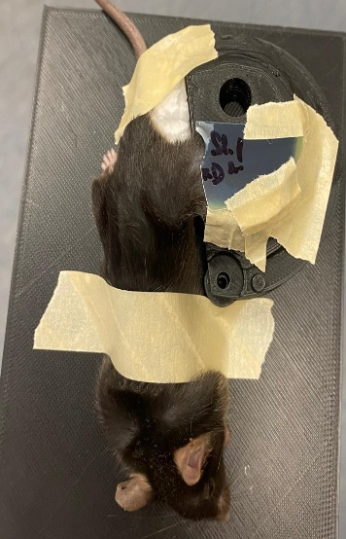
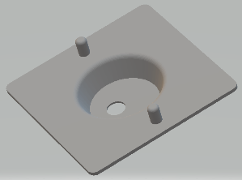
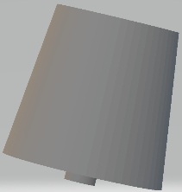
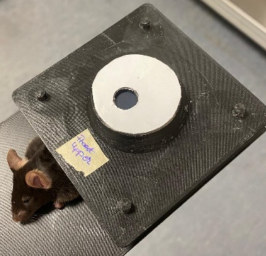
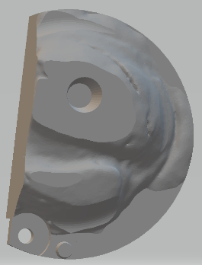
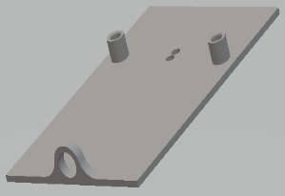
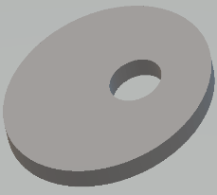
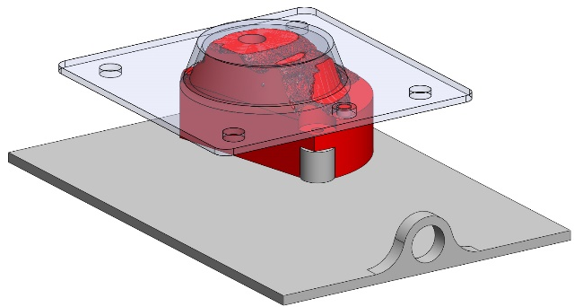

Single tube setups – skin & subQ tumour
Assembly
JHU flange adaptor & leg holder.
Upper tube, dose rate = 87 Gy/s.
Assembly
JHU flange adaptor, pedestal, tumour collimator & bed.
LhARA Collaboration Meeting, 2024.

Slide 25
What have we learnt so far?
FLASH-SARRP is a complex, early-stage system.
Working to establish best practices for tube conditioning & warmup – narrow operational window.
Potential limitations of the tubes for comparative studies at conventional dose-rates – may have to use conventional SARRP.
Non-trivial hardware & software upgrades are required.
Method of anesthesia is critical.
LhARA Collaboration Meeting, 2024.
Notes:
required to reach full potential

Slide 26
Summary
UKRI funded FLASH research program at dose rates < 200 Gy sec, enabled by the FLASH-SARRP.
QUB facility operational since March 2024.
  Dosimetry and beamline characterisation.
  Initiated in vivo studies June 2024.
  Initial parameter mapping – dose, dose rate thresholds, beam structure, fractionation.
Preclinical models linking tissue function & molecular mechanisms.
LhARA Collaboration Meeting, 2024.
Notes:
Hype cycle for flash-RT
Use the system to expand the evidence base for photon flash

Slide 27
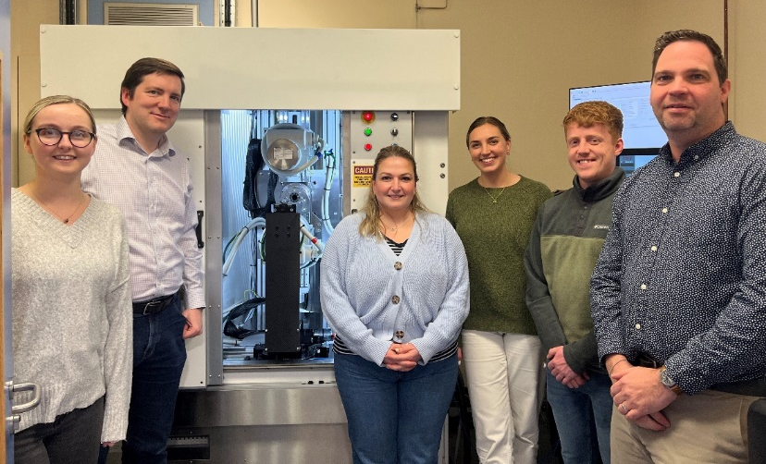




Acknowledgements
PGJCCR, QUB
Kevin Prise
Stephen McMahon
Mihaela Ghita
Kathryn Brown
Brianna Kerr
Malachy McIvor
Gerard Walls
Clinical Physics, NICC
Alan Hounsell
Conor McGarry
Owen McLaughlin
Johns Hopkins University
John Wong
Mohammed Rezaee
Daniel Sforza
National Physical Laboratory
Giuseppe Schettino
Anna Subiel
University of Pennsylvania
Yiannis Verginadis
Oxford University
Kristoffer Petersson
Lund University
Gabriel Adrian
LhARA Collaboration Meeting, 2024.

Slide 29
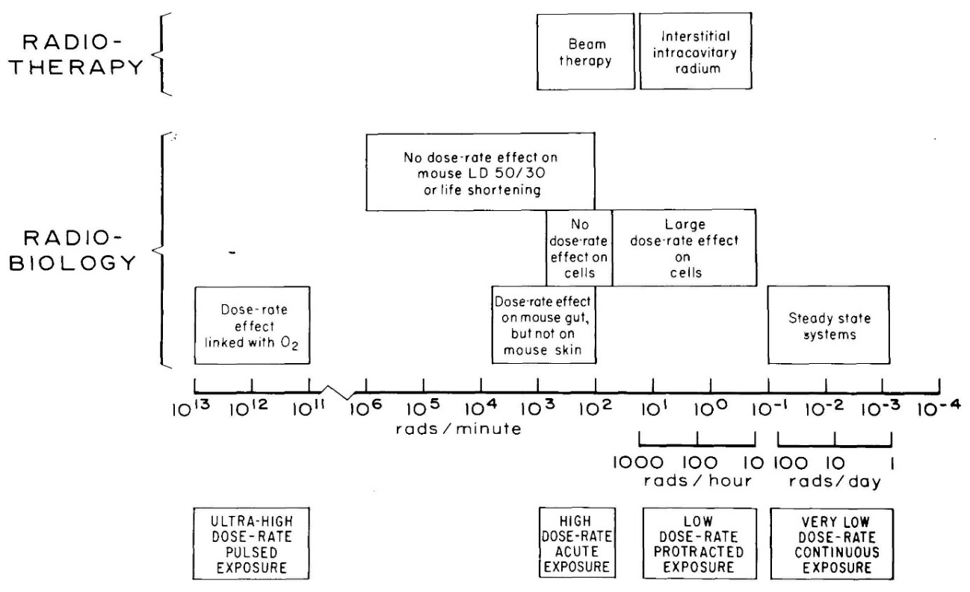
The dose-rate spectrum
‘At ultra-high dose-rates (pulses of micro or nanoseconds) a clear dose-rate effect has been demonstrated for bacteria, but is less certain for mammalian cells; these dose rates have no certain application in radiotherapy at the present time’.
‘These results have been explained in terms of local oxygen depletion: the rapid deposition of radiant energy causes oxygen to be consumed too quickly for diffusion to maintain an adequate level of Oxygenation’.
Hall E, BJR 1972.
LhARA Collaboration Meeting, 2024.
Notes:
Pres

Slide 30
Preclinical models & mechanisms of FLASH sparing
LhARA Collaboration Meeting, 2024.

Slide 31
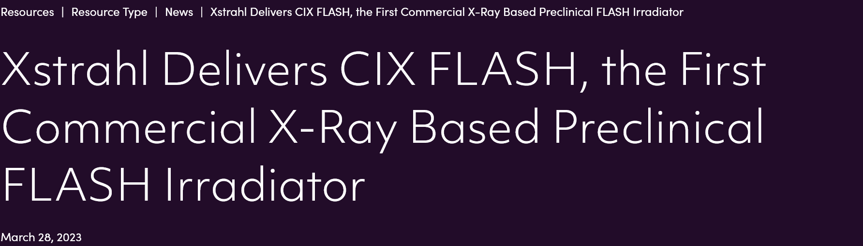
FLASH SARRP
SARRP FLASH early adopter supported by UKRI MRC October 2022.
UK delivery April & System install May 2023.
High priority – Beamline validation, tumour & NT responses to photon FLASH.
Medium-term – Biophysical mechanisms of FLASH-RT.
Long-term – Integrating the FLASH-SARRP across QUB radiobiology research.
LhARA Collaboration Meeting, 2024.

