Slide 1
LhARA FFA magnet design
02/09/24
Ta-Jen Kuo
Supervisor: Jaroslaw Pasternak, Jean-Baptiste Lagrange
Imperial College London, STFC

Slide 2
LhARA FFA
Variable input energy by changing value of magnetic field
(multiple ions are possible)
Variable extraction energy at fixed geometry
Parameters at highest energy (15-127MeV)
Number of Cells | 10
K index | 5.23
Spiral angle (degrees) | 53.9
R₀ (m) | 3.477
B₀ (T) | 1.405
Packing factor | 0.34

Slide 3
Magnetic field required
The goal is to have constant tune during acceleration
Arrange the integrated field with the ’Scaling Law’: $BL={BL}_{0} {(\frac{r}{r_{0}})}^{k+1}$
$$BL=r\int{B dθ }$$
where ${BL}_{0}$ is the integrated field at the reference radius 𝑟₀, 𝑘 the integrated field index defined as:
$$k_{int}= \frac{r}{\int{B} dθ}\frac{∂\int{B dθ}}{∂r}$$

Slide 4
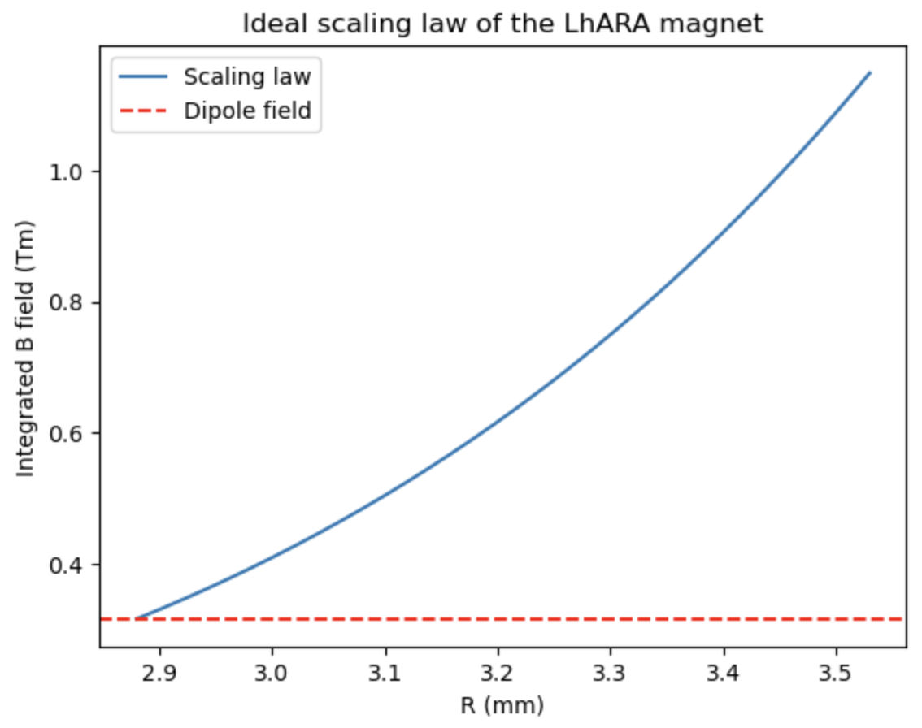
How is the scaling law achieved
A main coil provides the dipole field
Trim coils cross the pole face at constant radii and return around the side of the pole.
Gradient of the magnetic field achieved by adjusting the set of currents through the coils
Main coil
Trim coils
$$↑$$
$$↑$$
$$↑$$
(Shown without the clamps and yoke in this image)

Slide 5
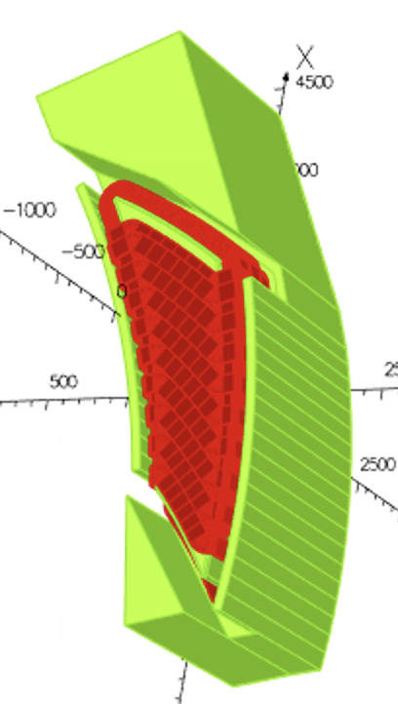
Modelling in OPERA-3D
H type magnet with inner and outer return yokes
Field clamps, connected to the pole, following the spiral equation to control the fringe field
Coils in red wrapped around the pole
Outer return yoke
Field clamp
Field clamp
Inner return yoke

Slide 6
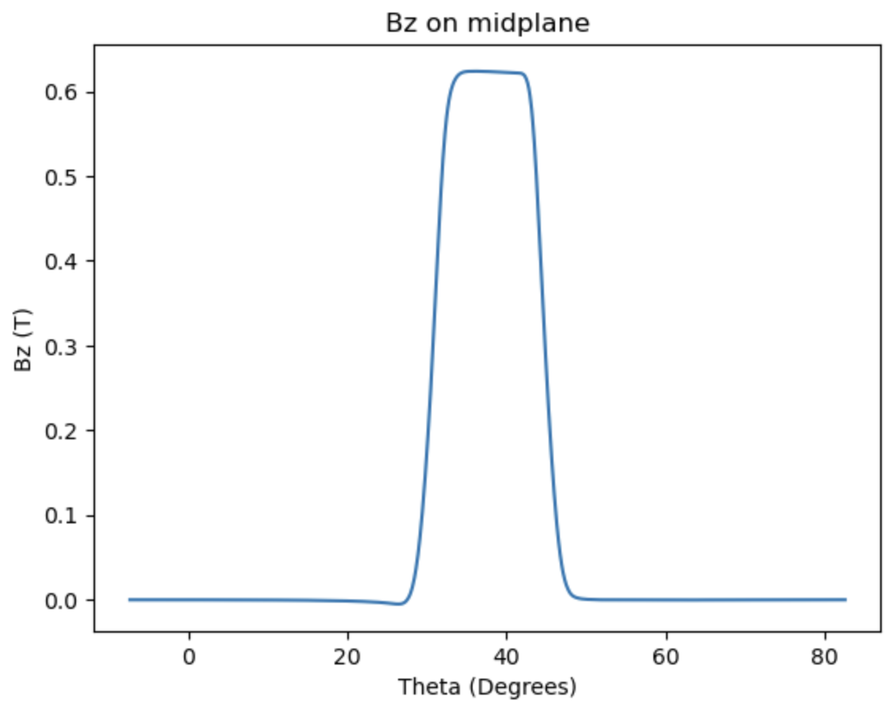
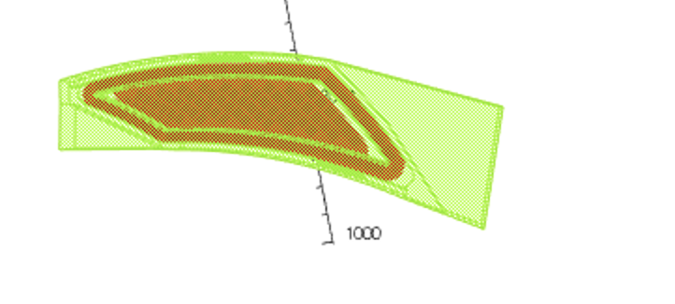
Bz on the midplane with constant radius varying theta
$$BL=r\int{B dθ }$$
In the 3D Opera model, sweeping through theta obtain Bz on midplane at a particular radius
Repeat of different radius to obtain integrated B field at different radii

Slide 7
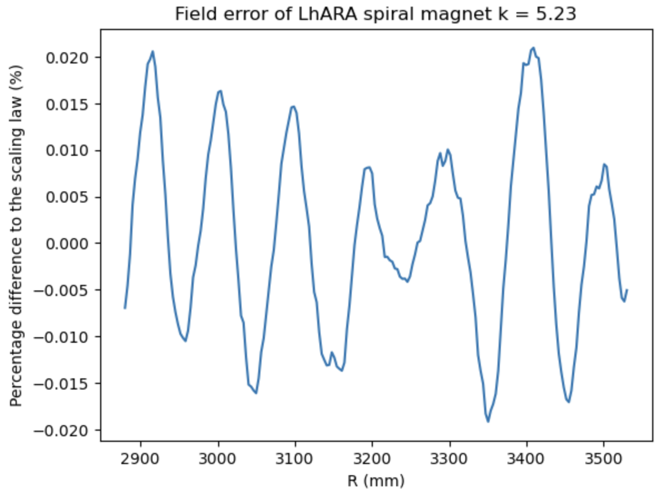
Field error from optimizing integrated B field
$$BL={BL}_{0} {(\frac{r}{r_{0}})}^{k+1}$$
Central scenario: BL₀ : 1.44 Tm , r₀ :3.477m, k : 5.23 (15 – 127 MeV)
Oscillation in residuals due to
The discretization of trim coils

Slide 8
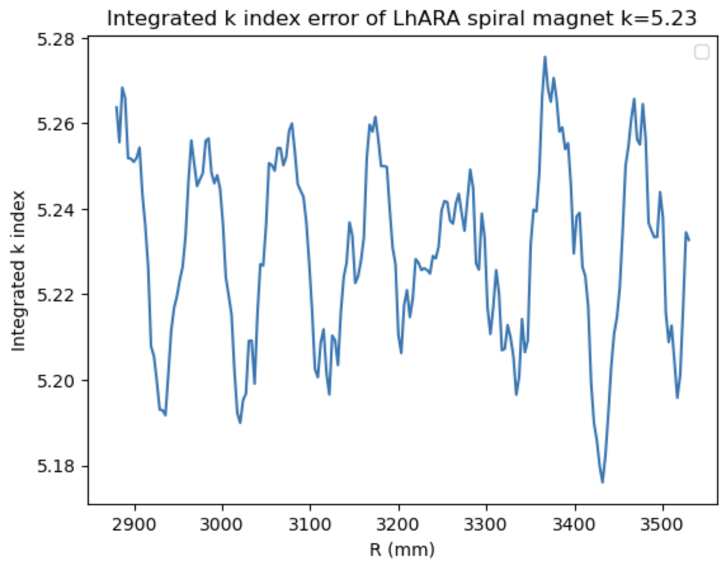
Integrated k index after optimisation
$$k_{int}= \frac{r}{\int{B} dθ}\frac{∂\int{B dθ}}{∂r}$$

Slide 9
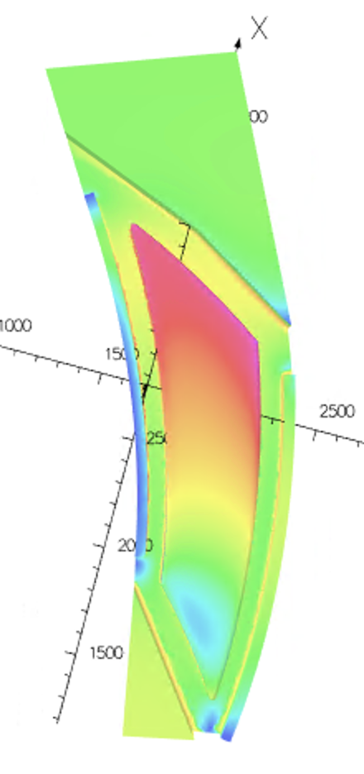
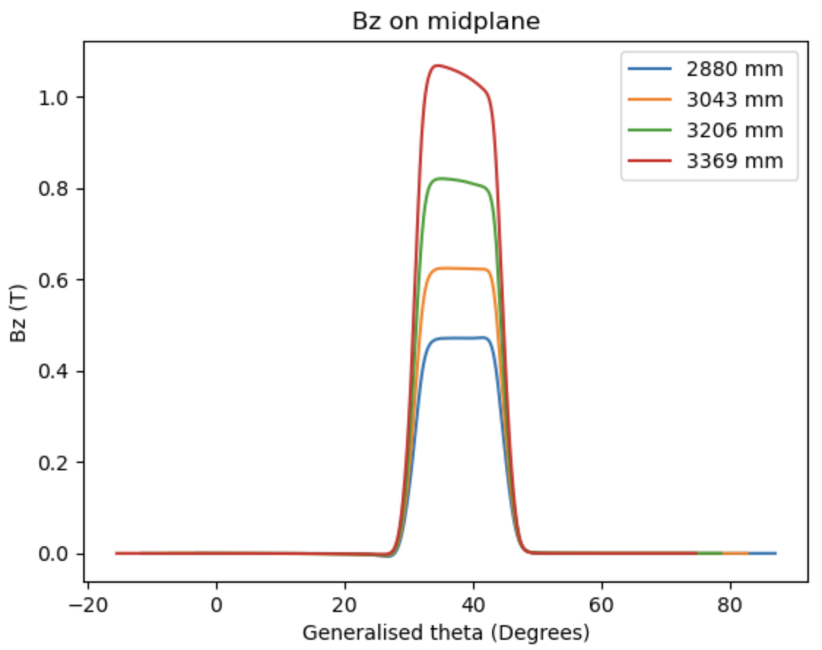
Bz on the midplane with constant radius varying theta
Part of the pole reaching 2.66T
Flat top of field distorted at higher radii due to
Saturation and will have an impact to the tune

Slide 10
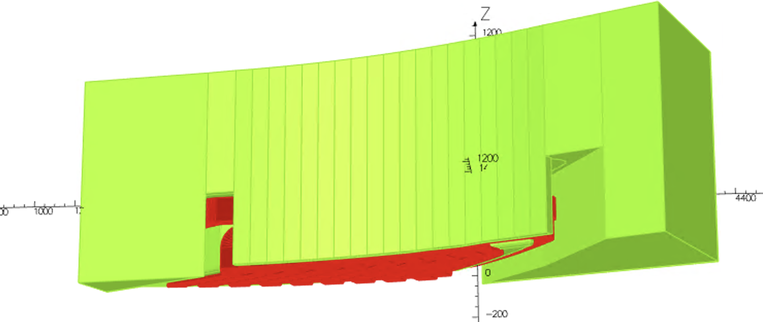
The vertical tune can be further controlled by adjusting the
Vertical aperture of the clamps
Aperture of clamp increases at larger radii

Slide 11
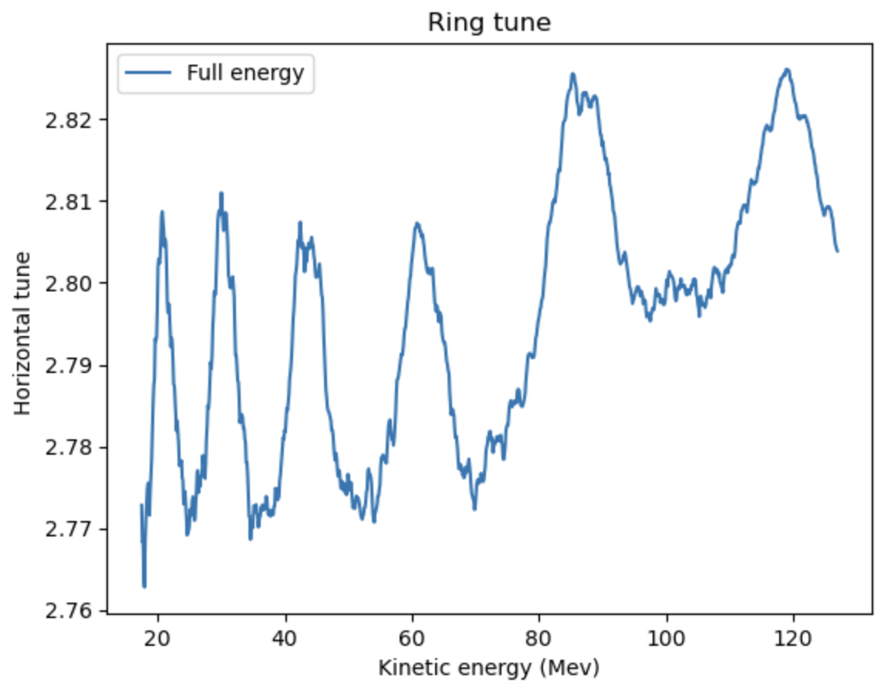
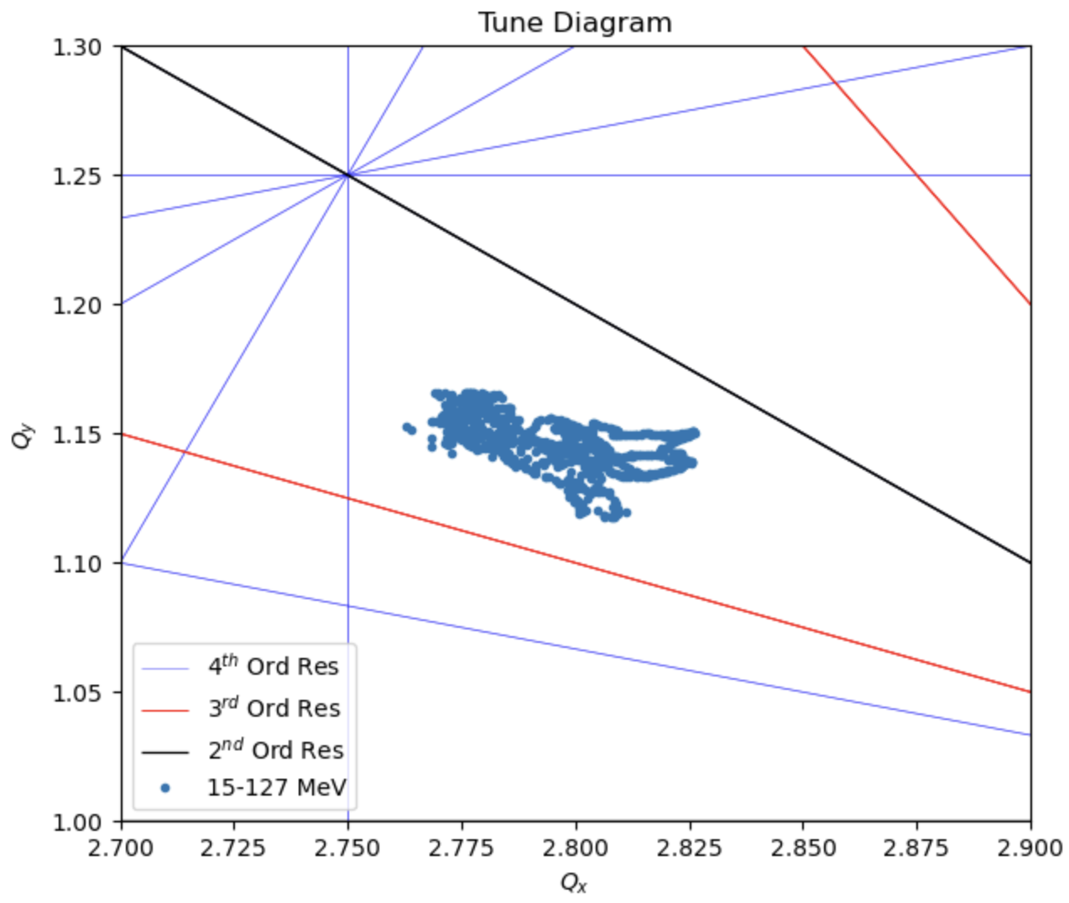
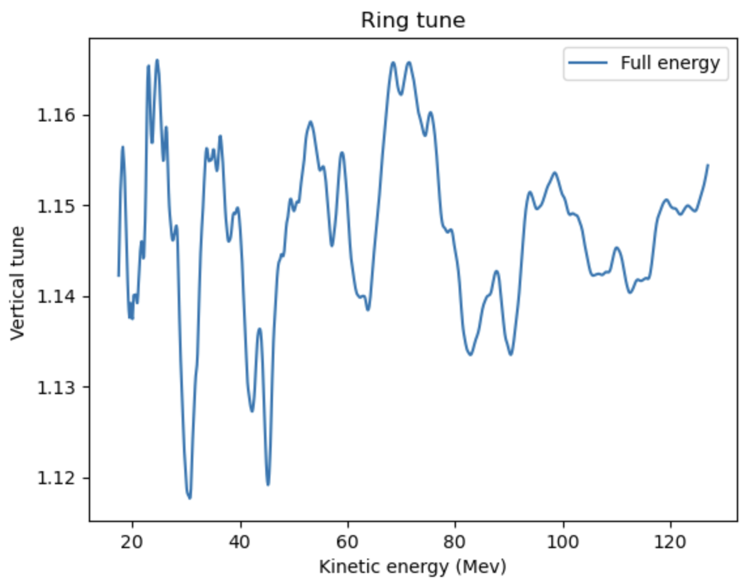
Tune from optimizing integrated B field

Slide 12
Power Consumption for magnet
Trim |  |  |  | Main
Coil width | 0.01 | m |  | Coil width | 0.075 | m
Coil height | 0.0925 | m |  | Coil height | 0.117 | m
Coil area | 0.000648 | m^2 |  | Coil area | 0.006143 | m^2
Cu Resistivity | 1.68E-08 | Ohm.m |  | Cu Resistivity | 1.68E-08 | Ohm.m
Trimcoil | Length (m) | Current (AT) |  | Resistance (Ohm) |  | Power (W)
0 | 4.812 | 16545.03586 |  | 1.32E-05 |  | 3.60E+03
1 | 2.37 | 6908.102679 |  | 6.14E-05 |  | 2.93E+03
2 | 2.61 | 4795.473091 |  | 6.77E-05 |  | 1.56E+03
3 | 2.85 | 3883.575168 |  | 7.39E-05 |  | 1.12E+03
4 | 3.09 | 3184.744926 |  | 8.02E-05 |  | 8.14E+02
5 | 3.33 | 2674.097645 |  | 8.65E-05 |  | 6.18E+02
6 | 3.58 | 2250.996819 |  | 9.28E-05 |  | 4.70E+02
7 | 3.82 | 1921.652039 |  | 9.90E-05 |  | 3.66E+02
8 | 4.06 | 1653.689303 |  | 1.05E-04 |  | 2.88E+02
9 | 4.30 | 1449.587291 |  | 1.12E-04 |  | 2.34E+02
10 | 2.77 | 6908.102679 |  | 7.20E-05 |  | 3.43E+03
11 | 3.02 | 4795.473091 |  | 7.82E-05 |  | 1.80E+03
12 | 3.26 | 3883.575168 |  | 8.45E-05 |  | 1.27E+03
13 | 3.50 | 3184.744926 |  | 9.08E-05 |  | 9.21E+02
14 | 3.73 | 2674.097645 |  | 9.69E-05 |  | 6.93E+02
15 | 3.98 | 2250.996819 |  | 1.03E-04 |  | 5.23E+02
16 | 4.22 | 1921.652039 |  | 1.10E-04 |  | 4.05E+02
17 | 4.46 | 1653.689303 |  | 1.16E-04 |  | 3.17E+02
18 | 4.70 | 1449.587291 |  | 1.22E-04 |  | 2.56E+02
 |  |  |  |  |  | Total Power (W)
 |  |  |  |  |  | 2.16E+04
Total power for one magnet: 43.2 kw, 10 magnets in a ring: 432 kw

Slide 13
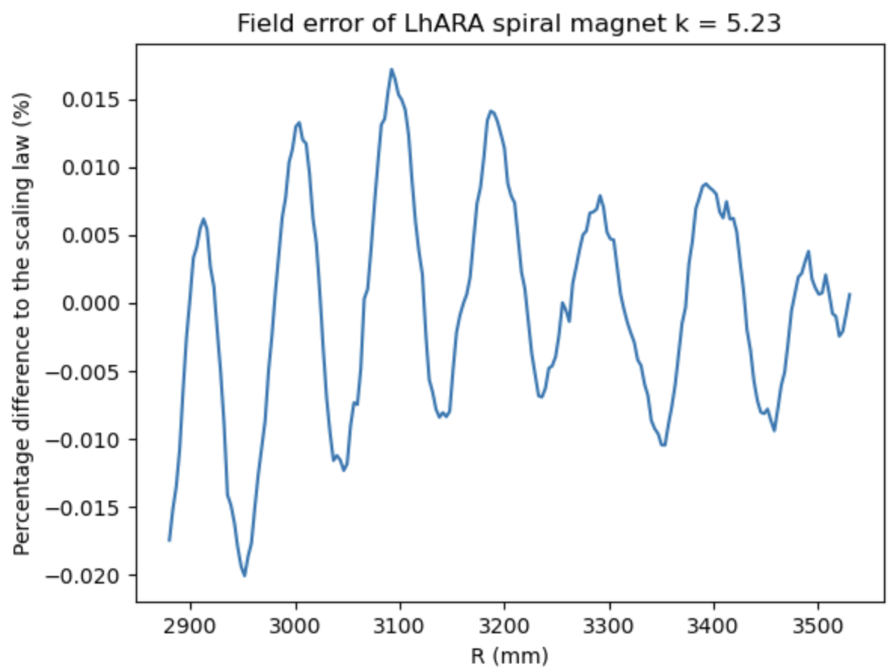
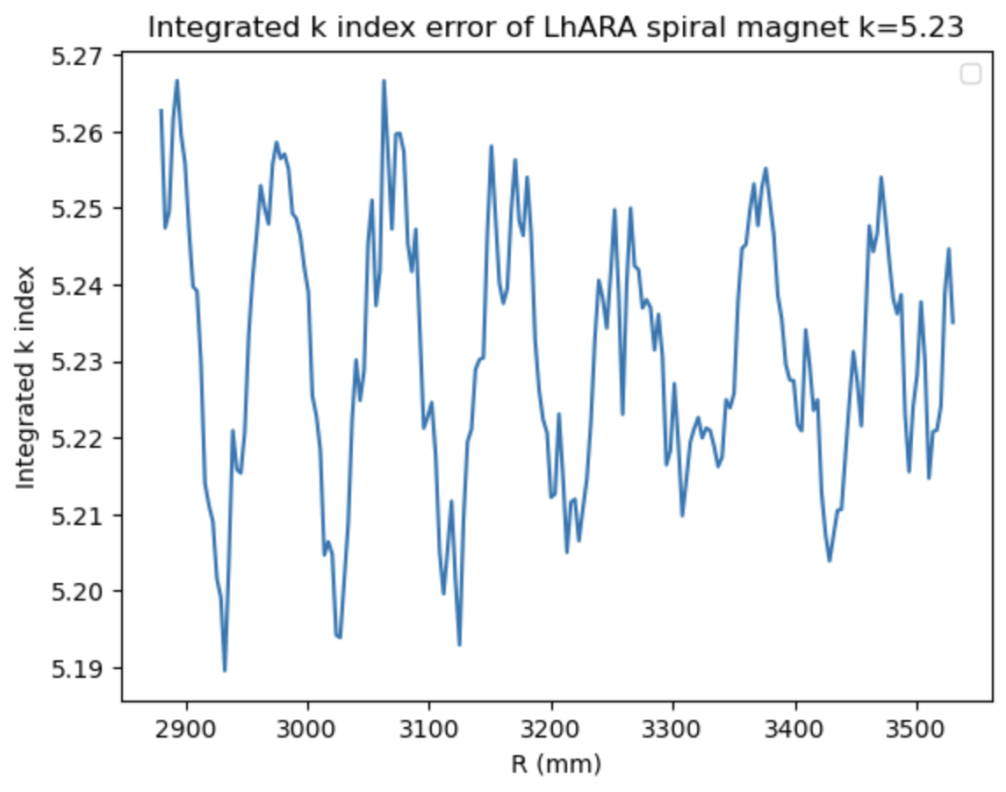
Performance at different energy range
For the LhARA machine, we would like to accelerate beams at different energy while
being at the same tune point.
This can be done by scaling the BL₀ value in the integrated field
Setting BL₀ to $\frac{2}{3}$ of the original value, 6- 57 MeV energy range

Slide 14
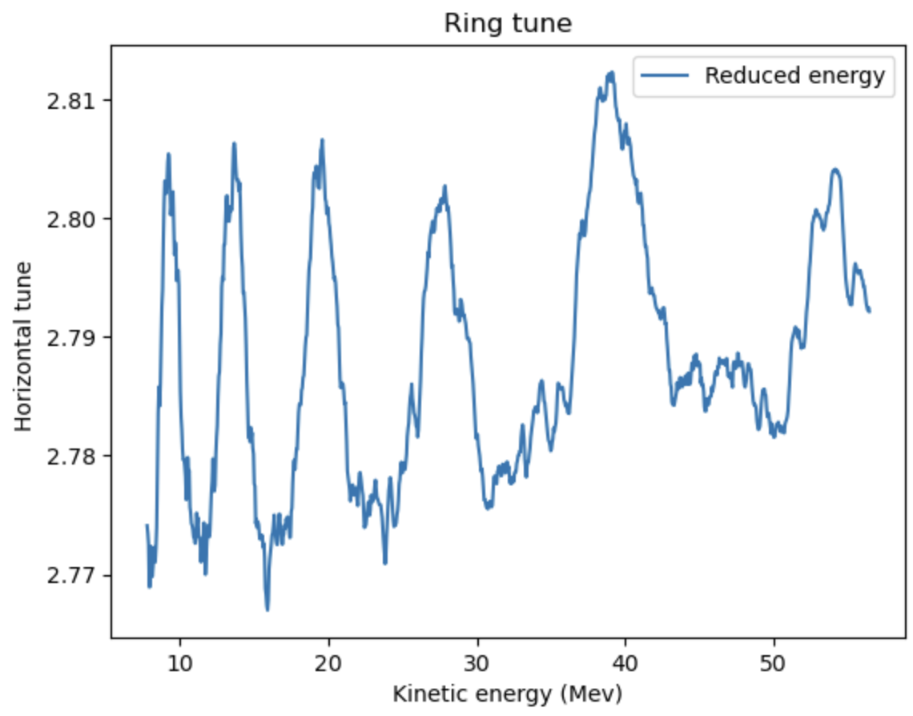
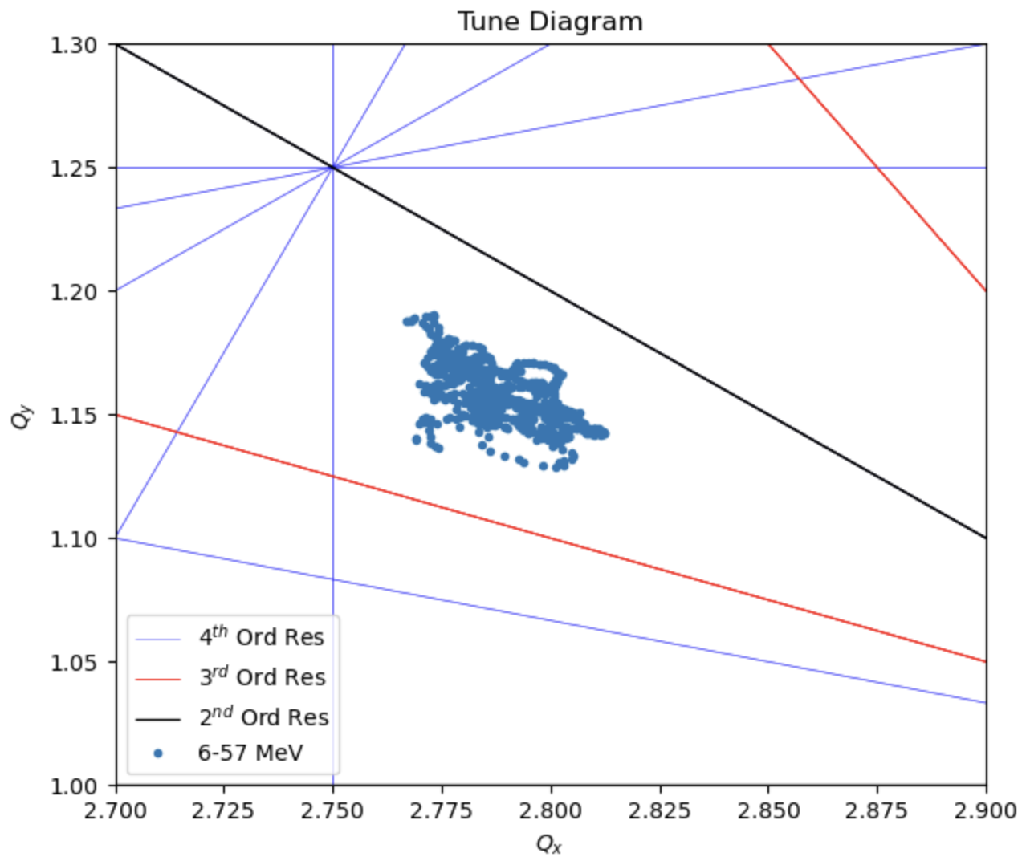
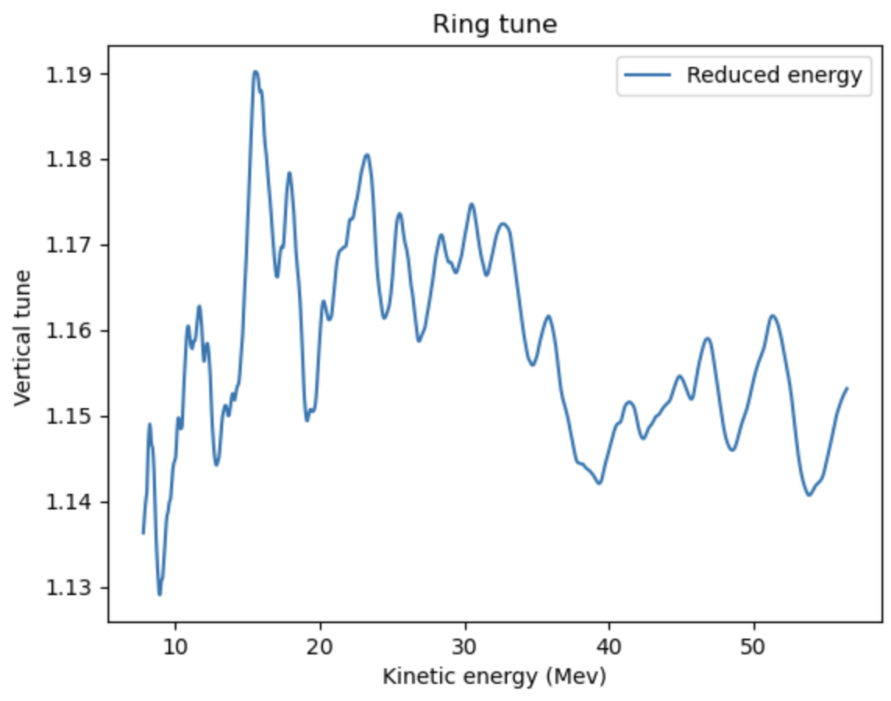
Tune from optimizing integrated B field

Slide 15
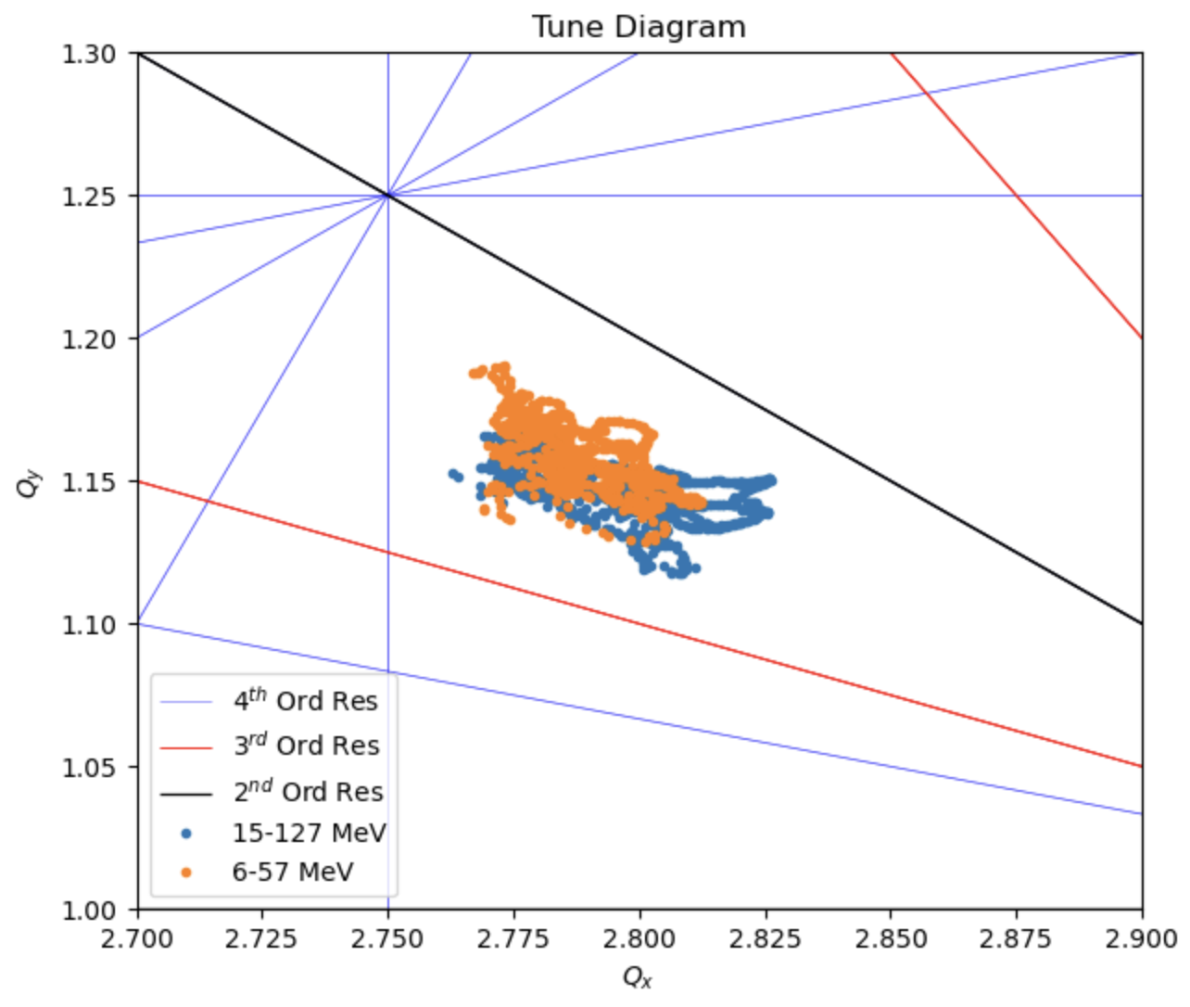
Tune at different energy ranges

Slide 16
Next Steps
Initial tune computed and looks promising
Need to check dynamic aperture
The real magnet might have larger errors in tune comparing to the simulation results
Investigate whether further tune spread reduction is required.
Vertical tune spread reduction: Further optimize aperture and position of clamps
Horizontal tune spread reduction: Increase number of power supplies to run different sets of current for the two layers of trim coils.

