Slide 1
WP3: Proton and ion capture
ITRF/LhARA Collaboration Meeting and ITRF 24 month review (2nd September 2024)

Slide 2
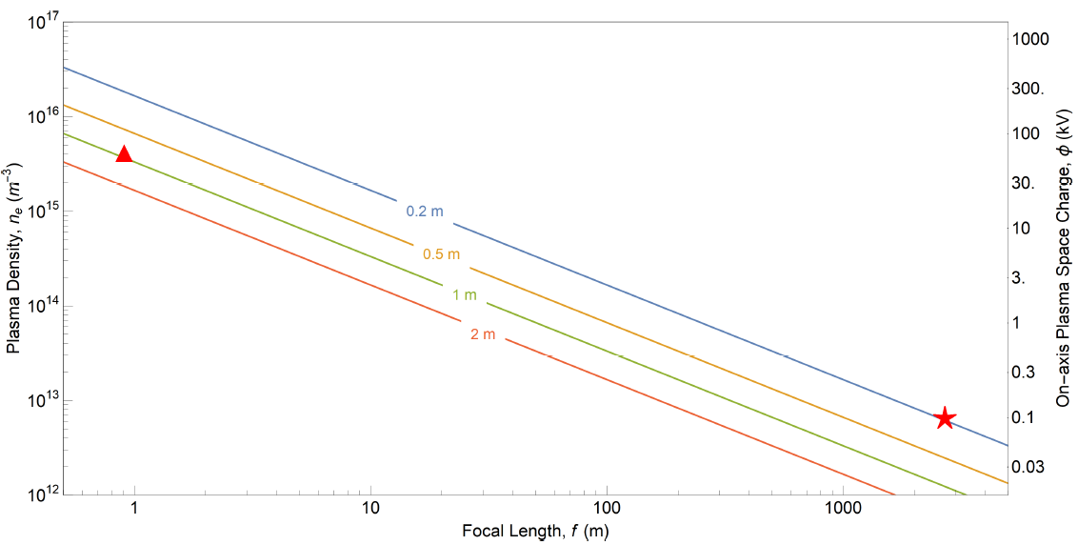
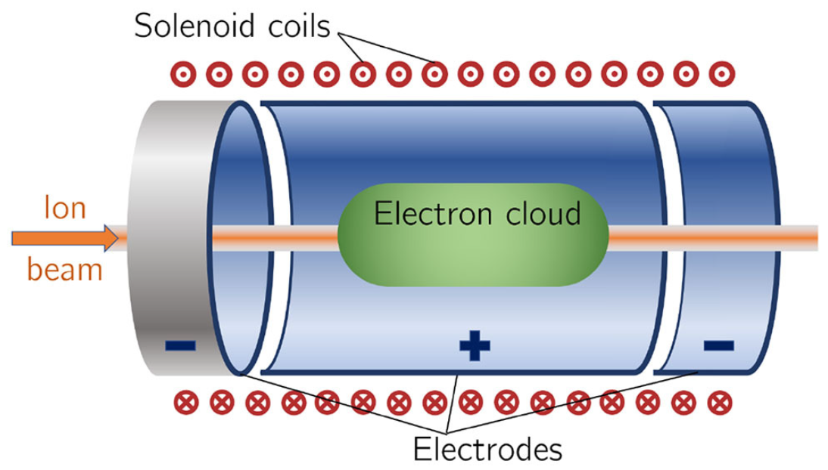
Gabor lens
The focal length $(f)$ of the Gabor lens:
$\frac{1}{f}=\frac{e^{2}n_{e}l}{4ε_{0}U}$
where $e$ is electric charge of the electron
$n_{e}$ is the plasma density
$l$ is the length of the plasma
$ε_{0}$ is the permittivity of free space
$U$ is the kinetic energy of the positively charge particle.
Penning-Malmberg trap
Plasma density: 4×10¹⁵ m⁻³
Radius: 3.65 cm
Length: 1 m
Aymar, G., Becker, T., Boogert, S., Borghesi, M., Bingham, R., Brenner, C., ... & Xiao, R. (2020). LhARA: the laser-hybrid accelerator for radiobiological applications. Frontiers in Physics, 8, 567738.
ITRF/LhARA Collaboration Meeting and ITRF 24 month review (2nd September 2024)

Slide 3
Swansea Positron Beamline
ITRF/LhARA Collaboration Meeting and ITRF 24 month review (2nd September 2024)

Slide 4
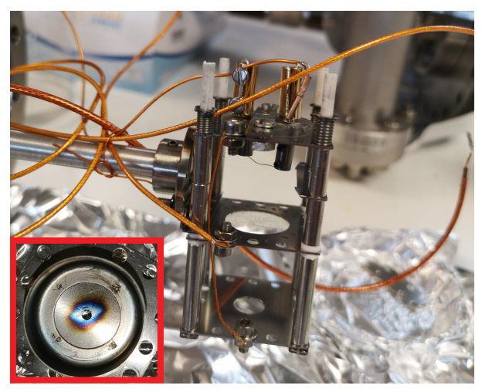
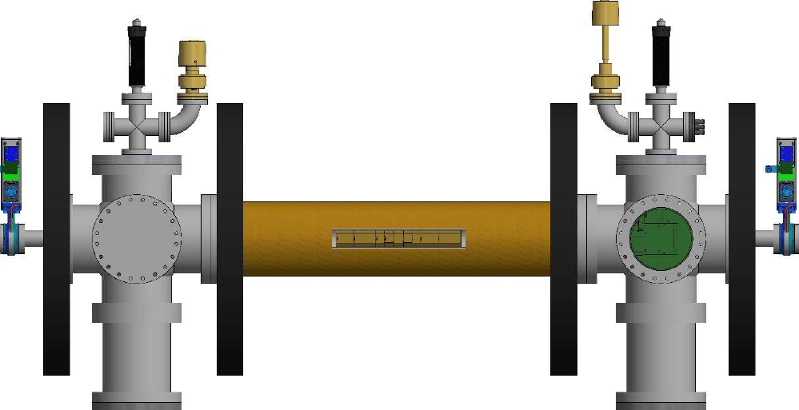
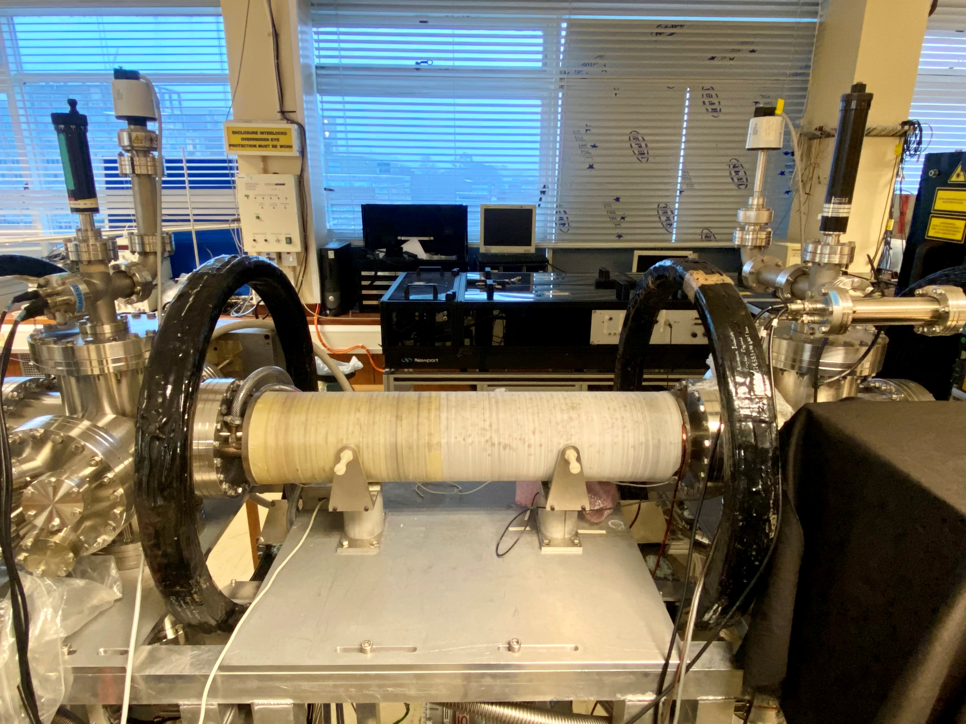
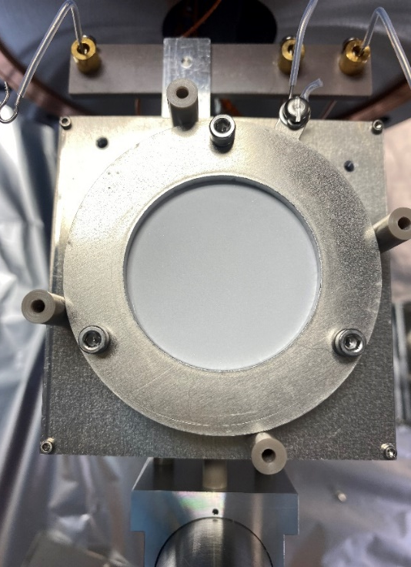
Experimental setup
Electron source
Solenoid: B$\sim 40$ mT
Brillouin density limit: $n_{B}=$ 7.7×10¹⁵ m⁻³
Phosphor screen
4.1cm
28.1cm
ITRF/LhARA Collaboration Meeting and ITRF 24 month review (2nd September 2024)

Slide 5
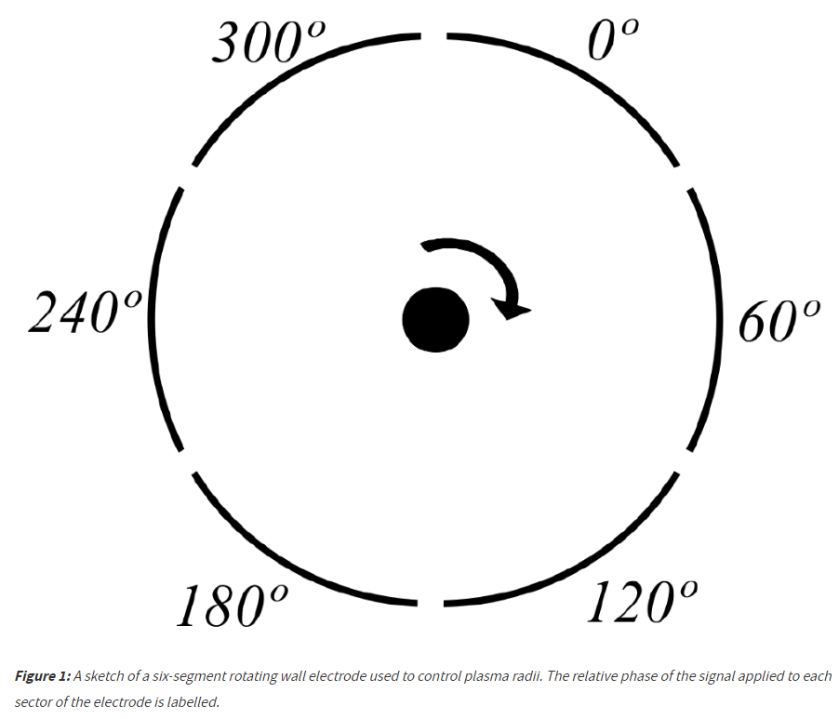
Results (presented in the last meeting)
Using rotating wall to compress the plasma
A six-segment rotating wall electrode is used to control plasma radii.
The relative phase of the signal applied to each sector of the electrode is labelled.
This gives a rotating electric field perpendicular to the axis of symmetry of the plasma.
The electric field induces an electric dipole moment in the plasma, leading to plasma compression.
RW
-140V
0V
-140V
r
r
0.1 r
https://alpha.web.cern.ch/science/rotating-wall
ITRF/LhARA Collaboration Meeting and ITRF 24 month review (2nd September 2024)

Slide 6
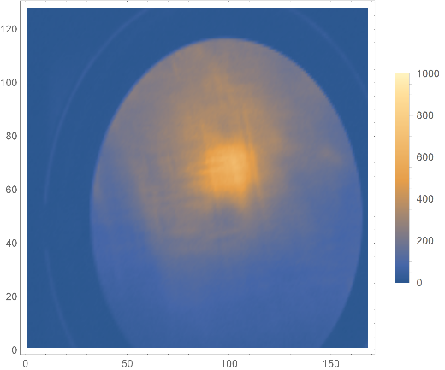
Results (presented in the last meeting)
Using rotating wall to compress the plasma
Load: 1s
Hold: 17us
RW: 14 MHz, 2.5 V_{pp},1s
CO₂ pressure: 8.3×10⁻⁷ mBar
RW applied
1.7×10⁹ electrons
RW
-140V
0V
-140V
Radius: $r≈1.6 mm$
Length: $l≈19.3 cm$
ITRF/LhARA Collaboration Meeting and ITRF 24 month review (2nd September 2024)

Slide 7
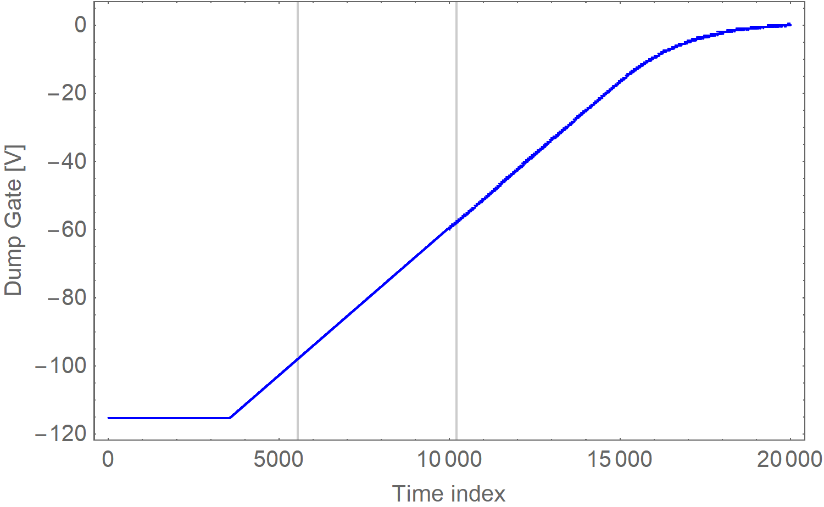
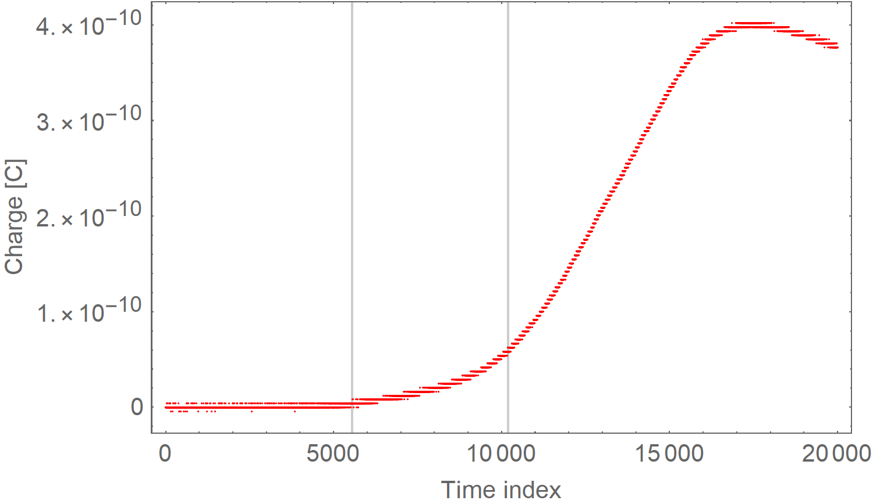
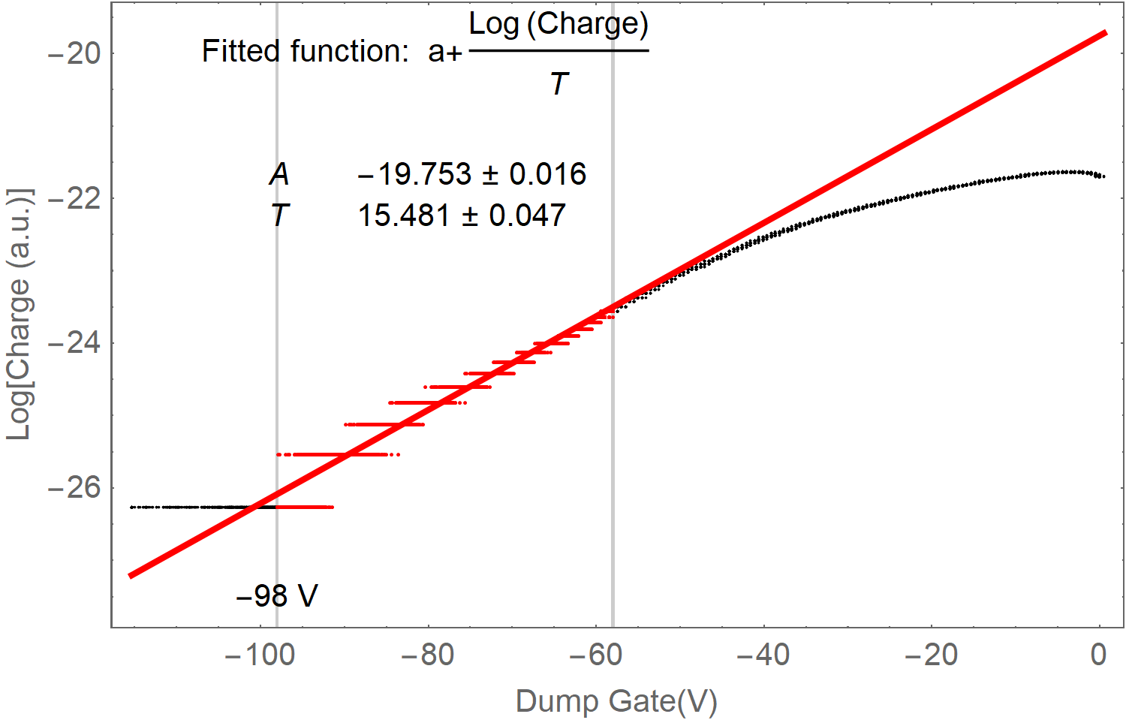
Results (presented in the last meeting)
Plasma temperature
Measuring the temperature by detecting the number of electrons escaping from the trap when reducing the trap potential.
RW applied
1.7×10⁹ electrons
RW
-140V
0V
-140V
Temperature: $T≈15 eV$
Space charge: $φ≈−98 V$
ITRF/LhARA Collaboration Meeting and ITRF 24 month review (2nd September 2024)

Slide 8
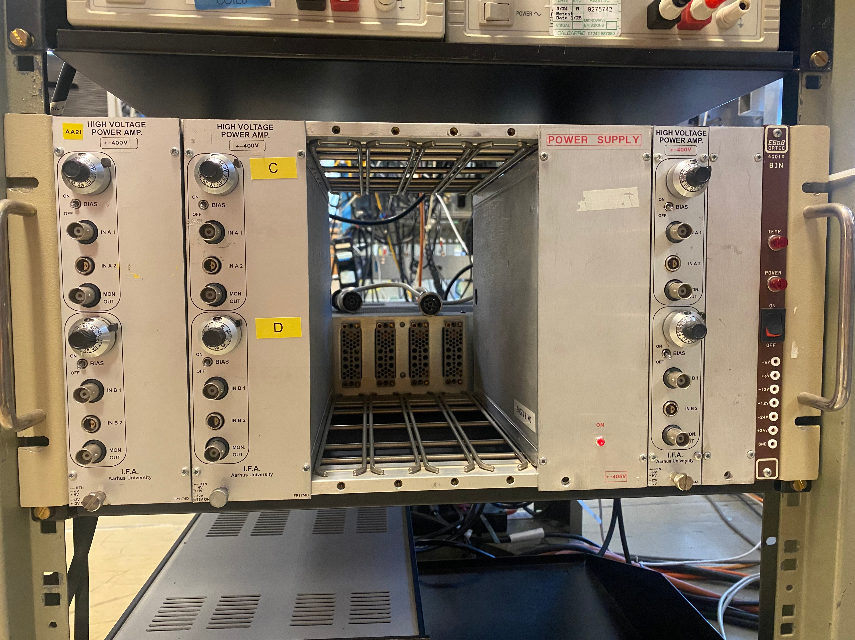
Updated results
Peak density calculation.
Varying the pressure of the cooling gas.
Modifications:
Installed the solenoid coil translation stage
Installed HV amplifier for generating deeper trap potentials.
ITRF/LhARA Collaboration Meeting and ITRF 24 month review (2nd September 2024)

Slide 9
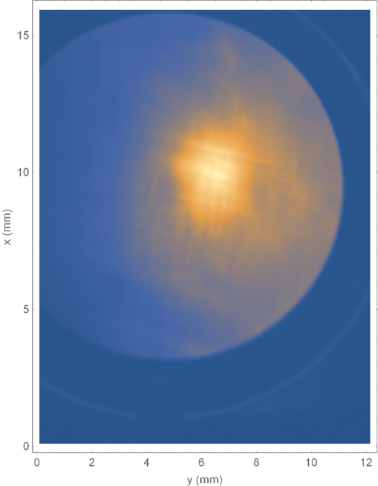
Calculate peak density
Load: 1s
Hold: 17us
RW: 14 MHz, 2.5 V_{pp},1s
CO₂ pressure: 8.3×10⁻⁷ mBar
ITRF/LhARA Collaboration Meeting and ITRF 24 month review (2nd September 2024)

Slide 10
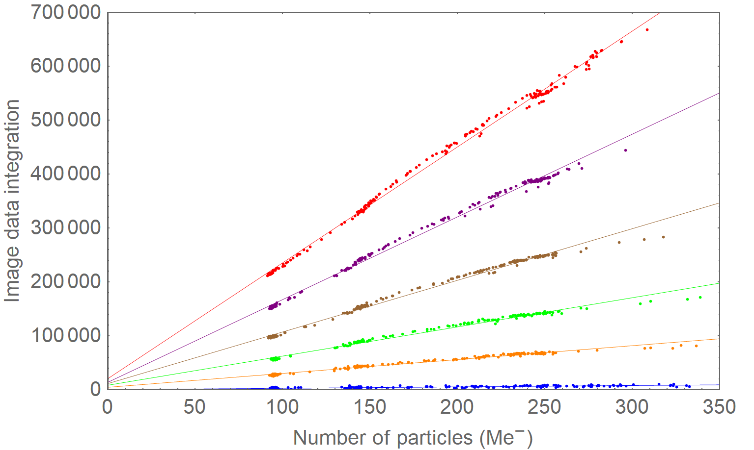
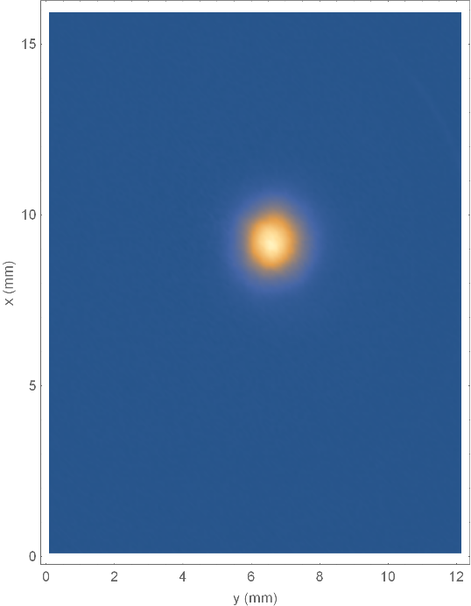
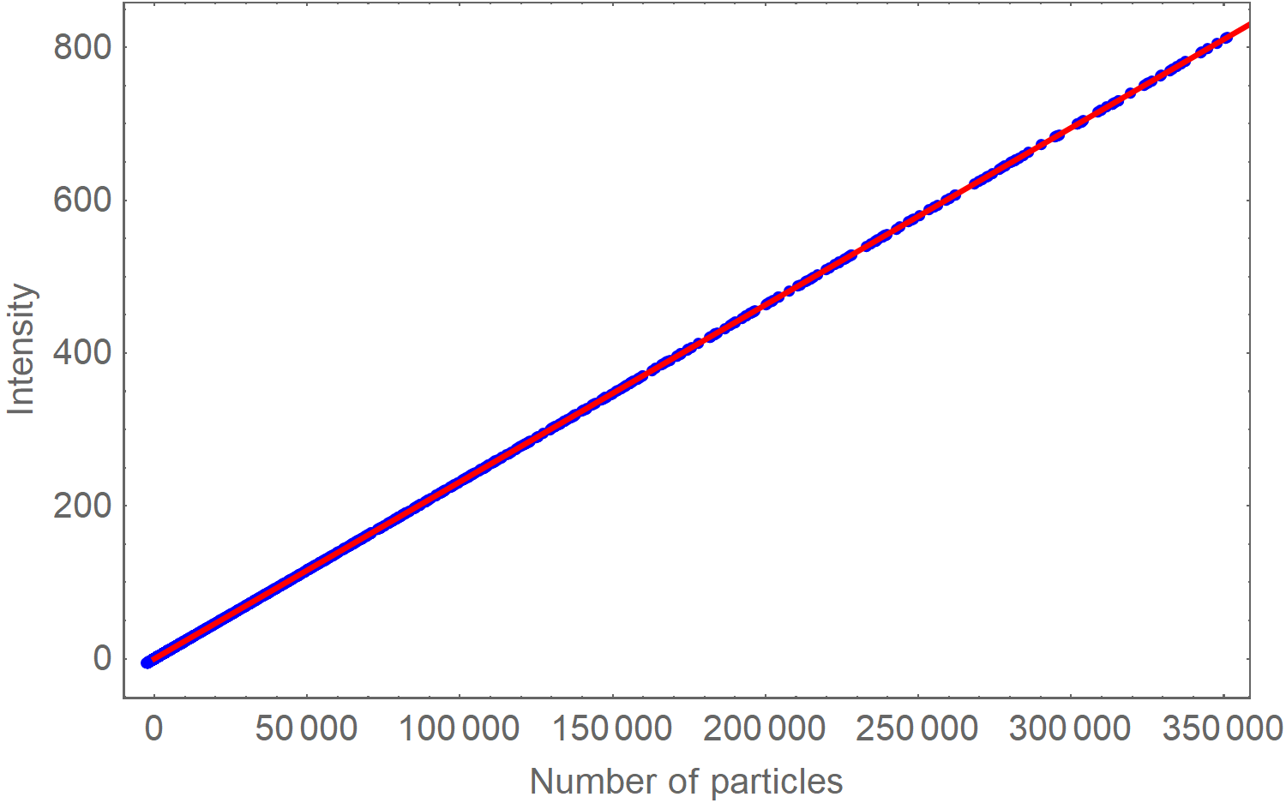
Calculate peak density
Calibration measurement
Load: 3 us, Hold: 17us
P-screen bias: 3kV
$$f\left(x\right)=2149 x+20401$$
$$f\left(x\right)=1534 x+13660$$
$$f\left(x\right)=958 x+11288$$
$$f\left(x\right)=541 x+8212$$
$$f\left(x\right)=257 x+4379$$
$$f\left(x\right)=26 x+0$$
93.8 Me⁻
Fitted function: $ax+b$
$$a=\text{0.00231634}$$
$$b=\text{0.000060}\text{70}$$
Total image intensity = 217361
ITRF/LhARA Collaboration Meeting and ITRF 24 month review (2nd September 2024)

Slide 11
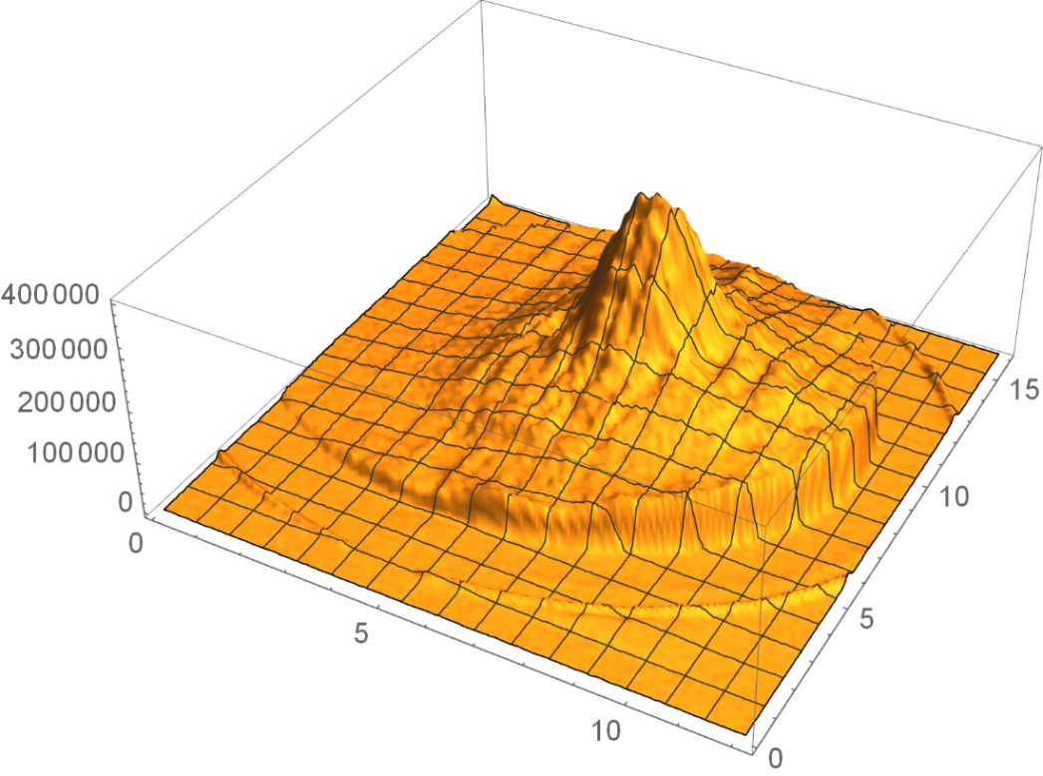
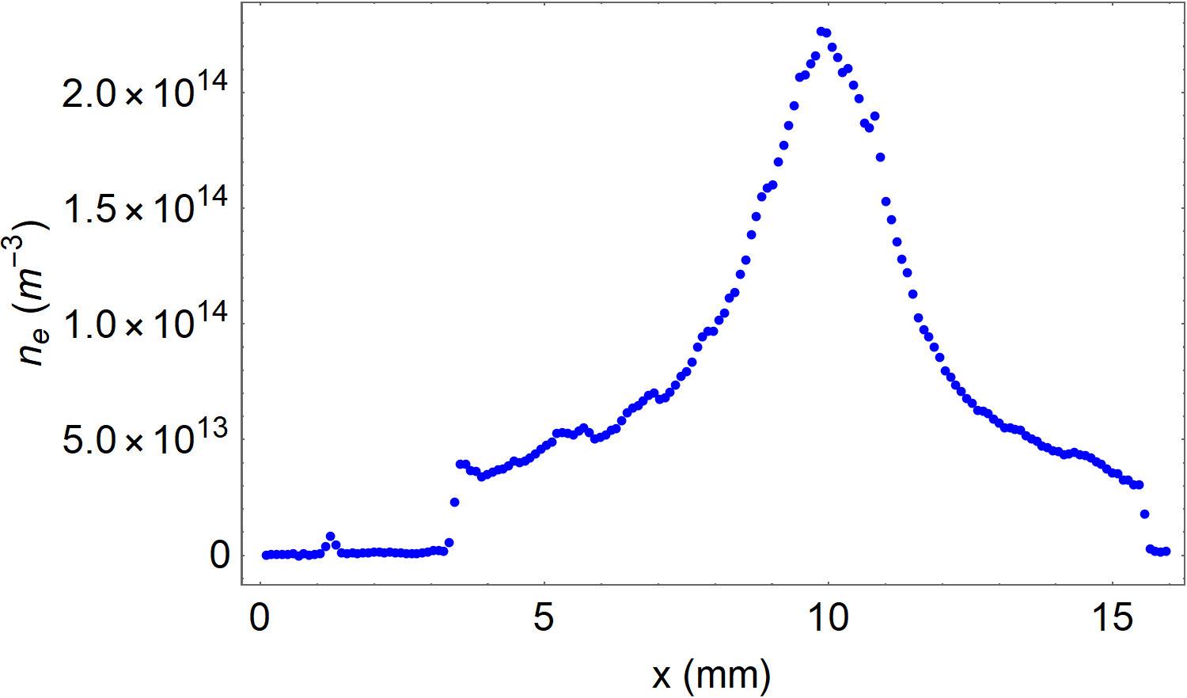
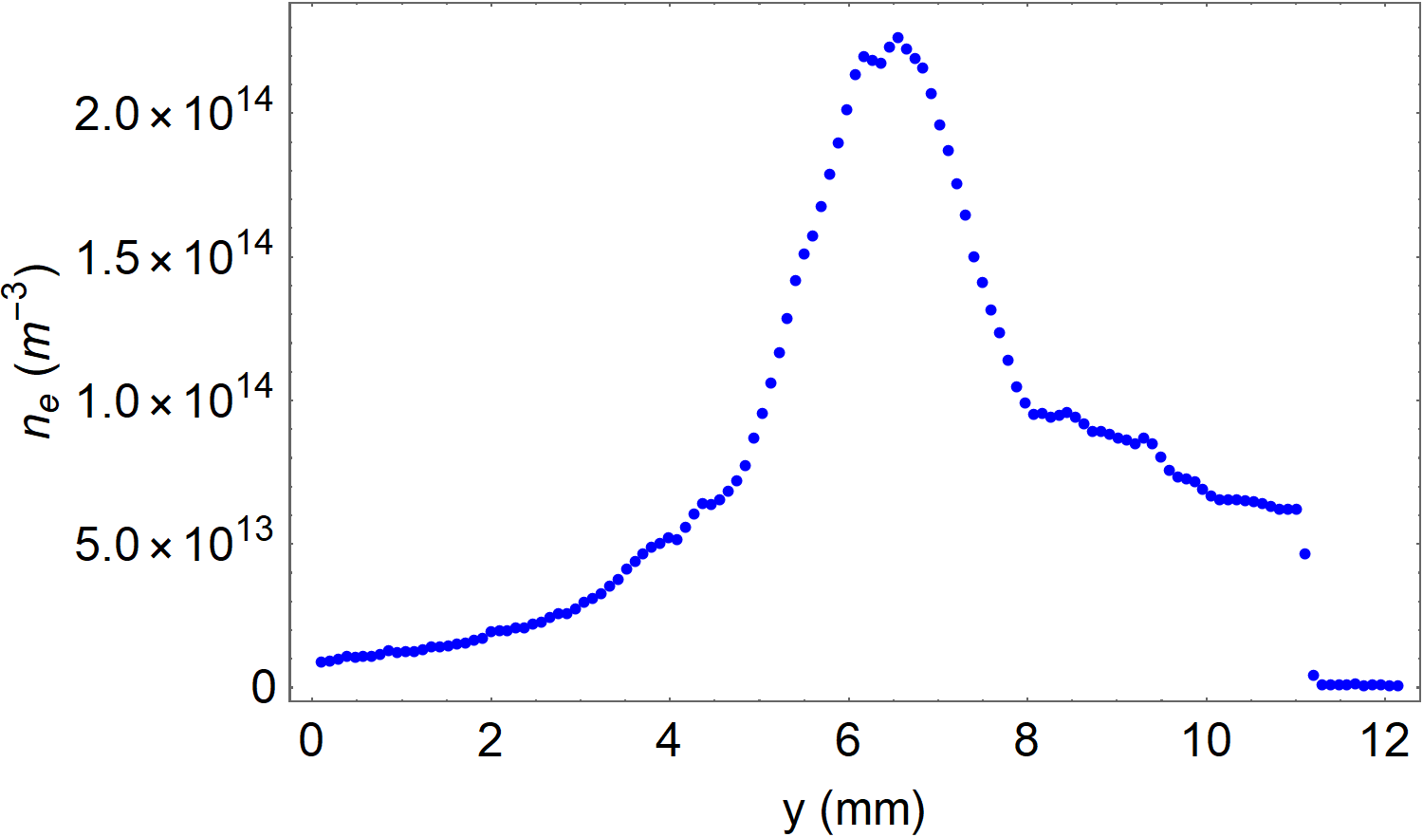
Calculate peak density
Load: 1s
Hold: 17us
RW: 1-30 MHz, 2.5 V_{pp},1s
CO₂ pressure: 8.3×10⁻⁷ mBar
Number of particles
x (mm)
y (mm)
~ 3 % of the Brillouin limit
ITRF/LhARA Collaboration Meeting and ITRF 24 month review (2nd September 2024)

Slide 12
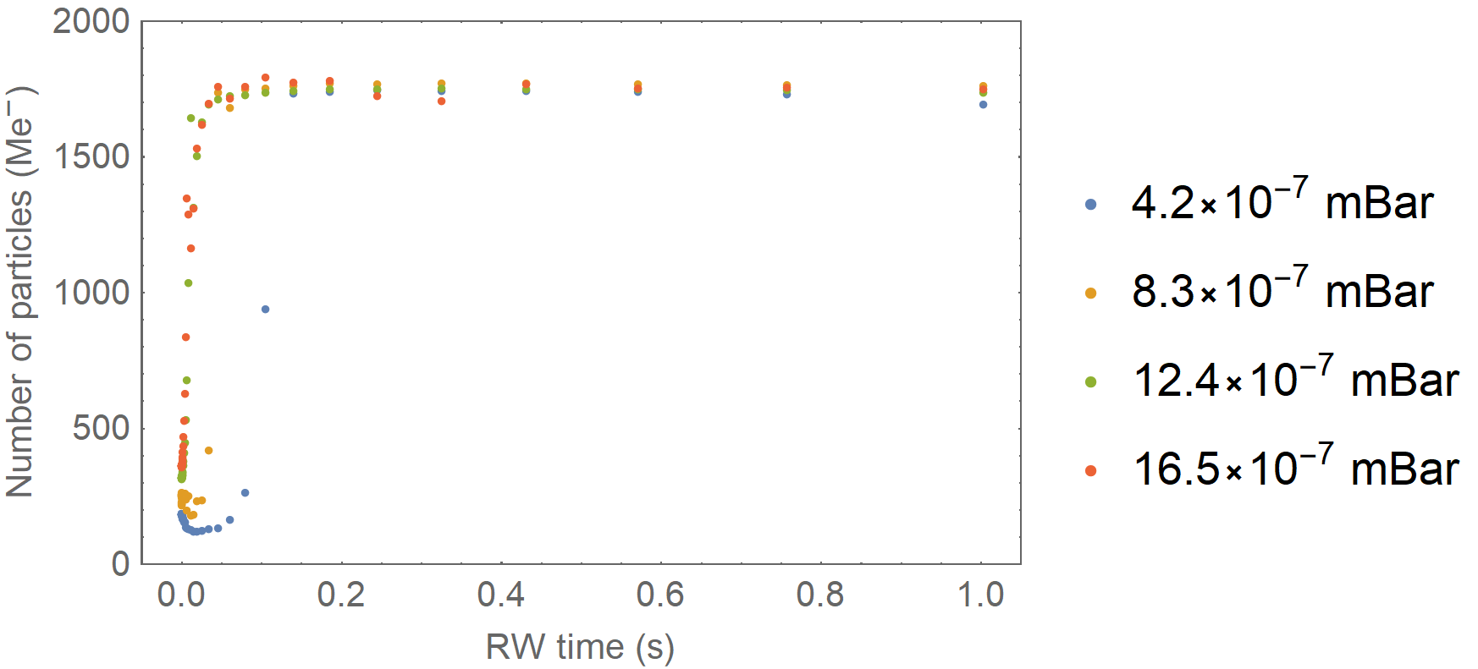
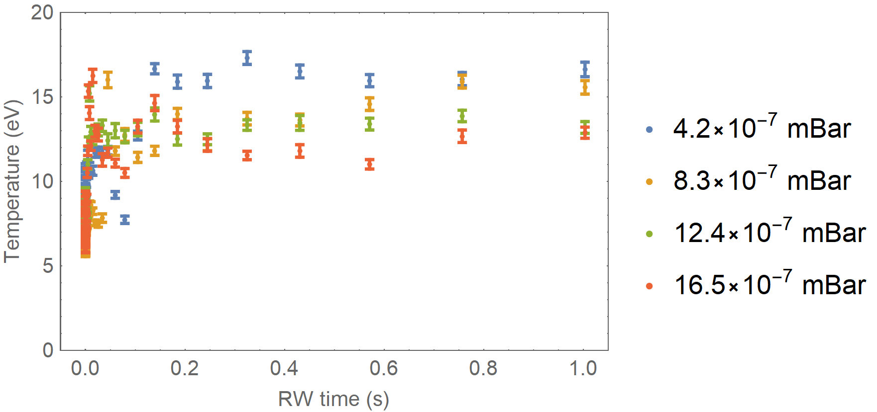
Vary CO₂ pressure
Load: 1s, Hold: 17us, CO₂ cooling gas, Pressure: 4.2×10⁻⁷ – 16.5×10⁻⁷ mBar
RW frequency: 14MHz, 2.5V_{pp}, 3us-1s
4.2×10⁻⁷ mBar
8.3×10⁻⁷ mBar
12.4×10⁻⁷ mBar
16.5×10⁻⁷ mBar
ITRF/LhARA Collaboration Meeting and ITRF 24 month review (2nd September 2024)

Slide 13
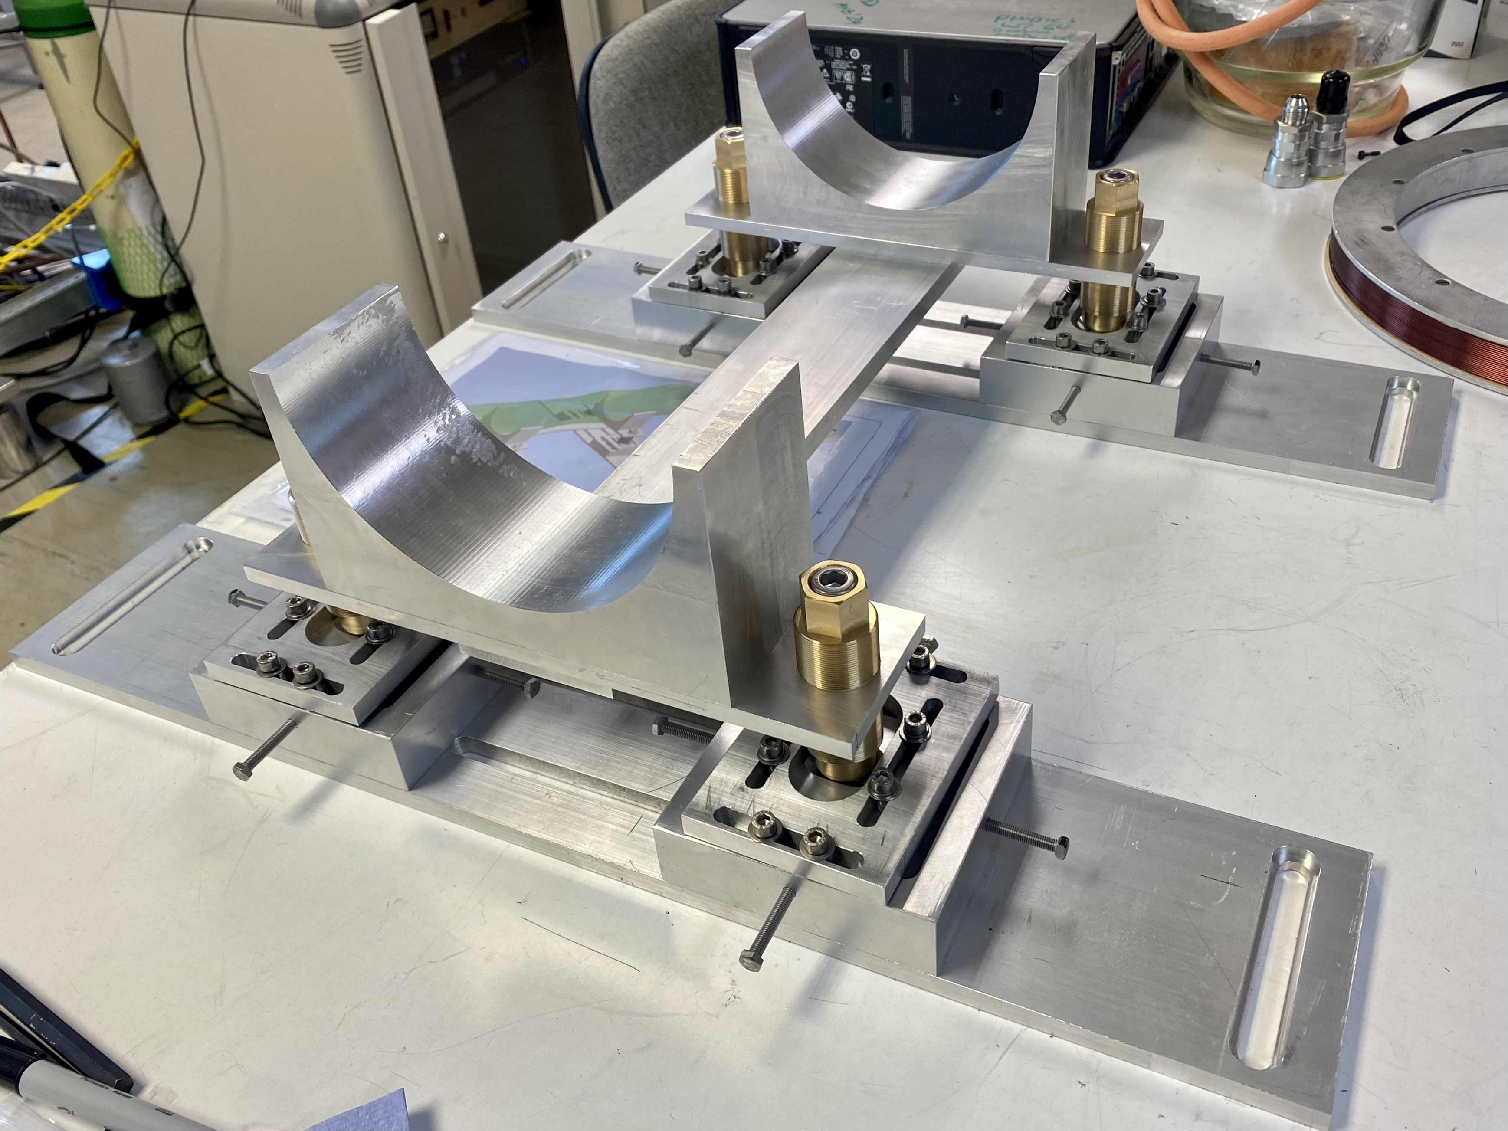
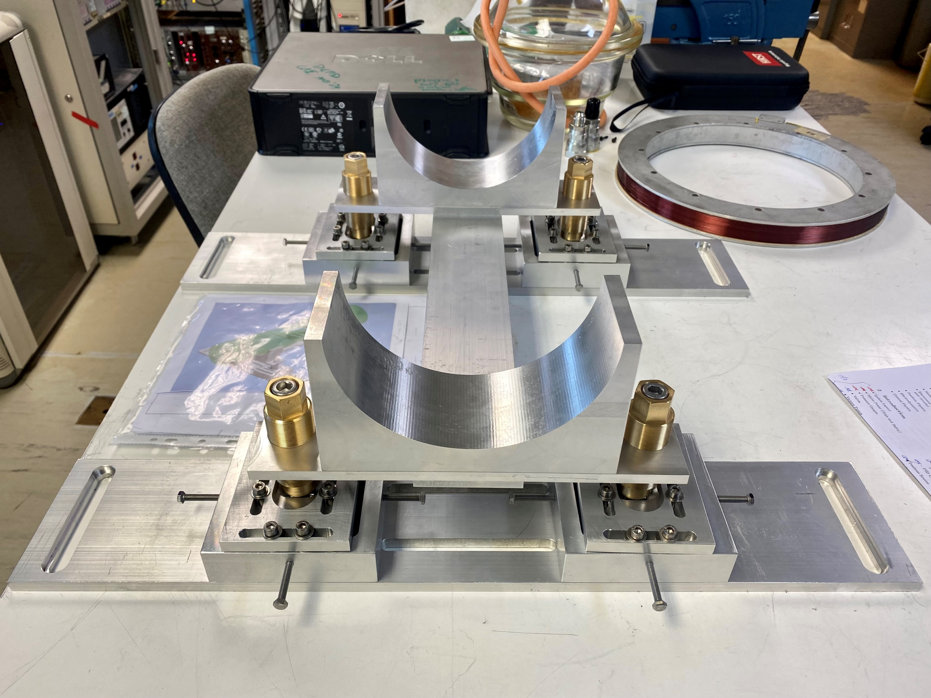
Solenoid coil translation stage
ITRF/LhARA Collaboration Meeting and ITRF 24 month review (2nd September 2024)

Slide 14
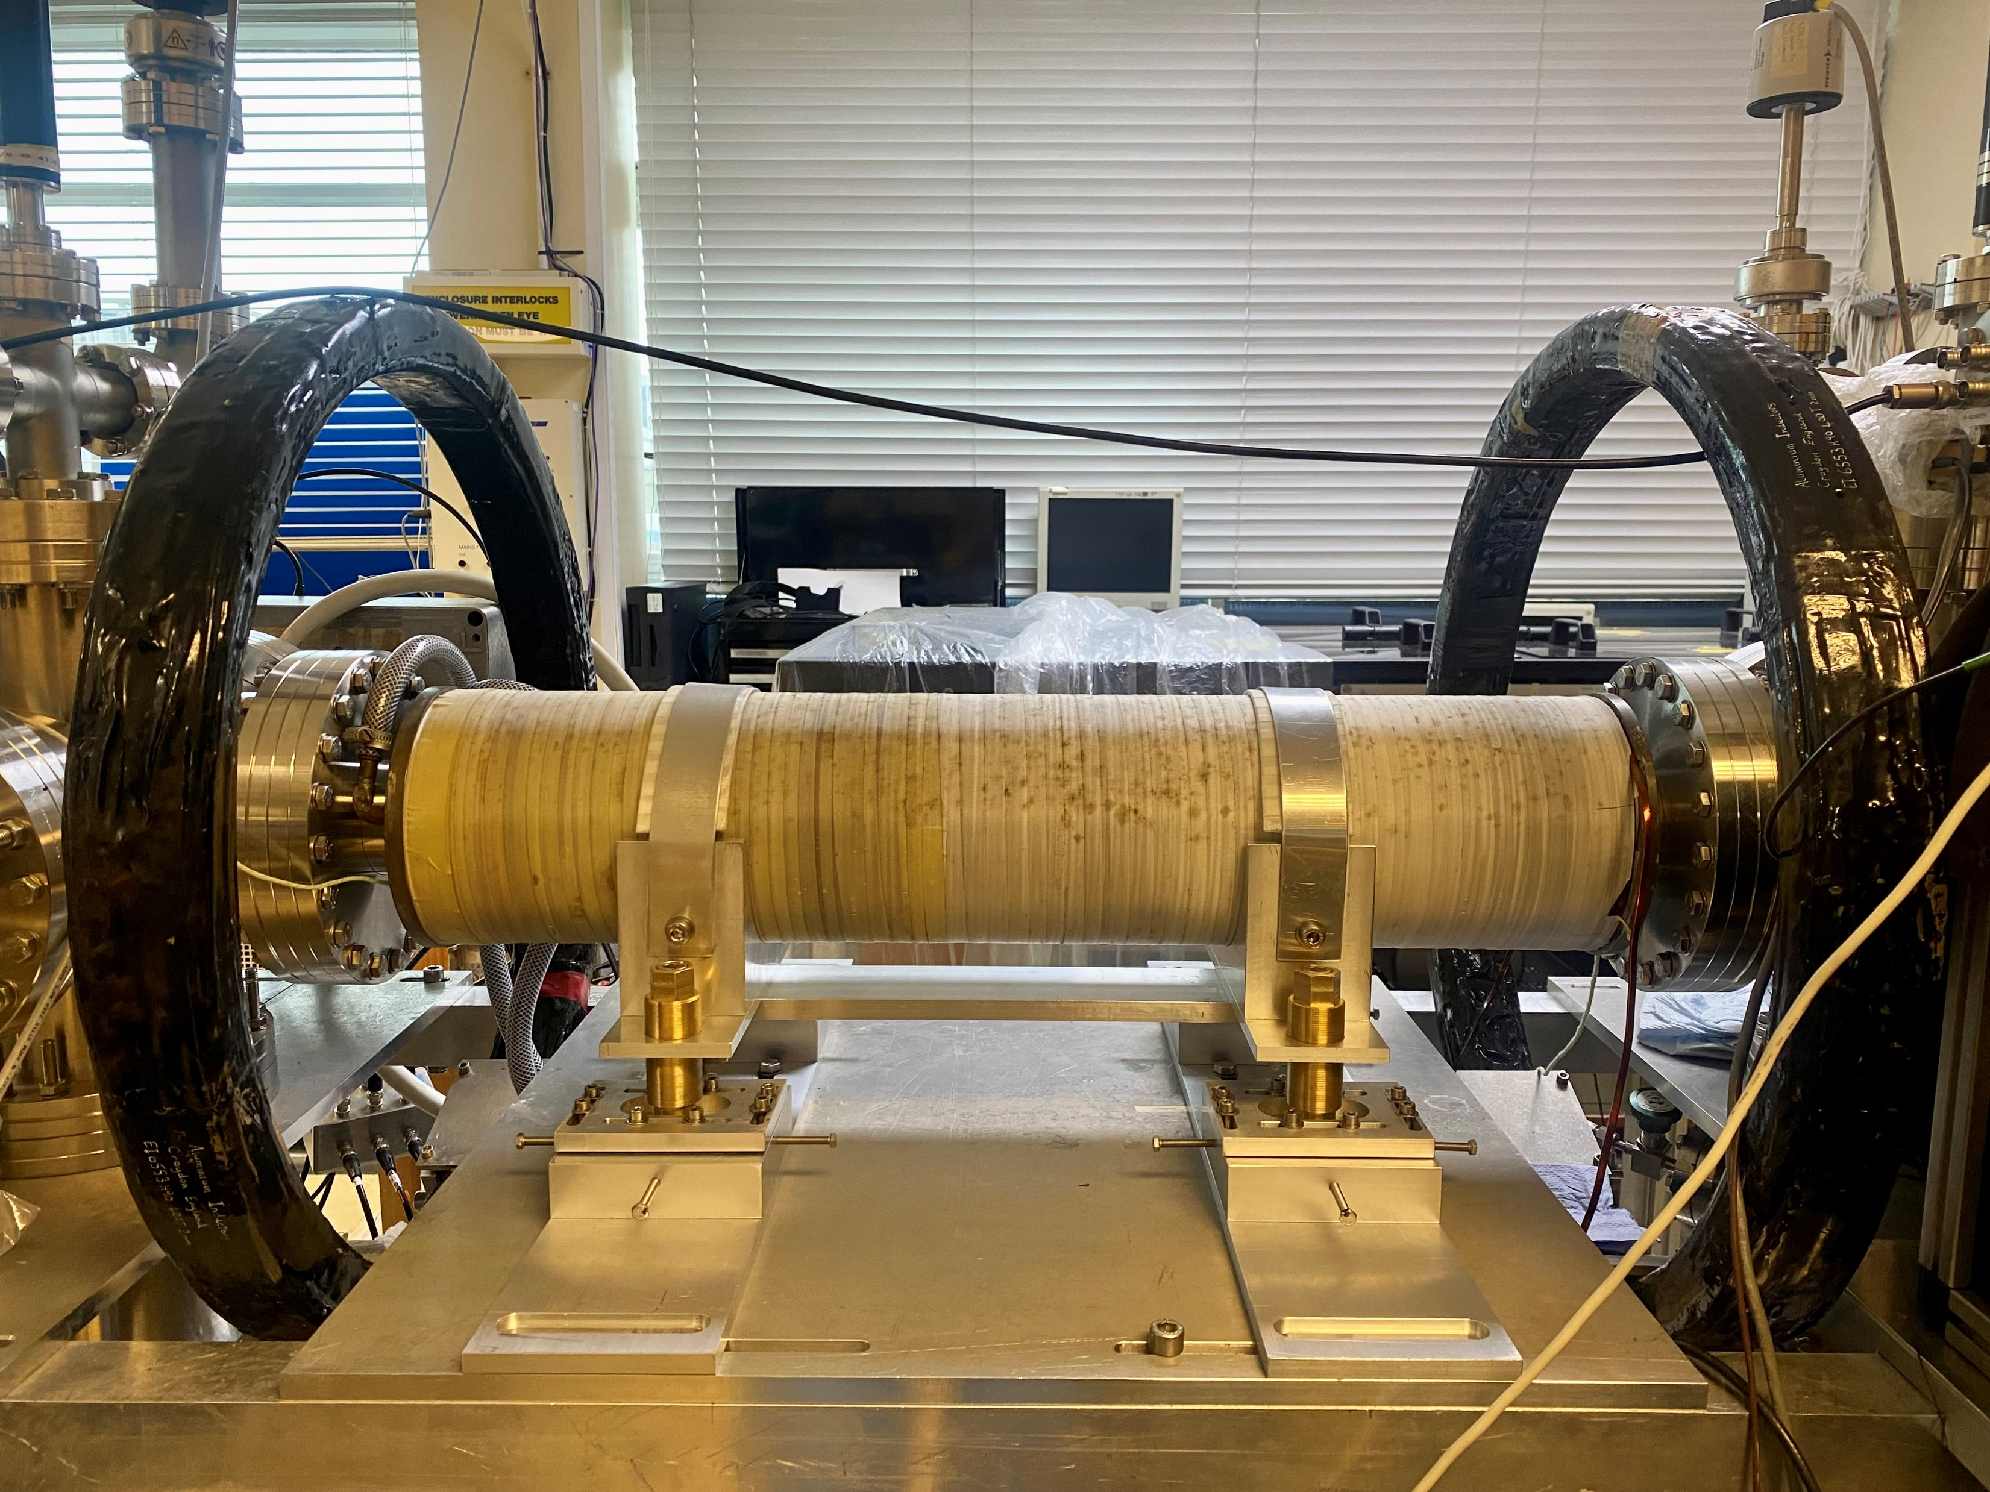
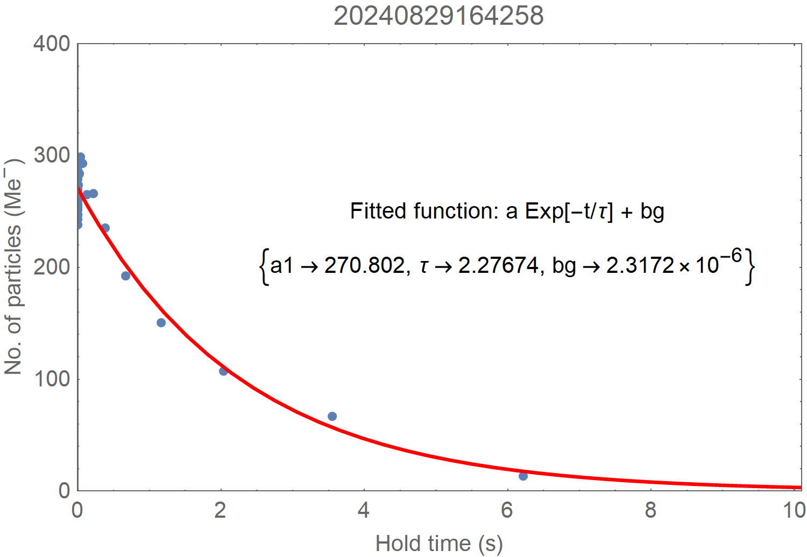
Solenoid coil translation stage
Lifetime
Load: 1s
Hold: 3us-10s
V bias: -140V
0V
-140V
x
z
y
ITRF/LhARA Collaboration Meeting and ITRF 24 month review (2nd September 2024)

Slide 15
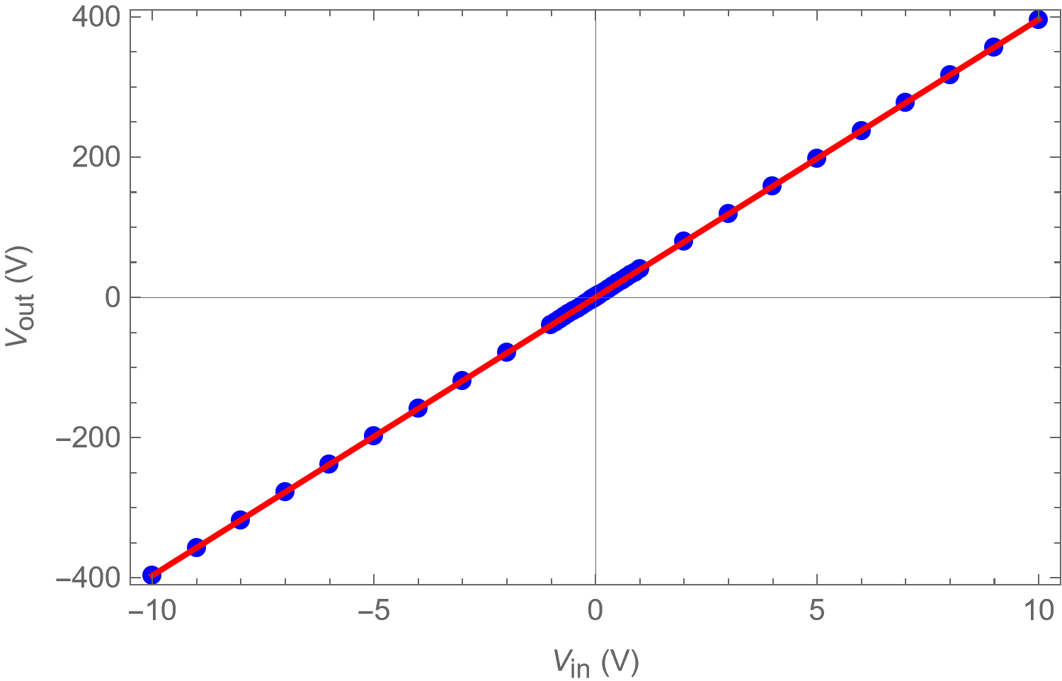
HV amplifier calibration
09/08/2024 (Fri)
V_{out} = 39.6439 V_{in} - 0.0370893
ITRF/LhARA Collaboration Meeting and ITRF 24 month review (2nd September 2024)

Slide 16
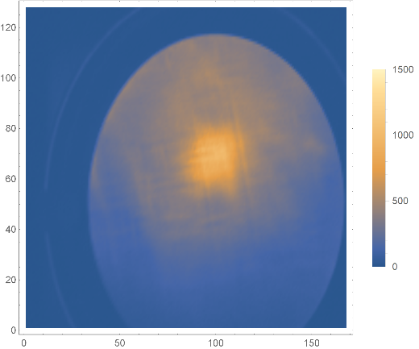
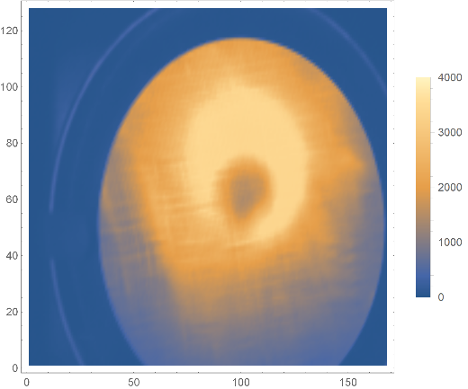
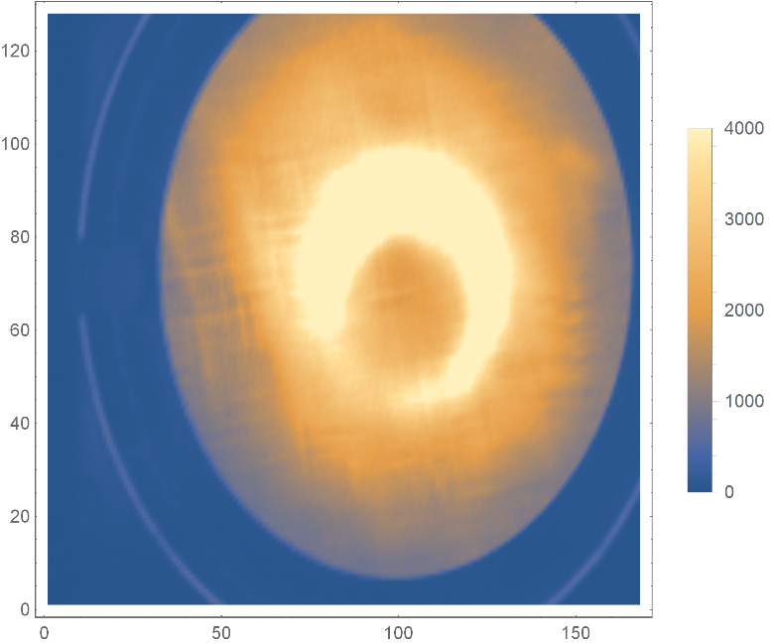
Rotating wall + CO₂
09/08/2024 (Fri)
-140V: 20240815112355
-400V: 20240815114339
Load: 1s
Hold: 17us
RW: 14 MHz, 1s, 2.5 V_{pp}
CO₂ pressure: 8.3×10⁻⁷ mBar
Trap depth: -140V
Trap depth: -400V
Moved P-screen up
ITRF/LhARA Collaboration Meeting and ITRF 24 month review (2nd September 2024)

Slide 17
Conclusion and outlook
Peak density
The density of the generated plasmas is 2.3×10¹⁴ m⁻³.
Radius
The radius of the created plasmas is 1.6 mm.
Using the deeper trap potential:
Higher number of particles → Larger radius → Higher density
Next steps …
Investigate the dumping mechanism.
More systematic RW studies:
Apply stronger rotating wall
Optimize the cooling gas pressure
Large parameters …
Plasma density: 4×10¹⁵ m⁻³
Radius: 3.65 cm
Length: 1 m
ITRF/LhARA Collaboration Meeting and ITRF 24 month review (2nd September 2024)

Slide 18
WP3 Personnel
W. Bertsche
M. Charlton
S. Eriksson
D. P. van der Werf
C. A. Isaac
C. Baker
P. Ruksasakchai
T. Dascalu
J. Fajans
J. Wurtele
B. Bingham
R. Hugtenburg
J. Purden
A. Knoll
E. Bennet
ITRF/LhARA Collaboration Meeting and ITRF 24 month review (2nd September 2024)

