Slide 1
PPAP: Software and Computing
26 June 2024
Dave Britton, Pete Clarke, Davide Costanzo, Jon Hays

Slide 2
Introduction. On software and computing for PP
Software and computing is a “subsystem” of any particle physics experiment
We all depend on it: data processing, simulation, theory, …
The UK delivers computing as part of our formal commitment to experiment participation
Offline computing is largely deterministic – for example once the LHC luminosity is set, the detector is constructed, and the physics program is approved - not elective
From the survey (see Ruben’s talk)
Lack of effort in research software engineers (RSE)
Linked to development of skills and career for RTP
Physical hardware infrastructure under severe capital pressure in UK
Risk of failing to provide agreed “fair share” (reputational damage as unreliable partner)
Shortfall in compute -> shortfall in physics
The pressure will increase across all programmes as additional data intensive experiments start taking data
Failure to deliver on computing pledges is equivalent to failing to provide detectors or other core M&O contributions

Slide 3
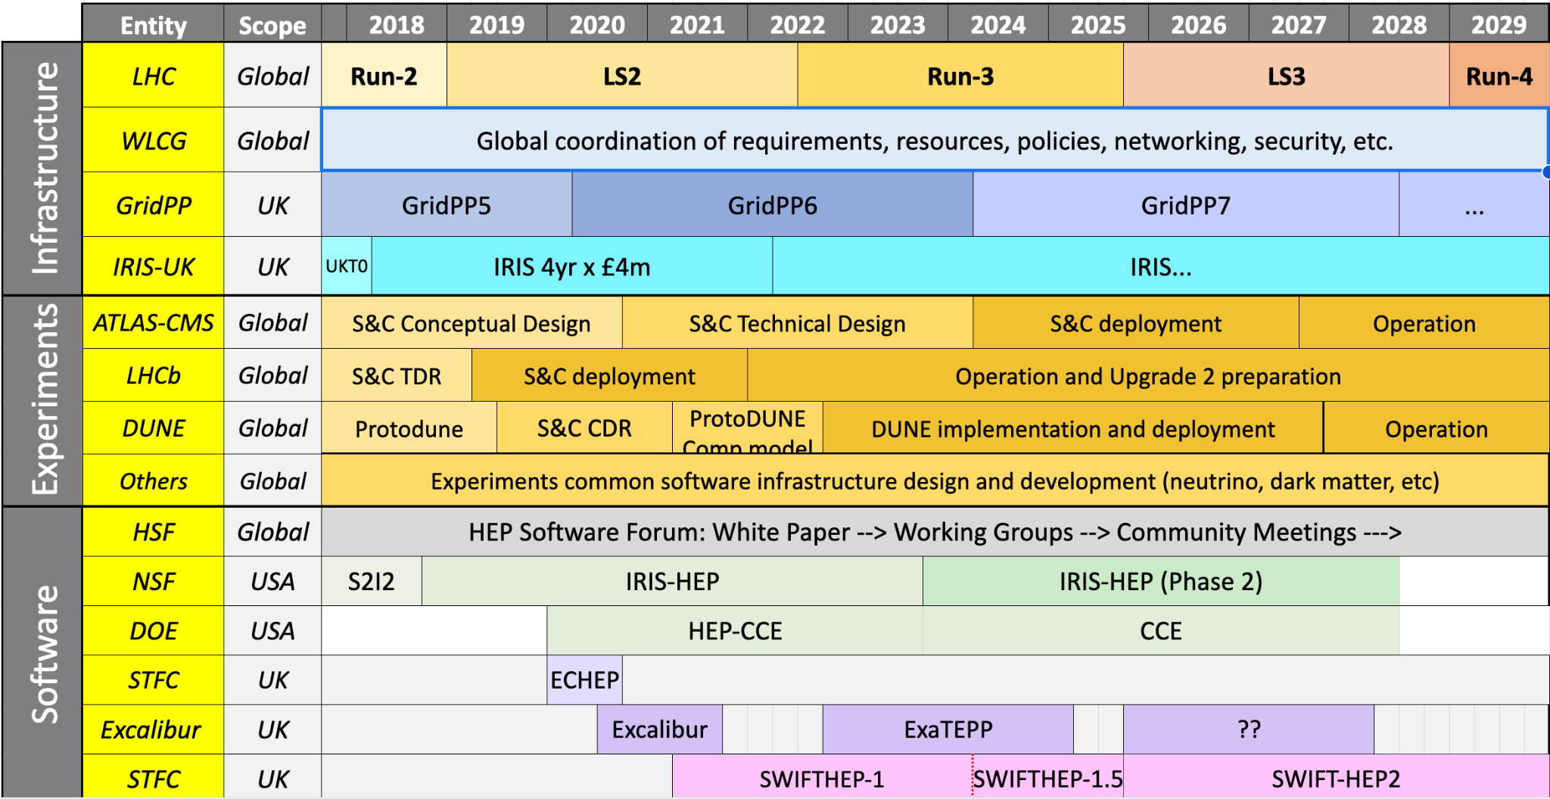
Timeline (incomplete)

Slide 4
UK computing infrastructure
GridPP: Provides the compute, disk, and tape needed to extract physics from current PP experiments. This also include the software fabric and the support needed to run experiment payloads. GridPP also has a key role in defining and developing the infrastructure for HL-LHC.
IRIS: Provides federated computing and storage across STFC to help build a joined-up approach with coherence, collaboration, coordination and sharing across all of STFC
DiRAC: UK high performance computing facility supporting STFC users (including PP theory)
Staff effort to support the infrastructure is a key part of this!
It’s not just running hardware – majority of the effort is running, maintaining, and developing the systems that sit on top of the hardware
HEP
PPAN

Slide 5
UK computing infrastructure
UKRI Digital Research Infrastructure:
A bold (but financially modest) programme to build a UK wide harmonised approach to digital research infrastructure
Built around 5 key themes:
Data infrastructure
Large-scale computing
Secure services for sensitive data
Skills and People
Foundational tools, techniques and practices

Slide 6
UK computing infrastructure
UKRI Digital Research Infrastructure:
A bold (but financially modest) programme to build a UK wide harmonised approach to digital research infrastructure
Large investments in GPU based AI machines
Access model likely to be focused towards large AI payloads
GPU usage is slowly growing in HEP but at present there is no scenario where a large GPU machine in a HPC configuration can meet our needs
Co-evolution of HEP software with grid computing resources has led to highly cost-effective solutions. Using large-scale general-purpose or HPC resources, has large cost implications (factors of 2!)

Slide 7
GridPP
GridPP 7 Compute
Currently delivering around 1 billion core hours / year
GridPP 7 storage requirements:
Disk 110 PB rising to 170 PB (2028)
Tape 194 PB rising to 295 PB (2028)
Environmental Sustainability:
Over the last two years UK has led the investigation of ARM based architectures and demonstrated energy savings (up to 35% but is architecture dependent and subject to the on-going arms-race between architectures)
As a result of this UK-led work, last week the WLCG MB approved the pledging of ARM resources to ATLAS for 2025.
Potential benefits to be realised through stimulating competition between x86 and ARM-based architectures
Data centre upgrades, reduced PUE @ Edinburgh & Glasgow, heat-recovery systems @ QMUL

Slide 8
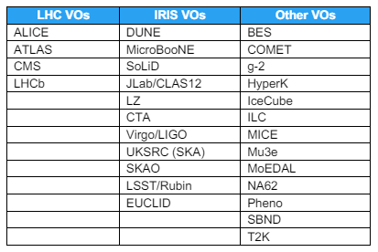
GridPP
Strong integration with IRIS and continuing support for non-LHC workloads

Slide 9
IRIS
IRIS Provides compute, storage and federation services for STFC Science
Works across PPAN activities and National Facilities – key strategic partners in GridPP, DiRAC, and SCD
Annual allocation process provides technical review and allocation of resource to already peer reviewed science (no tensioning based on science)

Slide 10
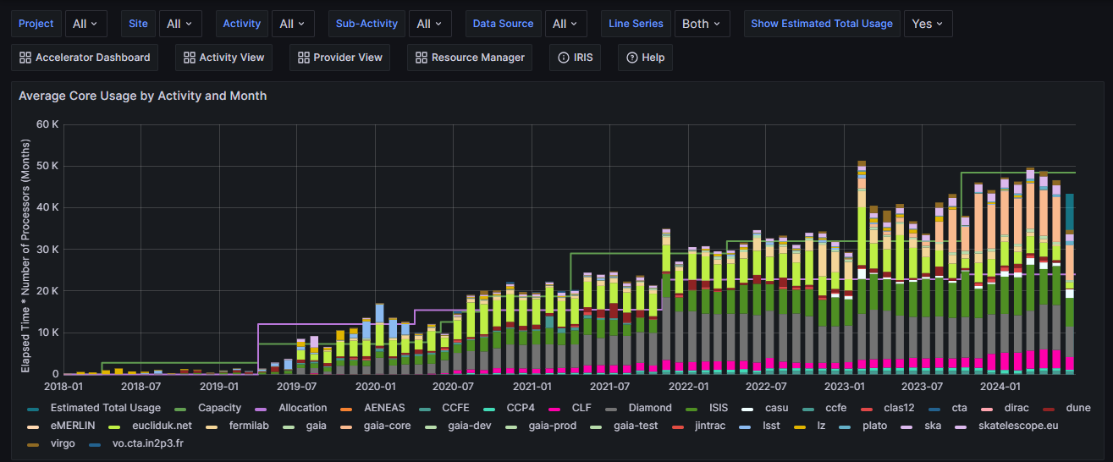
IRIS
IRIS Provides compute, storage and federation services for STFC Science
Pooling of resources across sites, facilities, enables flexible delivery and efficiency savings as well as enhanced resilience against failure.
Around 50k virtual cores (~2 x 25k physical cores) provided through SCD, GridPP, DiRAC, and others.

Slide 11
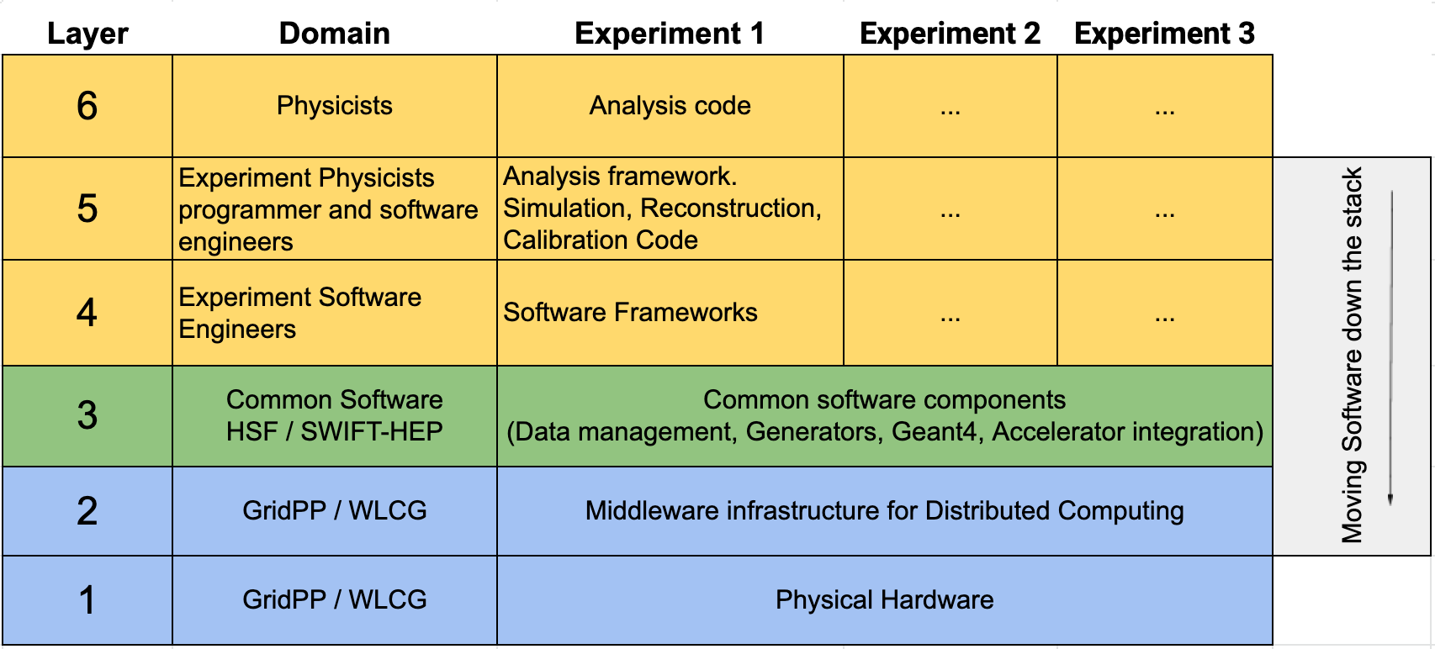
Multi-experiment software development
The UK Particle Physics Technology Advisory Panel (PPTAP) (link)
[34] Likewise within software and computing the UK has significant leadership in a significant number of important areas, including in exploitation of computing accelerators, exploitation of low power compute units, computing operations, enabling software and computing, reconstruction algorithms, software framework development, development of cross- experiment development tools, use of HPC and development of collision simulation/generation programmes.

Slide 12
Software projects - SWIFT-HEP
Submitted an SoI at the end of April as a community led project
Design 3 scenarios: minimum, core, desired
SwiftHEP-2 necessary to meet goal for software efficiency, reduced computing hardware needs and carbon footprint. These cannot be achieved without serious software advances.
In the core/desired scenarios, 7 work packages:
WP1 Distributed systems and analysis
WP2 Event generators
WP3 Simulation of particle interactions with matter
WP4 Reconstruction algorithms
WP5 Benchmarking and sustainability
WP6 Software frameworks for future experiments
WP7 Artificial intelligence tools and emerging technologies
Additional effort funded via the ExCALIBUR programme in collaboration with Lattice QCD
This is now finishing. Possible new call in 2025

Slide 13
Conclusions - Discussion
Investment in computing is essential for the community
“Small experiment ≠ small computing problem” (cfr Snowmass report)
Developing skills, training and career is of central importance
The strategy for computing in PP needs to be expanded in an updated roadmap
We need to ensure we have the people, services, and systems to deliver the science
Also, key that we continue to build on and exploit synergies across STFC and UKRI DRI
This goes in both directions across disciplinary boundaries and goes much deeper than just sharing and pooling hardware
Some significant examples include work with SKA-UKSRC, LSST, Euclid etc.
Investments in computing for PP also generate value elsewhere within UKRI
We should embrace the development in “AI tools”
They will improve the science output we produce
But be aware that they are not the solution to all our problems

Slide 14
Backup

Slide 15
On the international landscape
The Snowmass process (USA) identified a “computing frontier, alongside, “energy”, “intensity”, “precision”, …
The JENA process is underway in Europe
Report expected in the Autumn
Good UK participation to the working groups
Various cross-experiment software project funded
IRIS-HEP and CCE in the USA
CERN EP R&D
NextGenTrigger (private donor)
Various EU projects (e.g. ESCAPE) and other FAs
Coordination via WLCG and HSF. But also as part of ECFA

