Slide 1
Accelerator R&D
Stewart Boogert
PPAP Community Meeting Birmingham
26th June 2024

Slide 2
Introduction
Far too much accelerator R&D work in the UK to cover in a 20-minute talk
Rather personal view presented and intended for discussion and preparation for our “strategy year”
Projects omitted (EIC, AWAKE…) as focus on HEP energy frontier machines
20 years has seen a divergence of accelerator and HEP communities
  Frequency of applied sciences accelerators vs HEP projects
Summary of existing national and international scale accelerator projects
  Currently wide range of national scale projects in the plans
  Whistle stop tour of the current projects

Slide 3
Project landscape
Important national scale projects (non-HEP)
  EPAC (1-10 GeV e⁻)
  Diamond 2 (3.5 GeV e⁻)
  RUEDI (10s MeV e⁻)
  CLARA/FEBE (250 MeV e⁻)
  ISIS2 (1.2 GeV p → Neutrons)
  UK XFEL (8 GeV e⁻)
  LhARA/ITRF (10-15 MeV p)
International HEP projects
  Electron Ion Collider (EIC)
  International Linear Collider (ILC)
  Compact linear Collider (CLIC)
  International Muon Collider (IMC)
  Future Circular Collider (FCC-ee, -hh)

Slide 4
Topics and theme landscape
Areas with strong interest from UK accelerator institutes
  Particle beam therapy (Protons, VHEE, Ions)
  FLASH particle beam therapy (> 40 Gy/s)
  Sustainability of accelerators
  Advanced acceleration (PWFA, LWFA)
Areas of UK strength in conventional accelerators
  Machine detector interface
  Beam instrumentation
  Sustainability and energy efficiency
  Beam dynamics
  Positron production
  Radio-frequency
  Advanced acceleration

Slide 5
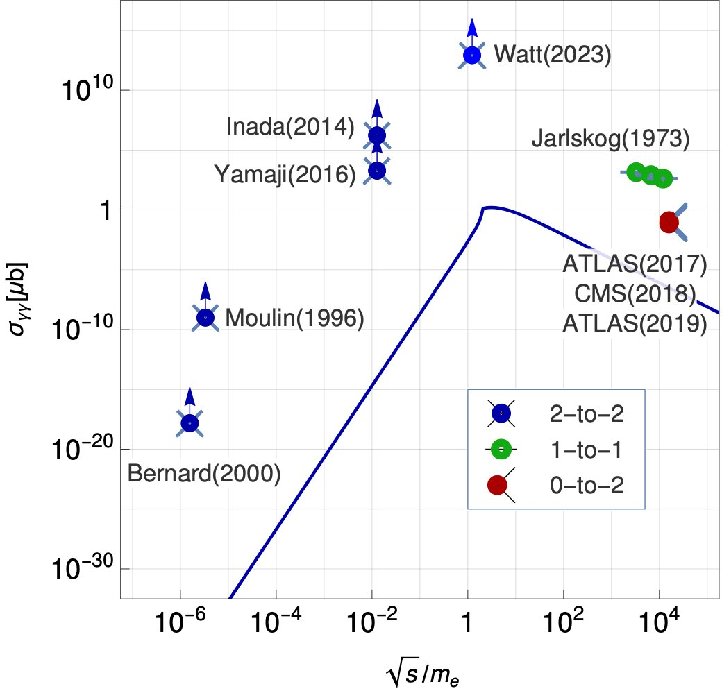
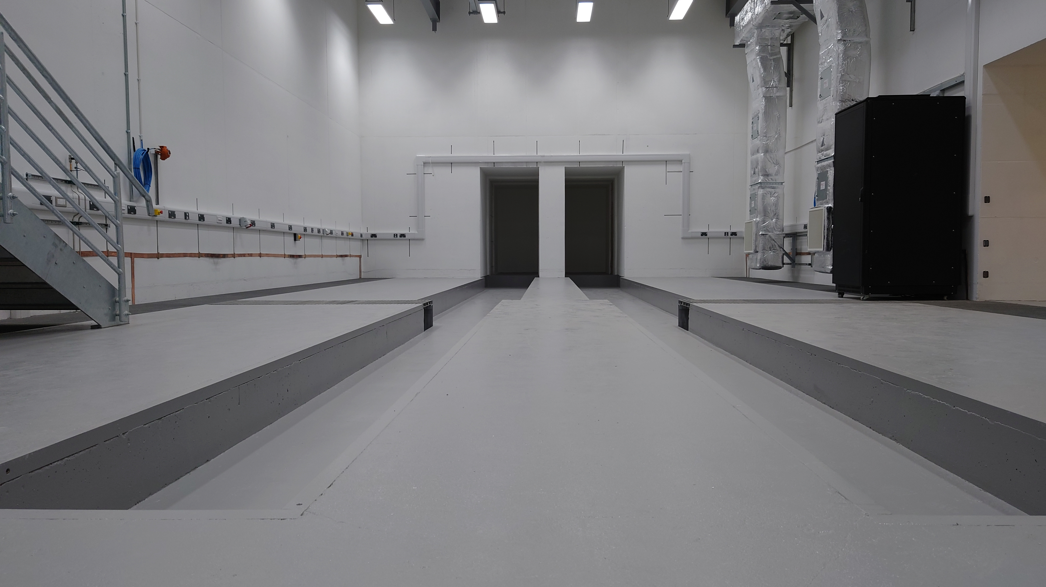
Extreme Photonics Applications Centre (EPAC)
New RAL based user facility
  Due to come online in 2025
  10 Hz Petawatt laser
  Two experimental areas
  1-10 GeV electron beams

Slide 6
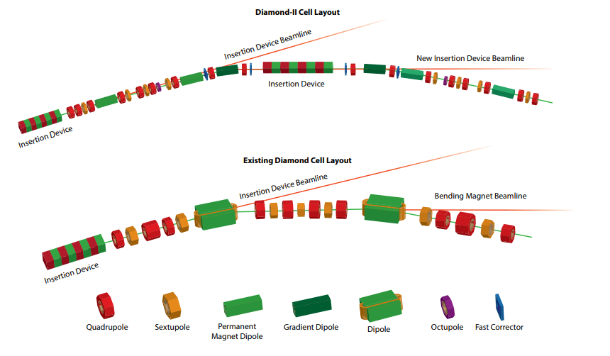
Diamond II
Upgrade to UK synchrotron source
  ~£500 M investment
  Increase energy from 3 GeV to 3.5 GeV
  New lattice based on double triple bend achromats
  Reduce horizontal emittance by factor 20
  Up to 3 orders of magnitude gain for harder end of the X-ray spectrum
  24 straight sections for potential insertion devices
https://www.diamond.ac.uk/Home/About/Vision/Diamond-II.html

Slide 7
RUEDI
Relativistic Ultrafast Electron Diffraction & Imaging
  Single shot time-resolved with MeV electrons
  Ultra-fast electron diffraction down to 10 fs
  Current designs split the imagine and diffraction
  £124 M approved from infrastructure fund
  User facility at Daresbury Lab
Recent designs split accelerator for imaging and diffraction
https://ruedi.uk

Slide 8
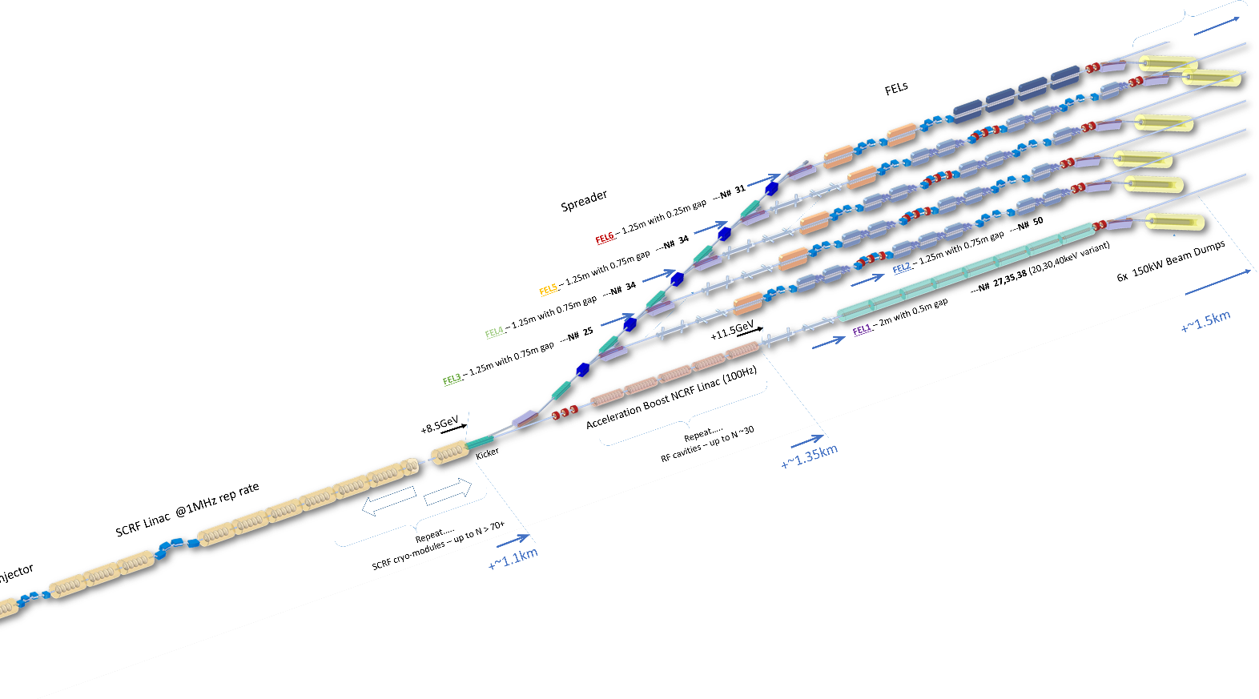
UK X-ray free electron laser
8 GeV superconducting, 1 MHz electron linac
  Multiple different colour X-ray beam-lines
  Focus on scientific throughput and flexibility
Funding from infrastructure fund
https://xfel.ac.uk

Slide 9
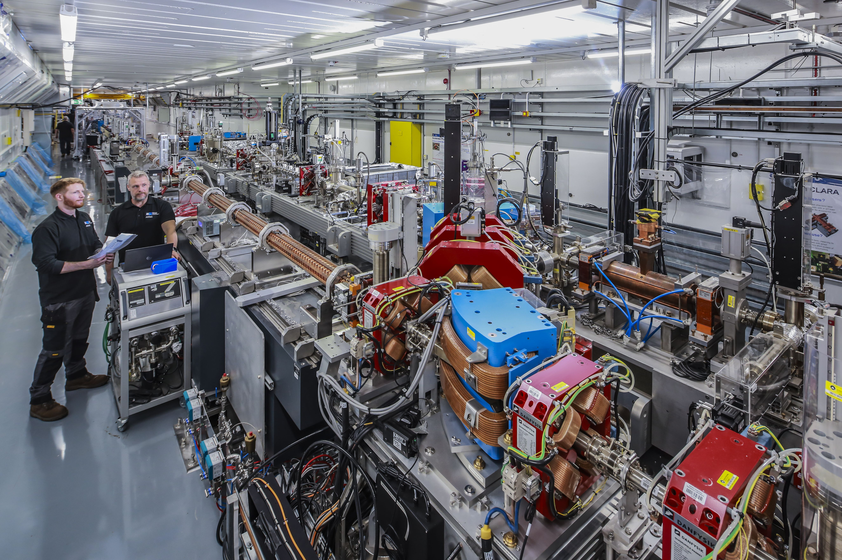
CLARA/FEBE
In preparation for UK XFEL there is the CLARA facility
  Test system for FEL technologies
  100 Hz, 250 MeV FEL quality beam
Full energy beam exploitation (FEBE)
  Experimental area to test PWFA and LWFA
  FEL beam combined with 130 TeV laser system
Phys. Rev. Accel. Beams 27, 041602

Slide 10
LhARA/ITRF
Laser driven source to accelerate protons and ions for radiobiology
Laser solid interaction to accelerate protons and/or ions
Two stage project
FFAG to reach higher energies
Phase 2
Phase 1
https://indico.stfc.ac.uk/event/986/

Slide 11
ISIS2
Replacement for the current ISIS neutron spallation source
  High power proton beam
  Target stations to >MW
Accelerator options
  Low energy linac → rapid cycling synchrotron to 1.2 GeV
  Full energy linac to 1.2 GeV → accumulator ring to bunch compress
  Low energy linac → fixed field alternating gradient to accelerate 1.2 GeV and compress
RCS
FFA
AR
https://www.isis.stfc.ac.uk/Pages/ISIS-II-webinar-13-March-2024.aspx

Slide 12
UK accelerator community
STFC and community has been successful in obtaining UKRI infrastructure funding
Securing funding for UK XFEL or ISIS2 will absorb significant (human) resources for decades
Depth of capability within the accelerator community could make significant contributions to a future HEP collider
There is a desire to engage more significantly with HEP projects
Strong steer from PP community and STFC required for accelerator institutes and ASTeC to engage more fully

Slide 13
National facilities and relevance to HEP
Are there credible HEP uses of planned UK accelerator infrastructure?
UK XFEL
  Single electron dump experiment light dark matter
  Strong field Quantum Electrodynamics
  Unruh radiation? Kaons?
ISIS 2
  Muon/flavour physics (a la PSI)
CLARA/FEBE
  Testing of staging plasma accelerator beams
  Manipulation of beams for injection into plasma
EPAC
  Real photon collision cross section measurement
  Strong field QED (again)

Slide 14
FCC-ee
FCC-ee is many machines over time
  Low energy Z-pole ~ B-factory or DAΦNE (36 MeV/turn)
  High energy tt threshold (9.2 GeV/turn)
  Significantly increase the RF power delivered to beam as the CoM energy is increased
STFC/ASTeC/Cockcroft is investing significantly in SCRF technologies
https://www.isis.stfc.ac.uk/Pages/ISIS-II-webinar-13-March-2024.aspx

Slide 15
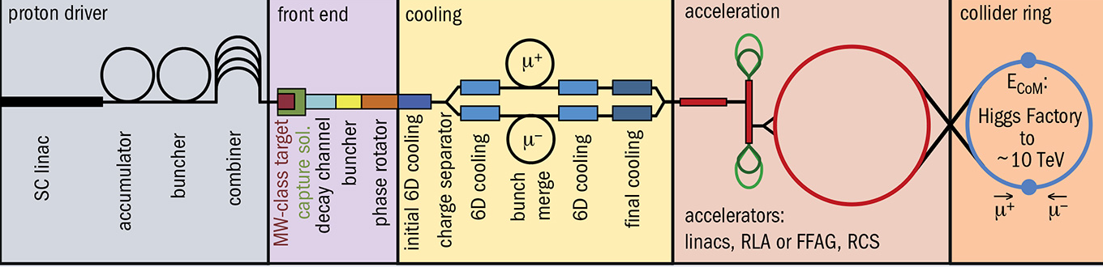
International Muon Collider
Potential to reach multi TeV lepton collisions
Challenges are manifold
  Production target, cooling and acceleration
In general, an important requirement is high RF gradients in the presence of large magnetic fields
Collider ring magnet technology
https://iopscience.iop.org/article/10.1088/1748-0221/19/02/T02015/pdf

Slide 16
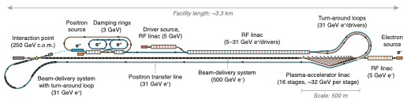
HALHF
Hybrid, asymmetric, linear Higgs factory
  Plasma-wakefield for electrons and conventional RF for positrons
  Staging multiple plasma accelerators to reach 100s GeV is far from a solved problem
  Beam power handing is a significant issue
  Reduction in overall collider length and cost saving potentially substantial
https://iopscience.iop.org/article/10.1088/1367-2630/acf395

Slide 17
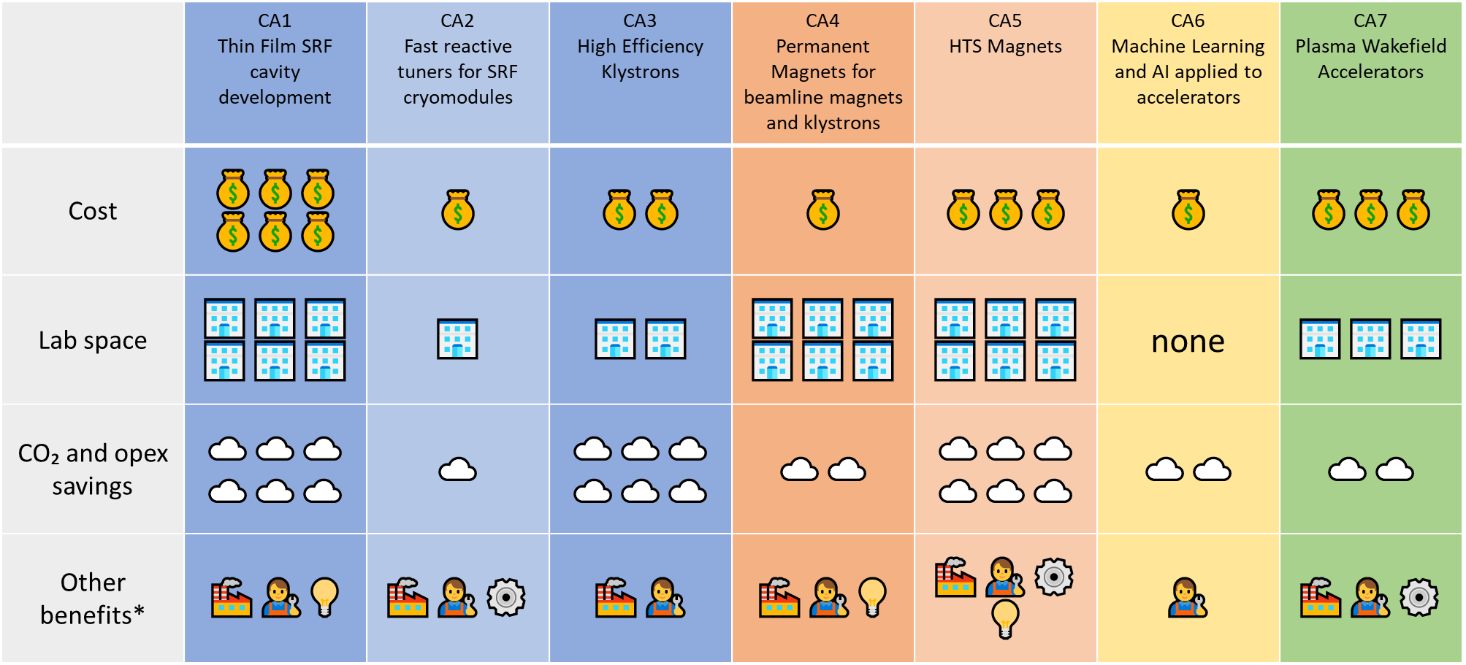
Sustainability
B Sheppard Talk at IoP PAB meeting 2024

Slide 18
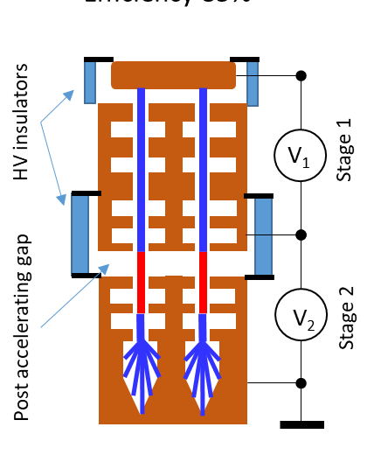
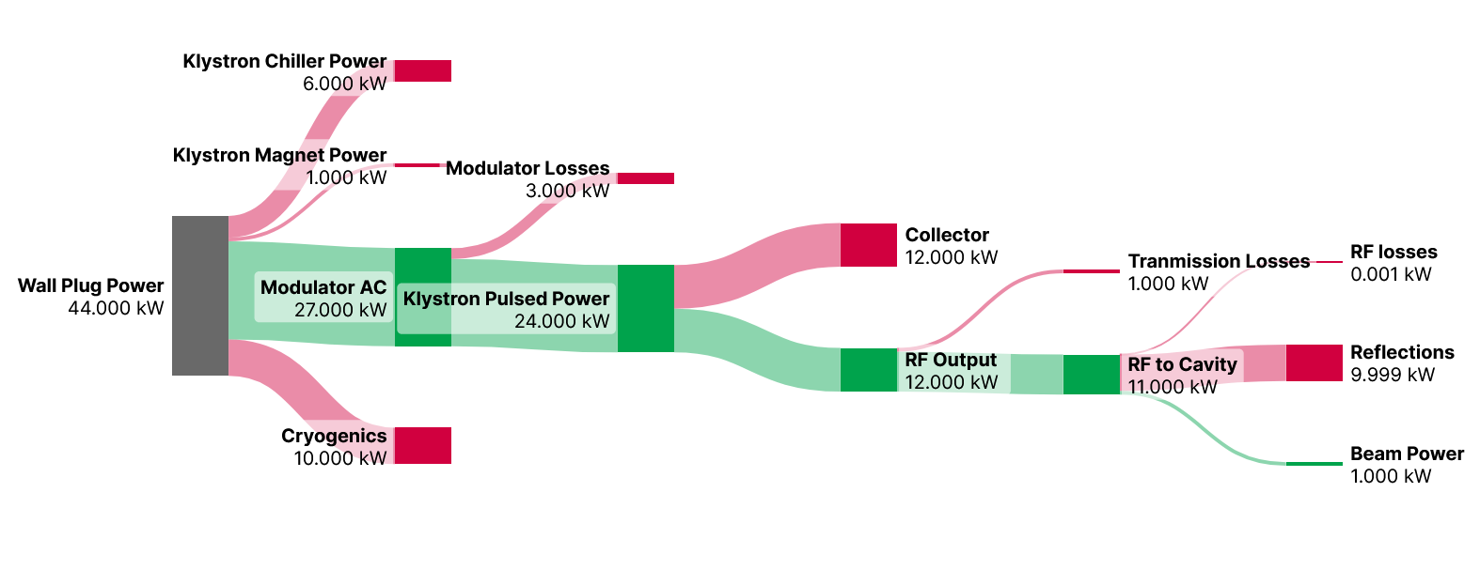
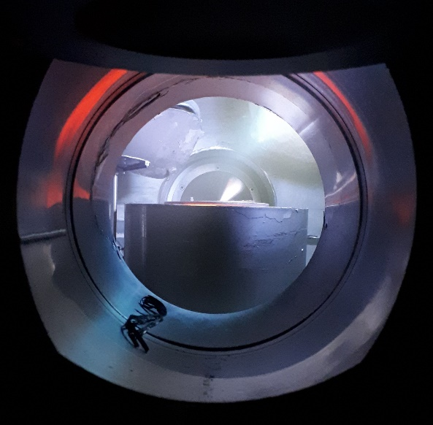
SCRF efficiency
Look at the SC RF system efficiency
  Creating the RF power (klystrons)
  Delivering the RF power to the accelerating structures (FRTs)
  SC Material and T_{c} speaks to the cryogenic systems
Fast reactive tuners can reduce this by 10
High efficiency Klystrons can halve this
Thin film SRF can halve this
B Burt Talk at IoP PAB meeting 2024

Slide 19
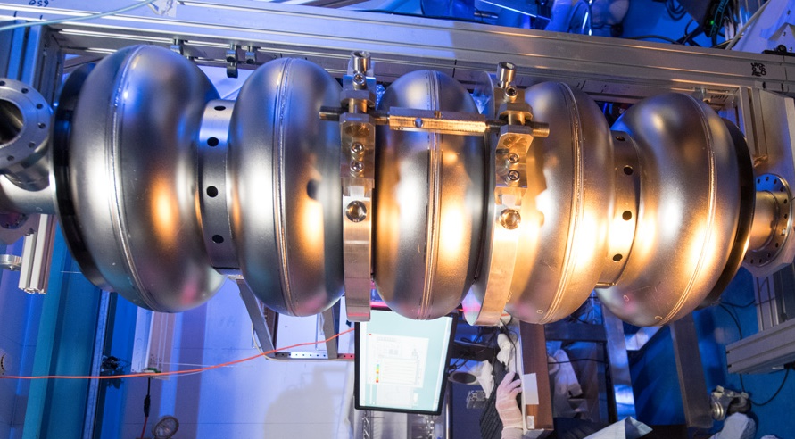
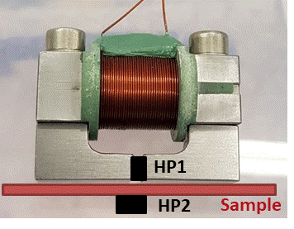
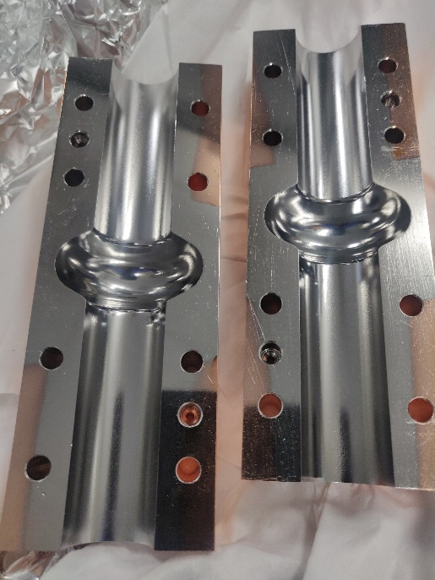
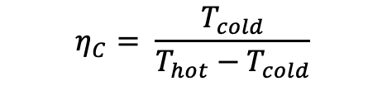
Thin super conducting films
Replace bulk Niobium e.g copper with thin SC film
Higher T_{c} material (Nb₃Sn, V₃Si, NbN, NbTiN, MgB₂)
Reduce cyrogenic power consummation
Improve accelerator performance (gradient, quality factor)
$$η_{C}= \frac{T_{cold}}{T_{hot}−T_{cold}}$$
B Sheppard Talk at IoP PAB meeting 2024
Deposit
Fundamental
measurements
Acc structure
measurements

Slide 20
Mapping research onto projects (incomplete)
Research area | IMC | FCC-ee | FCC-hh | HALHF | UK XFEL | ISIS2
SCRF (RF efficiency) | Proton linac High-B and RF | Replace SR losses |  | 200 GeV Electron linac | 8 GeV linac | 1.2 GeV p linac
High field magnets | Collider ring |  | Collider ring
RCAs/FFAs | Rapid acc |  |  |  |  | High power
Advanced acceleration |  |  |  | Plasma staging
Machine detector interface | Complex IR | Significant IR radiation |  | See ILC issues
Beam instrumentation
Beam dynamics

Slide 21
Summary
UK community is comparatively rich with non-HEP accelerator projects
ASTeC and STFC is rightly focused on national facilities
Cockcroft and John Adams Institutes have the expertise to made meaningful contributions to FCC-ee, IMC, HALHF (insert HEP collider project of your choice here) etc.
  ASTeC and STFC will also play an important role if construction of a new project is approved
Sustainability will and should play a significant part of the R&D considerations.
Mapping current UK expertise onto planned HEP collider projects is probably a worthy exercise in preparation for STFC strategy development, ECFA visit and ESPPU

