Slide 1
Flavour programme at colliders
Dr. Harry Cliff
Cavendish Laboratory, University of Cambridge
PPAP Community Meeting
University of Birmingham
Tuesday 25th June 2024

Slide 2
Flavour physics
Why six quarks and six leptons?
CP violation?
What drives the hierarchy of fermion masses?
What explains the pattern of mixing between generations?
Are quarks and leptons connected?
All these questions can be probed by studying beauty and charm quarks

Slide 3
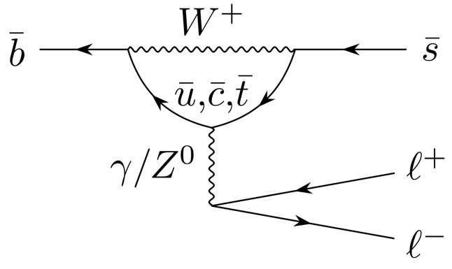
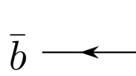

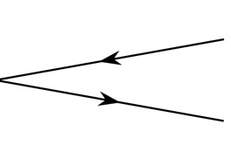

Flavour as a probe of new physics
Standard Model
New Physics
?
studying heavy flavour decays gives sensitivity to BSM quantum fields in the loops
sensitive to energy scales above direct reach of LHC (up to 100 TeV in FCNC b decays)

Slide 4
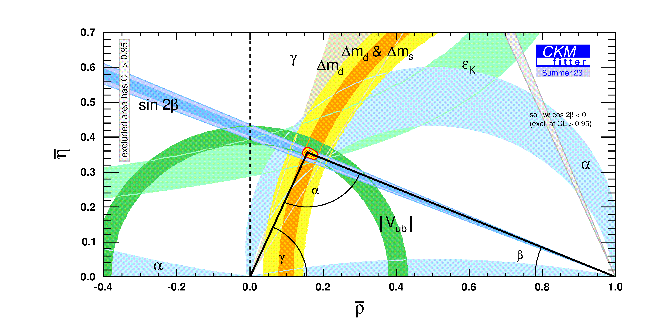
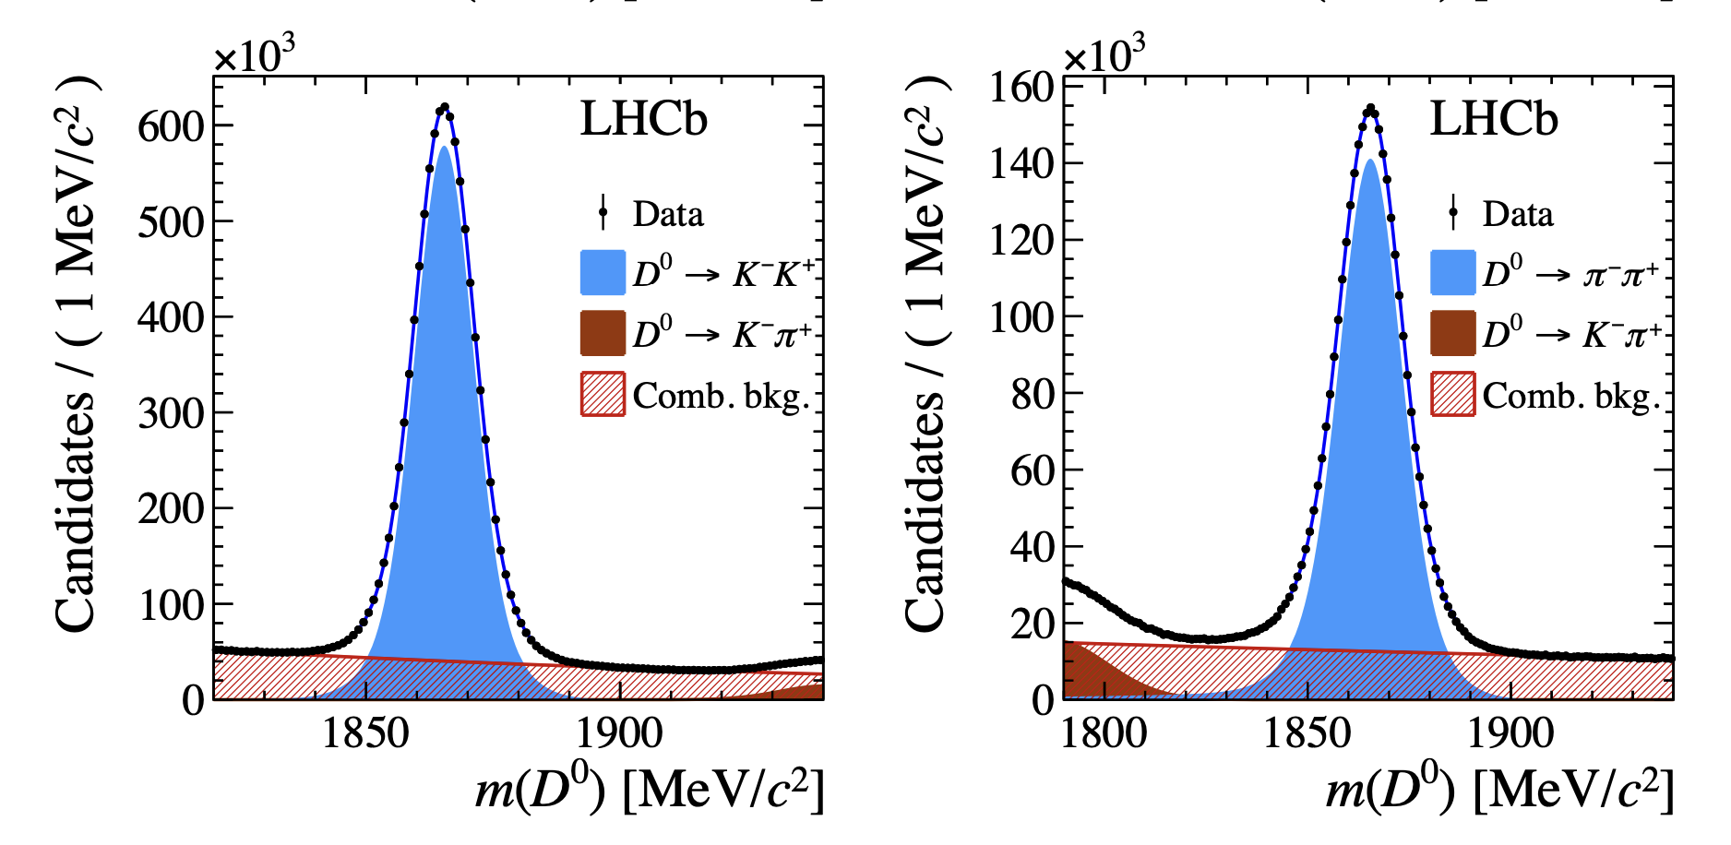
Flavour physics at the LHC
Nature Phys. 18 (2022) 1
B oscillations
CKM triangle
Phys. Rev. Lett. 122 (2019) 211803
CP violation in charm
Exotic hadrons

Slide 5
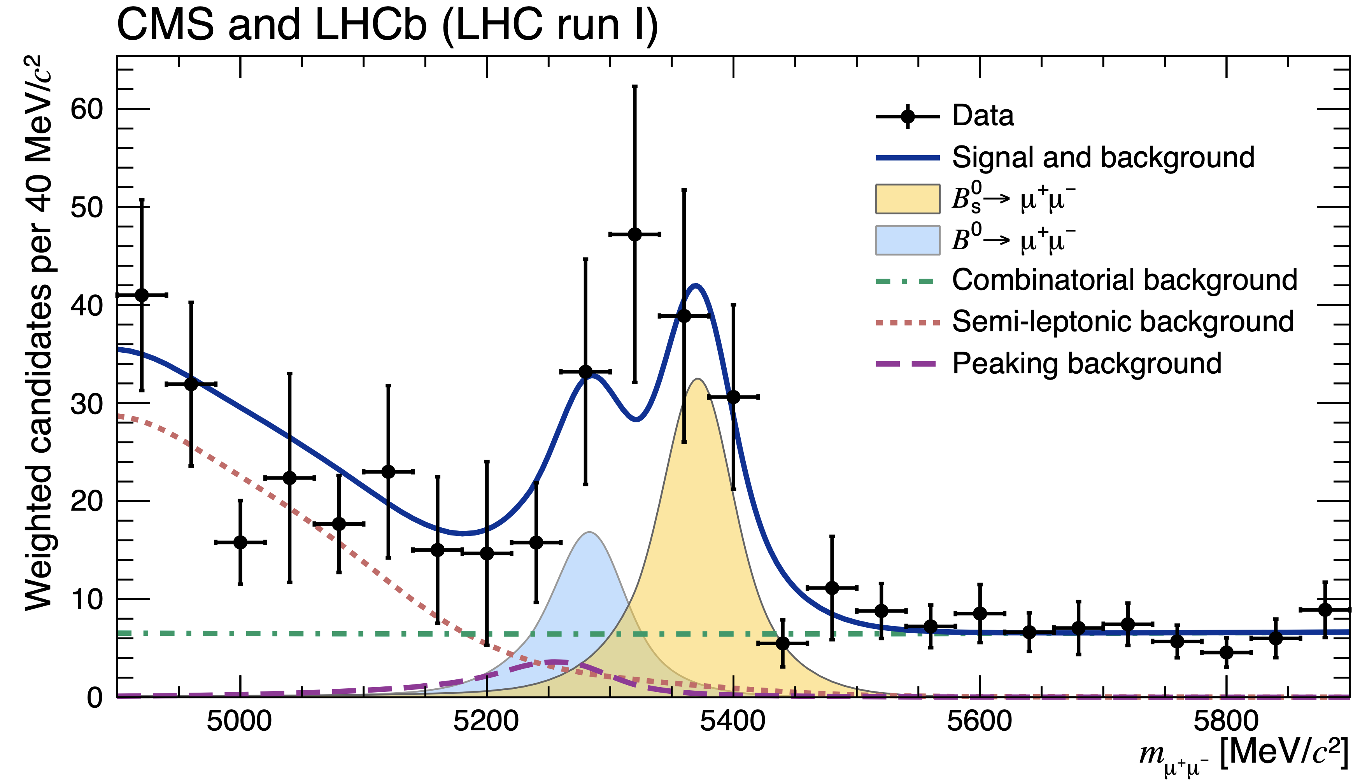
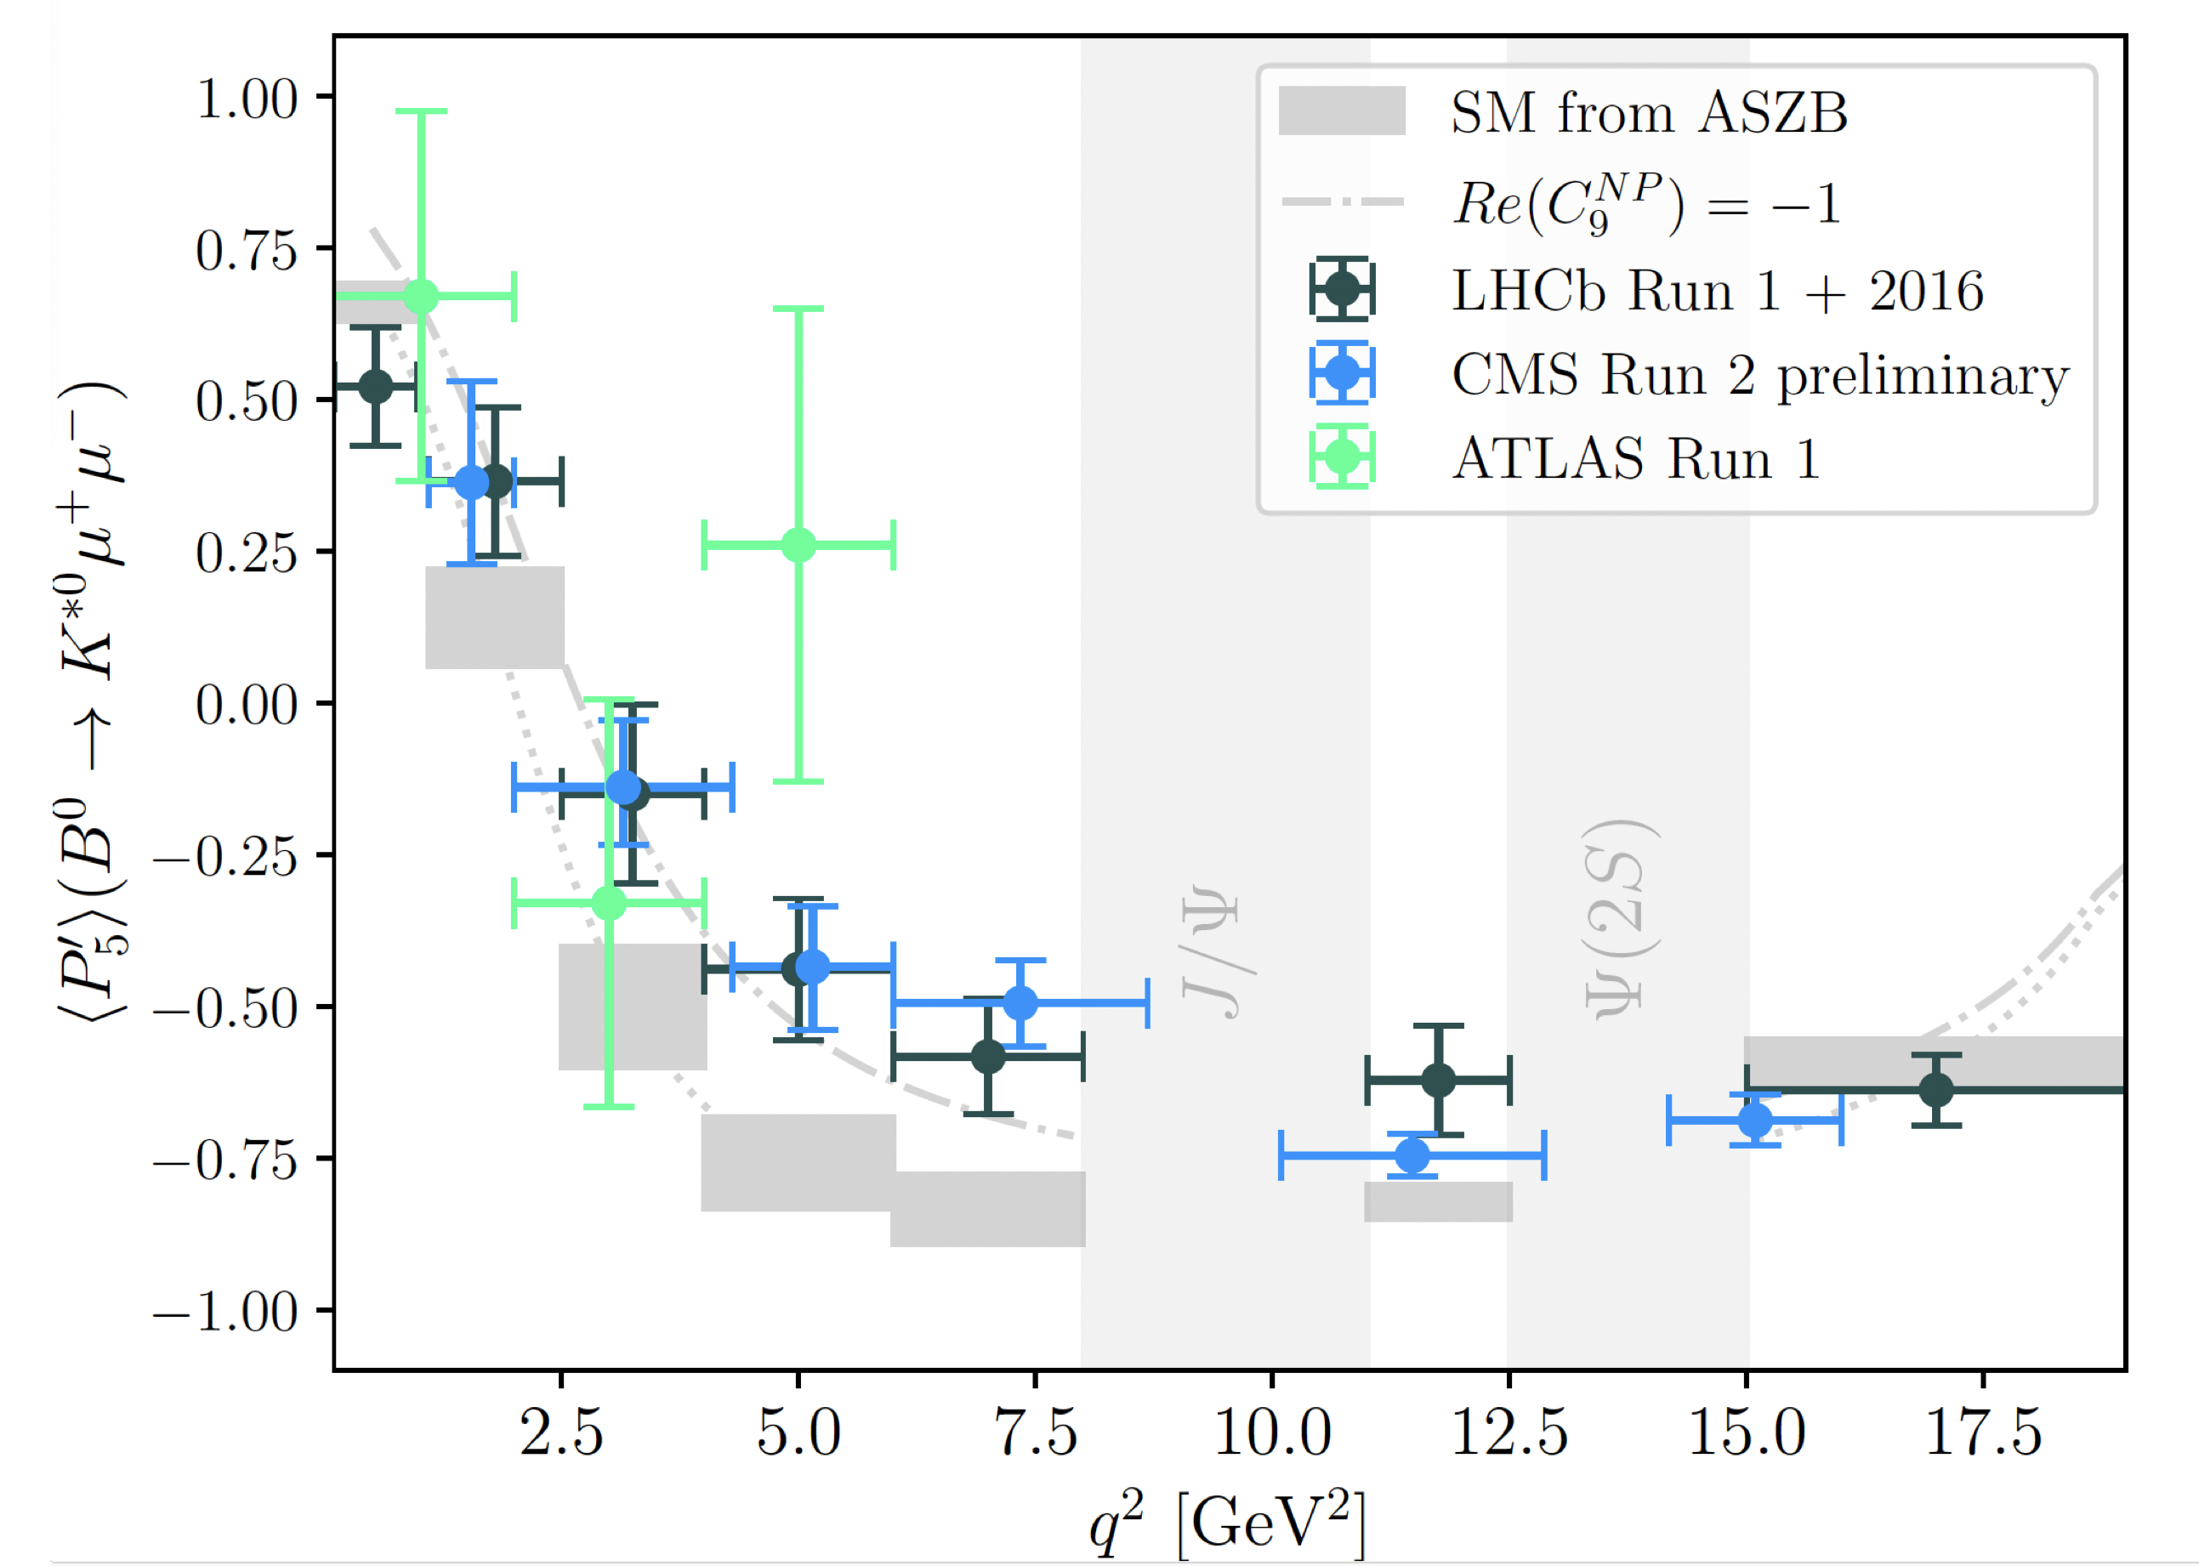
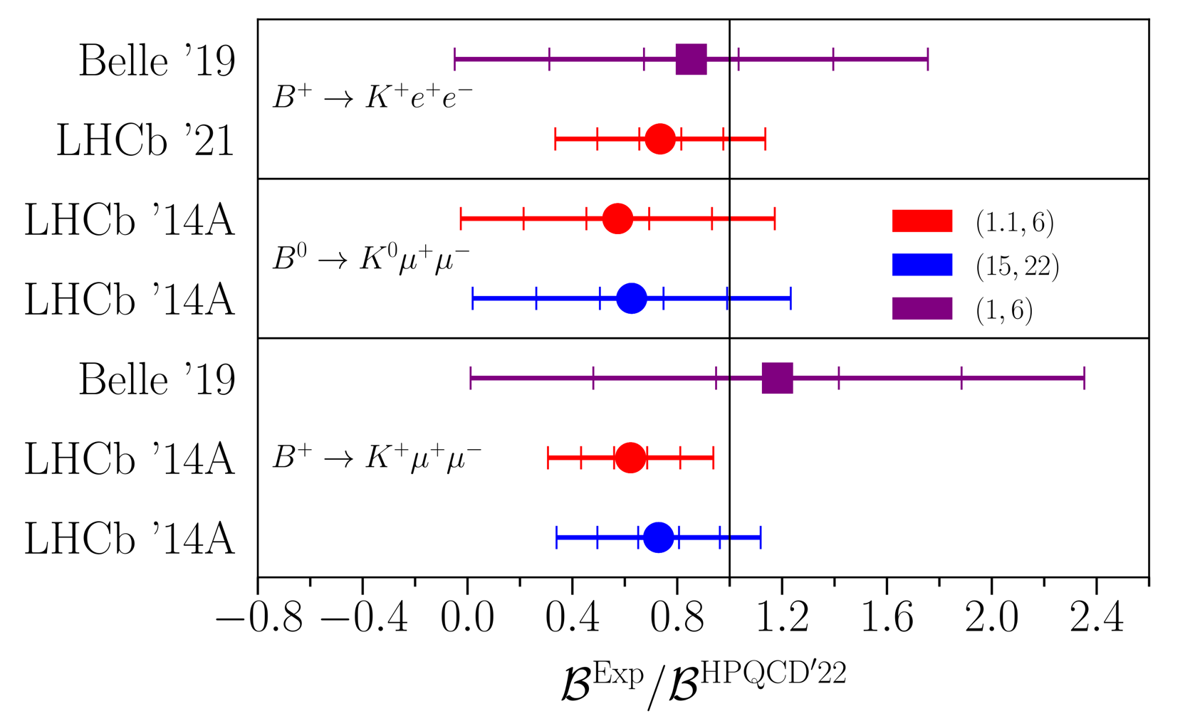
Flavour physics at the LHC
Nature 522 (2015), 68-72
Eluned Smith @LHCP
B_{s} → μ⁺μ⁻
Parrott, Bouchard, Davies: Phys. Rev. D 107, 014511 (2023)
FCNC angular
FCNC branching fractions

Slide 6
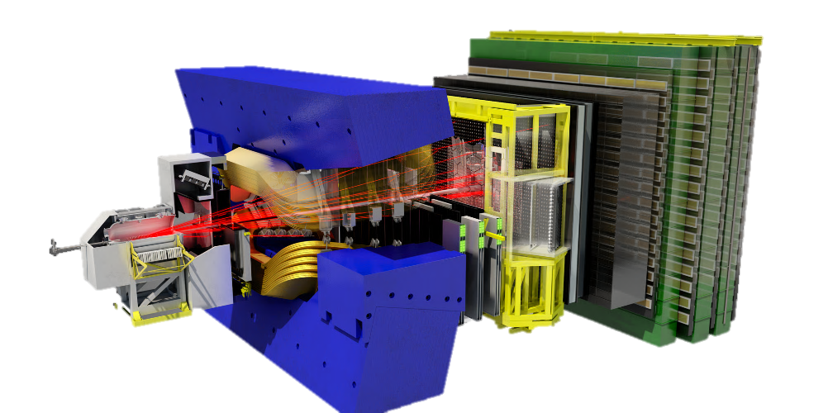
The LHCb Upgrade I
Major upgrade to LHCb now in operation:
Almost all-new detector to allow readout at 30 MHz
Removal of hardware trigger
Full software trigger
Unprecedented beauty samples:
Targeting 50fb⁻¹ by end of Run 4
Significant increase in trigger efficiencies for many modes
New ring-imaging Cherenkov detectors
New data centre and all-software trigger
New silicon pixel vertex locator
New scintillating fibre tracking system
New silicon upstream tracker

Slide 7
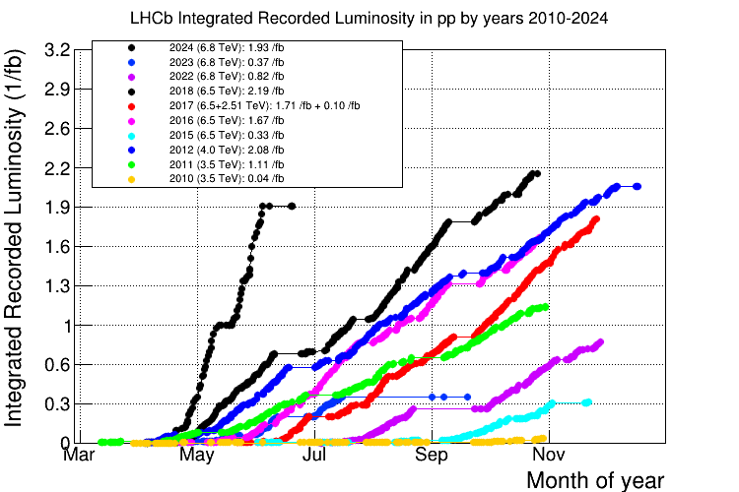
LHCb Upgrade I
Notes:
Not the final gradient

Slide 8
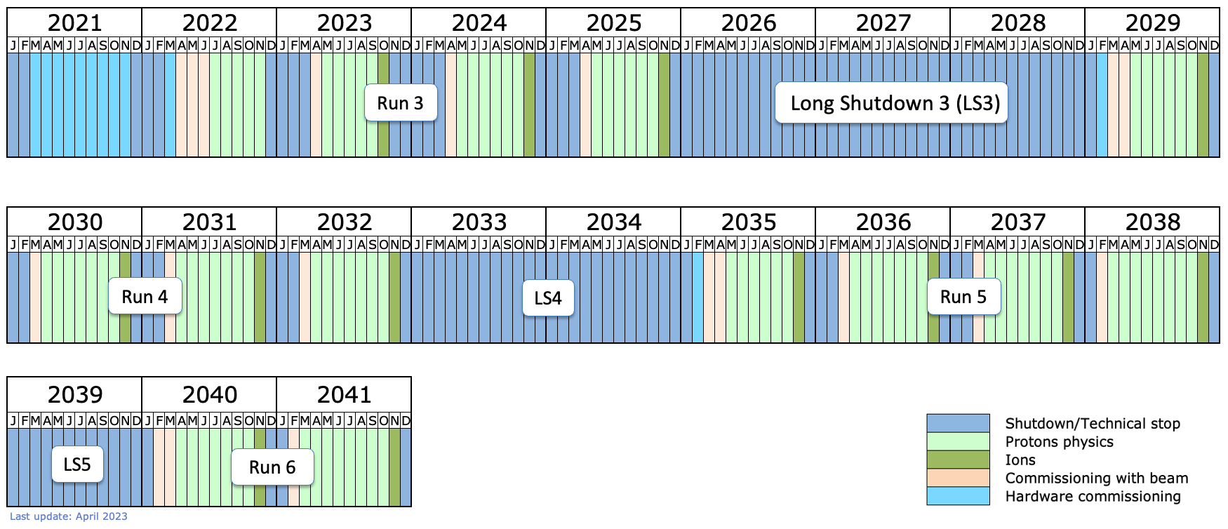
LHC Schedule
High-Luminosity LHC
LHCb Upgrade II
European Strategy Update 2020: “The full potential of the LHC and
the HL-LHC, including the study of flavour physics, should be exploited”

Slide 9
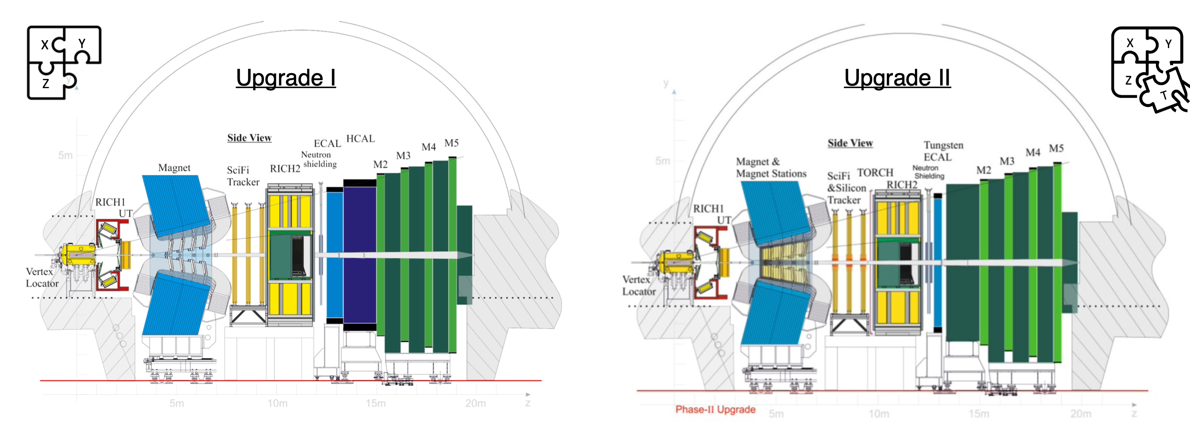
LHCb Upgrade II
Detector for the HL-LHC era
Most physics statistically rather than systematically or theoretically limited→ motivates high luminosity experiment.
Aim to record 300fb^{–1} by end of HL-LHC.
PicoCal
Global changes:
Fast timing to reduce backgrounds
Radiation hardness
Removal of HCAL, introduction of TORCH and magnet tracking stations
LHCb-TDR-023

Slide 10
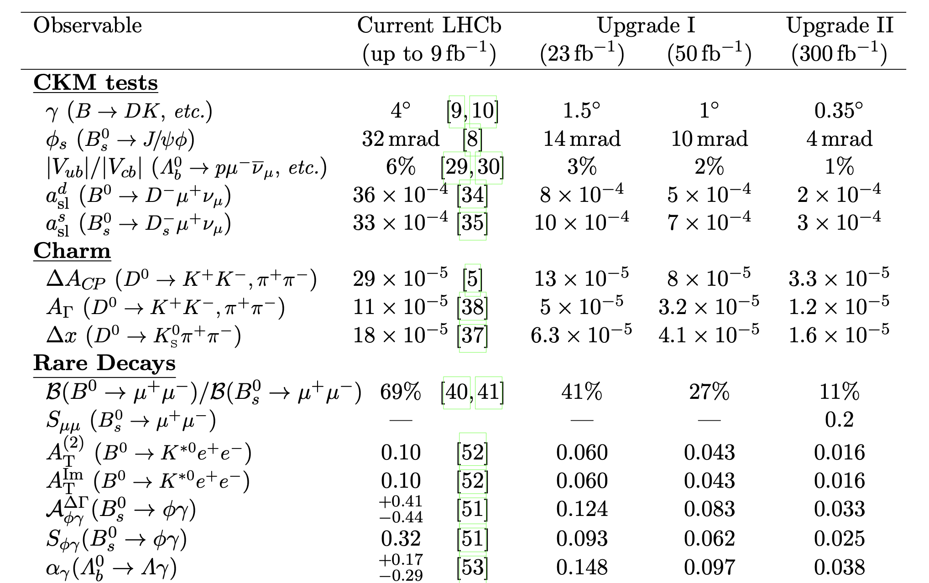
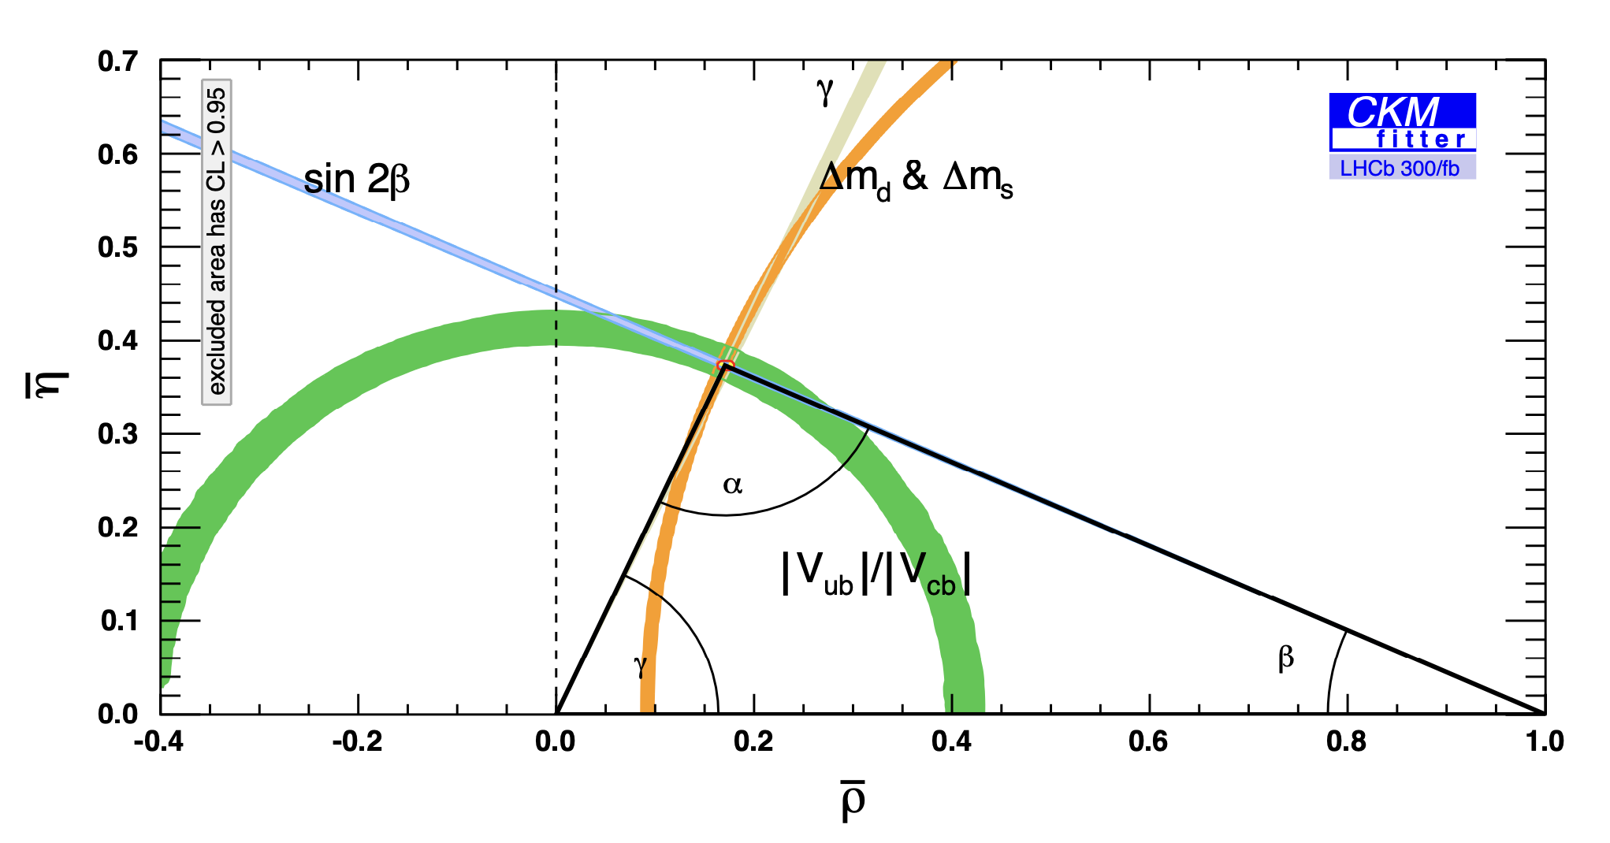
LHCb Upgrade II - Physics
Targeting huge improvements in precision on key flavour observables
LHCb-TDR-023

Slide 11
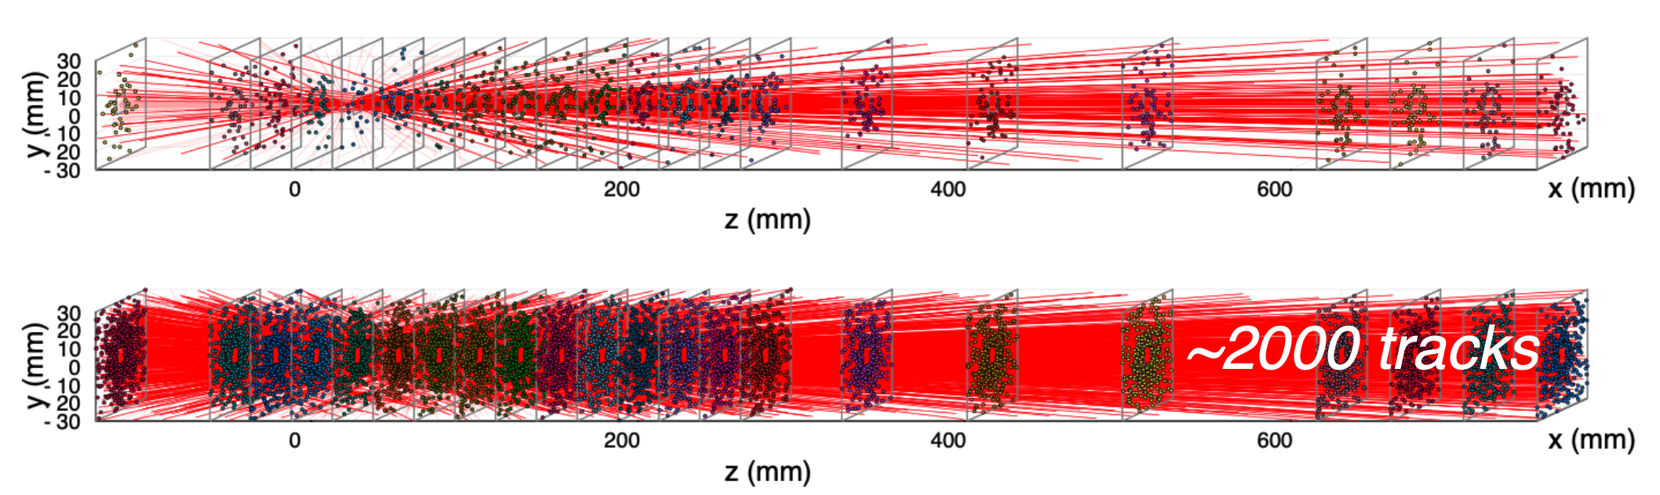
LHCb Upgrade II – Luminosity
The challenge of luminosity
Instantaneous luminosity increase from 2 × 10³³ cm⁻² s⁻¹ to 1.5 × 10³⁴ cm⁻²s⁻¹
42 interactions per bunch crossing
2000 charged particles within LHCb acceptance
Design challenges:
Higher granularity, non-uniform detectors to cope with busier events
Radiation-hard detectors to survive intense conditions
Introduce fast timing to separate overlapping pp interactions
Run 3: pile-up ~6
Upgrade II: pile-up ~42
LHCb-TDR-023

Slide 12

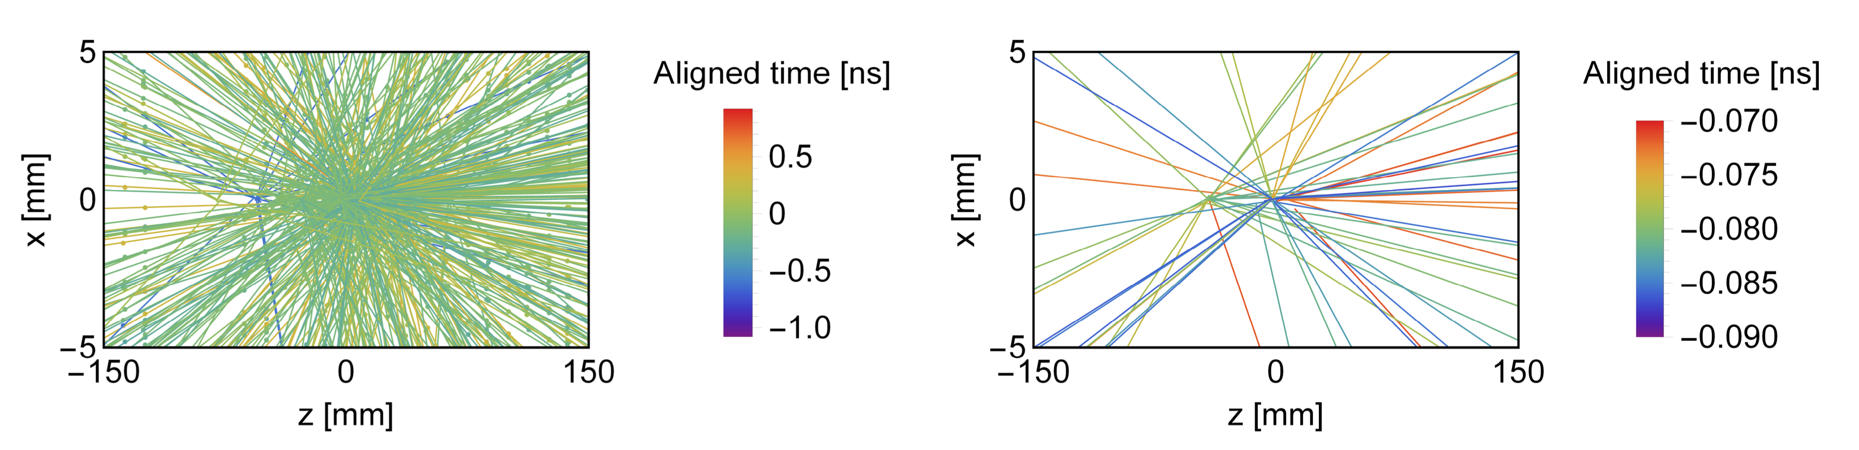
LHCb Upgrade II –Timing
Fast timing crucial to reduce backgrounds in high luminosity environment
LHC bunches are long (50mm) and pp interactions occur over 0.2 ns.
Timing with a few tens of ps resolution per particle allows charged tracks and photons to be associated to the correct primary vertex.
VELO, RICH, TORCH and ECAL will be fast timing detectors:
Adds new dimension to information exchanged between sub-detectors
New potential for data suppression in front-end hardware and software trigger
Sets challenging R&D requirements, particularly for sensors and front-end ASICs.
No timing
20 ps window
LHCb-TDR-023
Notes:
UK involvement in VELO, RICH TORCH

Slide 13
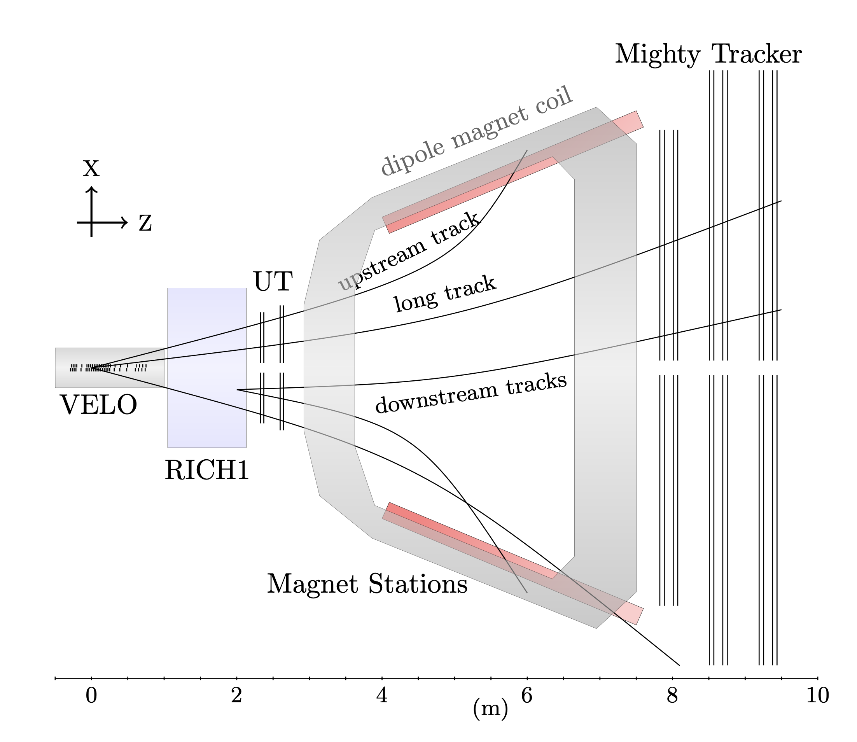
LHCb Upgrade II –Tracking
Tracking system comprised:
Vertex Locator (VELO)
Upstream Tracker (UT)
Magnet Stations (new addition)
Mighty Tracker (SciFi + inner silicon)
Higher occupancies require higher granularity.
Mismatch rate between upstream and downstream track segments needs to be minimised.
Shift from strip to pixel technology and add fast timing.
LHCb-TDR-023

Slide 14
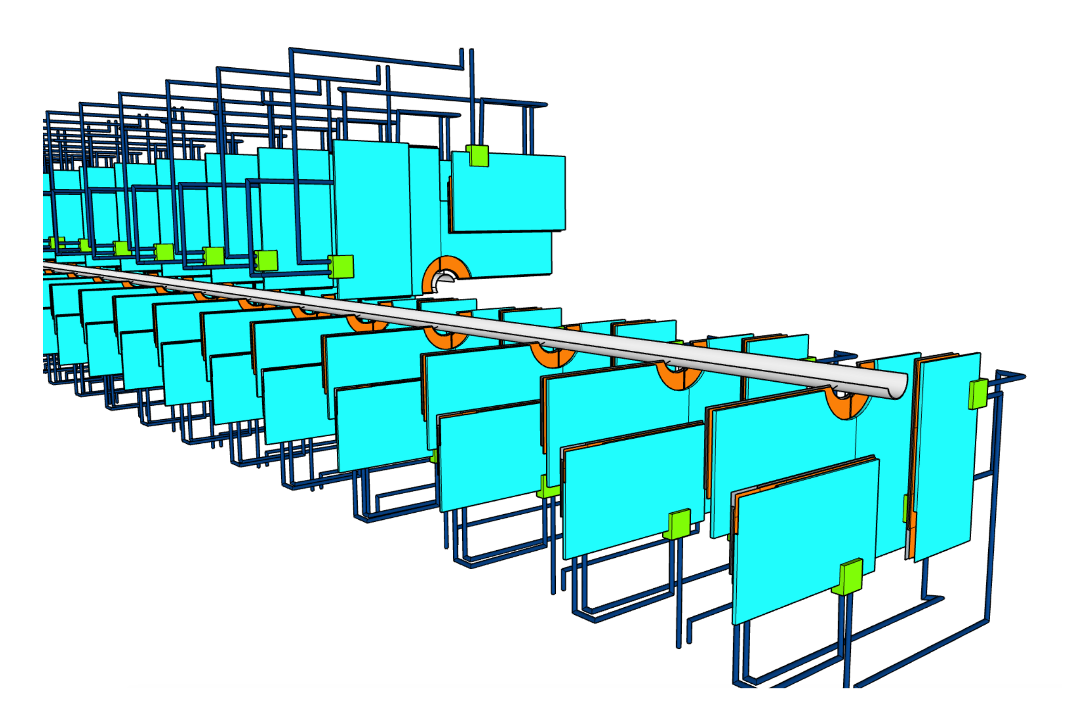
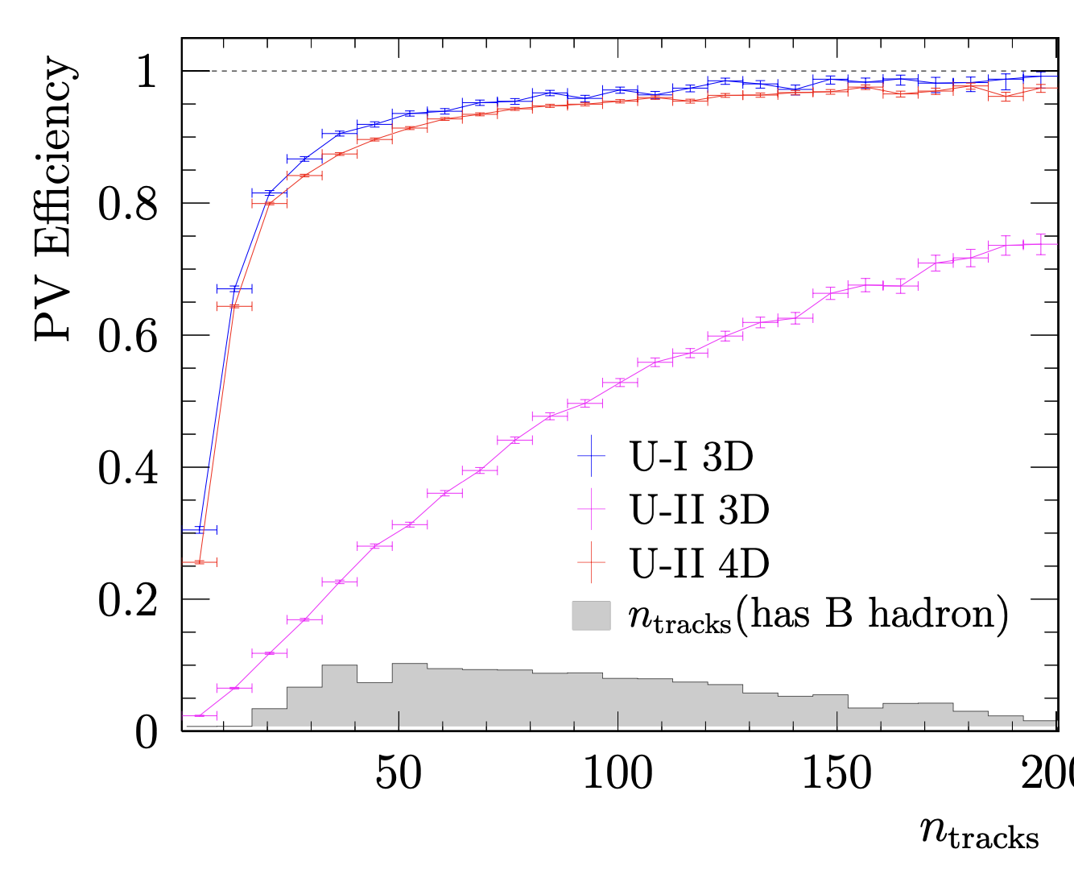
LHCb Upgrade II –VELO
Candidate sensors:
thin planar, 3D sensors
Candidate ASICs (28 nm technology)
VeloPix2, IGNITE
Mechanical design challenges:
cooling, module replacement, minimisation of material (RF foil), vacuum compatibility
Timing
Improvements in spatial resolution not sufficient
Require track time resolution of ~20ps and hence hit time resolution of 50 ps for the 4D pixels.
LHCb-TDR-023
Notes:
Low Gain Avalanche Diodes – degredation at high fluences

Slide 15
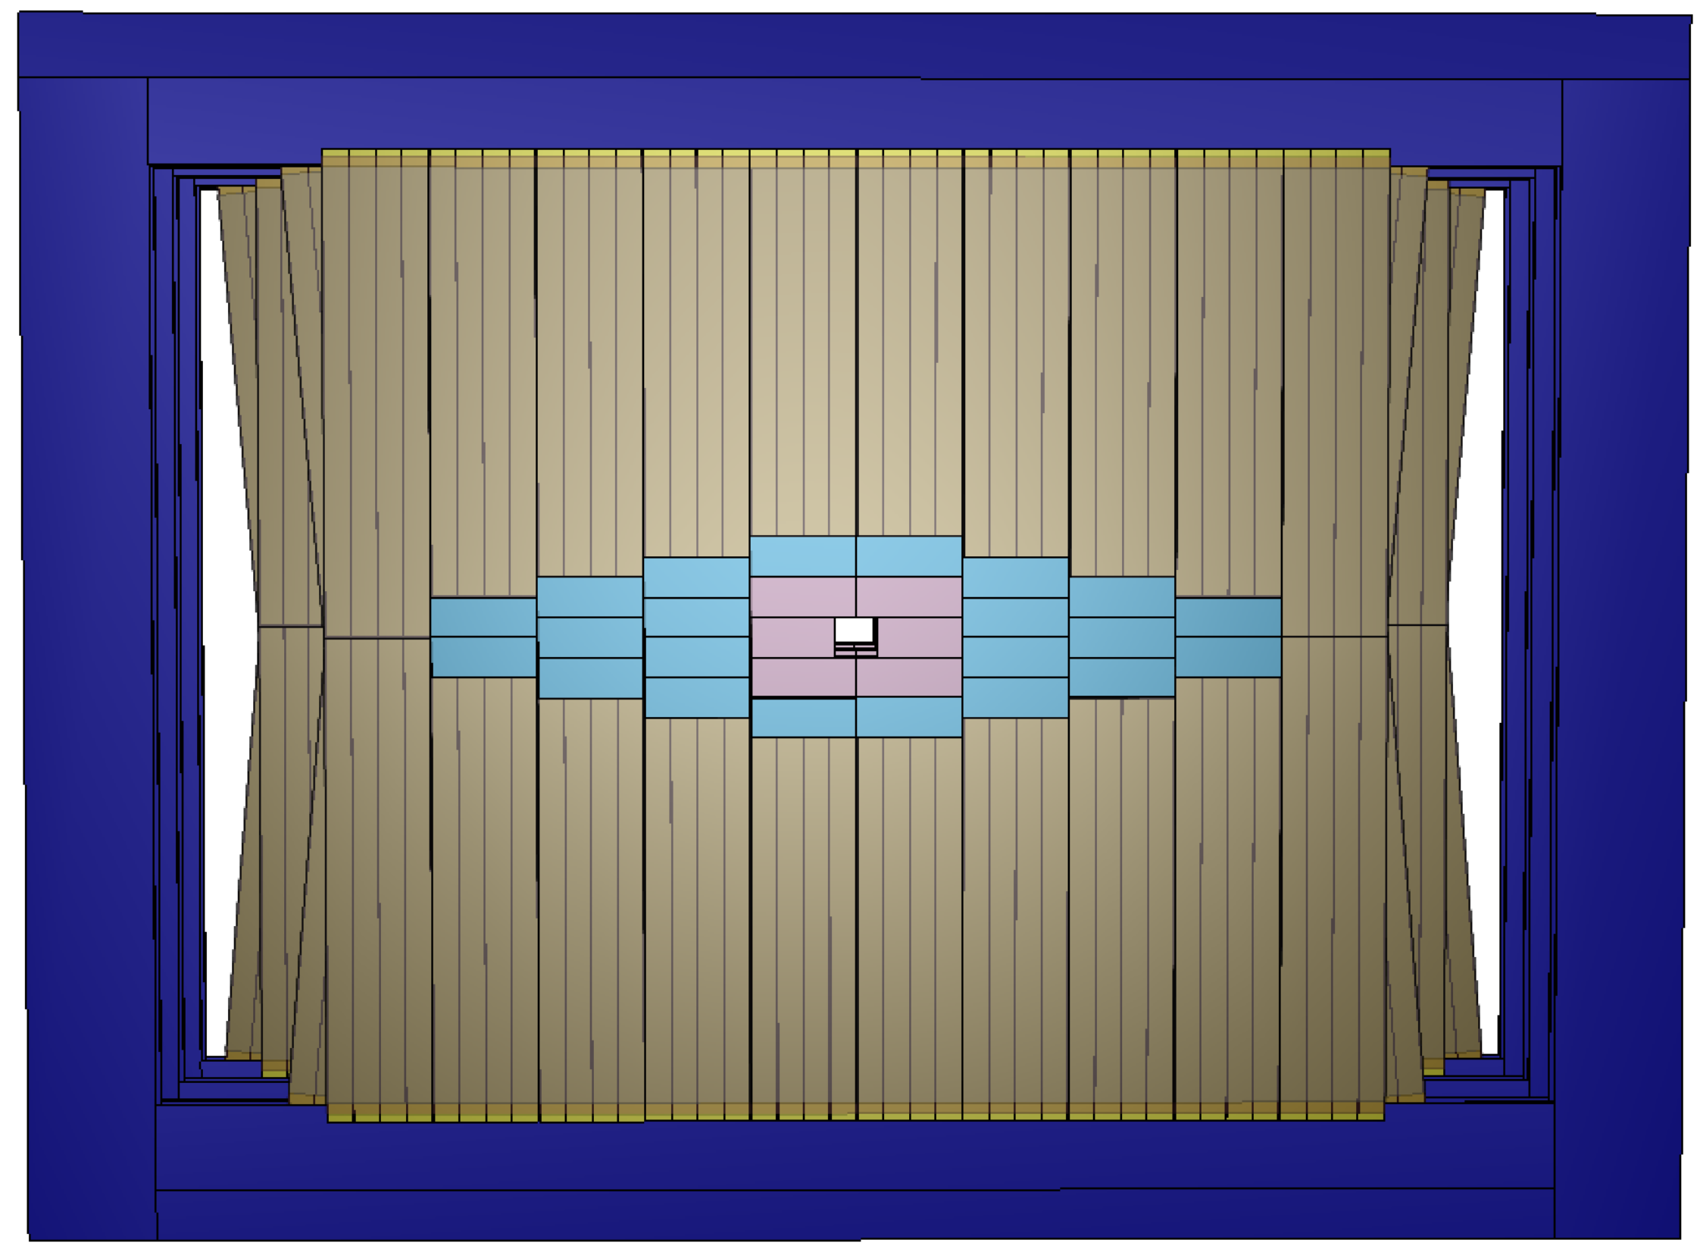
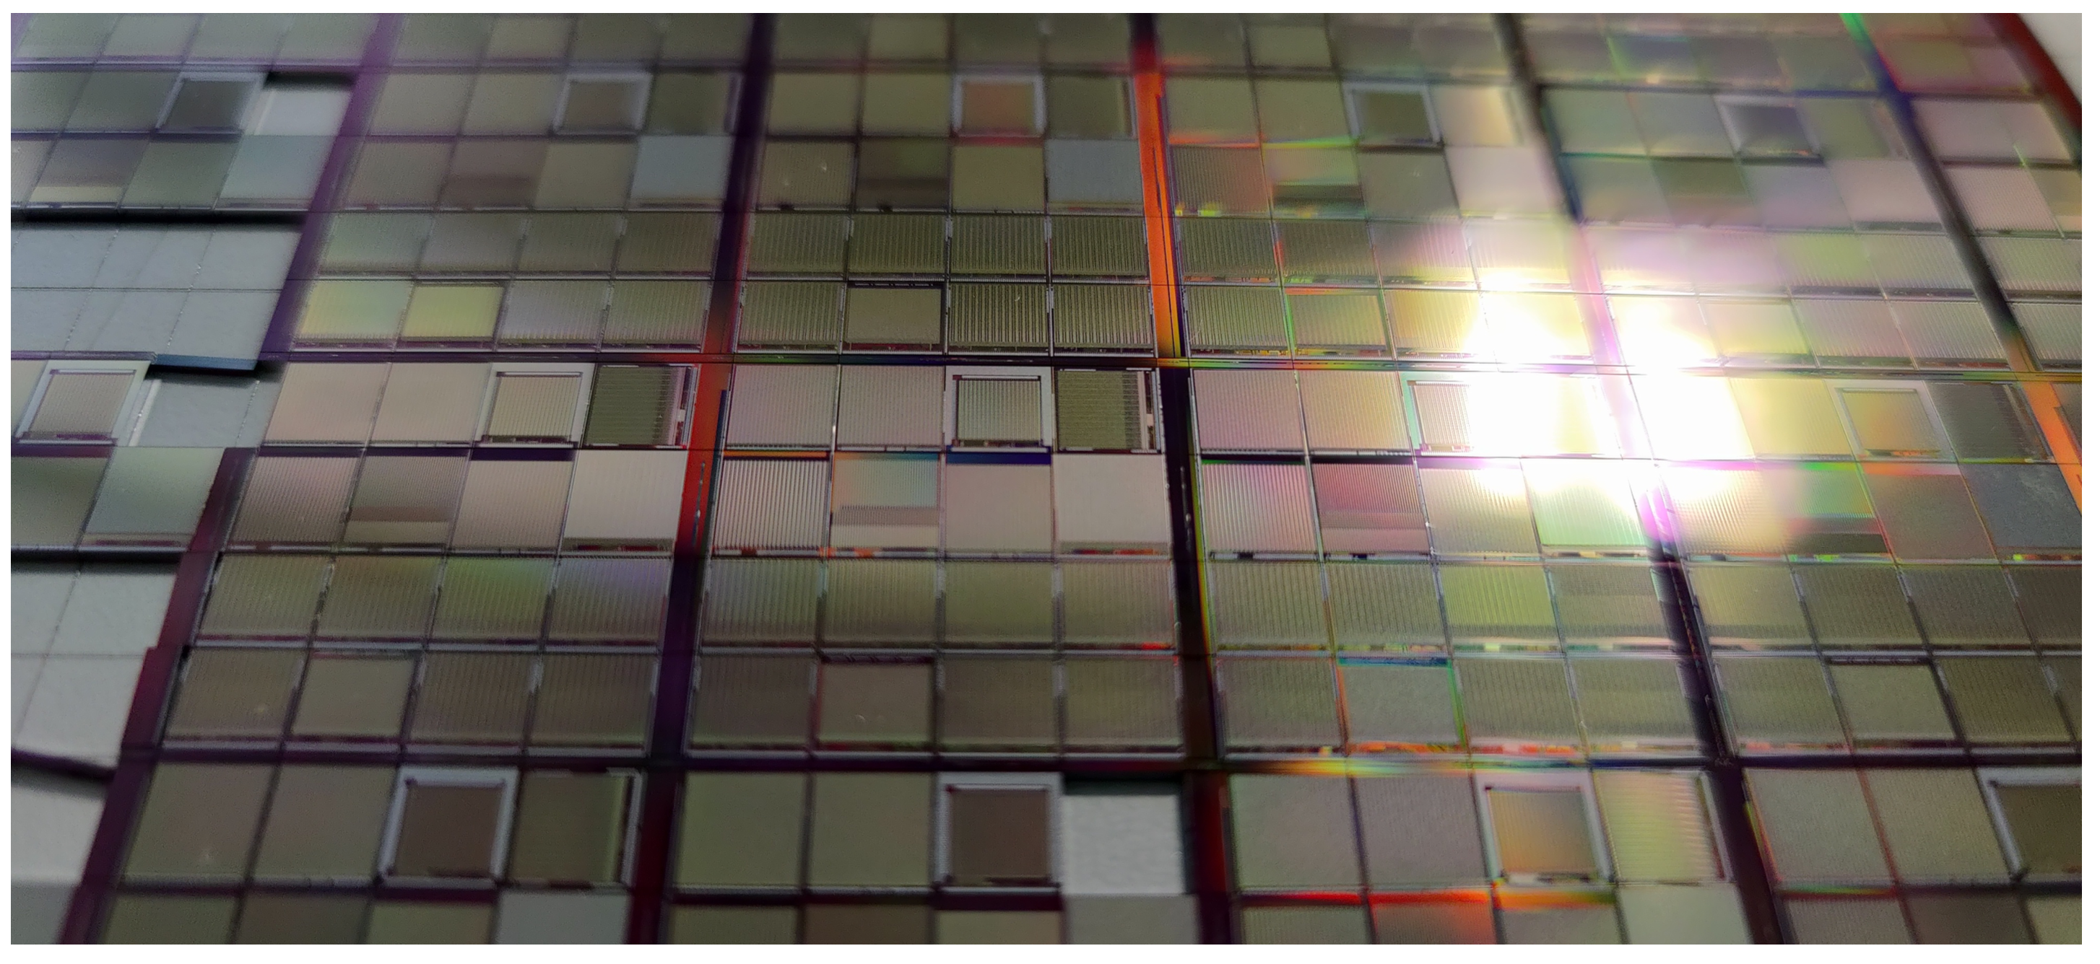
LHCb Upgrade II –MAPS Trackers
Mighty Tracker
Replace central region of of SciFi tracking stations with silicon detecors
Use Monolithic Active Pixel Sensors (MAPS) for both Mighty Tracker and UT
First large-scale tracking detector with this technology
Meets radiation requirement (3 × 10¹⁵ n_{eq}/cm² at UT)
Building on experience from STAR, ALICE, ATLAS and mu3e
LHCb-TDR-023

Slide 16
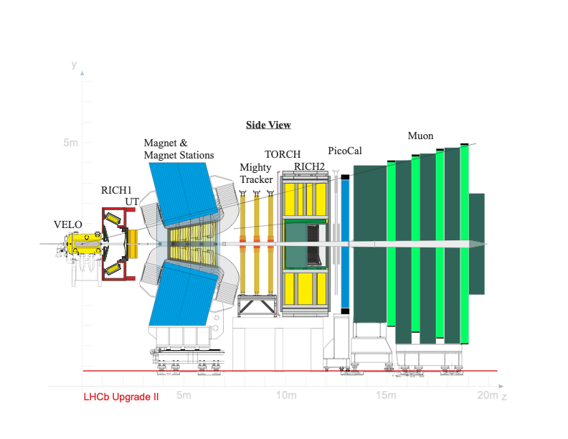
LHCb Upgrade II –Particle Identification
New TORCH (Time of internally reflected Cherenkov light) will cover the lower momentum range from 2-10 GeV/c by combining the time-of-flight and time-of-propagation techniques.
The electromagnetic calorimeter (ECAL) performs photon, electron and π⁰ identification - separated from the muon detectors by a 1.7 m-thick iron shield.
Ring-Imaging Cherenkov detectors (RICHs) perform charged hadron ID from 3 GeV/c (veto mode) to 65 GeV/c using C₄F₁₀ in RICH 1 and 15-100 GeV/c using CF₄ in RICH 2.
LHCb-TDR-023
Notes:
Greenhouse gases – R&D into alternative radiators and RICH gas-tight boxes

Slide 17
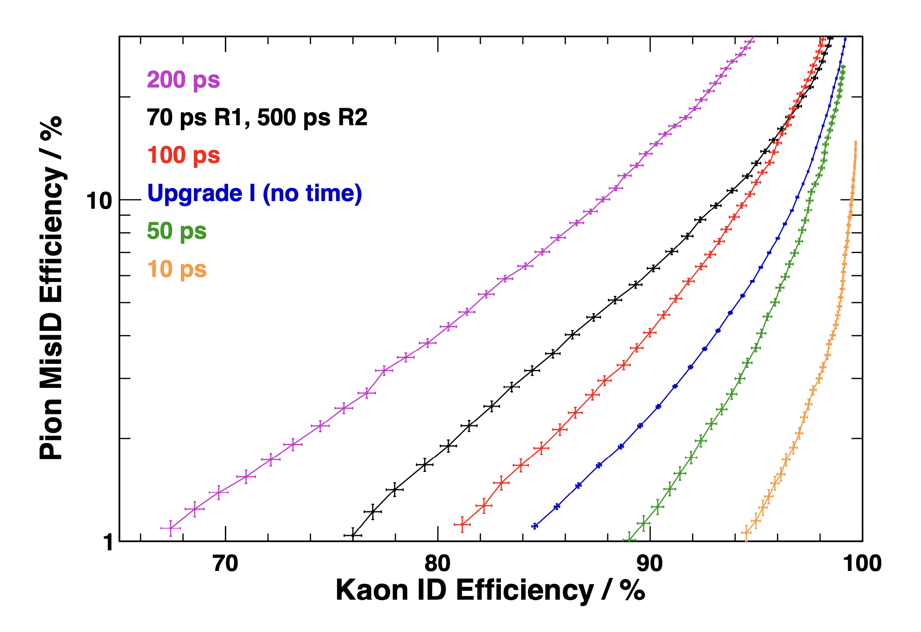
LHCb Upgrade II –RICH
RICH:
Reduced footprint vs current detector
Improved granularity to 1.0 x 1.0 mm² pixels avoids peak photon occupancy exceeding 100%
Sensors under study: SiPMs, MCP-based detectors, next gen MaPMTs
Using reconstructed parameters in the RICH algorithms and the PV t-zero, can predict the detector hit times to within 10 ps.
Time gate around the predicted time significantly reduces combinatorial background and helps to recover the Run 3 particle ID performance.
Faster detectors are better, as in practice the photon detector resolution will dominate the width of the time gate. Aiming for a resolution better than 100 ps.
LHCb-TDR-023

Slide 18
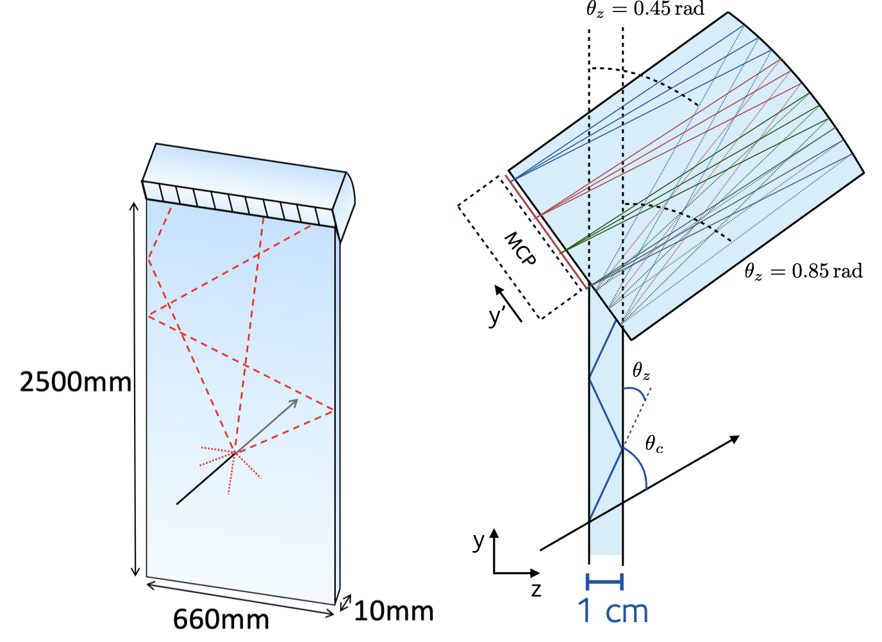
LHCb Upgrade II –TORCH
TORCH (Time Of internally Reflected CHerenkov light):
Innovative ToF detector providing pion/kaon (kaon/proton) separation up to momenta of 10 (20) GeV.
Highly-polished 1 cm thick quartz plate used as radiator
Photons internally reflected and focussed onto photon detectors.
Arrival time of photons measured precisely.
At 10 metres from collision point require per track resolution of 15 ps for 3σ K/π separation
Per photon resolution of 70 ps.
“Start time” t₀ determined from timing of other tracks from primary vertex
LHCb-TDR-023

Slide 19

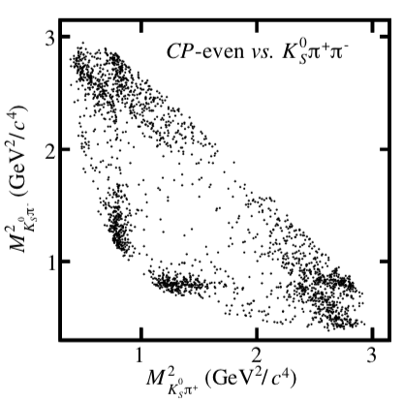
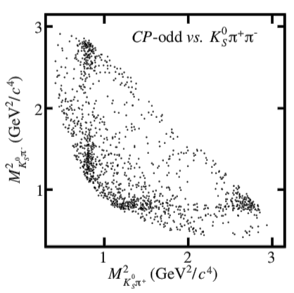
BESIII
Beijing Spectrometer III (BESIII) runs at Beijing Electron-Positron Collider
Variable beam energy between 2 and 4.6 GeV, luminosity 10³³ cm^{–2}s^{–1}
Charm physics with D⁰/D⁺: dataset 7 x larger than before now available
Very clean e⁺e– environment. Semi-leptonic/leptonic decays for V_{cd} and V_{cs}
Work here forms important input to LHCb (and Belle2)
Driven by UK groups (there are 3 on BESIII)
Also other datasets for exotic charm spectroscopy, Λ_{c} physics
Future: Super Charm-τ Facility (STCF) -> 100 x larger dataset!
Nano-beam scheme: 40 x increase in luminosity
Asymmetric collisions at sqrt(s) = m(Υ(4S))
Advantages for final states with π⁰, γ, K_{S}, K_{L} and neutrinos
Higher tagging power and electron reconstruction efficiency
Wide programme to explore e+e- → τ+τ-
D⁰ decays are quantum correlated.
Without entanglement these plots would look identical!
LHCb-TDR-023

Slide 20
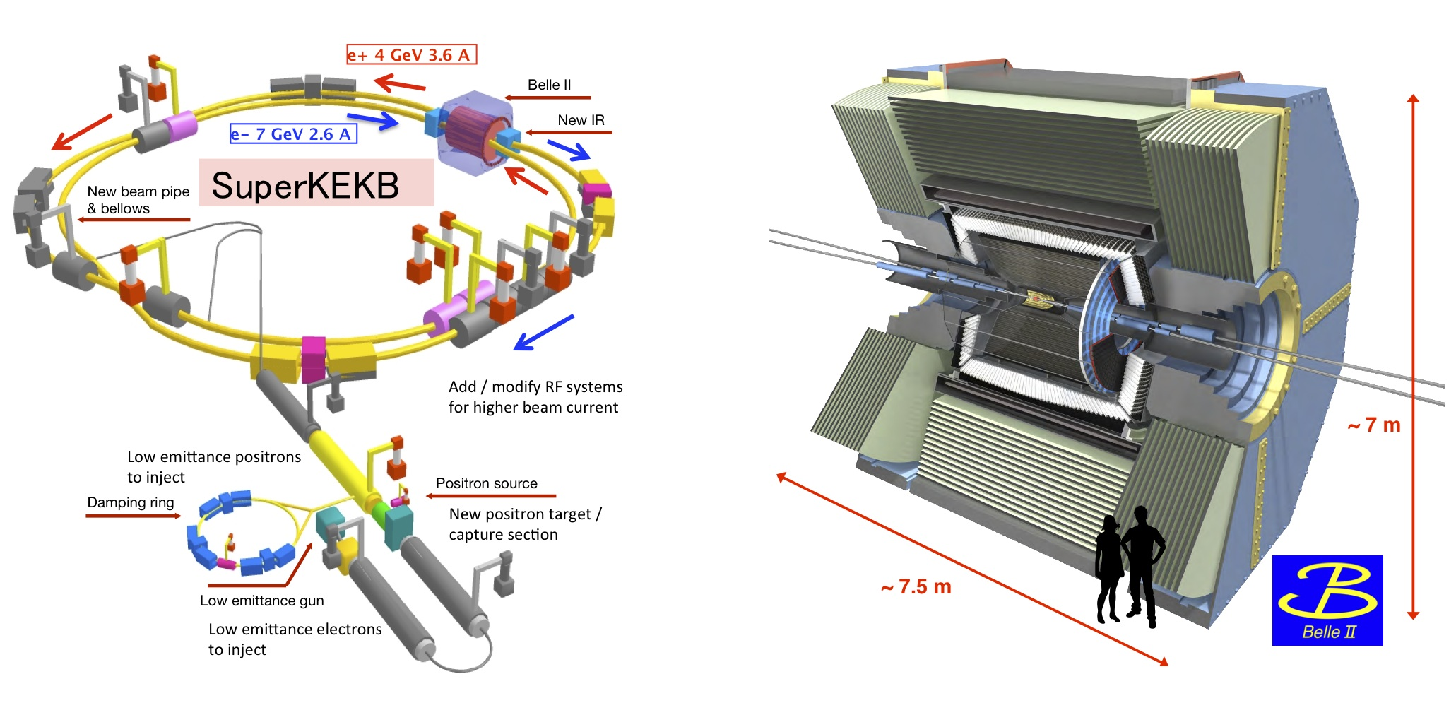
SuperKEKB and Belle II
Major upgrade of KEKB e⁺e⁻ collider
Nano-beam scheme: 40 x increase in luminosity
Asymmetric collisions at sqrt(s) = m(Υ(4S))
Advantages for final states with π⁰, γ, K_{S}, K_{L} and neutrinos
Higher tagging power and electron reconstruction efficiency
Wide programme to explore e+e- → τ+τ-
LHCb-TDR-023

Slide 21
SuperKEKB and Belle II
During phase I (2019-2022) recorded 400 fb⁻¹ → targeting 50 ab⁻¹ by end of experiment.
Things to look forward to:
Lepton flavour violating τ decays
Searches for b→sνν decays
Time dependent CPV in b→sg
Modes with neutrals, allowing flavour symmetries to be exploited
… and many more
LHCb-TDR-023

Slide 22
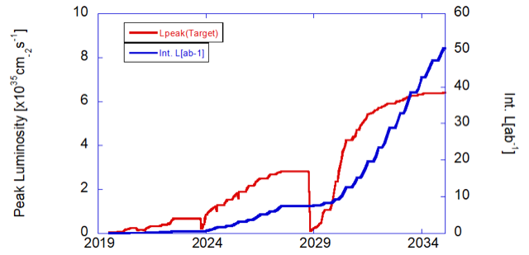
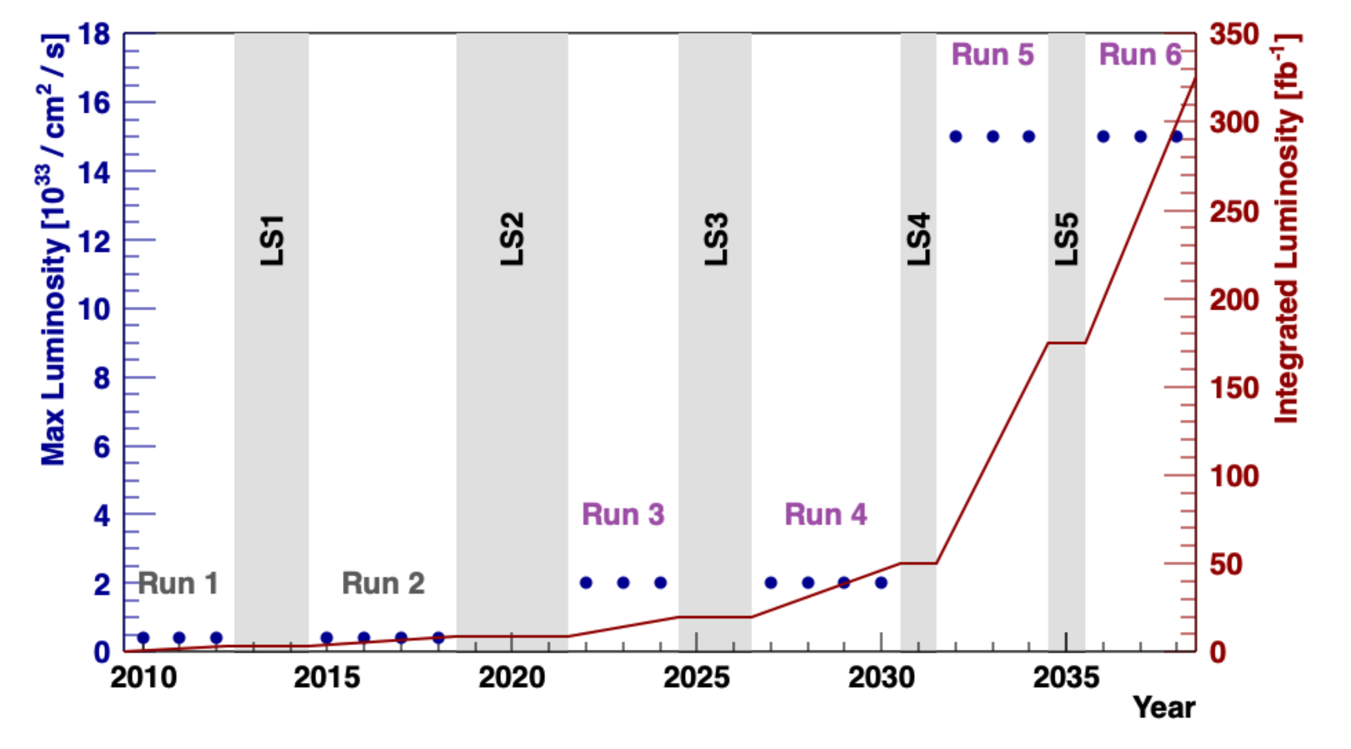
Exciting times ahead
Despite all the great results that will flow from LHCb Upgrade I, most observables will still be statistically limited by the end of Run 4
LHCb Upgrade II will make it possible to fully exploit the HL-LHC for flavour physics
UK leadership at all levels, now in exciting R&D phase
Also strong flavour programme at ATLAS and CMS, particularly in beauty decays to muons
Despite challenges, Belle II will provide crucial cross-checks of LHCb results and complementary sensitivity in final states that are hard to access at LHCb
In longer term, beauty samples from 5x10¹² Z boson decays at FCC-ee offer opportunities in specific final states (neutrinos and taus) that complement HL-LHC programme
Belle II
LHCb
To FCC-ee
LHCb-TDR-023

Slide 23
Backup
LHCb-TDR-023

Slide 24
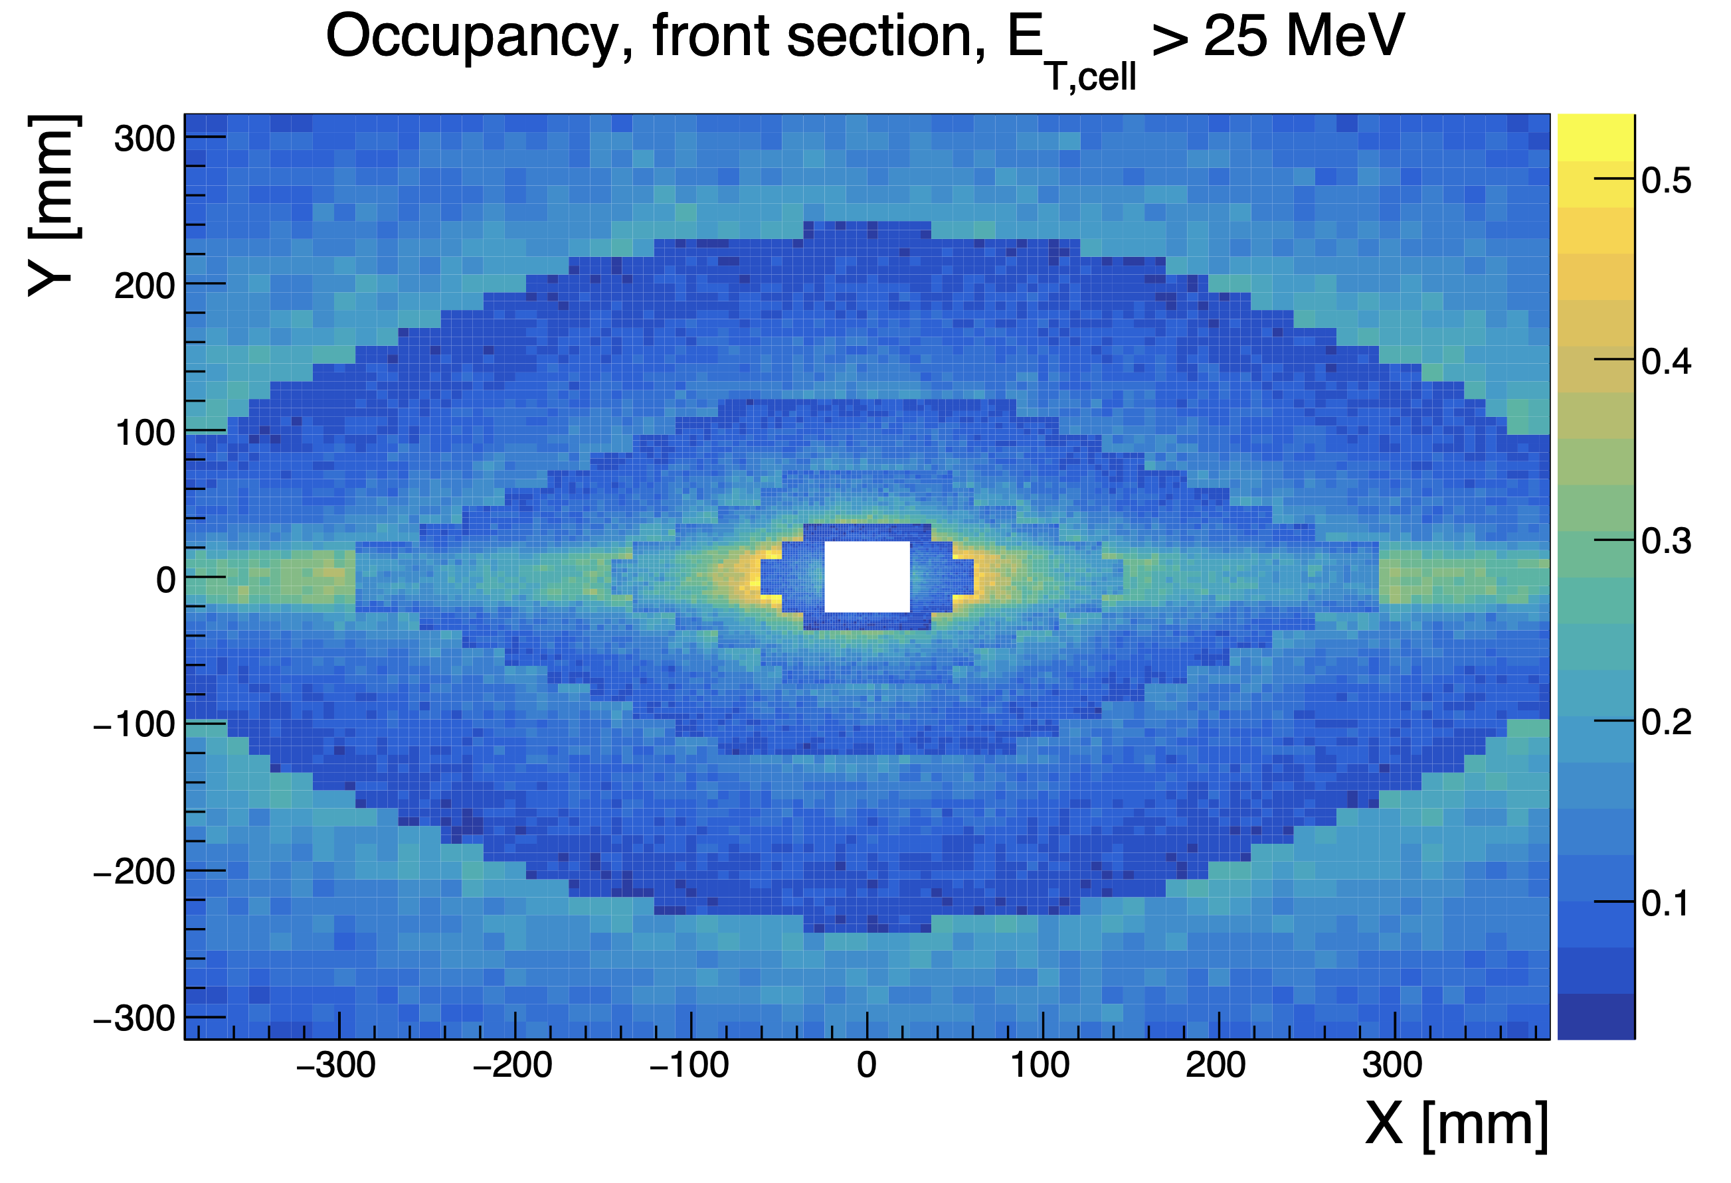
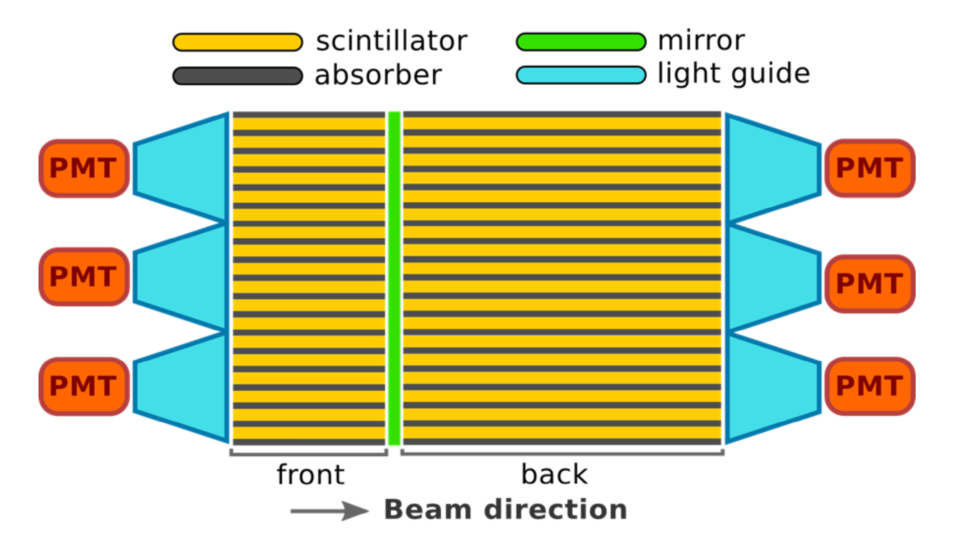
LHCb Upgrade II –ECAL
LHCb Electromagnetic Calorimeter not replaced (except electronics) in Upgrade I
During Run 3 will operate at 25x its design luminosity!
Main challenges for Upgrade II:
Achieving same energy resolution and reconstruction efficiency as original detector at significantly higher pile-up and occupancy
Radiation hard to accumulated 300 fb⁻¹
Proposal: crystal fibres (SpaCal) in central region and Shashlik (outer region)
20 ps timing information to supress background
LHCb-TDR-023

