Slide 1
Industry Panellist Introductions
Karola Bejm
Jon Burr
Alix Fell
James Grundy
Martha Hilton
Mike Nelson

Slide 2
Karola Bejm

Slide 3
Work opportunities for scientists in industry
Elmos Semiconductor SE
Notes:
Presentation as of 18.08.2020

Slide 4
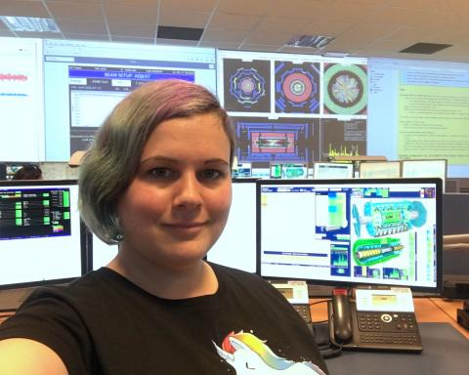
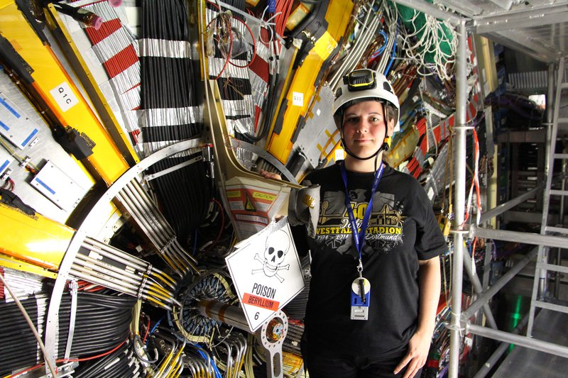


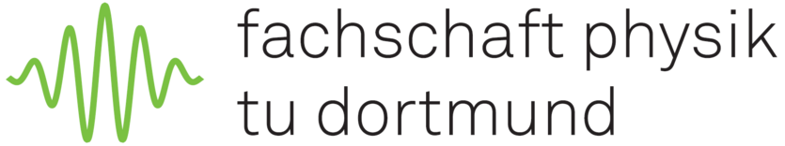

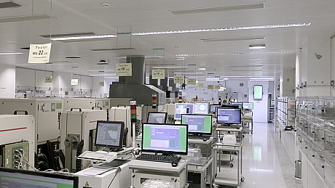

About me
…to industry
Certified Project Management Professional®
Working as project manager in a company that develops, produces and tests integrated circuits mainly used in the automotive industry
Leading a diverse team of engineers, designers, quality testers, logistic experts and many more
Bridging the communication between technical teams and customers
Head of PMO Service group, improving processes and tool landscape for project management work
From science…
PhD at CERN in cooperation with the Technical University of Dortmund
“Commissioning of the ATLAS Insertable B-Layer and first operation experience”
Shift leader for the ATLAS experiment, coordinating the daily operation of the detector
Post-Doctoral Fellow & Senior Research Associate at the University of Toronto

Slide 5
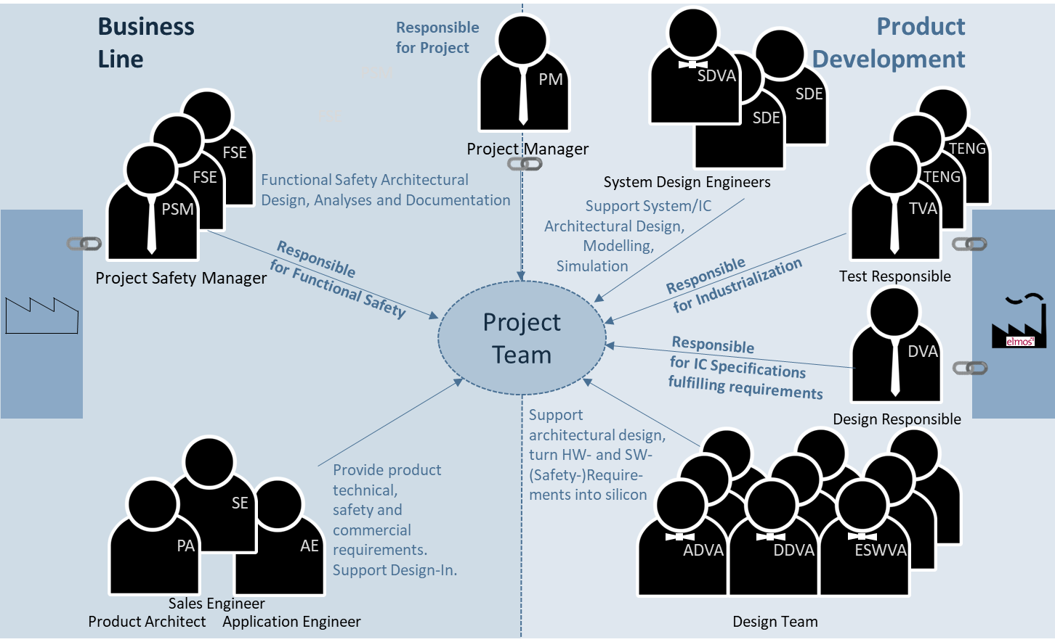
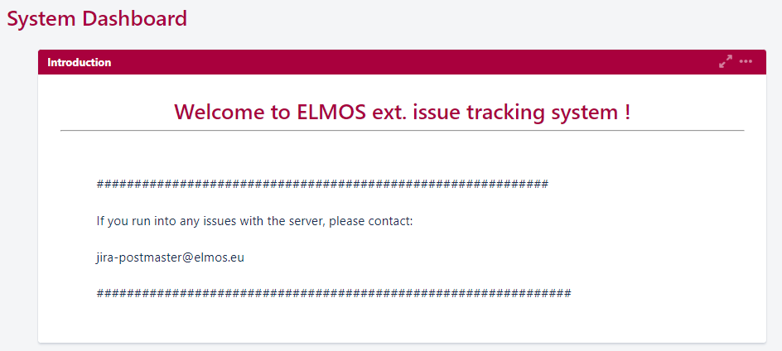
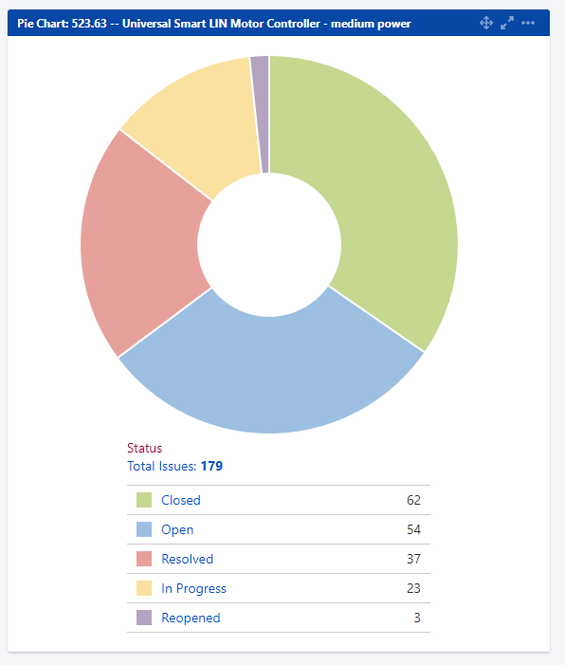
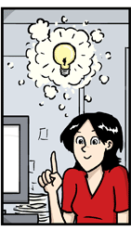
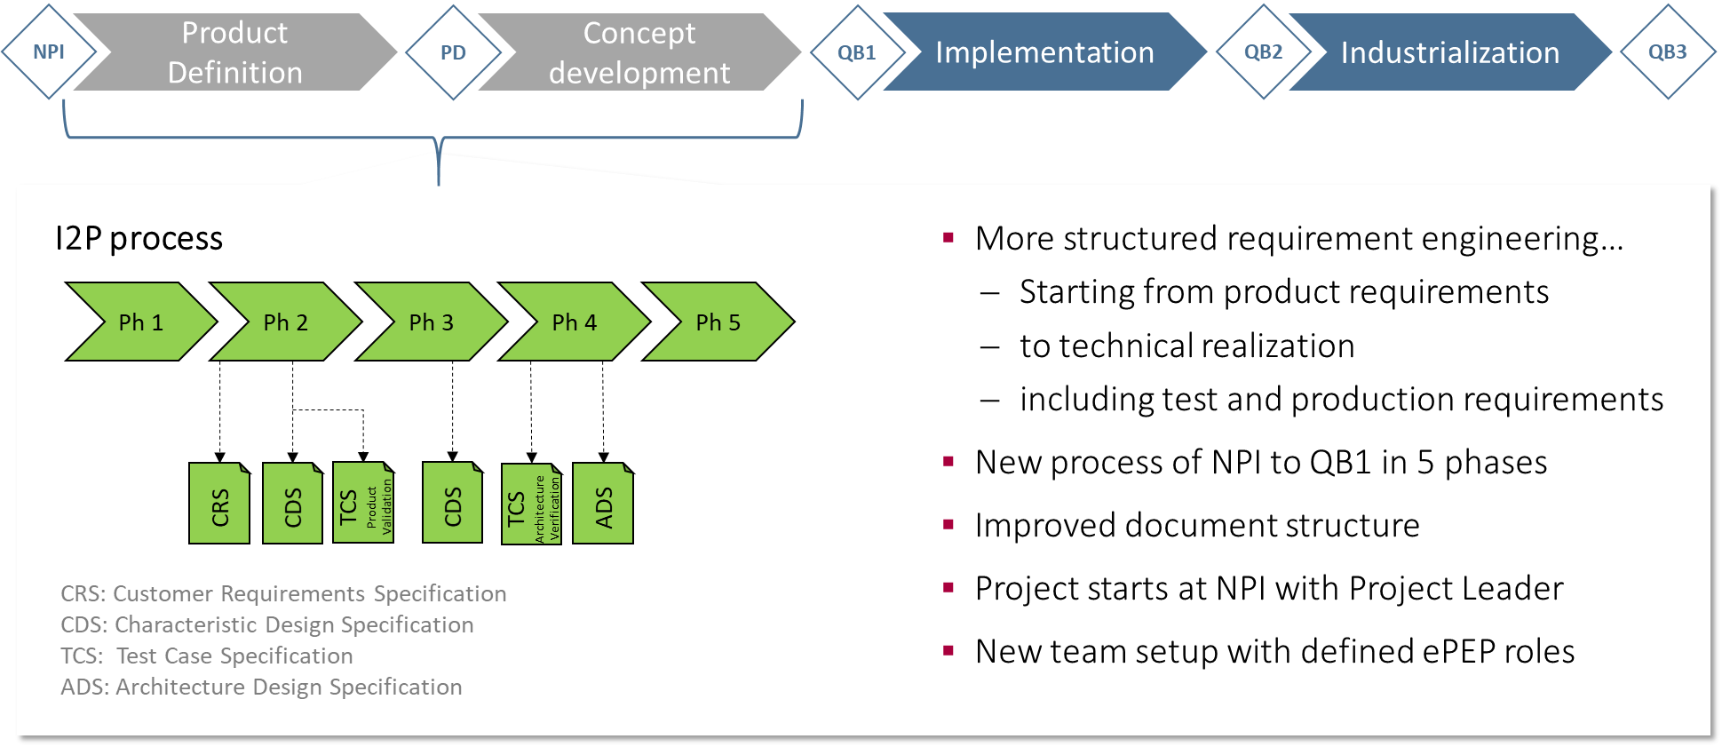
Project Management is more than planning…
A project manager:
Shapes a development project from the start
Gives direction to the team & leads it
Keeps track of important KPIs (Key Performance Indicators) and ensures the project stays on track

Slide 6
Jon Burr

Slide 7
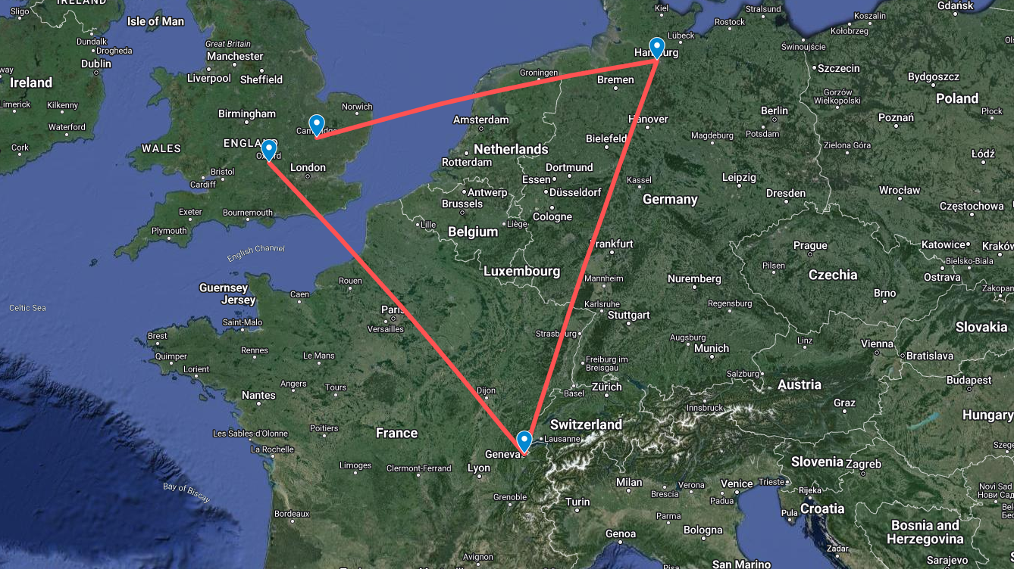
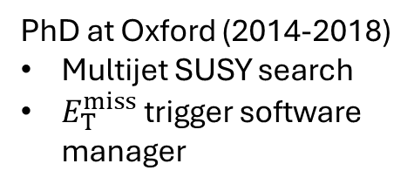
PhD at Oxford (2014-2018)
Multijet SUSY search
$E_{T}^{miss}$ trigger software manager

Slide 8
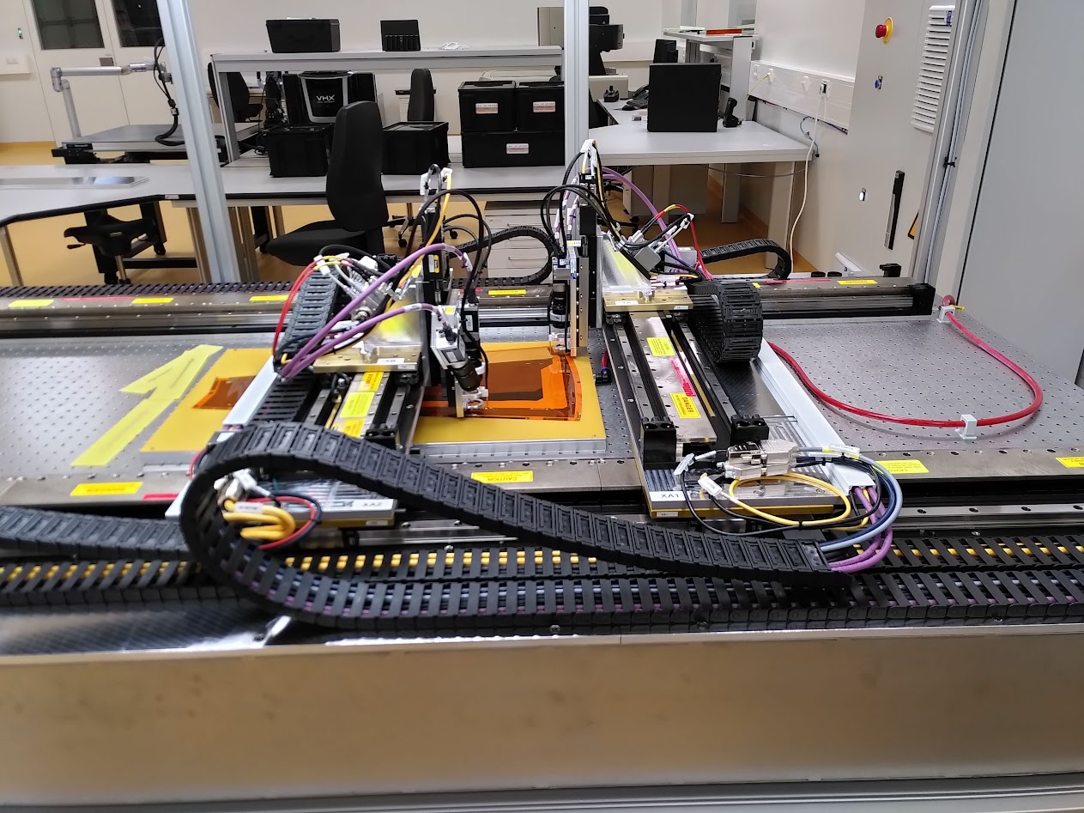
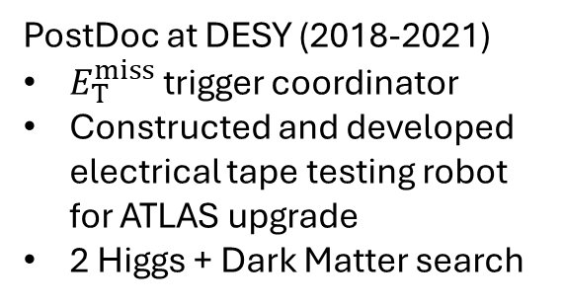
PostDoc at DESY (2018-2021)
$E_{T}^{miss}$ trigger coordinator
Constructed and developed electrical tape testing robot for ATLAS upgrade
2 Higgs + Dark Matter search
PhD at Oxford (2014-2018)
Multijet SUSY search
$E_{T}^{miss}$ trigger software manager

Slide 9

PostDoc at Cambridge (2021-2023)
$E_{T}^{miss}$ trigger coordinator
ANUBIS feasibility studies
ProANUBIS detector construction and DAQ software
PostDoc at DESY (2018-2021)
$E_{T}^{miss}$ trigger coordinator
Constructed and developed electrical tape testing robot for ATLAS upgrade
2 Higgs + Dark Matter search
PhD at Oxford (2014-2018)
Multijet SUSY search
$E_{T}^{miss}$ trigger software manager

Slide 10
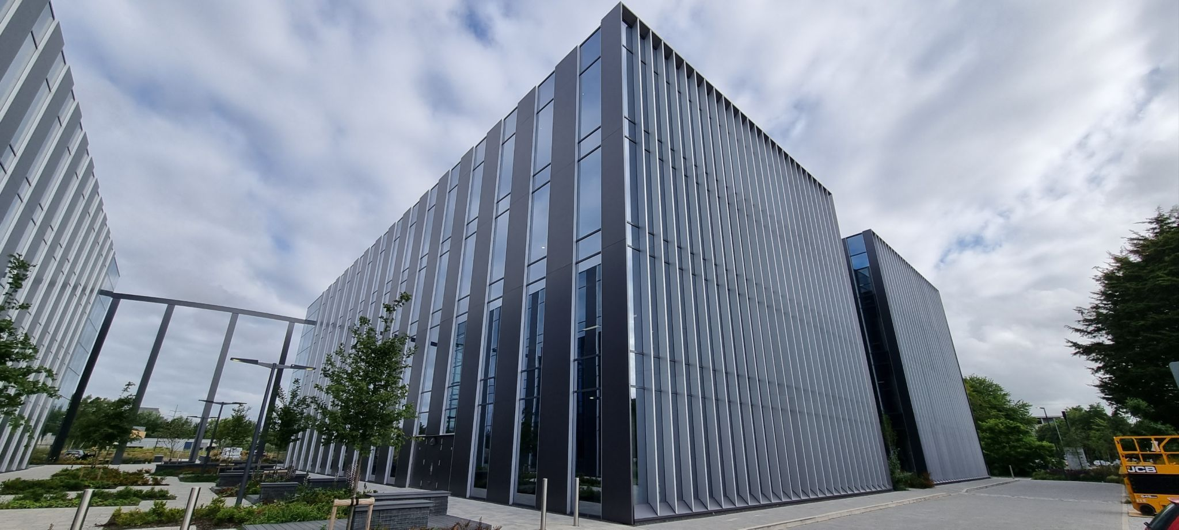
Senior Software Engineer at MathWorks (Oct 2023 – present)
Part of the parallel computing team working on the infrastructure to run computations on multiple MATLABs in parallel
Developing mostly in C++ and MATLAB

Slide 11
Alix Fell

Slide 12
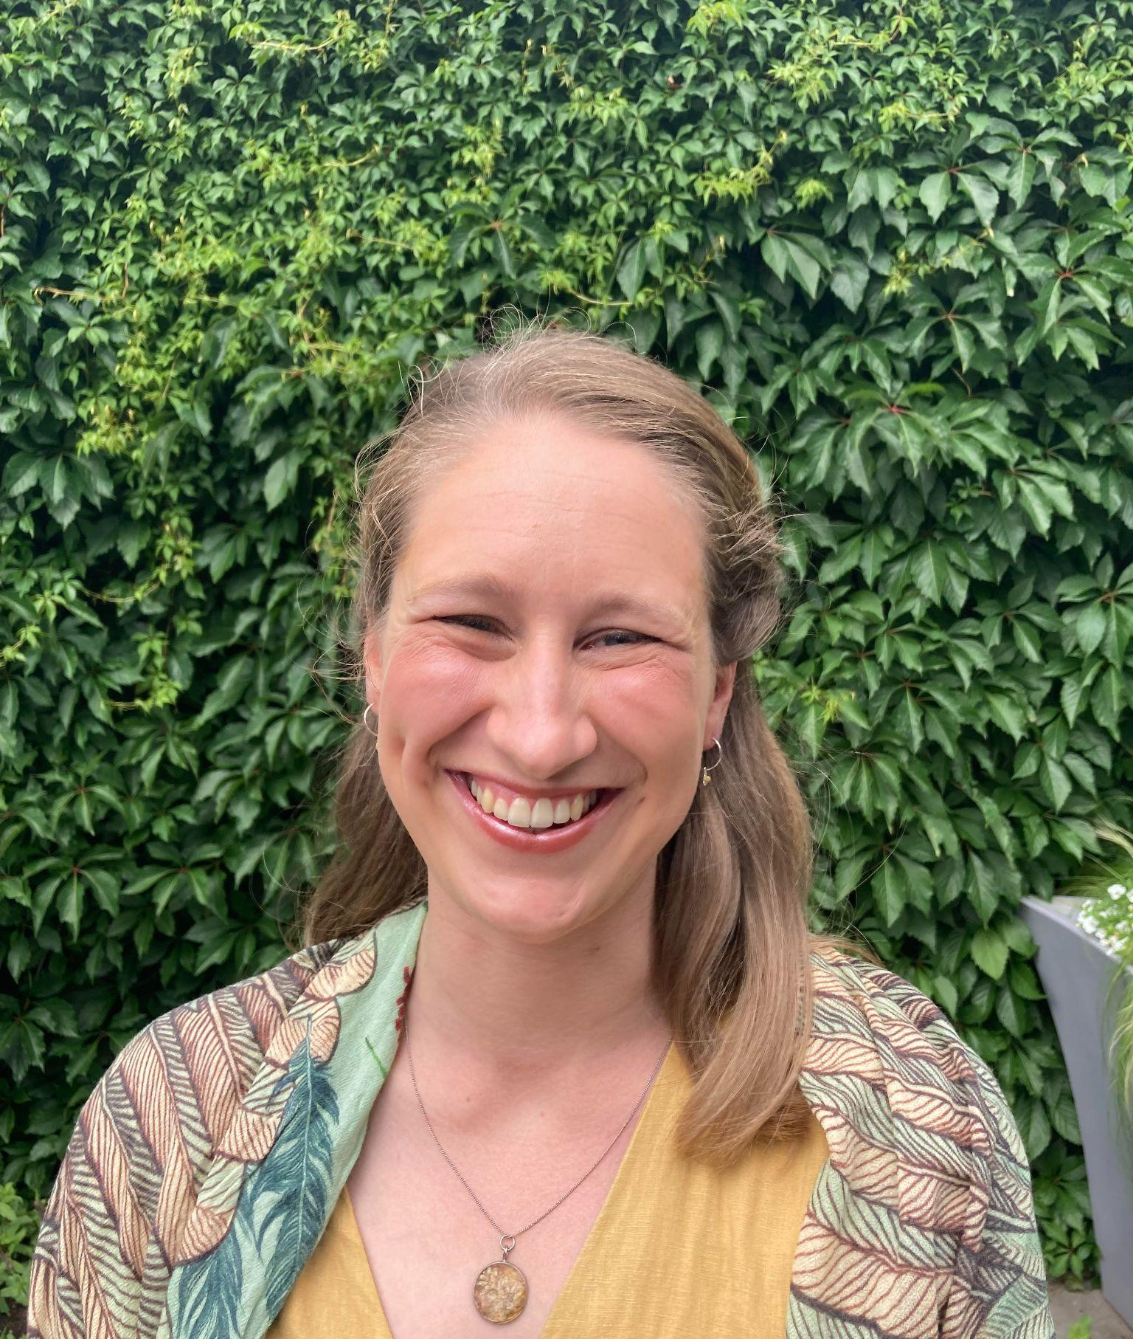
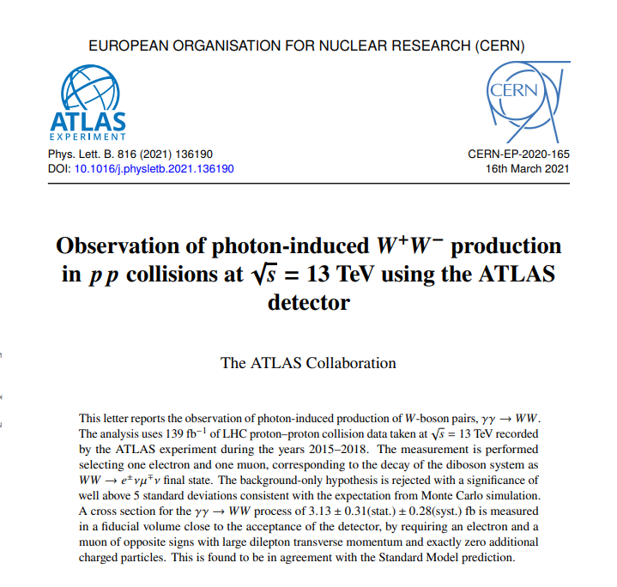


Alix Fell
2017-2021:
The University of Sheffield
The ATLAS Collaboration
2021 - 2022:
Tutoring
2022 - Present:
Multiverse
Notes:
In 2017 I began a PhD at the University of Sheffield studying photon induced WW boson production at the ATLAS experiment. I had a teaching scholarship at the University so I spent several hours a week teaching the first year undergraduate maths course alongside my research. As a PhD student, I developed my understanding of statistics and data science and contributed to the significant observation (8.4 sig) of photon-induced WW boson production in 2020. After submitting my thesis and gaining my PhD, I decided that I wanted to take a step away from academia in search of something more people-focussed. I leant into my teaching skills and worked as a tutor for a while, before finding a job as a Data Coach at a company called "Multiverse". Multiverse is a scale-up company that offers digital apprenticeships to a mix of career starters and career builders. My role is largely guiding and coaching apprentices through their Level 4 Data Analyst apprenticeship, however the fast-paced nature of a scale-up organisation means that no day is ever the same. We are driven by the needs of our clients, which means I have the opportunity to stay in touch with the latest data science tools and techniques industry. Whilst some days I spend my time teaching and coaching, other days I am applying my data skills to improve processes and identify strategies. I enjoy this role because it has a good mix of people-facing tasks and analytical tasks.

Slide 13
My Journey
From Academia to Industry
Academia
Skills Gained
Industry
Studied photon induced WW boson production at the ATLAS collaboration
Author qualification project in electron ID
Taught a first year undergraduate maths course as part of my teaching scholarship
Data handling and analysis
Statistics
Coding - python, C++, linux systems
The ability to ask questions
The ability to articulate complex concepts
Problem Solving
EdTech Scale-up organisation
Fast paced environment
Teaching and Coaching digital skills
Refining processes to work at scale
Aims to unlock economic opportunity through learning

Slide 14
James Grundy

Slide 15
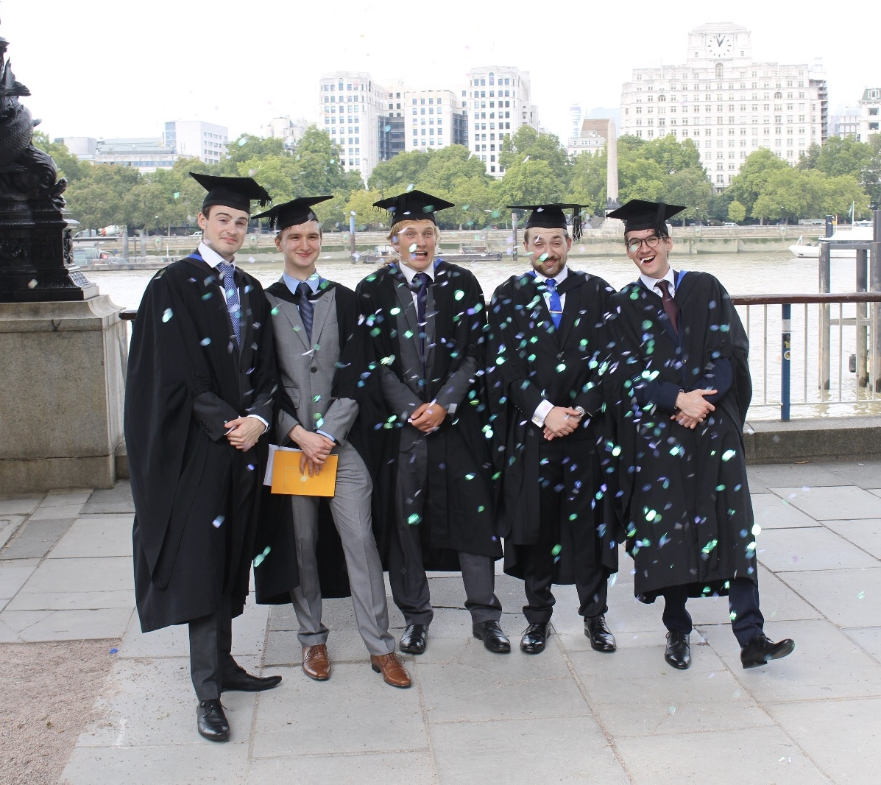
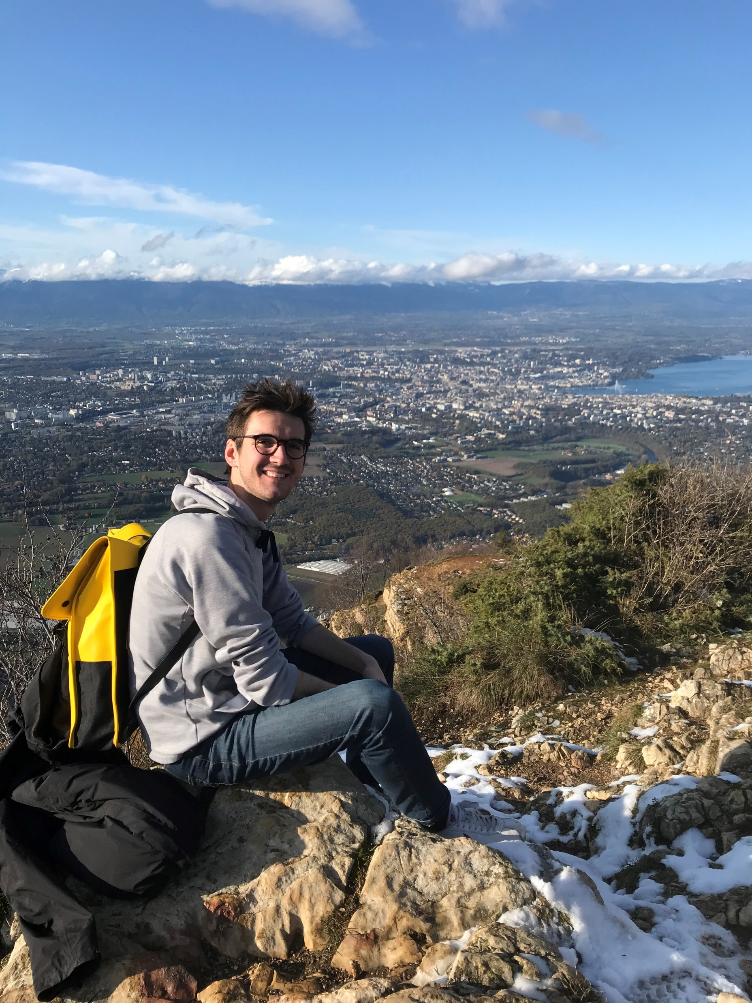
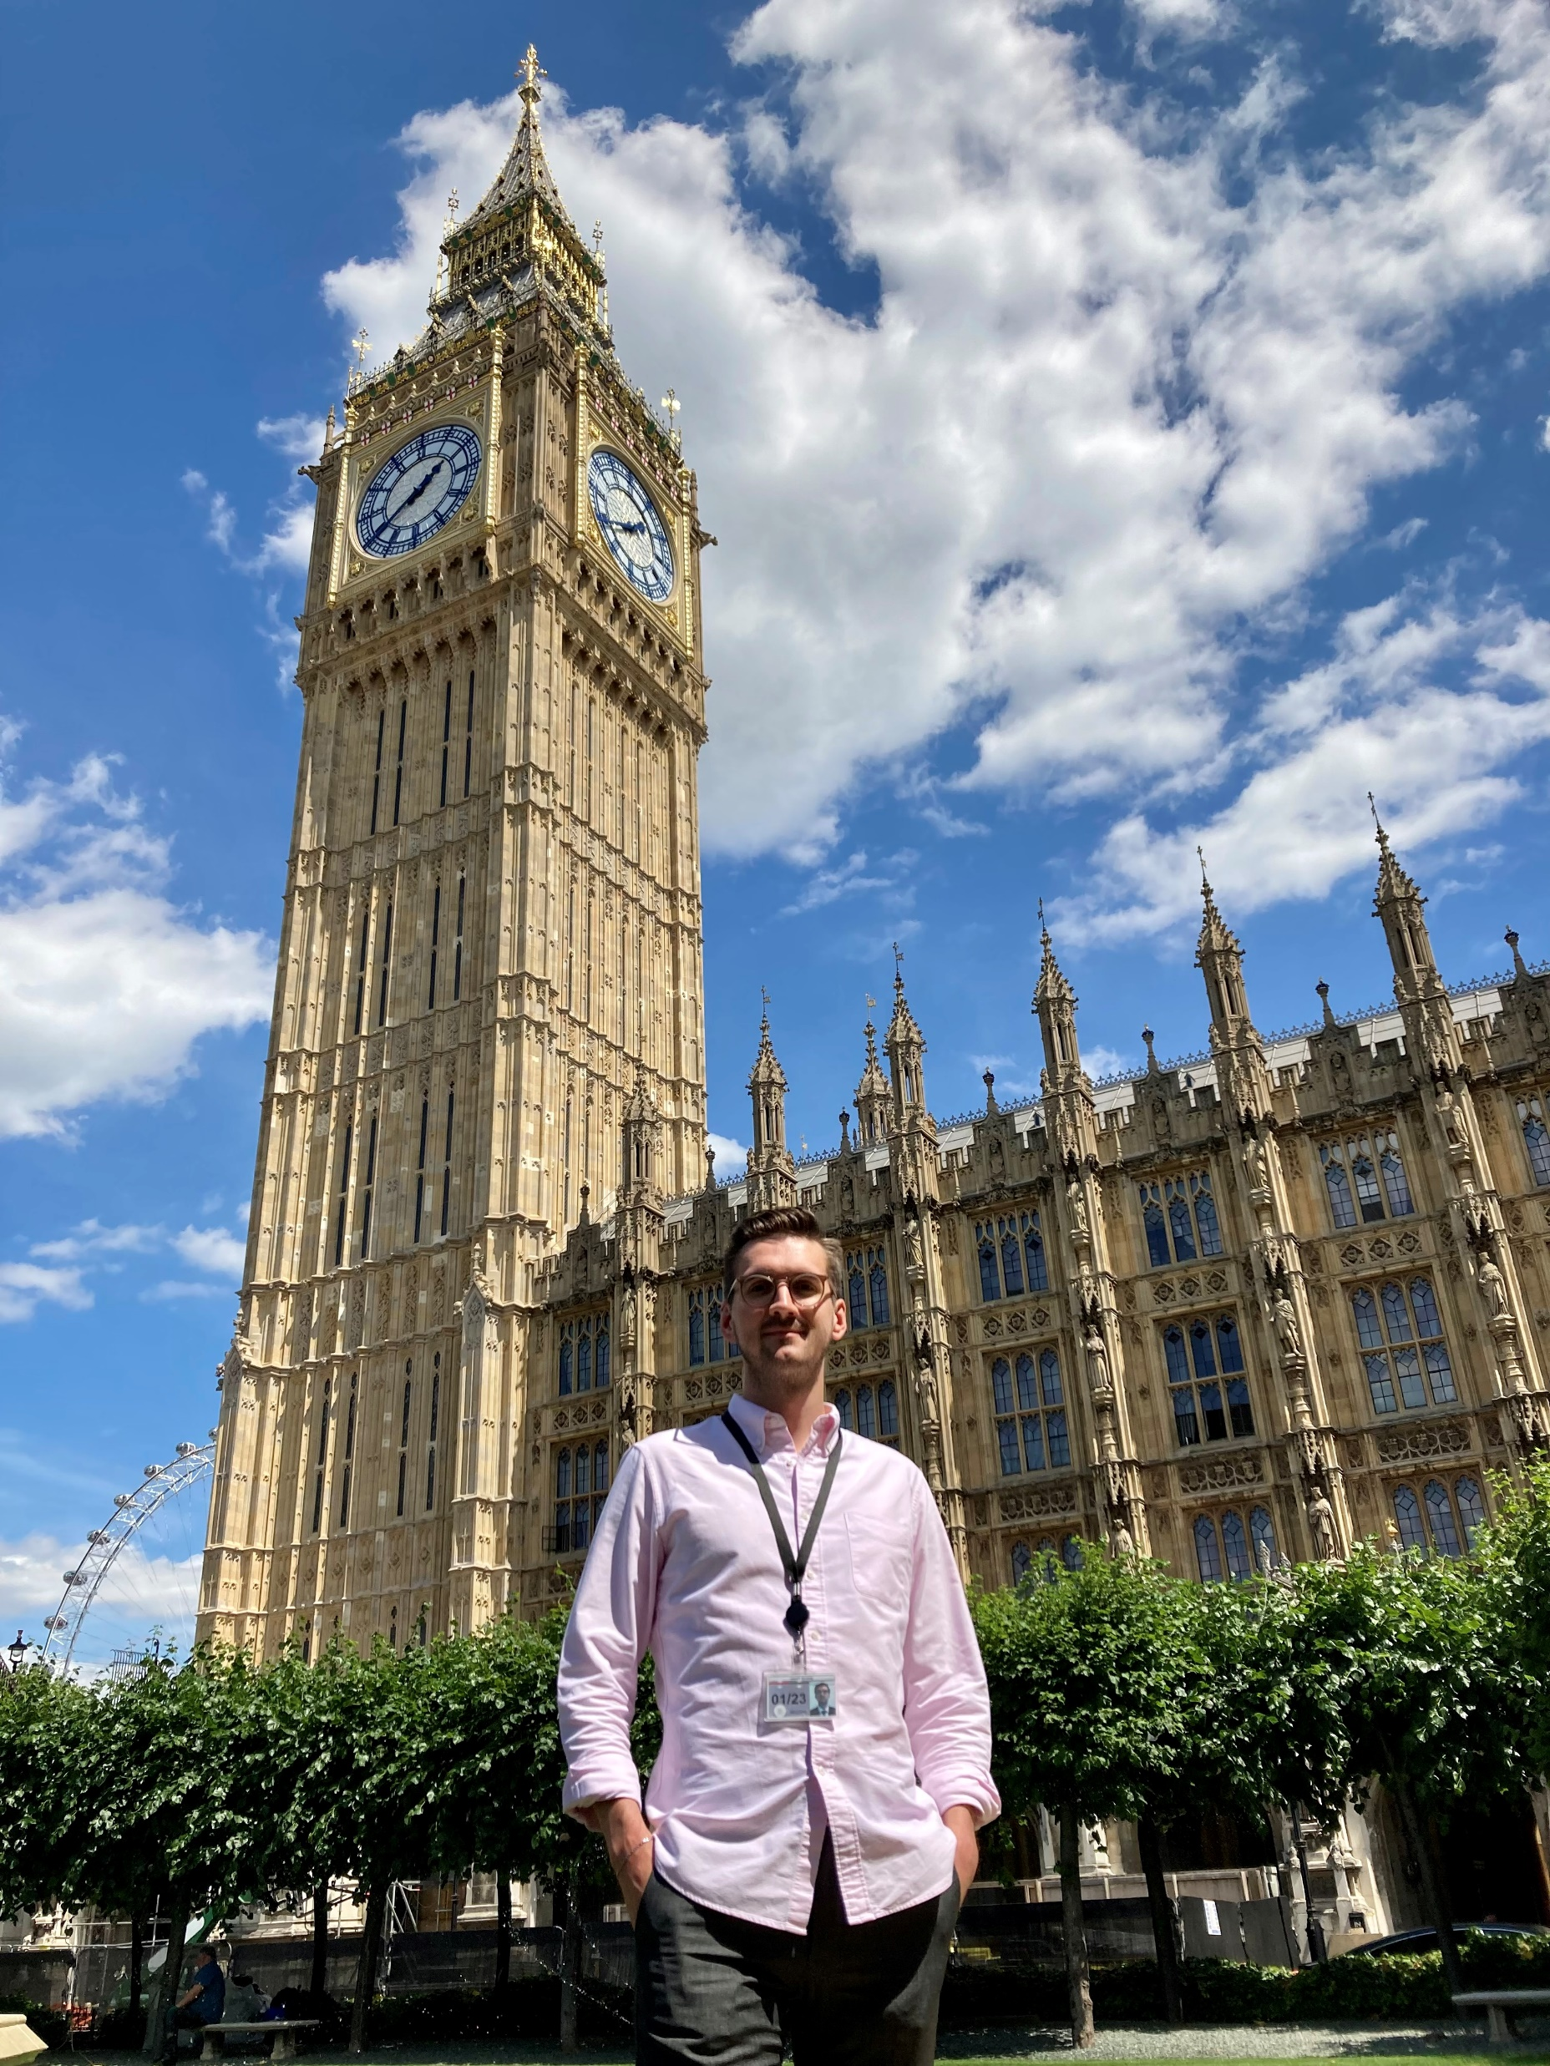
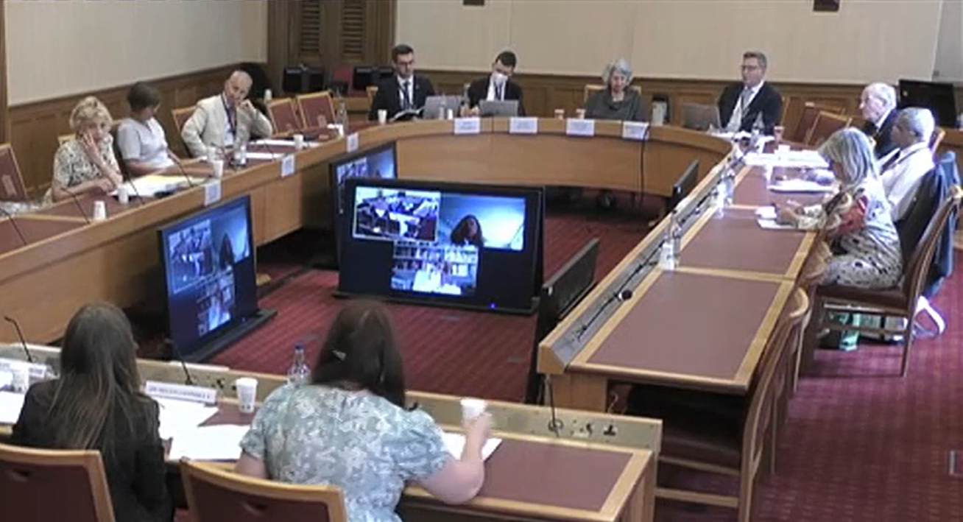
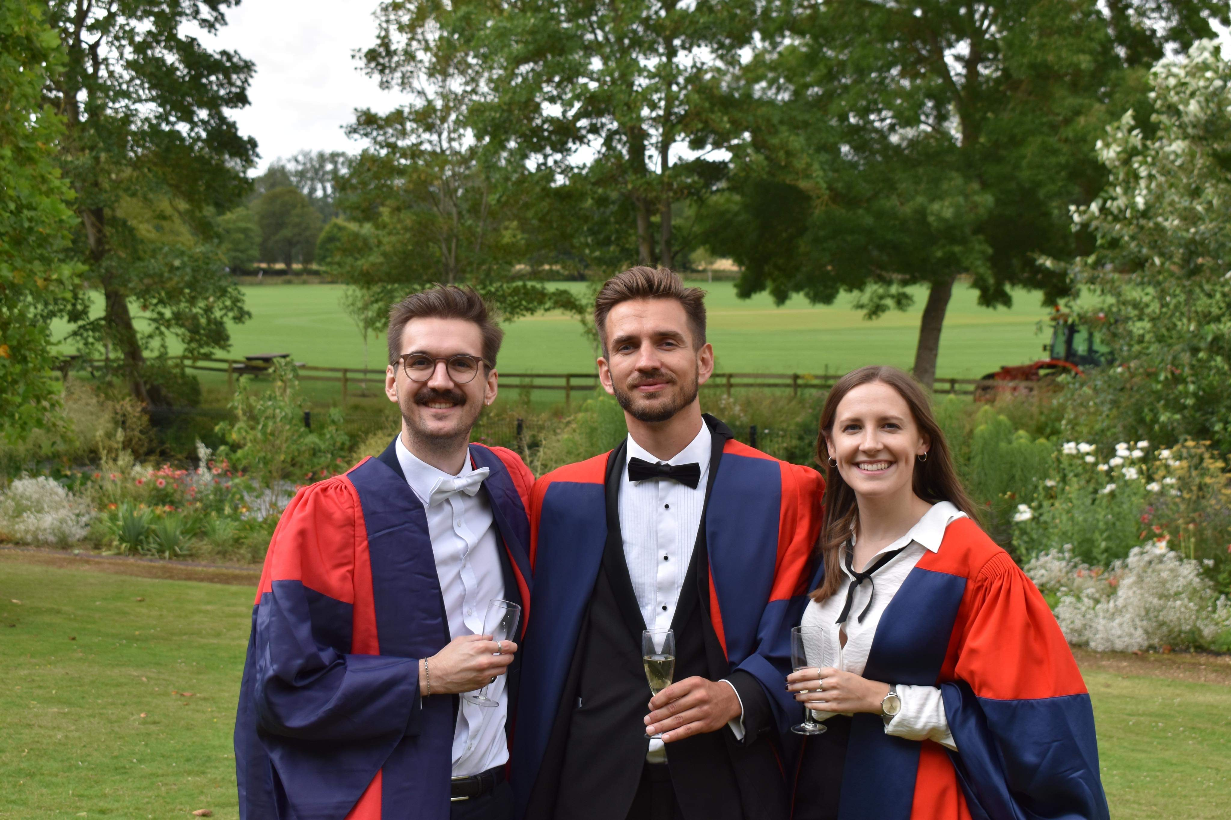
Pathway to my Current Career
2014 - 2018: MSci in Physics
2018 – 2022: DPhil on ATLAS searching for HH → bbbb
Unsure if academia was the right for me long-term. Always interested in politics and public service. Heard good things about the Civil Service.
Spring- Summer 2022: UKRI Policy Internship
House of Lords JHA Select Committee
Autum 2022: Civil Service Fast Stream
Now: Second year OR Fast Streamer at DWP
Notes:
The Civil Service supports the government of the day to implement its policies effectively on behalf of every community across the UK. From benefits and pensions to employment services, prisons to driving licenses, our work touches every aspect of UK life.

Slide 16
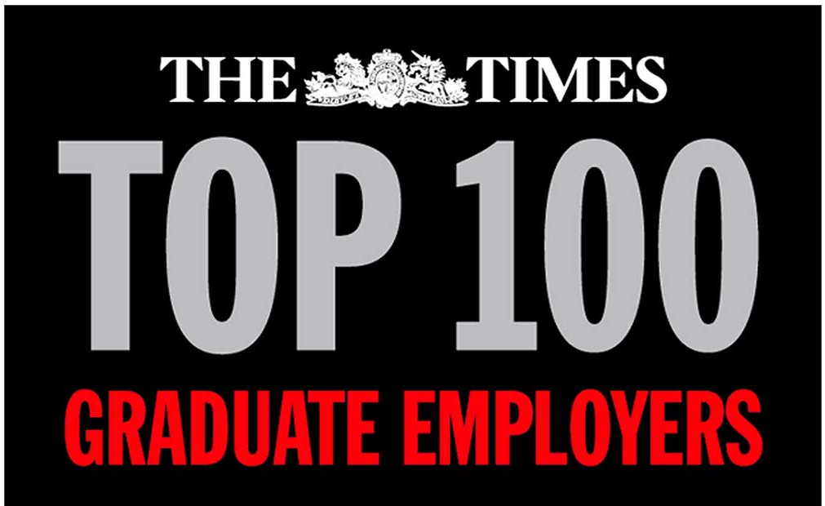


My Career as a Civil Servant
Currently, I’m a second year on the Operational Research stream of the Civil Service Fast Stream.
The Fast Stream is the graduate scheme for future leaders in the Civil Service, offering a range of roles across multiple departments. It held the No. 1 spot on The Times’ list of Top Graduate Employers from 2019 – 2022.
I’m on the Operational Research scheme ran by GORS (Government OR Service). In GORS, we use scientific and mathematical techniques to find solutions to complex problems and improve decision making in government.
In my first year, I worked on the Work and Health Programme, the biggest employment programme for people with disabilities in the UK.
Created regular performance reports to evaluate the performance of the programme.
Acted as an analysis consultancy, creating ad hoc analysis to assist colleagues, e.g., forecasting the future number of attendees on the programme.
In my second year, I worked on policies to help people in work increase their earnings.
Conducted statistical analyses to evaluate the impact of Job Centre interventions.
Provided analysis to support policy writers in making evidence-based decisions.
Next, potentially health at MoD, trade with NI at DEFRA, data science at DBT – we’ll see!
For any more info, feel free to drop me a line - James.Grundy@dwp.gov.uk
Systems Mapping
Experimental Design
Casual Inference
Optimisation Methods
Machine Learning
Data Collection
Decision Analysis
Forecasting
Python/R/SQL
Data Science
Modelling
Statistics
And a whole lot more…
Notes:
Our award-winning Fast Stream programme accelerates careers, developing talented, high-potential people into future Civil Service leaders and managers.
Fast Stream, Mainstream and Civil Service Jobs!

Slide 17
Martha Hilton

Slide 18
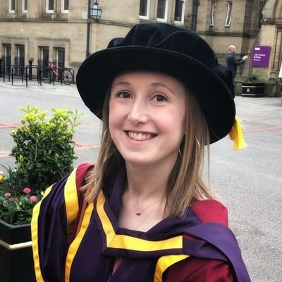
My path through academia
Studied physics at Imperial College London.
I did my PhD at the University of Manchester on charm physics at LHCb
  Got involved in many diversity and early career initiatives including sitting on the Early Career Gender and Diversity committee for the LHCb collaboration.
Stayed at Manchester for a Post Doc for one year, then decided to leave academia and pursue a career in the public sector….

Slide 19



My career in the public sector
After my undergraduate I worked for the social leadership charity RECLAIM in Manchester which works with working class young people on a leadership and development program.
After finishing my Post Doc I worked as a Senior Data Analyst for the Institute of Physics until recently.
I have just taken a position as Senior Analyst at UKRI.
As a state school educated woman in physics I have an active commitment to equality and diversity within the subject.

Slide 20
Mike Nelson

Slide 21


Life after HEP: statistics and the markets
Mike Nelson,
Head of Spot & Futures Quantitative Research, Keyrock

Slide 22
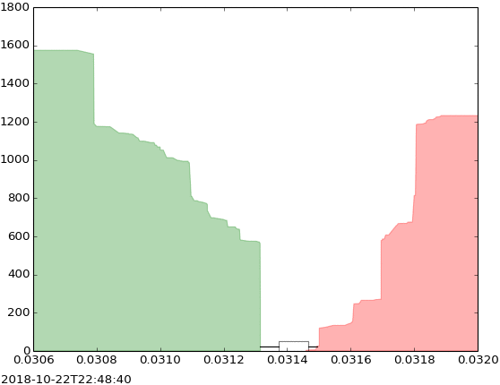

Where I am: machine learning, statistics, and algorithmic trading
-> The game: building mathematical models to understand how prices move.
-> Working with computer scientists, physicists, mathematicians to turn models into algorithmic trading strategies.
-> Trading currencies and cryptocurrencies over millisecond - several hour time horizons.

Slide 23
How I got there
DPhil: SUSY searches and hadronic jet physics on ATLAS
→ Got interested in thinking about statistics more deeply
-> Introduced to the ideas of machine learning
-> Knew nothing about finance, biology etc
PostDoc: Knew I wanted to apply statistics to new problems
-> Became interested in economics & the markets

Slide 24
How I got there
DPhil: SUSY searches and hadronic jet physics on ATLAS
→ Got interested in thinking about statistics more deeply
-> Introduced to the ideas of machine learning
-> Knew nothing about finance, biology etc
PostDoc: Knew I wanted to apply statistics to new problems
-> Became interested in economics & the markets
Quantitative researcher at Winton Capital
→ Large hedge fund, scientifically-driven
-> Statistics to forecast trends in commodities, currencies, rates, equities over days/weeks/months
→ Wanted to explore one other topic before “deciding” …

Slide 25
How I got there
PostDoc take two: Computational cancer biology/research fellowship
→ Statistical techniques applied in finance, now for cancer growth
-> Maths models of gene regulation to understand how the immune system responds to lung cancer
-> Decided ultimately problems in economics appealed most to me

Slide 26
How I got there
PostDoc take two: Computational cancer biology/research fellowship
→ Statistical techniques applied in finance, now for cancer growth
-> Maths models of gene regulation to understand how the immune system responds to lung cancer
-> Decided ultimately problems in economics appealed most to me
Quantitative researcher again!
→ Voltz Labs: small trading firm, got to experience how a research team is built. Statistics in fixed income and cryptocurrency markets
→ Keyrock: algo trading firm, a fascinating mix of statistical research and computer science to comprehend and trade the markets. Now leading a research team there.

