Slide 1
ECFA-UK Report
Sinead Farrington
25th June 2024

Slide 2
Who are the UK members of ECFA?
ECFA: European Committee for Future Accelerators
UK members: term: 3+3 years
Daniela Bortoletto (Oxford) - Restricted ECFA member for the UK
Sinead Farrington* (Edinburgh)
Joel Goldstein (Bristol)
Haroon Rafique (RAL)
Aidan Robson (Glasgow)
Sarah Williams (Cambridge)
Matthew Wing (UCL)
Lab directors (AsTeC - Jim Clarke and PPD - SF soon) plenary members
ECR members (see next talk): term 2+2 years
Julia Allen*
Patrick Dougan
Atanu Modak*
Holly Pacey*
*upcoming vacancies later this year
Nominations are solicited via the STFC committee call

Slide 3
What does ECFA do (internationally)
ECFA: European Committee for Future Accelerators
Assess and assure the health of the particle physics field in Europe, to assure the future of the field
Assure that the previous European strategy is enacted

Slide 4
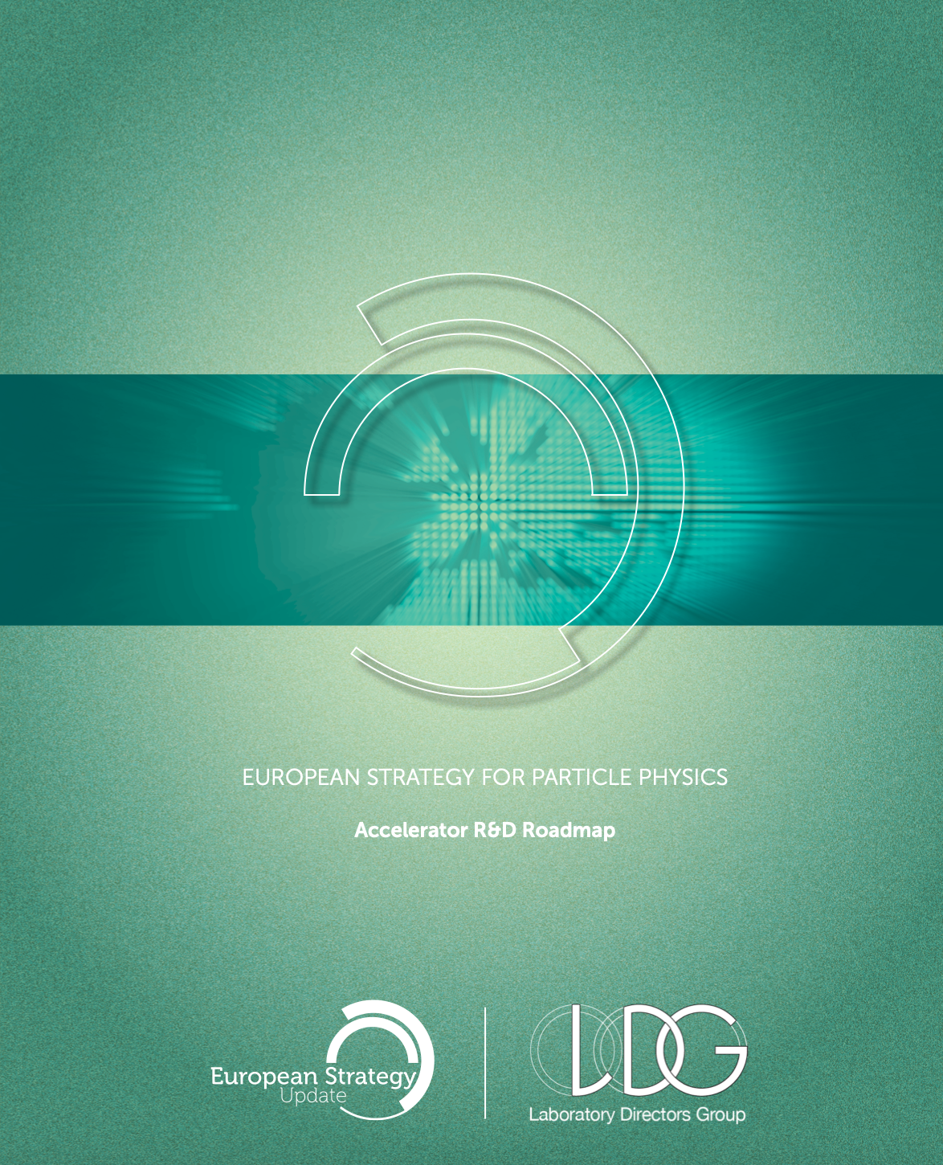
What does ECFA do (internationally)
European Detector Roadmap has been written by an ECFA group chaired by Phil Allport
This has spawned the Detector R&D collaborations (see Chris Parkes’ talk)
(the accelerator European roadmap has been written by the Lab Directors Group chaired by Dave Newbold)

Slide 5
What does ECFA do (internationally)
ECFA e+e- Higgs Factory study group (chairs Aidan Robson and Christos Leonidopoulos)
Bringing together all e+e- accelerator collaborations into one physics (including detector) study group
Previous meetings at DESY, in Paestum, next one in Paris in October
https://indico.in2p3.fr/event/32629/

Slide 6
What does ECFA do (internationally)
Plenary ECFA meets twice a year
Next meeting next week in Frascati, report from UK labs as one of the regular lab reports
Restricted ECFA meets around 4 times a year
The decision-making body of ECFA
Reviews particle physics in ~4 countries a year, writes a report with recommendations for the country
Joint meetings with nuclear and astroparticle physics, next one to be held in the UK in 2025
“JENAS” (Joint ECFA, Nuclear physics European Collaboration Committee, Astroparticle Physics European Consortium)

Slide 7
What does ECFA do (in the UK)
Attend meetings, appointed as individuals but also representing the country
Organising RECFA visit to the UK this September
Following the prescribed format for the visit
To be held at the Royal Society
Speakers have been invited

Slide 8
What does ECFA do (in the UK)
European Strategy Particle Physics Update:
Workshop at IPPP, Durham in September organised by ECFA-UK
https://conference.ippp.dur.ac.uk/event/1357/ please register!
Organised by ECFA-UK and IPPP, Durham
Bring the community together for a physics (rather than strategic) focused workshop
Discuss the major physics goals of the next decades of particle physics and encourage UK contributions to analysis studies which can be submitted to the strategy process, either as individual studies, or as submissions by already-established consortia, or as inputs to the ECFA e+e- study (as an example).
Provide talks on opportunities and challenges in detector R&D and accelerator physics.
Workshop is open to all, with participation across all particle physics scientific interests - theorists and experimentalists - and across the community demographic.
It is not intended to discuss preferences for facilities at this meeting, rather to inform the next steps in our national discussion.

Slide 9
What does ECFA do (in the UK)
European Strategy Particle Physics Update:
Workshop at IPPP, Durham in September organised by ECFA-UK
If you have topics to contribute please contact the session chairs (in each case the last one is the ECFA-UK member helping with that area):
Detector R&D: Chris Parkes, Daniela Bortoletto
Accelerator R&D: Phil Burrows, Jim Clarke, Stewart Boogert, Matthew Wing, Haroon Rafique
Theory cross-cutting the below areas: Michael Spannowsky, Sinead Farrington
e+e-: Guy Wilkinson, Aidan Robson
eh: Uta Klein, Matthew Wing
10 TeV pCM colliders: Andy Pilkington, Karol Krizka and Sarah Williams
HL-LHC: Jon Butterworth, Sinead Farrington, Daniela Bortoletto
Neutrinos: Kirsty Duffy, Sarah Williams
Direct Dark Matter: Sally Shaw, Sarah Williams
Non-collider experiments: Carl Gwilliam, Mark Lancaster, Sarah Williams
Quantum technologies: Ian Shipsey, Sarah Williams

Slide 10
Drafting Day
October, date to be advised:
UK national EPPSU submission Drafting Day: here the work begins on a community-wide draft.
Try to converge around UK positions on some key questions.
We may have a set of questions by then for national inputs to the European Strategy Update.
This drafting day will aim to write down, from day one, statements that the UK community can agree on for submission. Later drafting days will iterate on this - the suggestion is 1-2 further drafting days before the deadline in March 2025.
The editors will be drawn from ECFA-UK and co-opted PPAP members, to provide expertise across the full range of areas.

Slide 11
ESPPU Context
Formulating Europe's strategy for particle physics Five stages: 1. Community provides input by 31/3/25 2. Physics Preparatory Group (PPG) produces a Briefing Book 3. Open community meeting, June/July 2025 4. European Strategy Group (ESG) meets to draft the text; expected UK ESG members: Mark Lancaster (Manchester, UK CERN Council Scientific Delegate) Jim Clarke (AsTeC), Sinead Farrington (RAL-PPD) – UK national lab representatives
5. Proposal goes to CERN Council, late 2025/ early 2026.
This is all coordinated by the Strategy Secretary, appointed last week by CERN Council: Karl Jakobs. Now that he is in place, details on processes/procedures will follow.

