Slide 1
Outreach at Boulby Lab
Bioscience and beyond...
Notes:
To edit the background image, select ‘Format’ from the PowerPoint menu and ‘Slide Background’ from the drop-down menu. Within the new list of options that appears on the right of the screen, select the ‘File’ button under ‘Insert picture from’ and select your image from your file browser. Remember to delete the image credit if using your own image.

Slide 2
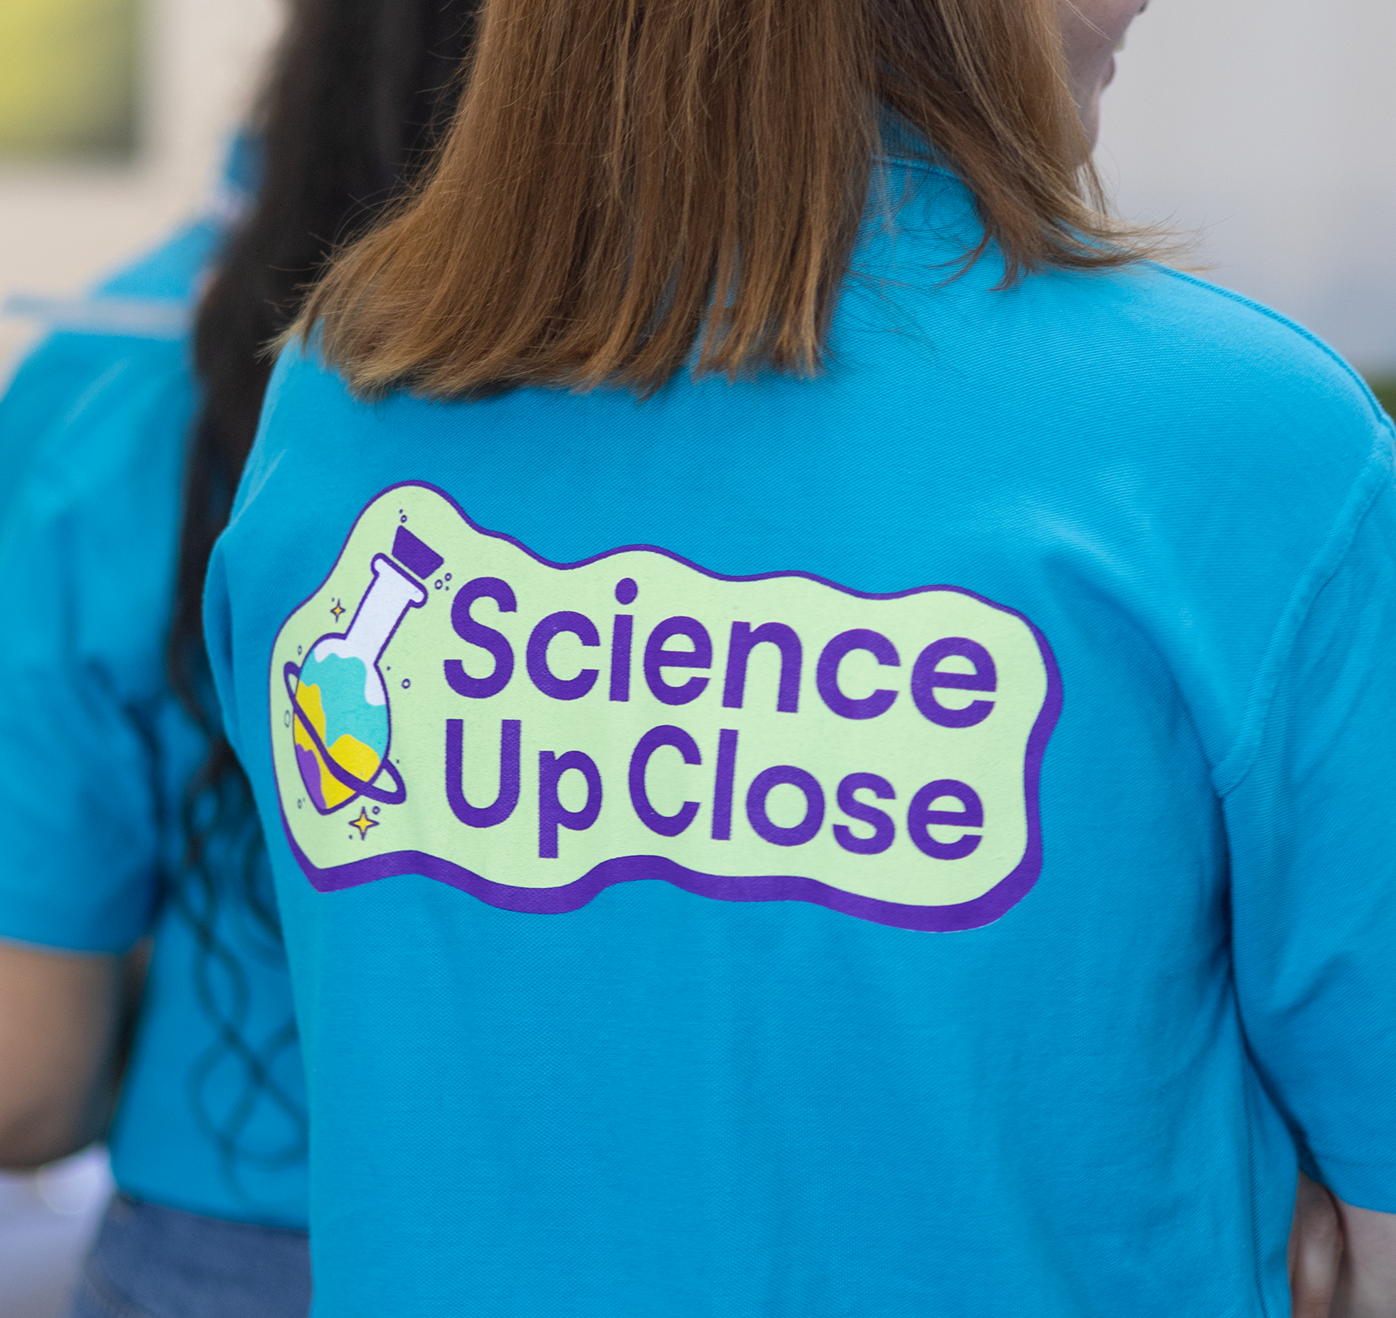
Contents
1 Introductions
Who's this guy?
Boulby's outreach aims
2 How do you do it?
How to do great outreach while being a kilometre underground
3 How do we do it?
Boulby Lab's current outreach portfolio
4 Outlook
The outlook for outreach at Boulby
Notes:
To replace photo with one of your own. 1) Send the geometric shape overlay to the back – Right-Click > Send to Back > Send to Back. 2) Replace image – use the guides provided to correctly position it. 3) Send your image to the back so that the geometric overlay re-appears over the image. Remember to delete the image credit if using your own image.

Slide 3
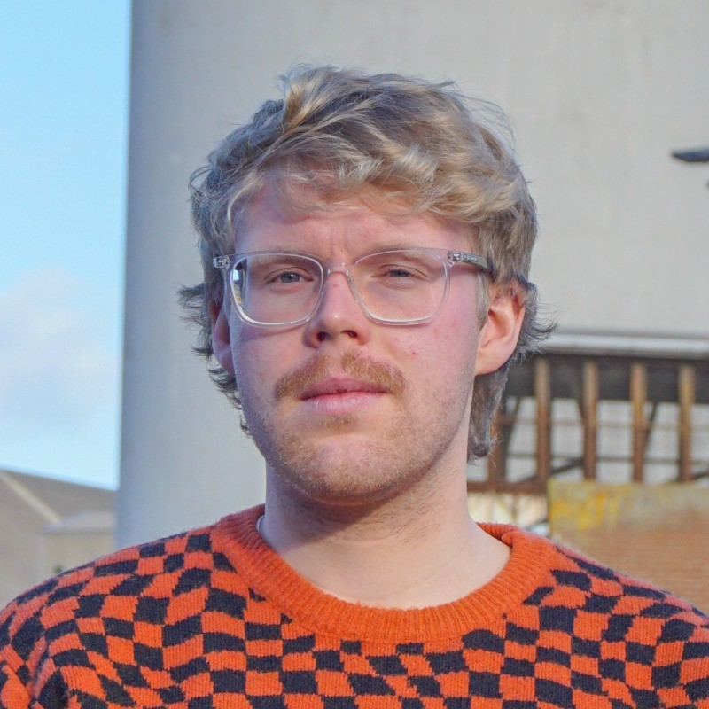
Jonny Gutteridge
Engagement Officer at Boulby Underground Lab
Started at Boulby in July 2023 as Science Communications Industrial Placement Student
Focused on social media content creation (the "comms side of things")
Stayed on as Engagement Officer
Role now involves broader outreach (public engagement, stakeholder liaison)
But it's not just me!
DULIA-Bio 2024
Notes:
Please replace photo of presenter with a portrait of your own. 1) Send the geometric shape overlay to the back – Right-Click > Send to Back > Send to Back. 2) Replace image – use the guides provided to correctly position it. 3) Send your portrait to the back so that the geometric overlay re-appears over the portrait.

Slide 4
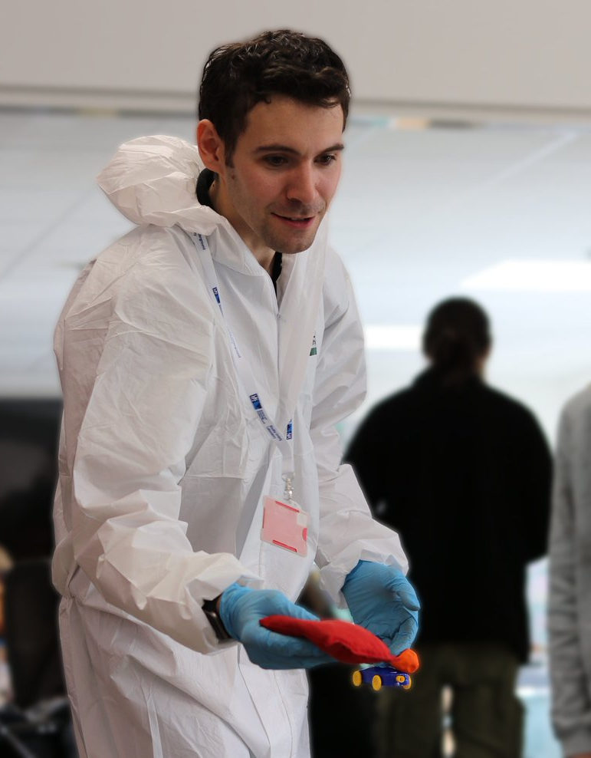
Key Stakeholders
Target audiences for Boulby Underground Laboratory
Local area (ICL, general public, education providers, local government and industry)
Academics and institutions (universities, research groups such as BGS)
Government and wider investment (e.g. DSIT)
Other facilities nationally / internationally
Image © STFC John Dawson
Notes:
PLEASE DELETE/REPLACE PHOTO CREDIT IF CHANGING THE IMAGE.

Slide 5
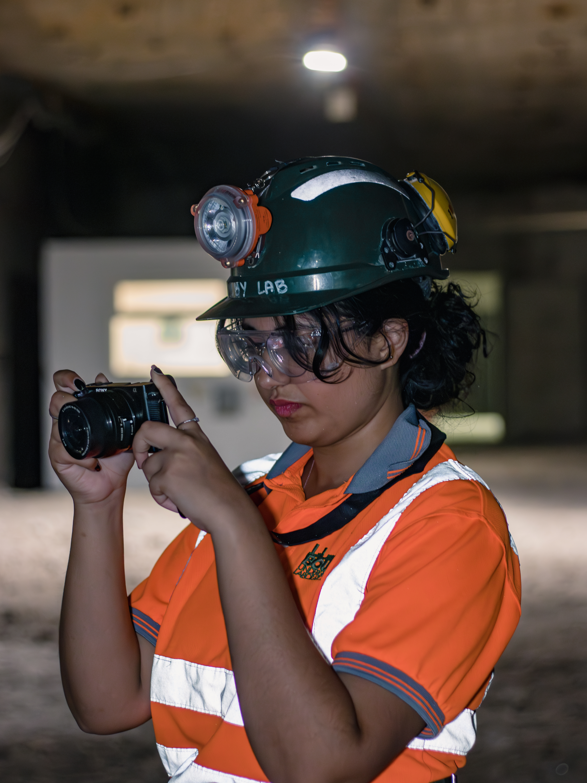
STFC SM Goals
Primary aims of social media for STFC facilities
Raise awareness and understanding of STFC
Highlight involvement with projects and international collaborations
Promote workplace
Celebrate diversity and achievement
Encourage STEM careers
Redirect traffic to other content
Image © STFC John Dawson
We do all of these!
DULIA-Bio 2024
Notes:
PLEASE DELETE/REPLACE PHOTO CREDIT IF CHANGING THE IMAGE.

Slide 6
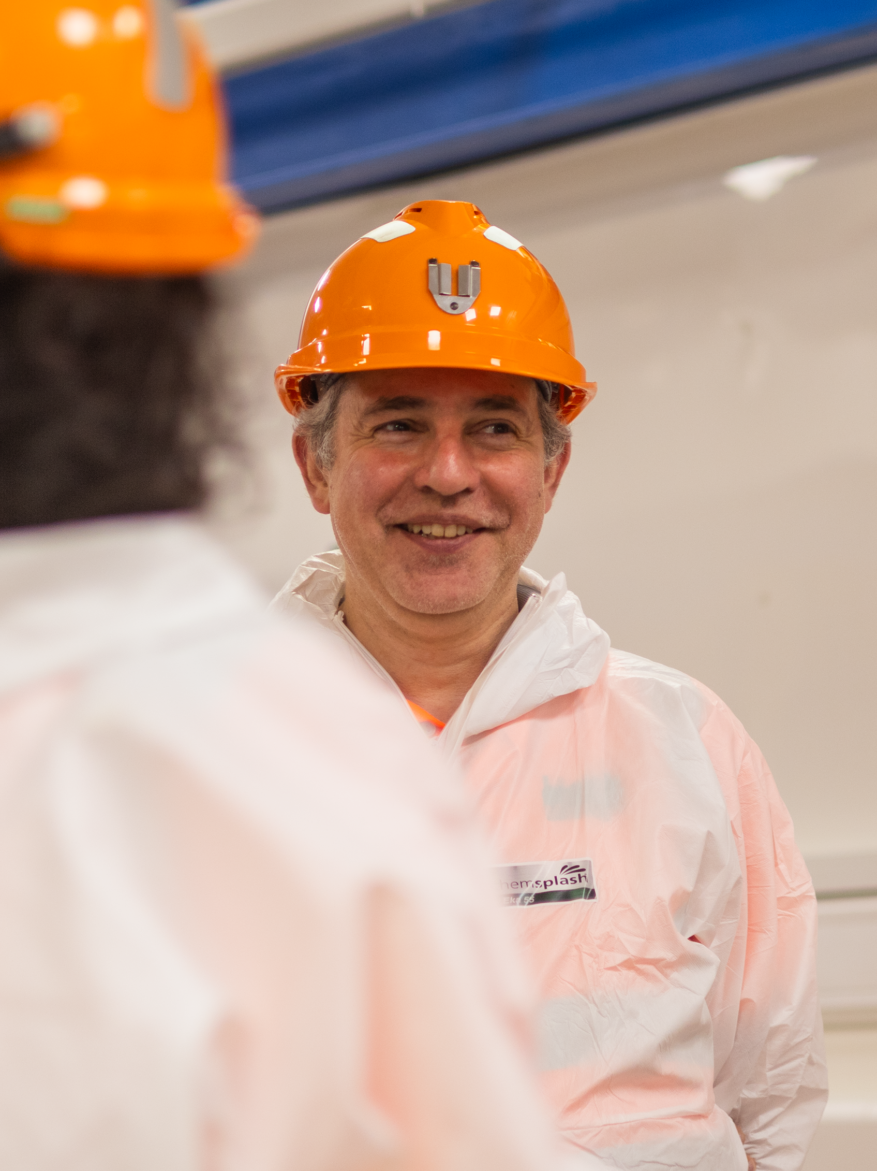
Boulby's core missions
Develop, manage and support strong and varied facility science programme
Maintain and operate high quality facility infrastructures, services and operational systems
Maintain strong, positive & clear stakeholder communications
Educate and inspire
Image © STFC John Dawson
Notes:
PLEASE DELETE/REPLACE PHOTO CREDIT IF CHANGING THE IMAGE.

Slide 7
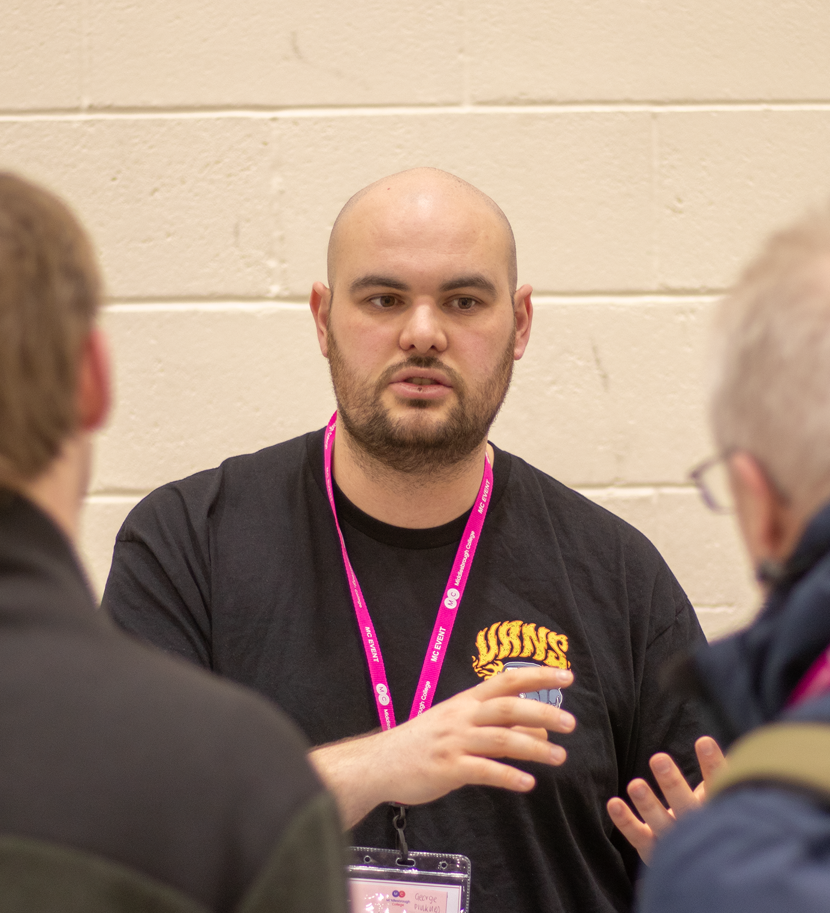
How do you do it?
How to do great outreach while being over a kilometre underground
Challenges and opportunities that arise from such an environment
DULIA-Bio 2024
Notes:
To replace photo with one of your own. 1) Send the geometric shape overlay to the back – Right-Click > Send to Back > Send to Back. 2) Replace image – use the guides provided to correctly position it. 3) Send your image to the back so that the geometric overlay re-appears over the image. Remember to delete the image credit if using your own image.

Slide 8
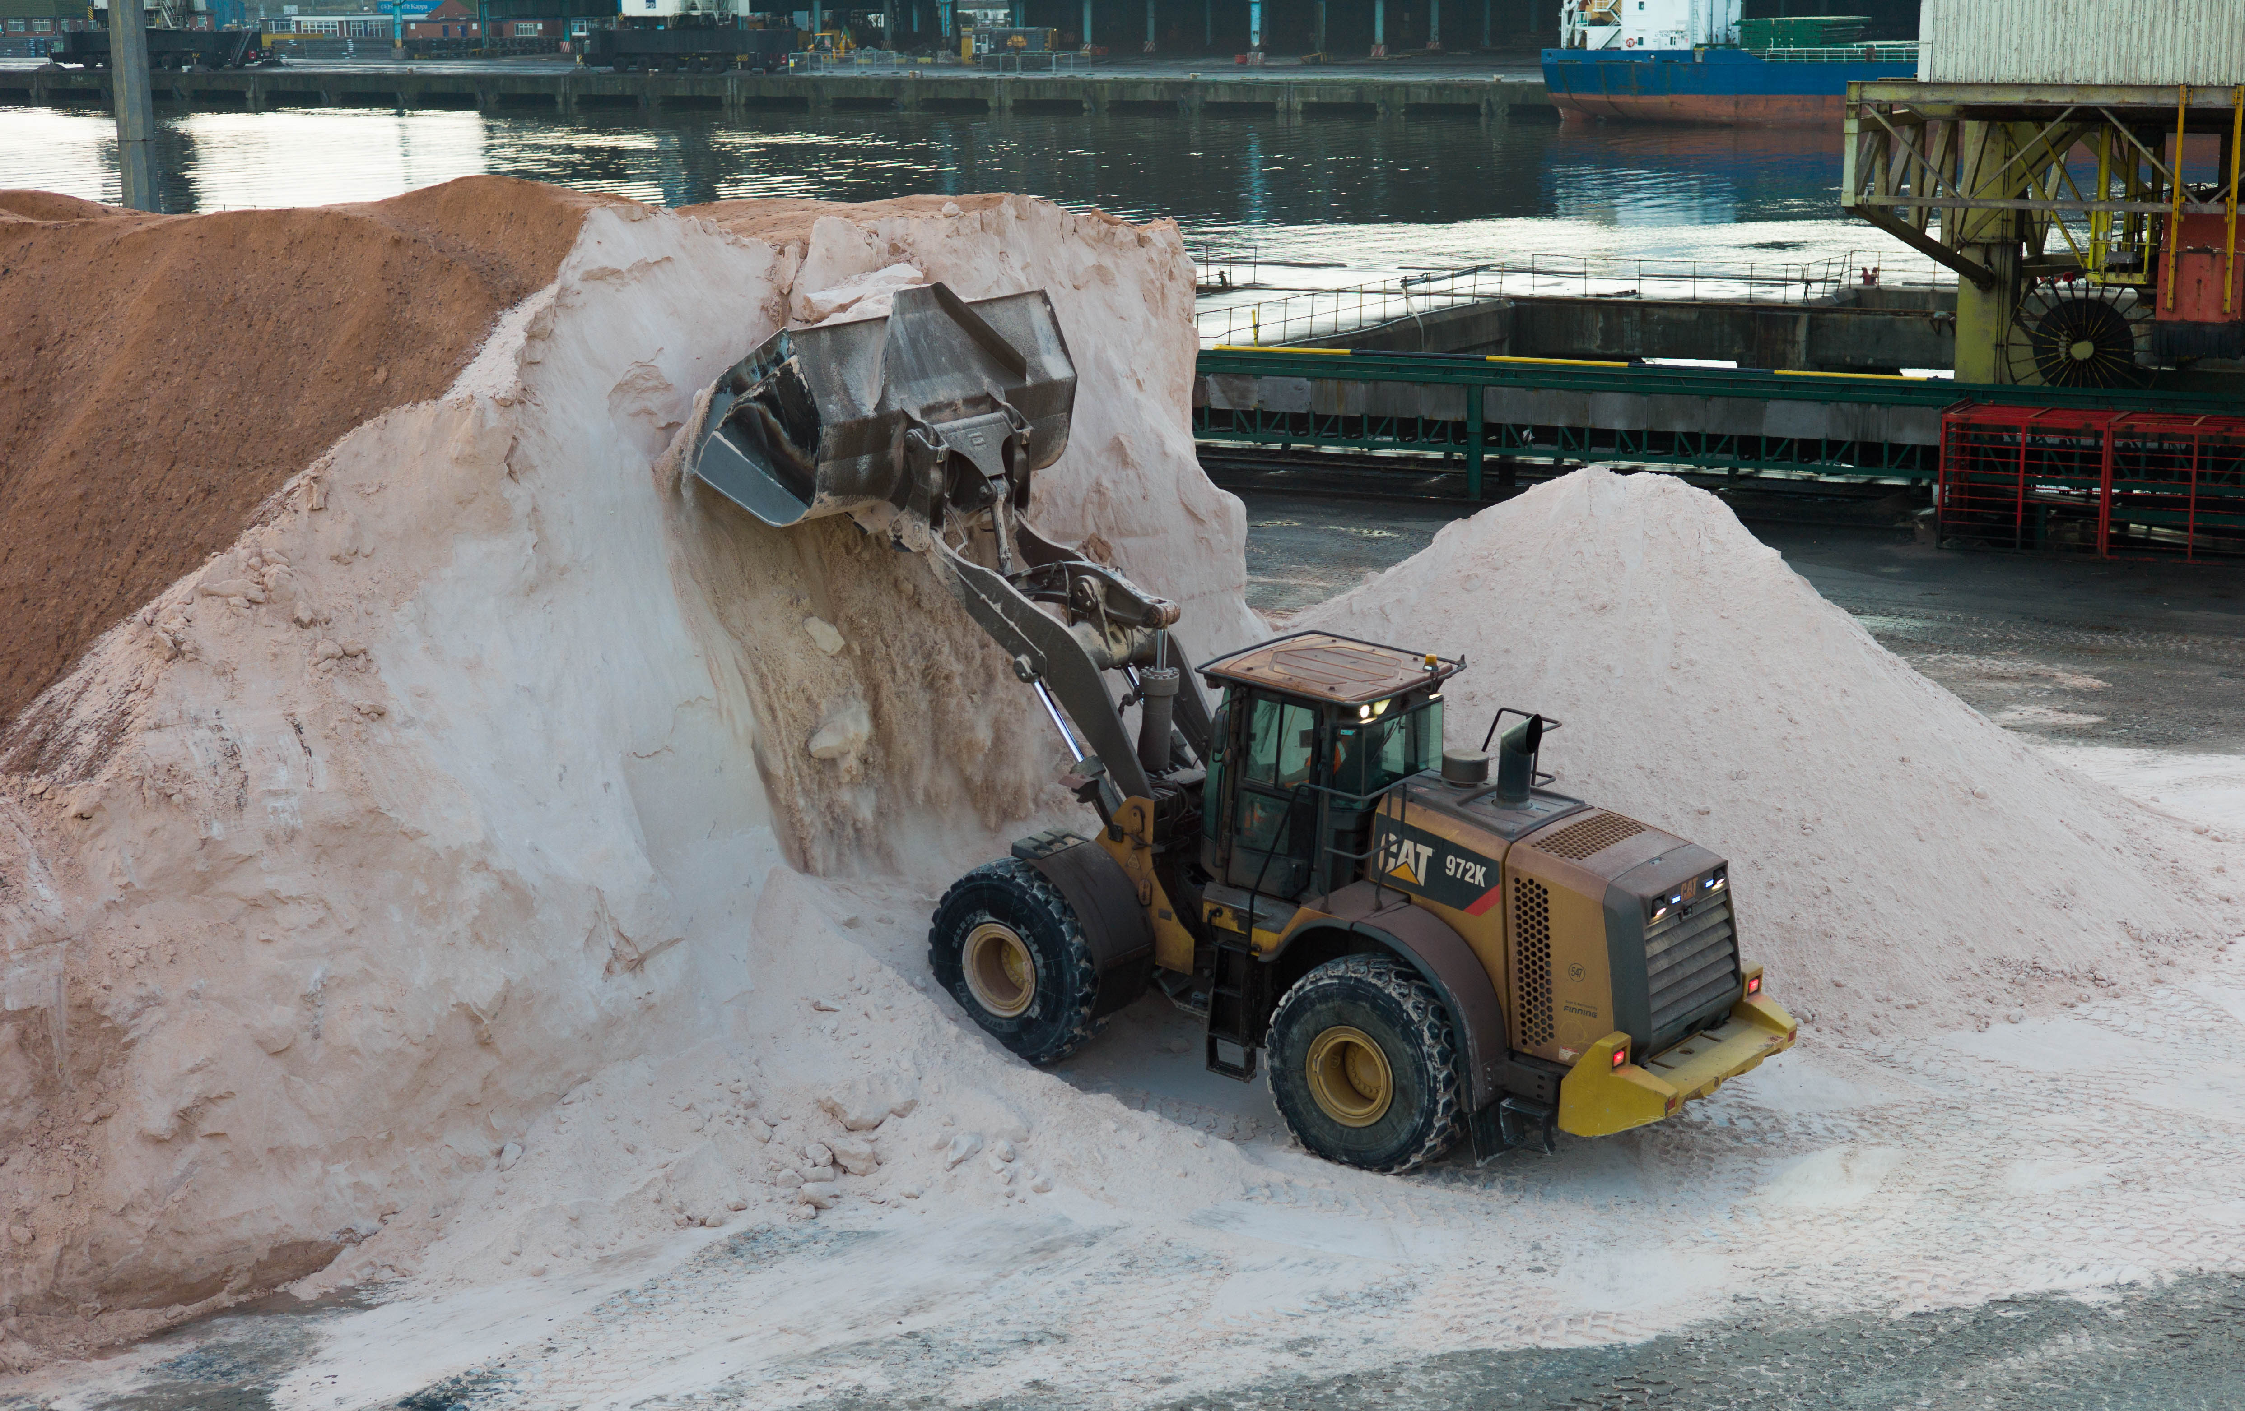
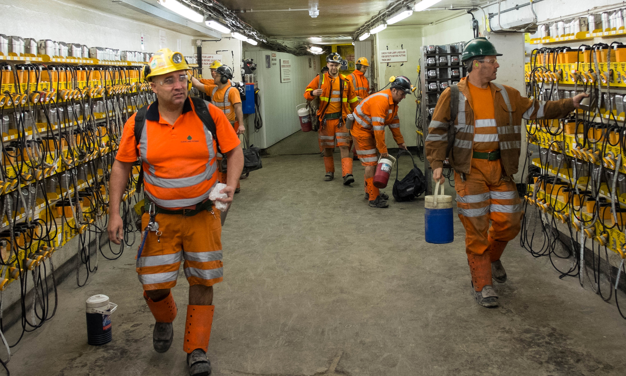
Limitations
Must be 18 or older to go underground
Active, working mine (UG and surface)
Mine safety procedures dictate numbers
Broad and complex science programme requires expertise
Notes:
The abstract pattern can be removed or repositioned if required. Be careful to ‘Send to Back’ so that it does not obscure any important information.

Slide 9
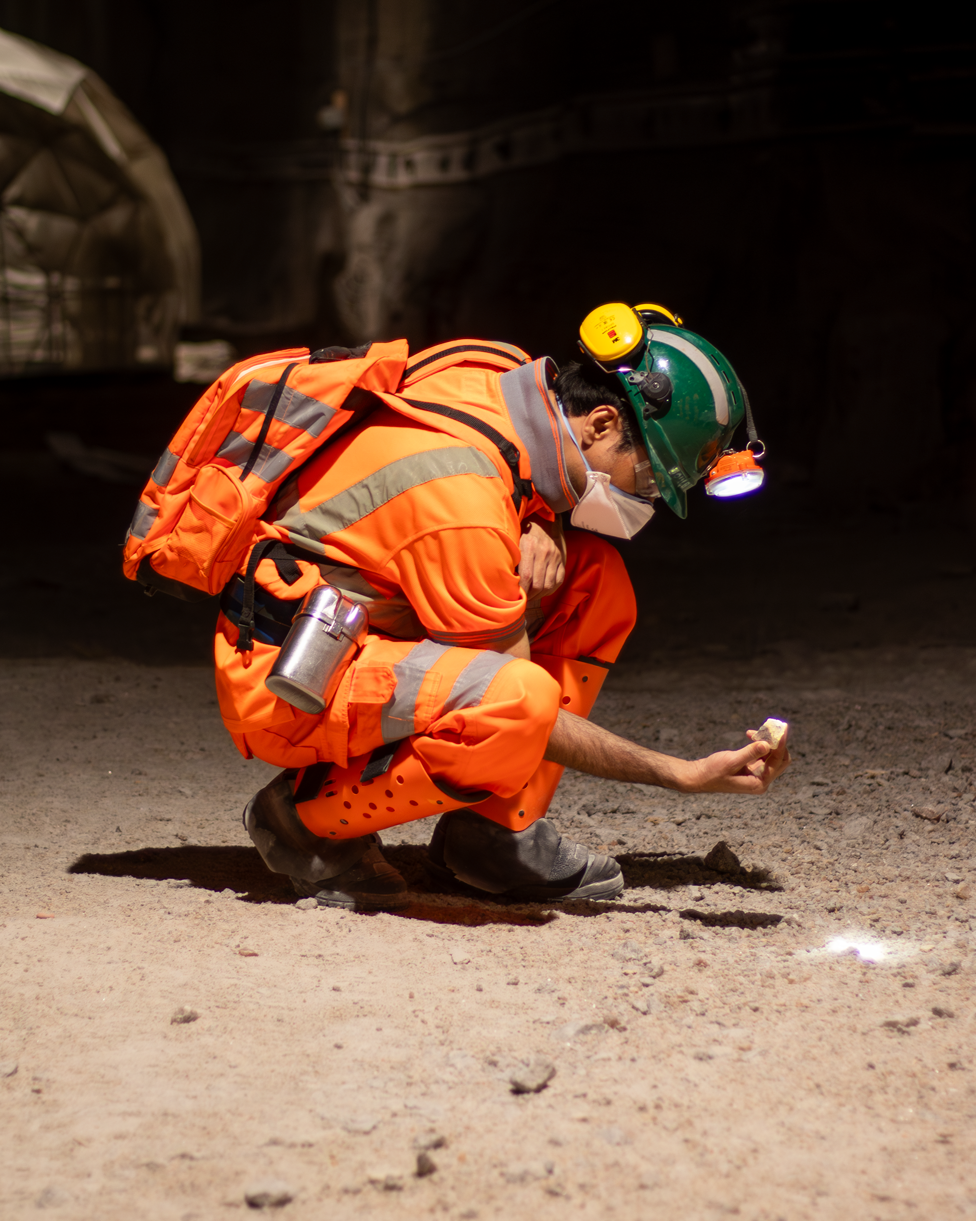
Opportunities
Complexity allows for explanation on multiple levels – applicable to a variety of understandings
Breadth of science allows for engagement with different interest groups (Physics undergrad to kids interested in "outer space")
Challenge your thinking – how to illustrate concepts remotely and accessibly?
Notes:
The abstract pattern can be removed or repositioned if required. Be careful to ‘Send to Back’ so that it does not obscure any important information.

Slide 10
How do we do it?
Boulby Lab's current outreach programmes
DULIA-Bio 2024
Notes:
To replace photo with one of your own. 1) Send the geometric shape overlay to the back – Right-Click > Send to Back > Send to Back. 2) Replace image – use the guides provided to correctly position it. 3) Send your image to the back so that the geometric overlay re-appears over the image. Remember to delete the image credit if using your own image.

Slide 11
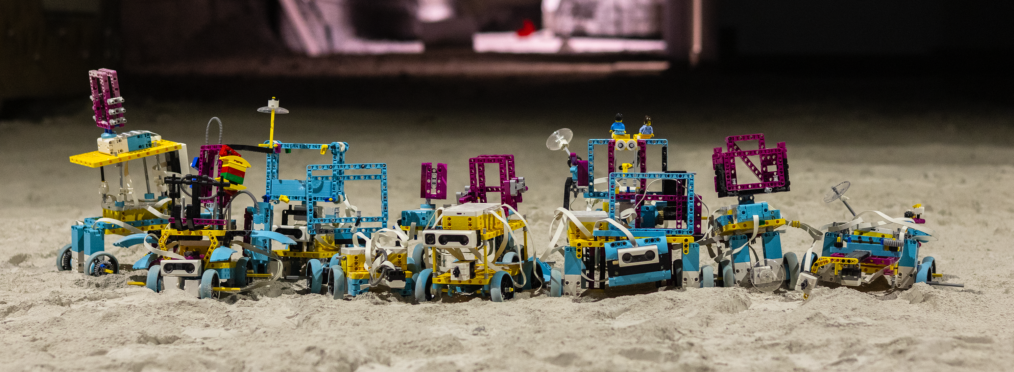
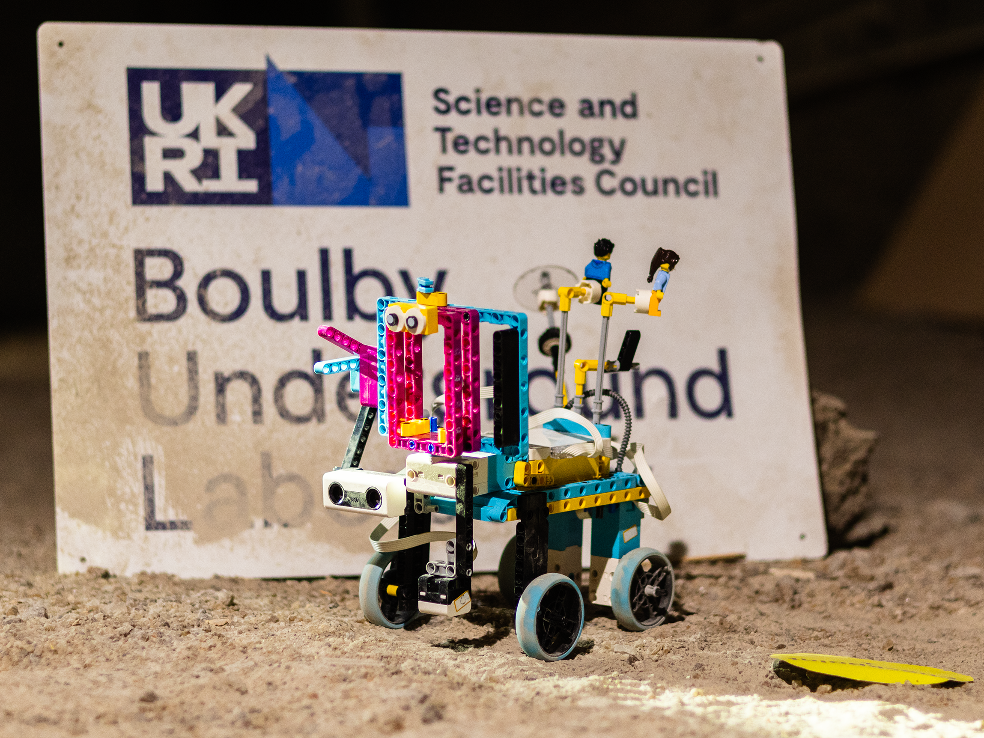
Remote³
Funded by a Nucleus Award
Run in conjunction with the University of Edinburgh and STFC's Rutherford Appleton Laboratory
Mentors will work with groups of kids to design, build and code LEGO MINDSTORM Mars rovers
Tested at RAL before being put to the test 1.1km underground in our Mars Yard
Notes:
The abstract pattern can be removed or repositioned if required. Be careful to ‘Send to Back’ so that it does not obscure any important information.

Slide 12
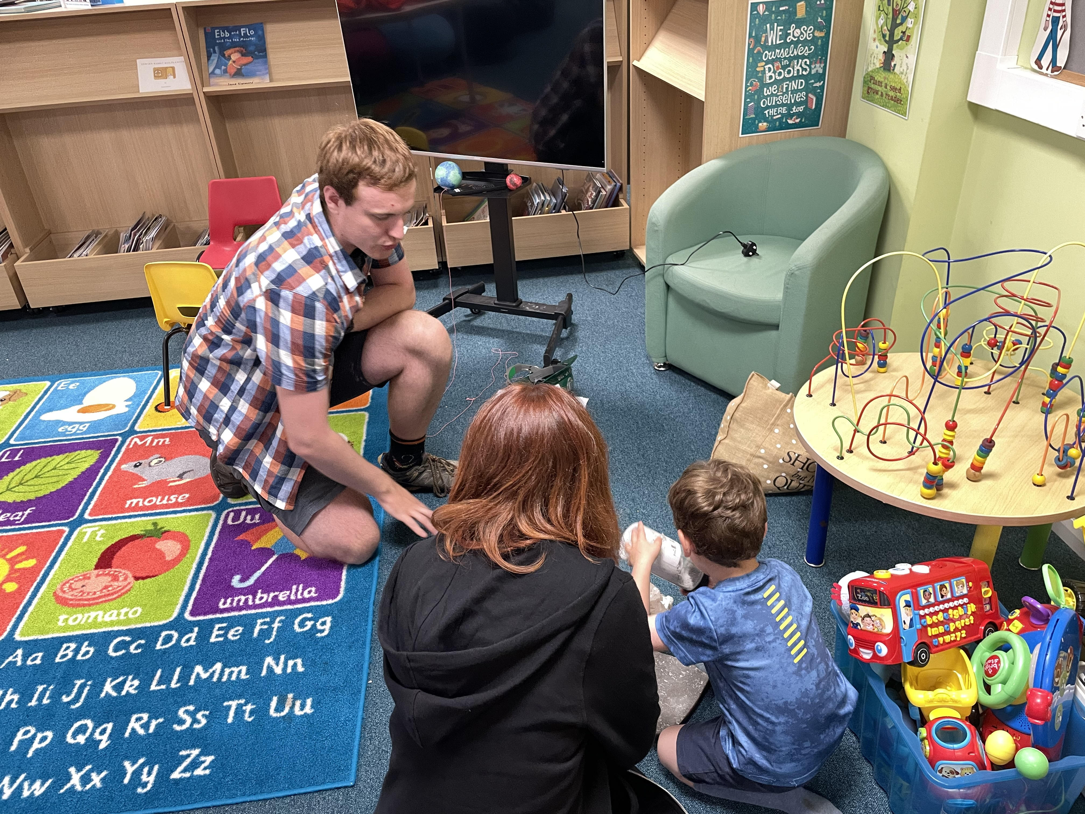
The Little Robot
Story written with STFC PE team
Follows a little Mars rover who travels underground to Boulby lab for testing
Acts as a medium to teach kids about the lab and the science projects that we host
Working with local schools, libraries and groups at HOW
Notes:
The abstract pattern can be removed or repositioned if required. Be careful to ‘Send to Back’ so that it does not obscure any important information.

Slide 13
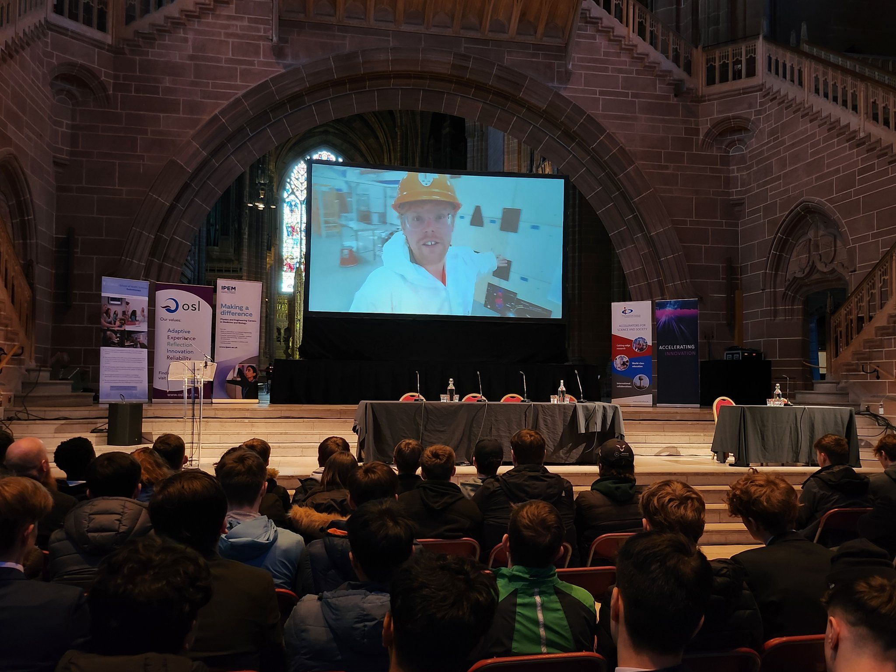
Live links
Virtual tours of the lab
Relatively simple – laptop cameras
Applicable to lots of audiences – speaker to tailor
Physics undergrad, secondary schools, HOW, public events (EMF)
How do we make this concept more accessible?
Notes:
The abstract pattern can be removed or repositioned if required. Be careful to ‘Send to Back’ so that it does not obscure any important information.

Slide 14
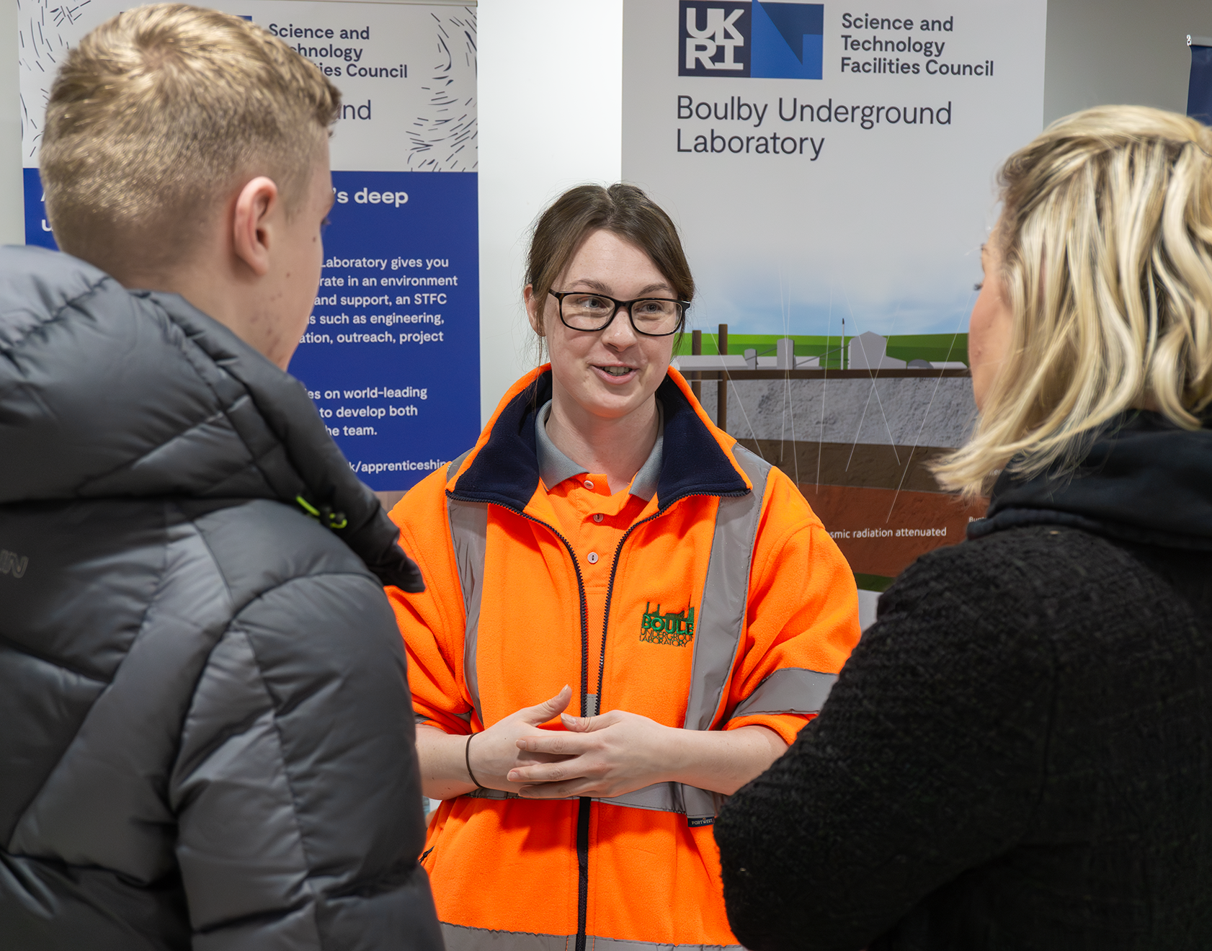
Careers fairs & similar events
Recruitment but also for raising awareness
NAW careers fairs
Making local education providers aware that we are here – inspiring and educating
Land of Iron – mines in the modern age
Notes:
The abstract pattern can be removed or repositioned if required. Be careful to ‘Send to Back’ so that it does not obscure any important information.

Slide 15
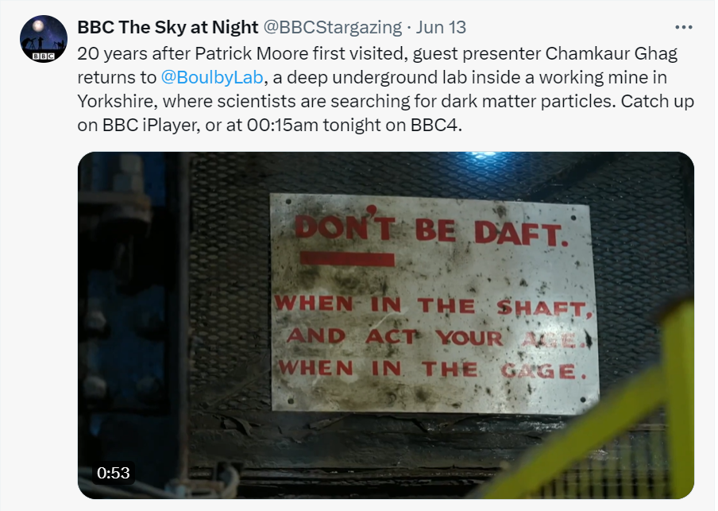
Social media
Facebook, Twitter / X, Instagram, LinkedIn, YouTube
Promotion of local events, redirecting traffic to other content, talk about our impact, and more...
A lot like STFC's primary goals
Notes:
The abstract pattern can be removed or repositioned if required. Be careful to ‘Send to Back’ so that it does not obscure any important information.

Slide 16
Follow us pleaase :)

Slide 17
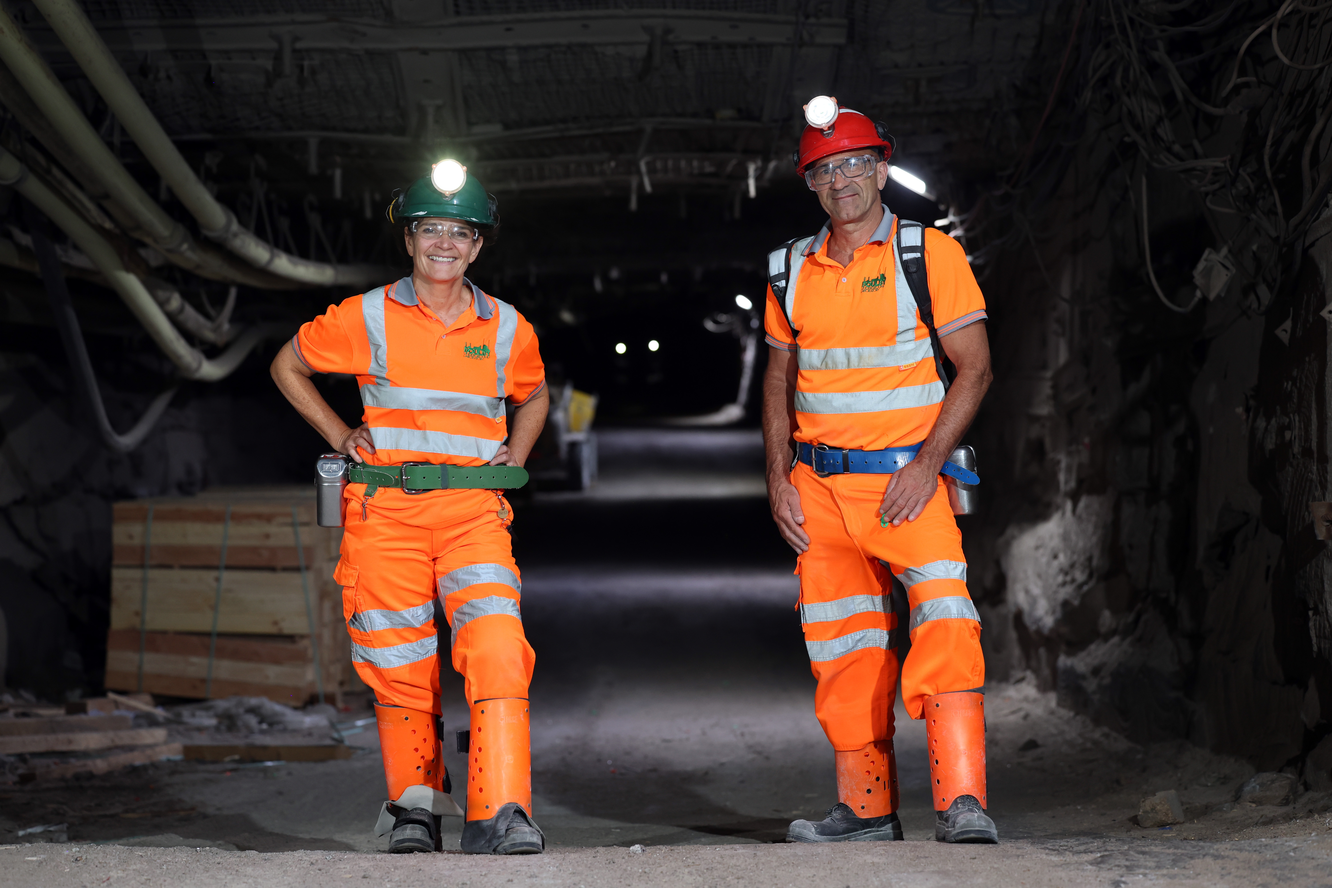
Broader media
Daily Mail
BBC's The Sky at Night
Channel 5
BioSPHERE has attracted a lot of interest!
Notes:
The abstract pattern can be removed or repositioned if required. Be careful to ‘Send to Back’ so that it does not obscure any important information.

Slide 18
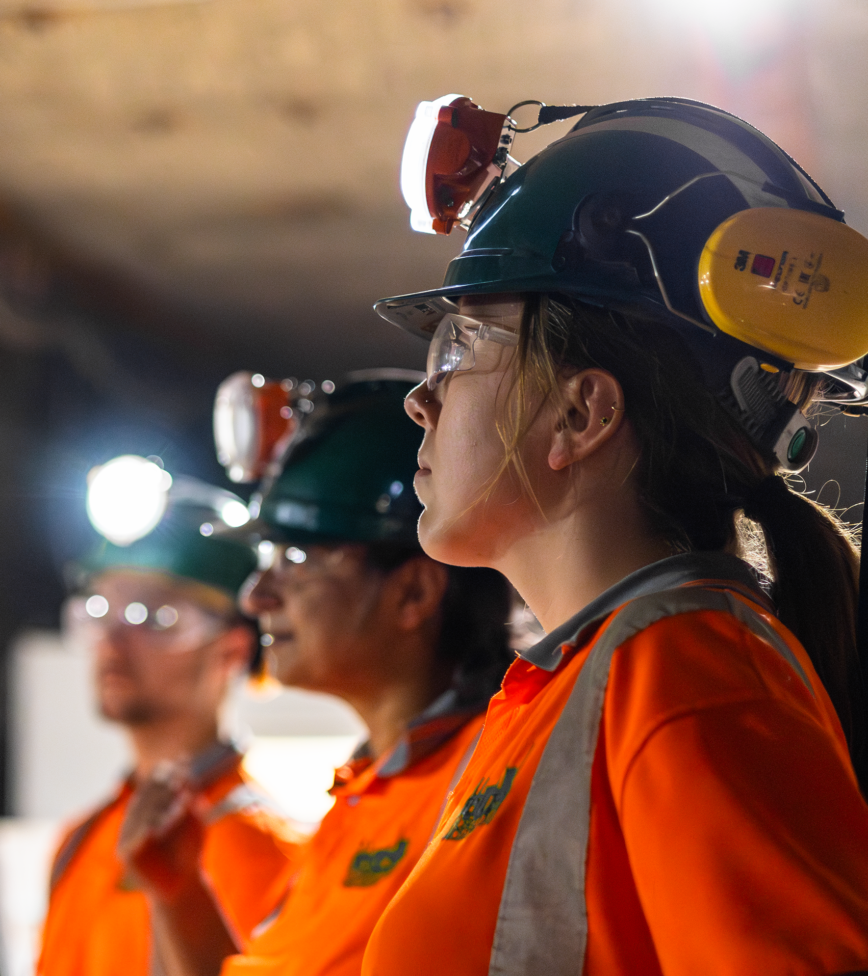
Outlook
What does the future of outreach look like at Boulby and as a whole
DULIA-Bio 2024
Notes:
To replace photo with one of your own. 1) Send the geometric shape overlay to the back – Right-Click > Send to Back > Send to Back. 2) Replace image – use the guides provided to correctly position it. 3) Send your image to the back so that the geometric overlay re-appears over the image. Remember to delete the image credit if using your own image.

Slide 19
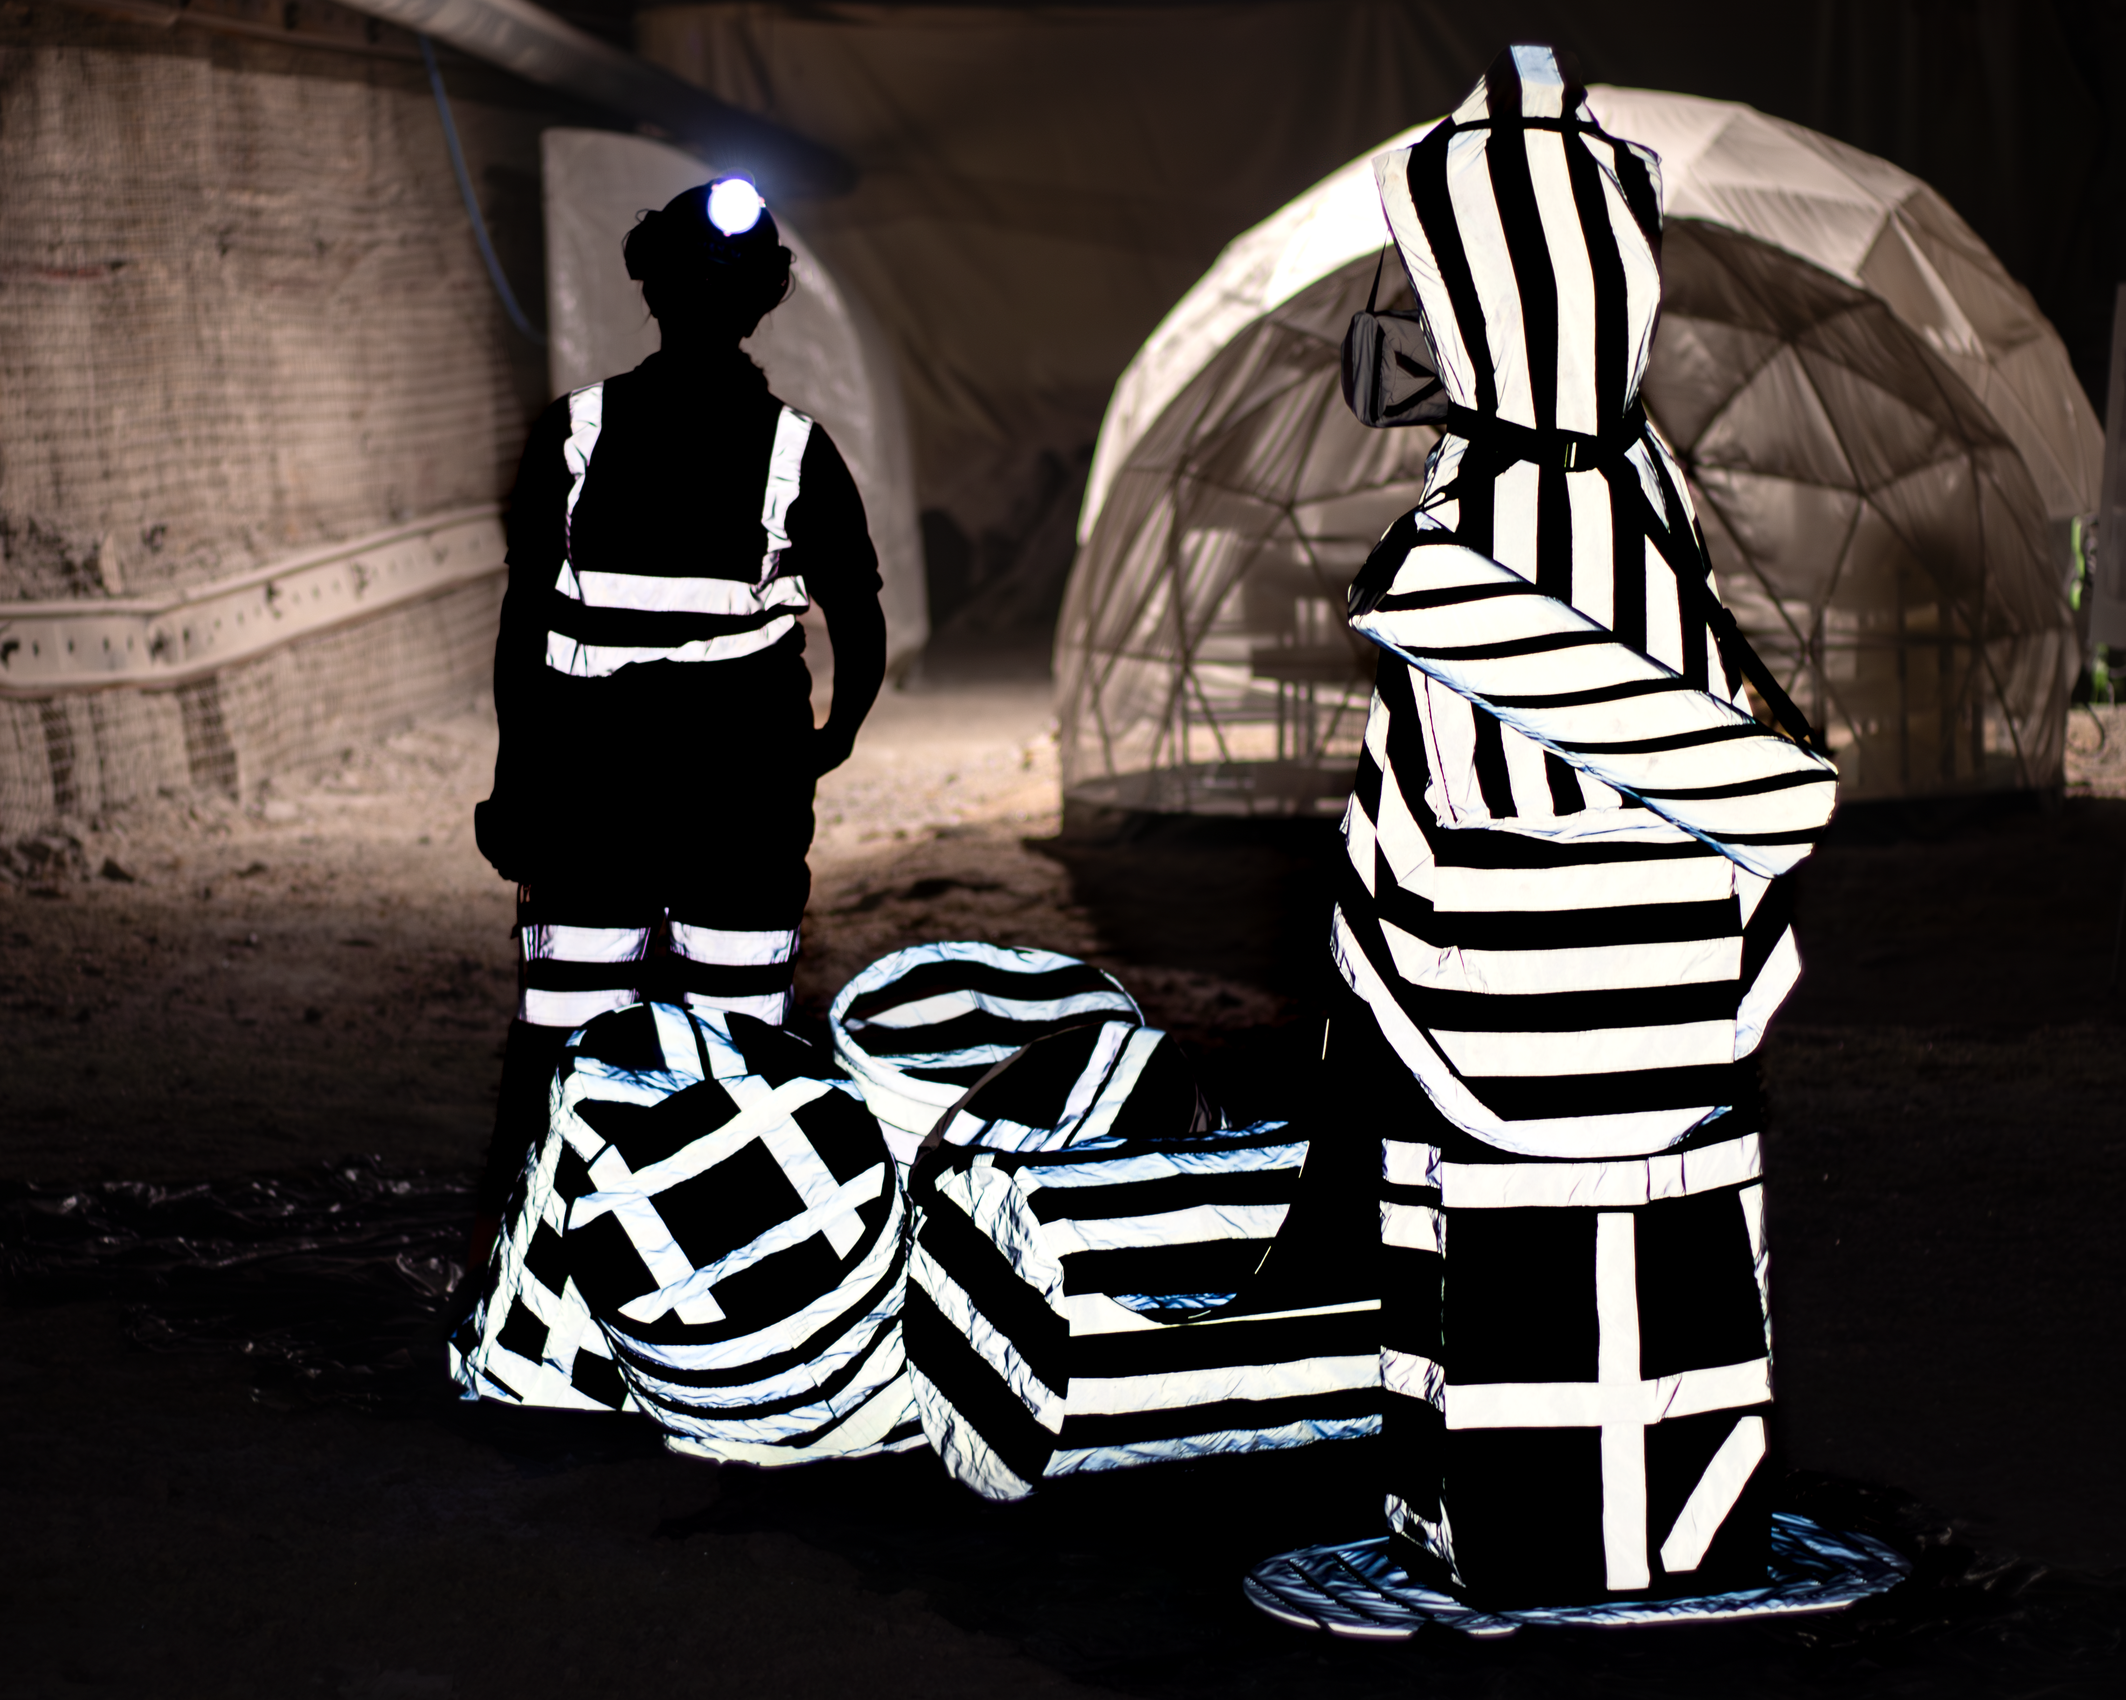
What's around the corner?
The "general public" doesn't exist
How do you do great outreach internationally?
How do you marry science and art?
And is it art or a tool?
Image © STFC John Dawson
Notes:
PLEASE DELETE/REPLACE PHOTO CREDIT IF CHANGING THE IMAGE.

Slide 20
Science and Technology Facilities Council
@STFC_matters
Science and Technology Facilities Council
Notes:
The abstract pattern can be removed or repositioned if required. Be careful to ‘Send to Back’ so that it does not obscure any important information.

Slide 21
Notes:
The abstract pattern can be removed or repositioned if required. Be careful to ‘Send to Back’ so that it does not obscure any important information.

