Slide 1
DULIA-BIO Bio Sciences Workshop 2024 Opportunities and challenges of deep underground science facilities and research laboratories Goabaone Gaobotse, PhD Senior Lecturer of Stem Cell Biology Botswana International University of Science and Technology gaobotseg@biust.ac.bw

Slide 2
Seminar Content
Botswana
Opportunities of deep underground facilities
Challenges to deep underground facilities
Summation

Slide 3
Botswana
Source: Library of Congress

Slide 4
Botswana
Independence: 1966
Population: 2.6 million
Capital: Gaborone
Mode of Governance: Democracy

Slide 5
Botswana
President: Dr. Mokgweetsi Eric Masisi
Official languages: English and Setswana
Economy: Second diamond mining country in the world (NS Energy, 2020)
Jwaneng mine: Second largest diamond mine in the world (Mining technology, 2019)

Slide 6
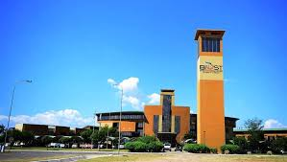
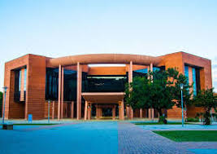
Botswana
Education
Botswana International University University of Botswana (UB)
of Science and Technology (BIUST)

Slide 7
Botswana
Tourism
Okavango Delta: UNESCO world heritage site (UNESCO, 2014)
Tsodilo Hills: UNESCO world heritage site (UNESCO, 2001)
Central Kalahari Game Reserve: the second largest game reserve in the world (Botswana tourism, 2020)
Botswana has the largest population of wild elephants in the world (Blackie, 2019)

Slide 8
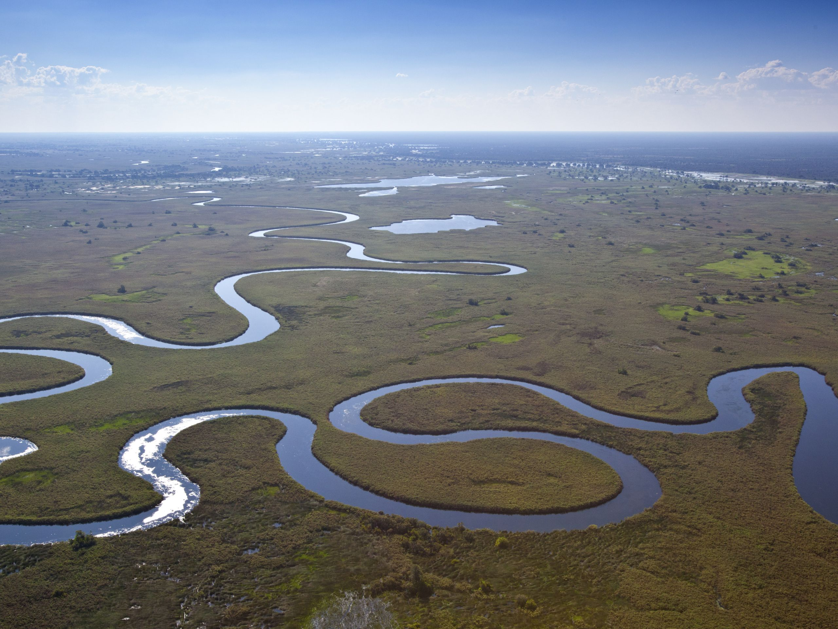
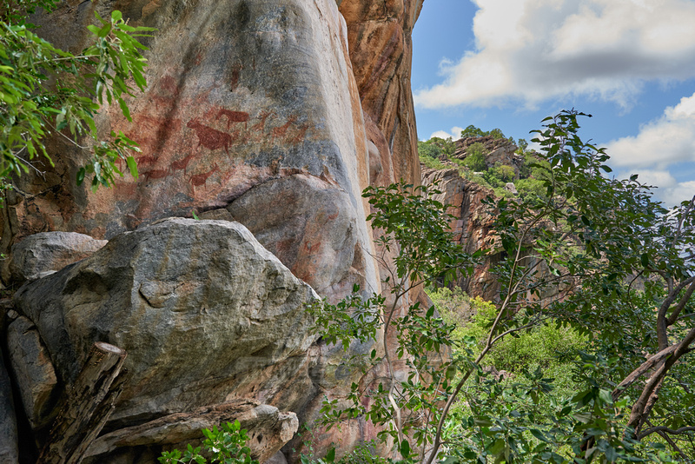
Botswana
Tourism
Okavango Delta (Source: news.sky.com)
Tsodilo Hills (Source: travel4pictures.com)

Slide 9
Botswana
Free education up to tertiary level
Every citizen eligible for free
education
The home country of 200m athletics
Olympic Champion – Letsile Tebogo
(Source: AP News)

Slide 10
Opportunities of deep underground facilities
Sustainable outlet for the disposal of radioactive waste
Training of qualified personnel
Provision of controlled and stable environment for research and experimental purposes
Protection from varying environmental conditions such as air quality and sudden and unanticipated weather changes

Slide 11
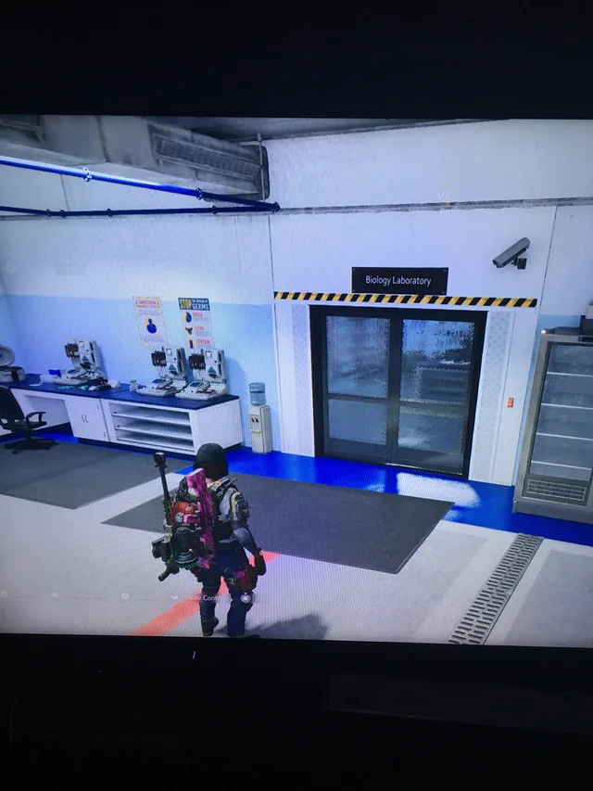
Opportunities of deep underground facilities
Applications
Physics (e.g. nuclear physics)
Geology (e.g. geochemistry)
Agriculture (e.g. food production)
Biology (e.g. microbiology)
(Source: Reddit.com)

Slide 12
Opportunities of deep underground facilities
Economical gains
Food sustainance
Food security
Employment opportunities

Slide 13
Challenges to deep underground facilities
Development costs
First underground laboratory in Africa to commence this year
Insuffient skilled personnel
Need for public education

Slide 14
Summation
Deep underground science facilities and research laboratories offer many opportunities
Many challenges face the development of deep underground science facilities and research laboratories

