Slide 1

Does ionizing radiation affect HIV release from human macrophages?
DULIA-Bio workshop - Biosciences in Underground Labs
Aug 19-22, 2024
David O. Nkwe, PhD
Department of Biological Sciences & Biotechnology,
Botswana International University of Science & Technology (BIUST)
Palapye, Botswana

Slide 2
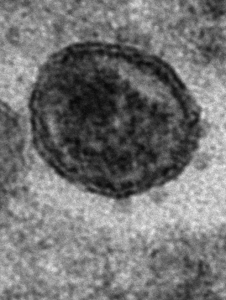
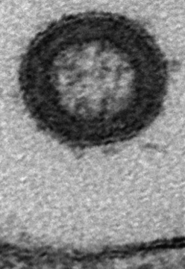
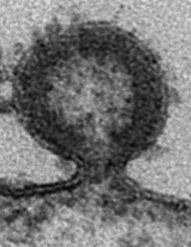
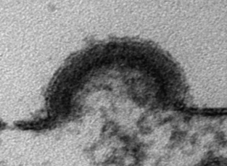
HIV-1 replication cycle
2022 Statistics (WHO)
1.3 million new infections
630,000 deaths
Early events
Late events
1. Binding
12. Maturation
CD4
2. Fusion
CCR5/CXCR4
3. Capsid release
11. Release
4. Reverse transcription
6. Integration
“Lollipop-like” virus structure
5. Uncoating & nuclear import
7. Transcription
8. RNA Export
9. Translation
10. Assembly
EM by J. Burden, UCL, UK

Slide 3
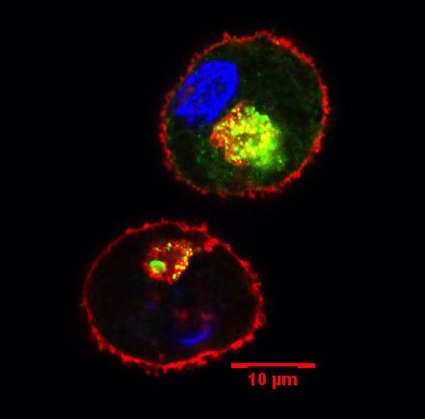
Target cells for HIV-1 infection
Key immune system cells expressing receptors (CD4) and co-receptors (CCR5 and CXCR4)
T-cells and macrophages are the main target cells for HIV in vivo
CD44 Hoechst HIV Gag
Macrophages
IPMC
Resistant to cytopathic effects of HIV
Viral reservoirs - Intracellular Plasma Membrane-connected Compartments (IPMCs)
PM

Slide 4
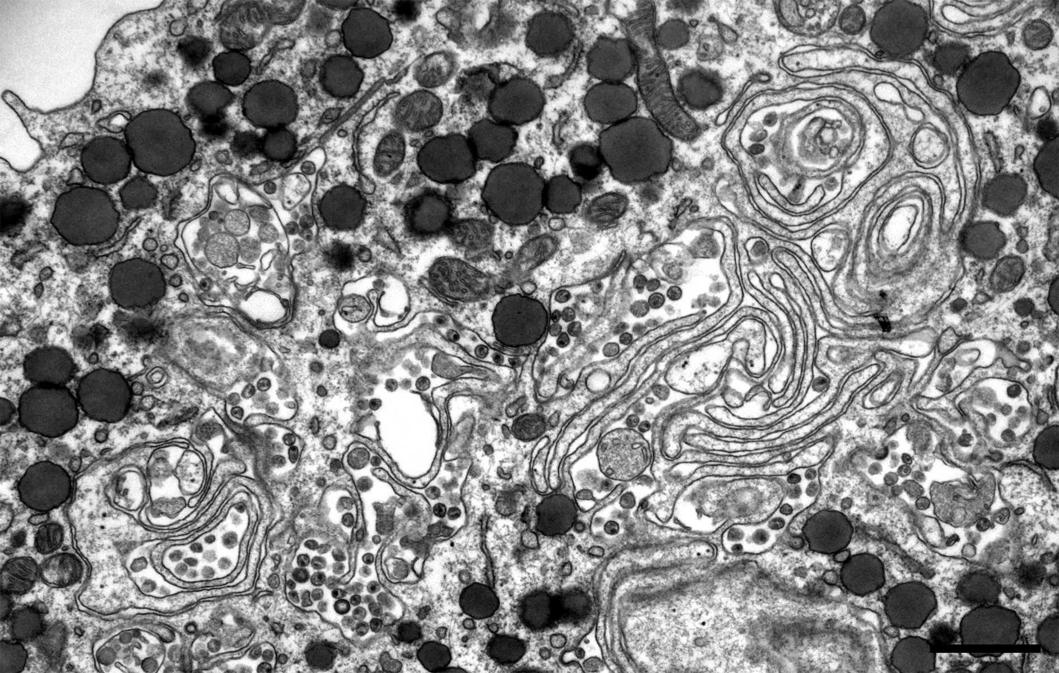
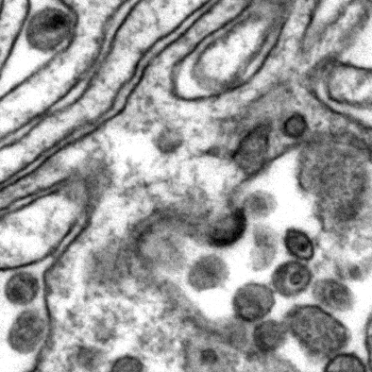
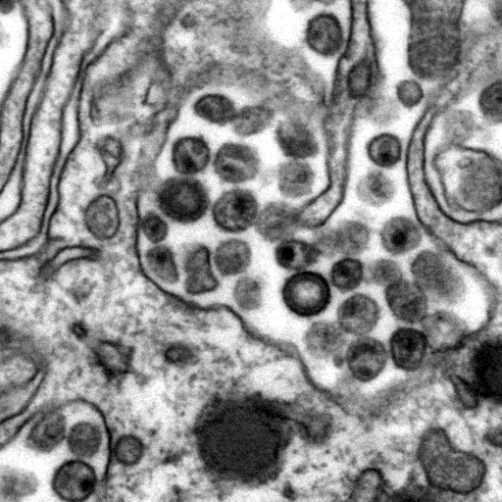
HIV-1 assembly in macrophages
1 µm
EM by A. Pelchen-Matthews, UCL, UK

Slide 5
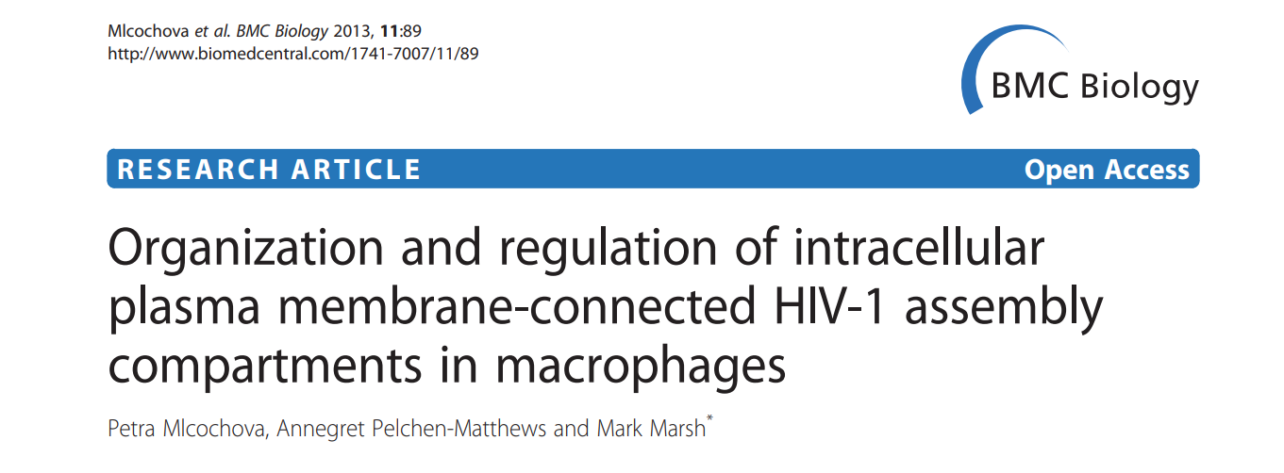
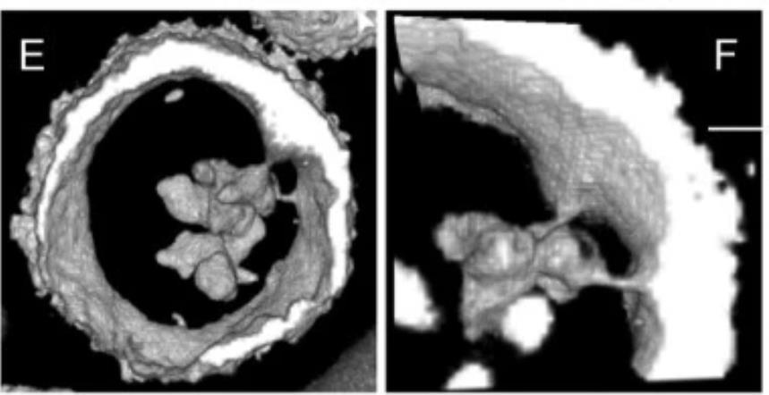
Organisation of the IPMC
IPMCs continuous with plasma membrane
Functionally intact actin cytoskeleton required to maintain organization of IPMCs
HIV-1-infected cells, perturbation of actin cytoskeleton influences
  organization of compartment
  and release of sequestered virus

Slide 6
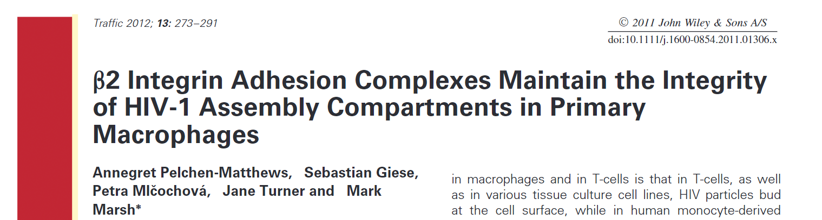
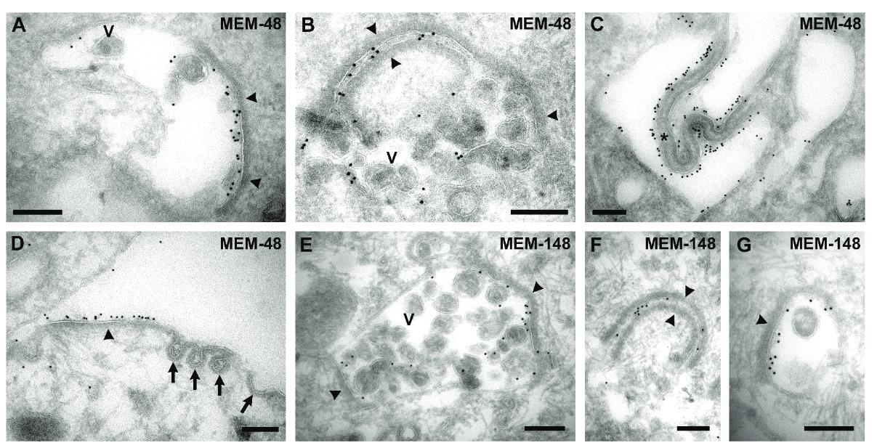
Organisation of the IPMC
The thick coats contain the leukocyte-speciﬁc β2 integrin, CD18.
CD18 knockdown alters the appearance of virus-containing IPMC in HIV-infected MDM
Notes:
Integrins form a diverse group of transmembrane glycoproteins that facilitate an active interaction with other cell surface and ECM components, which coordinate the signaling cascades regulating cell adhesion, survival, and cytoskeleton organization
Immunogold labelling of cryosections from human MDM infected with HIV-1 for 7 days. A–D) Immunolabelling with mouse mAb MEM-48 against CD18/β2 integrin. E–G) Immunolabellingwith mouse mAb MEM-148, which recognizes the activated conformation of CD18/β2 integrin.

Slide 7
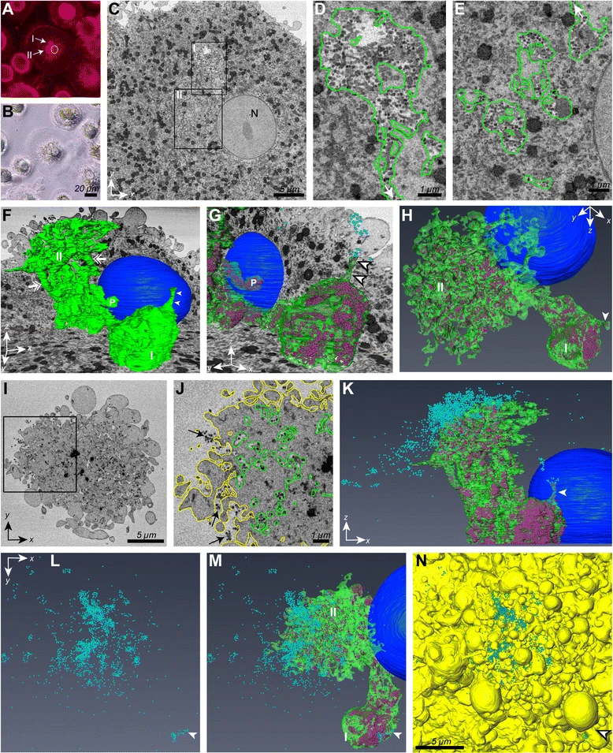
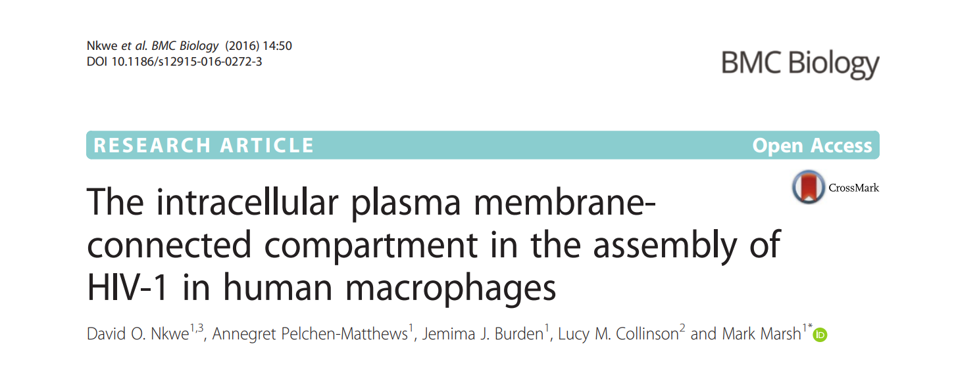
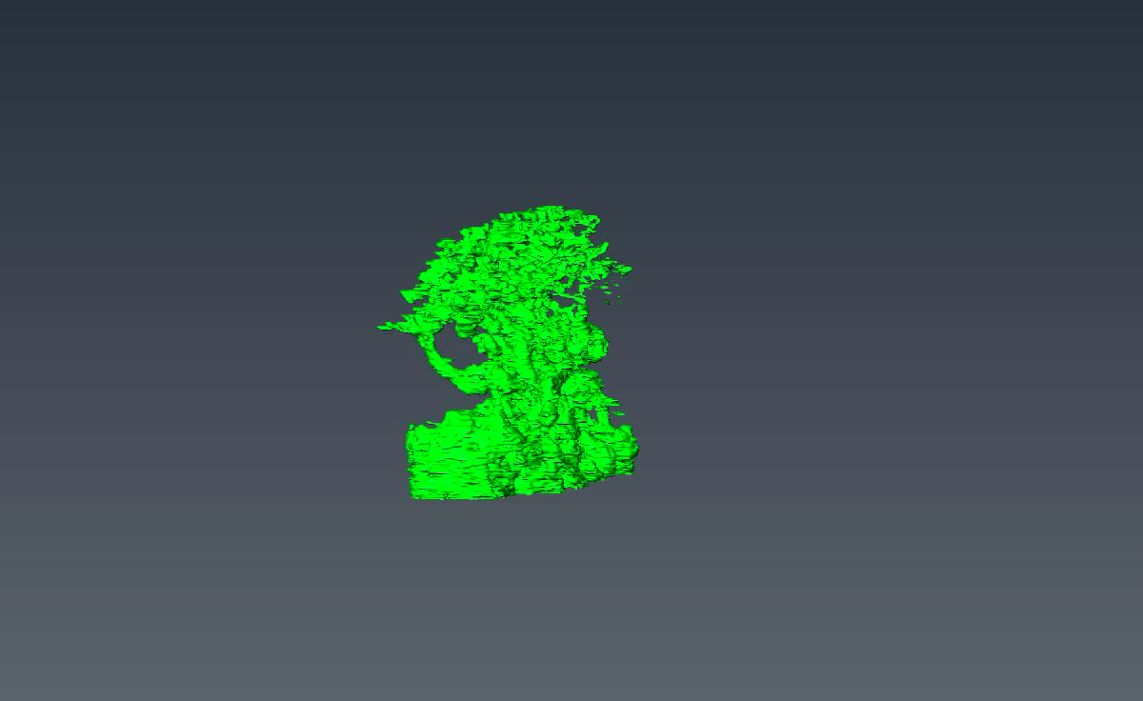
Notes:
Monocyte-derived macrophages (MDMs) were infected with HIV-1 R3A PTAP⁻YP⁻, stained with CellMask orange to visualise the plasma membrane and IPMCs, fixed and processed for serial block-face scanning EM

Slide 8
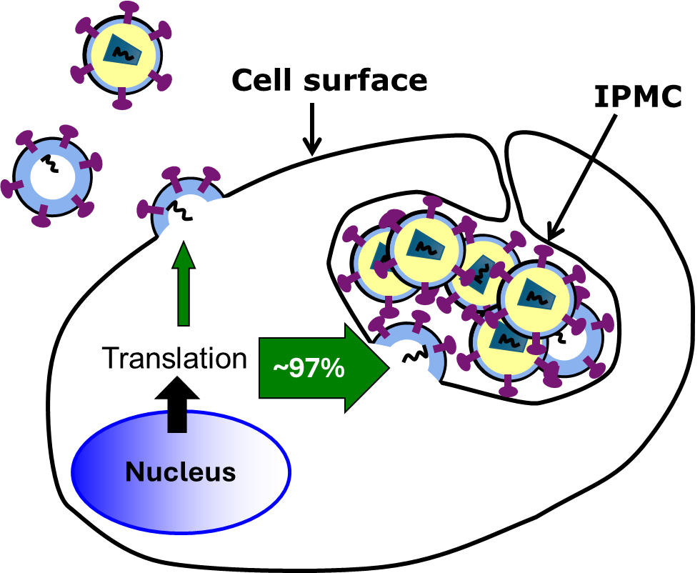
IPMC is principal site for HIV assembly in macrophages
Notes:
HIV assembly in MDMs is targeted primarily to IPMCs, with fewer than 5 % of budding events seen at the cell surface

Slide 9
Can ionizing radiation affect IPMC morphology in macrophages?

Slide 10
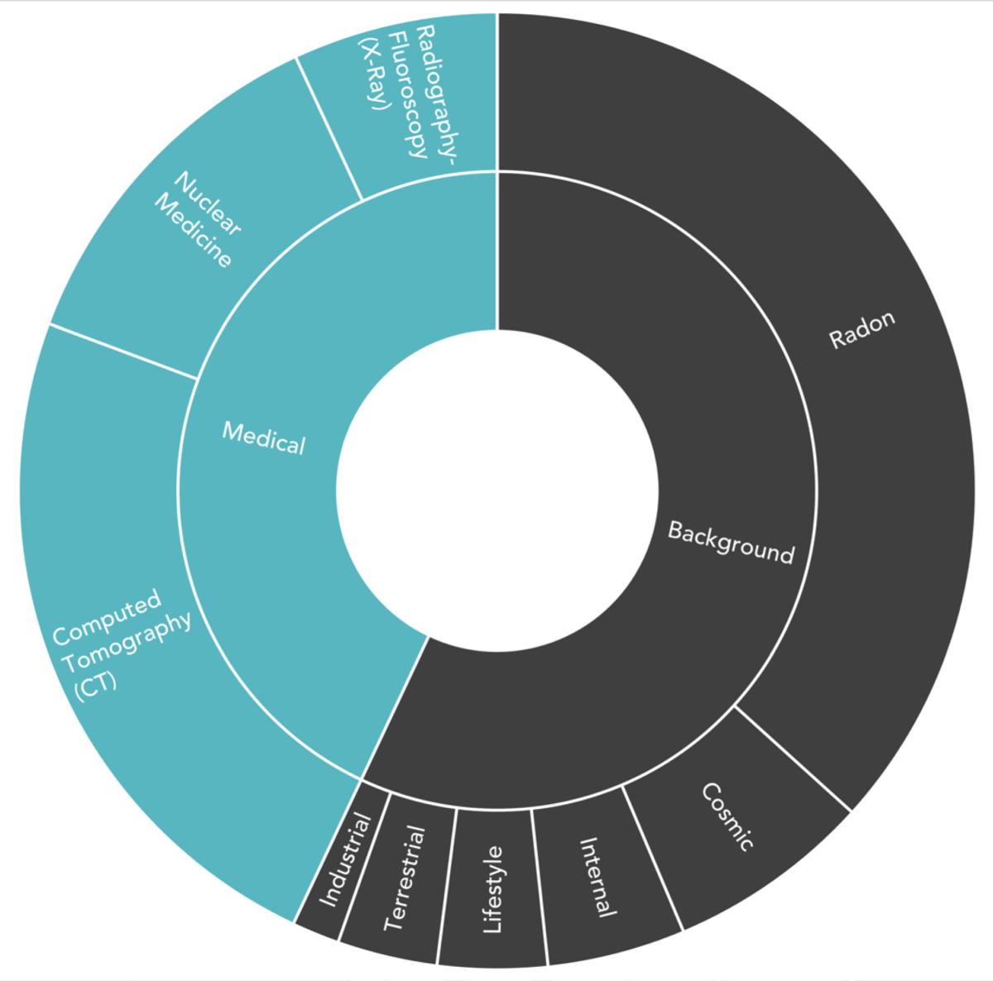
Radiation exposure
People are exposed to natural sources of ionizing radiation, such as in soil, water, and vegetation, as well as in human-made sources, such as x-rays in medical devices.
People are also exposed to natural radiation from cosmic rays, particularly at high altitude
80% of the annual dose of background radiation that a person receives is due to naturally occurring terrestrial and cosmic radiation sources.
Background radiation levels vary geographically due to geological differences. Exposure in certain areas can be more than 200 times higher than the global average.
https://fwradiology.com/radiation-dose/

Slide 11
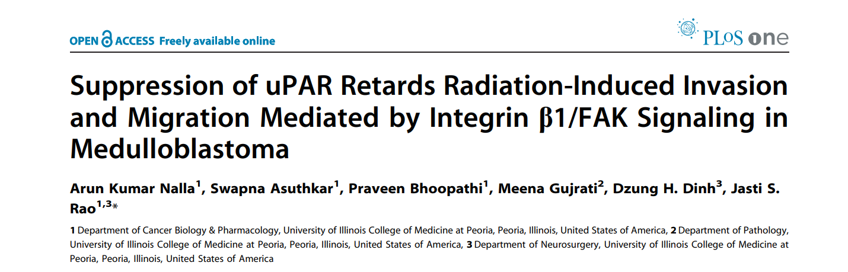
Ionizing radiation and cell adhesion molecules
Ionizing radiation increased the activation of the uPAR/integrin and β1/FAK pathway, enhancing the phosphorylation of cell adhesion-related molecules
Identified an increase in invasion and migration of irradiated compared to non-irradiated medulloblastoma cells
  increased expression of uPA, uPAR, focal adhesion kinase (FAK), N-Cadherin and integrin subunits (e.g., α3, α5 and β1) in irradiated cells.
Notes:
uPAR (urokinase-type plasminogen activator receptor) – a glycoprotein – is one of the transmembrane receptors that forms an active complex with integrins and plays a crucial role in activating integrin-mediated downstream signaling related to cell adhesion and migration
Plasminogen is the precursor of plasmin, which lyses fibrin clots
The binding of urokinase-type plasminogen activator (uPA) to its receptor, uPAR, mediates a variety of functions in terms of vascular homeostasis, inflammation and tissue repair.
uPAR is requires association with a signaling-transducing component and different partners, which include CD11b/CD18 integrin

Slide 12
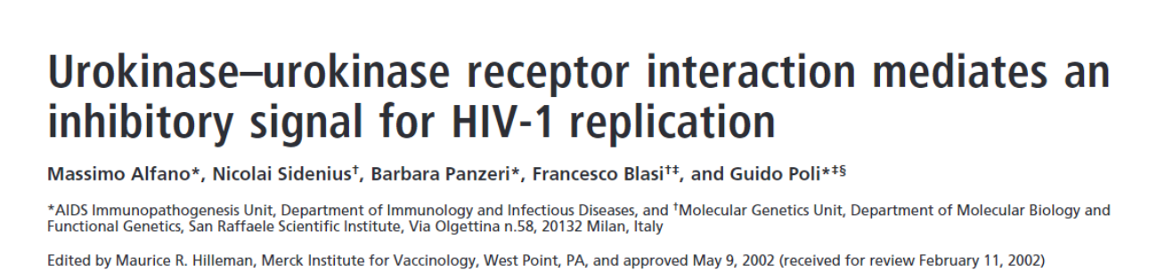
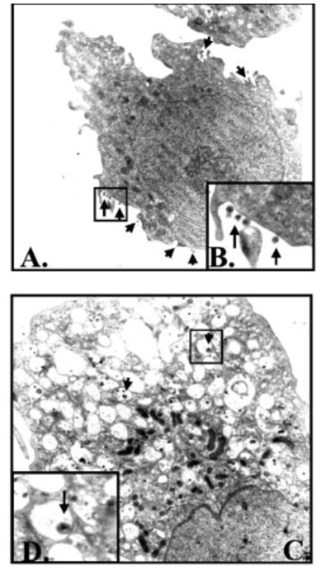
uPA & HIV replication
pro-uPA (or uPA) inhibits HIV-1 expression in U937-derived chronically infected promonocytic U1cells
Cell-associated HIV protein synthesis was not decreased by pro-uPA
Ultrastructural analysis conﬁrmed that virions were preferentially retained within cell vacuoles in pro-uPA treated cells
pro-uPA may represent a previously uncharacterized class of antiviral agents
Notes:
The role of urokinase plasminogen activator has previously been associated with HIV-1 replication in promonocytic cell line

Slide 13
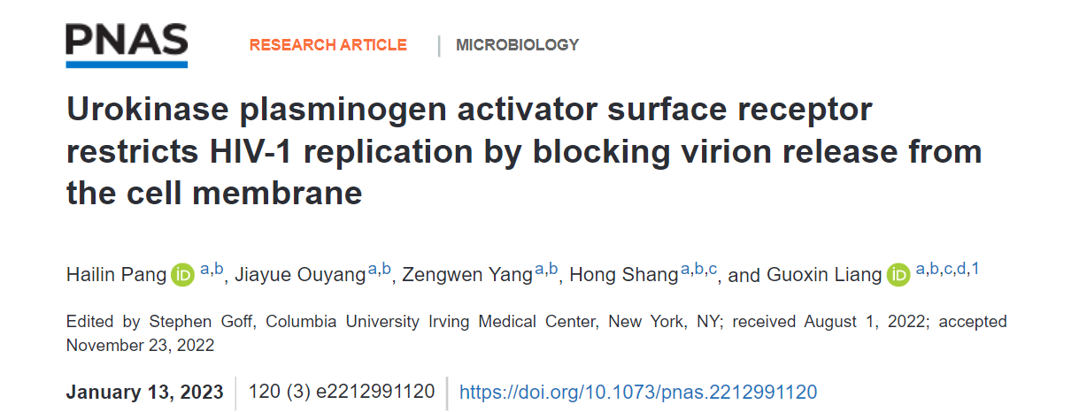
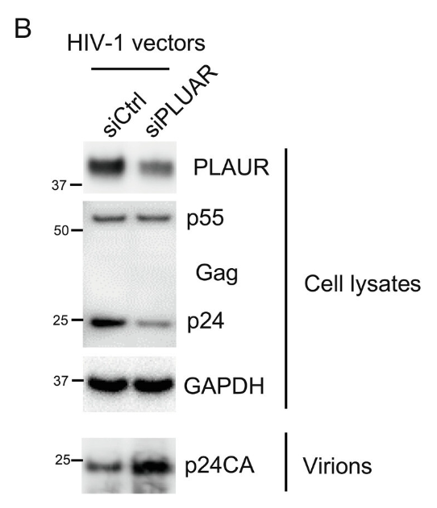
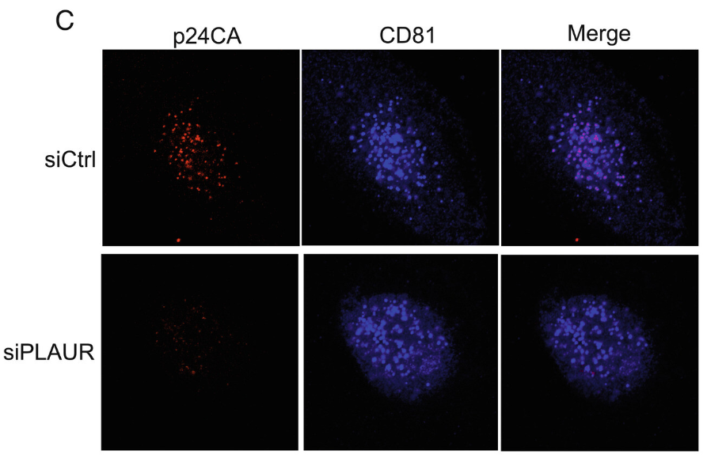
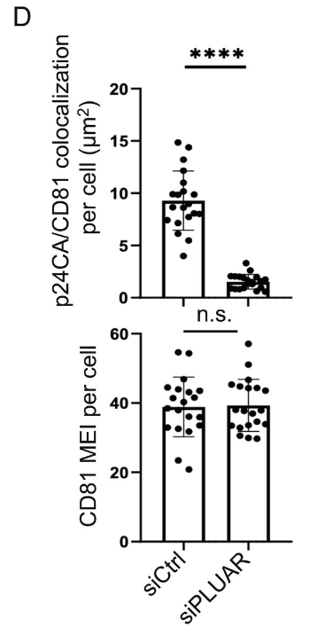
uPAR/PLAUR has antiviral activity
PLAUR, a new antiviral factor, blocks release of HIV-1 progeny from cell membrane of macrophages and DCs.
the ligand uPA slightly promotes HIV-1 production in macrophages by interfering with the antiviral activity of PLAUR.

Slide 14
Conclusion
Ionizing radiation may positively or negatively affect HIV release from macrophages
  Activating cell adhesion proteins such as uPAR/uPA
Short-term study
How does radiation exposure affect the dynamics of HIV replication and release from macrophages? OR other viruses in physiologically relevant cells?
Long-term study
How does radiation exposure affect HIV prognosis and treatment outcomes at different geographic altitudes, given that background radiation levels differ geographically?

Slide 15
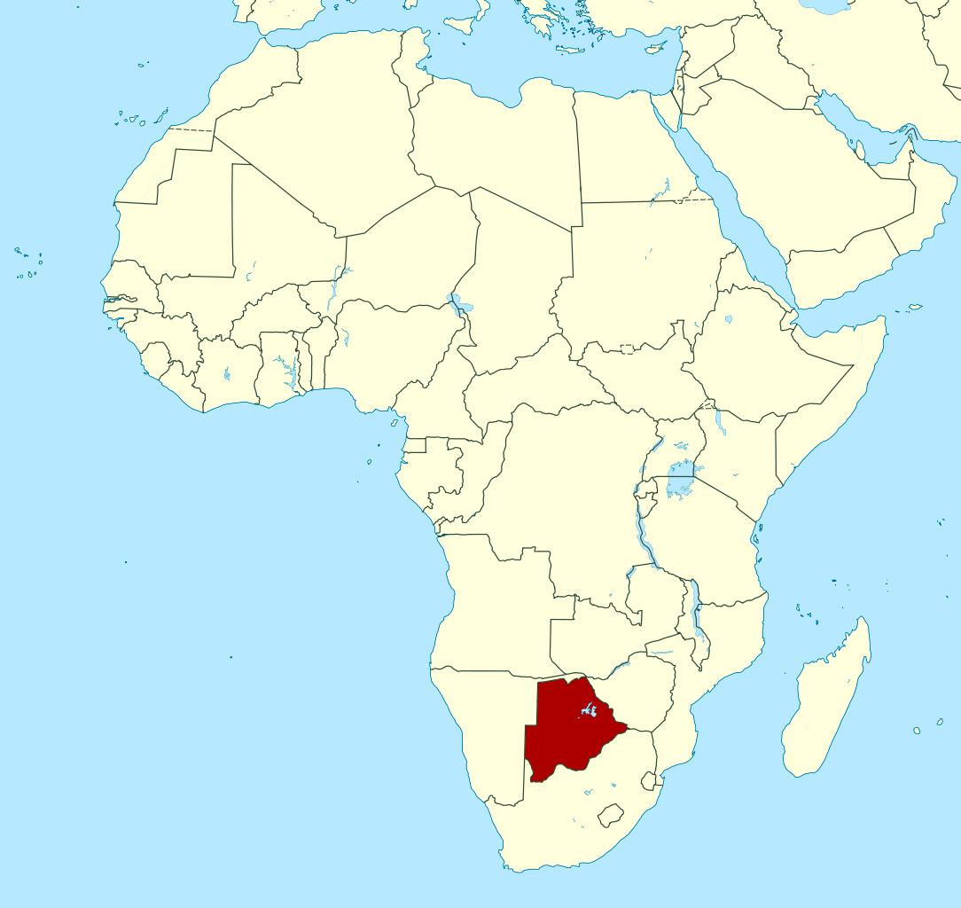
Paarl Africa Underground Laboratory (PAUL)
PAUL
Notes:
The underground lab close to Botswana and where some of these studies can be conducted is located in South Africa

Slide 16
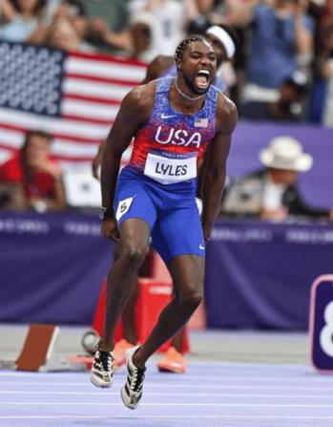

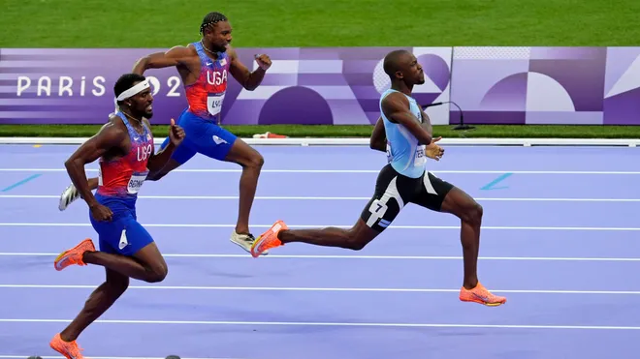
Entrance!
Exit!
THE RACE

Slide 17


Dr David O. Nkwe
nkwed@biust.ac.bw
Department of Biological Sciences and Biotechnology
School of Life Sciences, BIUST
Thank you!

