Slide 1



Adaptive and evolutionary responses of microalgae to ultra-low radioactivity at the Modane Underground Laboratory
V. Breton, A. Beauger, C. Insa, A-H Le Jeune, C. Mallet, I. Mary
LPCA, GEOLAB, LMGE, LP2I, LSM
Credits: L-A Baker, N. Lampe, W. Nitschke, S. Kolovi
1

Slide 2
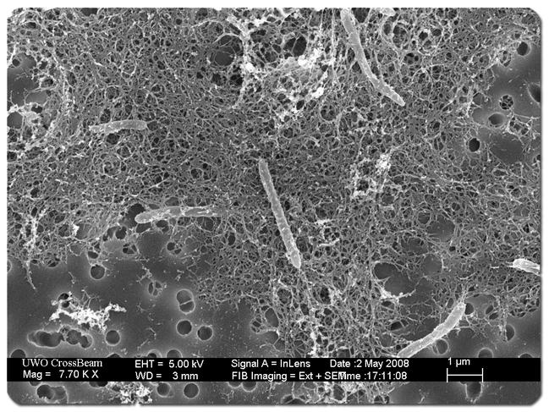
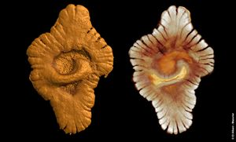
Is natural radioactivity a friend or a foe of microbial life ?
It is a source of energy for deep underground biosphere
  single-species ecosystem fueled by hydrogen from water radiolysis in SA gold mine
2.1 billion years old multicellular and eukaryotic organisms were found 30 km away from natural nuclear reactors in Gabon
  Fossils 400 million years older than spontaneous fission reactions
Desulforudis audaxviator from Chivian, et al, Science (2008) 322:275-278.
El Albani et al, Nature, 466 (2010)
Research program since 2012 on the impact of
natural radioactivity on microorganism evolution
2
Notes:
Présenter les trois activités en cours

Slide 3
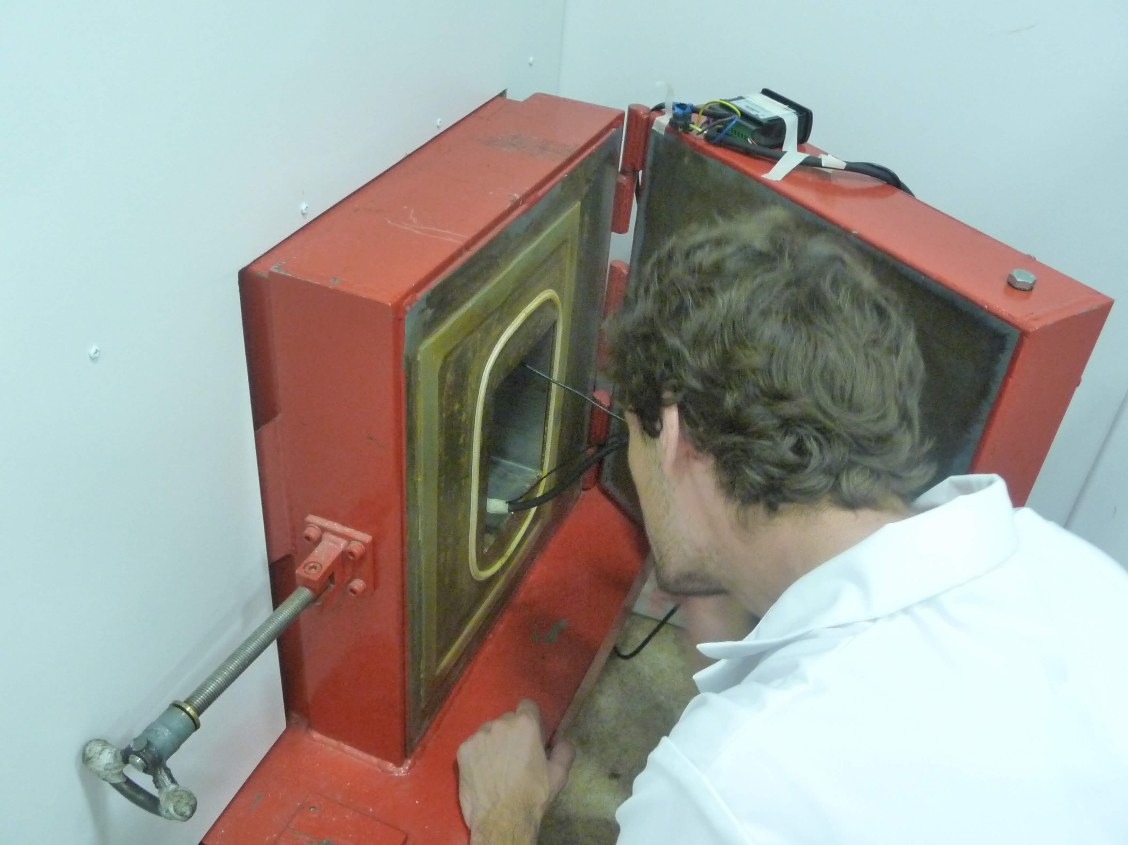

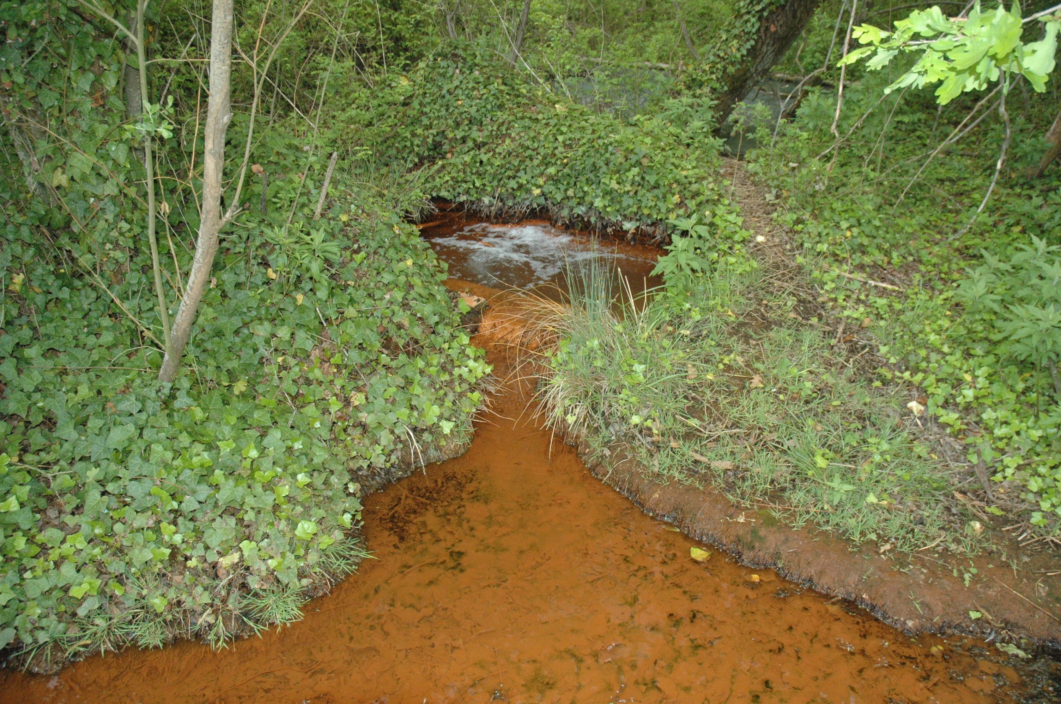


Our strategy up to 2024 …
Suppress radioactivity => underground laboratory experiments (2012-2017)
Study microbial biodiversity of naturally radioactive ecosystems to look for long term effects (2017-2023)
Develop tools and methods to accurately evaluate the dose absorbed => MC simulation
3
Notes:
Présenter les trois activités en cours

Slide 4
Our first focus: Long Term Evolution Experiments
Question: is natural radioactivity playing a role on the evolution of microorganisms ?
Method: compare the evolution of bacterial strains in Underground and Reference laboratories
First experiment : 2014-2017@Modane Underground Laboratory
  1000 generations
  E. Coli strain from Lensky Long Term Evolution Experiment
Lampe N. et al, Understanding low radiation background biology through controlled evolution experiments. Evol Appl. (2017) 10:658–66. doi: 10.1111/eva.12491
N. Lampe et al, Scientific Reports (2019)9:14891

Slide 5
Absorbed Dose during Evolution Experiment at LPC and LSM
Source | Method | LPC Clermont (nGy hr⁻¹) | LSM (nGy hr⁻¹) | LSM (shielded) (nGy hr⁻¹)
γ background | Dosimeter (simulations support this value) | 150 | 20 | <1
Cosmic rays (charged) | UNSCEAR | 31 | <<1 | <<1
Cosmic rays (neutrons) | Simulation | 4.4 | <<1 | <<1
⁴⁰K (γ) | Simulation | 0.13 | 0.13 | 0.13
⁴⁰K (β) | Simulation | 26 | 26 | 26
¹⁴C (β) | Simulation | <<1 | <<1 | <<1
 | Total | 212 | 46 | 26
99% of the residual radiation comes from E. coli nutritive medium
Dose reductions for biology experiments in underground laboratories are limited by ⁴⁰K in the nutritive medium
Lampe et al. (2016), EPJ Web of Conferences

Slide 6
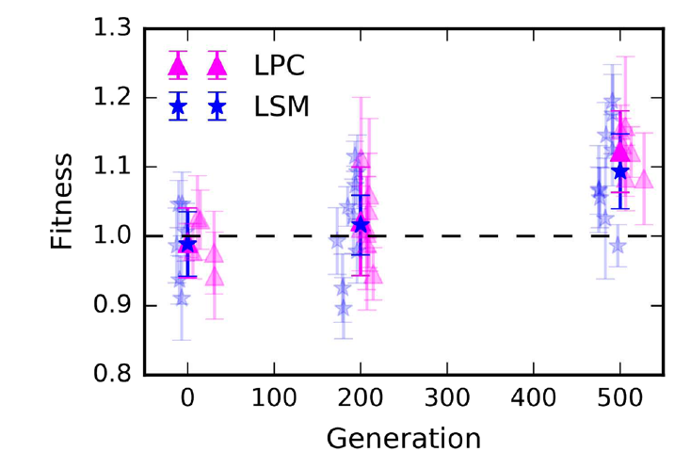
Experimental Evolution Experiment
No impact of low radiation background observed on E. coli first evolutionary steps
N. Lampe et al, Scientific Reports (2019)9:14891

Slide 7
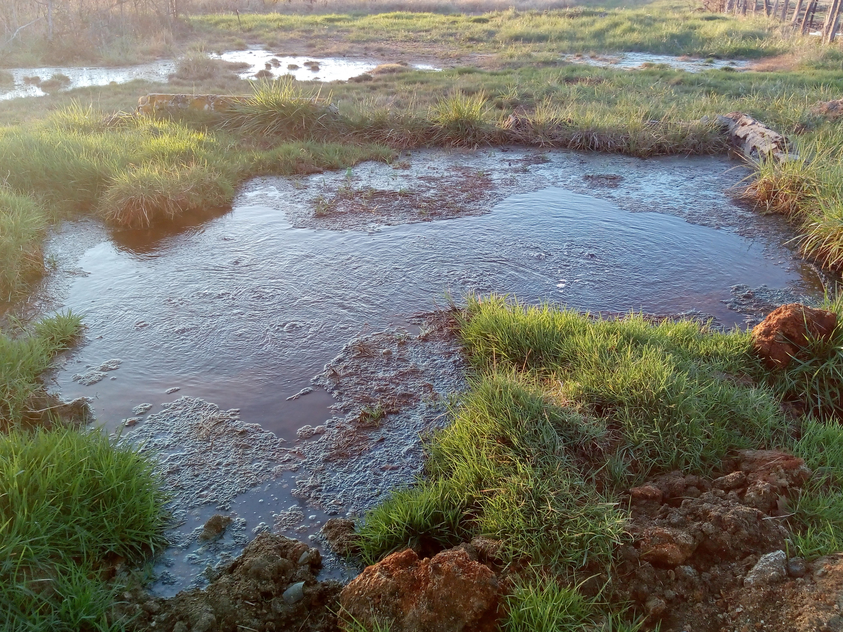
Exploring the impact of long term exposure to natural radioactivity in mineral springs
« But if – and oh what a big if - we could conceive in some warm little pond with all sorts of ammonia & phosphoric salts,—light, heat, electricity present, that a protein compound was chemically formed, ready to undergo still more complex changes. » — Charles Darwin, Letter to Joseph Dalton Hooker, February 1st 1871

Slide 8
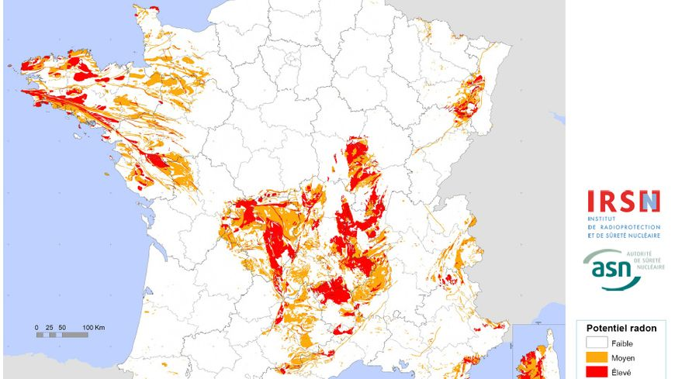
Radioactive mineral springs
Isolated ecosystems with long term (geological) stability
Each spring has its own physico-chemical and radiological properties
Auvergne springs:
Dissolved radon up to 4000 Bq/l
Radium activity in sediments up to 40 Bq/g
Notes:
Because of its geology, Auvergne is one of the regions in Metropolitan France with the highest radon risk.

Slide 9
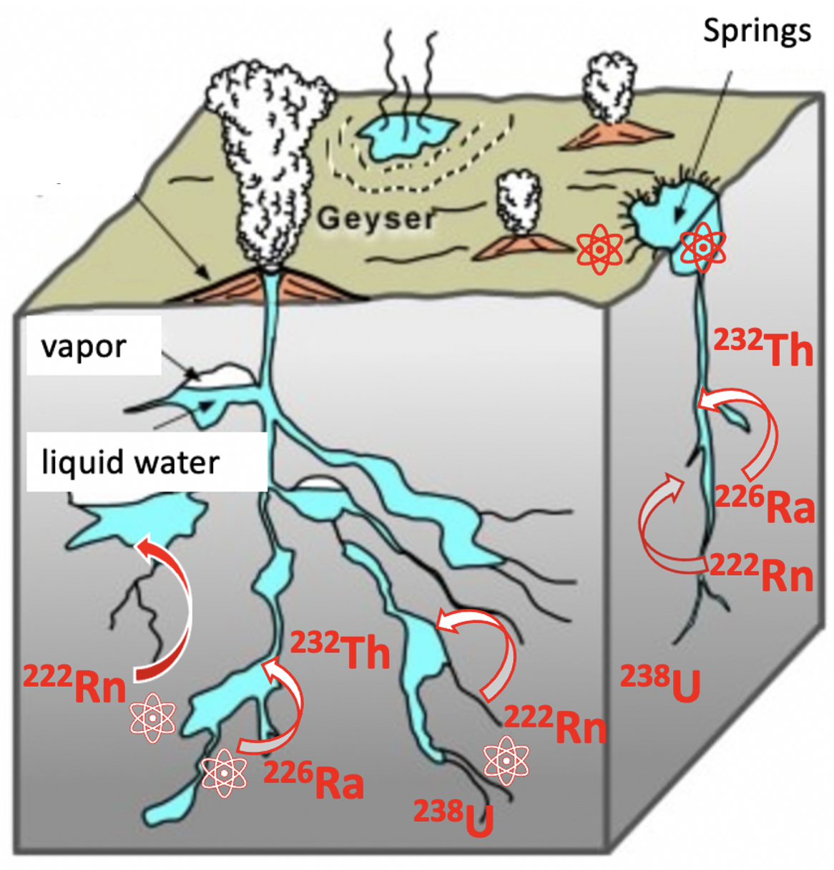
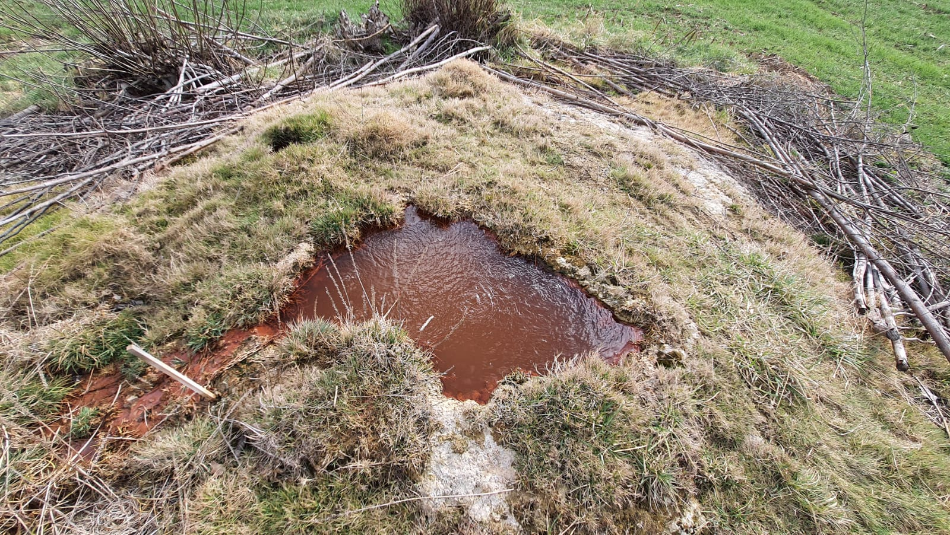
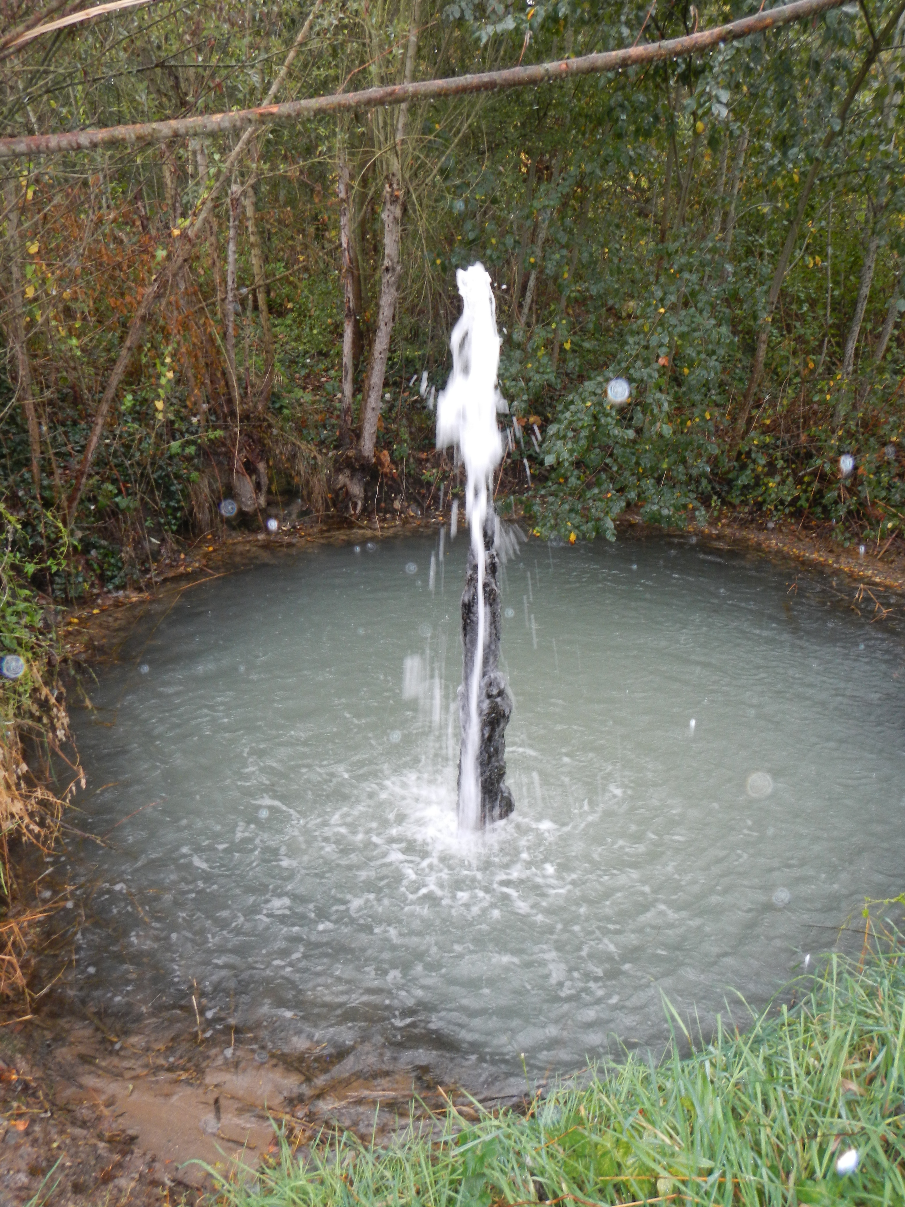
The ecosystem of a mineral spring
Springs
Microorganisms
Microorganisms
Travertine deposits
Geyser in Auvergne (Tennis)
Mineral spring in Auvergne (Daguillon)
[Bourque]
9

Slide 10
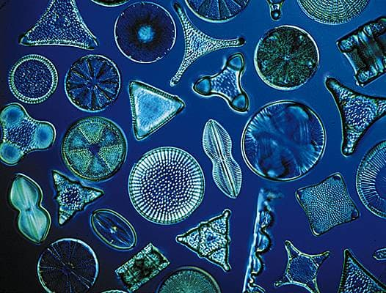
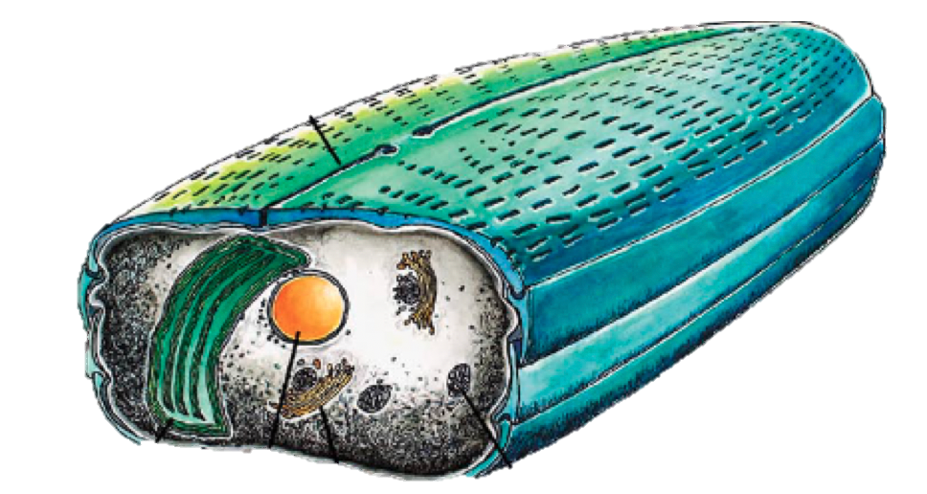
Focus on diatoms
SiO₂
frustule
μm
nucleus
Notes:
Why diatoms ? Because of their frustule, an exoskeleton that can display teratogenous shapes when the organism is stressed.

Slide 11
Key results
222Rn is the main factor explaining the structure of the diatom communities in Auvergne mineral springs
The Planothidium frequentissimum species is associated to mineral springs enriched in 222Rn
Several diatom species get deformed in the most radioactive springs
Presence of radionucleids does not reduce the bacterial richness and diversity in the springs
Millan F. et al, The effect of natural radioactivity on diatom communities in mineral springs, Botany Letters, 2019
Planothidium frequentissimum
normal shape
Abnormal shape observed
In Auvergne radioactive spring
Planothidium Frequentissimum was isolated and
cultivated for In vitro experiments (irradiation, growth in underground laboratory)
L-A Baker et al, Diatom DNA metabarcoding to assess the effect of natural radioactivity in mineral springs on ASV of benthic diatom communities. Science of the Total Environment, 2023
11

Slide 12

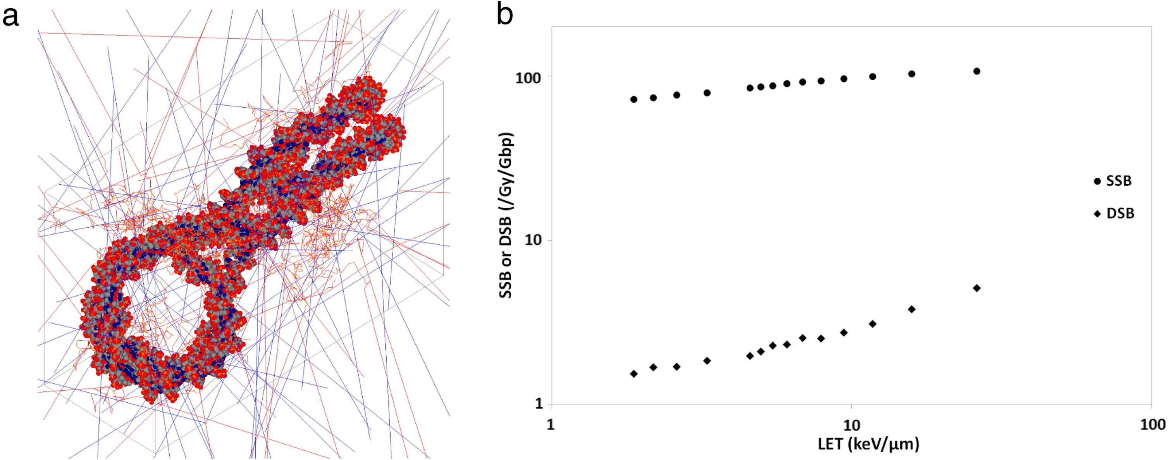
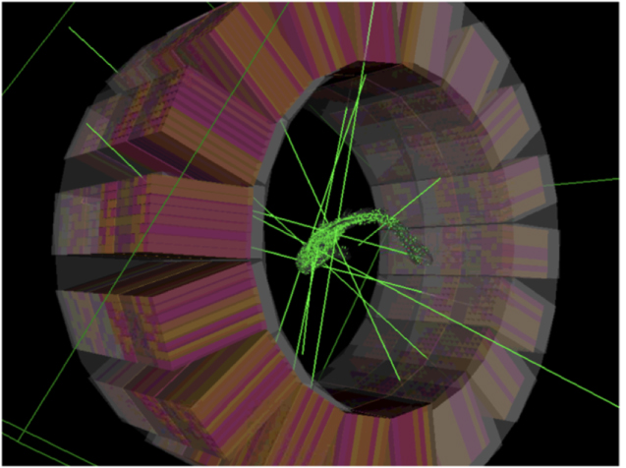
Monte Carlo simulation toolkits
micro
[Delage 2015]
Initiated in 2004
v 9.1
Based on Geant4 libraries
Macros
Initially for medical applications: now extending to new fields (e.g. environmental applications)
Various outputs including Physical Dose
Open-source
Monte Carlo Track Structure codes
Initiated in 2001
v 11.0
C++ and macros
Interactions at cellular and DNA level
High spatial and energy resolution: particles are tracked down to ~eV in water
DNA detailed geometries available
Detailed simulations of water radiolysis available
Various outputs including DNA damage
nano
[Sarrut 2021]
12

Slide 13
Total dose rates exceed recommended threshold
Suggested threshold for the protection of ecosystems [EU 2014]
Highest [²²⁶Ra] in sediments
Highest [²²²Rn] in water
Absorbed dose up to 180 μGy/h once corrected for short-lived daughters (1000 times more than normal background, 18 times the recommended threshold)
Radiation is a potential abiotic driver for the evolution of life in Auvergne most radioactive springs
13

Slide 14
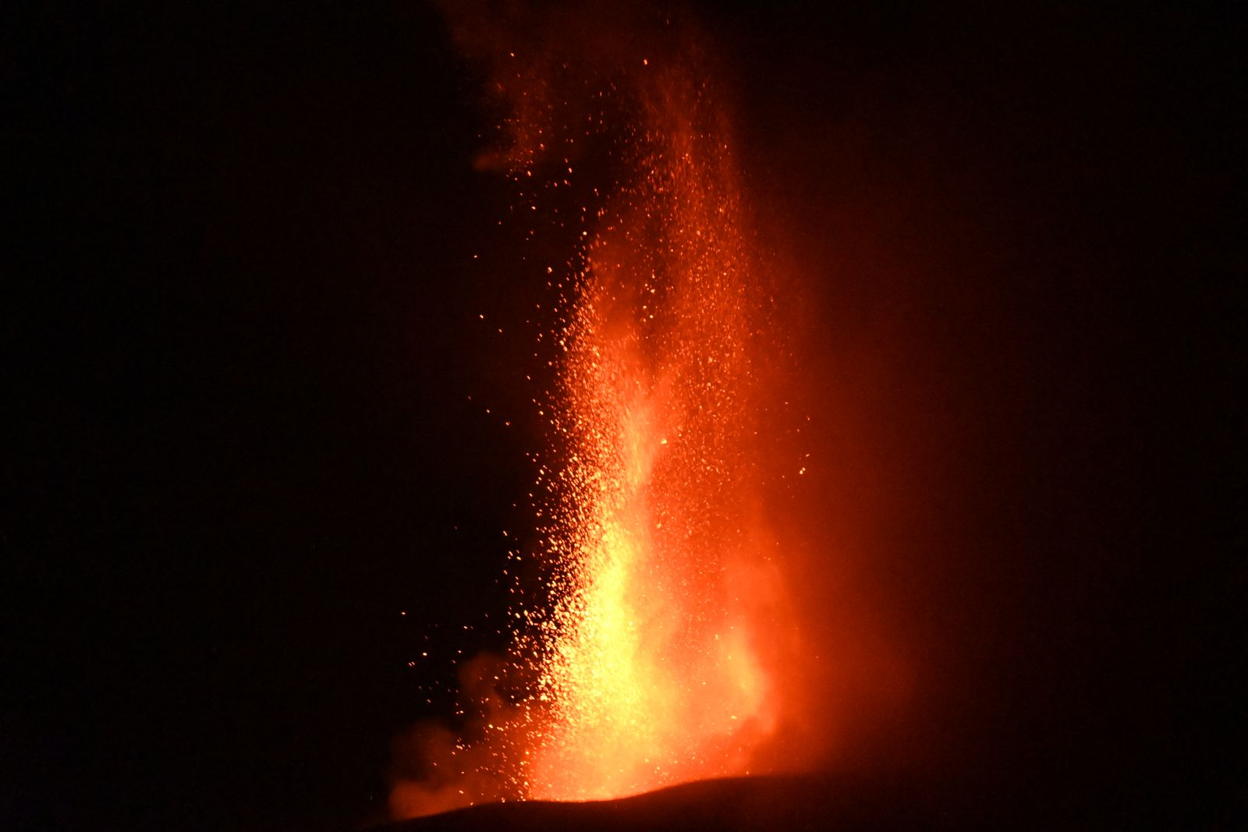
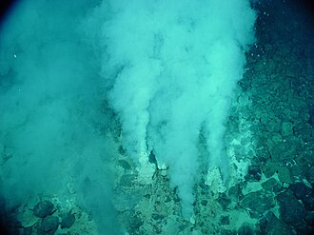

Next steps…
Impact of radioactivity on
life emergence and evolution
Naturally radioactive ecosystems
In vitro radiobiology experiments
Monte-Carlo simulation at µ - and nanoscale
1-Isolate and cultivate microorganisms of interest from naturally radioactive exosystems
2- In vitro experiments (DULs, accelerators)
3-full MC simulation down to nanoscale
DULs

Slide 15
The RAMURe project
Goal: compare adaptive and evolutionary responses of three species of microalgae
  Planothidium Frequentissimum isolated from a radioactive spring in Auvergne
  Phaeodactylum tricornutum, marine diatom used as a biological model to study response to stress
  Achnanthidium saprophilum, lake diatom used for radiochemistry studies on radioelement adsorption and absorbtion
In vitro controlled experiments
  Culture at Modane Underground Laboratory (LSM)
  Irradiation using photon, proton and alpha-beams at IN2P3 laboratories (Clermont-Ferrand, Nantes, Strasbourg)

Slide 16
The challenges
No previous experience of cultivating diatoms in ultralow radioactivity environment
  Very different from E. Coli LTER experiment
  Cyanobacteria isolated from radioactive springs will be cultivated simultaneously
Only one of the three diatom species has its genome sequenced
Underground monitoring of growth rate, size, volume, photosynthetic capacity, pigment and lipid content, as well as as oxidative and antioxydant stresses.

Slide 17
Validation of MC simulation results at µ- and nanoscale
Key importance of simulating the dose received by microorganisms in ultralow radioactivity experiments
  No instrument is able to measure it
Crucial need for experimental data to validate simulation results
  DULs are unique places to produce controlled radiation data at low dose exposure
Focus on DNA Double Strand Breaks data from long term stem cells preservation experiments @LSM (see G. Warot talk on Wednesday morning)

Slide 18
Conclusion
The role of radioactivity in the emergence and evolution of life on earth is still unknown
There are clear indications that radioactivity may have played a major role:
  As the main source of energy through radiolysis for deep underground microorganisms
  As an abiotic driver in peculiar terrestrial ecosystems such as naturally radioactive mineral springs
DULS are unique environments to study the impact of low-dose radiation in controlled experiments
  To explore the ultra-low radioactivity frontier
  To produce the data to validate the MC simulation codes used for µ- and nanodosimetry
Notes:
https://lejournal.cnrs.fr/articles/la-radioactivite-naturelle-moteur-dune-vie-souterraine-insoupconnee

Slide 19

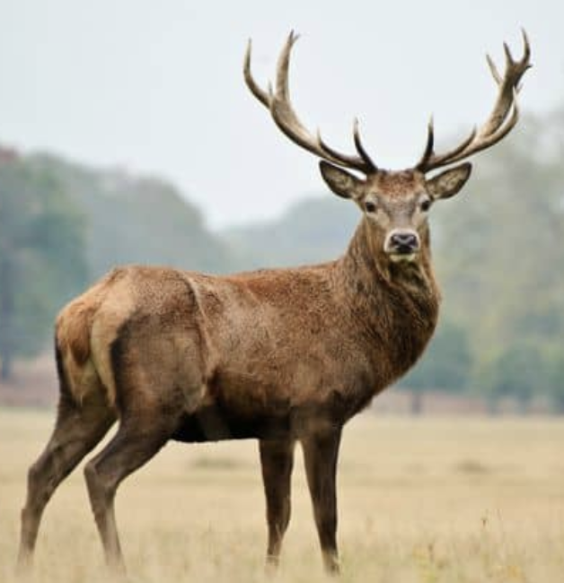

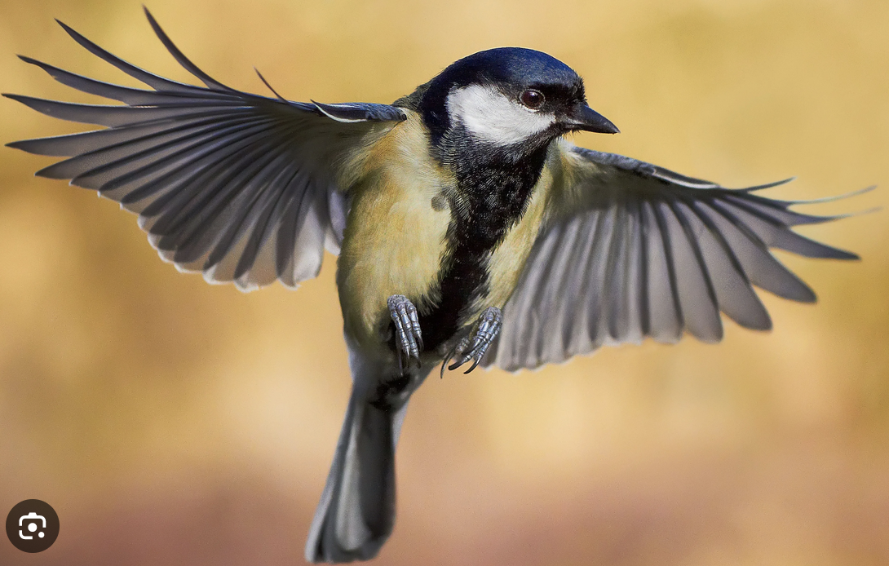
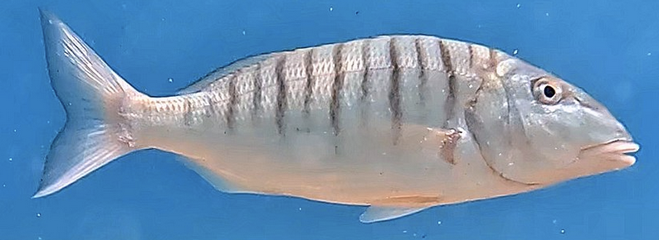

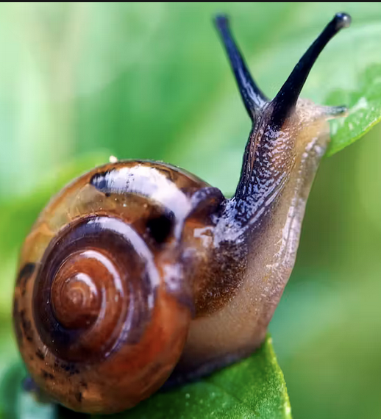
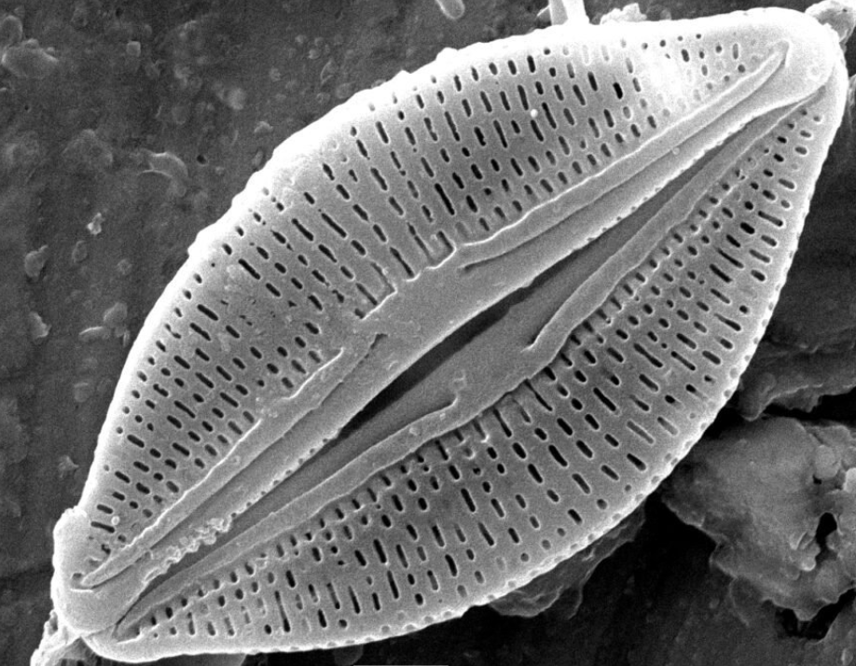

What are the dose rates to microorganisms?
10³ kg
The reference radioecological tool in Europe using
databases and tabulated radiological factors
Missing data on mineral springs
Water surface
Water
²²²Rn in water cannot be evaluated with ERICA’s approach
Sediments surface
Sediments
ERICA is not applicable on microorganisms
We need another tool to evaluate the dose rate to microorganisms
10⁻⁶ kg
⬄ r = 621 μm
Diatoms
10⁻¹² kg
⬄ r = 10 μm
19

Slide 20
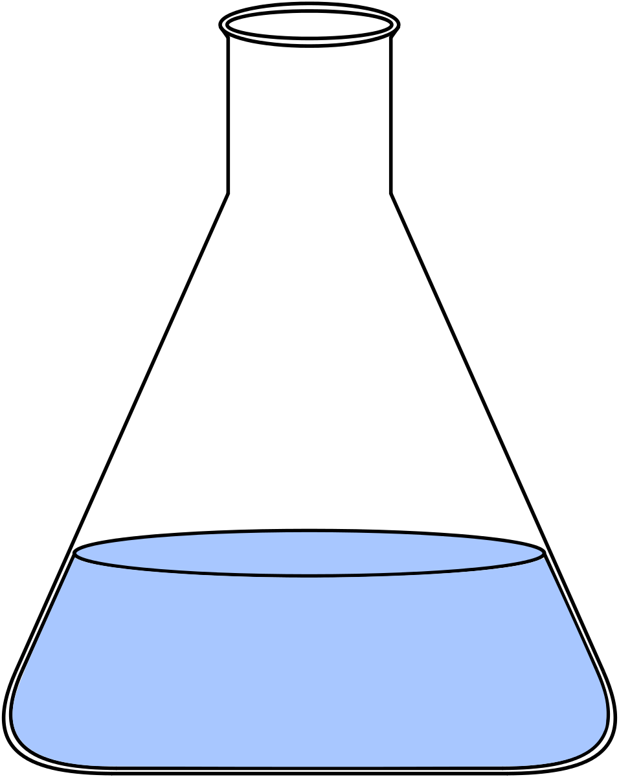
Experimental evolution
Ancestor Cell
Evolved Cell
Fitness: The relative advantage of an organism over another in a given environment.
Fitness
The change in fitness takes place over 100-200 generations
Time

Slide 21
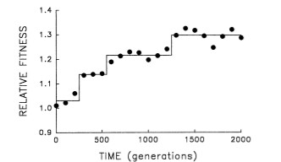
The Lenski Evolution Experiment
A wealth of data exists from the Lenski Evolution Experiment on E. coli.
  60,000 generations grown over 25 years
  Well-known likely mutations
Early mutations are known to cause fitness changes
We have replicated this experiment in two radiation environments.
The aim is to see if the fitness trajectory is different in the absence of radiation.
Focus on first 500 generations
Lenski (1994)

Slide 22
Some possible outcomes
Fitness
Expected trajectory
The reduced radiation background does not impact the behaviour of fitness
Time
Measure-ments
Fitness
The reduced radiation background stops fitness from increasing, possibly by halting mutations
Time
Fitness
The reduced radiation background reduces the cells performance initially, then genetic changes occur
Lampe N. et al Reducing the ionizing radiation background does not significantly affect the evolution of Escherichia coli populations over 500 generations. Sci Rep. 2019 Oct 17;9(1):14891.
Time

