Slide 1
SNOLAB: Infrastructure and Future for Expanded Science
Shaun Hall
Research Scientist- Chemistry
2024/08/20

Slide 2
SNOLAB is located on the traditional territory of the Robinson-Huron Treaty of 1850, shared by the Indigenous people of the surrounding Atikameksheng Anishnawbek First Nation as part of the larger Anishinabek Nation.
We acknowledge those who came before us and honour those who are the caretakers of this land and the waters.

Slide 3
Shaun Hall – Who?

Slide 4
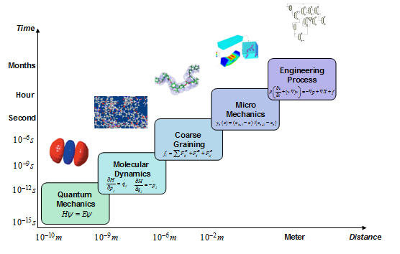
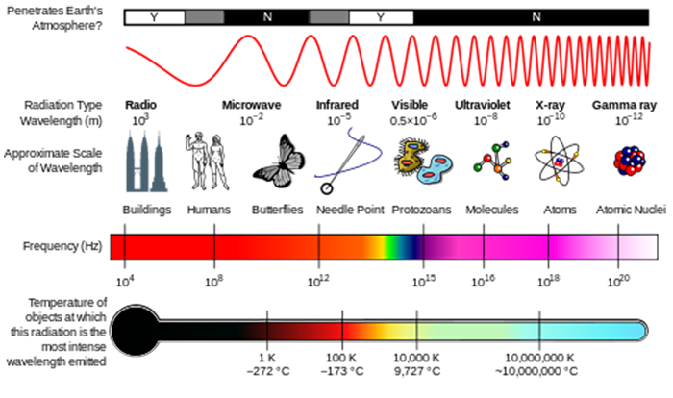
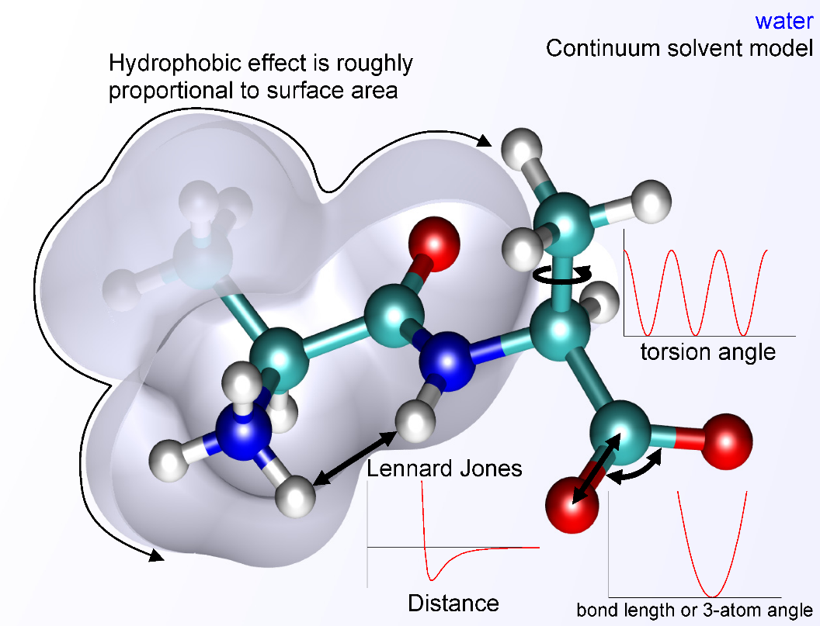
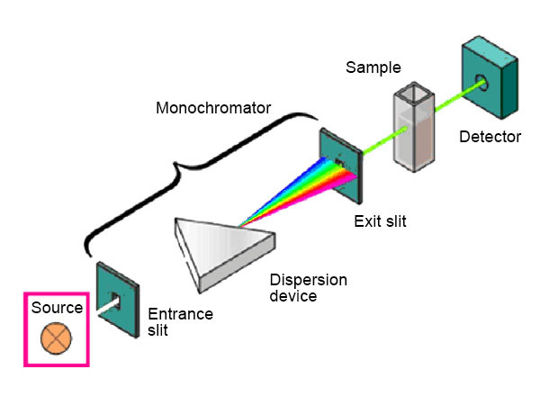
What does Shaun Do? Physical Chemistry

Slide 5
SNOLAB – Where and Why?

Slide 6
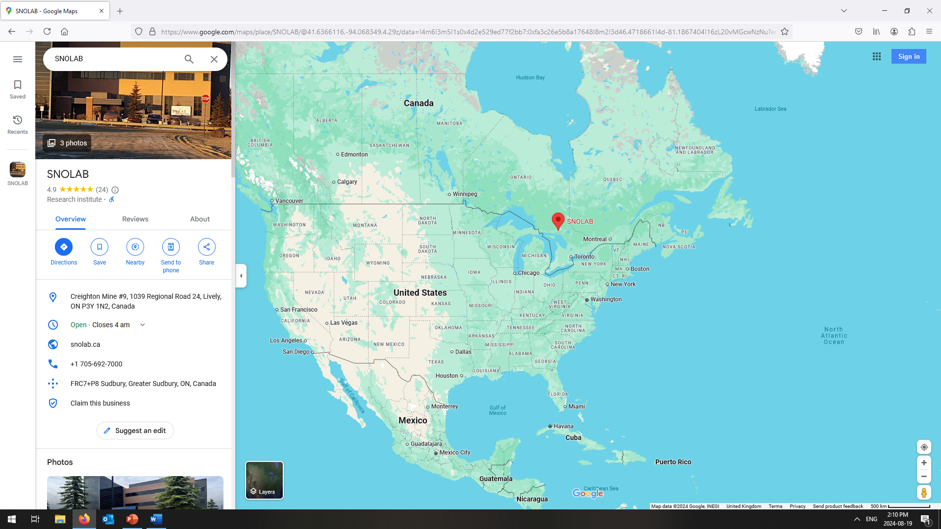
Where?

Slide 7
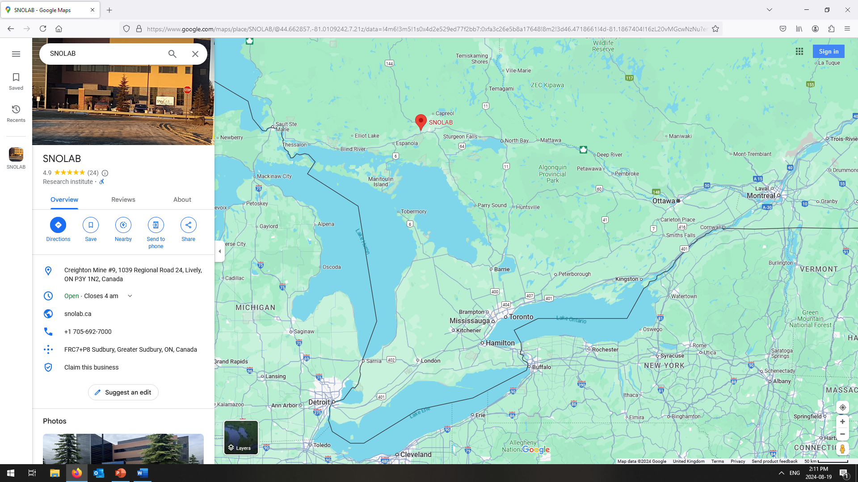
Where?

Slide 8
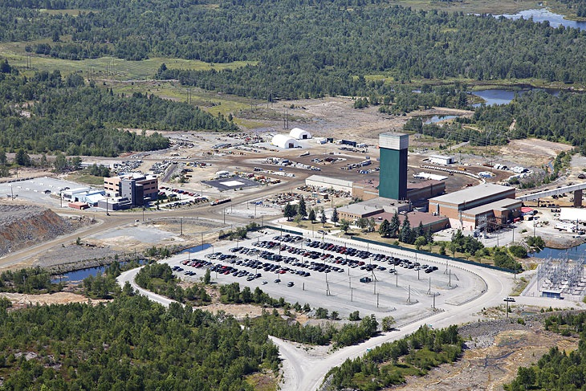
Where?

Slide 9
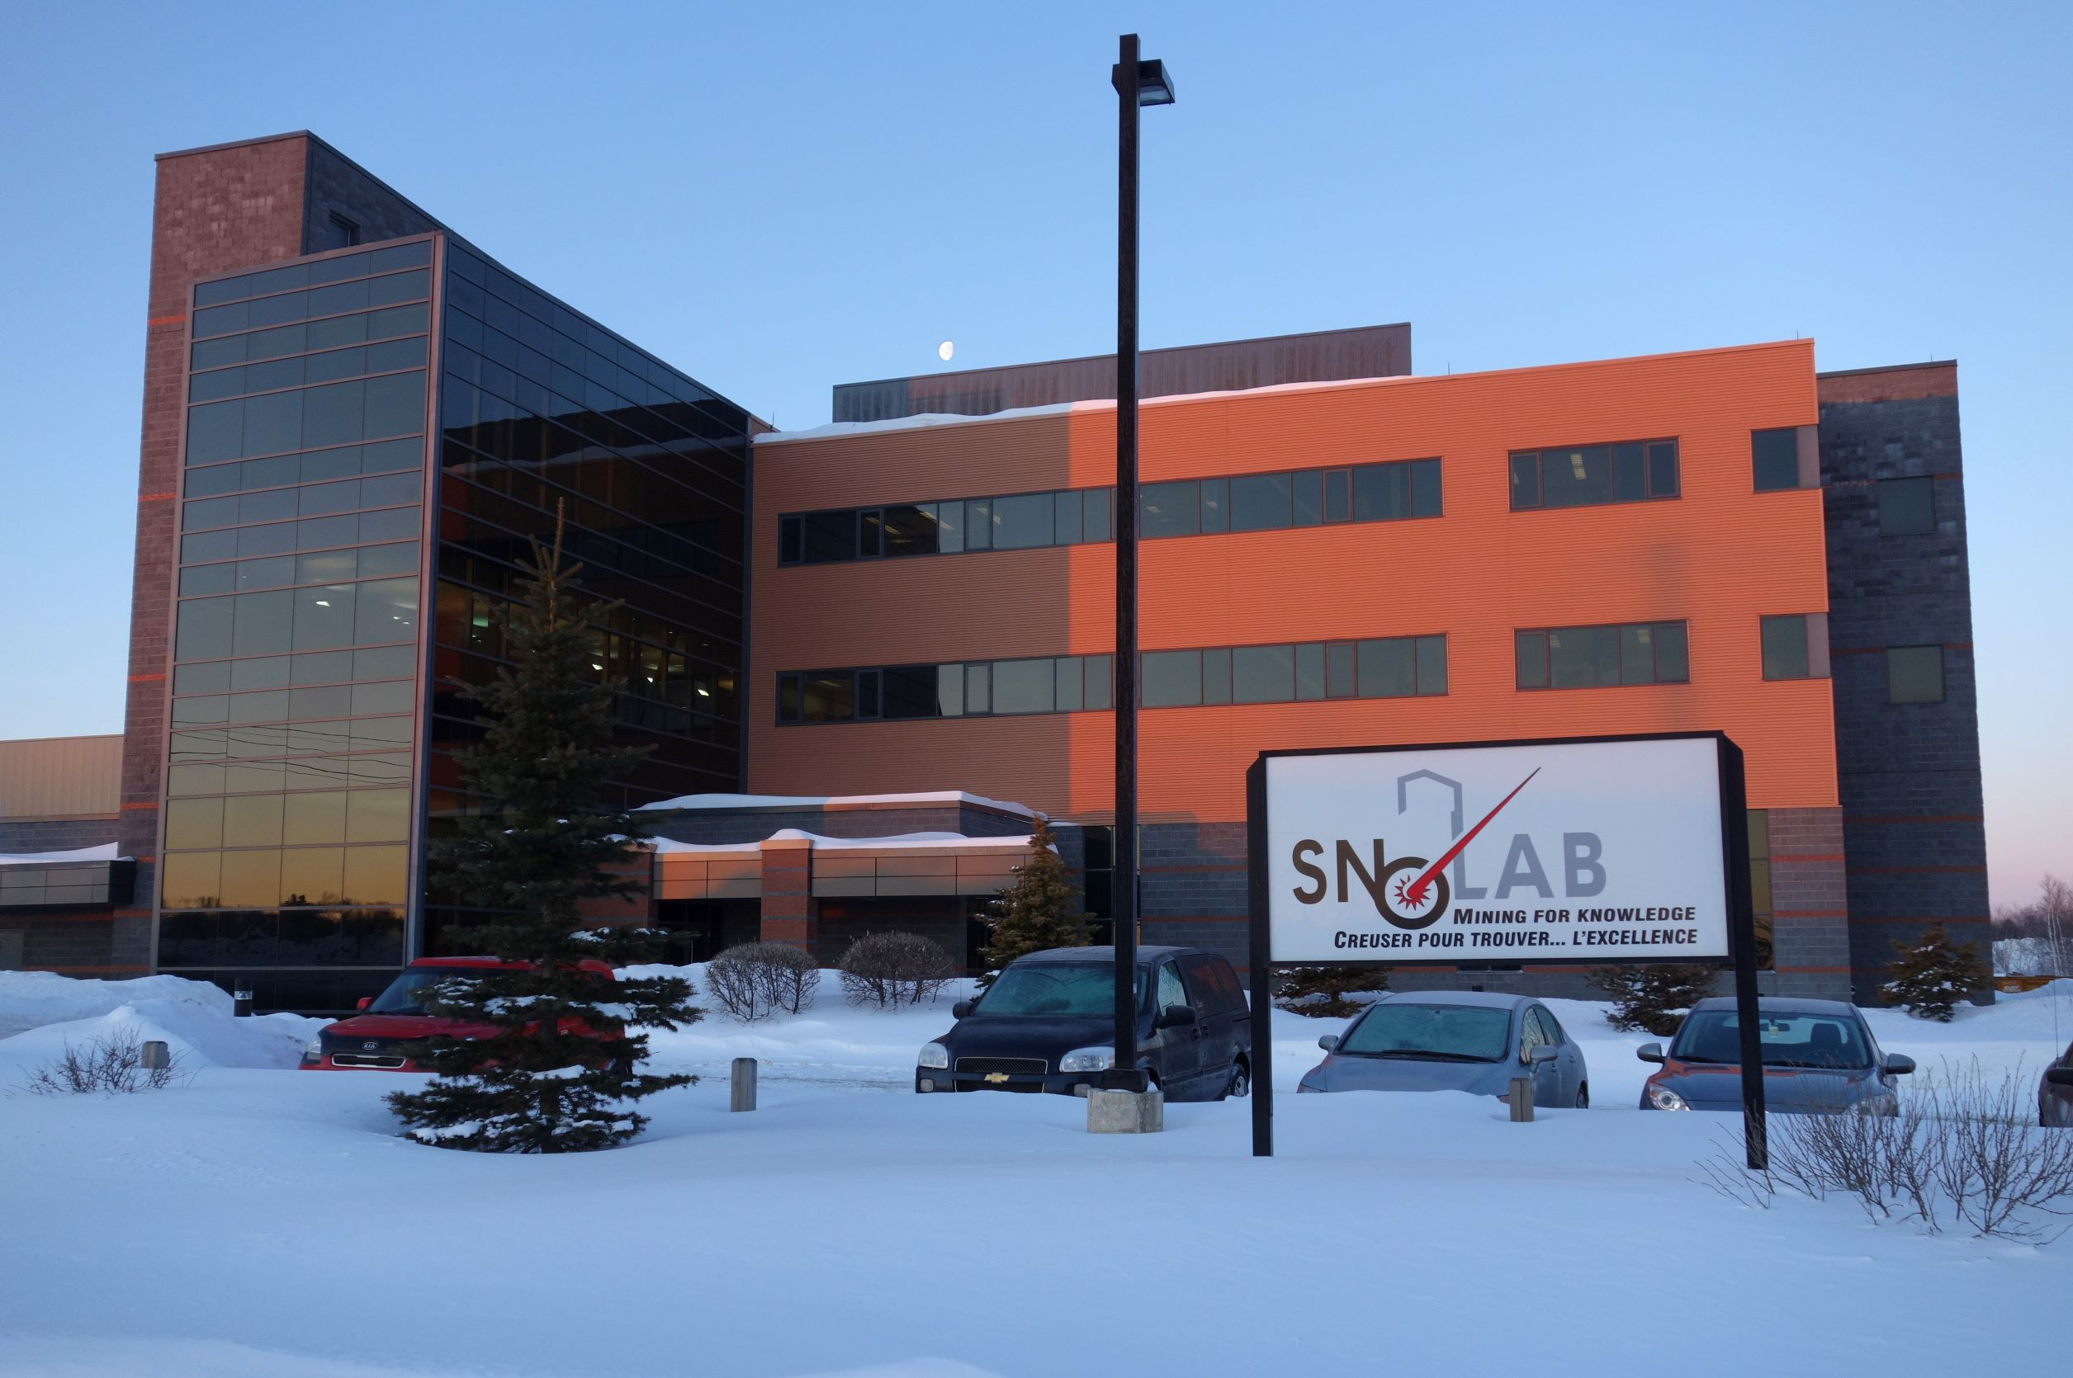
Where?

Slide 10
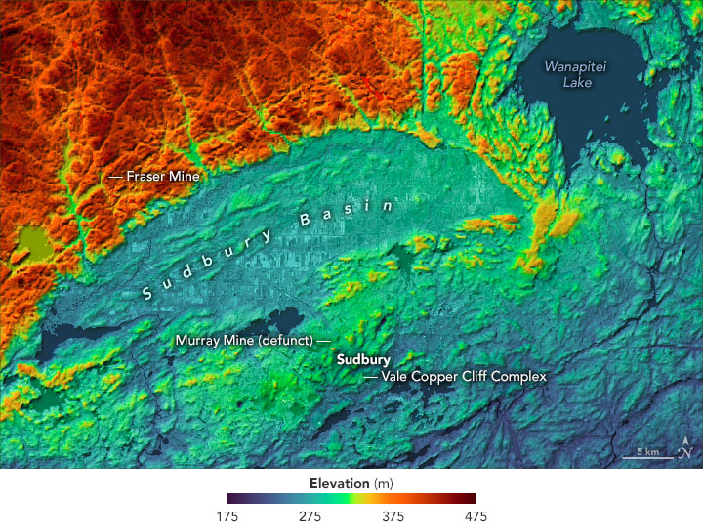
Why?

Slide 11
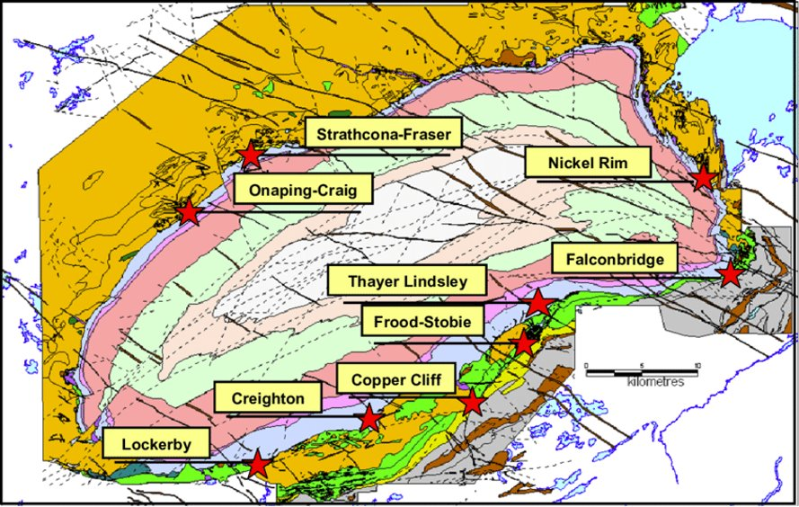
Why?

Slide 12
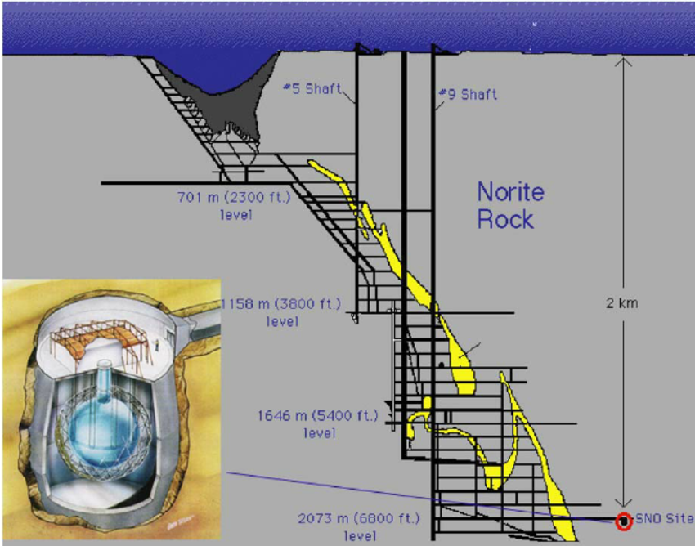
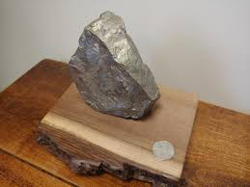
Why?
Nickel
Copper
Cobalt
Platinum
Palladium
Gold

Slide 13
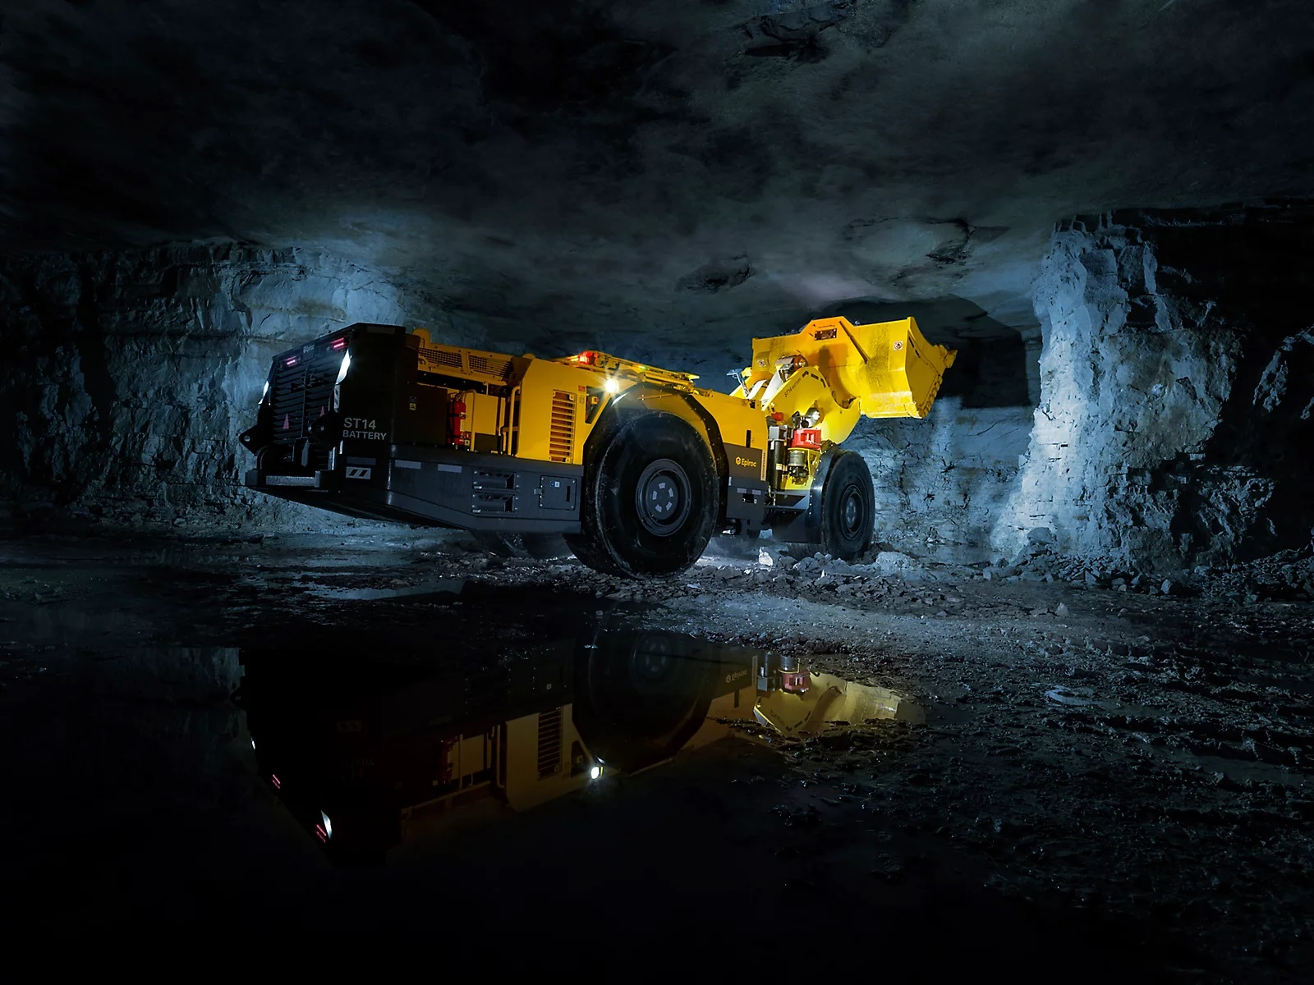
Why?

Slide 14
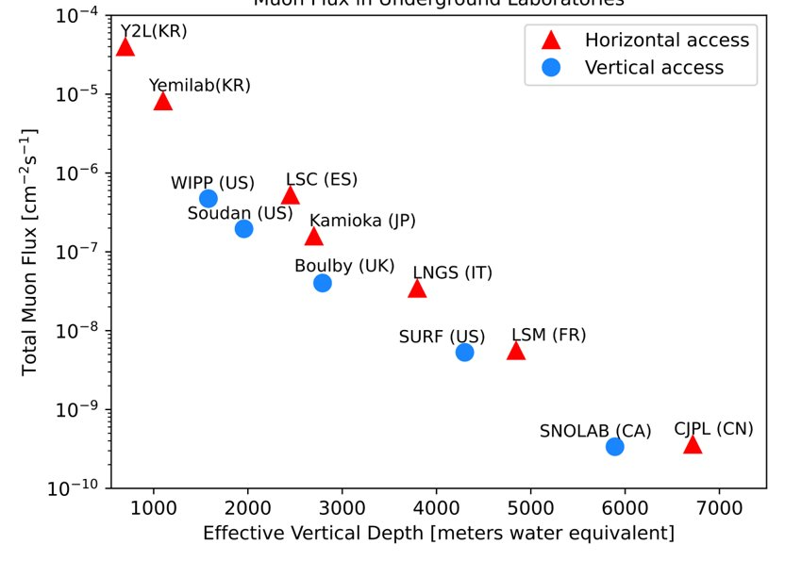
Why?

Slide 15
Why?

Slide 16
SNOLAB – Surface Facilities

Slide 17
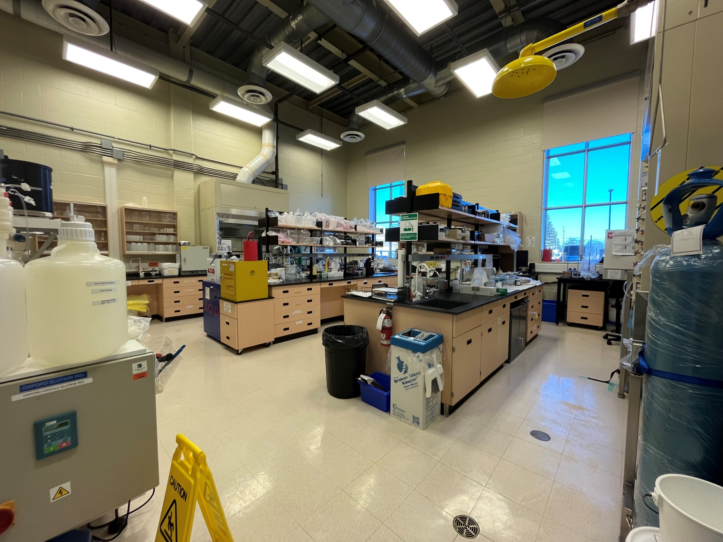
Surface Chemistry (General Science) Lab

Slide 18
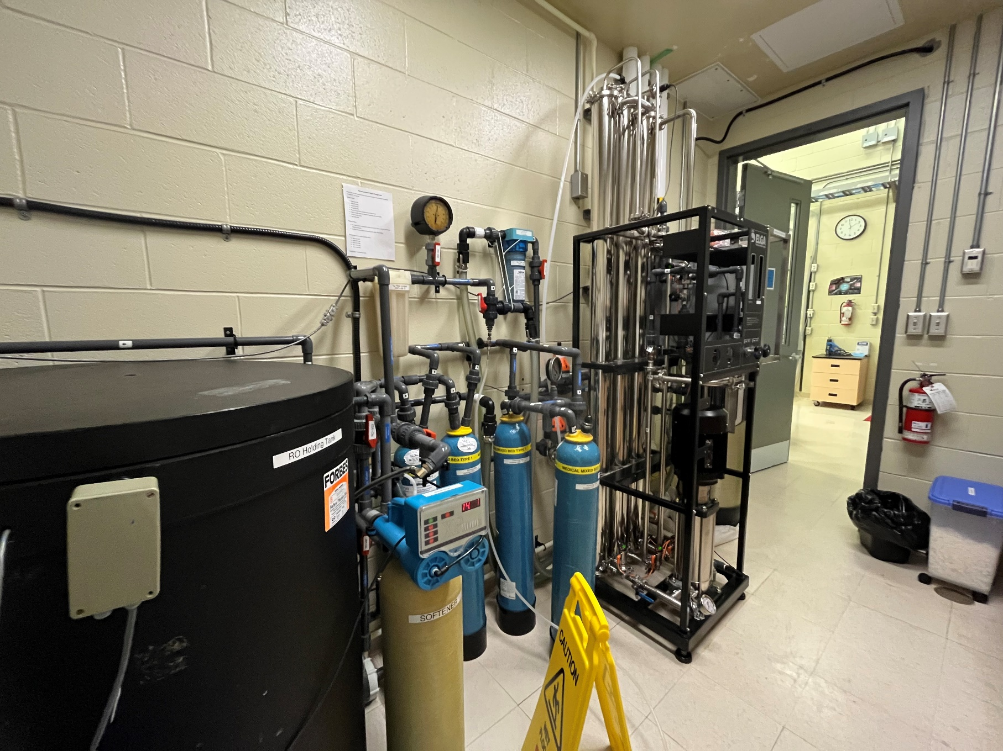
Ultra Pure Water Production (Surface)

Slide 19
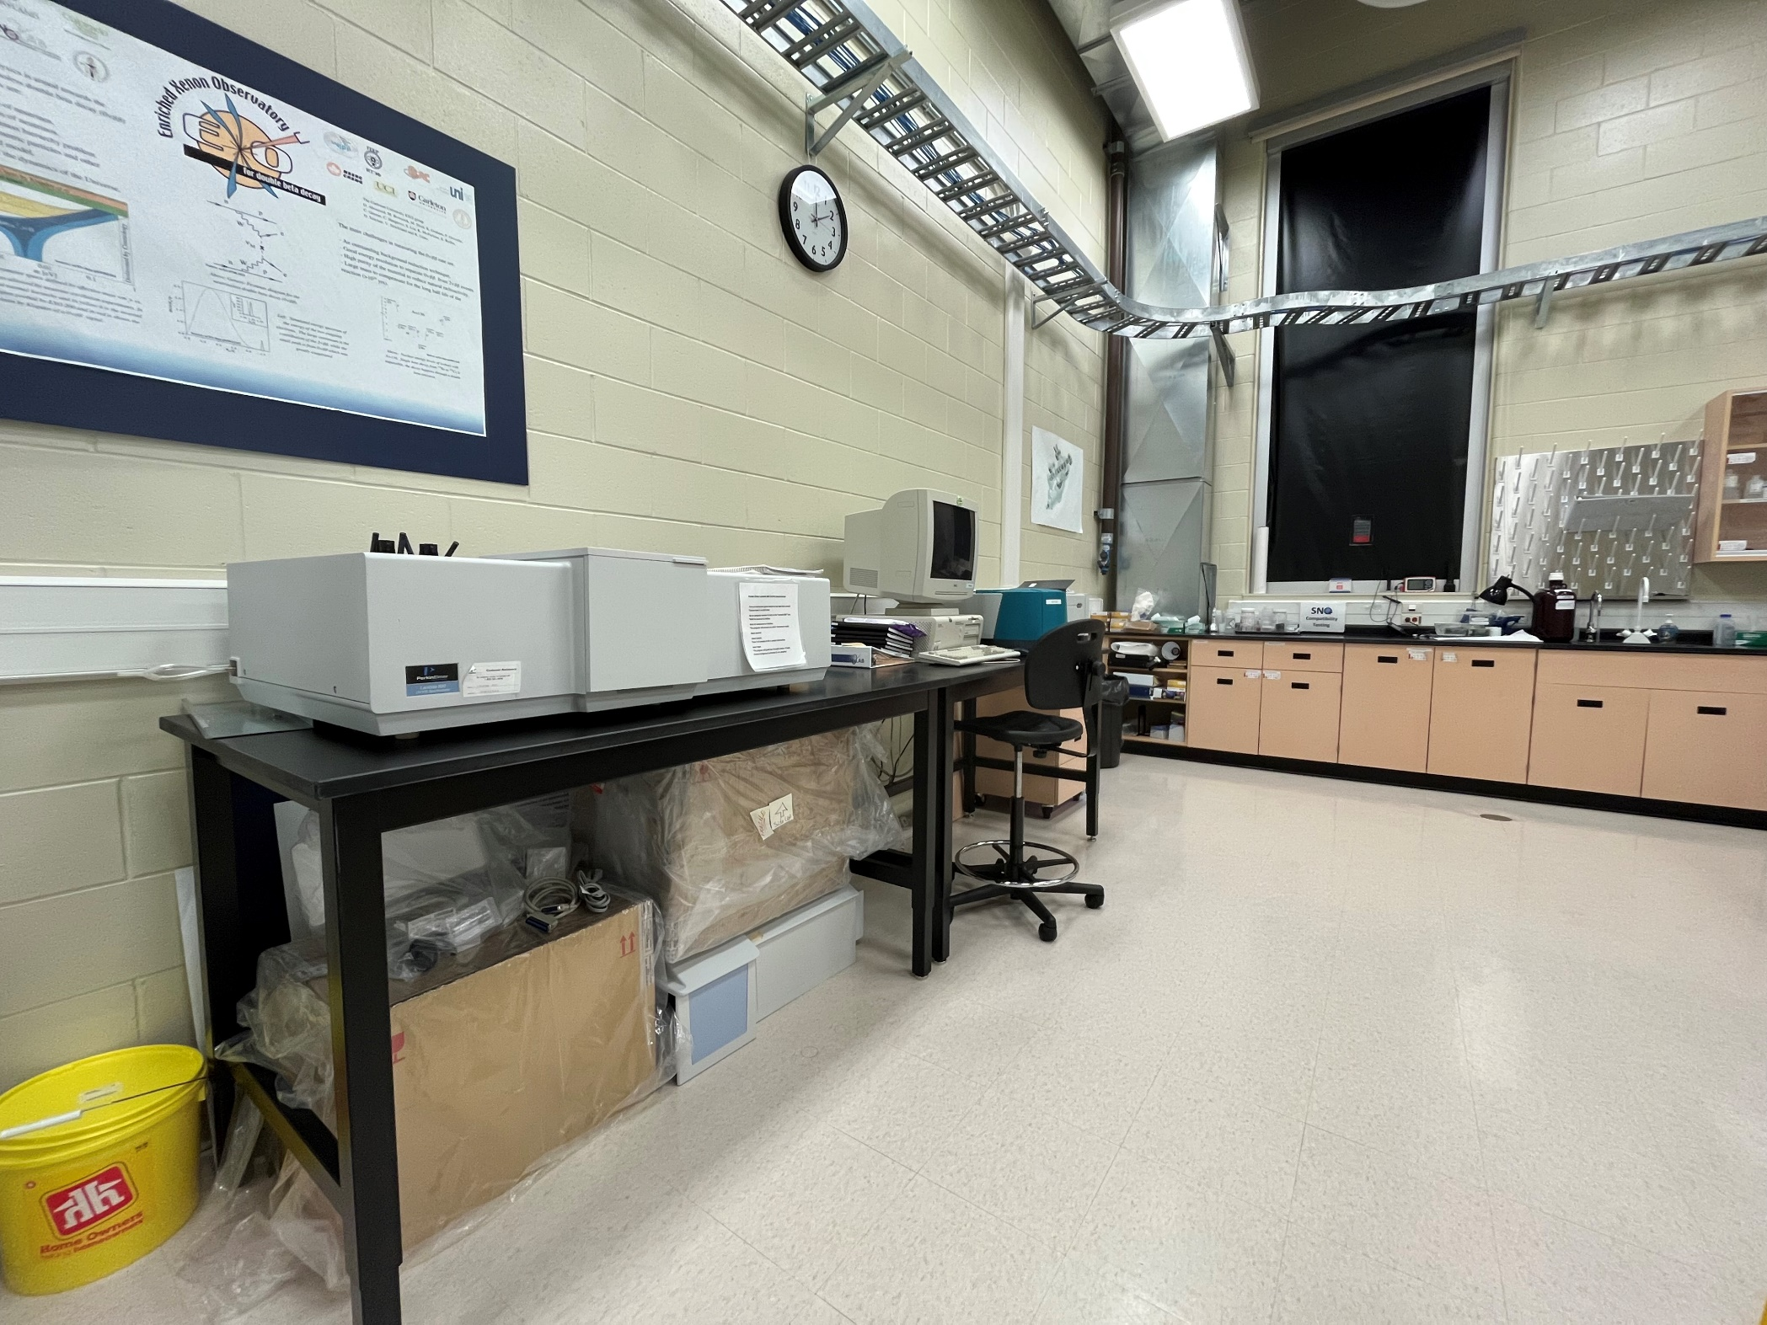
Instrumentation Lab

Slide 20
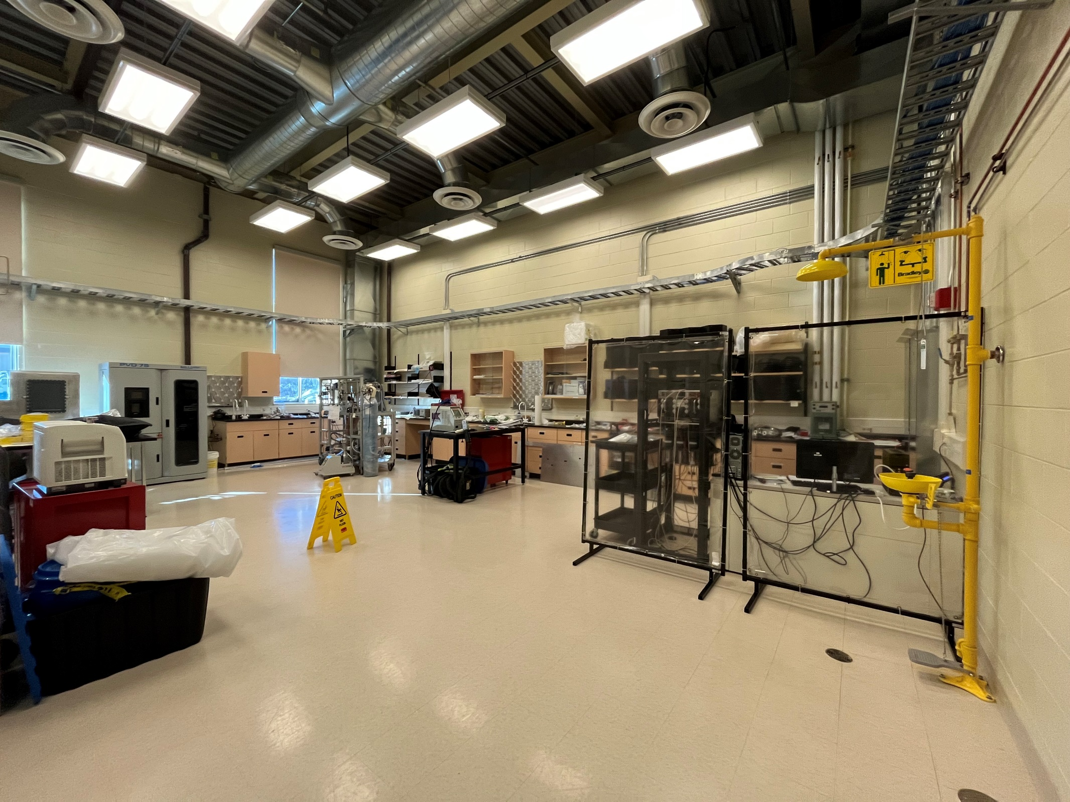
Research Labs

Slide 21
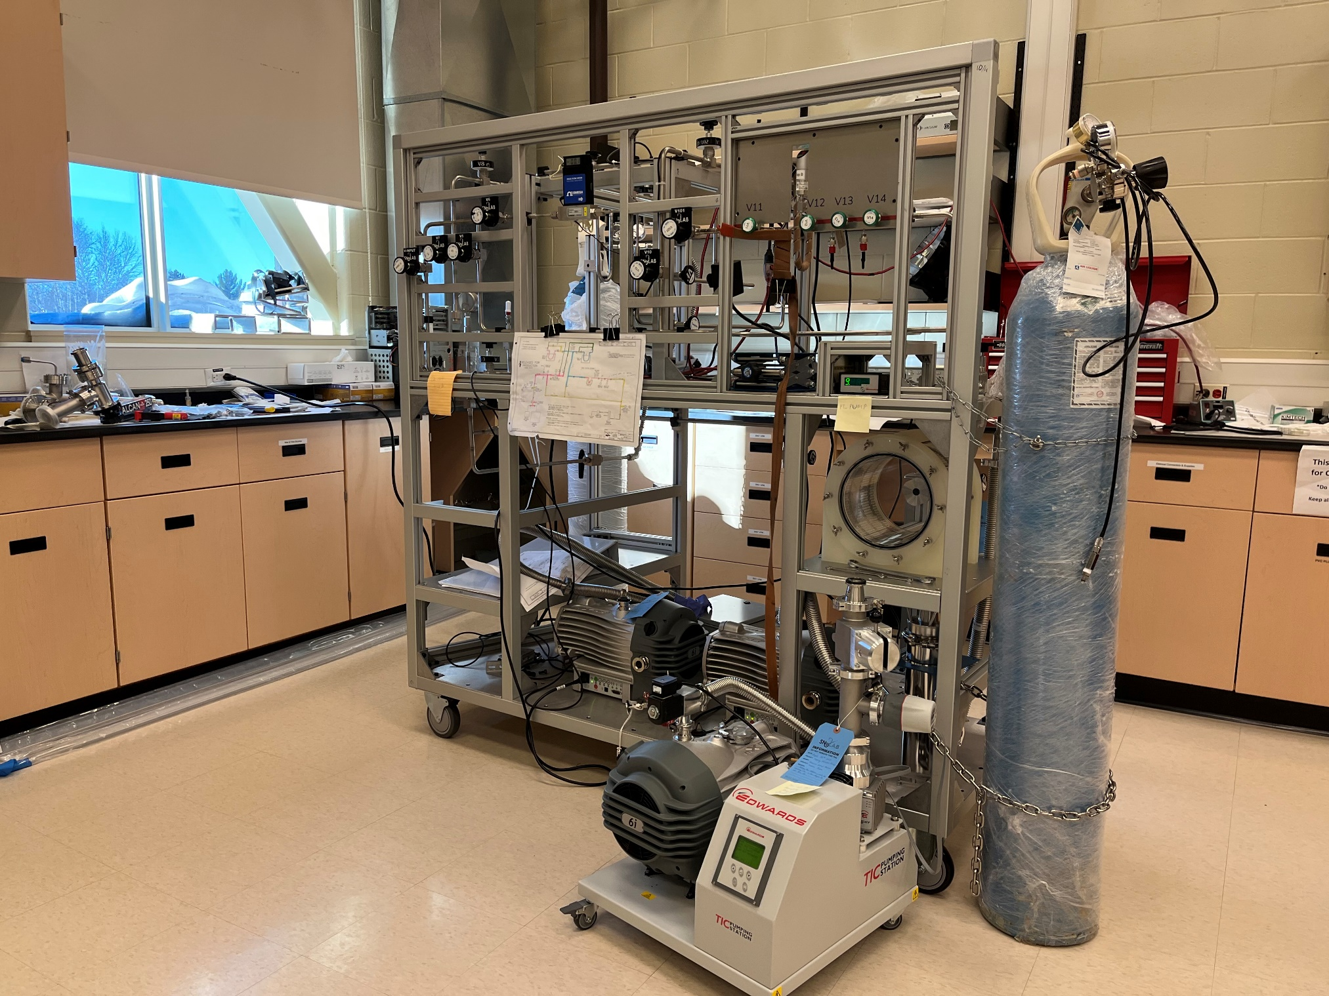
Research Labs – Radon Emanation

Slide 22
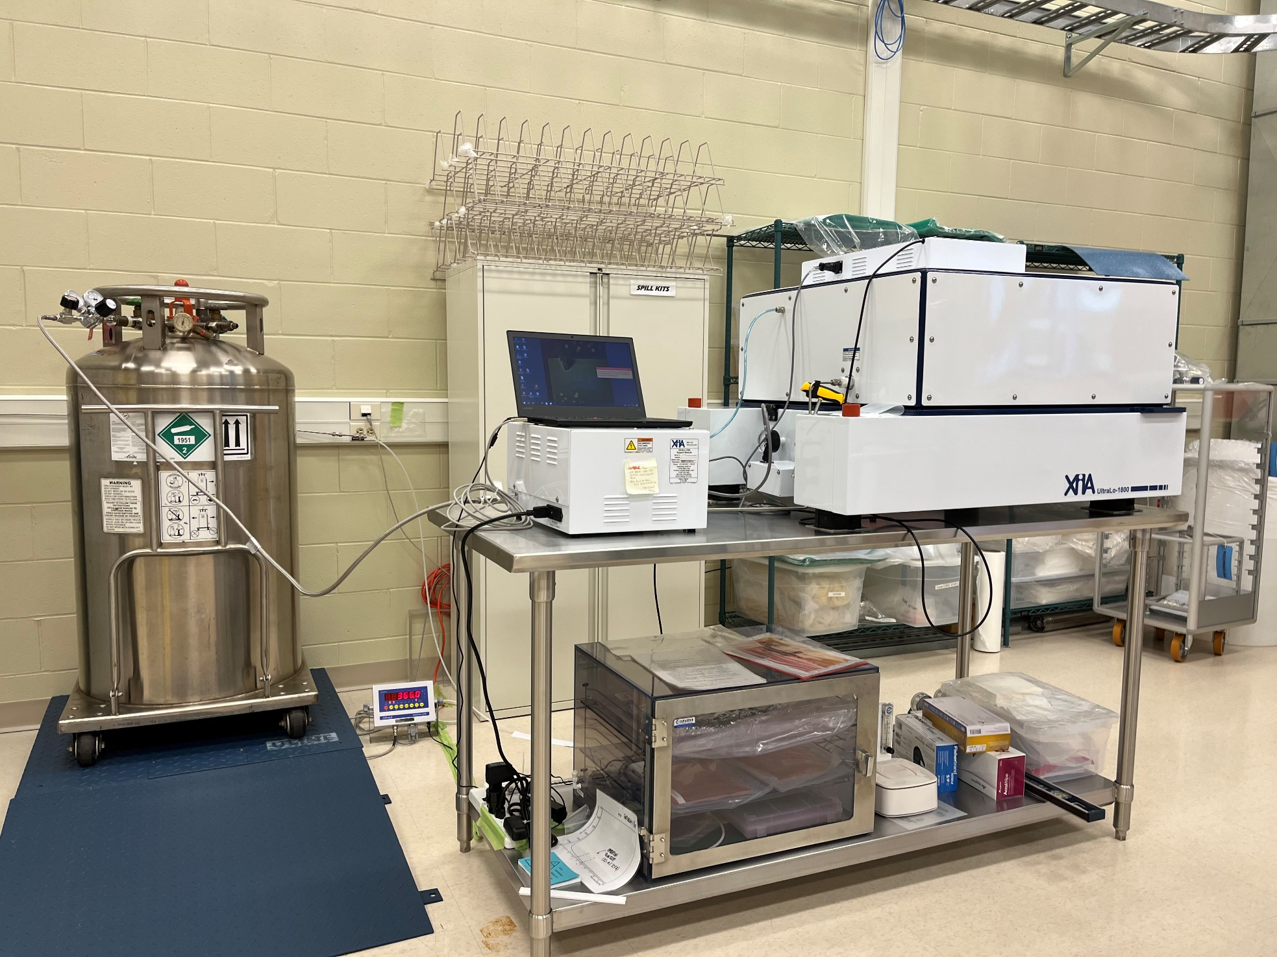
Research Labs – Surface Alpha Counters

Slide 23
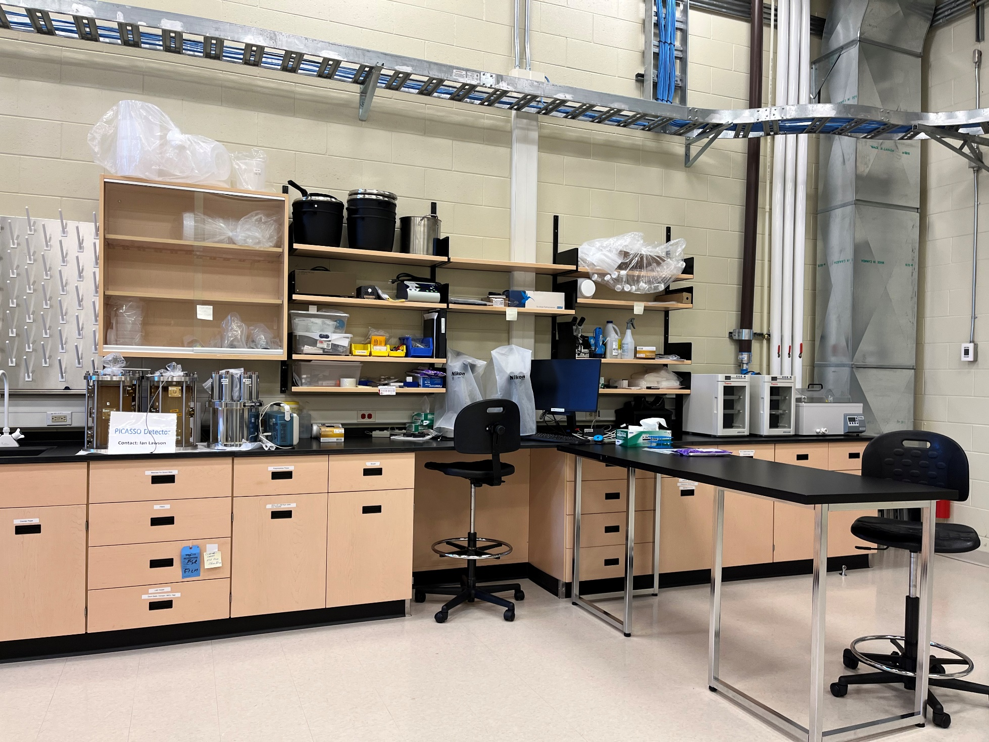
Research Labs – Cell Counting and Incubation

Slide 24
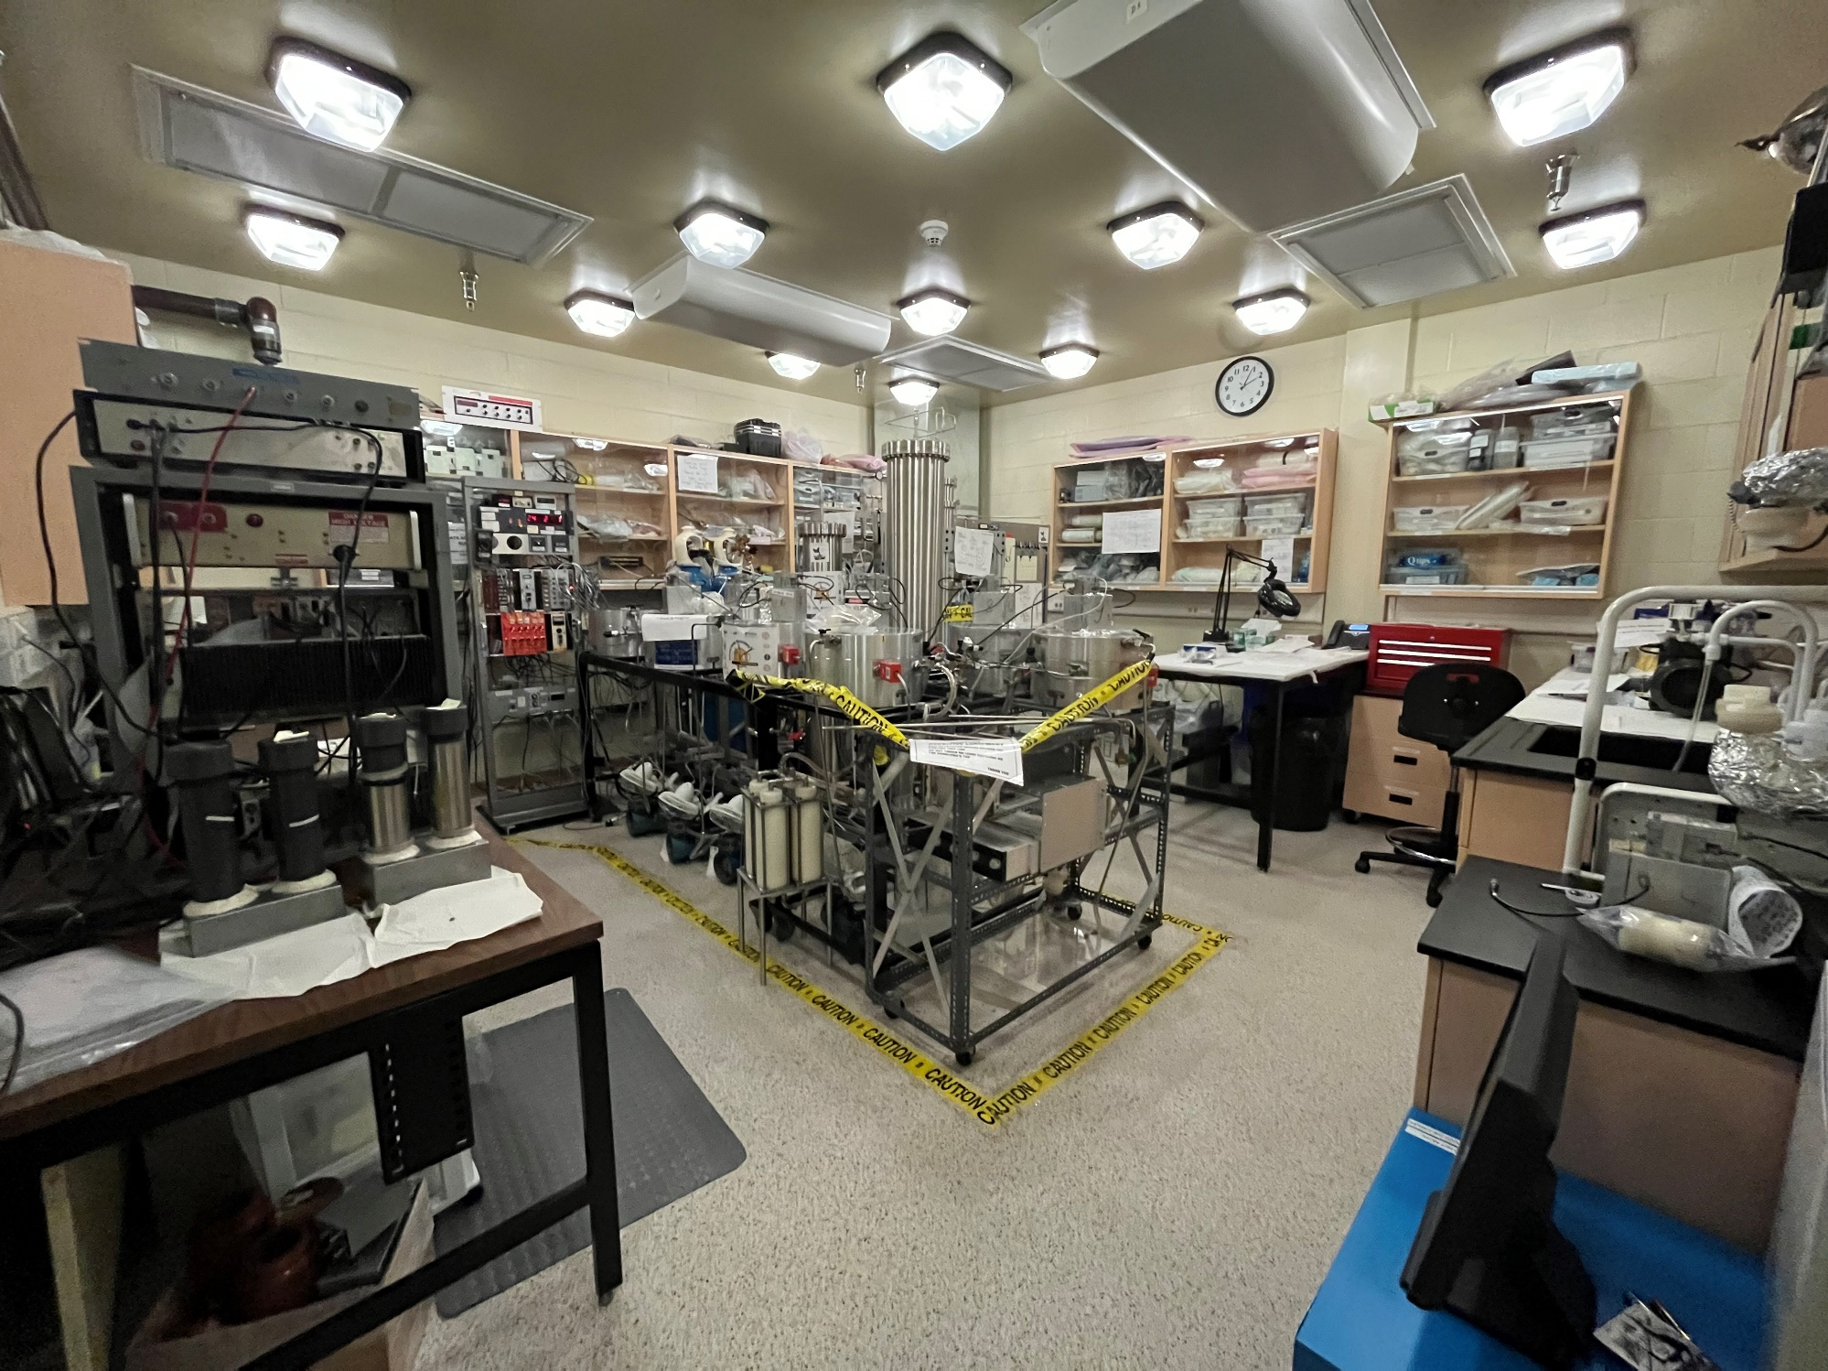
Research Labs – Surface Low Background Counting Facility

Slide 25
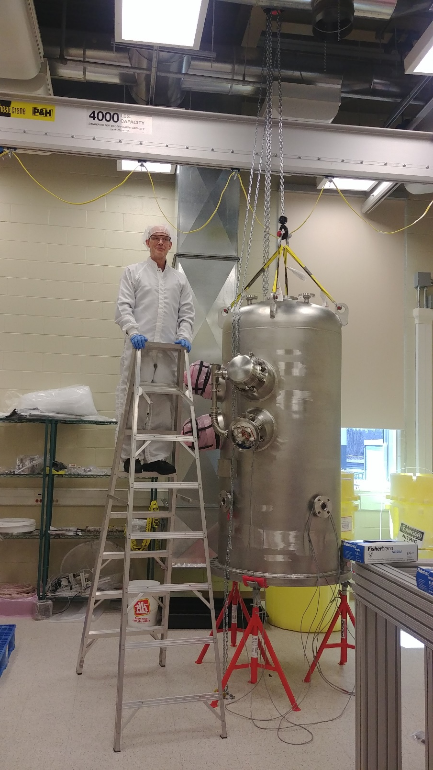
Surface Clean Assembly

Slide 26
SNOLAB – Underground Facilities

Slide 27
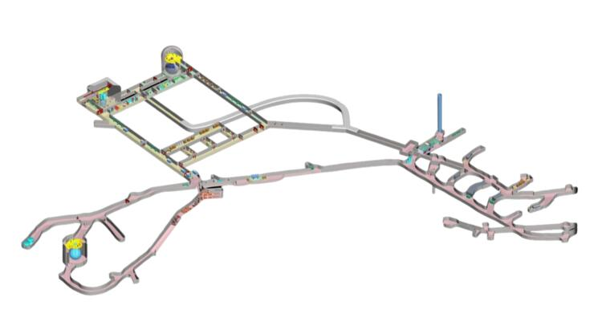
Lab Layout

Slide 28
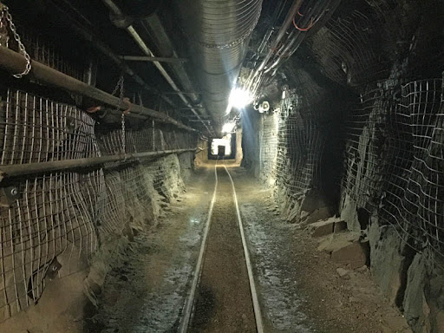
Lab Access

Slide 29
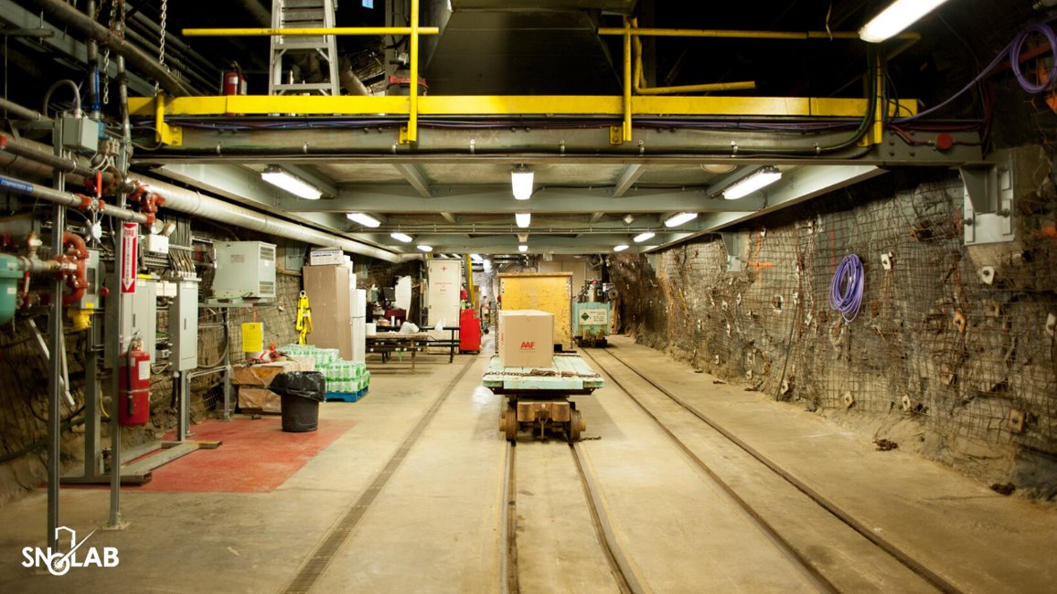
Lab Access

Slide 30
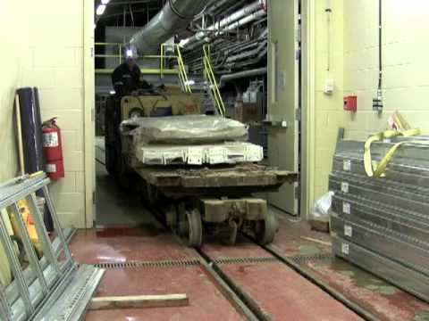
Lab Access

Slide 31
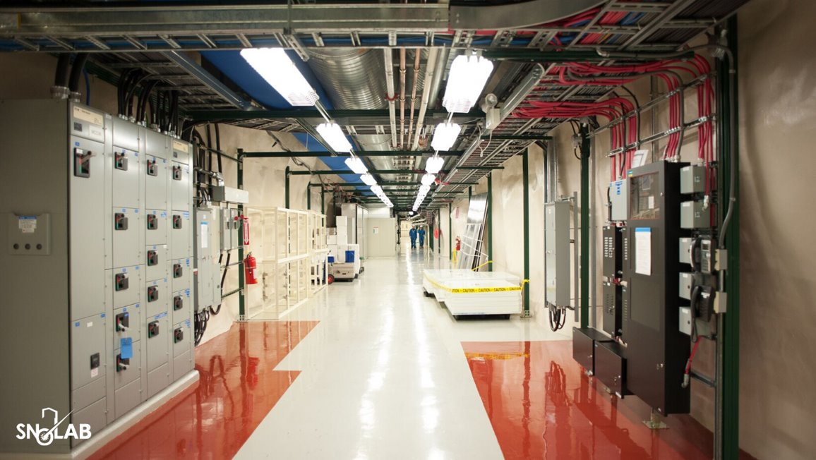
Inside SNOLAB

Slide 32
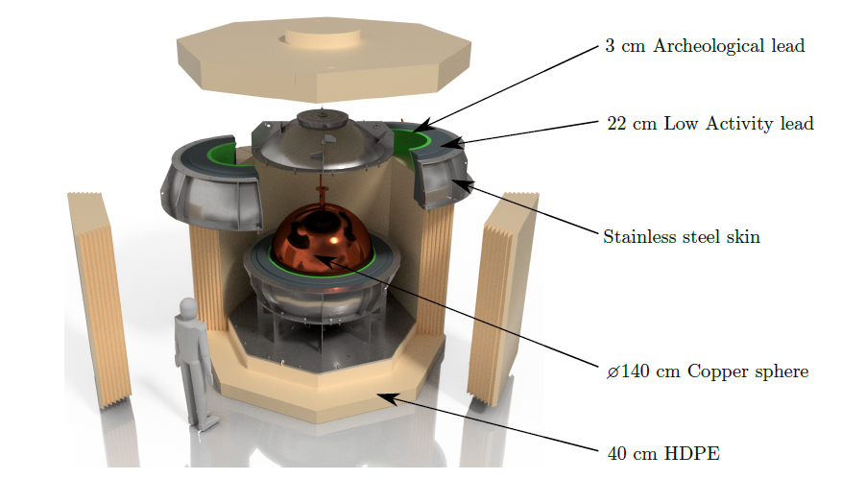
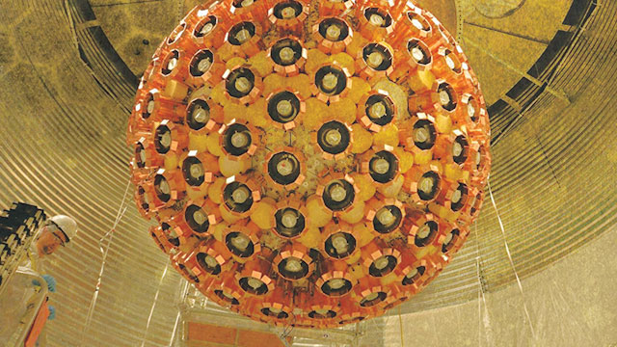
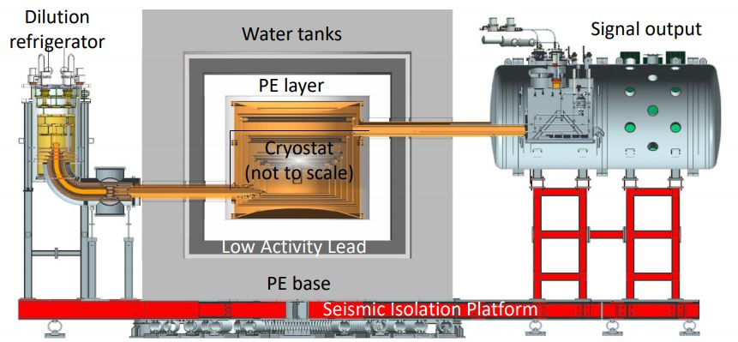
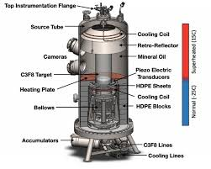
Experiment Highlights

Slide 33
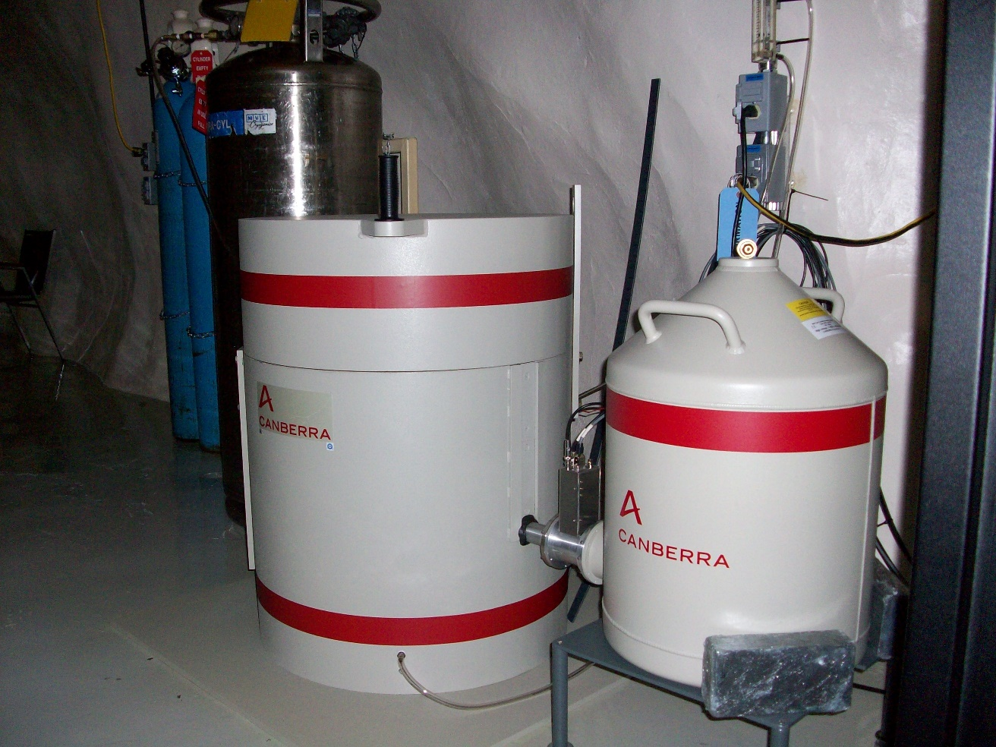
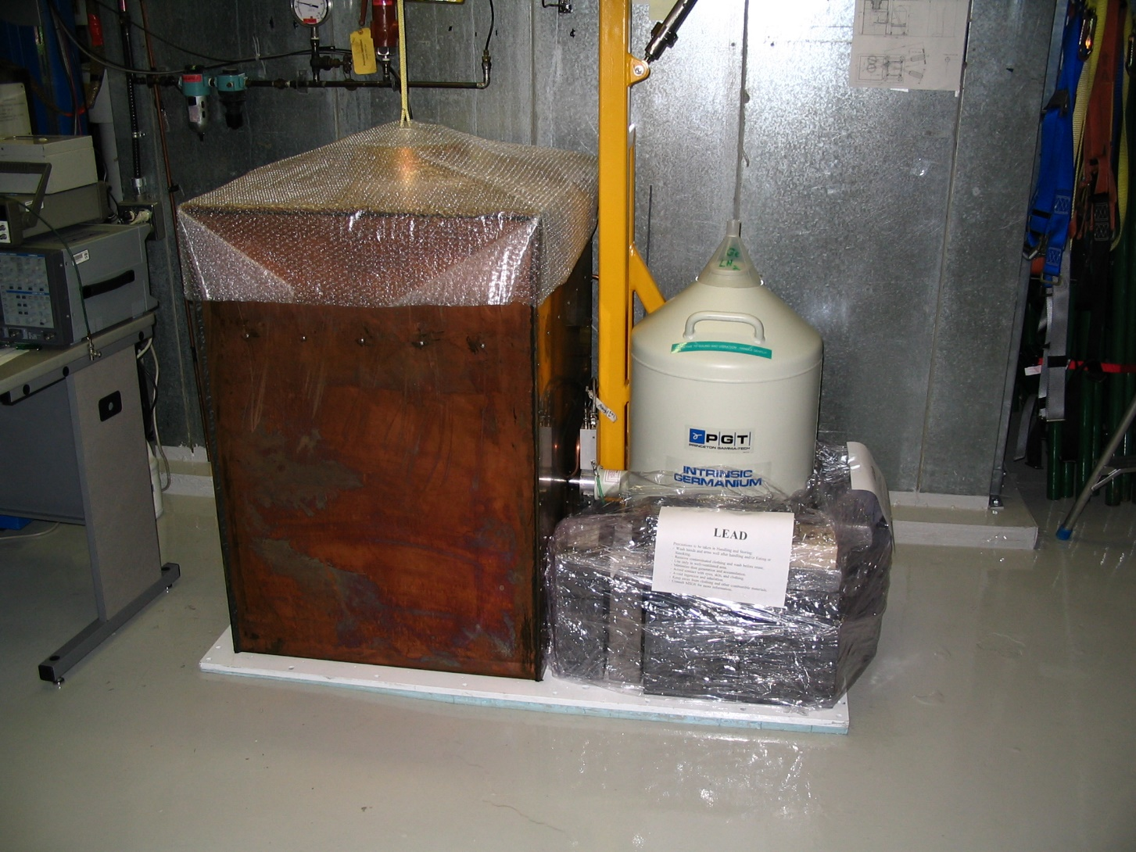
Underground Low Background Counting Facility

Slide 34
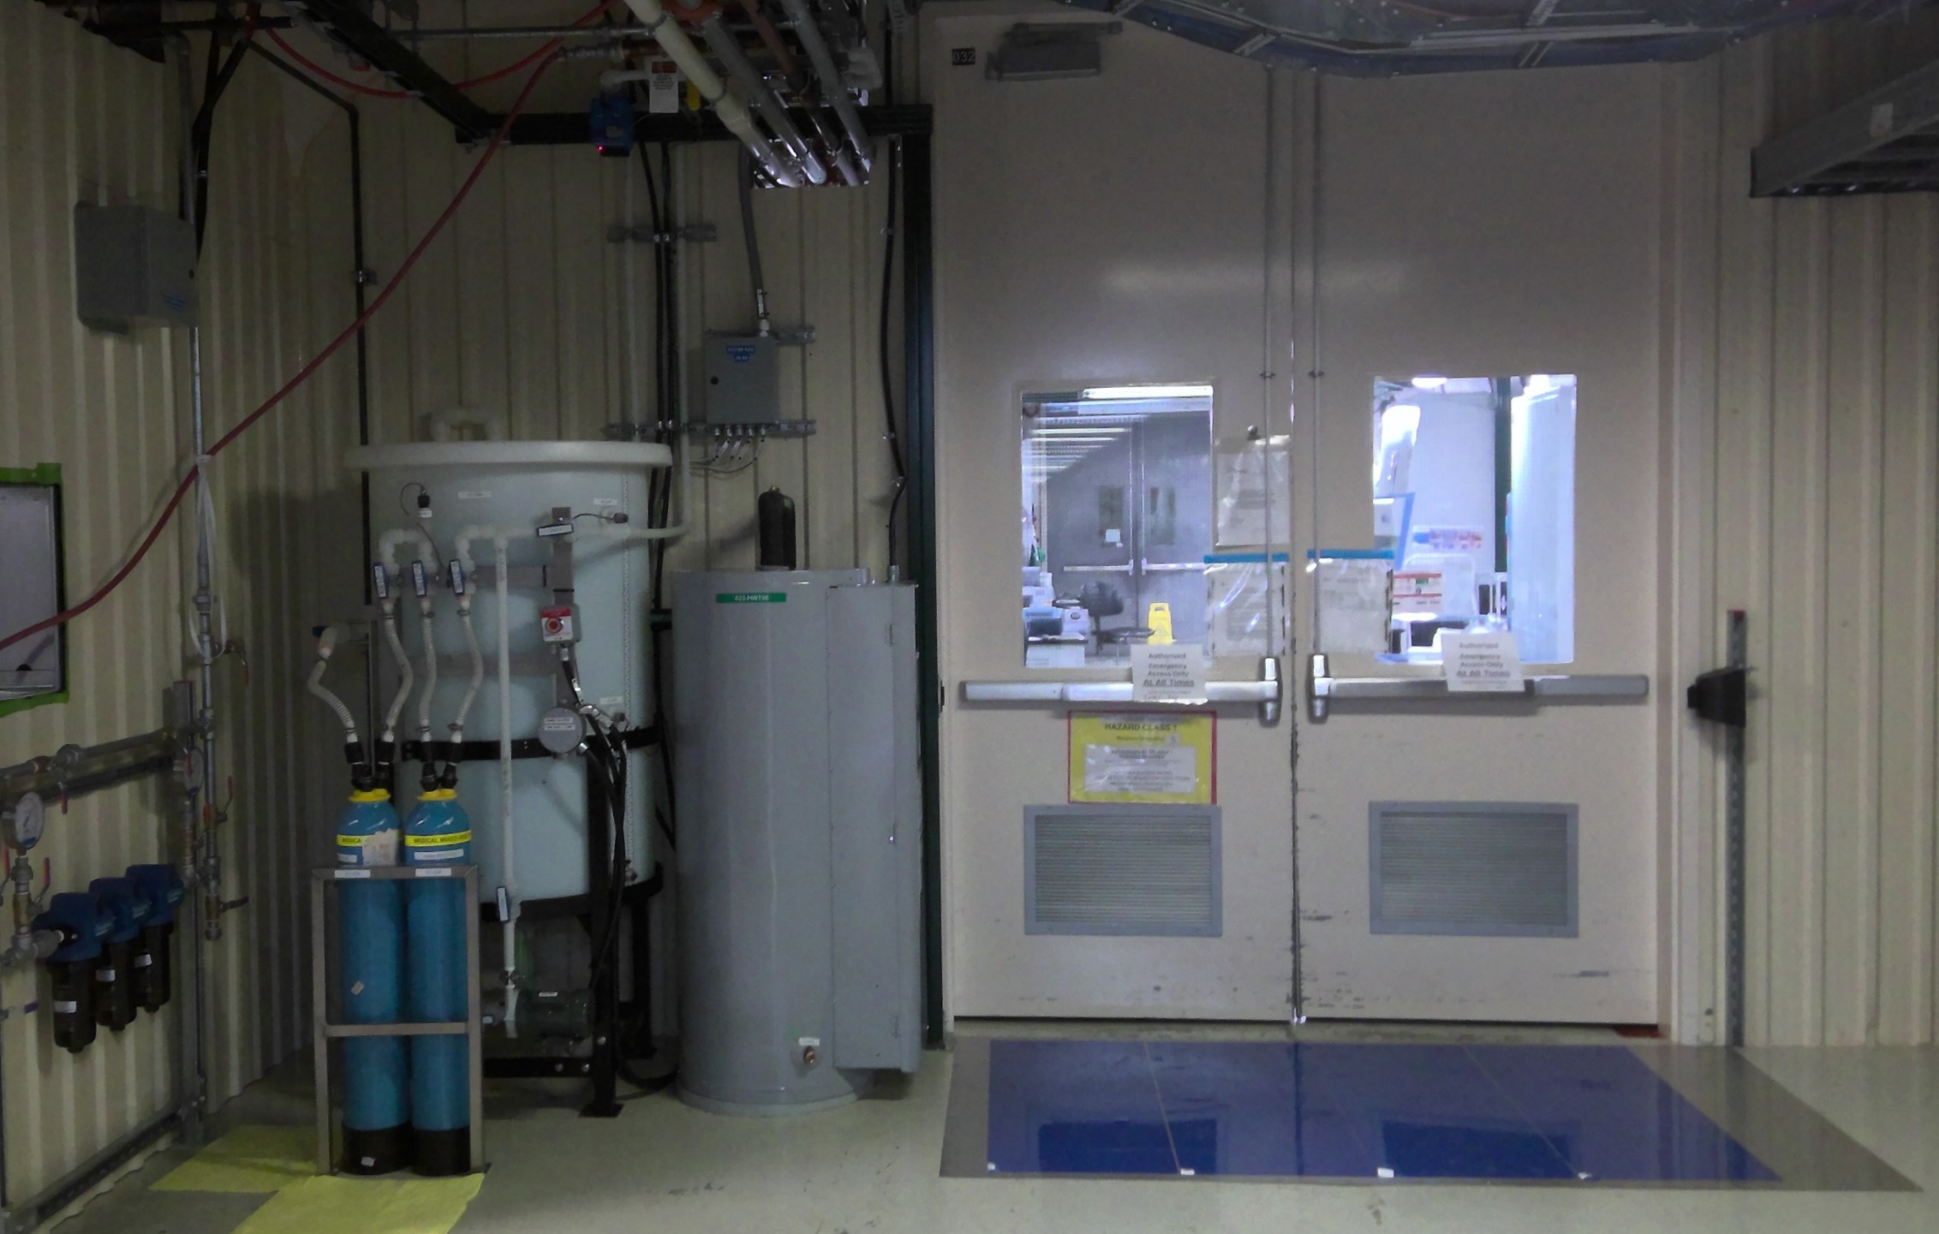
Underground Chemistry and Biology Laboratory

Slide 35
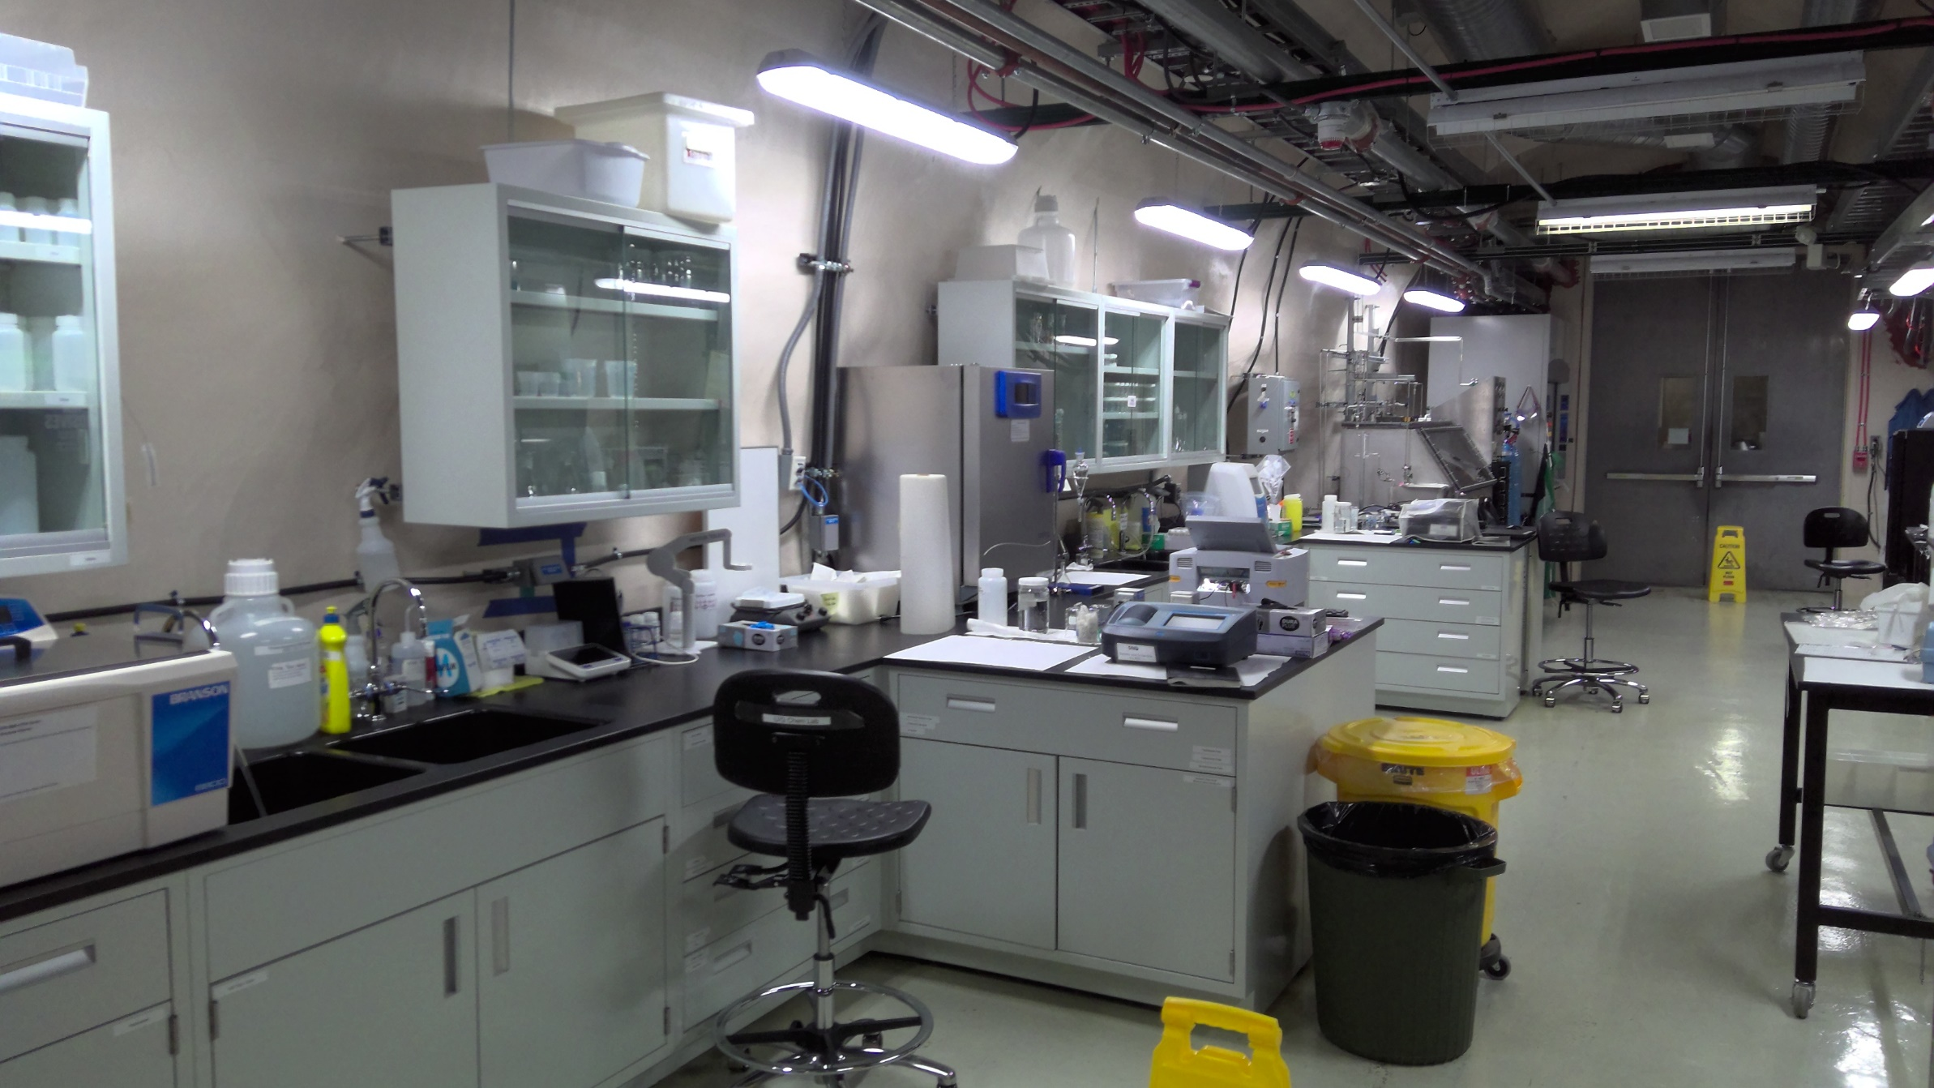
Underground Chemistry and Biology Laboratory

Slide 36
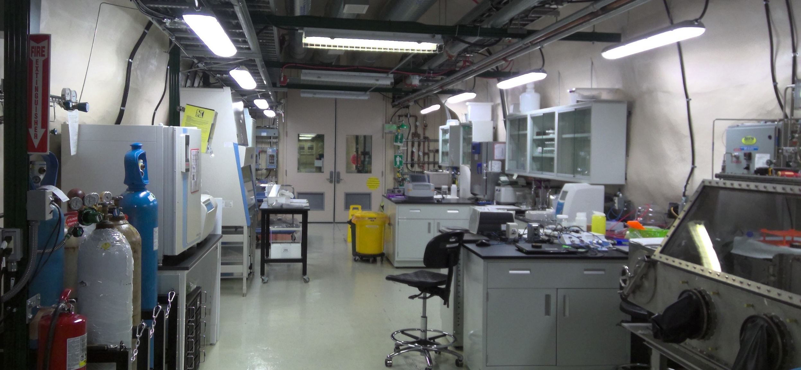
Underground Chemistry and Biology Laboratory

Slide 37
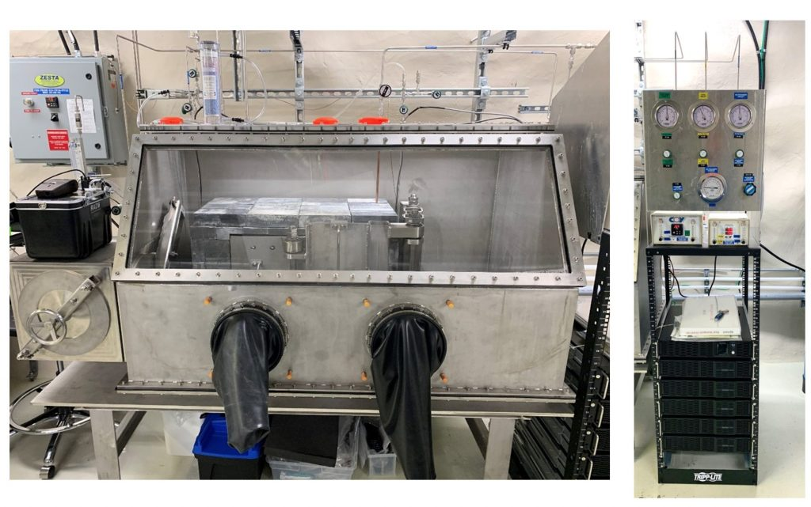
Bio Experiment 1: REPAIR

Slide 38
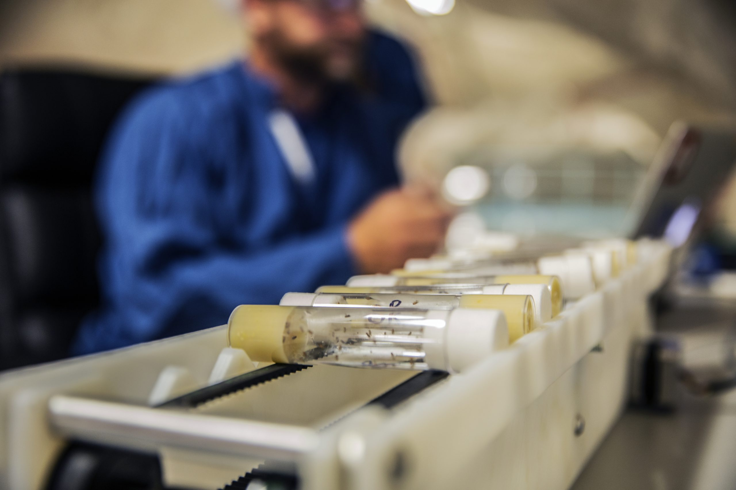
Bio Experiment 2: FLaME

Slide 39
SNOLAB – Always Improving

Slide 40
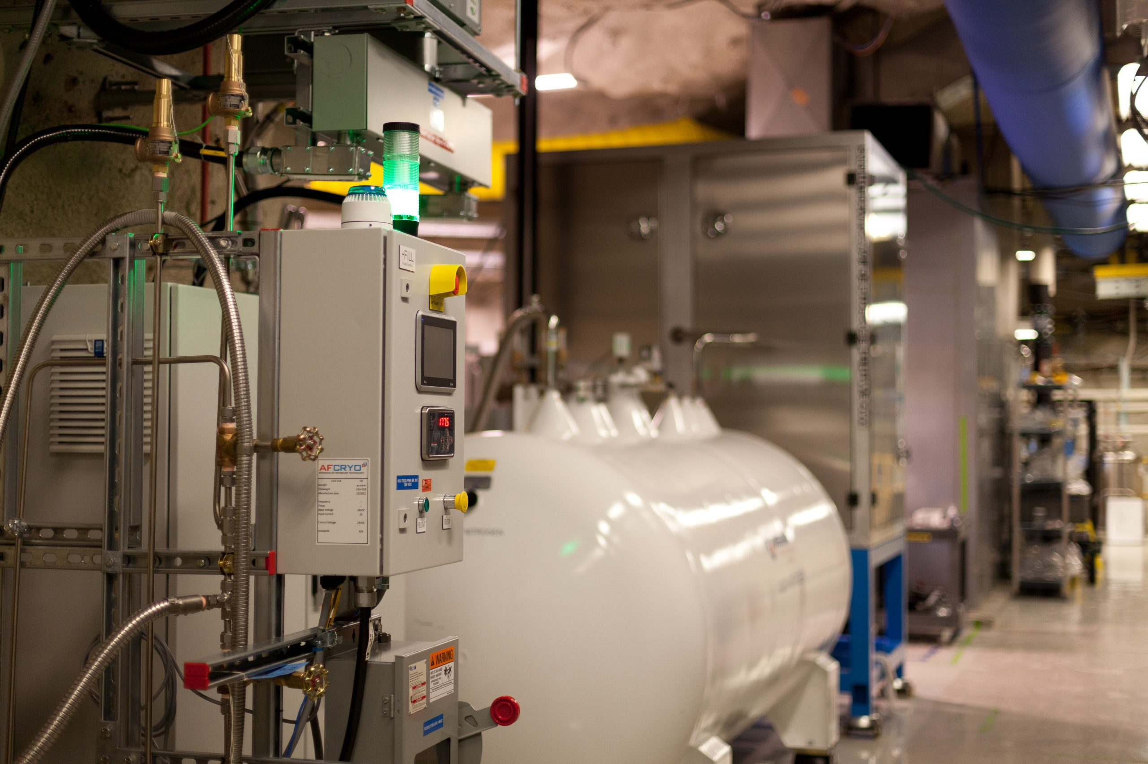
Underground LN2 Production

Slide 41
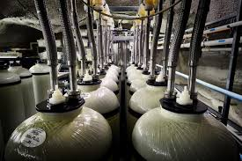
Improved UPW Production

Slide 42
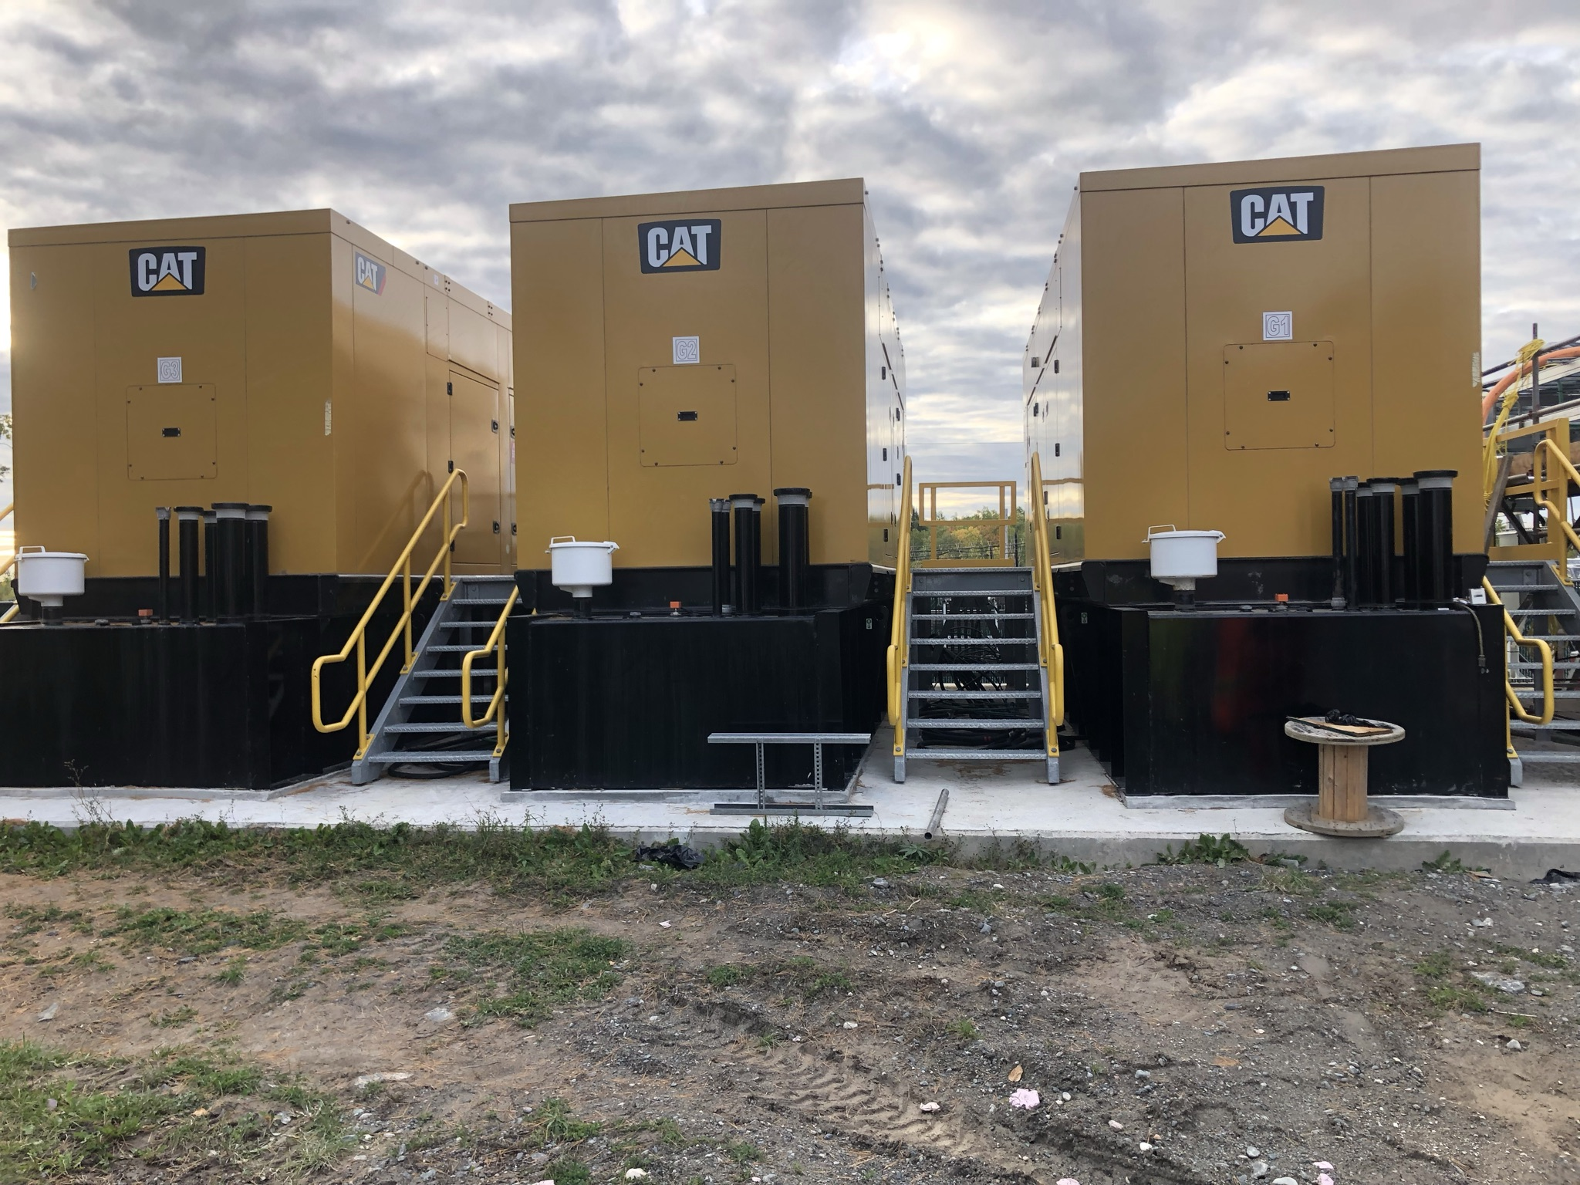
Redundant Power Production

Slide 43
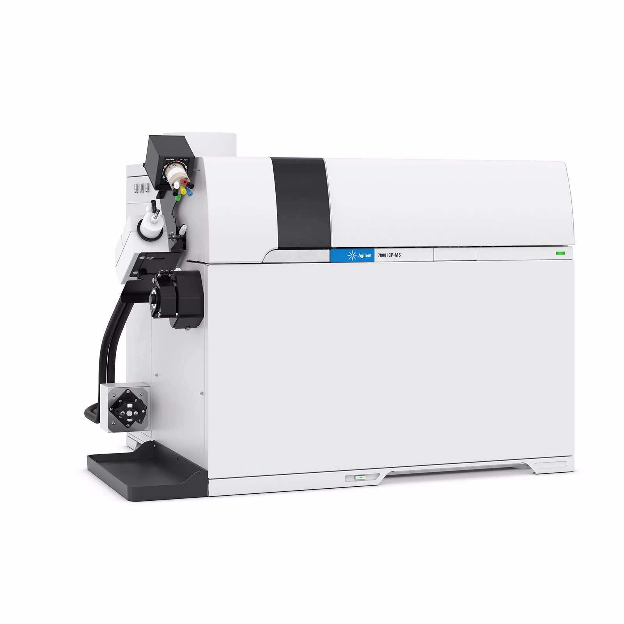
Low Concentration Metals Monitoring – ICP-MS

Slide 44
SNOLAB – Development, Outreach, Education

Slide 45
Development, Outreach, Education
Summer Schools
- TRISEP, CAPSS, ISSYP
Cosmic Rays Live
Collaboration with Science North and Dynamic Earth
Summer of Science (SuSi)
- Hosted visiting scientists for multi week stays
Development and dissemination of educational researchers
Engineer in Training Program
Co-op Student Program

Slide 46
Conclusion and Questions for the Community

Slide 47
SNOLAB – Prepared for Biology, Prepared for Science
Low Background Screening
Facilities
- UPW, LN2, Power, Internet, etc
Surface and Underground labs with necessary equipment
Increasing skills in biological process, in house and through collaboration with experiments
Outreach program
Clean construction and engineering
Chemical/Biological Safety
Excellent muon flux and background characterization

Slide 48
SNOLAB – Prepared for Biology, Prepared for Science
Radon characterization/reduction
Engineering and integration support
Program/project support
Funding applications
Underground and surface machining facilities
Simulation (background and chemical)
Seismic monitoring
Ultra low temperature systems (dilution fridges)
Cryogenics
…etc

Slide 49
SNOLAB – Questions for the Community
Dry Mines vs Wet Mines?
Impact crater vs ancient sea beds?
Experimental test beds vs single experiments?
1.2 atm vs surface pressure?
Combining skill sets?
- Computational chemistry + brine studies
- Background modeling + biological model systems
More complex models?
Training non-biologists to perform tasks (redundancy)
Chemical methods to reduce K⁴⁰? Low K⁴⁰ materials?
DULIA-Chem? DULIA-Math/Stats? DULIA-Modeling?

Slide 50
Many Thanks, Questions?

