Slide 1
Planned DRD7 involvement
Mark Prydderch – ASIC Design Group Leader, RAL
On behalf of the Common Interface ASIC Collaboration
mark.prydderch@stfc.ac.uk

Slide 2
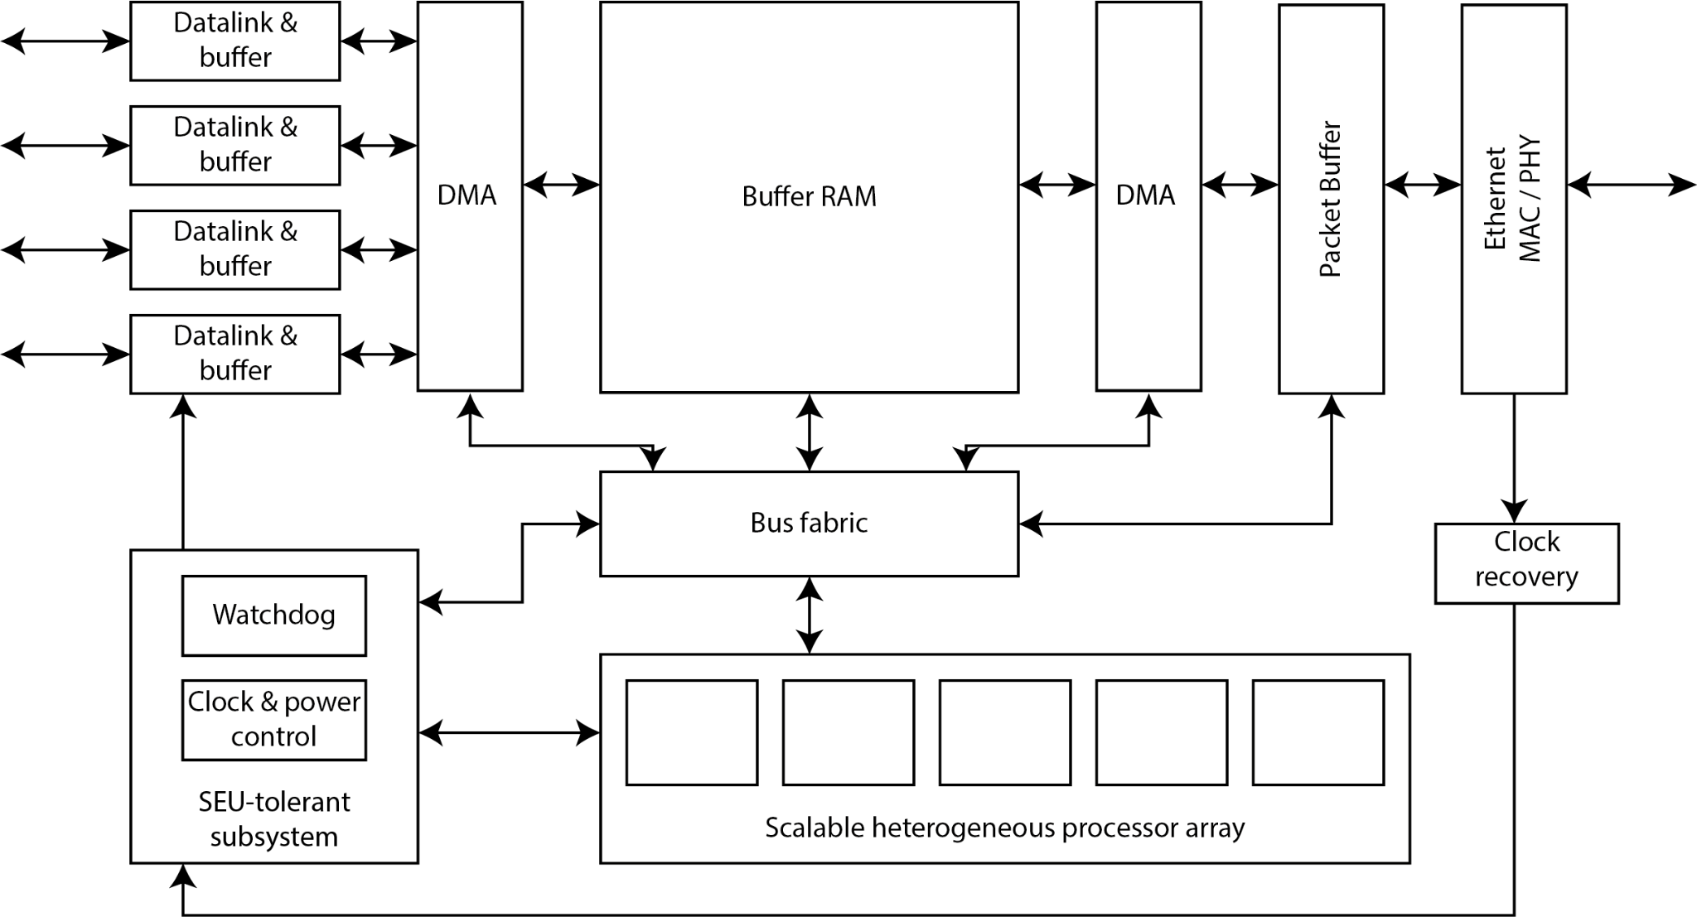
UK Consortium Concept
Motivation
Develop common interface ASIC to couple a range of specialised FE ASICs to a common industry-standard off-detector interface.
UK (STFC) Consortia
Birmingham
Bristol
Manchester
Oxford
RAL
Warwick
Proposed common interface ASIC for detector readout, timing, and control

Slide 3
UK Consortium Contribution – DRD 7.2b
Plans for DRD7.2b
Study/design of processor
Verification/testing of cores
Evaluate SoC platform
Software Ecosystem
Proposed common interface ASIC for detector readout, timing, and control

Slide 4
UK Consortium Contribution -- DRD 7.2c
Plans for DRD7.2c
Virtual Framework User
Evaluation and feedback
Possibly more?
Model
High level Model
FE
FE
FE
Physics
Data
FE
FE
FE
FE
FE
Example virtual model of a system

Slide 5
UK Consortium Contribution – DRD 7.5 b
Plans for DRD7.5
Help define link specifications and protocols.
ASIC emulation in FPGA using RISC-V/SoC open-source solutions.
Study & design of IPs necessary for 10 / 25 / 100Gb Ethernet cores.
Proposed common interface ASIC for detector readout, timing, and control

Slide 6
Status
Consolidated Grant Submission to STFC as DRD-UK
Common Interface ASIC
ItS for Early-stage R&D sent to STFC
£600k over 3 years -- fixed start date: 1/4/25
Shortlisting in May
Closing date for full proposals 17/7/24

Slide 7
Existing CFI funded 28nm development
1.2mm
Funded 3-year programme (now in final year, but extension planned)
2 Test-structure ASICs submitted 25th October 2023 including:
Rail-to-Rail Amplifiers - PMOS & NMOS Reference Drivers
Beta-Multiplier & Voltage Bandgap
10-bit IDAC & 10-bit VDAC
SLVS Clock Receiver, CML Output Driver & 2.4GHz PLL
Triplicated high-speed digital circuitry
Low-jitter LGAD Front-end
Vernier Delay Line TDC building blocks
More IP planned for manufacture later this year
Potential for involvement in SoC Block development ?
PURNIX →
1.2mm
1.2mm
1.2mm
←YELNIX

Slide 8
Thank you
Twitter:@STFC_matters
YouTube: Science and Technology Facilities Council

