Slide 1
LBNF Target and Associated Equipment
Project Update
13th May 2024
Chris Densham
STFC Rutherford Appleton Laboratory

Slide 2
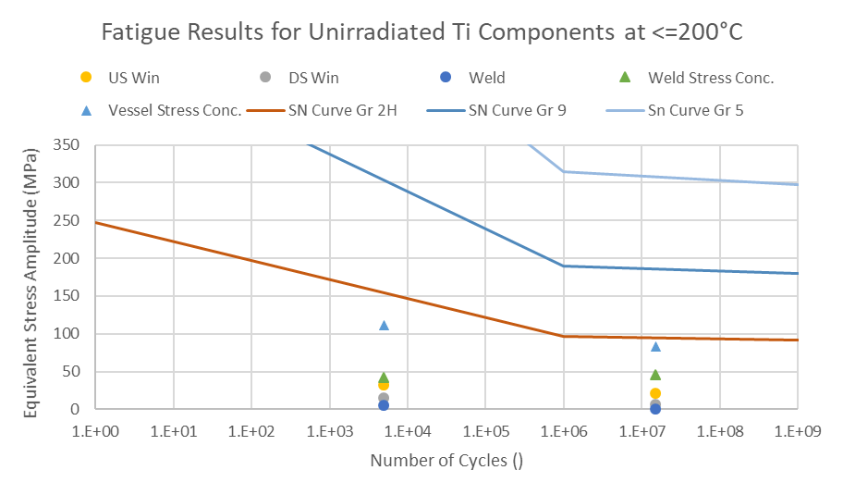
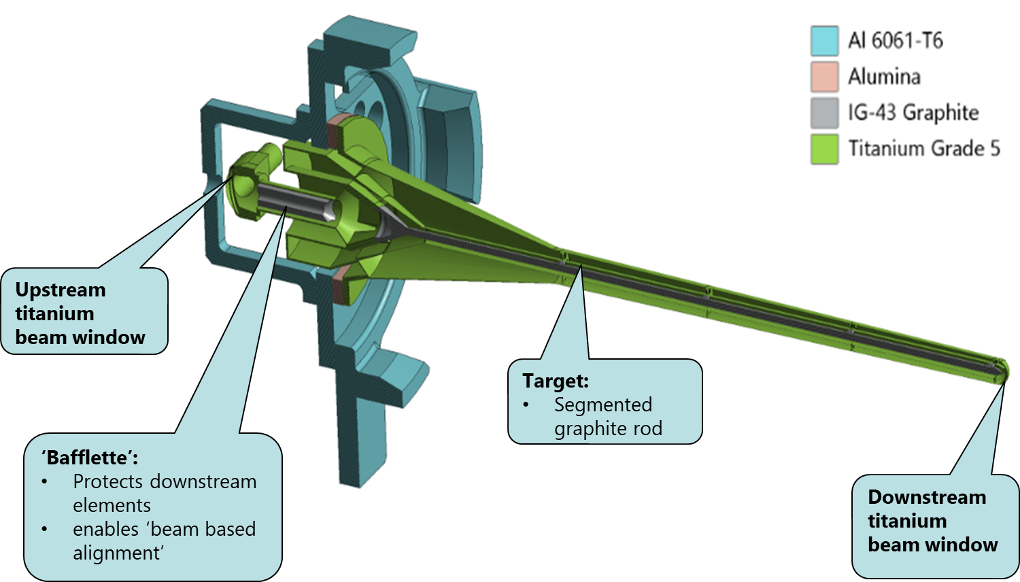
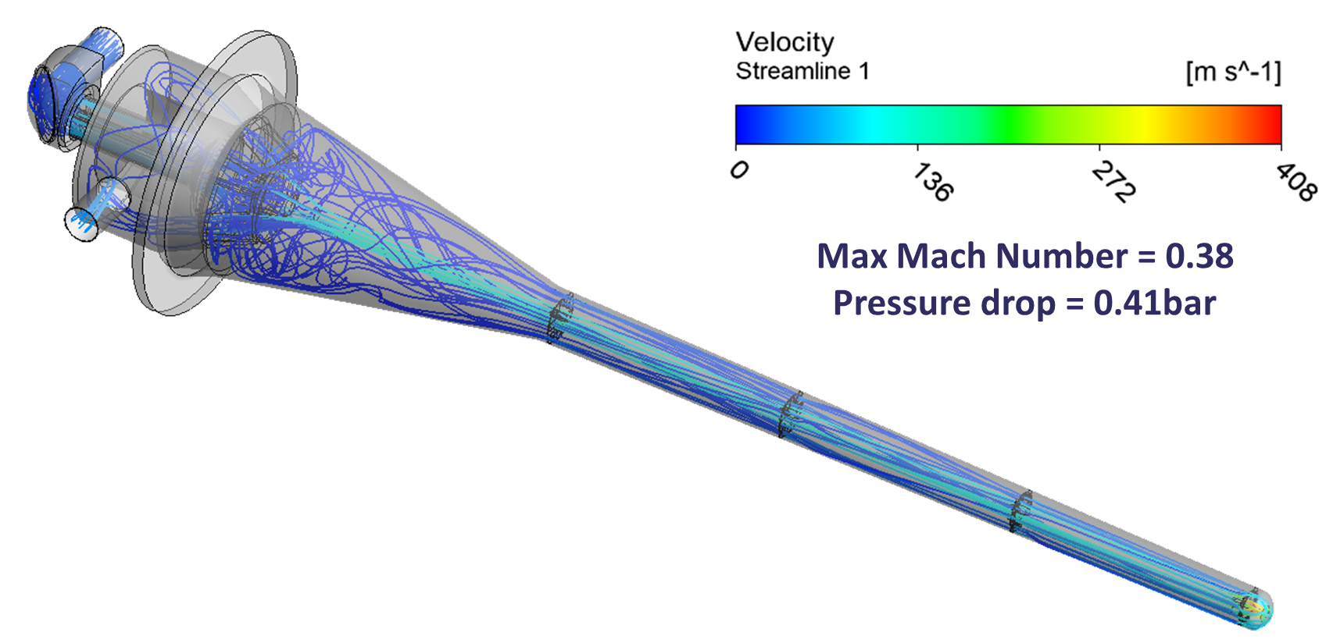
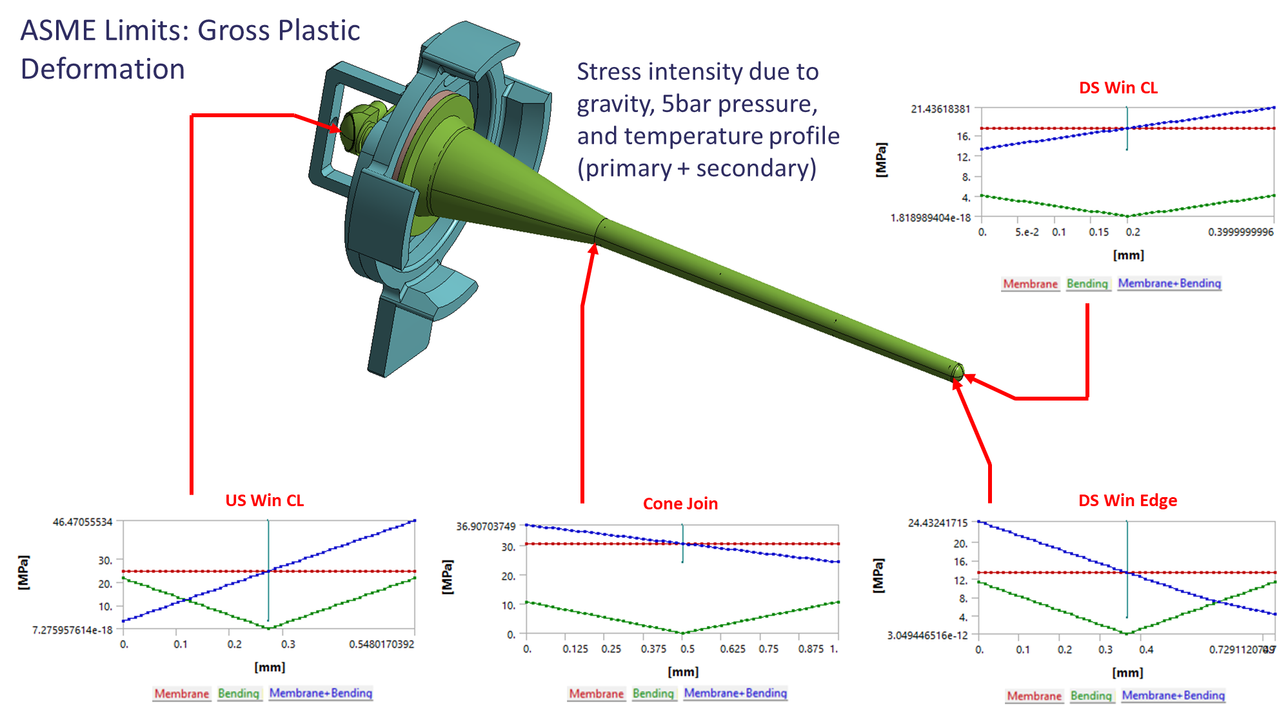
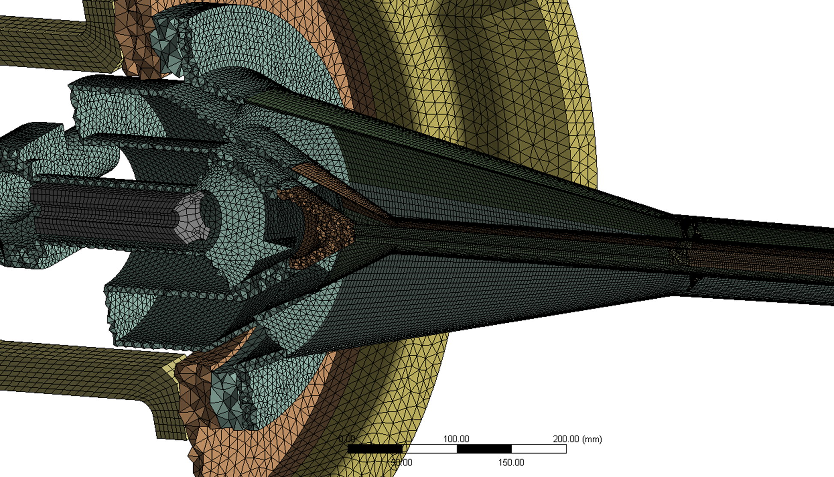
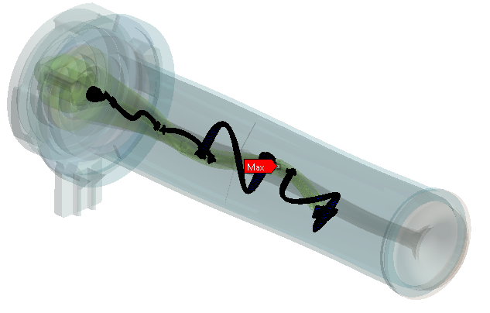
Engineering Analysis Work
Radiation Dose & heat loads (FLUKA):
Fatigue:
Geometry:
Helium cooling - CFD:
Stress Categorisation:
Thermal:
Mesh:
Lorentz force vibrations:
Pressure Code Design Approval
(FESHM and ASME BPVC)
Deflections exaggerated for display purposes

Slide 3
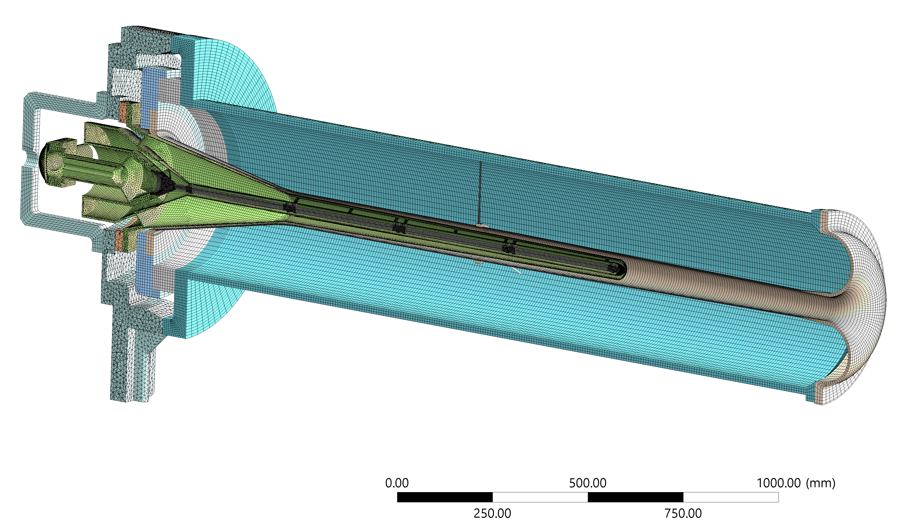
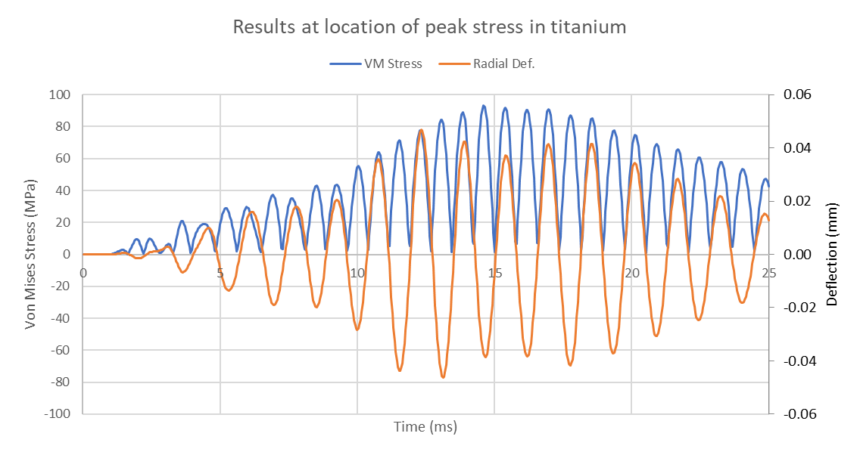
Present Modelling Effort: “Full Transient”
Gauge point is on target titanium flow-divider (location of peak stress)
Combined target + horn model with double thin-plate support
Full transient analysis with 300 kA, 1 ms horn current pulse
Two-way dynamic coupling
Driving frequency (axial deformation at the horn flange) is ~640Hz, c.10 µm amplitude
Similar frequency response in target, but direction is lateral (c.50 µm max. amplitude)
Safety factor of 2.5 for titanium fatigue life of 1.5 e9 cycles (c.1 year operation)
On the limits of what we can solve with available computational fire-power!
Horn current 300 kA

Slide 4
Target container weld design rationalization
8
9
7
6
1
2
3
4
5
10
Weld variant/Phase | Thickness | Angle | Welds included
A | 0.8mm | .537° | 1, 2, 3, 4
B1 | 4mm | 20° | 5, 6, 7
B2 | 4mm | 0° | 8, 9
B3 | 4mm | 90° | 10

Slide 5
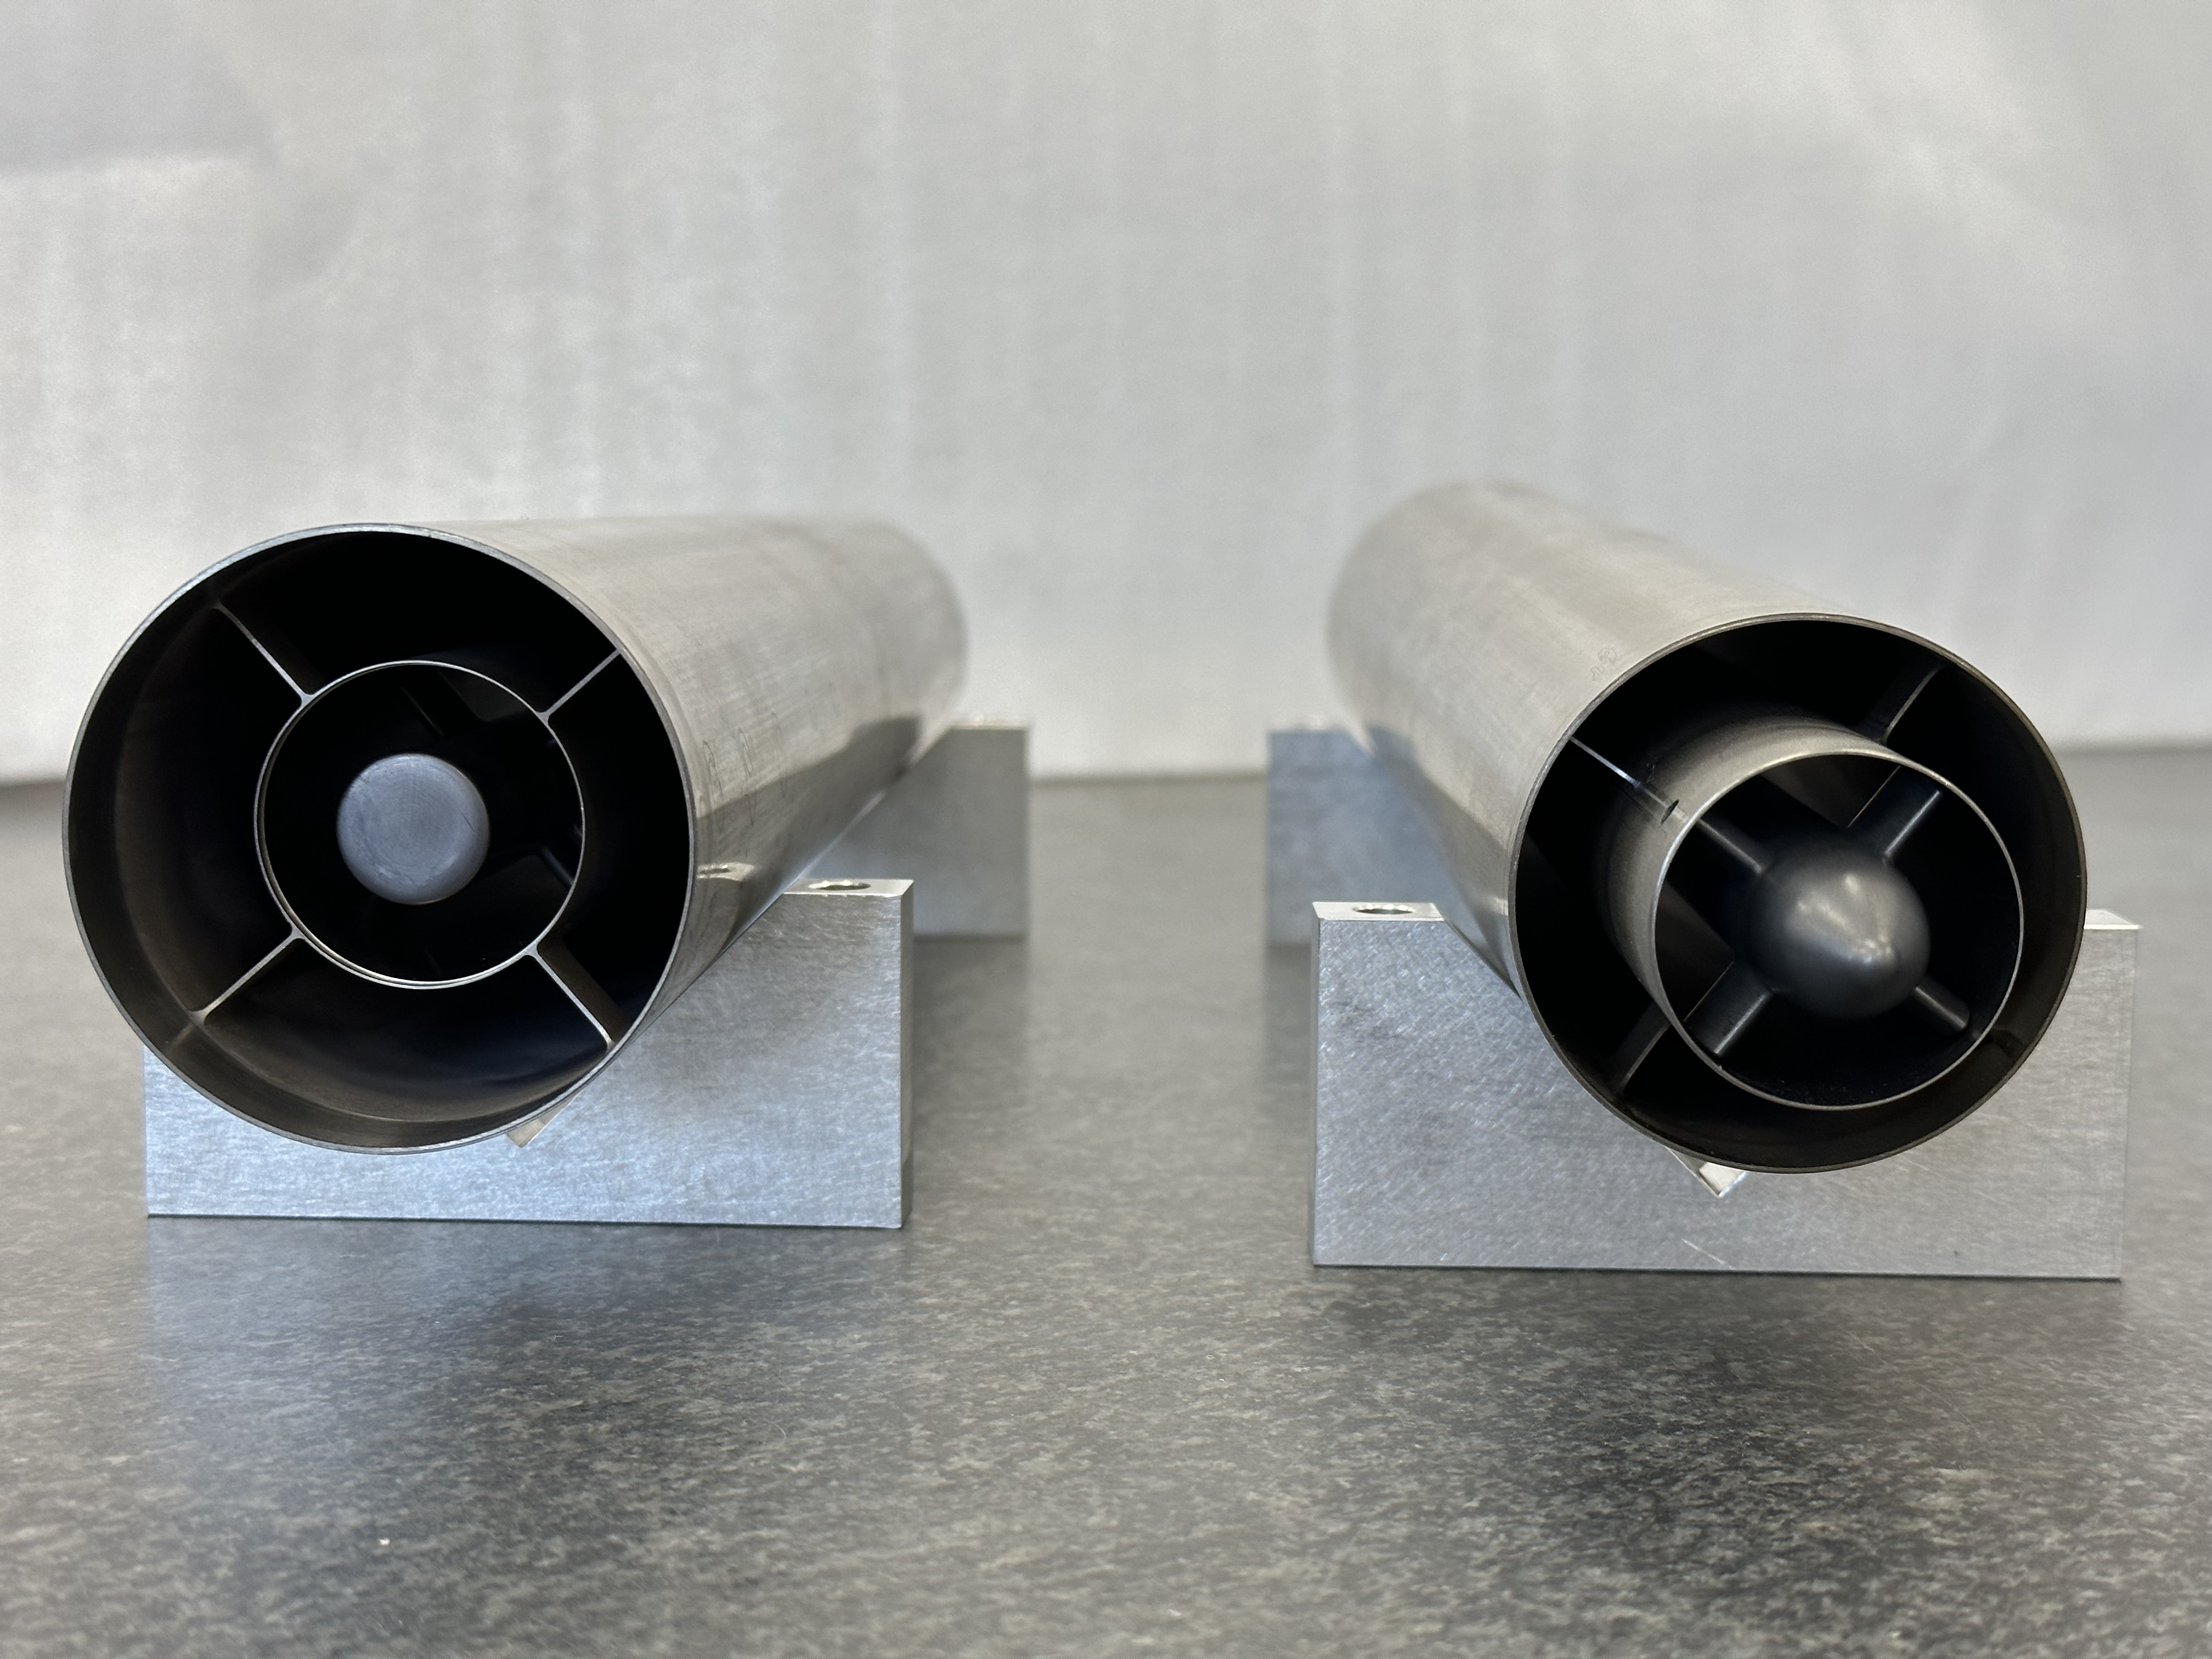
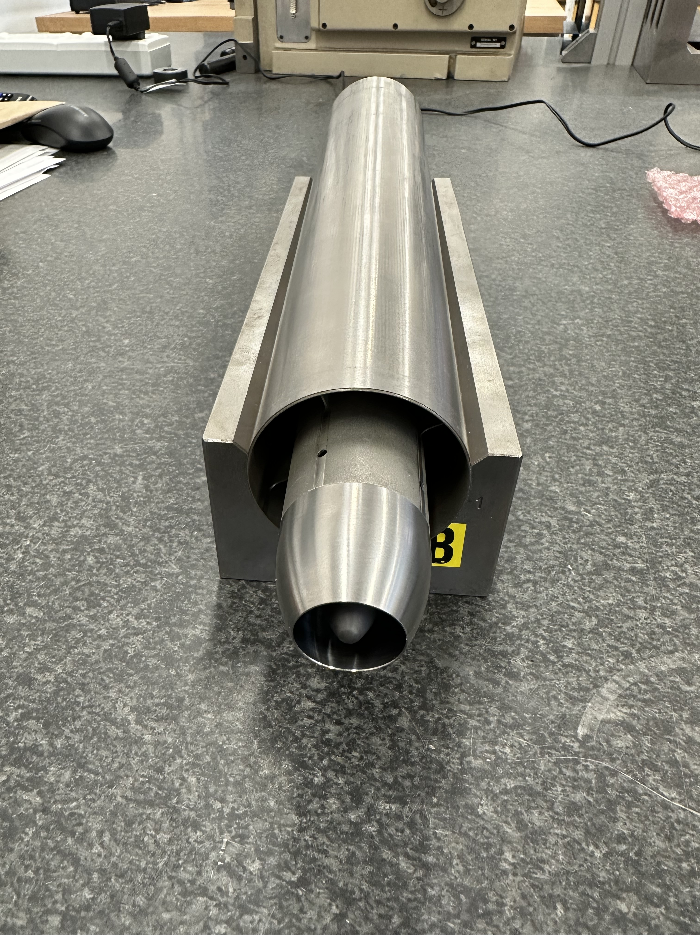
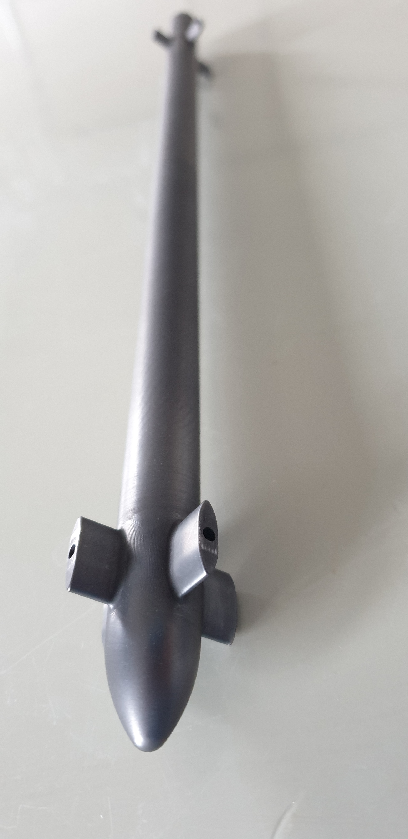
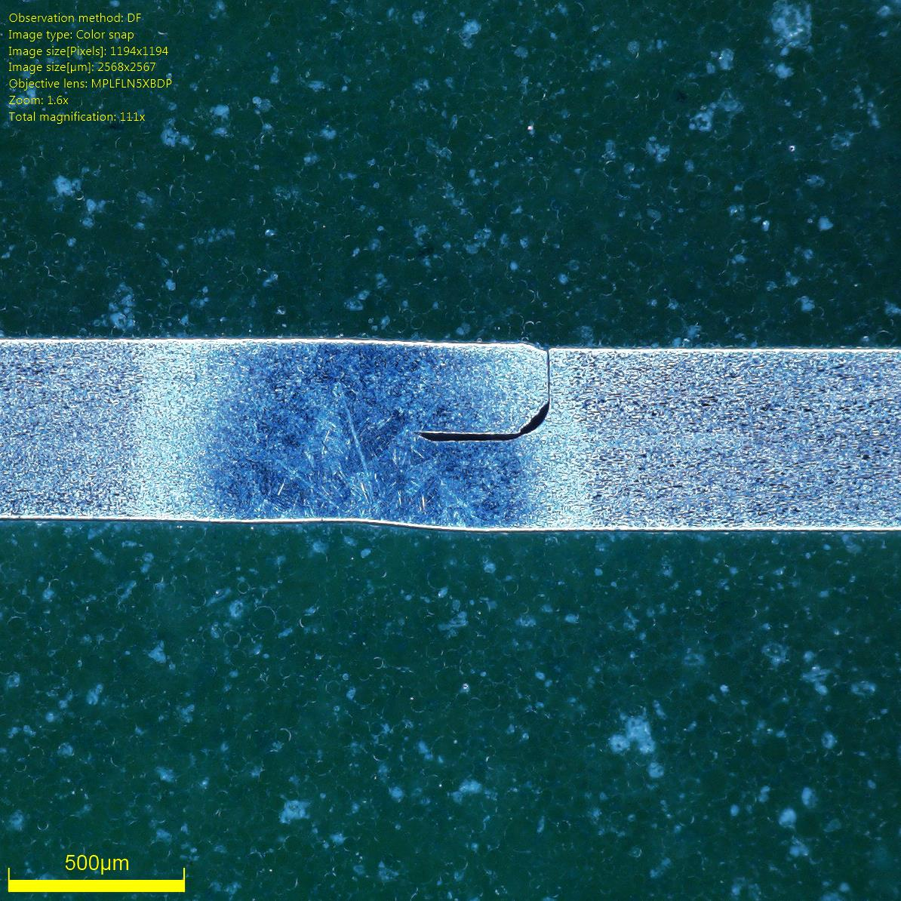
Prototyping update
Full length target core segment prototype completed:
Target core installation & welding
Prototype EB welding at RAL:
Nose cone flow guide
0.5 mm wall thickness

Slide 6
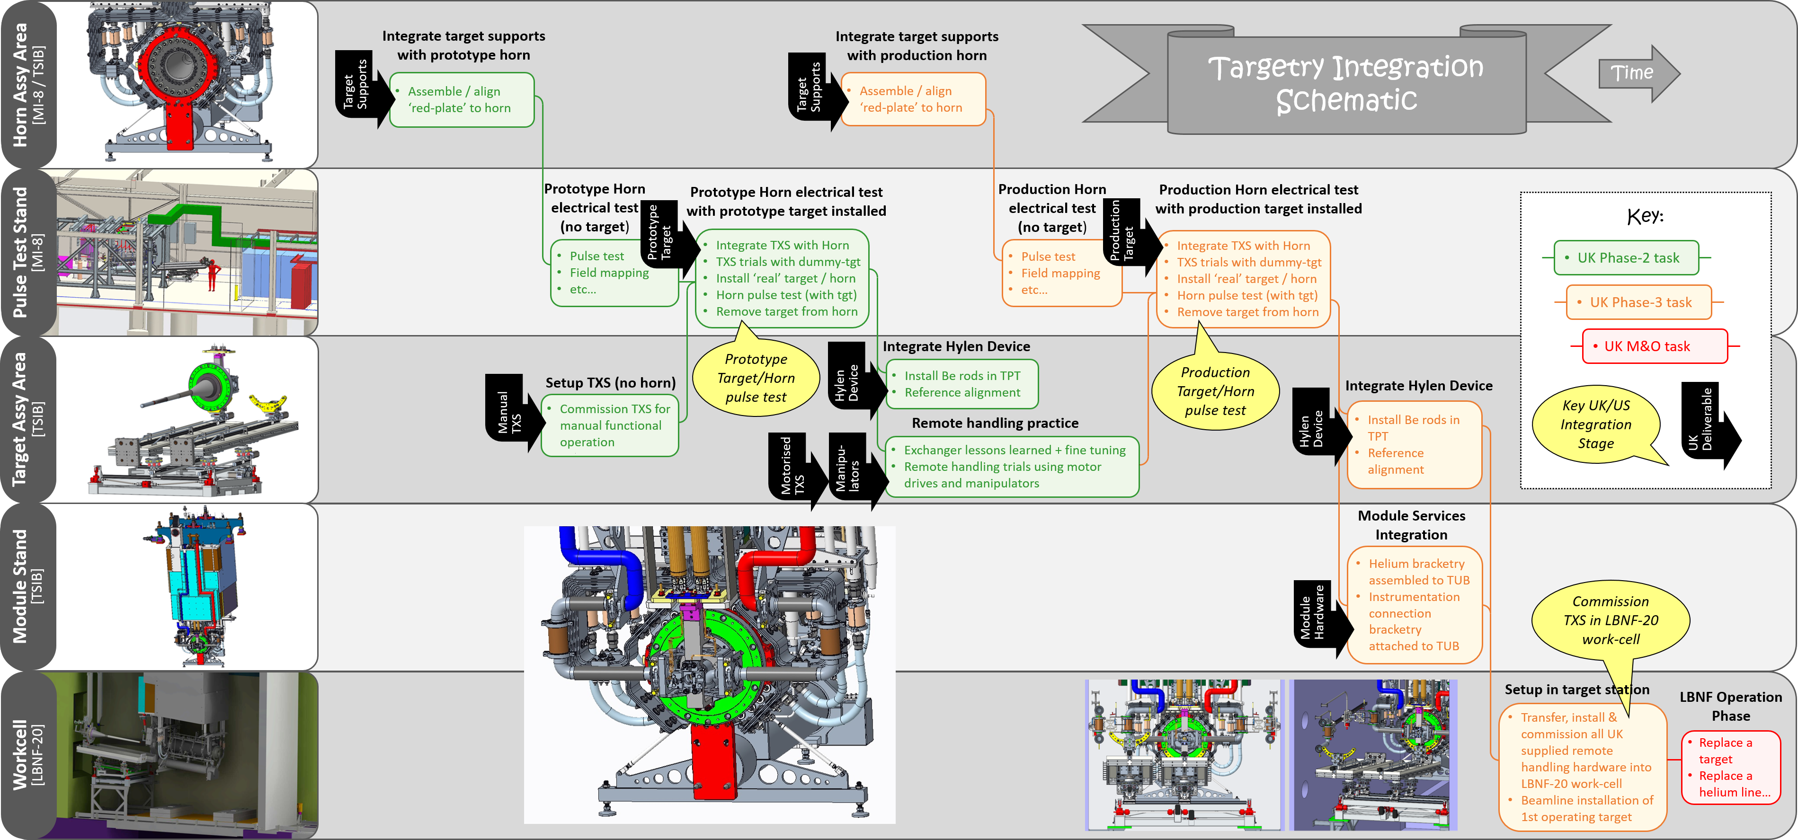
UK/US Targetry Integration Schematic

Slide 7
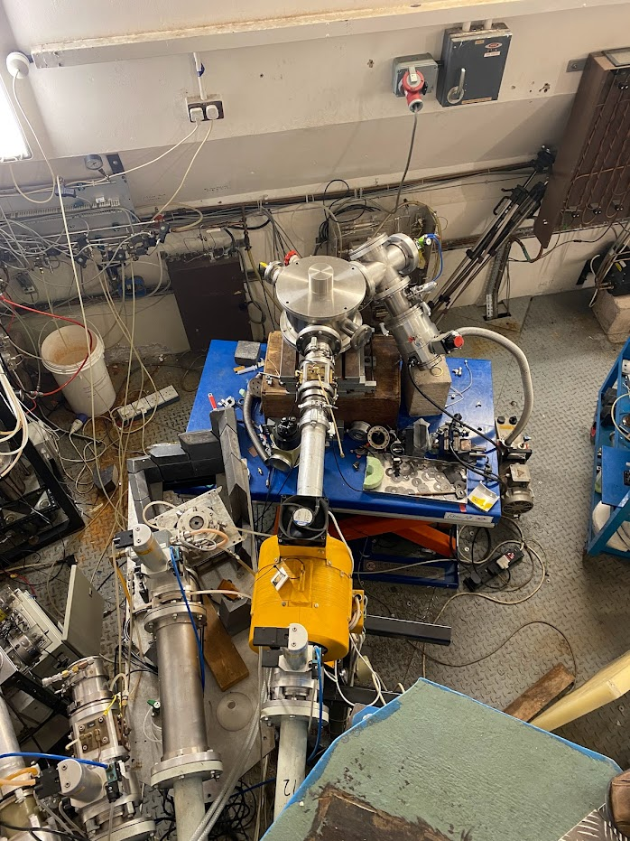
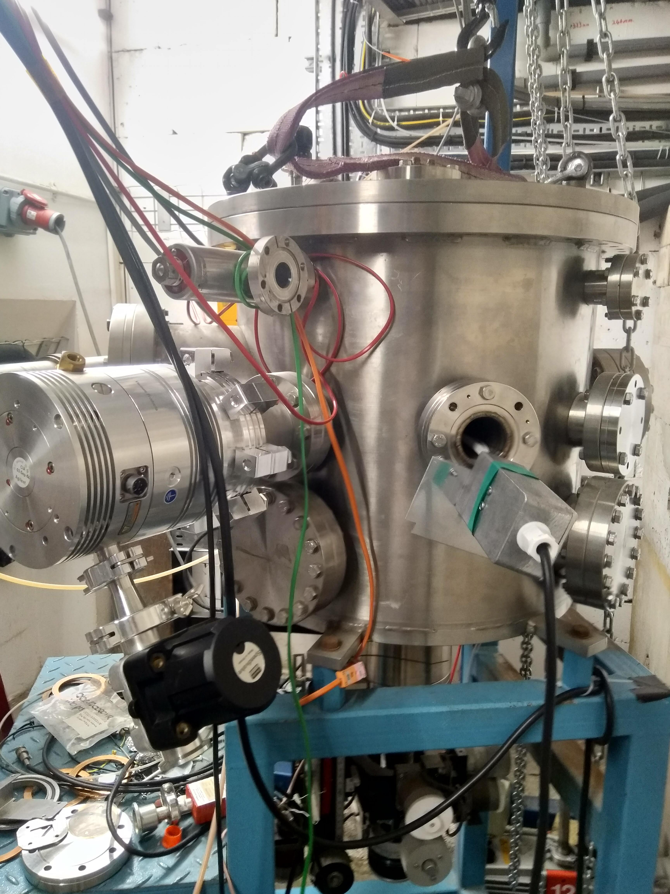
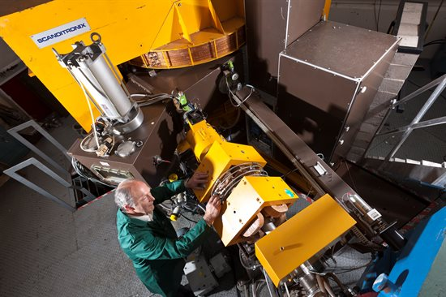
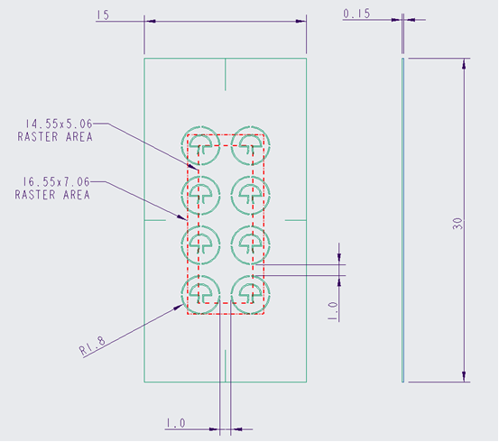
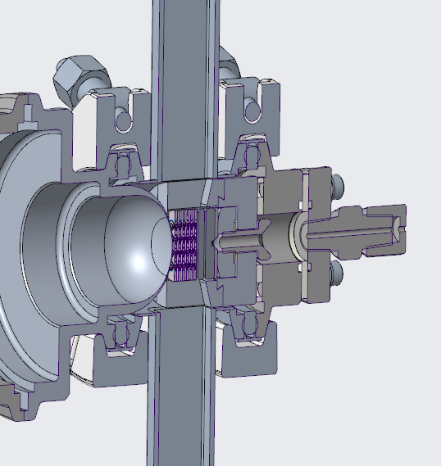
Birmingham MC40 Cyclotron for new materials irradiation studies:
Gas cooled meso-scale samples of candidate titanium alloy foils for future ultrasonic fatigue testing
MC40 Beamline for
Sample & environment
(Birmingham)
PIE
Micro/nano indentation
High cycle fatigue testing
TEM/XRD
MC40 irradiation
Sample design (Oxford)
Sample environment
(RAL)
Proton and He irradiation at high energy
(Birmingham)
(Oxford, Birmingham @Culham)
Remotely handleable sample environment ready for manufacture

Slide 8
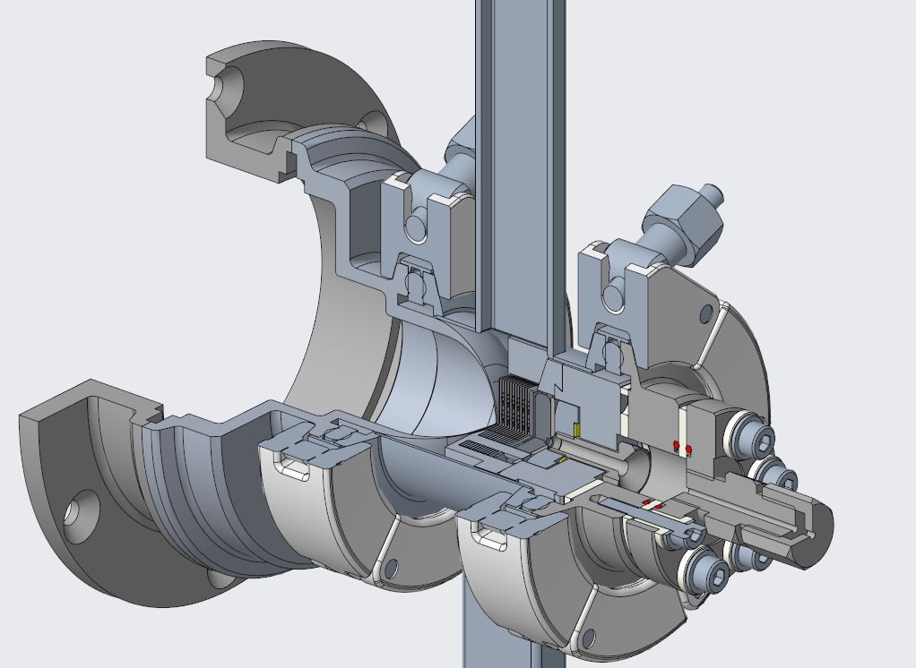
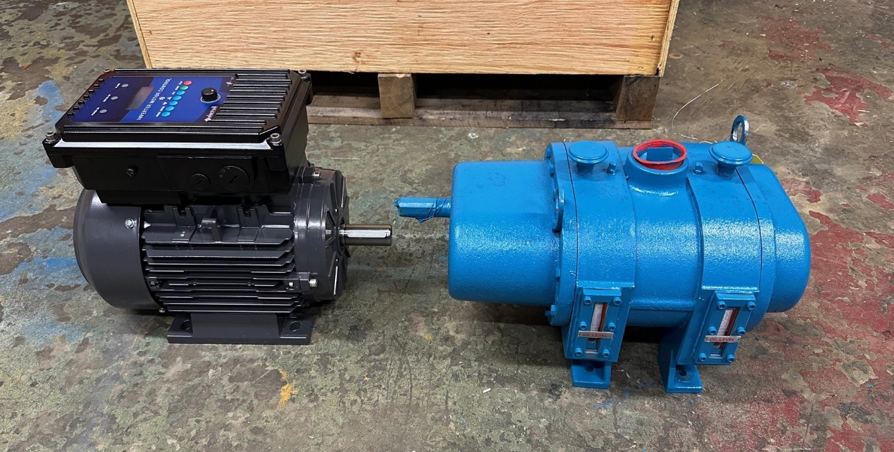
Status of Sample Environment
The design for the sample environment enclosure is now relatively mature and approaching manufacture. The design now includes temperature diagnostics for the graphite beam stop, as well as electrical isolation of the sample section to enable beam current measurement (taken from the beam stop thermocouple sheath).
A WIP drawing package exists for the whole sample environment assembly, in anticipation of imminent manufacture for offline flow testing at RAL prior to any irradiation runs at MC40.
The contract for a positive displacement blower for circulating the elevated pressure nitrogen coolant has been placed. The specification released in the RFQ for this item includes technical flow specifications as well as handling and size constraints based on the installation location in the MC40 beamline hall. The delivery of the blower, motor and variable speed drive is anticipated at RAL within the next month – the individual components are all with the supplier in Chesterfield, awaiting fitment to their “skid” baseplate.
Current sample environment containment CAD design. Note Macor isolation features (white) and downstream thermocouple compression fitting.
Nitrogen blower, motor and VFD for MC40 sample irradiation flow loop (prior to skid installation)

Slide 9
Orientation of gas flow reconfigured (from horizontal to vertical) to allow for correct orientation of raster profile (5x15mm)
Beam
Nitrogen

Slide 10
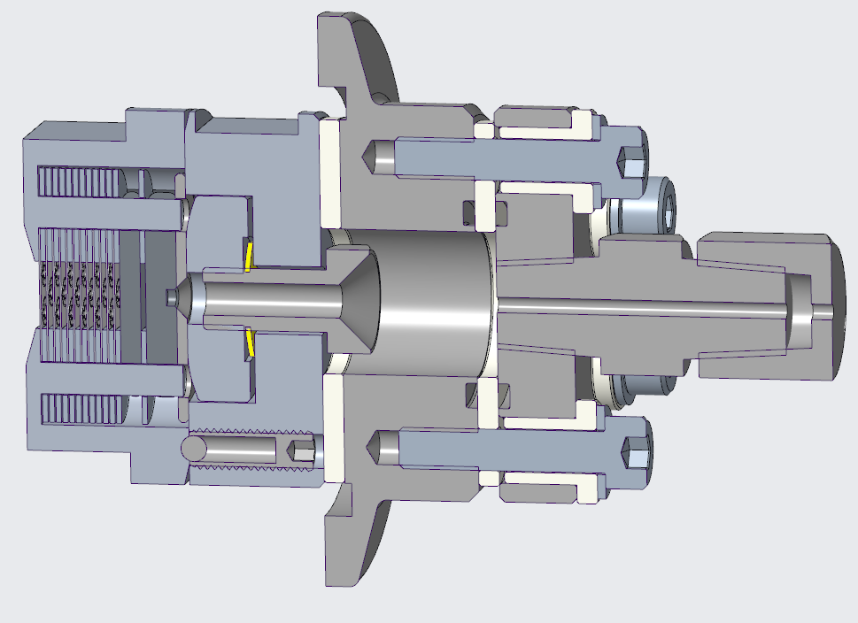
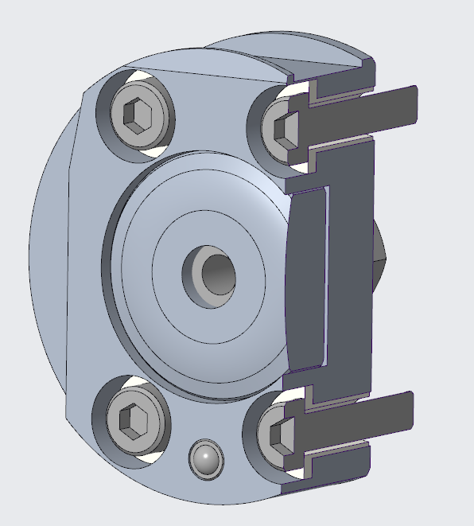
Macor isolator rings to enable beam current measurement (from TC)
Samples aligned on two pins and separated with 0.5mm spacers
Sample holder fasteners have nylon “top hat” washers for isolation:
Wave washer & preload block constrain samples within holder & allows for thermal expansion
(Samples backed with metal plate to avoid cracking graphite)
Compression fitting for 1.5mm thermocouple feedthrough (beam stop temperature measurement)
O-ring sealing on pressure boundary isolation ring
Spring plunger for retaining sample holder

Slide 11
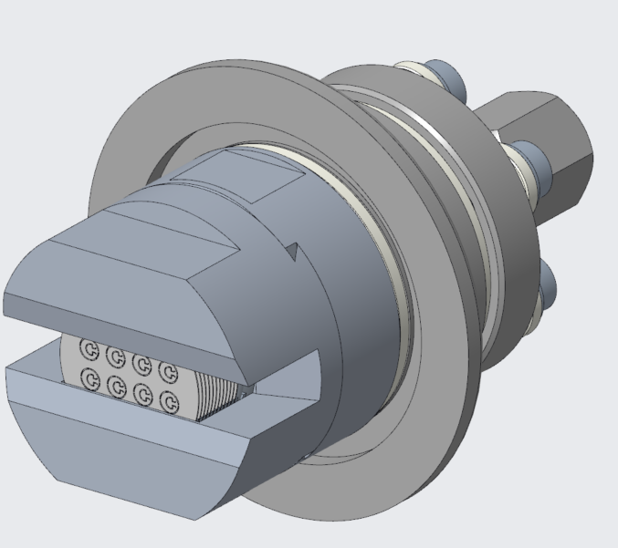
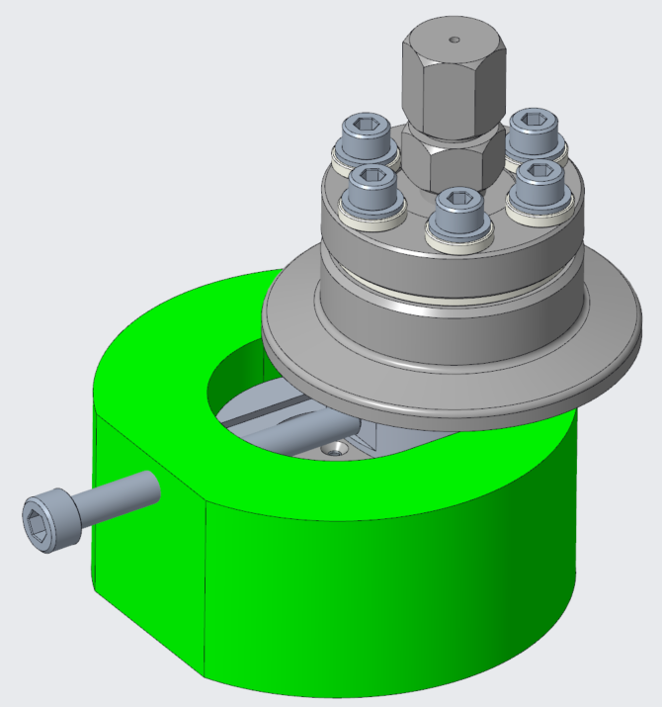
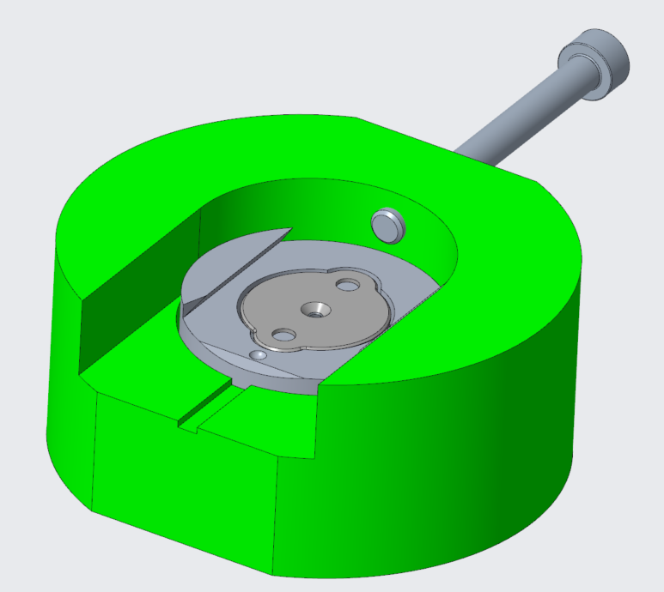
Ø30mm sample holder
NW40 flange
Ø20mm foil samples
Samples are removed (graphite and titanium foils) from holder using vacuum tweezers
This is the assembly shipped to MRF in transport cask
Sample backing flange is removed from sample holder in hot cell with removal tooling (green)

Slide 12
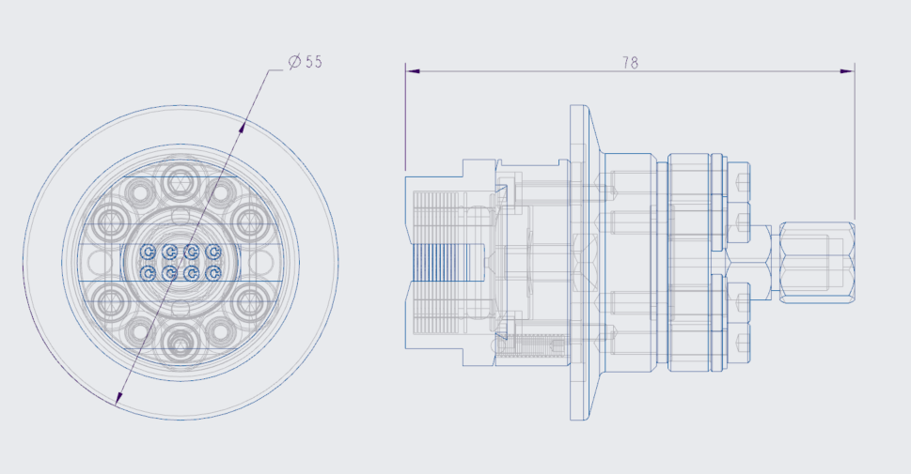
Sample Transport
Can UKAEA provide a suitable transport container to ship from MC40 to Culham?
Ø55x78 is likely as small as we can make the shipping assembly without risking unnecessary exposure to personnel at Birmingham
Are we close to a threshold in terms of container size or shipping regulations/costs?

Slide 13
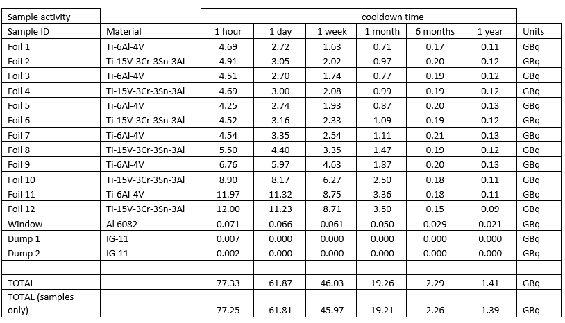
Sample cooldown times

Slide 14
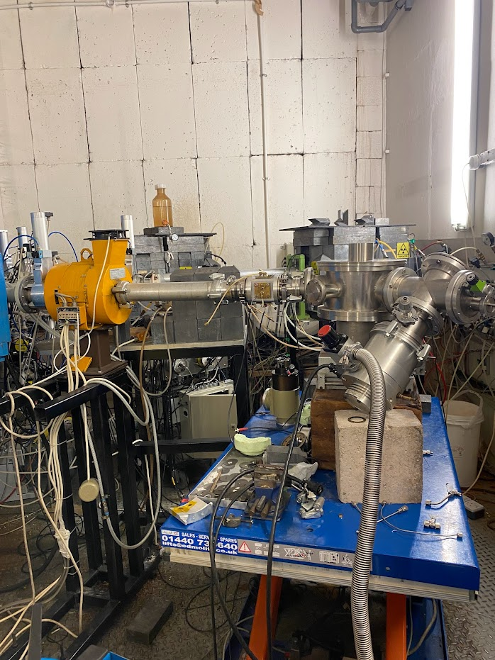
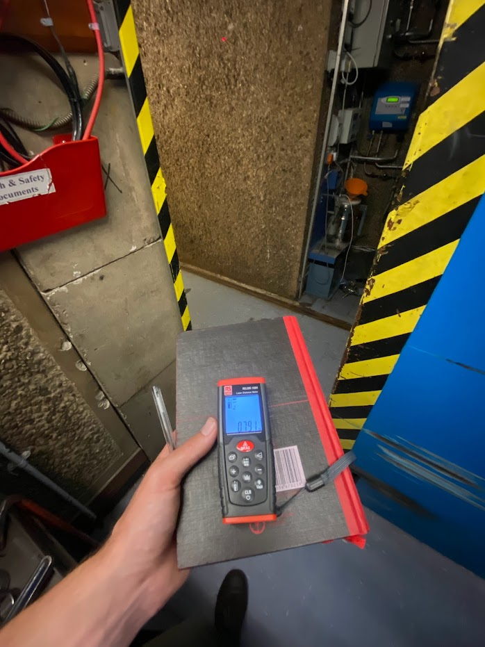
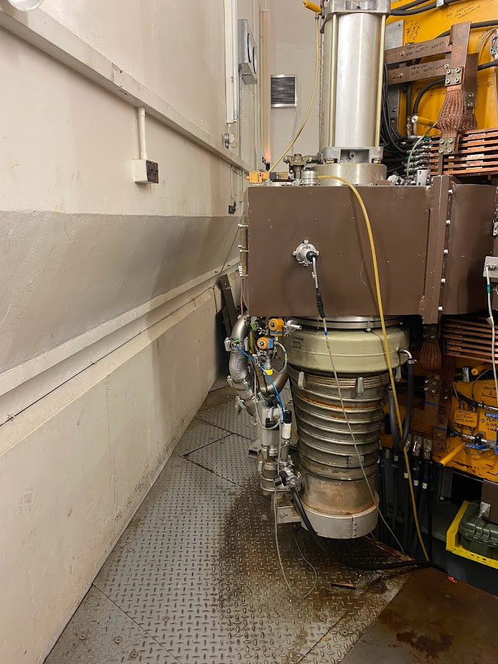
MC40 Installation

Slide 15
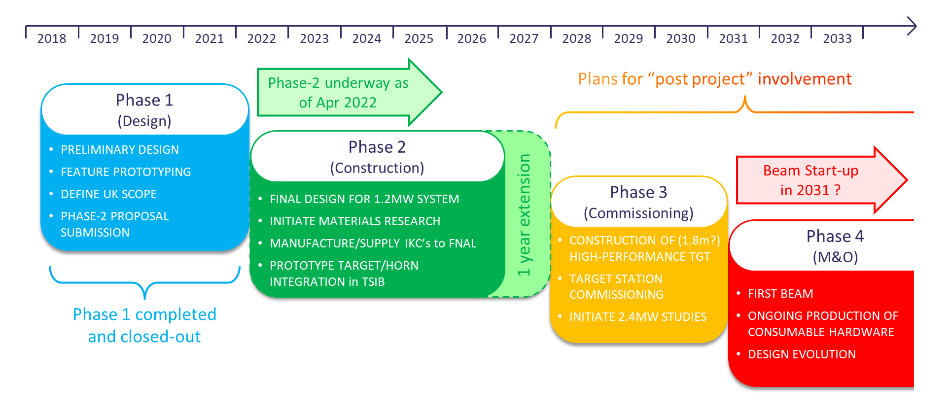
UK Project Timeline and Phases

Slide 16
Status of STFC Approval - & Actions Required
Approved: 1-year Phase-2 project extension to March 2028 needed to complete the present scope within existing approved equipment budget
Challenges
Sample preparation (Jicheng, Ishida-san + RAL?)
MC40 availability
Next: A 3-year Phase-3 commissioning and upgrade project 2028-2031
Bridging funding required from the end of the phase-2 project to beam start-up.
Supported in principle by STFC Programmes
Submission of detailed costs invited for next Oversight Committee – now expected for late 2024.

Slide 17
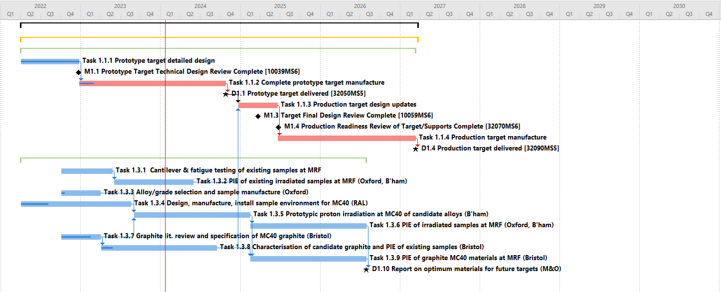
Material Science Task Status – NEEDS UPDATING
Literature reviews and testing of existing graphite and titanium samples feed into production target deliverable
MC40 sample environment design already started (RAL)
TITANIUM
GRAPHITE
TITANIUM
GRAPHITE

