Slide 1
CHEP 2024
Katy ellis, SCD all-hands, 12/11/24

Slide 2
Introduction
CHEP is the conference for Computing in High Energy and Nuclear Physics
Also now includes contributions from other Big Science computing areas, e.g. Astronomy
Takes place every ~18 months
This is the 27th event
Approx. 500 participants
Encompasses areas of computing from trigger systems to site infrastructure
A broad program of plenary talks, parallel talks (9 tracks) and posters

Slide 3
CHEP24 in Krakow

Slide 4
My involvement…

Slide 5
Program Committee chair – main roles
Responsible for the scientific program (with 3 colleagues)
Planning and running the plenary sessions
Managing the track convenors (4*9tracks = 36 TCs)
Writing a lot of emails
Wrangling Indico
Negotiating with the LOC (Local Organising Committee)
Keeping the IAC happy (International Advisory Committee)

Slide 6
Orgnisational timeline
Final coordination with Track Convenors
January
April
May
March
June
July
Aug
Sept
Oct
2025...
Feb
Start of monthly meetings with IAC and LOC
Sent invites to Track Convenor candidates
Took on role of ‘Program Committee chair’
Abstract acceptances (TCs)
Conference timetable with Track Convenors
Gathering ideas for plenary talks
Conference!
Abstract submission closes
Final promotions to plenary
A lot of emails with presenters, e.g. drop-outs
Setting up interactive elements
Proceedings…
Defining parallel track descriptions
Reviewing Track Convenor candidates

Slide 7
Tuesday before CHEP!

Slide 9
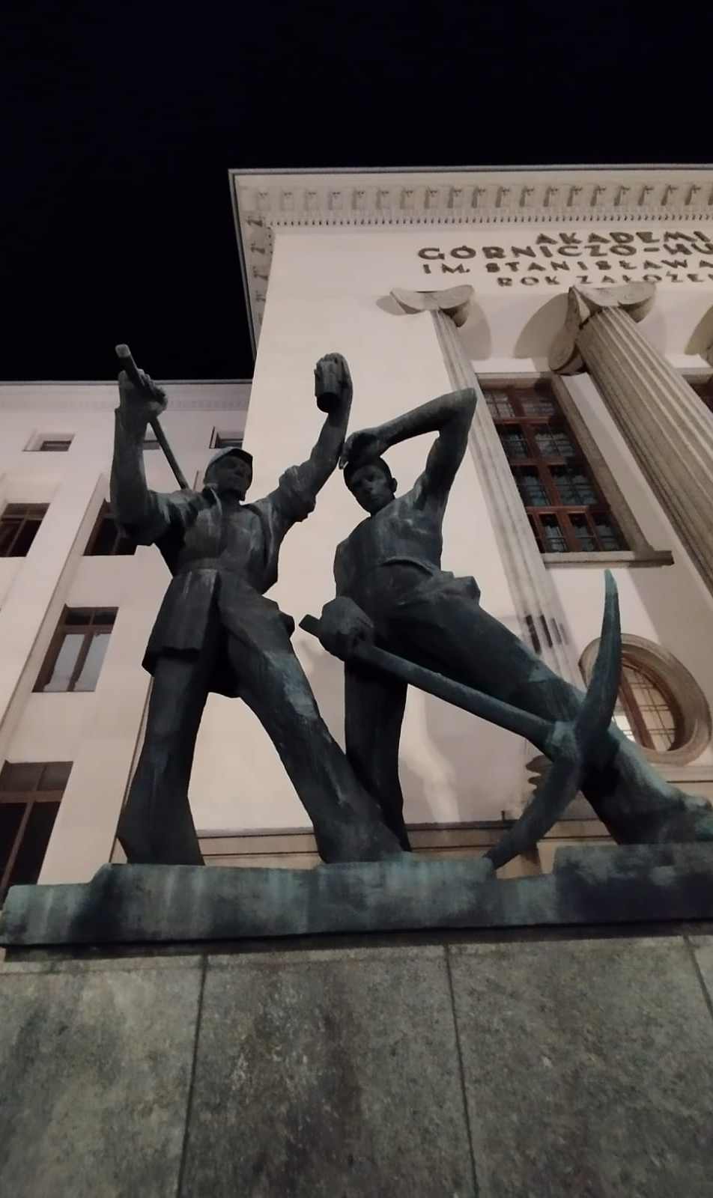
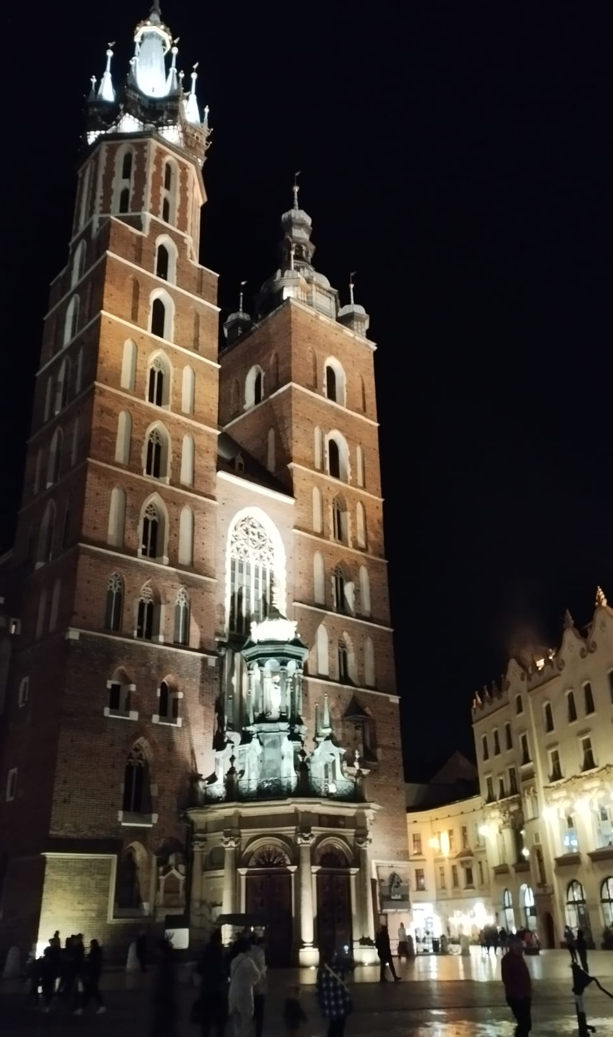
Krakow!

Slide 10
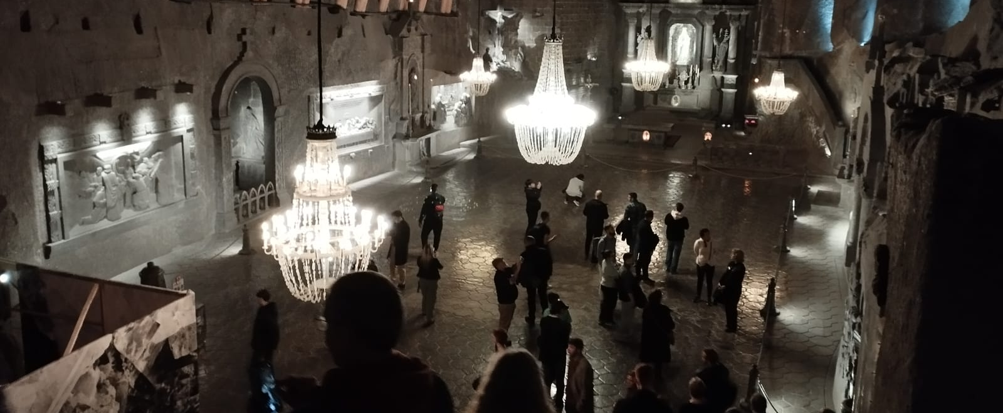
Salt mines

Slide 11
CHEP24 in Krakow

Slide 12
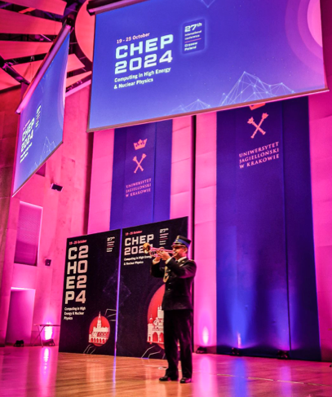
How to make an entrance

Slide 13
CHEP 24 stats
1 pre-conference workshop (training from HSF)
21 plenary talks (25+5 mins)
1 panel discussion
322 parallel talks (15+3 mins)
143 posters
9 track summaries

Slide 14
CHEP 24 more stats
5000 cups of coffee
2500 cups of tea
1500 litres of water
176kg of potatoes
470kg of meat
140kg of desserts
200 bottles of wine at welcome
250 litres of beer/150 bottles of wine at conference dinner

Slide 15
Plenary talks

Slide 16
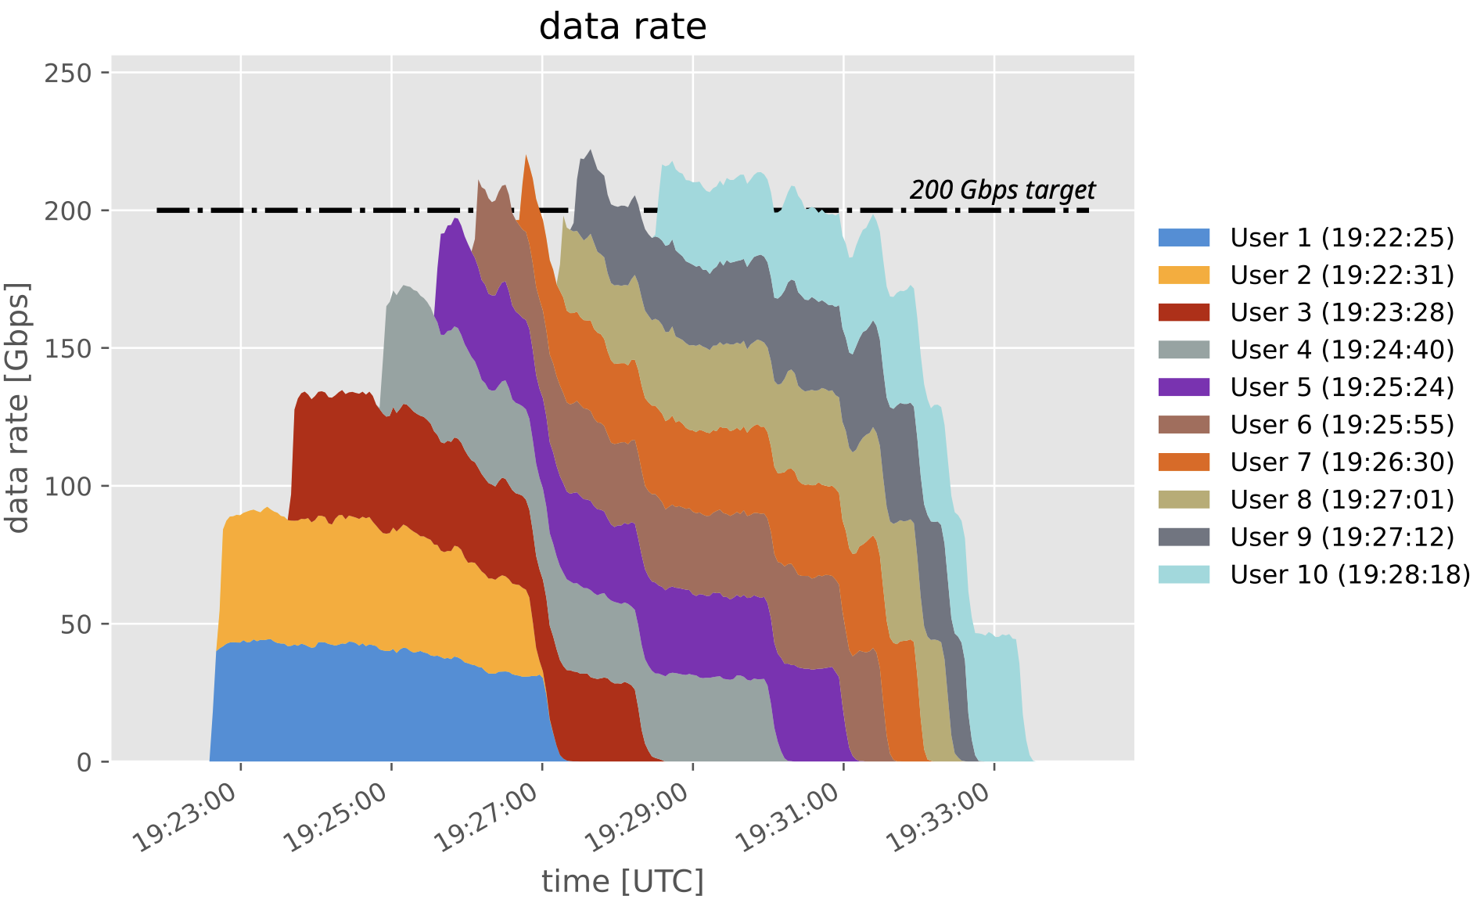
The 200Gbps Analysis Challenge: Imagining HL-LHC Analysis Facilities

Slide 17
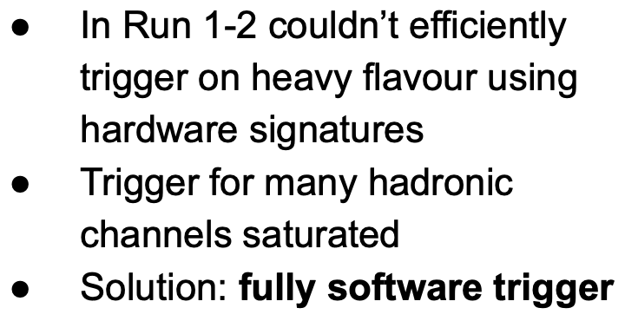
Triggering TB/s of data: The CMS and LHCb perspectives

Slide 18
Julia in HEP

Slide 19
CMS Flash-Sim: End to end sim with ML

Slide 20
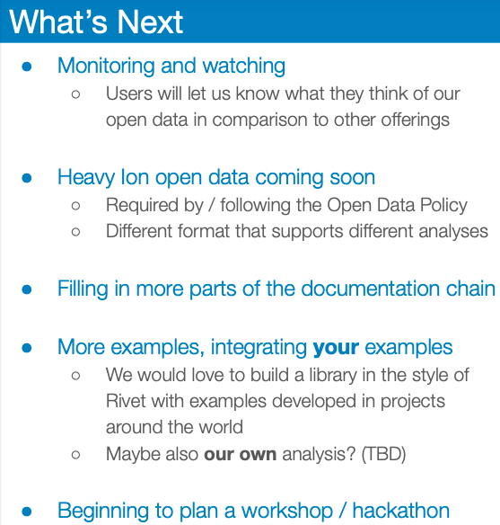
The first release of ATLAS OpenData for research

Slide 21
“New technologies” double session

Slide 22
Panel discussion
Are new technologies such as LLMs, AI and quantum computing going to be disruptive?
6 panel members, chaired by Liz Sexton-Kennedy
A robust discussion!
The audience were encouraged to ask questions via a webpage, or vote up/down previous questions
In general, the panel were in agreement: change would be evolutionary rather than revolutionary

Slide 23
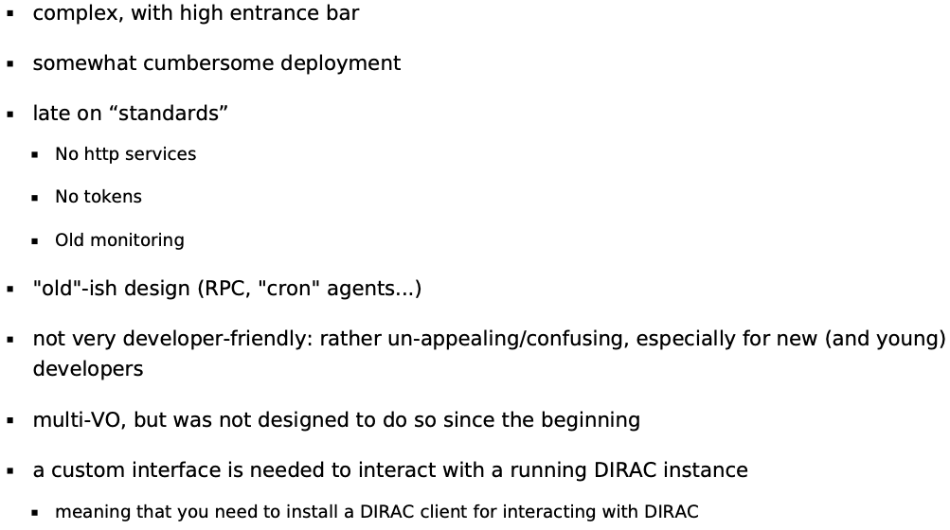
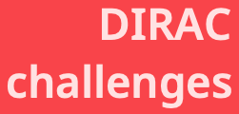
The neXt Dirac Incarnation
Flexible ”interware” for VOs to run on the Grid
Used by many, many experiments, including LHCb, Belle II, T2K…
Rewrite of Dirac software as Dirac X

Slide 24
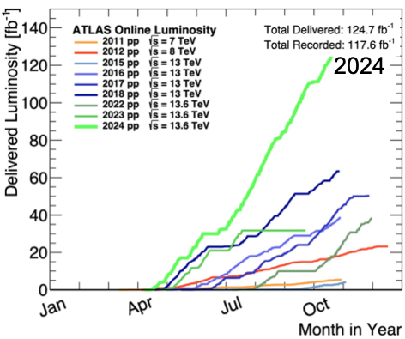
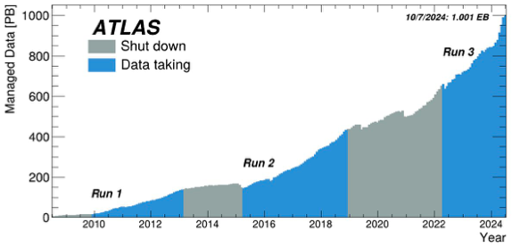
Total Cost of Ownership and Evaluation of Google Cloud Resources for the ATLAS Experiment at the LHC
ATLAS makes heavy use of opportunistic resources – can they use commercial cloud?
Technically, yes.
To be at all affordable, must have a subscription.
Can LHCONE be connected, to reduce egress costs?

Slide 25
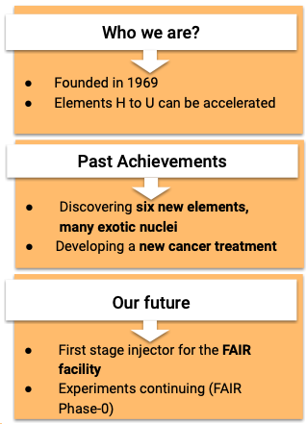
Developing a FAIR-Compliant Metadata Schema for Experimental Nuclear Physics
GSI Helmholtz Centre for Heavy Ion Research in Germany
Fair is fair:
Facility for Antiproton and Ion Research (FAIR)
Findability, Accessibility, Interoperability, Reusability (FAIR)

Slide 26
The ROOT Project at the end of Run 3 and towards HL-LHC
User support and involvement much stronger than in the past
”The quality of the ROOT experience for Python users is a priority”
ROOT 7 will be released during LS3…in time for Run 4 MC production
An evolutionary approach

Slide 27
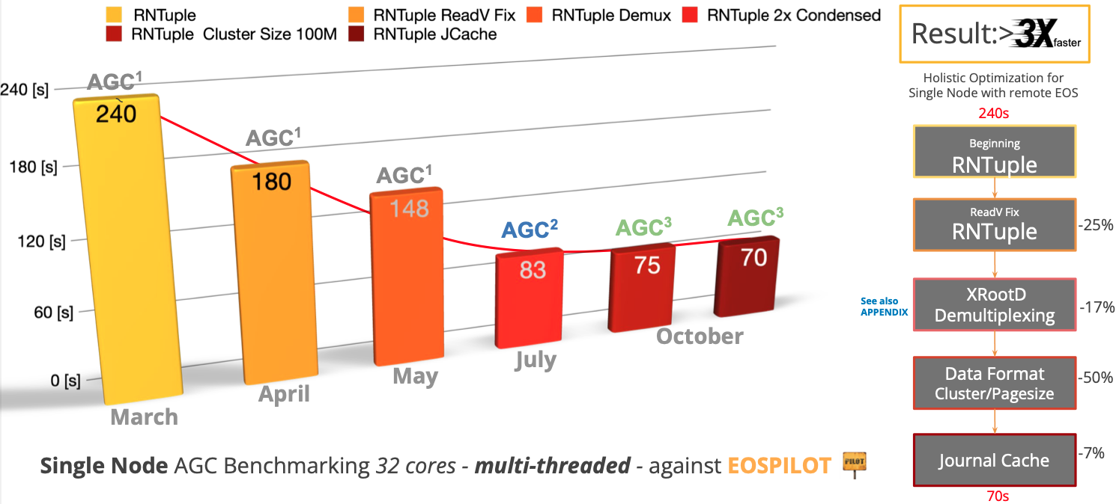
ROOT RNTuple and EOS
Root is the software used by physicists to analyse and view data
RNTuple is a new data format to optimize I/O for end-users
The EOS part described the validation of RNTuple in the CERN environment
Example test case: CMS Analysis Grand Challenge

Slide 28
WLCG Data Challenge 2024

Slide 29
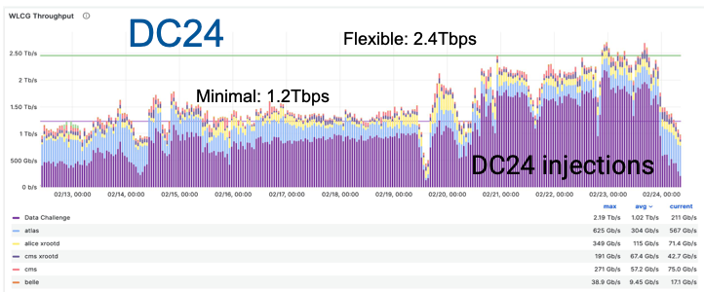
WLCG Data Challenge 2024

Slide 30
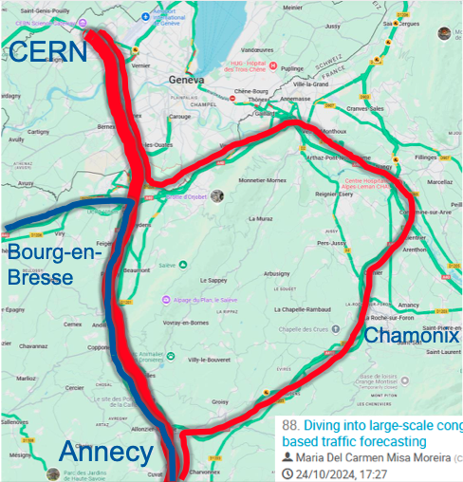
Global Networking Challenges for the Coming Decade
Some history...and predictions from the past!
Why are individual transfer rates so slow?
Summary of recent changes/R&D
Jumbo frames, SciTags, NOTED
Further complications with new big data experiments coming online

Slide 31
Data Challenges in JUNO distributed computing infrastructure towards JUNO data-taking

Slide 32
The State of Event Generators for the HL-LHC
Explanation of why we need improvements for Run 4
Progress with GPUs
Machine Learning solutions

Slide 33
Serving Photon Science and HEP at the same facility
Evaluation of HEP and non-HEP computing at DESY
dCache development
News from Germany on HPC usage

Slide 34
Simulating the Carbon Cost of Grid Sites
Balancing the complex optimization between capacity, financial cost and CO2 cost
Choosing hardware…
…and running it efficiently

Slide 35
Hardware technology trends in HEP computing

Slide 36
Parallel program

Slide 37
Parallel program
9 tracks (some partial)
Data and Metadata organization, Management and Access
Online and real-time computing
Offline computing
Distributed computing
Simulation and analysis tools
Collaborative software and maintainability
Computing infrastructure
Collaboration, reinterpretation, outreach and education
Analysis facilities and interactive computing

Slide 38
Parallel program
9 tracks (some partial)
Data and Metadata organization, Management and Access
Online and real-time computing
Offline computing
Distributed computing
Simulation and analysis tools
Collaborative software and maintainability
Computing infrastructure
Collaboration, reinterpretation, outreach and education
Analysis facilities and interactive computing
These are most relevant to me

Slide 39
Parallel program
9 tracks (some partial)
Data and Metadata organization, Management and Access
Online and real-time computing
Offline computing
Distributed computing
Simulation and analysis tools
Collaborative software and maintainability
Computing infrastructure
Collaboration, reinterpretation, outreach and education
Analysis facilities and interactive computing
Brij plans another seminar soon on this track

Slide 40
Links to track summaries
9 tracks (some partial)
Data and Metadata organization, Management and Access
Online and real-time computing
Offline computing
Distributed computing
Simulation and analysis tools
Collaborative software and maintainability
Computing infrastructure
Collaboration, reinterpretation, outreach and education
Analysis facilities and interactive computing

Slide 41
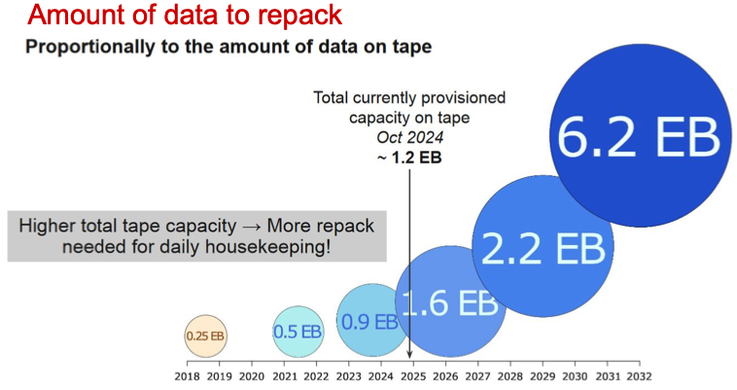
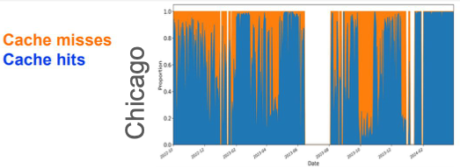
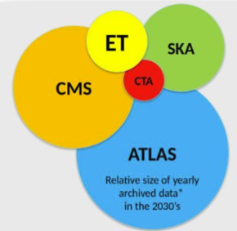
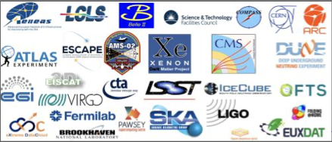
Data Management summary
Track 1
Data movement challenges
Improved tape archive/retrieval
Storage software, caches
Data formats and metadata
Monitoring, databases, Rucio etc.
Storage management frameworks; data access protocols; object, metadata and event store systems; content delivery and caching; data analytics; FAIR data principles; non-event data; data classification (including ML); online and offline databases; exabyte-scale datasets.
Experiments using Rucio

Slide 42
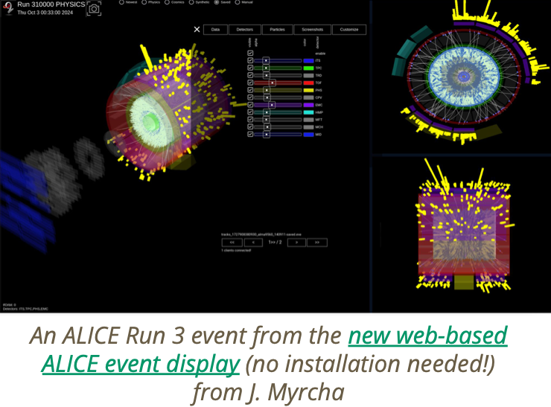
Online summary
Track 2
Making hardware triggers smarter…or removing them
Maximising physics output
E.g. CMS scouting
Orchestrating DAQ using e.g. k8s
AI for reconstruction and monitoring
Improvements via GPU
Energy efficiency
Data acquisition; triggers; streaming and trigger-less data acquisition; online calibration/reconstruction; real-time analysis; event building; configuration and access controls; detector control systems; real-time analytics and monitoring; trigger techniques and algorithms; hardware trigger algorithms; ML for triggers or outlier detection; accelerators and hybrid computing for online computing.

Slide 43
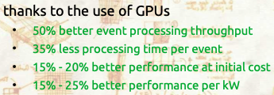
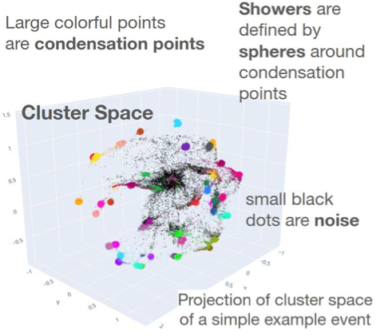
Offline summary
Track 3
Offline reconstruction; detector calibration; detector geometries; data quality systems; data preparation; physics performance; compute accelerators and hybrid computing for offline; ML for offline computing/calibration/outlier detection; quantum algorithms and general quantum computing technologies.

Slide 44
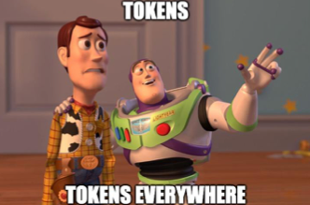
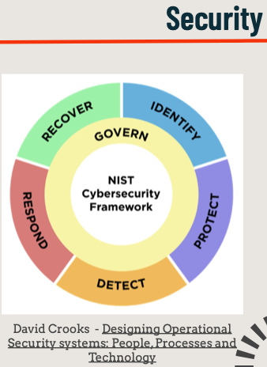
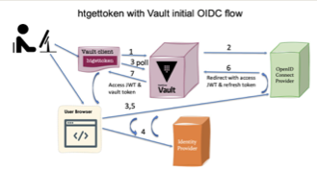
Distributed computing summary
Track 4
Tokens, tokens, tokens!
Operations, monitoring
New architectures – supercomputers, ARM, Clouds
Non-WLCG computing models
Grid middleware; monitoring and accounting frameworks; security models and tools; distributed workload management; federated authentication and authorisation infrastructures; middleware databases; software distribution and containers; heterogeneous resource brokerage.

Slide 45
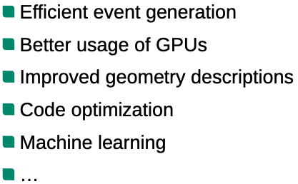
Simulation and tools summary
Track 5
Object identification; object calibration; analysis workflows; software for end-user analysis; ML in analysis workflows; lattice QCD; theory calculations; MC event generation; detector simulation; fast simulation (classic and ML); quantum simulation and algorithms.

Slide 46
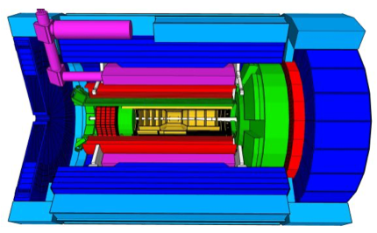
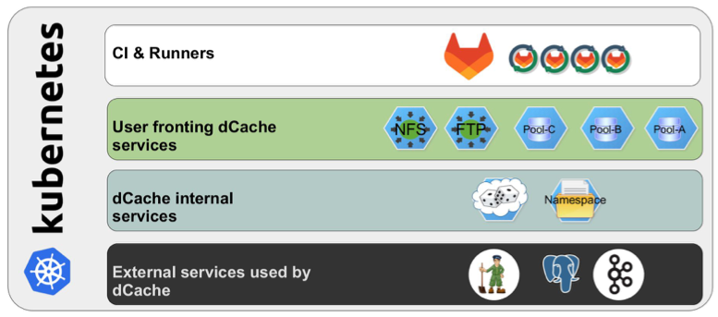
Collaborative software summary
Track 6
CERN ChatBot
Containerization in the ATLAS Offline Code Management System
dCache testing with k8s
Collaborative software; sustainable software; software management, continuous integration; software building; testing and quality assurance; software distribution; programming techniques and tools; integration of external toolkits; Manuals and documentation; ML for documentation, LLMs.

Slide 47
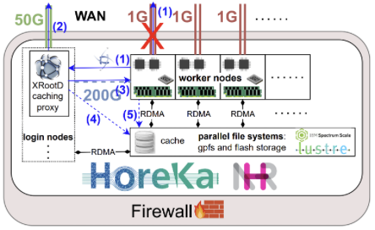
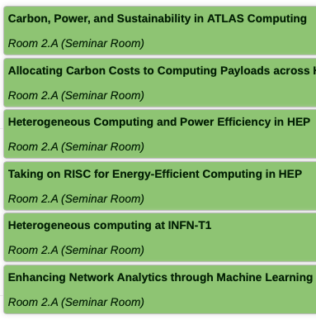
Infrastructure summary
Track 7
Opportunistic resources, orchestration of virtual machines and containers; cloud; HPC and exascale; networking; computing centre infrastructure; energy efficiency; cost of computing; management and monitoring; quantum networks.

Slide 48
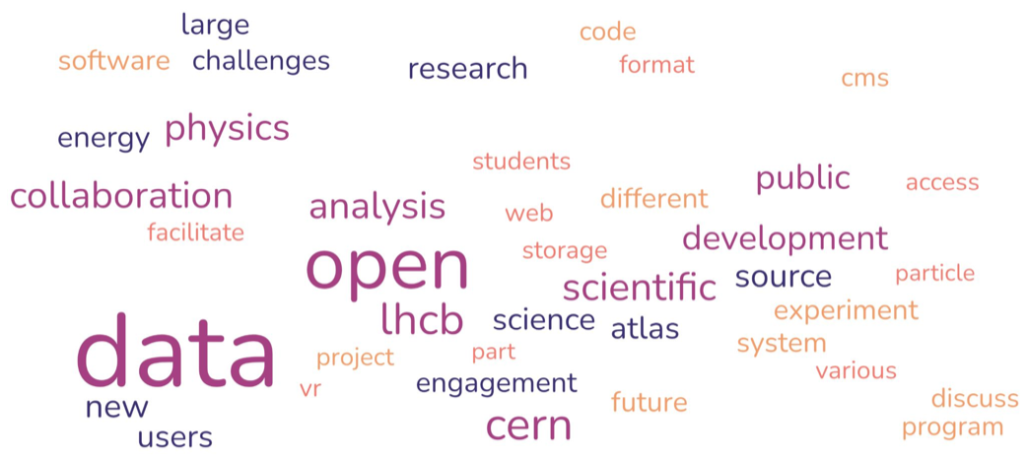
Outreach summary
Track 8
Collaborative tools; reinterpretation tools; analysis preservation and reuse; data preservation for collaboration; outreach activities; open data for education and training; training initiatives; event displays.

Slide 49
Analysis facilities summary
Track 9
Frameworks; infrastructure for interactive computing; applications and use-cases; experience with AF production systems and pilots; aspects of reproducibility in interactive computing.

Slide 50
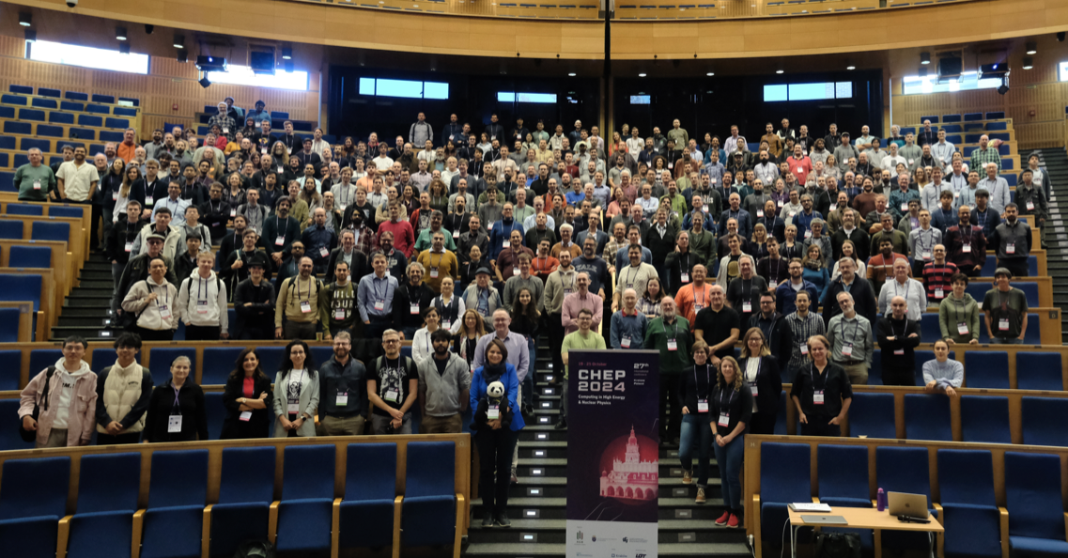

Slide 51
Next CHEP …May 2026 in Bangkok!

