Slide 1
Decommissioning legacy Tier-1 Network
Alastair Dewhurst
Notes:
The abstract pattern can be removed or repositioned if required. Be careful to ‘Send to Back’ so that it does not obscure any important information.

Slide 2
Motivation
For historical reasons there are a significant number of non-Tier-1 services in the Legacy Tier-1 network.
The Tier-1 has been migrating to a new Network since November 2022.
New Network provides LHCOPN and LHCONE access as well as IPv6.
Plan:
Tier-1 migrates remaining services needing LHCOPN/ONE access.
Tier-1 migrates remaining Tier-1 services.
?????
Decommission Legacy Tier-1 network.
Once 2. is completed motivation of Tier-1 staff to look after network diminishes.
People need to be aware of risk and take appropriate actions.

Slide 3
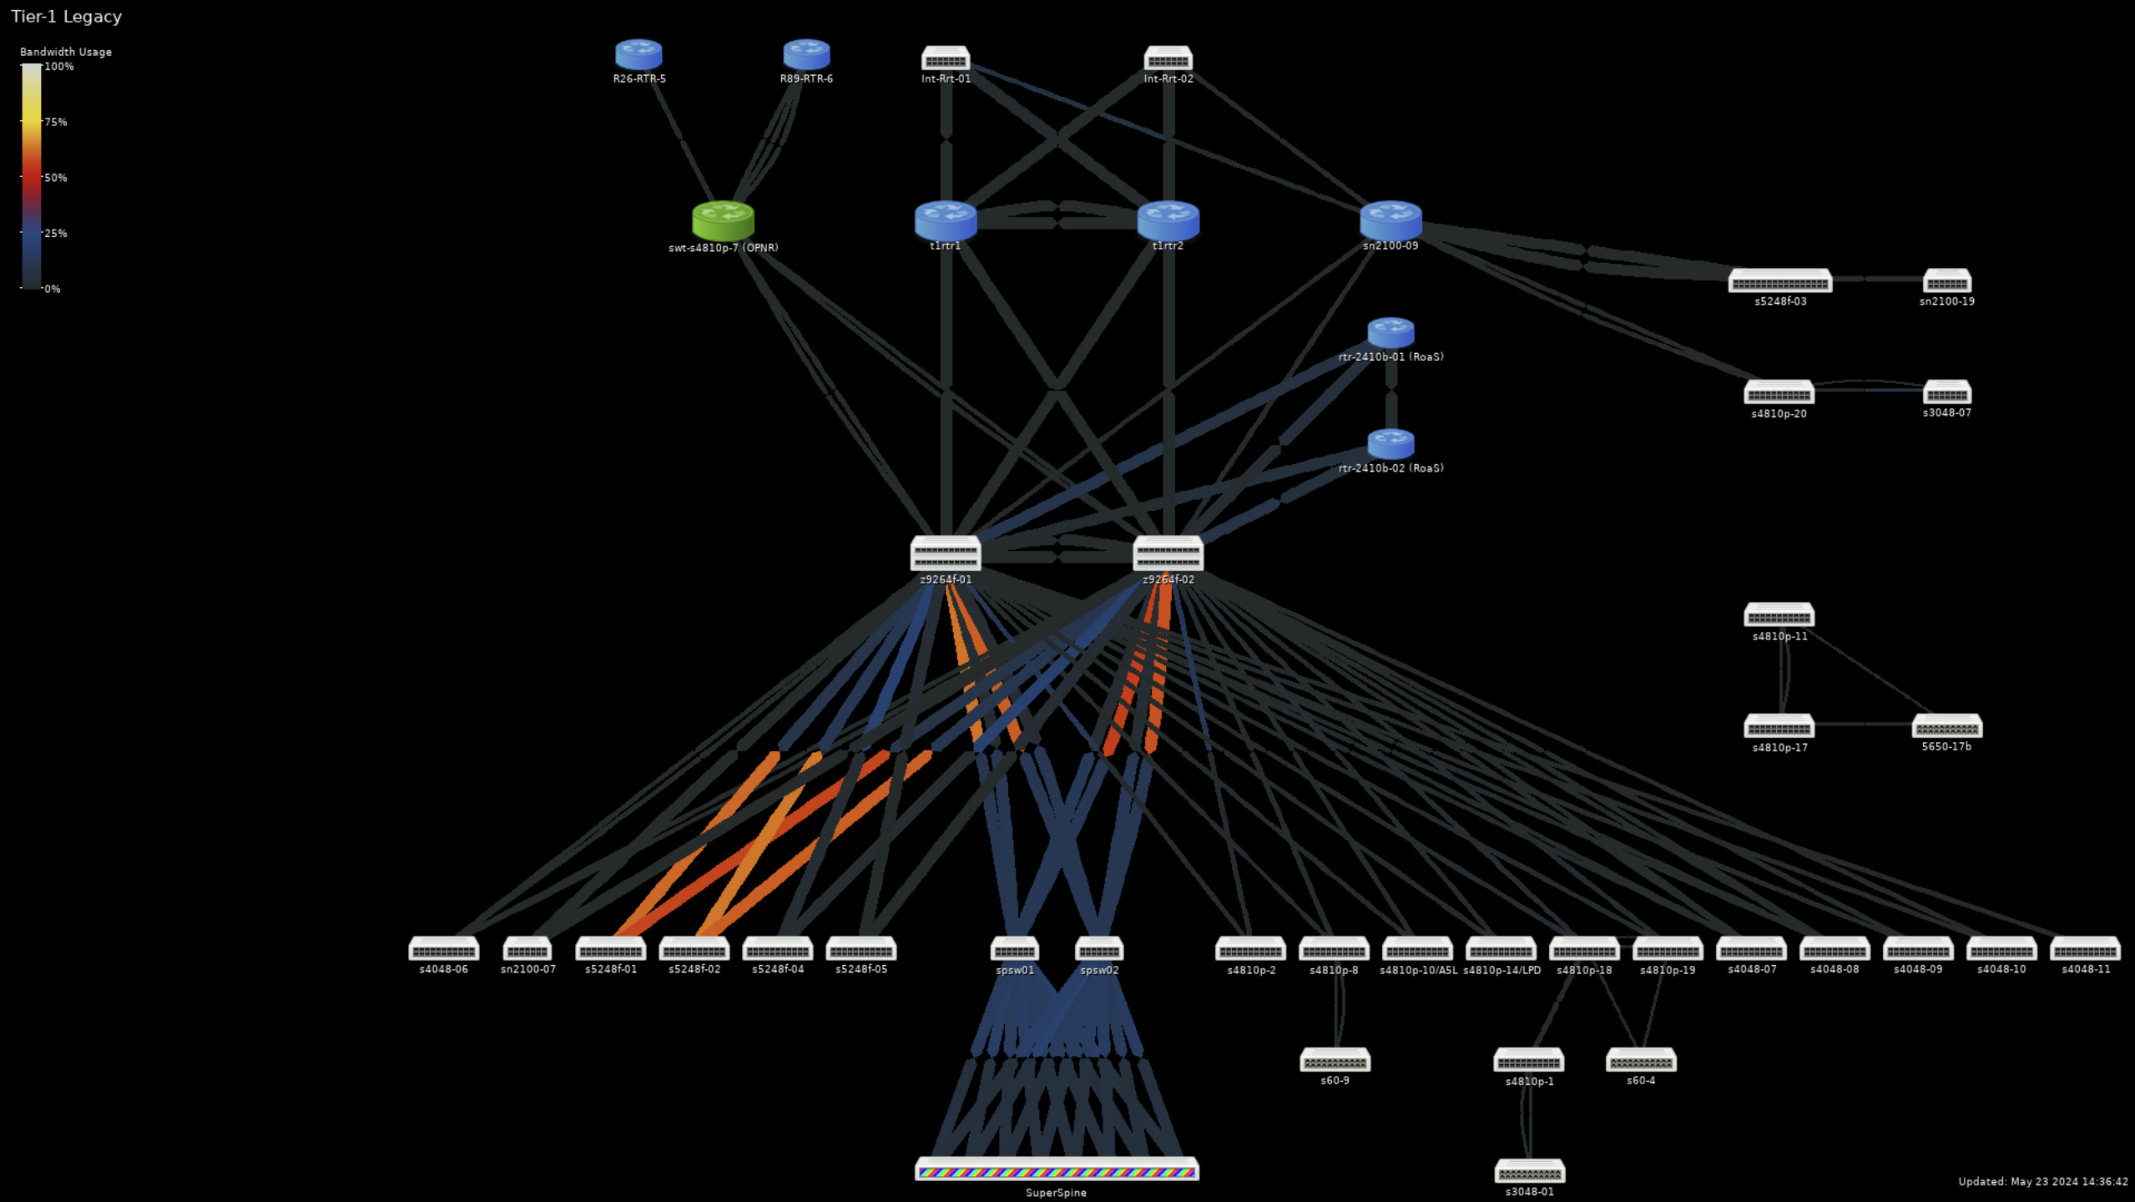
Tier-1 Legacy Network
Facilities part of the Tier-1 network
OPNR (warranty expired 2018)

Slide 4
Tier-1 services
Decommission Echo and Batch Farm nodes from 2018 (or earlier)
Migrate Echo and Batch Farm nodes from 2019.
Migrate VMWare cluster
Migrate CVMFS service

Slide 5
Some Racks
s60-9
S4810p-10
S4810p-18
S4810p-1
S3048-01
s60-4
S4810p-19

Slide 6
Other services
Elastic Search → Olaf OpenSearch (Cloud Network)
InfluxDB → Timon Victoria Metrics (Cloud Network)
Icinga → ? → Shared SCD Infrastructure Pod
Aquilon + Mirrors → ? → Shared SCD Infrastructure Pod
Loggers → Shared SCD Infrastructure Pod or SecOP Pod
Postgres Database → ?

Slide 7
Facilities
In the facilities part of the Legacy Tier-1 Network there is:
StorageD
ADS service
DMF
Tape Libraries
Numerous Databases, eg Galera, Bellona
Assume these service are all waiting on new Facilities Pod to be migrated to?

Slide 8
Dependencies
Waiting on the creation of:
Facilities Network Pod.
Shared SCD infrastructure Pod.

Slide 9
Notes:
The abstract pattern can be removed or repositioned if required. Be careful to ‘Send to Back’ so that it does not obscure any important information.

