Slide 1


RF Linear accelerators
L7: Gradient limits: Breakdown
Prof Graeme Burt
Lancaster University

Slide 2
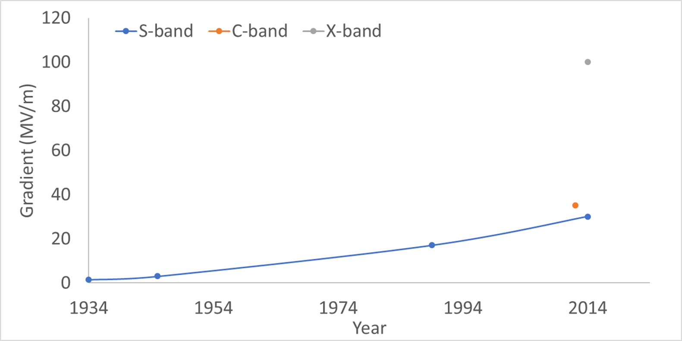
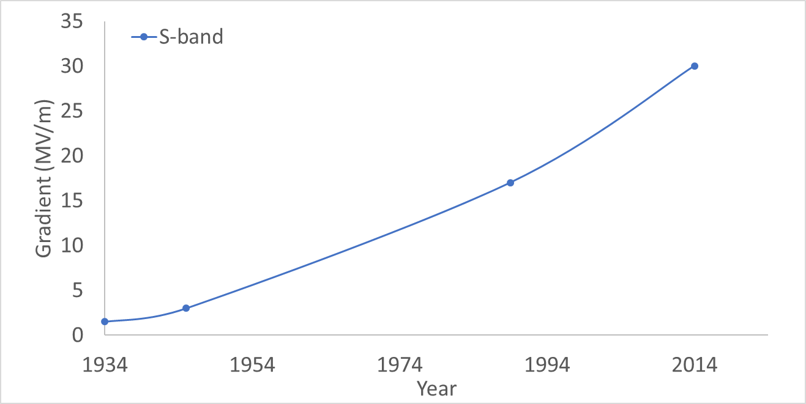
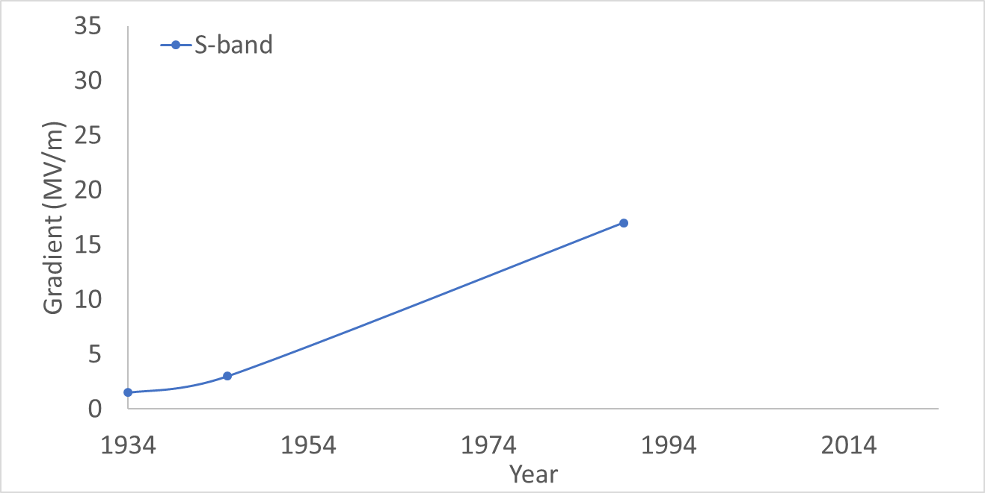
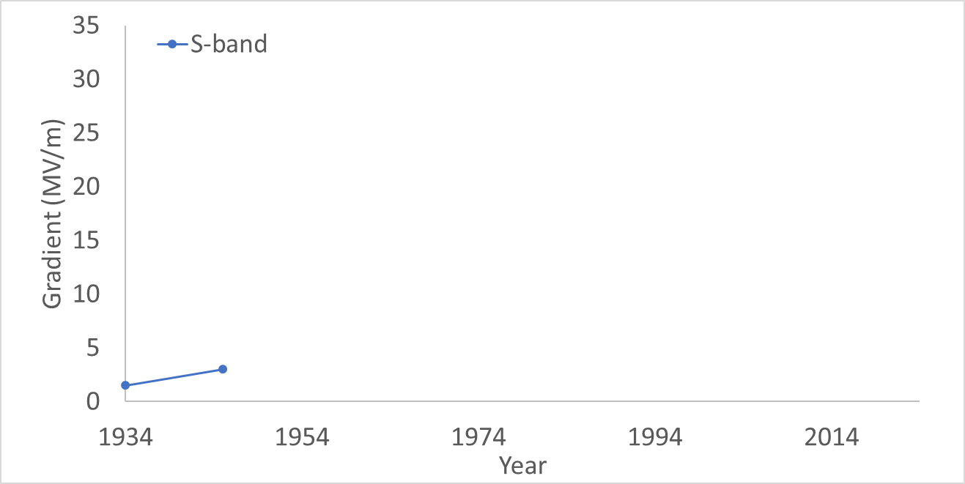
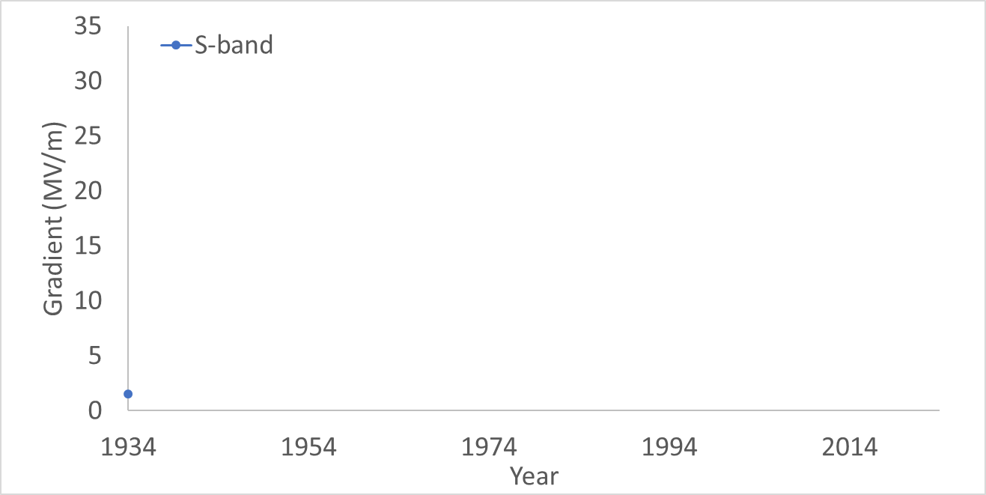
History of RF gradients
Modern 3 GHz accelerators similar to the SLC have settled to a limit of around 30 MV/m
Moving to higher frequencies have allowed higher gradients with C-band (6 GHz) around 35-40 MV/m and X-band (12 GHz) at 65-100 MV/m depending on duty cycle
The Stanford linear accelerator moved to higher frequencies and yet higher powers to achieve 17 MV/m helped by the faster velocity of electrons compared to ions
The first large scale linac was developed by Sloan and Lawrence using 30 drift tube linacs, giving 1.26 MV in 1.1 m, just over 1 MV/m
The development of RaDAR during the 2nd world war had produced high power RF sources, allowing the Alvarez linac to more than double the gradient of the Sloan linac reaching 32 MeV in 12 meters

Slide 3
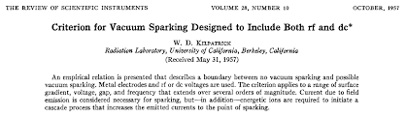
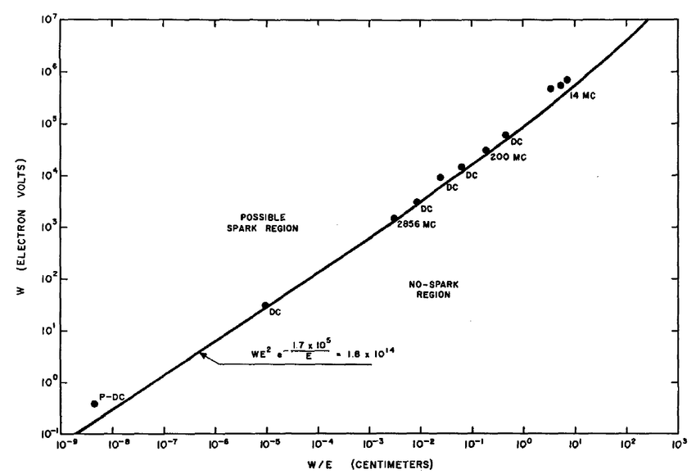

Kilpatrick Limits
The limit for the maximum operating gradient is often breakdown, where a plasma forms on the cavity surface
In the 1950’s W. Kilpatrick created an empirical formula for the peak surface electric field a linac could operate at based on experiments at SLAC
The field strength increases with frequency.
Kilpatrick limit is now regularly exceeded but it’s a useful yard-stick
The maximum field strength also varies with pulse length as t^{-0.25}

Slide 4
Field Enhancement
However the field needed to get an appreciable current and hence heating is in the range of GV/m way beyond what we observe
The surface of an accelerating structure will have a number of imperfections at the surface caused by grain boundaries, scratches, bumps etc.
As the surface is an equipotential the electric fields at these small imperfections can be greatly enhanced.
In some cases the field can be increase by a factor of several hundred.
E_{local}=β E₀
2b
h

Slide 5
Fowler-Nordheim
Using the Schrödinger equation it can be shown that the emitted current is
This is dependant on the emitter size, the work function and the field enhancement factor.

Slide 6
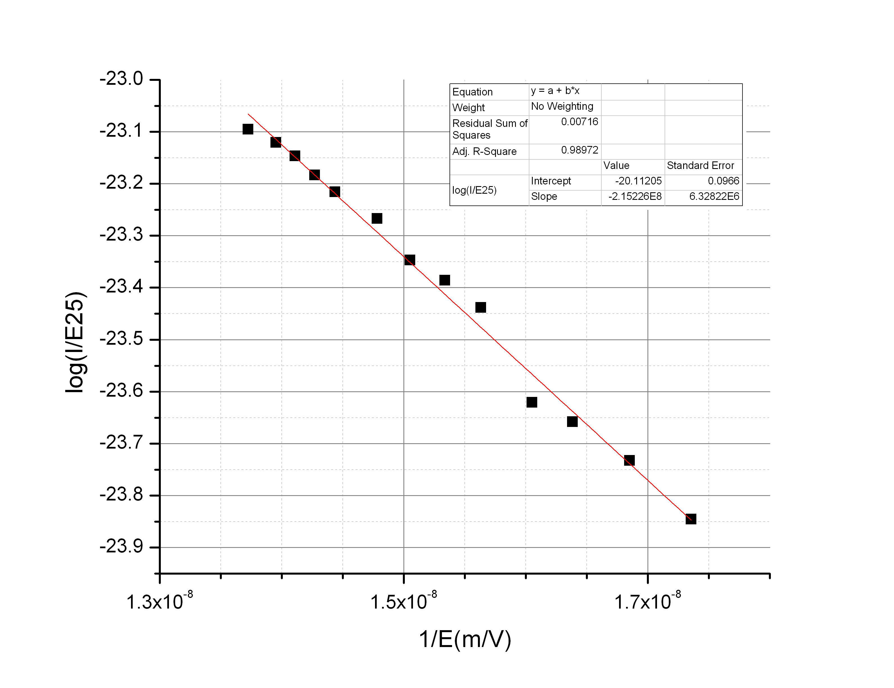
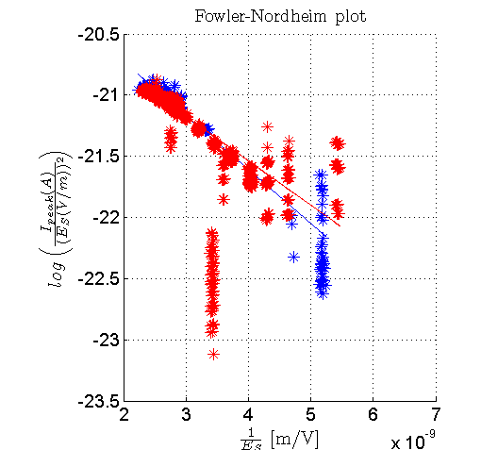
Finding the field enhancement factor
29 Feb 2012
11 March 2012
If we plot log(I/E_{s}²) vs 1/E_{s} the slope can be used to find the field enhancement factor if we know the work function.
Field enhancement factor β = 60-75
From TERA

Slide 7
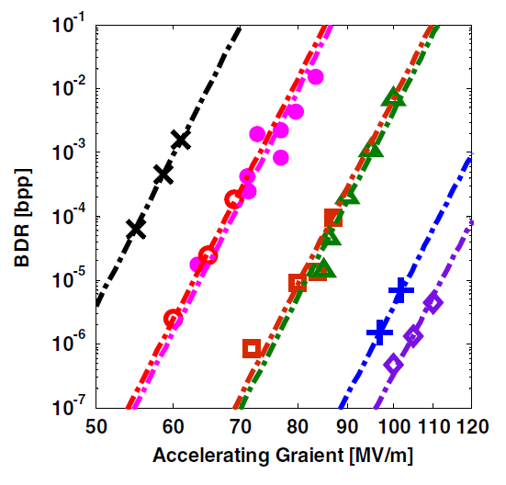
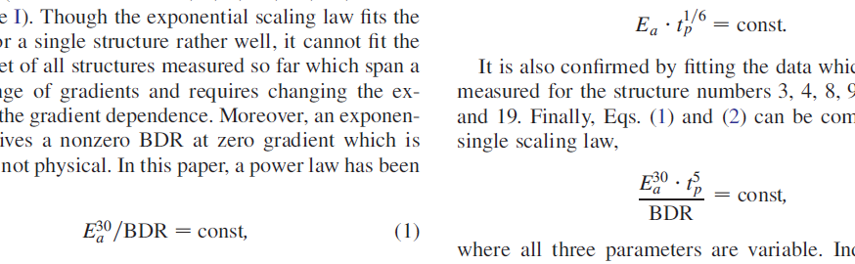
Breakdown Rate
The structure could statistically breakdown at any field but it becomes more likely at higher fields
It is often convenient to discuss the breakdown rate (BDR), given as the number of breakdowns/pulse per unit length..
From observation
The constant is dependant on geometry, material and history of the structure

Slide 8
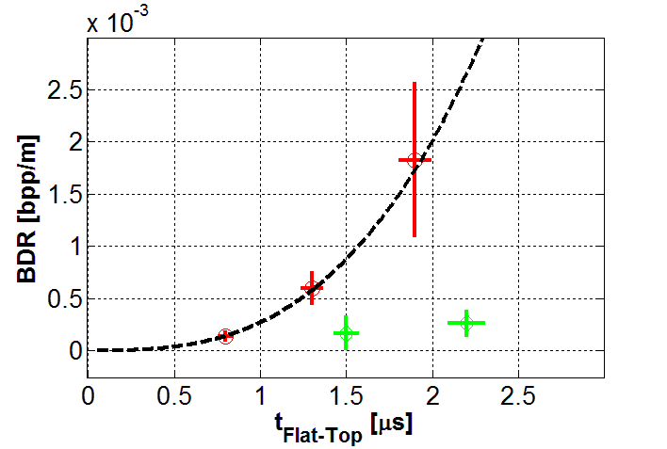
BDR Vs pulse length
It takes breakdown time to start so it is also dependant on pulse length.
nominal
pulse
length
double
pulse
length
half
pulse
length
E₀=58 MV/m
If pulse length goes down by 20 the field almost doubles.

Slide 9
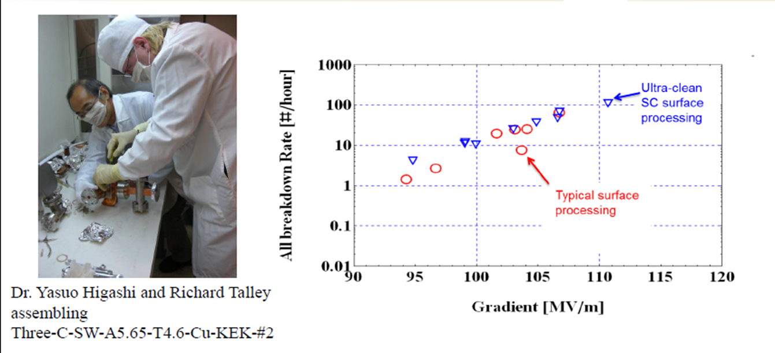
What causes the whiskers?
Generally thought breakdown is initiated by field emission on whiskers enhancing the field but where do they come from?
Machining defects? Not observed beforehand
Dust and dirt? Cleanroom construction reduces conditioning time but not ultimate gradient
Lattice defects under electric stress?
Micro-cracking due to heating?
Damage from breakdown, multipactor etc?

Slide 10
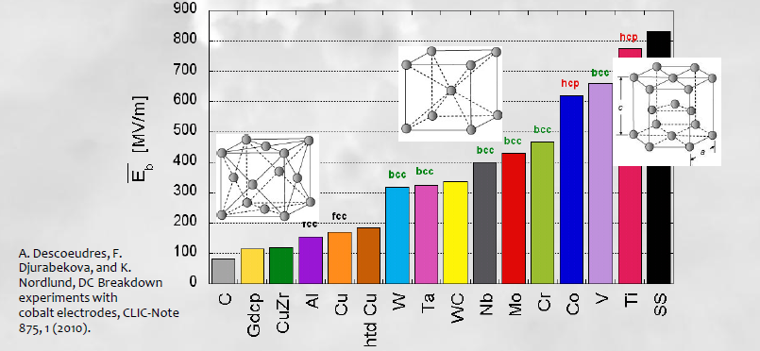
Breakdown field vs Material
DC Breakdown strength is correlated with crystal structure. This would suggest the dominant cause is dislocations.
The stress can come from pulsed heating or the electric field itself.

Slide 11
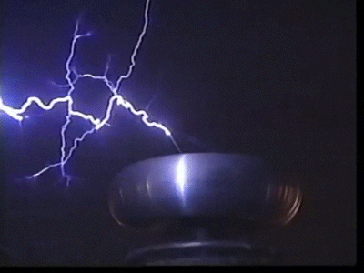
Vacuum Breakdown
Breakdown occurs when a plasma discharge is generated in the cavity.
The stress of the electric field on a defect creates an emitter tip
This causes extensive heating and evaporation via field emission
The vapor is then ionised by field emission.
This melts a crater into the cavity surface
This is the major limitation to gradient in most pulsed RF cavities and can permanently damage the structure.

Slide 12
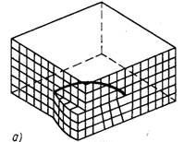
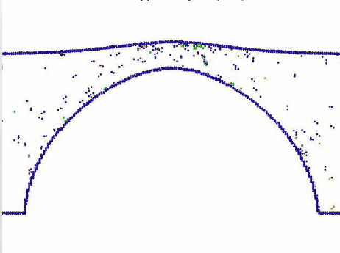
Stress model
The stress model suggests the Lorentz force on the cavity surface creates defects from voids in the bulk near the surface.
The BDR is proportional to
Where ΔV is the defect volume and T is temperature

Slide 13
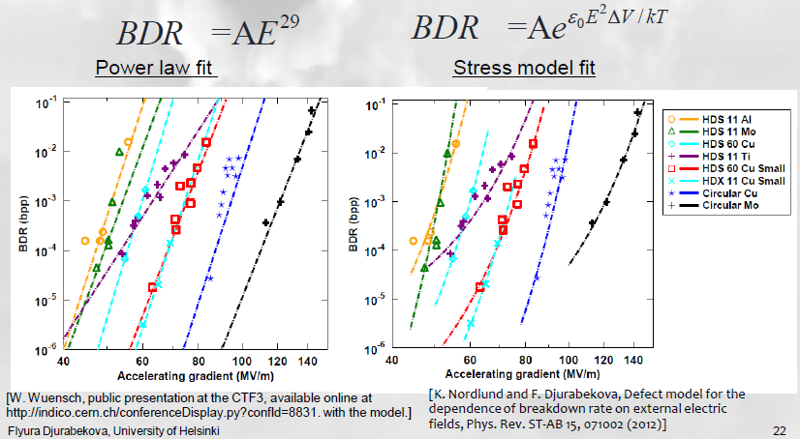
Curve fitting

Slide 14
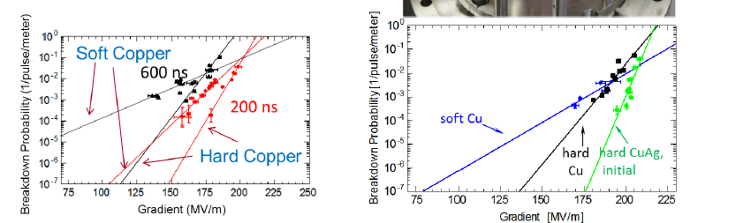
Copper Alloys
We were already aware that DC breakdown was related to crystal structure
Studies have been performed on different alloys of copper, hard or soft to find if the BDR was affected
Hard alloys tended to withstand higher surface field

Slide 15
Cryogenic Copper
The stress model gives a temperature dependence of the BDR, hence SLAC did a pioneering experiment to measure the BDR of a copper linac at low temperature
It was found that there was a significant increase in allowed peak surface electric field at a given BDR at 45 K compared to room temperature
SLAC have now measured acceleration of a beam at 150 MV/m in prototype cryomodule

Slide 16
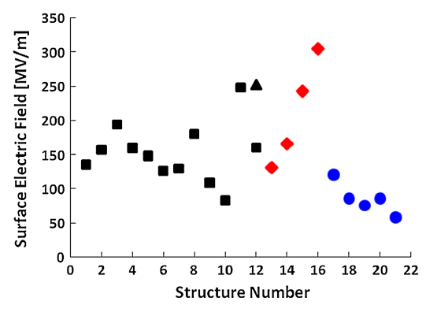
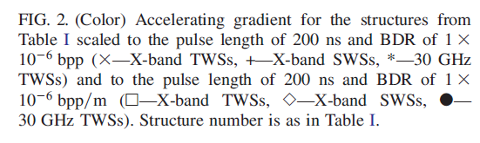
Peak surface Electric field
You would expect that for RF the breakdown electric field on the surface would be constant for all copper cavities.
The plot below from CERN would suggest otherwise hence electric field might not be the full story.
From W. Weunch

Slide 17
Pulsed Heating
The power deposited is
And the temperature on the surface is
ρ is density, κ is thermal conductivity and c_{e} is specific heat
Pulsed RF however has problems due to heat diffusion effects.
Over short timescales (<10ms) the heat doesn’t diffuse far enough into the material to reach the water cooling. This means that all the heat is deposited in a small volume with no cooling.
Cyclic heating can lead to surface damage if the temperature rise creates thermal stress (~40 K) .

Slide 18
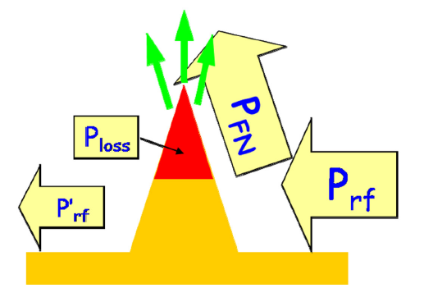

Power Flow model
Another recent theory suggests that the breakdown rate depends on the maximum poynting flux near the surface.
This is because the RF power is often larger than the field emitted power.
This is mainly based on fitting the data to lots of different cavities.

Slide 19
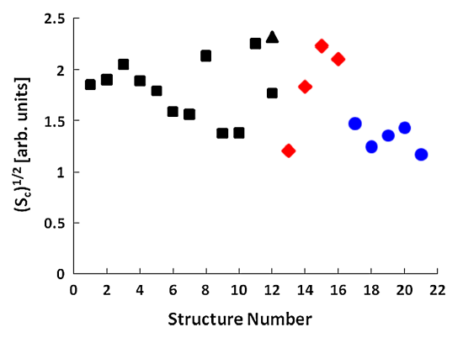

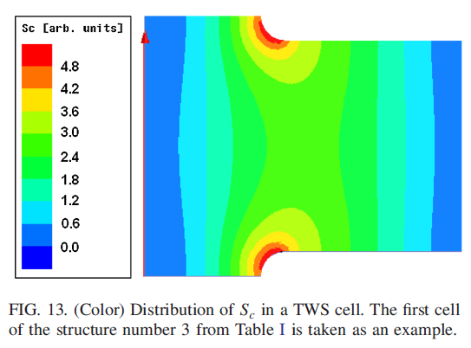
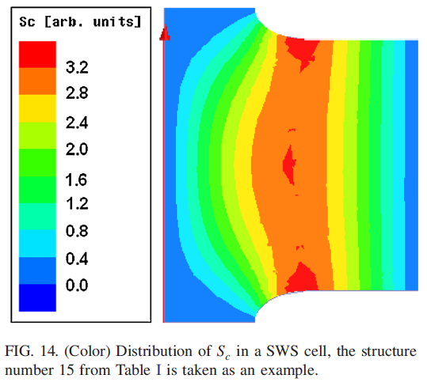
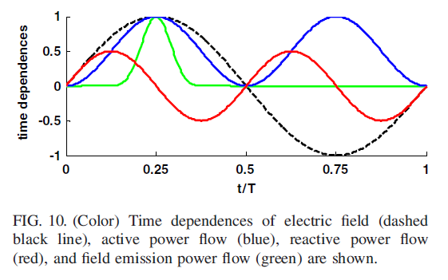
Power flow model
CERN have created a modified poynting vector to account for the fit to SW and TW cavities.
Relates to local power flow near the breakdown site.
It can be seen that all structure breakdown at roughly Sc= 2 Watt/cm²

Slide 20
Power flow model
CERN have created a modified poynting vector, S_{c}, to account for the fit to SW and TW cavities.
Relates to local power flow near the breakdown site.
It can be seen that all structure breakdown at roughly S_{c}= 2 MW/mm² when scaled to the same pulse length (shorter pulses of 200 ns achive ~ 4 MW/mm² )
Improved understanding of the field limits allows better structure geometries to minimize S_{c}

Slide 21
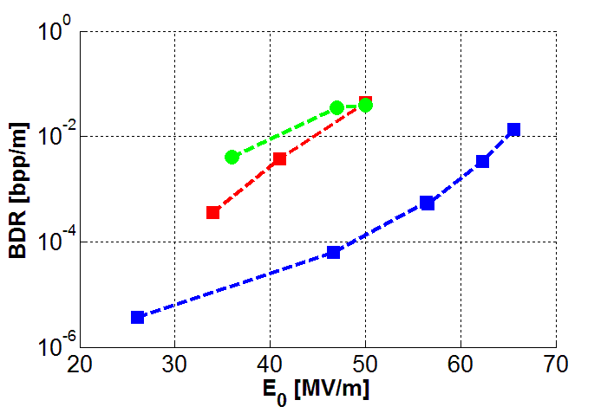
RF Conditioning
As a cavity is often manufactured with a number of nucleation sites for breakdown it is necessary to condition the cavity.
This consists of a number of semi-controlled RF breakdowns, caused by increasing the RF power or pulse length very slowly over a number of days/hours.
This causes vaporisation of the nucleation sites (sharp points) just above the breakdown threshold causing a minimum amount of damage.
Winter’10
Fall’11
Winter’12
In theory this should allow the structure to be conditioned to any gradient but in practice every structure has a maximum field at which processing fails to be effective.
This is likely to be due to the production of secondary nucleation sites after melting the primary sites.
S. Verdú-Andrés et al, High-power test results of a 3 GHz single-cell cavity,
arXiv:1206.1930v2

Slide 22

Dark Current Trapping
When we looked at beam dynamics we saw that we could inject a low energy bunch in a beta=v/c=1 structure and it could be accelerated to the speed of light and arrive on crest.
If we have field emitted electrons in the structure these could also be capture and can travel with the main beam.
The gradient at which this occurs is given by

Slide 23
Maximum Gradient Limits
All the limiting factors scale differently with frequency.
They also mostly vary with pulse length which is frequency dependant.
The limiting factor tends to be different from cavity to cavity.

Slide 24
Higher frequencies

Slide 25
Higher frequency accelerators
CERN used a two-beam accelerator to demonstrate gradients of 152 MV/m for an 8 ns pulse at 30 GHz.
At higher frequencies 100–300 GHz high gradients have been demonstrated with wakefield-driven structures with a maximum gradient of 400 MV/m
Gyrotron-driven structures have achieved 150 MV/m, however 3MW laser-based sources are now available allowing gradients in excess of this.

Slide 26
RF Linear accelerators
L8: Gradient limits: Other limitations
Prof Graeme Burt
Lancaster University

Slide 27
Multipactor
Multipactor is a resonant electron instability where an electron striking the surface with a given energy generates statistically more than one secondary particle.
If the secondaries are returned to the surface at the same rf phase and energy as the primary then an exponential growth in electrons will occur. These electrons can absorb all additional RF power from the cavity keeping the cavity from increasing it’s voltage.

Slide 28
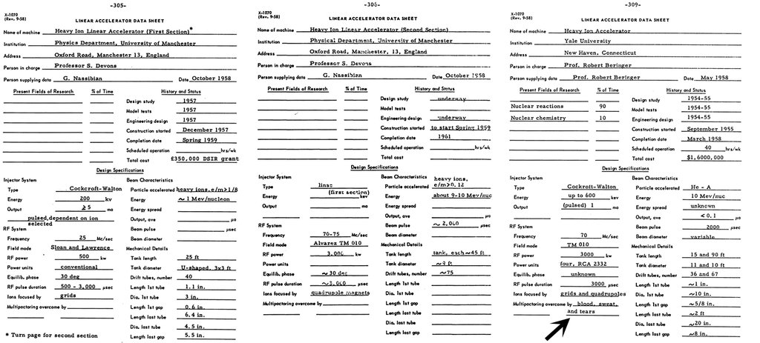

Slide 30
Parallel Plate Multipactor
One of the most common type of multipactor is two-point multipactor that occurs between two metallic plates.
The RF fields accelerate the particle across the gap. The RF fields reverese every half period so the electron motion is resonant if it take (n+1/2) periods to traverse the gap
a.c. electric field
across gap or in
waveguide
Notes:
A discharge is the passage of a conduction current (i.e. not a displacement current) through a medium that does not normally have any charge carriers.

Slide 31
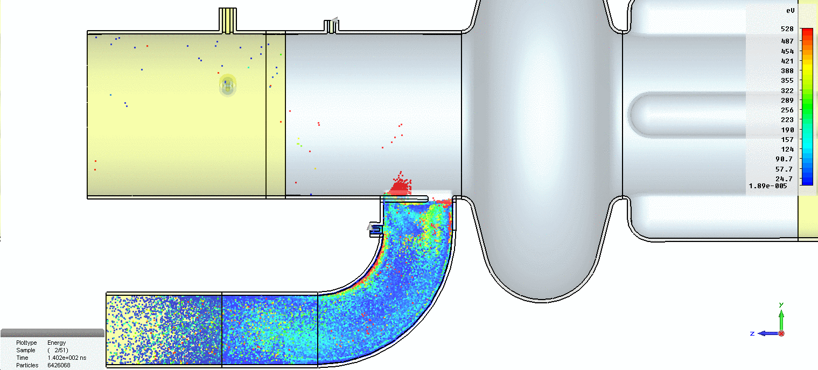
DLS coupler Multipactor

Slide 32
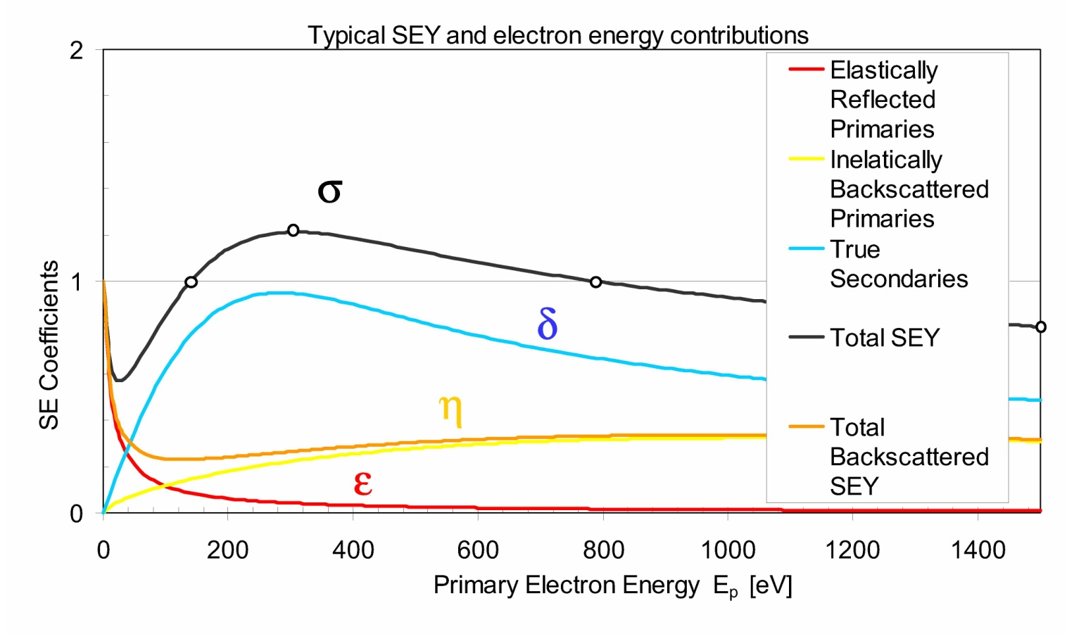
Secondary Electron Yield
Secondary Emission Yield
For multipactor to occur each electron striking the surface must generate more than one secondary on average.
The ratio of primary to secondary electrons is given by the secondary emission yield (SEY).
SEY is strongly dependant on impact energy and only gives an SEY>1 for a finite range of low energies

Slide 33
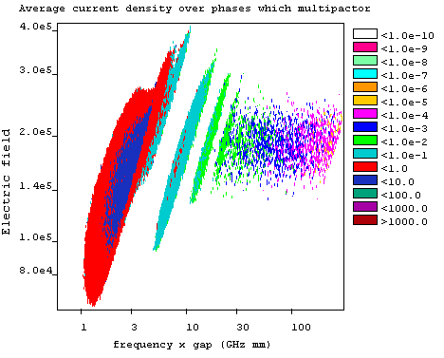
Computed Multipactor bands (Field vs gap freq. Product)

Slide 34
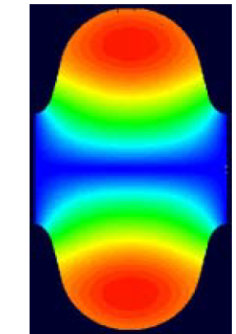
Multipactor in Cavities
Two point multipactor can also occur in pillbox and elliptical cavities.
The electron trajectories are bent by the RF magnetic field to form semi-circles.
In pillbox cavities trajectories are resonant if the cyclotron conditions are met
Multipactor will occur if the electric field accelerates the electrons to energies between ~50-500 eV depending on the material.
In elliptical cavities the resonant condition varies with radius as smaller arcs are required causing any resonant trajectories to break up, preventing multipactor.
Electron trajectory

Slide 35
Average Heating Limits
In normal conducting cavities, the RF deposits large amounts of power as heat in the cavity walls.
This heat is removed by flushing cooling water through special copper cooling channels in the cavity. The faster the water flows (and the cooler), the more heat is removed.
For CW cavities, the cavity temperature reaches steady state when the water cooling removes as much power as is deposited in the RF structure.
This usually is required to be calculated in a Finite Element code to determine temperature rises.
Temperature rises can cause surface deformation, surface cracking, outgassing or even melting.
By pulsing the RF we can reach much higher gradients as the average power flow is much less than the peak power flow.

Slide 36
Water cooling
Temperature rise of water
kW = Flow rate (litres/second) x Specific heat capacity of fluid (Water is 4.182 kJ/kg) x ɗT
Mass follow rate is
To get that flow rate we need a chiller that can overcome the pressure drop
Where f is the friction coefficient
And Re is the Reynolds numbers (describes turbulent and laminar flow)

Slide 37
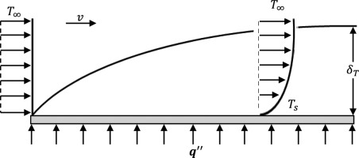
Water cooling
But there is also a temperature difference between the water and the walls of the cooling pipes as the water velocity is slow near the walls causing a boundary layer to form
The temperature of the water is higher in the boundary layer than in the main flow of water.

Slide 38
Water cooling
Temperature rise of walls
Where h is the heat transfer coefficient
Nu is the Nusselt number (for turbulent flow) which is the ratio of conductive to convective heat
And Pr is the Prantl number, where μ is viscocity, and is the ratio of viscous to thermal diffusion

Slide 39
Water cooling
Cooling capacity depends on water temperature and ambient temperature

Slide 40



Iris heating
$$ΔT=\frac{k}{A}\dot{Q}dx$$
Temperature rise of iris
Where Qdot is RF losses, k is thermal conductivity and A is the cross sectional area the heat flows through given by
Where x is the radius and t is the iris thickness hence the temperature rise of a cavity of radius R and iris radius a is
Note this is independent of cooling capacity and is an unavoidable limit
Can reduce it by reducing the duty cycle Qdot=P_{losses}*f_{rep}*t_{pulse}
$$A=2πxt$$
$ΔT=\frac{k}{2πxt}\dot{Q}dx=\frac{k}{2πt}\dot{Q}$ln(R/a)

Slide 41
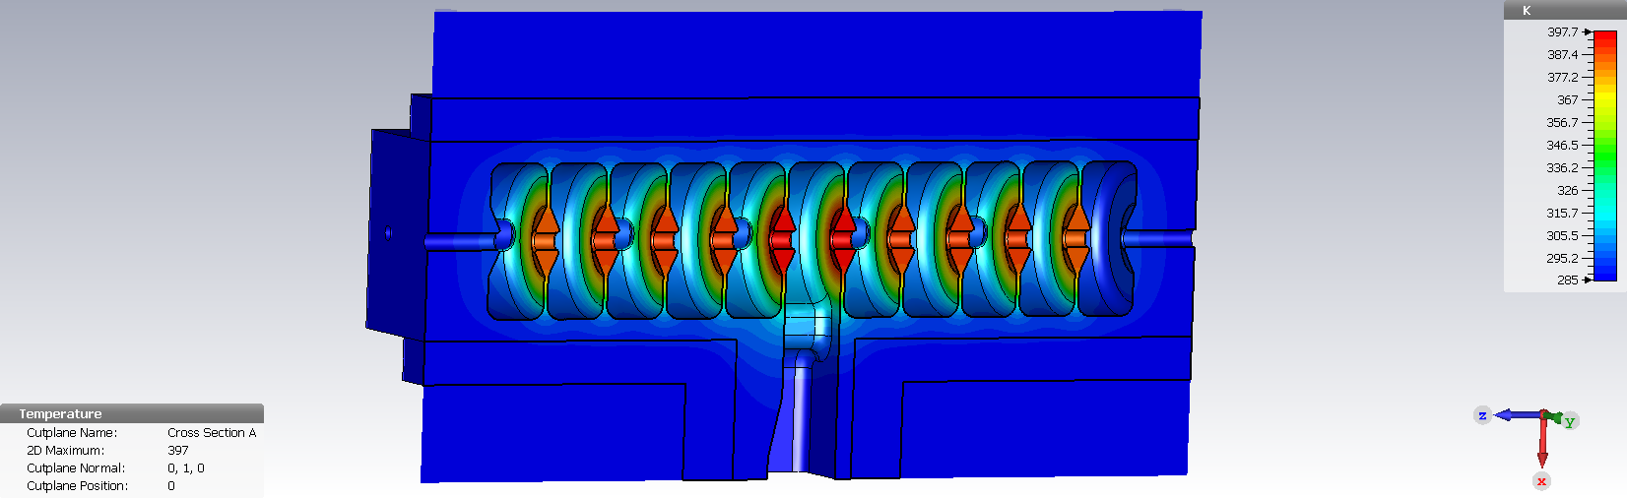
Iris heating

Slide 42
Cavity temperature with distance
Temperature
Thermal conductivity, given by dT=Q’ κ L/A
Iris is thin so has a large gradient
T_{iris}
Boundary layer temperature gradient, the same in all pipes/cells. Can be corrected with water temperature
T_{pipe}
T_{wall}
Increase in water body temperature, increases along the pipe causing temperature gradients and differential thermal expansion
T_{water}
T_{outer}
Position

Slide 43
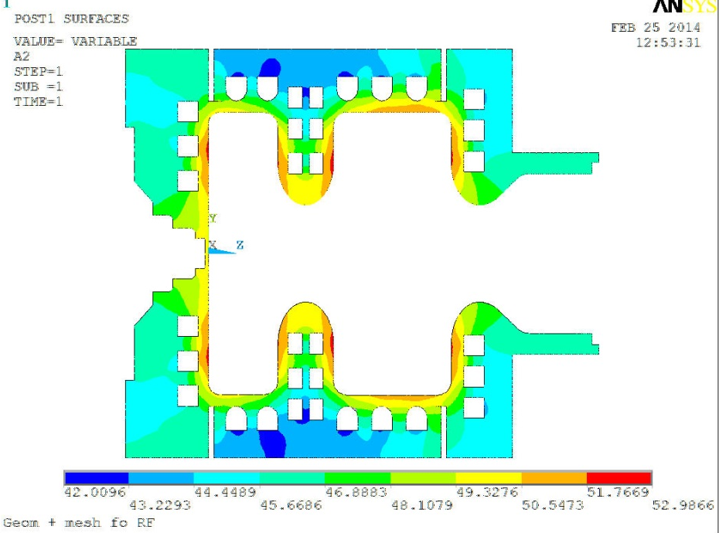
Cell design for high average power
If we need to operate with high average powers then we need to improve cooling in the iris
If we make the iris thicker we improve the temperature gradient as the temperature rise along the iris is proportional to thickness
For even higher power we can add cooling pipes in the iris to eliminate conductive temperature gradients almost entirely
The downside is shunt impedance and peak surface fields are worse for thick iris so no matter what we do we cannot achieve the highest gradients, we are either limited by heating or the impedance

Slide 44
Thermal expansion
The coefficient of linear expansion for copper is 17 x 10⁻⁶ which means that the frequency error is
Δf/f=(17 x 10⁻⁶)ΔT
Given that the maximum allowable frequency shift is given as f/Q this allows the maximum temperature change as
ΔT= =(Q 17 x 10⁻⁶)⁻¹
The Q of a copper cavity is around 10,000 so the max temperature rise is 6 degrees

Slide 45
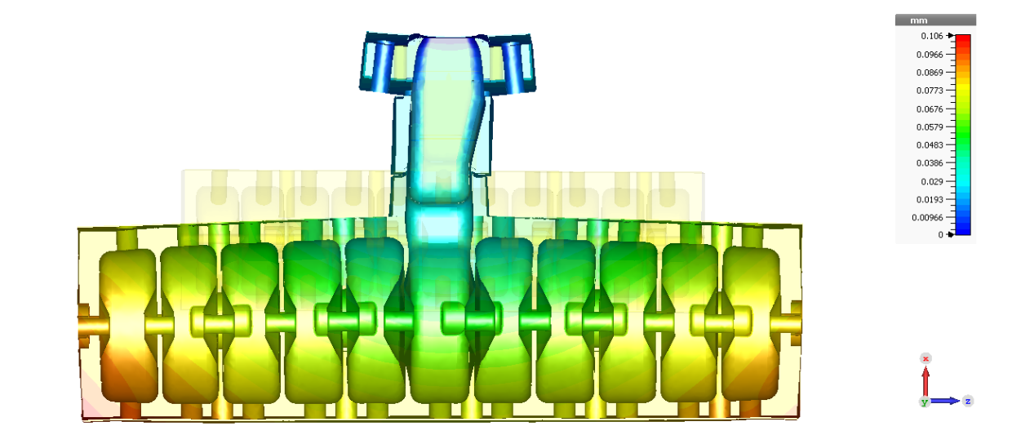
Thermal expansion
Not all temperature rises result in deformation, as if the outside is cooler than the inside of a cavity the expansion is constrained.
This results in a stress on the cavity which can cause damage but typically higher temperatures can be withstood for stress than expansion

Slide 46
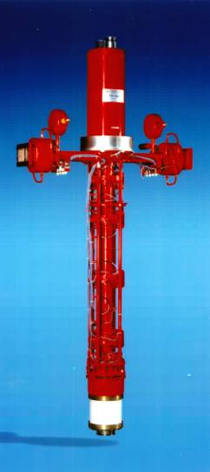
Power Limits (Klystrons)
Many linacs are actually limited by RF power.
The highest power klystrons are around 50 MW pulsed (200 ns) or 1 MW CW, this is enough to meet the current maximum operating gradients.
We can store the energy from longer pulses and release then in a short timescale creating higher powers. This is known as pulse compression and can double or quadruple the peak power (to 200 MW)
If we overcome the gradient limits we may well be limited by the maximum power we can deliver which scales as E²
Even if higher power klystrons could be obtained we may still be limited by the power limits of RF components like windows, splitters and loads.

Slide 47
Other limits to gradient
RF linacs are driven by klystrons which operate at sub-50% efficiency
How much longer can we use inefficient RF sources for accelerators from a climate change perspective?
To continue to operate at higher gradient/power we need more efficient RF sources
The klystron efficiency impact on the FCC power consumption.
Example of the efficiency upgrade from existing 70% to 85%.
 | Klystron eff. 70% | Klystron eff. 85% | Difference
RF power needed for 3TeV CLIC | 105 MW
DC input power | 150MW | 131MW | -19MW
Waste heat | 45MW | 26MW | -19MW
Annual consumption (5500 h assumed) | 825 GWh | 720.5GWh | -104.5 GWh
Annual cost (60 CHF/MWh assumed) | 49.5 MCHF | 43.2 MCHF | -6.3 MCHF
Electricity installation dimensioned for | 150MW | 131 MW | -13%
CV installation dimensioned for | 45 MW | 26 MW | -42%
From Erk Jensen

