Slide 1


RF Linear accelerators
L3: Coupling to Standing wave cavities
Prof Graeme Burt
Lancaster University

Slide 2
Travelling waves
Most circuit theory makes the assumption that the voltages do not depend on cable lengths
At higher frequencies this assumption is no longer true and waves propagate along the cables.
Waves can propagate forwards, V₊, or backwards, V₋,
The voltage at any point is a superposition of both waves
V=V₊+V₋
The same happens with current where
I=I₊-I₋
The generator is a source of forward current, I₊, not current, I
V+
V-

Slide 3
Scattering Parameters
When making RF measurements, the most common measurement is the S-parameters.
Black Box
Input signal
S_{1,1}
S_{2,1}
input reflection coefficient
forward transmission coefficient
The S matrix is a m-by-m matrix (where m is the number of available measurement ports). The elements are labelled S parameters of form S_{ab} where a is the measurement port and b is the input port.
S₁₁
S₁₂
S =
S₂₁
S₂₂
The meaning of an S parameter is the ratio of the reflected/transmitted voltage (normalised to impedance) measured at the measurement port to the forwards voltage at the input port (assuming a CW input).
S_{ab} =V_{a} / V_{b}

Slide 4
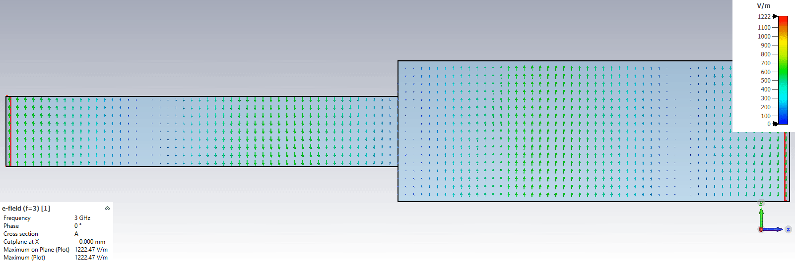


Mode matching
At an interface the fields must be continuous at the interface (ie the same on both sides)
On any metal walls the metallic boundary conditions must be preserved (E||=H_{T}=0)
For this to be true the sum of the modes on each side of the interface should create identical E and H fields, where a_{n} is the amplitude of forward mode n and b_{n} is the amplitude of reflected mode n
The same occurs for the magnetic fields
$$\sum_{all modes}^{region1}{{a_{n}E}_{n}}+\sum_{all modes}^{region1}{{b_{n}E}_{n}}=\sum_{all modes}^{region2}{{a_{m}E}_{m}}$$
$$\sum_{all modes}^{region1}{{a_{n}H}_{n}}+\sum_{all modes}^{region1}{{b_{n}H}_{n}}=\sum_{all modes}^{region2}{{a_{m}H}_{m}}$$

Slide 5
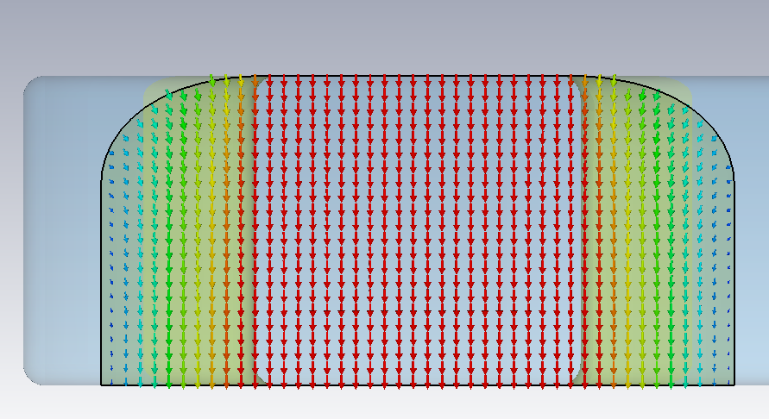
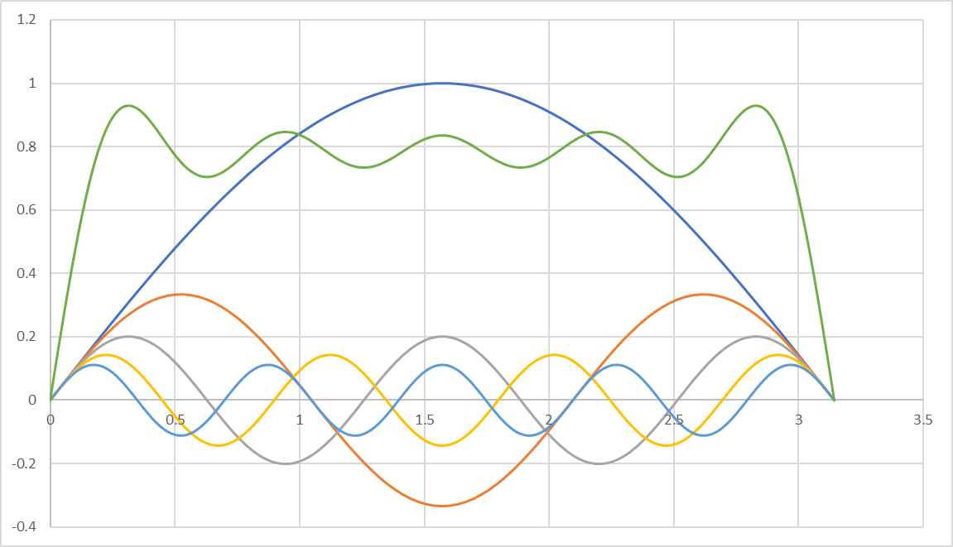
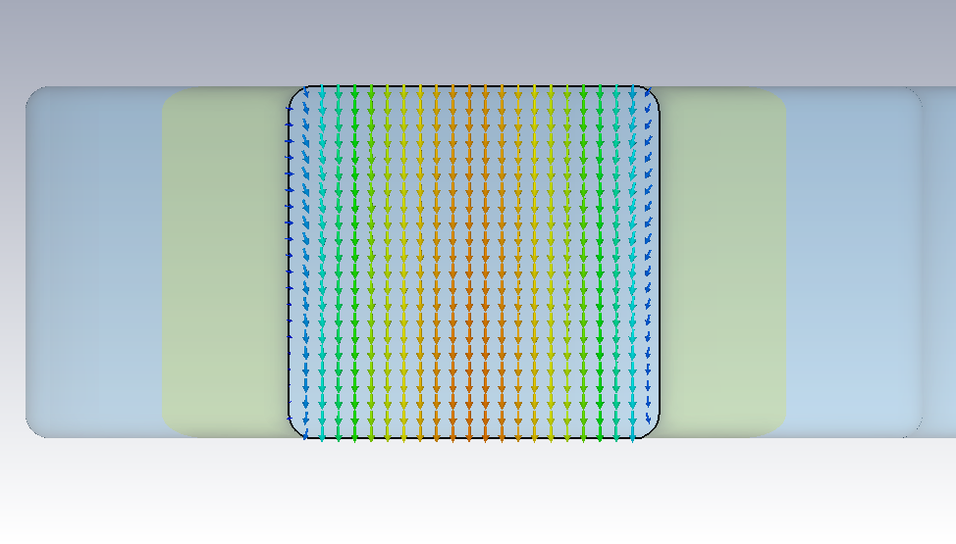
Mode matching and Fourier series
In rectangular waveguide the modes vary in each cartesian dimension as a sine or cosine wave, meeting the boundary conditions at the walls forcing one component to zero
Fourier theory says any shape can be created by a superposition of sinusoidal waves of different harmonics
Therefore any field pattern can be created by a superposition of modes
As we can have forwards and reverse waves this would not be single valued, but the requirement to match both E and H reduces it to a single solution comprising of a finite number of mode amplitudes
Field in the cavity (square)
Field in the coupler (sinusoidal)

Slide 6
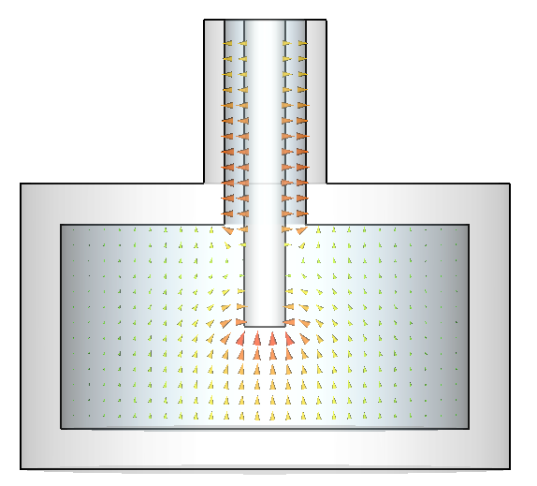
Electric coupling
For coaxial lines it is more convenient to use equivalent circuits, and represent the coupling as a current/voltage source and a capacitor/inductor
For capacitive coupling we leave the inner conductor unterminated and use the capacitance between the conductor and the cavity walls to couple
The equivalent circuit for electric coupling is a current source in parallel with a capacitance.
The top rail represents the inner conductor and the ground plane is the cavity body and outer conductor.
We get the charge by integrating Gauss’ law over the tip of the inner conductor.

Slide 7
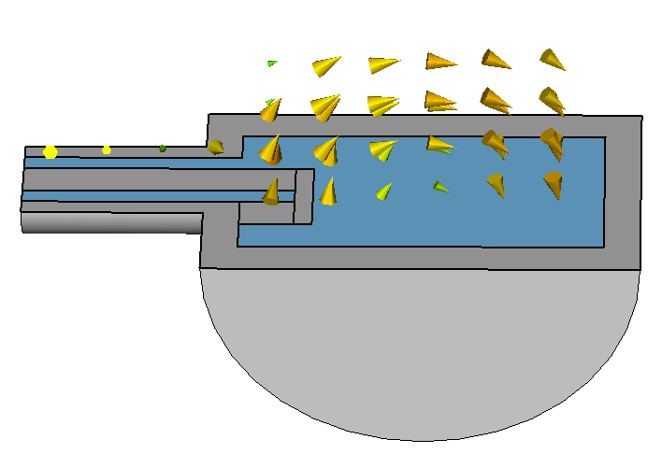
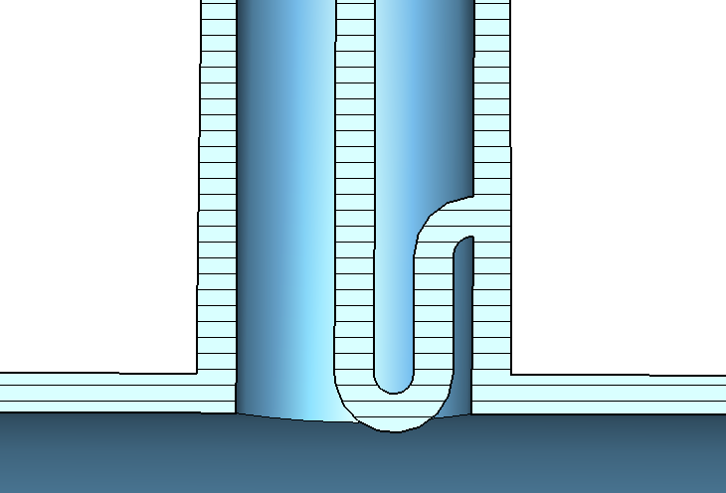
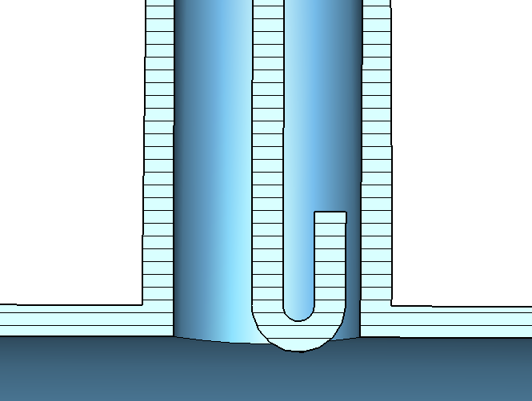
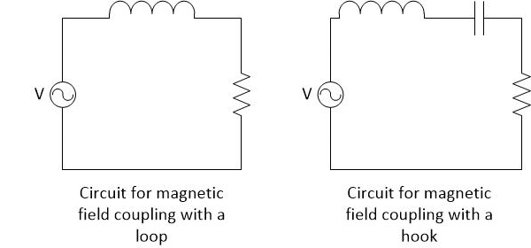
Magnetic coupling
From Faradays law
Loop
Hook
The equivalent circuit for magnetic coupling where the inner conductor loops round and is connected to the outer conductor is a voltage source in series with an inductance
.
If the loop isn’t physically connected then there is also a series capacitance making a band pass filter.

Slide 8
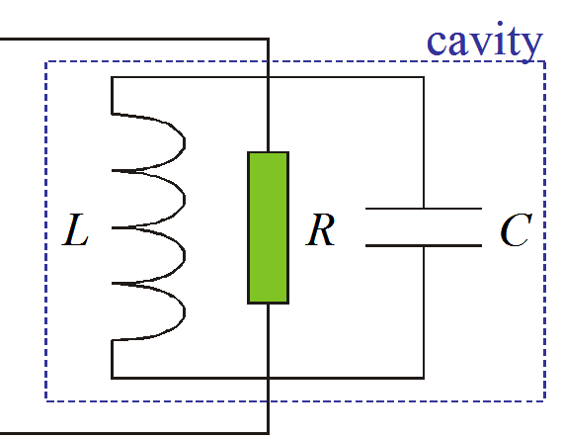
Parallel resonant circuit
A resonator can be modelled as a parallel LRC circuit. Here we drive it with a current source.
Applying Kirchoff’s loop law gives.
Solving for sinusoidal varying I and V yields (Q=ωRC)
where

Slide 9
Resonant Bandwidth
U
1
ω₀
Δ ω=
=
t_{L}
Q_{L}
ω-ω₀
SC cavities have much smaller resonant bandwidth and longer time constants. Over the resonant bandwidth the phase of S₂₁ also changes by 180 degrees.

Slide 10
Impedance and filling
The cavity impedance is given as the voltage divided by the current.
If the RF is turned off the voltage will decay exponentially as the losses are proportional to the stored energy.

Slide 11
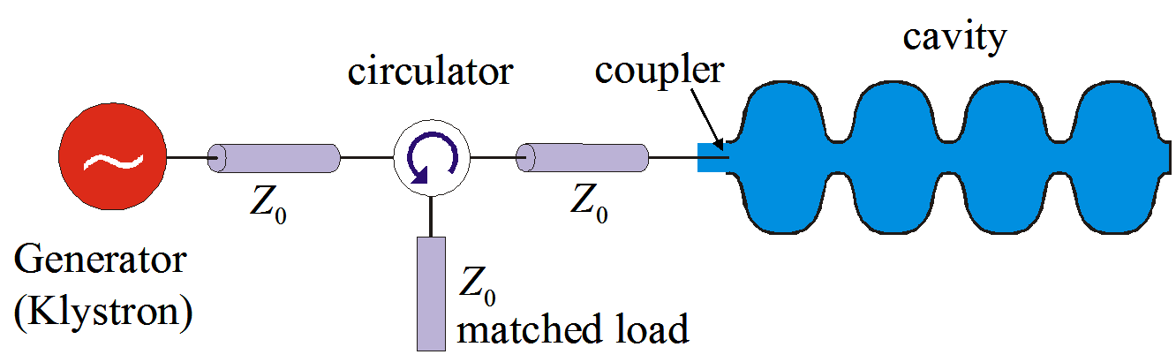
Couplers
However the RF source has an impedance (plus the inductance of the coupler) which isn’t always matched to the cavity. This can be represented as a transformer.
The RF source is represented by a ideal current source in parallel to an impedance and the coupler is represented as an n:1 turn transformer.
Typically Z₀ is 50 Ohms but the cavity shunt impedance, R, is ~Mohms.

Slide 12

Coupler circuit representation
The transformer makes the load impedance seen smaller by a factor of n²
By varying the coupling we vary n allowing us to set the load impedance.
I=I_{s}/n
Z₀n²
The reflection (ie match) depends on the difference in the coupler and cavity impedance
When on resonance the cavity impedance equals the shunt impedance (Z_{c}=R)
We can then simply model the circuit as two parallel resistors.
$$P_{R}=P_{g}\left(\frac{{\left(Z_{0}−Z_{c}\right)}^{2}}{{\left(Z_{0}+Z_{c}\right)}^{2}}\right)$$

Slide 13
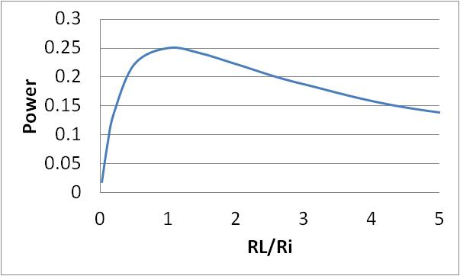
Power Transfer Theory
V_{s} = I_{s} R_{i}R_{L}/(R_{i}+R_{L})
P_{L}=V_{s}² / R_{L} (the power delivered to the load)
P_{L} = I_{s}² R_{i}²R_{L}/ (R_{i}+R_{L})²
P_{L}= I_{s}² R_{i}² / (R_{i}²/R_{L} +2R_{s}+R_{L})
I_{s}
R_{i}
R_{L}
The minimum peak power occurs when
Which occurs when R_{L}=R_{i}
In this case the load
dissipates a peak power
P_{L}=I_{s}²R_{i}/4

Slide 14
External Q factor
Ohmic losses are not the only loss mechanism in cavities. We also have to consider the loss from the couplers. We define this external Q as,
Where P_{e} is the power lost through the coupler when the RF sources are turned off.
We can then define a loaded Q factor, Q_{L}, which is the ‘real’ Q of the cavity

Slide 15
Cavity Voltage
The generator power is given by:
Where I use the circuit definition of R.
Rearranging this gives the current
The voltage is given by
Hence

Slide 16
Reflected Power
The reflected power in steady state operation is the power supplied to the cavity minus the power that is dissipated in the cavity.
Here we assume a matched system and look at the power dissipated in the cavity resistance by looking at the power lost in two parallel resistors.
I_{s}
R_{i}
R_{L}

Slide 17
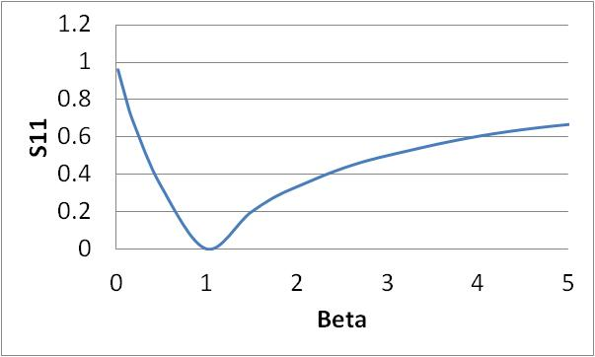


Reflected Voltage
We can also define the reflection in terms of β and we find the match occurs at β=1.
The reflection also depends on the frequency difference between the source and the cavity resonance
$P_{R}=P_{g}\left(\frac{{\left(Z_{0}−Z_{c}\right)}^{2}}{{\left(Z_{0}+Z_{c}\right)}^{2}}\right)$ $=P_{g}{\left(\frac{1−β−iδ}{1+β+iδ}\right)}^{2}$
$$δ=Q\left(\frac{ω}{ω_{0}}−\frac{ω_{0}}{ω}\right)$$
where
S11
Δf

Slide 18
Under and Over coupled
We can tell if β is greater or less than 1 from the polar plot of S₁₁.
If the circle doesn’t encompass the origin then beta is less than 1 (undercoupled)
If the circle does encompass the origin then beta is greater than 1 (overcoupled)

Slide 19
Cavity matching
In the case of a cavity we have two reflective elements
  the coupling iris the joins the waveguide to the cavity
  the back of the cavity
The wave will bounce between those two elements and hence the reflections will change with time as the fields build up.
Ideally in steady state the reflections from each element are equal and opposite cancelling each other out and hence matching.
But a cavities field amplitude changes with time as it fills so matching is a time dependent problem, typically we aim for perfect coupling in steady state (ie after its filled)

Slide 20
Cavity filling
The most important behaviour we must understand is when the cavity is in steady state (ie when the cavity stored energy is constant and U=U₀). We can use the definitions of β and Q to derive,
The cavity fills with time as 1-e^{-t/τ} where τ is the filling constant/time.
The filling constant is
τ=2Q_{L}/ω
The higher the loaded Q the higher the stored energy but the longer it takes to fill.
Filling of cavity with τ=1ms

Slide 21
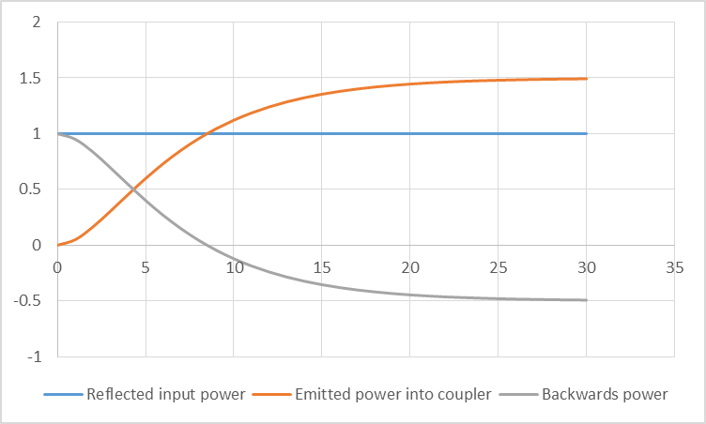
Transient reflections
When filling, the stored energy in a resonant cavity varies with time and hence so does the reflections.
As we vary the external Q of a cavity the filling behaves differently.
Initially all power is reflected from the cavity at the interface due to the difference in impedance
As the cavities fill the reflections reduce as we get cancellation from waves coming from inside the cavity.
The cavity is only matched if the external Q of the cavity is equal to the ohmic Q (you may include beam losses in this).

Slide 22
Transient reflections
The reflections can also be calculated from circuit theory
As we know the voltage increases as 1-e^{-t/τ} with time
Using the definition of reflected voltage and knowing that V₊ is constant

Slide 23
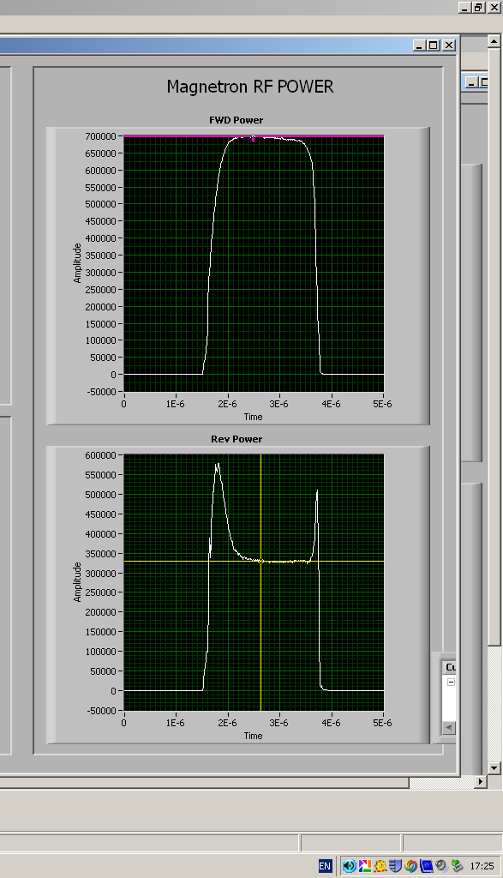
Reflections from a square wave
Excited by a square pulse steady state reflections depends on β as we have seen, but when the RF is turned off the emitted power is also dependant on β

Slide 24
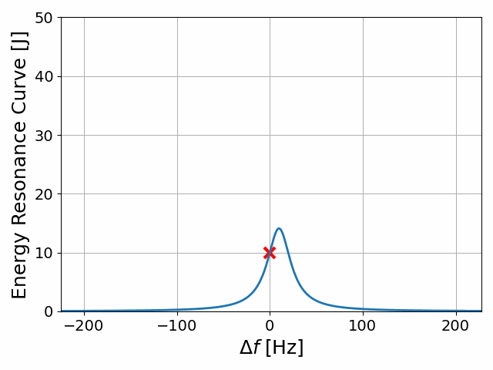

Microphonics
Microphonics cause the cavity resonant frequency to vary in time by anywhere from 10 Hz to 10 kHz.
As we have seen before the reflections are dependent on the difference between the drive and natural frequencies.
$$S_{11}=\frac{V_{−}}{V_{+}}=\frac{1−β−iδ}{1+β+iδ}$$
As the detuning angle is proportional to the Q factor it leads to an poor coupling for SRF cavities, which have high Q’s.
To avoid this a lower external Q is chosen than the ohmic Q, ie the coupler is not matched.
Power demand for 1 watt ohmic heating in ALICE

Slide 25
Beam Loading
In addition to ohmic losses we must also consider the power extracted from the cavity by the beam.
The beam draws a power P_{b}=V_{c} I_{beam} from the cavity.
I_{beam}=q f, where q is the bunch charge and f is the repetition rate
This acts as a current source in series with the cavity
I=I_{s}/n
Z₀n²
I_{b}

Slide 26
Coupling with Beam Loading
The rf source will not see any difference between the power dissipated in the cavity walls and the power extracted by the beam hence we can calculate a new Q factor, Q_{cb}.
this Q_{cb} will replace Q₀ when calculating cavity filling. This means the match will change as well as needing more power.
Normally we aim for β=1 with beam and have reflections when filling.

Slide 27
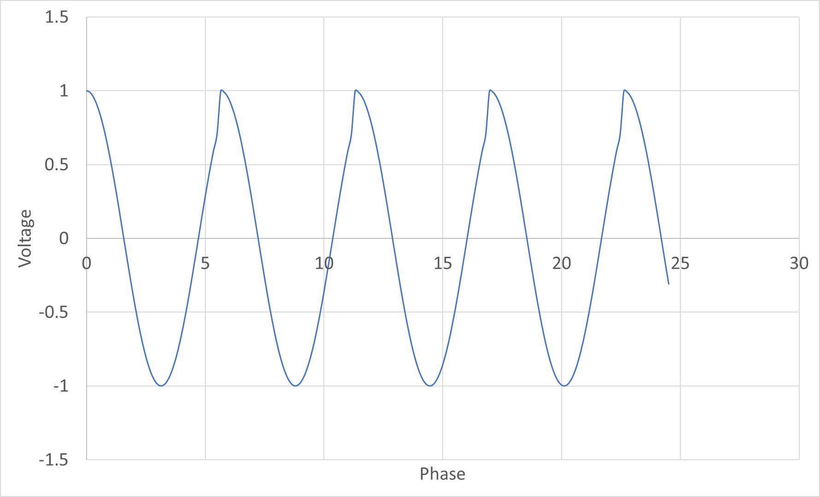
Detuning
In many RF systems the beam is not accelerated on crest, but at a phase slightly above or below the maximum voltage.
In this case the beam induces a current in the cavity which is out of phase with the main RF and hence changes the cavity phase, which must be controlled.
Beam V
V before beam arrives
Note the period is not 2pi in phase
This causes a phase (and frequency) shift as the imaginary part remains the same.
Correcting the phase take more (reactive) power than simply replacing power lost to the beam
The phase/frequency shift is effectively adding a capacitance to the cavity circuit.
This can be fixed by detuning the cavity so that we reduce the cavities capacitance accordingly.

Slide 28
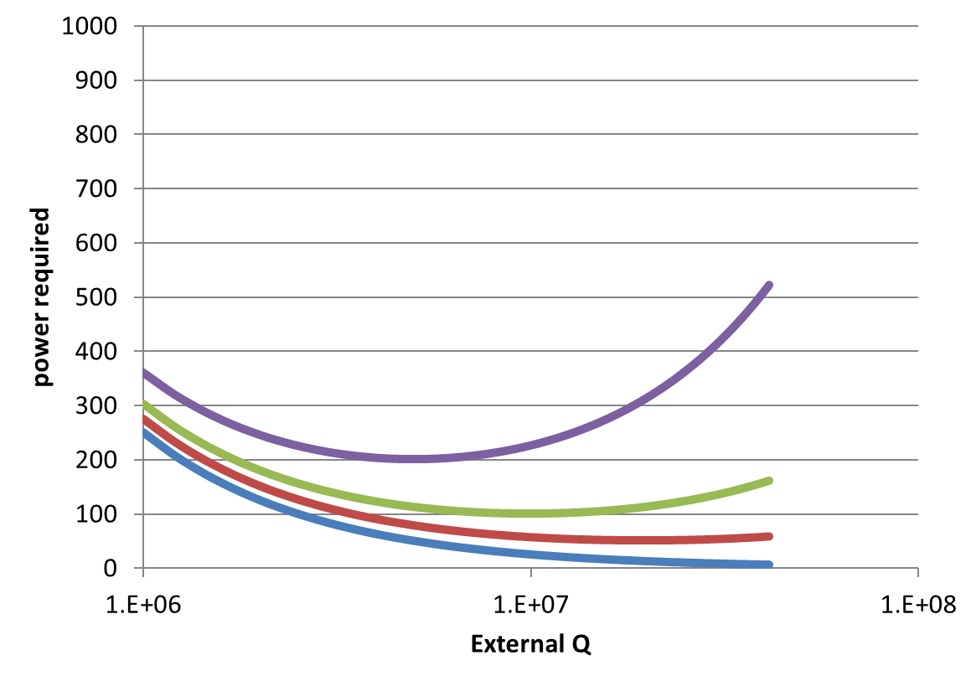
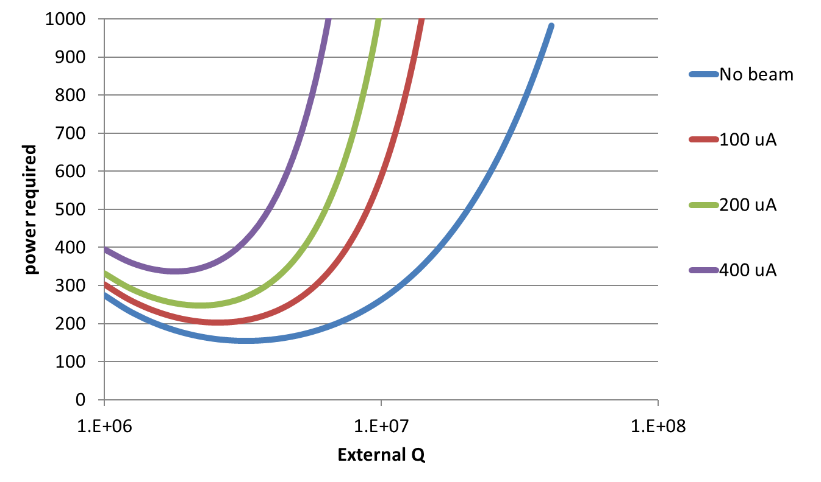
Required Power with beam
In this case the power is
Where
Normally the 2nd term on the RHS is neglected.
In an ERL the loading due to the injected and spent beam exactly cancel. This means that the beamloading can be neglected
No microphonics
200 Hz amplitude microphonics

Slide 29
END

