Slide 1
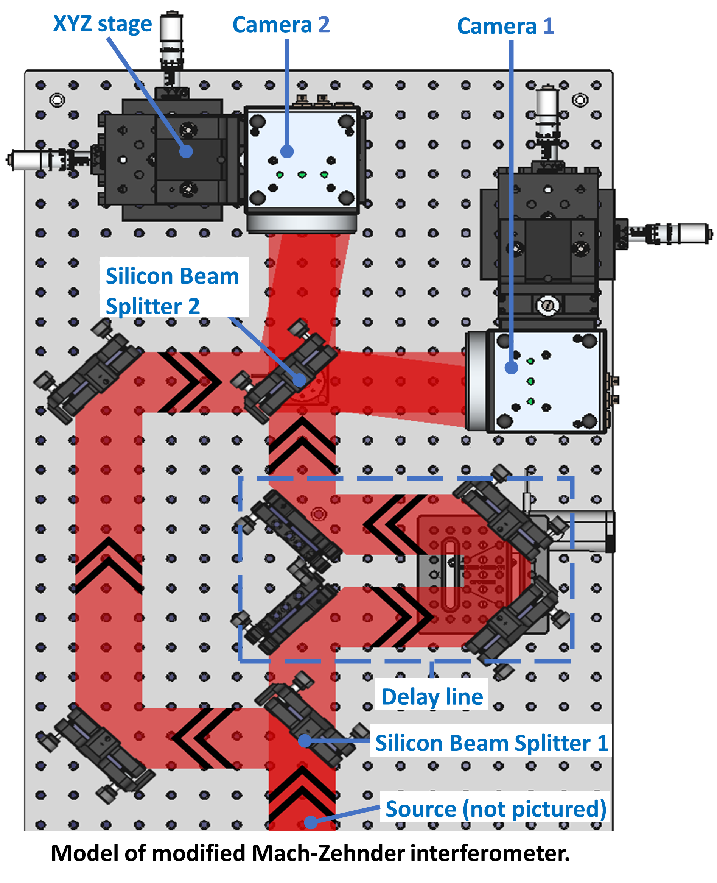
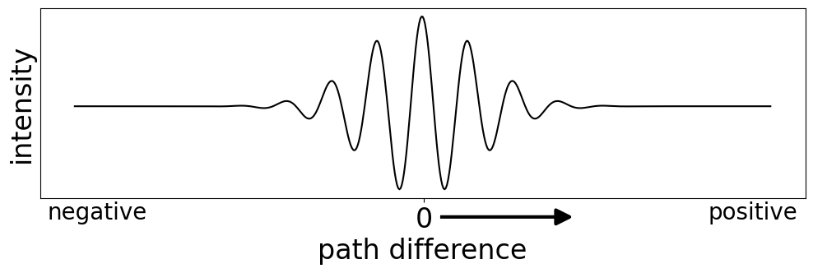
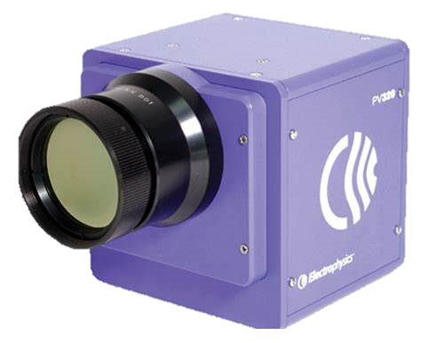
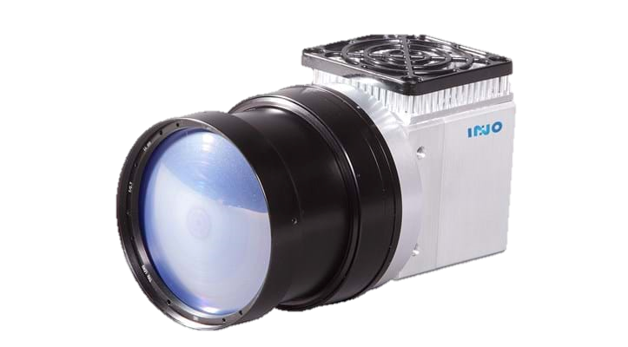
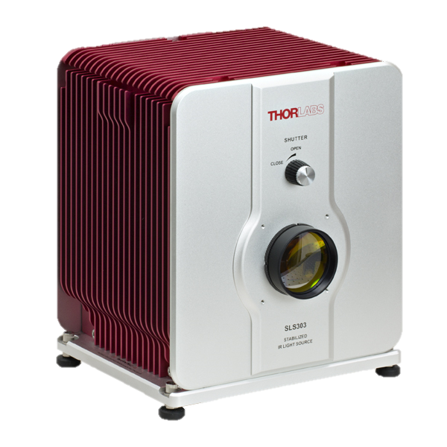
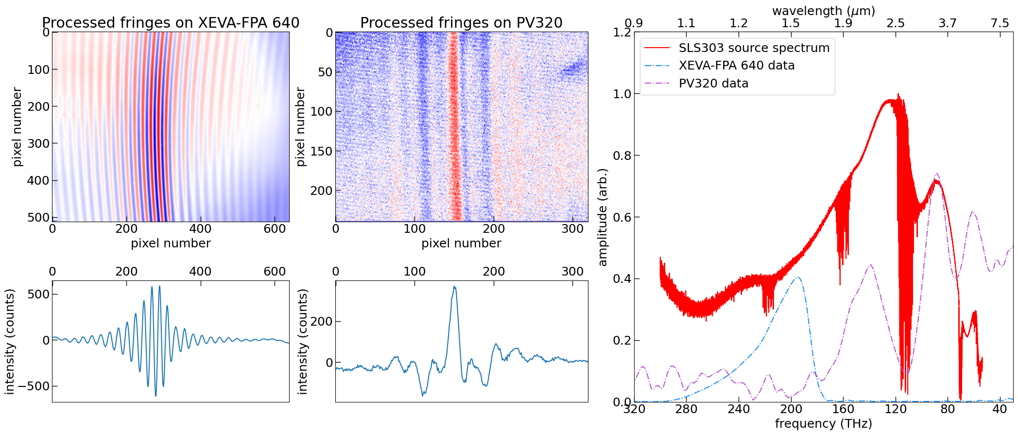
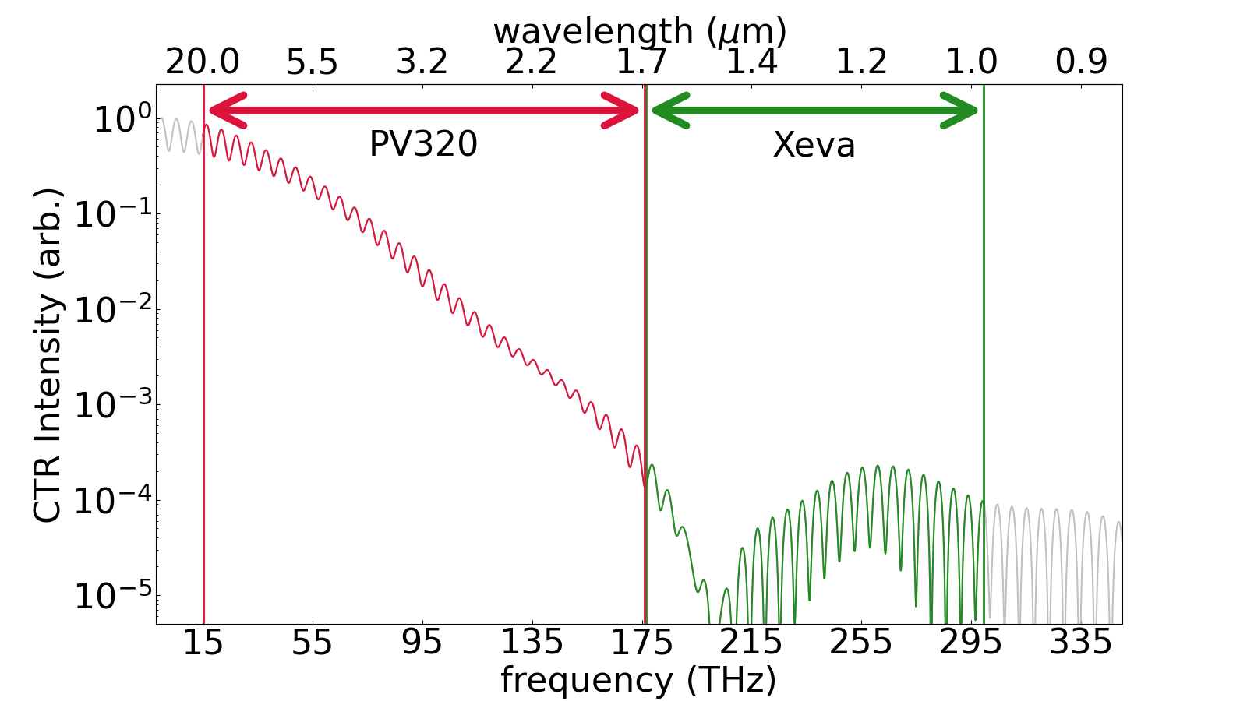
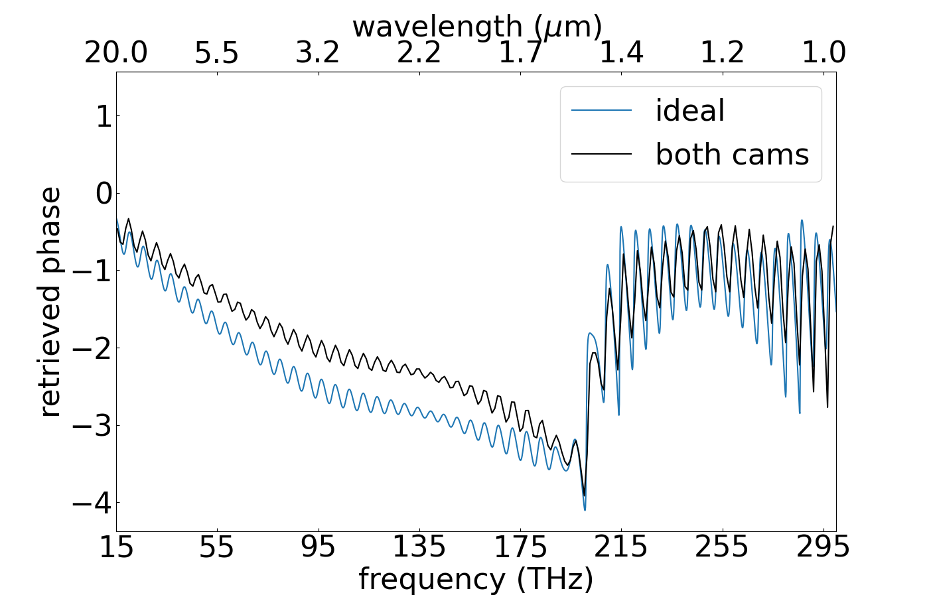
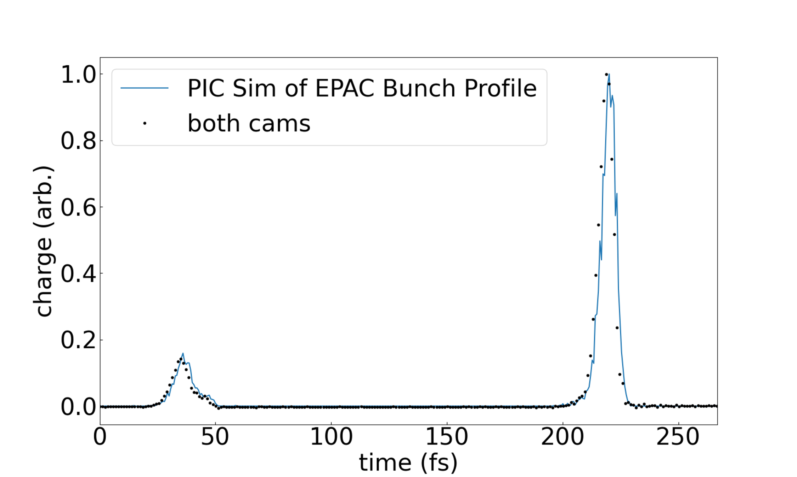
Longitudinal bunch profile diagnostics for EPAC
Kirill Fedorov¹, Jamie Watts ^{1,2}, Phillip Bradford¹, Chris Armstrong ¹, Rajeev Pattathil¹, Alex Koala³, Ettore Pedretti³, Elin McCormack³, Peter Huggard³
¹ Central Laser Facility, STFC Rutherford Appleton Laboratory, Didcot, OX11 0QX, UK ²University of Bath, Bath, BA2 7AY, UK
³ RAL Space, STFC Rutherford Appleton Laboratory, Didcot, OX11 0QX, UK
Introduction
Ultrashort (≈50fs) relativistic electron bunches, such as those produced by a laser wakefield accelerator, can be reliably and non-invasively inferred from spectral measurements of Coherent Transition Radiation (CTR). At the Extreme Photonics Applications Centre (EPAC), we are planning to use the CTR emitted when electrons cross the boundary between two different media to measure electron bunch properties. The CTR spectrum will be detected single-shot in the region ≈20µm – 2µm.
Coherent THz/MIR radiation emitted by EPAC
The electron bunch length, s, is related to the coherence and intensity of the emitted radiation.
From the coherent part of the THz spectrum, we can:
Measure the bunch duration,
Determine the bunch profile (i.e. microbunching)
PIC Sim of EPAC Bunch Profile
Corresponding CTR emission in frequency space
Single-shot THz spectroscopy
Interference between the beams creates fringes on both cameras
Here the path difference varies across the camera sensor ⇒ we can use it in single-shot mode
Xeva-FPA 640 InGaAs
[1.0-1.7µm]
[300-180THz]
PV320 pyroelectric
[1.7-20µm]
[180-15THz]
INO microbolometer
[3-14µm]
[100-21THz]
Thorlabs SLS303 blackbody [0.6-15µm]
[500-20THz]
When two coherent beams superpose at an angle, φ, an interference pattern with a period of, Λ, arises.
$$λ=2Λ\sin{\frac{φ}{2}}$$
Instrument Resolution:
$$Δf=\frac{c}{2 sin\frac{φ}{2} L}$$
Maximum detectable frequency:
$$f\text{max}=\frac{c}{4 sin\frac{φ}{2} d}$$
where L is the length of the detector and d is the pixel pitch
2D and 1D (2D averaged) taken with blackbody source. Background have been removed. The measured spectra have been normalised for the camera sensitivity.
Electron bunch reconstruction from THz spectrum
Phase retrieval:
$ψ\left(ω\right) −Phase$
Profile retrieval:
$$Δt=\frac{2 sin\frac{φ}{2} d}{c}$$
Achievable bunch profile
The quality of our bunch profile measurement is limited by our spectrum bandwidth.
$$ψ\left(ω\right)=\frac{2}{π}\int_{0}^{∞}{\frac{−ω\ln{(\sqrt{F(x)}/\sqrt{F(ω)})}}{(ω^{2}−x^{2})}ⅆx}$$
$$F\left(ω\right)−Spectral Form factor$$
$$ρ \left(t\right)=\frac{1}{π}\int_{0}^{∞}{\sqrt{F(ω)} e^{iψ\left(ω\right)}e^{iωt}ⅆω}$$
Resolution:
$$T_{max}=\frac{2 sin\frac{φ}{2} L}{c}$$
$x −Convolution Variable \left[ω\right]$
Bandwidth:
$$e^{iψ\left(ω\right)} −Phase component$$
$Δt≈ 1.7$ fs
$T_{max}≈900$ fs
Pushing the limit:
Additional spectral information can be obtained using a VIS-light grating spectrometer.
The temporal resolution can be increased to 0.5 fs.
Our spectrometer is designed to have a resolution of 1.3 THz and spectral bandwidth of 15 – 300 THz.
The Kramers-Kronig minimal phase retrieval algorithm can be used to restore phase information which is lost during interferometry.
As a result, we will be able to resolve complex bunch structure in a range of 900 fs with resolution of 1.7 fs.
References
Acknowledgements
[1] Bajlekov S. I., Heigoldt M., Popp A., Wenz J., Khrennikov K., Karsch S. and Hooker S. M., "Longitudinal electron bunch profile reconstruction by performing phase retrieval on coherent transition radiation spectra", (23 April 2013) Phys. Rev. ST Accel. Beams :16 : 040701.
[2] Dogeun Jang, Hanran Jin, and Ki-Yong Kim, "Single-shot terahertz spectrometer using a microbolometer camera", (31 August 2020) Appl. Phys. Lett. :117 (9): 091105.
[3] Guo-Qian Liao, Yu-Tong Li, Xiao-Hui Yuan, “Relativistic Laser-Driven Table-top Intense Terahertz Transition Radiation Sources” [Internet] [cited: 27 November 2023] Available from: http://www.2physics.com/2016/07/relativistic-laser-driven-table-top.html
This work is supported by,
CFI funding: Single-shot THz spectroscopy
Royal Society: Dorothy Hodgkin fellowship
Strategic Priorities Fund

