Slide 1
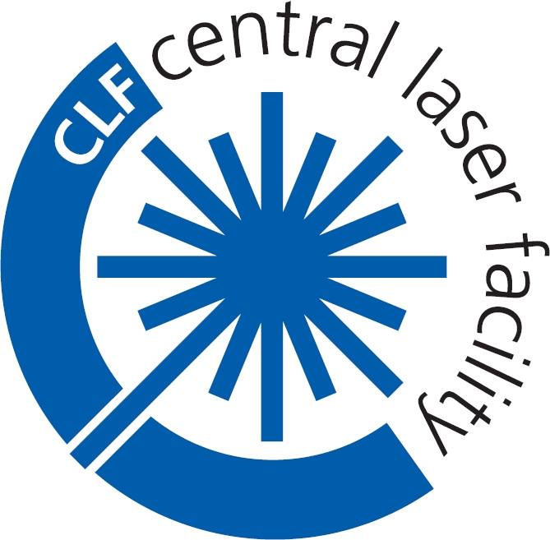
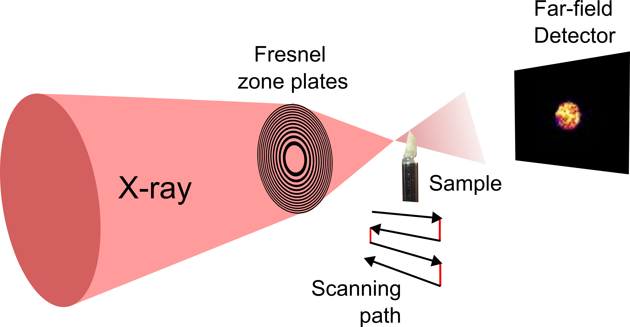
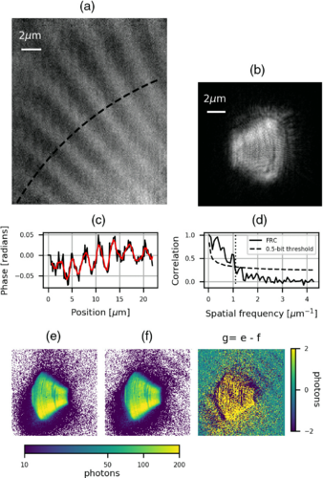
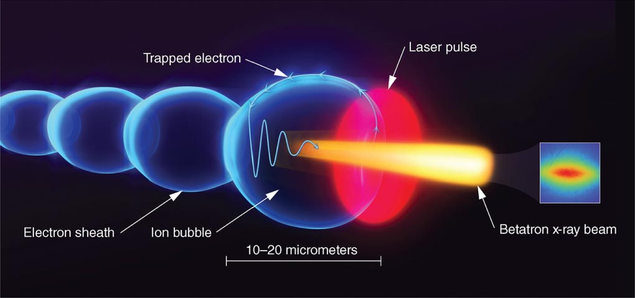
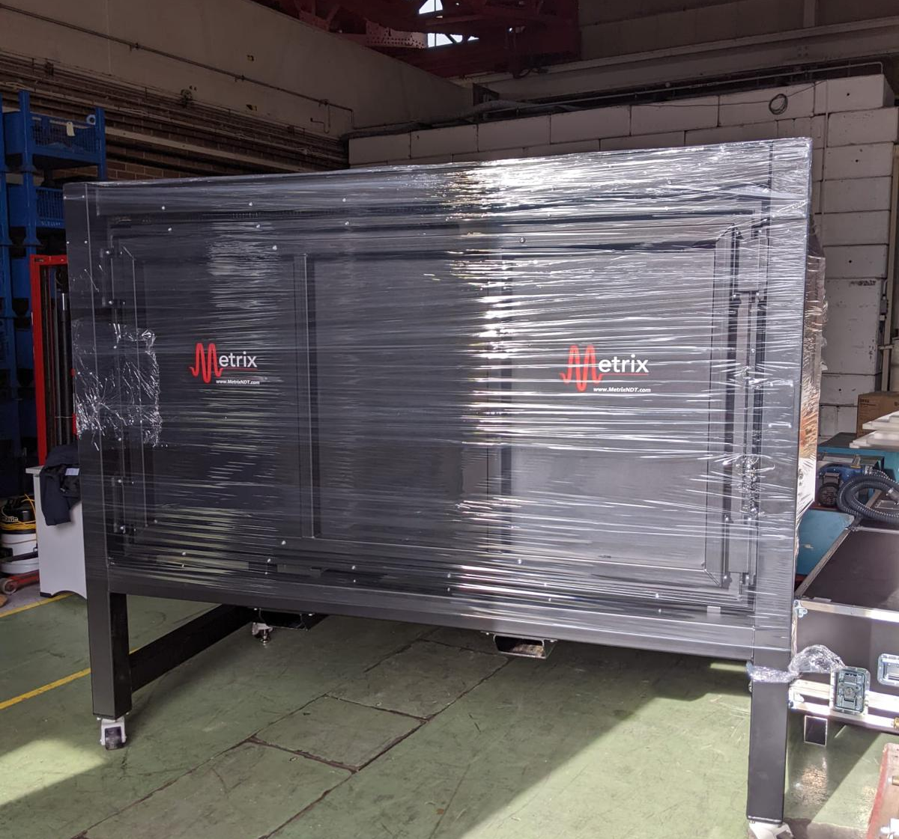
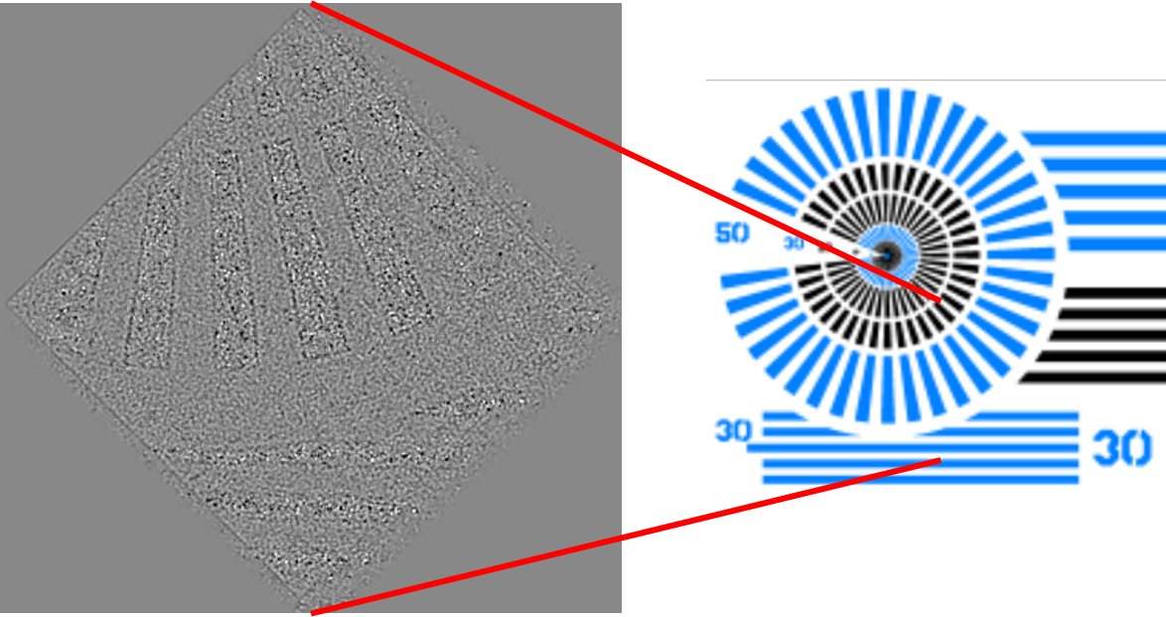
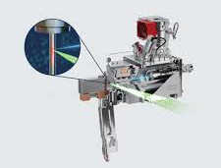
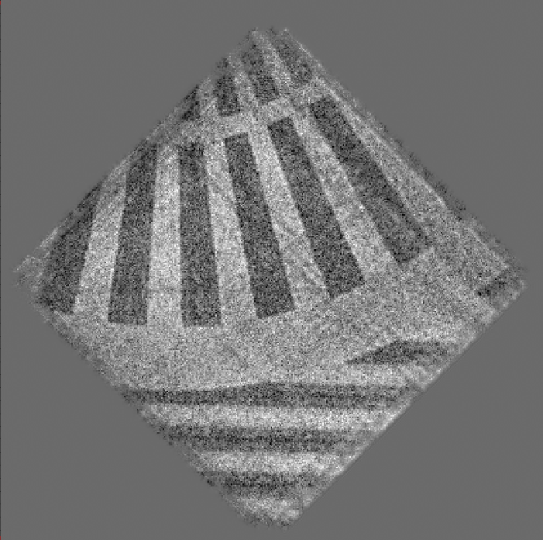
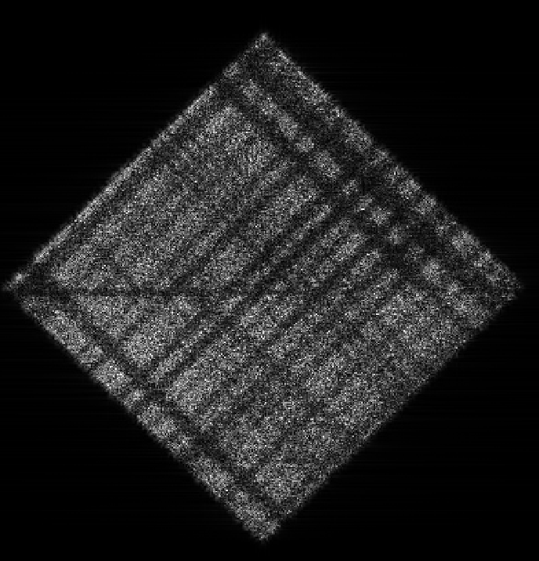
Coherent Diffraction Imaging Techniques with Laboratory and Laser Driven X-ray Sources
L. Fardin⁽¹⁾, C. D. Armstrong⁽²⁾, D. Batey⁽³⁾, A. Olivo⁽¹⁾, and S. Cipiccia⁽¹⁾
(1) University College London, (2) Central Laser Facility, (3) Diamond Light Source
Ptychography: scanning CDI
Ptycho: from synchrotron to the lab
Ptychography is a microscopy technique at the nanoscale [1]. It is a form of CDI: no lens is used after the sample to form an image.
X-ray ptychography has been recently proven to be feasible in a laboratory setting using bright liquid metal jet (LMJ) X-ray sources [3]. Further work required for increasing the efficiency of the system.
Figure 2: X-ray ptychography performed using a LMJ source.
PROS:
Free from lens aberration.
Diffraction limited resolution.
High sensitivity to small changes in electron density.
Robust reconstruction algorithms [2].
Figure 1: Typical X-ray ptychography setup. A lens focus the coherent beam down to the sample. The sample is scanned while diffraction patterns are recorded in the far field
CONS:
Requires high quality beam (coherence).
Requires scanning: slow.
Ptycho
LWFA
Laser driven
x-ray sources
Combining them
High-power lasers have been proven capable of driving high brilliance x-ray sources, e.g. betatron radiation in a laser
plasma wakefield accelerator (LWFA).
Key feature: small source size, ultra short pulses (fs).
WHY
HOW
Figure 3: betatron radiation production from a LWFA [4]
Simultaneous access to the highest spatial and temporal resolution (fs-nm)
Enable new science
Feed into EPAC and Vulcan 2020.
Develop single-shot schemes;
Develop broadband schemes;
Dedicated laboratory implementations.
LMJ ptycho-lab at CLF
A joined UCL-CLF laboratory is being setup at CLF, equipped with an LMJ X-ray source.
Objectives:
Develop/test new low-coherence ptychography schemes;
Develop/test LWFA compatible CDI schemes.
Detector testing.
Preliminary work @
PXS beamline: Cu k-alpha source Near-field ptychography experiment at the PXS (Cu k-alpha) beamline.
TEAM
PRELIMINARY
RESULTS:
ISSUES:
Thermal instabilities
Cu-tape limited scan length
ON GOING:
- Optimization study by simulations.
Figure 5 The LMJ shielded enclosure for the joined UCL/CLF laboratory.
Phase
Modulus
Illumination
Figure 4 Schematic of an LMJ x-ray source from Excillum.
Figure 6: the retrieved phase and modulus of a Siemens star resolution target from a near field ptychography scan performed at ELI PXS beamline.
References
Acknowledgements:
[1] Rodenburg et al. Phys. Rev. Lett. (2007).
[2] Maiden and J.M. Rodenburg, Ultramicroscopy (2009).
[3] Batey et al. Phys. Rev. Lett. (2021).
[4] Albert et al. Plasma Phys. Control. Fusion 2014).
We thank ELI beamlines for the beamtime ELIUPM-91.
All the beamline staff of PXS for their help during the experiment.
Notes:
Print-ready version
The colours in this template have been adjusted for printing purposes. Use this template if the primary use for your poster will be in print.

