Slide 1

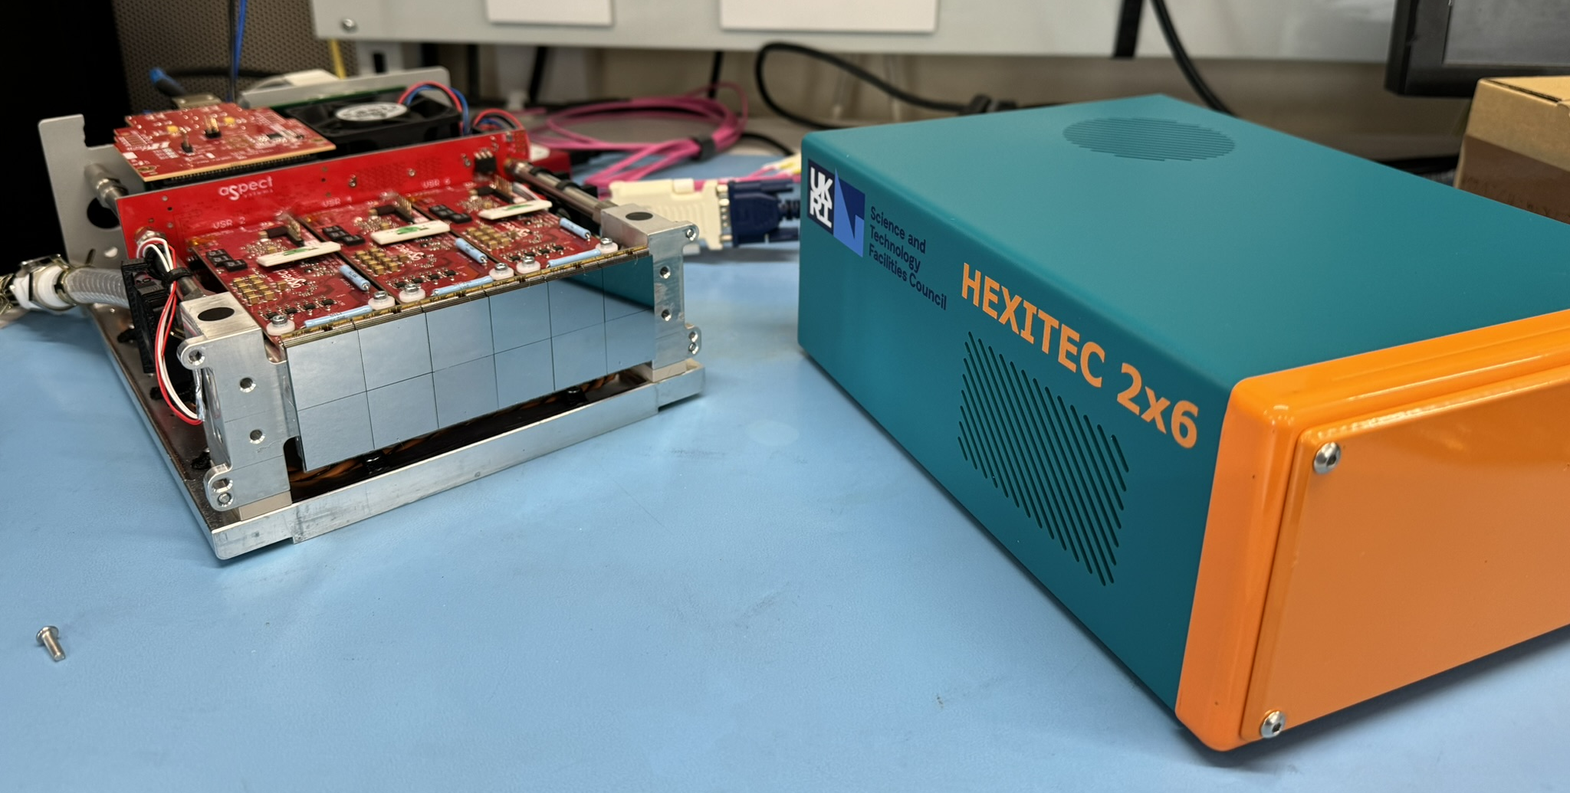
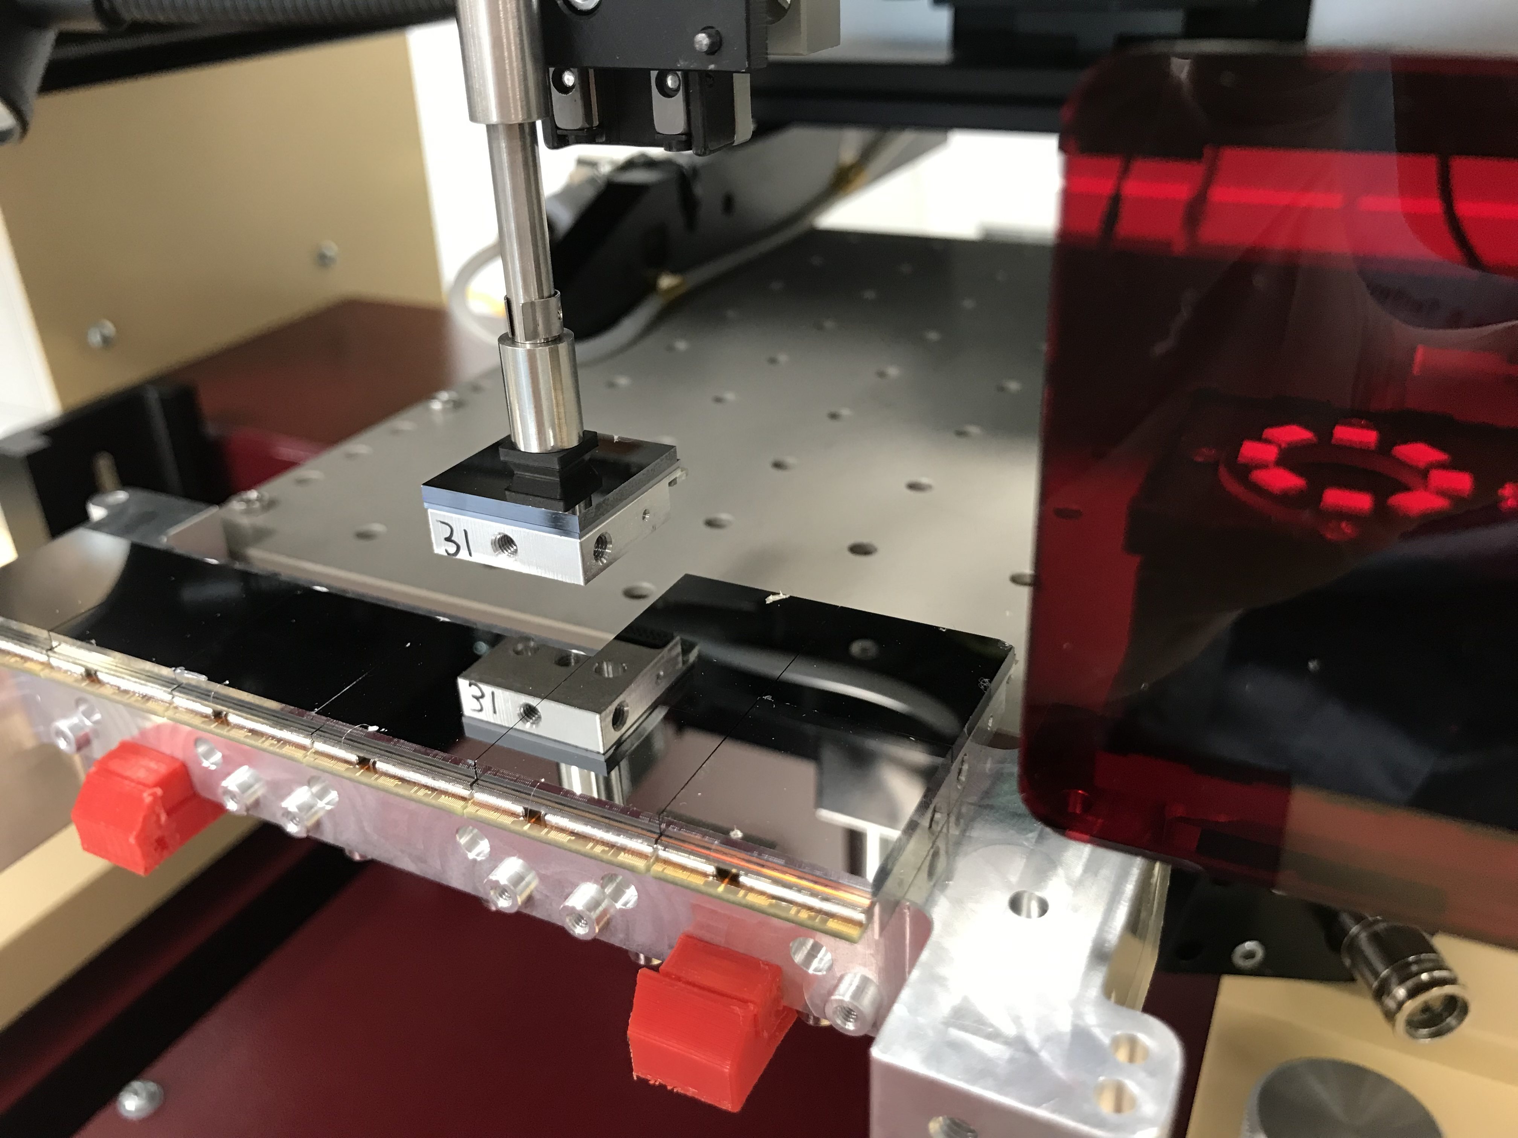
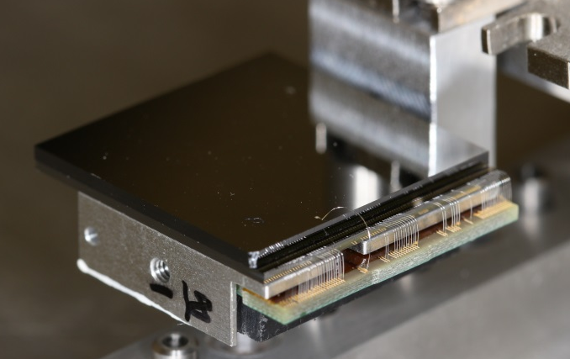
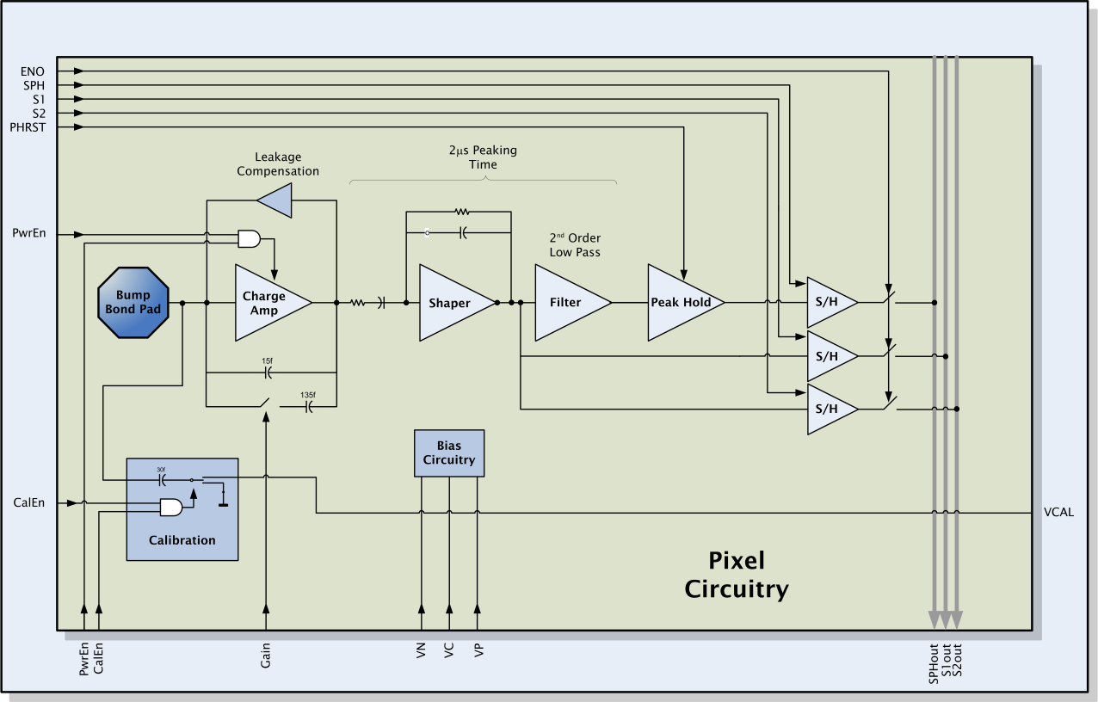
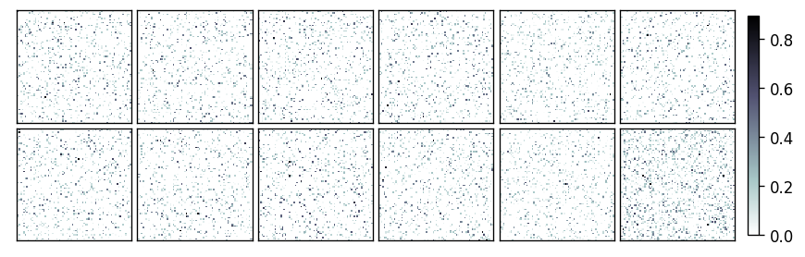
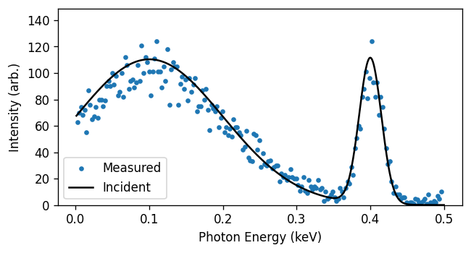
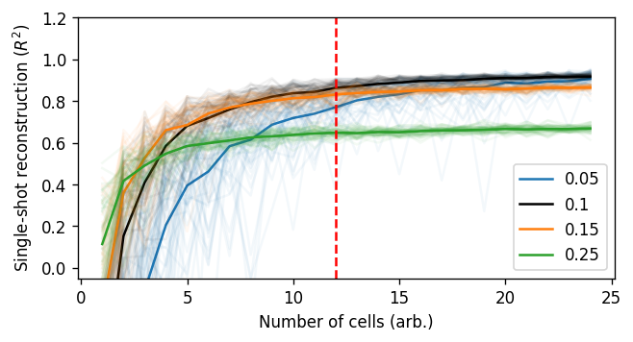
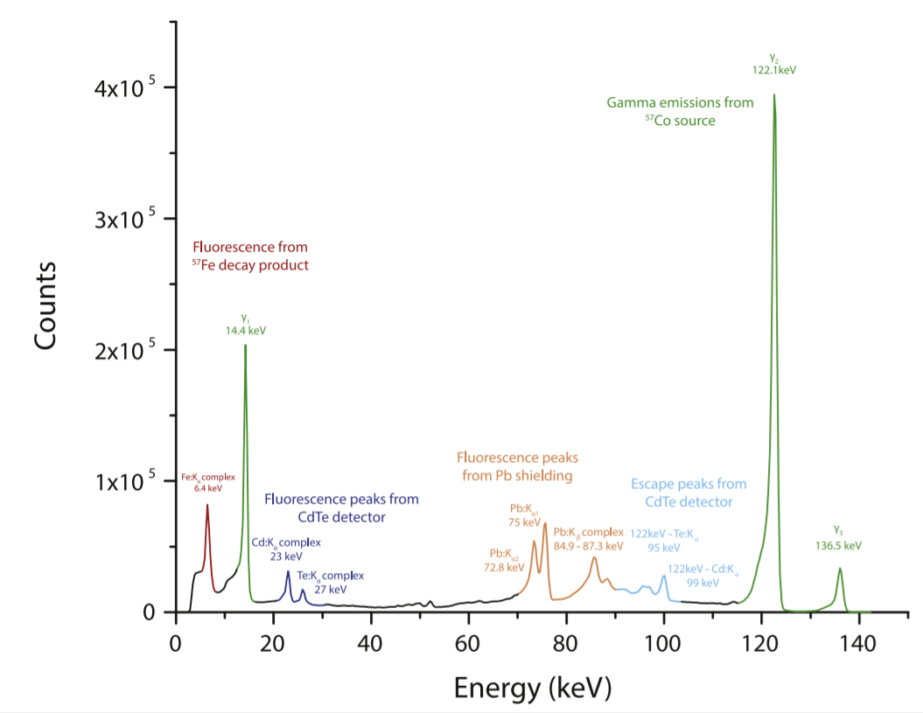
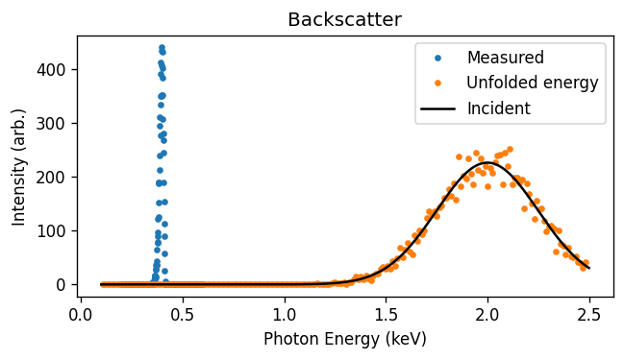

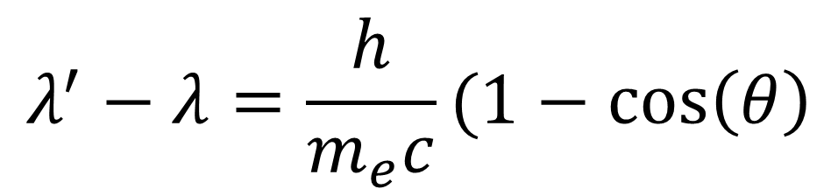




High resolution X-ray characterisation with a pixelated spectroscopic CdZnTe detector
Matt Wilson¹, Christian Angelsen¹, Paul Booker¹, Ivan Church¹, James Hollingham¹, Navid Ghorbanian¹, Tim Nicholls¹, Sooraj Pradeep¹, Matthew Roberts¹, Rhian-Mair Wheater¹ and Chris Armstrong²
Contact: Matt.Wilson@stfc.ac.uk | CLF Lead: Chris.Armstrong@stfc.ac.uk | 1. Technology Department, Science & Technology Facilities Council 2. Central Laser Facility, Science & Technology Facilities Council
Introduction
2x6 Camera
EPAC need to measuring the X-ray energy and spectral profile per shot to calibrate the source and normalise the experimental data.
Detectors with a large number of energy resolving (aka spectral) pixels are needed to capture a sufficient individual photons to build up a spectrum per shot. The detector must operate to 100s of keV and be easy to operate.
The 3 side buttable HEXITEC modules are bonded and assembled and arranging into a 2x6 array in STFC’s clean rooms.
HEXITEC Detector
The 2x6 camera
Has 76800 independent energy resolving pixels
Collects data when triggered up to kHz frame rates
Outputs the energy per pixel per shot over 10G ethernet
Forms a spectrum per shot in software
Operates from 12V and uses water cooling
HEXITEC is an energy resolving detector developed by STFC.
It has 2mm thick CdZnTe to provide good stopping power and spectral performance.
The ASIC has an energy resolving circuit per pixel as below.
Single-shot spectroscopy
Direct
$$z>2m$$
Single-shot reconstruction from laser-plasma interactions requires high energy range, and a high number of samples
A HEXITEC module has
0.25mm pitch pixels
80x80 pixels/module
Energy range of 3-200keV or 6-600keV
~1keV FWHM energy resolution
Indirect
$$λ^{′}−λ=\frac{h}{m_{e}c}(1−\cos\left(θ\right)$$
Pushing to higher energies via Compton scattering can increase the effective range of spectroscopy.
$$θ_{1}$$
$$θ_{2}$$
Outlook
$$θ_{1}$$
$$θ_{2}$$
All parts for the HEXITEC 2x6 cameras have been delivered.
The systems are being assembled and calibrated in the coming months with delivery to EPAC later in 2024.
Backscatter → Higher energies
Forescatter → Higher fluxes
Notes:
Print-ready version
The colours in this template have been adjusted for printing purposes. Use this template if the primary use for your poster will be in print.

