Slide 1
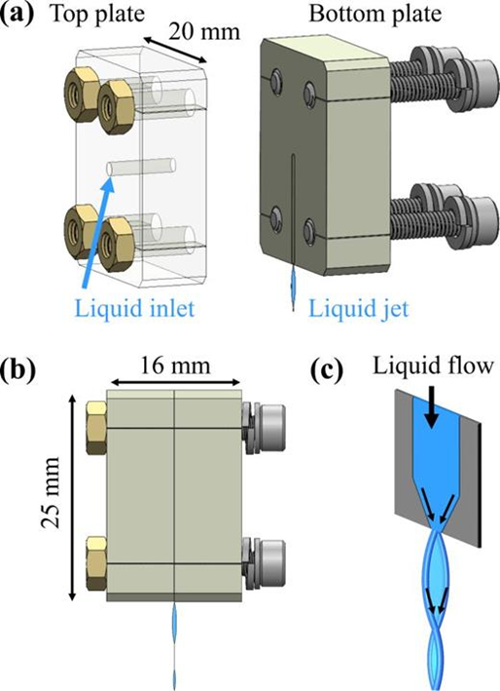
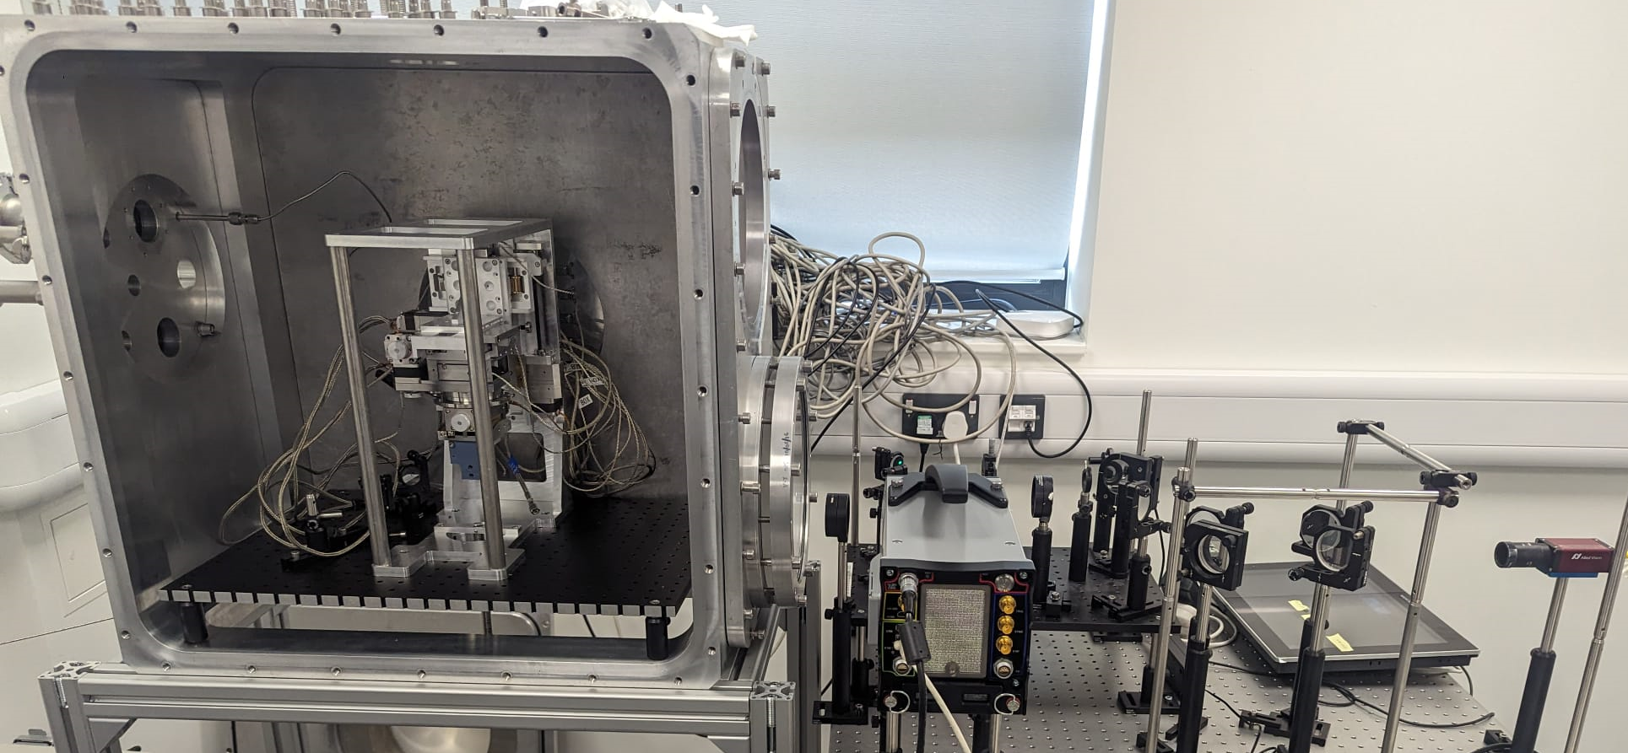
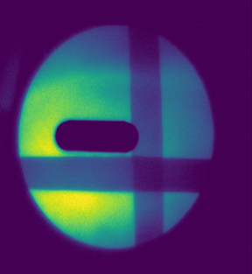
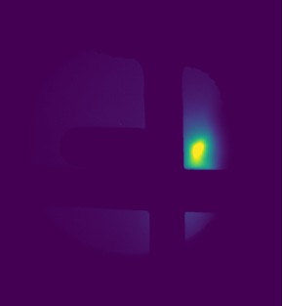
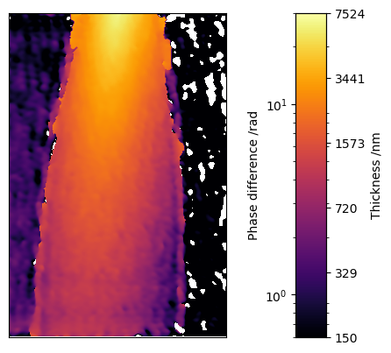
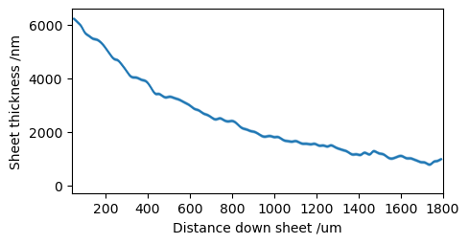
Liquid Sheet Targetry Development for EPAC Experimental Areas
P. Parsons ¹, S. Astbury ², D. Crestani ², D. DePonte ³, H. Edwards ², M. Gauthier ³, G. Glenn ³, S. Glenzer ³, G. Jain ³, W. Robins ², C. Spindloe ², F. Treffert ⁴, C. Palmer ¹
¹ Queen’s University Belfast, UK ²Central Laser Facility, Science and Technology Facilities Council, UK ³SLAC National Accelerator Laboratory, US ⁴Lawrence Livermore National Laboratory, US
Why Liquid Sheets at EPAC?
Design
For EPAC, well-characterised targets supplied at up to 10 Hz will be required. In EA2, many experiments will use high repetition rate (HRR) compatible solid-density targetry, which will likely include tape drives and liquid targets. Liquid sheet targets are ideal for EPAC because:
Can be shot at 10 Hz (up to ≥ KHz rates)
Can produce thicknesses from 10s nm to 10s micron
Produce less debris than HRR solid targetry
Are more stable than HRR solid targetry
Other potential applications at EPAC for liquid sheets:
HRR plasma mirrors – for applications that require high laser contrast
Laser rejection post-interaction (e.g. in laser wakefield setups in EA1)
The use of liquid sheet targets has been demonstrated and commissioned at some HPL and XFEL facilities. Significant R&D is required to develop systems for reliable, high-quality targets for EPAC.
Our focus is on creating liquid sheets using a converging nozzle design – a single jet produces a sheet due to the nozzle converging in one dimension.
Alternative methods:
Two colliding jets
Single liquid jet flattened by two gas jets
3D printing has allowed quick production of prototypes for testing different nozzle geometries.
The liquid must then be collected by a ‘catcher’ and the exhaust vapour/liquid is removed from the chamber.
Challenges:
Maintaining a good vacuum
Avoiding freezing of the sheet
Continuous, stable, long-term operation
Avoiding damage to vacuum system
Resistance of nozzles to laser-induced damage
C
A converging nozzle design [1]
Characterisation
Example Application: High repetition rate ion acceleration
There is a set-up for liquid sheet characterisation in EPAC prep room D. This is currently predominantly looking at thickness measurements. Tests of the liquid sheet target under vacuum and of the catcher system will begin soon.
Liquid sheets can be used as targets for ion acceleration. This has been demonstrated in an experiment in Gemini TA2 using a water sheet target, which generated proton beams at 5 Hz with very desirable characteristics [2]:
Low divergence, up to an order of magnitude less than standard thin foil / tape drive targets:
High stability:
High conversion efficiency and maximum proton energy for given laser energy.
Deuterons have also been accelerated from heavy water sheets [3] and have successfully been used to drive neutron sources.
Thickness Measurements:
Mach Zehnder interferometry:
Can be used live in an experiment
Assumes thinnest part of sheet has less than one wave phase shift (reasonable in most cases)
White light interferometry:
Requires a smooth sheet
Can give information on structure/ smoothness of sheet
Commercial systems exist which can measure points on a sheet (e.g. Filmetrics)
Future characterisation:
Vapour density Measurements:
Low densities (≤ 10¹⁷ cm⁻³ ) make this challenging
Rayleigh scattering or plasma emission measurements may be possible
Debris:
High Speed camera
Witness slides
Nozzle damage mechanisms
100 mrad
Tape drive target:
Water sheet target:
Transatlantic Collaboration
This work involves a collaboration between CLF Target Fabrication, Queen’s University Belfast and SLAC National Accelerator Laboratory (USA), which is supported by funding from the EPSRC, grant number EPSRC-EP/Y001737/1.
Target development:
Learning from experience at SLAC of using liquid sheets for sample delivery at XFEL experiments and as targetry in HPL experiments.
The CLF target fabrication group has complimentary manufacturing and rapid prototyping capabilities.
Experimental:
Gemini TA2 experiment (see above)
Proposals have been submitted for future experiments on ion acceleration from liquid sheets.
Future Work and Aims
Testing and development of catcher system at RAL
Characterisation of vapour density around sheet and debris production
Study laser-induced damage mechanisms of nozzles
Implementation of liquid sheet targetry system in EPAC EA2
Experiment(s) using a liquid sheet target for HRR proton acceleration, especially studying the propagation of the proton beam through the vapour around the sheet.
.
References
[1] F. Treffert, et.al. Phys. Plasmas, 2022; 29 (12): 123105.
[2] M. Streeter et.al. In preparation
[3] F. Treffert, et.al. Appl. Phys. Lett., 2022; 121 (7): 074104
Notes:
Print-ready version
The colours in this template have been adjusted for printing purposes. Use this template if the primary use for your poster will be in print.

