Slide 1
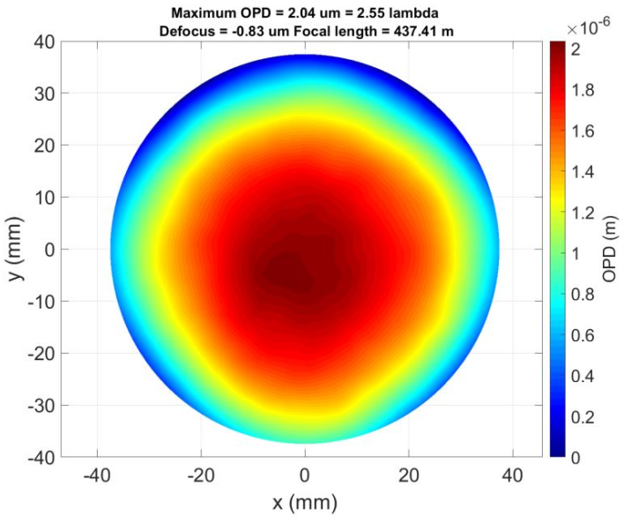
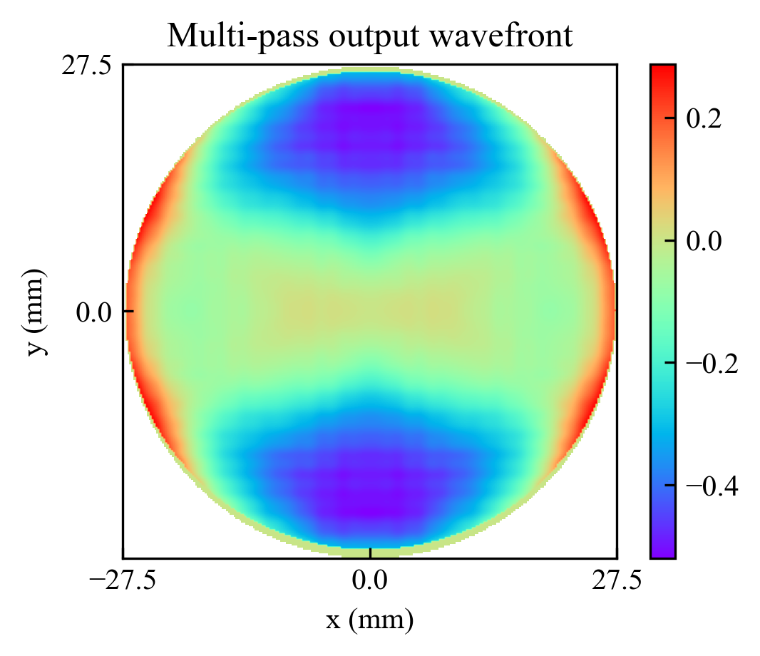
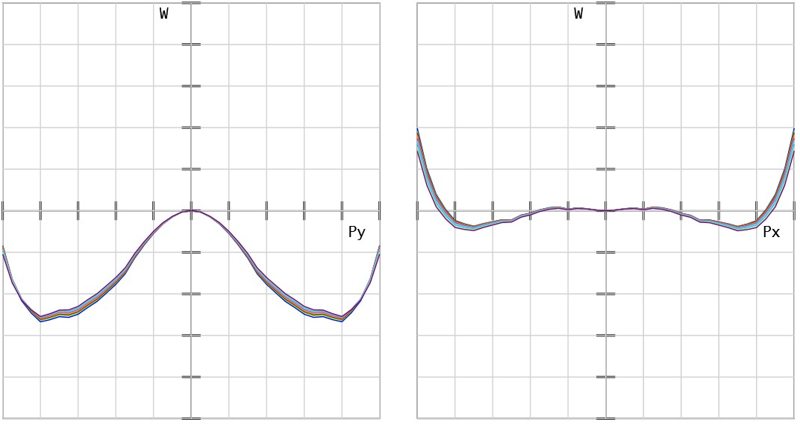
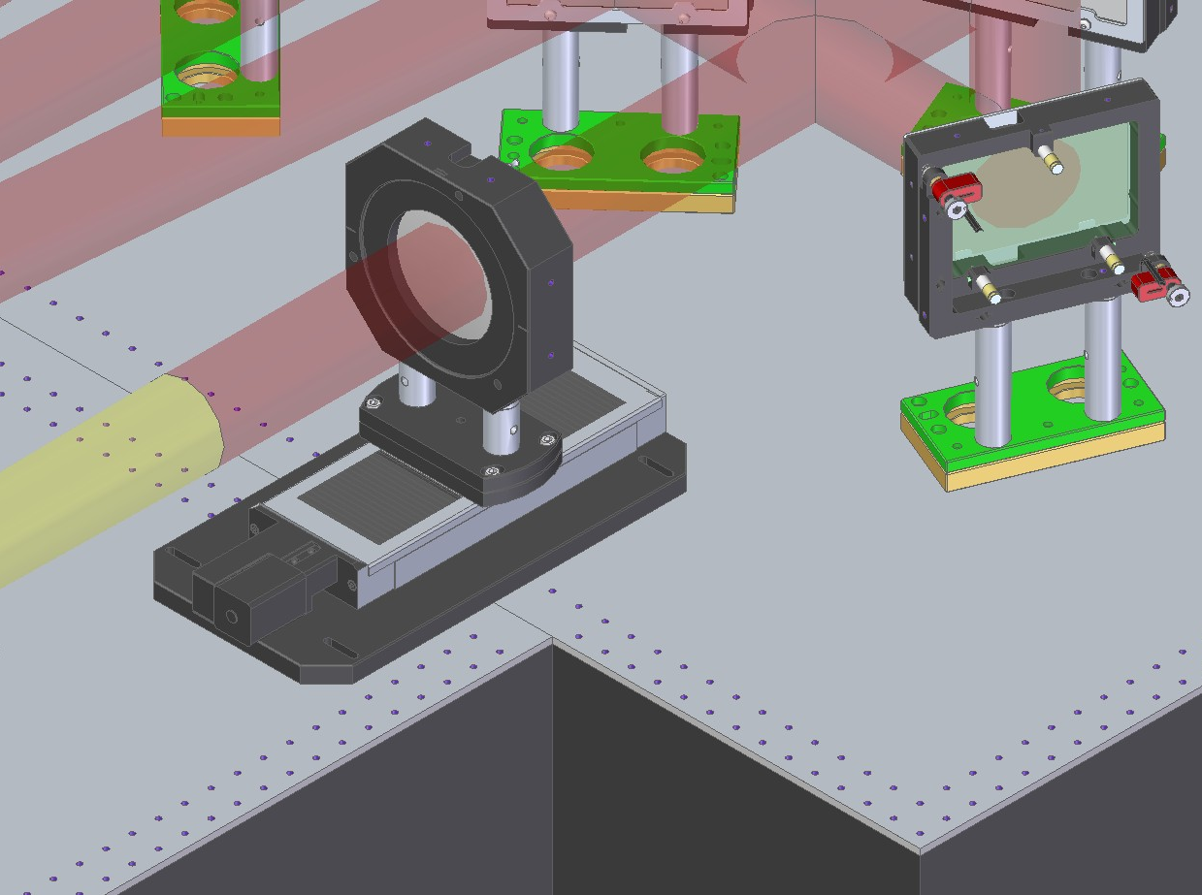
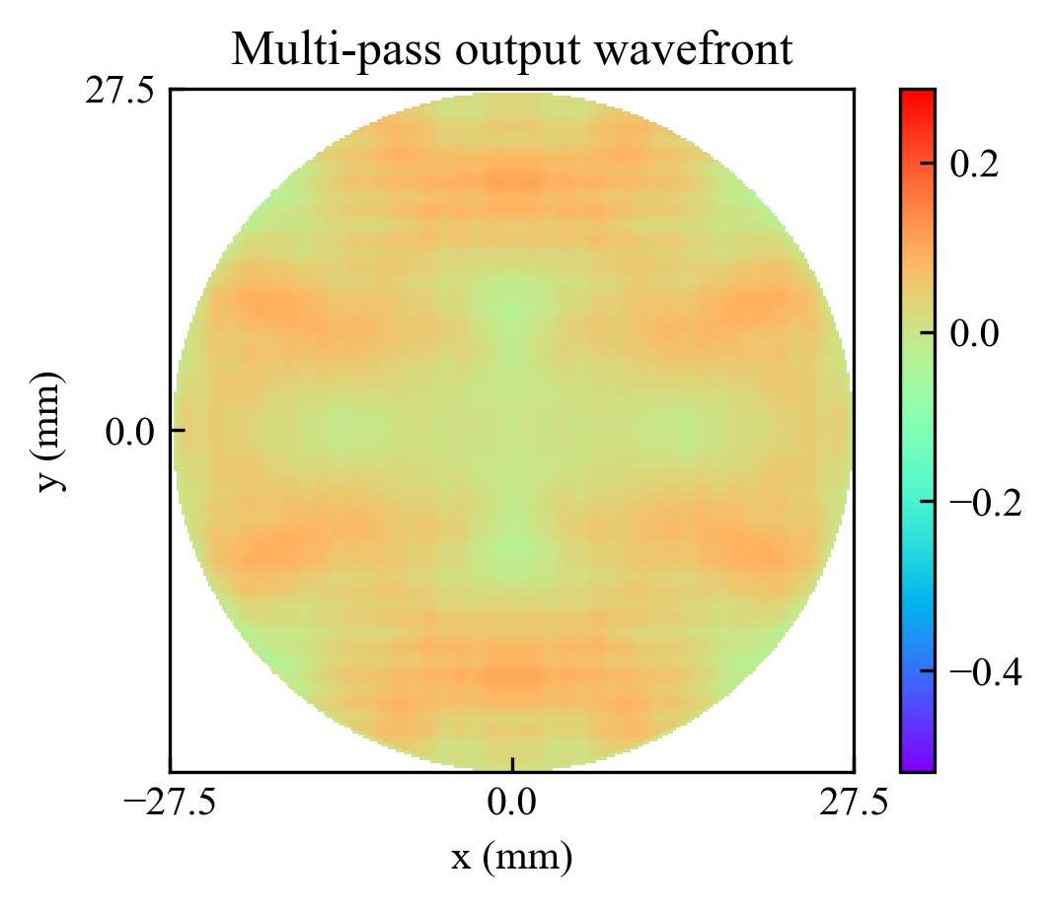
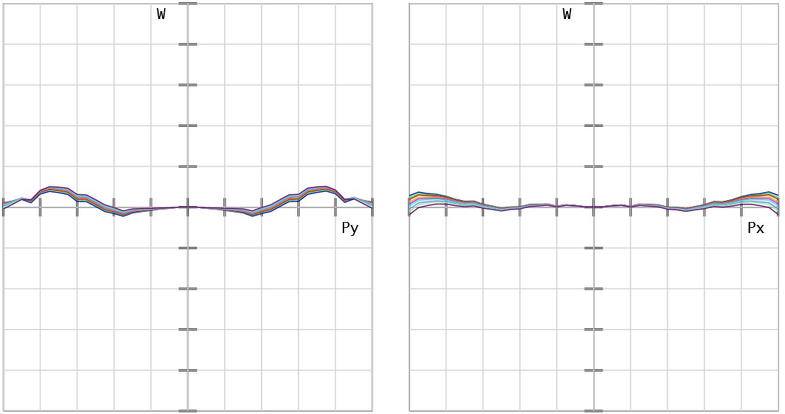
Design of an achromatic multi-pass relay-imaging telescope for the EPAC high-energy Ti:Sa amplifier
Tiago de Faria Pinto, Rob Heathcote, Mark Harman, Paul Mason, Cristina Hernandez-Gomez
Central Laser Facility, Science and Technology Facilities Council, Rutherford Appleton Laboratory,
Harwell Science and Innovation Campus, Didcot OX11 0QX, United Kingdom
Abstract
Thermal lens simulations
System requirements
B_{int} below 0.5 for the entire multi-pass section
Chromatic wavefront error below λ/10
Wavefront error with adaptive optic compensation range
Needs to accommodate large changes in thermal lens
Careful management of focusing reflections
Eliminate 1st order focusing reflections
2nd order focusing reflections away from optics
Thermal lens created on the Ti:Sa crystal has been simulated for various pumping energies and cooling conditions:
Thermal changes to refractive index
Bulk thermal expansion
Stress-induced birefringence
Thermal lens simulations incorporated in the OpticStudio models used to design the imaging system
EPAC multi-pass relay imaging
4-pass cooled Ti:Sa amplifier
1:1 relay telescope between each pass, 3 m focal length
Thermal lens is compensated at each pass to ensure proper collimation and wavefront at the crystal
Vacuum spatial filters to mitigate back-propagating reflections
Characterisation and management of focusing back-reflections
Vacuum spatial filters
Ti:Sa amplifier head
Moveable doublets
S-FPL53
S-FPL53
N-LAK22
N-LAK22
Laser
Custom doublet design
Thermal lens compensation
Challenges:
Focusing back reflections create a plasma in air which compromises subsequent pulses
Tilting the lenses to deflect these reflections severely degrades performance
Low n₂ requirements restrict glass choices
Solution:
Double meniscus doublets
No focusing 1st order reflections
Still has focusing reflections from vacuum windows, but those can be tilted without a performance drop
Second-order ghosts enclosed in vacuum
Peak-to-valley wavefront error after 4 passes below λ
Well within adaptive optic correction
4-pass chromatic aberration below λ/10
B_{int} below 0.12 for all telescopes combined
Input and output doublets are the same to reduce costs
VSF input doublet of each pass moves equal distance to compensate thermal lens changes
Large changes in thermal lens
Caused by changes to pump energy or repetition rate
Lenses move to preset positions for coarse correction
Small changes in thermal lens
Caused by changes to pump-seed timing and day-to-day variation
Lenses finely optimised and wavefront optimised with an adaptive optic
Lenses move 90 mm between cold system and maximum thermal lens (full pumping, no extraction)
Doublet position automated
by the control system
Specifications met over the
full doublet position range
Ghost reflections characterised
over the full movement range
Without simulated AO correction
Future work
June 2024: Optics installation
July 2024: CW alignment
September 2024: Low-energy pulsed alignment
October 2024: High-energy - 1 Hz
November 2024: High-energy - 10 Hz
With simulated AO correction
Notes:
Print-ready version
The colours in this template have been adjusted for printing purposes. Use this template if the primary use for your poster will be in print.

