Slide 1
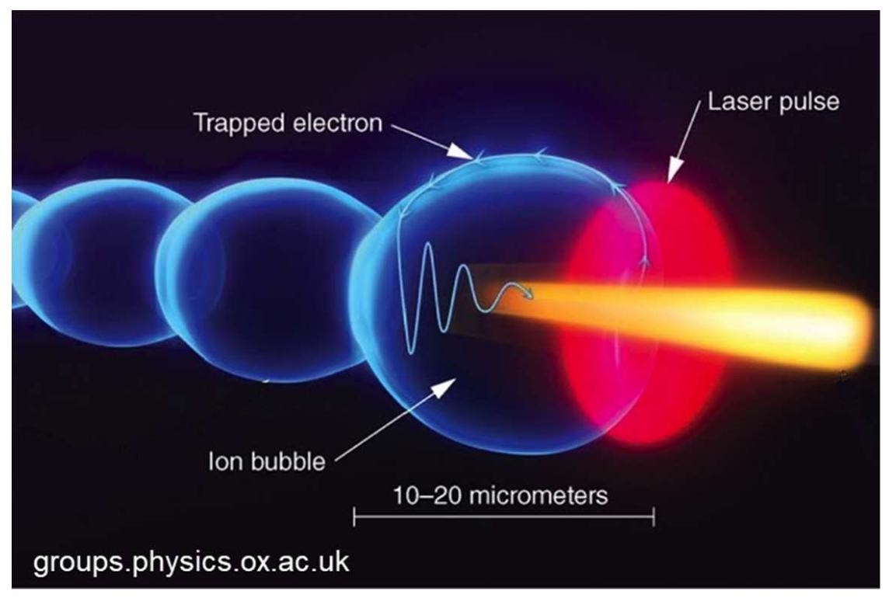
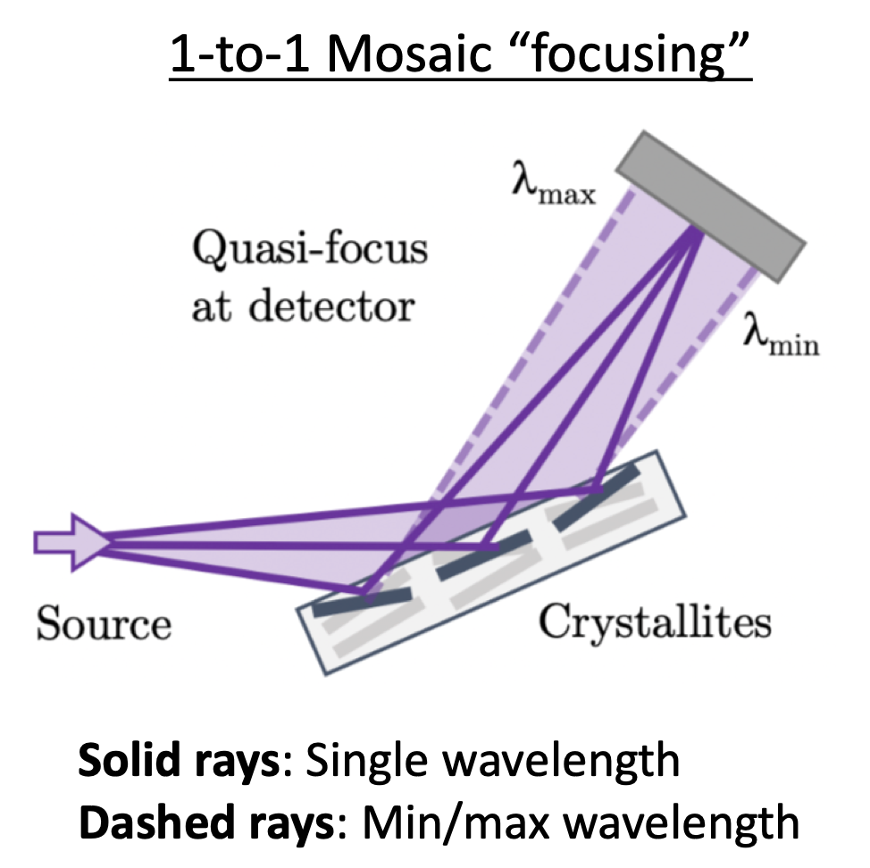
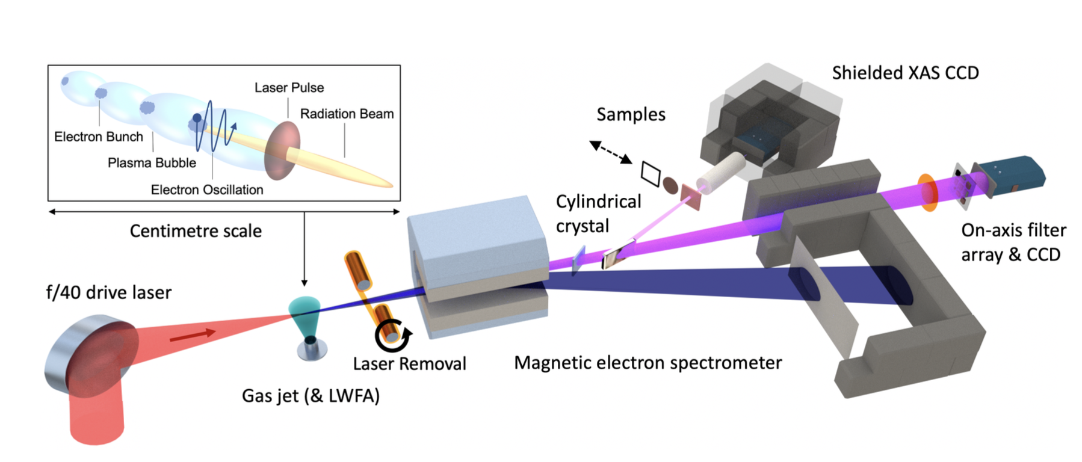
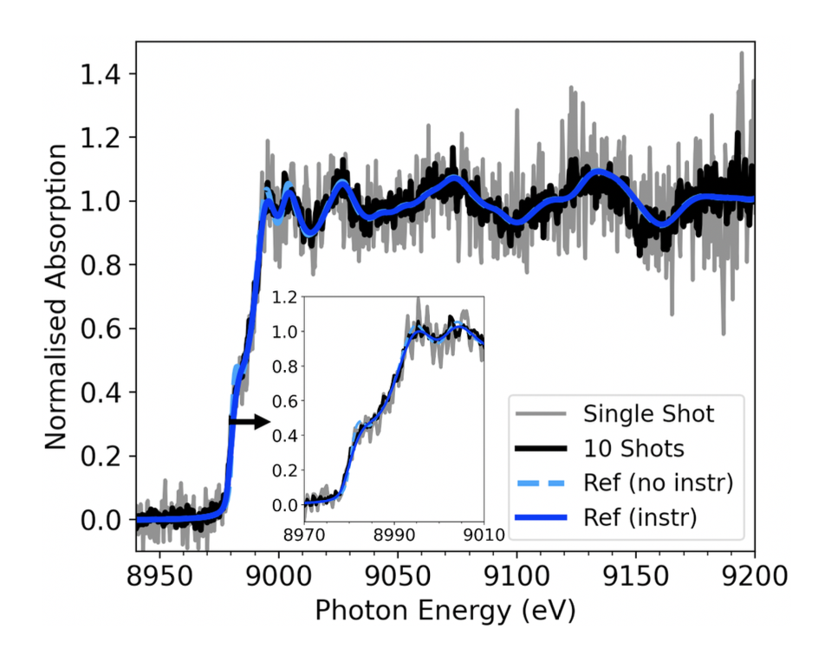
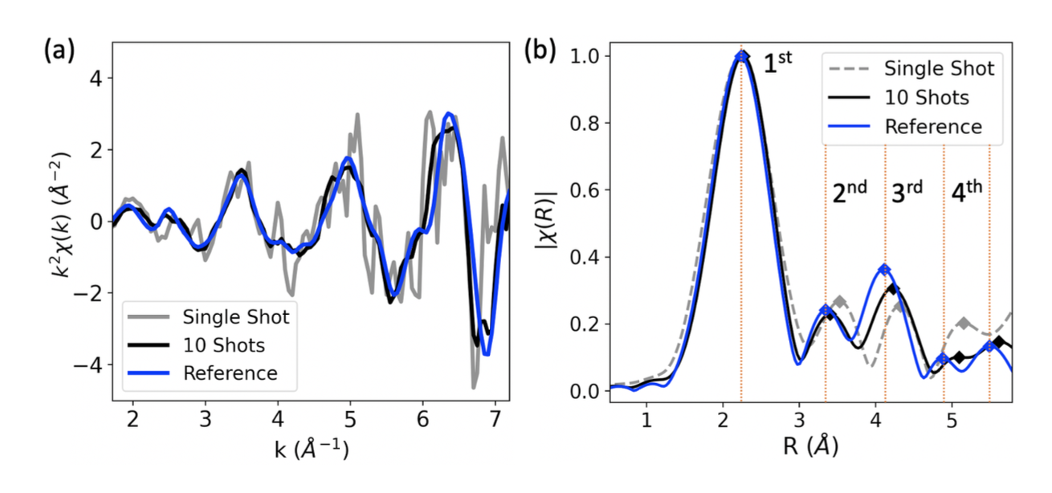
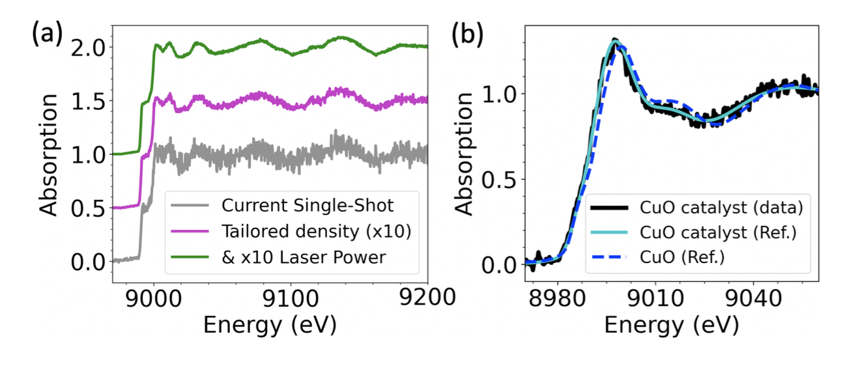
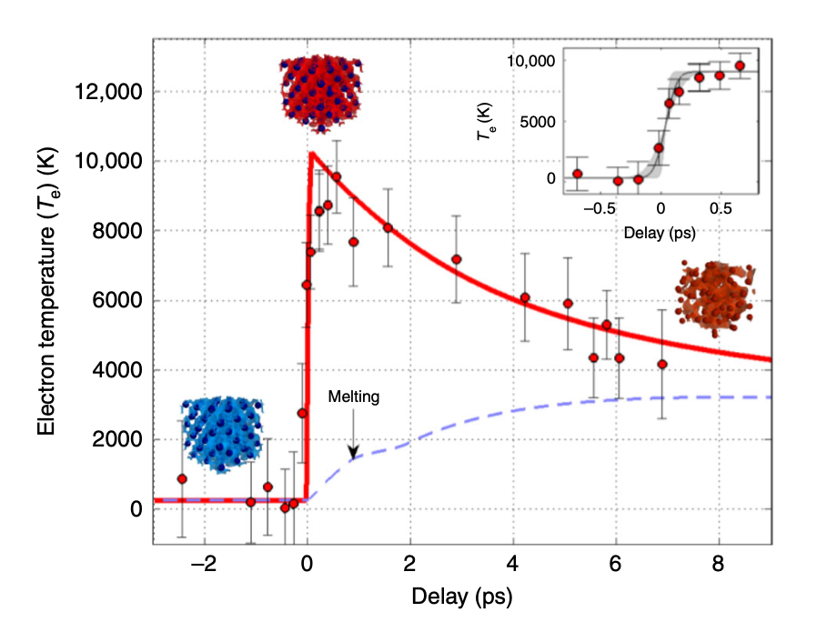
LWFA-driven X-ray Absorption Spectroscopy at the
Extreme Photonics Applications Centre (EPAC)
L.E. Bradley¹, B. Kettle¹, D. R. Symes² & S. P. D. Mangles¹
The John Adams Institute for Accelerator Science, Imperial College London, London, SW7 2AZ
2. Central Laser Facility, STFC Rutherford Appleton Laboratory, Didcot, OX11 0QX
Author email: l.bradley23@imperial.ac.uk
3 EPAC facility
1 Introduction
Betatron X-ray radiation is produced by the transverse oscillations of the electrons as they are accelerated in plasma¹.
The broadband nature of the produced betatron X-rays are suitable for spectroscopic applications.
EPAC Experimental Area 1 (EA1) will be a long focus laser wakefield acceleration area, producing GeV electrons and bright X-rays from keV to tens of MeV.
We aim to develop XAS on EPAC with 10s fs resolution, comparable with X-FEL facilities.
This will create new R&D opportunities for industry such as photocatalyst systems⁶, photobiology⁷ and radiobiology applications⁸.
A dedicated XAS end-station chamber will contain a sample and will be angle adjustable to select sample specific energies for XAS.
A laser wakefield driven source may be used to perform X-ray Absorption Near-Edge Spectroscopy (XANES) and Extended X-ray Fine Structure (EXAFS)² measurements. These methods give information on the local atomic and electronic structure of materials.
The duration of the X-rays is on the order of a few femtoseconds enabling processes on very short timescales to be resolved.
Enables the study of warm-dense matter (WDM)³ , such as found in planetary interiors, to be explored in the laboratory.
Potential to use for femtosecond pump-probe experiments in material and biological science⁴.
Concept of a XAS end-station where the chamber rotates relative to the LWFA x-ray beamline.
X-rays diffract from crystal lattice planes at the Bragg angle.
How to decouple X-ray focus with dispersion?
A different crystal for each element (expensive).
A single mosaic crystal which is adjustable in both focus and dispersion.
2 Ultrafast single-shot X-ray absorption
XAS experimental setup in the Gemini experiment of 2019
4 Industrial use case
Compact, ultrafast single-shot XANES & EXAFS method produces element specific absorption spectrum.
Single-shot XAS proof of principle has been demonstrated on a Gemini experiment at the CLF⁴. 250 eV spectral window achieved with significant improvement in single-to-noise ratio over previous experiments.
Copper K-edge and local atomic structure observed in a single shot⁵.
We are collaborating with Johnson Matthey to explore the potential of fs-XAS for in-situ time-resolved characterisation of catalysts.
Tunable XAS in soft and hard X-ray energy range enables study of carbon, oxygen, sulphur and metals simultaneously.
Possible combination of XAS, microscopy and x-ray diffraction and multi-modal imaging of fuel cells.
Multi-mode imaging of a working fuel-cell or water electrolysis set-up.
Normalised absorption spectrum for 4 micron of copper. Inset: XANES profile.
EXAFS k-space (a) and R-space (b) showing oscillations and peaks of first four neighboring atoms.
Warm-dense matter is near solid density at 1 – 100 eV (a few 10⁴ K) temperatures.
WDM studies use a ns pulse to heat up the target and probe with a delayed fs X-ray pulse.
XAS allows electron and ion temperatures to be measured in WDM.
(a) Expected signal improvement using EPAC; (b) measured absorption profile for copper oxide catalyst.
References
[1] L. M. Chen et al Bright betatron X-ray radiation from a laser-driven-clustering gas target Sci. Rep. 3, 1912 (2013)
[2] F. Albert et al Laser wakefield accelerator based light sources: potential applications and requirements Plas. Phys. Con. Fus. 56, 084015 (2014)
[3] B. Mahieu et al Probing warm dense matter using femtosecond X-ray absorption spectroscopy with a laser-produced betatron source Nature Comms 9,3276 (2018)
[4] B. Kettle et al Single-Shot Multi-keV X-Ray Absorption Spectroscopy Using an Ultrashort Laser-Wakefield Accelerator Source Phys. Rev. Lett. 123, 254801 (2019)
[5] B. Kettle et al X-ray absorption spectroscopy using an ultrafast laboratory-scale laser-plasma accelerator source arXiv:2305.10123 (2023)
[6] S. H. Park et al Direct and real-time observation of hole transport dynamics in anatase TiO2 using X-ray free-electron laser Nature Comms 13, 2531 (2022) [7] C. Bressler and M. Chergui, Molecular Structural Dynamics Probed by Ultrafast X-Ray Absorption Spectroscopy Annual Review of Physical Chemistry 61, 263 (2010)
[8] G. N. George et al X-ray-induced photo-chemistry and X-ray absorption spectroscopy of biological samples J. Synchrotron Rad 19, 875-886 (2012)
Electron temperature time evolution from [3] showing the electron-ion thermal equilibration.
Notes:
Print-ready version
The colours in this template have been adjusted for printing purposes. Use this template if the primary use for your poster will be in print.

