Slide 1
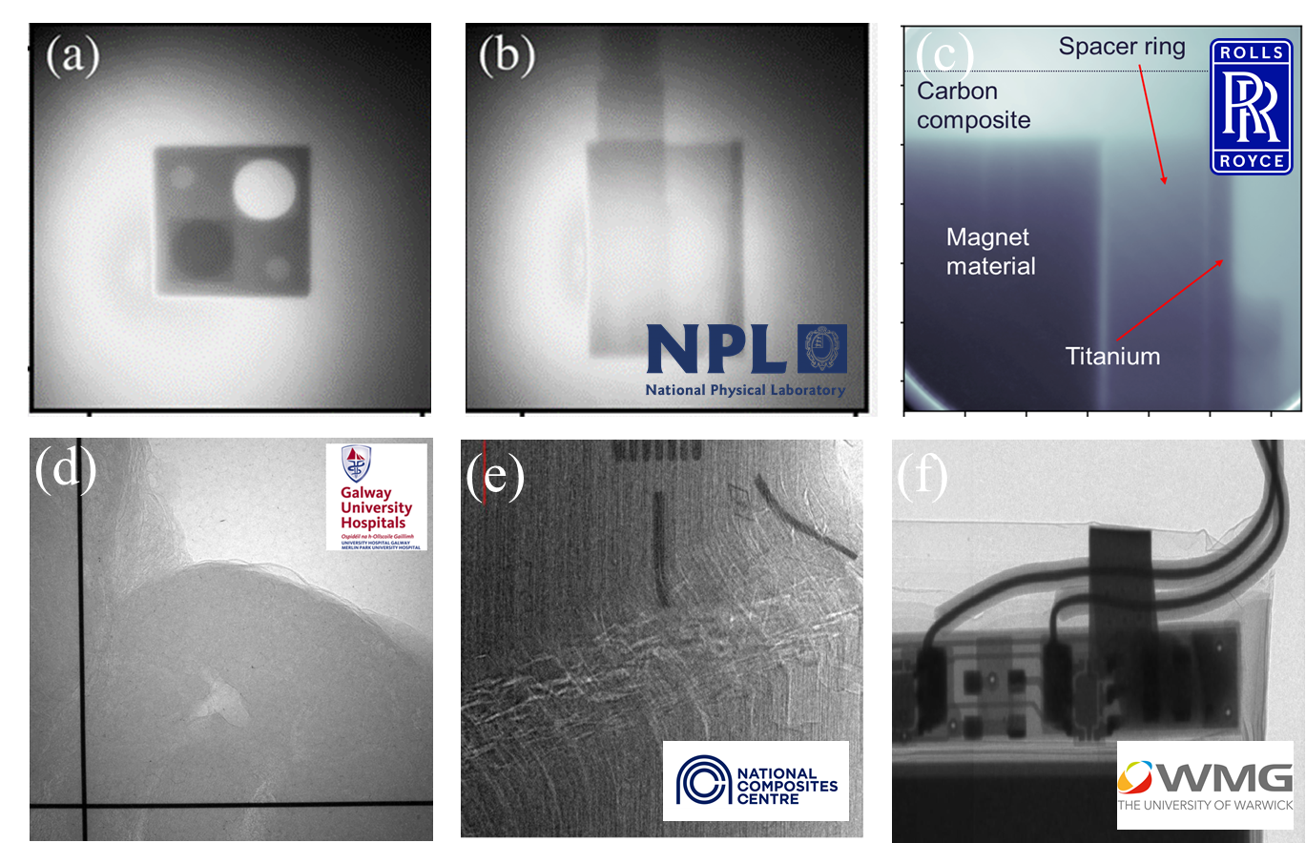
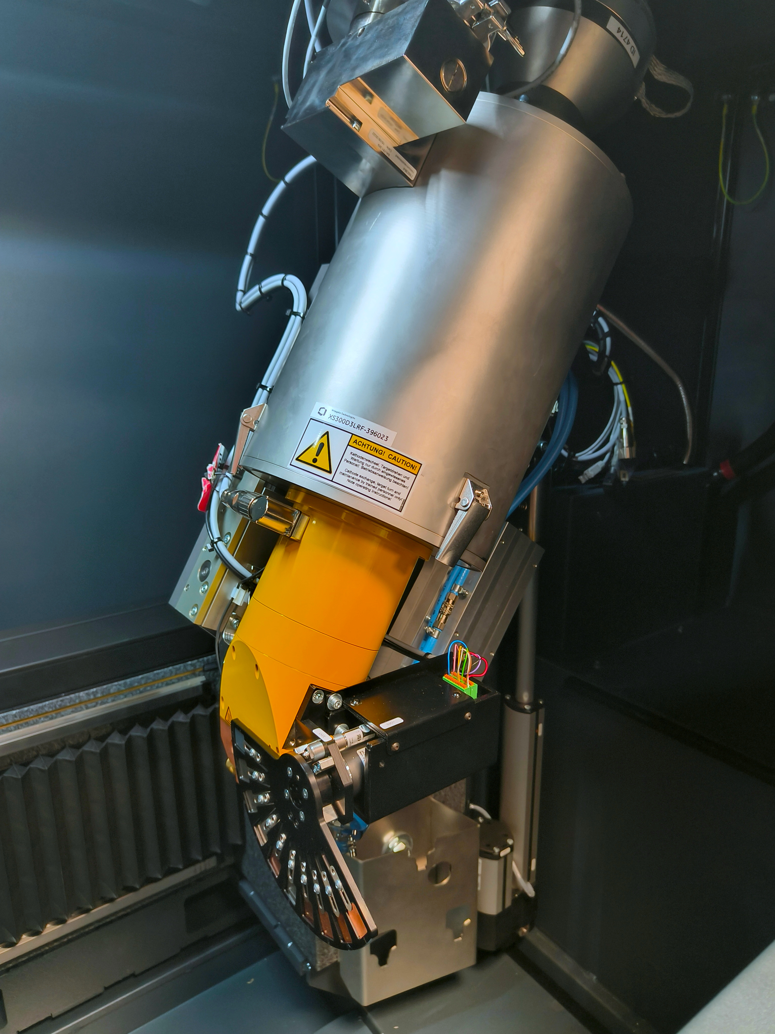
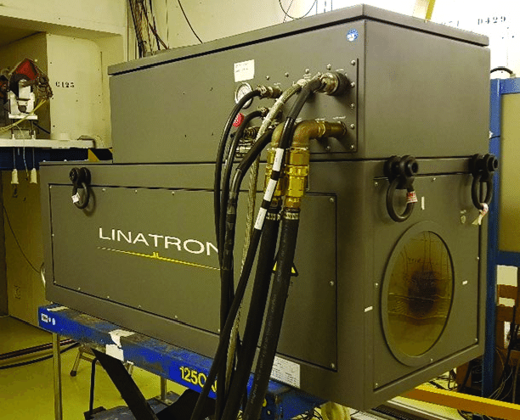
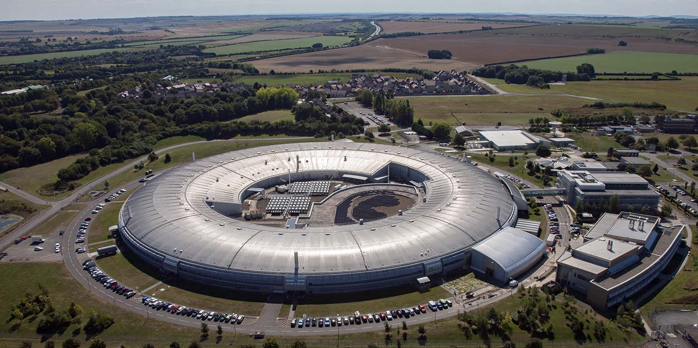
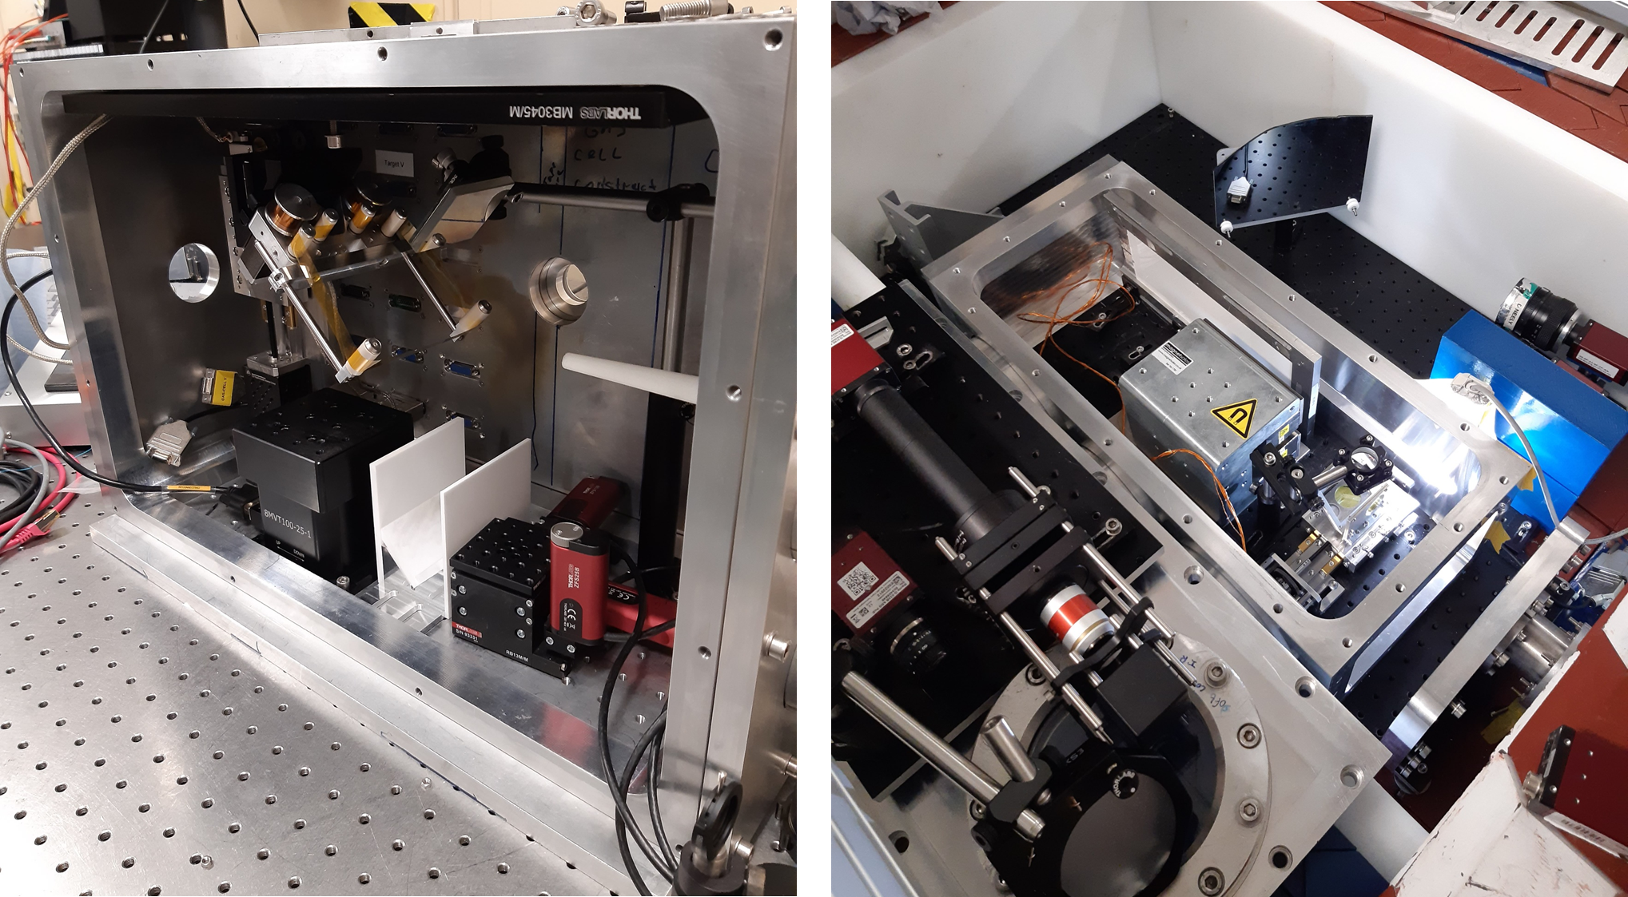
Industrial X-ray Computed Tomography at the
Extreme Photonics Applications Centre (EPAC)
E. Kiely¹, J. M. Warnett¹, M. J. V. Streeter², D. McCartney², C. A. McAnespie², G. Sarri², C. D. Armstrong³, A. Bhardwaj³, K. Fedorov³, J. Watts³, O. J. Finlay³, N. Bourgeois³, T. Dzelzainis³, Z. Athawes-Phelps³, R. Lyon³, S. J. D. Dann³, B. Spiers³, S. Devadesan³, W. Robins³, A. Thomas³, R. Sarasola³, D. Bloemers³, I. Symonds³, B. Morkot³, & D. R. Symes³
1. WMG, University of Warwick, Coventry, CV4 7AL; 2. School of Mathematics and Physics, Queen’s University Belfast, BT7 1NN
3. Central Laser Facility, STFC Rutherford Appleton Laboratory, Didcot, OX11 0QX
Introduction
X-ray Computed Tomography (XCT) is a non-destructive method for industrial inspection – in particular for complex internal structure.
X-ray tubes, LINACs and synchrotrons are widely used, but have limitations in flux, resolution, or accessibility.
This motivates R & D into new compact light sources delivering exceptional performance with deployable technologies.
Laser plasma accelerators can meet this challenge, providing tuneable, pulsed, high-energy x-rays that could be used for rapid, dynamic imaging with μm-scale resolution.
Laser wakefield acceleration generates electrons in the GeV range within centimetres
X-rays are produced through betatron emission, inverse Compton scattering, or bremsstrahlung in a foil¹.
EPAC will develop laser-plasma technology to deliver a viable option for industry.
Proof-of-principle experiments
Feasibility studies using Gemini have demonstrated imaging with each x-ray generation method:
Phase contrast imaging with 20 keV betatron emission
Penetrative imaging with MeV bremsstrahlung
Generation of high energy photons through inverse Compton scattering
Variations in the laser and target properties cause x-ray instability, impacting the quality of images produced.
(a) & (b) Tomographic scan of NPL test piece using high energy ICS radiation²; (c) MeV bremsstrahlung radiograph of Rolls Royce rotor³; (d – f) phase contrast using betatron emission of a kidney sample, a kink-band failure in a composite cylinder⁴, and a pouch cell⁴.
Laser-driven x-ray source development
The test beamline in Gemini Target Area 2 will address stability issues
Implement active stabilisation of laser pointing and focusing
Develop control code for automated optimisation routines
Optimise imaging performance and test XCT routines
Test verification methods of source and XCT set up
This work will prepare for EPAC by establishing robust imaging protocols at industrial standard
Internal chamber houses the gas target and tape-drive beam dump. There is space after the accelerator for quadrupole magnets or a sample; diagnostic chamber contains a YAG:Ce scintillator screen, dipole magnet spectrometer, & x-ray camera.
X-ray tomography in EPAC Experimental Area 1
EPAC Experimental Area 1 will be configured as a GeV-scale Laser Wakefield Accelerator beamline
During facility commissioning, we will demonstrate the unique capabilities of these x-ray sources for dynamic, high resolution imaging on fast timescales.
References
[1] F. Albert et al., Laser wakefield accelerator based light sources: potential applications and requirements, PPCF 56, 084015 (2014).
[2] C. A. McAnespie et al., Characterisation of an all-optical inverse Compton scattering source for industrial imaging, CLF Ann. Rep. (2023).
[3] M. Gear et al., Industrial imaging using bremsstrahlung generated by a laser-plasma accelerator, CLF Ann. Rep. (2022).
[4] J.-N. Gruse et al., Application of compact laser-driven accelerator X-ray sources for industrial imaging, NIMA 983, 164369 (2020).
Notes:
Print-ready version
The colours in this template have been adjusted for printing purposes. Use this template if the primary use for your poster will be in print.

