Slide 1
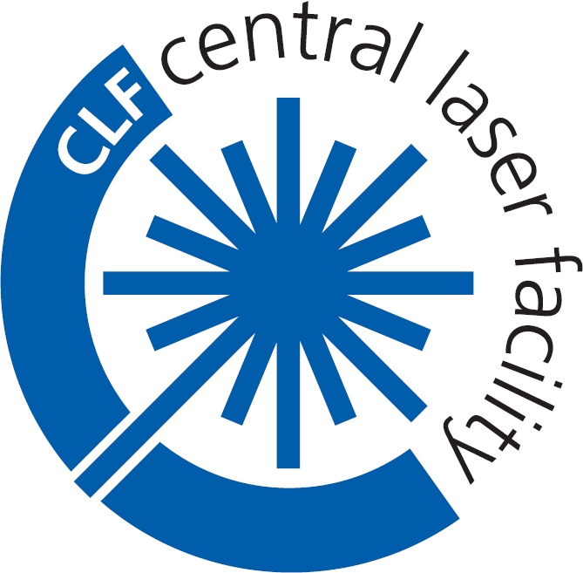


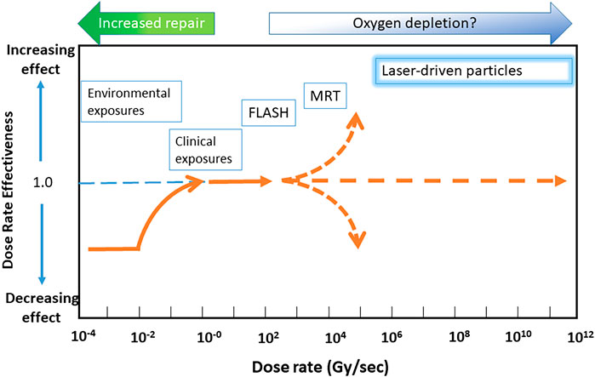
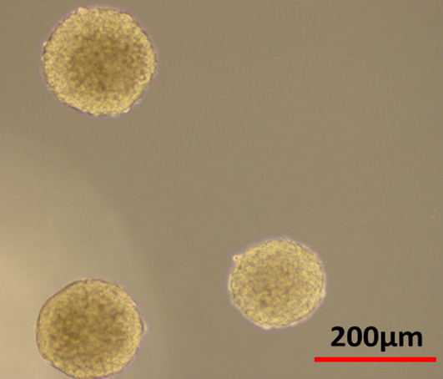
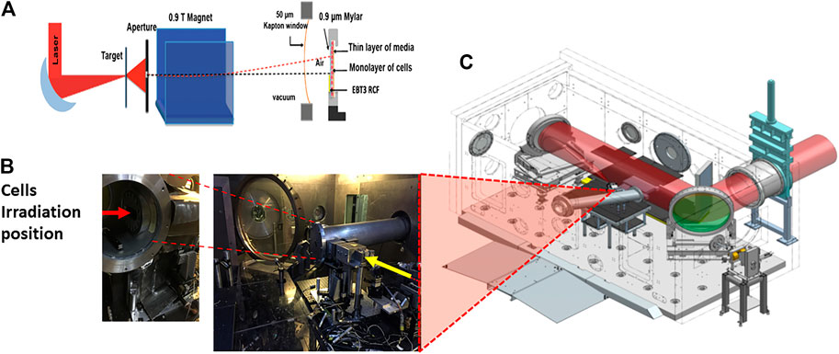
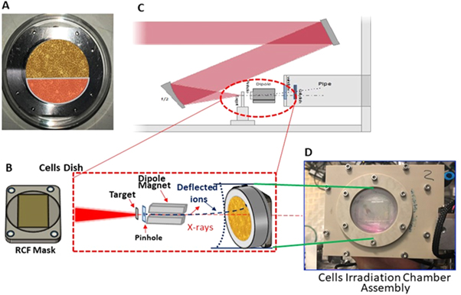
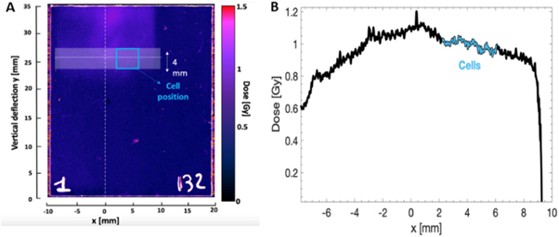
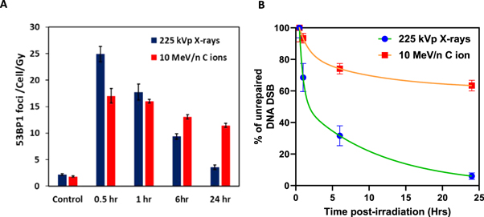
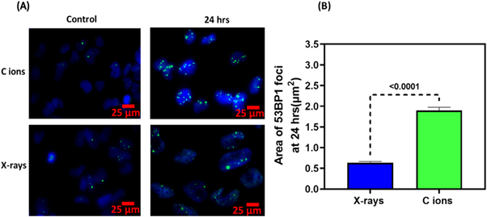
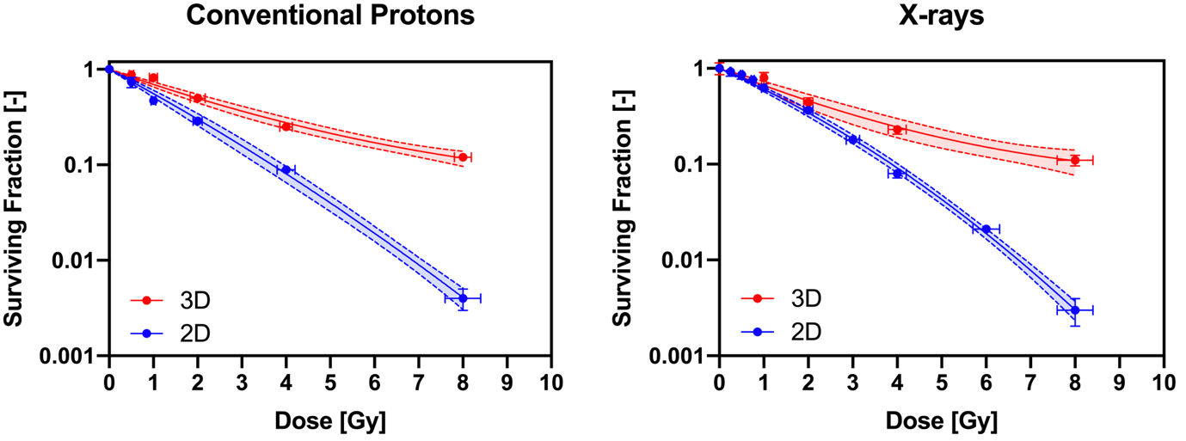
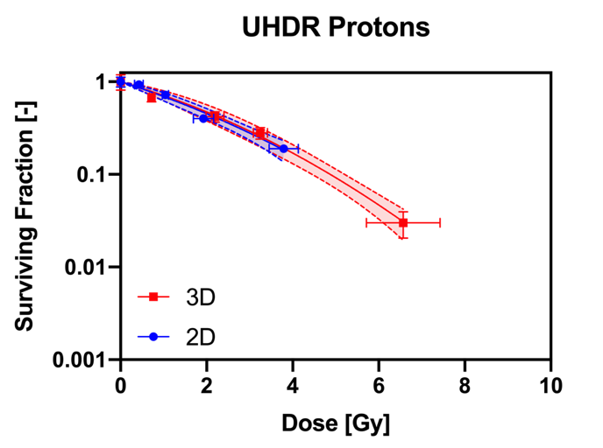
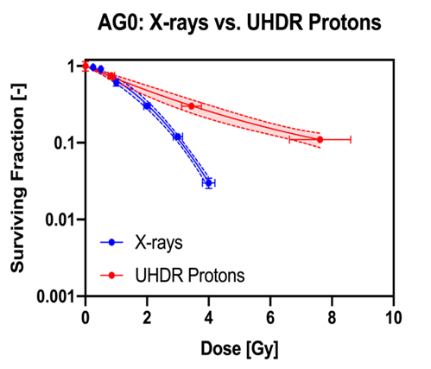
Radiobiology experiments in EPAC Experimental Area 2
Pankaj Chaudhary¹ , Hamad Ahmed²,Giuseppe Schettino¹, Kevin M Prise³ and Marco Borghesi⁴
1. National Physical Laboratory, Hampton Road Teddington, Middlesex, 2. Experimental Science Group, Central Laser Facility, Rutherford Appleton Laboratory, Didcot, Oxford, OX11 0QX, England, United Kingdom. 3.The Patrick G Johnston Centre for Cancer Research, Queen’s University Belfast, UK. 4. Centre for Light Matter Interaction, School of mathematics and Physics, Queen’s University Belfast, UK.
Ultra-high dose Radiobiology
The use of proton radiotherapy is well known for sparing normal tissues and increasing the overall therapeutic index. Recent studies show that normal tissue sparing can be further enhanced through proton delivery at 100 Gy/s and above, in the so-called FLASH regime.
Laser-accelerated proton beams have unique temporal emission properties, which can be exploited to deliver Gy-level doses in single or multiple pulses at dose rates exceeding, by many orders of magnitude, those currently used in FLASH approaches.
An extensive investigation of the radiobiology of laser-driven protons (and ions) is not only necessary for future clinical application, but also offers the opportunity of accessing yet untested regimes of radiobiology. Some of the pioneering work on radiobiology studies using laser-driven ions was carried out at the CLF’s laser facilities by researchers at Queen’s University Belfast (QUB).
Figure 1 - Representation of dose rate effectiveness as a function of dose rate. Various radiotherapy modalities are displayed according to their approximate DREF values and dose rates. Abbreviations: MRT, Microbeam Radiotherapy.
Ultra-High dose Radiobiology Experience on Vulcan TAP
Radiobiology experiments on Gemini
Ions Accelerated : protons
Energy: up to 40 MeV
Proton pulse Duration: ~ 700 ps
Cellular Models: Human Normal and Brain Tumour Organoids
Endpoints: DNA Damage and Cell Survival
Ions Accelerated : protons and carbon ions
Energy: up to 15 MeV protons and 10 MeV/n C ions
Pulse Duration: ~500ps – 1ns for protons and C ions
Cellular Models: Human Normal and Brain Tumour Cells
Endpoints: DNA Damage
Glioblastoma Stem cells 3D neurospheres and normal human skin fibroblast showing radiation induced DNA DSB damage foci
Figure-4. Irradiation set up and carbon ions used at GEMINI as shown in Pankaj Chaudhary et al 2023 Phys. Med. Biol. 68 025015
Figure-2. (A) Schematic of the arrangement of the target, aperture, magnet, beam exit and cells. (B) Actual image showing the laser target interaction point setup along with the beam exit and sample irradiation position. (C) Overview of the Laser Interaction chamber of the Vulcan Target Area Petawatt Laser.
Key results:
We demonstrated a method of accelerating carbon ions at ultrahigh dose rates
and characterized DNA damage induction by high LET Carbon ions.
Our study demonstrates the feasibility of radiobiology investigations at unprecedented dose rates using laser-accelerated high-LET carbon ions in clinically relevant models.
Results :
We demonstrated a method of accelerating protons at ultrahigh dose rates (UHDR) and characterized key radiobiological features at such dose rates.
At UHDR, normal Cells (AG01522) showed higher degree of sparing than
brain tumour cells.
Laser-driven ions effectively induce cell killing in radioresistant 3D
neurospheres of GBM stem cells over-riding the impact of tumour
microenvironment.
RBE
Future experiments on EPAC
Conventional dose rate protons in 2D monolayers showed RBE of 1.21 ± 0.09 relative to X-rays while 3D neurospheres showed resistance with RBE decreasing to 0.65 ± 0.05.
As EA2 comes online, it will be a unique platform for the user community to conduct experiments harnessing its high repetition rate capability and stability to collect an unprecedented breadth of data to significantly progress the field of UHDR radiobiology. Such experiments on EPAC will require:
Proton or carbon ion beams up to 10s MeV/n. Initial experiments would likely be conducted in 10-40 MeV proton range, but as EA2 develops, beams in the range of 50-100 MeV could be more routinely available.
Tuneable ion beam energy to sample, either from selected acceleration or post-target beam transport with diagnostics to monitor critical beam parameters.
Ability to irradiate a sample with multiple doses in short succession or large number of individual samples in a single data run.
Acknowledgements:
The authors acknowledge the funding received from the Engineering and Physical Sciences Research Council (EPSRC), through Grants EP/K022415/1, EPJ500094/1 and EP/P010059/1.
We would like to acknowledge the support of the mechanical engineering staff of the Central Laser Facility and the staff at the Research Complex, STFC.
Notes:
Print-ready version
The colours in this template have been adjusted for printing purposes. Use this template if the primary use for your poster will be in print.

