Slide 1


EPAC ISTAC
Commissioning plan for 2024-25
Cristina Hernandez-Gomez
May 2024
Notes:
The abstract pattern can be removed or repositioned if required. Be careful to ‘Send to Back’ so that it does not obscure any important information.

Slide 2
Overview
Commissioning activities
Commissioning activities in the laser started in September 23
Requires coordination with ongoing installation tasks
Hold weekly meetings to assess progress and coordinate with some installation tasks
There has been delays with key laser systems : Diode pumps for 100 J amplifier and the front end ns OPCPA pump, both expected to have SAT upcoming weeks
There is a partition wall installed between the compressor are and Ti:Sa amplifier area to separate commissioning and installation activities
The gratings will be delayed so expecting to commissioning parts of beam transport ahead of compressor
Looking a coordination of commissioning activities and installation in the experimental areas in the coming months

Slide 3
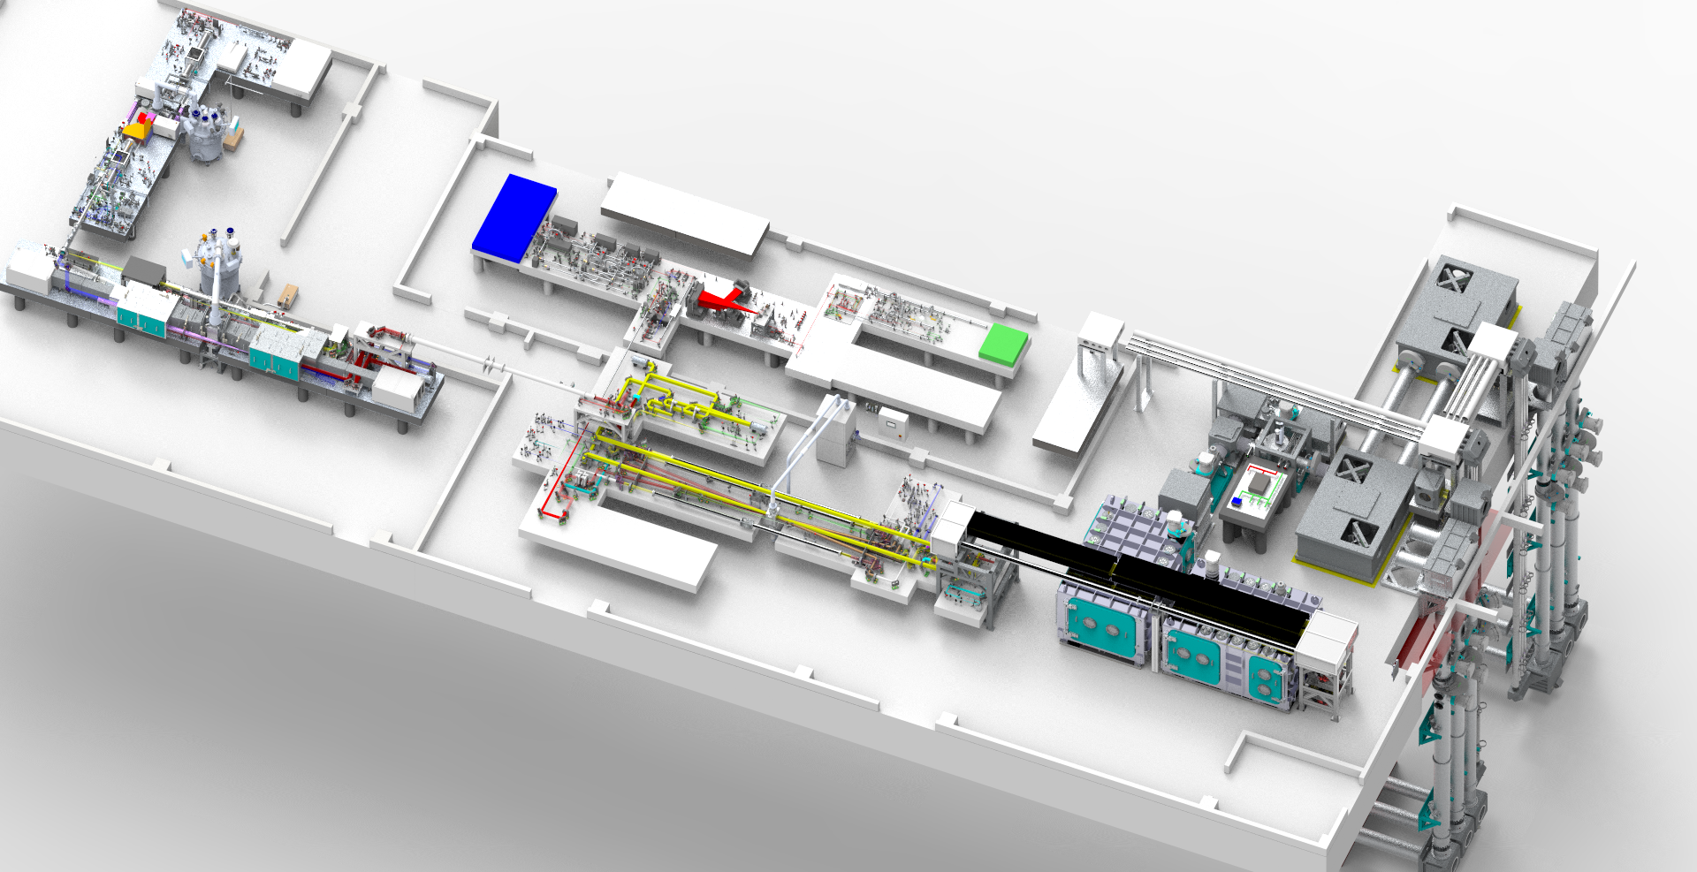
EPAC
EPAC Front End-Seed
Beam transport
EPAC specification
1PW@10Hz
Output Energy 20 J day 1
Pulse duration ≤ 30 fs FWHM
Repetition rate 10 Hz, 1 Hz, Shot on Demand
Different energy modes available
DPPLS Pump
Green conversion
Ti:Sa High Energy Amplifier
Compressor & diagnostics
EPAC seed
10 Hz TiSa Amplifier
Compressor
Beam propagation
Experimental Areas
EPAC pump
2 W Conversion

Slide 4
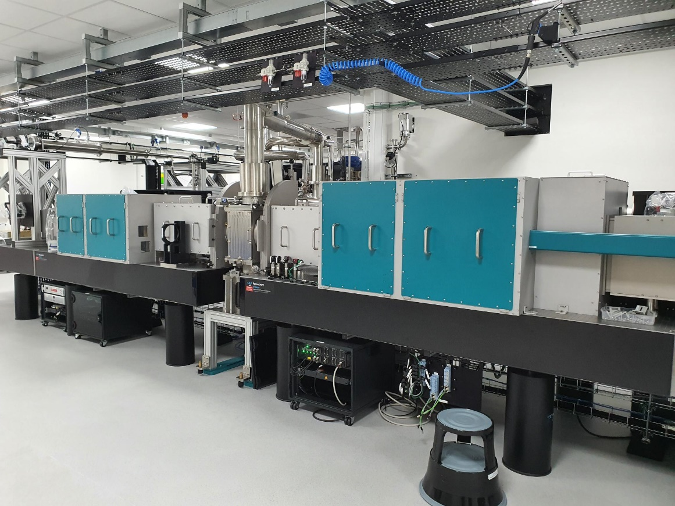
Pump
Pump Front end
10 J Cryo amplifier
100J Cryo amplifier
Beam transport
Commission single PUMP operating at two repetition rates 1Hz and 10 Hz . Energy will ramp up to a maximum of 120J . Beam will be directed to Ti:Sa amplifier beam transport
Beam will be ready to inject to Ti:Sa room using alignment mode prior to full energy commissioning
Commissioning activities started in September 23 with front end
May 24
June
July
August
September
October
November
December
Jan 25
Feb 25
CW alignment
1 Hz Pulse commissioning
10 Hz Commissioning
Pump Laser system operational

Slide 5
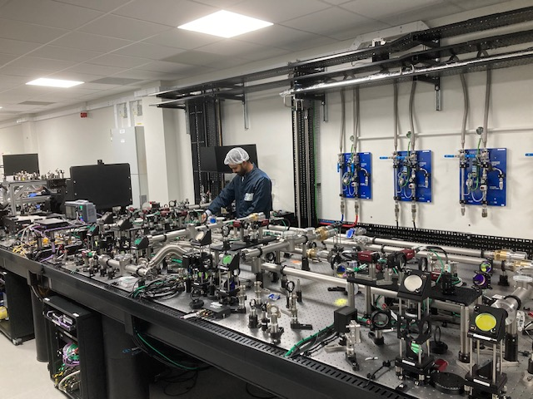
Front End
Pump 1
Pump 2
Seed
Ps OPCPA1
Stretcher
NS OPCPA2
Beam transport
Commission the front end subsystems to meet the bandwidth and energy specifications, the different energy modes will be commissioned
Use a temporary stretcher to stretch the pulse to the nanosecond regime for initial commissioning, will require further commissioning of the system with final stretcher
Beam will be ready to inject to Ti:Sa room using alignment mode prior to full commissioning
Commissioning activities started in 2023
May 24
June
July
August
September
October
November
December
Jan 25
Feb 25
Ps OPCPA1 pulse commissioning
Front End system operational
Temporary stretcher pulse commissioning
Final stretcher pulse commissioning
CW alignment Ns OPCPA 2
Ns OPCPA2 pulse commissioning
Full energy system Commissioning

Slide 6
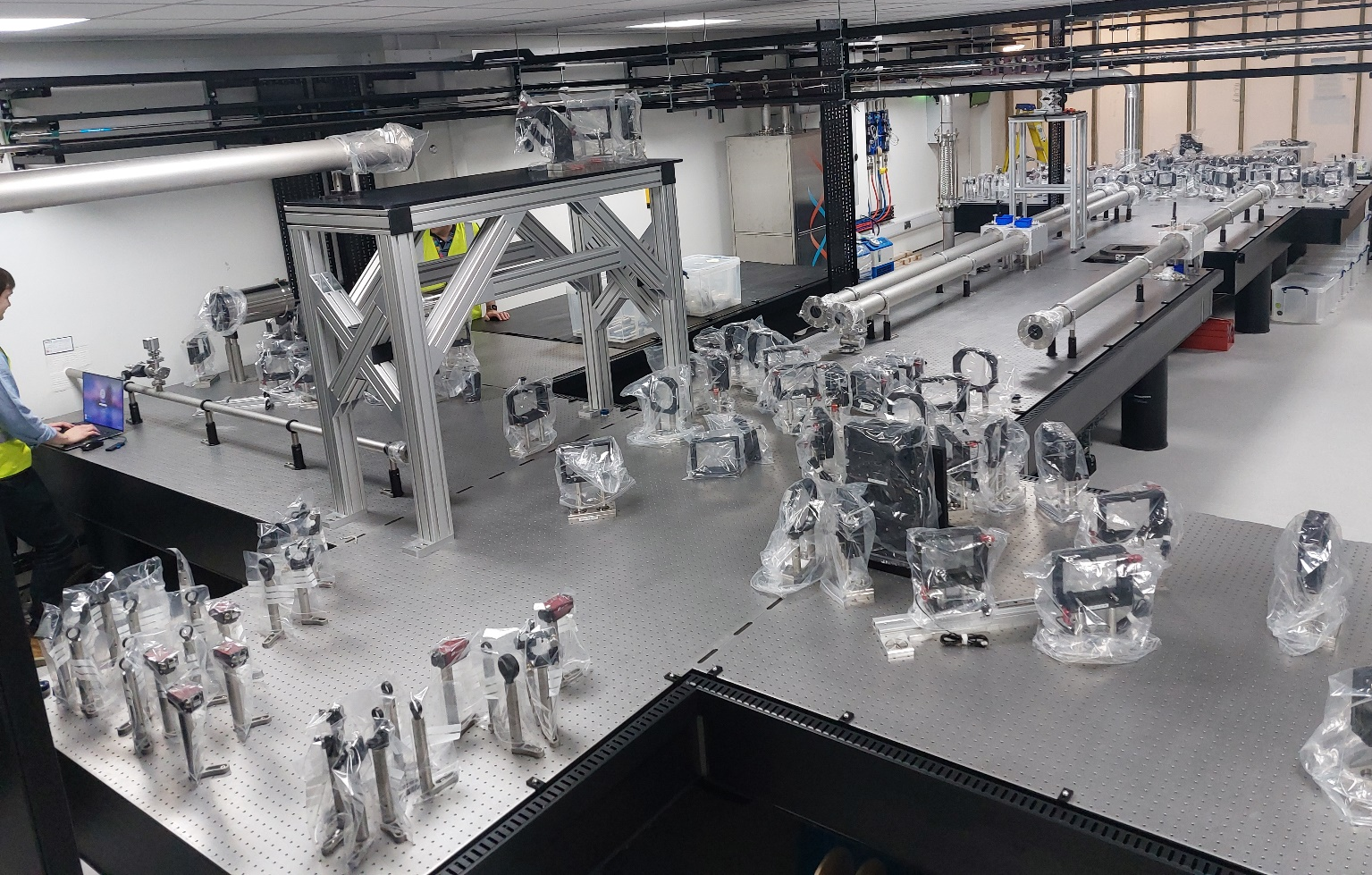
Ti:Sa Amplifier
Front End
EPAC pump
2 w conversion and beam shaping
High energy Ti:Sa amplifier
Beam expander and transport
Commission Ti:Sa will start in June 24
Commissioning will be coordinated with commissioning activities of PUMP and Front End
June 24
July
August
September
October
November
December
Jan 25
Feb 25
March 25
CW alignment of amplifier
Ti:Sa Amplifier operational
Front End pulse injection
PUMP Injection to 2w
1Hz pulse commissioning
Full energy system 10Hz

Slide 7
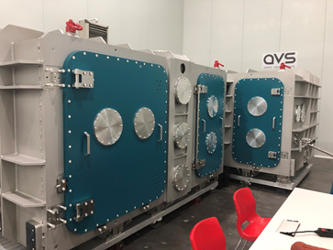
Pulse Compressor
TiS amplifier
Compressor
Short pulse diagnostics
Beam transport
Gold gratings arrive at the end of March 25, the plan has been adjusted
Input expanding telescope is expected later than anticipated
Need to remove the temporary wall between Ti:Sa and compressor for final commissioning
Dec 24
Jan 25
Feb 25
March 25
April 25
May 25
June 25
July 25
Aug 25
Sept 25
Initial CW pencil beam alignment compressor
Compressor operational
Input VSF alignment
CW alignment Final
CW alignment of Diagnostics
Pulse system commissioning

Slide 8
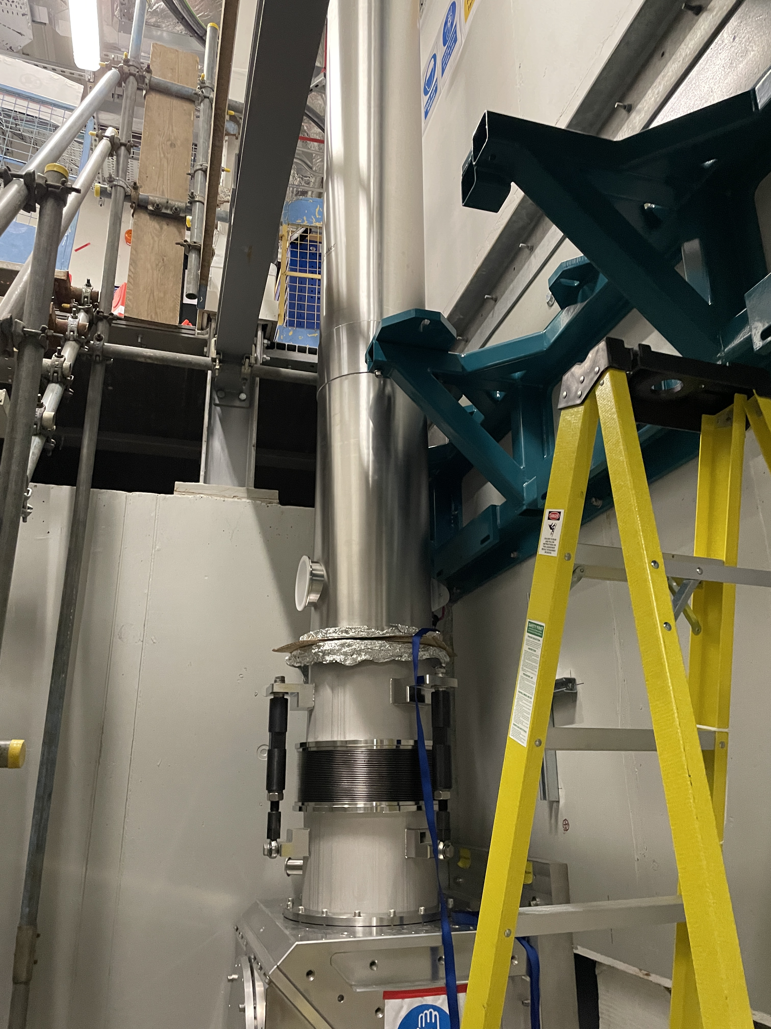
Beam Transport
Switchyard
Beam transport – riser
Beam transport pits
Focus on the commissioning of the beam transport for EA1
The probe commissioning timescales are still dependant on arrival of laser system and installation
Feb 25
March 25
April 25
May 25
June 25
July 25
Aug 25
Sept 25
Oct 25
CW alignment beam transport
Beam transport commissioned
Low power Pulse injection
Pointing tests
Pulse commissioning

Slide 9
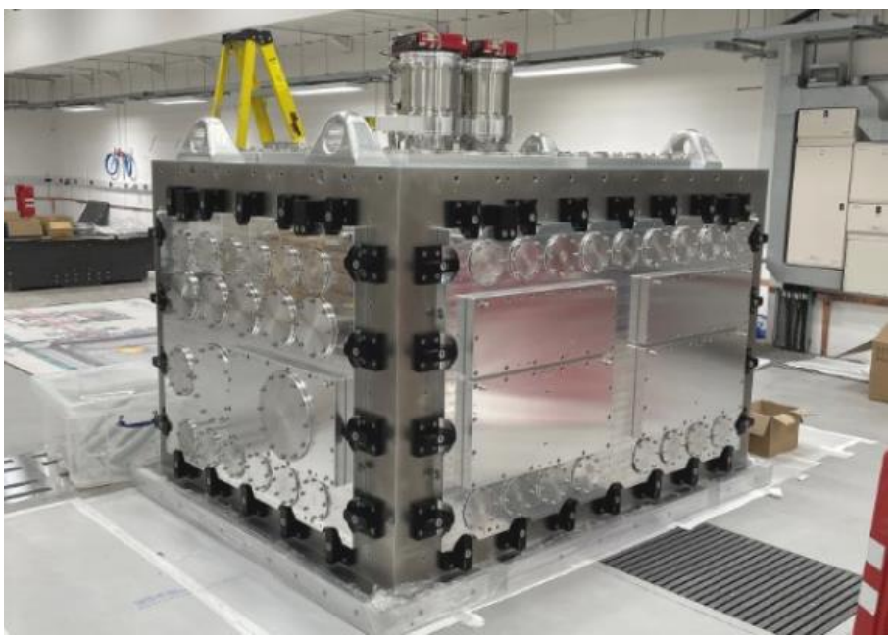
Experimental Area 1
Focussing Chamber
Diagnostics
Interaction chamber
Electron beamline
The timescales are indicative at this stage pending progress made on installation
The probe commissioning timescales are still dependant on arrival of laser system and installation
Feb 25
March 25
April 25
May 25
June 25
July 25
Aug 25
Sept 25
Oct 25
Nov 25
Optic Installation & Initial alignment
Low Power commissioning
EA1 ready for source commissioning experiments
Full Power Commissioning

Slide 10
Summary
Commissioning has progressed well in PUMP and Front End
Commissioning activities currently in laser areas and progressing well
Key item in the critical path is the delivery of gratings
Looking a coordination of commissioning activities and installation in the experimental areas in the coming months

Slide 11
Thank You

