Slide 1
Data Management in EPAC
Stephen Dann and EPAC DMS team

Slide 2
Outline
Overview of the Data Management in EPAC
Progress Update on Infrastructure Installation
Network Infrastructure
Data Management System Infrastructure
Progress Update on Software Solutions
Experimental Orchestrator: Bluesky
Data Display
Facilities Data Pipeline
Computed Tomography Package
Next Development Steps
Digital Lab books
EPAC data policy

Slide 3
Recap:Top-Level Data Management Architecture
Fast & extensible Pipelines
Data services
Instruments (DAQ)
Data analysis
Direct access
Broker
Short-term data store
Long-term data store
Data archive
Expandable
(if necessary)
Data access
Components developed & being tested
Being developed
Located in EPAC building
Located in Scientific Computing Building
Most of these are now prototyped
Notes:
Architecture consists of:
Components in EPAC building that we’re developing
Components developed and hosted by Scientific Computing
Core pipeline components have now been developed and are being tested

Slide 4
Recap: Top level DMS architecture
EPAC DMS
EPAC controls
Experimental Orchestrator providing DAQ control and functions
Pulse ID system
SCD/ALC
Control System Interface
SCD/ALC provides Data storage, archiving, analysis and access solutions
Catalogue
Run Engine
Control system
PVs
Facilities Data Pipeline
GUIs
Detector support
File Writer
Data is recorded using EPICS and sent to Kafka
Operations Gateway
Devices
IOCs
Kafka
OG
Exporter
EPICS Archiver
Dashboard
(Grafana)
Dashboard for short-term display
Operations Gateway for historic trends
Live display (EPICS)
Kafka stores all data briefly
EPICS archiver provides the backup
Notes:
EPICS
Data storage and facility data display
Experimental orchestrator/Bluesky
Facilities data pipeline
Development largely complete
Still work in progress

Slide 5
Delivery roadmap
Now
“Day 1”
Operations
Installation and laser commissioning
Source commissioning
User access
DAQ
and
DMS
“Expert” user interface
“Friendly” user interfaces
Bluesky
Adaptive scans (feedback and ML)
DMS components
Testing DMS components
Data
display
EPICS archiver
live facility dashboards
General user access
OperationsGateway
Live Experimental data display
Live data analysis
Data storage and archiving
Facility data pipeline
Data transfer
Electronic lab books
Notes:
Two key milestones
Day 1; project completion
Full operations with general user access
Most features will be in place for day 1 with some key exceptions

Slide 6
Delivery roadmap
Commissioning experiments
General user access
Dashboards showing data and trends
“Expert” interface to DAQ
IPython/Jupyter
Support for 10 Hz, 1 Hz, and single-shot operation
Central storage for data and metadata
Electronic lab notebooks
“Simple” interface to DAQ
Adaptive scanning and optimisation
Facility supported analysis for key instruments
Automatic metadata collection
Usability improvements to central storage

Slide 7
Outline
Overview of the Data Management in EPAC
Progress Update on Infrastructure Installation
Network Infrastructure
Data Management System Infrastructure
Progress Update on Software Solutions
Experimental Orchestrator: Bluesky
Data Display
Facilities Data Pipeline
Computed Tomography Package
Next Development Steps
Digital Lab books
EPAC data policy

Slide 8
Network architecture redesign
Redesigning the initial network infrastructure to improve data flow distribution and redundancy
Implementing a future-proof hub and spoke network topology
Two hubs on separate floors for enhanced redundancy
Single-mode fibre network for consistent high-speed data transmission
Segmentation: Separate devices and infrastructure for different networks
Adaptable to future network expansion and technological advancements
Commissioning of DMS infrastructure is delayed slightly because of this
Notes:
24 core single mode OS2 links, which translate to 12 pairs (12 devices per room can connect to either network) reinforce the reliability

Slide 9
Outline
Overview of the Data Management in EPAC
Progress Update on Infrastructure Installation
Network Infrastructure
Data Management System Infrastructure
Progress Update on Software Solutions
Experimental Orchestrator: Bluesky
Data Display
Facilities Data Pipeline
Computed Tomography Package
Next Development Steps
Digital Lab books
EPAC data policy

Slide 10
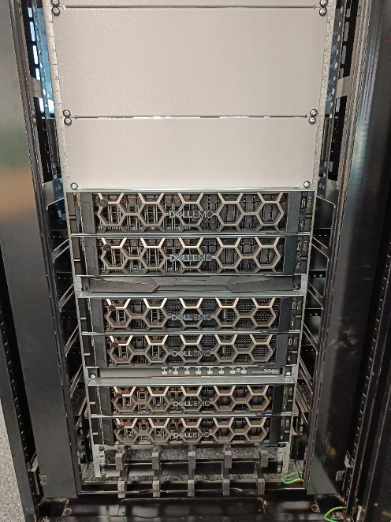
Initial DMS servers installed
Six servers for initial EPAC operations
Development of the main software components largely complete but they need to be integrated together to test the functionality
The file writer library is now functional. Full-featured Python and Rust applications using this library have been built
Along with ADKafka, which produces image data to Apache Kafka, we have implemented a “forwarder” to handle scalar and waveform data
Connecting up the servers has been slightly delayed by the network redesign
We will be doing the commissioning of these servers and initial test of the DMS in the next couple of months

Slide 11
Outline
Overview of the Data Management in EPAC
Progress Update on Infrastructure Installation
Network Infrastructure
Data Management System Infrastructure
Progress Update on Software Solutions
Experimental Orchestrator: Bluesky
Data Display
Facilities Data Pipeline
Computed Tomography Package
Next Development Steps
Digital Lab books
EPAC data policy

Slide 12
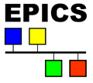
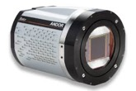
Experimental orchestrator and user interface for DAQ
User interface
WP9
Will allow users to do scans/experimental runs in an automated way (i.e. move drives, move sample, adjust diagnostic settings, triggers etc.). This is what makes Diamond DAQ user-friendly
Will allow users to pick and choose diagnostics for acquisition
Allow specific triggering/timing requirements for diagnostics
Visualisation of some data and custom live analysis
Diamond uses GDA – this is going to be integrated with Bluesky
We are developing this with Observatory Sciences
User interface
Data Management System
View data live
Control data recording
Data Acquisition System Backend
Control instruments
View data live
Control data recording
Control instruments
Notes:
…
DLS solves this problem with GDA; many facilities have their own solutions
Many now using Bluesky; GDA being integrated with Bluesky
We are adopting Bluesky and developing necessary capabilities with OSL

Slide 13
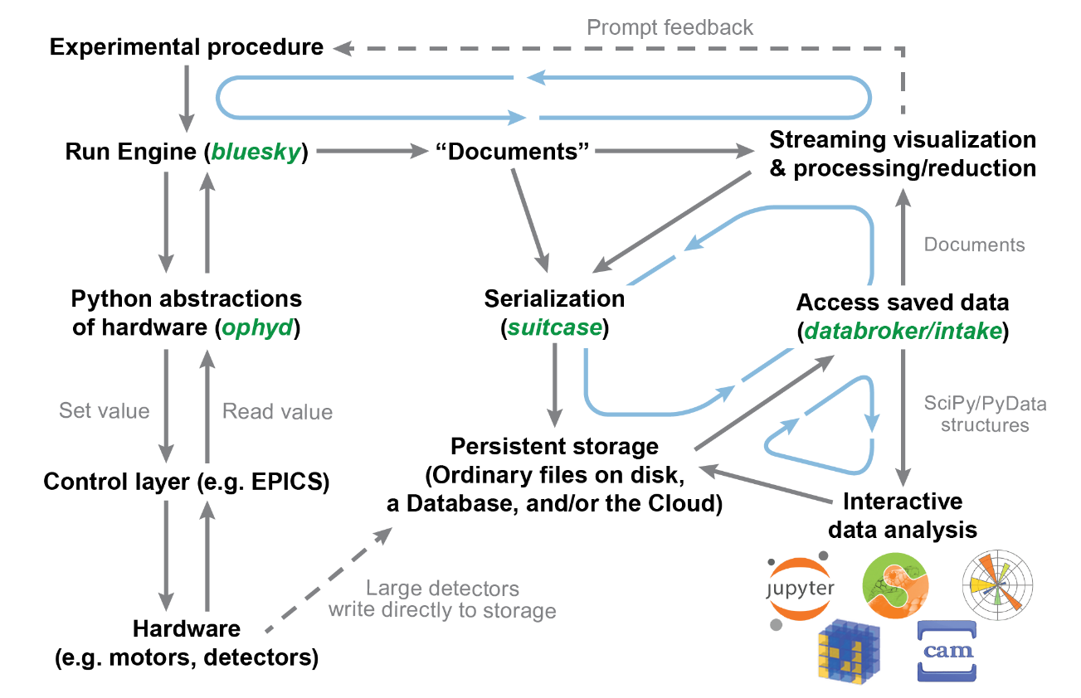
Bluesky and user interfaces
Bluesky tackles DAQ, automation, and data access
Adoption at several facilities, including Diamond
Native interface is Python, but several UI projects exist
EPAC will have “advanced” and “basic” interfaces
Advanced interface developed first

Slide 14
Bluesky lab demo
Camera data transported through Kafka and written to HDF5 file
Sample
LED checks synchronisation with laser
7 segment display checks synchronisation between cameras
Rotation stage

Slide 15
Recorded demo

Slide 16
Outline
Overview of the Data Management in EPAC
Progress Update on Infrastructure Installation
Network Infrastructure
Data Management System Infrastructure
Progress Update on Software Solutions
Experimental Orchestrator: Bluesky
Data Display
Facilities Data Pipeline
Computed Tomography Package
Next Development Steps
Digital Lab books
EPAC data policy

Slide 17
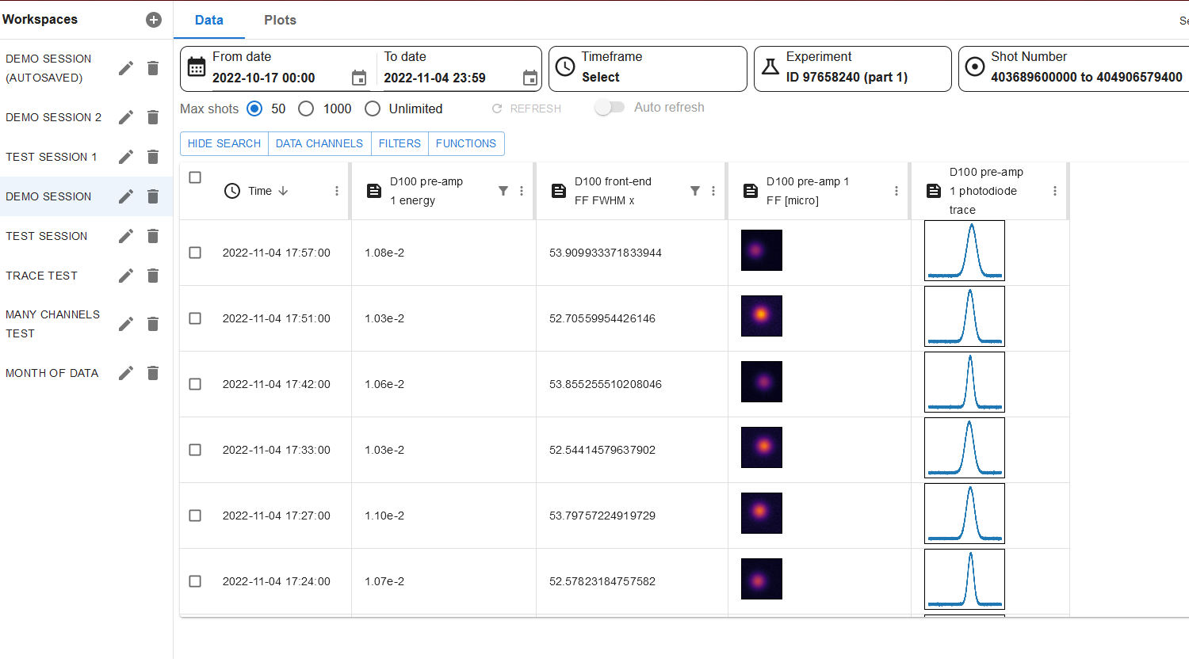
A data discovery, visualisation and analysis tool for EPAC historic operational data
Twenty-nine components completed, and three major components remain: Data Export (CLF), Data Display, and Functions.
Next Steps:
end-to-end testing
Delivery as an operational system around January 2025

Slide 18
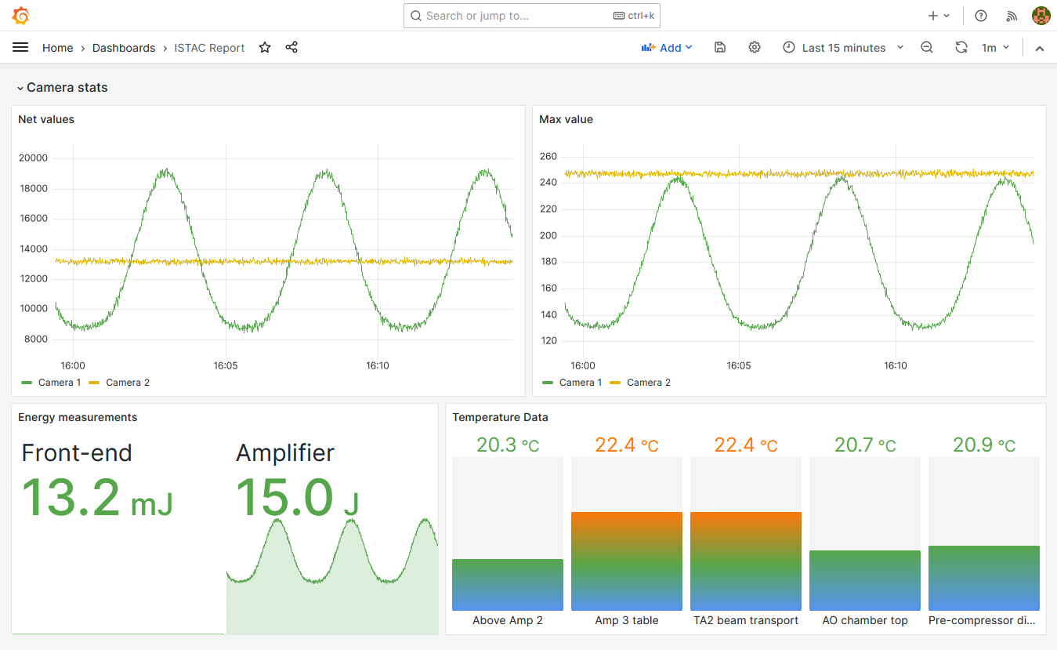
Grafana
Industry standard solution for dashboards
Users can edit and save their own dashboards
EPICS archiver integration exists
Will be deployed in EPAC
Custom development may be needed (e.g. beam images)

Slide 19
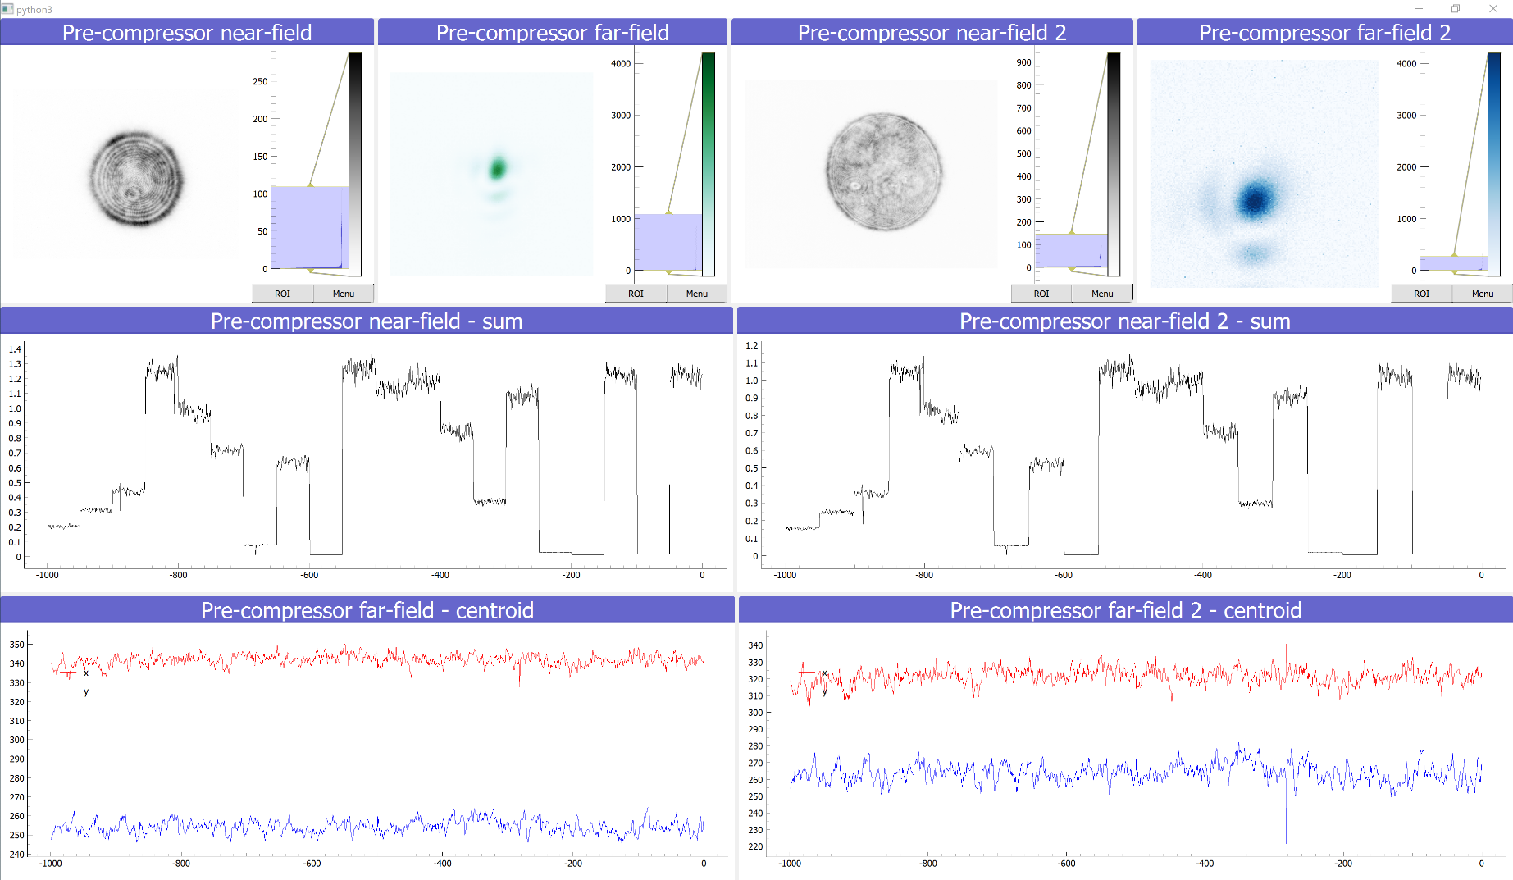
Live Data Analysis and Display
Live data from multiple instruments
Real-time analysis
User extendable
View historical data
Prototyping and requirements gathering
Screenshot of Gemini system
EPAC system will be based on this

Slide 20
Outline
Overview of the Data Management in EPAC
Progress Update on Infrastructure Installation
Network Infrastructure
Data Management System Infrastructure
Progress Update on Software Solutions
Experimental Orchestrator: Bluesky
Data Display
Facilities Data Pipeline
Computed Tomography Package
Next Development Steps
Digital Lab books
EPAC data policy

Slide 21
Data Pipeline for EPAC – by SCD/ALC
Data storage
Data stored online for some time (few months)
Later transferred to tape archive (long-term)
SCD/ALC is developing a data pipeline for EPAC
Working to design end to end pipeline, accounting for existing tools, services, and expertise in SCD.
Currently doing a gap analysis to enable full programme of work
Existing tools have funding and development plans in place – funded by SCD, IRIS, ALC and EPAC
Data access
DAaaS
Analyse data without downloading it
Share software environments and code
Data Analysis
Download data files
Special bulk data transfer systems
Data curation and cataloguing tools
Provide DOIs to data sets
Make sure data is searchable
FAIR data

Slide 22
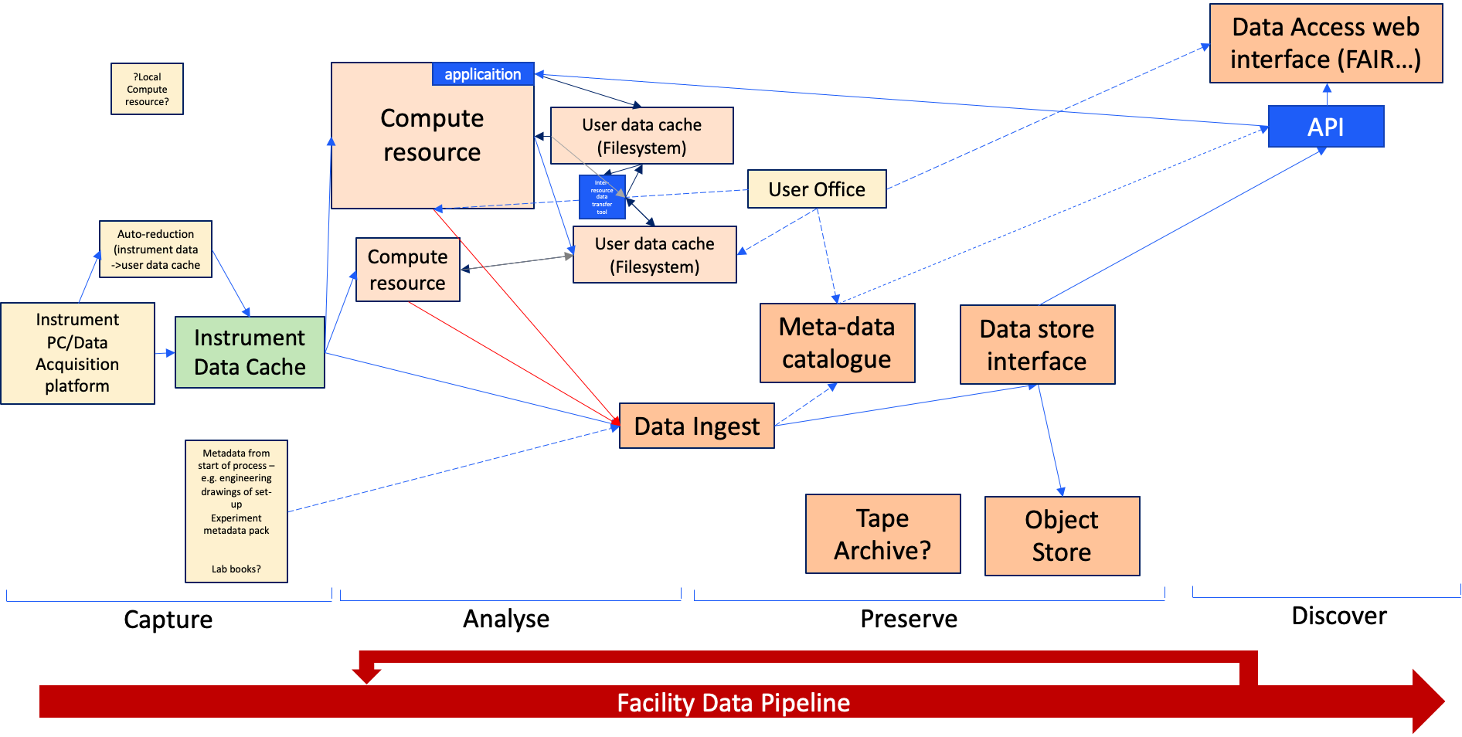
Data Pipeline for EPAC – by SCD/ALC
Scientist in the facility performing experiment
Scientist analysing their experimental data
Scientist/facility scientist choses which user data to preserve/publish alongside instrument data and edits/amends/adds any additional metadata
Publicly accessible FAIR data
Funded through ALC now
Reviewed EPAC requirements
A viable product will be delivered during 2025 to support source commissioning.

Slide 23
Outline
Overview of the Data Management in EPAC
Progress Update on Infrastructure Installation
Network Infrastructure
Data Management System Infrastructure
Progress Update on Software Solutions
Experimental Orchestrator: Bluesky
Data Display
Facilities Data Pipeline
Computed Tomography Package
Next Development Steps
Digital Lab books
EPAC data policy

Slide 24
Interactive CT GUI development
Pipeline for Computed Tomography (CT) reconstruction with CIL
An image processing and reconstruction package
Handles Nexus & lab-based XCT data files
Pre-processing:
Transmission to Absorption Conversion
Centre of Rotation Correction
Beam profile correction
Reconstruction
Parallel & Cone beam
GUI
Interactively configure process list
Export of process list for re-running
Interactive data visualisation in each step
DAaaS deployment
Notes:
CIL and CILViewer backend

Slide 25
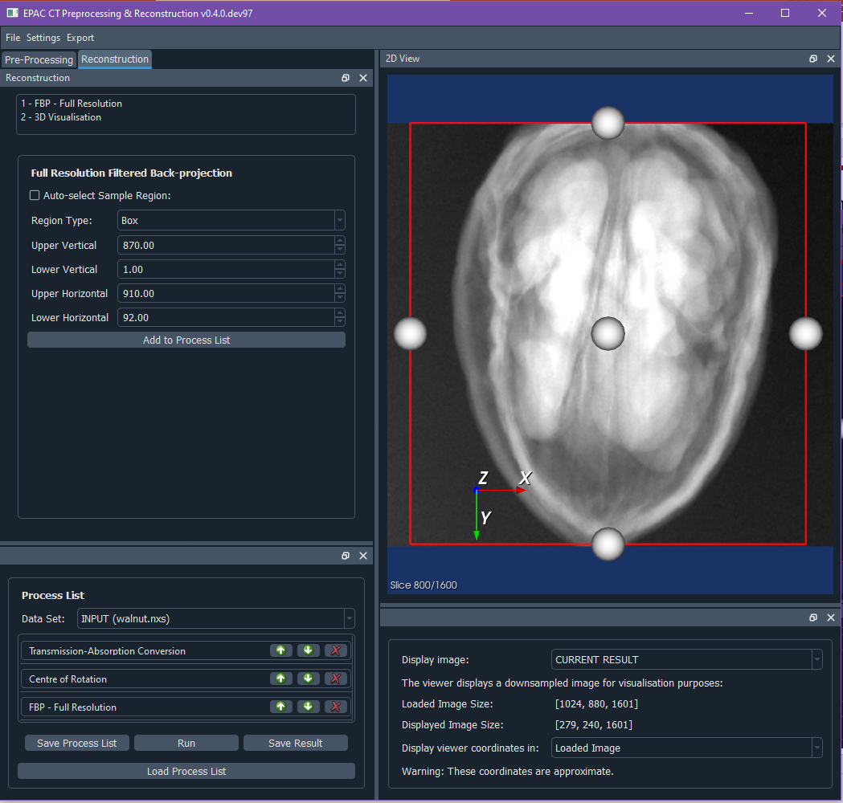
GUI
CILViewer provides visualisation + interaction with data for configuring current step
Configuration parameters
CIL provides the pre-processing and reconstruction methods
User-defined process list, can be saved, re-run and exported
Selection of displayed data
Notes:
Here’s the GUI in a bit more detail, showing:
CILViewer to display and interact with data
Process list and configuration on left

Slide 26
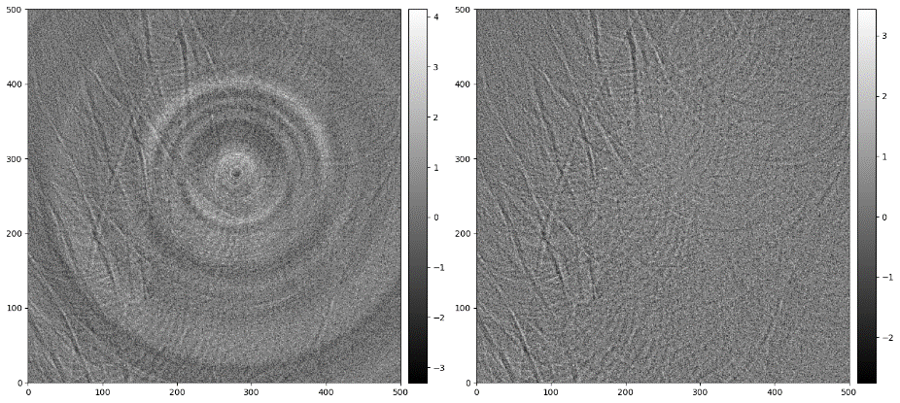
Deployment & Development
v0.5.0 (June 2023) enhanced process list functionality:
Increased speed of processor chaining
Process list can be run, saved and reloaded at any point
New releases automatically deployed on DAaaS, available to EPAC team
GUI workshop run with EPAC and WMG in June 2023
User feedback is driving work plan. Current priorities:
Stability, workflow and usability
Addition of necessary pre-processors in CIL
Availability on DAaaS
Current work to integrate new CIL features and simplify workflow
WMG has extensively tested the CT GUI and package and have found it very good
Improved Ring Removal processor in CIL (Data: `tomo_00072` available at https://tomobank.readthedocs.io/en/latest/source/data/docs.data.rings.html )
Notes:
Development is ongoing. Releases automatically made available on DAaaS.
CCPi working with WMG
GUI workshop last year driving work plan
WMG very happy with progress so far

Slide 27
Ongoing work
Applicable to most users
Simple acquisition
Standard Pipeline
Standard processing for lab/synchrotron.
Centre of Rotation Correction
Manual adjustments
Dual Slice (CIL now supports tilted rotation axis)
Flux normalisation
Flat field corrections
Beam hardening
Phase Retrieval
Ring Removal
Fast low-res reconstruction
Improved interaction with data
Advanced
Cases with no current standard procedure:
Sparse data e.g. limited angle
Iterative reconstruction
EPAC Plug-in
Beam Profile Correction
Discard low-flux projections
Notes:
Add esrf

Slide 28
Outline
Overview of the Data Management in EPAC
Progress Update on Infrastructure Installation
Network Infrastructure
Data Management System Infrastructure
Progress Update on Software Solutions
Experimental Orchestrator: Bluesky
Data Display
Facilities Data Pipeline
Computed Tomography Package
Next Development Steps
Digital Lab books
EPAC data policy
Notes:
I’ve already mentioned the need for additional integration work on Bluesky

Slide 29
Digital Lab book
Implemented in ELI
Replaces the “hard-copy” lab books used for experiments
Records all the associated “metadata”
Allows users to perform on-the-spot calculations on the data and save the results
We would like to have a “standardized solution” - makes it easier for the user community
Also looking at commercial options
Notes:
While hard copy lab books have long since been replaced, we need a proper digital solution
Satisfy data policy (in a minute)
Google docs is not a suitable solution
Here’s an example from ELI

Slide 30
EPAC Data Policy
We are in the process of developing a data policy for EPAC (and for CLF)
Although the data belongs to the ”user groups”, CLF will have an obligation to preserve and curate the data
Committed to the principles of FAIR data (https://www.go-fair.org/fair-principles/)
Policy will deal with data, metadata, storage, curation and access to the data
Define timescales for preservation (on hard drive as well as in tapes) – will have a bearing on the design of the Facility Data Pipeline
Planning to conduct workshops in the next few months to develop this. Can adopt principles from others (eg. ISIS and Diamond)

Slide 31
Summary and outlook
The Data Management System development for EPAC is progressing well
Most components for a Minimum Viable Product (for commissioning and Day 1 of the plasma accelerator optimisation) exist but they need to be connected together and stress-tested
SCD/ALC have agreed to deliver a working version of the Facility Data Pipeline by end of the project – a costed plan is being prepared
Commissioning of the initial DMS system will happen over the next few months, along with the development of components required for experimental operations (Bluesky, Digital Lab books, Dashboards etc.)
Intend to do a technical review of the EPAC data management system in the next few months

