Slide 1
EPAC control system review
Process and overview

Slide 2
Outline
EPAC control system overview
Requirement for a review
Review Process
Initial feedback

Slide 3
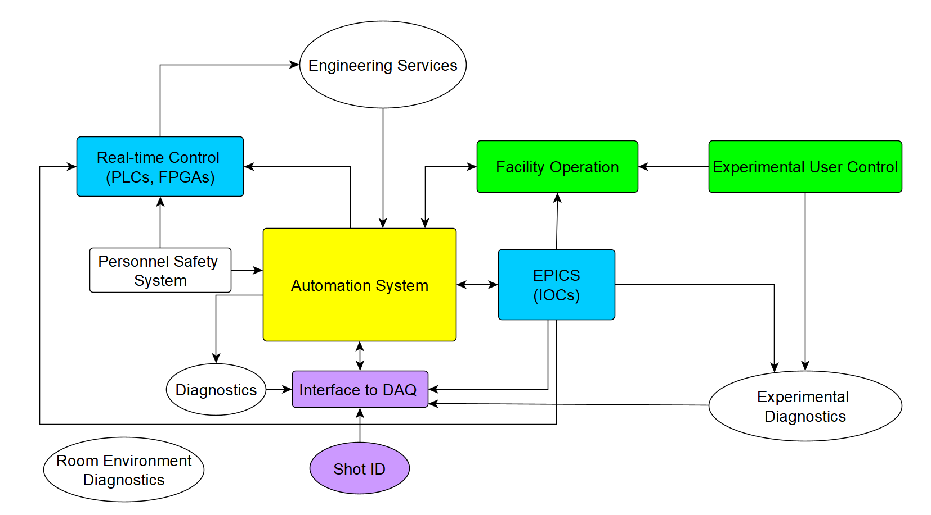
EPAC control system is based on EPICS
EPICS – acronym for Experimental Physics and Industrial Control System
Easy to write software drivers in a basic non-programmer language Community has numerous drivers already written
Previous experience in HILASE and DIPOLE 100x Reusing software from these projects
Good distributed control Very good at controlling multiple devices
Widely used in synchrotron and accelerator beamlines (eg. Diamond, ISIS, ESS, XFEL…)
Controlling non-system critical devices with EPICS
Diagnostics
Custom systems
Motors

Slide 4
Control system view of an EPAC experiment
Laser areas
Experimental area
Pump laser
Target
Sample
Detector
Seed laser
Amplifier
Switchyard
Automated turn on - system warm up

Slide 5
Control system view of an EPAC experiment
Laser areas
Experimental area
Pump laser
Target
Sample
Detector
Seed laser
Amplifier
Switchyard
Manual alignment
Automated turn on - system warm up
Manual alignment

Slide 6
Control system view of an EPAC experiment
Laser areas
Experimental area
Pump laser
Target
Sample
Detector
Seed laser
Amplifier
Switchyard
Manual alignment
Prepare experiment (pump chambers, setup gas)
Automated turn on - system warm up
Manual alignment
Turn on automated alignment and open shutter to Amplifier
Check alignment with EPAC beams

Slide 7
Control system view of an EPAC experiment
Laser areas
Experimental area
Pump laser
Target
Sample
Detector
Seed laser
Amplifier
Switchyard
Manual alignment
Prepare experiment (pump chambers, setup gas)
Automated turn on - system warm up
Manual alignment
Turn on automated alignment and open shutter to Amplifier
Check alignment with EPAC beams

Slide 8
Control system view of an EPAC experiment
Laser areas
Experimental area
Pump laser
Target
Sample
Detector
Seed laser
Amplifier
Switchyard
Manual alignment
Prepare experiment (pump chambers, setup gas)
Automated turn on - system warm up
Manual alignment
Turn on automated alignment and open shutter to Amplifier
Check alignment with EPAC beams
Energy ramp (progress from Mode 4 to Mode 1)
Beam ready for Experimental Areas

Slide 9
Control system view of an EPAC experiment
Laser areas
Experimental area
Pump laser
Target
Sample
Detector
Seed laser
Amplifier
Switchyard
Manual alignment
Prepare experiment (pump chambers, setup gas)
Automated turn on - system warm up
Confirm alignment with EPAC beam and optimise focus in Mode 4
Manual alignment
Turn on automated alignment and open shutter to Amplifier
Check alignment with EPAC beams
Energy ramp (progress from Mode 4 to Mode 1)
Beam ready for Experimental Areas

Slide 10
Control system view of an EPAC experiment
Laser areas
Experimental area
Pump laser
Target
Sample
Detector
Seed laser
Amplifier
Switchyard
Manual alignment
Prepare experiment (pump chambers, setup gas)
Automated turn on - system warm up
Confirm alignment with EPAC beam and optimise focus
Manual alignment
Turn on automated alignment and open shutter to Amplifier
Check alignment with EPAC beams
Request laser pulses either manually or through and experimental orchestrator
Energy ramp (progress from Mode 4 to Mode 1)
Beam ready for Experimental Areas

Slide 11
Control system view of an EPAC experiment
Laser areas
Experimental area
Pump laser
Target
Sample
Detector
Seed laser
Amplifier
Switchyard
Manual alignment
Prepare experiment (pump chambers, setup gas)
Automated turn on - system warm up
Confirm alignment with EPAC beam and optimise focus
Manual alignment
Turn on automated alignment and open shutter to Amplifier
Check alignment with EPAC beams
Request laser pulses either manually or through and experimental orchestrator
Energy ramp (progress from Mode 4 to Mode 1)
Beam ready for Experimental Areas
Check data and adjust target/detector/sample

Slide 12
Primary Responsibilities of Control system
Alignment
Motion control Cameras Closed-loop
Timing
Timing system Motion control Oscilloscopes Energy output
Laser metrology
Temporal diagnostics Spatial diagnostics Energy Spectrum
Experiment config
Target configuration Target positioning Sample positioning Detector configuration Repetition rate
DAQ interface
ADKafka Channel Access Archiver DAQ system input
Monitor and alert
IOC manager Alarm summary MPS input PSS display

Slide 13
Outline
EPAC control system overview
Requirement for a review
Review Process
Initial feedback

Slide 14
Still a relatively new platform for CLF
Moved to EPICS a decade ago for the HiLASE project. Installed and operational since 2016.
Almost identical system built for the European XFEL. Commissioned last year and first experiments performed.
Those systems are equivalent to JUST the pump laser section of EPAC
Design of a full-fledged laser facility based on EPICS is quite different
New challenges with scale, integration, and user experiments.

Slide 15
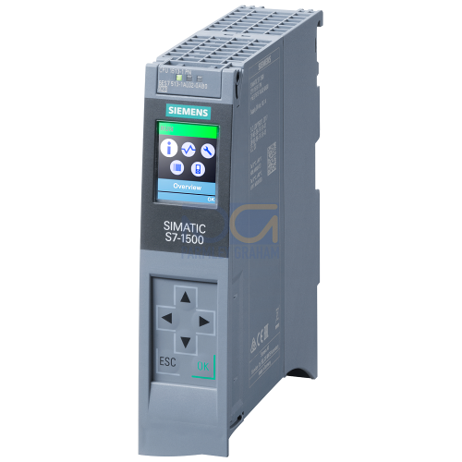
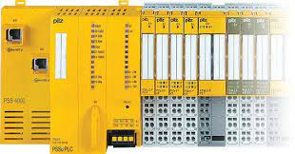
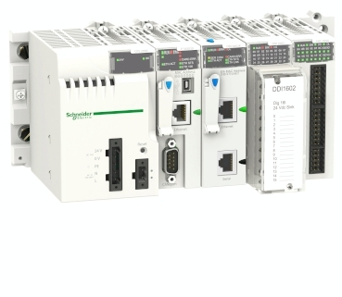
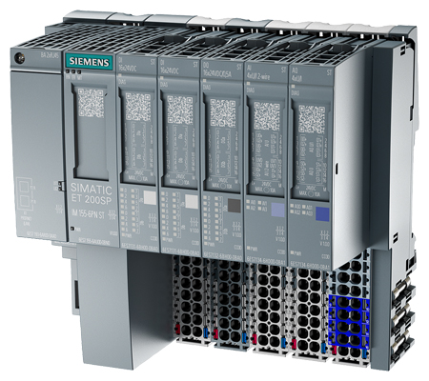
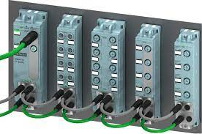
Change in the Machine Protection System
Past Machine Protection Systems
EPAC MPS System Architecture
2 Laser systems with MPS already developed and installed
MPS rules are processed by software control system
Software control system monitor devices connected to PLC and sends commands to PLC to drive Actuators
1 IOC for MPS rules
1 IOC for comms with PLC
Vulnerability is high – potentially slow
MPS rules are processed by the controls PLC
Controls PLC also in charge of controlling other systems like the vacuum system
Direct communication with Personal
Safety System PLC
Faster and more reliable
Notes:
MPS has already been developed for 2 systems. This past example was built for a project similar to the pump room. EPAC is much bigger.
All the MPS rules are processed in the software control system
The software control system is connected the electrical control PLC and the personal safety system using Modbus TCP
The software control system will read the status of all the devices connected to the PLC (shutters, motorised flippers, vacuum gauges), read status from PSS PLC and some other devices like pre-amplifiers, process the rules and send commands to the controls PLC to drive MPS devices.
Only 1 IOC that runs the logic Machine safety
There is another IOC for comms with PLC

Slide 16
Risks from a control system perspective
Integration of sub-systems
We have experience on a similar system, but with less complexity and lower repetition rate.
New kinds of experiments and users
The control system needs to support a new experimental model for the CLF (more akin to a beamline)
Operational procedure and details not fully resolved.
Machine protection
Untested in EPAC but has been validated elsewhere at the CLF.
But that system didn’t have the integration challenges of EPAC.

Slide 17
Outline
EPAC control system overview
Requirement for a review
Review Process
Initial feedback

Slide 18
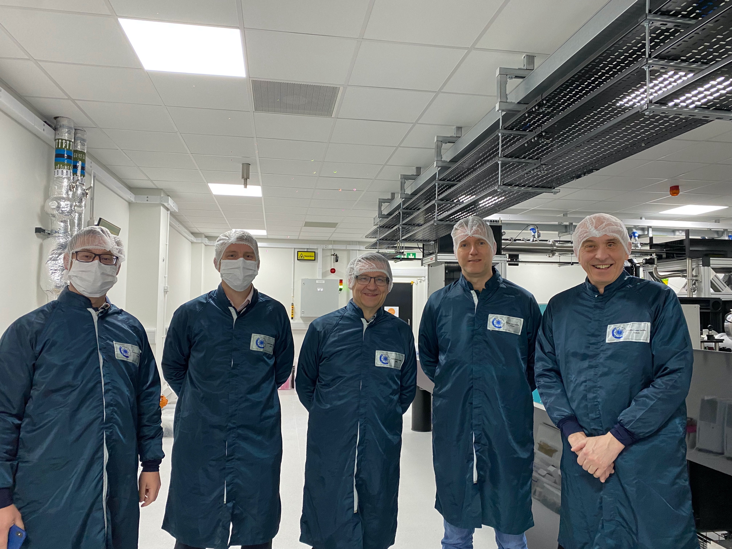
Control system review in April - 2024
Some of the world’s EPICS experts on the panel
Timo Korhonen – ESS
Ralph Lange – ITER
Tyler Johnson – SLAC
Graham Cox – ASTeC
Two-day review (on 24th and 25th of April)
EPAC team members presented various aspects of the control system, its interfaces, infrastructure support and deployment strategies

Slide 19
Control system review in April - 2024
Overall control system architecture and potential challenges in integration
Appropriateness of the control system for enabling smooth user operations
Functionality of the automation system
Flexibility for adapting to changing user requirements
Machine Protection System
Graphical User interfaces
User friendliness of the GUIs
Resilience to future versions of EPICS
Interface with DAQ
PulseID system
Capability to process large data volumes
Futureproofing
Implementation of feedback loops

Slide 20
Outline
EPAC control system overview
Requirement for a review
Review Process
Initial feedback

Slide 21
Initial feedback
Overall control system architecture
Overall architecture seems good; nothing seriously concerning. ✓
Appropriateness of the control system for enabling smooth user operations
Most things make sense; some bits are still being developed ✓
Machine Protection System
Very pleased to see this moving in the right direction. Endorsed. ✓
Graphical User interfaces
This will work for EPAC but there is an underlying risk of single point failure as it is not using built-in GUI of EPICS (Phoebus). Consider moving over gradually ✓
Interface with DAQ
For 10Hz, it looks fine. For higher rep-rate, you may need a different solution for PulseID ✓
Futureproofing
Use PV access as far as possible as it is the new standard. Main issue is regarding GUI, Bluesky etc. which currently support only channel access ✓

Slide 22
Automation : switchyard
EA 1
EA 2
Beam sent to EA1. Automatic alignment on. To switch to EA2:
Pre-requisite: Mode 4
Diagnostic

Slide 23
Automation : switchyard
EA 1
EA 2
Beam sent to EA1. Automatic alignment on. To switch to EA2:
Pre-requisite: Mode 4
Turn off closed loop alignment
Block the laser from the amplifier

Slide 24
Automation : switchyard
EA 1
EA 2
Beam sent to EA1. Automatic alignment on. To switch to EA2:
Pre-requisite: Mode 4
Turn off closed loop alignment
Block the laser from the amplifier
Rotate mirror

Slide 25
Automation : switchyard
EA 1
EA 2
Beam sent to EA1. Automatic alignment on. To switch to EA2:
Pre-requisite: Mode 4
Turn off closed loop alignment
Block the laser from the amplifier
Rotate mirror
Confirm end of motion. Allow laser.

Slide 26
Automation : switchyard
EA 1
EA 2
Beam sent to EA1. Automatic alignment on. To switch to EA2:
Pre-requisite: Mode 4
Turn off closed loop alignment
Block the laser from the amplifier
Rotate mirror
Confirm end of motion. Allow laser.
Turn-on closed loop alignment.

Slide 27
Team structure
UK
Poland
India
EPAC
EPAC
5 years
4 years
Network
8 years
6 years
4 years
3.5 years
1 year
System architect
4 years
1 year
1 year
1 year
1 year
1 year
0.5 years
4.5 years
2 years

Slide 28
Project : infrastructure
Deployment
We have a working version but may look to improve.
Drive system
Low-level work done. User-facing GUI needed. Q4 24
MPS
Requirements not complete. Have tested principle on another system. Phase 1 in Q3 24

Slide 29
Architecture
DAQ
Lab GUI
Control Room GUI
Kafka
EPICS Gateway
EPICS archiver
Sequencer
PSS displays
EPICS Gateway
epac-
forwarder
Kafka
Channel Access
IOCs
HMIs
IOC
IOCs
IOCs + areaDetector
adKafka
Pulse ID +
Timestamp
Interlock information
Data + Heartbeat
IOCs
PLCs
MPS logic
Security bridge
Devices
Devices
IOC
Pulse ID system
PSS
Detectors
Timing system
Notes:
Note that next few slides are basic IOC structure, timing system, and gateways. MPS will be covered later. Pulse ID will come in the DAQ presentation, along with epac forwarded and maybe ADKafka.

Slide 30
Energy mode change
There are four energy modes. Mode 4 is lowest (for alignment) and Mode 1 is highest (for science).
Mode 1 uses the pump to amplify the seed to full energy.
Mode 2 is the seed only.
Mode 3 is the attenuated seed.
Mode 4 is the doubly attenuate seed.
Change in energy mode has implications for personnel: these changes are made by the PSS system

Slide 31
Energy mode change
Mode 1
Mode 2
Impacts mostly amplifier and downstream
Control system gets a 10 second warning to change filter wheel, lens positions
Easy to model as a state: SNL
Pump laser
Pump laser
Seed laser
Amplifier
Seed laser
Amplifier
Mode 3
Mode 4
Pump laser
Pump laser
Seed laser
Amplifier
Seed laser
Amplifier

